Slide 1
Model Simulations
WRF-Chem V4.0_beta
2-domain setup (12km and 4km)
IC&BC: ECMWF (meteorology), MOZART-4 (chemistry)
YSU PBL, Monin-Obukhov Similarity scheme surface layer scheme, NOAA Land-surface model
51 vertical levels between surface and 50 hPa
Meteorological initialization every 24 hours at 6 UTC from 10 Aug – 13 August 6 UTC
Analysis nudging in d01
Chemical Mechanism: MOZART-MOSAIC_4_bin
MEGAN online biogenic emissions (isoprene*0.5, monoterpenes*1.5)
FINN fire emissions with plume rise
Anthropogenic Emissions: NEI 2011v2 (Stu McKeen) with the following updates:
  Mobile Emissions -50%, take out diurnal cycle
  Oil and Gas Emissions *2 (aside from NOx, C2H6 and C3H8)
NEI 2011v2 NEI 2011v2 modified
Emission Totals for Front Range
Percentage gives
(NEI 2011v2 modified-NEI 2011v2)/NEI 2011v2

Slide 2
Results do not change much when the OG emissions diurnal cycle is taken out

Slide 3
Effects of turning off direct HCHO emissions in d02 on O3 and HCHO
Difference
Difference
Difference
Difference
Changes in HCHO up to about 50% in OG and about 25% in City during early morning, much smaller during other times.
Changes on ozone small, < 0.5 ppb.
With direct emissions, HCHO diurnal concentrations peak early morning when ozone production is low. The HCHO peak at midday, when ozone production is taking place, is mostly due to photochemical production.

Slide 4
Effects of turning off direct HCHO emissions in d02 on OH reactivity
with without
Mostly small relative differences given that HCHO changes mostly happen early morning when reactivity is low, but reactivity is lower throughout the day in OG (to lesser extend in City).

Slide 5
Effects of turning off direct HCHO emissions in d02 on Net HCHO production
with without
Net HCHO production lower without direct HCHO emissions (Note that y-scale is different between graphs)

Slide 6
Effects of turning off direct HCHO emissions in d02 on HCHO chem. generation
with without
HCHO chemical generation is very similar

Slide 7
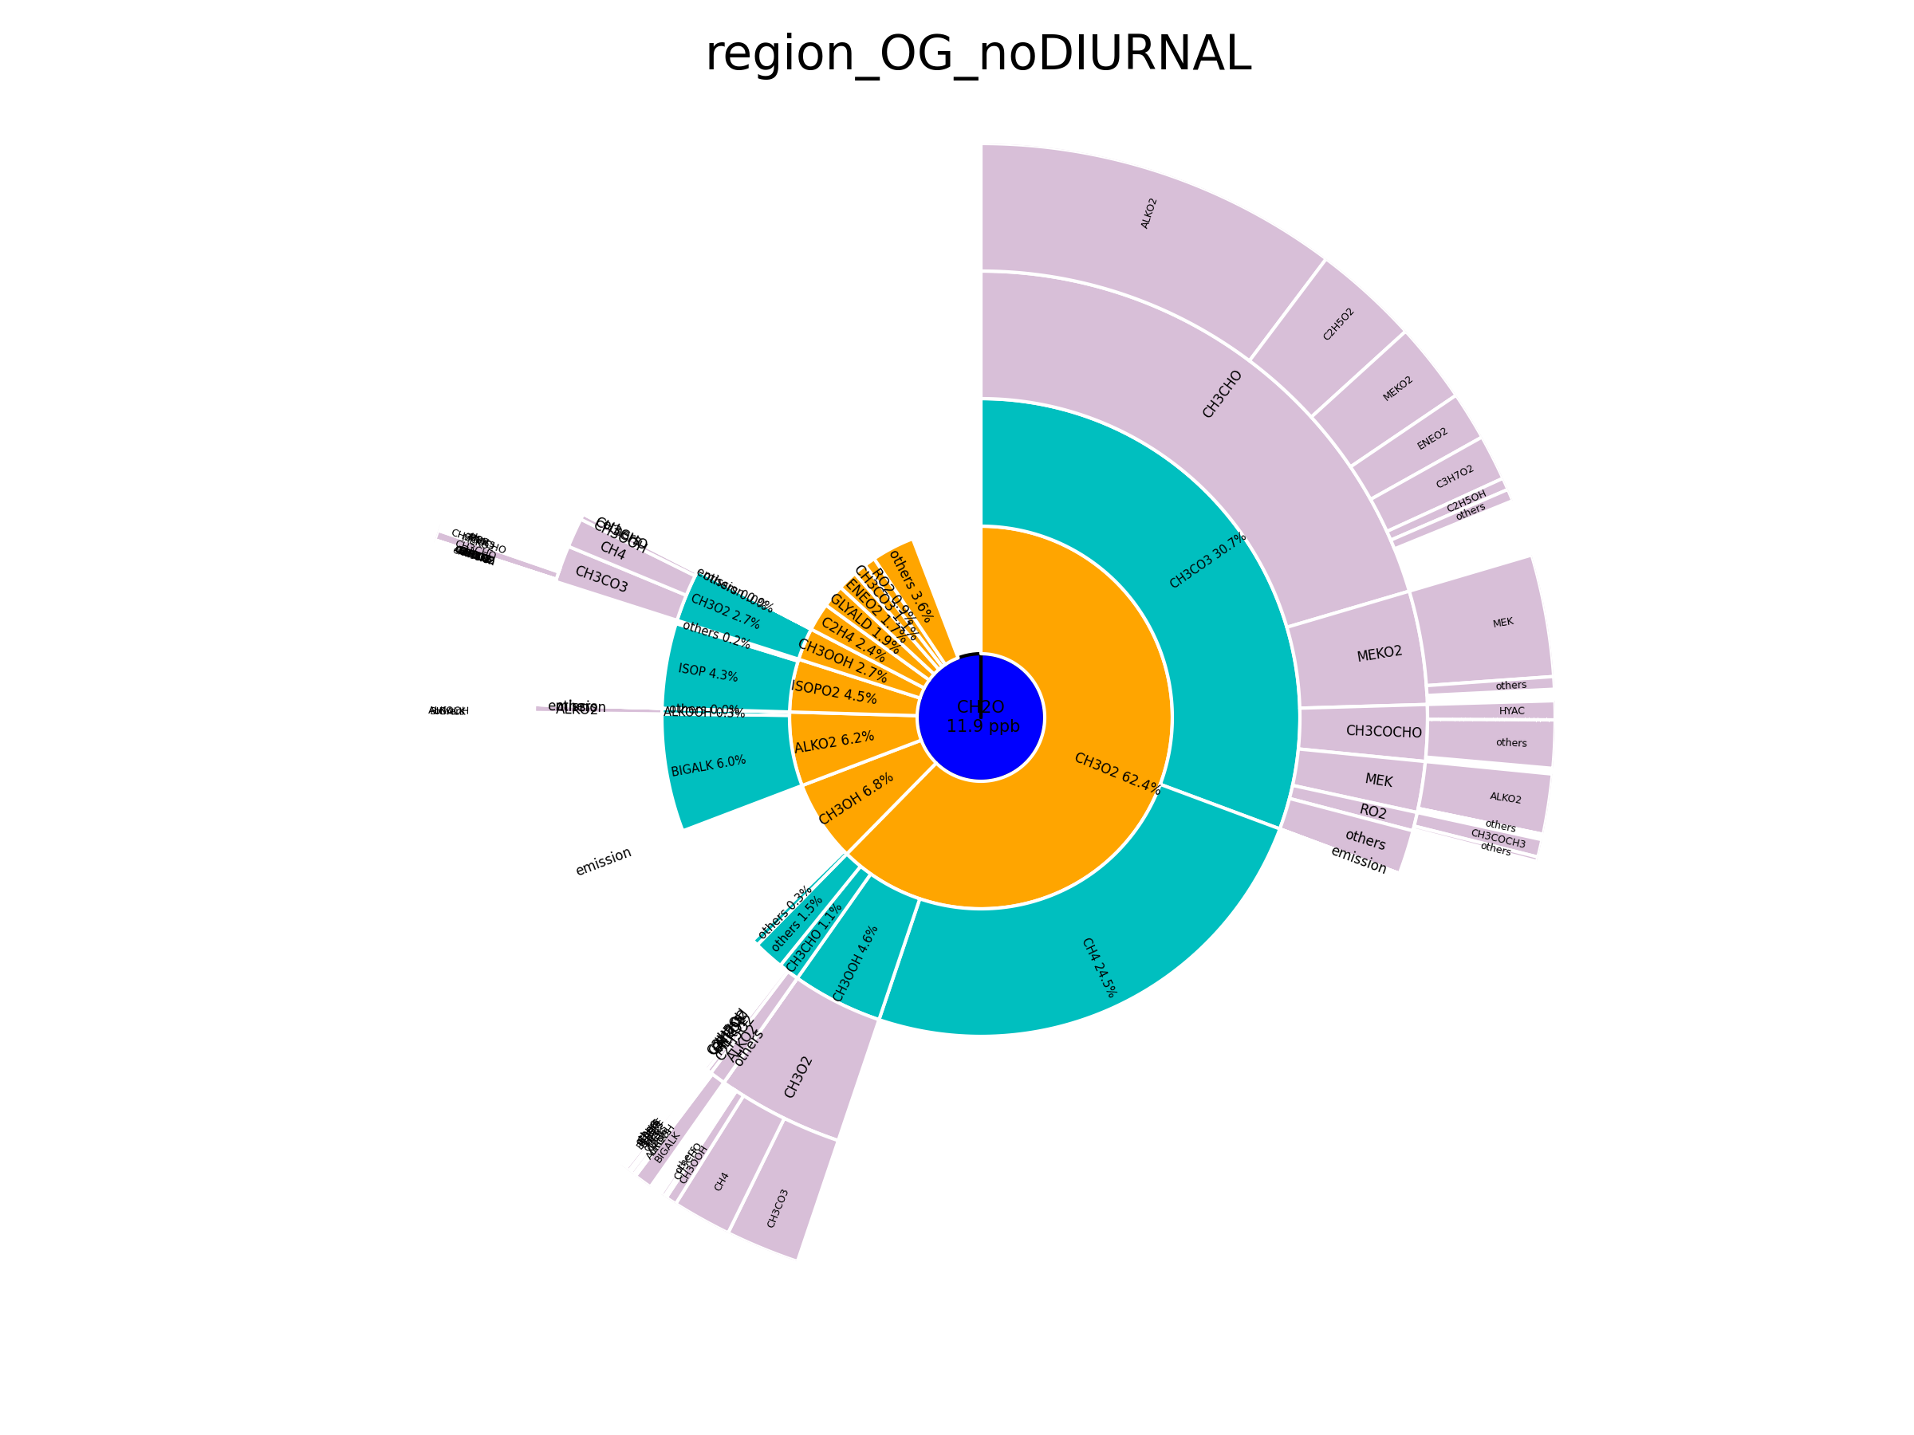
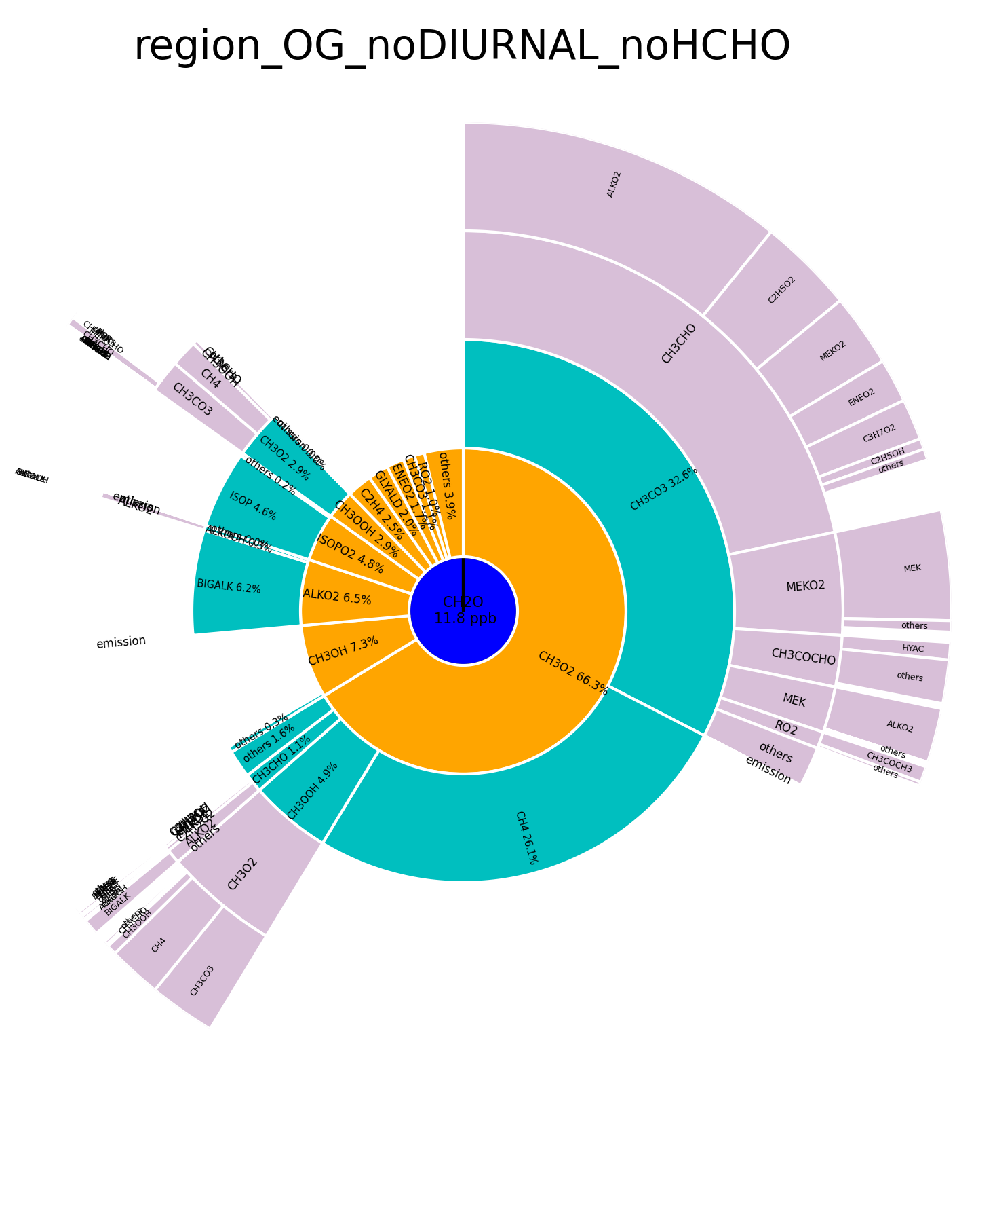
Effects of turning off direct HCHO emissions in d02
with without
Sunburst for HCHO production in City region– the contribution from direct emissions disappears and the relative role of individual VOCs increases in the noHCHO run

Slide 8
Effects of turning off direct CH3CHO emissions in d02 on O3 and CH3CHO
Difference
Difference
Difference
Difference
.
Similar as HCHO
Changes in CH3CHO due to emissions early morning ~10% for OG and ~35% in City.
Little change in CH3CHO during the day -> minor changes in ozone concentrations

Slide 9
Effects of turning off direct CH3CHO emissions in d02 on OH reactivity
with without
Minor changes

Slide 10
Effects of turning off direct CH3CHO emissions in d02 on Net CH3CHO production
with without
Net CH3CHO very similar (Note that y-scale is slightly different between graphs)

Slide 11
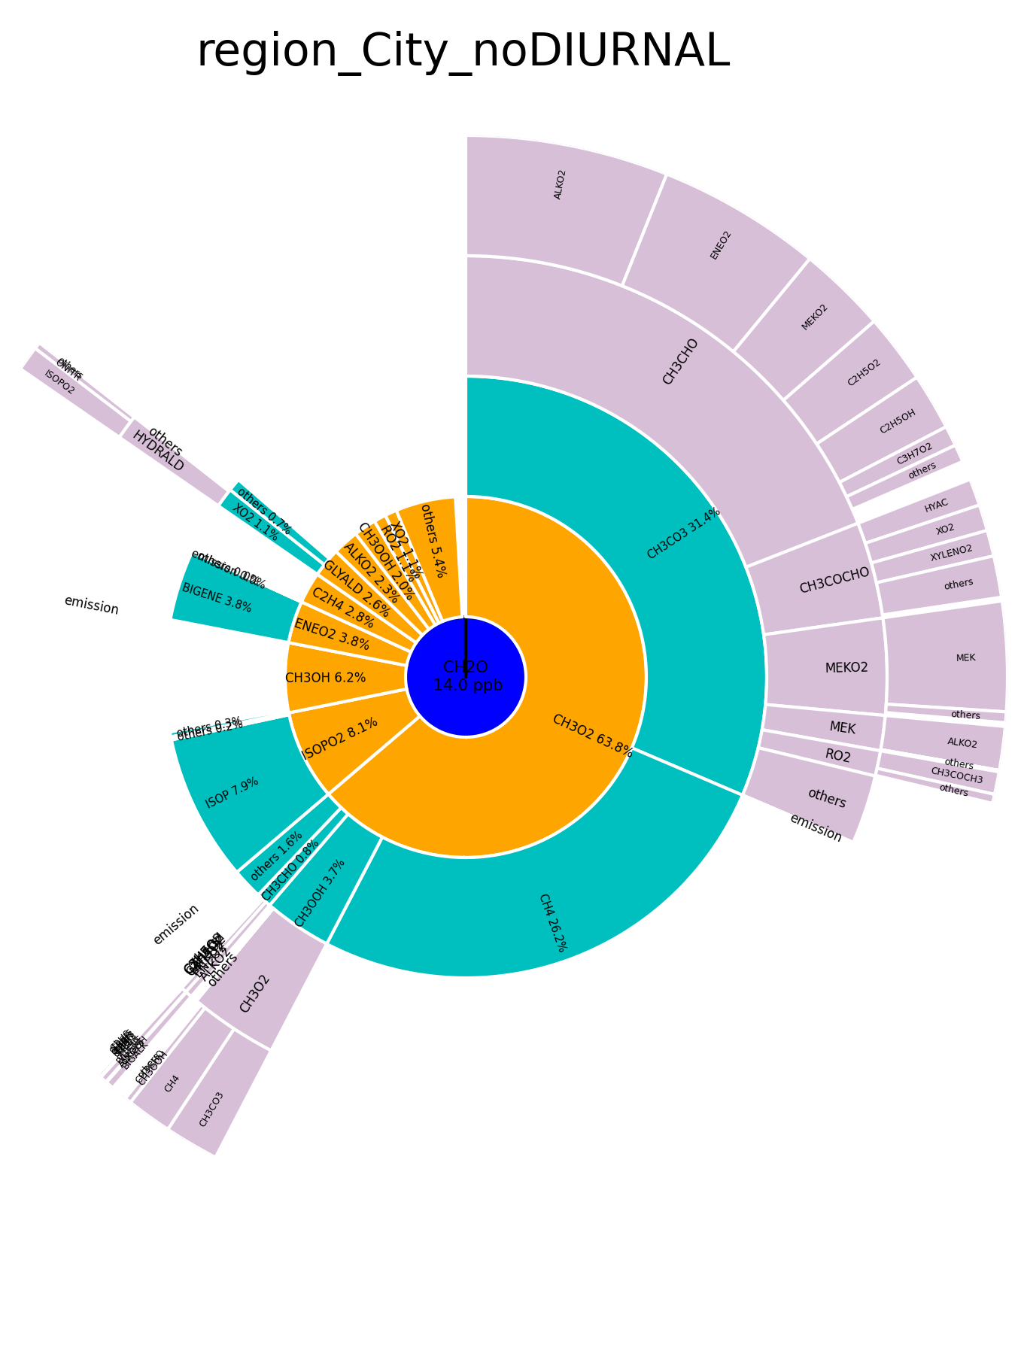

Effects of turning off direct CH3CHO emissions in d02
with without
Sunburst for HCHO production in City region– since the white gap in the CH3CHO segment does not change much without CH3CHO direct emissions – transport?

Slide 12
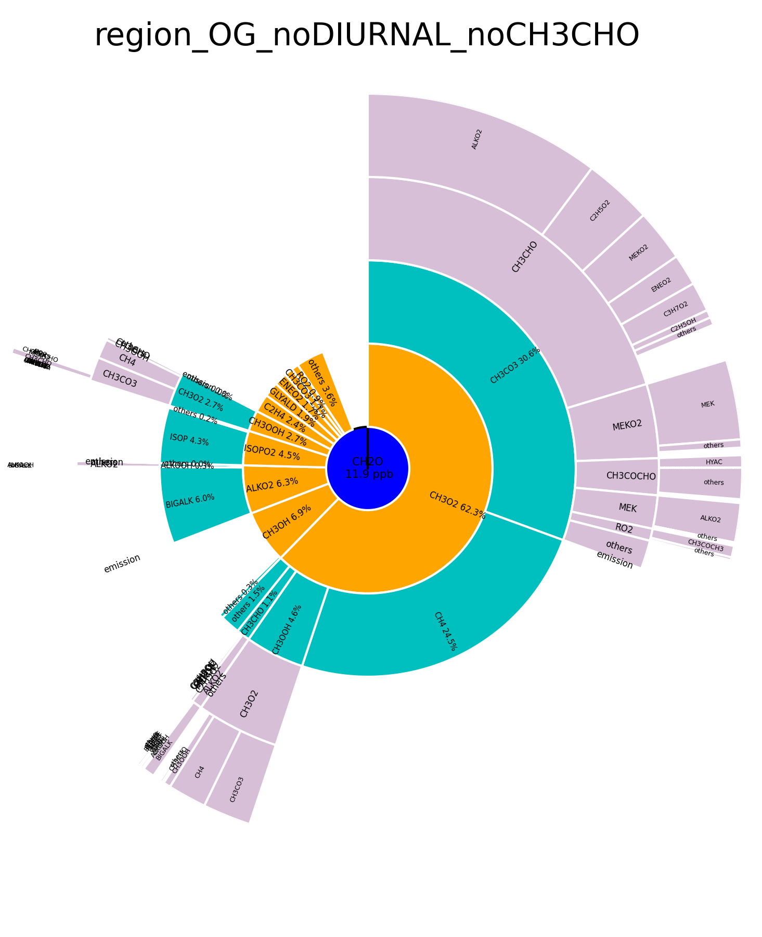
Effects of turning off direct CH3CHO emissions in d02
with without
OG region similar as City region before: Sunburst for HCHO production – since the white gap in the CH3CHO segment does not change much without CH3CHO direct emissions – transport?

Slide 13
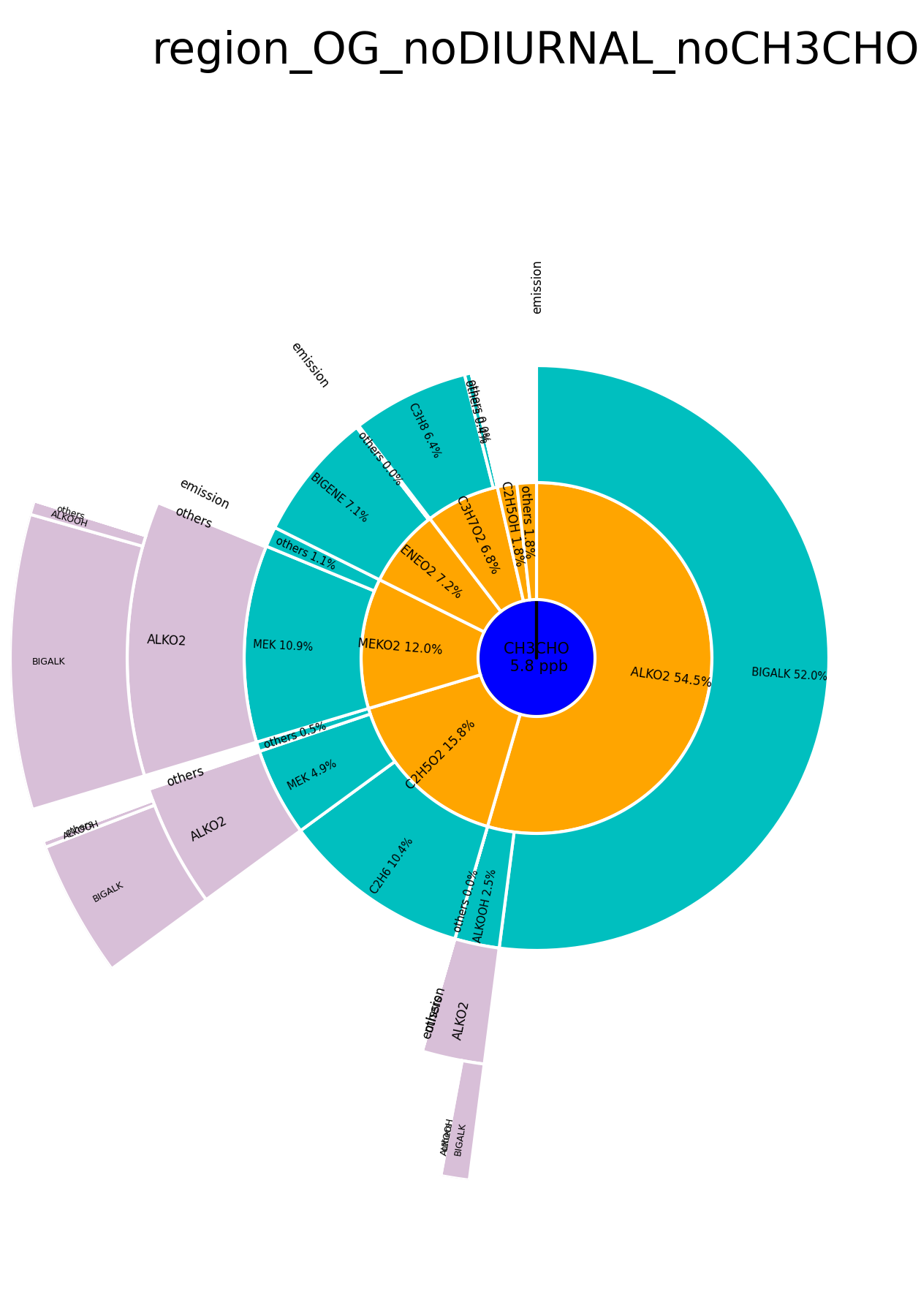
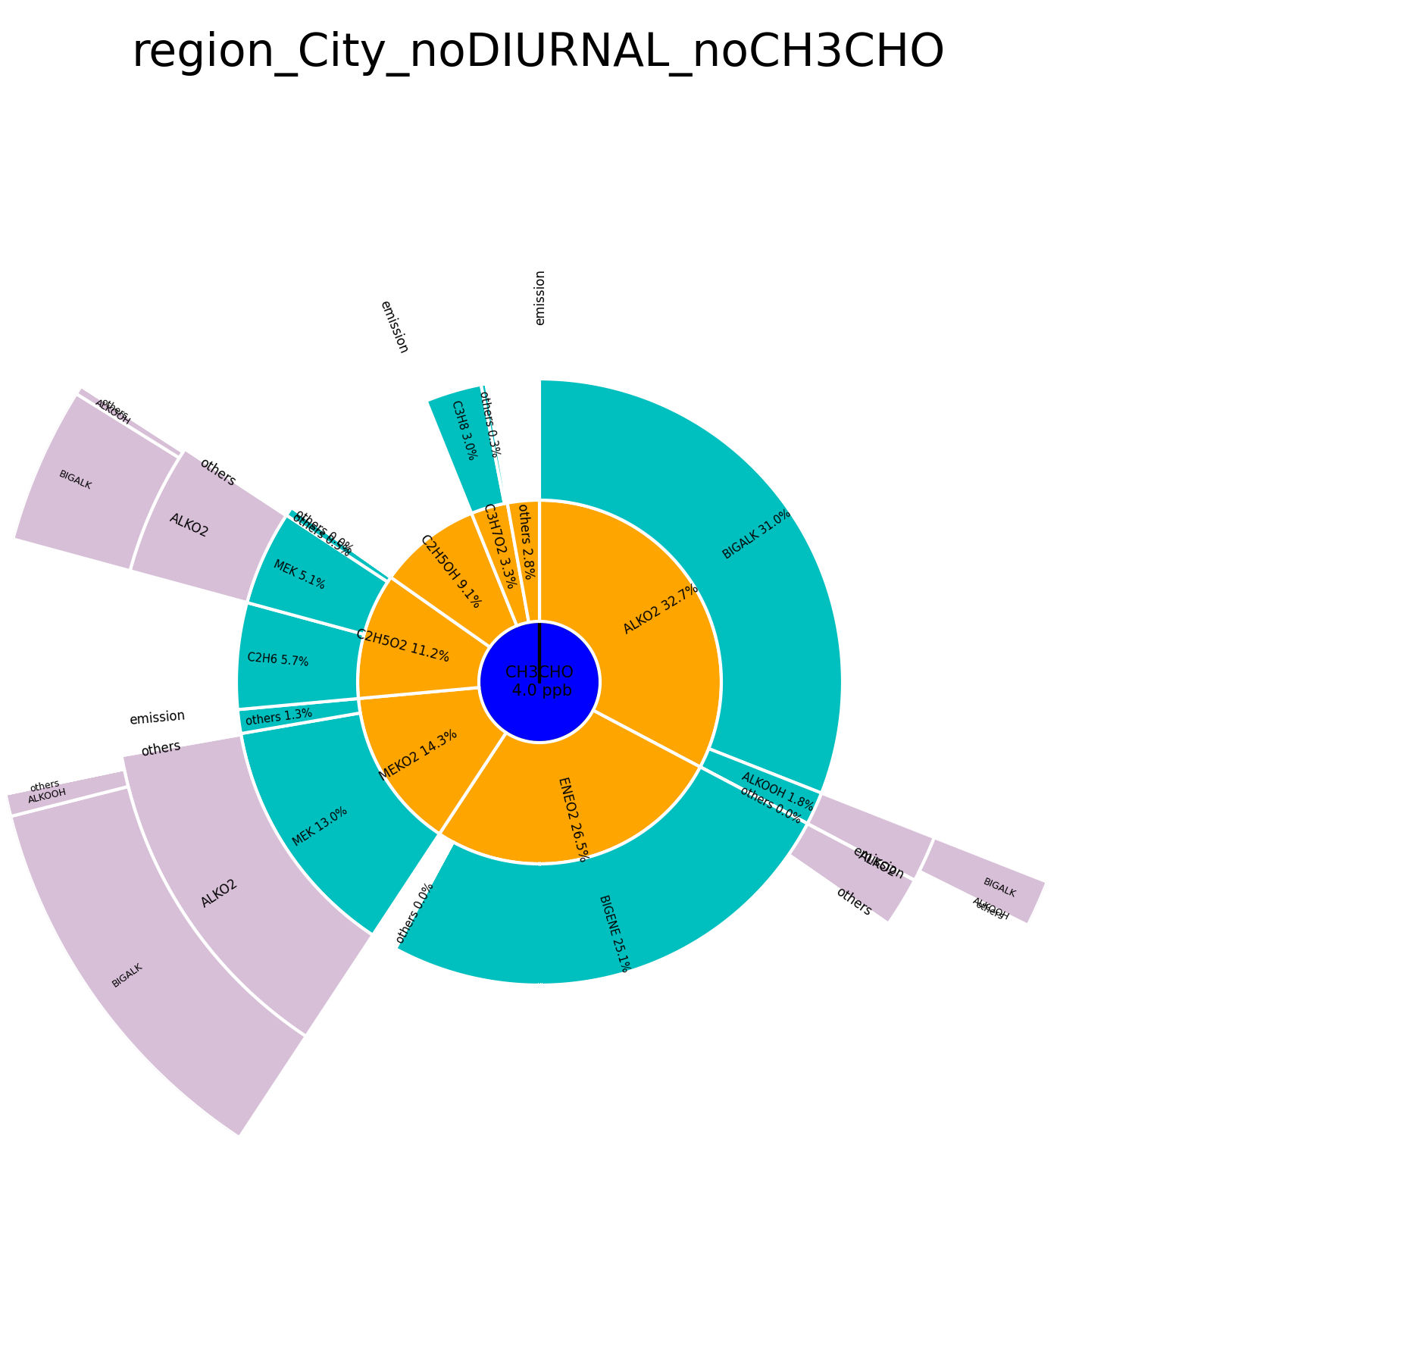
Sunburst for CH3CHO production
(looks pretty much the same with and without direct Ch3CHO emissions)
BIGALK play a dominant role

Slide 14
Effects of turning off direct NOx emissions in d02 on O3 and NOx
withNOx
Difference
withNOx
Difference
withNOx
Difference
withNOx
Difference
Note that these runs are with a diurnal cycle in OG emissions.
NFR regions: Increase in O3 in City early morning without NOx emissions. During the day ozone decreases by up to 25 ppb.

Slide 15
Effects of turning off direct NOx emissions in d02 on O3 and NOx
withNOx
Difference
withNOx
Difference
withNOx
Difference
withNOx
Difference
FH regions: without Colorado NOx emissions ozone concentrations are close to what is expected to be the "background"; Peak absolute difference in O3 is larger for FH regions compared to NFR regions - reflects the higher ozone production of NFR airmasses into the mountains when NOx emissions are included.

Slide 16
Effects of turning off direct NOx emissions in d02 on net O3 chem. production
with without
NFR regions

Slide 17
Effects of turning off direct NOx emissions in d02 on OH reactivity
with without
NFR regions; the relative role of HCHO decreases

Slide 18
Effects of turning off direct NOx emissions in d02 on net O3 chem. production
with without
Foothills: only small ozone production

Slide 19
Effects of turning off direct NOx emissions in d02 on OH reactivity
with without
Foothills regions

Slide 20
Effects of turning off direct NOx emissions in d02 on NOx reactivity
with without

Slide 21

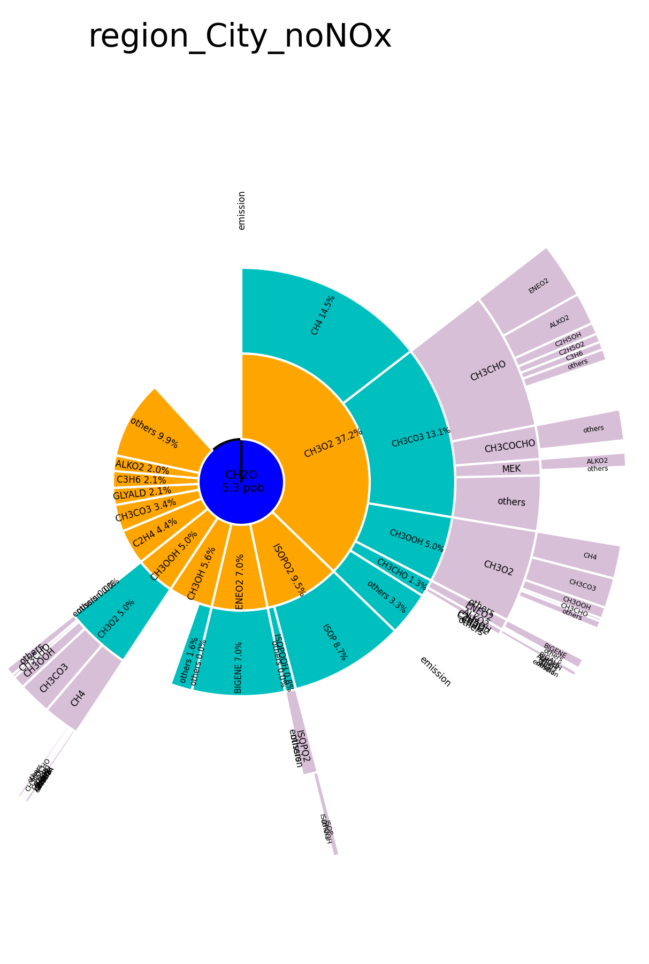
Effects of turning off direct NOx emissions in d02 on HCHO production
with without
City region: changes in the role of individual VOCs (role of CH3CO3 and of CH4 decreases, BIGENE, CH3OH become more important and also direct emissions/transport.

Slide 22
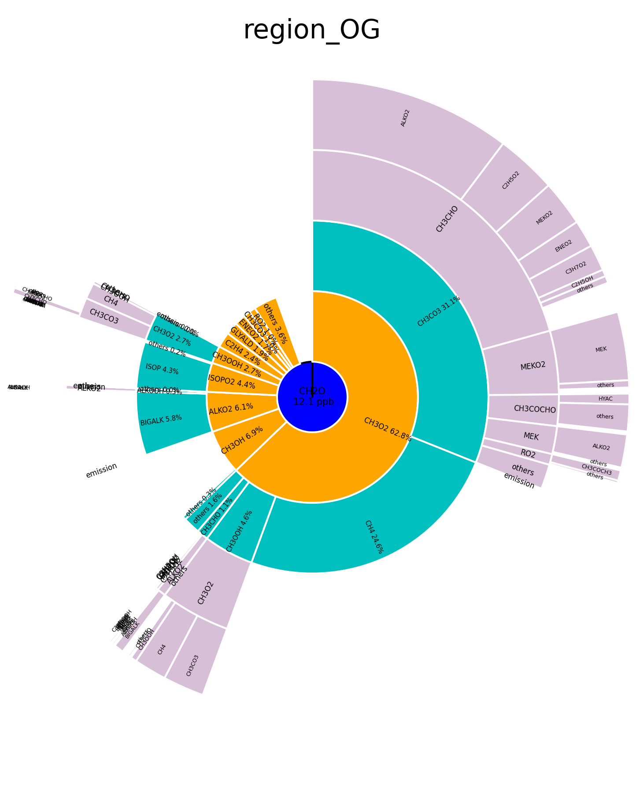
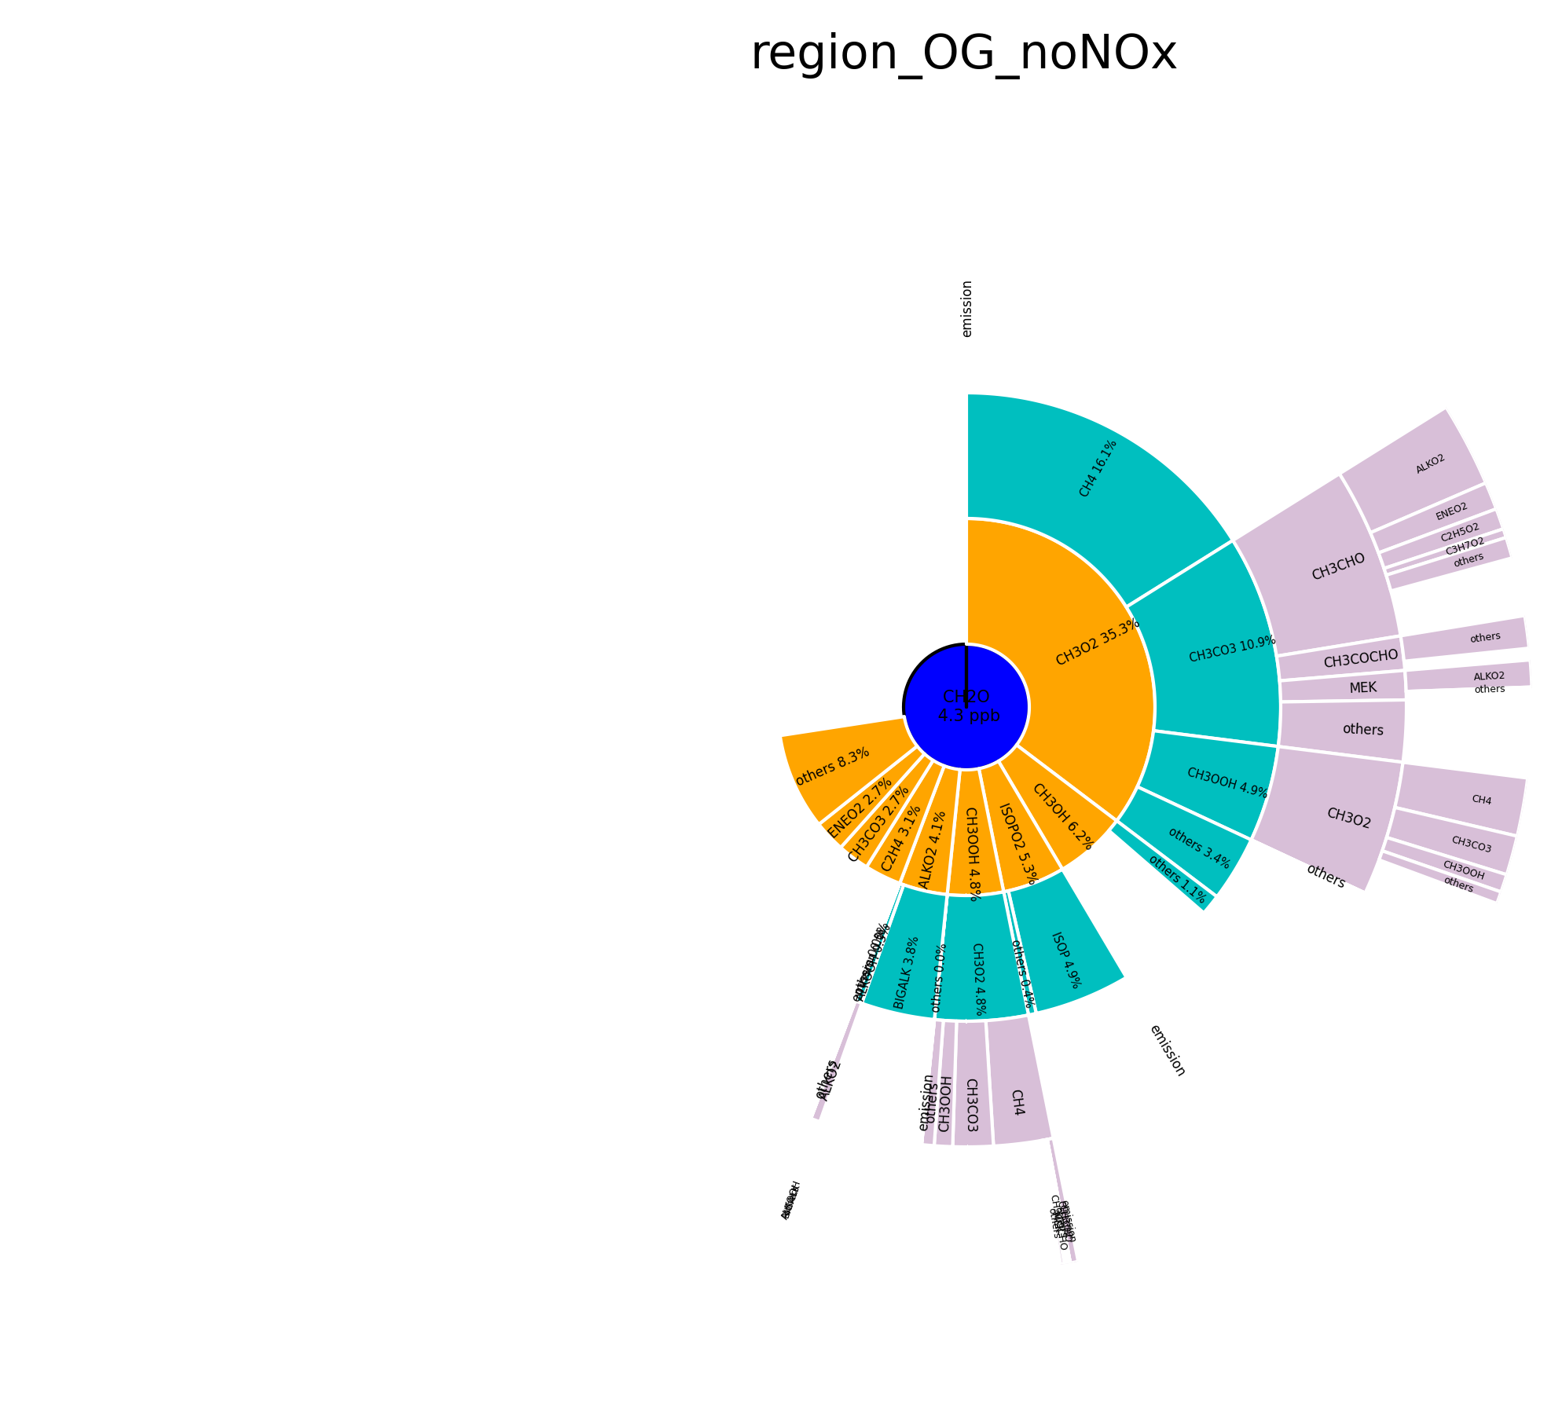
Effects of turning off direct NOx emissions in d02
with without
OG region: changes in the role of individual VOCs (role of CH3CO3 and of CH4 decreases, BIGENE, CH3OH become more important and also direct emissions/transport.

