Slide 1


Evaluating ammonia (NH₃) predictions in the NOAA National Air Quality Forecast Capability (NAQFC) using in situ aircraft measurements
William Battye, Casey Bray & Viney Aneja,
North Carolina State University
Raleigh, NC 27695
&
Daniel Tong, Pius Lee & Youhua Tang,
National Oceanic and Atmospheric Administration
Silver Spring, MD
Joint FRAPPE – DISCOVER-AQ Science Team Meeting
May 4-8, 2015
Notes:
Thank you Dr Aneja for that generous introduction
click

Slide 2

Introduction
Purpose:
Improve NH₃ predictions in the Community Multi-scale Air Quality Model (CMAQ) to enable accurate forecasting of fine particles (PM_{2.5}) in AirNow (airnow.gov*)
Background
PM_{2.5} impacts
Health: aggravated asthma, irregular heartbeat, premature death
Ecological: visibility impairment, cloud nucleation impacts
NH₃ compounds make up half the mass of PM_{2.5}
NH₃ emissions are based on allocations, not reporting
____________________________
*Implemented by the National Oceanic and Atmospheric Administration (NOAA)
Notes:
My research is aimed at using measurement data to improve NH3 predictions in the AirNow CMAQ model framework, and thereby allow accurate forecasting of fine particulate matter.
AirNow is the system that the government uses to give forecasts for air pollution for the general public
It’s implemented by NOAA, and you occasionally see their forecasts finding their way into your local weather report.
Fine particles are defined as particles less than 2.5 microns, that can penetrate to the lungs? click
NOAA does the forecasting to assess the air quality relative to national ambient air quality standards.
Which were established by EPA based on epidemiological studies, to protect against a range of adverse health effects. click
And why do we care about NH3?
As a gas its mildly toxic, but it reacts with other atmospheric pollutants to form these microscopic particles.
Ammonia compounds (sulfates and nitrates) make up half of fine particulate matter almost everywhere you look.
So ammonia becomes a key input to the fine particulate forecast. click
Now, about 90% of the ammonia emitted to the air comes from agriculture…
Either the decomposition of amino compounds in animal wastes or the evaporation of ammonia from synthetic nitrogen fertilizers.

Slide 3
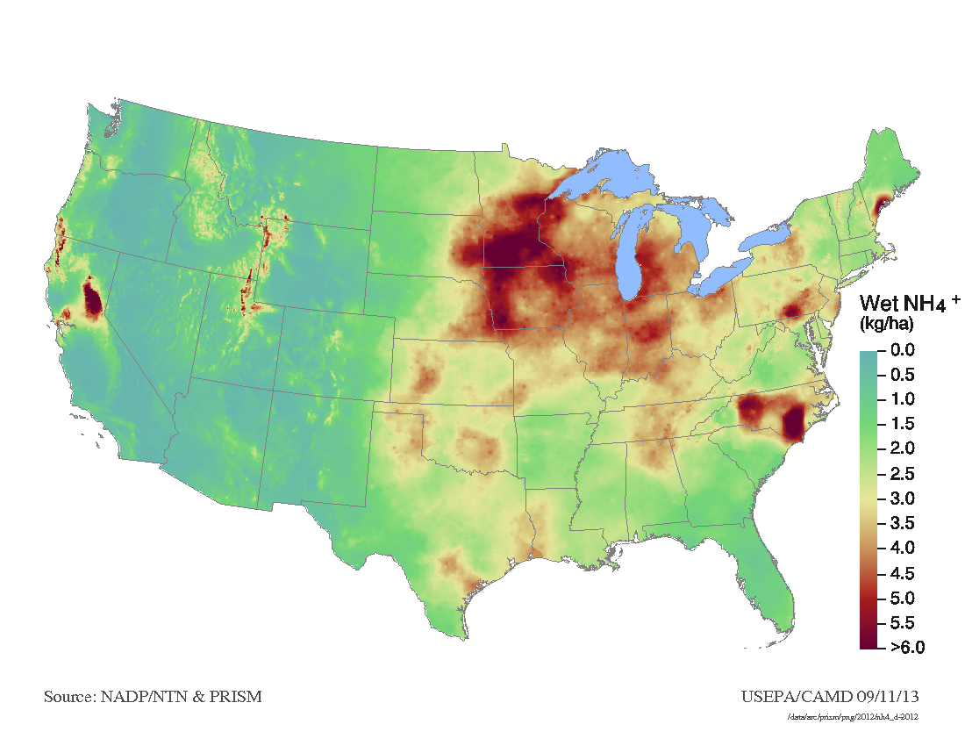
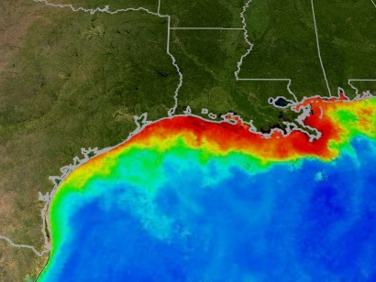
Other impacts of elevated ammonia (NH₃)
Nitrogen deposition
Nitrogen enrichment & eutrophication
Acidification
Climate change
Formation of nitrous oxide (N₂O)
Browning of organic carbon PM_{2.5}
Measured wet deposition
as NH₄⁺ (USEPA NADP 2013)
Algal blooms
(NASA MODIS)
Notes:
Ammonia also has a variety of other impacts in the environment.
I want to touch on nitrogen deposition because its an important impact of ammonia, and its also modeled in CMAQ
Ammonia, NH3, is an excellent source of biologically available nitrogen.
And this makes it a potential source of eutrophication and other problems in the natural environment. click
Here we have a map of measured ammonia deposition in rainfall.
We you can see that the spatial distribution of wet deposition reflects areas of intensive agriculture.
We have less of a handle on dry deposition… and improving the treatment of NH3 in CMAQ would improve our understanding of NH3 dry deposition and its transport in general.
For instance, how much does all of this deposition contribute to the anoxic zone in the outfall of the Mississippi?

Slide 4
Problems and objectives
Problems
Because of the nature of NH₃ sources, it is difficult to quantify emissions on the spatial and time scales needed for daily predictions of PM_{2.5}
NH₃ inventory methods developed in the 1990’s, before ambient measurements
Most model validation has focused on final outputs – PM_{2.5} and wet deposition
Objective and approach
Use in-situ and satellite based measurements to test model NH₃ predictions
Identify potential improvements for spatial and temporal distribution of NH₃
And they think their $#@! doesn’t stink?!
Notes:
So the problem for modeling ammonia is that given the nature of the sources, its difficult to quantify emissions on the spatial and temporal scales needed form AirNow forecasts. click
Also, the PM model is piggy backed on the ozone model, and the data flows were developed before the collection of NH3 monitoring data

Slide 5
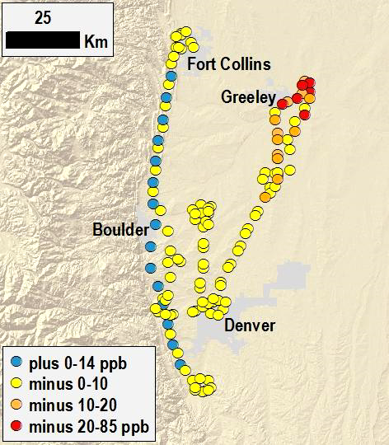
Comparing model results with measurements
Measurements
Discover-AQ Colorado
July-August 2014
Airborne in-situ
Proton Transfer Mass Spectrometer
Model
NAQFC-CMAQ
4-dimensional interpolation to measurement location and time

Slide 6
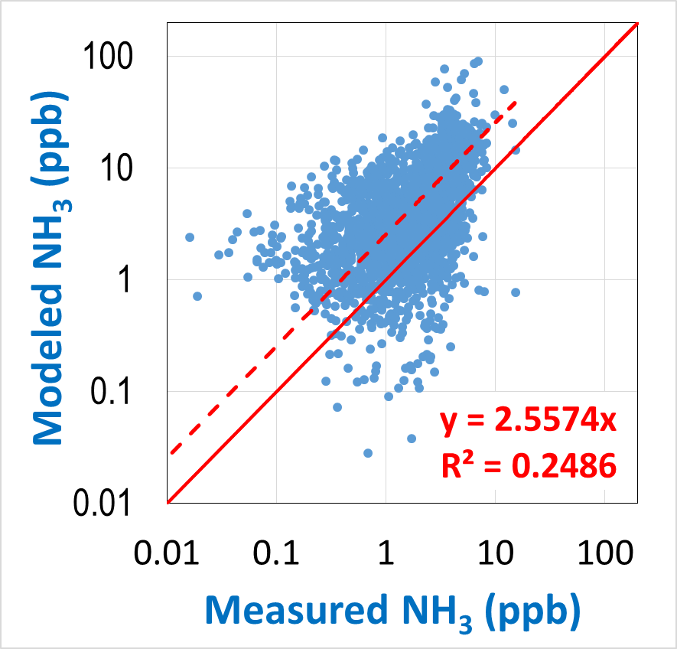
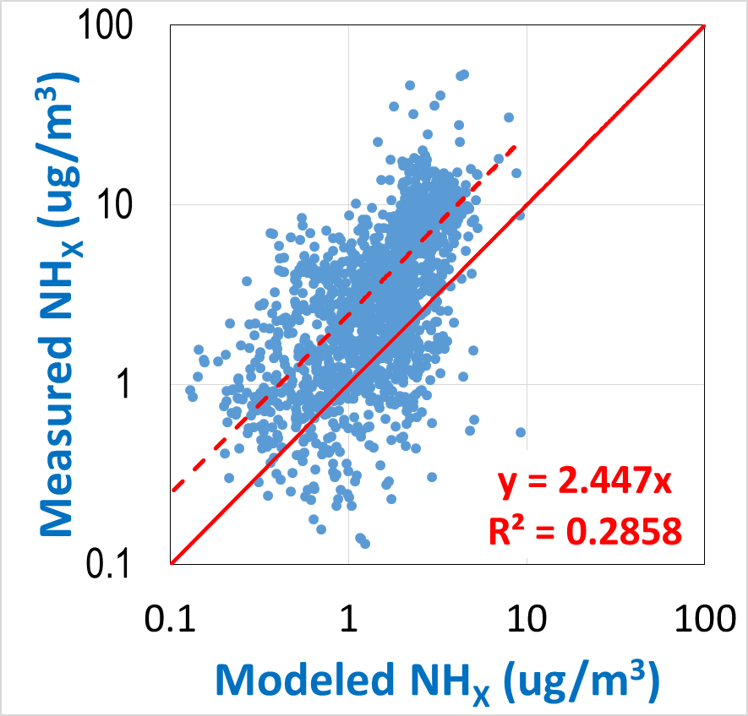
General comparison for NH₃ and total ammonium near ground level (<1 km altitude)
Solid line = model prediction (one-to-one)
Dotted line = actual measurement
(total ammonium: NH_{X} = NH₃ & NH₄⁺)

Slide 7
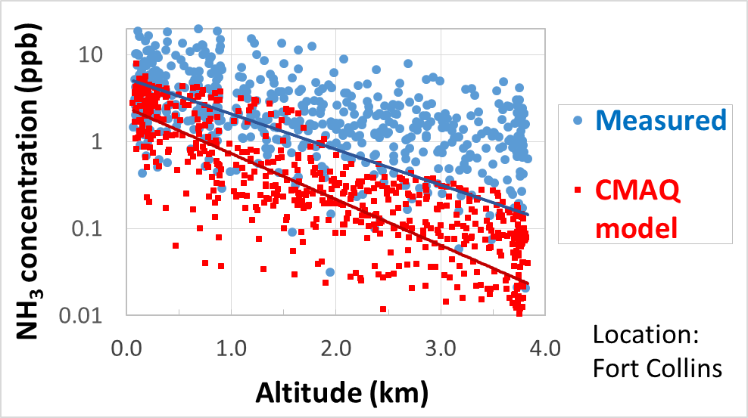
Vertical NH₃ gradients – measured and modeled

Slide 8
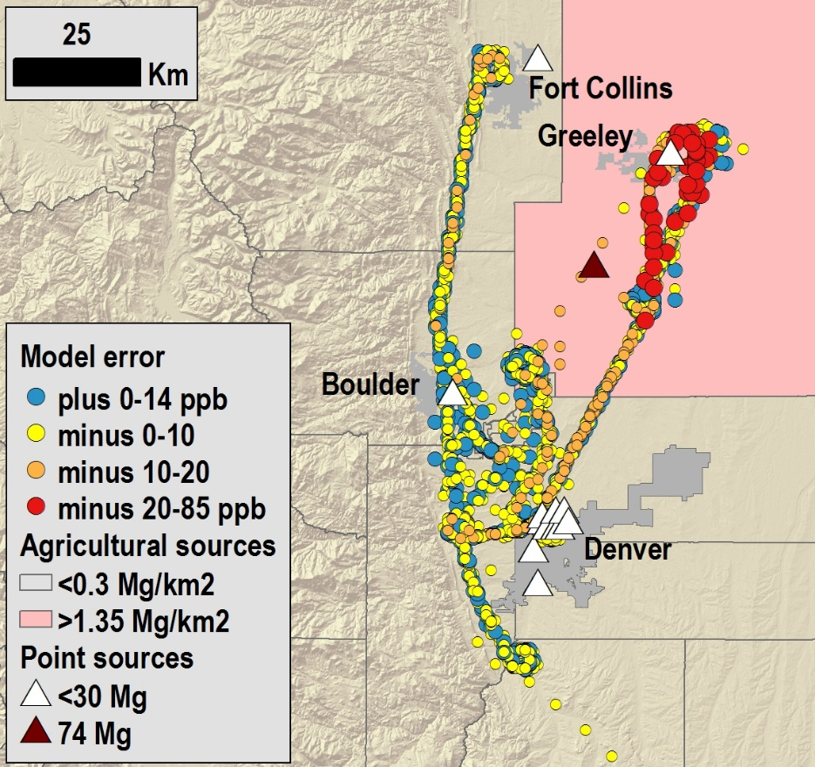
Spatial pattern in relation to NH₃ emission sources
Underestimation is more pronounced in areas of relatively high emissions

Slide 9
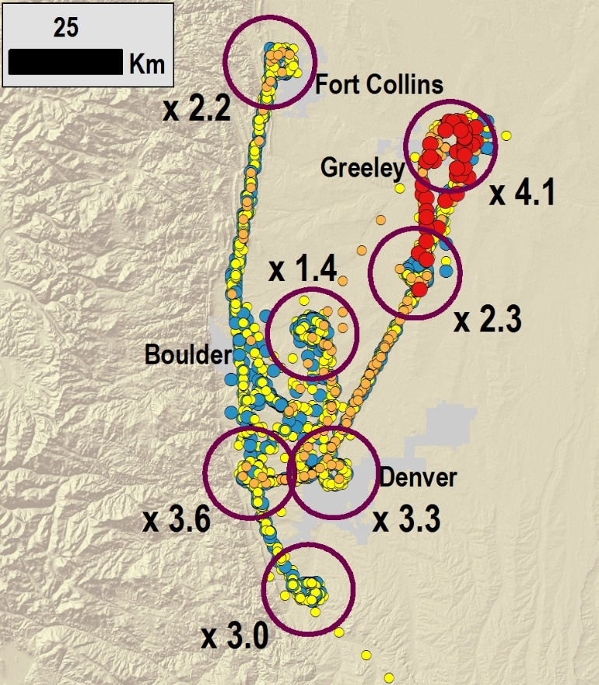
Spatial pattern of NH₃ underestimation
Ratio of measured concentration to modeled concentration for seven clusters of measurements
Range of ratio: 1.4 to 4.1

Slide 10
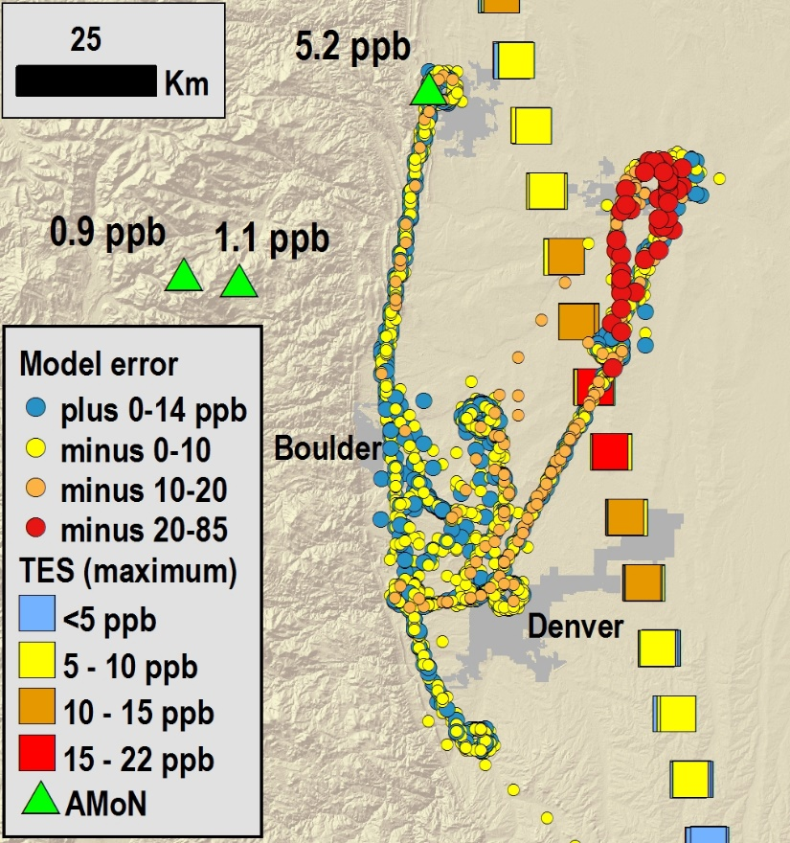
Other NH₃ measurement data
TES on
Aura satellite
Aura satellite
Tropospheric Emissions Spectrometer (TES)
5 passes during campaign
10 minute snapshots at midday and midnight
AMoN
Passive samplers
2-week averages

Slide 11
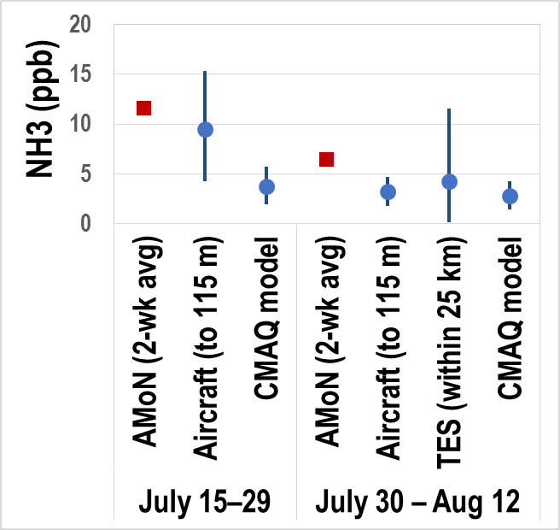
Comparison of different NH3 data sources
Location: Fort Collins
Time frame: July-Aug 2014
AMoN: 2 week averages
Aircraft and CMAQ: averages of 1-min data over 2 weeks
TES: average over 2 weeks

Slide 12
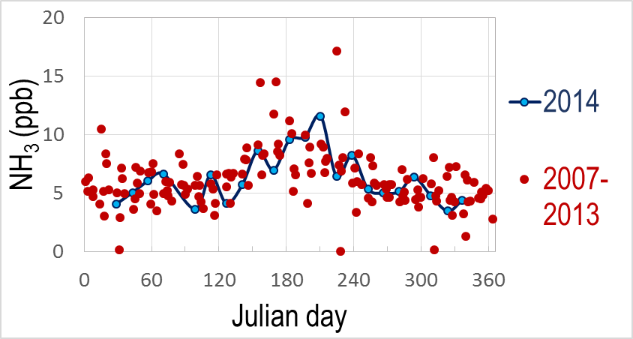
Summer 2014 in relation to broader seasonal NH₃ patterns – Fort Collins AMoN site
Aircraft
measurements

Slide 13
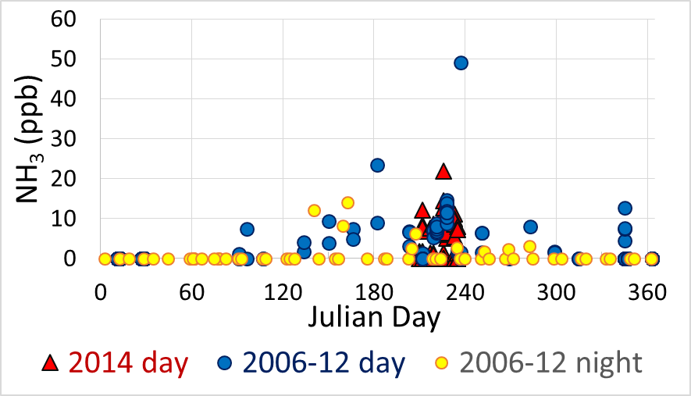
Summer 2014 in relation to broader seasonal and diurnal NH₃ patterns – TES measurements near Greeley
Aircraft
measurements

Slide 14
Conclusions
Aircraft measurements suggest that the AirNow version of CMAQ, or the emission inventory underestimate NH₃ in the FRAPPE domain
Average error at low altitude is more than a factor of 2
Errors are larger in areas of high emissions
Errors are larger in the lower atmosphere
NH₃ concentrations for summer 2014 are within ranges of longer-term measurements
Vertical gradients predicted by the model agree well to measured gradients
NH₃ concentrations in the mixed layer are subject to substantial spatial and temporal variability

Slide 15
Next steps
Broaden spatial comparisons using AMoN and TES
Update NH₃ inventory
Incorporate bidirectional NH₃ flux

Slide 16
Acknowledgements
NCSU Air Quality Research Group
NOAA National Air Quality Forecast Program
NASA Langley Research Center, for travel support

