Slide 1
Key features of summer ozone meteorology and climatology for Colorado's Front Range and an assessment of how 2014 compares with previous years.
Joint FRAPPE/DISCOVER-AQ Science Team Meeting
May 4, 2014
Patrick J. Reddy
Air Pollution Control Division
Colorado Department of Public Health & Environment, patrick.reddy@state.co.us

Slide 2
O3 in Colorado increases with:
Upper level high pressure strength,
Surface and upper level temperature,
Decreased 700 mb zonal wind speeds,
Regional mean OMI tropospheric NO2,
Enhanced mountain-plains circulations.

Slide 3
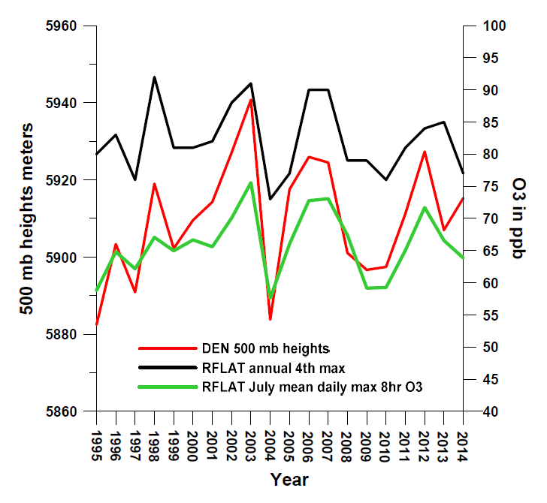
Pearson Correlations: O3 and NCEP/NCAR
Reanalysis variables for July
For 1995-2014 | DEN July 500 mb heights | DEN July 700 mb temperature | DEN July 700 mb Zonal winds
RFLAT 4th max O3 | 0.75 | 0.50 | -0.50
RFLAT July mean daily max 8-hr O3 | 0.91 | 0.78 | -0.69
Manuscript to be submitted to JGR in May outlines relationships among O3, meteorological variables, and
satellite-derived NO2. Much of what follows is based on this paper, which should provide a context for
interpreting the 2014 campaigns and a road map for components of an O3 SIP Weight of Evidence Analysis:
Reddy, P. J, G. G. Pfister, and B. L. Blaser, “July maximum surface ozone, meteorological variables, and
satellite NO₂ in Colorado, Utah, and other western US states, to be submitted”.

Slide 4
Year | DEN July-August 500 mb heights percentile | DEN July-August 700 mb temperature percentile | DEN July-August 700 mb zonal wind speed percentile | NREL July 17- August 18 Mean MDA8 O3 percentile
1995 | 21 | 53 | 95 | 32
1996 | 37 | 26 | 53 | 84
1997 | 26 | 16 | 84 | 0
1998 | 84 | 32 | 32 | 53
1999 | 47 | 21 | 74 | 16
2000 | 79 | 89 | 53 | 95
2001 | 74 | 68 | 47 | 58
2002 | 58 | 74 | 26 | 63
2003 | 100 | 100 | 37 | 100
2004 | 0 | 0 | 68 | 11
2005 | 42 | 58 | 42 | 26
2006 | 53 | 37 | 11 | 89
2007 | 89 | 84 | 21 | 79
2008 | 11 | 63 | 5 | 37
2009 | 5 | 11 | 100 | 5
2010 | 16 | 42 | 89 | 42
2011 | 68 | 95 | 79 | 68
2012 | 95 | 79 | 16 | 74
2013 | 63 | 47 | 0 | 47
2014 | 32 | 5 | 63 | 21
July & August of
2014 were low
for O3, 500 mb
heights and 700
mb temperatures,
and high for 700
mb zonal wind
speeds
Percentiles analysis for 2014 campaign period. O3 increases with heights & temperatures, decreases
with zonal wind speed. 2014 saw low O3, heights, and temperatures and higher wind speeds.

Slide 5
Previous work has demonstrated the
predictive power of 500 mb heights.
We can create a weather-corrected
O3 time series using the residuals of
a regression between O3 and 500 mb
heights – 13 Front Range sites.
The resulting trend analysis for Front
Range sites shows an increasing trend
from 2001-2008, a drop of ~7 ppb with
the Recession by 2009, and a drop of
~7 ppb in 2014.

Slide 6
R² = 0.82
Denver Reanalysis grid cell OMI tropospheric NO2 is highly correlated with 500 mb heights - a straight line is a good fit. Meteorology has had more impact on NO2 than year-to-year changes in emissions. 2014 is an outlier, suggesting a possible change in emissions.

Slide 7
Colorado July power plant NOx emissions.
DEN Reanalysis grid cell July level 3 OMI tropospheric
NO2 (30% cloud screened).
2012 was a high year for wildfire smoke and 2014 was a low year for smoke. Does the
difference in NO2 reflect the effects of reservoir species such as PAN on NO2? Did changes
in NOx emissions from other sources affect NO2 in 2014?

Slide 8
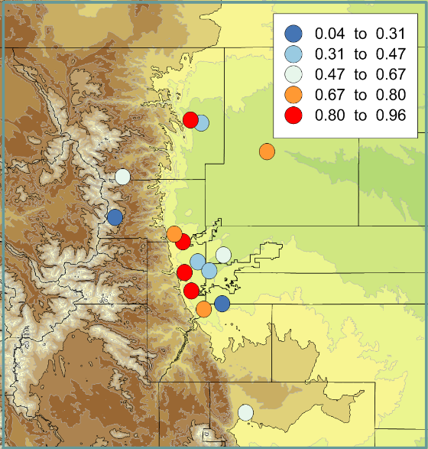
This is the 2.5 by 2.5 degree NCEP/NCAR
Reanalysis grid cell over Denver. Pearson
correlations between weather-corrected OMI
level 3 tropospheric NO2 (30% cloud screened)
and weather-corrected July mean MDA8
O3 for 2005-2014 suggest that sites along the
foothills have the highest sensitivity to NOx
while valley/urban sites such as Carriage,
HLD, FTC, and ARV are least sensitive to NOx.

Slide 9
July MDA8 versus OMI tropospheric NO2 for Reanalysis grid cells over DEN (left) and LA (right).
July 2014 level 3 OMI tropospheric NO2 for the NCEP/NCAR Reanalysis grid cell over Denver was 0.98 x10^15
mol/cm2, which is at roughly the 30th percentile level for 2005-2014. 2012 was above the 80th percentile.
Plots suggest that the Front Range is generally NOx sensitive during this period and more so than LA. Trend in
NO2 more consistently downward with time for LA. DEN OMI NO2 and O3 may be more affected by year-to-year changes in weather.

Slide 10
July 2014 Boulder NWS Weather Summary:
July 12-17: A strong upper level trough… allowed a series of cold fronts to push across northeastern Colorado...which resulted in wetter and cooler weather across the region from the 12th through the 17th.
July 18-26: Hot and dry weather returned to north central and northeastern Colorado by the 18th as upper level high pressure re-established over the southwestern states. A nine day stretch of 90 degree plus weather occurred in Denver from the 18th through the 26th.
July 29-30: The month ended on a much cooler and wetter note. A cold front moved across the region on the afternoon of the 29th producing an upslope flow behind it. This front combined with increased monsoon moisture produced widespread rain on the 29th and 30th.
August 2014 Boulder NWS Weather Summary:
............August 2014 cooler and wetter than average.............
Periods of monsoonal moisture moved over Colorado during the month of August which resulted in higher than average precipitation...increased cloud cover and cooler temperatures across much of north central and northeastern Colorado.

Slide 11
Despite the fact that the campaigns occurred in a period generally unfavorable for O3 and with low July OMI NO2, 500 mb heights, and temperatures; flight days represent a variety of conditions, include annual peak concentration days, and include hourly concentrations above 90th percentile levels.
7/22: Annual 1st max MDA8 at RFLAT and NREL, annual second max at SBC and Welch, and annual 3rd max at FTCW, Aspen Park, Welby, and CHAT.
8/03: Annual second max MDA8 at NREL, annual 3rd max at CAMP and Welch, and annual 4th max at La Casa.

Slide 12
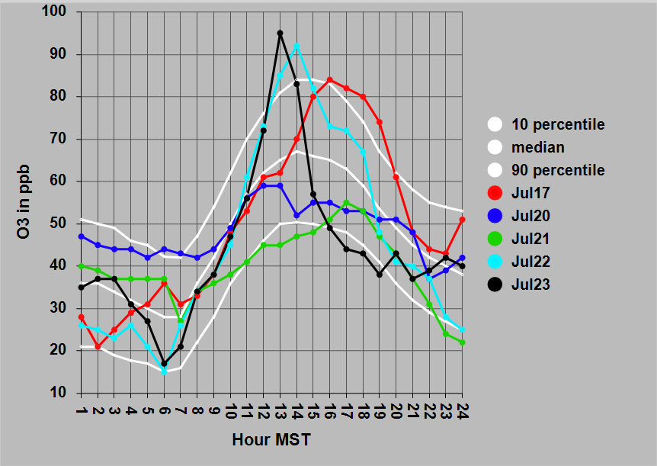
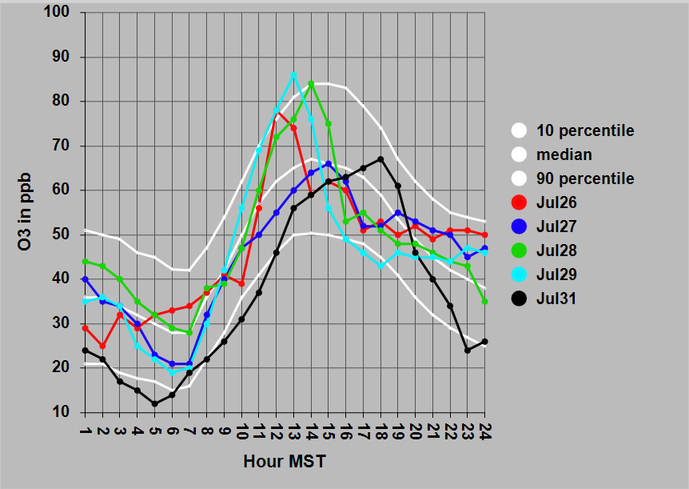
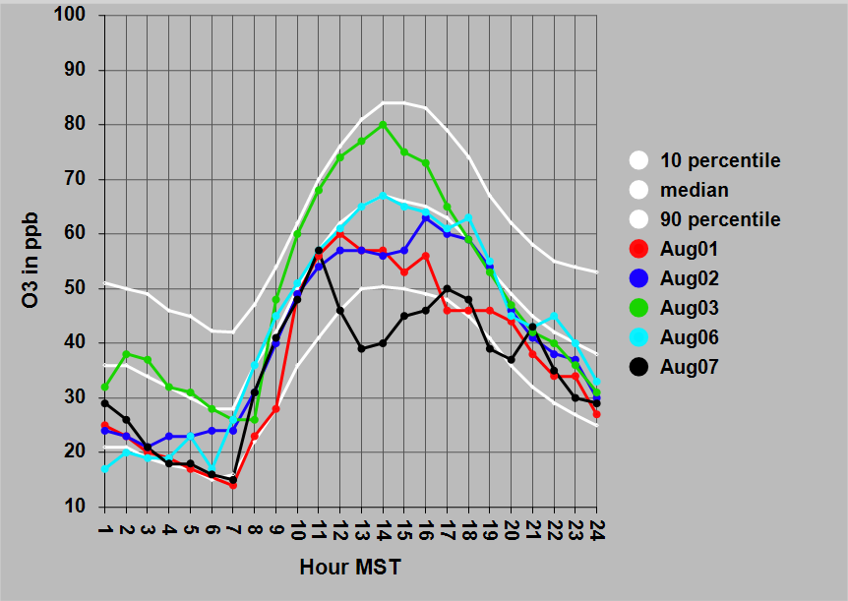
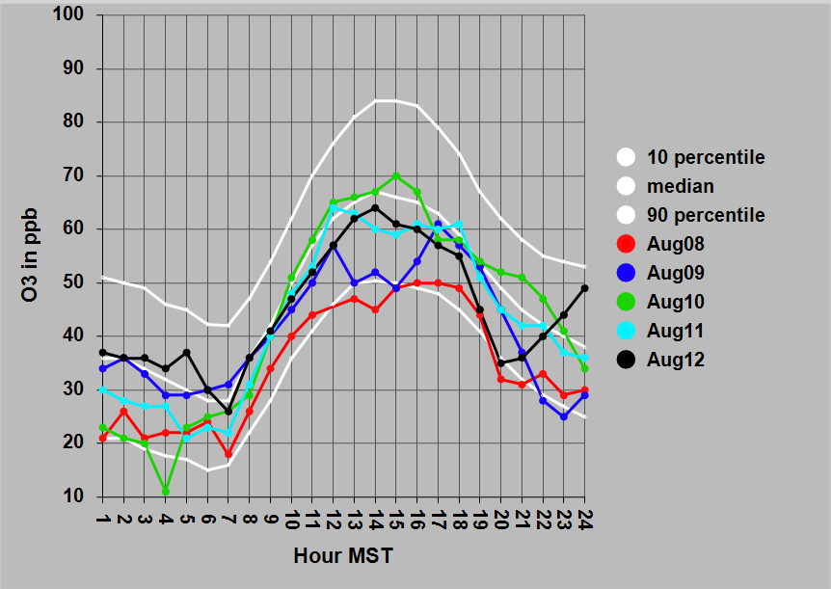
Chatfield
hourly O3
profiles by
flight day.
10th and 90th
percentile and
median profiles
based on July & Aug 2005-2014.
Near 90th:
7/17, 7/22, 7/23,
7/26, 7/28, 7/29,
8/03
Below median:
7/20, 7/21, 7/27,
8/01, 8/02, 8/07, 8/08, 8/09,8/12

Slide 13
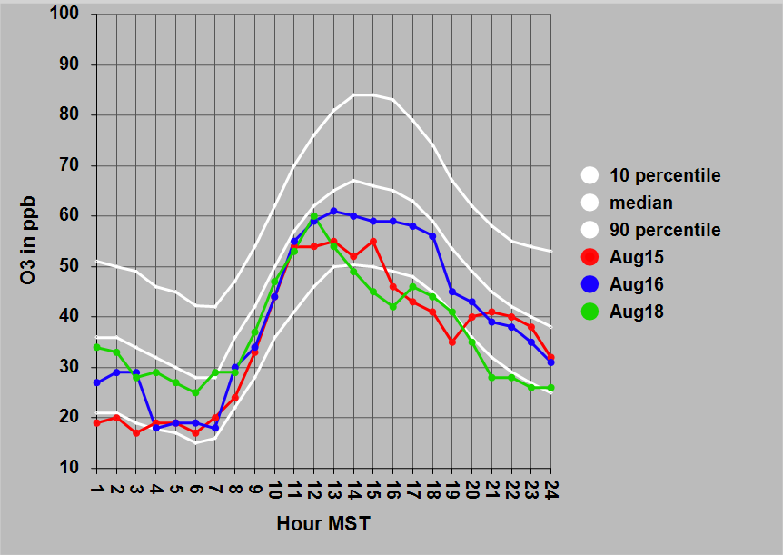
Chatfield
hourly O3
profiles by
flight day.
10th and 90th
percentile and
median profiles
based on July & Aug
2005-2014.
Below median:
8/15, 8/16, 8/18

Slide 14
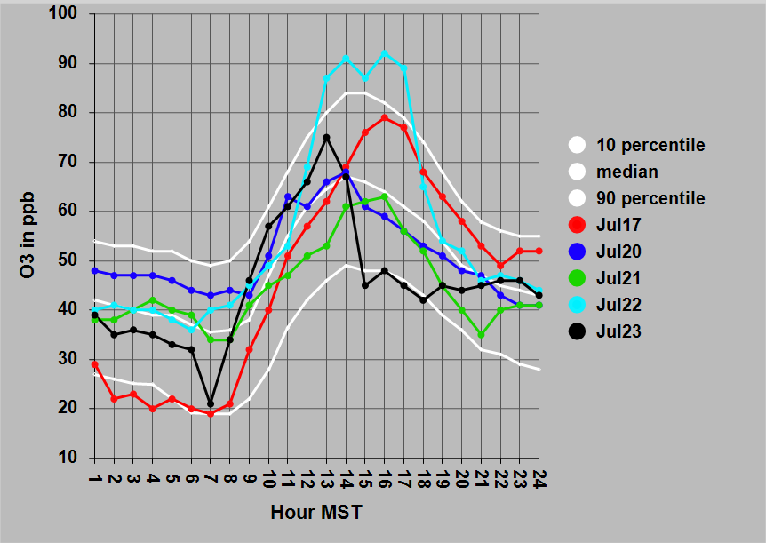
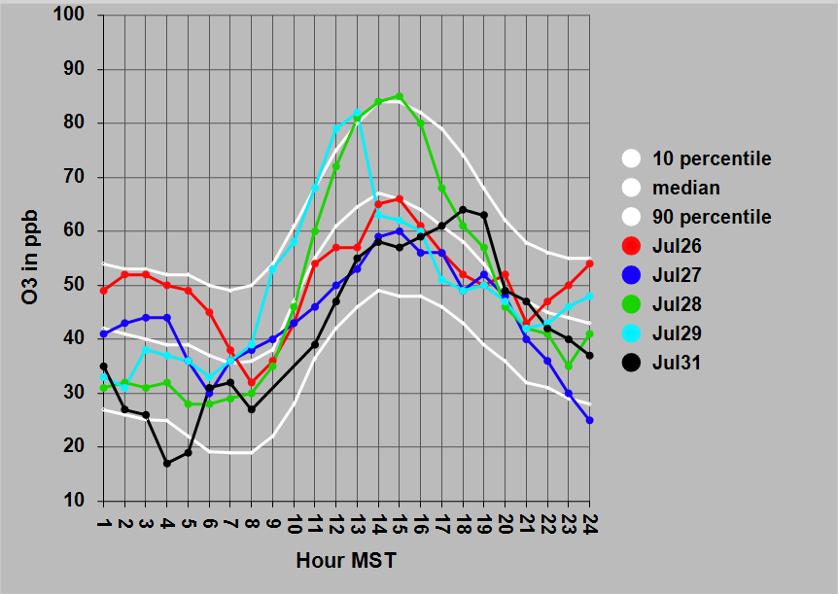
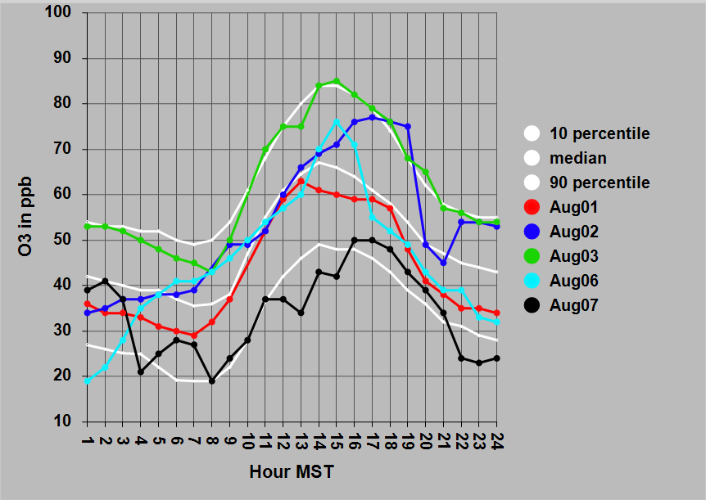
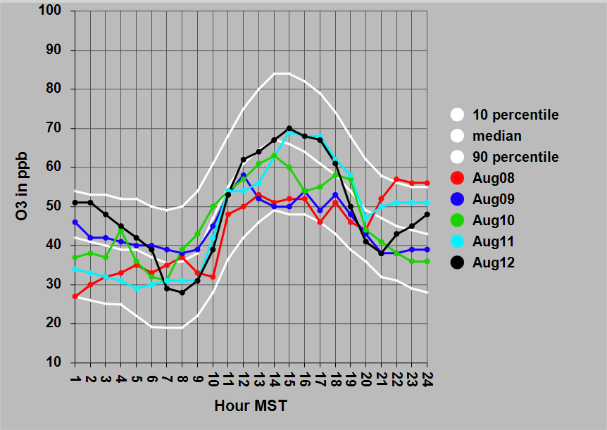
NREL
hourly O3
profiles by
flight day.
10th and 90th
percentile and
median profiles
based on July & Aug
2005-2014.
Near 90th:
7/17, 7/22, 7/23, 7/28, 7/29, 8/02, 8/03
Below median:
7/21, 7/23, 7/27, 8/07,8/08, 8/09, 8/10

Slide 15
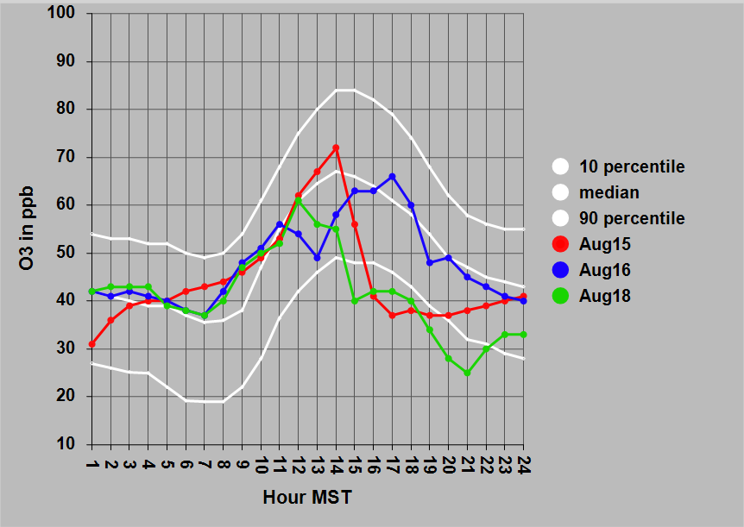
NREL
hourly O3
profiles by
flight day.
10th and 90th
percentile and
median profiles
based on July & Aug
2005-2014.
Below median:
8/15, 8/18

Slide 16
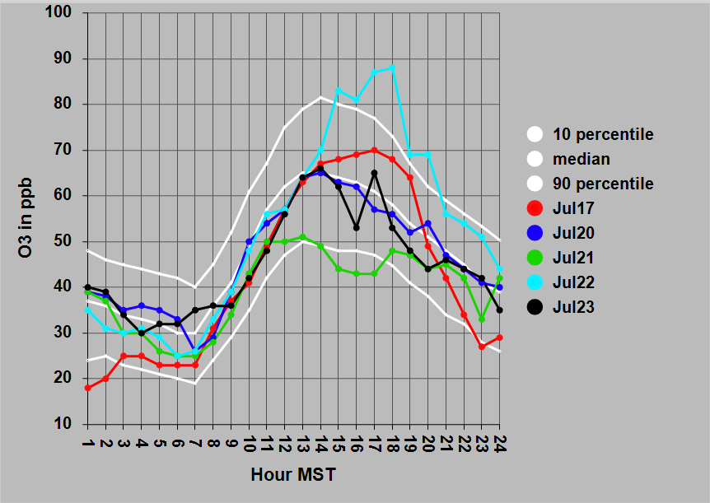
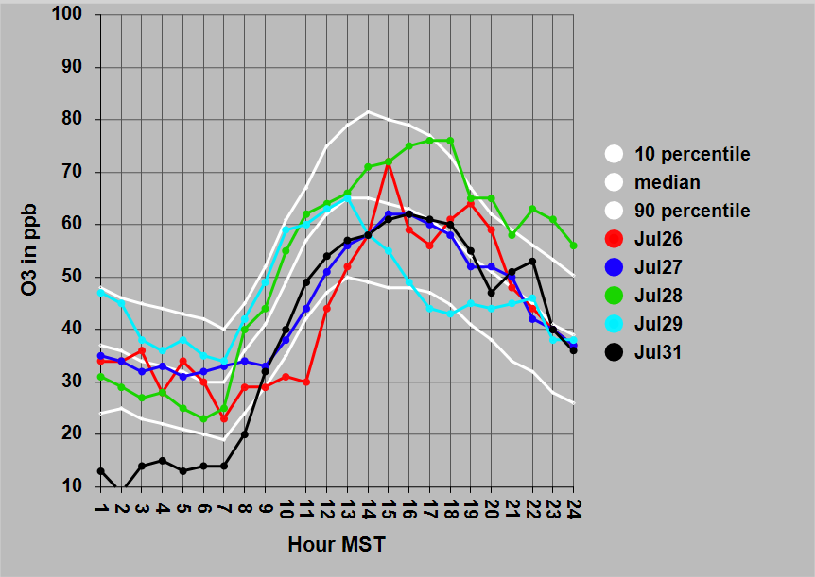
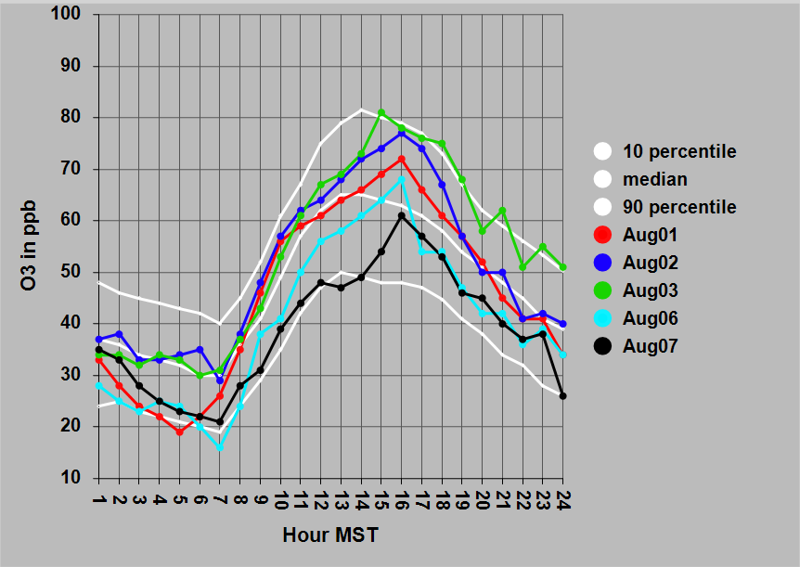
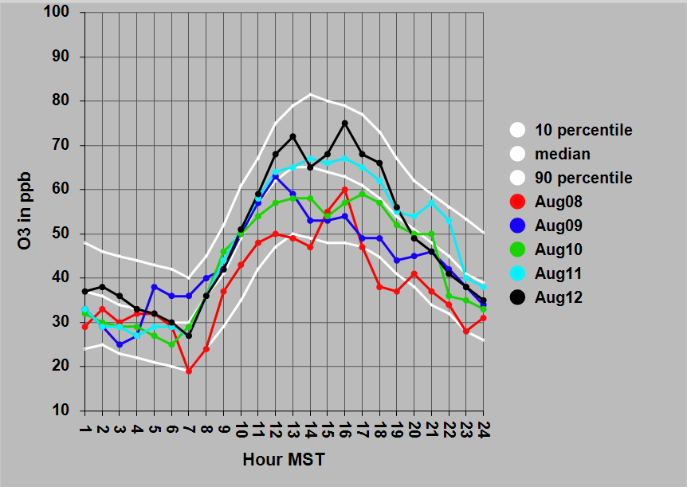
FTCW
hourly O3
profiles by
flight day.
10th and 90th
percentile and
median profiles
based on July & Aug
2005-2014.
Near 90th:
7/22, 7/28, 8/02, 8/03
Below median:
7/21, 7/29, 8/07, 8/08, 8/09, 8/10

Slide 17
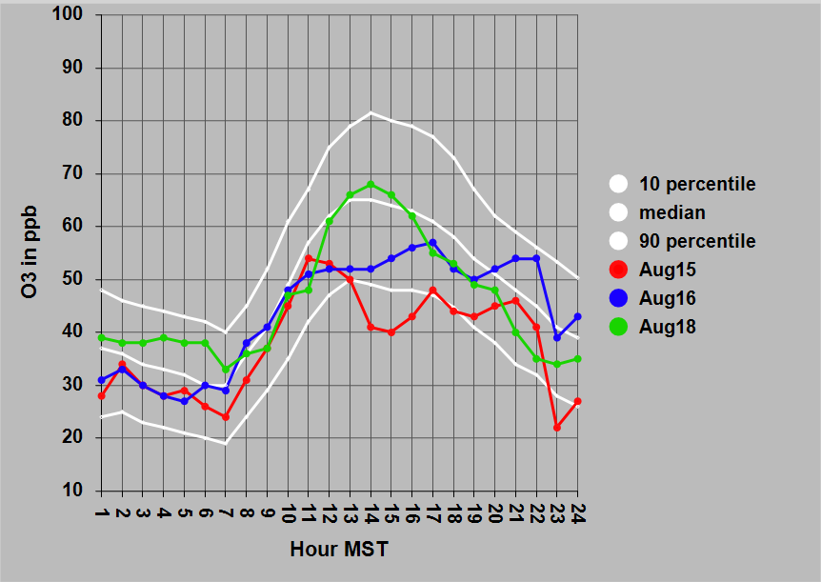
FTCW
hourly O3
profiles by
flight day.
10th and 90th
percentile and
median profiles
based on July & Aug
2005-2014.
Below median:
8/15, 8/16

Slide 18
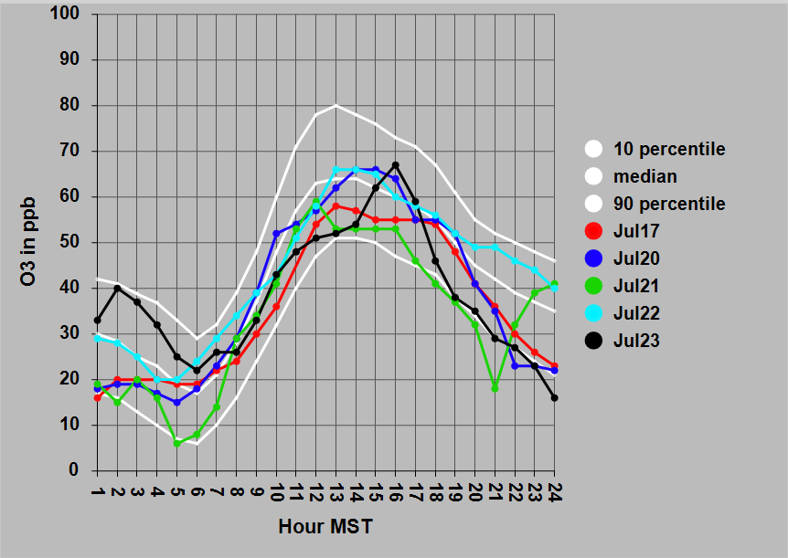
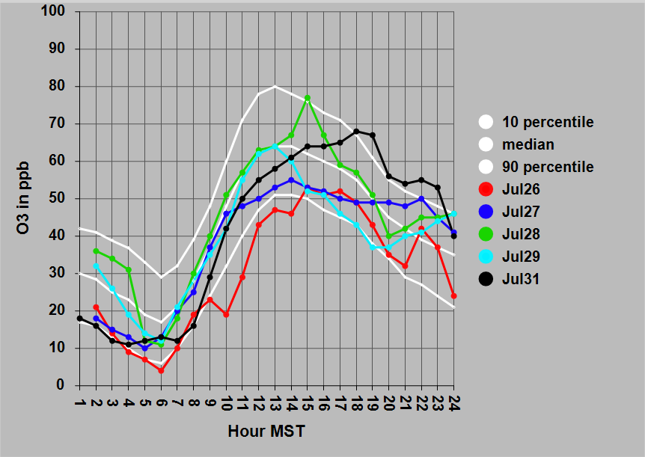
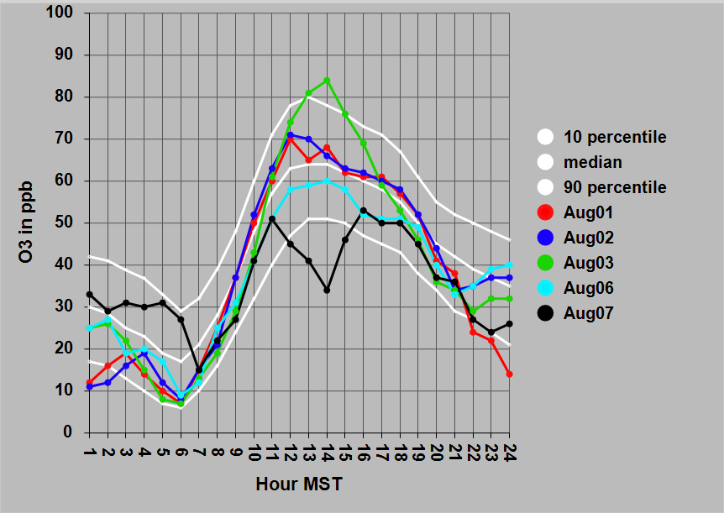
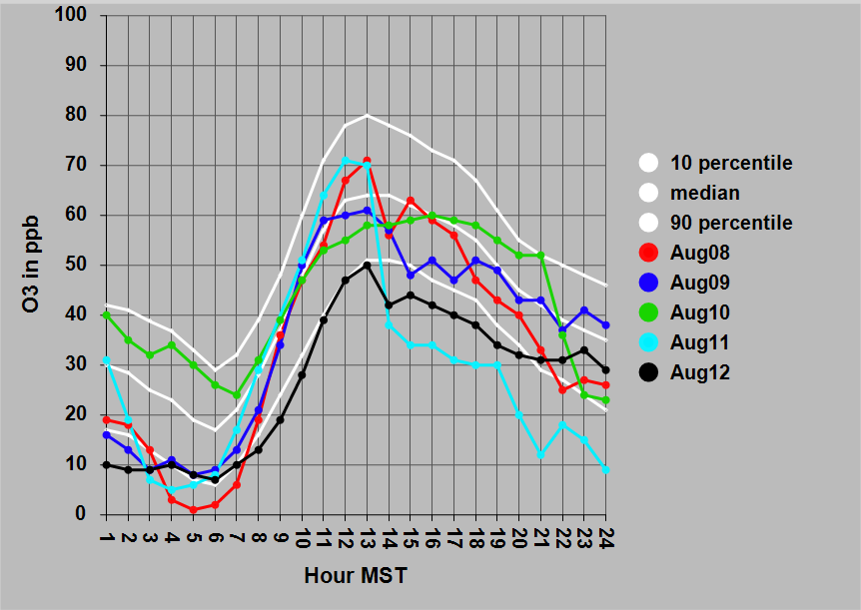
GRE
hourly O3
profiles by
flight day.
10th and 90th
percentile and
median profiles
based on July & Aug
2005-2014.
Near 90th:
7/31, 8/03
Below median:
7/17, 7/21, 7/26, 7/27, 7/29, 8/06, 8/07, 8/09, 8/12
Early AM O3
was anomalously
low.

Slide 19
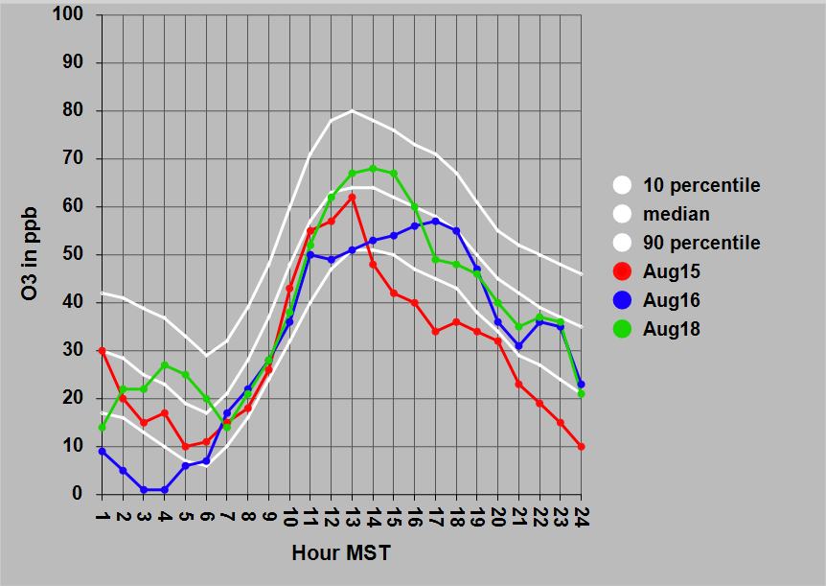
GRE
hourly O3
profiles by
flight day.
10th and 90th
percentile and
median profiles
based on July & Aug
2005-2014.
Below median:
8/15, 8/16

Slide 20
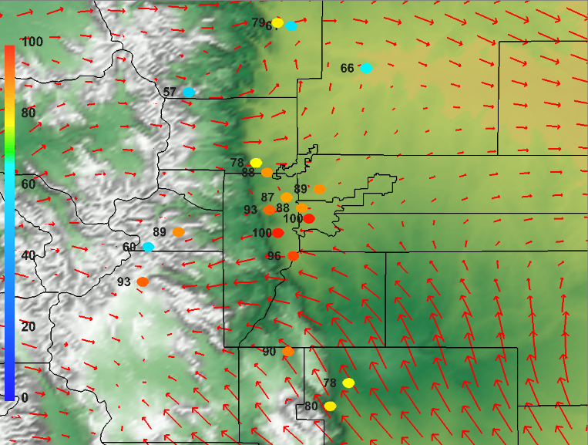
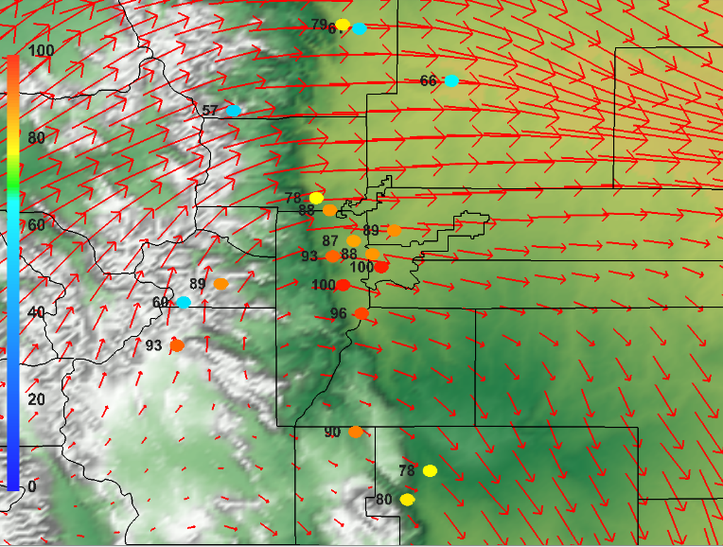
It’s difficult to quantify mountain-plains solenoid frequency and strength for 2014, but it seems
that there were fewer well-developed solenoids, like this one for 2008 pictured below.
One-hour ozone for select Colorado sites for 19 MST July 10, 2008, with NCEP NAM12 17 MST analysis run
winds for 675 mb left and (d) 550 mb right. Maps show mountain-plains solenoid circulation and its impacts on
ozone. NAM12 mixing heights for 17 MST were near the 475 mb level or 6 km.

Slide 21
The FRAPPE/DISCOVER-AQ period was generally less favorable for O3, with low July OMI NO2 and July/August 500 mb heights and temperatures and higher 700 mb zonal winds.
Mountain-plains solenoid circulations may have been less frequent and/or less well-developed.
Nevertheless, flight days occurred during some of the highest O3 periods of the year and provide a representative sample of a wide range of photochemical conditions along the Front Range.
Wildfire smoke was not present to any significant degree.

Slide 22
Extra Slides

Slide 23
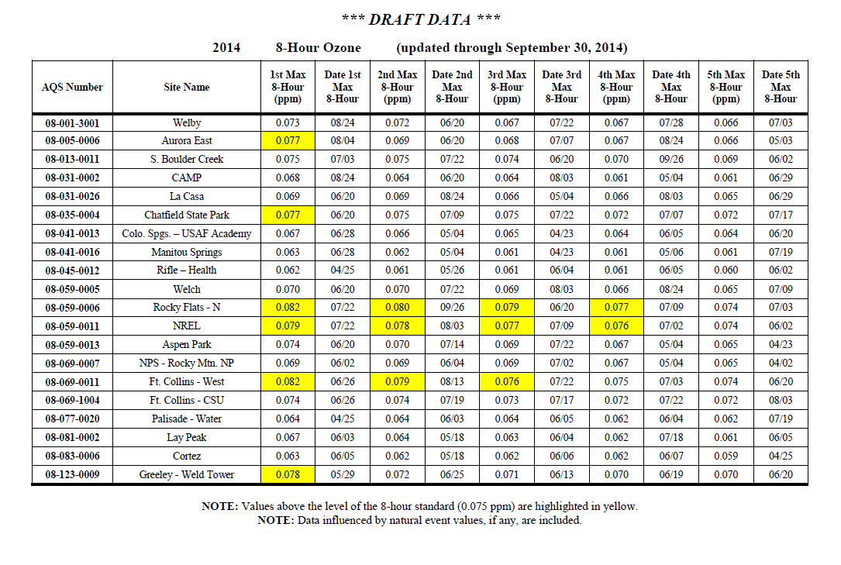

Slide 24
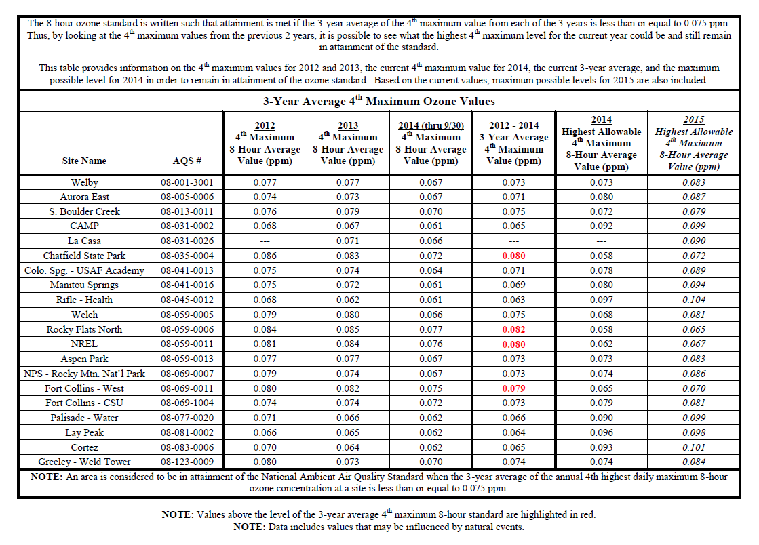

Slide 26
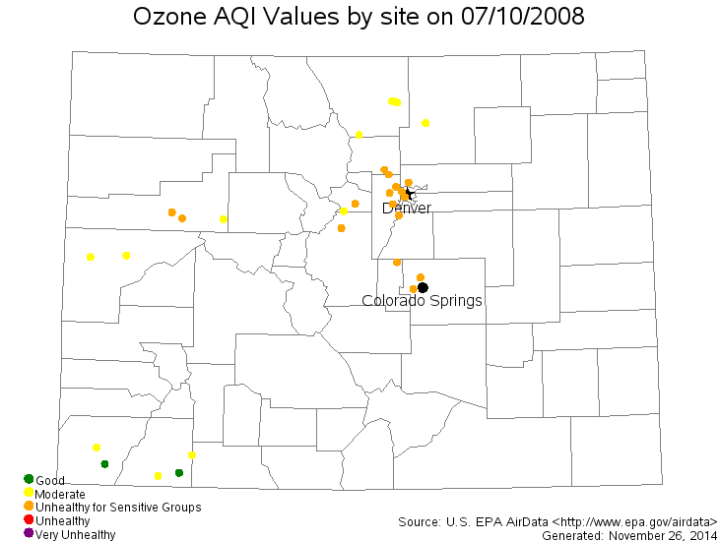
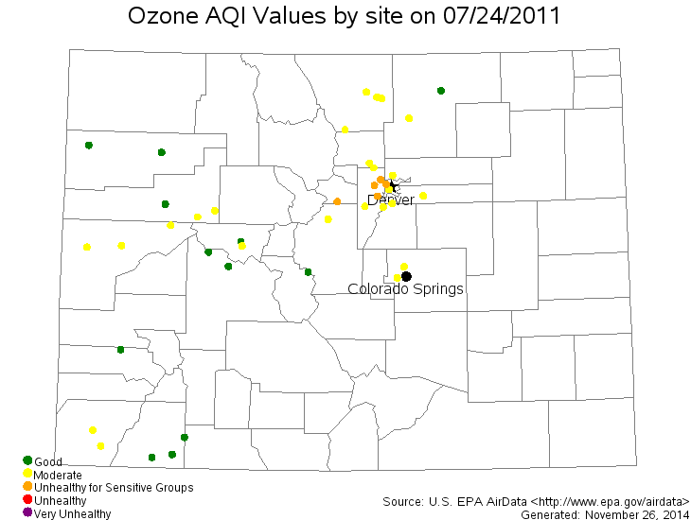

Slide 27
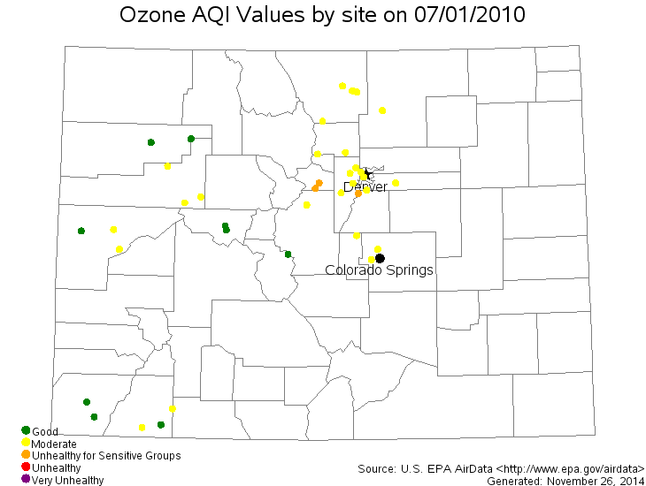
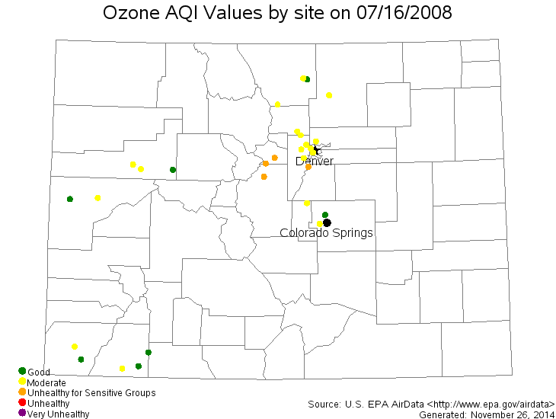

Slide 28
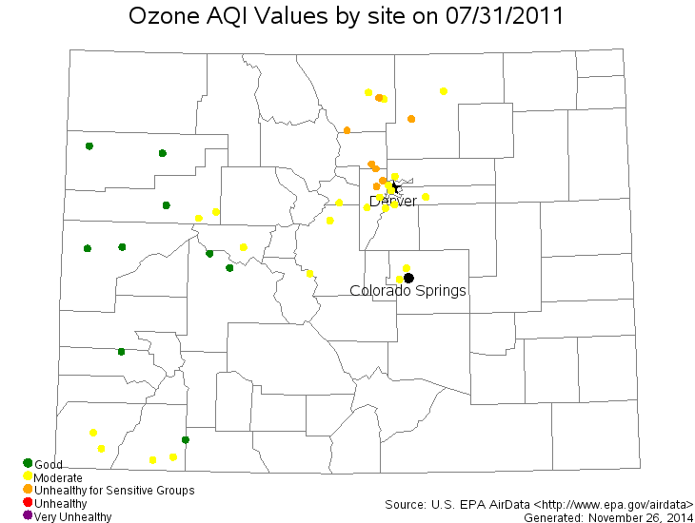
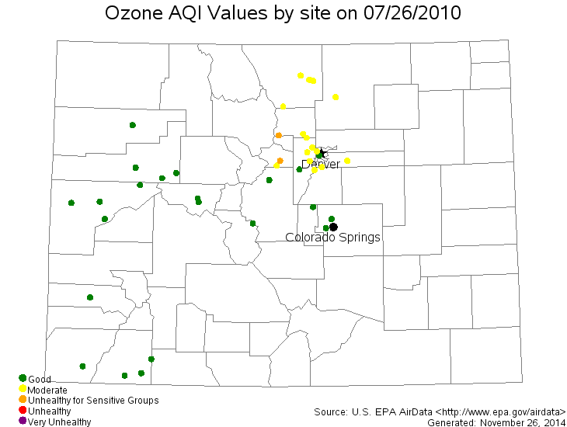

Slide 29
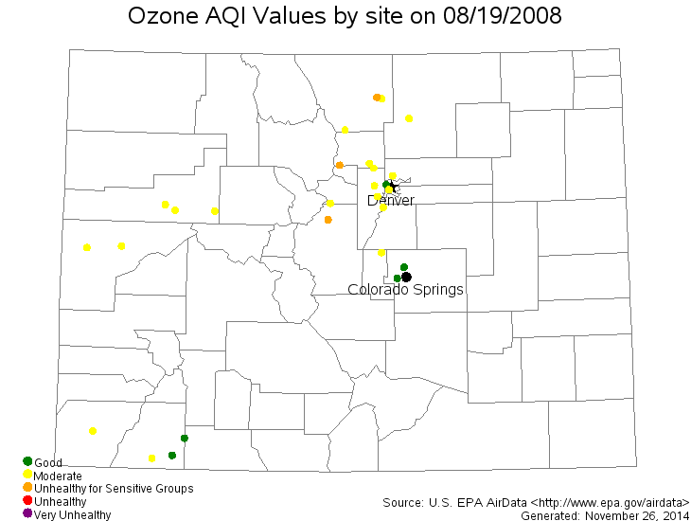
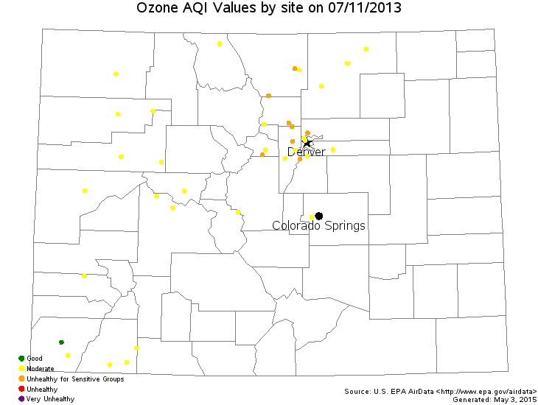

Slide 30

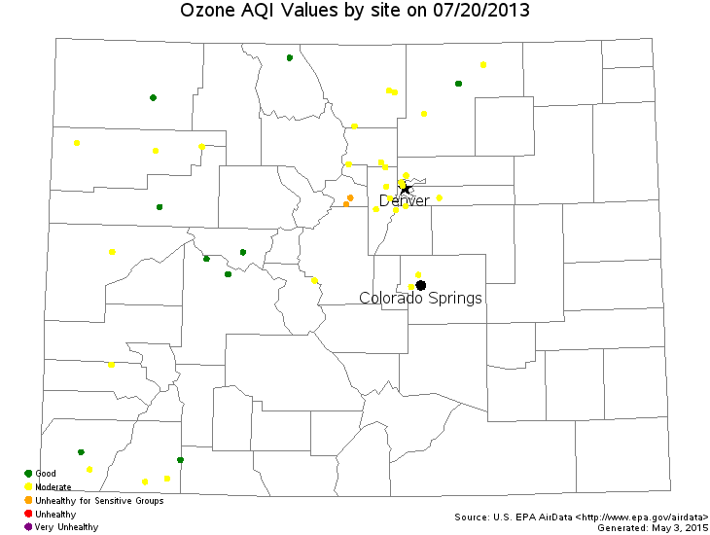

Slide 31
