Slide 1
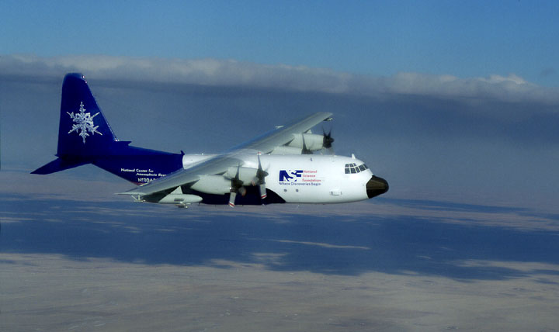
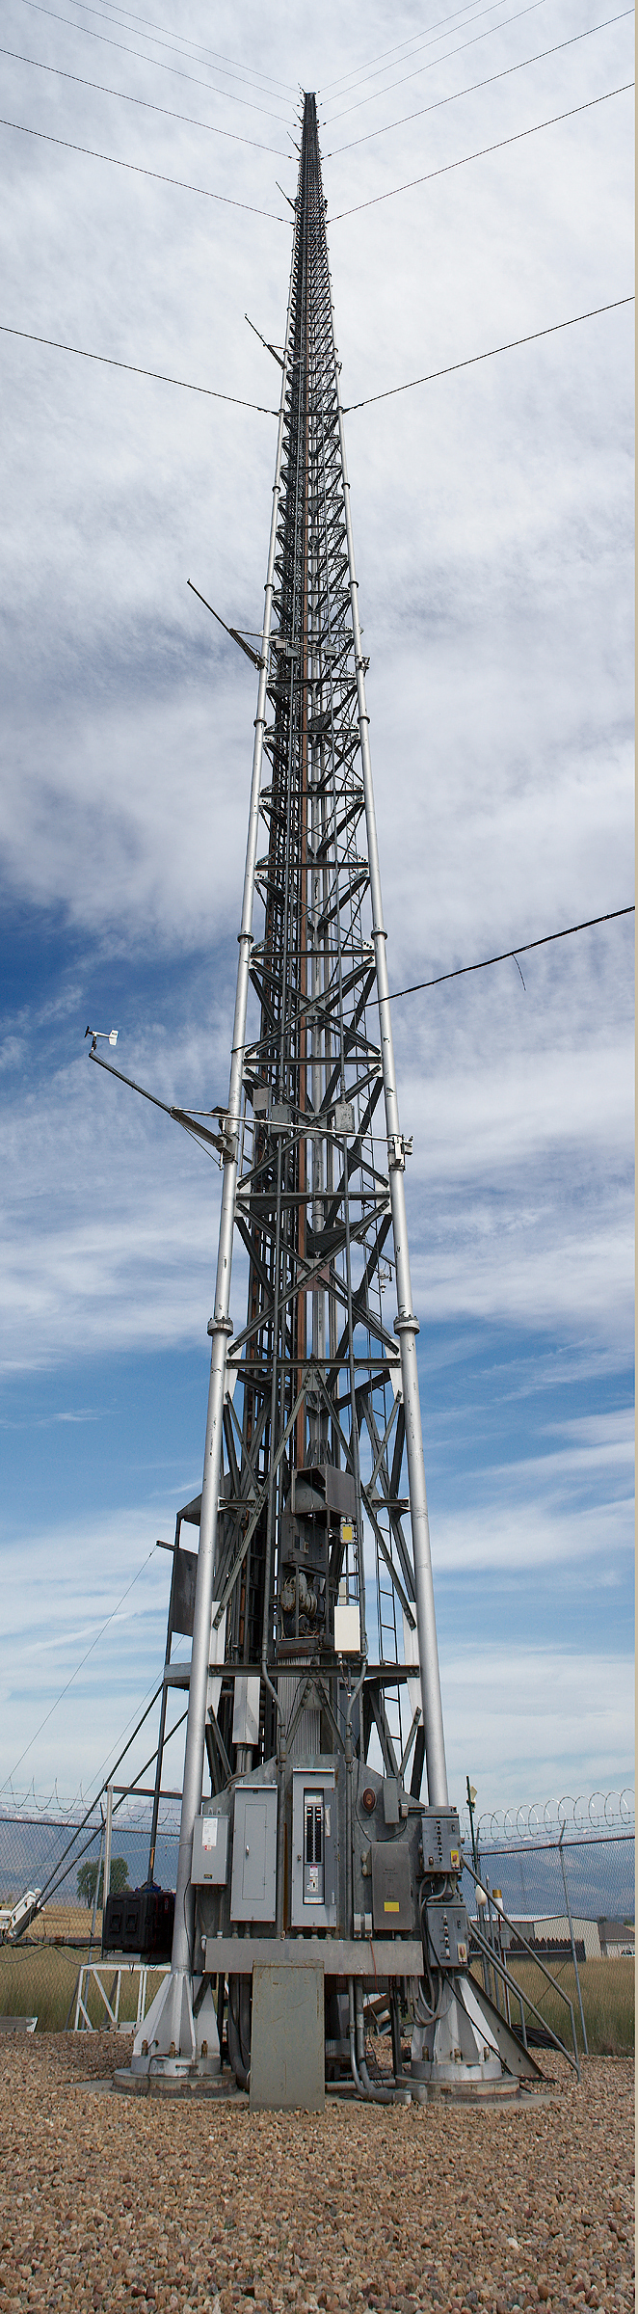
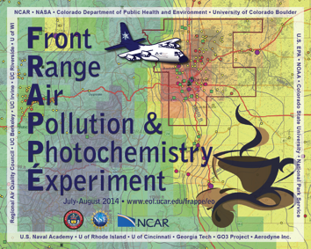
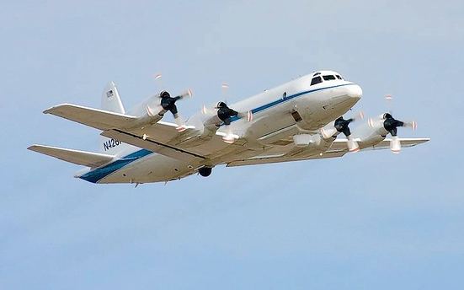
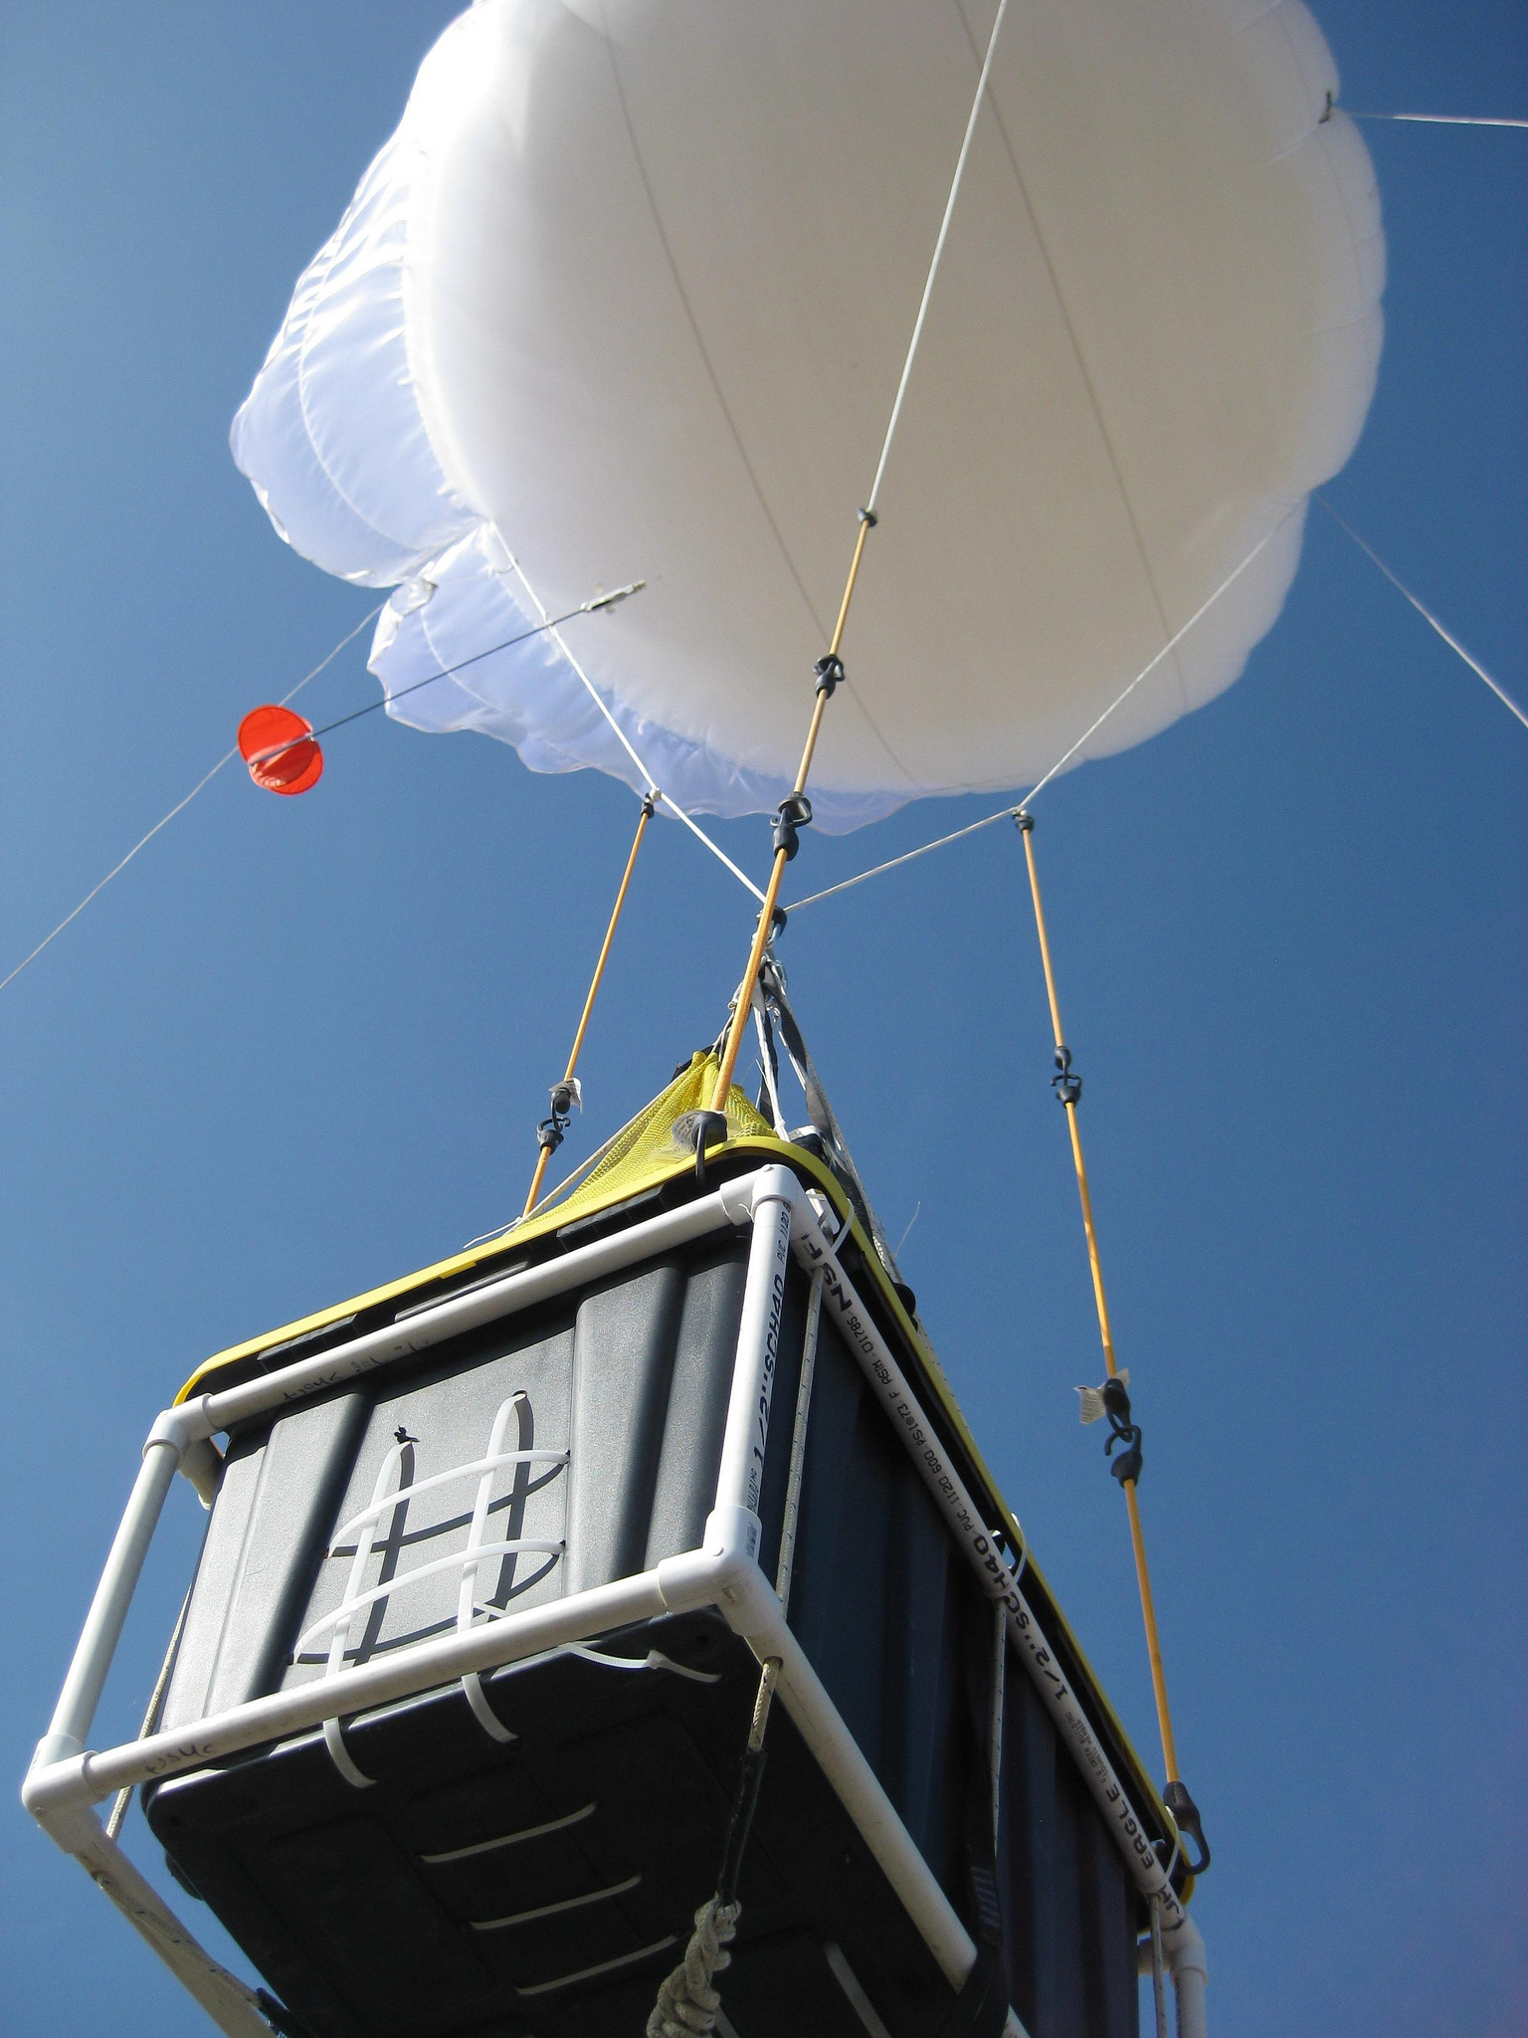
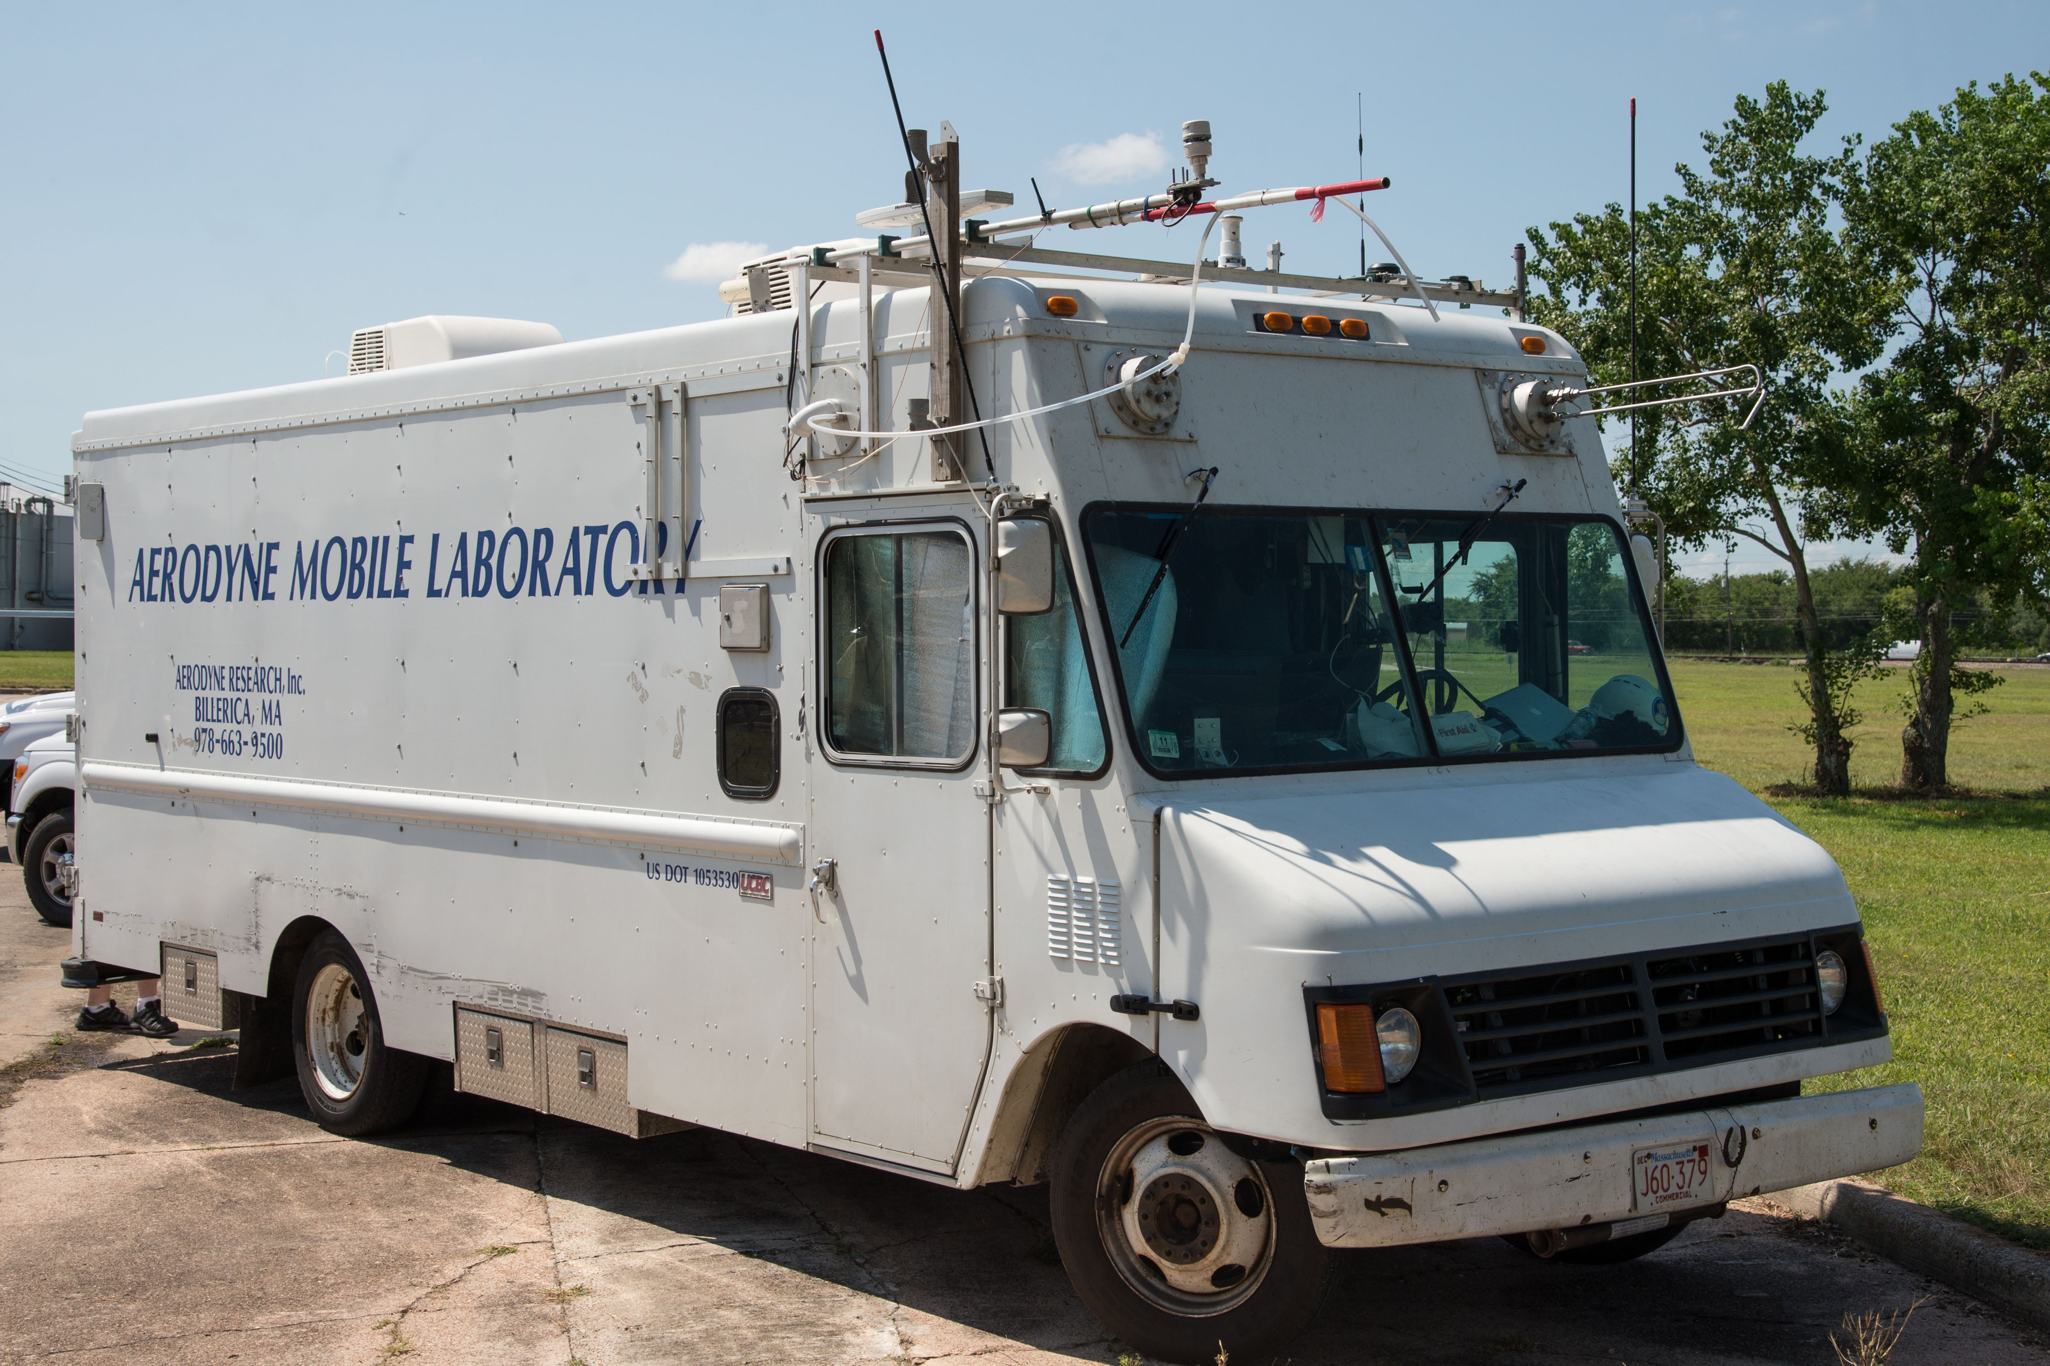

MEASUREMENTS

Slide 3
Surface Monitors

Slide 4
Surface Monitors

Slide 5
Surface Monitors

Slide 6
Mobile Units

Slide 7
Mobile Units

Slide 8
Mobile Units

Slide 9
Mobile Units

Slide 10
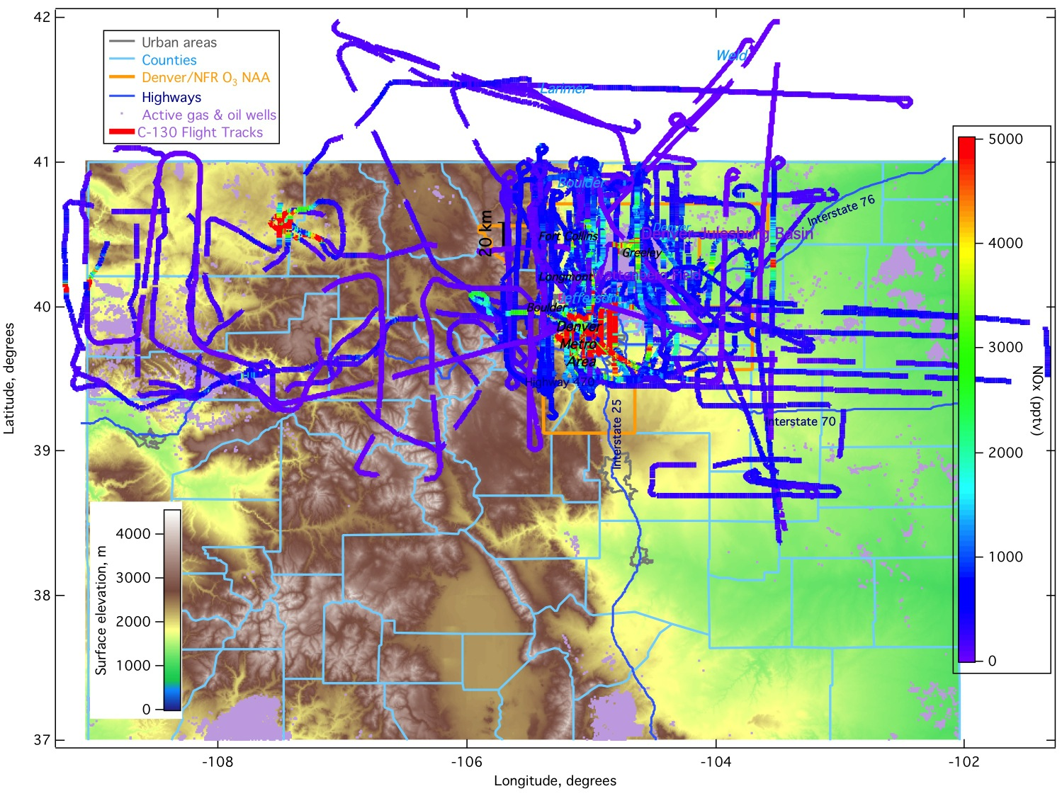
C-130 NO_{x}

Slide 13
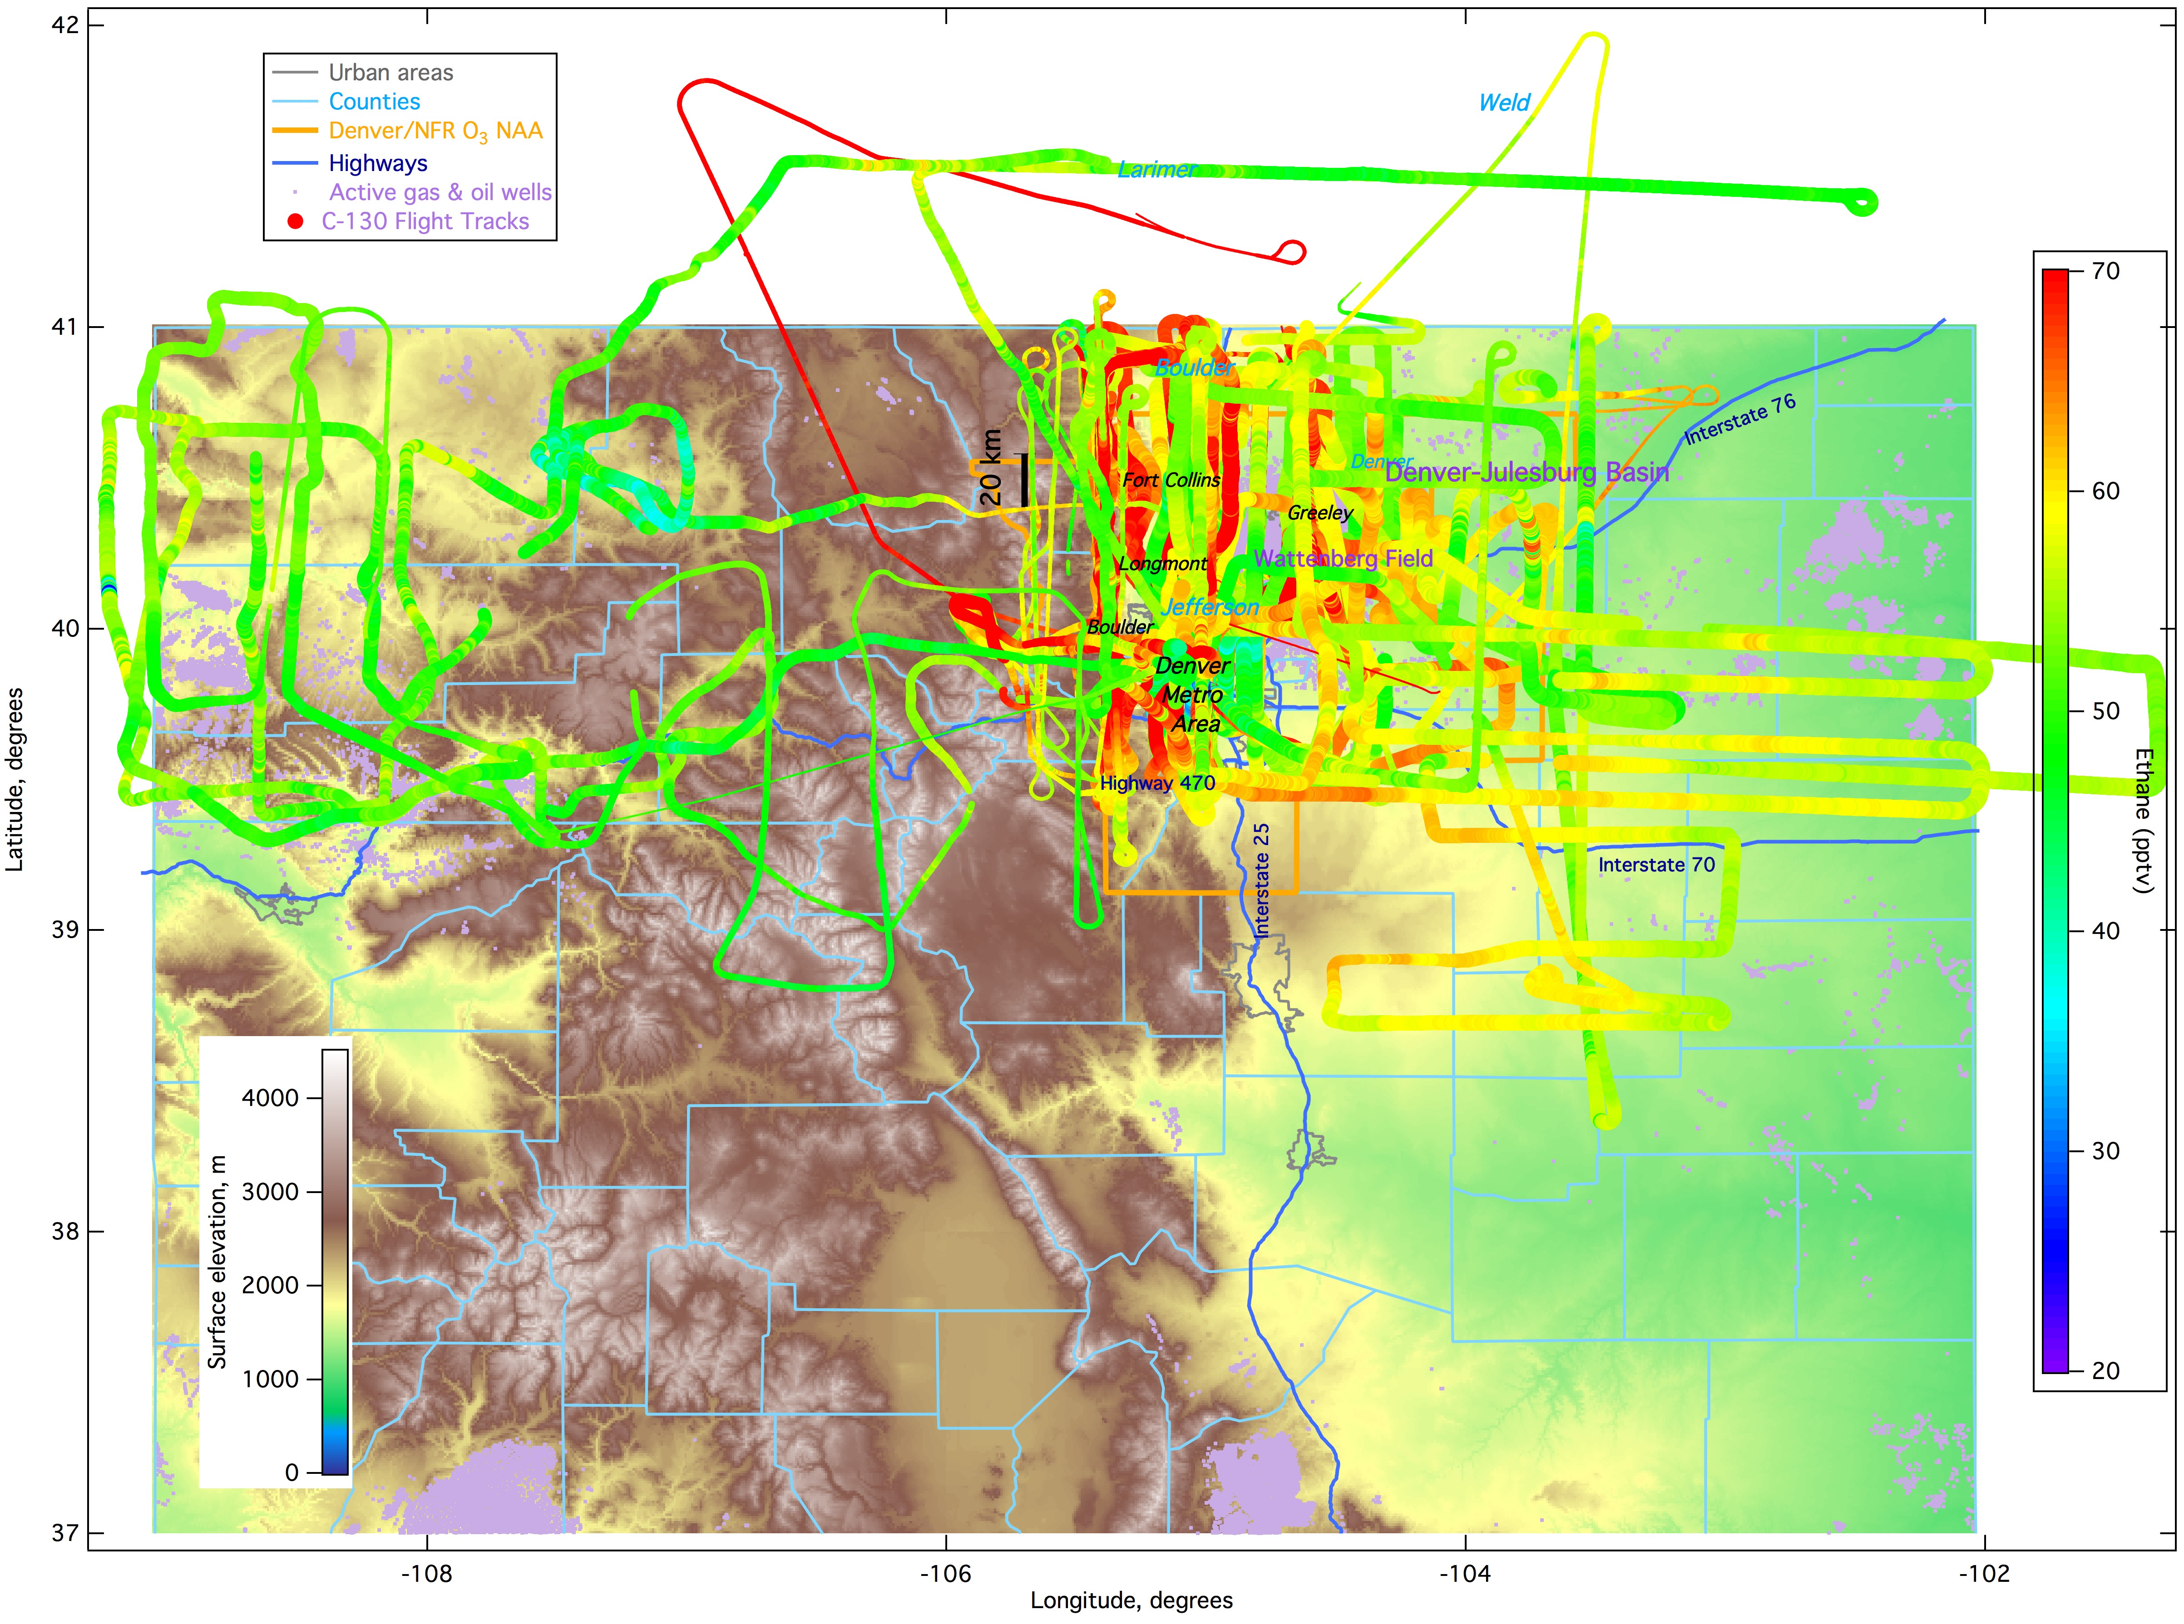

Slide 14
FRAPPÉ Flight Objectives
Date | Objective
0726 (RF01) | Front Range Emissions
0727 (RF02) | Front Range Emissions & Denver Cyclone
0728 (RF03) | Front Range Emissions & Denver Cyclone & Transport to NW out of Fort Collins
0729 (RF04) | Large scale pollution over NW Colorado and S WY & Jay’s CAFO & Pawnee PP
0731 (RF05) | Mountain-Valley (not well developed)
0802 (RF06) | Mountain-Valley
0803 (RF07) | Mountain-Valley
0806 (RF08) | Piceance and Uintah Basin & Hayden and Craig PP
0807 (RF09) | Front Range Emissions
0808 (RF10) | P-3 Intercomparison & Platte River Valley Flow
0811 (RF11) | Mountain-Valley
0812 (RF12) | Mountain-Valley
0815 (RF13) | Inflow from WY (not found) & Hayden, Craig, Ute PP, Rifle OG & SE outflow
0816 (RF14) | SE Outflow & TES Overpass – 2 spirals
0817 (RF15) | Front Range Emissions & Piceance Basin Emission to Front Range & Upslope

Slide 15
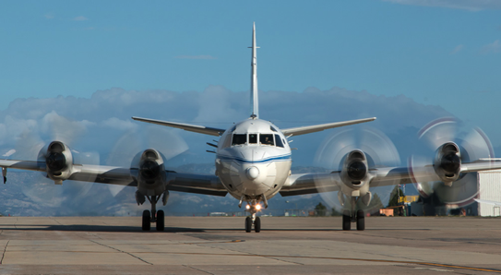
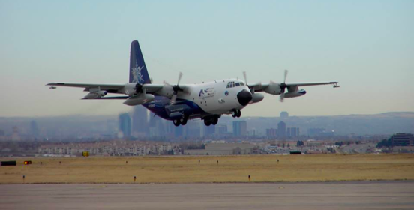
NASA P3
15 Flights
NASA B200
16 Flights
FRAPPÉ and
DISCOVER-AQ Flights
NASA Falcon
10 Flights
NCAR C130
17 Flights (2TF)
NASA Aircraft pictures by Paul Filmer, NCAR C130 picture by Sam Hall

Slide 16
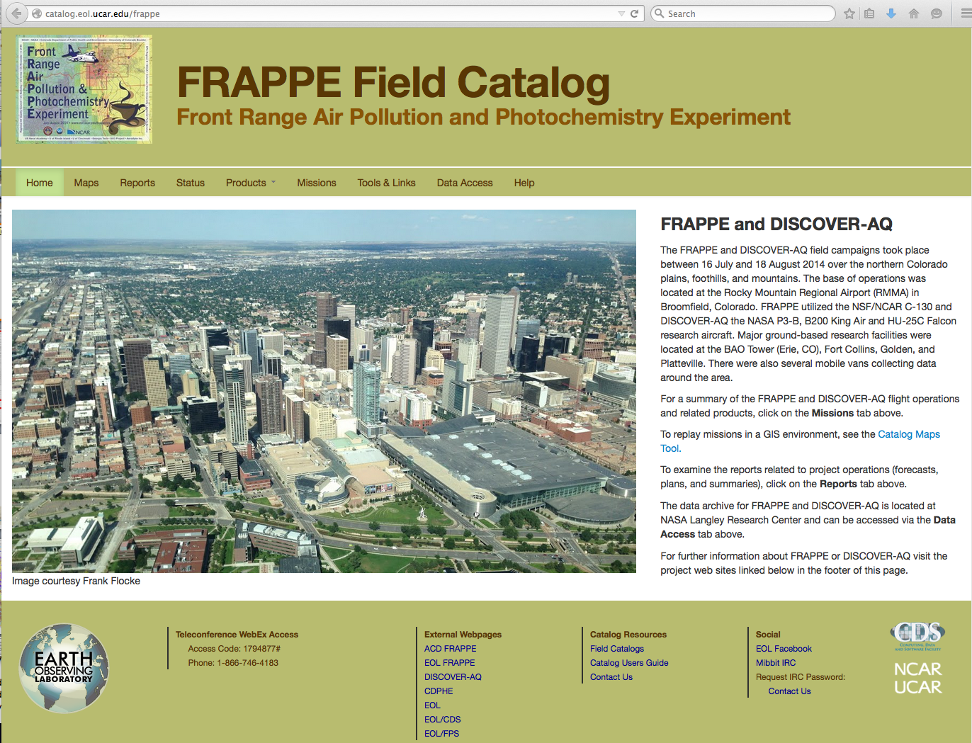
FRAPPÉ Field Catalog
Field Campaign Guidance and Archive

Slide 17
http://catalog.eol.ucar.edu/maps/frappe

