Slide 1


Sources and Processes Affecting the Chemical and Physical Properties of Denver Aerosol during DISCOVER-AQ
FRAPPÉ/DISCOVER-AQ Science Team Meeting
4 May 2015
Christopher J. Hennigan
University of Maryland, Baltimore County

Slide 2
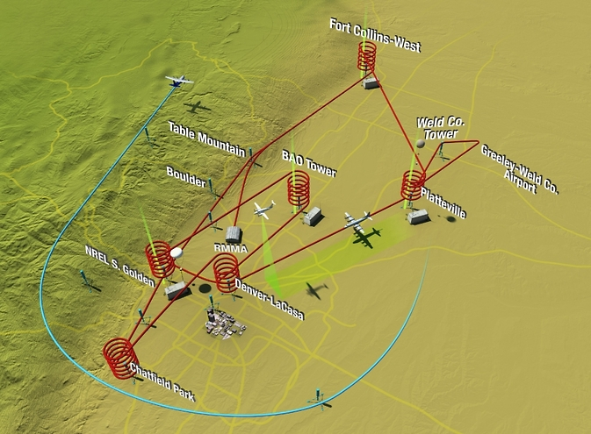
DISCOVER-AQ Colorado 2014
Image from NASA

Slide 3
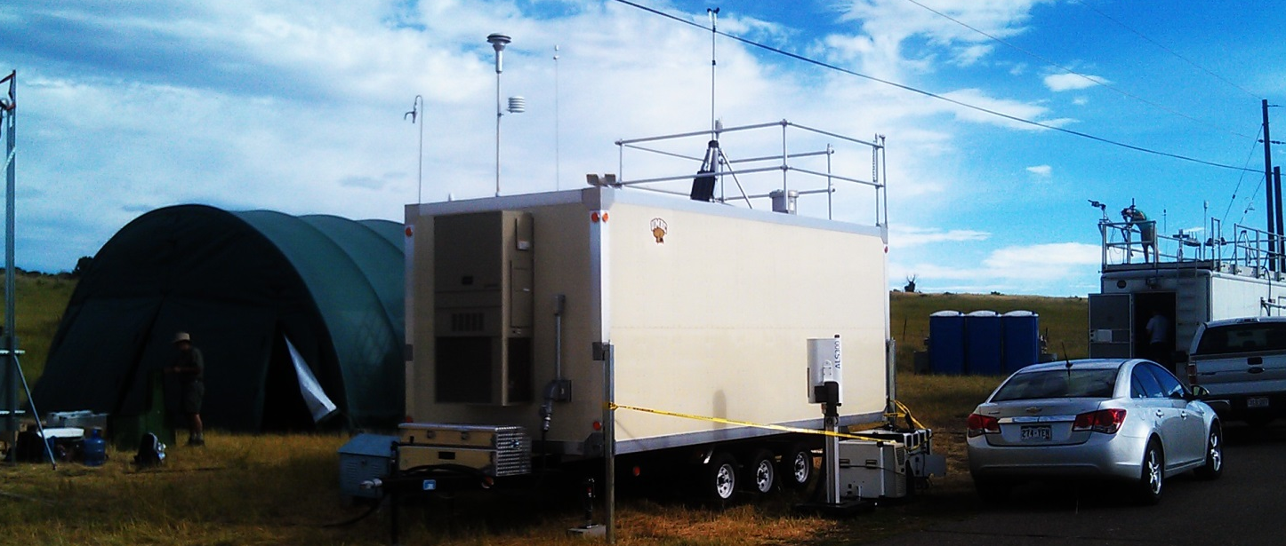
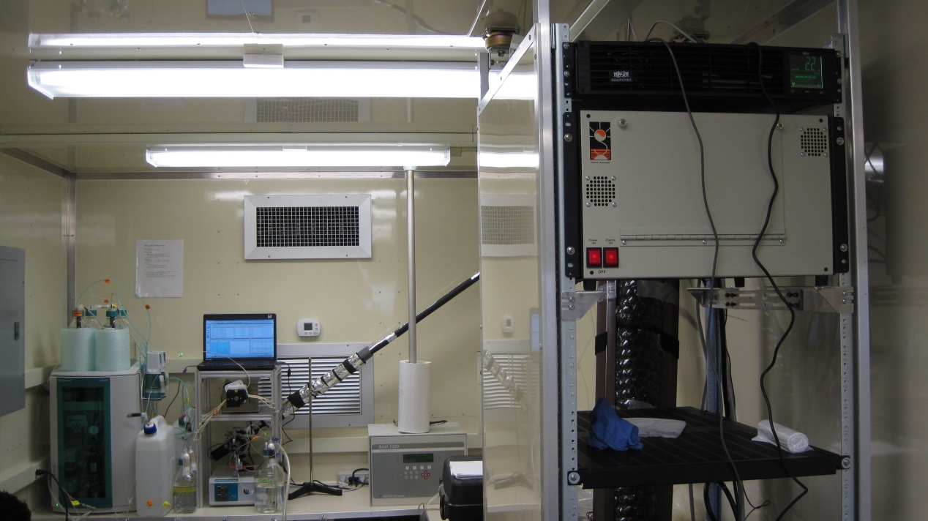
UMBC Measurement Approach
PM_{2.5} Organic Carbon (OC)
Elemental Carbon (EC)
Sunset Labs OCEC Field Analyzer
Time resolution: 30-min sample every 45 min
PM_{2.5} Inorganic Composition:
(Na⁺, NH₄⁺, K⁺, Ca²⁺, Mg²⁺, Cl⁻, NO₃⁻, SO₄²⁻)
Particle-into-Liquid Sampler with dual Ion Chromatographs (PILS-IC)
Time resolution: 20-min samples

Slide 4
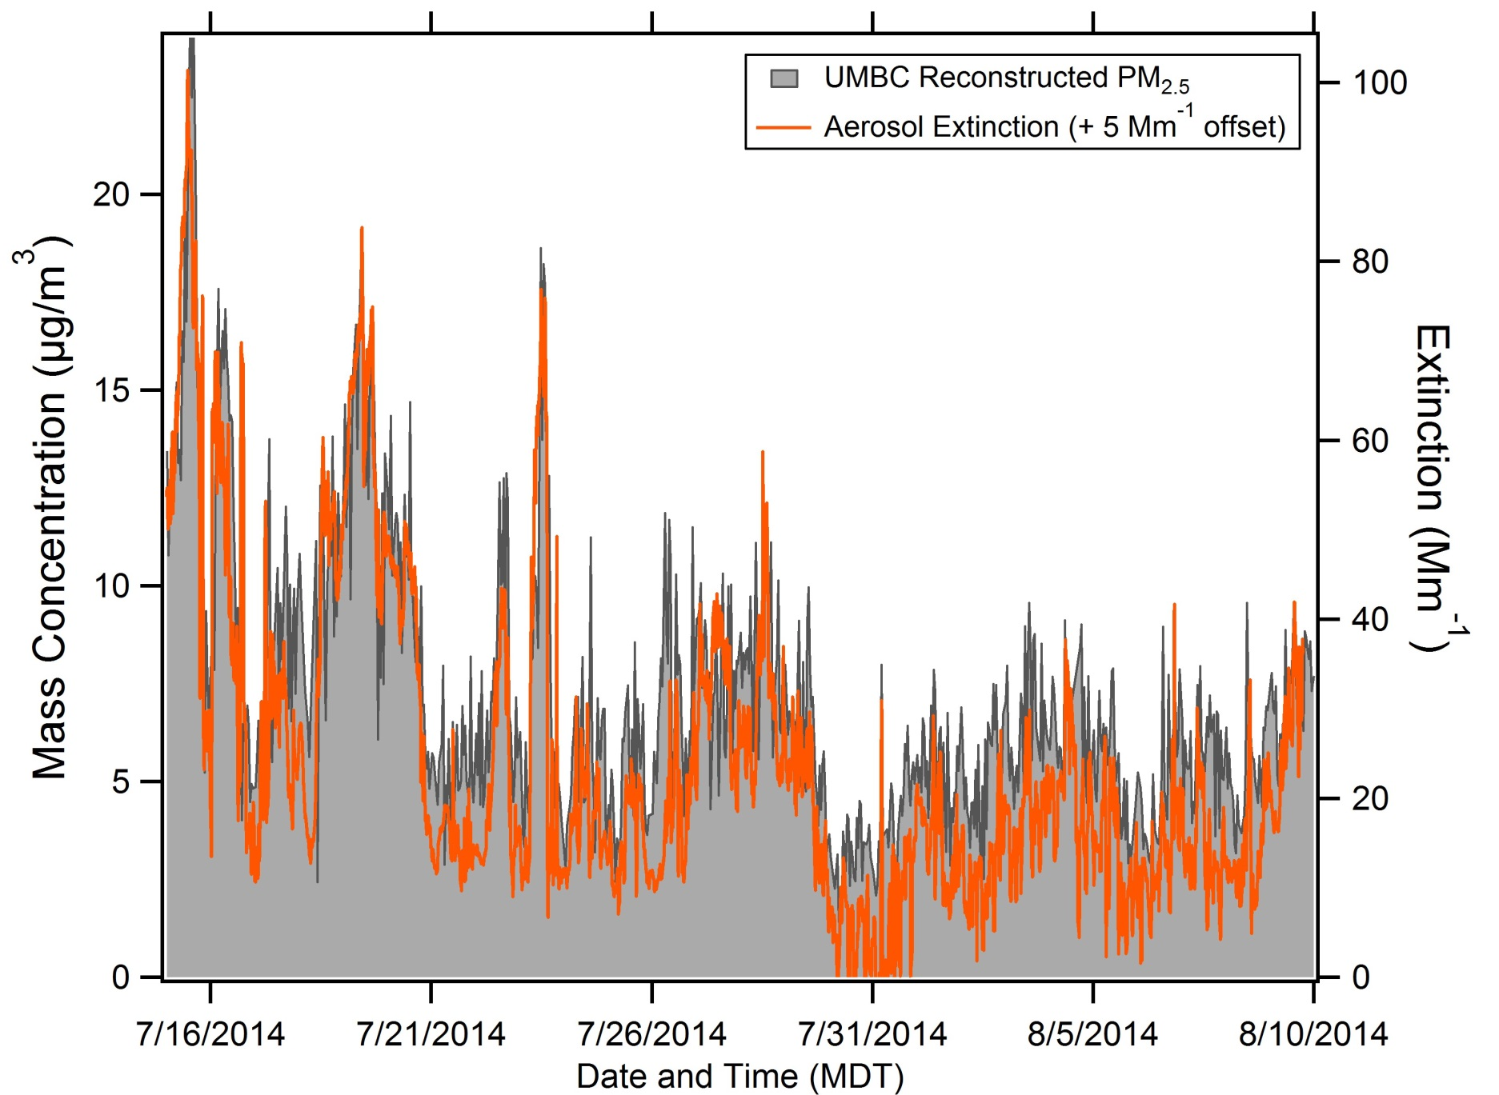
UMBC PM_{2.5} - Comprehensive
NREL-Golden ground site

Slide 5
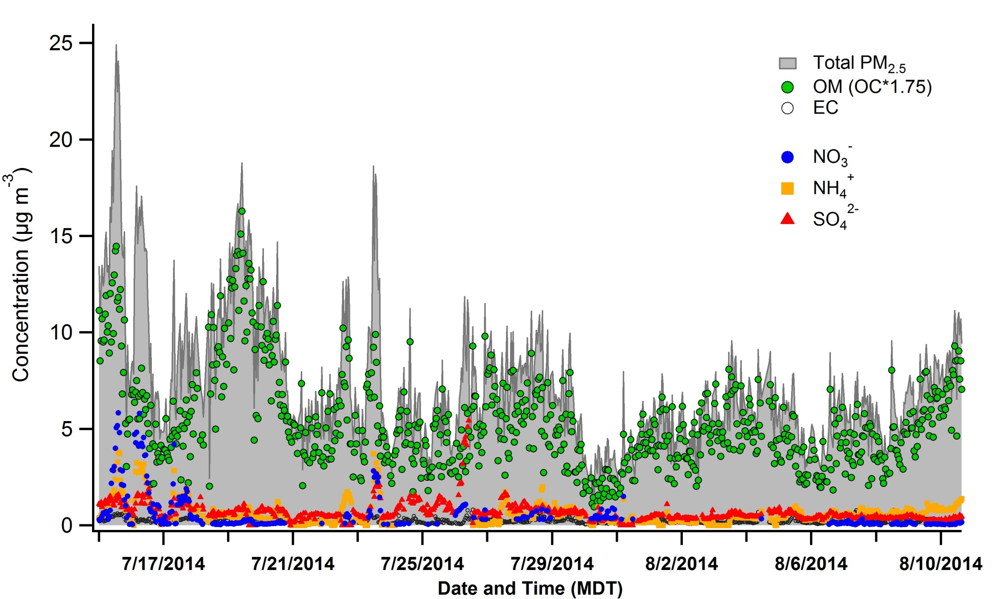
DISCOVER-AQ: Aerosol Concentrations
Predominance of organic aerosol species (Average = 75% of fine aerosol mass)

Slide 6
Primary vs. Secondary OC in Denver

Slide 7
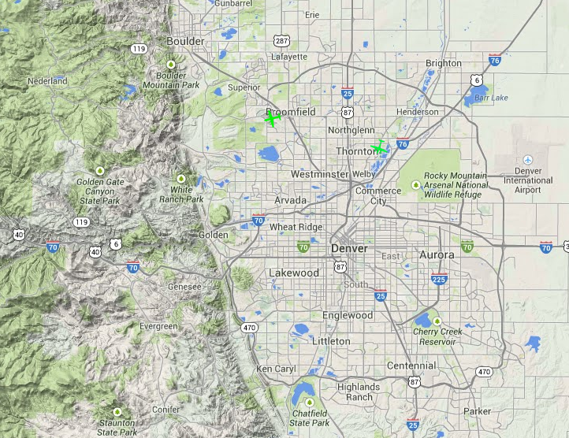
Topography of Denver
Image from NASA

Slide 8
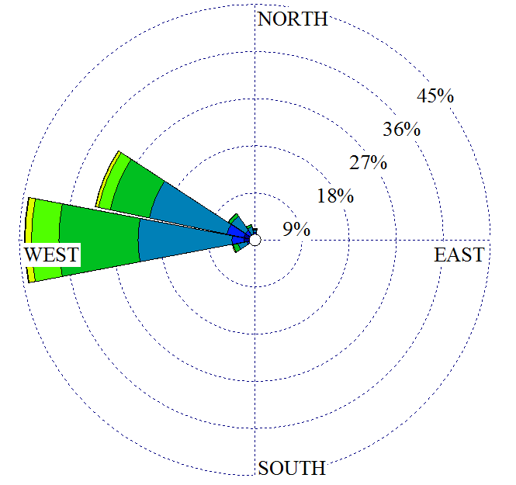
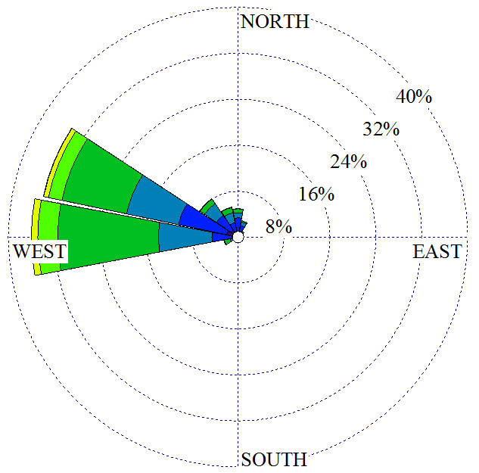
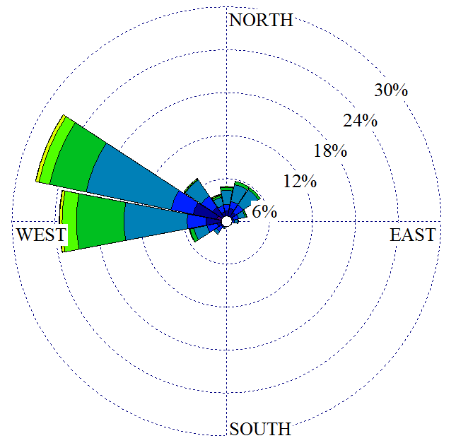
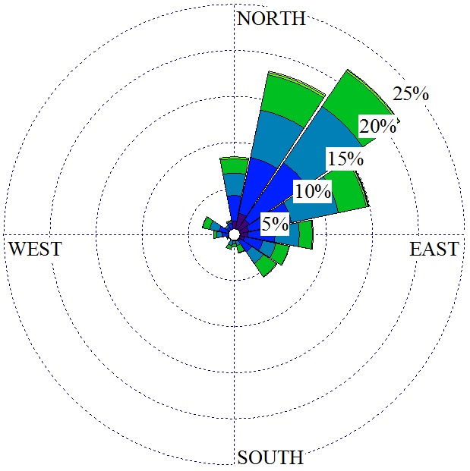
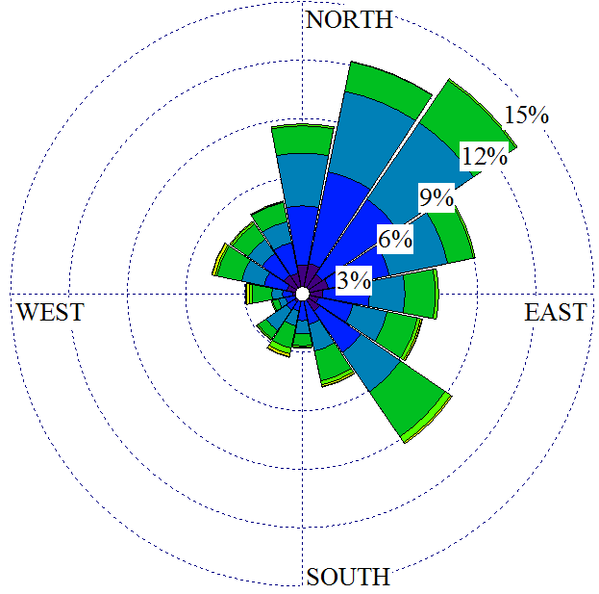
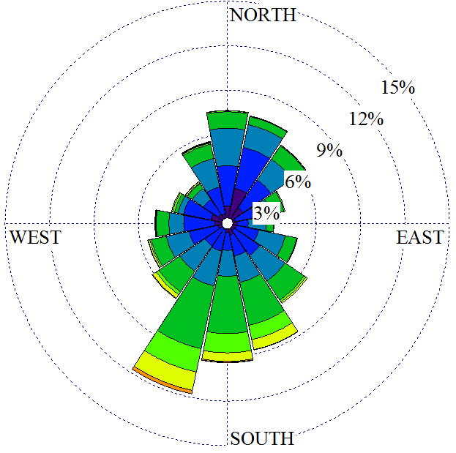
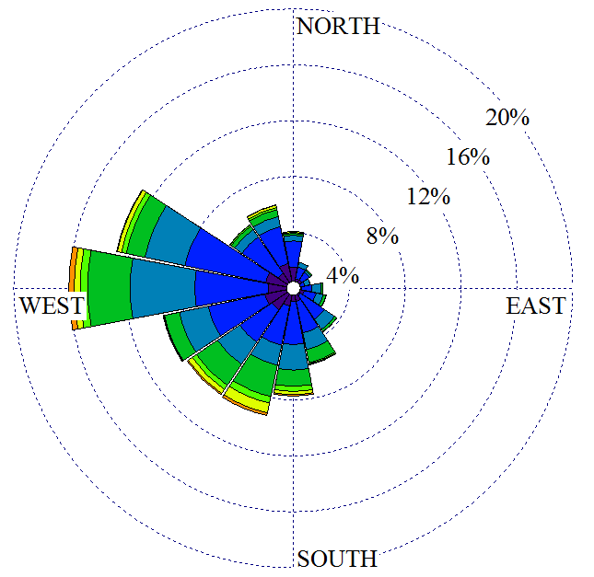
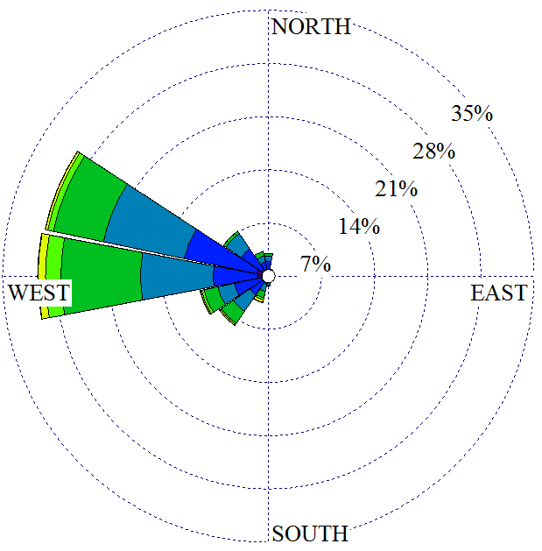

0:00 to 3:00
3:00 to 6:00
6:00 to 9:00
9:00 to 12:00
12:00 to 15:00
15:00 to 18:00
18:00 to 21:00
21:00 to 00:00
NREL-Golden
Diurnal wind profile (local Time)
> 10
8.5
7.0
5.5
3.9
2.4
1.9
1.4
< 1.4
Wind Speed (m/s)

Slide 9
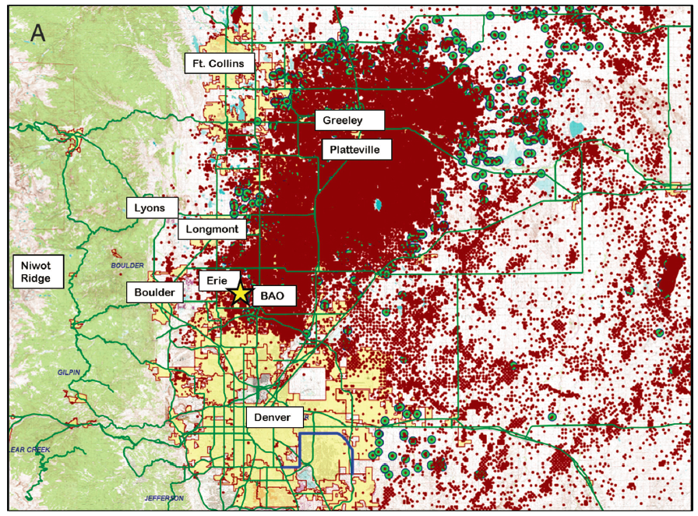

Local vs. Regional Sources
· Red dot: active oil/gas well
WD: 09:00-15:00 local
WD: 18:00-09:00 local
(Thompson et al., Elementa, 2014)

Slide 10
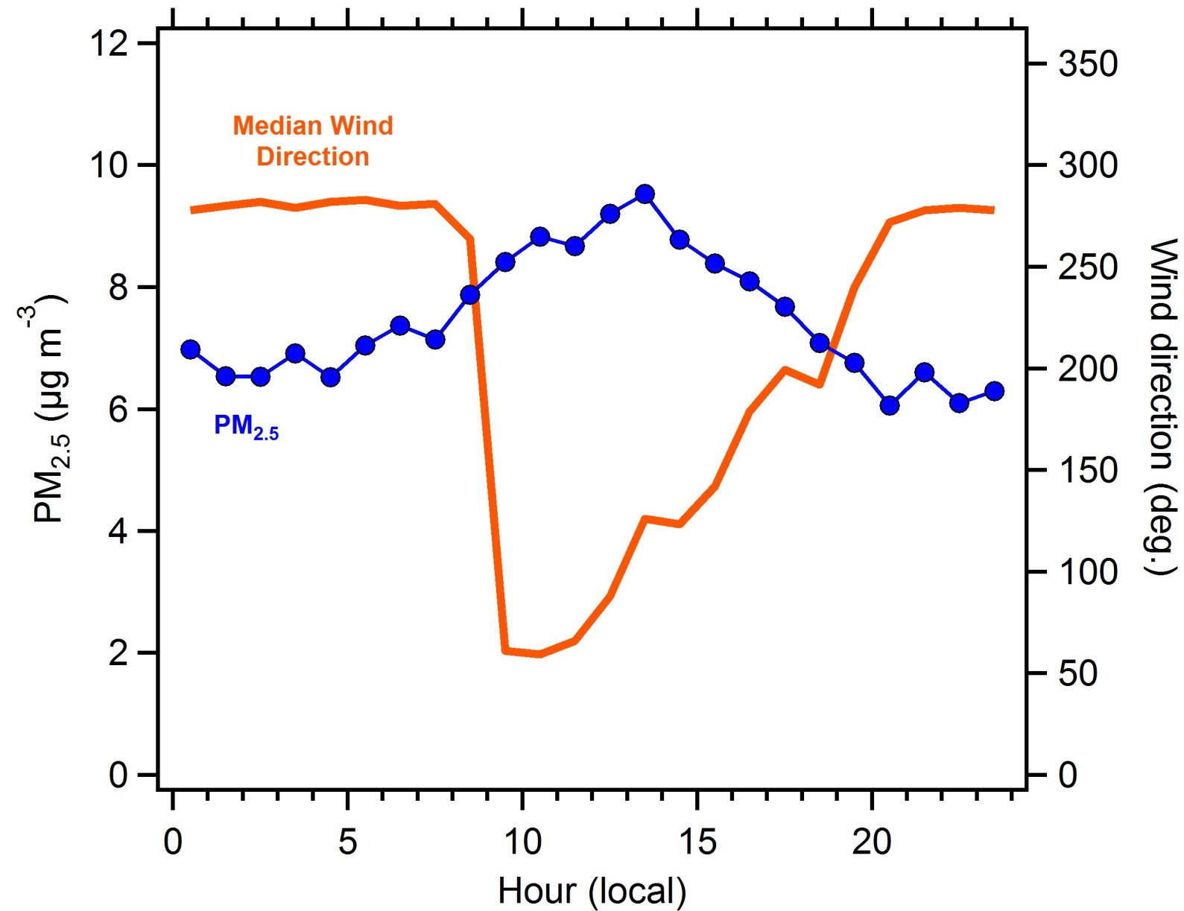
Golden: Local vs. Regional Sources
NREL-Golden UMBC measurements
~2.5 µg m⁻³ increase in PM_{2.5} (northeast source)
~30% of Denver’s summertime PM_{2.5} appears to be from ‘local’ sources

Slide 11
Golden: Local vs. Regional Sources
NREL-Golden UMBC measurements
Increase in PM_{2.5}:
OM: +1.25 µg m⁻³ (x 1.25 increase)
NH₄NO₃: +1.0 µg m⁻³ (x 3 increase)
SO₄²⁻: +0.15 µg m⁻³ (x 1.25 increase)
EC: +0.1 µg m⁻³ (x 2 increase)

Slide 12
Local Sources: Transport vs. Chemistry
NREL-Golden UMBC measurements

Slide 13
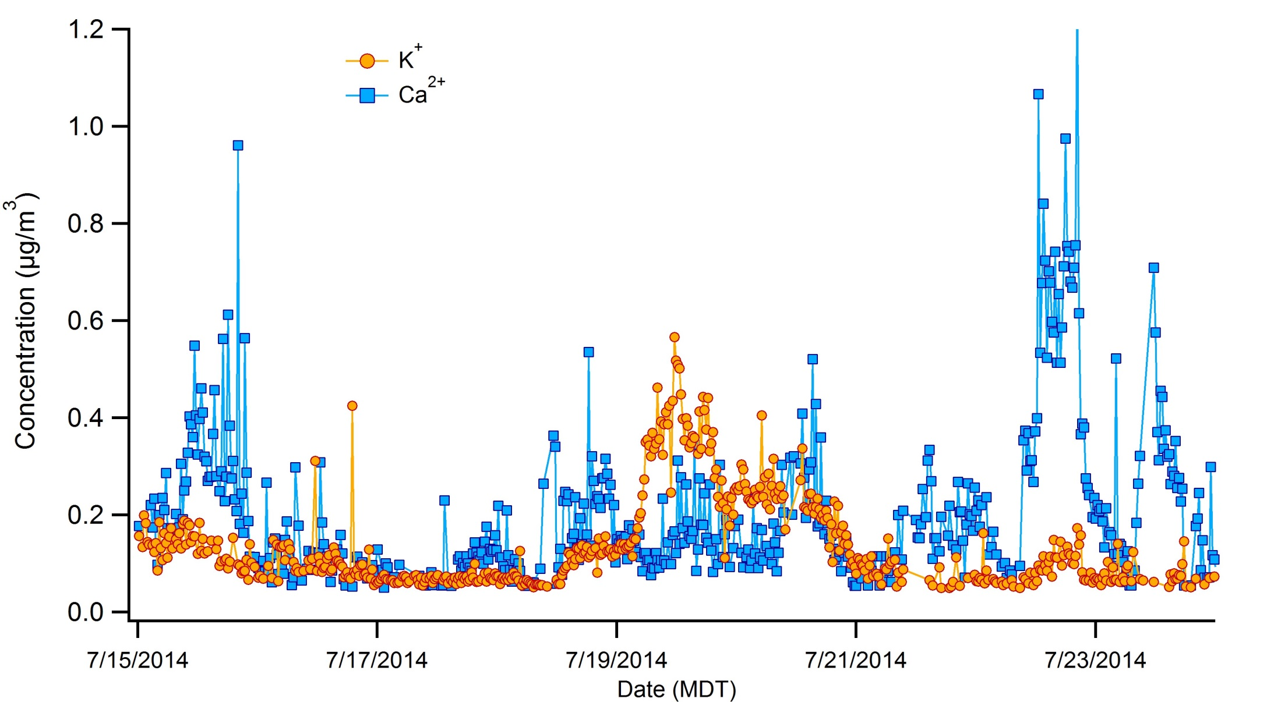
DISCOVER-AQ: Dust and Fire Impacts
Only major fire impact at NREL-Golden appears to be 18-20 July 2014
P-3 and C-130 flights on 20140720

Slide 14
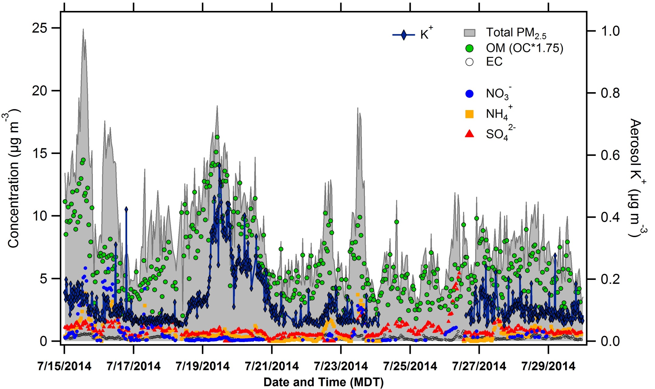
DISCOVER-AQ: Dust and Fire Impacts
Highest OC concentrations measured at NREL-Golden corresponded to K⁺ events

Slide 15
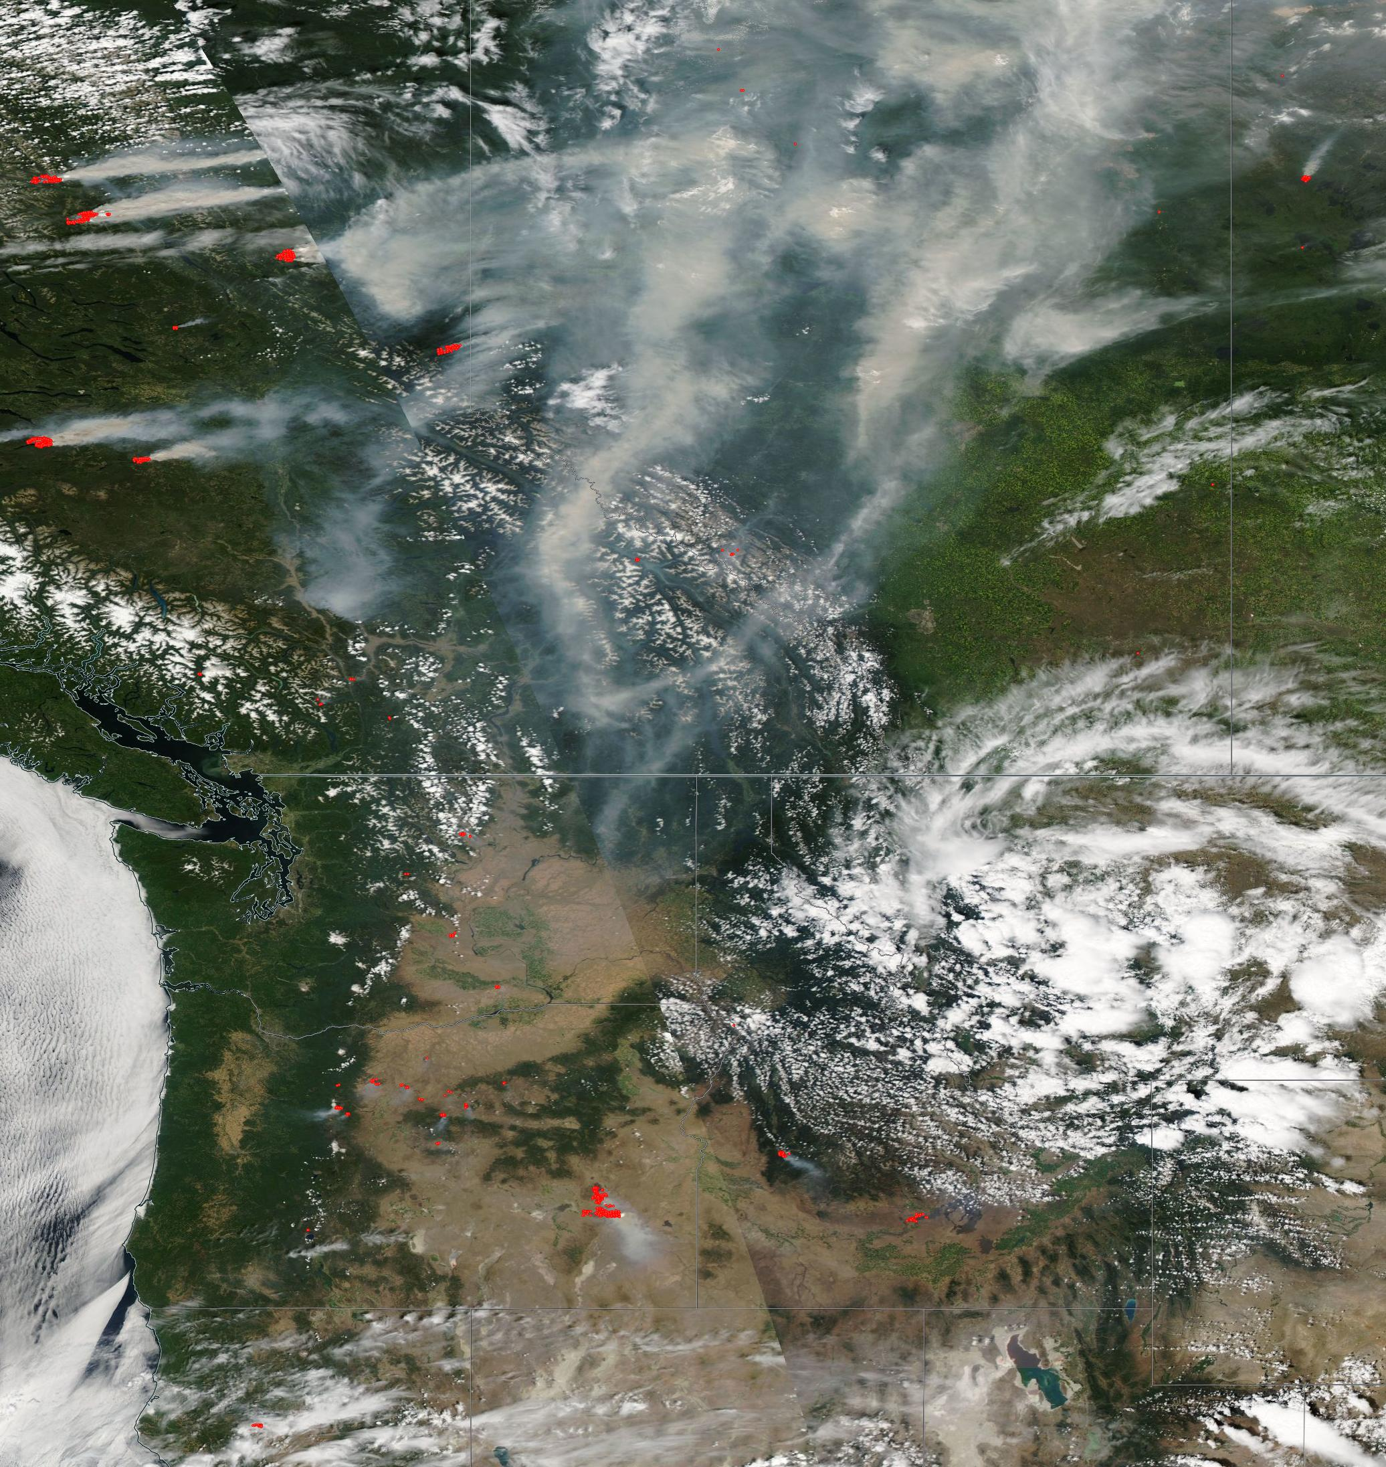
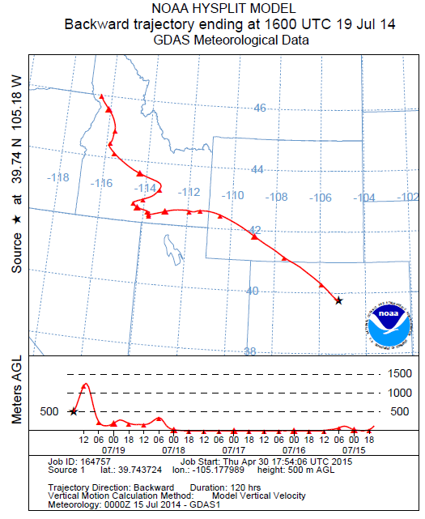
DISCOVER-AQ: Dust and Fire Impacts
5-day back trajectory
Fire and Thermal Anomalies 15 July 2014
Terra and Aqua/MODIS

Slide 16
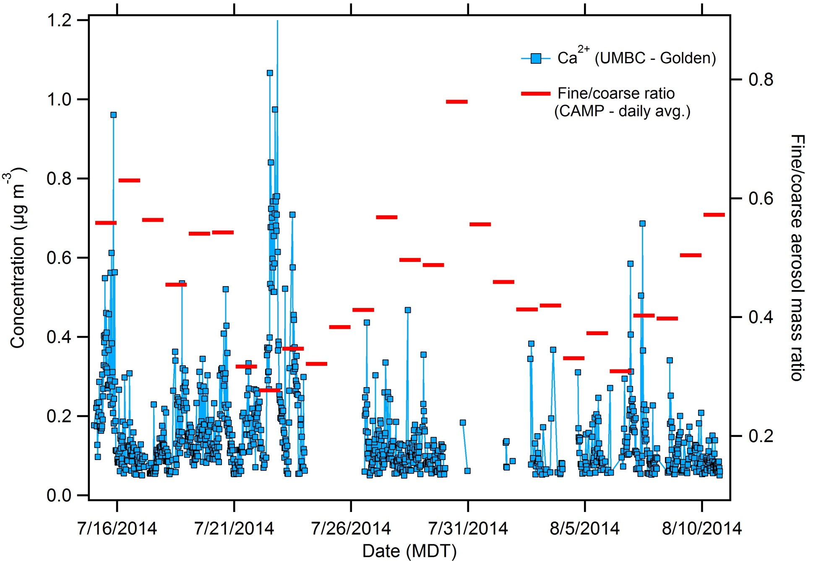
DISCOVER-AQ: Dust and Fire Impacts

Slide 17
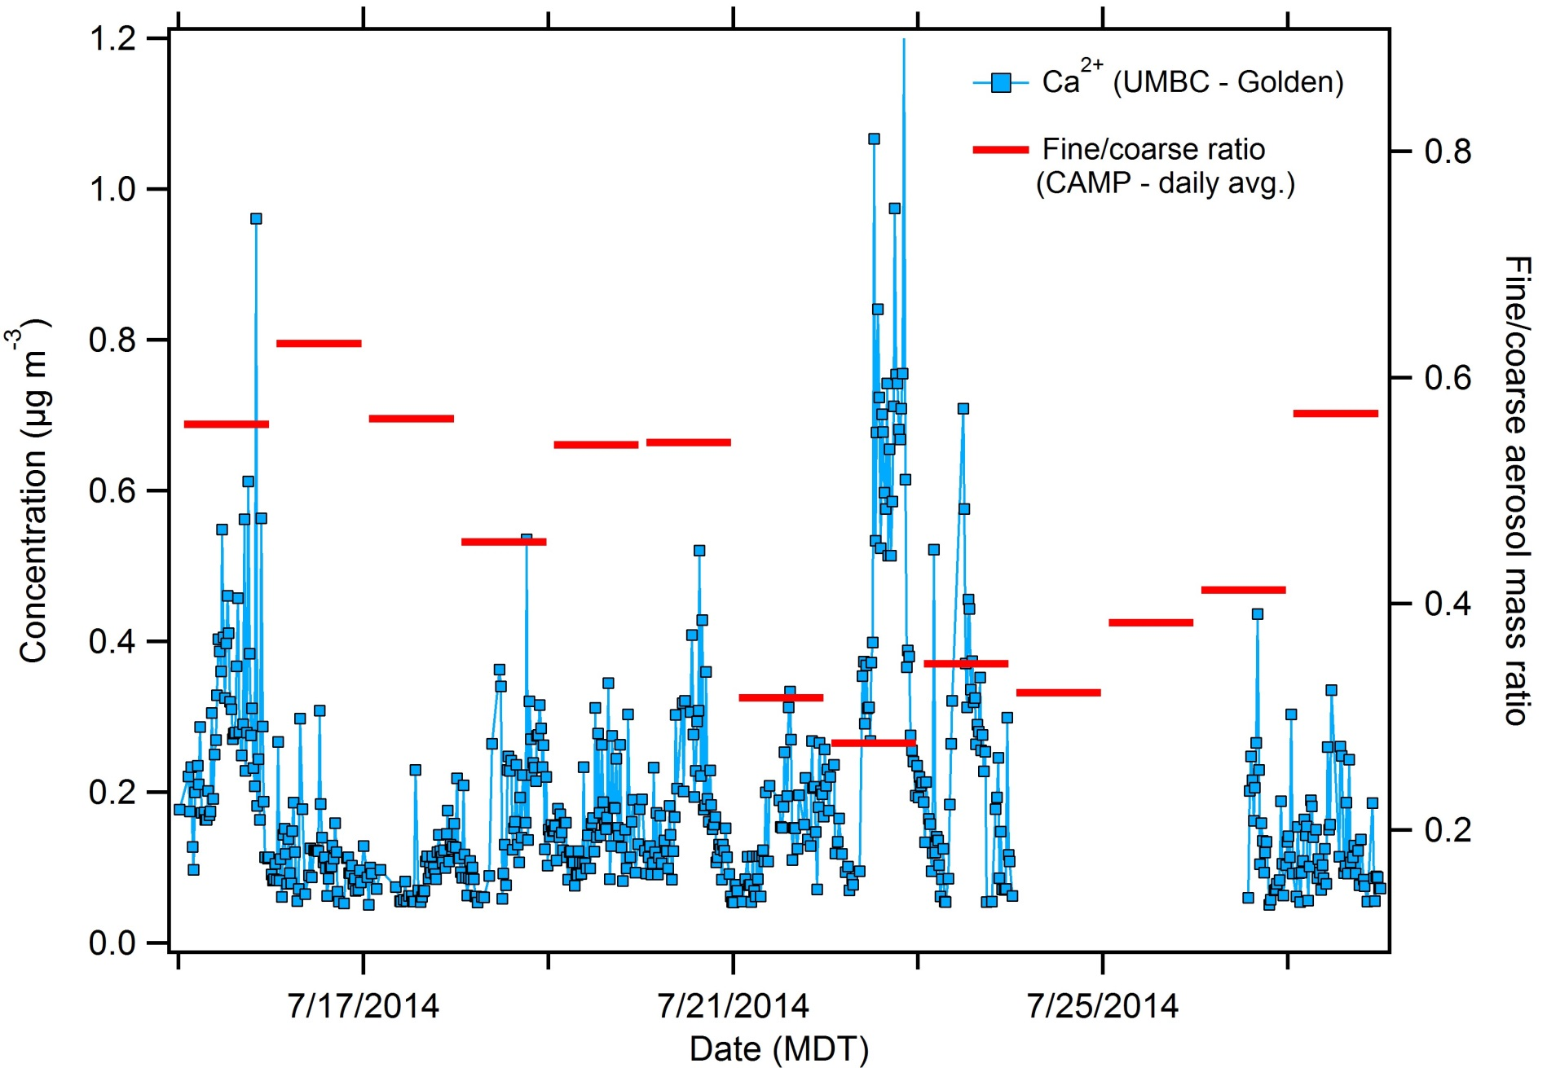
DISCOVER-AQ: Dust and Fire Impacts
Major dust impacts at NREL-Golden appear to be: 21-23 July 2014
P-3 and C-130 flights on 20140722 and 20140723

Slide 18
Aerosol Light Extinction

Slide 19
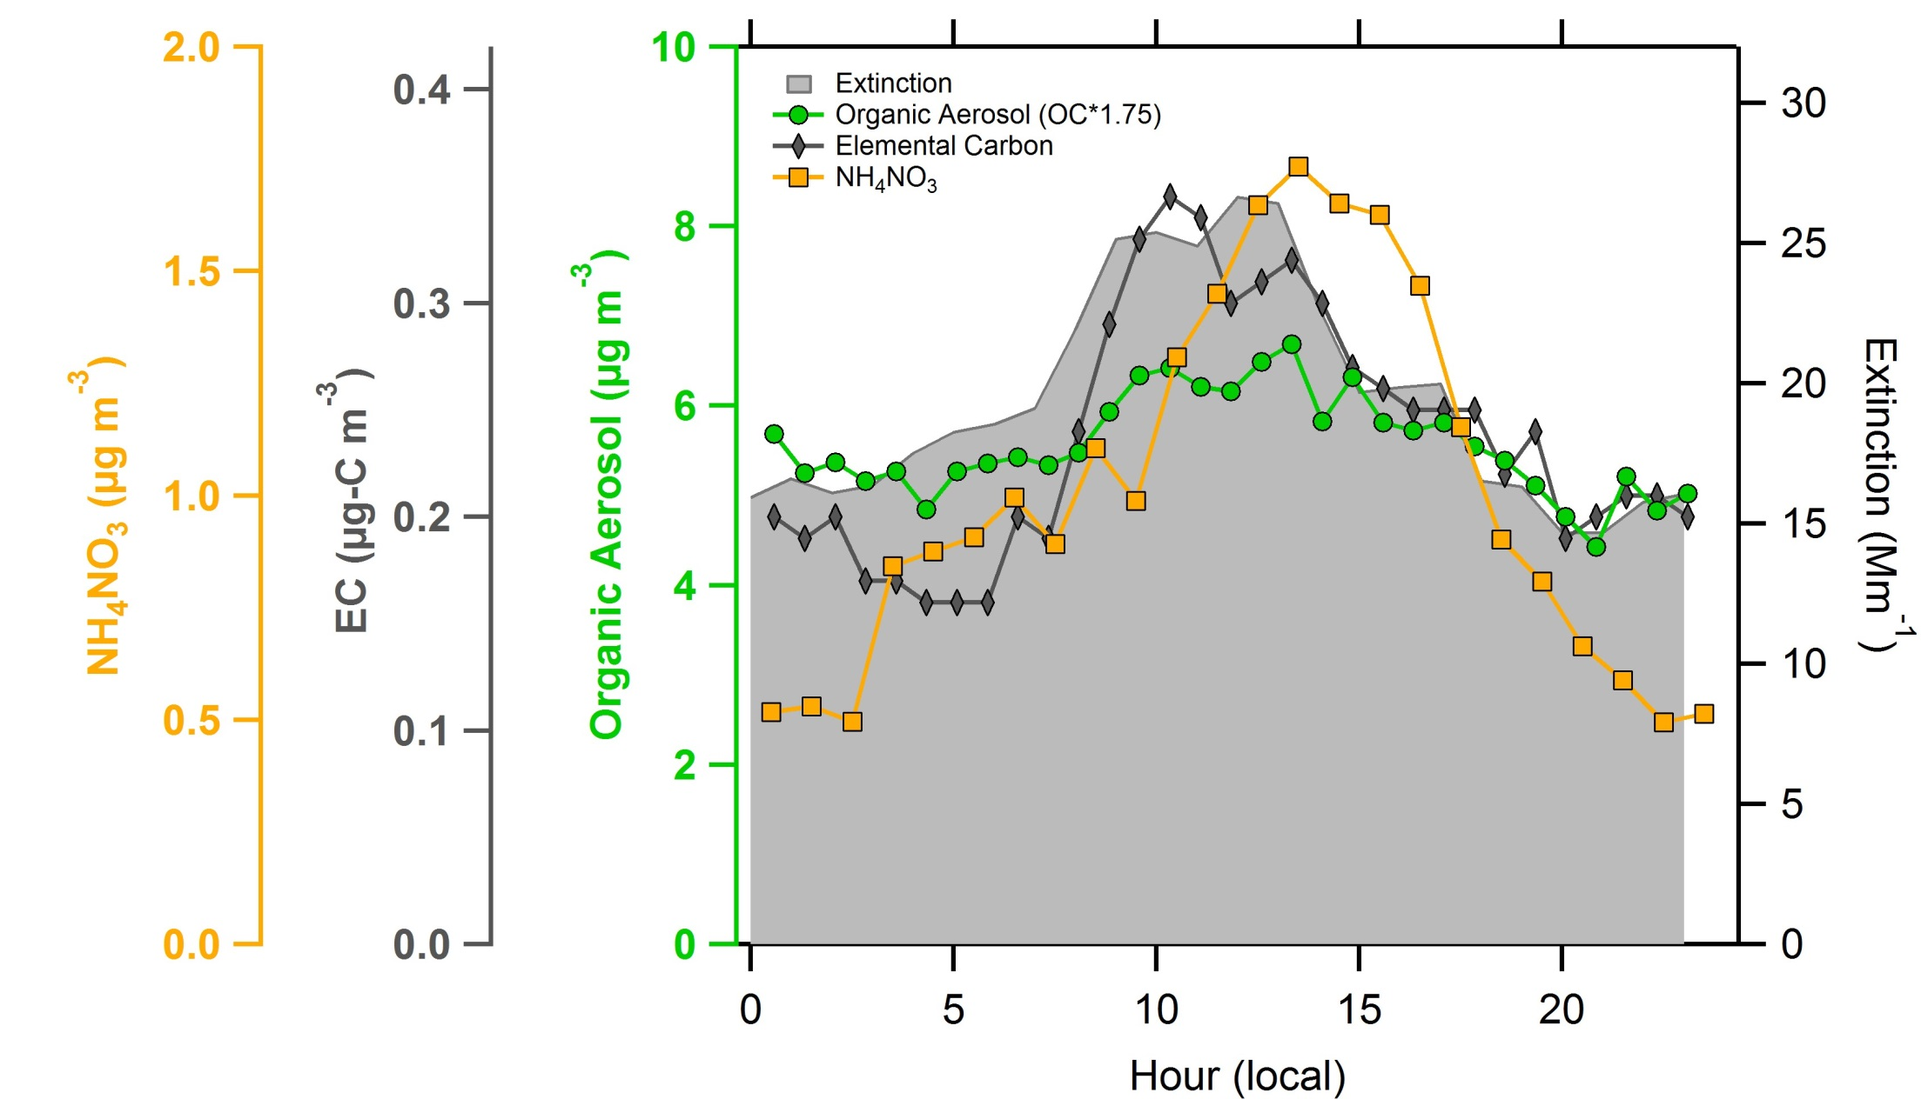
Contributions to Aerosol Light Extinction

Slide 20
DISCOVER-AQ: Preliminary Conclusions
Summer 2014: Aerosol composition in Golden was dominated by organics: most of this OA was secondary
Most of the PM was regional (~70%), but a strong local signature was evident most days (~30% of PM) – sources of the local PM (OM, NH₄NO₃, EC) need to be investigated
Aerosol extinction also showed a mid-day enhancement due to local sources (likely) and chemistry
Identified periods of fire and dust impact during the study (overall - limited)
Ongoing: ground-aircraft connections + BL evolution
Question: spatial distribution of aerosols during study (CAMP-Golden comparison)?

Slide 21
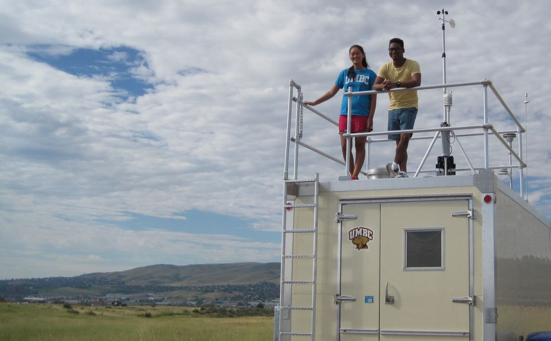
Acknowledgements
UMBC – CBEE
Jared Johnson
Jessica Izumi
Michael Valerino
UMBC – Physics/JCET
Ray Hoff
Daniel Orozco
Ruben Delgado

Slide 22
Backup Figures

Slide 23
Sources of SOA: Regional

Slide 24
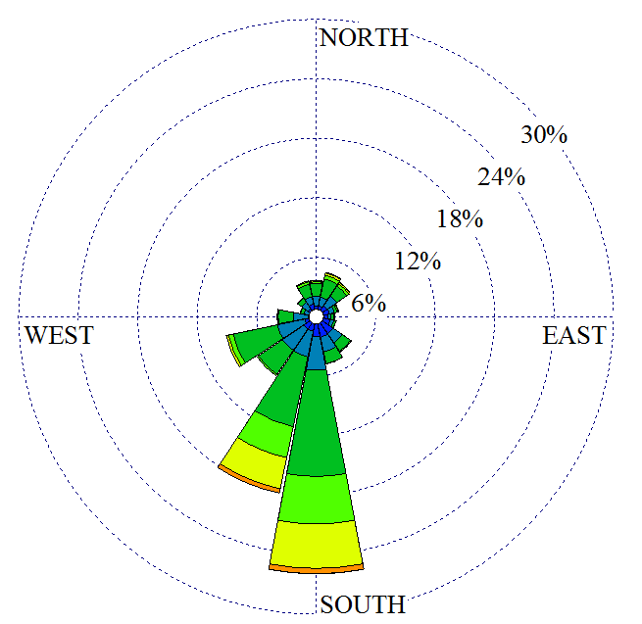
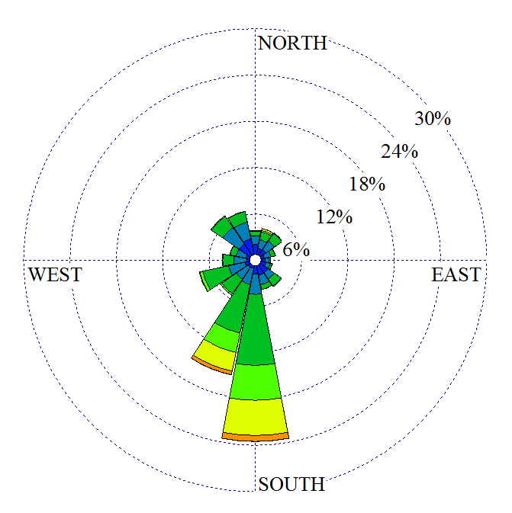
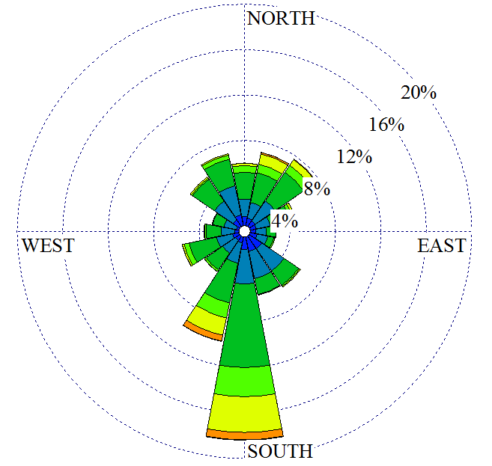
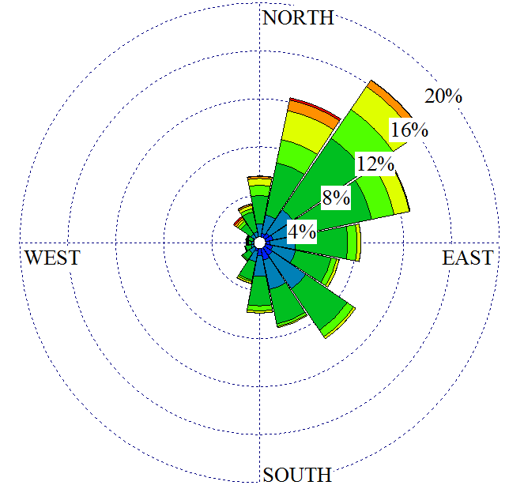
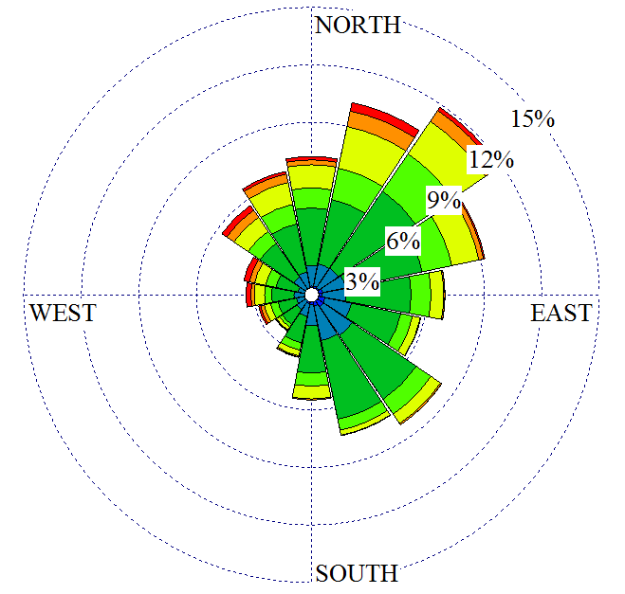
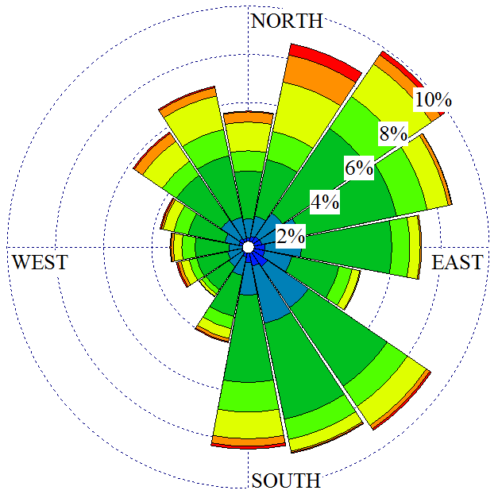
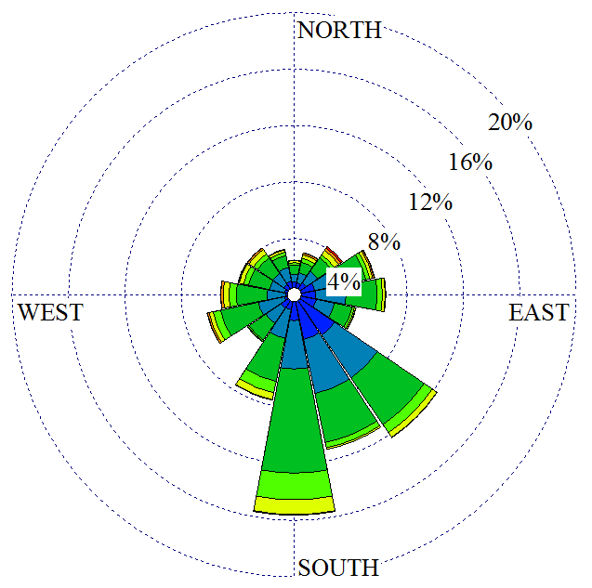
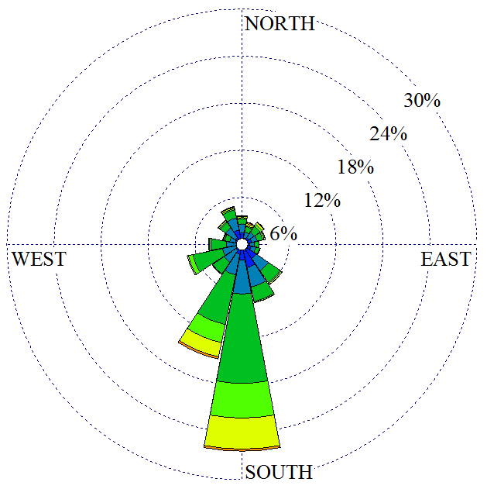
0:00 to 3:00
3:00 to 6:00
6:00 to 9:00
9:00 to 12:00
12:00 to 15:00
15:00 to 18:00
18:00 to 21:00
21:00 to 00:00
CAMP
Diurnal wind profile (local time)
> 10
8.5
7.0
5.5
3.9
2.4
1.9
1.4
< 1.4
Wind Speed (m/s)

Slide 25
NREL vs. CAMP Wind

