Slide 1
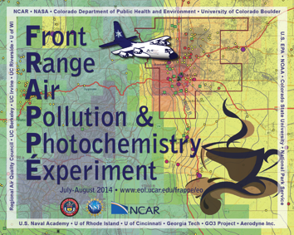

A Synopsis of Forecast Activities and Ongoing Modeling Efforts
Gabi Pfister, Ken Pickering and Brad Pierce
THANKS!
To a Most Amazing Forecasting Team
& Garth d'Attilo and Tim Frederick
For Seamless Operations of the Forecast Center
Joint FRAPPÉ/DISCOVER-AQ Science Team Meeting, May 2015

Slide 2
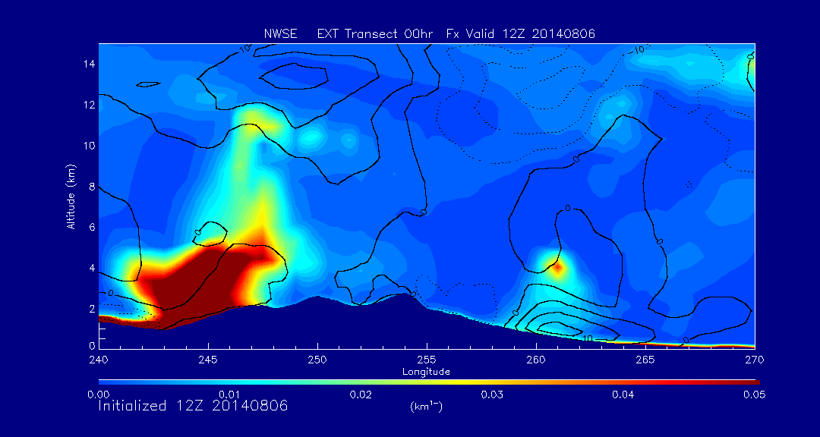
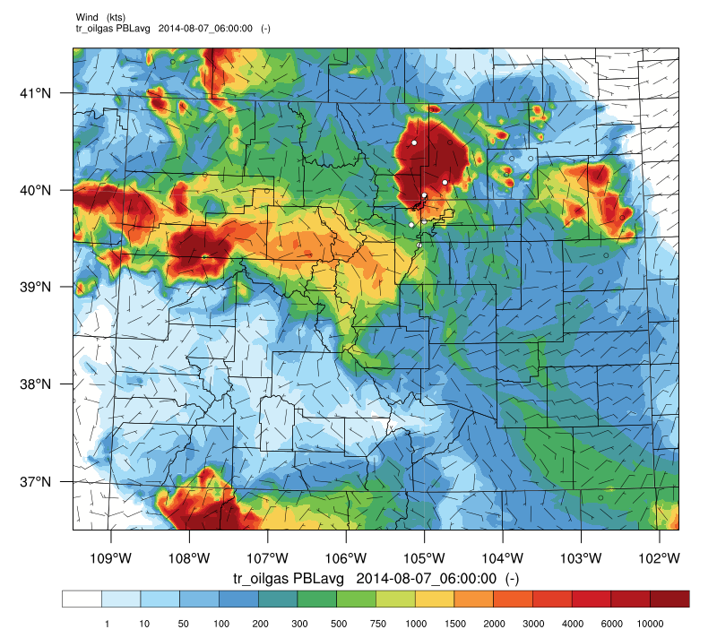
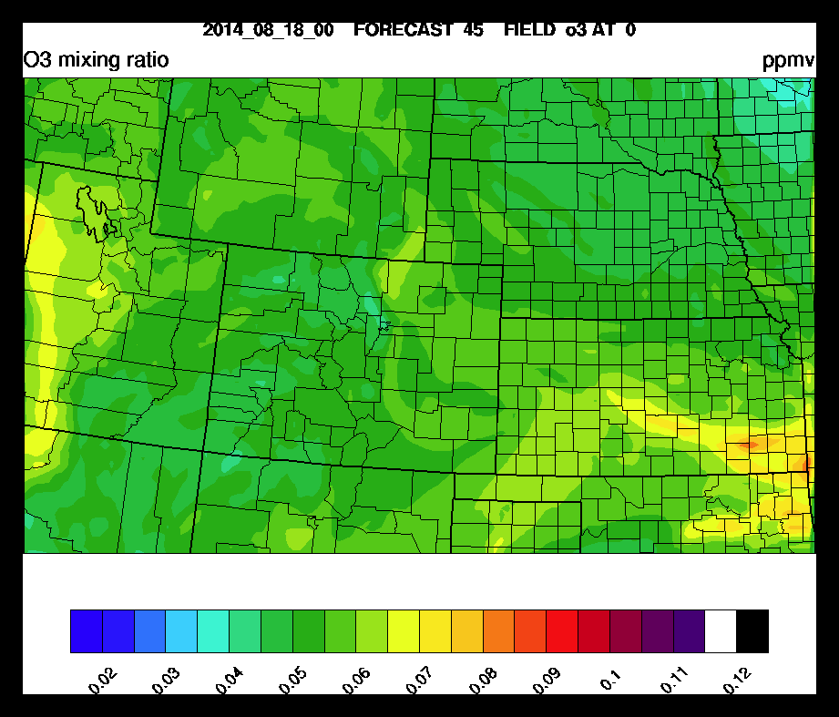
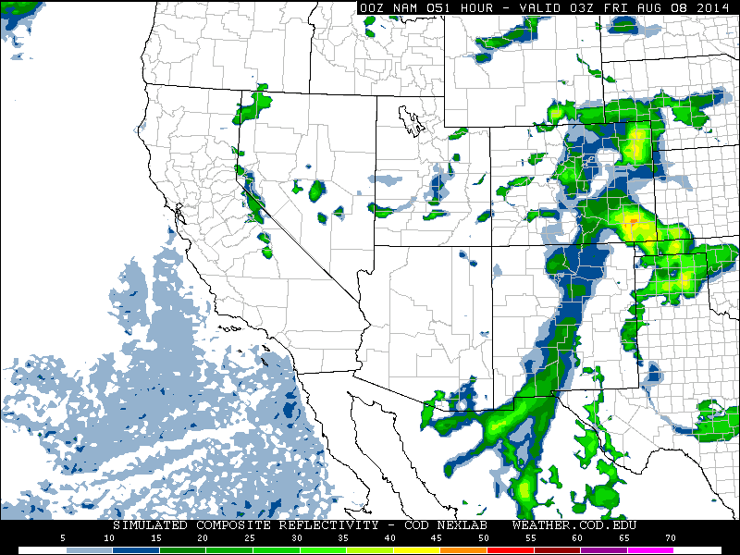
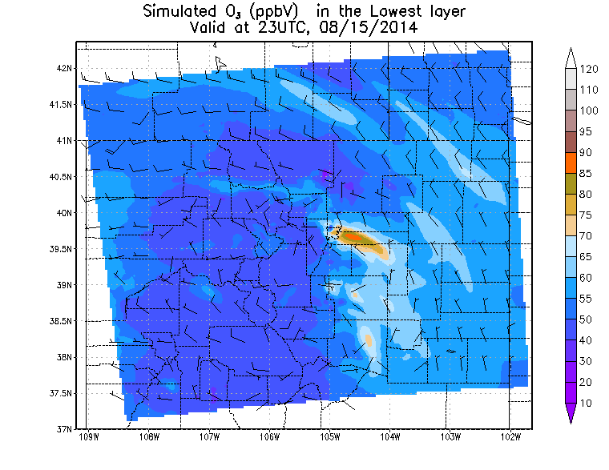
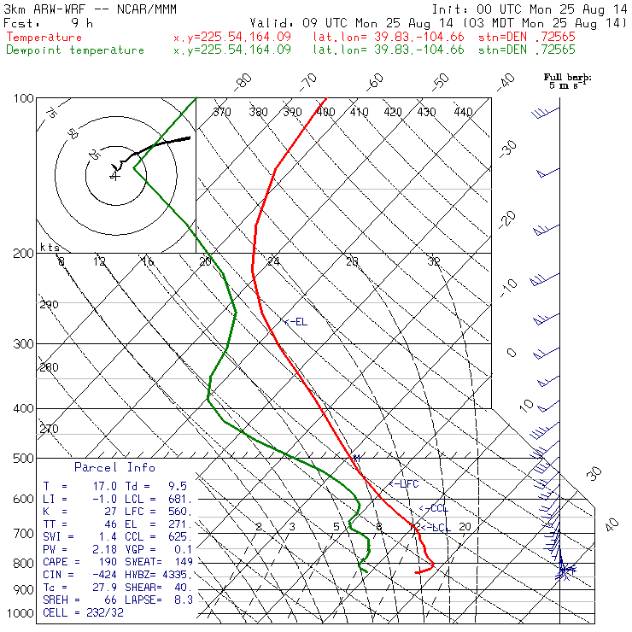
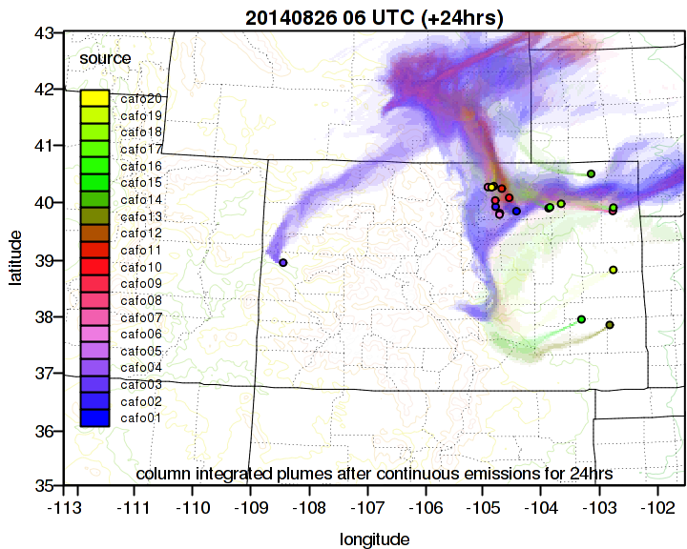
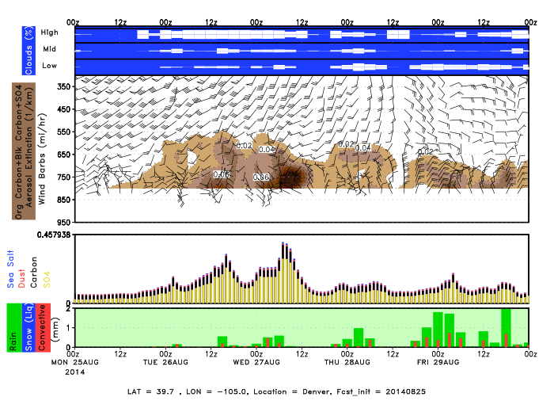
Forecast Models
Global Met NCEP GFS
Global Chemistry NOAA/CIMSS RAQMS*
NCAR MOZART-4
NASA GEOS-5 (CO, Aerosols)
Regional Met NOAA/ESRL HRRR Forecast
NCEP NAM
Regional Chemistry NOAA/ESRL RAPChem
NOAA CMAQ
Regional Tracers NCAR Flexpart*
NCAR WRF ARW STEP
NCAR WRF ARW MMM*
All Forecast Graphics & Reports are archived in the FRAPPÉ Field Catalog http://catalog.eol.ucar.edu/frappe/model
* Model Data available from NASA Archive, Contact PIs for Additional Model Products

Slide 3
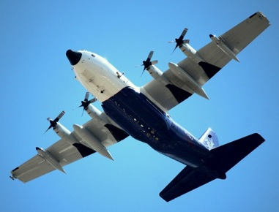
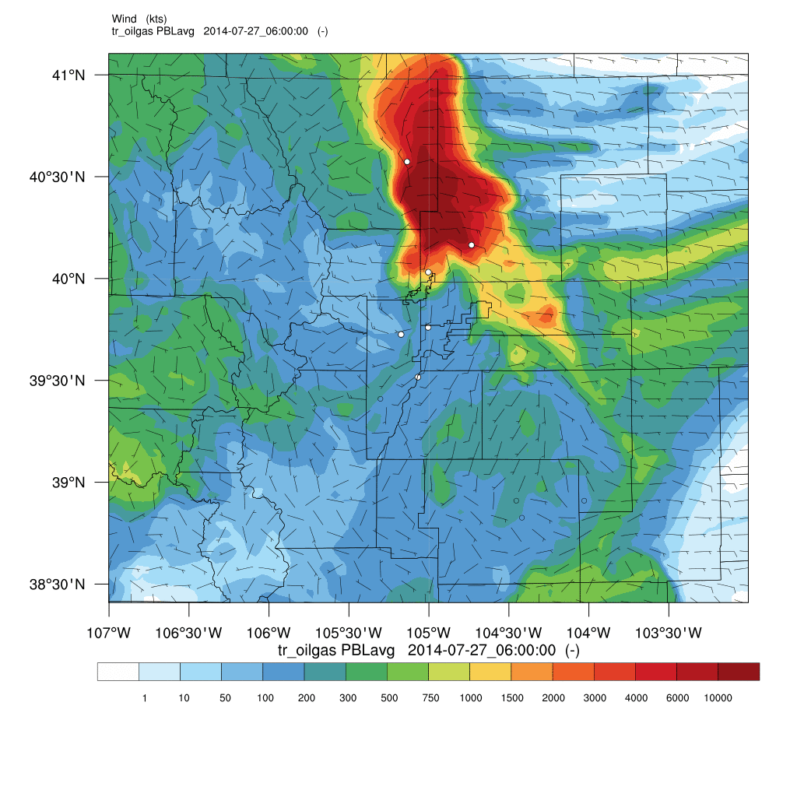
WRF ARW Tracer Run
How did we do?
The Denver Cyclone
NCAR WRF ARW MMM, OG Tracer
What the model predicted
What the C-130 saw
Notes:
DCVZ conditions form when a low-level moist, southeasterly flowing air mass meets the Palmer Divide, a ridge that extends east of the Colorado Front Range. If the moist air lifts over the ridge and meets northwesterly winds originating in the Rocky Mountain foothills, winds may converge to create enhanced cyclonic vorticity.^{[2]}

Slide 4
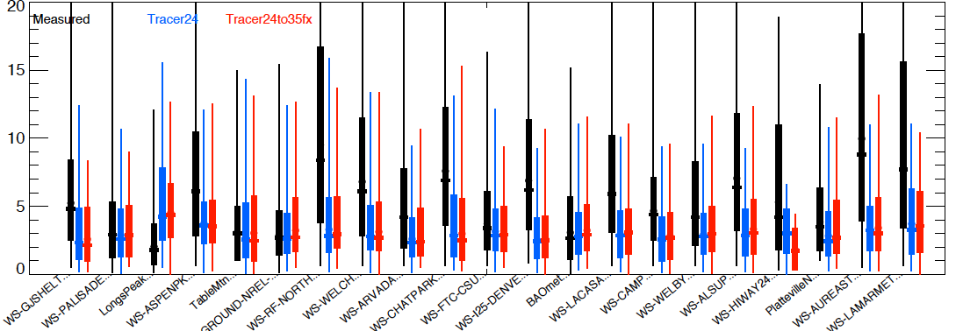
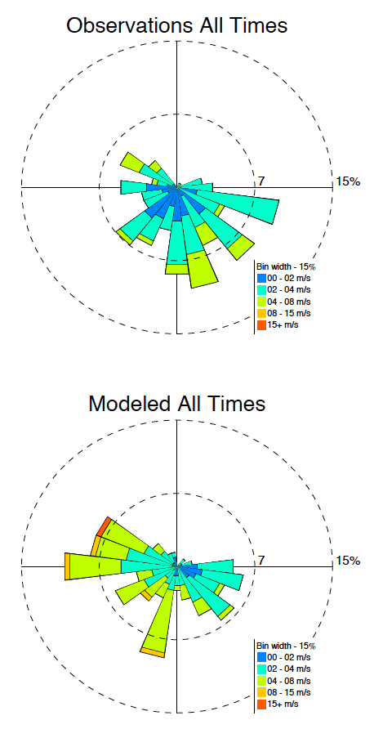
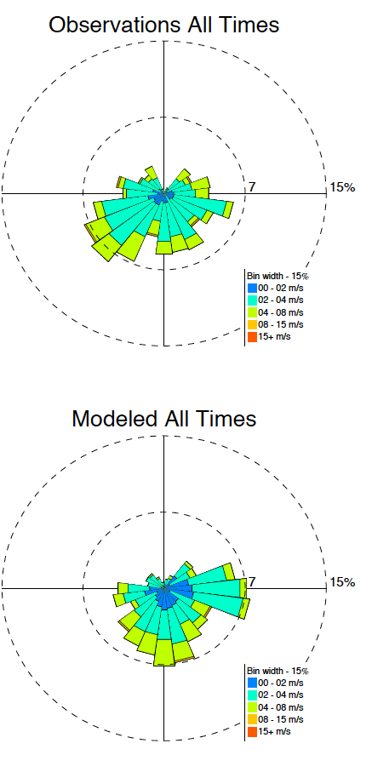
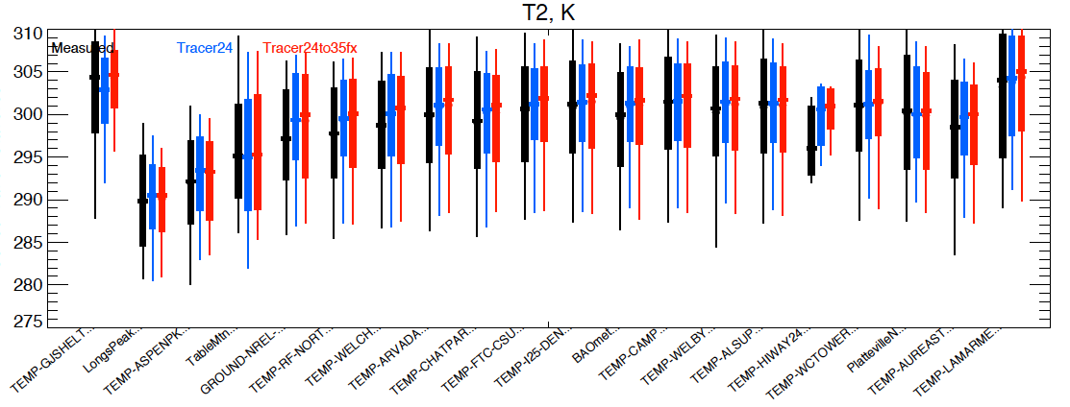
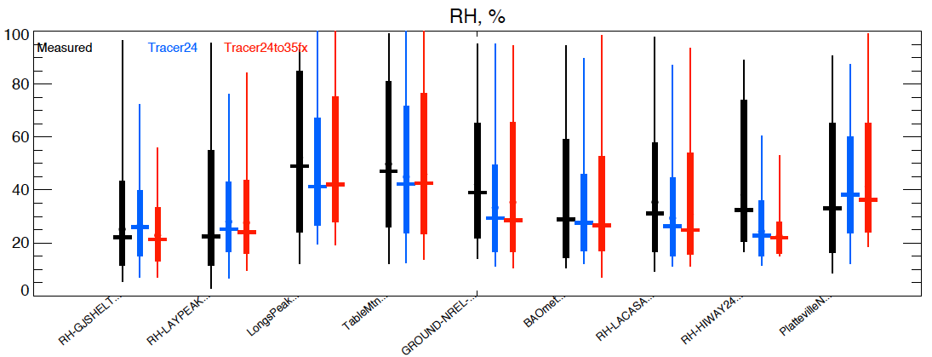
WRF ARW Tracer Run
How did we do?
Platteville
Fort Collins
WS 10m
(m/s)
T 2m
(K)
Measured Initial Forecasts 24-hour Forecasts
RH
(%)
Notes:
Also during campaign we saw that the best forecast was not always the latest forecast
Show all times comparisons

Slide 5
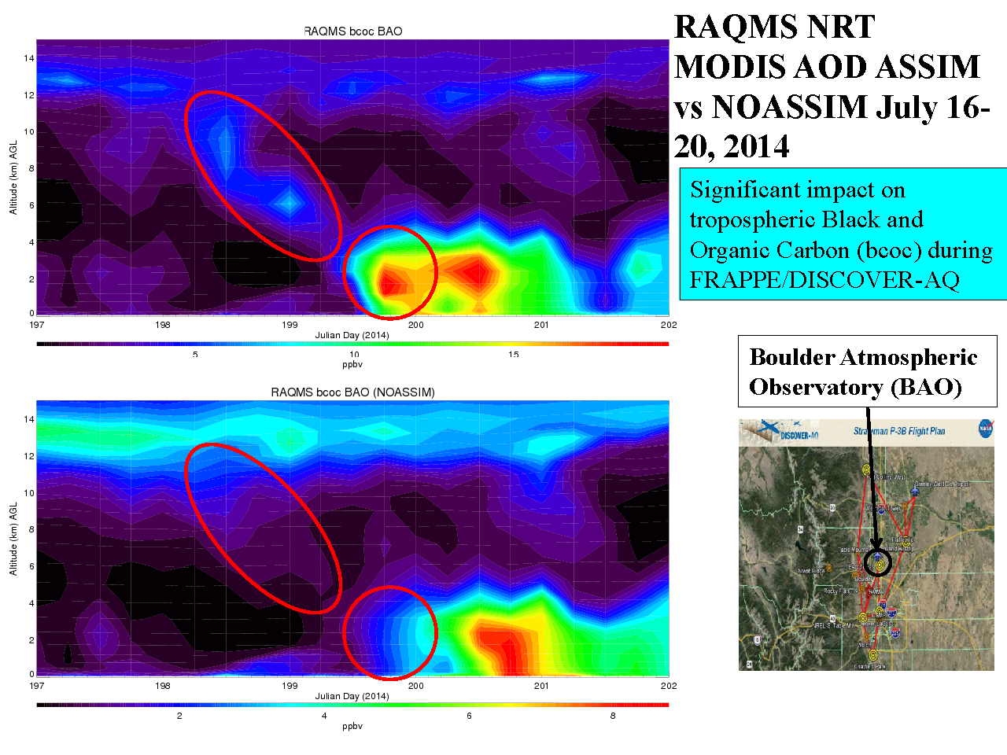
RAQMS
Smoke prediction (with MODIS AOD Assimilation)
RAQMS MODIS AOD ASSIM vs
NO ASSIM
July 16-20, 2015
Smoke prediction (no MODIS AOD Assimilation)

Slide 6
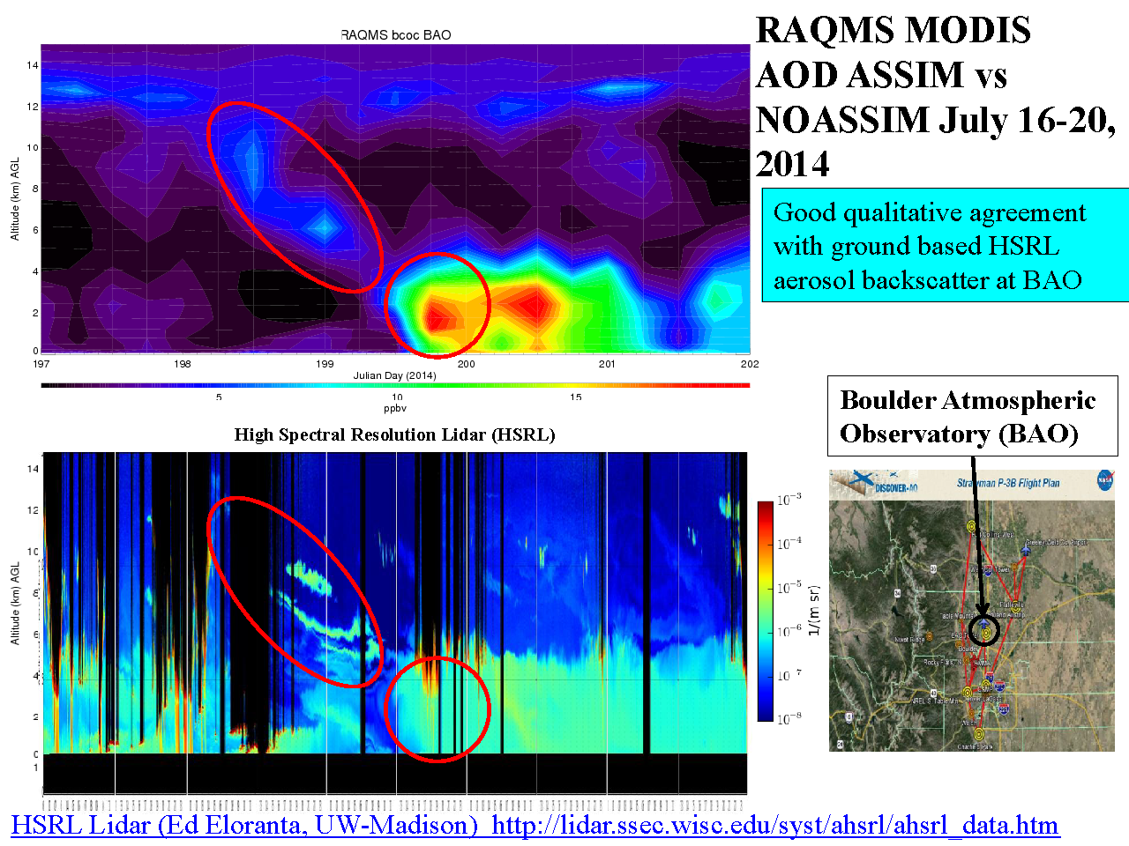
RAQMS
Smoke prediction (with MODIS AOD Assimilation)
RAQMS MODIS AOD ASSIM vs
UX HSRL
July 16-20, 2015
High Spectral Resolution Lidar (HSRL)

Slide 7
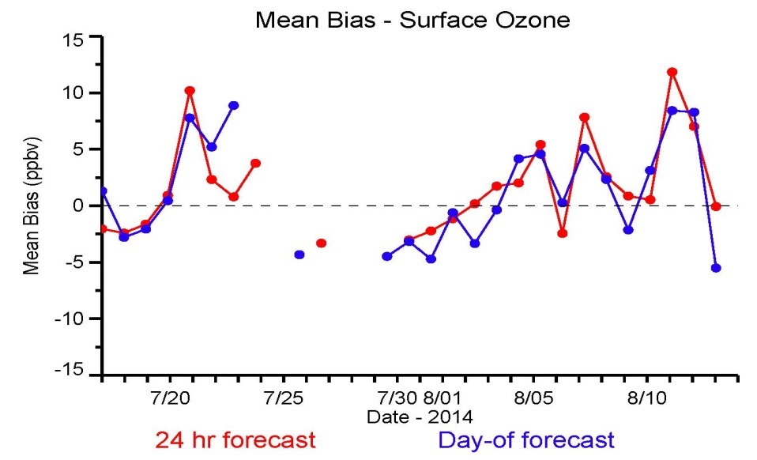
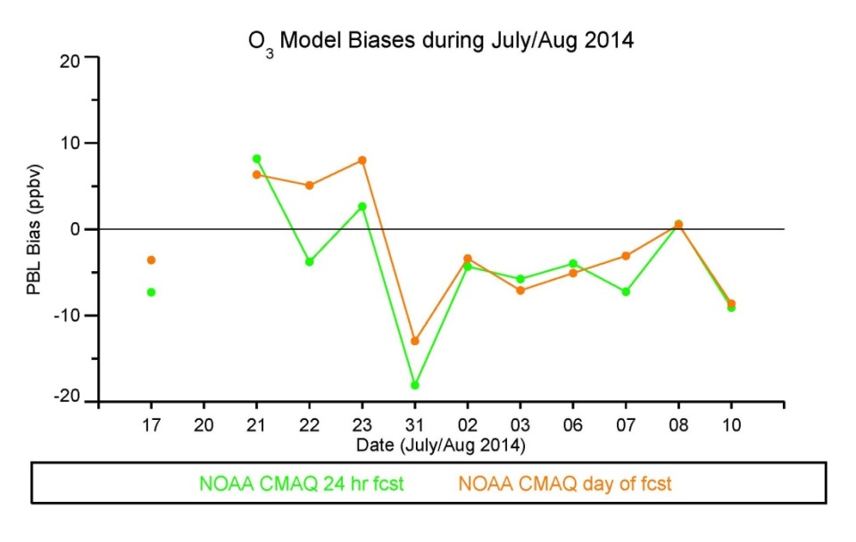
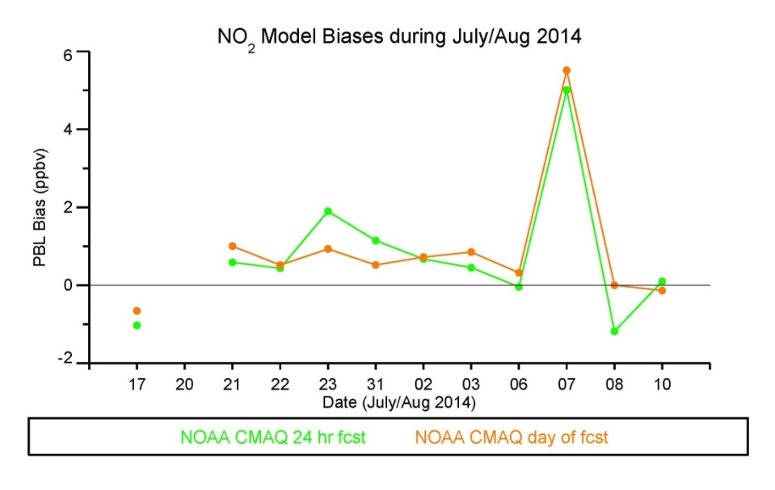
CMAQ
NAQFC-$β \text{f}$orecasting support: Initialized at 00 UTC with 60 hours forecast duration
2005 NEI as base year, mobile projected using AQS*, area and off-road used CSAPR, point source uses 2012 CEM data
WRAP oil and gas emissions data, BEIS-3.14 Biogenic
RAQMS Boundary Conditions
Mean Bias – AQS Surface O3
12 km nested to 4 km
24 hr - MB: 1.7 ppbv / RMSE: 14 ppbv
Day-of - MB : 1.1 ppbv / RMSE: 14 ppbv
Mean O₃ Bias (P-3B obs, PBL only)
Mean NO₂ Bias (P-3B obs, PBL only)
24 hr - MB: -4.7 ppbv (6%)
Day-of - MB : -2.7 ppbv (3%)
24 hr - MB: 0.5 ppbv (156%)
Day-of - MB : 0.6 ppbv (129%)
Air Resources Laboratory/NOAA

Slide 8
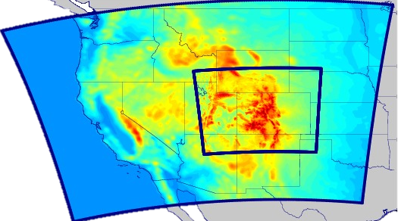
Ongoing Modeling Efforts
NCAR/ACOM (Pfister) WRF-Chem/MOZCART
2 domains (15km and 3km)
Anthro: NEI 2011
FINN Fires, MEGAN Biogenic
24-hour Meteorology Cold Start
NCAR/ACOM (Pfister/Mizzi) DART/WRF-Chem/MOZCART
Assimilation of Met, MOPITT CO, (IASI O3 & CO, OMI NO2, MODIS AOD)
NCAR/ACOM (Kaser) WRF-Chem Single Column Model
Please let me know of ongoing and planned modeling efforts

Slide 9
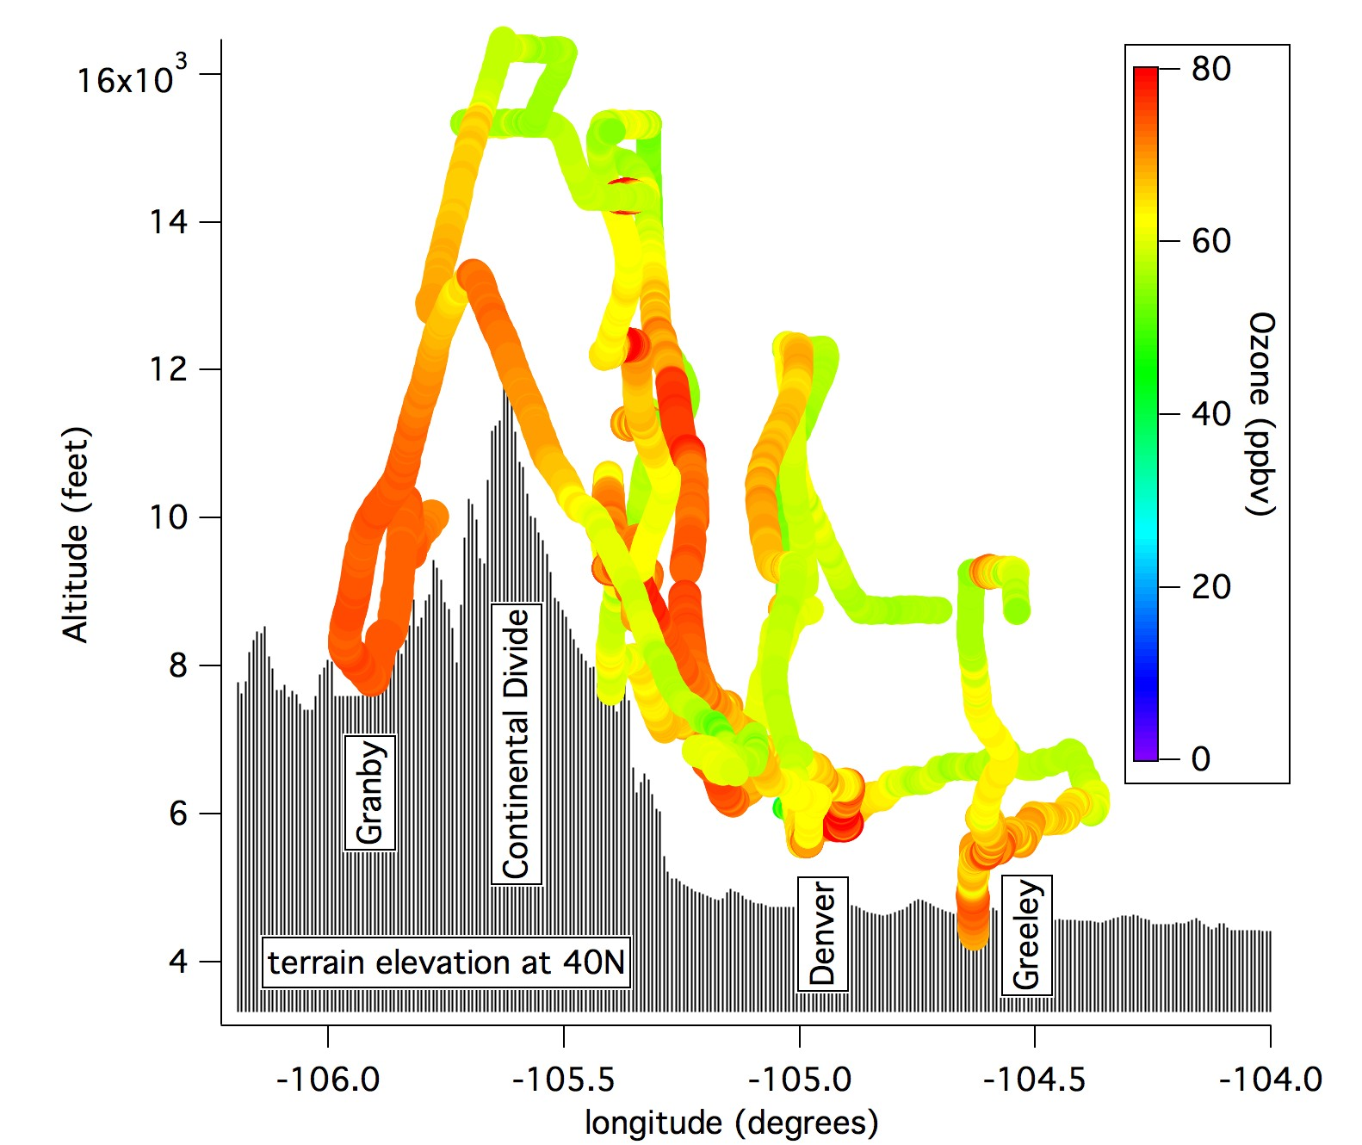
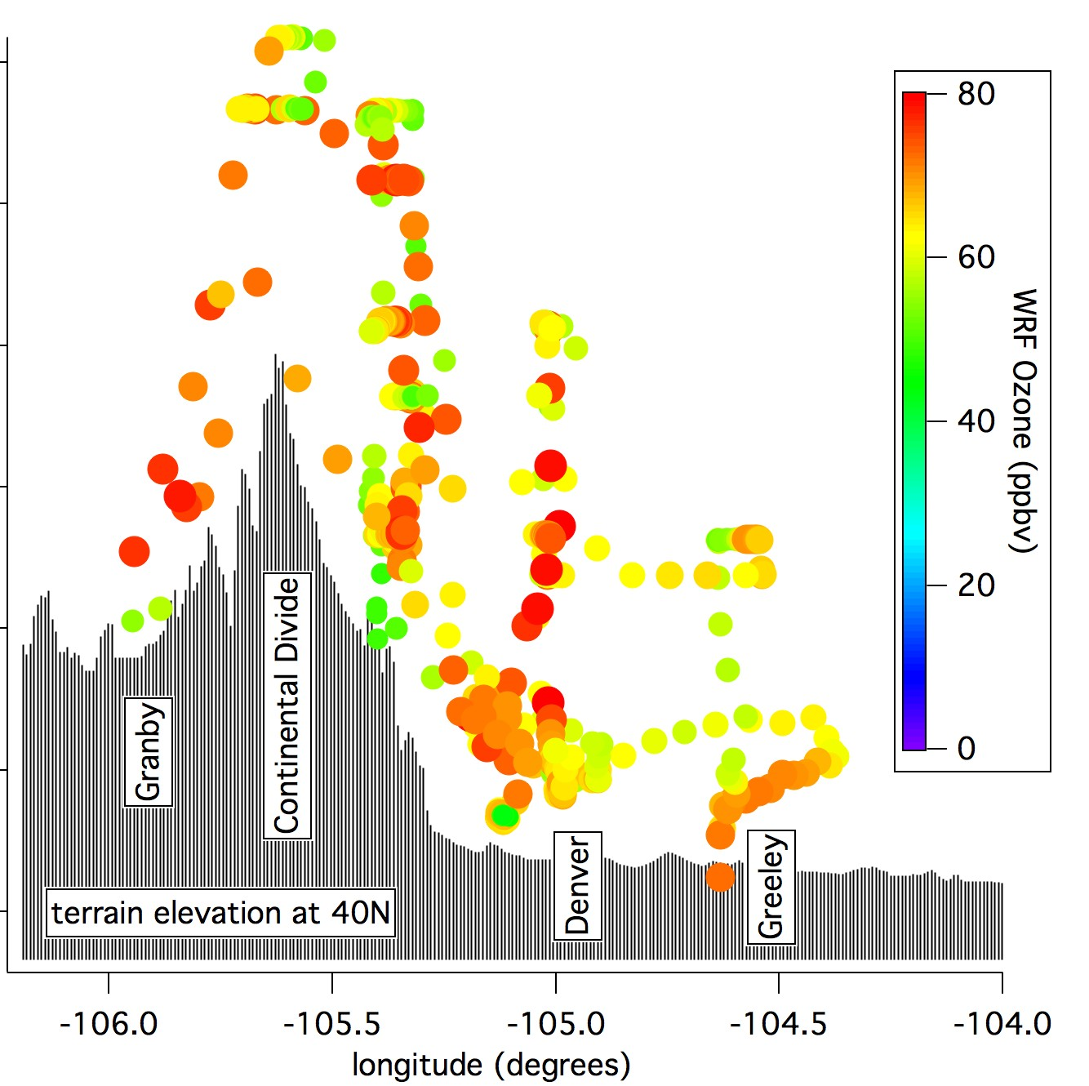
WRF-Chem
Pollution Transport into the Mountains
Background
(50 ppb)
C-130
WRF-Chem
Evening
spillover
Upslope flow
Ozone produced over the Front Range is pushed westward into the mountains by thermally driven upslope. Some is re-circulated back.
Model represents this Transport well and seems to show recirculation
12 August 2014
Notes:
Ozone that is produced over the Front Range is pushed westward into the mountains by thermally driven upslope.
Demonstrates how Front Range Ozone can impact remote areas up to the divide and into the adjacent valleys West of the divide.

Slide 10
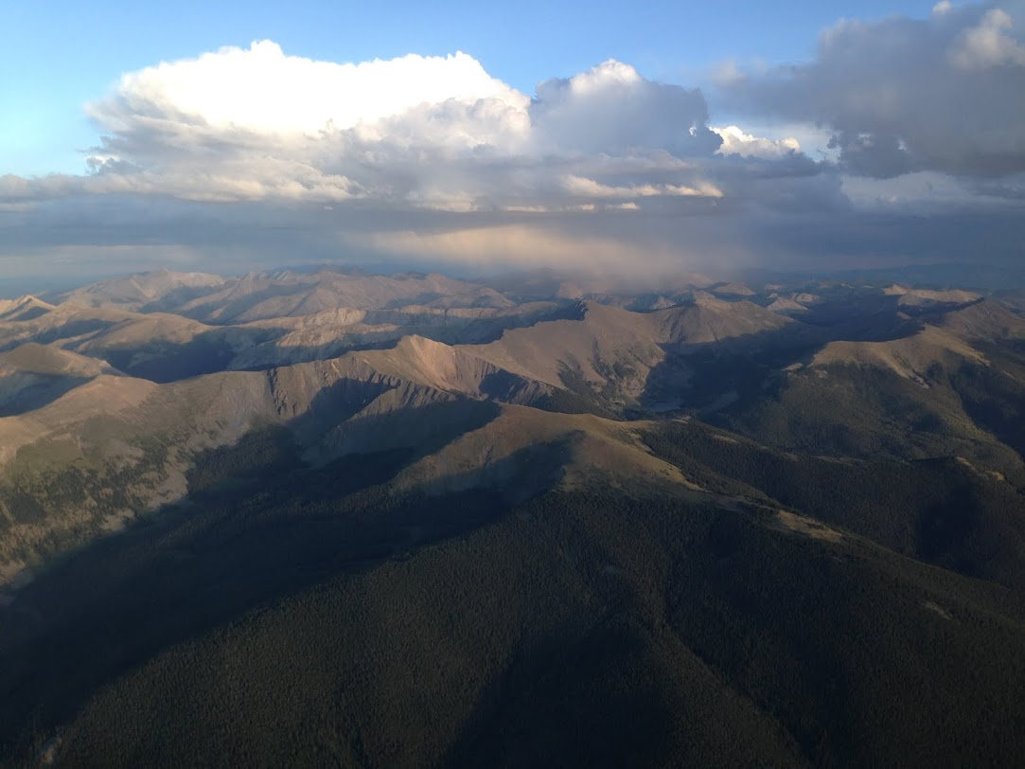
WRF-Chem
Measured (CDPHE)
WRF-Chem
Pollution Transport into the Mountains
Evolution of Surface Ozone for Upslope Events on August 11&12
What about Ozone Ingredients?

Slide 11
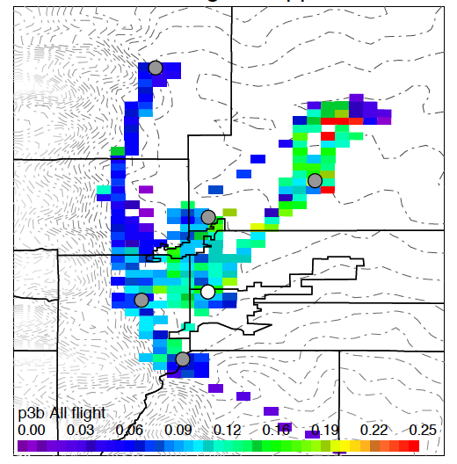
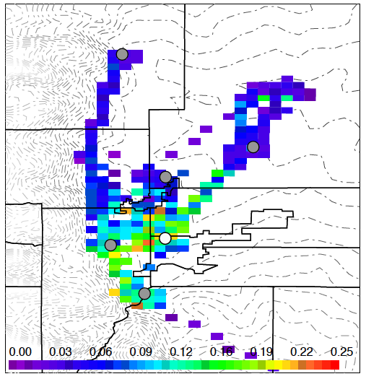
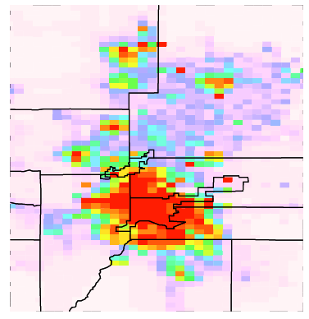
WRF-Chem
NEED - Anthropogenic Emissions
Currently available: NEI 2011 (provided by Stu McKeen/NOAA)
Need better region specific emissions (CDPHE, WESTAR, others?) & Speciation
Update Emissions based on Observations (who?)
➔ Front Range Emission Working Group (proposed by K. Briggs, CDPHE)
P-3 Benzene (<3km)
WRF-Chem Benzene (<3km)
NEI 2011 Benzene
Data: A. Wisthaler, U Innsbruck
Notes:
Nox, CO too high
VOCs all over the board

Slide 12
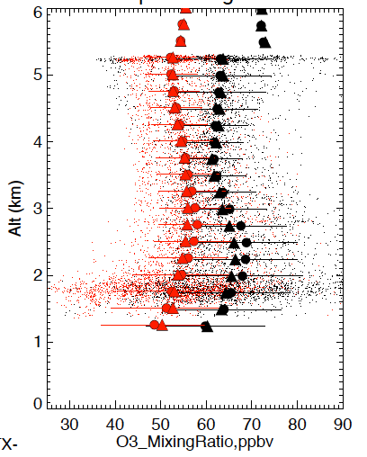
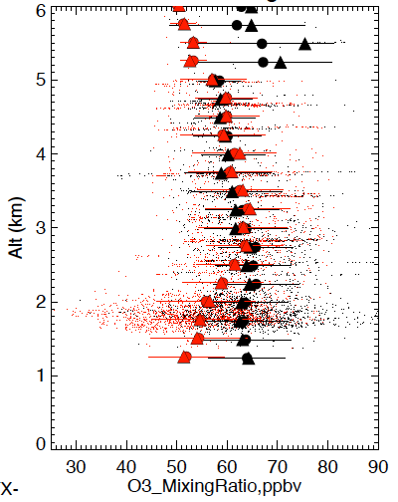
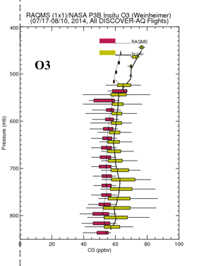
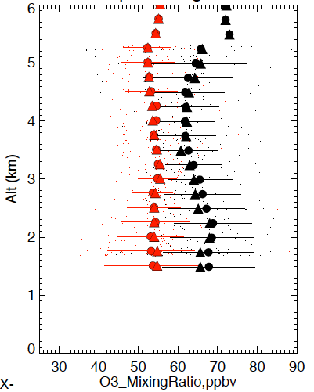
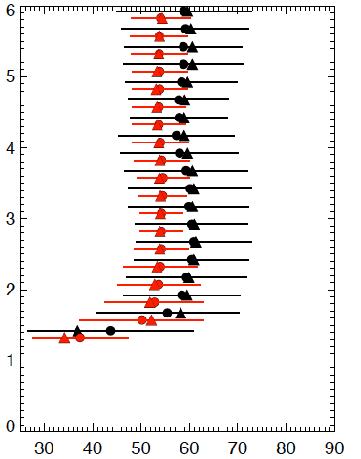
WRF-Chem
NEED – Large Scale/Background
Observations WRF-Chem
Similar Bias also in MOZART
Pacific Inflow/Background?
Recirculation? Stratosphere?
Low Bias
also in RAQMS
All Flights P-3
Front Range C130
Ozone (ppb)
Ozone (ppb)
Ozone (ppb)
Need Validated Model Inputs for Large Scale, also Out-of-State Emissions
Platteville P-3
Platteville Sondes
Platteville Sondes
Ozone (ppb)
Ozone (ppb)
Data: A. Weinheimer (Aircraft) A. Thompson (Sonde)
Notes:
P3 bias persistent at all times
C-130 does not give clear bias, but seems that the WY leg and some legs over Divide are also low.
P3 bias (all data) is smaller in the PM than in the AM. Still slightly larger than Sondes, but need to separate time for 02 profile only
Sonde bias ~ 5 ppb (~10%), P3 Platteville bias ~8 ppb (>10%)

Slide 13
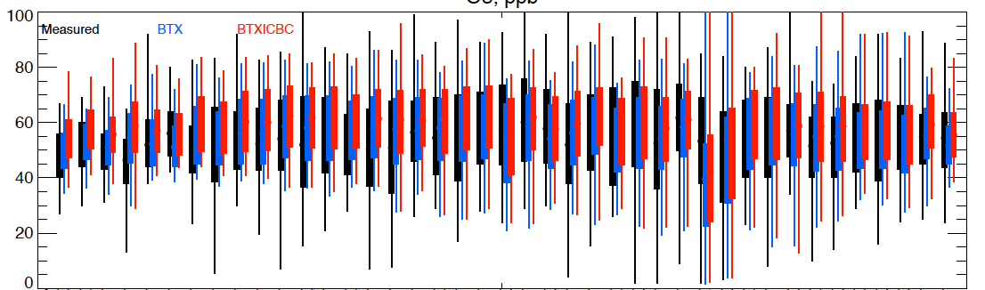
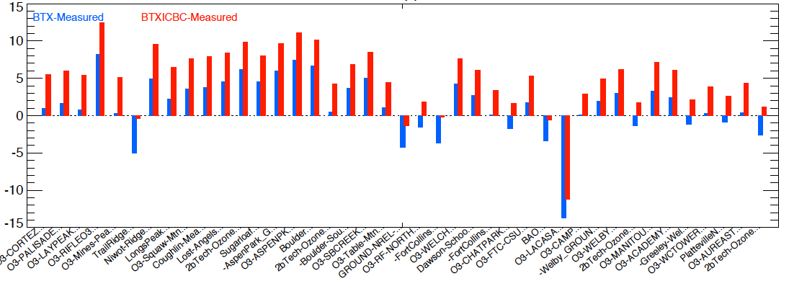
WRF-Chem
NEED - Measurements in 4D
Evaluation with Surface Ozone
Measured WRF-Chem Base WRF-Chem LBC_O3
Model biased high at most surface sites
Base-Measured LBC_O3-Measured
Improving the low FT bias increases the high surface bias
W -> E
10-18 LT
Surface Data: CDPHE, EPA, NPS, NOAA, NASA, CU

Slide 14
Thanks everyone for participating and
looking forward to a successful meeting!
Notes:
Some food for thought

Slide 15
EXTRAS
Notes:
Some food for thought

Slide 16
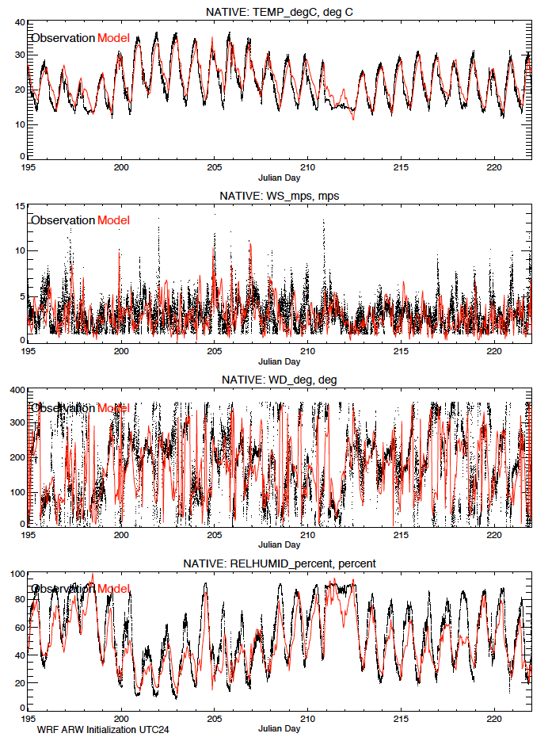
WRF ARW Tracer Run
How did we do?
NCAR WRF ARW MMM Met Evaluation
Notes:
DCVZ conditions form when a low-level moist, southeasterly flowing air mass meets the Palmer Divide, a ridge that extends east of the Colorado Front Range. If the moist air lifts over the ridge and meets northwesterly winds originating in the Rocky Mountain foothills, winds may converge to create enhanced cyclonic vorticity.^{[2]}

Slide 17
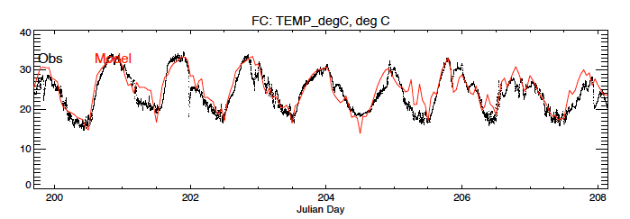
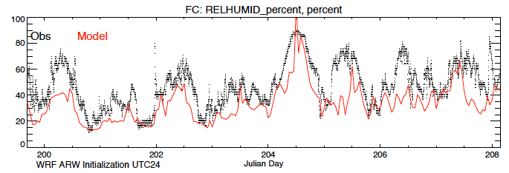
WRF ARW Tracer Run
How did we do?
NCAR WRF ARW MMM Met Evaluation
Notes:
DCVZ conditions form when a low-level moist, southeasterly flowing air mass meets the Palmer Divide, a ridge that extends east of the Colorado Front Range. If the moist air lifts over the ridge and meets northwesterly winds originating in the Rocky Mountain foothills, winds may converge to create enhanced cyclonic vorticity.^{[2]}

Slide 18
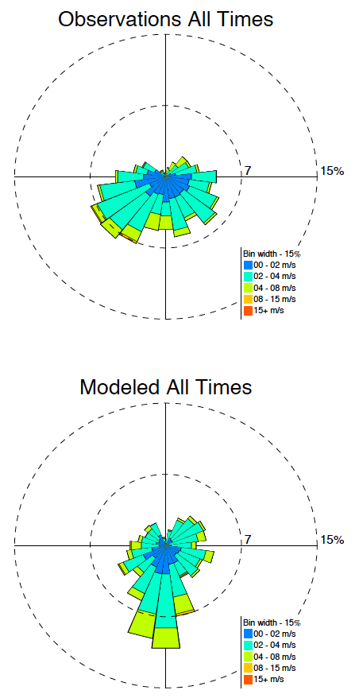
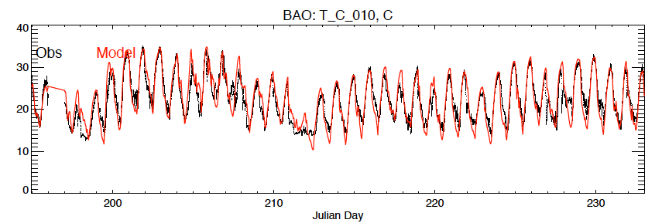
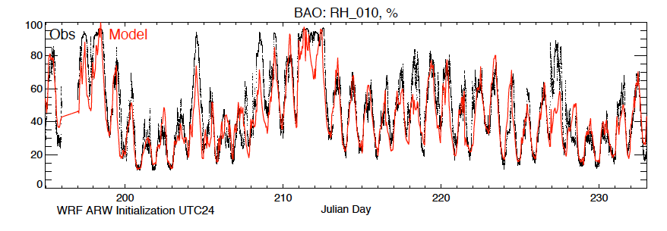
WRF ARW Tracer Run
How did we do?
NCAR WRF ARW MMM Met Evaluation
Notes:
DCVZ conditions form when a low-level moist, southeasterly flowing air mass meets the Palmer Divide, a ridge that extends east of the Colorado Front Range. If the moist air lifts over the ridge and meets northwesterly winds originating in the Rocky Mountain foothills, winds may converge to create enhanced cyclonic vorticity.^{[2]}

Slide 19
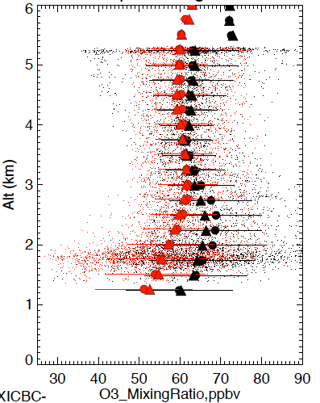
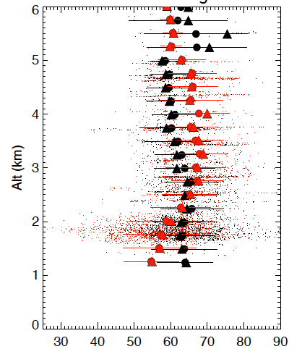
Modeling NEEDS- Larger Scales
Observations WRF-Chem
MOZART BC O3 Standard
All Flights P-3
Front Range C130
Ozone (ppb)
Ozone (ppb)
MOZART BC O3*1.2
Ozone (ppb)
Ozone (ppb)
Data: A. Weinheimer (Aircraft) A. Thompson (Sonde)
Notes:
P3 bias persistent at all times
C-130 does not give clear bias, but seems that the WY leg and some legs over Divide are also low.
P3 bias (all data) is smaller in the PM than in the AM. Still slightly larger than Sondes, but need to separate time for 02 profile only
Sonde bias ~ 5 ppb (~10%), P3 Platteville bias ~8 ppb (>10%)

Slide 20

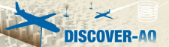

NAQFC-orecasting support: Initialized at 00 UTC with 60 hours forecast duration
WRF-ARW | Both North America (12 km) & CONUS (4 km)
Map projection & grid | Lambert Conformal & Arakawa C staggering
Vert. co-ordinate | 42 σ-p unevenly spaced levels
advection | RK3 (Skamarock and Weisman (2008))
SW & LW radiation | RRTMG (Iacono et al. 2008))
PBL Physics | Mellor-Yamada-Janjic (MYJ) level 2.5 closure
Surface layer scheme | Monin-Obukhov Similarity with viscous sub-layer
Land Surface Model | NCEP NOAH
Cloud Microphysics | Thompson et al. (2008)
Cloud convective mixing | Betts-Miller-Janjic Mass adjustment
AForecast: 12 km nested to 4 km
CMAQ4.7.1 | Both CONUS(12 km) & DISCOVER-AQ/FRAPPE (4 km)
Map projection & grid | Lambert Conformal & Arakawa C staggering
Vert. co-ordinate | 42 σ-p unevenly spaced levels
Gas chemistry | CB05 with 156 reactions
Aerosol chemistry | Aero5 with updated evaporation enthalpy
Anthropogenic emission | 2005 NEI as base year, mobile projected using AQS*, area and off-road used CSAPR, point source uses 2012 CEM data
 | WRAP oil and gas emissions data
Biogenic emission | BEIS-3.14
Lateral BC | RAQMS (B. Pierce)
42 vertical layers
Air Resources Laboratory/NOAA
Notes:
^12 km domain is set a bit large to match National AQ Forecasting Capability for side-by-side verification.

Slide 21
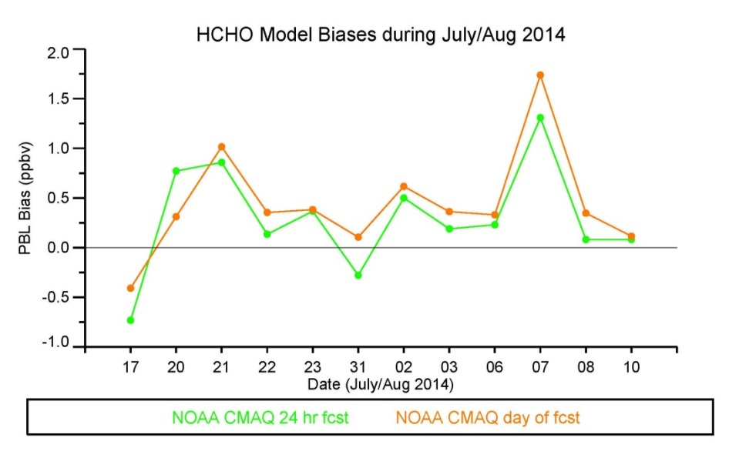
NOAA CMAQ forecast
Mean Bias – AQS surface O3
Mean O₃ Bias (P-3B obs, PBL only)
24 hr - MB: -4.7 ppbv (6%)
Day-of - MB : -2.7 ppbv (3%)
24 hr - MB: 1.7 ppbv / RMSE: 14 ppbv
Day-of - MB : 1.1 ppbv / RMSE: 14 ppbv
Mean NO₂ Bias (P-3B obs, PBL only)
Mean HCHO Bias (P-3B obs, PBL only)
24 hr - MB: 0.5 ppbv (156%)
Day-of - MB : 0.6 ppbv (129%)
24 hr - MB: 0.2 ppbv (30%)
Day-of - MB : 0.4 ppbv (36%)
* PBL Height from WRF
MB = Mean Bias (Mean Percent Bias)

Slide 22
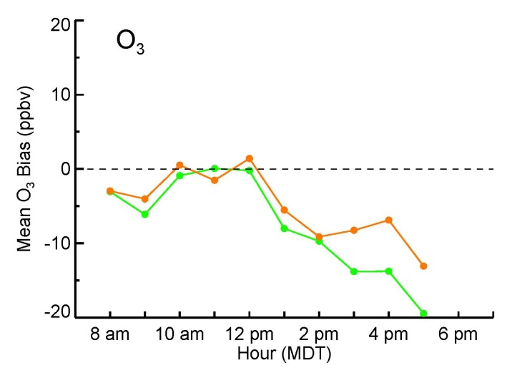
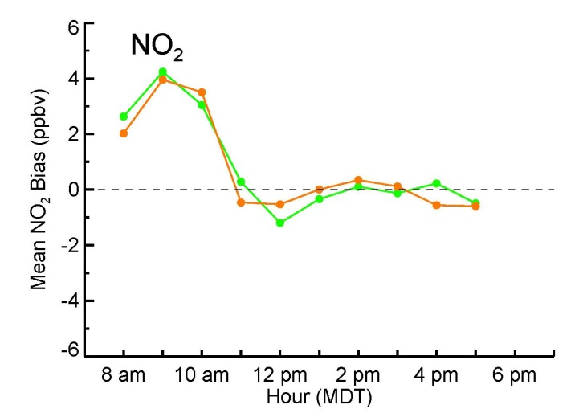
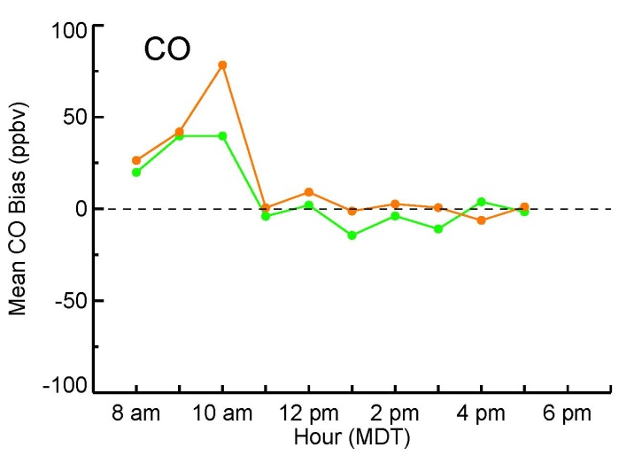
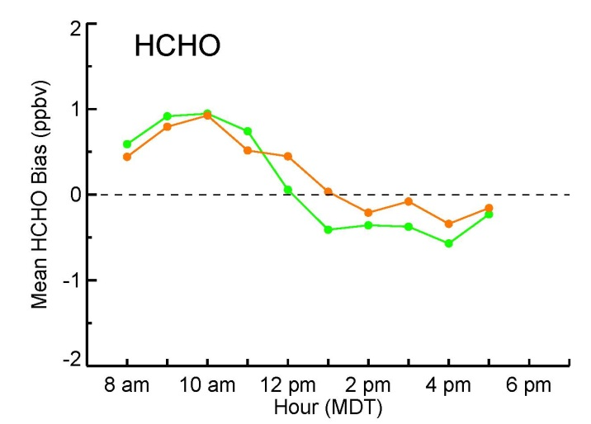
NOAA CMAQ forecast Diurnal variation of mean bias (≤ 2 km)
Overestimation of NO2, CO, and HCHO in the morning
Possible that emissions are too high or PBL height is too low
24 hr forecast Day-of forecast

Slide 23
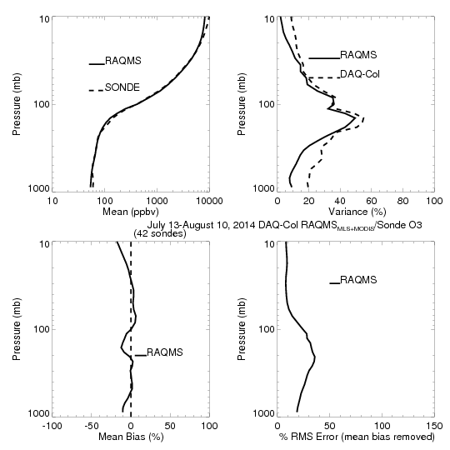

Comparison of RAQMS NRT OMI+MLS analysis with ozonesondes FRAPPE/DISCOVER-AQ (42 sondes, July-August, 2014)
Platteville ground site
+/-10%
Generally within +/- 10% with underestimate below 700mb.
UTLS variance is well represented but underestimate in variance below 300mb
PI:ANNE M. THOMPSON GSFC

Slide 24


Comparison of RAQMS with NASA P3 during FRAPPE/DISCOVER-AQ
Systematic underestimate of O3 below 700mb and NO2 below 750mb – does not resolve strong local urban sources
O3
NO2
Insitu O3 and NO2 from Andrew Weinheimer (NCAR)

Slide 25



Comparison of RAQMS with OMI Tropospheric NO2
CONUS July 2014
Overestimate urban and wildfire NO2 compared to OMI – Note gap in Cloud Cleared OMI data over Denver, CO

Slide 26


Distributed Regional Aerosol Gridded Observation Networks (DRAGON)-USA 2014 Colorado Front Range Urban Corridor
July 16-20
DRAGON
RAQMS
(DRAGON-USA, Brent Holben, NASA/GSFC)
http://aeronet.gsfc.nasa.gov/new_web/DRAGON-USA_2014_Colorado.html

Slide 27

Distributed Regional Aerosol Gridded Observation Networks (DRAGON)-USA 2014 Colorado Front Range Urban Corridor
July 16-20
DRAGON
RAQMS
(DRAGON-USA, Brent Holben, NASA/GSFC)
http://aeronet.gsfc.nasa.gov/new_web/DRAGON-USA_2014_Colorado.html

