Slide 1


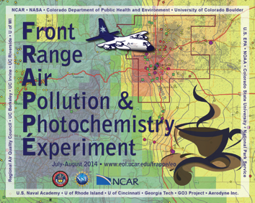
Front Range Air Pollution and Photochemistry Éxperiment
PIs: Gabriele Pfister and Frank Flocke
National Center for Atmospheric Research (NCAR)
Funded by State of Colorado & National Science Foundation
National Center for Atmospheric Research (NCAR), NASA Airborne Science Program
Colorado Department for Health and Environment (CDPHE), Colorado State University (CSU),
University of Colorado Boulder, Environmental Protection Agency (EPA) Region 8,
National Oceanic and Atmospheric Administration (NOAA), National Park Service (NPS),
Regional Air Quality Council (RAQC), UC Berkeley, UC Irvine, UC Riverside, US Naval Academy,
U of Wisconsin, U of Rhode Island, U of Cincinnati, Georgia Tech, GO3 Project, Aerodyne Inc., and others
Northern Front Range Metro Area (NFRMA)
July 15 - August 18, 2014
http://www2.acd.ucar.edu/frappe

Slide 2
FRAPPÉ and DISCOVER-AQ Measurement Suite
Full chemistry payload on NCAR/NSF C-130
(almost) Full chemistry payload on NASA P3
Roughly equivalent # of measurements at BAO, NREL, Platteville; plus LIDARs
Many important pollutants on six mobile vans
Enhanced CDPHE*( ground network (EPA monitors)
Remote sensing / atmospheric column measurements on two aircraft and at 16 ground locations
Tethered Balloons and Ozone Sondes
Personal Pollution Monitoring
& Comprehensive Modeling Efforts
* Colorado Department of Public Health and the Environment

Slide 3
Surface Monitors

Slide 4
FRAPPÉ Flight Objectives
Date | Objective
0726 (RF01) | Front Range Emissions
0727 (RF02) | Front Range Emissions & Denver Cyclone
0728 (RF03) | Front Range Emissions & Denver Cyclone & Transport to NW out of Fort Collins
0729 (RF04) | Large scale pollution over NW Colorado and S WY & Jay’s CAFO & Pawnee PP
0731 (RF05) | Mountain-Valley (not well developed)
0802 (RF06) | Mountain-Valley
0803 (RF07) | Mountain-Valley
0806 (RF08) | Piceance and Uintah Basin & Hayden and Craig PP
0807 (RF09) | Front Range Emissions
0808 (RF10) | P-3 Intercomparison & Platte River Valley Flow
0811 (RF11) | Mountain-Valley
0812 (RF12) | Mountain-Valley
0815 (RF13) | Inflow from WY (not found) & Hayden, Craig, Ute PP, Rifle OG & SE outflow
0816 (RF14) | SE Outflow & TES Overpass – 2 spirals
0817 (RF15) | Front Range Emissions & Piceance Basin Emission to Front Range & Upslope

Slide 5
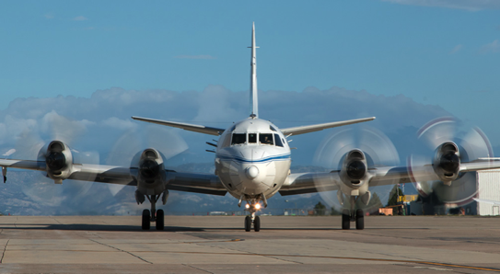
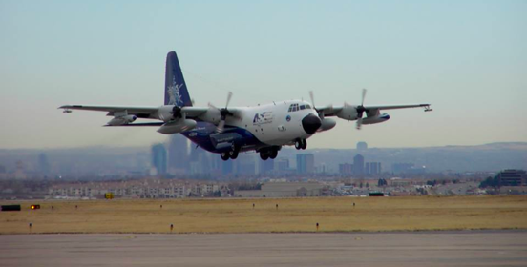
NASA P3
15 Flights
NASA B200
16 Flights
FRAPPÉ and
DISCOVER-AQ Flights
NASA Falcon
10 Flights
NCAR C130
17 Flights (2TF)
NASA Aircraft pictures by Paul Filmer, NCAR C130 picture by Sam Hall

Slide 6
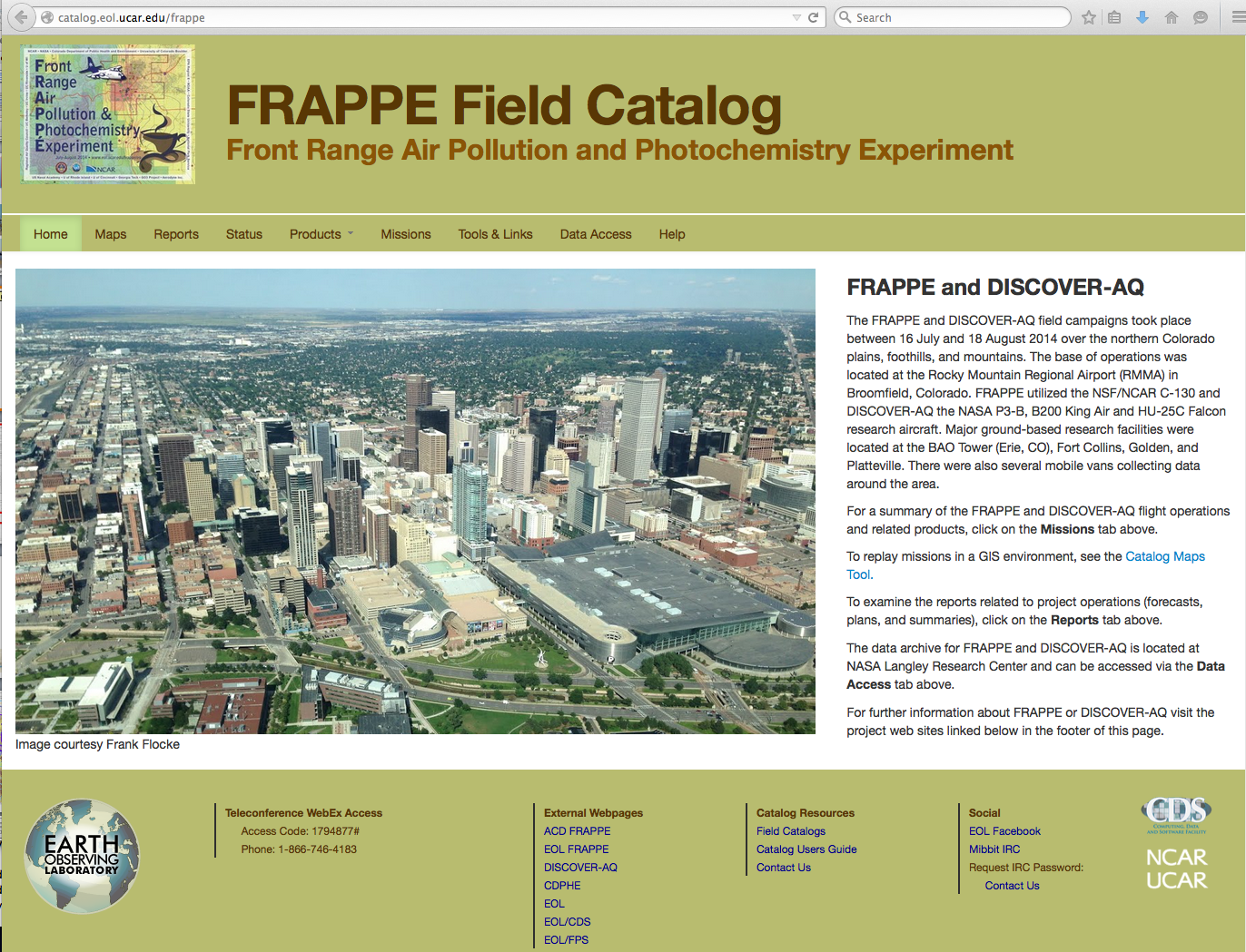
FRAPPÉ Field Catalog
Field Campaign Guidance and Archive

Slide 7

Flight Coverage
All Data and Analysis are PRELIMINARY !

Slide 8
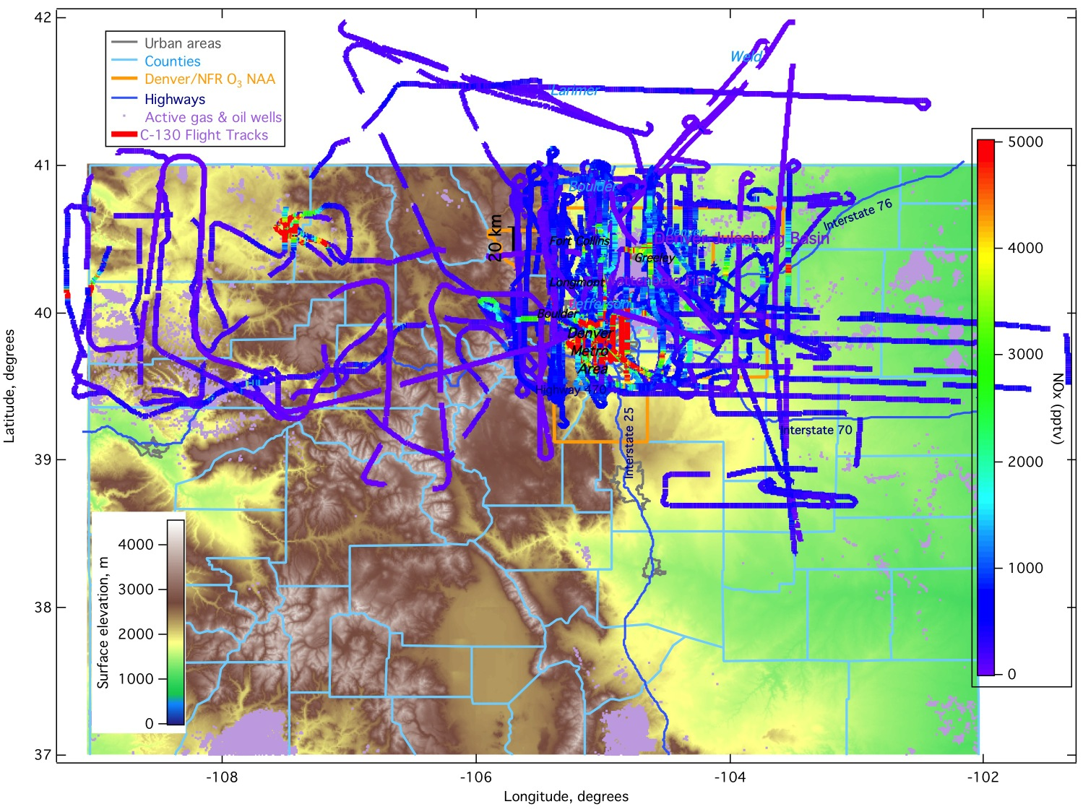
C-130 NO_{x}

Slide 9
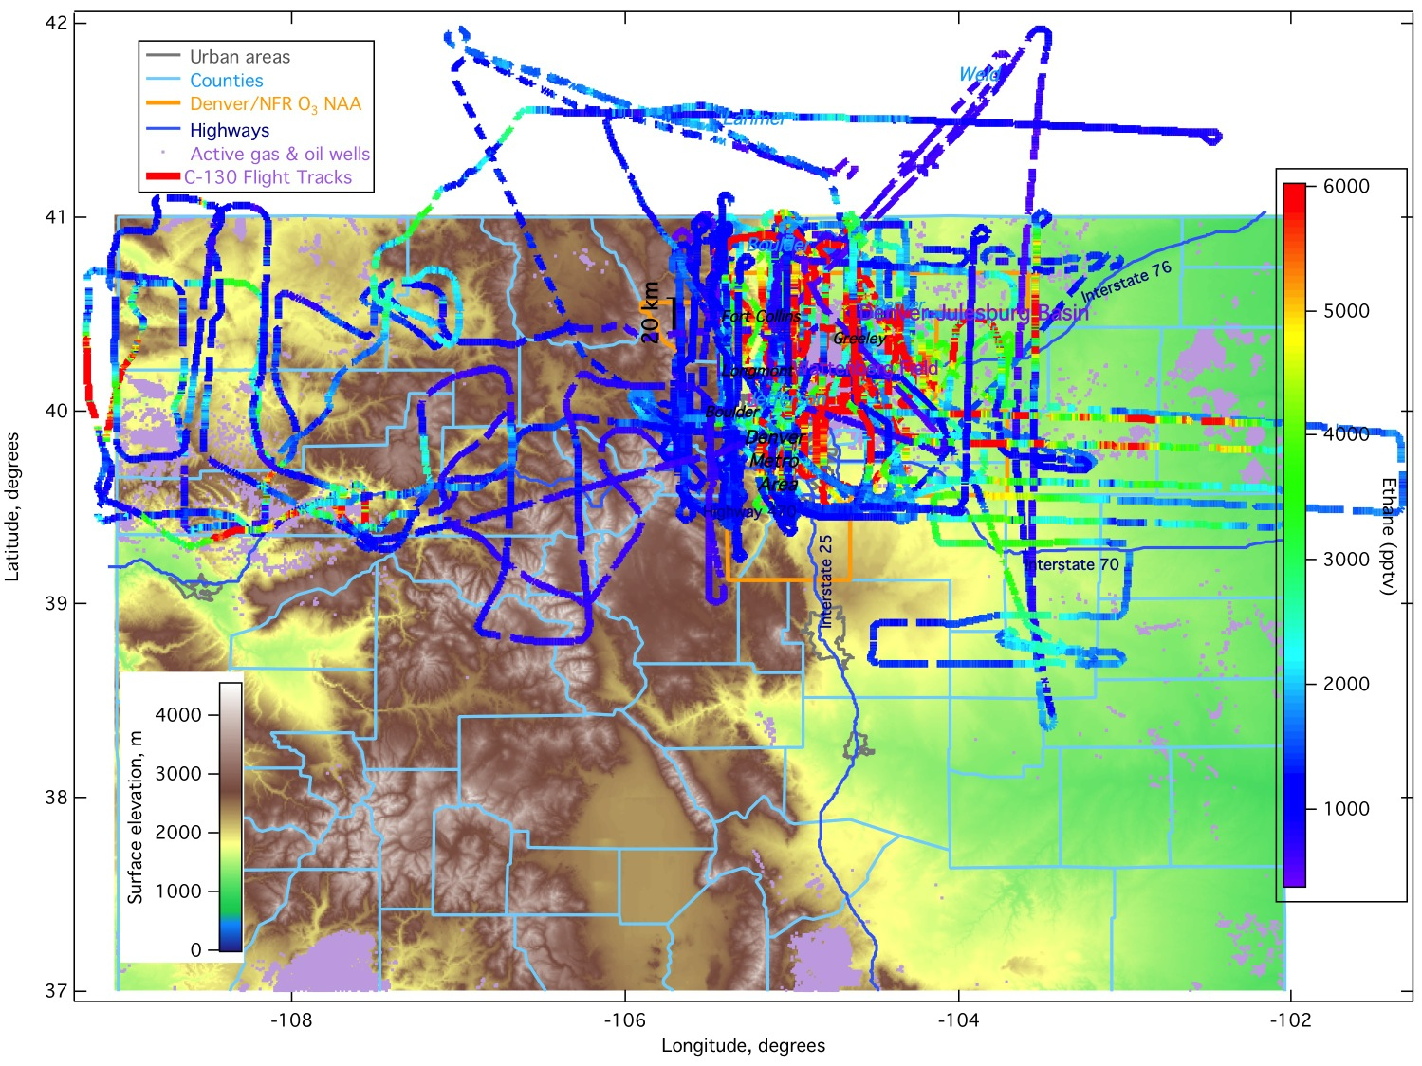
C-130 Ethane

Slide 10
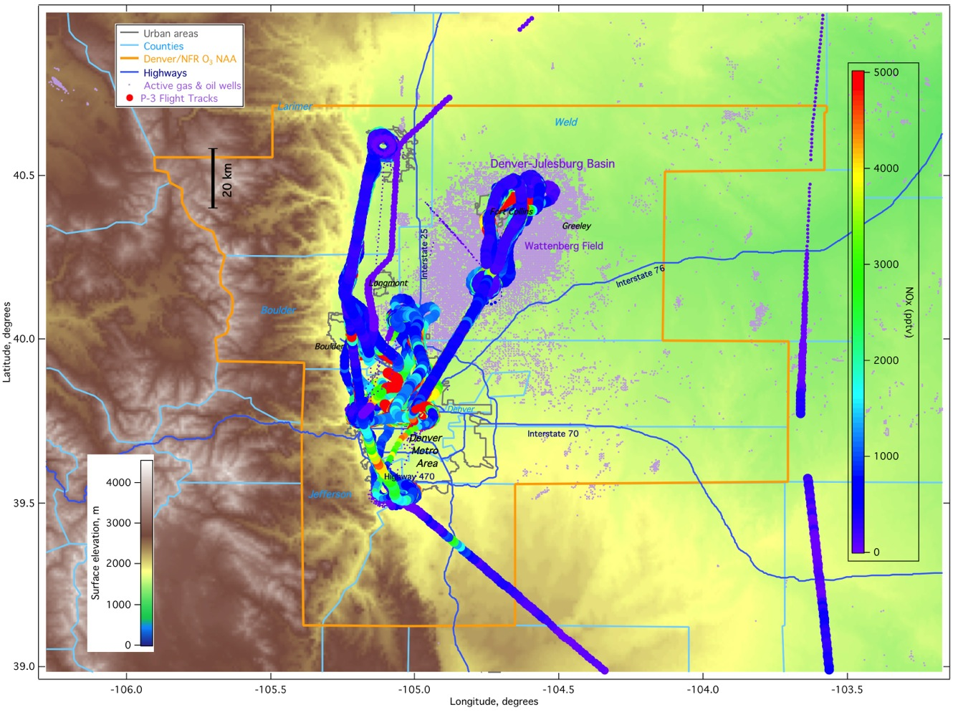
P-3 NO_{x}

Slide 11
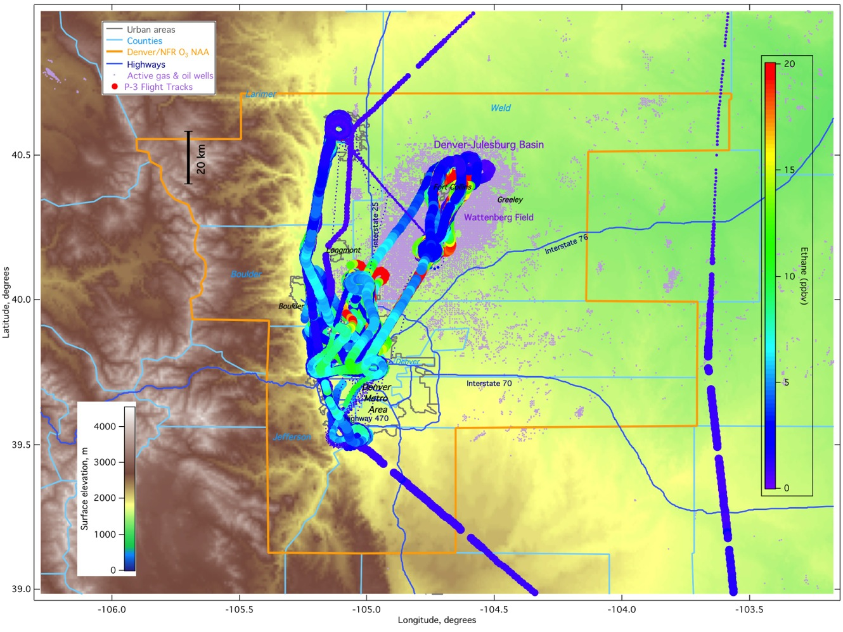
P-3 Ethane

Slide 12
SOURCES
All Data and Analysis are PRELIMINARY !

Slide 13
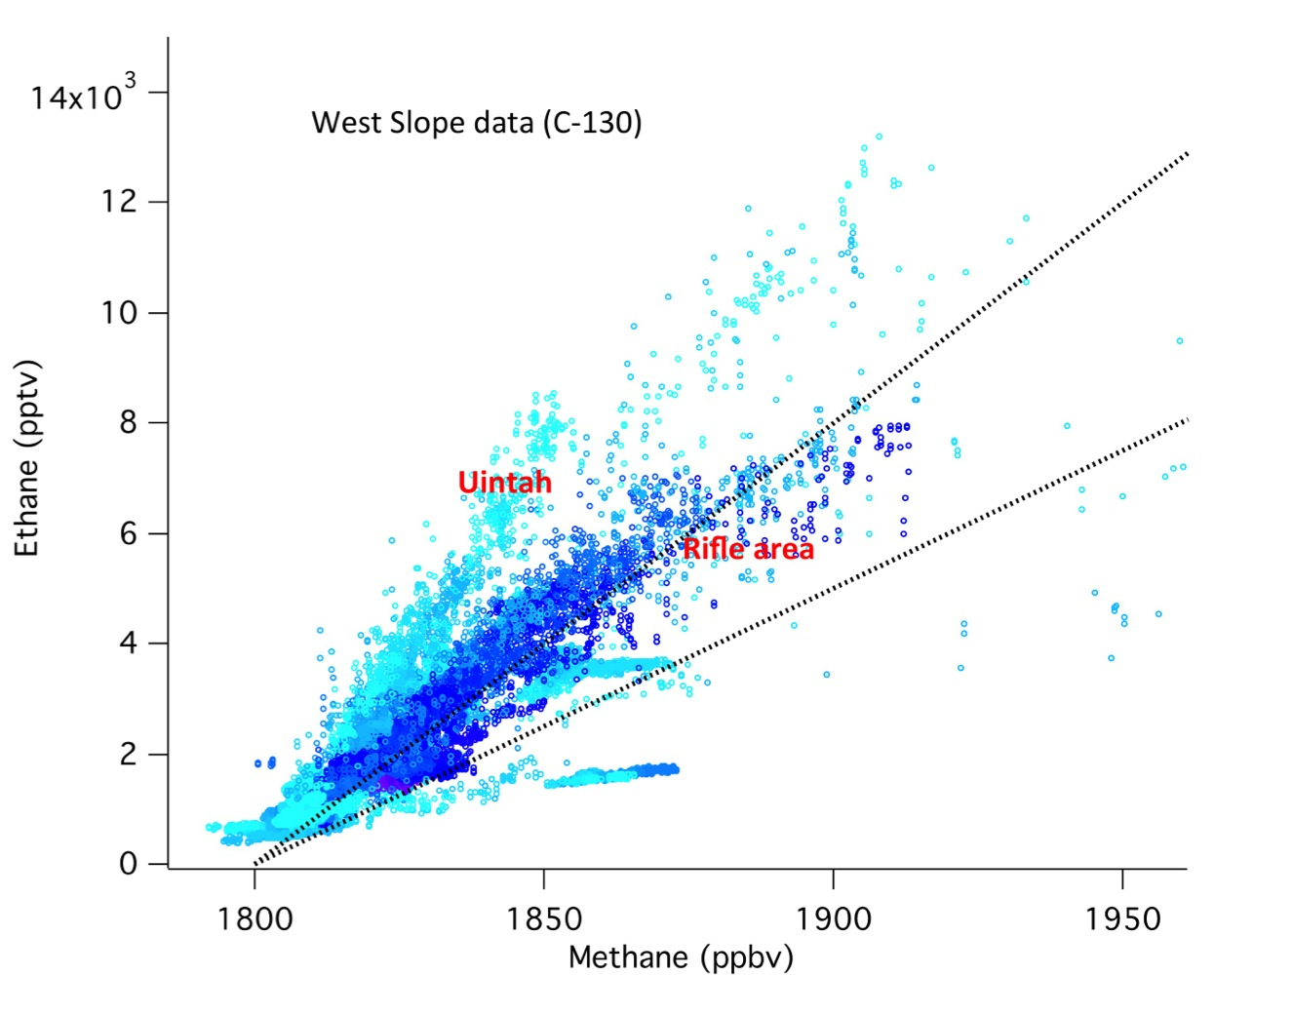
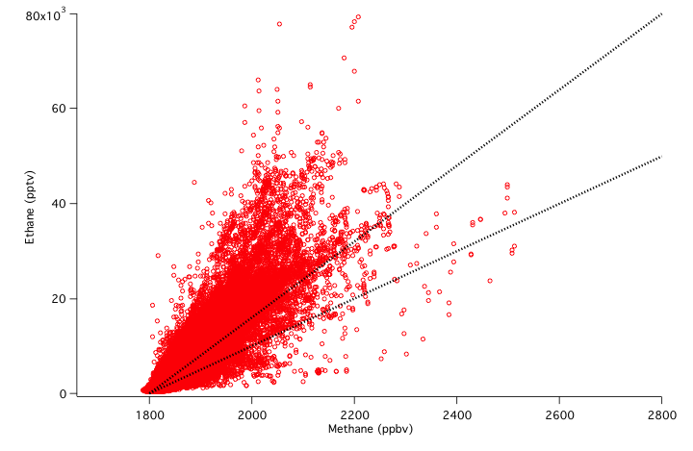
Ethane to Methane Ratio
8% Ethane*
5% Ethane*
Western Slope (C-130)
8% Ethane*
Wattenberg (C-130)
5% Ethane*
*Composition of Natural Gas
as provided by Xcel Energy

Slide 14
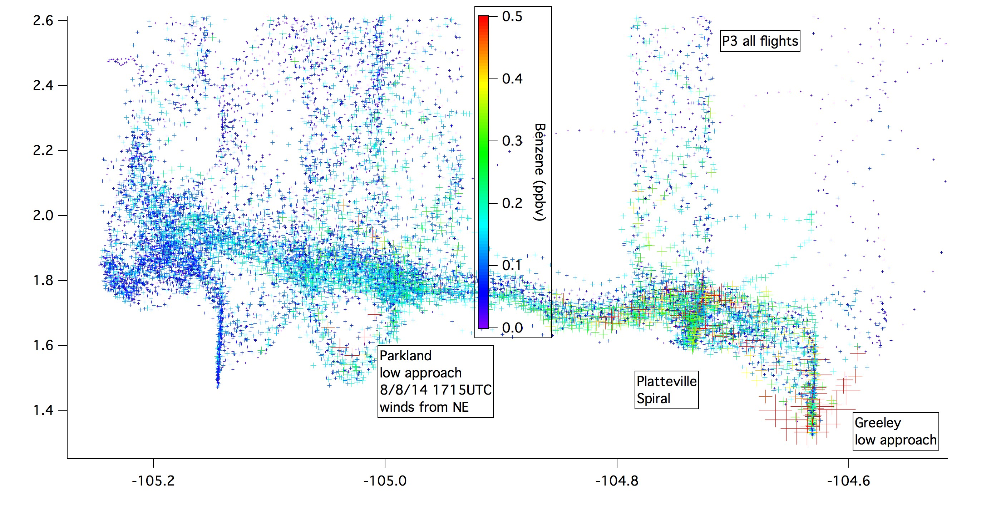
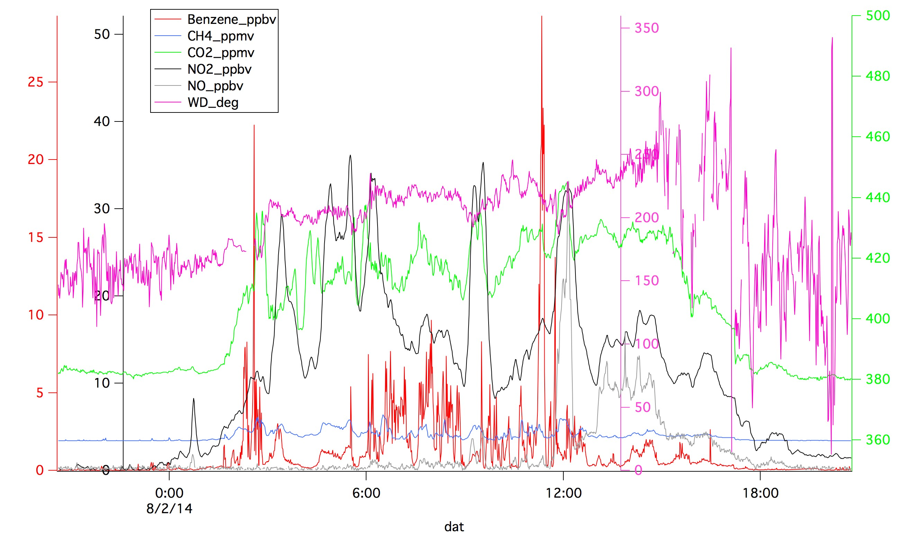
All data NASA P3
Benzene
Alt (km)
0.5
Longitude (deg)
25
Platteville

Slide 15
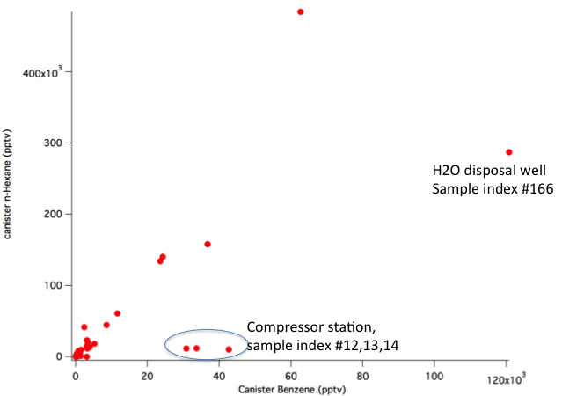
Benzene Correlations
Canister Benzene correlates better with heavier alkanes, not well with CH4 or ethane
or even propane
C130 Aircraft Benzene also correlates better with heavier alkanes
(TOGA data from 7/28/14 flight)

Slide 16
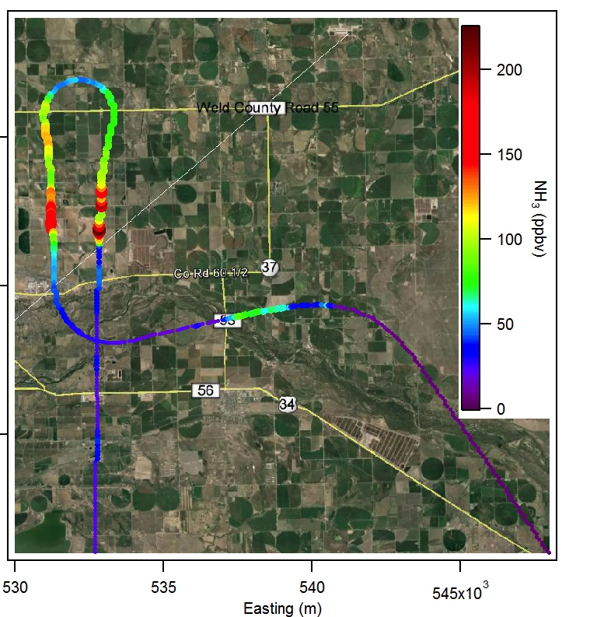
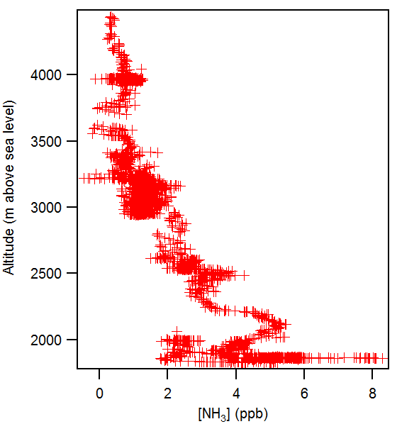
Ammonia from Feedlots
C-130 Low Approach KGXY
C-130 Data

Slide 17
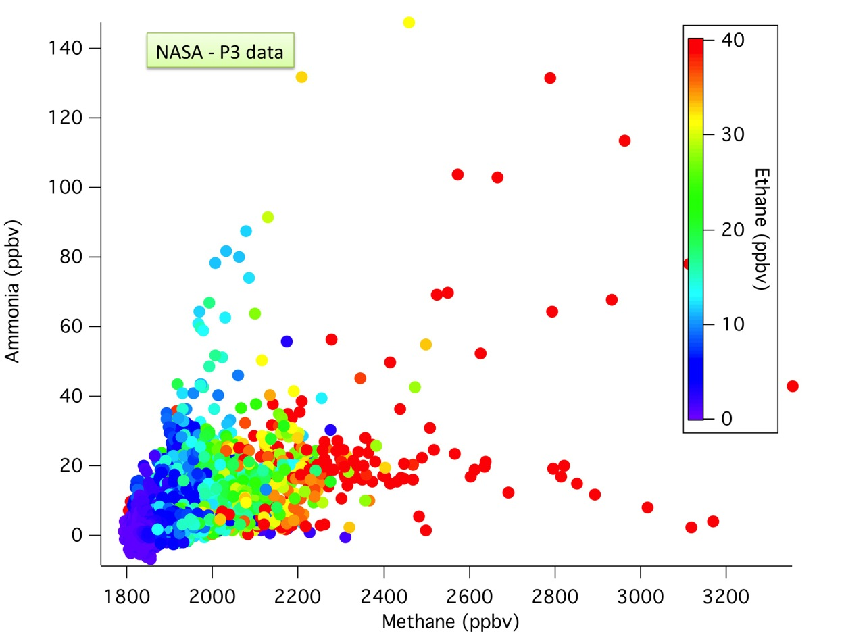
Ammonia to Methane Ratio
Color-coded by Ethane

Slide 18
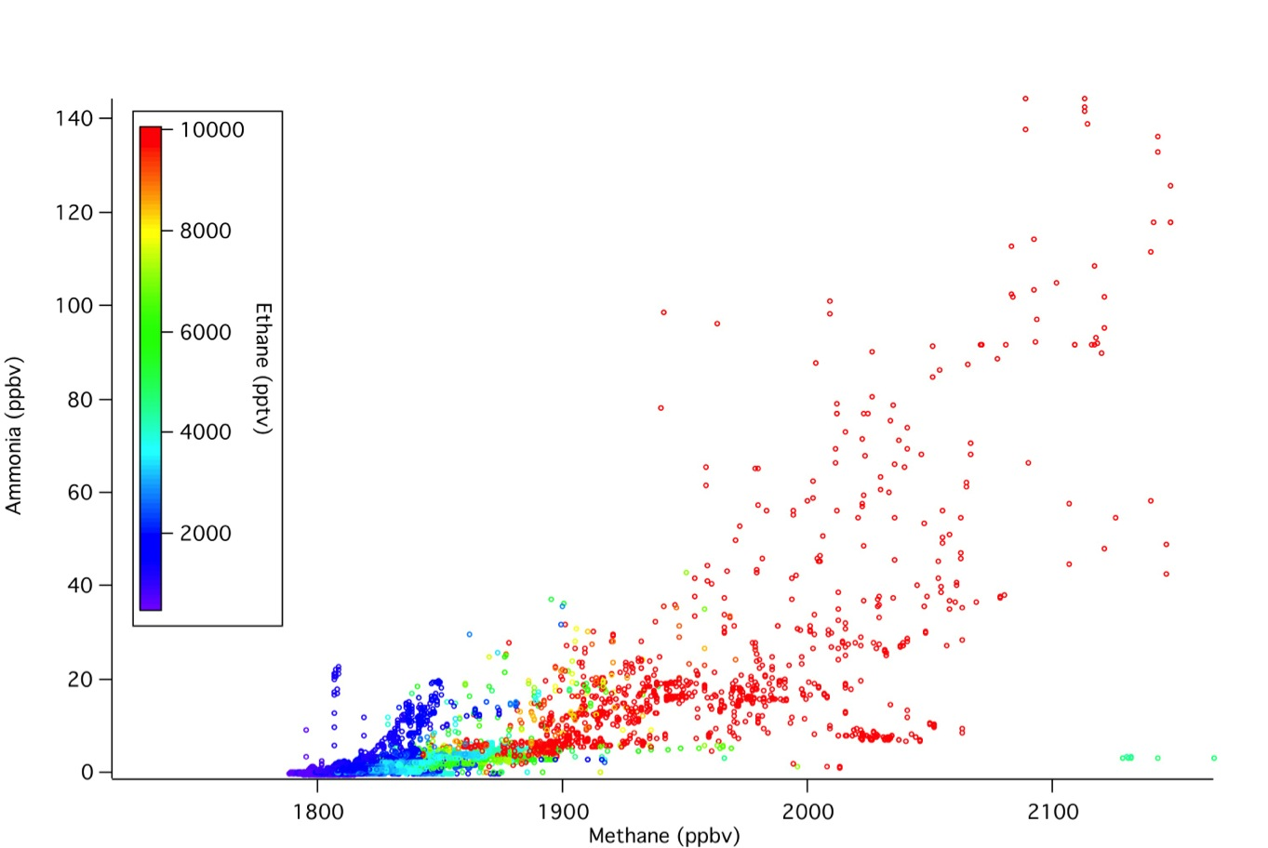
Ammonia to Methane Ratio
C-130 Flights 12-15 for Front Range

Slide 19
Methane Isotopes
Measurements & Analysis: Amy Townsend-Small
Oil and gas sources have a δ²H signature of -202‰
Biogenic (landfill and cattle feedlot) sources have a δ²H signature of -290‰
Example flight dataset: In RF03 it seems the aircraft mostly flew through agricultural sources
Platteville has about equal contribution of O&G and agricultural sources

Slide 20
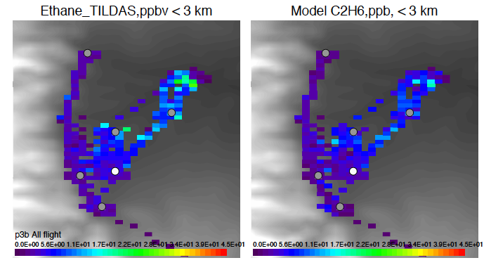
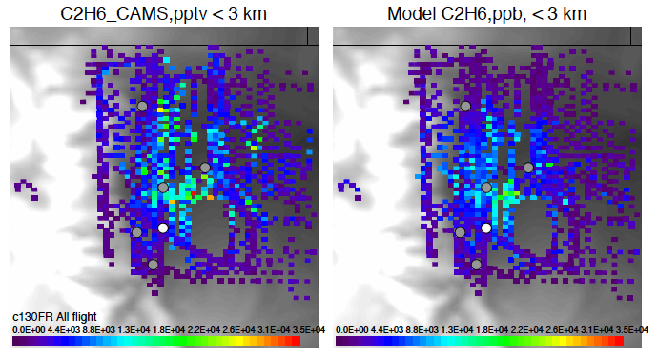
Ethane
Measurements < 3km Model < 3km
WRF-Chem NEI 2011
Disagreement in magnitude
10-16 Local Time

Slide 21
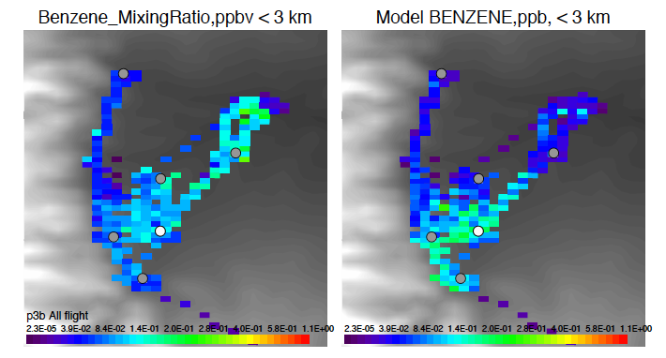
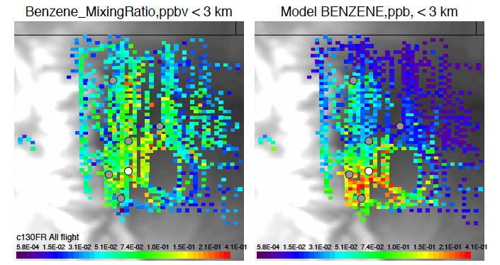
Benzene
Measurements < 3km Model < 3km
WRF-Chem NEI 2011
Disagreement in magnitude, distribution and ratios
10-16 Local Time

Slide 22
Point Sources
All Data and Analysis are PRELIMINARY !

Slide 23
Power Plants – C-130 NO_{x} and SO₂
Hayden, Craig
Valmont
Bonanza

Slide 24
Commerce City – C-130 NO_{x} and So2
Typical coal fired
PP plumes
NO_{x} enhancements of 30-45 ppb
converted boilers Cherokee EGU ?

Slide 25
Power Plants – C-130 NO_{x} and SO₂
NO_{x}
SO₂
Hayden
Bonanza
Craig
Valmont

Slide 26
Mountain-Valley Flow
All Data and Analysis are PRELIMINARY !

Slide 27
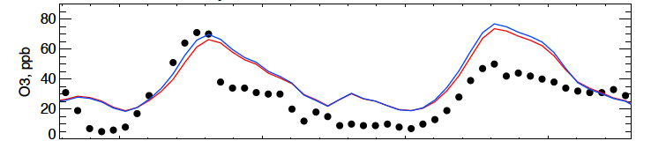
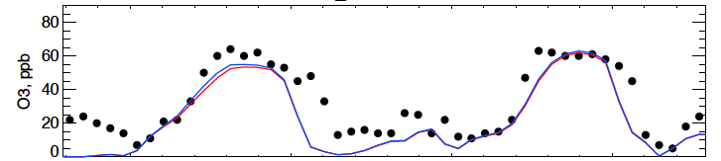
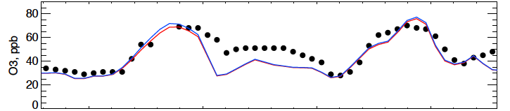
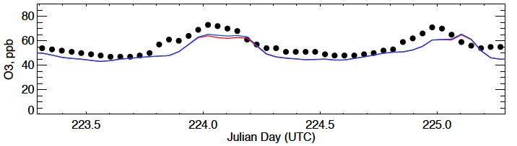
August 11 & 12, 2014
Transport
into the Mountains
Surface Ozone
Greeley
Denver La Casa
NREL Golden
Mines Peak
Surface Monitoring (CDPHE)
WRF-Chem NEI 2011
WRF-Chem + 50% O&G emissions
12 August 2014
4pm LT
4pm LT

Slide 28
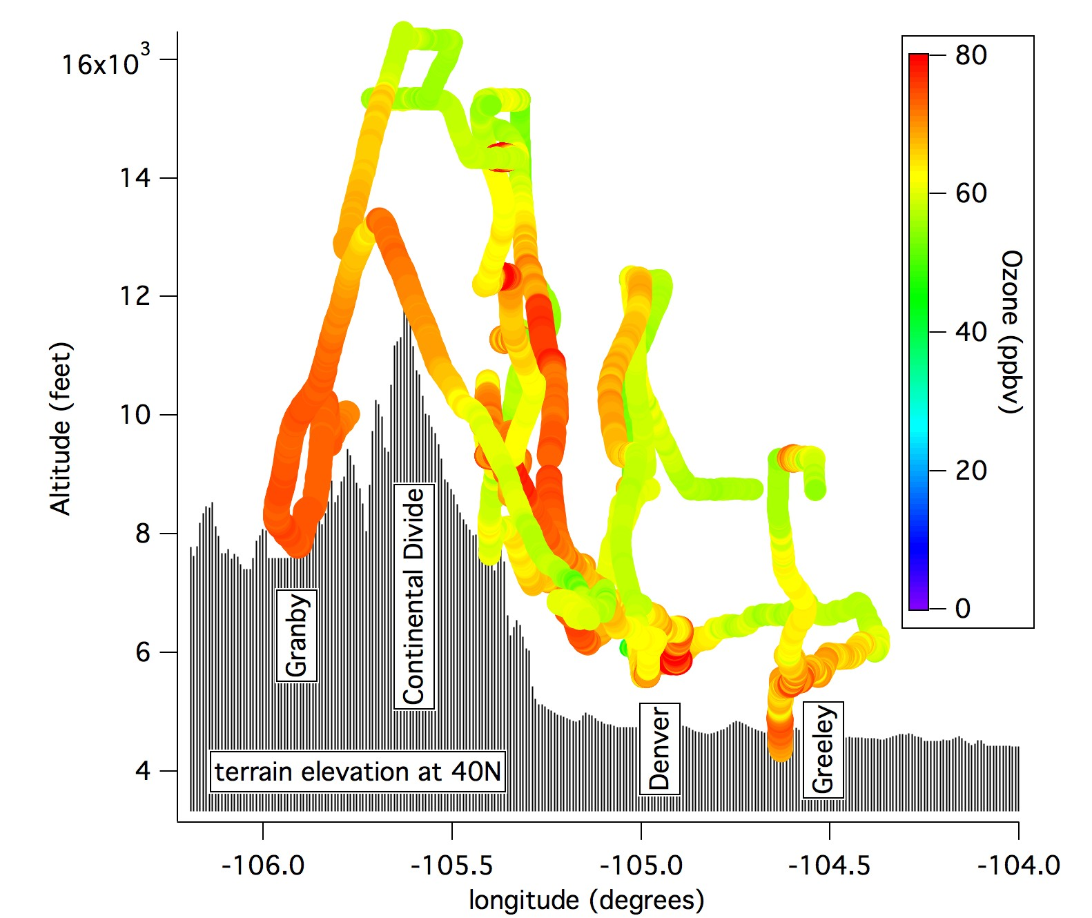
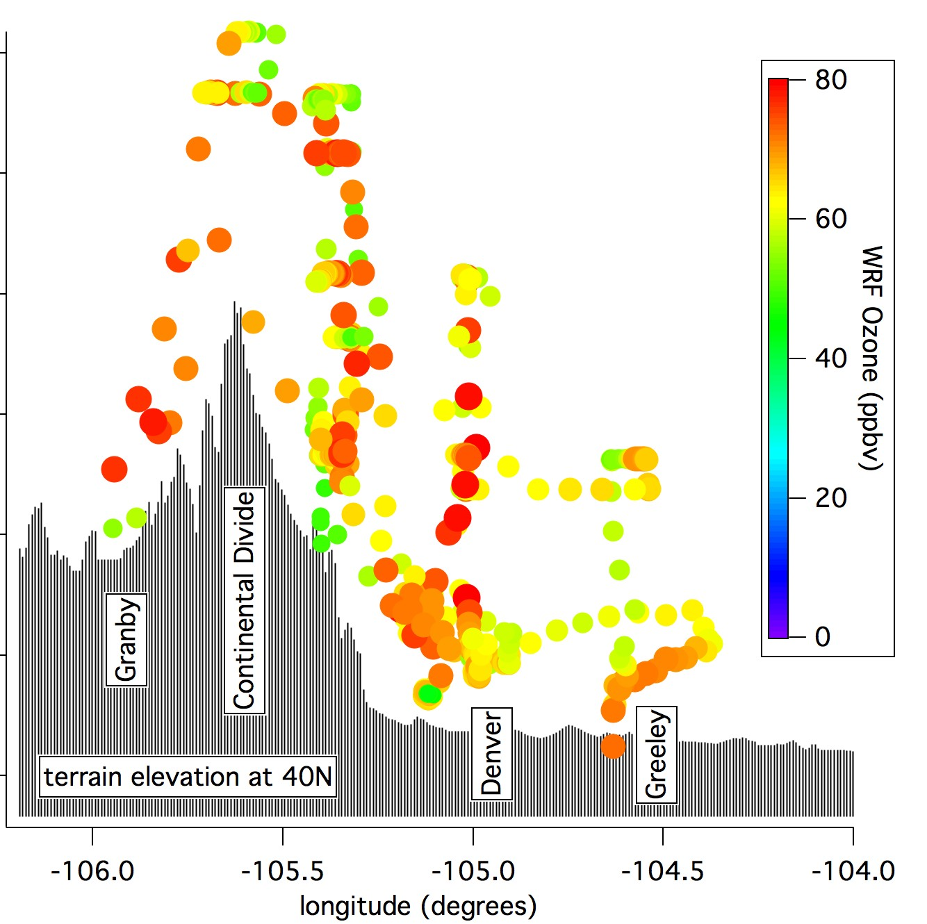
Transport into the Mountains - Ozone
Background O₃ (50 ppb)
C-130
Modeled
Evening
spillover
Upslope flow
The Figures highlight the transport event for ozone - produced over the Front Range and being pushed westward into the mountains by thermally driven upslope.
This demonstrates how Front Range ozone can impact remote areas up to the divide and into the adjacent valleys on the west side of the divide.
12 August 2014

Slide 29
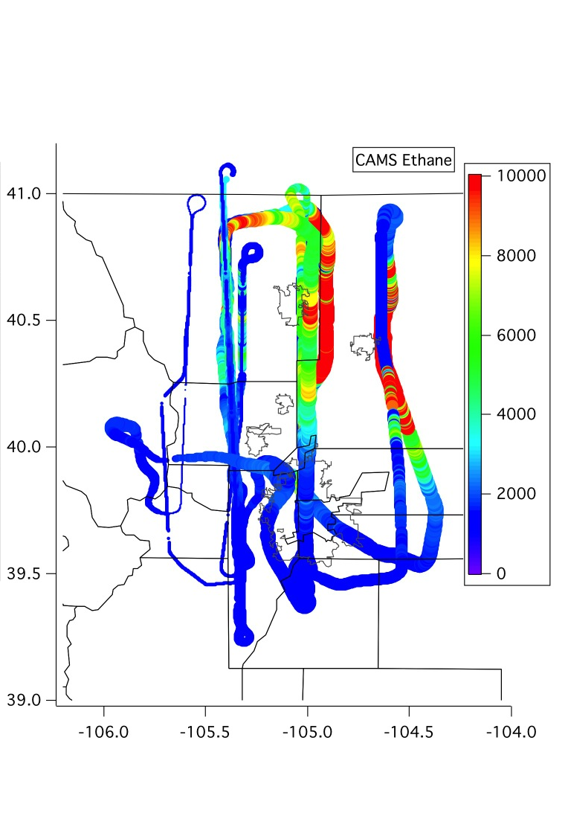
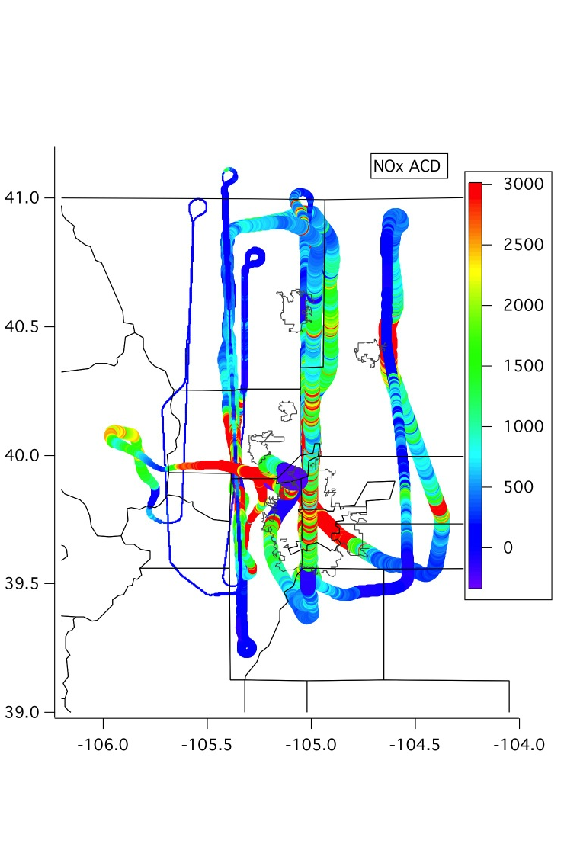
Transport into the Mountains – Ethane & NOx
C-130 Ethane
C-130 NO_{x}
12 August 2014

Slide 30
Outflow
All Data and Analysis are PRELIMINARY !

Slide 31
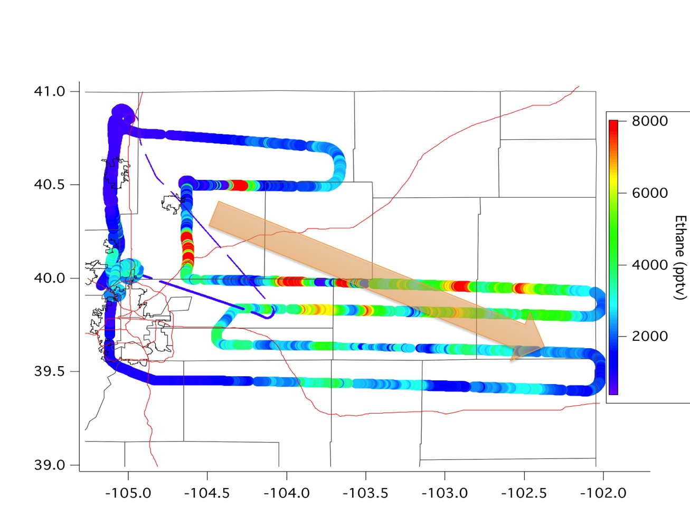
Front Range Outflow (C-130 Ethane)

Slide 32
Denver Cyclone Event
All Data and Analysis are PRELIMINARY !

Slide 33
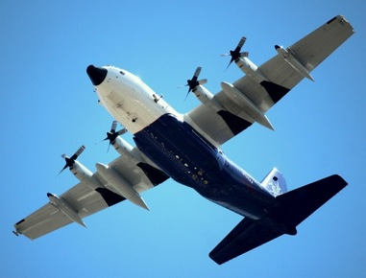
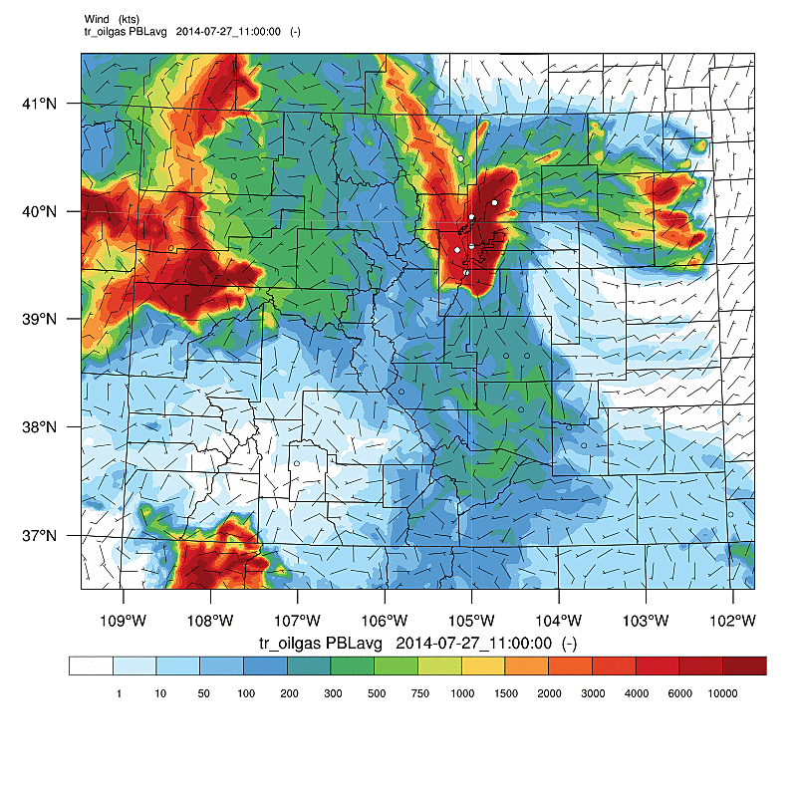
The Denver Cyclone
What the model predicted
What the C-130 saw
Notes:
DCVZ conditions form when a low-level moist, southeasterly flowing air mass meets the Palmer Divide, a ridge that extends east of the Colorado Front Range. If the moist air lifts over the ridge and meets northwesterly winds originating in the Rocky Mountain foothills, winds may converge to create enhanced cyclonic vorticity.^{[2]}

Slide 34
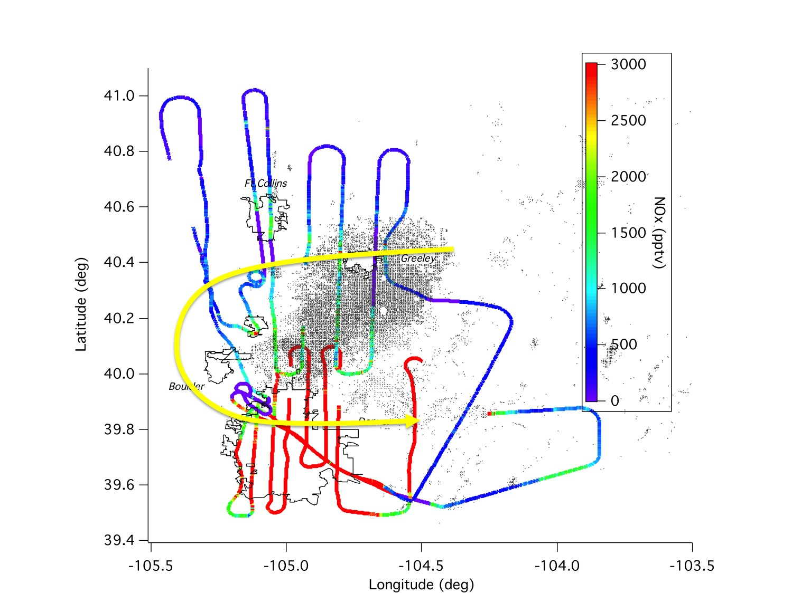
Local emissions - Separation and Mixing
C-130 NO_{x}

Slide 35
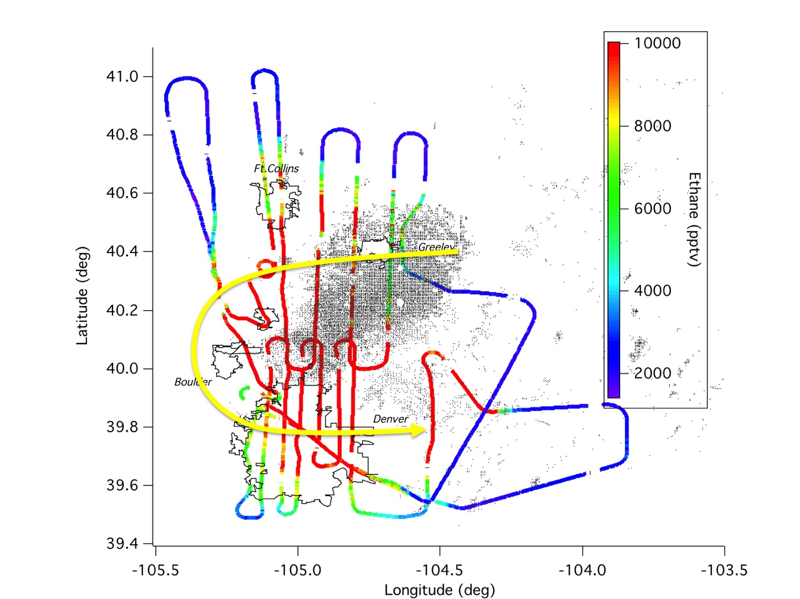
Local emissions - Separation and Mixing
C-130 Ethane

Slide 36
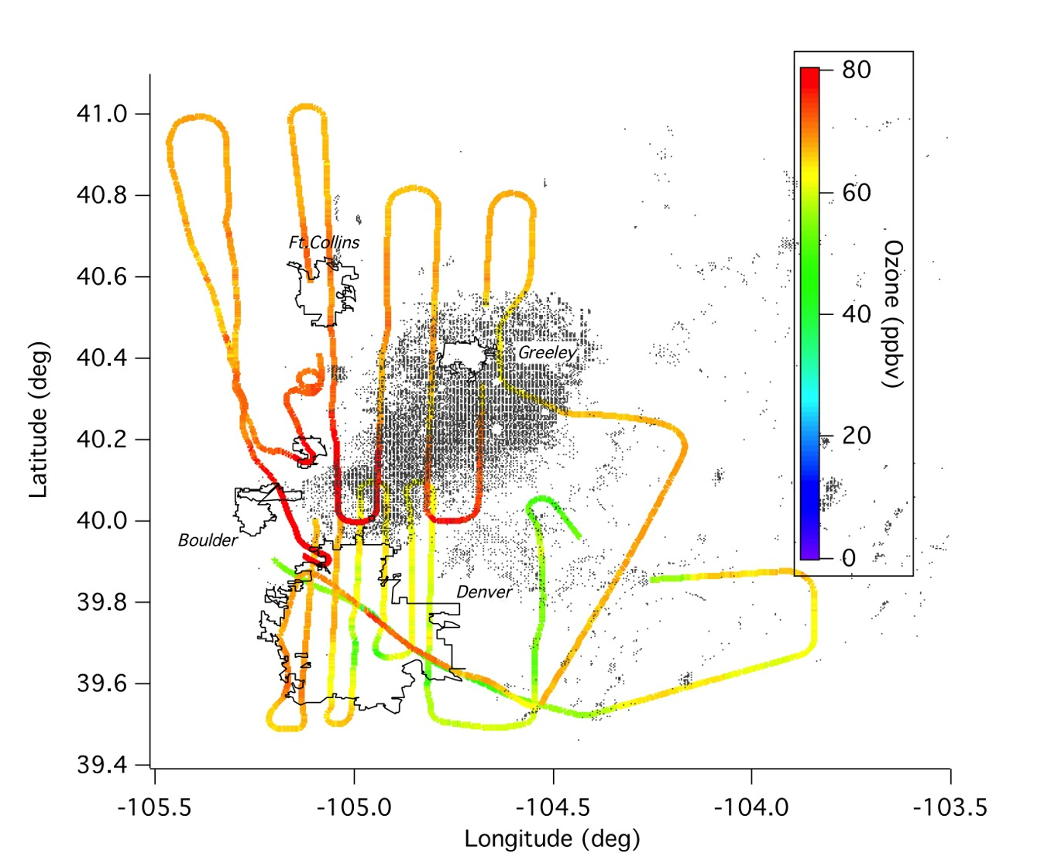
Local emissions - Separation and Mixing
C-130 Ozone

Slide 37
Regional Pollution
All Data and Analysis are PRELIMINARY !

Slide 38
Inflow from the West?

Slide 39
Regional Ozone Distribution
C-130 All altitudes

Slide 40
PRELIMINARY Findings
Clearly identified and characterized all emission sources in the Front Range and Western Slopes slope
  Northern Front Range / Greeley / DJ Basin dominated by oil & gas and agricultural emission signatures
  Denver / Boulder urban centers usually dominated by traffic and industrial emissions
Ozone efficiently formed across the region
In the absence of wildfires, this summer’s Front Range air quality was mainly controlled by local emissions.
Air Quality in Eastern Foothills and to the Continental Divide dominated by Front Range emissions
Elevated regional ozone background
Influence of Western Slope sources on Front Range are small
Transport of front range air pollution into mountains and adjacent valleys was seen regularly.
Outflow from Front Range into Eastern Plains can be significant
Identified potential new / better monitoring locations
Need for improved emission information for AQ modeling

Slide 41
More to come …
Joint FRAPPÉ/DISCOVER-AQ Science Team Meeting
May 4-8, 2015
UCAR Center Green (CG1)
3080 Center Green Drive
Boulder, Colorado
https://www2.acd.ucar.edu/frappe/may-2015

