Slide 1
Two-dimensional remote sensing of trace gases by the GeoTASO and GCAS airborne instruments during DISCOVER-AQ
Caroline Nowlan, Xiong Liu, Gonzalo Gonzalez Abad, Kelly Chance
Harvard-Smithsonian Center for Astrophysics
James Leitch, Joshua Cole, Tom Delker, Bill Good, Lyle Ruppert, Dan Soo
Ball Aerospace
Scott Janz, Chris Loughner, Melanie Follette-Cook, Matt Kowalewski, Ken Pickering
NASA Goddard Space Flight Center
Alan Fried
INSTAAR, University of Colorado Boulder
Jassim Al-Saadi
NASA Langley Research Center
Jay Herman
NASA Langley Research Center
Lukas Valin and James Szykman
Environmental Protection Agency
FRAPPE/DAQ Science Team Meeting, May 2017

Slide 2
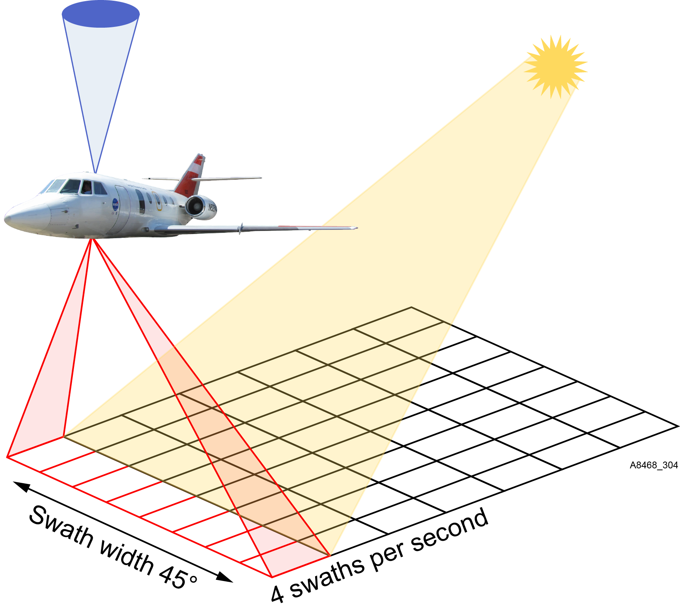
GeoTASO and GCAS
GeoTASO and GCAS are test-bed instruments for geostationary satellite missions
Provide test data
Satellite analog for field campaigns
Future validation instruments

Slide 3
GeoTASO and GCAS Instruments
Geostationary Trace gas and Aerosol Sensor Optimization
Ball Aerospace, now with Scott Janz at NASA GSFC
GEO-CAPE Airborne Simulator
NASA GSFC follow-on from ACAM (D-AQ Maryland/California) (also led by Scott Janz)
 | GeoTASO | GCAS | TEMPO
Wavelength range | 290 – 400 nm 415 – 695 nm | 300 – 490 nm 480 – 900 nm | 290 – 490 nm 540 – 740 nm
Spectral resolution | 0.43 nm 0.88 nm | 0.58 nm 2.8 nm | 0.57 nm 0.57 nm
Spatial resolution (NO₂) | 250 m x 250 m | 250 x 500 m | 2.1 km x 4.4 km
Reference spectrum | Zenith or clean nadir | Clean nadir | Solar diffuser

Slide 4
Trace Gas Analysis
Two step procedure:
Fit slant columns from spectra
Apply air mass factor to get vertical column
VLIDORT for radiative transfer calculations
CMAQ or WRF-Chem for vertical profile shapes

Slide 5
Algorithm Summary
NASA GSFC (PI: Scott Janz)
Use WinDOAS (BIRA) spectral fitting package for slant columns
Slant column data on DISCOVER-AQ archive for:
ACAM (Maryland 2011, California 2013)
GCAS (Texas 2013, Colorado 2014)
Current versions will be updated soon for Texas and Colorado to fix geo-registration
Plans for GCAS air mass factor calculations (Lok Lamsal, GSFC)
Smithsonian Astrophysical Observatory (Caroline Nowlan and Xiong Liu)
Use OMI/TEMPO heritage algorithms
Sub-contracted by Ball Aerospace to provide trace gas retrievals from GeoTASO
Responsible for ACAM/GCAS research grade product
SAO provides slant columns, vertical columns, scattering weights at ~250x500 m²

Slide 6
DISCOVER-AQ Texas GeoTASO NO₂
13 September 2013 (Houston AM Flight)
[Nowlan et al., AMT, 2016]

Slide 7
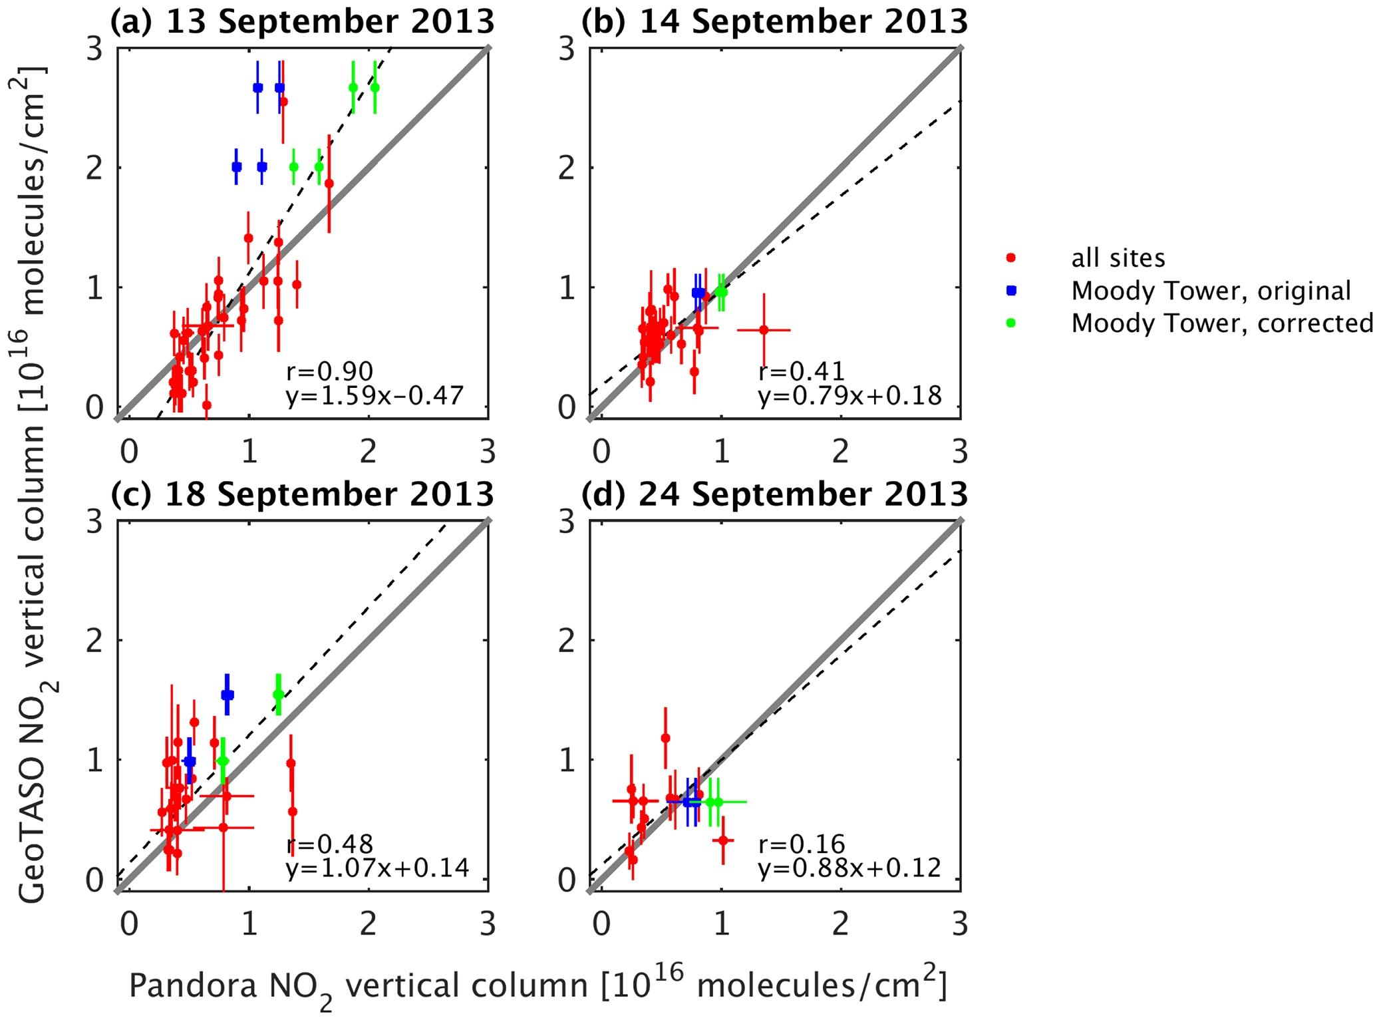
DISCOVER-AQ Texas GeoTASO NO₂
[Nowlan et al., AMT, 2016]

Slide 8
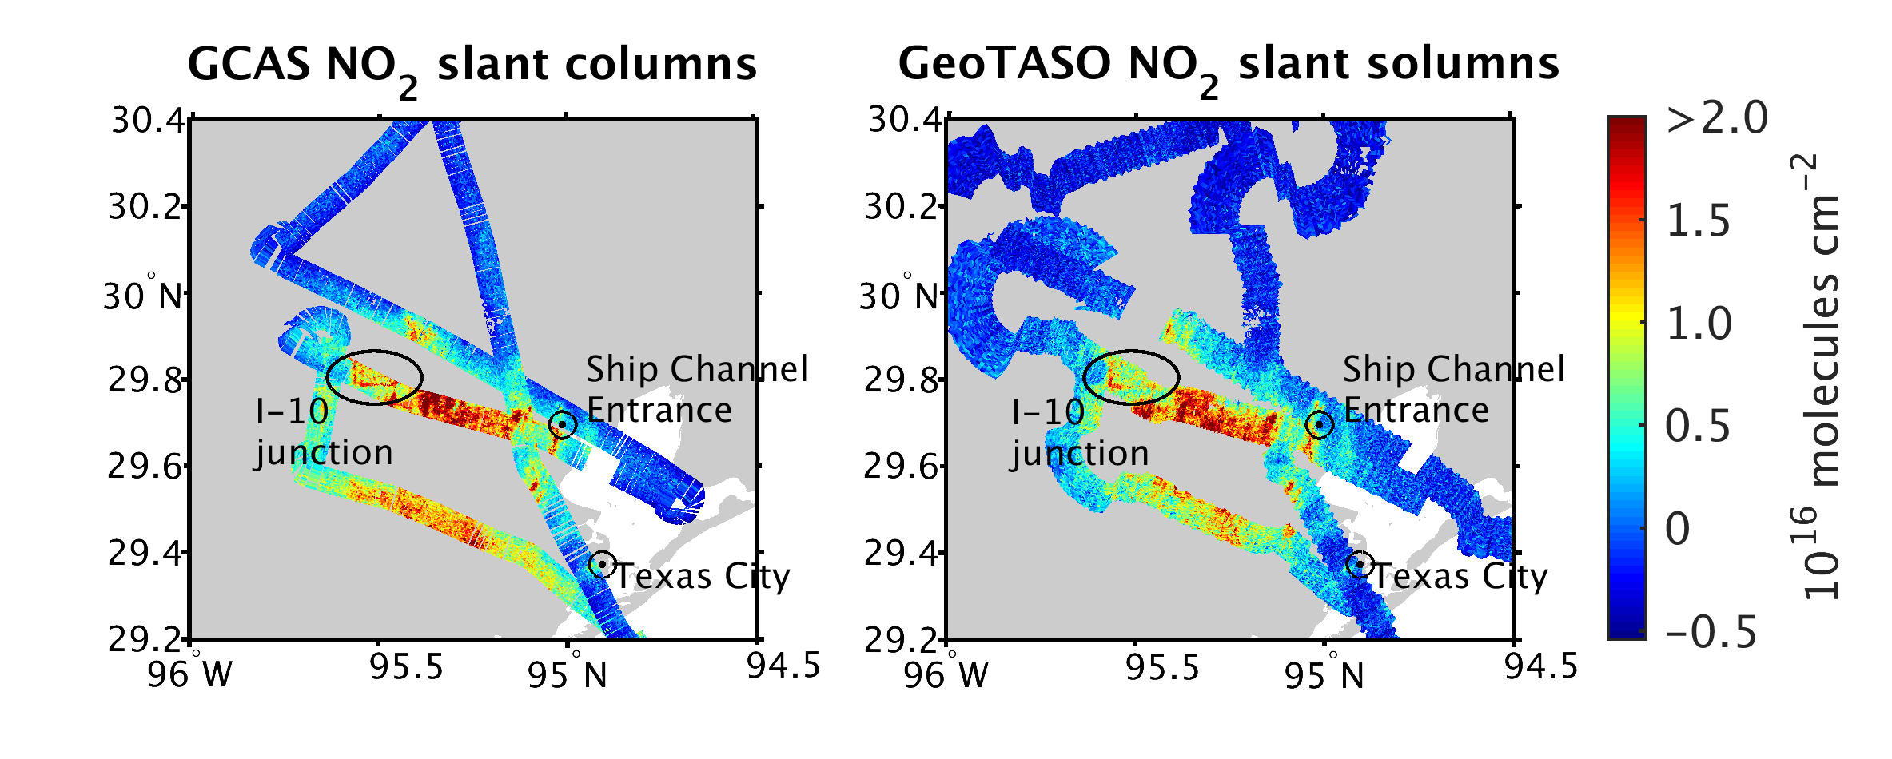
DISCOVER-AQ Texas GCAS and GeoTASO NO₂
13 September 2013 (Houston AM Flight)
[Nowlan et al., AMT, 2016]

Slide 9
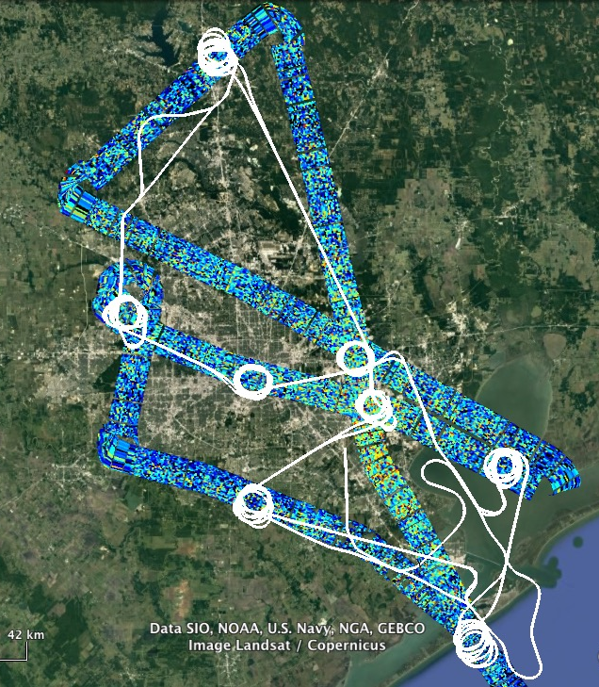
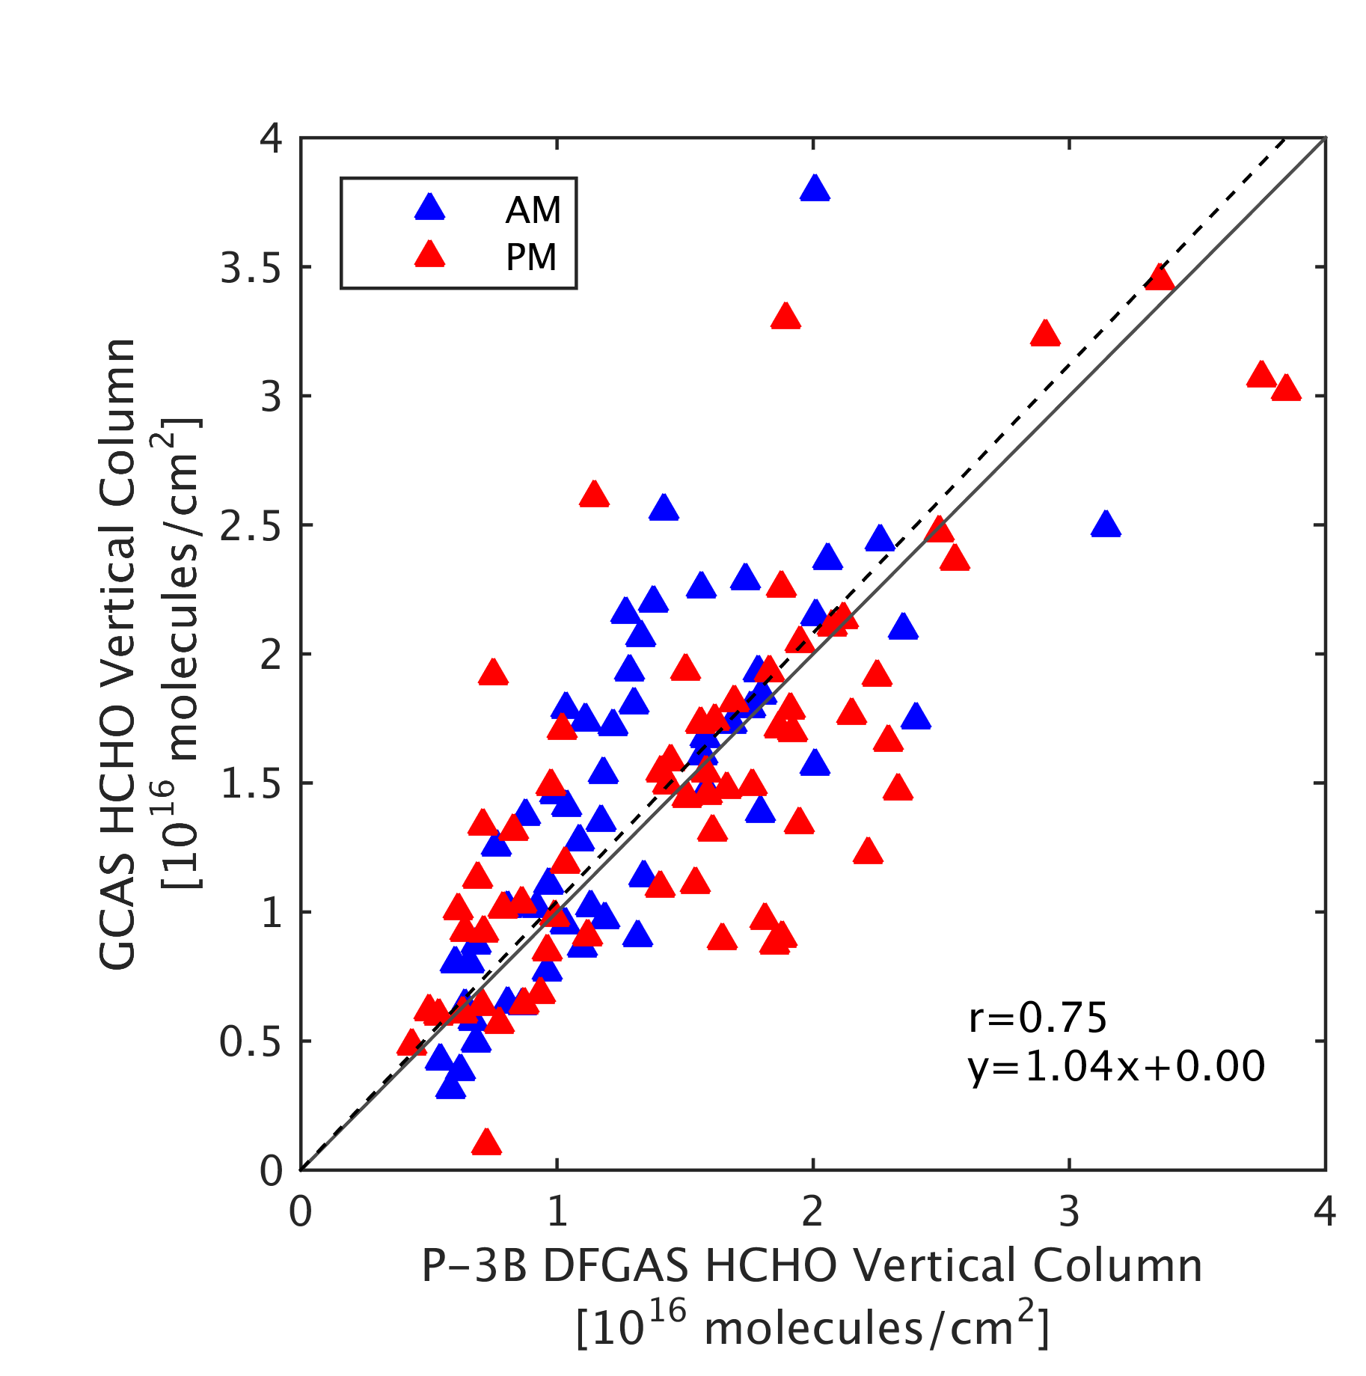
DISCOVER-AQ Texas GCAS Formaldehyde
25 September 2013
2:00 – 3:30 PM LT
GCAS Vertical Columns Averaged over P-3B Spiral Area (all days)

Slide 10
DISCOVER-AQ Colorado GeoTASO NO₂
2 August 2014 Raster Scans
8:00 – 11:30 AM Local time
2:00 – 4:00 pm local time
Slant
Column

Slide 11
DISCOVER-AQ Colorado GeoTASO NO₂
PANDORA Vertical Columns vs. GeoTASO Slant Columns
[Luke Valin, EPA]

Slide 12
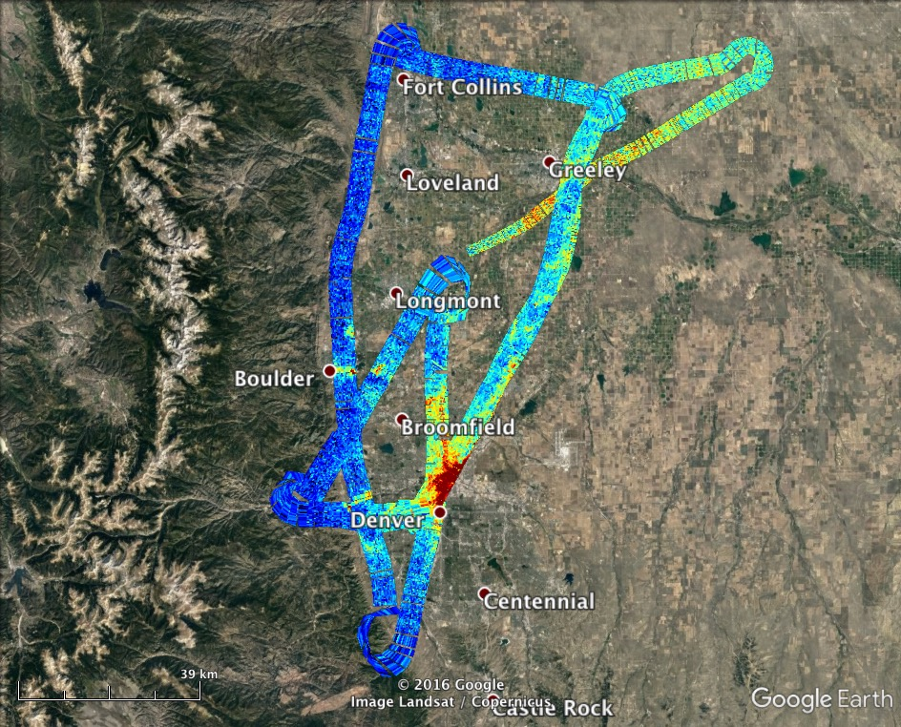
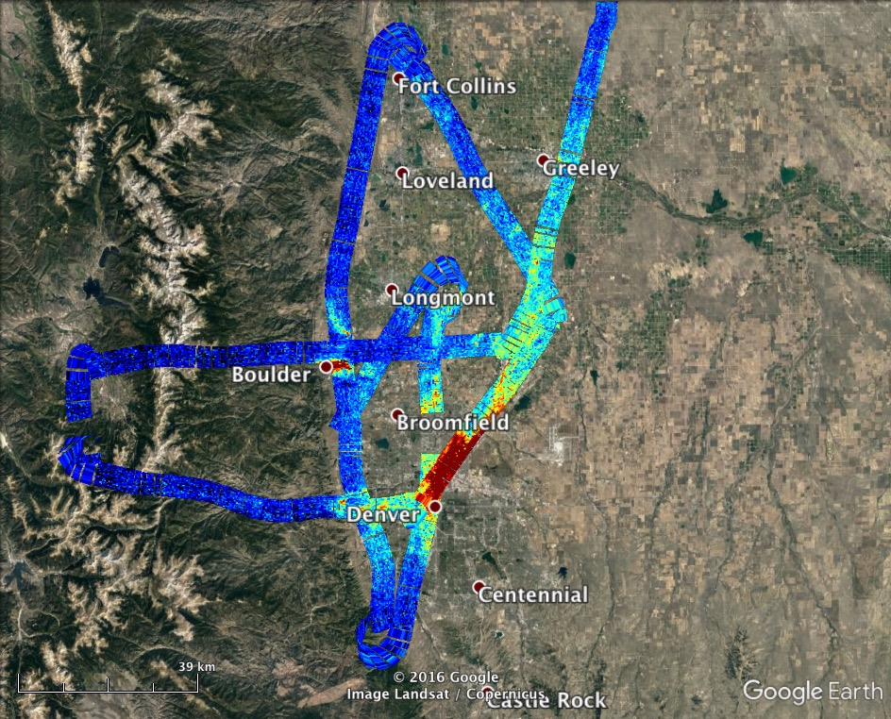
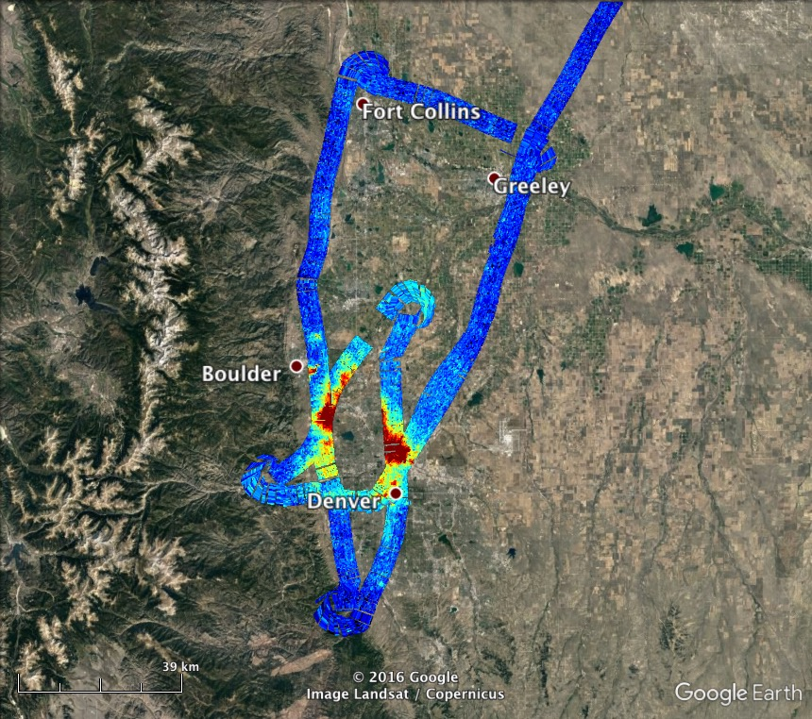
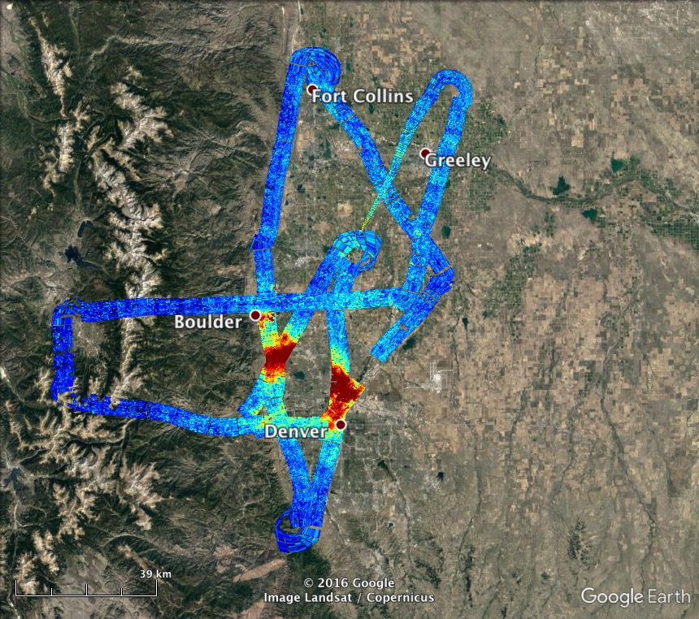
DISCOVER-AQ Colorado GCAS NO₂
Slant
Column
2 August 2014
8:00-10:00 LT
2 August 2014
10:00-11:15 LT
2 August 2014
13:10-15:00 LT
2 August 2014
15:00-16:40 LT

Slide 13
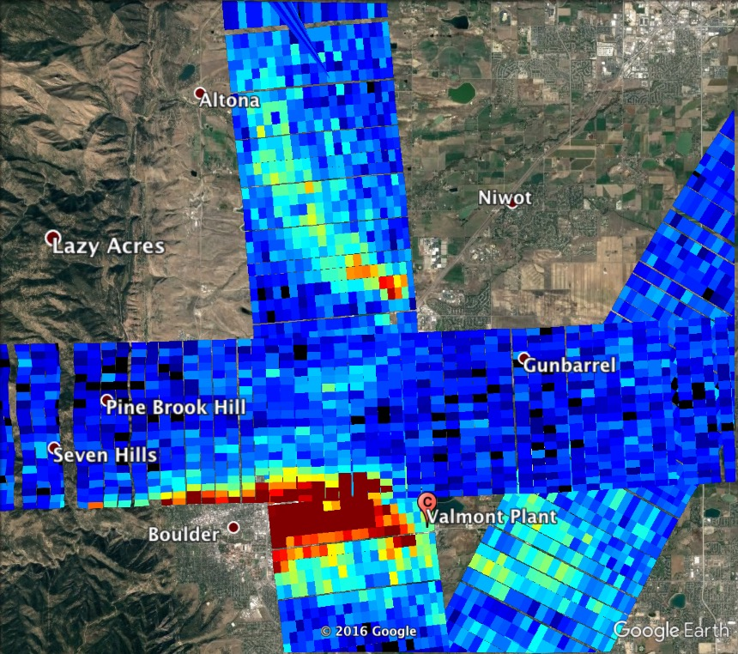
DISCOVER-AQ Colorado GCAS NO₂
2 August 2014
10:00-11:15 LT
Slant
Column

Slide 14
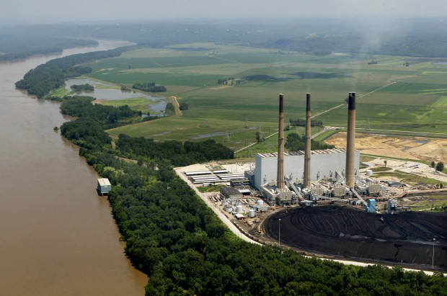
DISCOVER-AQ Colorado GeoTASO SO₂
GeoTASO measured coincident slant columns of NO₂ and SO₂ downwind from Labadie Power Station, Missouri’s largest coal-burning power plant, on transit from Colorado to Virginia (08/13/2014)
Photo by J.B. Forbes

Slide 15
Data Status and Plans
DISCOVER-AQ Texas
GeoTASO
NO₂ vertical columns on DISCOVER-AQ archive [Nowlan, et al., AMT, 2016]
UV absorption suffered from straylight issues
GCAS
NO₂ and HCHO almost finalized and will be on archive soon
DISCOVER-AQ Colorado
GeoTASO
NO₂ and SO₂ slant columns available upon request
GCAS
NO₂ and HCHO slant columns available upon request
Vertical column calculations under way and data should be on archive soon
Future Work
GeoTASO absolute spectral calibration needs improvement for O₃ profile retrievals
What model or idealized trace gas profiles to use for data in archive?
Quantifying the effects of aerosols

Slide 16
DISCOVER-AQ Texas GeoTASO NO₂
Inferred surface NO₂ using CMAQ
[Nowlan et al., AMT, 2016]

