Slide 1



The Potential of Low Cost Sensors to Inform Horizontal and Vertical Variability during
DISCOVER-AQ and FRAPPE
Morgan Silverman, Jim Szykman, Rachelle M. Duvall, Russell W. Long, Melinda R. Beaver, Patti Tyler, Travis, Knepp, Jim Crawford, Steve Brown, Erin E. McDuffie, William P. Dube, Andrew J. Weinheimer, Denise D. Montzka.
DISCOVER-AQ Science Team Meeting
Boulder, CO
May 2-3, 2014

Slide 2
Outline
Objective: Evaluate the performance and potential science applications of small sensors used in D-AQ Denver/FRAPPE campaign.
CairClip sensor and sensor performance
  Collocate measurements with FRM/FEM and research-grade analyzers.
  Precision and accuracy assessment.
Spatial and vertical variability analysis
  Use of sensor to capture spatial gradient across urban scales (kms).
  Use of sensor to capture vertical gradients during daily cycle of the planetary boundary layer, including transition periods and nighttime decoupling during SBL.

Slide 3
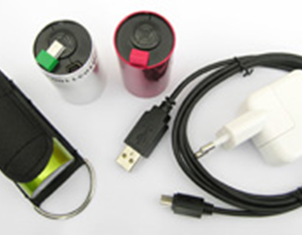
CairClip Sensor
Combined O₃/NO₂ by CAIRPOL (Méjannes les Alès, France).
Alphasense electrochemical sensor - electrochemical-based method to detect gaseous pollutants.
Details can be found in Stetter and Li (2008) and Mead et al. (2013).
Components enclosed in a cylindrical, aluminum casing measuring 32 x 62 mm.
Weigh ~ 55 g, Battery life of 24-36 hrs.
Detection range of 0-250 ppbv.
Contain an integrated data logger. For this study, programmed to collect 1-minute averaged data.
Sensors located at the D-AQ Golden ground site, 2 nearby citizen science sites, as well as placed at different altitudes on the BAO Tower.

Slide 4
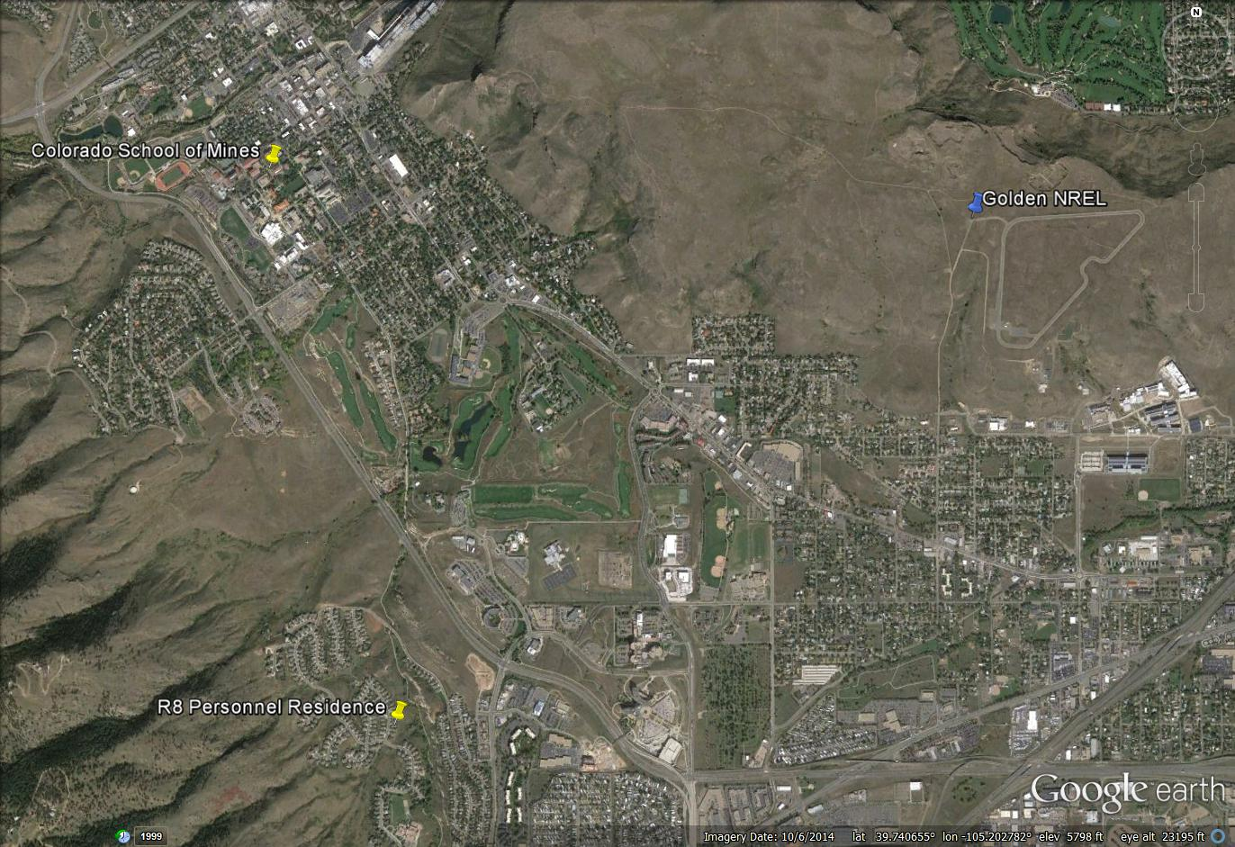
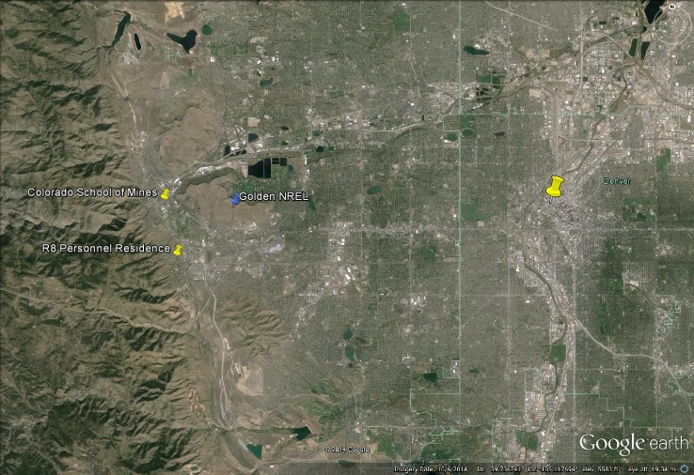
Citizen Science Network - Golden, CO
Cairclip NO₂ + O₃
Cairclip NO₂
Cairclip NO₂ + O₃
Cairclip NO₂
AQMesh
Aeroqual O₃
Aeroqual NO₂/T/RH
Elms (Perkin Elmer)
Upod (Univ of Colorado - Boulder)
EPA R8 Building
Downtown Denver
Cairclip NO₂ + O₃
Cairclip NO₂ + O₃
Cairclip NO₂

Slide 5
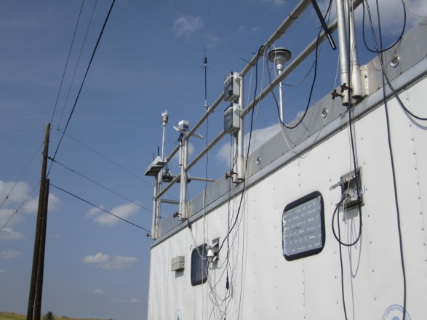
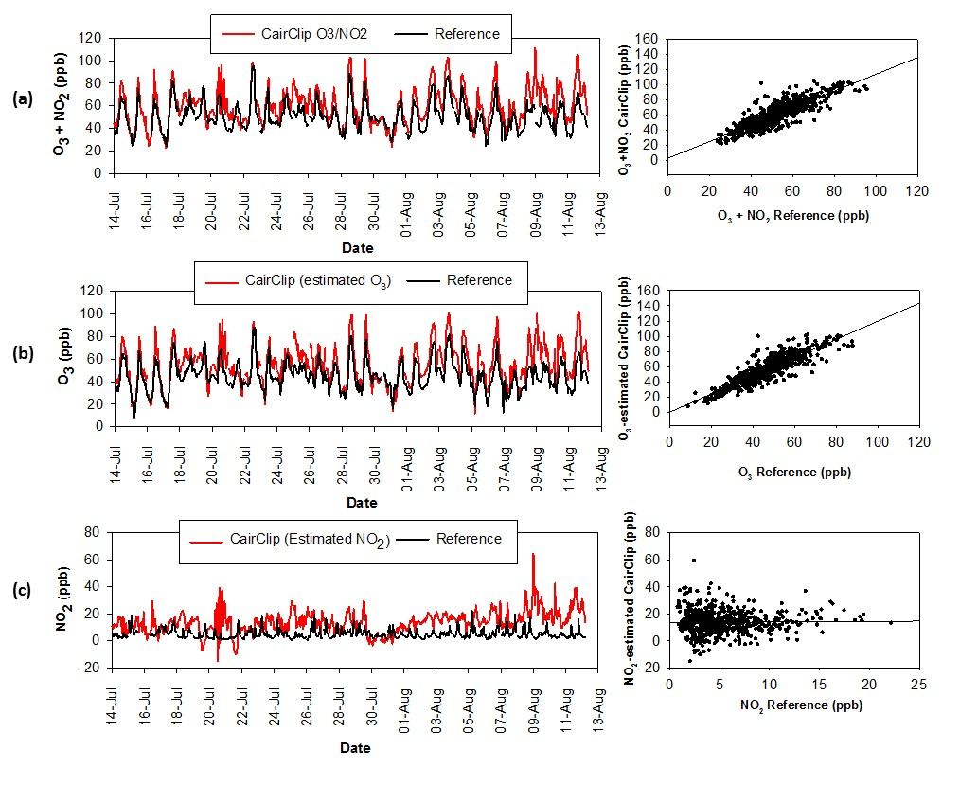
Sensor Consistency - Golden, CO
CairClip sensors collocated with EPA FRM/FEM measurements at Golden DISCOVER-AQ site.
2 citizen science sites located around Golden.
Duvall et al., 2016
y=1.10x+3.35 (R²=0.72 )

Slide 6
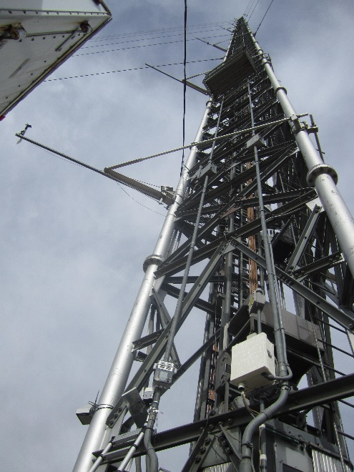
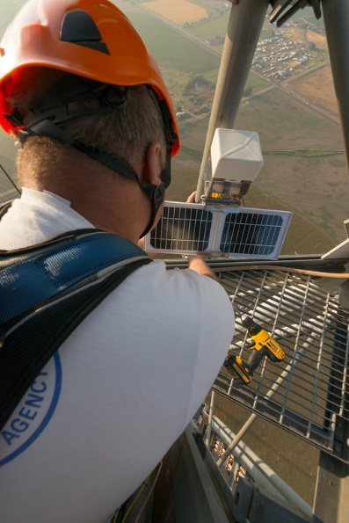
Sensor Consistency – BAO Tower
CairClip sensors located on BAO Tower – GL, 100 m, 200 m, and 300 m powered via solar panels.
NOAA research instruments on BAO carriage used as reference measurement.
Ground Level CairClip

Slide 7
Sensor Consistency – BAO Tower
BAO CairClip vs NOAA Arnold correlation has good agreement, R² = 0.82
Higher NO₂ % better agreement than lower NO₂ %.
45-55 ppbv, ~ 5 ppbv difference
Larger differences at higher observed values and smaller at lower values

Slide 8
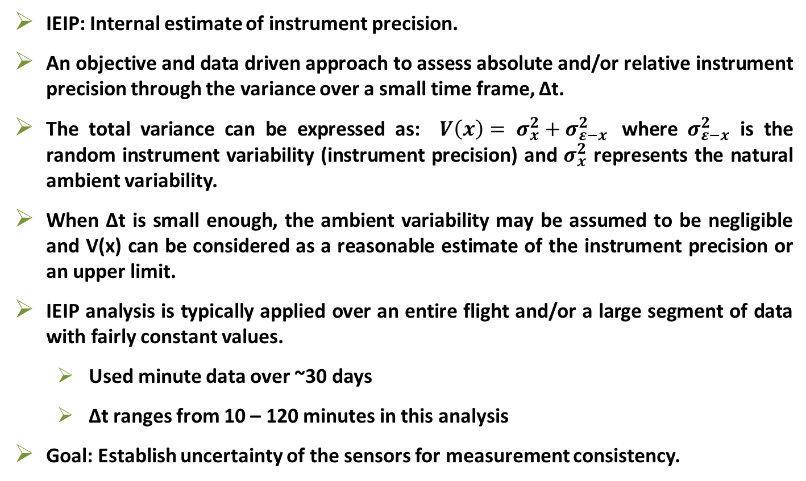
Sensor Performance – Precision Assessment using IEIP
IEIP: Internal estimate of instrument precision.
An objective and data driven approach to assess absolute and/or relative instrument precision through the variance over a small time frame, Δt.
The total variance can be expressed as: $V\left(x\right)= σ_{x}^{2}+σ_{ε−x}^{2}$where $σ_{ε−x}^{2}$ is the random instrument variability (instrument precision) and $σ_{x}^{2}$ represents the natural ambient variability.
When Δt is small enough, the ambient variability may be assumed to be negligible and V(x) can be considered as a reasonable estimate of the instrument precision or an upper limit.
IEIP analysis is typically applied over an entire flight and/or a large segment of data with fairly constant values.
  Used minute data over ~30 days
  Δt ranges from 10 – 120 minutes in this analysis
Goal: Establish uncertainty of the sensors for measurement consistency.

Slide 9
Sensor Precision
Golden
BAO Tower 100 m
Local Residence
Looking at relative precision instead of absolute due to Ox range 0-200 ppbv over campaign.
~3-6 % uncertainty across the CairClips.

Slide 10
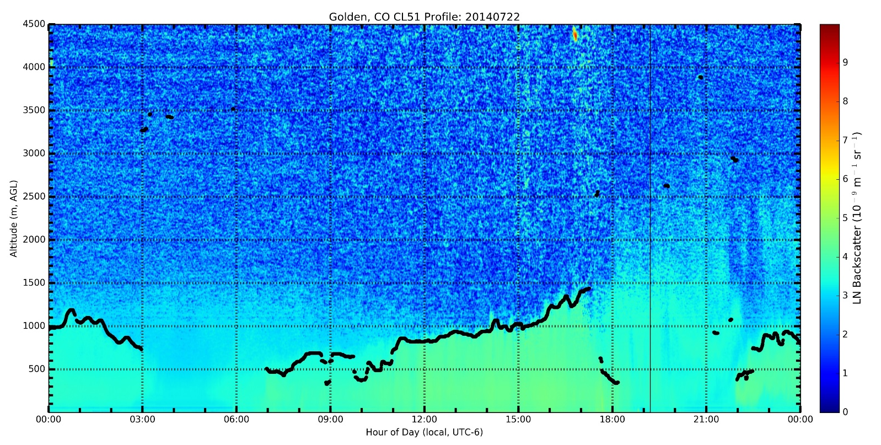
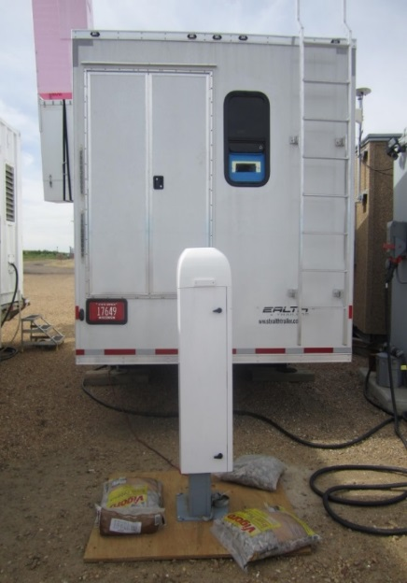
Spatial Variability – Golden, CO
Can the sensors capture the spatial gradients across an urban area?
July 22 – 4 state monitoring sites in Denver area categorized as “unhealthy for sensitive groups”.
Used Andy Weinheimer’s P-3B NO₂ and O₃ data.
Only used P-3B data below Mixing Layer Height (MLH) as derived from CL-51 using the Vaisala BL-View
P3-B spiral –

Slide 11
P-3B BL Spatial Variability - Golden, CO

Slide 12
P-3B BL Variograms - Golden, CO

Slide 13
Spatial Variability – Golden, CO
P-3B variograms used to gauge spatial variability across the Golden airshed.
P-3B variograms – 15Z shows minor spatial variability (low BL/MLH) with increasing variability for 17Z and 21Z during growth of BL/MLH, and decreased variability for 23Z spiral when BL/MLH becomes well mixed.
Variability between Golden and CSM site consistent with P3-B variograms. RES CairClip consistently lower through the day. Site was located in foothills of Lookout Mountain.
Comparison of the 15-minute Averaged O₃/NO₂ Cairclip, FRM/FEM, and NASA P-3B Aircraft data on July 22, 2014

Slide 14
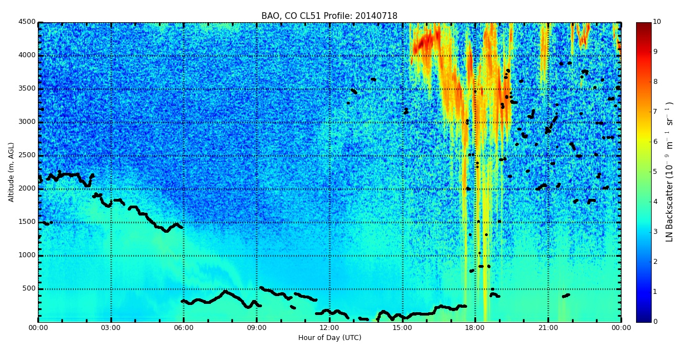
Vertical Variability – BAO Tower (work in progress)
Can the sensors on the BAO tower capture the daily boundary layer cycle?
MLH derived from CL-51 using the Vaisala BL-View
Characteristic backscatter curtain plot generated in BL-View for 18-July, 2014

Slide 15
Vertical Variability – BAO Tower (work in progress)
CairClip sensors located at BAO Tower – GL, 100 m, 200 m, and 300 m powered via solar panels.
300 m sensor appears to have experienced performance issues shortly after start of the study.
Ground Level
CairClip

Slide 16
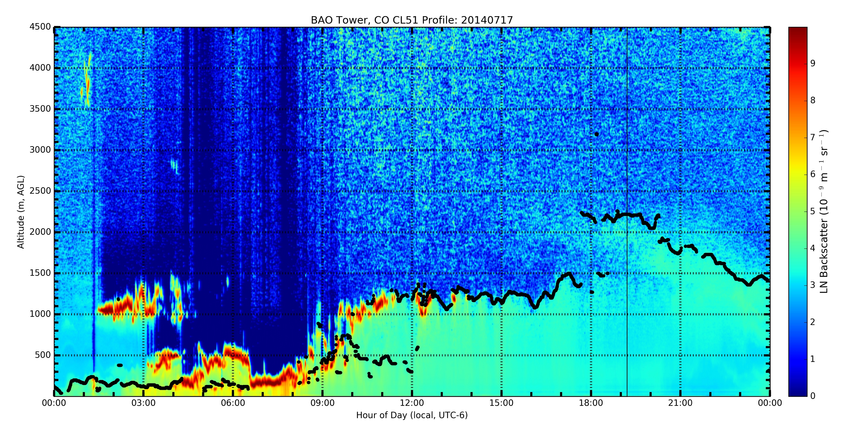
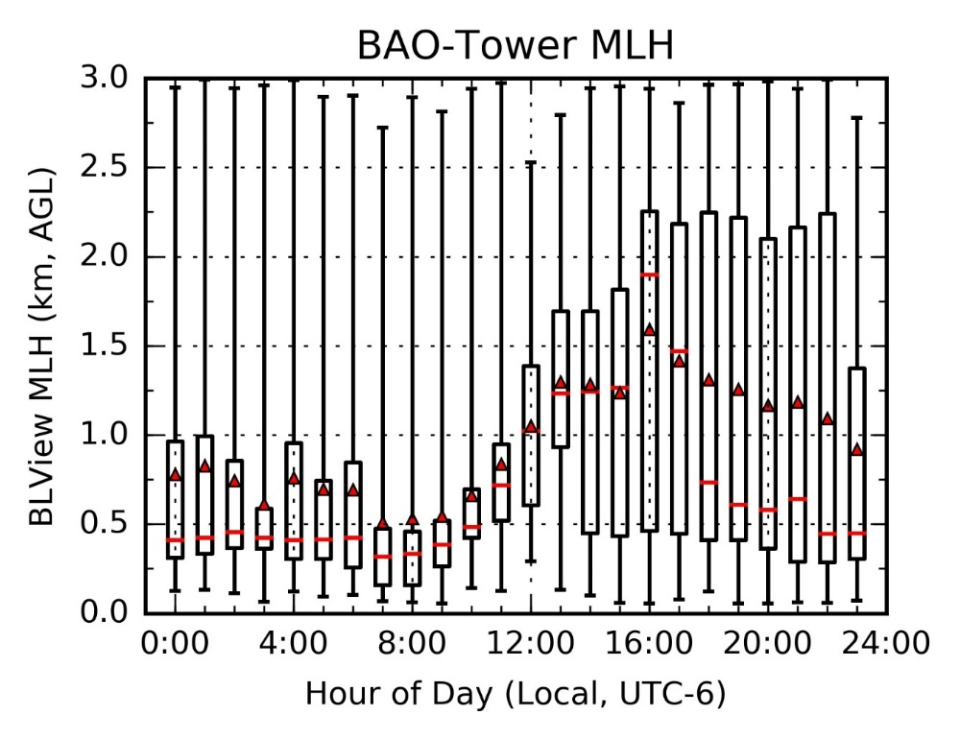
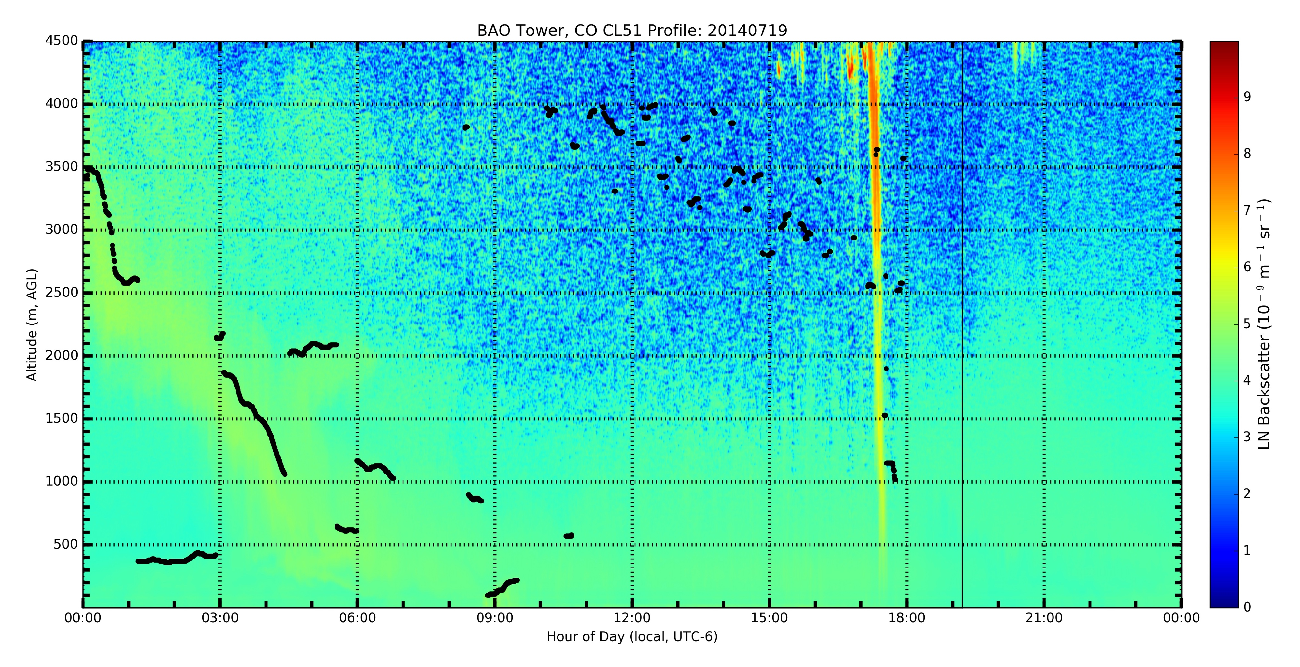
Vertical Variability – BAO Tower (work in progress)
Well-defined MLH
CL-51 used to screen days with well-defined MLH
Diurnal plot for days with well-defined MLH
No well-defined MLH
Can low cost sensors be an effective means to capture concentrations gradients between the SBL and Residual Layers?

Slide 17
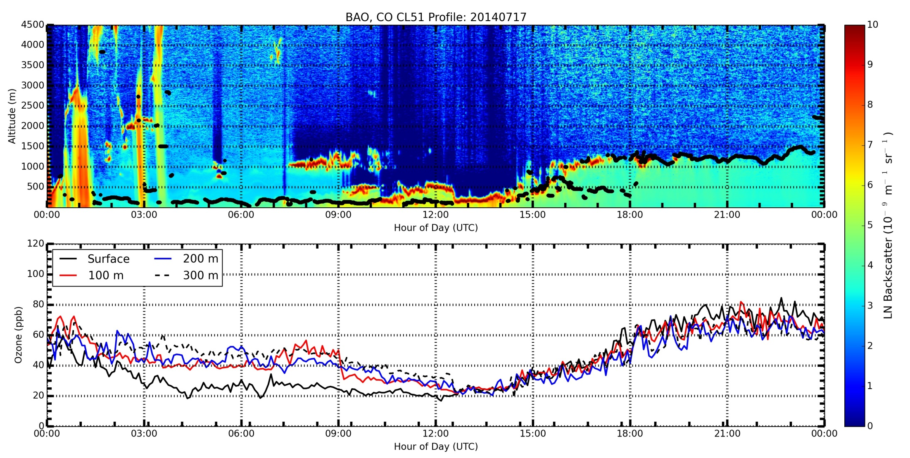
DISCOVER-AQ Boulder Atmospheric Observatory - Erie, CO July 17, 2014
Derived MLH based on aerosols levels measurement by ceilometer
Well mixed boundary layer
Decoupling of BL from residual layer
CAIRCLIP O₃ + NO₂ (ppb)
Top Image: CL-51 ceilometer aerosol backscatter overplotted with derived mixed layer heights.
Bottom image: Sum of Ozone and Nitrogen Dioxide measurements with CAIRCLIP sensors on NOAA BAO 300 m Tower. Sensors at 3m, 100m, 200m, and 300m AGL.
Combined measurements capture decoupling of boundary layer from residual layer between surface and 100m due to night time radiational cooling and growth of boundary layer on the next day.

Slide 18
Summary
DISCOVER-AQ/FRAPPE provided a unique set of science measurements to evaluate potential science applications of small sensors.
Performance of CairClip Ox sensors appear to have sufficient accuracy for science applications.
  Sensors appear to have better performance at higher NO2.
  CairClips have ~3-6% uncertainty consistently across all 7 CairClips.
  Need to repeat NO2/O3 consistency analysis for Golden Site with collocated FRM/FEM and CairClip.
Spatial Variability:
  Capture spatial gradient across urban scales (kms).
  Case Study Day presented – further analysis to focus on full campaign.
Vertical Variability:
  Case Study indicated CairClip capturing vertical gradients during daily cycle of the planetary boundary layer, including transition periods and nighttime decoupling during SBL.
  Additional analysis planned to analyze variability at time of day and identify additional period of a decoupled SBL and Residual Layer.

Slide 19
Additional Slides

Slide 20
BL-View Software:
  Uses a proprietary gradient method algorithm
  Identifies up to 3 aerosol layers for consideration of MLH
  Layers assigned quality index (QI) 1 to 3; 3 highest confidence
  Use of variable time and altitude averaging
Notes:
Altitude averaging is variable with altitude ranging from 80 meters near the surface to 360 meters above 1.5 km. Further, BL-View selectively removes false-positive MLH identifications by requiring a minimum number of similar MLH values (+/- 140 m) to occur within the last several minutes. Therefore, it is not unreasonable to expect a minimum standard deviation of 140 m.
identifies the height of the negative gradient (-d /dx) maximum in the backscatter, and in most cases the lowest of these gradient minima marks the top of the mixed layer in a well-mixed boundary layer.

Slide 21
