Slide 1



Surface Observations of Volatile Organic Compounds Along an Elevation Gradient in the Northern Colorado Front Range During FRAPPE
Helmig D.¹, Evans J. ¹, Thompson C. ¹, Hueber J. ¹, Smith K. ¹, Reed T. ¹, Wang W. ¹, and Pfister, G. ²
Presented by Sam Rossabi¹
¹Institute of Arctic and Alpine Research, University of Colorado, Boulder, CO 80305
²National Center for Atmospheric Research, Boulder, CO 80307
FRAPPÉ/DISCOVER-AQ Science Team Meeting: Surface Observations of VOC Along an Elevation Gradient in the Northern Colorado Front Range during FRAPPÉ Slide 1 of 16
Notes:
Hi, my name is Sam Rossabi. I’m a third year graduate student in the chemistry department at CU, and I am in Dr. Helmig’s Atmospheric Research Lab group. I was not yet in the group at the time of this work, but my research so far has been focused on VOC from different datasets, so I am here today to present this data on behalf of my group.

Slide 2
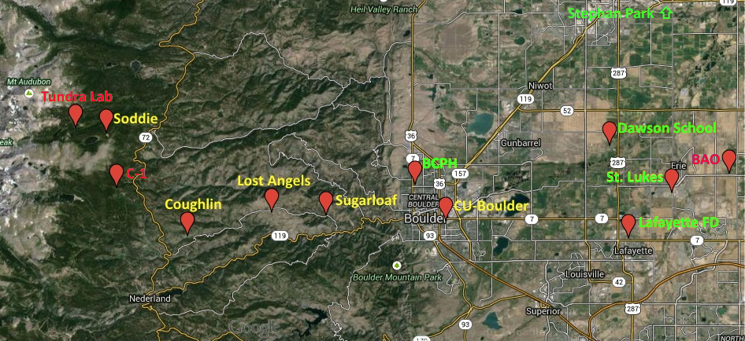
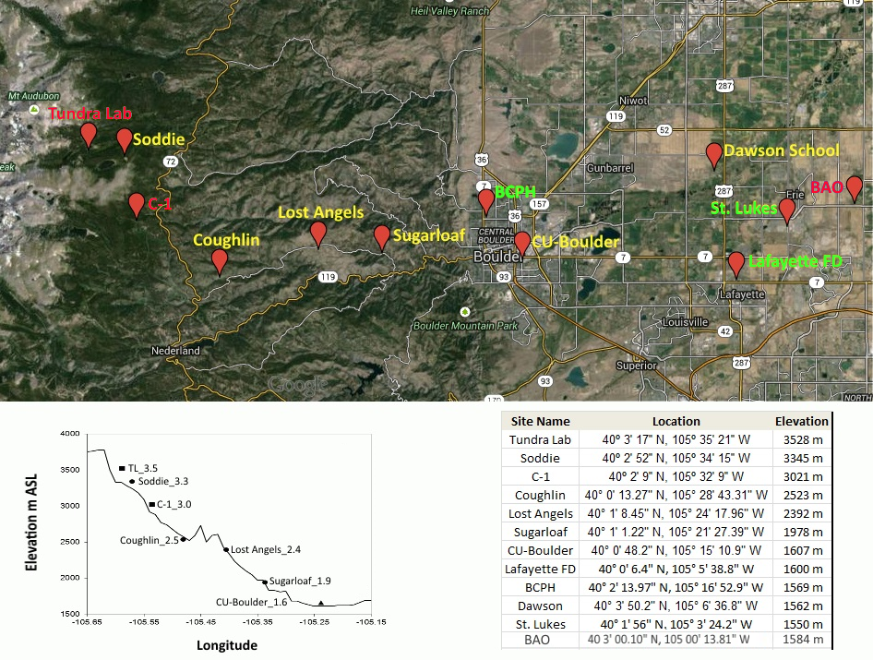
Title
FRAPPÉ/DISCOVER-AQ Science Team Meeting: Surface Observations of Ozone Along an Elevation Gradient in the Northern Colorado Front Range During FRAPPÉ Slide x of x
Notes:
This map shows the sites where VOC data were collected. The different colored text corresponds to different sample collection procedures. The sites in yellow were a part of the FRAPPE campaign. PFPs and Summa canisters were deployed to these sites on FRAPPE flight days to collect ground measurements. Green sites were a part of a Boulder County Public Health study. Adsorbent cartridges and Summa canisters were used at these sites to collect VOC data.

Slide 3
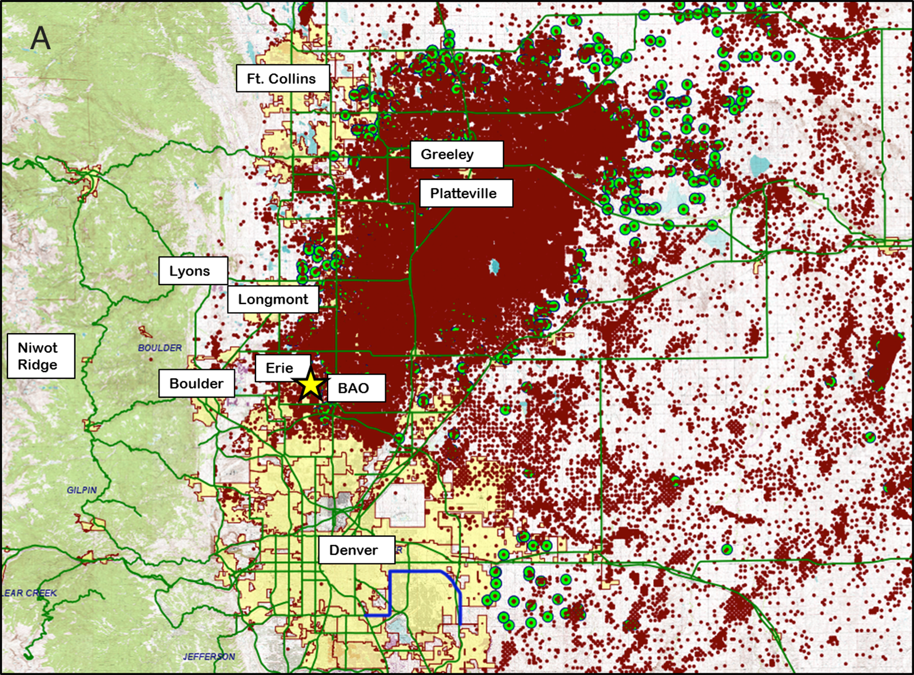
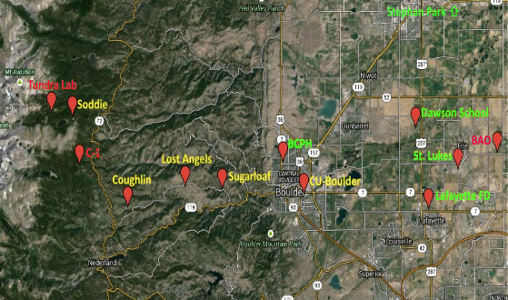

Slide 4
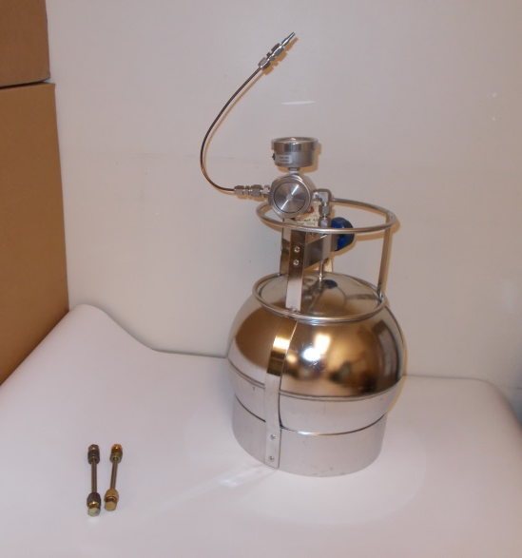
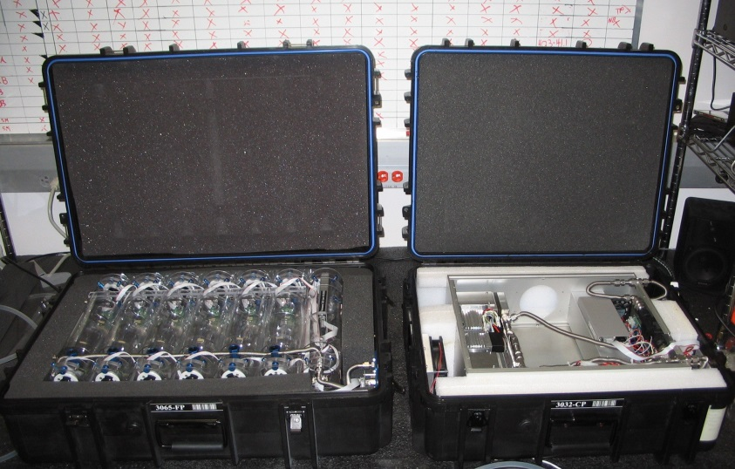
FRAPPE VOC Monitoring
Elevation gradients at five sites during selected flight days – canisters, noon – 3 pm sampling, analysis by GC/FID/MS at INSTAAR
Diurnal cycles, 2-hour resolution at INSTAAR, in-situ GC/FID
Programmable flask packages (PFP), diurnal cycle with 3-hour resolution at Lost Angels; analysis by GC/MS/FID at INSTAAR
Integrated 3-day sampling into Summa cans at four sites in Boulder and Eastern Boulder County, once every week, June – Aug.
Integrated 3-day sampling onto solid adsorbent cartridges in Boulder and Eastern Boulder County, once every week, June – Aug.
FRAPPÉ/DISCOVER-AQ Science Team Meeting: Surface Observations of VOC Along an Elevation Gradient in the Northern Colorado Front Range during FRAPPÉ Slide 5 of 16
Notes:
Some of this I mentioned a few slides ago. This details sampling procedures at the different sites. I’d like to point out the in-situ GCMS measurements. This instrument was running constantly throughout the FRAPPE campaign. The inlet was out the window of the RL-1 lab, at the intersection of Marine and 30th.

Slide 5
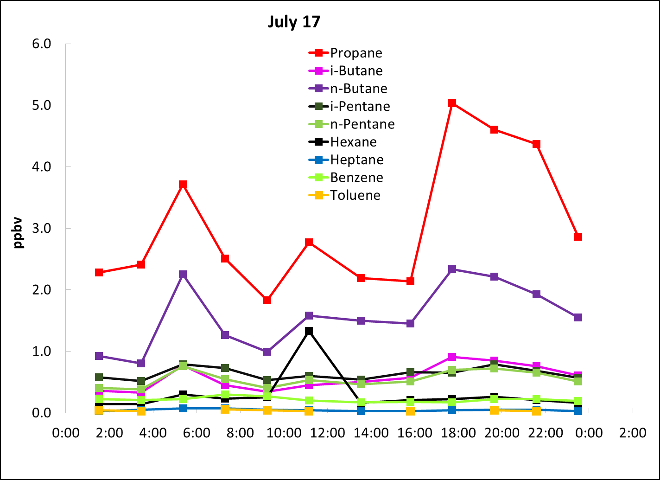
CU Boulder Site (INSTAAR) VOC Diurnal Cycles July 17
FRAPPÉ/DISCOVER-AQ Science Team Meeting: Surface Observations of VOC Along an Elevation Gradient in the Northern Colorado Front Range during FRAPPÉ Slide 5 of 16
Notes:
Here is an example of the data from the in-situ GCMS. Notice several of the compounds are elevated at the same times, and that the peaks occur early in the day, about midday, and in the early evening.

Slide 6

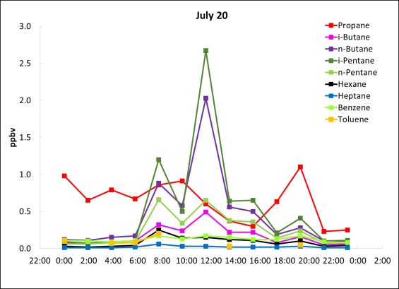
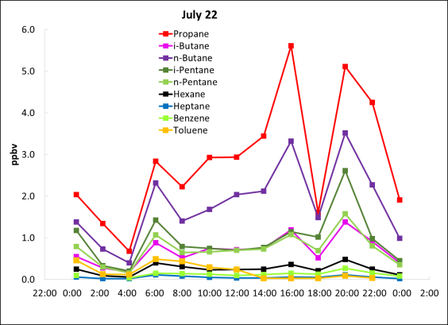
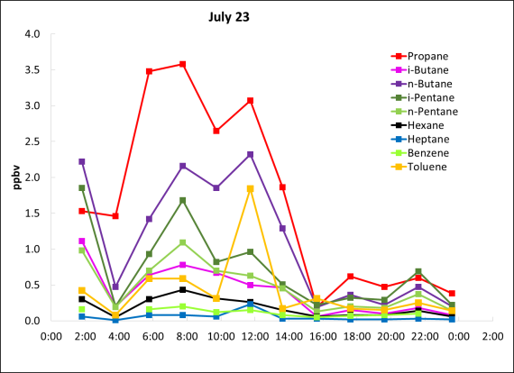
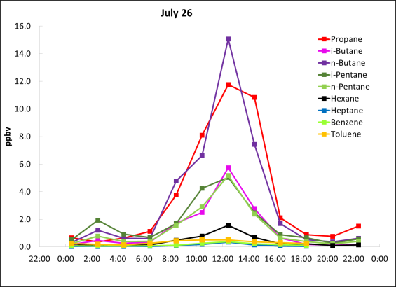
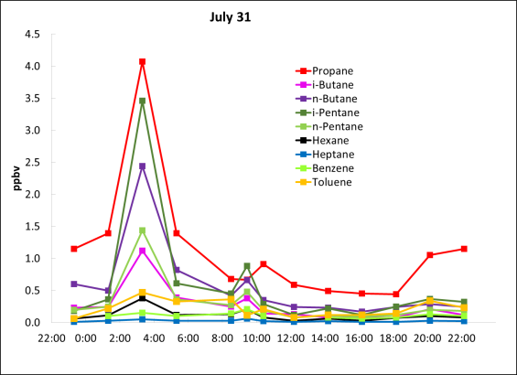
CU Boulder Site (INSTAAR) VOC Diurnal Cycles July 17, 20, 23, 26, 27, 31
FRAPPÉ/DISCOVER-AQ Science Team Meeting: Surface Observations of VOC Along an Elevation Gradient in the Northern Colorado Front Range during FRAPPÉ Slide 6 of 16
Notes:
This slide shows the data from the last slide, but also shows a few other days that month. These VOC diurnal cycles are very variable, with peaks occurring at all hours of the day. Most peaks show elevated levels of multiple compounds. The light alkanes track especially well, while benzene and toluene aren’t necessarily as responsive.

Slide 7
CU Boulder Site (INSTAAR) VOC Diurnal Cycles July 26
FRAPPÉ/DISCOVER-AQ Science Team Meeting: Surface Observations of VOC Along an Elevation Gradient in the Northern Colorado Front Range during FRAPPÉ Slide 7 of 16
Notes:
This is a particularly interesting day. There is a large peak of the light alkanes in the early afternoon. The mixing ratios observed at this time are comparable to levels seen in large cities. The 2012 Warneke study of L.A. saw propane mixing ratios of about 7 ppb. Further, this ocurred during mid day when the boundary layer is at its highest. Diurnal pattern is opposite to typical diurnal profiles seen in urban areas. This peak is much larger than peaks observed on other days. It suggests that there was transport from an upwind area where there was an emission pulse of these VOC.

Slide 8
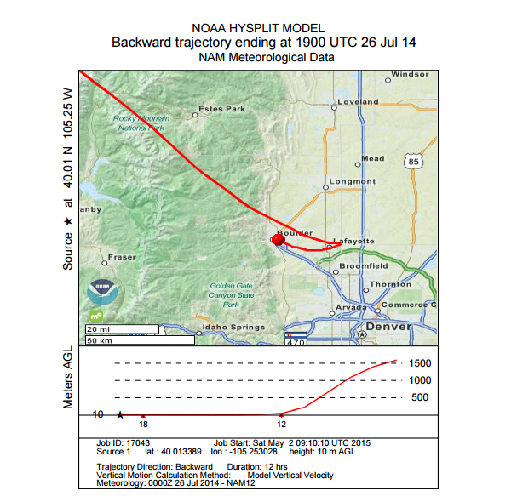
FRAPPÉ/DISCOVER-AQ Science Team Meeting: Surface Observations of VOC Along an Elevation Gradient in the Northern Colorado Front Range during FRAPPÉ Slide 8 of 16
Notes:
Here is a HYSPLIT back trajectory that ends at the peak of VOC concentrations observed in the last slide. The flow regime is very typical for sites along the Front Range, where easterly winds are predominant during late morning to early evening (upslope flow). While these back trajectories can be less reliable near the Front Range, this suggests that the air mass sampled during the peak included originated in an area east of Boulder, where oil and gas development takes place.

Slide 9
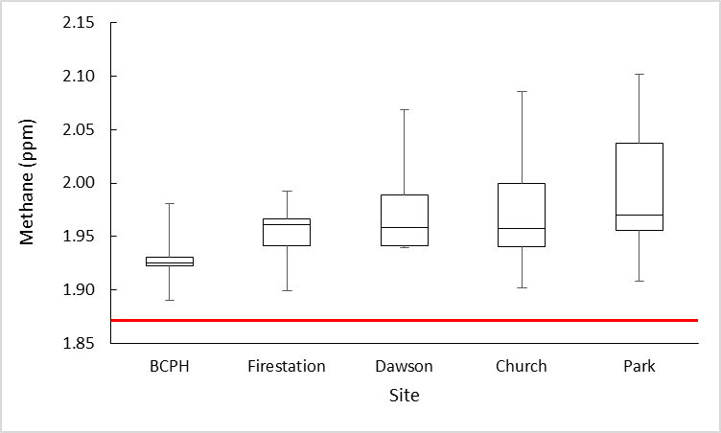
Methane spatial distribution June – Aug.
10-12 x 3-day sampling periods; 1-month mean total average spread over three months
=> 700-800 hours of data coverage
FRAPPÉ/DISCOVER-AQ Science Team Meeting: Surface Observations of VOC Along an Elevation Gradient in the Northern Colorado Front Range during FRAPPÉ Slide 16 of 16
Notes:
These methane measurements were integrated canister samples collected over 3 days. 10 to 12 samples were taken roughly weekly over the course of 3 months. The long sampling times suggest that these data are very representative of the areas where sampling occurred. The samples were collected at the green sites in the map. Methane mixing ratios increase steadily as you move north and east into the oil and natural gas producing region.

Slide 10
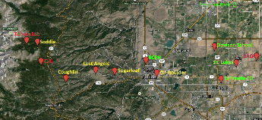
VOC Spatial Distribution June - August
FRAPPÉ/DISCOVER-AQ Science Team Meeting: Surface Observations of VOC Along an Elevation Gradient in the Northern Colorado Front Range during FRAPPÉ Slide 17 of 16
Notes:
This slide reinforces the last. The light alkane mixing ratios increase as you move spatially north and east from Boulder.

Slide 11
VOC Spatial Distribution June - August
FRAPPÉ/DISCOVER-AQ Science Team Meeting: Surface Observations of VOC Along an Elevation Gradient in the Northern Colorado Front Range during FRAPPÉ Slide 17 of 16
Notes:
This slide reinforces the last. The light alkane mixing ratios increase as you move spatially north and east from Boulder. Benzene and Toluene, which have diverse sources, with transportation/road being a major source, do not show this clear spatial gradient.

Slide 12
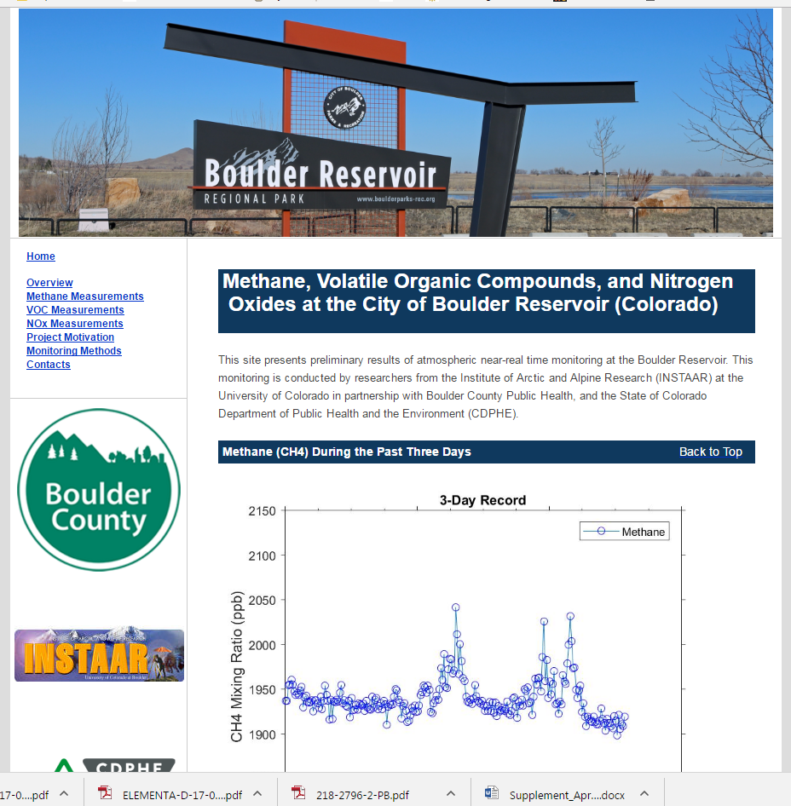
Continuous Monitoring at Boulder Reservoir
Methane (15 –min)
NOx (5-min)
VOC (2-hour)
Feb. 2017 – Fall 2018
Automated data analyses,
preliminary results for
methane, NOx, and 8 VOC
posted online near real
time

Slide 13
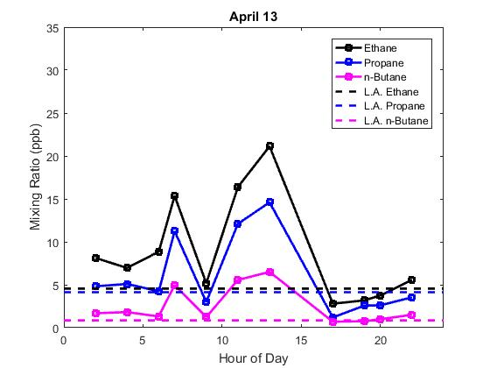
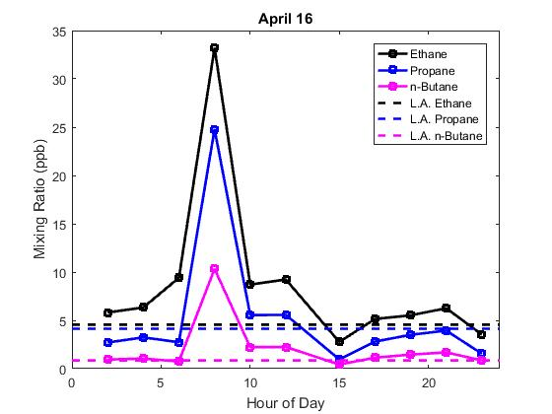
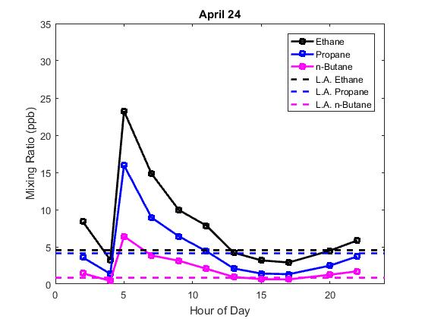
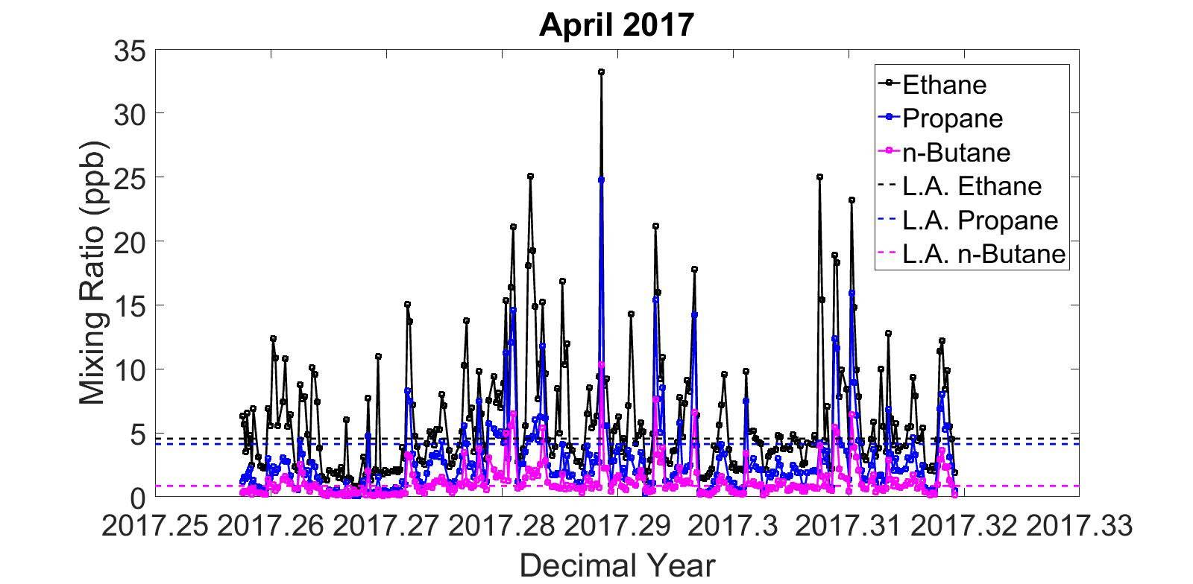
Boulder Reservoir - April 2017
In-situ GC, 1 hour time resolution
High day to day variability
Levels are high, similar range as big, big cities
Diurnal cycles vary day to day
FRAPPÉ/DISCOVER-AQ Science Team Meeting: Surface Observations of VOC Along an Elevation Gradient in the Northern Colorado Front Range during FRAPPÉ Slide 17 of 16

Slide 14
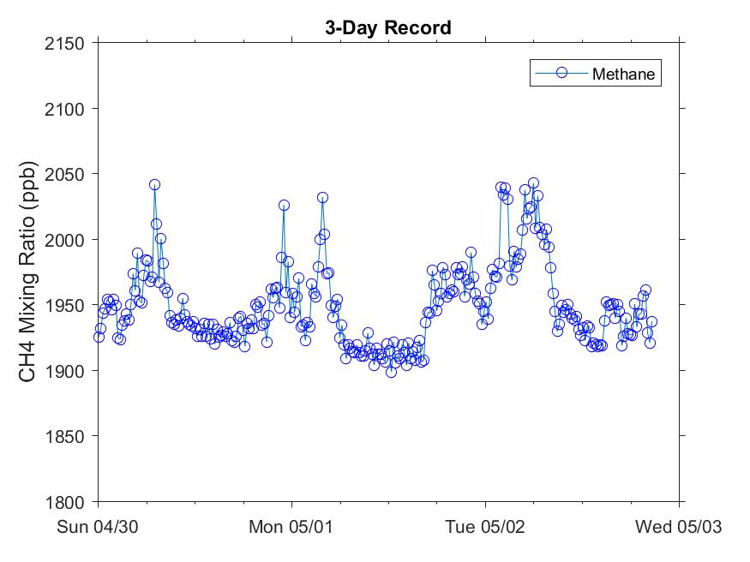
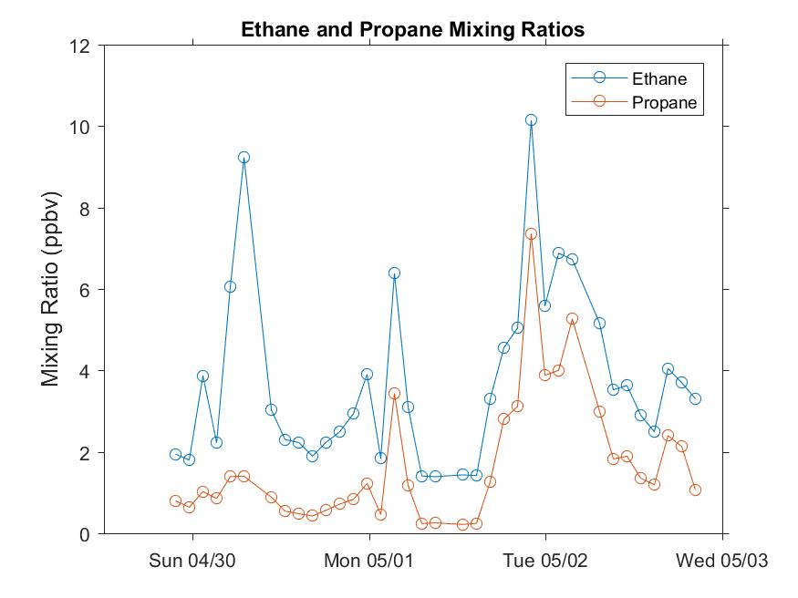
Methane and ethane/propane during last three days (April 30 – May 2, 2017)
Elevated methane events are mostly correlated with elevated ethane/propane
-> Oil and natural gas influenced air being transported to Boulder

Slide 15
FRAPPÉ/DISCOVER-AQ Science Team Meeting: Surface Observations of Ozone Along an Elevation Gradient in the Northern Colorado Front Range During FRAPPÉ Slide x of x

