Slide 1










Using Observations and Source Specific Model Tracers to characterize Transport Patterns
during FRAPPÉ and DISCOVER-AQ
Gabriele Pfister
Patrick Reddy, Frank Flocke
&
FRAPPÉ and DISCOVER-AQ Science Teams
(Pfister et al., to be submitted)

Slide 2
WRF Tracer Model Run
Tracers have a 2-day lifetime
Analysis for 3 km x 3 km domain
Focus on:
TR^{OG}
TR^{AreaMobile} = TR^{Area}+TR^{Mobile}
Oil and Gas TR^{OG} (Ethane-like)
Area Sources TR^{Area} (NOx-like)
Mobile Sources TR^{Mobile} (NOx-like)
Agri Sources TR^{Agr} (NH₃-like)
Diurnal Cycle in TR^{Area} and TR^{OG} Sources

Slide 3
Surface Winds
Observed
Modeled
WD - RF North
WD - WC Tower
80 km
WD - NREL Golden
WD - Aurora East
Dominance of upslope/downslope but large variability
Model represents wind direction (and speeds) generally well at NFRMA sites

Slide 4
Surface Winds
Observed
Modeled
WD - Trail Ridge Road
WD - Longs Peak
80 km
High elevation sites show mostly westerly winds with occasional upslope signatures
Observed Winds from NW vs Model from W - Longs Peak is in the valley for Cub Creek which has a NW to SE orientation & channels the flow. Something similar might be happening at the Trail Ridge road site.

Slide 5
Surface Winds
Observed
Modeled
WD - Trail Ridge Road
WD - Longs Peak
WS - Trail Ridge Road
WS - Longs Peak
80 km
High elevation sites show mostly westerly winds with occasional upslope signatures
WRF overpredicts wind speeds at high elevation sites

Slide 6
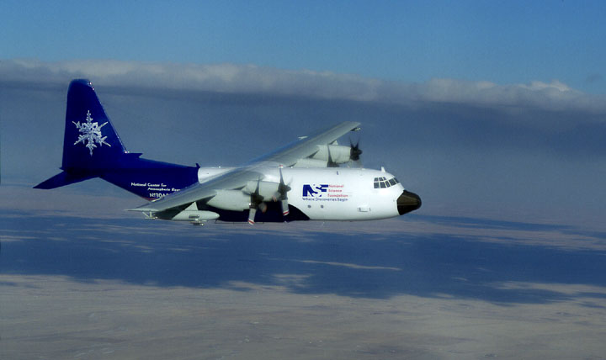
Spatial Distribution – C130
C-130 NO_{x}
TR^{AreaMobile}
C-130 Ethane
TR^{OG}
<3km ag

Slide 7
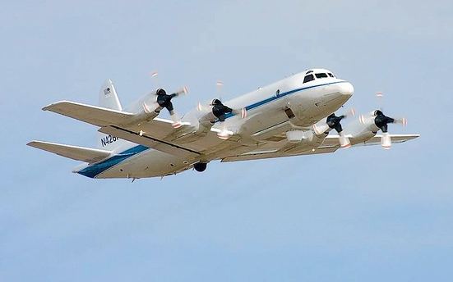
Spatial Distribution – P3B
P-3 NO_{x}
TR^{AreaMobile}
P-3 Ethane
TR^{OG}
<3km ag

Slide 8
Spatial Correlations
C-130
TR^{AreaMobile} TR^{OG}
P-3
TR^{AreaMobile} TR^{OG}

Slide 9
Transport Patterns
0-6LT
TR^{AreaMobile} reveals pooling of Denver emissions into Platteriver Valley
6-12 LT
Flow reversal brings aged emissions back into NFRMA mixing with fresh OG and fresh Metro Area emissions
12-18LT
Source regions more strongly separated. Transport into Foothills evident
18-24LT
Shallow PBL. Tracers remain close to sources
0-6 LT
6-12 LT
12-18 LT
18-24 LT
Average over Campaign period

Slide 10
Mountain-Valley Flow
[Upslope Winds Downslope Winds ]
WC-Tower [90º±45º 270º±45º ]
AuroraEast [135º±45º 270º±45º ]
____ Measured …… Model
RF North [45º±45º 270º±45º ]
Golden [45º±45º 270º±45º ]
Longs Peak [135º±45º 270º±45º ]
Trail Ridge [90º±45º 270º±45º ]
Notes:
Upslope (red) and Downslope (black) statistics from observations (solid lines) and WRF (dotted lined). Flow is defined when winds are from within a defined wind sector at least 2/3rd of the time within a given hour (Note that wind data for Trail Ridge Road are available hourly only and that model data are also only available on an hourly basis). Upslope: Upslope Angle ±45deg; Downslope: 270±45deg; only data with wind speeds > 0.3 m/s (i.e. data that are not defined calm based on Beaufort scale). The upslope angle has been defined based on windrose analysis. The frequency is given as percentage of upslope or downslope of all valid measurements.
Model okay job
All sites dominated by up/downslope
Upslope flows develop the earliest at the sites closest to the Foothills (RF-North and Golden) and then spread to the East and into the mountains.
upslope winds are also dominant at the sites East of the NFRMA, but these do not show a well-established downslope flow
Delayed in upslope at mountain sites.
Too strong in downlope but that is because due to our definition of downslope as winds from within 270±45 deg and the fact that the model winds are predominantly from the West while measured winds at Trail Ridge Road and Longs Peak are mostly from the NW and variable across the W-N, respectively
Pat: The Longs peak site ( I believe) is in the valley for Cub Creek which has a NW to SE orientation. This channels the flow. Something similar might be happening at the Trail Ridge road site

Slide 11
Pollution Transport to Mountain Sites
Days with RF North 12-18LT average ozone
> 70 ppb
Longs Peak
Trail Ridge
Ozone
TR^{OG}
(PBLavg)
12-20LT
12-20LT

Slide 12
Pollution Transport to Mountain Sites
Days with RF North 12-18LT average ozone
> 70 ppb < 60 ppb
Longs Peak
Trail Ridge
Longs Peak
Trail Ridge
Ozone
TR^{OG}
(PBLavg)
12-20LT
12-20LT
Tendency for high ozone and elevated TR^{OG} and TR^{AreaMobile}
at mountain sites on days with high ozone at NFRMA sites

Slide 13
Upslope Event 12 August
C-130 Ethane C-130 NO_{x}
TR^{OG} TR^{AreaMobile}
16:41-20:26 LT, < 2km

Slide 14
Upslope Event 12 August
Ozone
TR^{OG}
TR^{AreaMobile}
Longs Peak
Trail Ridge Road
Squaw Mountain
Mines Peak

Slide 15
Upslope Event 12 August
Ozone
TR^{OG}
TR^{AreaMobile}
Trail Ridge Road
Ozone
75+ ppb
70-75 ppb
65-70 ppb
60-65 ppb
55-60 ppb
< 55 ppb
19 LT
20 LT
21 LT
22 LT
23 LT

Slide 16
Upslope Event 12 August
40N
16 LT
20 LT
TR^{OG}
Notes:
Longitude-Altitude Cross Section of TR^{OG} at 40.07N (single grid box in latitude) for 12 August 22 UTC (16 LT, top) and 13 August 2 UTC (12 August 20 LT, bottom); Granby is at 40.08N and -105.94W, 2400m asl. Horizontal winds are indicated by black arrows, vertical winds are shown as white arrows. For clarity only vertical winds > 0.2m/s are included. The height of the PBLH is plotted as a black line.

Slide 17
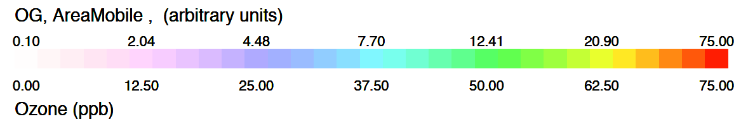
Other Upslope Events
Average
12 August
22 July
2 August
3 August
8 August

Slide 18
Summary
WRF tracers show value for forecasting and analysis; help to visualize the flows and trace them back to sources. They support the chemical analysis by informing about mixing of air masses from different sources.
AQ in Front Range is significantly influenced by transport patterns and recirculation patterns in the horizontal and vertical -> limits the value of surface wind data in determining the origin of pollution.
FRAPPÉ/DAQ provide valuable data on flow patterns frequently occurring in the Front Range and provide an excellent testbed for evaluating model performance.
The study demonstrates complexity and variability of flow patterns on small spatial and temporal scales – reasonable model performance of transport is crucial for simulating AQ.
Mountain sites are not necessarily representative of inflow/background conditions. Even if winds are from West, the air masses still can carry some influence from NFRMA given that NFRMA pollution can be transported across the Divide and then brought back via return flows → important to look at the air mass history and not just actual wind data.
Despite FRAPPÉ/DAQ providing a highly rich data set for addressing a wide range of topics, the measurements do not seem to provide solid proof of the degree to which solenoid flows might have contributed to pollution buildup.

Slide 19
EXTRAS

Slide 21
Trail Ridge Road 12 August
75+ ppb
70-75 ppb
65-70 ppb
60-65 ppb
55-60 ppb
< 55 ppb
Measured Ozone

Slide 22
Trail Ridge Road 12 August
75+ ppb
70-75 ppb
65-70 ppb
60-65 ppb
55-60 ppb
< 55 ppb
Model TR^{OG} (PBLavg)

Slide 23
Trail Ridge Road: 40.39N 105.686W

Slide 24
Trail Ridge Road: 40.39N 105.686W

Slide 25
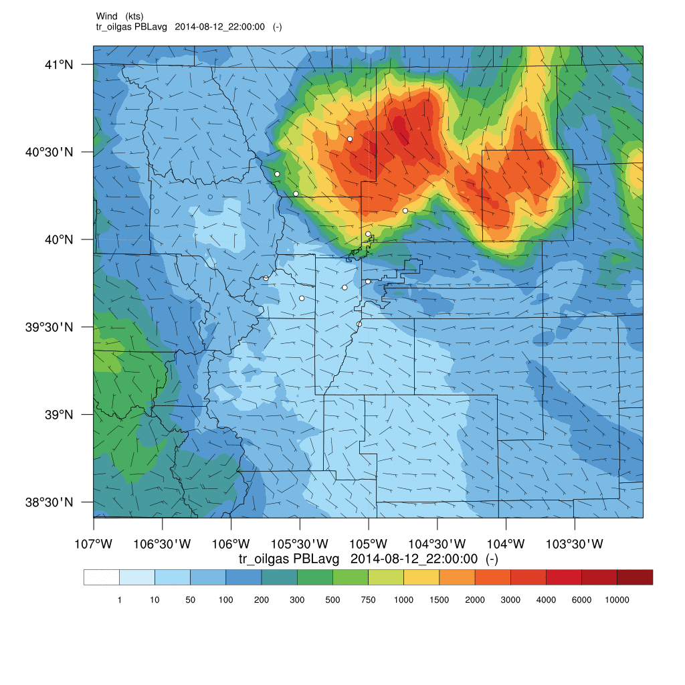
TR^{OG} PBL, 13 Aug 2014

Slide 26
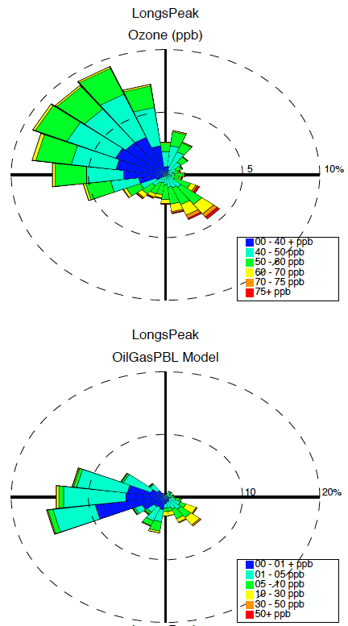
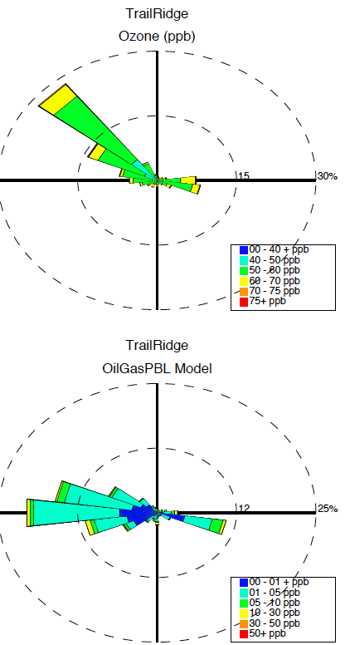
Winds at Longs Peak and Trail Ridge Road
Longs Peak is in the valley for Cub Creek which has a NW to SE orientation. This channels the flow. Something similar might be happening at the Trail Ridge road site

Slide 27
Boundary Layer
Observed Modeled
Fort Collins West
Platteville
Golden
Altitude (m)
Altitude (m)
Altitude (m)

