Slide 1


Using potential vorticity to specify the effect of stratosphere-troposphere
exchange on the vertical distribution of ozone during the FRAPPE 2014 field campaign
Yuyan Cui*, Stu McKeen, Ravan Ahmadov, Wayne Angevine, Gabi Pfister, Brad Pierce, Jia Xing, John Sullivan, Rohit Mathur
Motivation and background
Regional models for O₃ rely on upper and lateral boundary conditions
Upper Air data from FRAPPE/DISCOVER-AQ shows strat/trop exchange influence (Sullivan et al. 2015)
A recent global climatological study of O₃, potential vorticity, and O₃/PV ratio (Xing et al., 2016)
In-situ and remote upper air platform data used or shown here
NASA P-3B Aircraft
Platteville, Colorado Ozone Sondes (Penn State)
NASA GSFC Ozone Lidar
NOAA ESRL/CSD TOPAZ Ozone Lidar
NCAR C-130 Aircraft (Poster – Roya Bahreini)

Slide 2
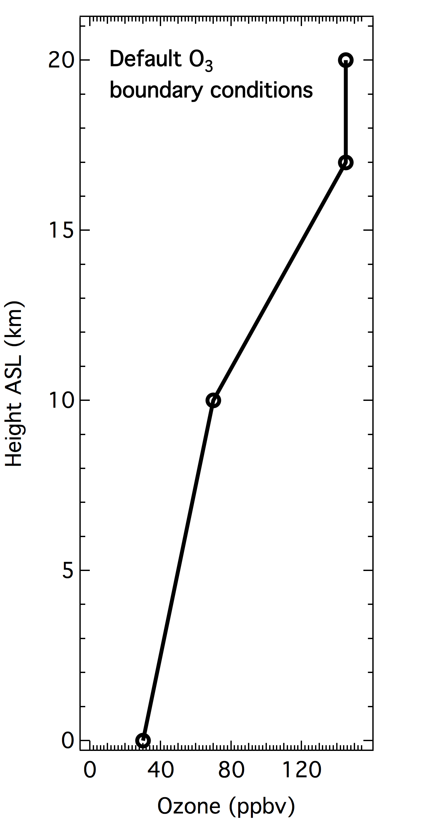
WRF/Chem model details
4 km, 7/24-8/10
Full gas-phase and
aerosol chemistry
12 km, 7/16-8/10
“Stratospheric” Tracers
1-Way nesting
NOx emissions mole/km²/hr
WRF/Chem model settings for FRAPPE simulations (7/24 to 8/10/14).
*
*
*

Slide 3
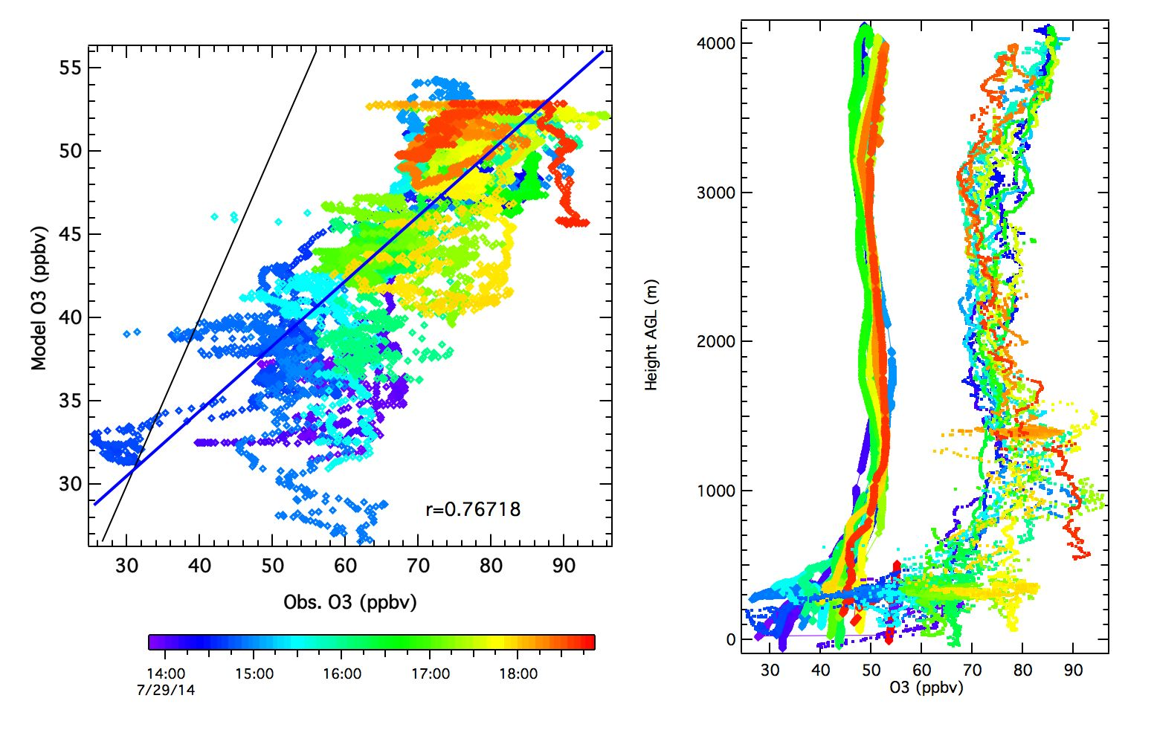
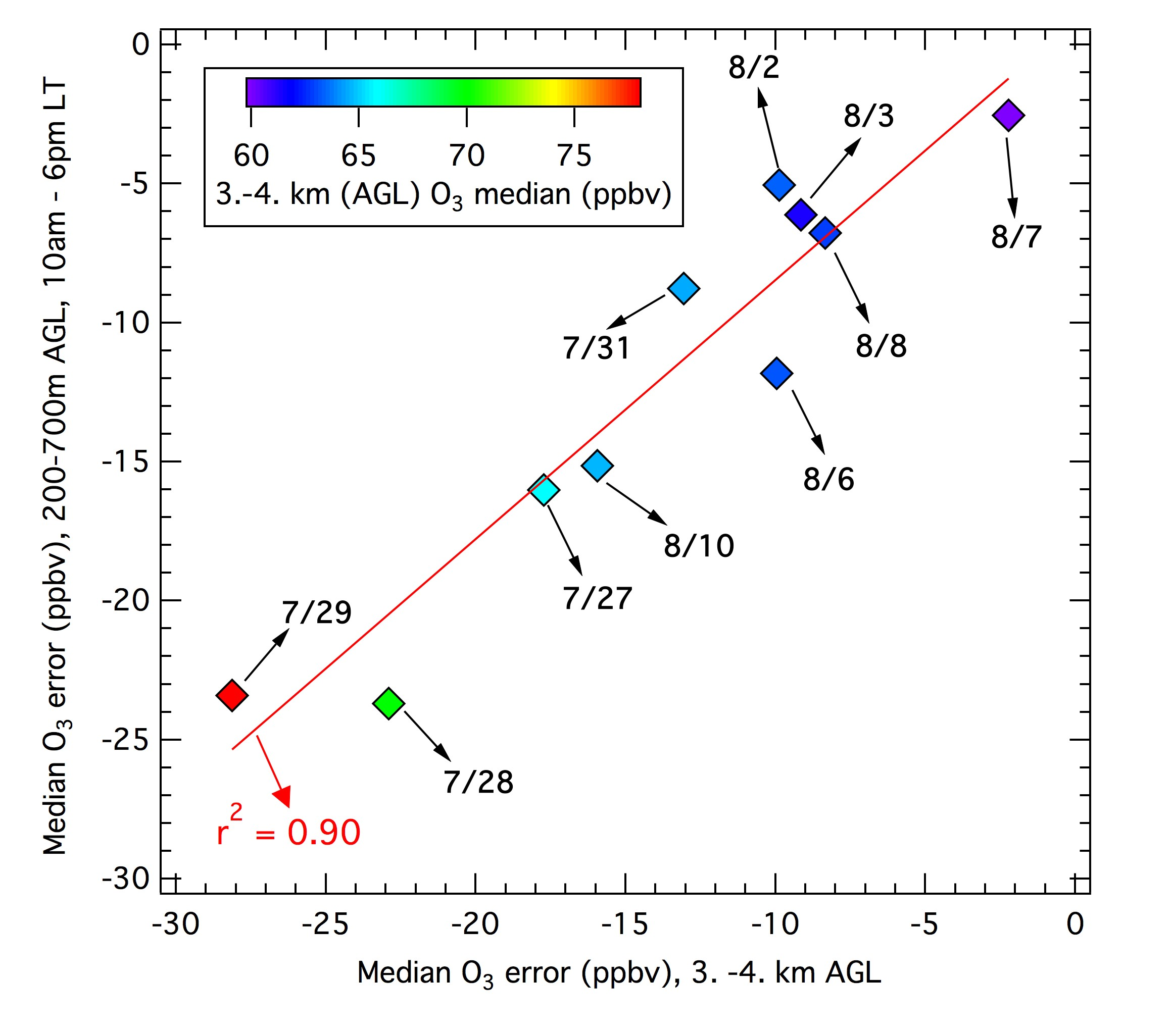
Default O₃ BCs: 23 ppbv bias, near-surface and 3-4km biases correlate
7/29/14
Model O₃ biases in the PBL versus biases 3-4km AGL.
Model
NASA P-3B
UTC
90% of model PBL bias can be attributed to biases aloft.
The 7/27/14 to 7/29/14 period with higher O₃ aloft is of particular interest.

Slide 4
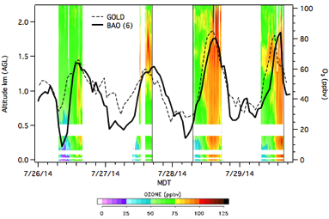
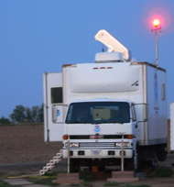
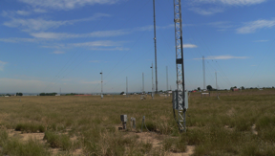
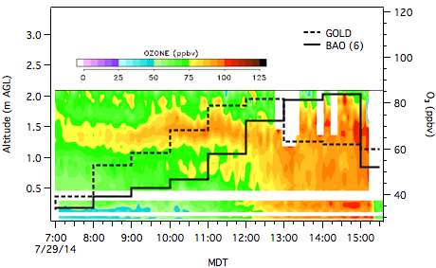
TOPAZ O₃ Lidar, July 26 – 29, 2014
Between 1 and 2 km AGL
7:00 AM (MDT)
O₃ = 70 -75 ppbv
On 7/26, 7/28 and 7/29
July 26-29
TOPAZ ozone lidar
Polluted layer aloft
High O₃ in residual layer
9:39 MDT Aug 8
July 29
Highest 1-h surface O₃ (84 ppbv) measured at BAO during FRAPPÉ/D-AQ

Slide 5
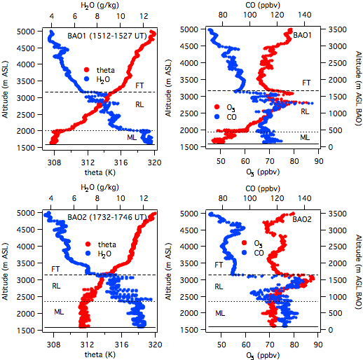
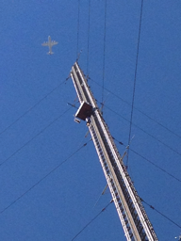
O₃ (Weinheimer), CO (Diskin)
NASA P-3B profiles above BAO tower, July 29, 2014
July 29
0920 MDT
CO and O₃ anticorrelate
above 2km AGL
July 29
1140 MDT
NASA P-3B
AT BAO

Slide 6
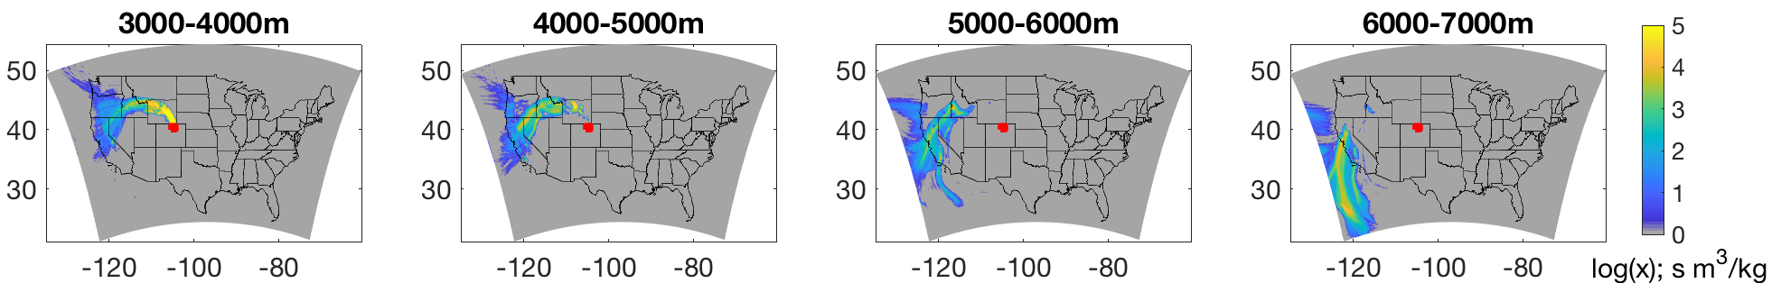
FLEXpart back trajectories, July 29, 2014
Arrival on 00:00 UTC 7/29/14, between 500-600 hPa (3 - 4.5 km AGL)
4-day back trajectories
Lagrangian particles released in a 1∘ X 1∘ box over the Front Range
Footprints show a large contribution from 6. to 7. km AGL 4 days earlier
Descending anticyclonic flow

Slide 7
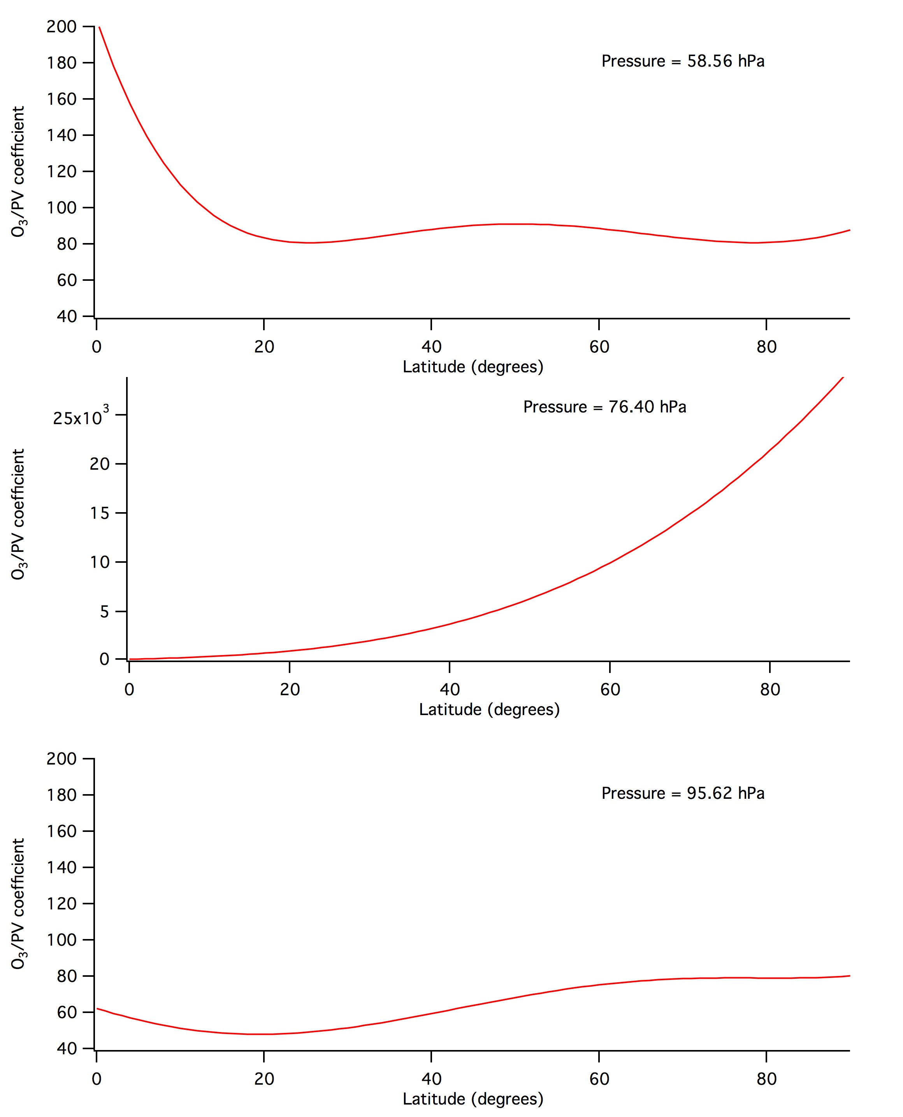
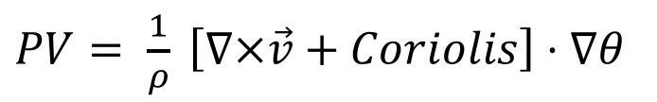

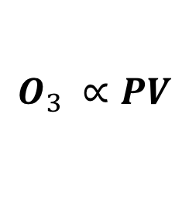
O₃ boundary conditions according to Potential Vorticity
$PV= \frac{1}{ρ} \left[∇×\vec{v}+Coriolis\right]⋅∇θ$
1 PV unit = 10⁻⁶$⋅$∘K$⋅$m²/kg-s
Danielsen (1968):
$$O_{3} ∝PV$$
In stratospheric folds and cut-off lows
Literature values: O₃/PV from 35 to 130 ppbv/PVU
Xing et al. (ACP, 2016) – A global climatology of O₃/PV ratios:
21 years of data (1990-2010)
WRF with NCEP reanalysis nudging
44 O₃ sonde locations from WOUDC
Latitude, Month, Pressure dependent
WRF/Chem Strat. Tracers:
IC/BC O₃ above 500 mb from O₃/PV
O₃/PV = 100 – upper limit
July

Slide 8
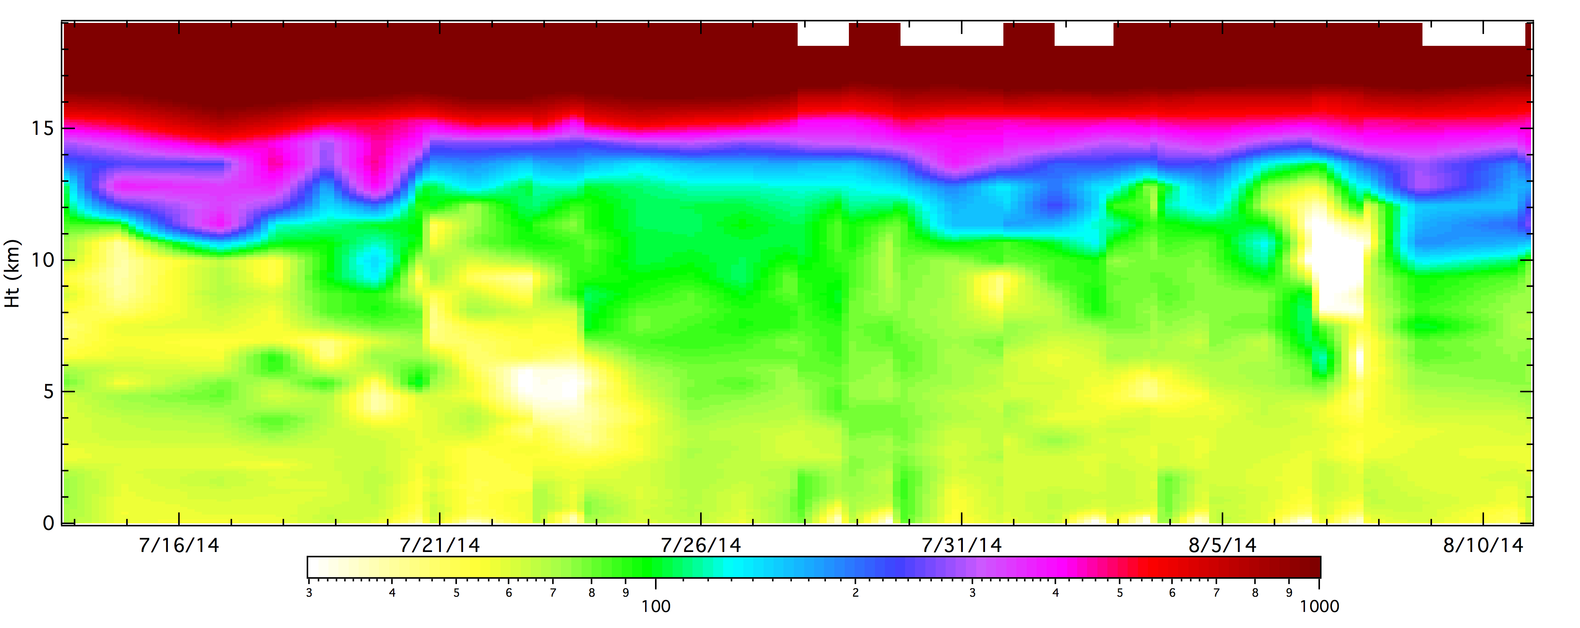
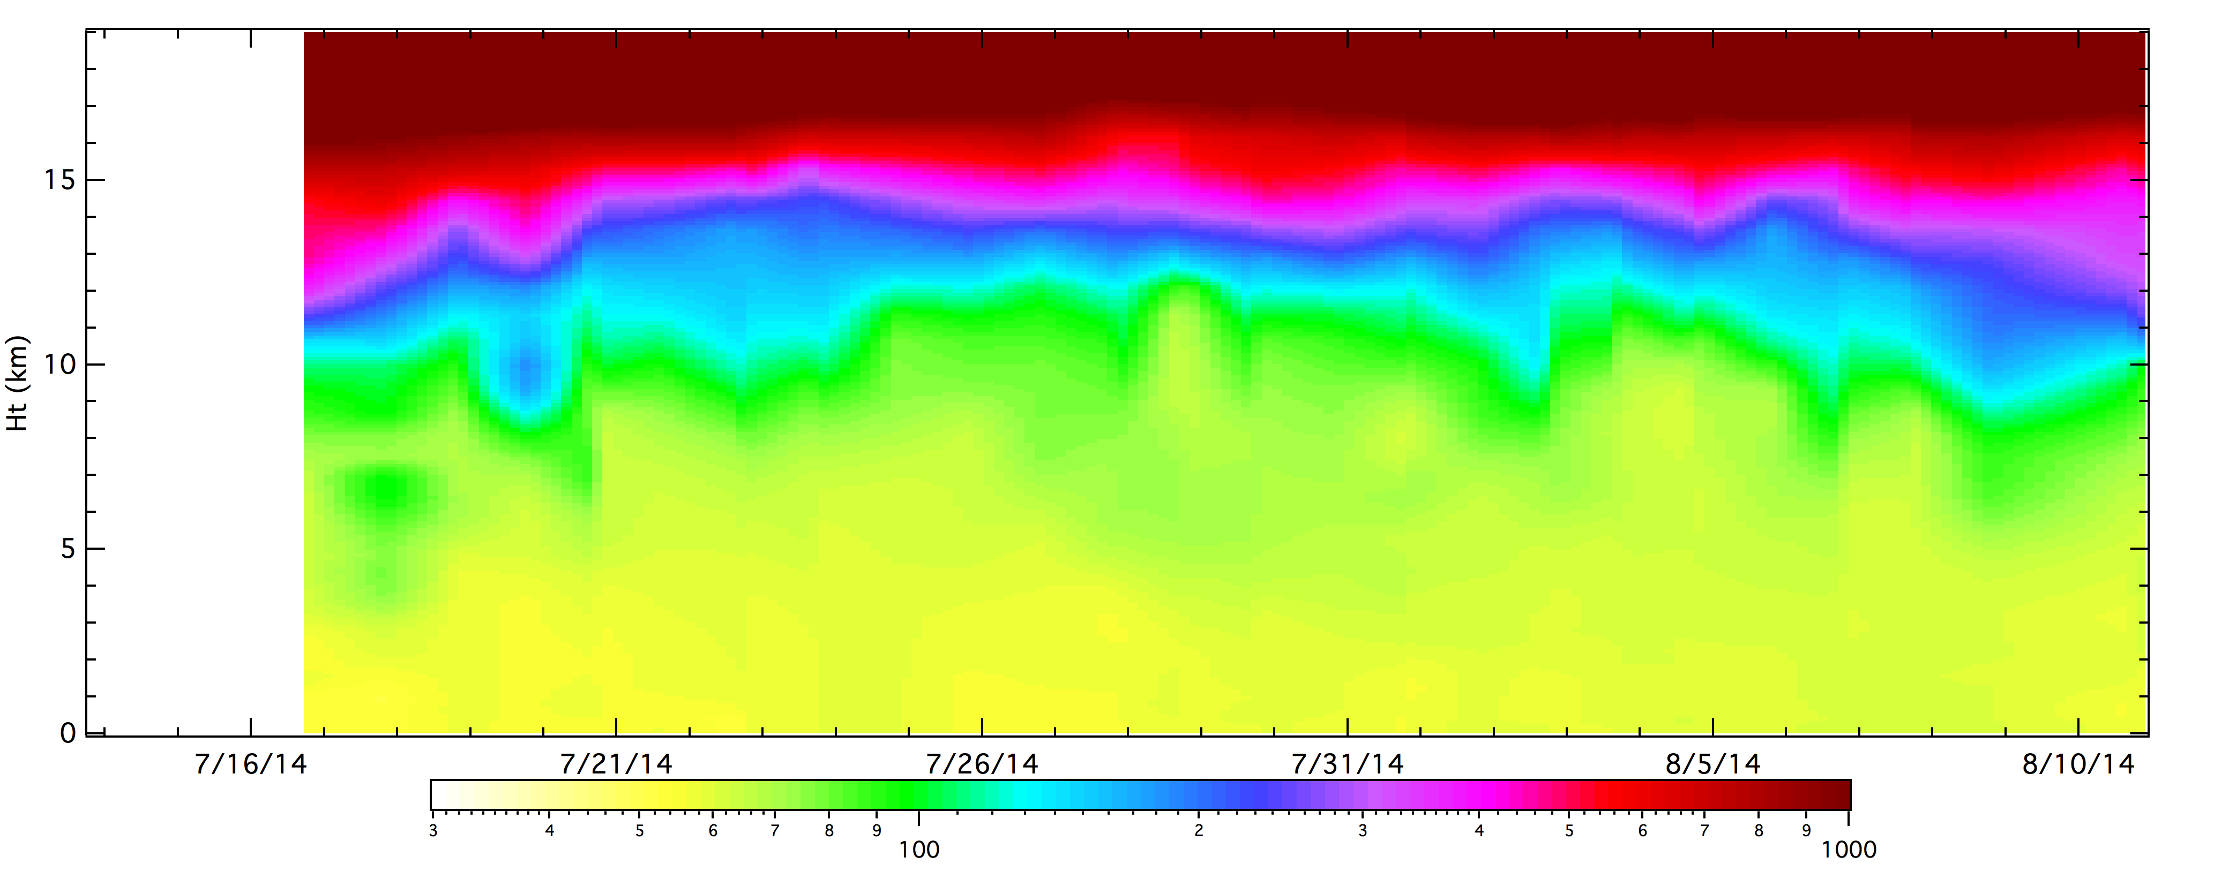
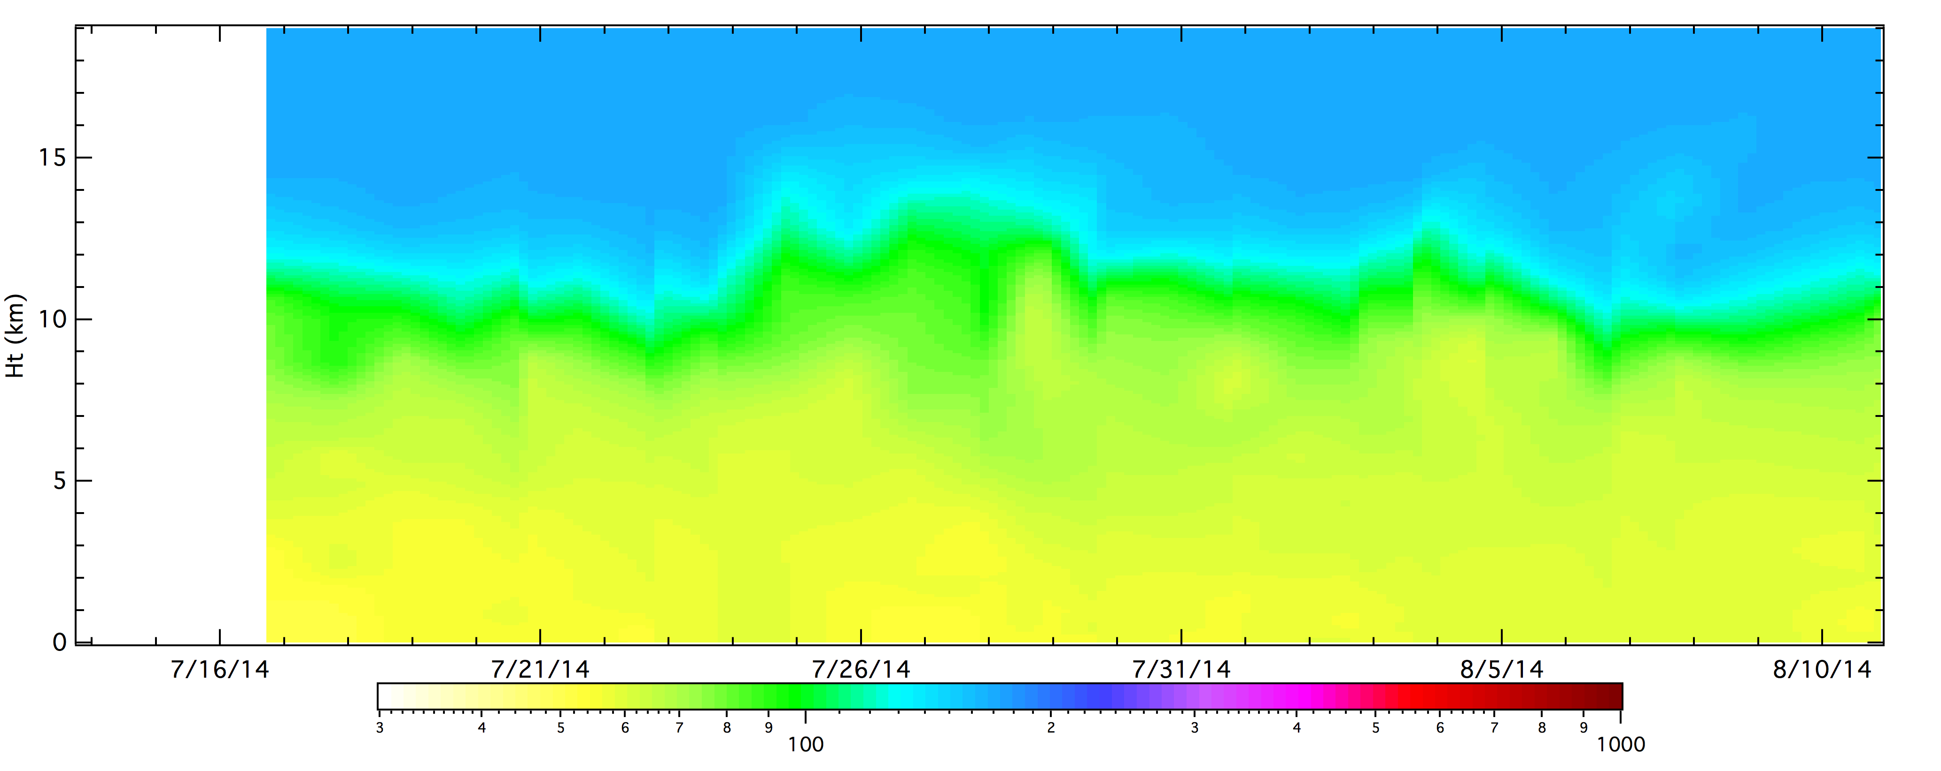
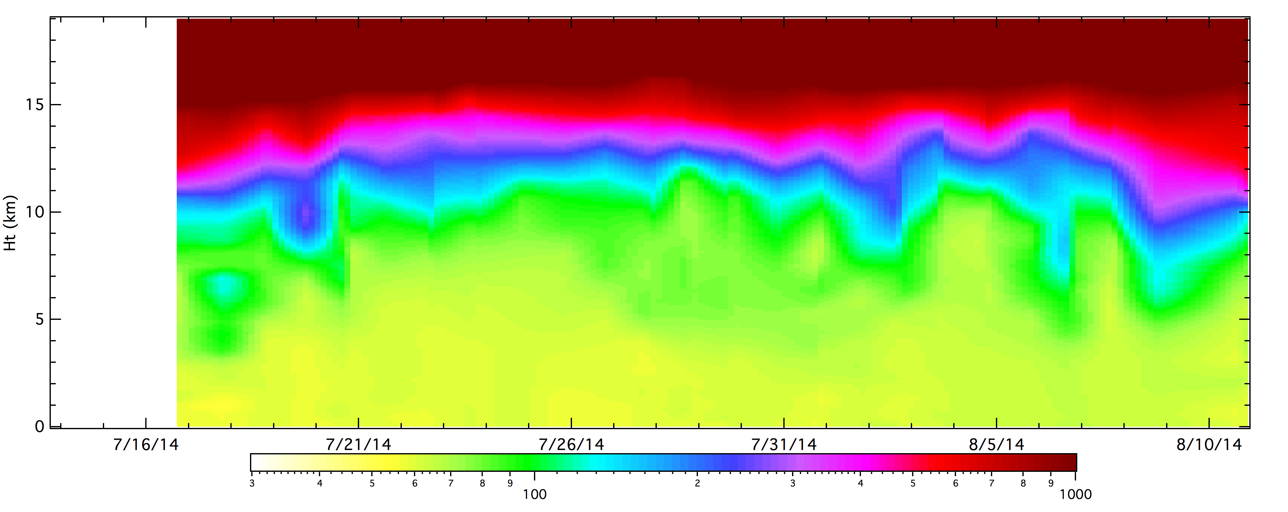
Penn State Platteville O₃ comparisons
Observations
O₃/PV from Xing et al. (2016) used for IC/BC
(ppbv)
Default IC/BC
O₃/PV=100
UTC

Slide 9
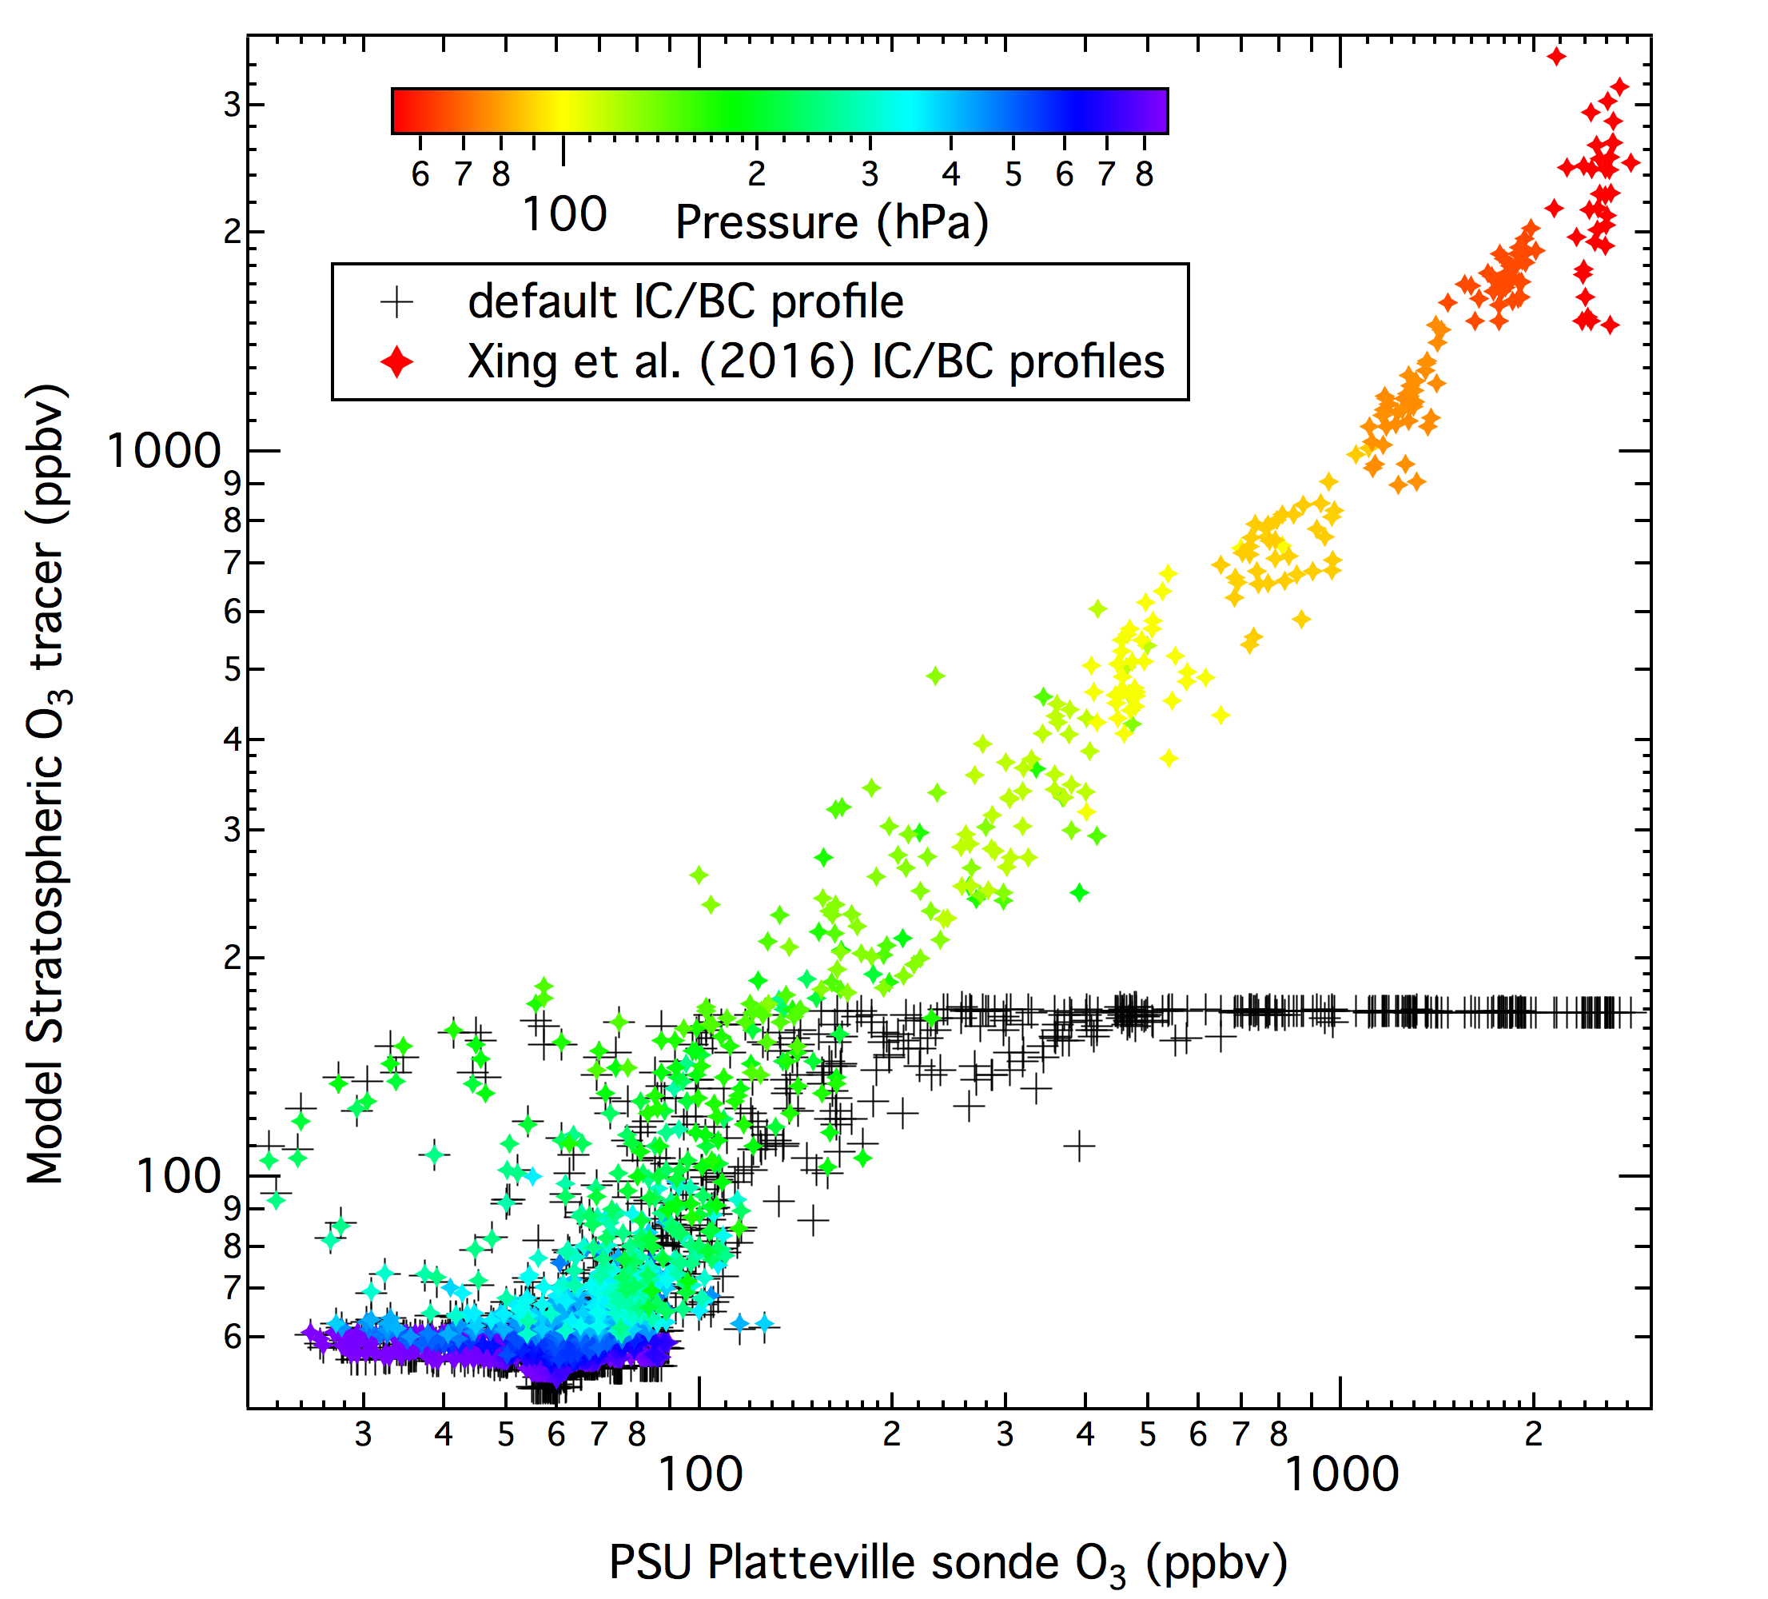
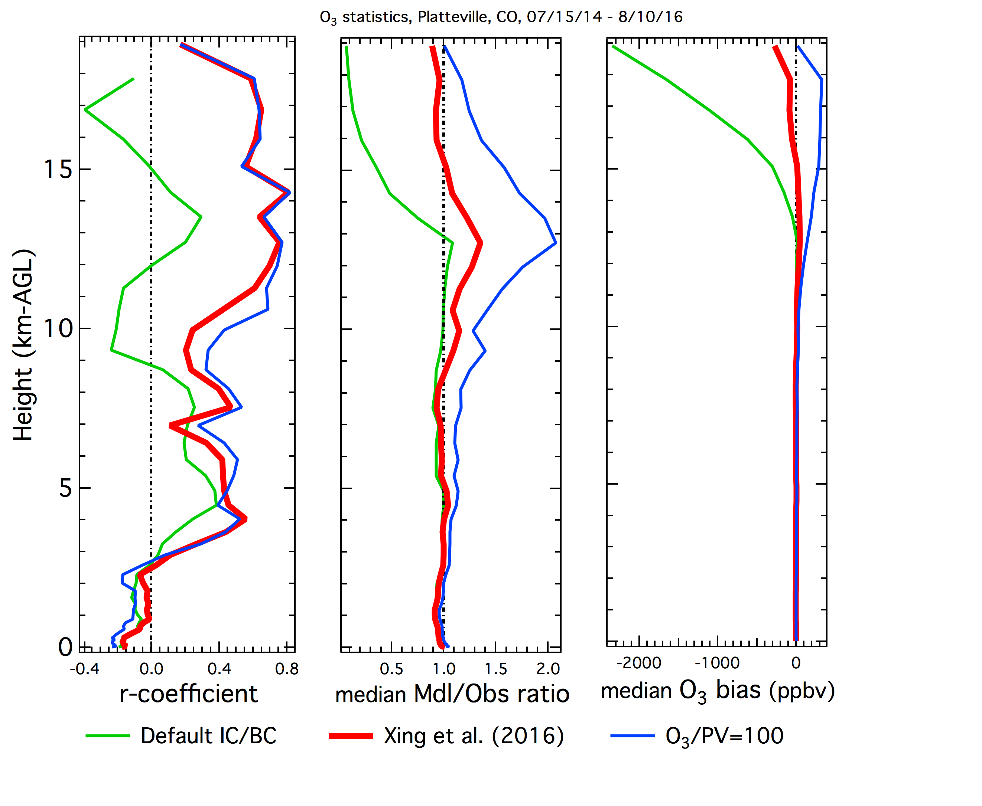
Penn State Platteville O₃ comparisons
Model shows much improved correlation and acceptable bias above 8 km when using Xing et al. (2016) to specify IC and BCs.
The case with O₃/PV=100 slightly improves correlation between 5 and 11 km, but also induces a high bias above 5 km.

Slide 10
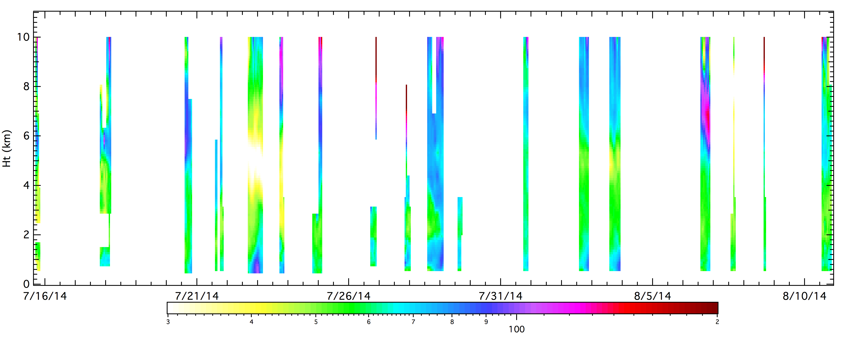
NASA/GSFC Fort Collins O₃ Lidar comparisons
AGL
7/27 to 7/29, 2014
8/6, 2014
Sullivan et al. (2015)
GSFC O₃ lidar data is from the TOLNet data webpage.
Lidar data is averaged hourly, centered at top of hour.
Lidar data is averaged vertically over the WRF/Chem model height levels.
7/27 to 7/29, 2014

Slide 11
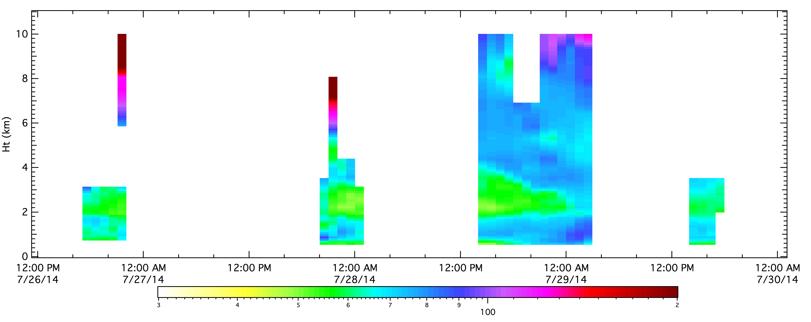
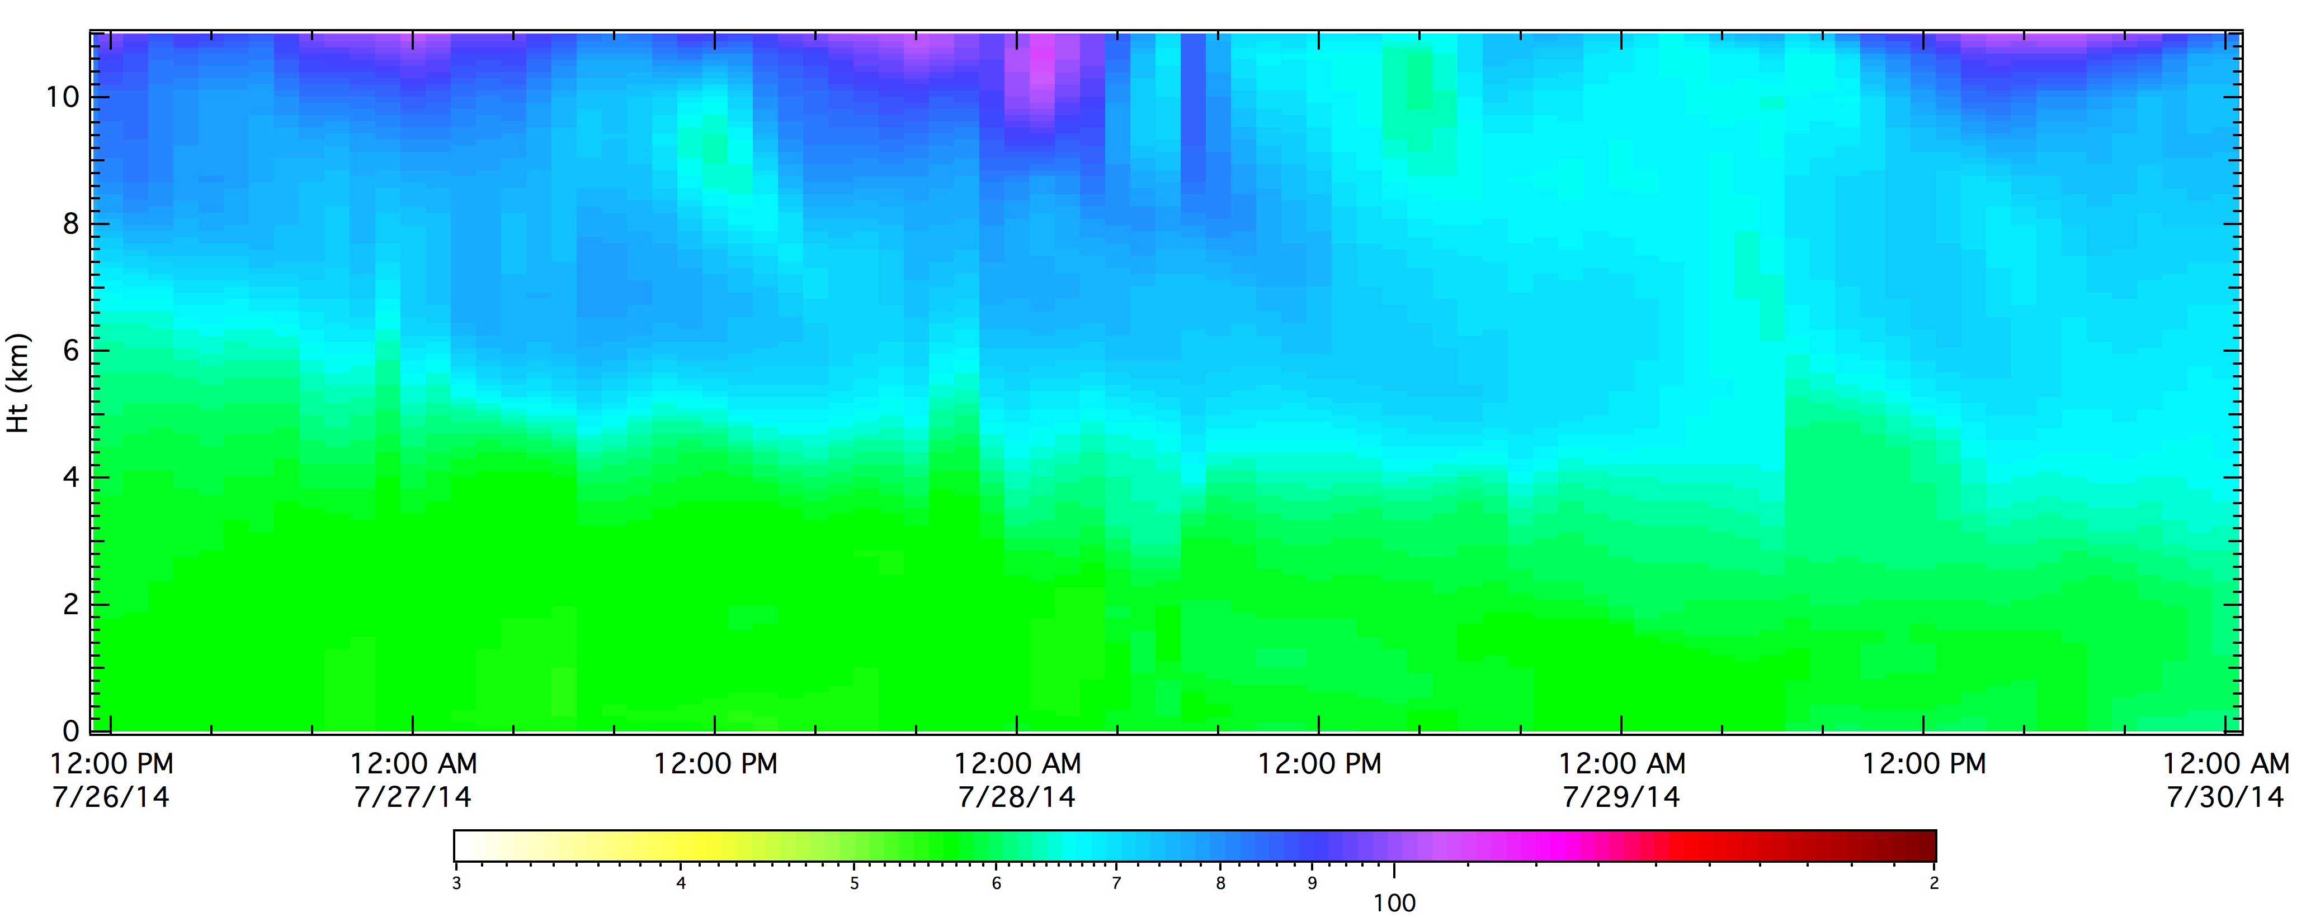
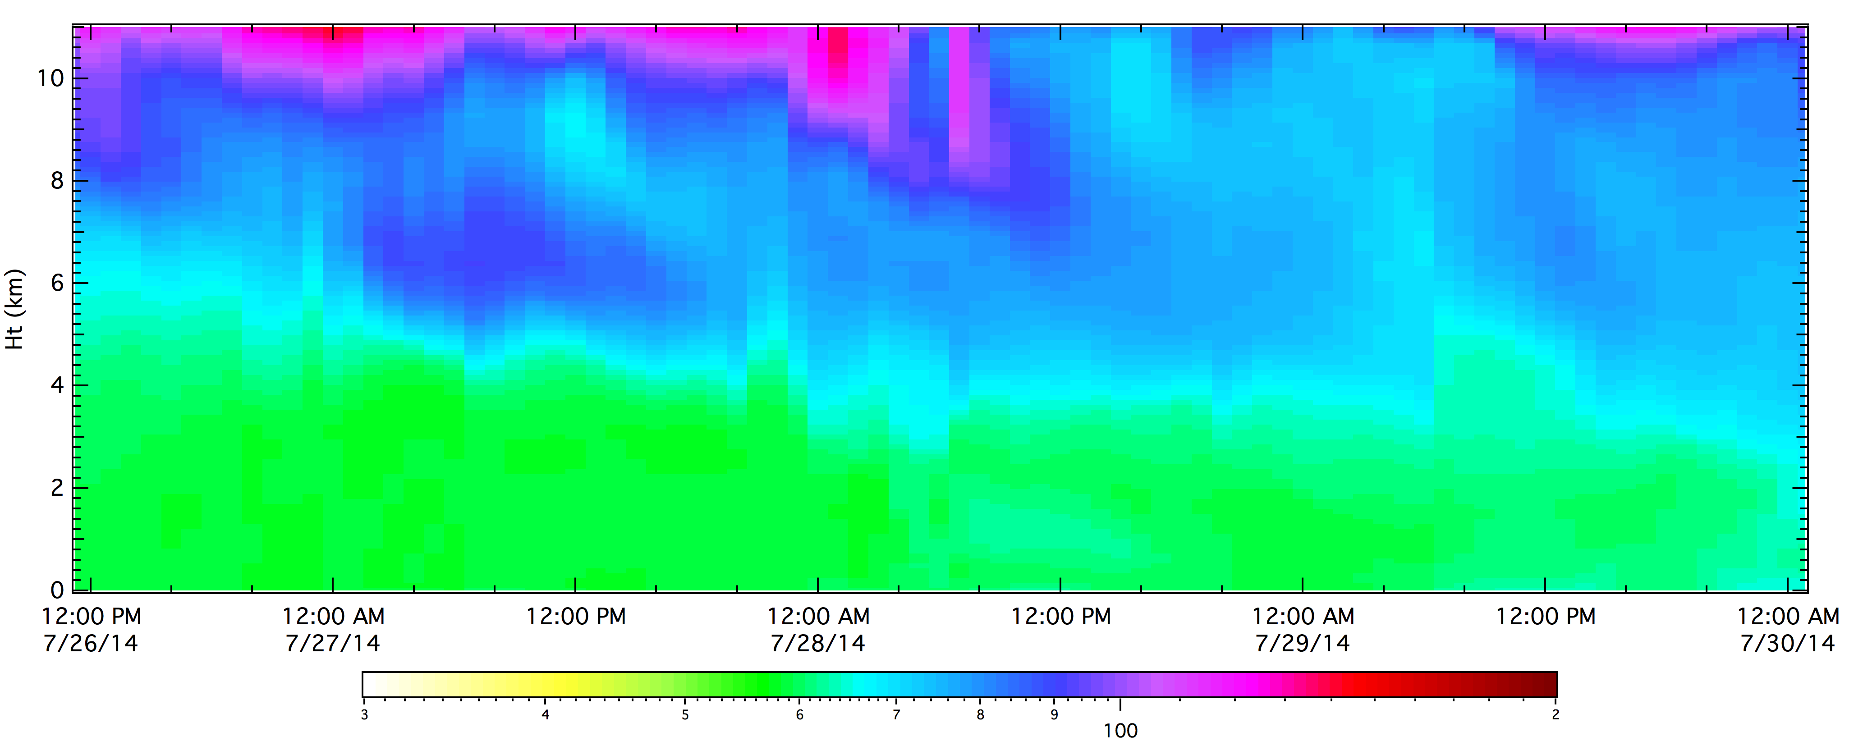
NASA/GSFC Fort Collins O₃ Lidar: 7/26 – 7/29
High O₃ >6km AGL from 7/26 through 7/28,
75 ppbv O₃ at 3.5 km in the afternoon of 7/28.
Photochemical O₃ formation below 2km AGL,
as high as~90 ppbv on the afternoon of 7/28.
Models have no photochemistry.
Both models predict downward O₃ transport from aloft,
with a sharp gradient at ~5km AGL.
The model case with O₃/PV=100 shows more O₃ impact,
but both models underpredict O₃ from 3.5 to 10km AGL.
O₃/PV from Xing et al. (2016)
UTC
O₃/PV = 100.
(ppbv)
O₃/PV from Xing et al. (2015)

Slide 12
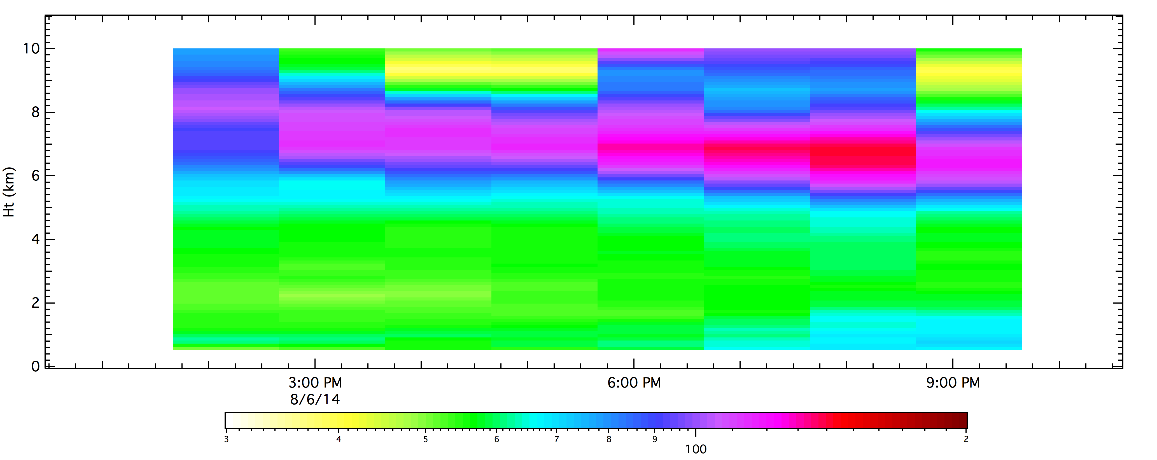
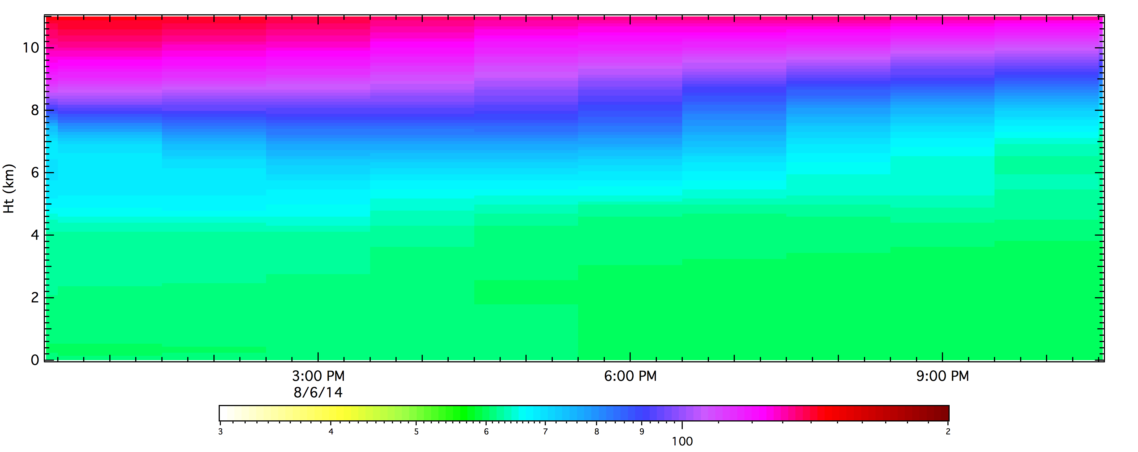
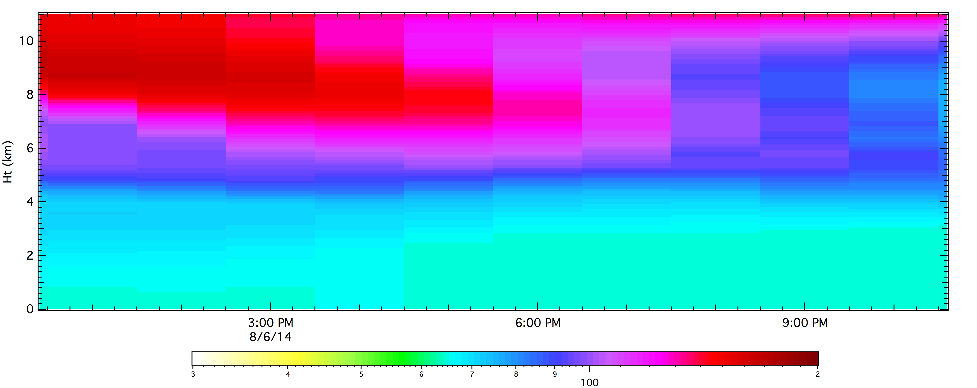
NASA/GSFC Fort Collins O₃ Lidar: 8/6/14 Episode
NASA/GSFC O₃ Lidar
Well defined intrusion seen in the lidar data.
Smeared out in the model simulations.
Models don’t consider low O₃ (less than default values)
from boundary conditions or regional photochemistry.
The model case with O₃/PV=100 shows a clear signature
of the intrusion, but vertical and timing differences
with the observations.
O₃/PV from Xing et al. (2016)
O₃/PV = 100.
(ppbv)

Slide 13
Stratospheric Tracers, 7/29/14 00:00 UTC (difference with default IC/BC case)
IC/BC from Xing et al. (2016), RAP met. forcing
IC/BC from O₃/PV=100, RAP met. forcing
IC/BC from O₃/PV=100, NAM met. forcing
3.6 km AGL (650 hPa)
Platteville location
In W-E cross-section
At 3.5 km AGL, only a small impact from using Xing et al. (2016) to specify IC and BCs.
Using O₃/PV = 100 for IC/BC gives a few ppbv of O₃ over the Front Range with a much larger impact 200km to the southwest
Using NAM versus RAP for meteorological IC/BCs gives quite different O₃ spatial patterns.

Slide 14
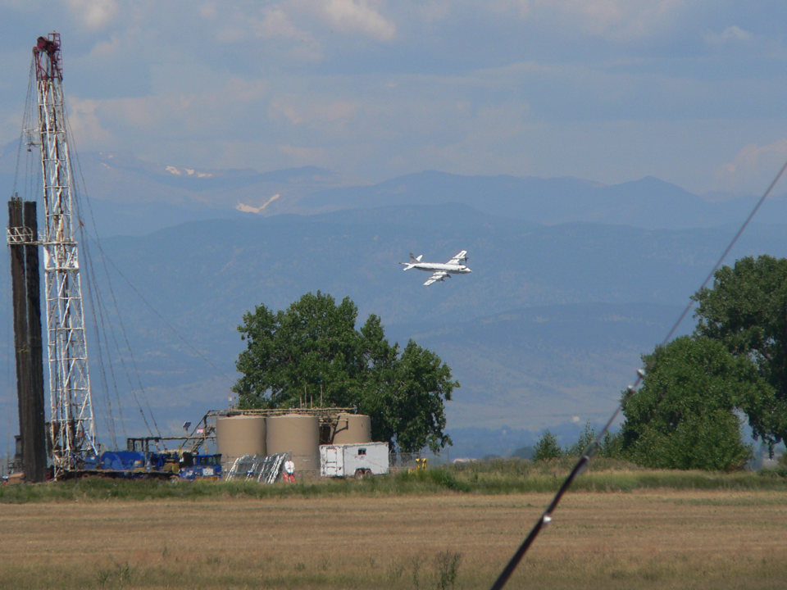
Summary
Stratospheric Influence on background O₃ over the Front Range 7/26 – 7/29 (70-75 ppbv @ 3km AGL).
WRF/Chem with default IC/BCs needs 40% more O₃ on 7/29.
Boundary Conditions from Xing et al. (2016) O₃/PV:
Very successful > 8km AGL, Little Impact < 8km AGL
Model O₃ intrusions depend on the meteorology driving WRF.
Combining measurements from different aircraft, sondes and lidars are helping to diagnose model deficiencies.

