Slide 1
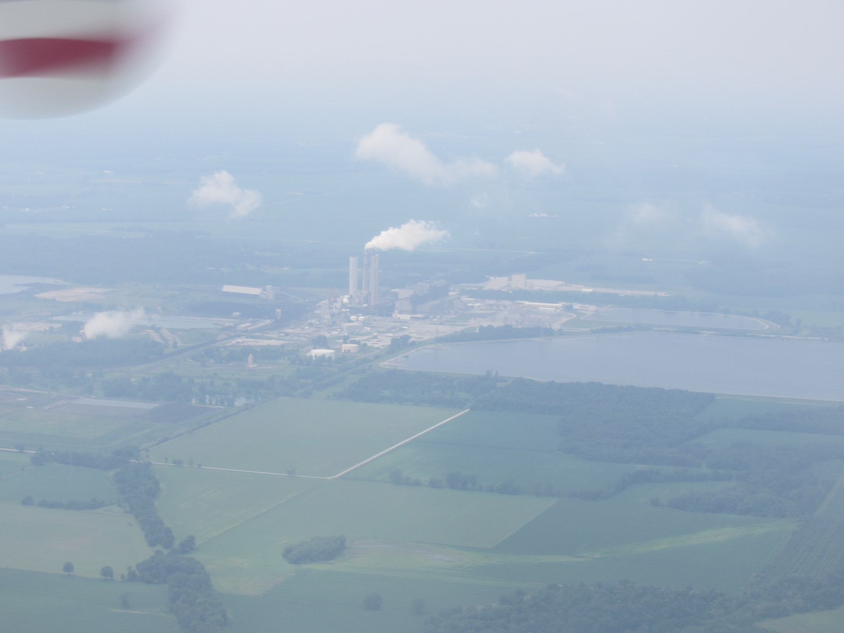


Anthropogenic Sources of non-OH Oxidants of SO₂
Lee Mauldin
Chris Cantrell
Department of Atmospheric and Oceanic Sciences, University of Colorado, Boulder
and the FRAPPE Science Team

Slide 2

SUOMI – SUlfuric OH and MSA Instrument
Hydroxyl (OH) – Primary oxidant in the Earth’s atmosphere
Sulfuric Acid (H₂SO₄) – Oxidation product of SO₂. Important in aerosol formation and growth
Methane Sulfonic Acid (MSA) – Oxidation product of dimethyl sulfide (DMS)
Utilizes Nitrate Chemical Ionization – Mass Spectrometry

Slide 3

OH is measured by first converting it to H₂³⁴SO₄ via:
OH + ³⁴SO₂ → H³⁴SO₃
H³⁴SO₃ + O₂ → ³⁴SO₃ + HO₂
³⁴SO₃ + 2H₂O → H₂³⁴SO₄ + H₂O
³⁴S is used to discriminate between H₂SO₄ produced from OH above and ambient H₂SO₄ – which is also measured
Then detecting via :
Nitrate Ion Chemical Ionization Mass Spectrometry
Ionized
Mass 62
HNO₃ → NO₃⁻
NO₃⁻ + H₂SO₄ → HNO₃ + HSO₄⁻
NO₃⁻ + (CH₃)SO₃H → (CH₃)SO₃⁻
Mass 99 for H³⁴SO₄⁻ (OH)
Mass 97 for HSO₄⁻
Mass 95
H³⁴SO₄⁻
NO₃⁻
HSO₄⁻
NO₃⁻
(CH₃)SO₃⁻
NO₃⁻
[OH] = C
[H₂SO₄] = C
[MSA] = C
Where C is a directly measured calibration coefficient

Slide 4
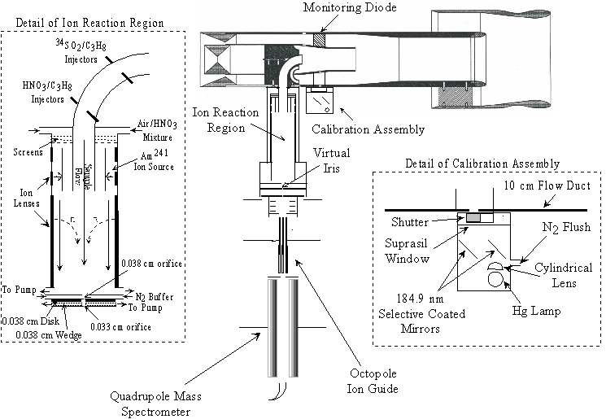

Slide 5


Slide 6
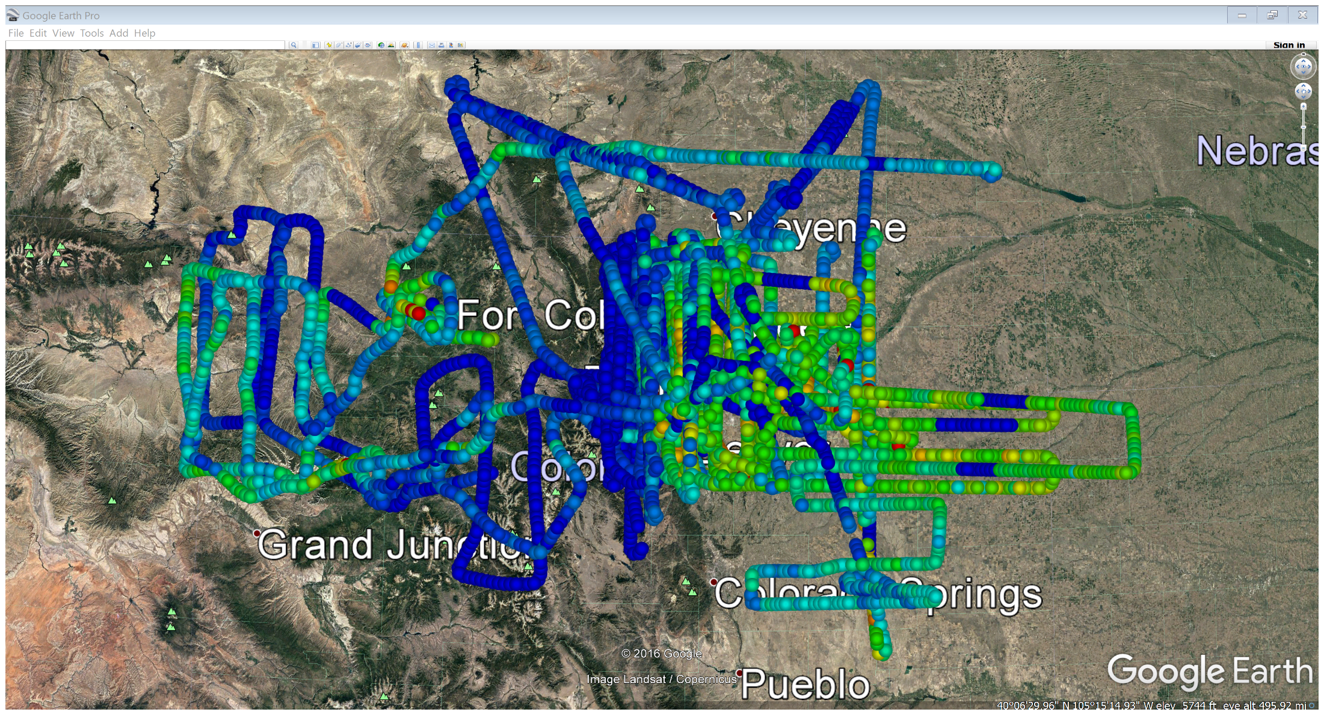
FRAPPE OH

Slide 7
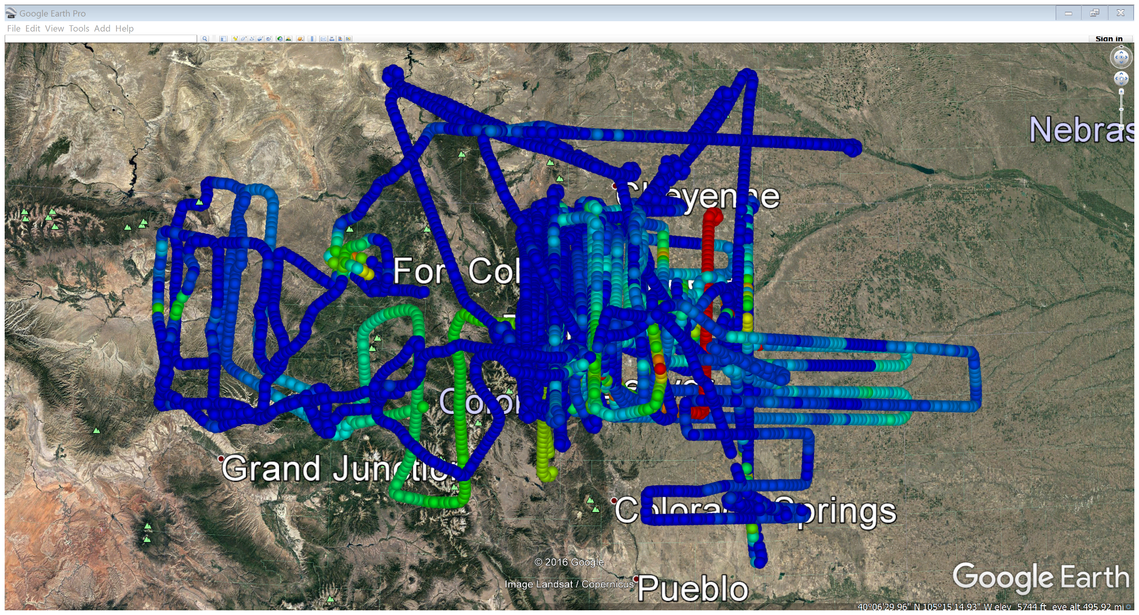
FRAPPE H₂SO₄

Slide 8
What is this “Other Oxidant” Measurement?
OH is measured by first converting it to H₂³⁴SO₄ via:
OH + ³⁴SO₂ → H³⁴SO₃
H³⁴SO₃ + O₂ → ³⁴SO₃ + HO₂
³⁴SO₃ + 2H₂O → H₂³⁴SO₄ + H₂O
and then measuring H₂³⁴SO₄
³⁴S is used to discriminate between H₂SO₄ produced from OH above and ambient H₂SO₄ – which is also measured
Additionally other unknown oxidants can also convert SO₂ into H₂SO₄. To account for these processes a second measurement is made by adding a small amount of OH scavenger, propane, to the front injectors.
This second measurement represents other oxidants that can oxidize SO₂ to produce H₂SO₄ but do not react with propane.
The difference in the H₂³⁴SO₄ without and with propane added is attributable to H₂³⁴SO₄ produced OH chemistry.

Slide 9
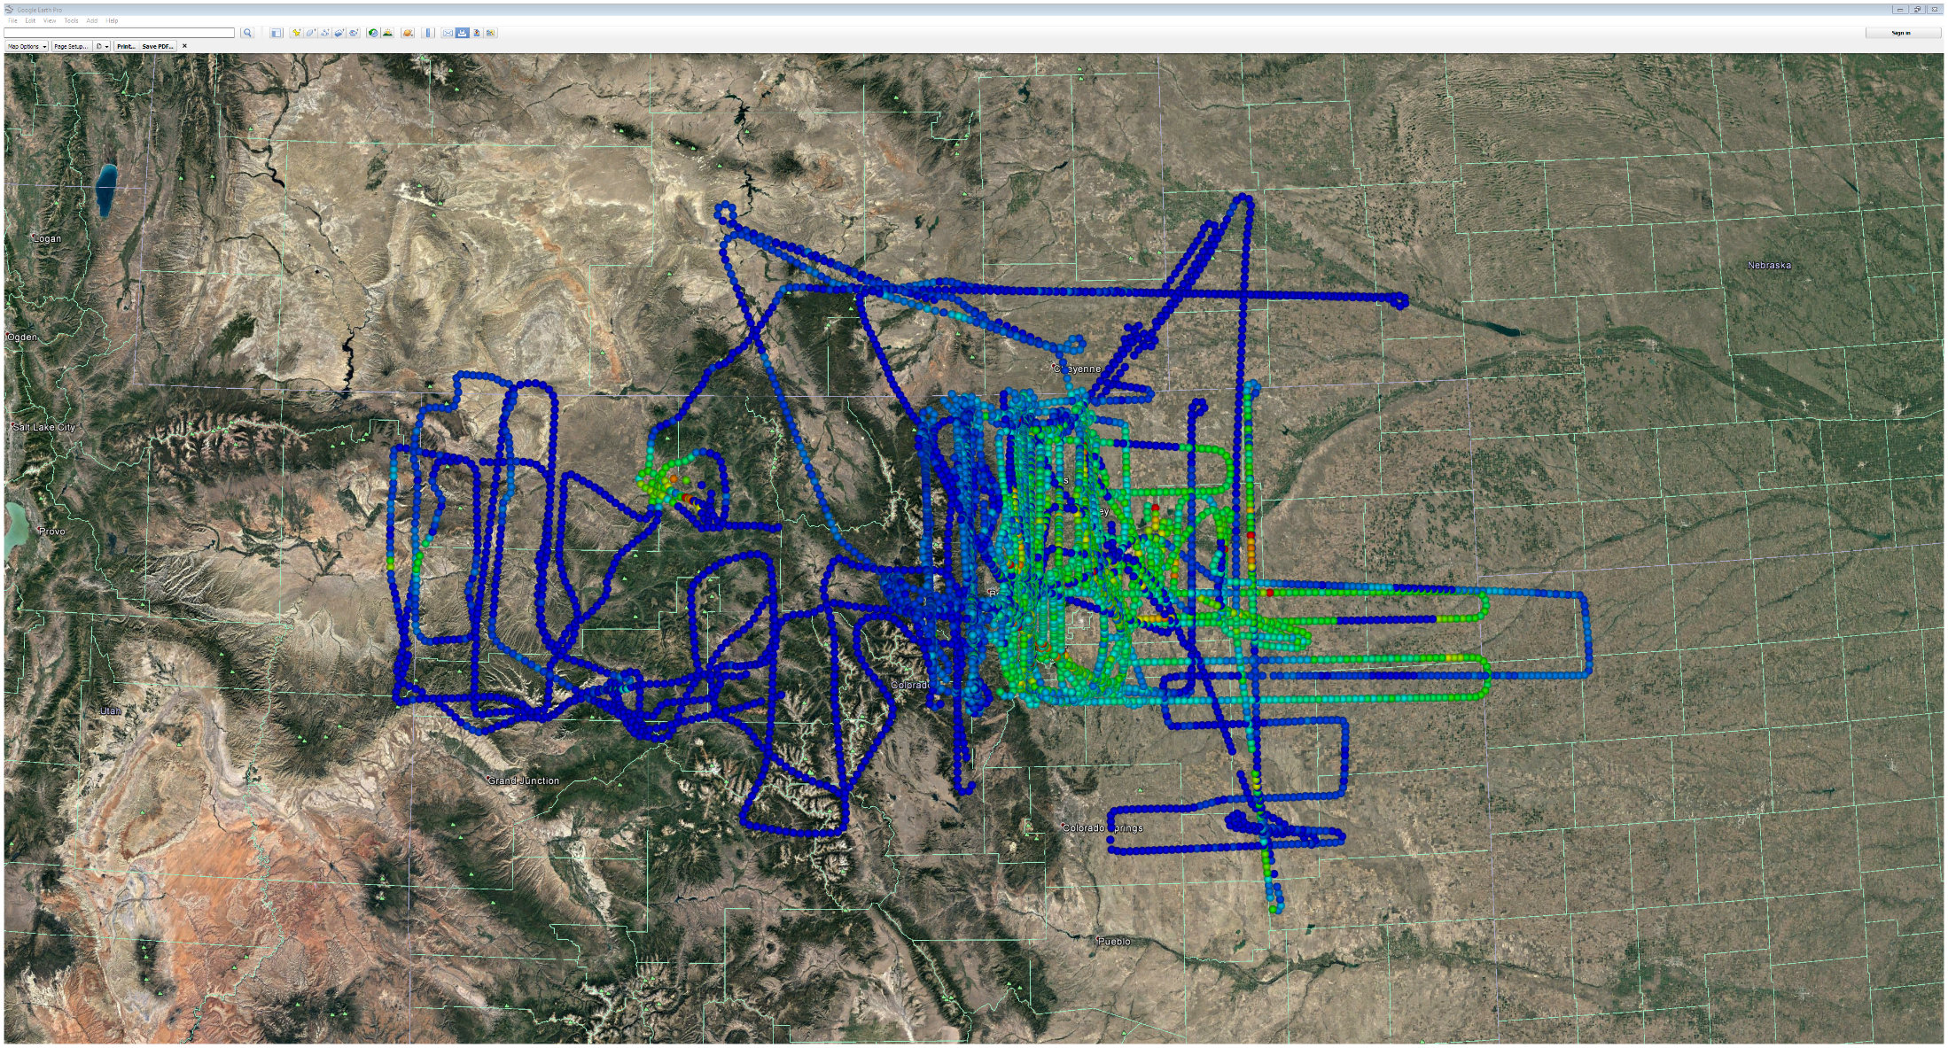

Slide 10
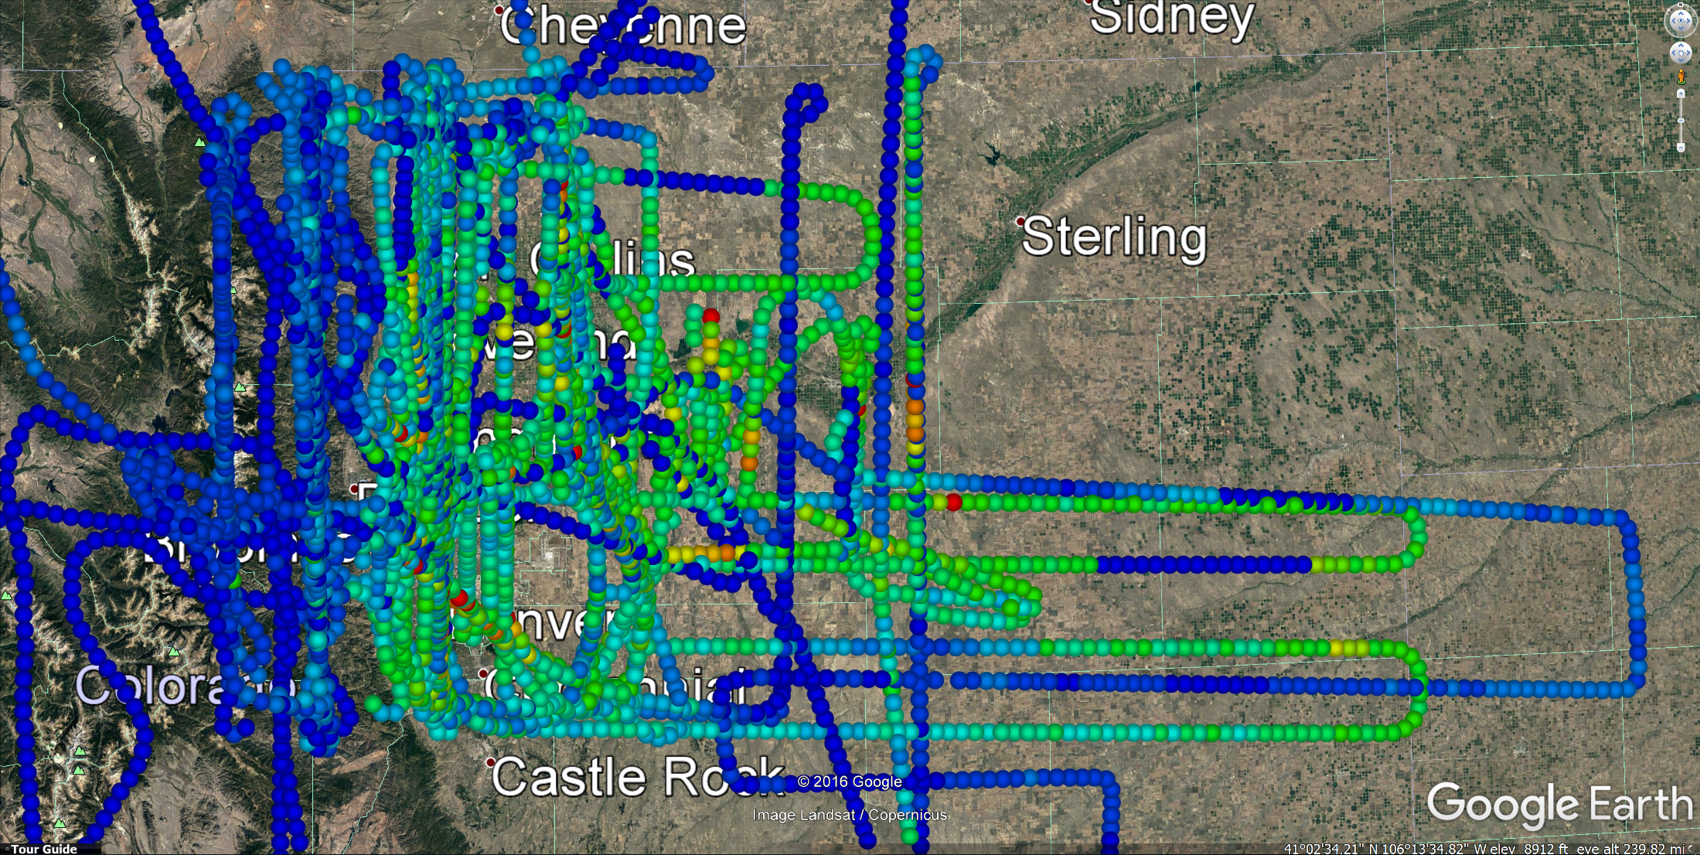

Slide 11
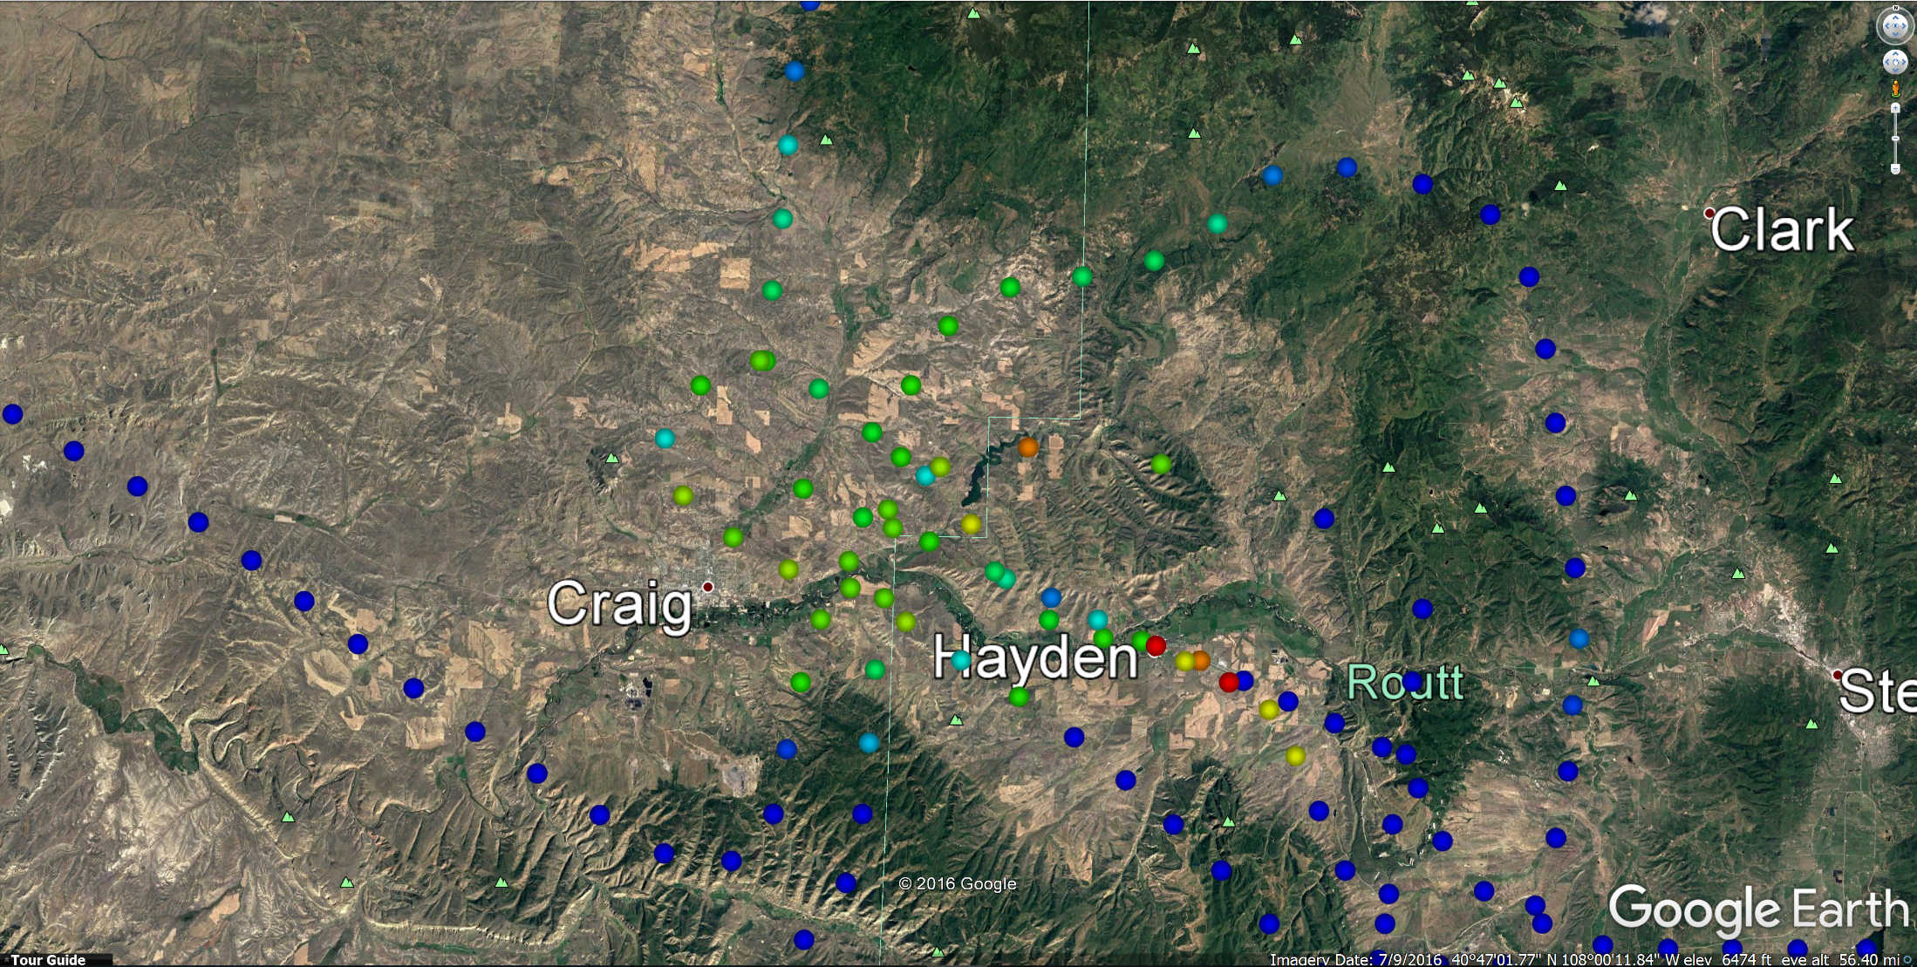

Slide 14
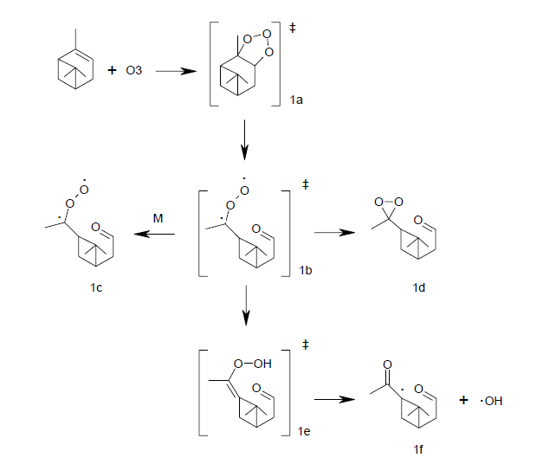
Alpha-Pinene Ozonolysis
Alpha-pinene
sCI

Slide 15
Novelli, A., et al., Identifying Criegee intermediates as potential oxidants in the troposphere, Atm. Chem. Phys. doi:10.5194/acp-2016-919, 2016.
Kim, S., et al., Potential Role of Stabilized Criegee Radicals in Sulfuric Acid Production in a High Biogenic VOC Environment, Environ Sci Technol, 49(6), 3383-3391, doi:Doi10.1021/Es505793t, 2015.
Mauldin, R. L., et al., A new atmospherically relevant oxidant of sulphur dioxide, Nature, 488(7410), 193-197, doi:Doi 10.1038/Nature11278, 2012.
Welz, O., et al, Direct Kinetic Measurements of Criegee Intermediate (CH2OO) Formed by Reaction of CH2I with O2, Science, 335, 204-207, 10.1126/science.1213229, 2012.

Slide 22
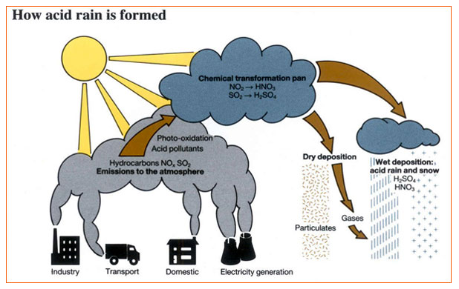

Slide 23
H₂SO₄ modeling
Assume steady state for H₂SO₄
Production
k_{SO2}[OH][SO₂]
k_{Ox}[Other Ox][SO₂]
Loss
Diffusion limited aerosol uptake
(4/(αυ))⁻¹ An α = mass accommodation coefficient
υ = molecular speed
A = Fuchs surface area
n = [H₂SO₄]

Slide 25
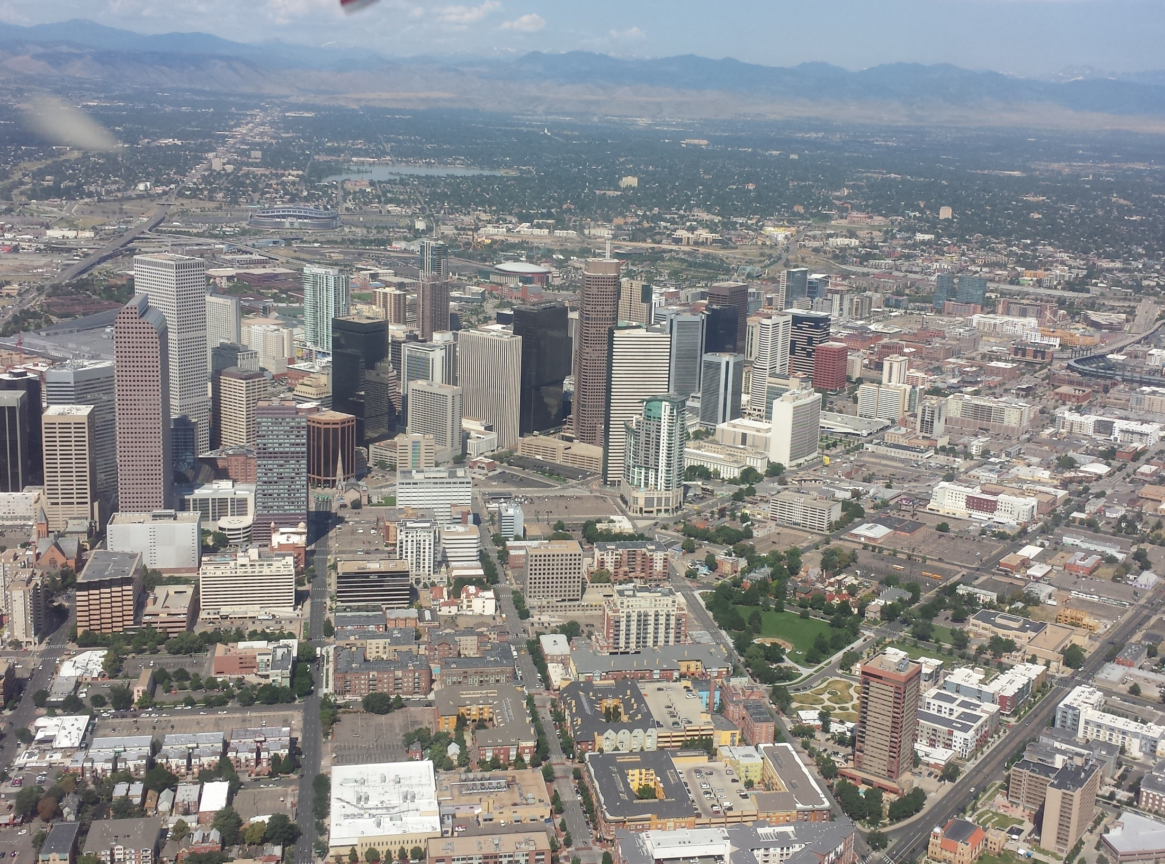
Conclusions
“Other Oxidant(s)” are seen in larger concentrations in areas with urban influences
Usual biogenic suspects for the formation of stabilized Criegee Intermediates don’t seem to correlate with observations.
Possible correlation with CH₃OOH – warrants further investigation
Future work
Try to identify class or classes of compounds responsible for Other Oxidant signal
Model H₂SO₄ and compare with measurement

