Slide 1
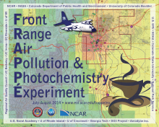
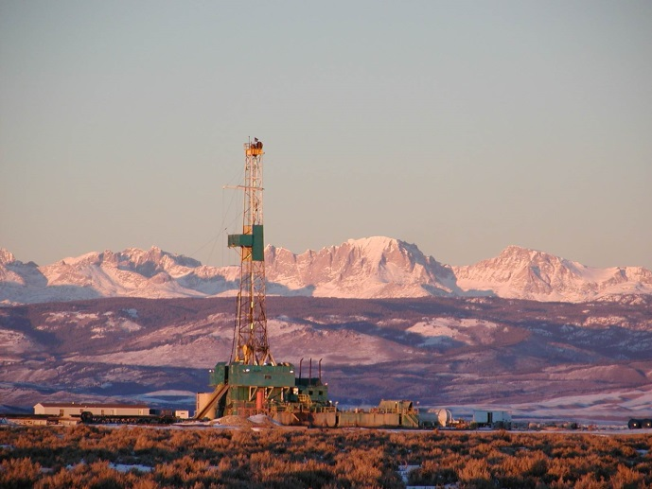
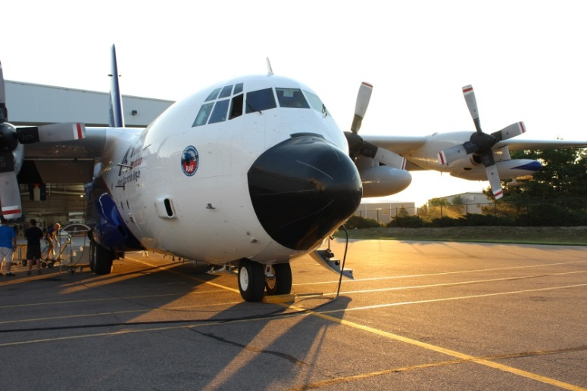
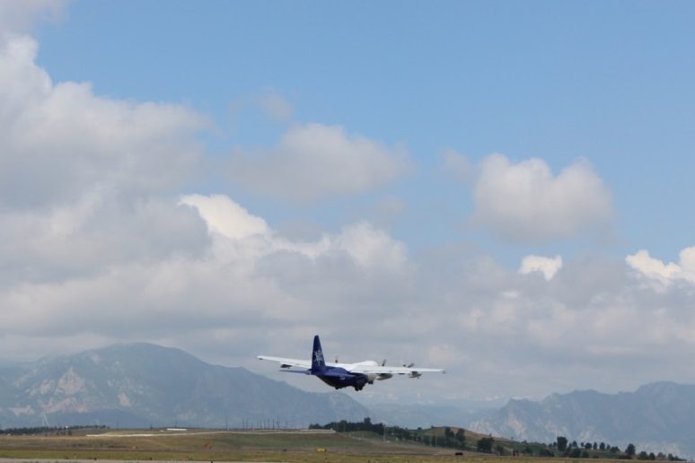
The Impact of Oil and Natural Gas Activity on Ozone Formation in the Colorado Front Range
Rebecca Hornbrook¹, Eric Apel¹­, Alan Hills¹, Don Blake², Nicola Blake², Jason Schroeder², Alan Fried³, Petter Weibring³, Dirk Richter³, James Walega³, Sojin Lee¹, Lisa Kaser¹, Steve Schertz¹, Roy Mauldin³, Chris Cantrell³, Sam Hall¹, Kirk Ullmann¹, Andy Weinheimer¹, Deedee Montzka¹, John Orlando¹, Geoff Tyndall¹, Teresa Campos¹, Meghan Stell¹, Brian Heikes⁴, Victoria Treadaway⁴, Dan O’Sullivan⁵, Greg Huey⁶, David Tanner⁶, Ronald Cohen⁷, Frank Flocke¹, Gabi Pfister¹, Christoph Knote⁸, Louisa Emmons¹
¹Atmospheric Chemistry, Observation and Modeling Laboratory (ACOM), NCAR, Boulder, CO
²University of California Irvine, Irvine, CA
³University of Colorado Boulder, Boulder, CO
⁴University of Rhode Island, Kingston, RI
⁵United States Naval Academy, Annapolis, MD
⁶Georgia Institute of Technology, Atlanta, GA
⁷Univeristy of California Berkeley, Berkeley, CA
⁸Meteorologisches Institut, Ludwig-Maximilians-Universität München, Germany
NCAR/ACOM VOC Measurements group
FRAPPE/DAQ Science Team Meeting – May 2017

Slide 2
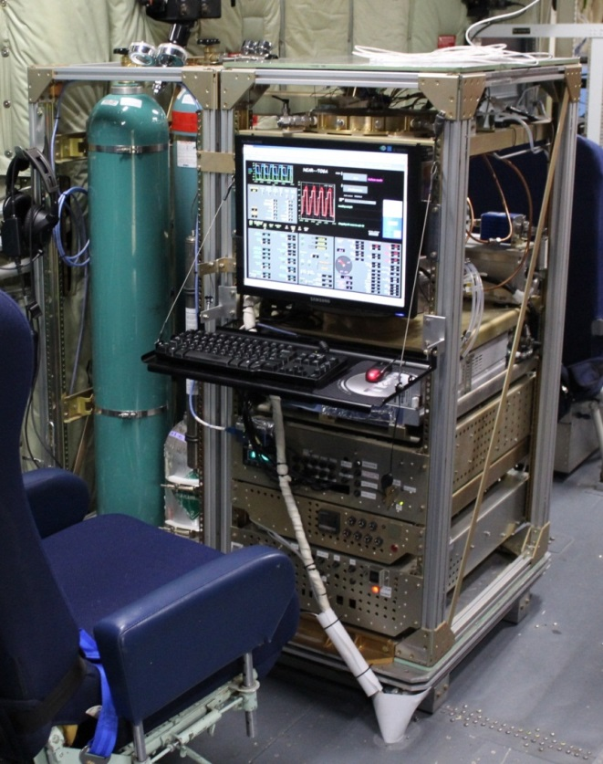
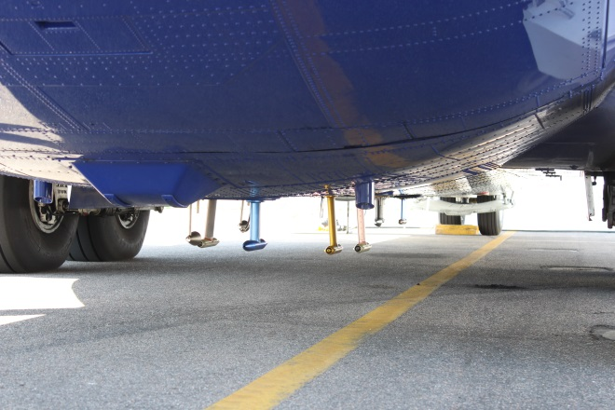
NCAR TOGA (Trace Organic Gas Analyzer)
Eric Apel (PI), Alan Hills, Rebecca Hornbrook; NCAR/ACOM
Instrument Specifications:
fast online GC/MS
35-second samples every 2 minutes
samples processed in flight
analyzed post-flight for 60+ VOCs
wide dynamic range
detection limits at low pptv to sub-pptv range
VOC tracers from several sources/types:
Biogenic VOCs and oxidation products
Anthropogenic VOCs
Oil & Gas Tracers
Long-lived Halogenated VOCs
Short-lived Halogenated VOCs
OVOCs, including HCHO
Alkyl Nitrates
Biomass Burning tracers (HCN, CH₃CN)
Sulfur-containing compounds (DMS, OCS)
Biogenic VOCs and oxidation products
Anthropogenic VOCs
Oil & Gas Tracers
Long-lived Halogenated VOCs
Short-lived Halogenated VOCs
OVOCs, including HCHO
Alkyl Nitrates
Biomass Burning tracers (HCN, CH₃CN)
Sulfur-containing compounds (DMS, OCS)
Biogenic VOCs and oxidation products
Anthropogenic VOCs
Oil & Gas Tracers
Long-lived Halogenated VOCs
Short-lived Halogenated VOCs
OVOCs, including HCHO
Alkyl Nitrates
Biomass Burning tracers (HCN, CH₃CN)
Sulfur-containing compounds (DMS, OCS)
TOGA installed on the C-130
C-130 inlets
NCAR/ACOM VOC Measurements group
FRAPPE/DAQ Science Team Meeting – May 2017

Slide 3
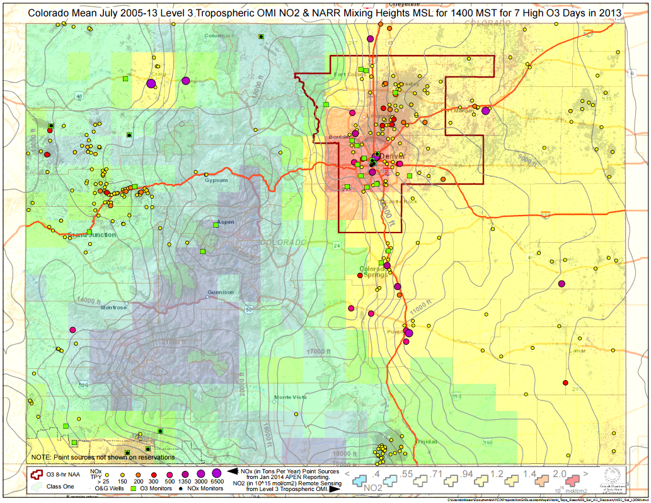
Colorado – OMI NO₂; O₃ nonattainment (8-hour 75 ppbV) area
2008 O₃ NAAQS nonattainment area
Ft. Collins
Greeley
Boulder
Denver
Colorado
Springs
NCAR/ACOM VOC Measurements group
FRAPPE/DAQ Science Team Meeting – May 2017

Slide 4
Methane observations
Uintah
Rifle
Points sized by methane
Methane data: T. Campos, M. Stell, S. Park, M. Reeves, F. Flocke, NCAR
NCAR/ACOM VOC Measurements group
FRAPPE/DAQ Science Team Meeting – May 2017

Slide 5
Ethane observations
Uintah
Rifle
Points sized by ethane
Ethane data: A. Fried, P. Weibring, D. Richter, J. Walega, CU Boulder
NCAR/ACOM VOC Measurements group
FRAPPE/DAQ Science Team Meeting – May 2017

Slide 6
n-Butane observations
Uintah
Rifle
Points sized by n-butane
NCAR/ACOM VOC Measurements group
FRAPPE/DAQ Science Team Meeting – May 2017

Slide 7
Ethane/n-Butane ratios
Uintah, Winter 2013
(Koss et al., ACP, 2015)
C₂/C₄ = 6.25
Denver-Julesburg Basin
BAO, Winter 2011
(Swarthout et al., JGR, 2013)
C₂/C₄ = 3.13
Uintah
Rifle
Uintah Basin
Piceance
Basin
DRY
GAS
WET
GAS
Points sized by ethane
NCAR/ACOM VOC Measurements group
FRAPPE/DAQ Science Team Meeting – May 2017

Slide 8
Isobutane/n-Butane ratios
Uintah, Winter 2013
(Koss et al., ACP, 2015)
iC₄/C₄ = 0.63
BAO, Winter 2011
(Swarthout et al., JGR, 2013)
iC₄/C₄ = 0.41
Uintah
Rifle
DRY
GAS
WET
GAS
Points sized by n-butane
NCAR/ACOM TOGA group
AGU Fall Meeting A12A-02

Slide 9
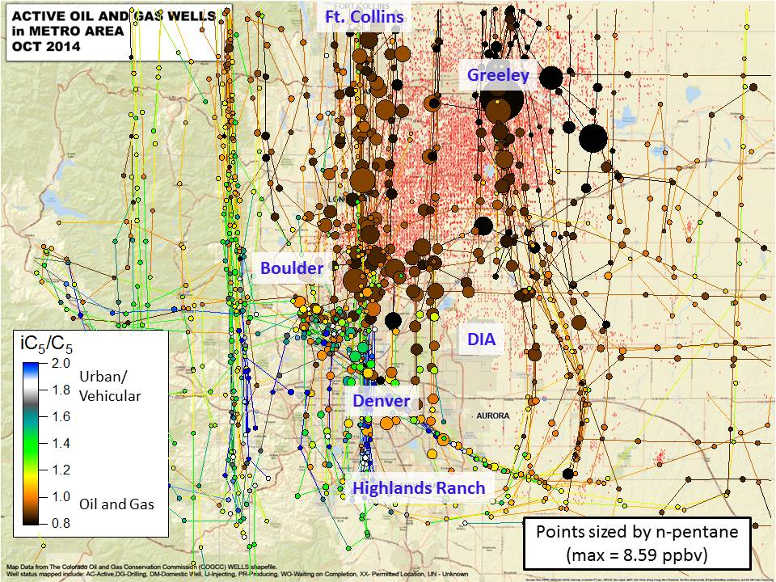
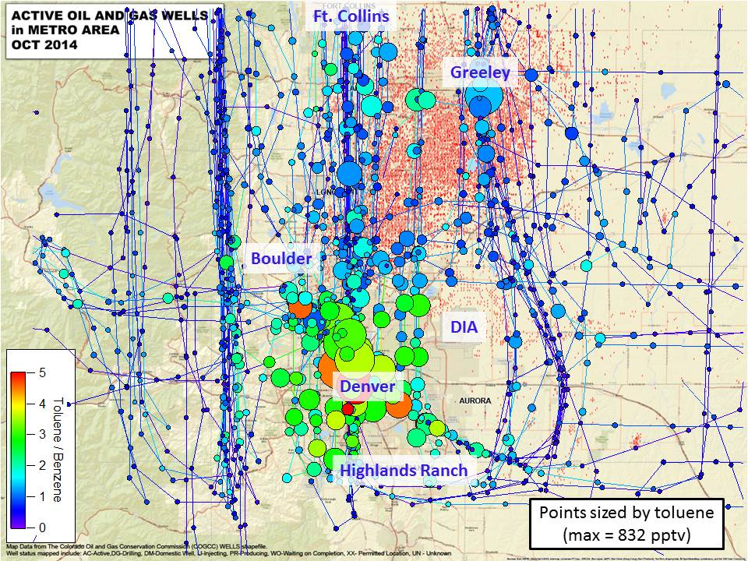
Key Questions:
What are the differences in the ozone production potential for the different regions sampled? (i.e., Denver urban area, Commerce City, Weld County, Uintah, Rifle, background upwind – Foothills, biogenic, etc., comparison of high NO_{x}, high VOCs?)
What is the impact of O&G activity in Weld country on ozone production?
What is the impact of wet/dry O&G emissions on ozone production potential? (i.e., Piceance Basin/Rifle vs. Denver-Julesburg Basin/Weld)
The TOGA merge averages high frequency measurements to the TOGA sampling time = 35 s every 2 min.
Using individual TOGA merge samples or groups of samples characteristic of the different sampling regions,
16 sets of initial conditions were selected to run using the BOXMOX model.
NCAR/ACOM VOC Measurements group
FRAPPE/DAQ Science Team Meeting – May 2017

Slide 10
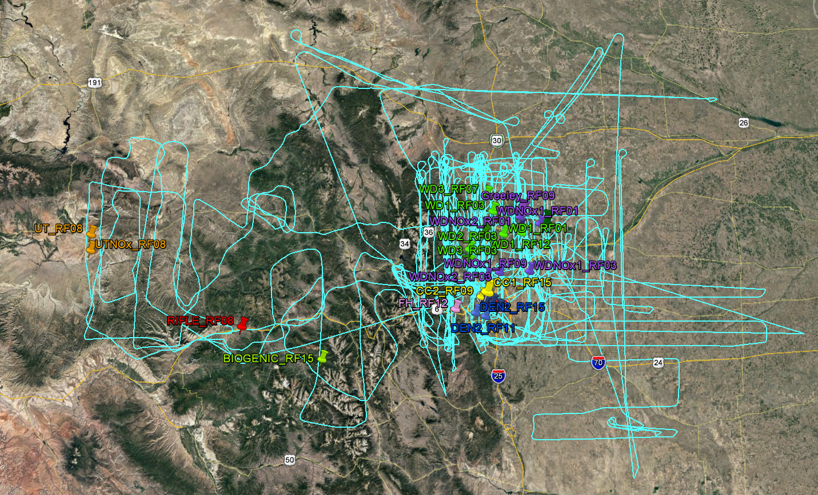
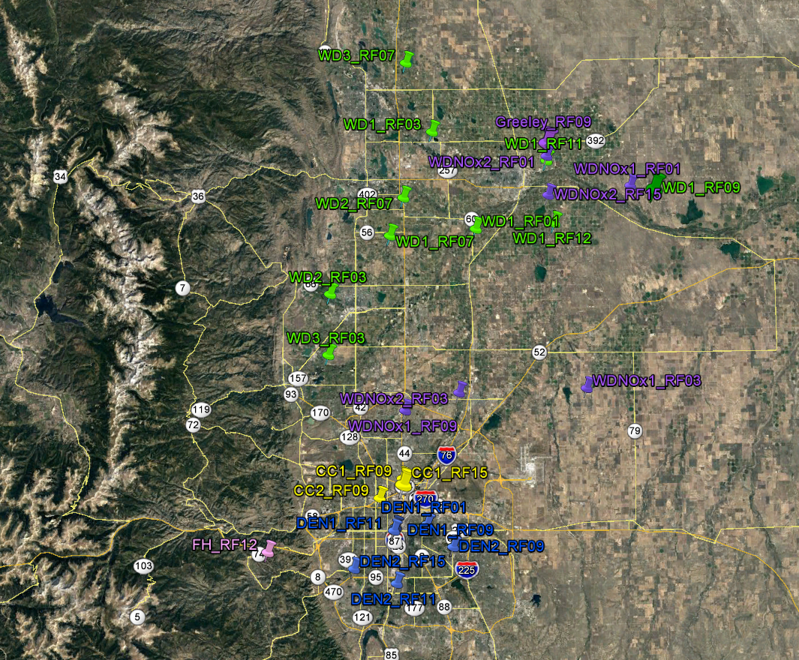
FRAPPÉ Flight tracks and Regional Data Selection
Greeley
Missed Approach
Weld (low NO_{x}):
C₅ > 1 ppb
NO_{x} < 3 ppb
Weld high NO_{x}:
C₅ > 1 ppb
NO_{x} > 3 ppb
Commerce City:
C₅ > 1 ppb
NO_{x} > 20 ppb
Denver:
toluene/benzene > 2
NCAR/ACOM VOC Measurements group
FRAPPE/DAQ Science Team Meeting – May 2017

Slide 11
FRAPPÉ BOXMOX Point Selection
NCAR/ACOM VOC Measurements group
FRAPPE/DAQ Science Team Meeting – May 2017

Slide 12
FRAPPÉ BOXMOX Point Selection
NO_{x}, ppbv
NCAR/ACOM VOC Measurements group
FRAPPE/DAQ Science Team Meeting – May 2017

Slide 13


BOXMOX Modeling
Uses the KPP (Kinetic Preprocessor [Sandu and Sander, 2006])
MCM (Master Chemical Mechanism), including 5258 species and 15176 reactions
User-selected input data, meteorological parameters, etc.
Simulates chamber experiments or Lagrange-type air parcel chemistry
Optional dilution, entrainment, mixing, deposition, etc.
Essentially puts the air parcel in a jar then follows the chemistry
(BOXMOX: Knote et al., Atmos. Environ, 2015)
* TOGA-merge samples were selected that coincided with WAS canister samples, available NO_{x}, O₃, CH₄, high-rate CAMS C₂H₆, etc.
Simulations:
a) 2 pm local, 40°N clear sky at surface, TUV, fixed T (290 K)
b) Diel cycle, beginning at noon local, 40°N clear sky, TUV, variable T
c) Same as above, but with an input of NO_{x} and urban trace gases after 12-24 hours
Uintah (pt) Commerce City (pt) Weld (pt)
Uintah_NOx (pt) Commerce City (avg; 3 pts) Weld (avg; 10 pts)
Rifle (pt) Denver (avg; 7 pts) Greeley (pt)
Foothills (pt) Biogenic (pt) Weld_NOx (avg,8)
Weld_lowVOC
Weld_lowVOC&NOx
Greeley_lowVOC
Greeley_lowVOC&NOx
NCAR/ACOM VOC Measurements group
FRAPPE/DAQ Science Team Meeting – May 2017

Slide 14
Simulation (a) – constant 1400h TUV
ΔO₃
MCM
All cases
Commerce City (avg and pt) and Uintah_highNOx generate the most O₃, followed by Greeley and Denver.
Reducing VOCs in Greeley significantly reduces O₃ production. The O&G NOx is only a small contribution.
14 ppb to 11.7 ppb = 16% decrease
Weld_pt
Weld_lowVOC
Separating Weld into high and low NOx groups demonstrates a strong contract between Weld (avg and pt) and Weld_highNO_{x} (avg).
Reducing VOCs in Weld leaves only a small reduction in O₃ production. Further reducing NO_{x} makes a much larger impact.
ΔO₃
Low NO_{x}
Weld_lowVOC&NO_{x}
NCAR/ACOM VOC Measurements group
FRAPPE/DAQ Science Team Meeting – May 2017

Slide 15
Simulation (b) - diel, starting at noon local
Greeley
Weld_NO_{x}avg
Denver_avg
MCM does not handle the highest NO_{x} cases well (CCavg, CCpt, UTNOx)
Similar overall separation in ΔO₃ between the high-NOx cases and the low-NOx cases.
NCAR/ACOM VOC Measurements group
FRAPPE/DAQ Science Team Meeting – May 2017

Slide 16
Impact of gas dryness on alkane OH reactivity
Rifle and Uintah – very dry and dry - similar contribution from C₂ through C₇s
Denver-Julesburg Basin (Weld) – wet gas, larger impact from C₄-C₅ alkanes.
NCAR/ACOM VOC Measurements group
FRAPPE/DAQ Science Team Meeting – May 2017

Slide 17
Summary
Ethane/butane (C₂/C₄) and isobutane/butane (iC₄/C₄) ratios are indicative of
  Wet gas vs. dry gas deposits
  Regional natural gas vs. oil production
The Niobrara/Denver-Julesburg Basin has a high proportion of wet natural gas and oil extraction activities.
The alkane OH reactivity in the DJ Basin region is dominated by C₄ – C₆ alkanes.
Elevated VOCs in Weld County regions with low NO_{x} increase the ozone production potential by ~ 16%
The transport of O&G VOCs into regions with high NO_{x} (i.e., Greeley) strongly increases in the impact of the O&G activities on ozone production (final assessment pending.)
NCAR/ACOM VOC Measurements group
FRAPPE/DAQ Science Team Meeting – May 2017

