Slide 1
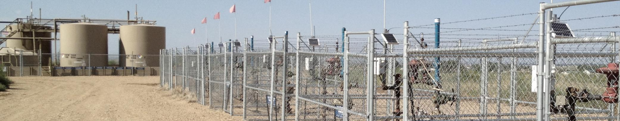


Airborne and Ground-Based Measurements of Emissions from
Oil and Gas Extraction and their Impacts in the Colorado Front Range
Jessica B. Gilman, R. Ahmadov, K.C. Aikin, M. Coggon, S. Eilerman, A.R. Koss, W.C. Kuster, B.M. Lerner, S.A. McKeen, J.A. Neuman, J. Peischl, T.B. Ryerson, M. Trainer, T. Tokarek, C. Warneke, B. Yuan and J.A. de Gouw
Natural gas well pad in northeastern Colorado
Overview of NOAA CSD datasets and measurement platforms
Mobile lab measurements in Weld County: agricultural and on-road sources
Ground-based measurements of VOCs at BAO: seasonal variability and OH reactivity
Airborne measurements of shale basins: VOC emissions and CH₄ fluxes
Cooperative Institute for Research in Environmental Sciences, Univ. of Colorado, Boulder, CO
NOAA Earth System Research Laboratory, Chemical Sciences Division, Boulder, CO

Slide 2
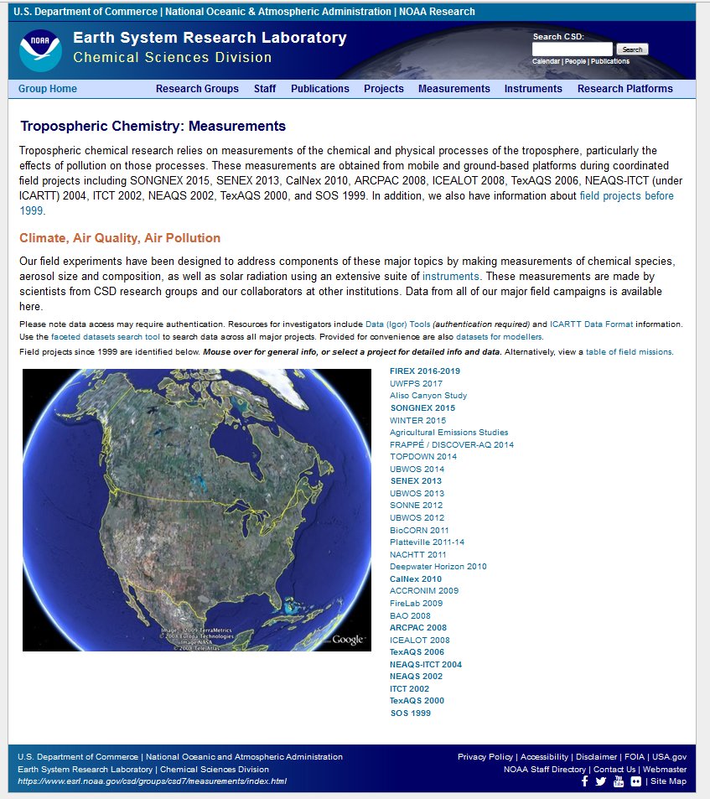
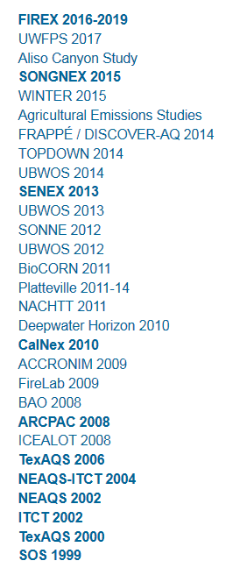
NOAA Chemical Sciences Division has been characterizing the composition of ambient air in the Front Range of Colorado for the last few decades
www.esrl.noaa.gov/csd/groups/csd7/measurements/
NOAA CSD datasets in the Colorado Front Range
Measurements at Niwot Ridge, Fritz Peak, and Boulder in 1980-1990’s
Airborne Studies:
TOPDOWN 2014
SONGNEX 2015
IGOR macros and mapping tools
NOAA CSD Data Manager:
kenneth.c.aikin@noaa.gov

Slide 3



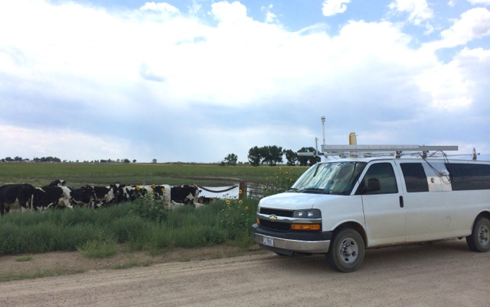
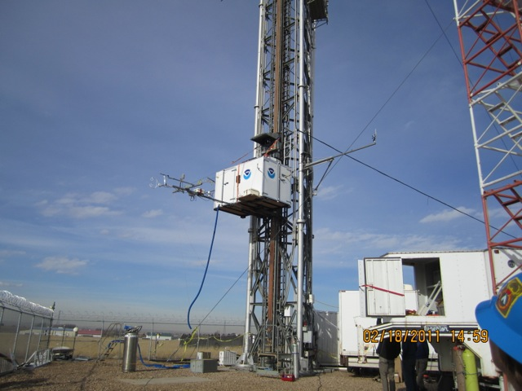
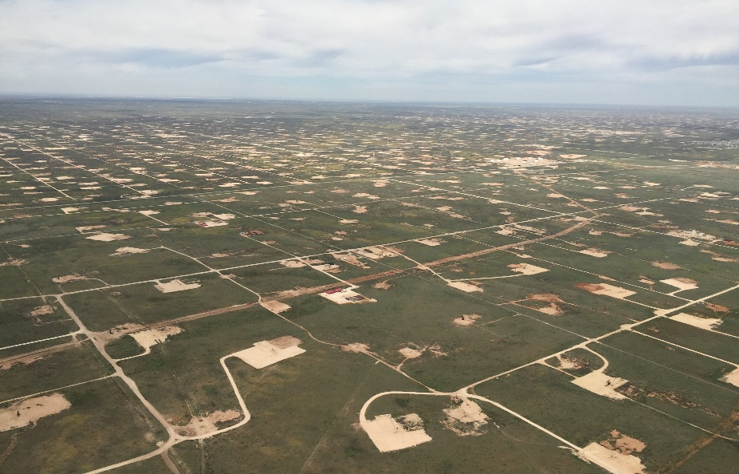
A variety of sampling platforms and measurement techniques are utilized to fully characterize emissions and environmental impacts of emissions from oil and gas operations.
2) Mobile Lab
3) Ground Sites
4) Airborne Sampling
Boulder Atmos. Obs.
(BAO tower)
Weld Co. Colorado
NOAA WP-3D research flight over the Permian Basin, NM
Photo: J. Peischl
Photo: F. Ozturk
Photo: C. Brock
Primary emissions, near source
Characterize emissions directly downwind of agricultural activities
Measure variability of gasoline and diesel on-road emission sources
Local measurements, longer-term
Detailed measurements of localized emissions, photochemistry, meteorology for atmos. models
Measurements over 4 - 6 weeks
Basin-wide, short-term measurements
Regional emissions, transport, photochemistry, and modeling
Emission flux measurements
Measure each basin 1 - 4 times
Uintah Basin w2014 (oil and gas)
Front Range s2014 - s2016
Uintah Basin w2012, w2013, w2014
Denver Basin at BAO w2011, s2012
SENEX s2013: 3 basins, 5 flights
SONGNEX sp2015: 12 basins, 19 flts
NACHTT
SONNE
w = winter measurements; s = summer measurements; sp = spring measurements

Slide 4
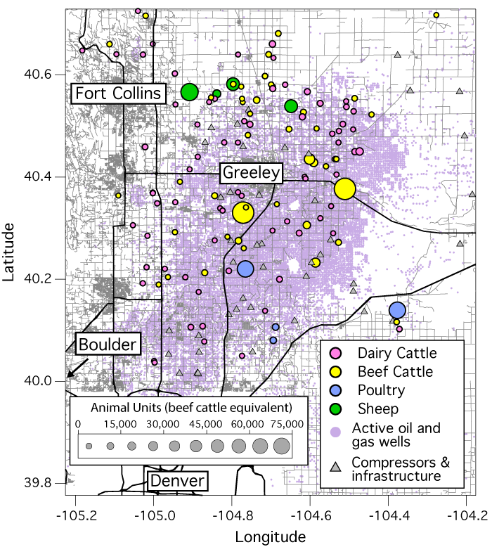
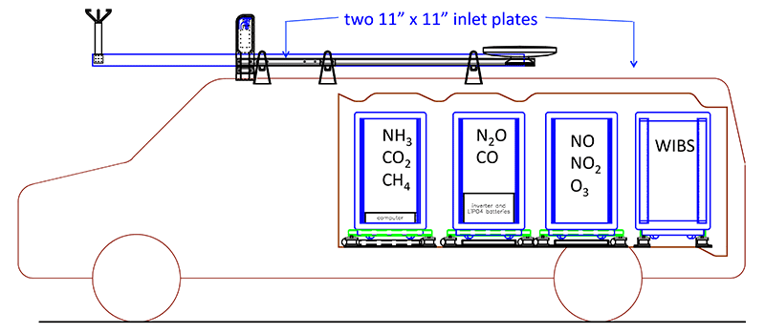
Mobile-lab measurements are used to characterize various emission sources in the Colorado Front Range including agricultural activities and on-road emission sources
2) Mobile Lab
Figure courtesy of S. Eilerman
Principle Investigators:
CH₄ and trace gases
Jeff Peischl (CAFOs and oil and gas)
Tom Ryerson
VOCs by TOF-CIMS (H3O⁺ and NO⁺)
Bin Yuan (CAFOs, agricultural)
Abby Koss (vehicle emissions)
Matt Coggon (biomass burning)
Carsten Warneke (oil and gas, UT)
Ammonia
Scott Eilerman (CAFOs)
Andy Neuman
Photo: J. Peischl
Oil and gas mobile studies:
Petron et al. (2012) JGR
Warneke et al. (2014) ACP
Collett et al. (2016) CDPHE report
TOF-CIMS
Notes:
In the Denver-Julesburg Basin, livestock and oil and natural gas extraction are co-located, and both emit methane.
Methane emissions from agriculture must be understood to attribute measured emissions to a specific source sector.
Ammonia measured by TOF-CIMS (H3O+ ionization), NH3-CIMS (acetone dimer ionization), and Picarro CRD

Slide 5
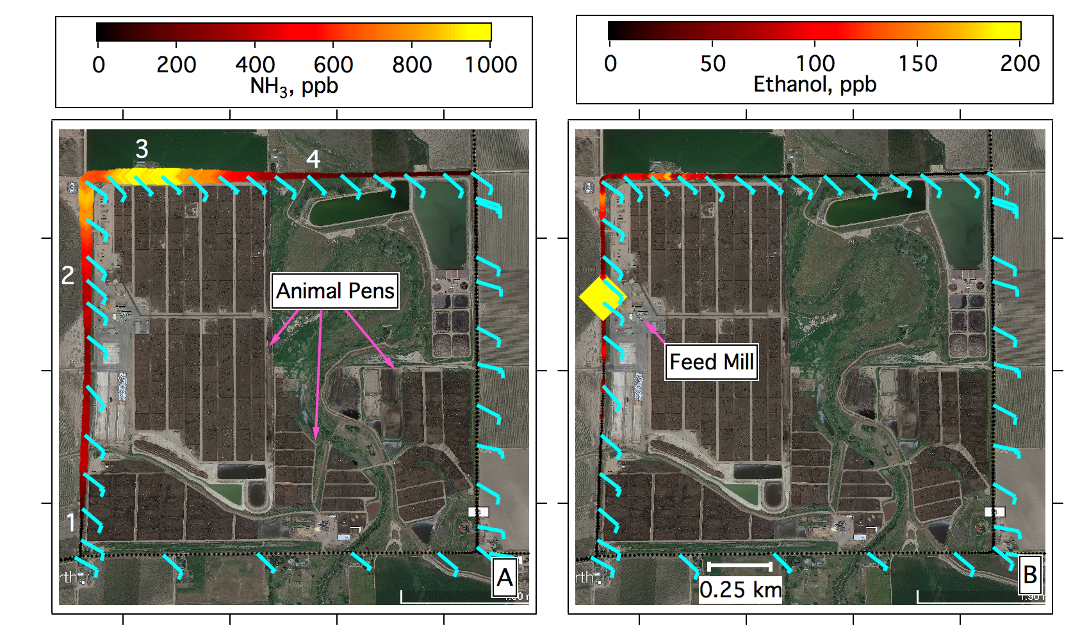
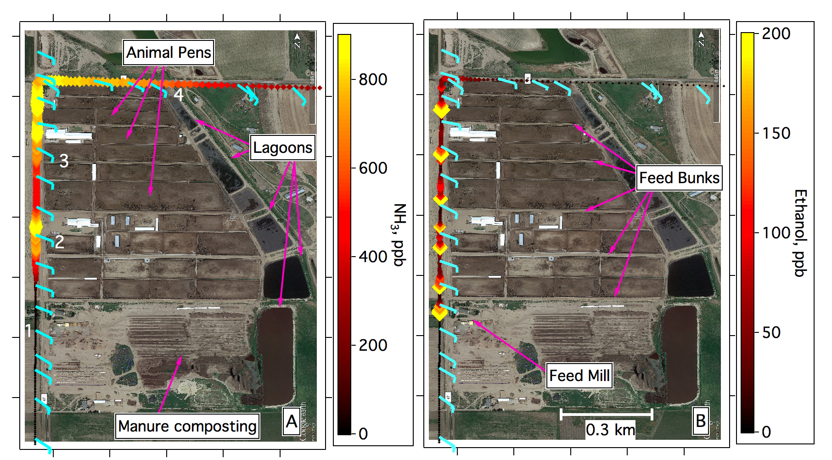
Mobile-lab measurements are used to characterize various emission sources in the Colorado Front Range including agricultural activities and on-road emission sources
Beef cattle farm in Weld Co.
Dairy cattle farm in Weld Co.
Emissions of many VOCs, NH₃, and CH₄ (not shown) were enhanced directly downwind of concentrated animal feeding operations (CAFOs)
NH₃ highest downwind of animal pens (panel A)
Ethanol highest downwind of feed mill and bunks (panel B)
CH₄ highest downwind of waste lagoon (not shown)
Measured CAFOs emissions for > 60 VOCs and GHGs for 5 facilities in Weld County Colorado in February 2016 [Yuan et al. 2017]
Integrate the VOC enhancements directly downwind of individual farms to determine the averaged VOC composition profile for different farms (e.g., beef and dairy cattle, sheep, and chicken)
NH₃ and CH₄ measurements and figures: Eilerman et al., ES&T 2016
VOC measurements and figures: Yuan et al., ACPD 2017
Notes:
Highly spatial van measurements are used to determine the sources of various VOCs within feedlots
Alcohols are mainly from feed storage/handling, whereas amines, amides and phenolic species are mainly from animals/waste

Slide 6
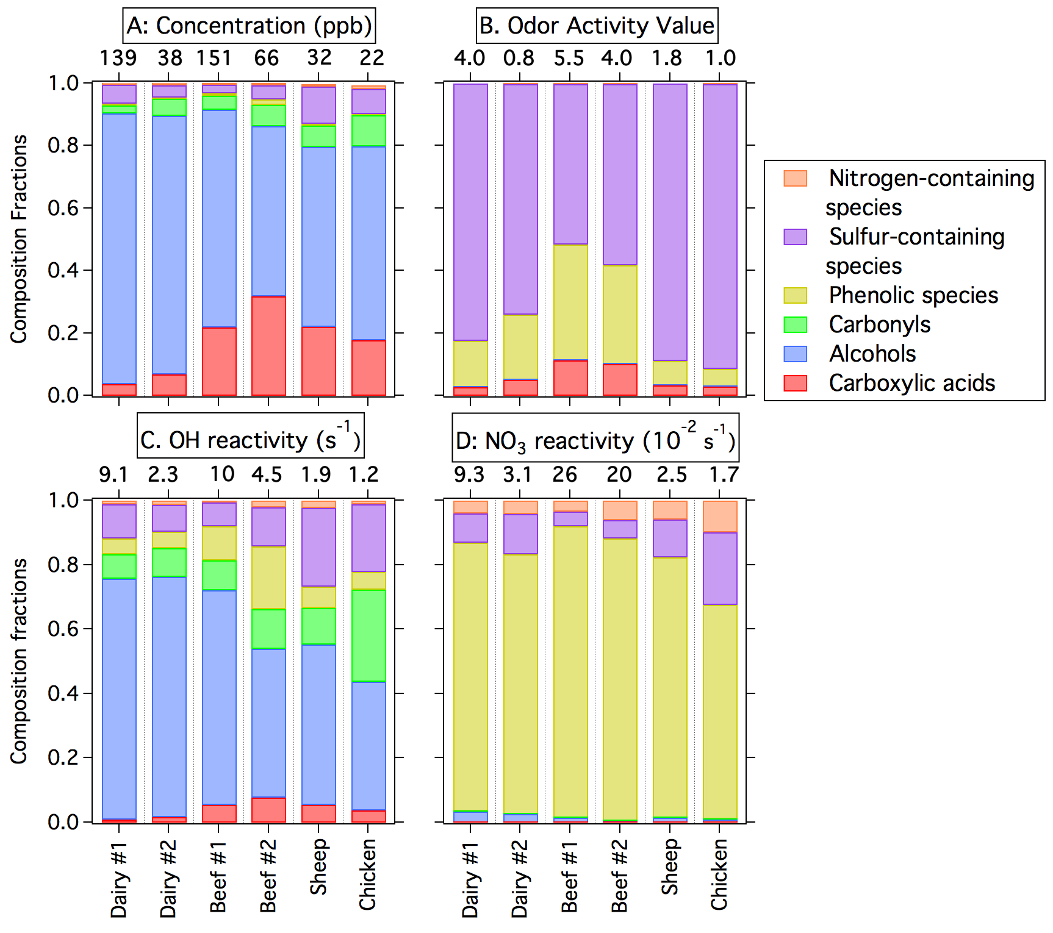

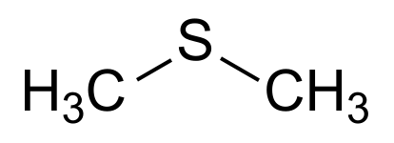
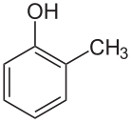
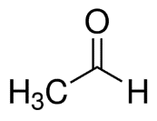

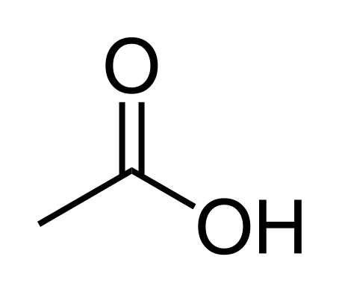
Integrate the VOC enhancements directly downwind of individual farms to determine the averaged VOC composition profile for different farms (e.g., beef and dairy cattle, sheep, and chicken)
Mobile-lab measurements are used to characterize various emission sources in the Colorado Front Range including agricultural activities and on-road emission sources
Average measured VOC composition
Agricultural activities are important sources of
O-, N-, and S-containing VOCs in the Denver Basin
Nitrogen-containing
Nitrogen species may be unique identifiers for agricultural activities
Amines, amides, Indole
Sulfur-containing
Sulfur species from animal waste contributes to the odor
H₂S, CH₃SH, DMS
Phenolics
Phenols are an important sink for NO₃
k_{NO3} = 1x10⁻¹¹ cm³ molec⁻¹ s⁻¹
Phenol, Cresol
Carbonyls can photo-dissociate and contribute RO• to ozone production cycle
Carbonyls
Acetone, Acetaldehyde
Largest emissions are of alcohols from animal feed; dominate near source OH reactivity due to high mixing ratios
k_{OH} = 3x10⁻¹² cm³ molec⁻¹ s⁻¹
Alcohols
Methanol, Ethanol
Carboxylic acids
Large primary emissions of organic acids from feed and animal waste
Acetic acid, C3-C7 acids
VOC measurements and figures: Yuan et al., ACPD 2017
Notes:
Concentrations and OH reactivity dominated by feed, odor and NO3 reactivity by animals
Odor activity = which compounds contribute the most to smell (concentration/odor threshold). Something that smells really bad will have a very small threshold (inverse relationship).

Slide 7
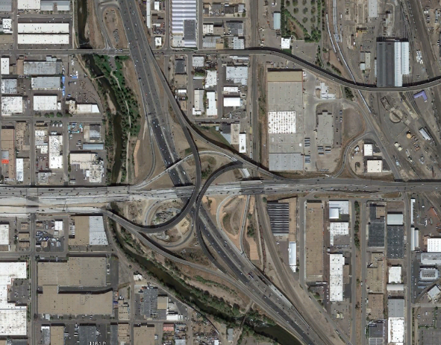
Mobile-lab measurements are used to characterize various emission sources in the Colorado Front Range including agricultural activities and on-road emission sources
Road-side measurements of VOCs
NOAA mobile laboratory parked next to I-25 off-ramp near 6th Ave. in Denver
Snapshot of actual vehicle fleet, real-world operating conditions [Bishop & Stedman, EST (2008)]
Ongoing measurements: June 2016 and July 2017
Koss et al. (2017) in preparation
I-25
downtown
Denver
6th Ave.
NOAA NO⁺-TOF-CIMS measurements
Notes:
Point of comparison: Diesel is 20% of on-road fuel use (by volume)
Previous studies: Gentner 2009 EST: about 30% of VOC overall comes from gas vapor

Slide 8
Mobile-lab measurements are used to characterize various emission sources in the Colorado Front Range including agricultural activities and on-road emission sources
Road-side measurements of VOCs
NOAA mobile laboratory parked next to I-25 off-ramp near 6th Ave. in Denver
Snapshot of actual vehicle fleet, real-world operating conditions [Bishop & Stedman, EST (2008)]
Ongoing measurements: June 2016 and July 2017
Koss et al. (2017) in preparation
i-Pentane
I-25
Gasoline vapor
downtown
Denver
6th Ave.
Gasoline exhaust
NOAA NO⁺-TOF-CIMS measurements
C6-C9 Aromatics
Gasoline exhaust
C7
C6
C8
C9
PMF factor time series
PMF factor identification
Diesel exhaust (Source 1)
Gasoline exhaust (Source 2)
Gasoline vapor (Source 3)
Isopropanol source (Source 4)
Residual
Notes:
Point of comparison: Diesel is 20% of on-road fuel use (by volume)
Previous studies: Gentner 2009 EST: about 30% of VOC overall comes from gas vapor

Slide 9
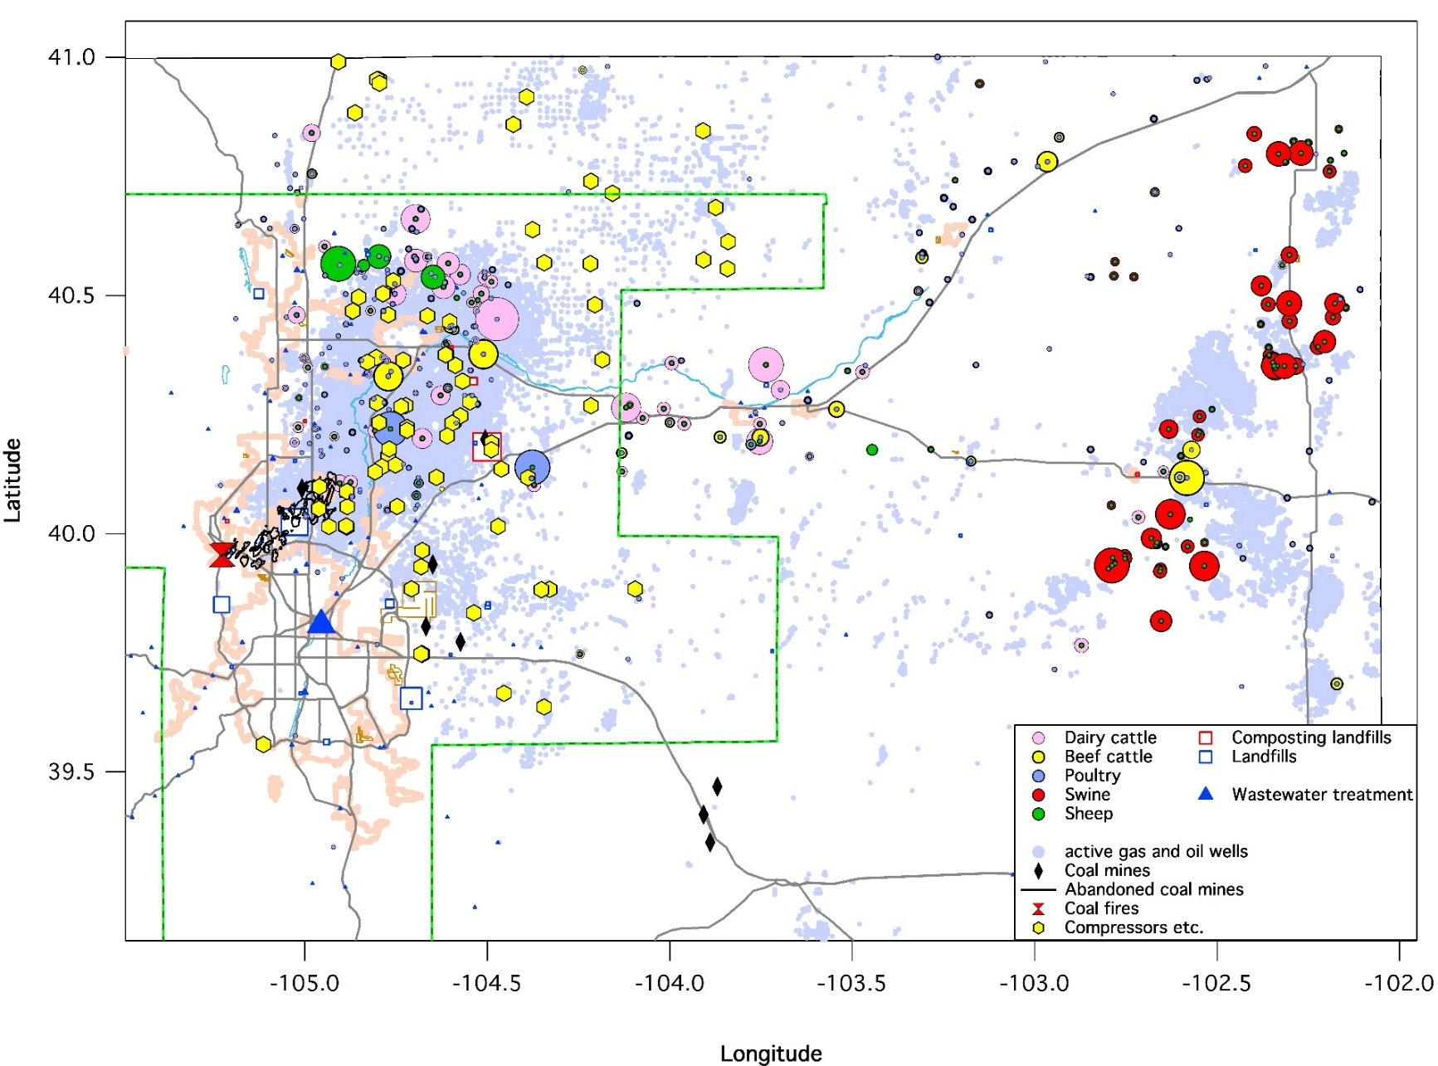
Ground-based measurements are used to characterize oil and natural gas emission sources, investigate seasonal changes in emissions and OH reactivity – a proxy for potential O₃ formation
Ground Sites
Ozone (O₃) non-attainment area
Boulder
Distinguish primary emissions from oil and natural gas sources in regions with complex mixtures of sources
Investigate seasonal differences of oil and natural gas emissions and secondary formation of oxygenated VOCs (OVOCs)
DENVER
Methane and VOC Sources in Denver Front Range, Colorado:
NOAA CSD measurements sites
Figure courtesy of: J. Peischl and K. Aikin (CIRES/NOAA CSD)

Slide 10
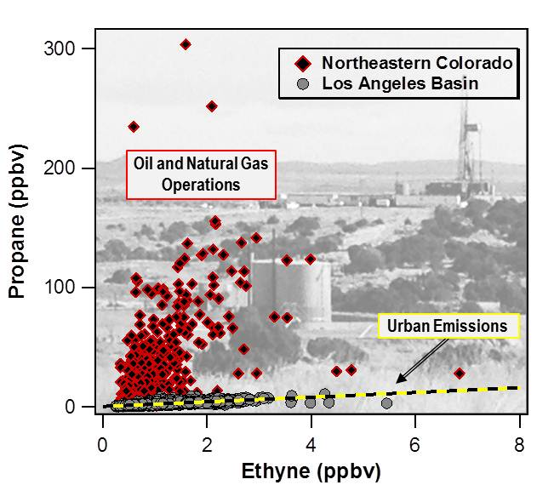
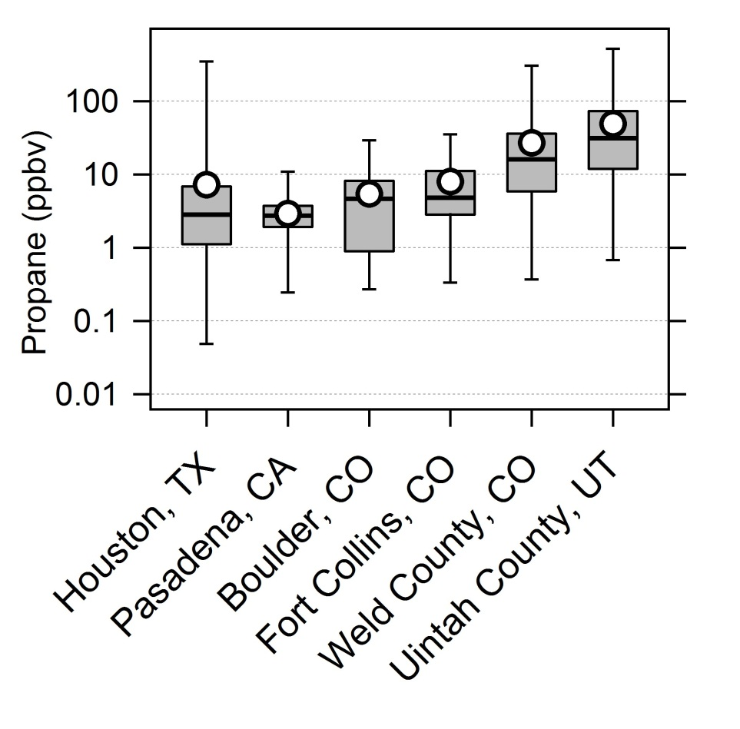
Ground-based measurements are used to characterize oil and natural gas emission sources, investigate seasonal changes in emissions and OH reactivity – a proxy for potential O₃ formation
Propane: a common component of oil and natural gas production
Range of 28 US Cities*
Gilman, et al. (2013). “Source Signature of VOCs from oil and natural gas operations in Northeastern Colorado.” ES&T. 3(47), p1297.
*Baker, et al. (2008). “Measurements of nonmethane hydrocarbons in 28 United States cities.” Atmos. Environ. 42(1), p170.

Slide 11
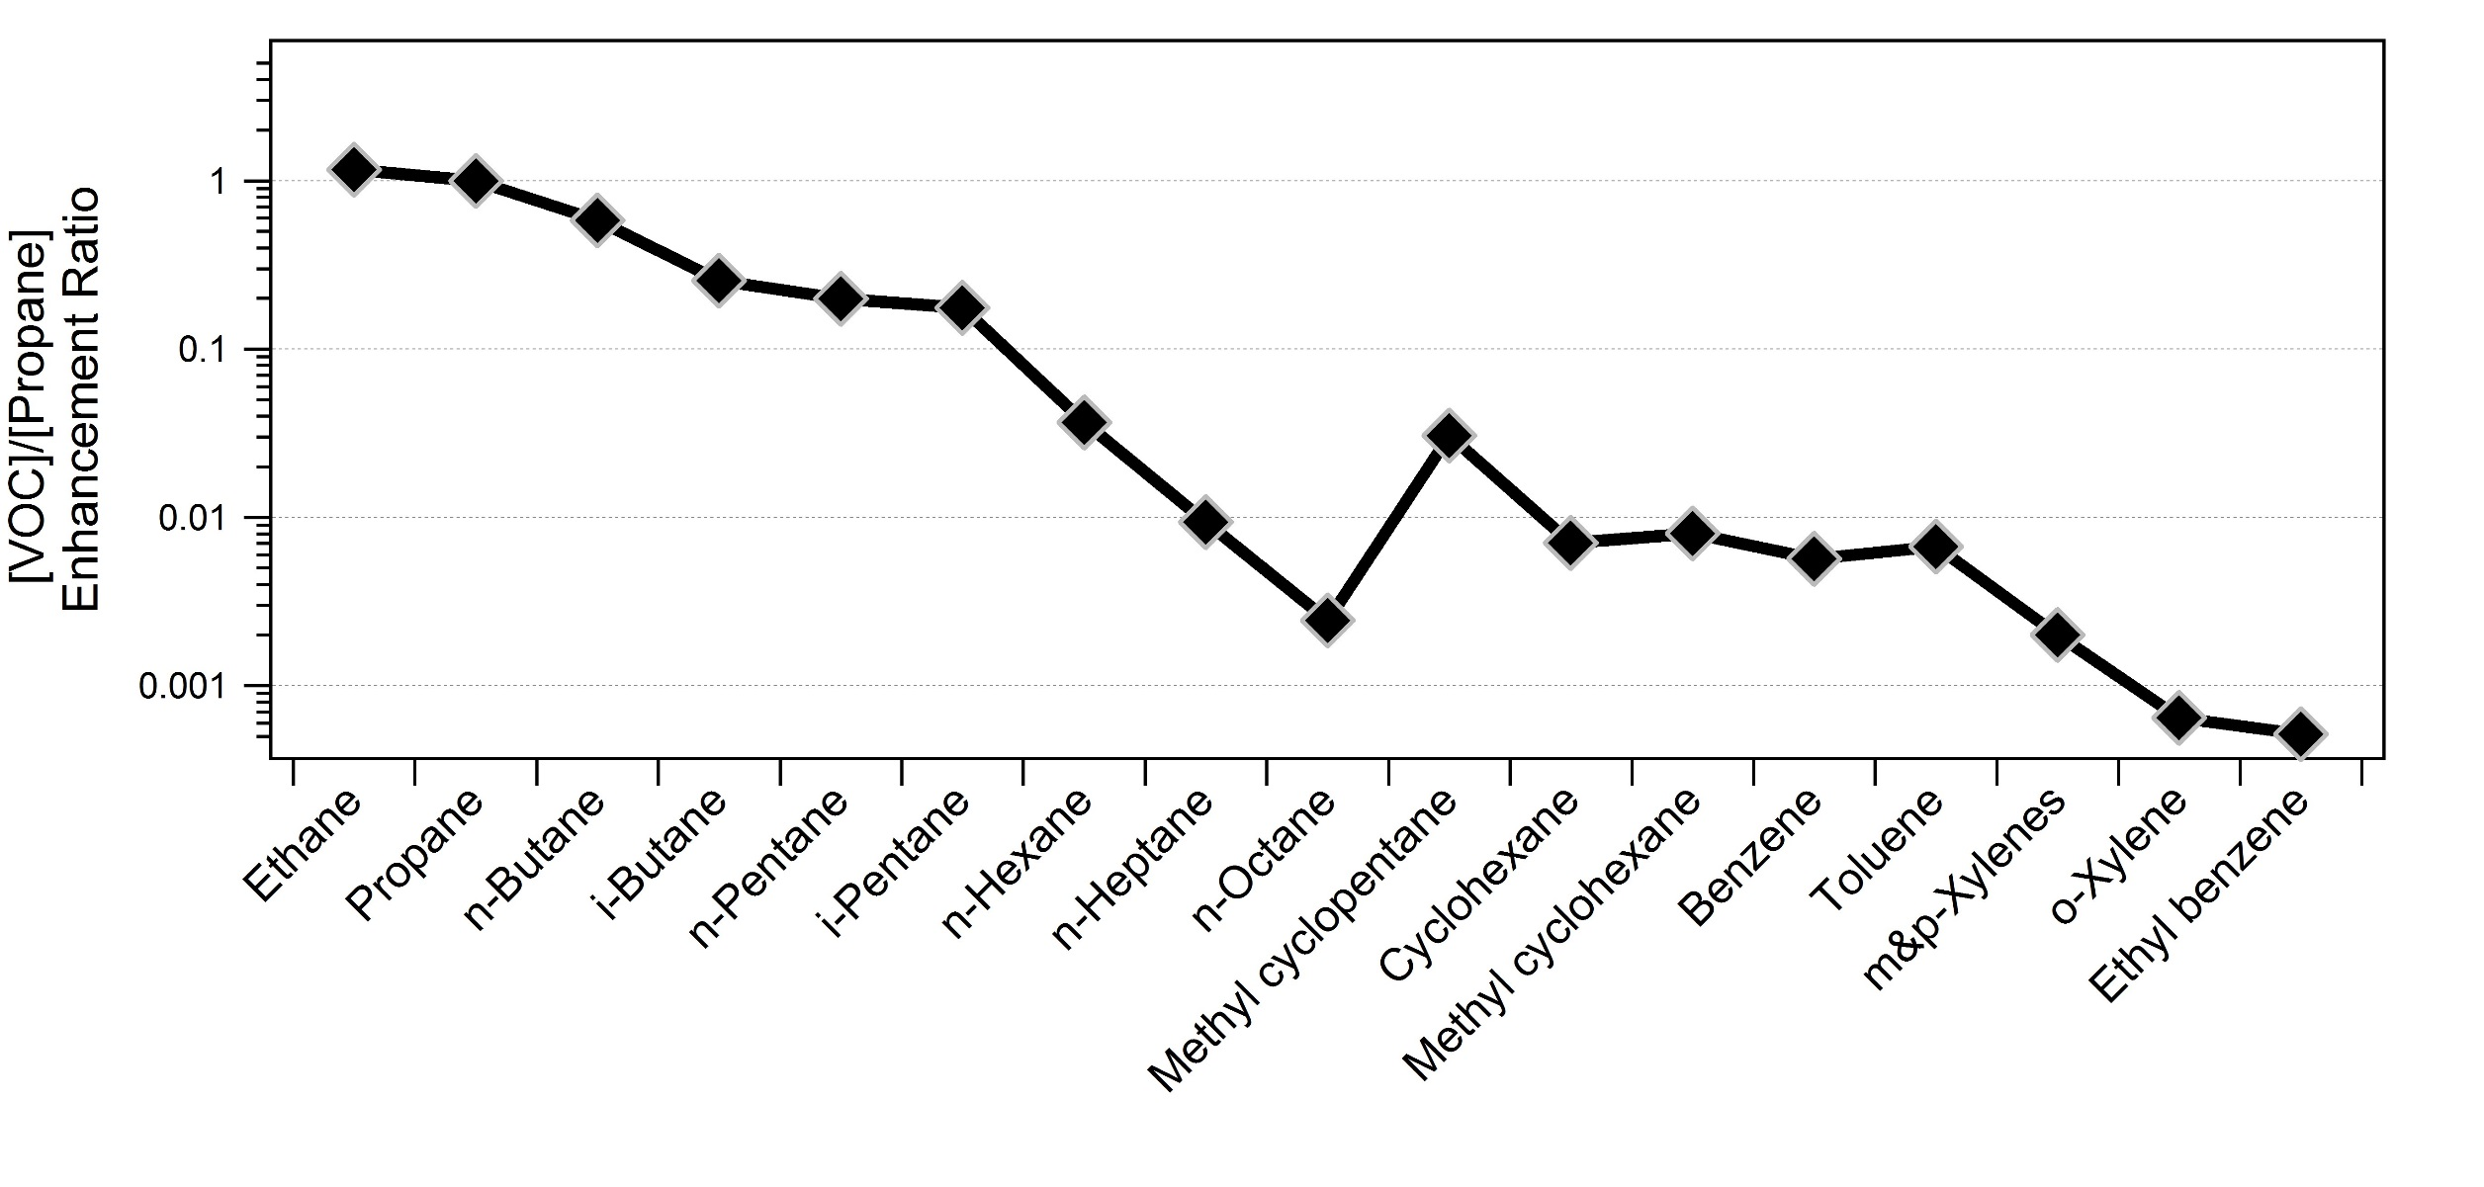
Ground-based measurements are used to characterize oil and natural gas emission sources, investigate seasonal changes in emissions and OH reactivity – a proxy for potential O₃ formation
Composition of VOCs observed in the Denver-Julesburg Basin have not changed significantly over the last 4+ years
[VOC]/[Propane] Enhancement Ratio:
Winter 2011 at BAO
Summer 2012 at BAO
Spring 2015, airborne over DJB
Slightly higher enhancement ratios in summer for C6+ hydrocarbons
Evaporation from condensate tanks?

Slide 12
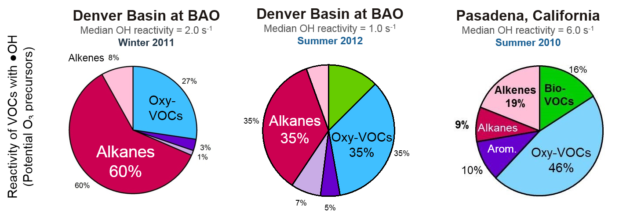
Oil and gas operations are sources of both VOCs and nitrogen oxides (NOx) – precursors to ozone formation. Characterizing their emissions is critical to assessing air quality impacts of ONG activities.
VOCs,
_{CO, CH4}
OH
NO₂
O₂
(O₂)
Sunlight
OVOCs,
CO₂, H₂O
HO₂
NO
O₃

Slide 13
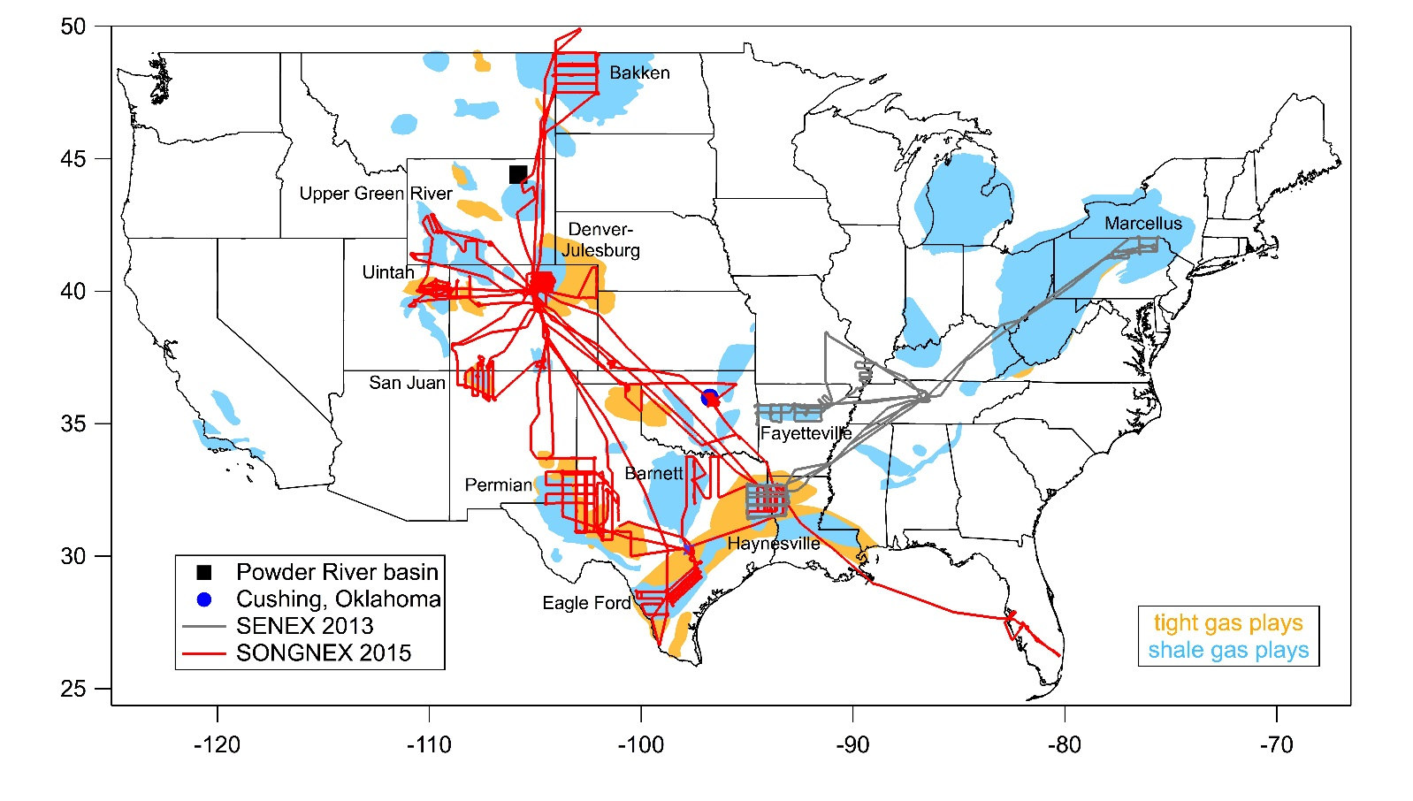
NOAA airborne measurements are used to characterize VOC emissions and hydrocarbon fluxes for several of the largest oil and gas producing shale basins in the U.S.
Airborne Sampling
NOAA has conducted measurements over most active production areas accounting for:
> 70% of U.S. shale gas production
> 83% of U.S. shale oil production
Production rates during NOAA study (April 2015):
Total Shale Gas = 41 billion ft³/day
Shale gas basins included in this study
Production from basins not studied
Total Shale Oil = 4.6 million bbl/day
1 bbl (barrel) = 159 L
Shale oil basins included in this study
Production from basins not studied
SONGNEX info: www.esrl.noaa.gov/csd/projects/songnex/
Data from U.S. Energy Information Administration

Slide 14

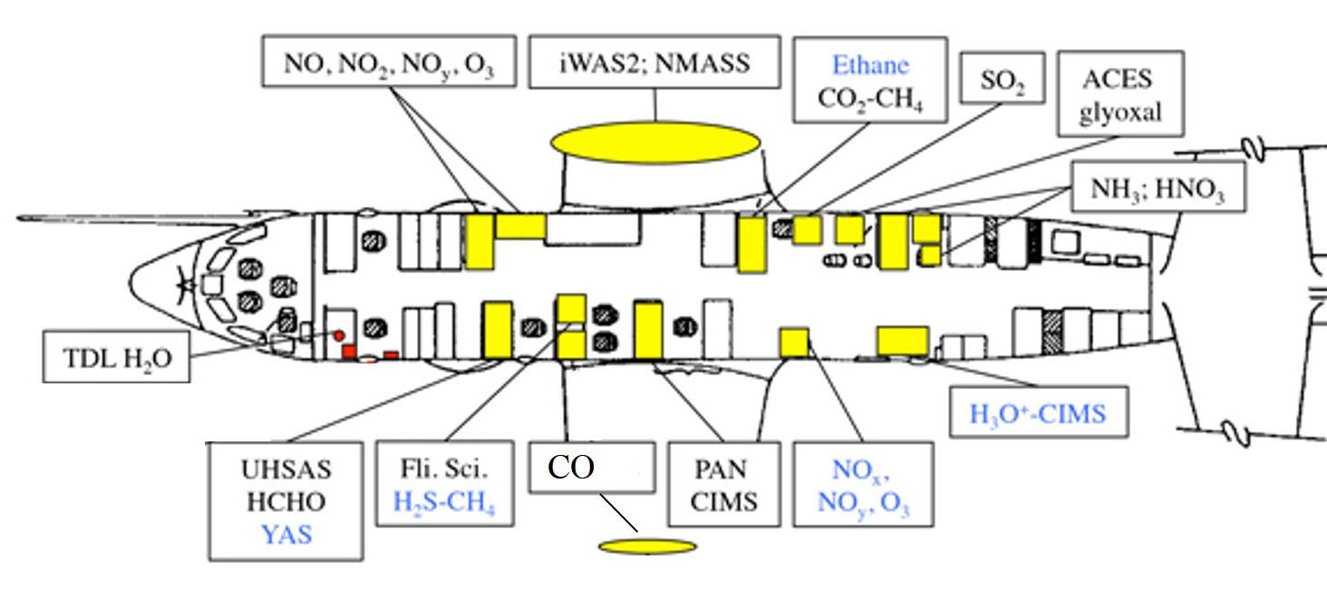
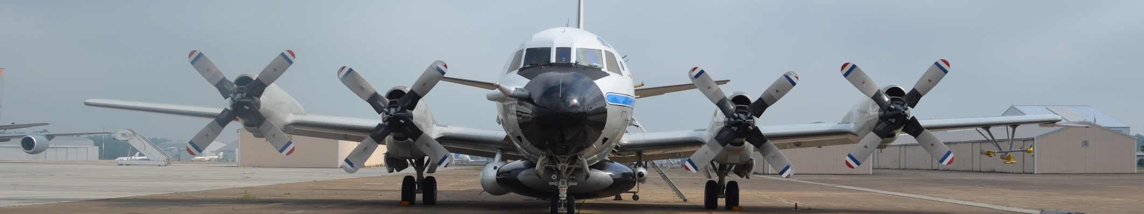
NOAA airborne measurements are used to characterize VOC emissions and hydrocarbon fluxes for several of the largest oil and gas producing shale basins in the U.S.
NOAA WP-3D instrument payload:
CO, CO₂, CH₄
O₃, NOx, NOy, NH₃, HNO₃, SO₂, H₂S
Particle size distributions & J-values
VOCs and NMHCs:
Fast ethane, HCHO, glyoxal
Fast OVOCs and NMHCs via H₃O⁺-TOF-CIMS
Discrete whole air samplers (WAS)

Slide 15
NOAA airborne measurements are used to characterize VOC emissions and hydrocarbon fluxes for several of the largest oil and gas producing shale basins in the U.S.
Species Measured | Instrument | Time Res.* | Principal Investigators
Alkanes (C2-C9), Cycloalkanes (C6-C7), Aromatics (speciated C6-C8) | Whole air samplers (WAS) with post-flight analysis by GC-MS | < 10 s fill time 72 per flight | B.M. Lerner, W.C. Kuster T. Tokarek, and J.B. Gilman
Methane (CH₄) Ethane (C₂H₆) | Picarro CO₂/CH₄ Aerodyne Fast Ethane Spect. | 1 Hz 1 Hz | J. Peischl and T.B. Ryerson
Aromatics (Sum of C9- C10), Oxy-VOCs | H₃O⁺ - Time of Flight - CIMS | < 1 Hz | B. Yuan, A. Koss, C. Warkene, J. de Gouw
Formaldehyde (HCHO) | Laser induced fluorescence | < 1 Hz | M. Thayer, F.N. Keutsch, G.M. Wolfe, and T. Hanisco
Carbon Monoxide (CO) | VUV resonance fluorescence | 1 Hz | J.S. Holloway
Nitrogen Dioxide (NO₂) | UV photolysis/O₃-induced chemiluminescence | 1 Hz | C. Thompson, and T.B. Ryerson
Nitrogen Dioxide (NO₂) | Cavity ringdown absorption spectrometer | 1 Hz | R.J. Wild, P. Edwards, B. Dube, and S.S. Brown
All 1 Hz measurements are averaged over the open/ close time of the WAS
Discrete whole air samples adequately capture ethane distribution in Permian, NM
Composition of air aloft matches surface measurements in Uintah, Utah and Denver-Julesburg, Colorado
Off Scale Max
Permian, NM (Flt2015-04-23)
Number of Occurrences
Propane (ppbv)
iso-Pentane (ppbv)
Ethane(ppbv)
Ethane(ppbv)
n-Pentane (ppbv)

Slide 16
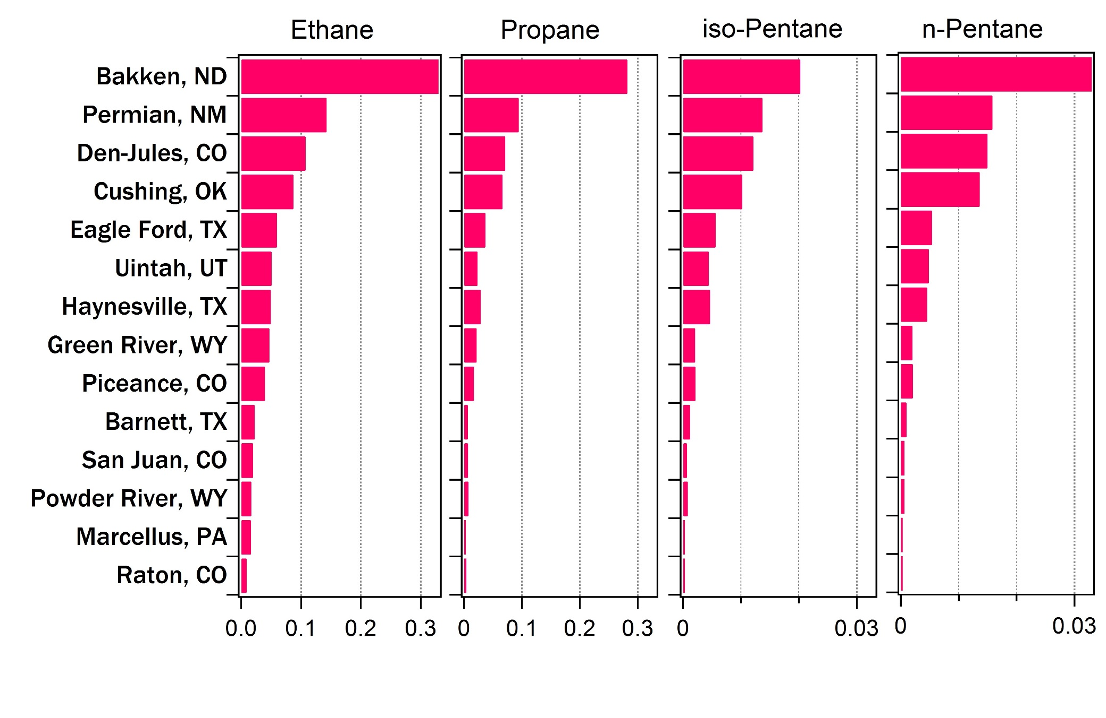
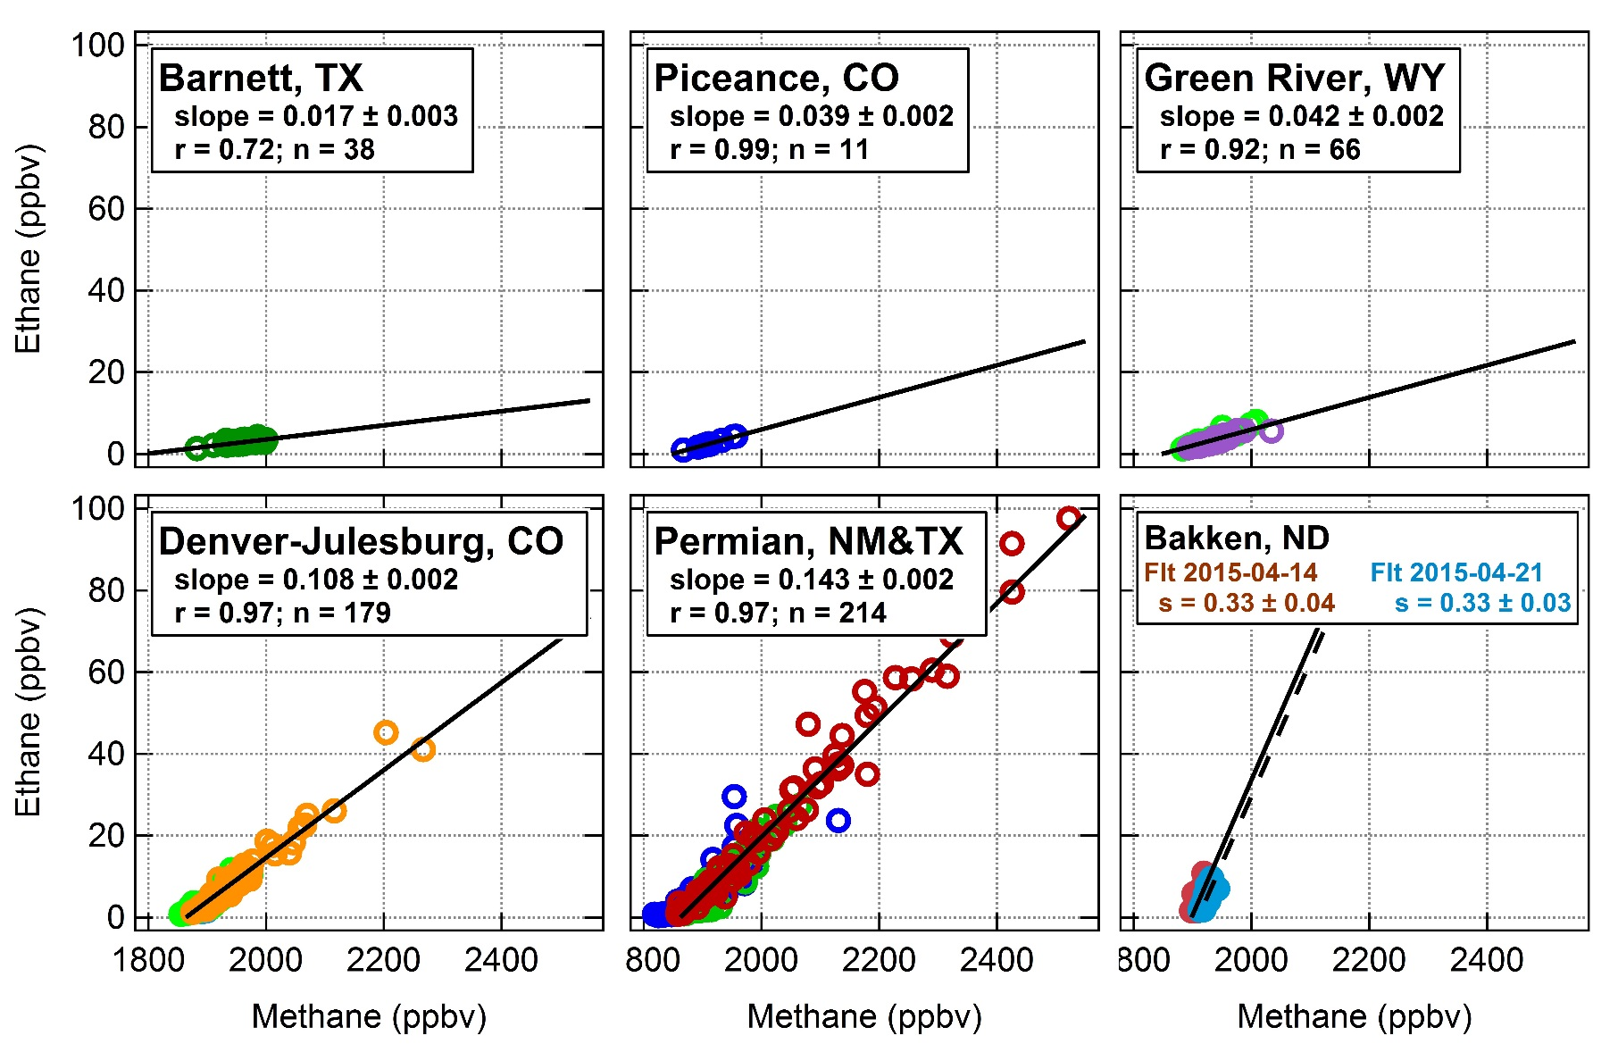
NOAA airborne measurements are used to characterize VOC emissions and hydrocarbon fluxes for several of the largest oil and gas producing shale basins in the U.S.
[VOC]/[CH₄]:
Range of ERs:
Ethane 0.009 - 0.33
Enhancement Ratios: minimize effects of air mass mixing and dilution
2 flights
Flt 2015-03-29
Flt 2015-04-27
3 flights
3 flights
2 flights
Flt 2015-03-28
Flt 2015-03-29
Flt 2015-04-13
Flt 2015-04-06
Flt 2015-04-09
Flt 2015-04-23
1
18

Slide 17
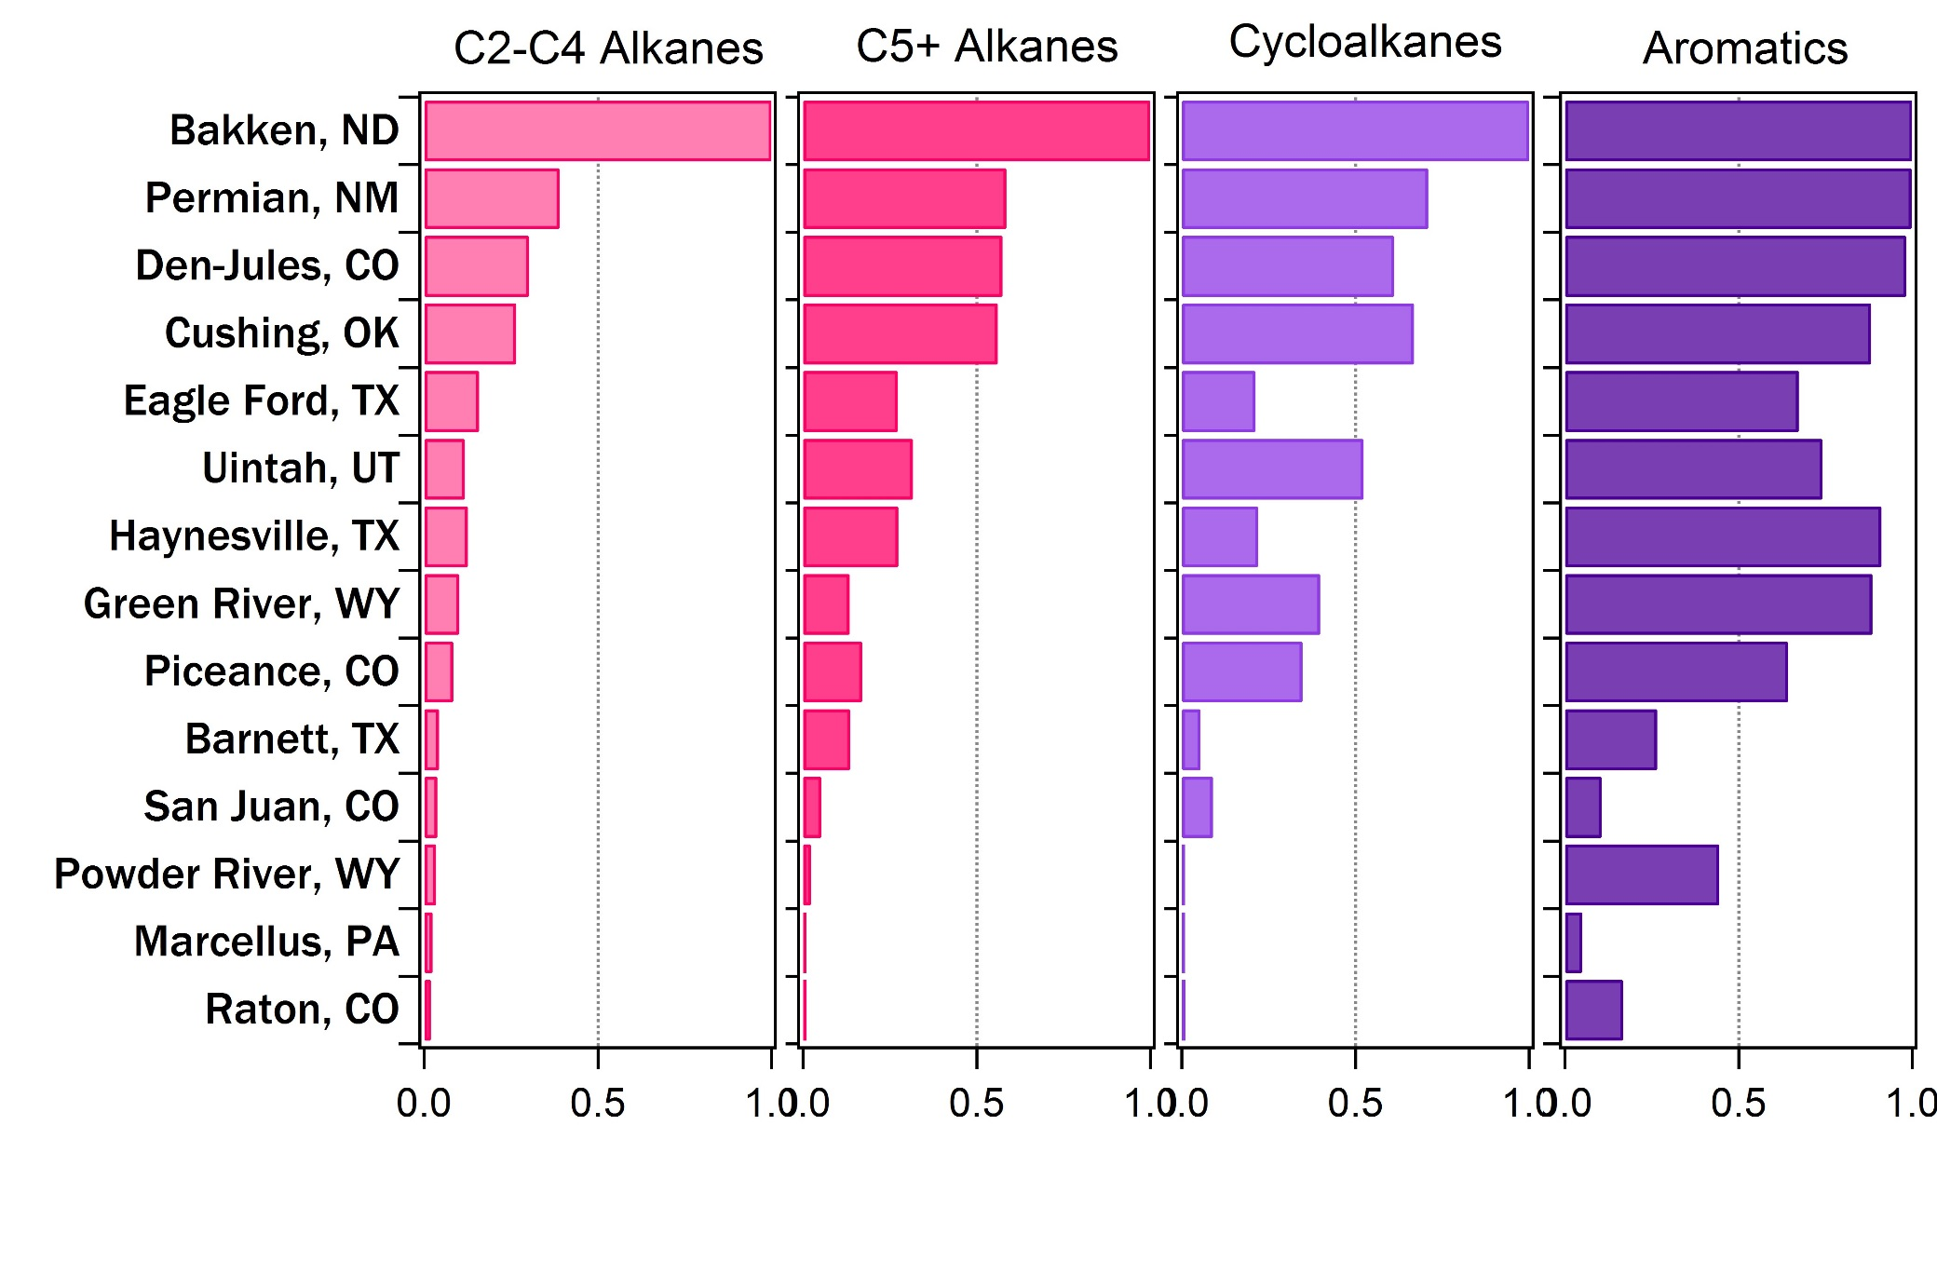

NOAA airborne measurements are used to characterize VOC emissions and hydrocarbon fluxes for several of the largest oil and gas producing shale basins in the U.S.
$$\frac{\sum{VOC group}}{Max Value}$$
C2-C4 Alkanes
Nat. Gas. Plant Liquids (NGPLs)
C5+ Alkanes
Liquid Condensates
Cycloalkanes
“Napthenes”
Aromatics
BTEX and Air Toxics
Max. [VOC]/[CH₄] for all VOC groups
0
0.001
0
0.001
0.5
1.0
0.5
1.0
0.5
1.0
0.5
1.0
[Sum of VOC class]/[Maximum Sum of VOC class]
Gilman et al., in preparation
[VOC]/[CH₄] Enhancement Ratios

Slide 18
NOAA airborne measurements are used to characterize VOC emissions and hydrocarbon fluxes for several of the largest oil and gas producing shale basins in the U.S.
$$\frac{\sum{VOC group}}{Max Value}$$
C2-C4 Alkanes
Nat. Gas. Plant Liquids (NGPLs)
C5+ Alkanes
Liquid Condensates
Cycloalkanes
“Napthenes”
Aromatics
BTEX and Air Toxics
Largest collective enhancement ratios for “light” natural gas plant liquids and natural gas/crude oil condensates
Moderate enhancement ratios for alkanes and cycloalkanes
Relatively large aromatic enhancement ratios
Smallest observed enhancement ratios for all compound classes compared to the Bakken
0
0.001
0
0.001
0.5
1.0
0.5
1.0
0.5
1.0
0.5
1.0
[Sum of VOC class]/[Maximum Sum of VOC class]
Gilman et al., in preparation

Slide 19

NOAA airborne measurements are used to characterize VOC emissions and hydrocarbon fluxes for several of the largest oil and gas producing shale basins in the U.S.
$\frac{\sum{NMHC}}{CH4+ \sum{NMHC}}$ =
NMHC mole fraction
A “wet” gas contains a larger fraction of non-methane hydrocarbons (NMHC)
Max. = 46%
Bakken, ND
Green River
Powder River
Uintah
Denver-Jules, CO
Marcellus
Piceance
Raton
Cushing, OK
San Juan
Permian
Barnett
Haynesville
Min. = 1.6 %; “Dry” gas is mostly methane
Eagle Ford
0
10
20
30
40
50
NMHC mole fraction
Gilman et al., in preparation

Slide 20
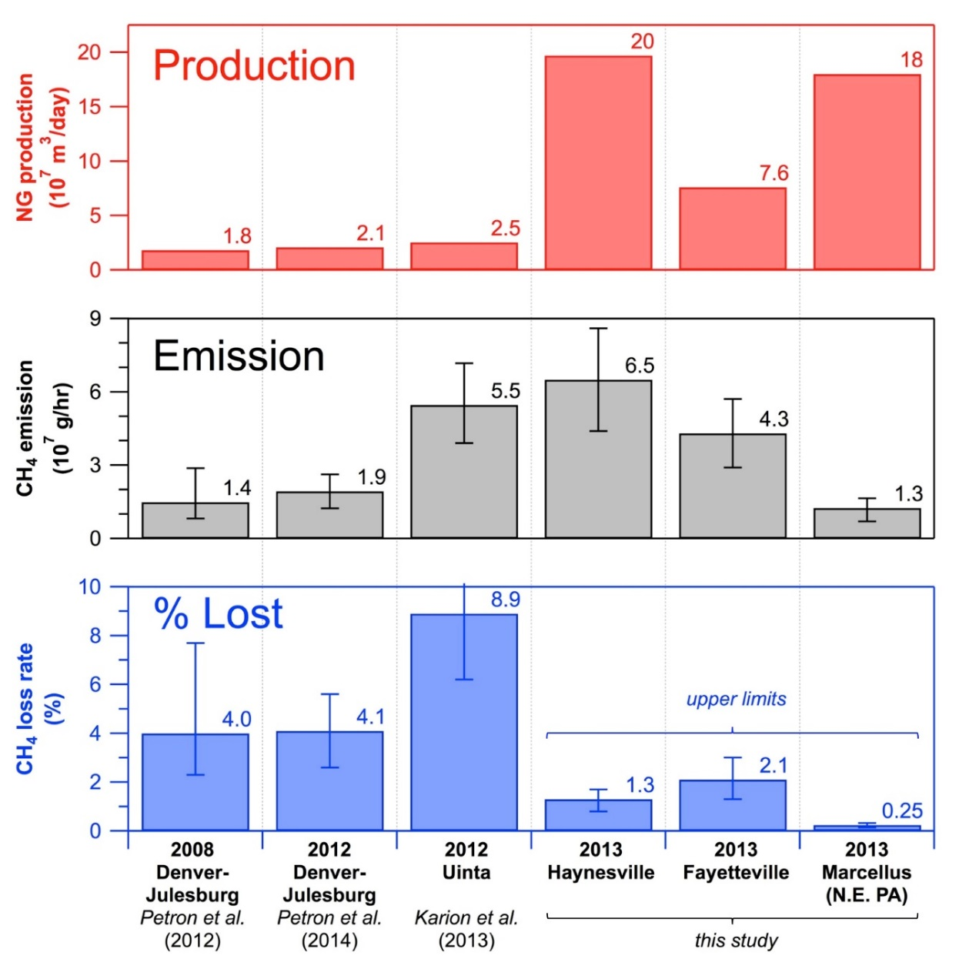
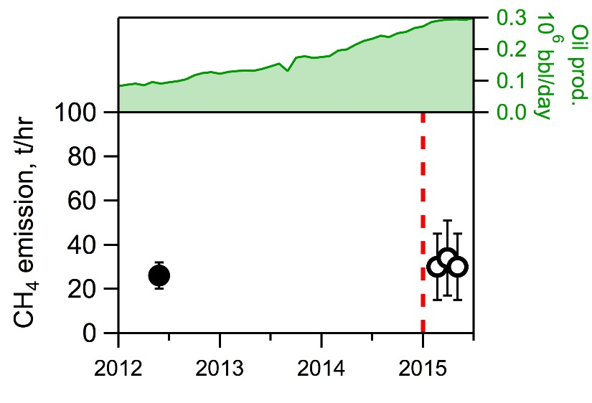
NOAA airborne measurements are used to characterize VOC emissions and hydrocarbon fluxes for several of the largest oil and gas producing shale basins in the U.S.
Basin-wide methane emission rates
Emissions do not simply scale with production
Variability in emissions from: raw gas/oil composition, local regulation, well age, industry practices, etc.
SONGNEX CH₄ and VOC emissions data forthcoming
Preliminary results from SONGNEX for Den.-Jules. Basin
FRAPPÉ/DISCOVER-AQ
field studies
Colo. regs. to reduce CH₄ & C₂H₆
emissions take effect
2 flights,
May 2012
Pétron et al.,
(2014)
CH₄ emissions from the DJB are not significantly different than found in a 2012 airborne study by Petron et al. [2014]
Peischl et al., in preparation
Figure from Peischl et al. (2015) JGR

Slide 21
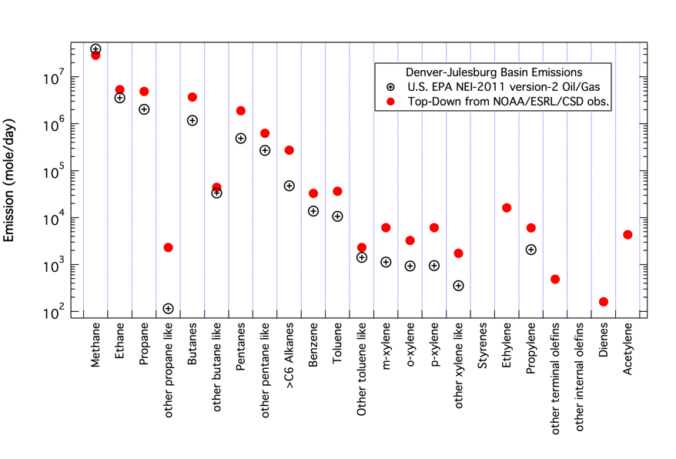
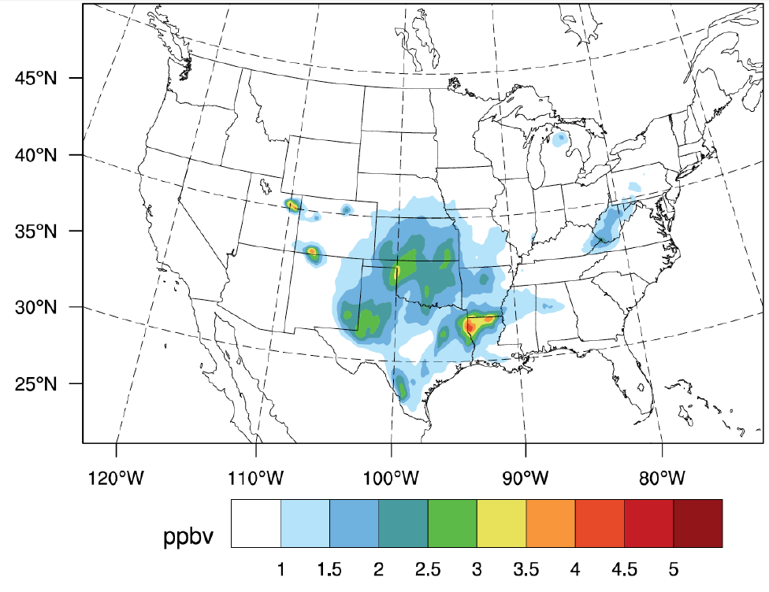
NOAA measurements are used to validate and improve national emission inventories of hydrocarbons from oil and natural gas activities and investigate their atmospheric impacts
Comparison of EPA’s National Emissions Inventory (NEI-2011v2)
oil and natural gas emissions to top-down measurements
WRF-Chem simulated surface ozone differences with and without oil and gas emissions from EPA NEI-2011 inventory averaged for June 2013 at 3 pm
McKeen et al., in preparation
Ahmadov et al., in preparation
∆ O₃
Fall 2016: newest NEI-2014 database was released
www.epa.gov/air-emissions-inventories/2011-national-emissions-inventory-nei-data
WRF-Chem https://ruc.noaa.gov/wrf/wrf-chem/

Slide 22
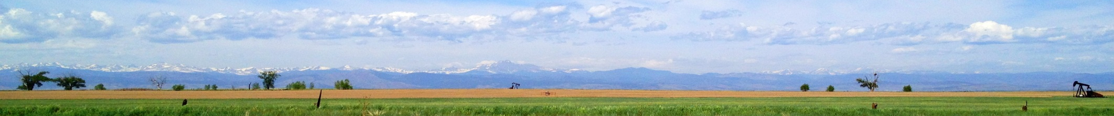
Summary:
NOAA and colleagues have utilized a variety of sampling platforms and measurement techniques to fully characterize emissions from agricultural activities, on-road sources, and oil and natural gas operations in the northern Colorado Front Range
Chemically detailed emission source characterization will aid in source apportionment of methane sources and ozone precursors in the Front Range
VOC source signature of oil and natural gas operations is distinctive and has not changed significantly over the last 4+ years of NOAA CSD measurements in the Denver-Julesburg Basin
Composition and magnitude of hydrocarbon emissions is unique for each shale basin
Denver Basin has higher emissions of VOCs relative to CH₄ compared to other western basins
Emission fluxes of CH4 over the Denver-Julesburg Basin are in agreement with previous measurements
NCAR seminar Monday, May 15 at 3:30 p.m. at Foothills Lab
jessica.gilman@noaa.gov

Slide 24
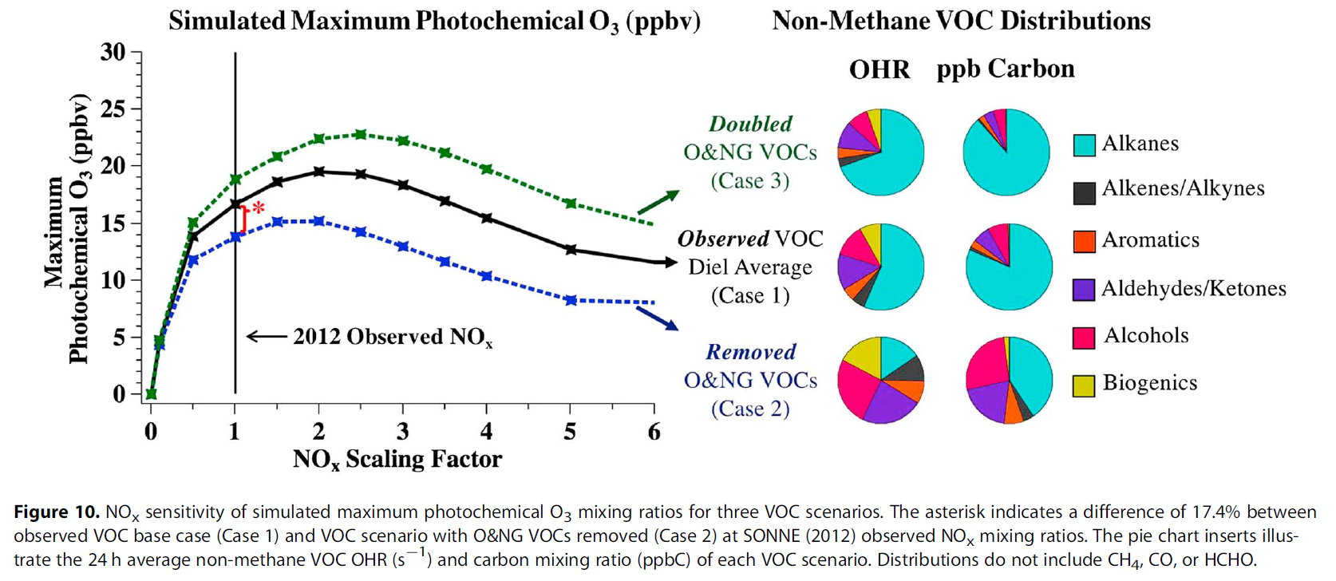
Influence of oil and gas emissions on summertime ozone in the Colorado Northern Front Range. E. E. McDuffie, P. M. Edwards, J. B. Gilman, B. M. Lerner, W. P. Dubé, M. Trainer, D. E. Wolfe, W. M. Angevine, J. deGouw, E. J. Williams, A. G. Tevlin, J. G. Murphy, E. V. Fischer, S. McKeen, T. B. Ryerson, J. Peischl, J. S. Holloway, K. Aikin, A. O. Langford, C. J. Senff, R. J. Alvarez, S. R. Hall, K. Ullmann, K. O. Lantz and S. S. Brown. Journal of Geophysical Research: Atmospheres, pn/a-n/a, doi:10.1002/2016jd025265, 2016.

Slide 25
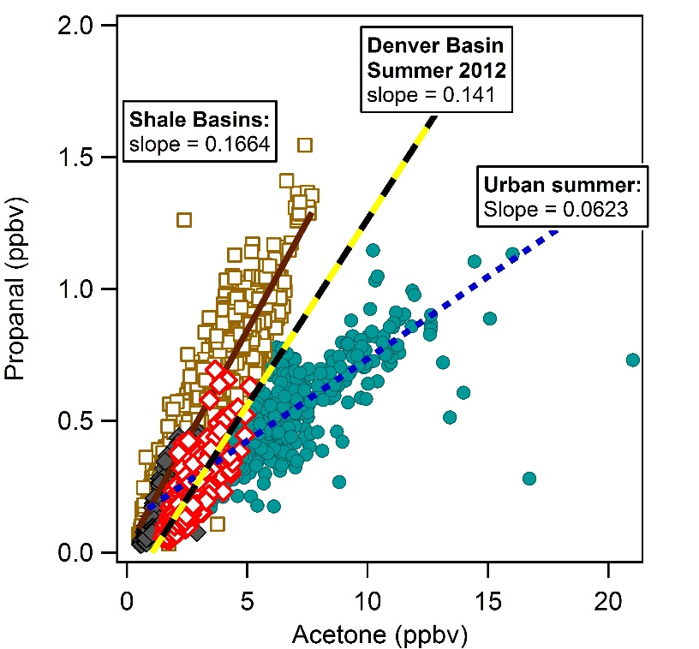
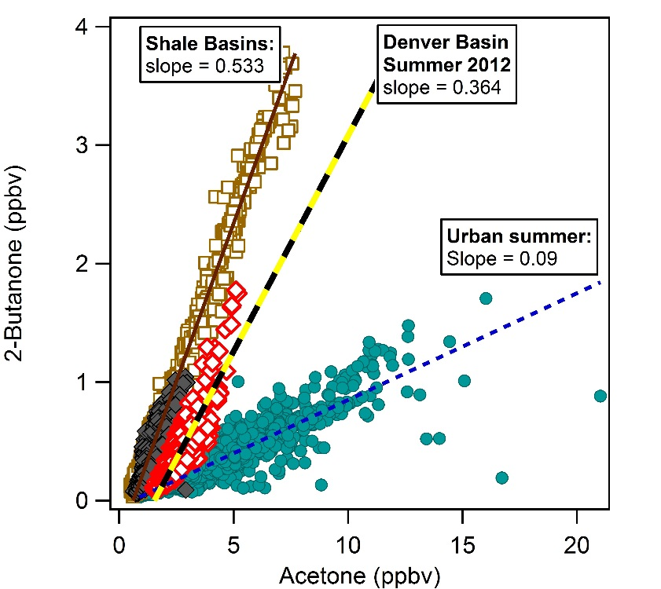
Ground-based measurements are used to characterize oil and natural gas emission sources, investigate seasonal changes in emissions and secondary production of oxygenated VOCs
[Propanal][Acetone] is larger for shale basins due to higher n-pentane to iso-butane ratios
Propanal from propane and n-pentane
Acetone from propane and iso-butane
Enhanced 2-butanone (MEK) mixing ratios due to higher abundances of n-butane in shale basins
2-Butanone formed from n-butane oxidation
Linear alkanes > branched alkanes for raw gas
Propanal (ppbv)
2-Butanone (ppbv)
Acetone (ppbv)
Acetone (ppbv)
Notes:
Source signature of VOCs from oil and natural gas operations is very distinctive. Photochemical oxidation of n-alkanes is an important source of oxygenated-VOCs (e.g., propanal, 2-butanone).
Suggests that photochemical oxidation of primary hydrocarbon emissions associated with natural gas production in the Denver Basin is an important source of OVOCs
OVOC ratios during summer 2012 in Denver Basin more closely match those observed from wintertime photochemistry in the Uintah basin
Suggests that photochemical oxidation of primary hydrocarbon emissions associated with natural gas production in the Denver Basin is an important source of OVOCs

Slide 26
Oxygenated product formed from oxidation of primary hydrocarbons | Primary hydrocarbon precursors in oil and gas basin | Primary hydrocarbon precursors in an urban area
Acetaldehyde CH3CHO | Ethane n-Butane | + Alkenes
Propanal CH3CH2CHO | Propane n-Pentane
Acetone CH3C(o)CH3 | iso-Butane Propane
2-Butanone (MEK) CH3CH3C(o)CH3 | n-Butane

Slide 27
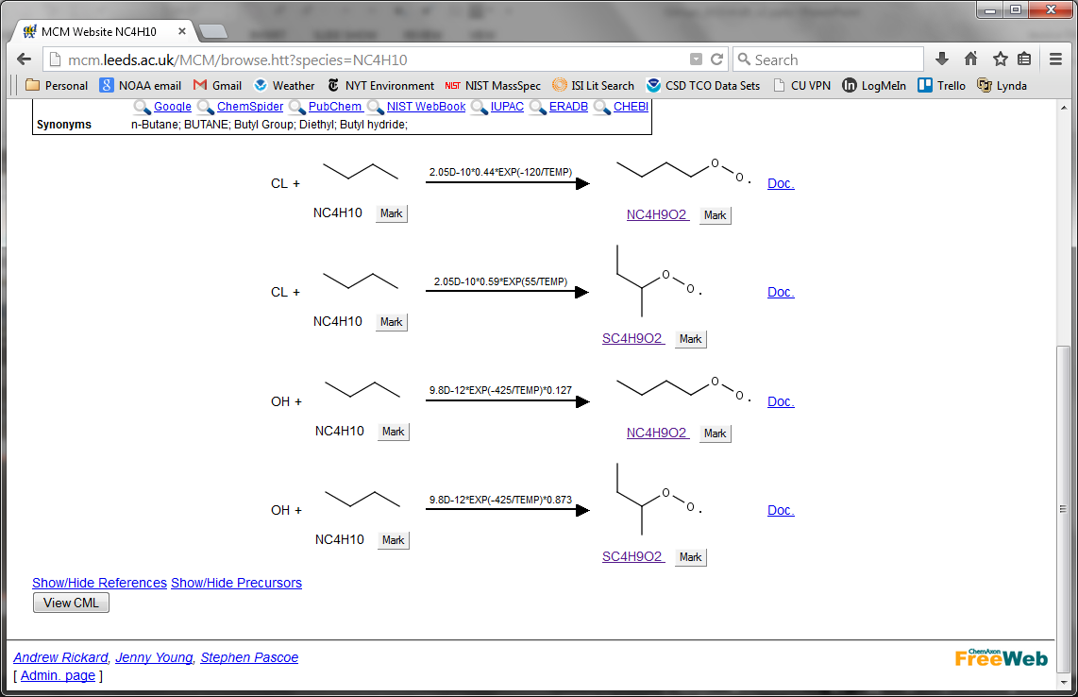
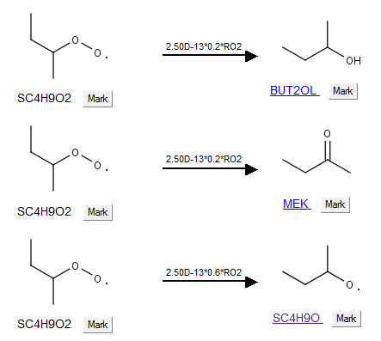
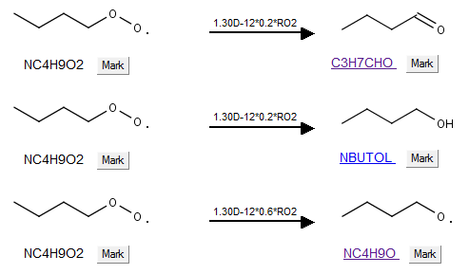
Oxidation of n-Butane:
Dominant pathway = MEK formation
Other pathway = butanal formation
Reaction schemes from Master Chemical Mechanism (http://mcm.leeds.ac.uk/MCM/)

Slide 28
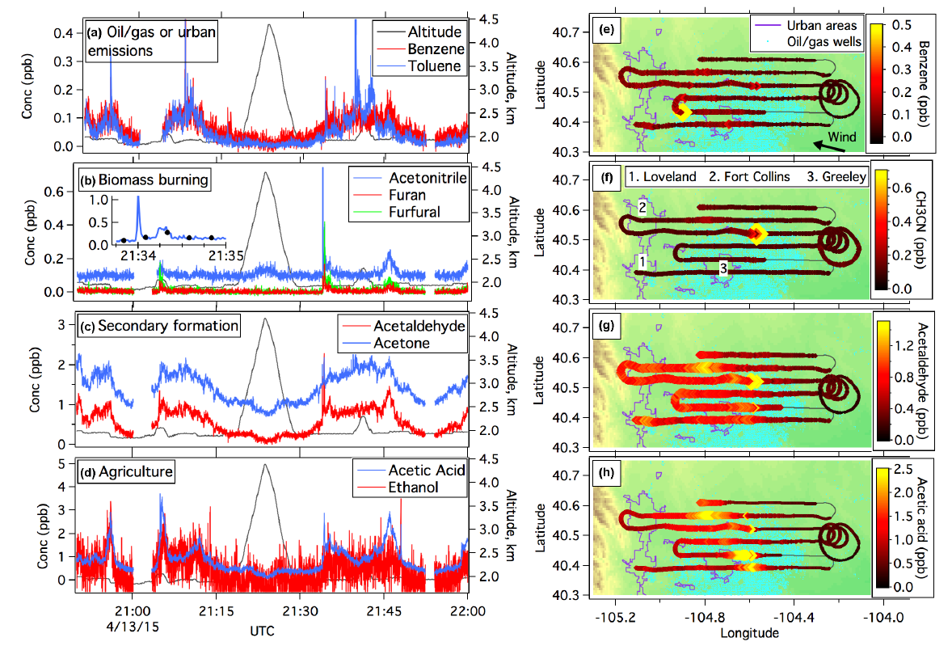
A high-resolution time-of-flight chemical ionization mass spectrometer utilizing hydronium ions (H3O+ ToF-CIMS) for measurements of volatile organic compounds in the atmosphere. B. Yuan, A. Koss, C. Warneke, J. B. Gilman, B. M. Lerner, H. Stark and J. A. de Gouw. Atmos. Meas. Tech., 6(9), p2735-2752, doi:10.5194/amt-9-2735-2016, 2016.
Notes:
13 April 2015
The four different VOC groups exhibited distinctly different time series and spatial distributions as a result of the different sources. It is important to identify all VOC sources in order to properly separate the contributions of these different sources to air quality issues in the front range.
Measurements of secondary products, in conjunction with primary emissions will be valuable to constrain chemical evolution of gas-phase organic carbon in the atmosphere.
Benzene and toluene were elevated over and downwind from the oil/gas field. Several concentrated spikes of aromatics were observed and attributed to ONG activities.
Few spikes in acetonitrile, and furan, biomass burning markers
Timeseries of acetal and acetone show the same broad enhancements downwind of the ONG wells. The timeseries lack the same sharp plumes as the primary emissions of aromatics, except for the biomass burning plume. This is consistent with secondary formation as their primary atmospheric source.
Acetic acid and ethanol from agricultural activities. Weld county is home to over half a million beef and dairy cttle in over 100 feedlots.

Slide 29
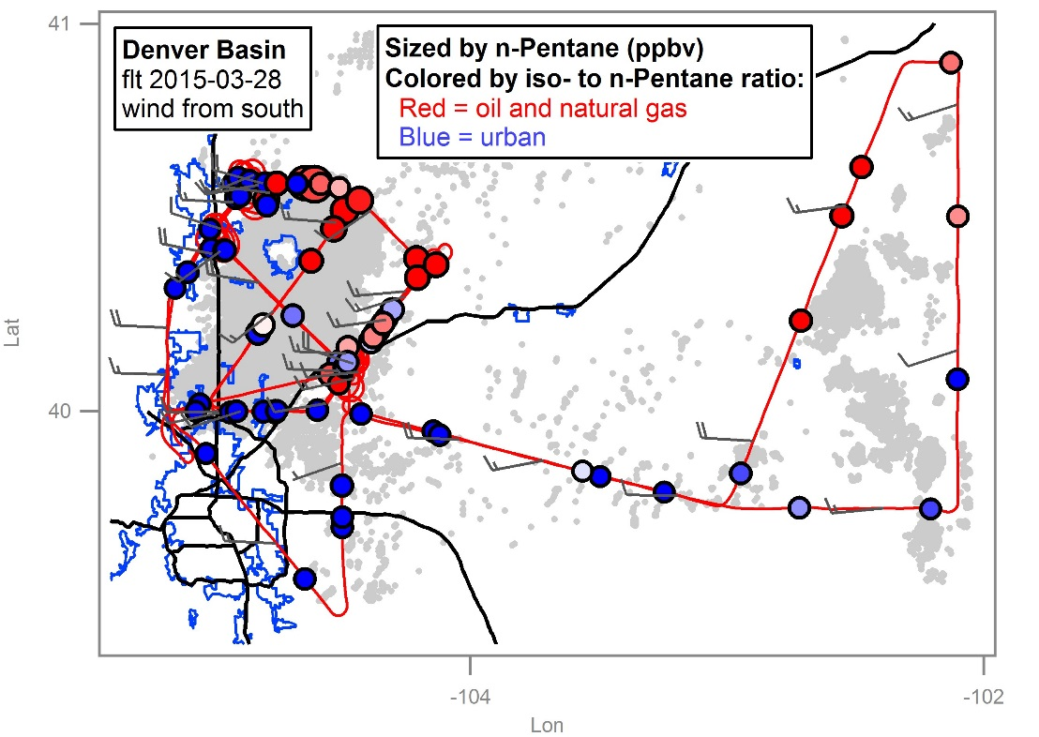
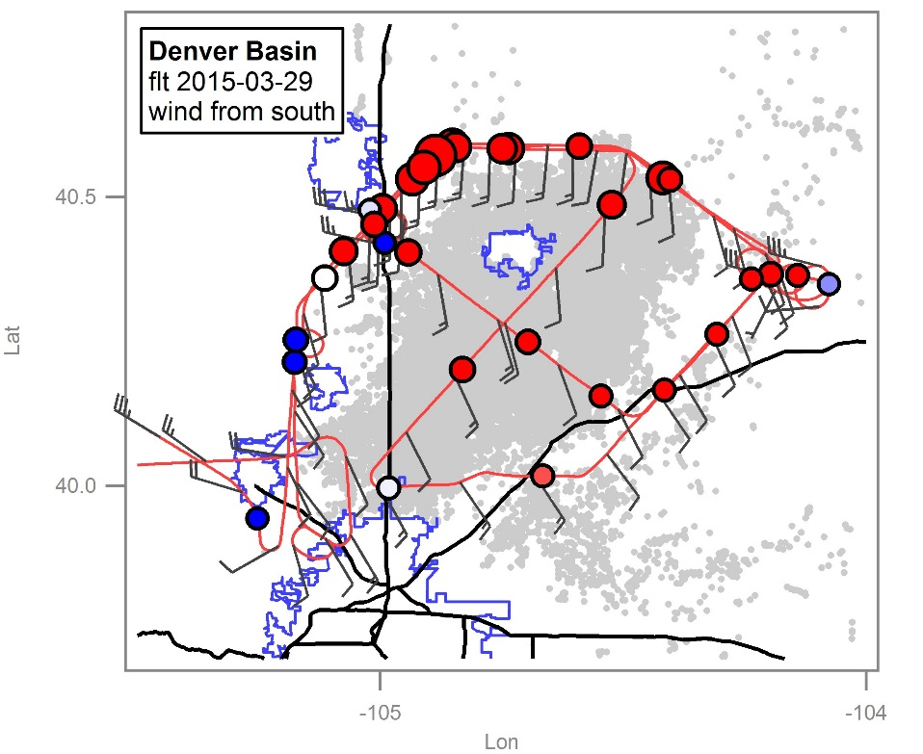
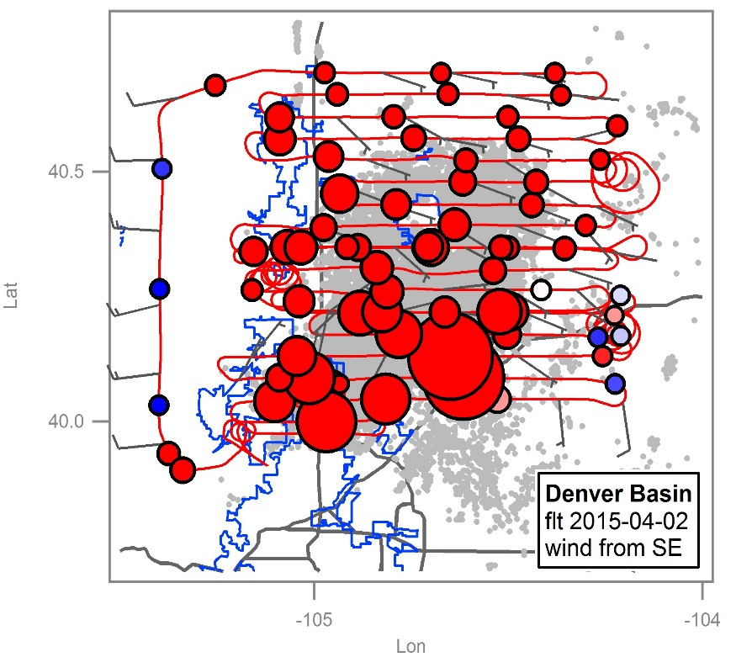
NOAA airborne measurements are used to characterize VOC emissions and hydrocarbon fluxes for several of the largest oil and gas producing shale basins in the U.S.
Notes:
Update pictures and add

