Slide 1
Evaluation of updated mobile and oil and gas emissions using C-130 aircraft observations from the FRAPPÉ and DISCOVER-AQ campaign
Sojin Lee, ACOM, NCAR
Thanks to Gabriele Pfister and Frank Flocke, ACOM, NCAR The FRAPPÉ and DISCOVER-AQ Science Teams Dale Wells, CDPHE Dennis McNally, Alpine Geophysics
Deborah Luecken , U.S. EPA
Notes:
Good afternoon everyone and thank you for still being here. This is a ongoing work that I’m presenting.

Slide 2
Objectives
Characterization of uncertainties in current emission inventories
Comprehensive evaluation of meteorological and chemical performance of regional air quality simulations
→ Sensitivity simulations for various emission control scenarios
Notes:
This talk is mostly focused on characterization of … We also performed comprehensive … Ultimately these will lead to conducting sensitivity simulations … So the goal of this is to be able to do test control scenarios.

Slide 3
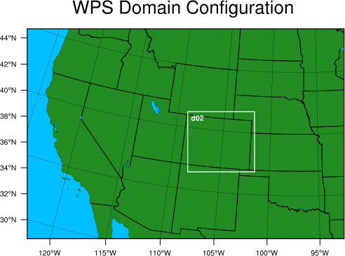
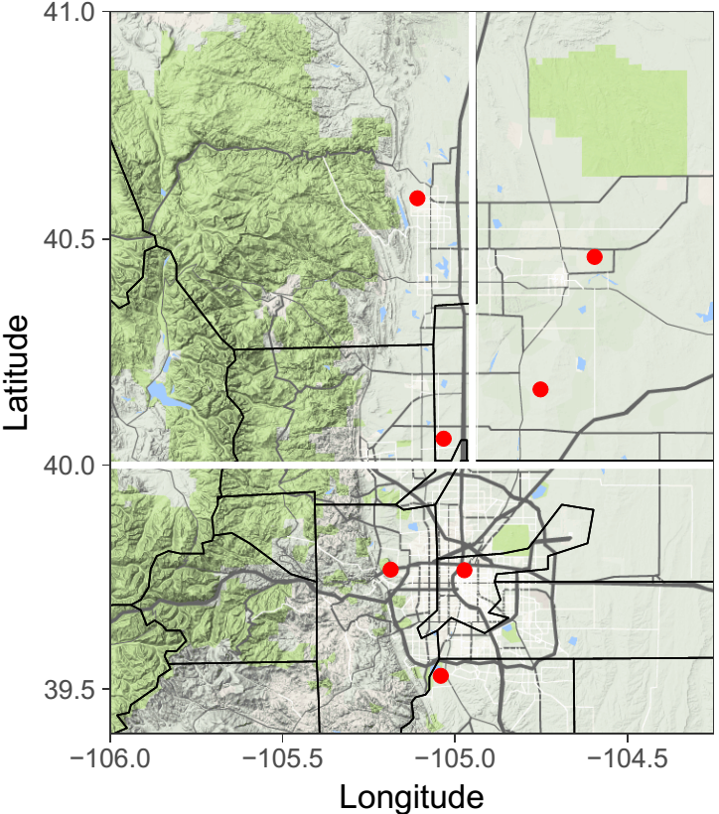
Modeling setup
non-Denver
urban
Oil & Gas
Fort Collins-West
Greeley
BAO Tower
Platteville
Denver urban
CTM | US EPA Models-3/CMAQ v 5.2 beta with Carbon bond version 6 (CB6) Domain 1: 12 ×12 km, Domain 2: 4 ×4 km
Met. Fields | WRF (v3.8.1) with ECMWF data and objective analyzes (OBSGRID: surface and upper-air)
Emission process | SMOKE v3.7
Episode | July to August, 2014 (FRAPPÉ/DISCOVER-AQ 2014)
NREL Golden
Denver-LaCasa
Chatfield Park
We focus on the three regions over NFRMA.
Notes:
We use two domains having 12 km and 4km resolutions. Denver region includes Denver metropolitan area mostly. The non-Denver urban region includes Boulder, Longmont, Fort Collins, and everything west of I-25. And the Oil & Gas region includes most Weld county and the area of east of I-25.

Slide 4
“a priori” Emission over Colorado
Category | EPA sectors | Source
Mobile | Onroad mobile, nonroad mobile + Rail emission | 2017 Alpine geophysics inventory 2017 emissions from EPA 2011v6.3 platform
Oil and Gas | Nonpoint & point oil and gas | 2014 CDPHE emission inventory
Other point | Electric Generating Unit (EGU) point NONIPM | 2014 EGU activity data 2017 emissions from EPA 2011v6.3 platform
Other Nonpoint | nonpoint RWC + nonpoint other + agriculture | 2017 emissions from EPA 2011v6.3 platform
Biogenic | Biogenic | BEIS v3.61 with BELD v4.1 land use
Fires | Fires | Fire INventory from NCAR (FINN) v1.5

Slide 5
Emissions in Front Range
Mobile emissions (Total + top 3 counties)
a priori mobile emissions are lower compared to NEI 2011 and NEI 2014
Oil and Gas production (O&G) emissions
a priori O&G VOC emissions are lower by 40% and 18% compared to NEI 2011 and NEI 2014
unit: ton/year
 | CO |  |  | NO_{x} |  |  | VOC
 | NEI 2011 | NEI 2014 | a priori | NEI 2011 | NEI 2014 | a priori | NEI 2011 | NEI 2014 | a priori
Total | 476,661 | 409,364 | 386,767 | 74,927 | 66,649 | 44,491 | 44,790 | 36,887 | 31,018
Arapahoe | 76,235 | 67,165 | 61,052 | 9,633 | 8,278 | 5,416 | 7,039 | 5,939 | 4,786
Denver | 72,826 | 72,142 | 57,794 | 11,037 | 13,497 | 6,043 | 6,538 | 6,442 | 4,433
Jefferson | 72,870 | 60,689 | 53,220 | 10,184 | 8,298 | 5,223 | 6,831 | 5,363 | 4,487
unit: ton/year
 | CO |  |  | NO_{x} |  |  | VOC
 | NEI 2011 | NEI 2014 | a priori | NEI 2011 | NEI 2014 | a priori | NEI 2011 | NEI 2014 | a priori
Total | 15,562 | 21,879 | 22,061 | 21,211 | 18,963 | 21,835 | 130,762 | 95,409 | 78,471
Weld | 14,159 | 20,746 | 21,017 | 18,249 | 17,892 | 19,783 | 123,506 | 91,709 | 75,665

Slide 6
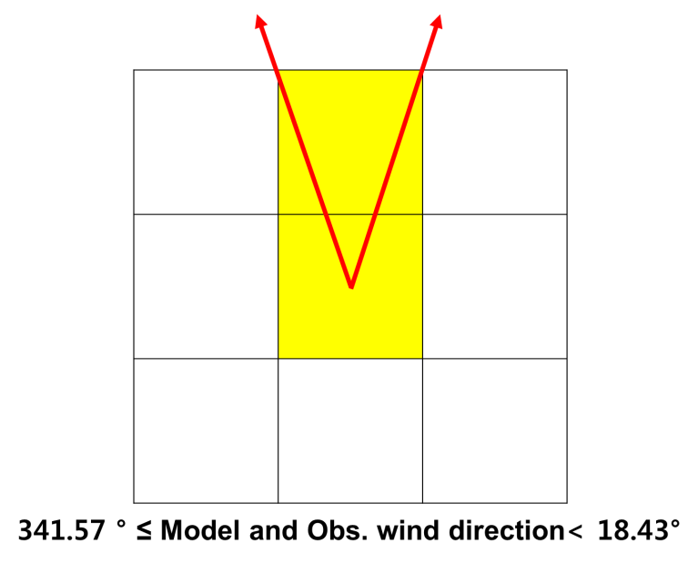
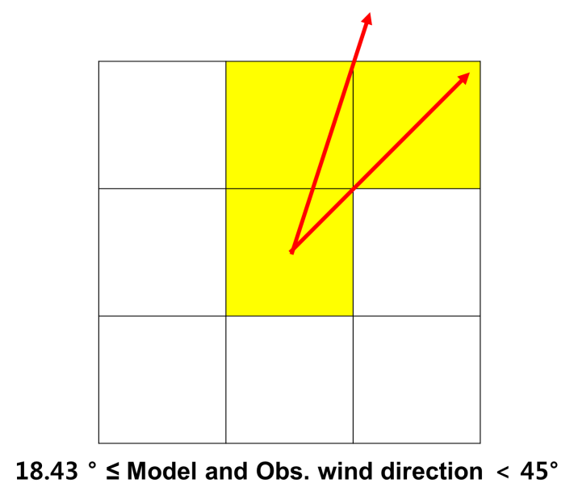
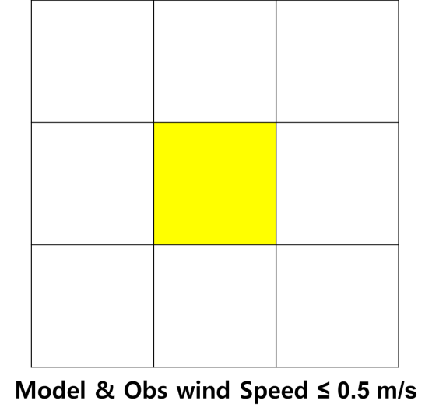
Model evaluation methods
1. Time and height criteria : between 10 to 17 LT and below 1km a.g.l.
2. Ethane criteria: < 10 ppbv in Denver and non-Denver urban regions (to reduce the effects by transport from the O&G area)
3. The emission criteria: mean emissions of model grid boxes of containing observation and adjacent upwind grids must have a contribution of > 60% from mobile or the O&G sector.
□ : model grid ■: observationally matched and upwind adjacent grids →wind direction
Notes:
Mention about the resoan of criteria 1

Slide 7
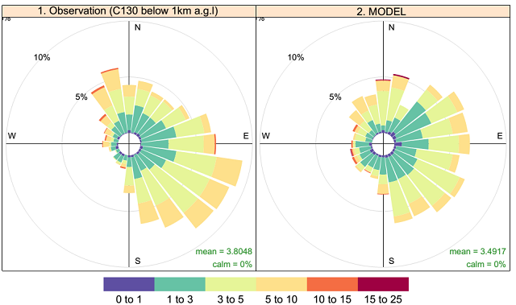
Model evaluation : Wind
Model vs. C-130 (10 – 17 LT, below 1km a.g.l)
- Model captures dominant upsloping winds.
- Observations show dominance of SE winds; not reflected in model.

Slide 8
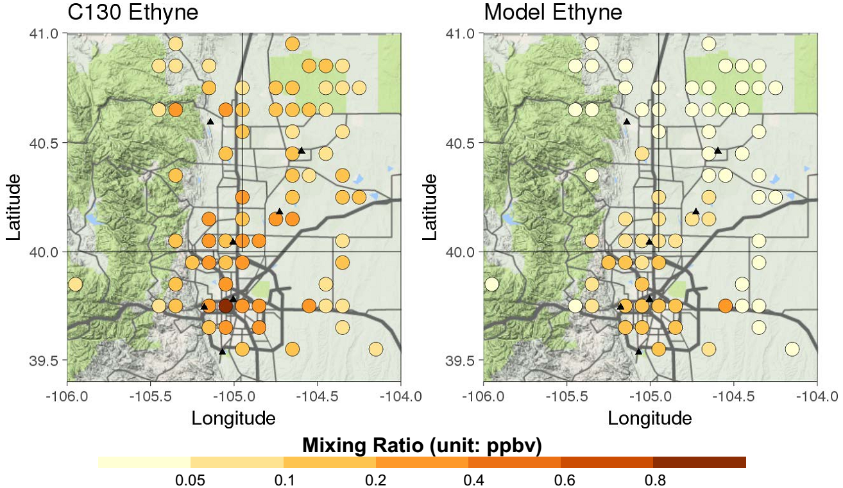
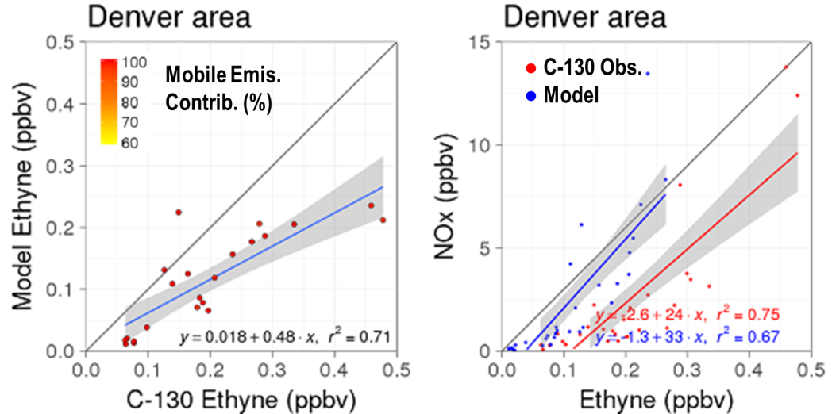
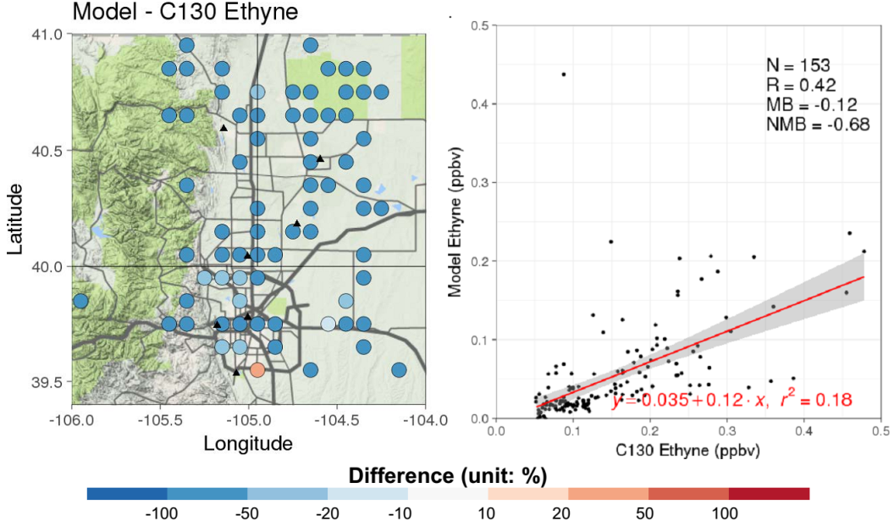
Mobile emissions evaluations
- Ethyne: emitted mostly from mobile
- Denver region
Ethyne is underestimated by factor of 2 in model (all regions).
Modeled Tracer-Tracer ratios are in line with observations
→ Suggestion: Ethyne for all mobile emissions increased by factor of 2.
Notes:
Here ethyne is underestimated by factor of two in Denver region. All the tracer to tracer rations from mobile emissions in Denver region look good when we look at the model. The way to fix that is to increase ethyne in all mobile emissions by factor of 2.

Slide 9
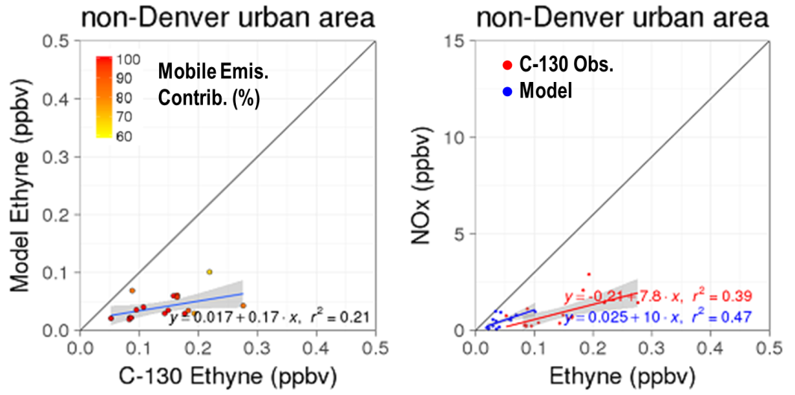
Mobile emissions evaluations
- Ethyne: emitted mostly from mobile
- non-Denver region
Ethyne is more strongly underestimated in non-Denver region.
Tracer to tracer ratios in model are also underestimated.
→ Suggestion: Increase all mobile emissions for non-Denver and O&G regions by factor of 2
Notes:
Then in case of the non-Denver region, ethyne is more strongly underestimated there and the ratios are also underestimated in model. We see that in the other tracers it’s not quite obvious because there are other sources in NOx as well. So in order to bring these in line, we suggest that the total volume of mobile traffic should be increased by factor of 2 in non-Denver region thinking that maybe the model is underestimated the rapid growth of that area.

Slide 10
Preliminary adjustment factors
Mobile emissions
non-Denver urban
Oil & Gas
Ethyne : a priori × 4
Other mobile tracers: “a priori” × 2
Denver urban
Ethyne : “a priori” × 2
Other mobile tracers: “a priori”

Slide 11
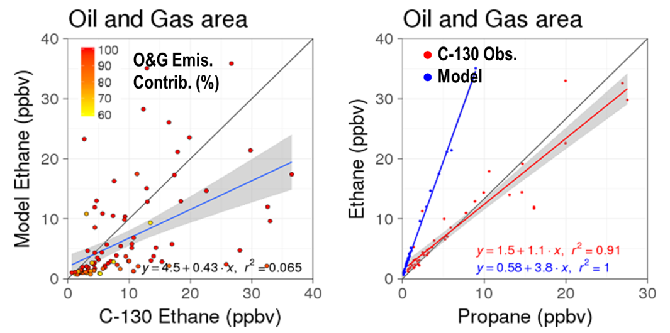
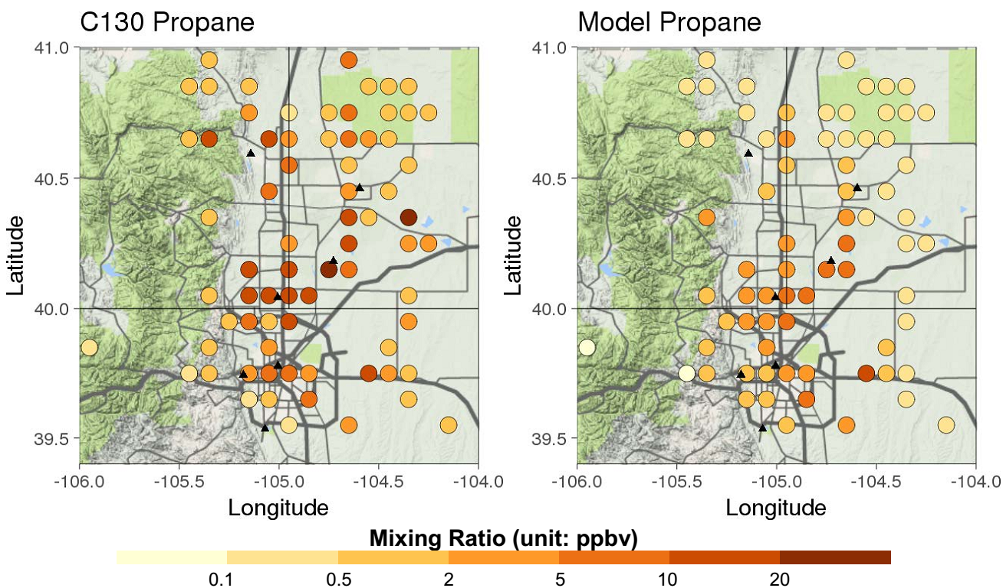
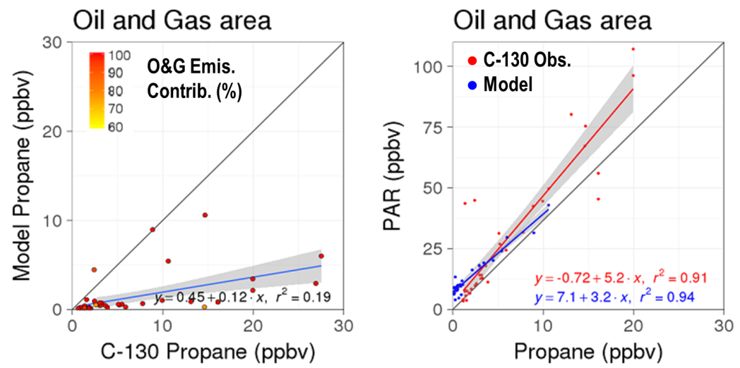
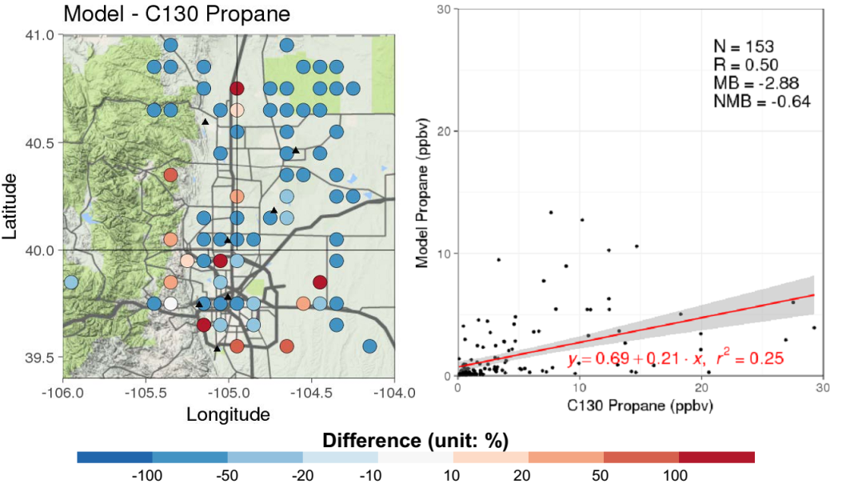
Oil and Gas emissions evaluations
- Propane: emitted mostly from O&G
- O&G region
(ethane)
All O&G tracer mixing ratios are strongly underestimated
Modeled Tracer-Tracer ratios are in line with observations
→ Suggestion: All O&G emissions increased by factor of 4. (except for ethane)
(except ethane).
(except ethane).
Notes:
All oil and gas tracers are strongly underestimated in model except for ethane for which no significant bias can be found.

Slide 12
Preliminary adjustment factors
Oil and Gas emissions
non-Denver urban
Oil & Gas
Ethane: “a priori”
- CO and NO_{x}:
“a priori”
- Other O&G tracers: “a priori” × 4
Denver urban

Slide 13
Results from this work
a priori emission inventory for mobile emissions is a factor of 2 low in ethyne in entire NFRMA.
Traffic volume in North of Denver is underestimated by at least a factor of 2.
VOC emissions from O&G activities are underestimated by a factor of 4 except for ethane.
 |  |  | unit: ton/year
Mobile | CO | NO_{x} | VOC
NEI 2014 | 409,364 | 66,649 | 36,887
a priori | 386,767 | 44,491 | 31,018
posteriori | 506,645 | 60,551 | 35,751
 |  |  | unit: ton/year
O&G | CO | NO_{x} | VOC
NEI 2014 | 21,879 | 18,963 | 95,409
a priori | 22,061 | 21,835 | 78,471
posteriori | 22,061 | 21,835 | 289,199

Slide 14
Next steps
To test and further refine emission adjustment factors by iteratively running CMAQ
To perform sensitivity simulations for various emission control scenarios.

Slide 15
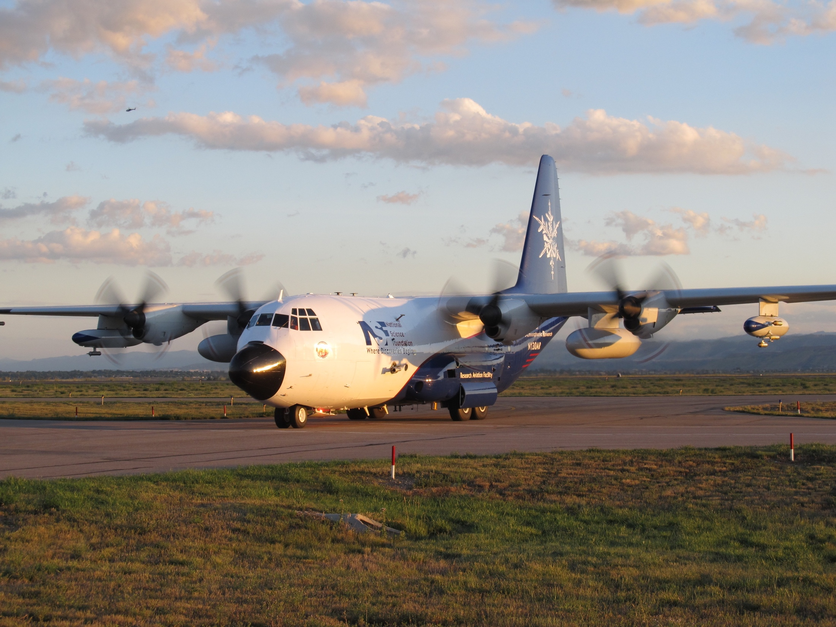
Thank you.

Slide 16
Mapping method
Model | Description | Mapping to C-130 Species
NTR1 | Simple organic nitrates | EthylNitrate_TOGA + i-PropylNitrate_TOGA + tert-ButylNitrate_TOGA + 2-ButylNitrate_n-ButylNitrate_TOGA + 2-PentylNitrate_3-PentylNitrate_TOGA
KET | Ketone carbon bond | MEK_TOGA
PAR | Paraffin carbon bond | TOGA: 4 × n-Butane_TOGA + 4 × i-Butane_TOGA + 5 × i-Pentane_TOGA + 5 × n-Pentane_TOGA + 5 × 2-Methylpentane_TOGA + 5 × 3-Methylpentane_TOGA + 6 × n-Hexane_TOGA + 7 × n-Heptane_TOGA + 3 × MEK_TOGA WAS: 4 × n-Butane_WAS + 4 × i-Butane_WAS + 5 × i-Pentane_WAS + 5 × n-Pentane_WAS + 5 × 2-Methylpentane_WAS + 5 × 3-Methylpentane_WAS + 6 × n-Hexane_WAS + 7 × n-Heptane_WAS + 4 × 2-2-Dimethylbutane_WAS + 6 × 2-3-Dimethylbutane_WAS + 5 × Cyclopentane_WAS + 6 × Methylcyclopentane_WAS+ 6 × Cyclohexane_WAS + 7 × Methylcylohexane_WAS + 7 × 2-4-Dimethylpentane_WAS + 7 × 2-2-4-Trimethylpentane_WAS + 8 × n-Octane_WAS
PRPA | Propane | Propane_WAS
ETHY | Ethyne | Ethyne_WAS
ETH | Ethene | Ethene_WAS
OLE | Terminal olefin carbon bond | Propene_WAS + i-Butene_n-Butene_TOGA

Slide 17
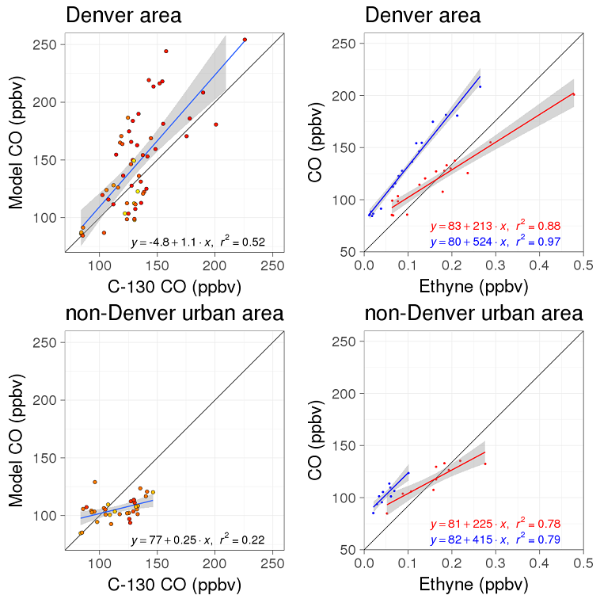
Mobile emissions evaluations (CO)
● C-130 Obs.
● Model
Mobile Emis.
Contrib. (%)

Slide 18
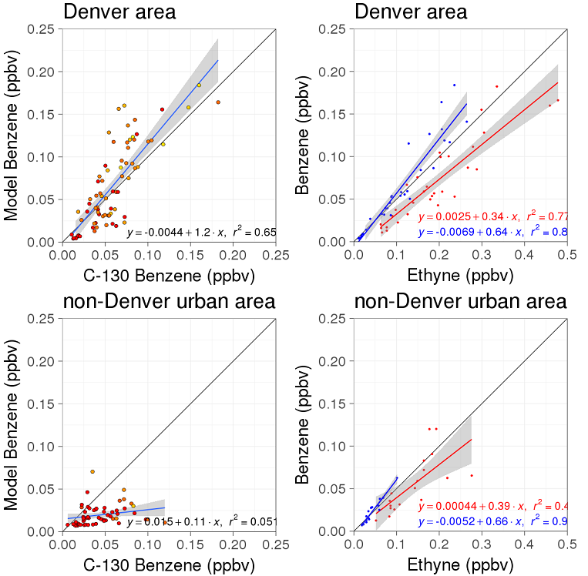
Mobile emissions evaluations (Benzene)
● C-130 Obs.
● Model
Mobile Emis.
Contrib. (%)

Slide 19
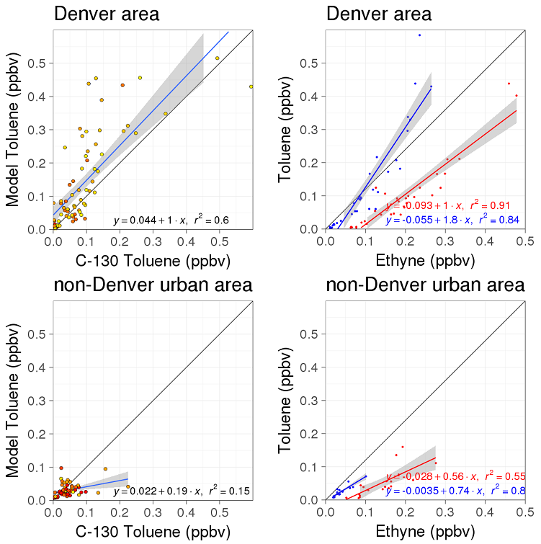
Mobile emissions evaluations (Toluene)
● C-130 Obs.
● Model
Mobile Emis.
Contrib. (%)

Slide 20
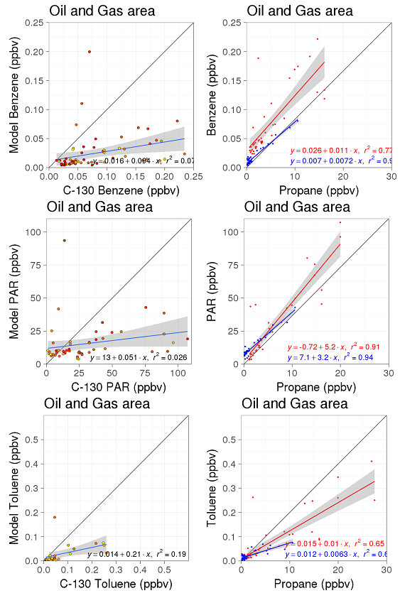
O&G emissions evaluations
● C-130 Obs.
● Model
O&G Emis.
Contrib. (%)

