Slide 1
Ozone and Volatile Organic Compound Distributions in Rocky Mountain National Park during FRAPPÉ: Key Insight into Factors Affecting Park Air Quality
Barkley C. Sive
Air Resources Division
ARD: Tony Prenni, Jim Cheatham, Bret Schictel, John Vimont
CSU/CIRA: Yong Zhou, Katie Benedict, Ashley Evanoski-Cole, Emily Fischer, Derek Day, Sara Callahan, Amy Sullivan, Jeff Collett
NCAR: Eric Apel, Becky Hornbrook
UCI: Stacey Hughes
SUNY-ESF: Huiting Mao, Ying Zhou
Air Resource Specialists, Inc.

Slide 2
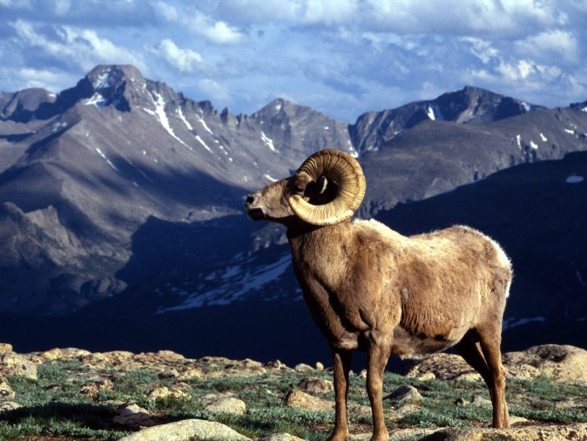
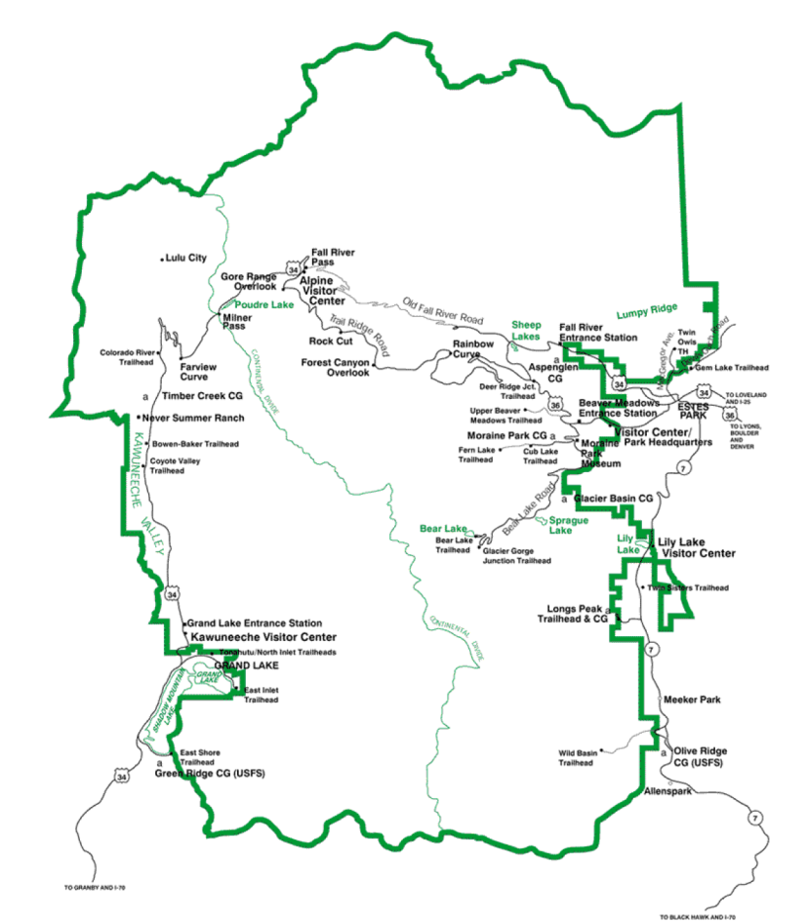
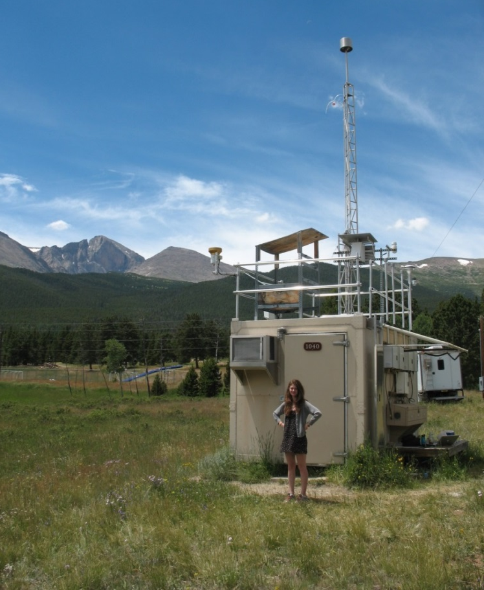
ROMO is a Class I area and suffers from multiple air quality problems including elevated ozone and harmful levels of nitrogen deposition.
Rocky Mountain National Park
Trail Ridge Road Site
11,600 ft.
Estes Park
Longs Peak Site
9,000 ft.

Slide 3
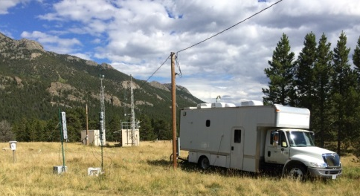
Rocky Mountain National Park Measurements
  Objective: Supplement continuous monitoring occurring at ROMO
  during FRAPPÉ intensive period.
  Key areas of NPS interest: Oil & gas impacts, N deposition, O₃
  Ongoing measurement programs:
IMPROVE, AMoN, NADP, CASTNET (O₃, met, filter packs)
Additional Measurements during FRAPPÉ
VOC GC
PTR-MS
PAN GC
CO, NH₃, NO_{x}, NO_{y}
MARGA
Spatial sampling:
VOCs with canisters
URG annular denuder system
Portable O₃ - Trail Ridge Road
Alkanes | Alkenes | Alkynes | Alkyl Nitrates
ethane | ethene | ethyne | MeONO2
propane | propene |  | EtONO2
i-butane | t-2-butene | Biogenics | i-PrONO2
n-butane | 1-butene | isoprene | n-PrONO2
i-pentane | i-butene | α-pinene | 2-BuONO2
n-pentane | c-2-butene | β-pinene | 3-PenONO2
cyclopentane |  |  | 2-PenONO2
n-hexane | OVOCs | Aromatics
n-heptane | methanol | benzene | Halocarbons
n-octane | acetaldehyde | toluene | C2HCl3
n-nonane | MEK | ethylbenzene | C2Cl4
 | MVK+MACR | m+p-xylene | CH3I
 | acetic acid | o-xylene | CH2Br2
 |  |  | CHBrCl2
 |  |  | CHBr3

Slide 4
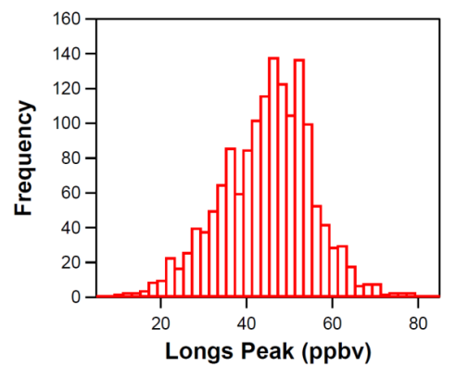
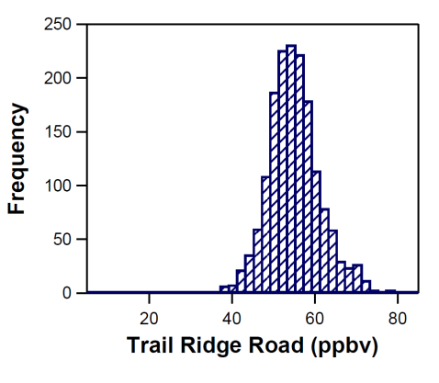
Ozone: Longs Peak and Trail Ridge Road
 | Longs Peak | Trail Ridge Road
Mean | 43 | 53
Med | 45 | 53
Max | 79 | 82
Min | 9 | 10
25th | 36 | 49
75th | 51 | 57

Slide 5
Temporal Distributions of VOCs at ROMO

Slide 6
Temporal Distributions of VOCs at ROMO

Slide 7
Oil & Gas Emissions Tracer
vehicular exhaust ~ 2.2-3.8
gasoline ~ 1.5-3
fuel evaporation ~1.8-4
Russo et al., 2010; ACP

Slide 8
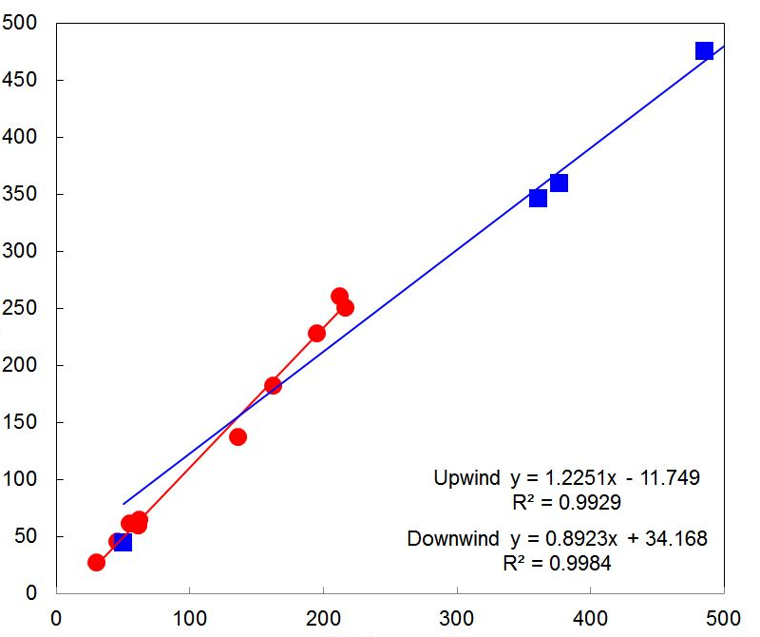
Oil & Gas Emissions Tracer
Flights 1-3
C-130
i-pentane (pptv)
Upwind: Slope =1.22
R²=0.99
Downwind: Slope = 0.89
R² = 0.99
n-pentane (pptv)
vehicular exhaust ~ 2.2-3.8
gasoline ~ 1.5-3
fuel evaporation ~1.8-4

Slide 9
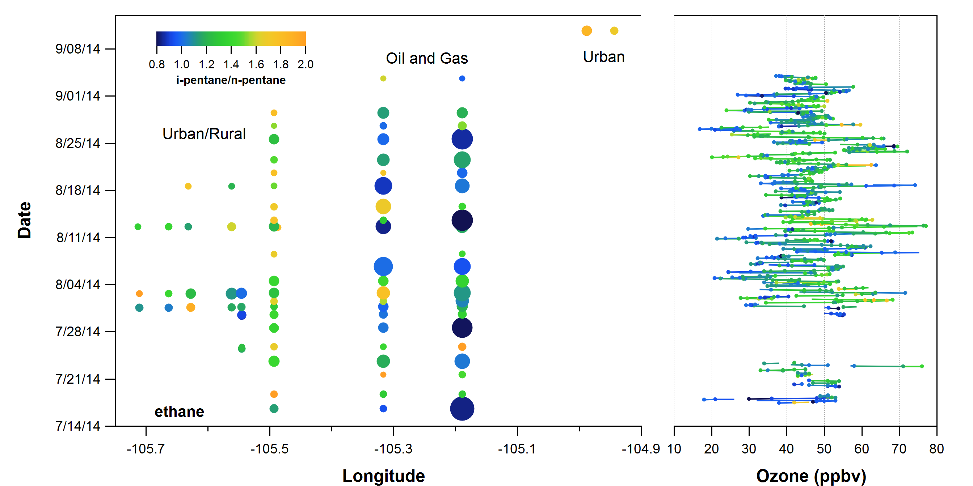
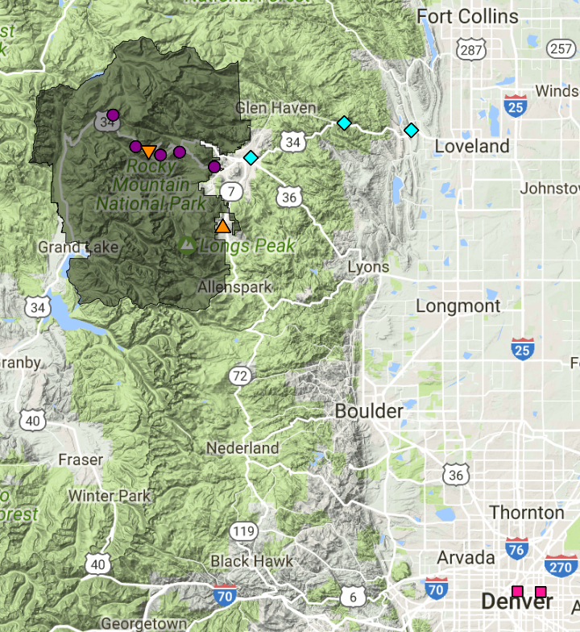
Transect Samples

Slide 10
Transect Samples

Slide 11
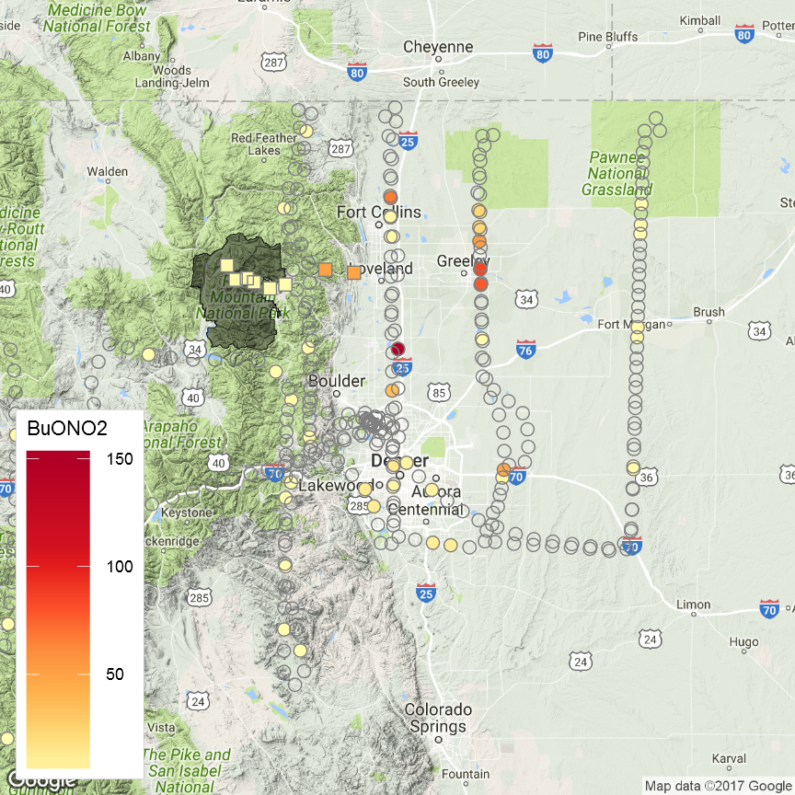
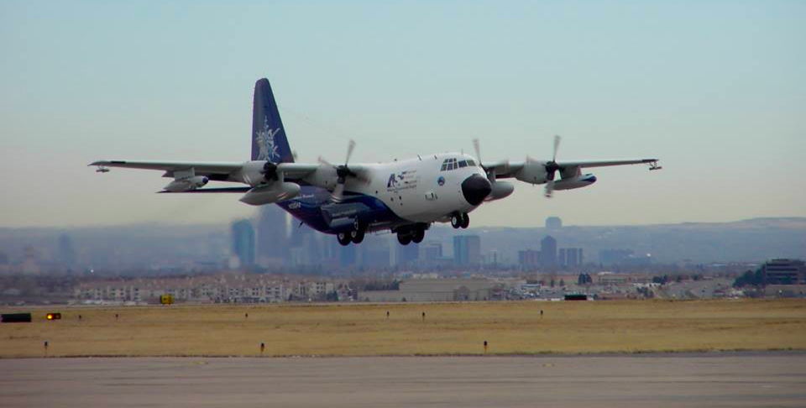
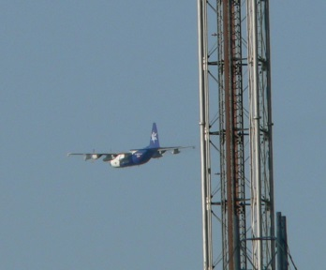
RF15
8/18/2014
Upslope Event
10 AM
3 PM
2-BuONO₂

Slide 12
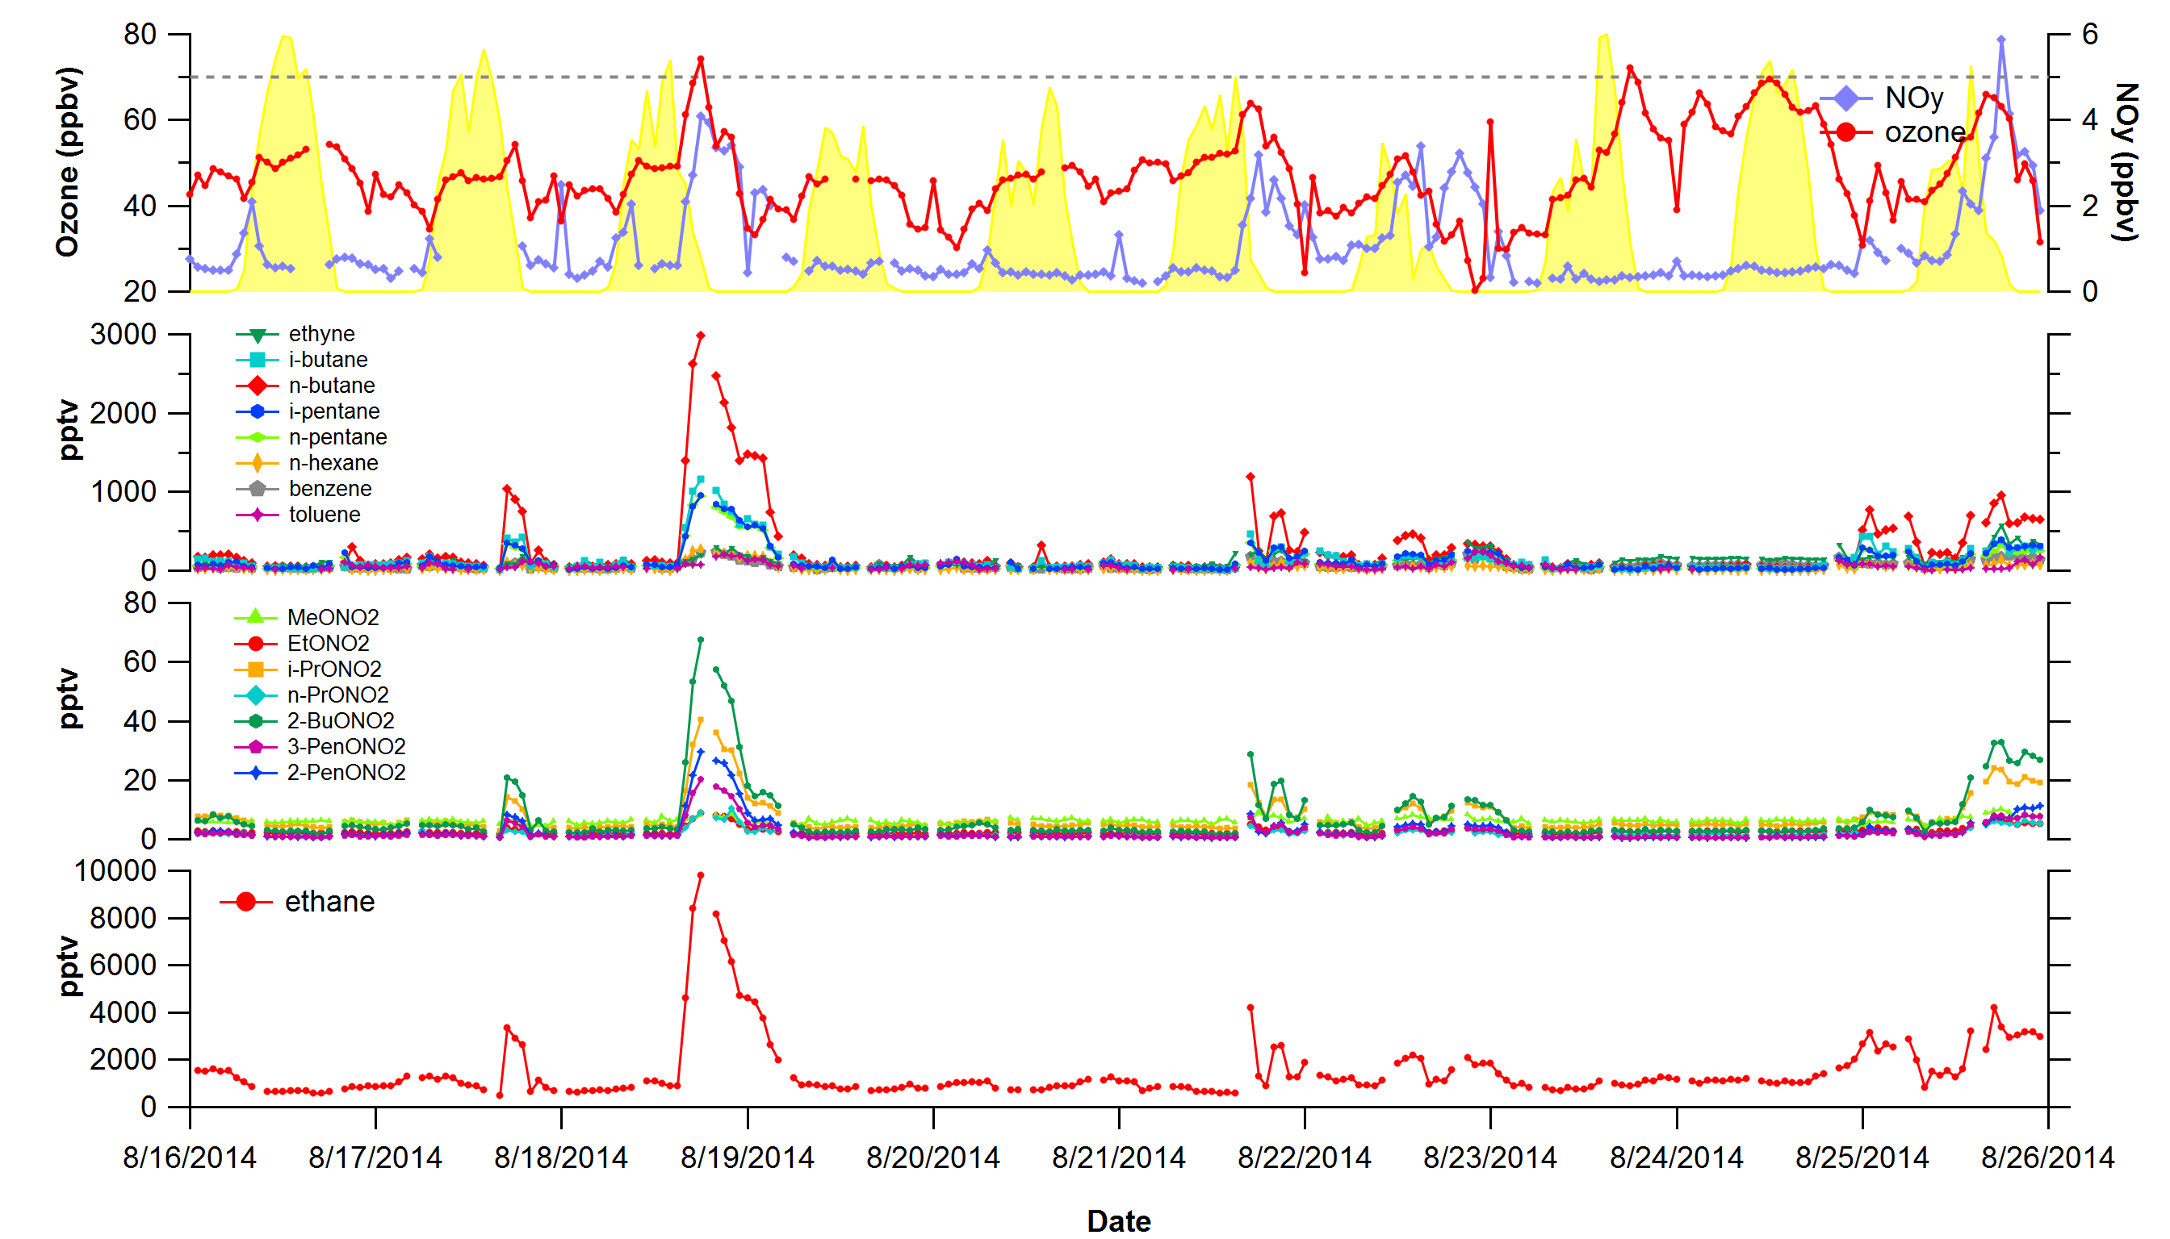
Upslope & Stratospheric Intrusion Events

Slide 13
Upslope & Stratospheric Intrusion Events

Slide 14
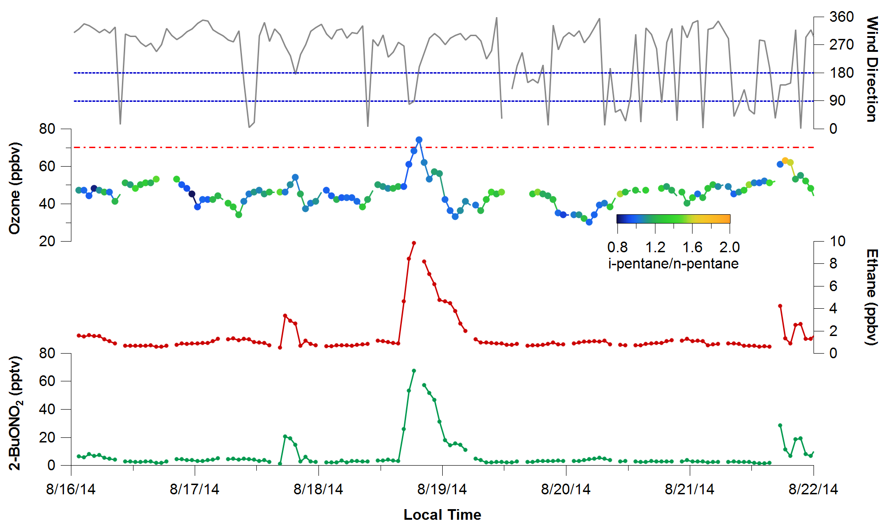
Upslope Event on August 18-19, 2014

Slide 15
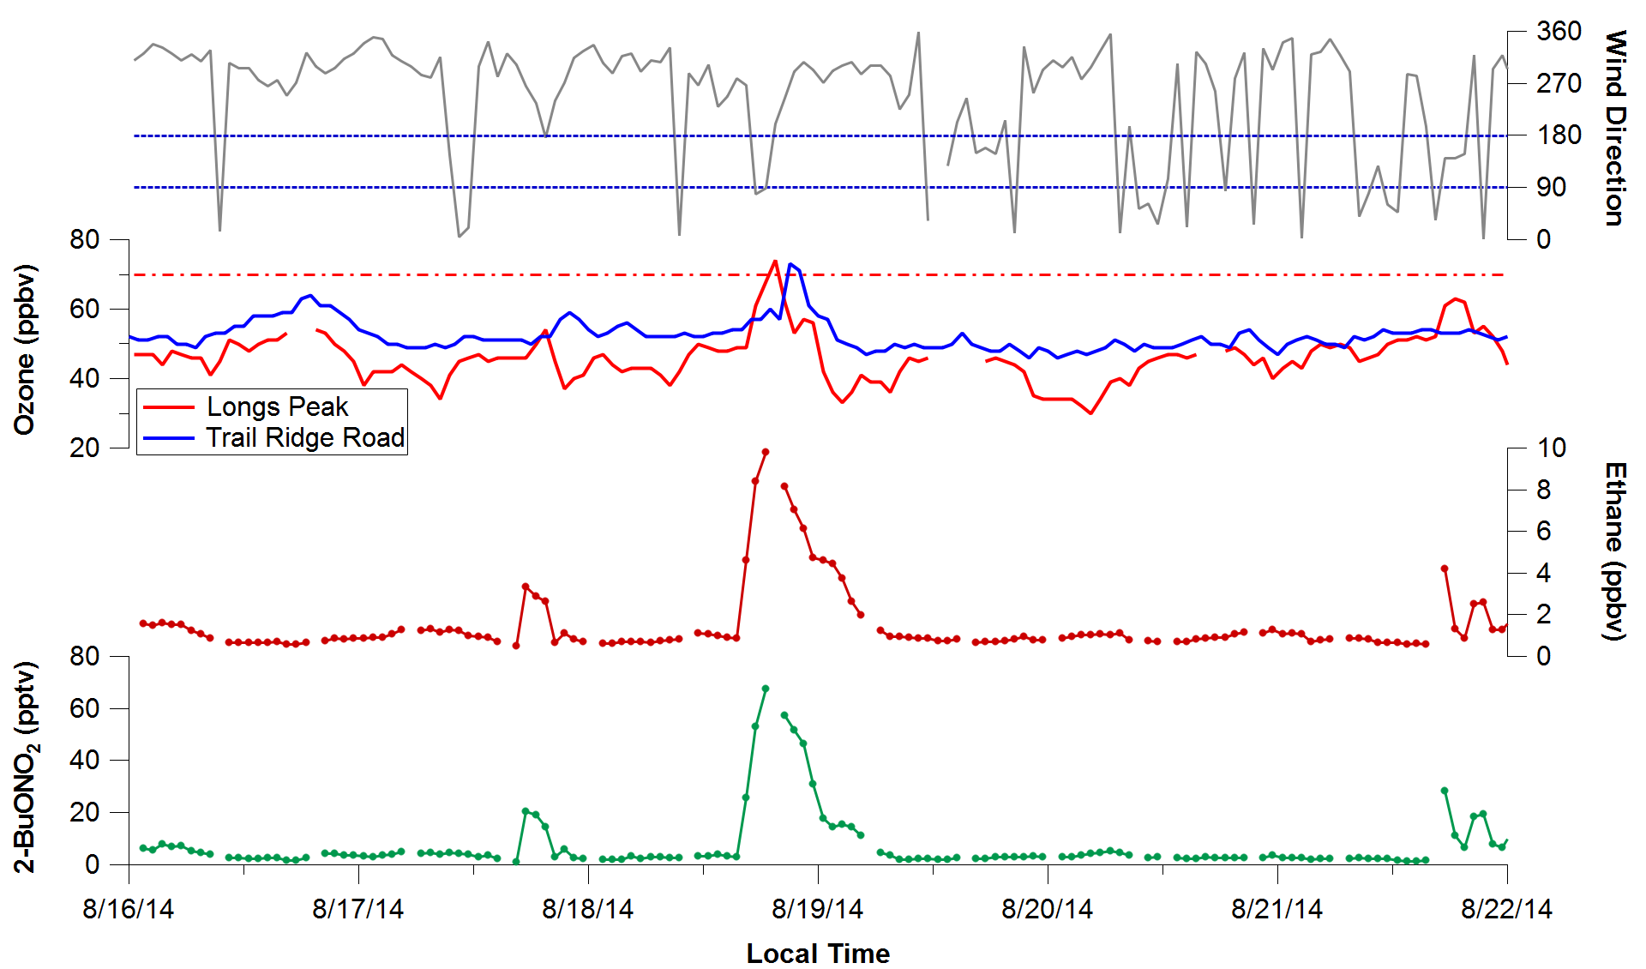
Upslope Event on August 18-19, 2014

Slide 16
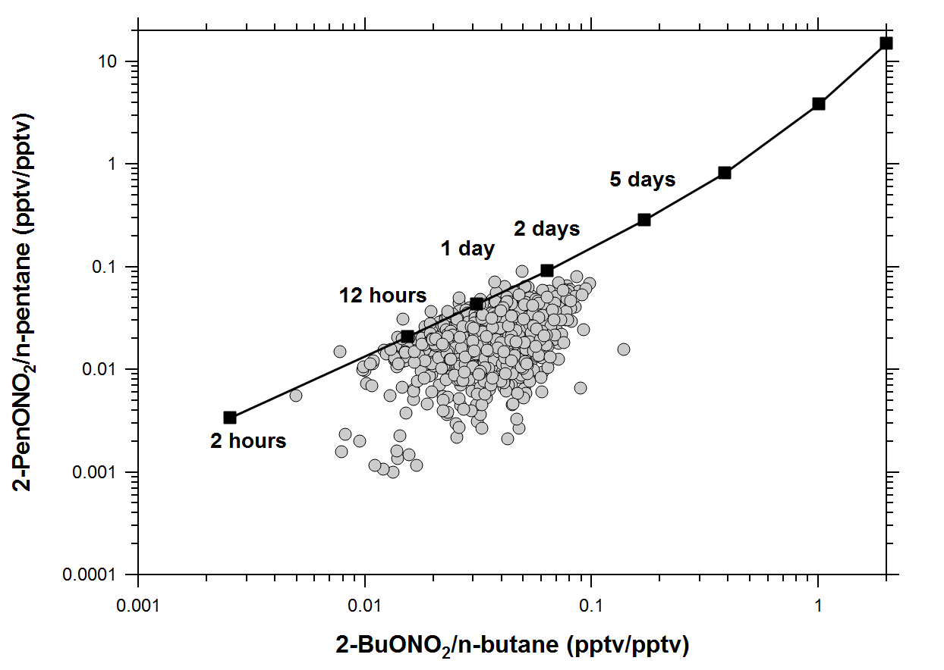
Photochemical Age using Alkyl Nitrates

Slide 17
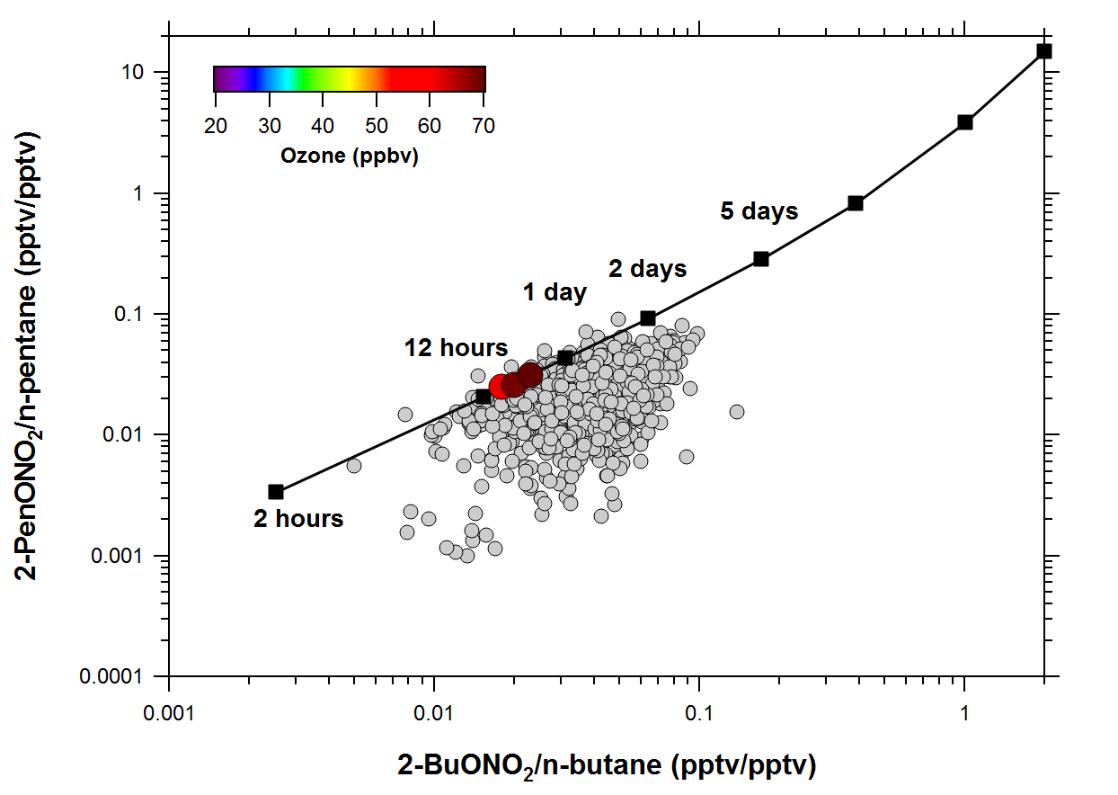
Photochemical Age using Alkyl Nitrates

Slide 18
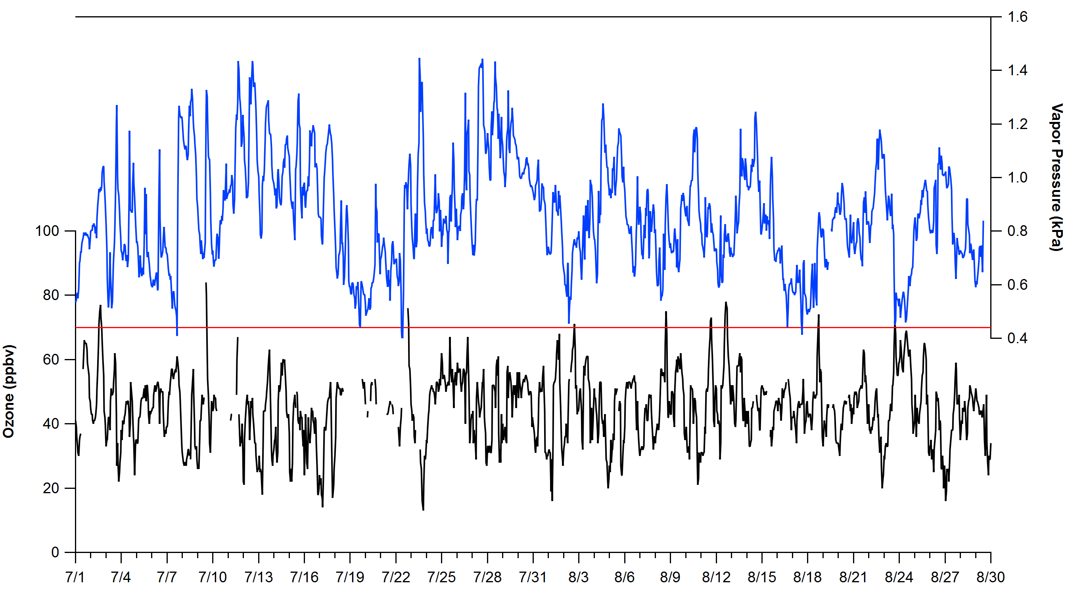
Stratospheric Intrusion Event on August 23, 2014

Slide 19
Stratospheric Intrusion Event on August 23, 2014

Slide 20
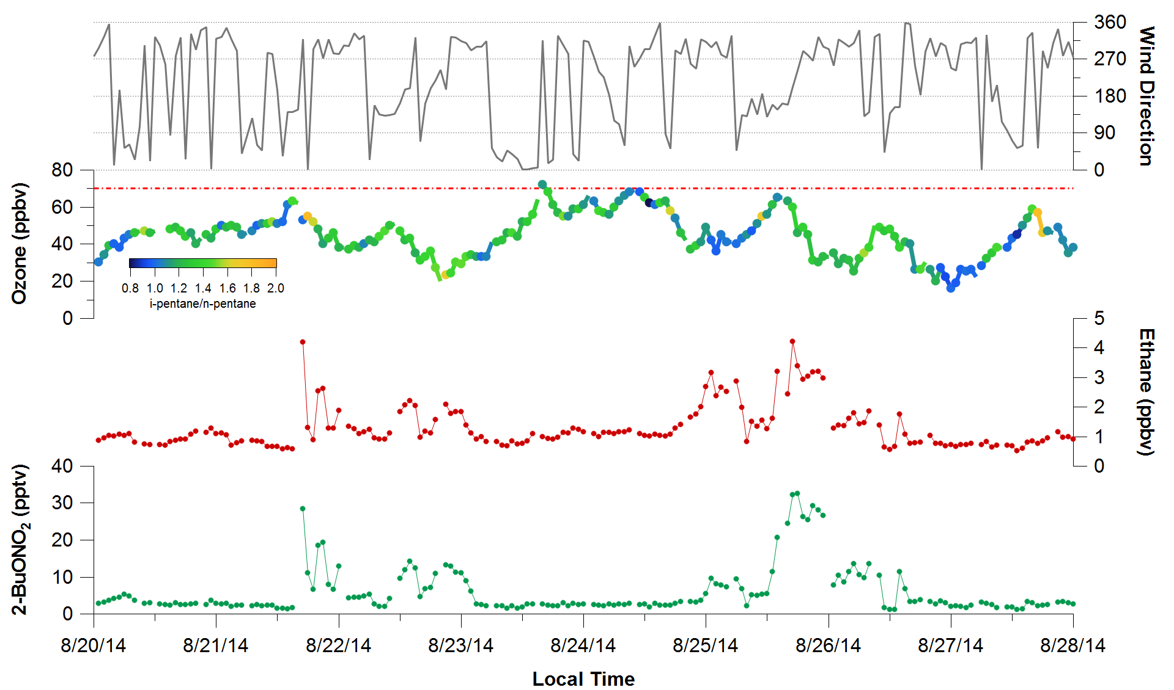
Stratospheric Intrusion Event on August 23, 2014

Slide 21
Stratospheric Intrusion Event on August 23, 2014

Slide 22
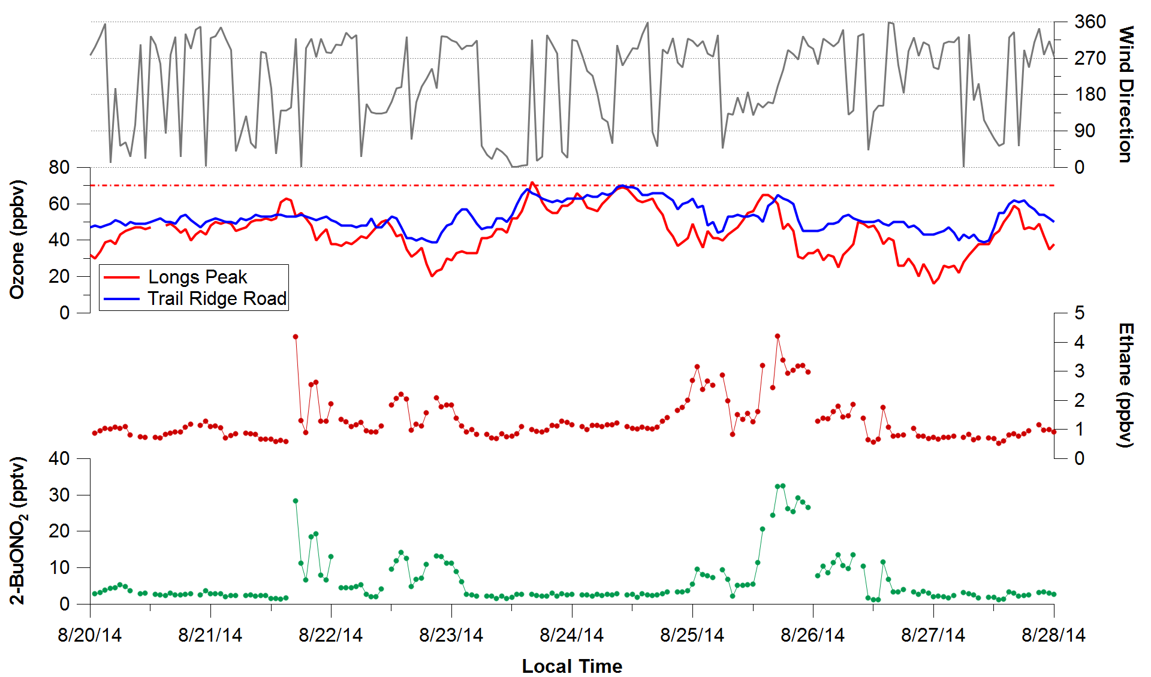
Stratospheric Intrusion Event on August 23, 2014

Slide 23
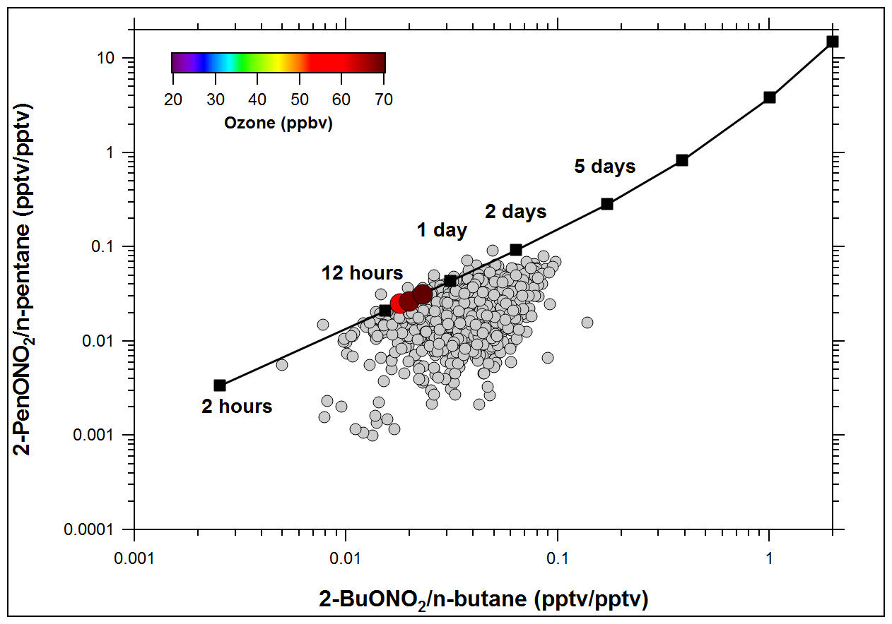
Photochemical Age using Alkyl Nitrates

Slide 24
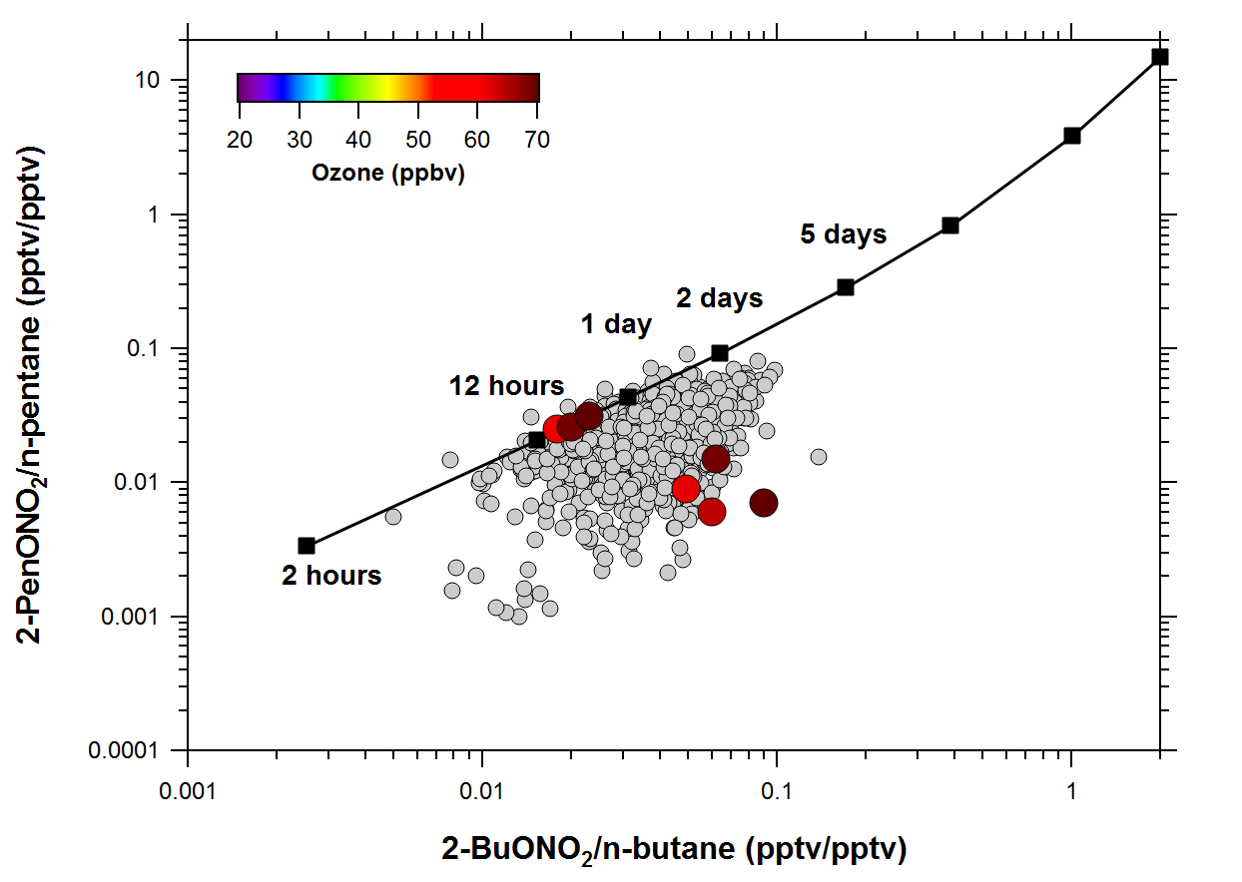
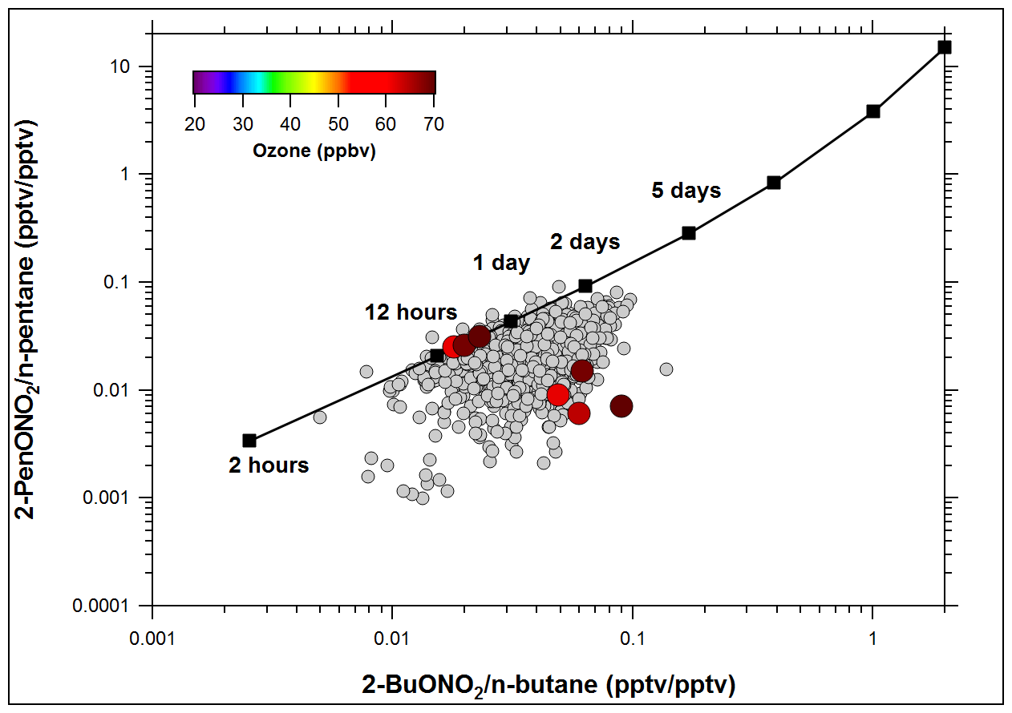
Photochemical Age using Alkyl Nitrates

Slide 25
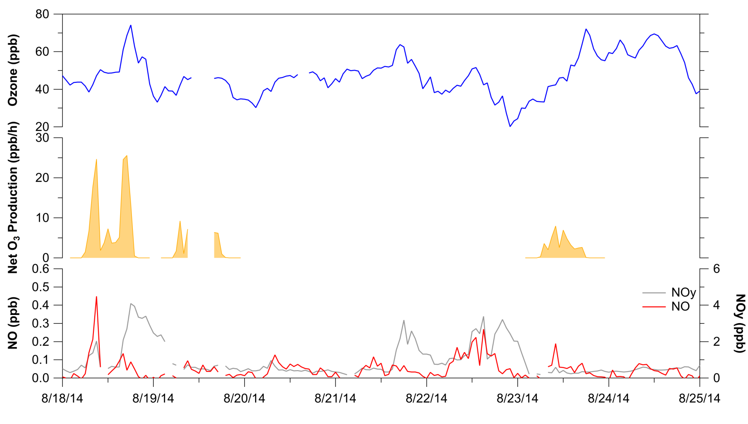
Upslope and Stratospheric Intrusion Events
Box Modeling with BOXMOX
Net ozone production rates ~25 ppb/h during upslope
~15 ppbv excess ozone at ROMO

Slide 26
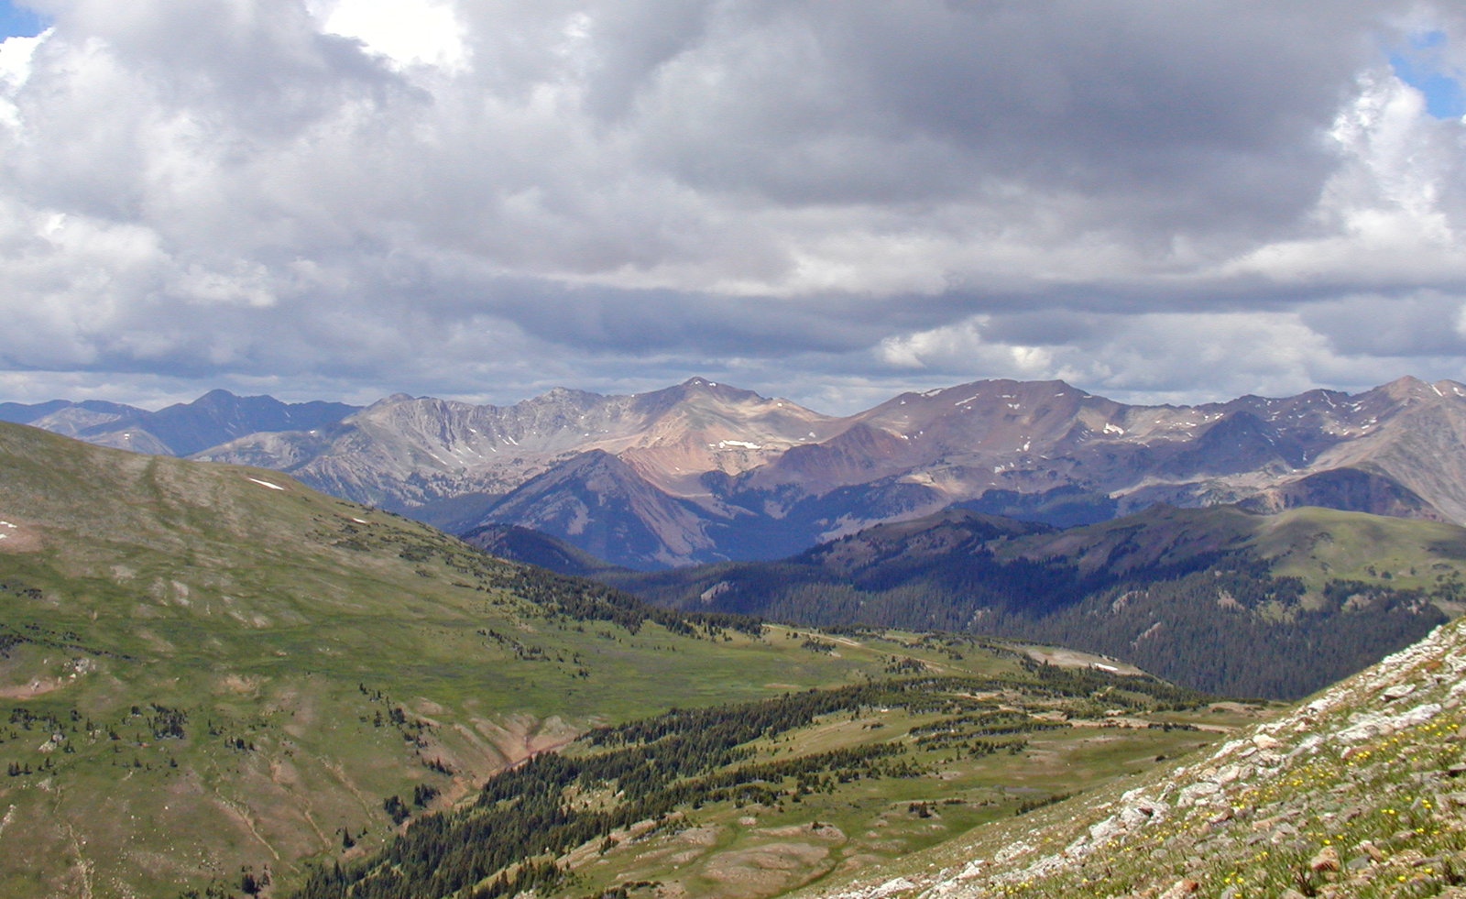

Slide 27
Summary
ROMO is a Class I area and afforded the highest level of air quality protection under the law. Parks should be the cleanest areas in the U.S. (CAA and NPS Organic Act).
Trail Ridge Road and Longs Peak sites tracked well; highest O₃ levels at high elevation.
Mixed signature of urban and oil and gas emissions observed at Longs Peak site.
NMHC distributions similar to summertime measurements in SW PA; mixed urban and oil and gas operations.
Elevated ozone and VOCs during upslope events, transport from the E and SE.
Highest levels of alkanes associated with oil and gas operations based on i-pentane/n-pentane ratio (i-butane/n-butane).
Net ozone production rates of ~25 ppb/h during the Aug 18-19 upslope event.
Upwards of ~15 ppbv excess ozone at ROMO during this event.
Is there a measureable impact from O&G production operations?
  Because O&G emissions are often coupled with urban emissions, this results in a significant ozone production potential for ROMO during upslope events (~20-35%).

Slide 28
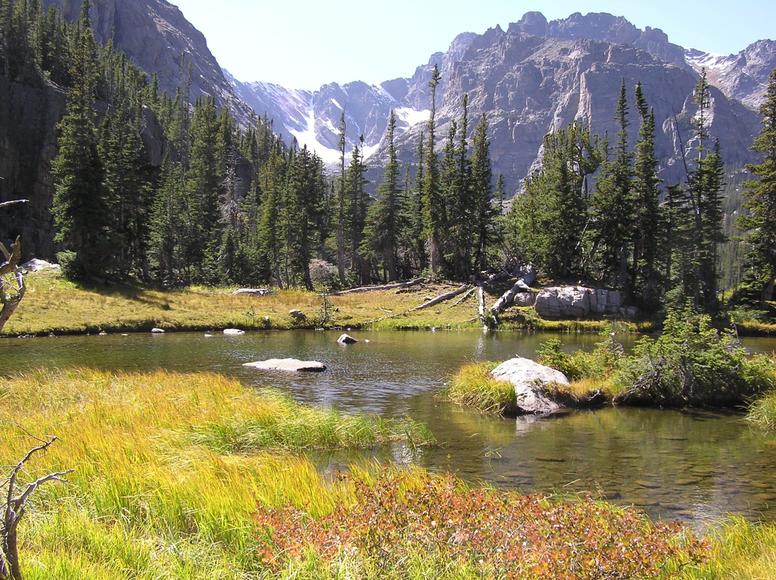

Slide 29
EXTRAS

Slide 30
Diurnal Profiles from ROMO

Slide 31
Transect Samples on August 18, 2014

Slide 32
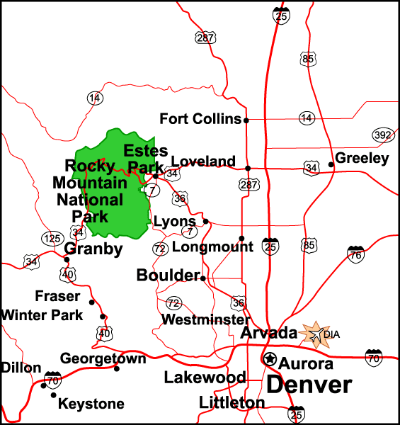
ozone
ethane
2-BuONO₂
270
90
270
90
270
90
180
180
180
ethyne
CHBr₃
270
90
270
90
180
180

Slide 33
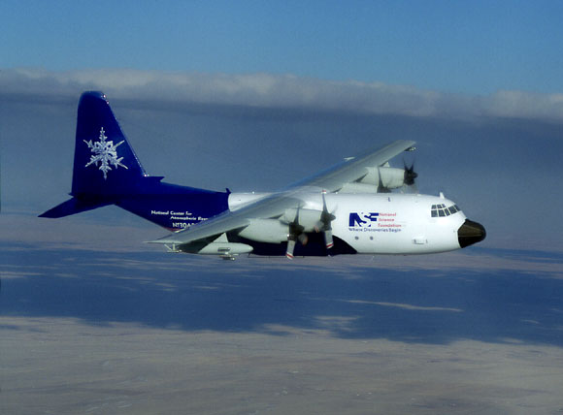
TOGA C-130
i-pentane/n-pentane ratio

Slide 34
Urban Study Comparison of Light NMHCs
1916 Organic Act –
NPS Mission Established
Clean Air Act – Importance of Clean “Pristine” Air in these Areas a National Goal

