Slide 1
Ozone Enhancement and Attribution to Wildfires: A case study in the Northern Colorado Front Range
Audra McClure-Begley^{1,2}, Irina Petropavlovskikh^{1,2}, Samuel Oltmans², Brad Pierce³ , John Sullivan⁴
University of Colorado, Cooperative Institute for Research in Environmental Sciences
National Oceanic and Atmospheric Administration Global Monitoring Division
National Oceanic and Atmospheric Administration NESDIS
National Aeronautics and Space Administration GSFC

Slide 2
What is the impact of biomass burning on surface/tropospheric ozone in the Colorado Front Range?
Overview
-Tropospheric Ozone in the Front Range
-Wildfires and Ozone
Case Study: July 19, 2014 -Episode Identification -Episode Confirmation -Spatial Extent
-Next Day Comparison
Long-Term Trends and Analysis: BAO Tower How does 2014 compare to other years?

Slide 3
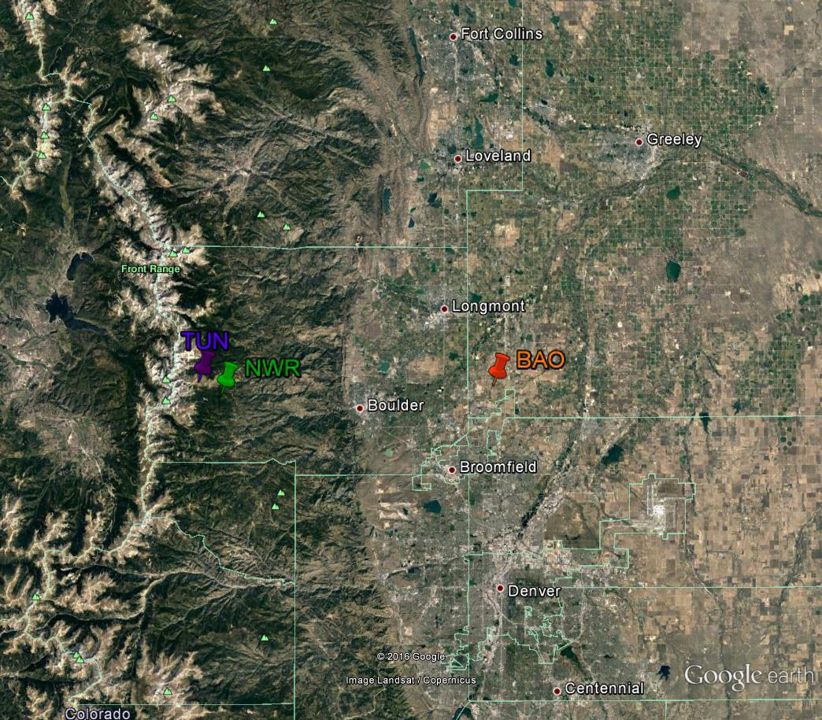
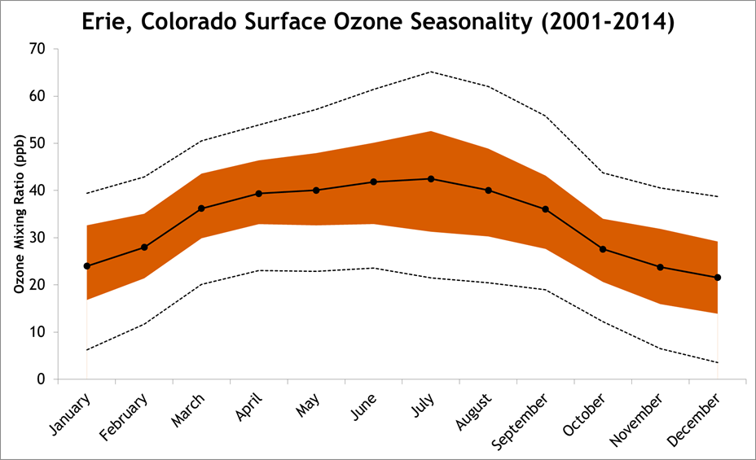
Tropospheric Ozone in the Front Range
Essential species for the photochemical oxidation and radiative forcing processes of the atmosphere
Secondary Pollutant, formed from reactions of primary pollutants
Photochemical Smog
Greenhouse Gas
High levels negatively impact human health and ecosystem functioning

Slide 4
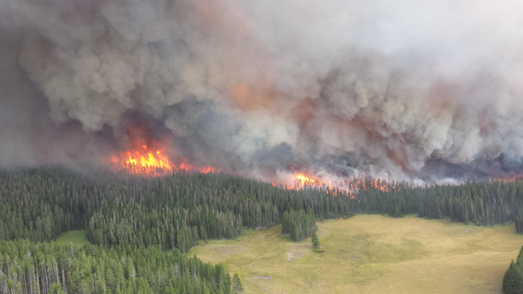
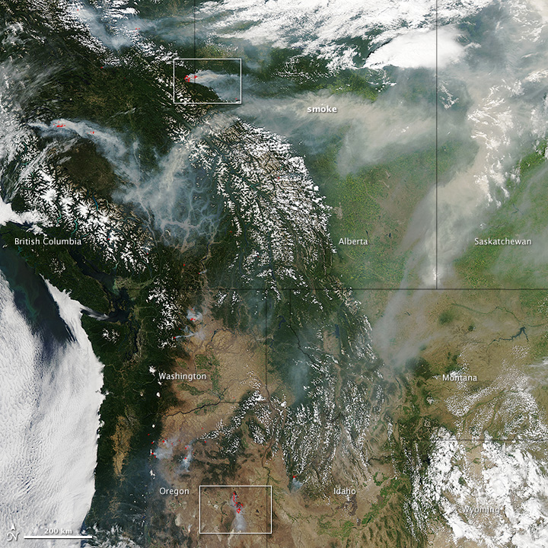
Ozone and Biomass Burning
Fire emissions are different for each fire
Material burned
Smoldering/flaming
Biomass burning releases a suite of compounds into the atmosphere (Andrae and Merlet, 2001)
Many are ozone precursor pollutants
Wide range of NMOC emitted (Jaffe and Widger, 2012)
Global climate patterns impact biomass burning and the transport of associated pollutants. (Eckhardt et. al, 2003 and Stohl et. al, 2007)
Complex interactions of pollutants and meteorological conditions vary between episodes. (Jaffe and Widger, 2012)
VOCs
PM
Image: NASA Earth Observatory
Notes:
Long Range Transport of smoke from outside regions

Slide 5
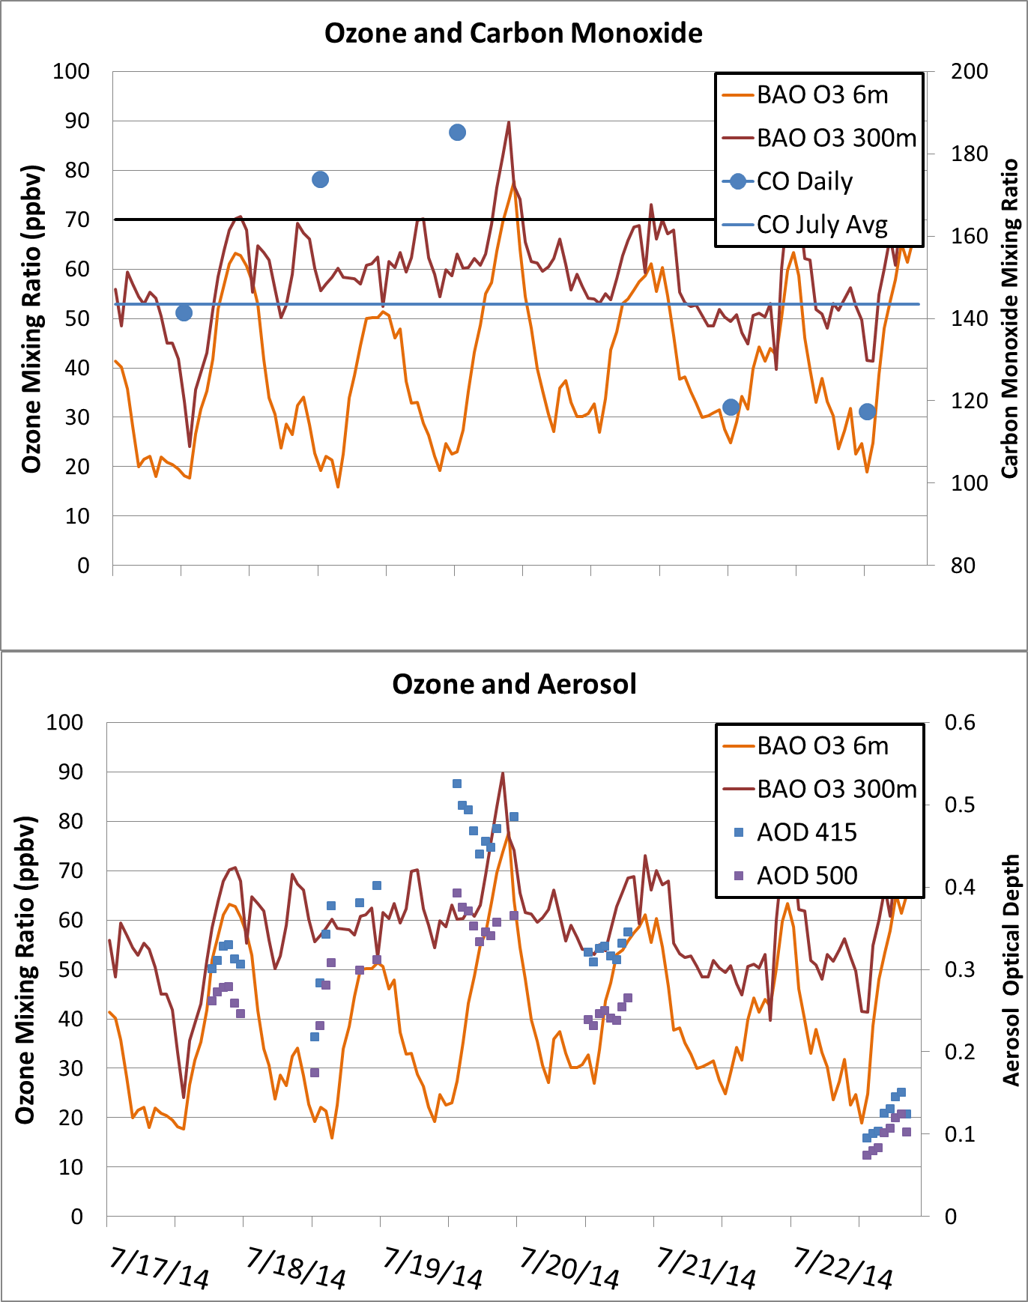
July 19, 2014 – Identification Method
How are Episodes Identified?
Co-Located Measurements
Carbon Monoxide
Trace Gases
Black Carbon +
Aerosol Properties
Satellite Imagery
Back-Trajectory Analysis
NOAA ARL Hysplit
Models
NOAA RAQMS
NOAA CMAQ
MOZART-4

Slide 6
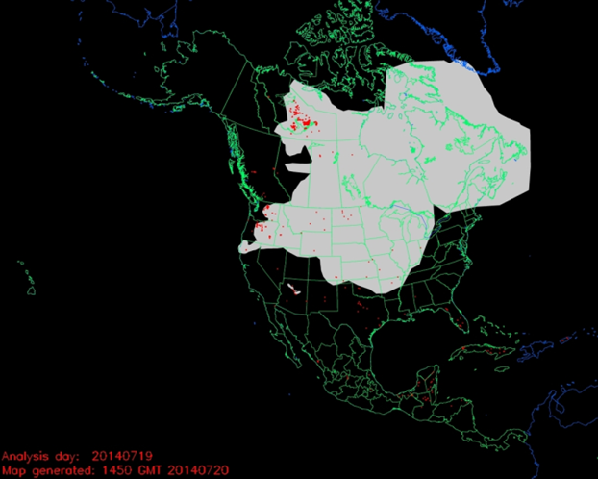
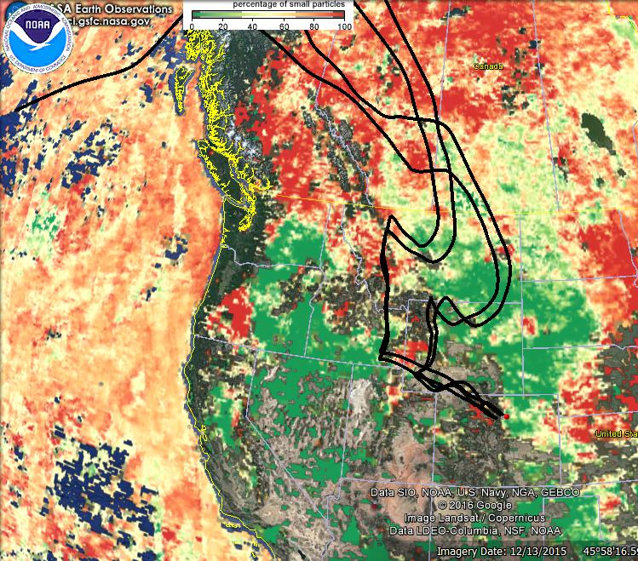
July 19, 2014 – Identification Method
Long range transport of wildfire plumes from boreal regions has been detected previously and can impact ozone production at intercontinental distances. (Val Martin et. al, 2006)
FRAPPE Team Meeting: Boulder, Colorado May 3, 2017

Slide 7
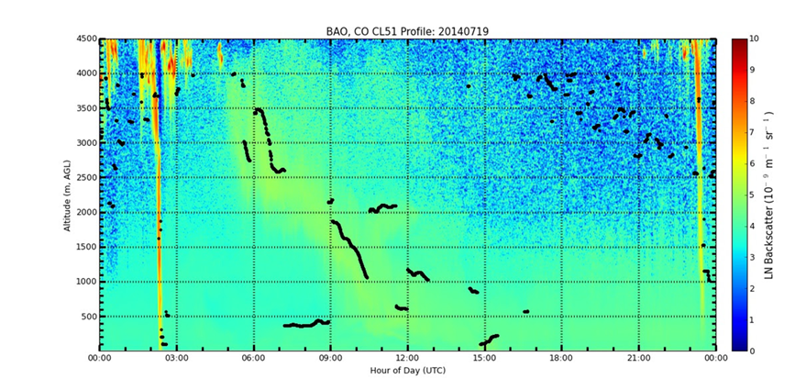
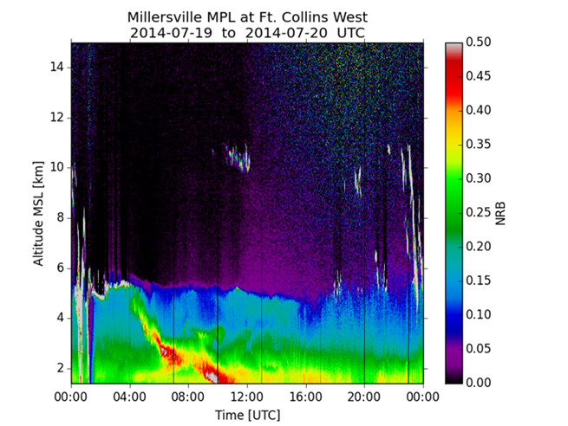
July 19, 2014 – Episode Confirmation
FRAPPE Team Meeting: Boulder, Colorado May 3, 2017

Slide 8
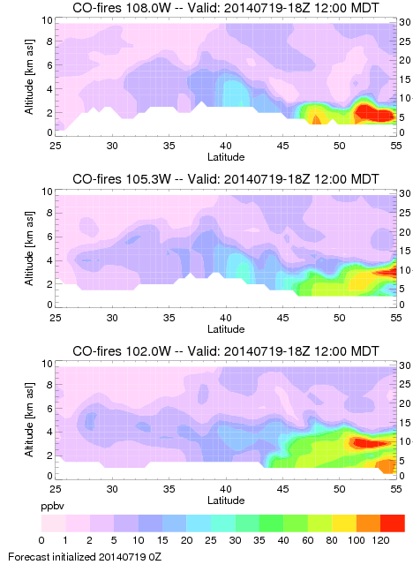
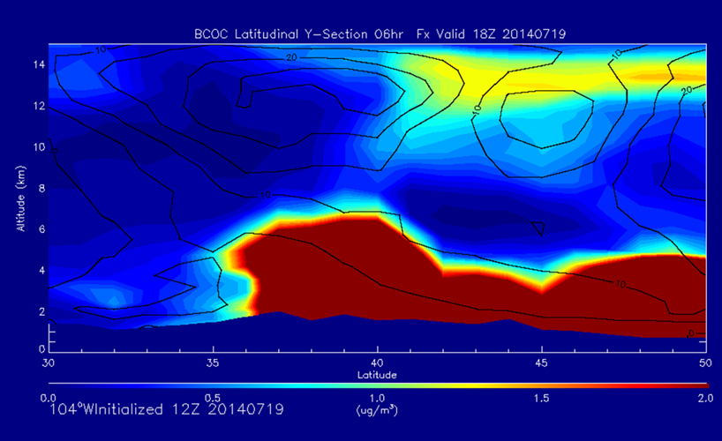
July 2014 – Episode Confirmation
MOZART 4 Carbon Monoxide and RAQMS Black Carbon models provide visualization and confirm the results detected with the MPL and Ceilometer.
FRAPPE Team Meeting: Boulder, Colorado May 3, 2017
MOZART4 output: Louisa Emmons

Slide 9
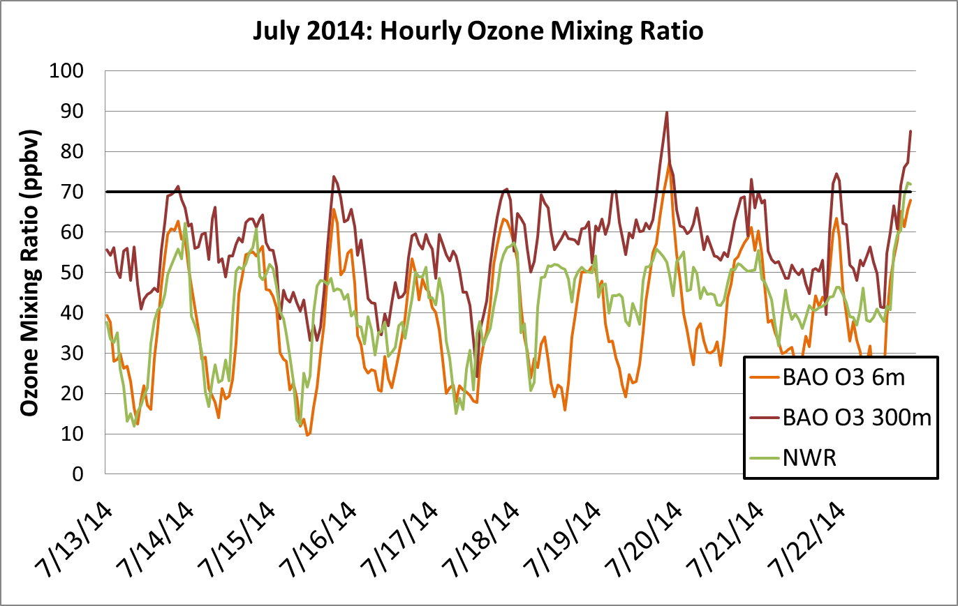
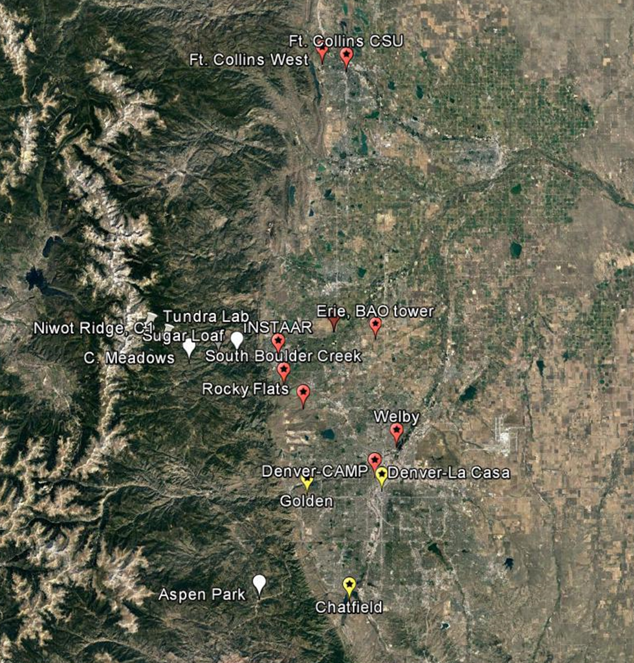
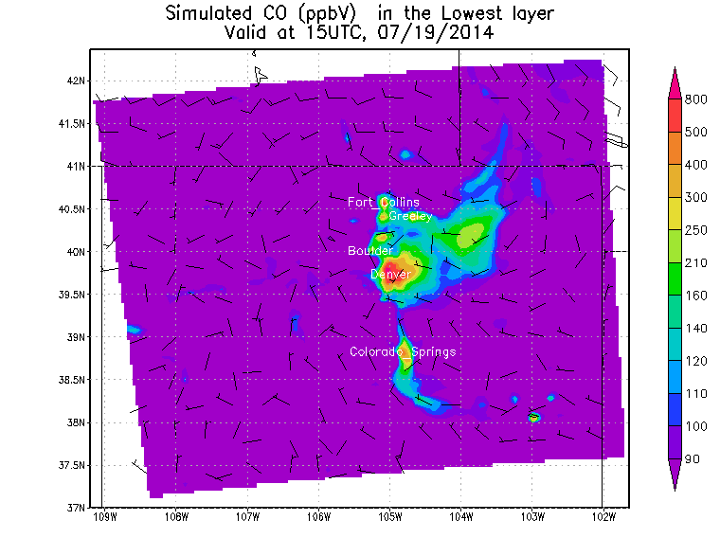
July 2014 – Spatial Extent
FRAPPE Team Meeting: Boulder, Colorado May 3, 2017
Notes:
As reported by Jaffe and Wigder (2012), NOx is often the limiting compound for ozone production in wildfire plumes. The urban (Erie) area has more NOx available for the chemical production of ozone with the VOC’s present in the polluted air mass. In the NOAA CMAQ forecast for NOx, it is clear that there is an increase in NOx along the urban portion of the CFR which are critical for ozone production and accumulation. Niwot Ridge Station lacks the NOx required for the production of Ozone in this area.

Slide 10
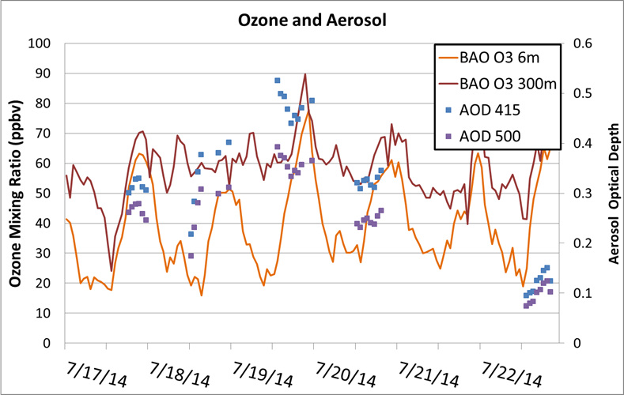
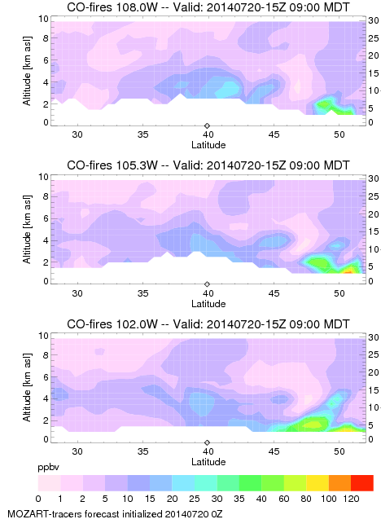
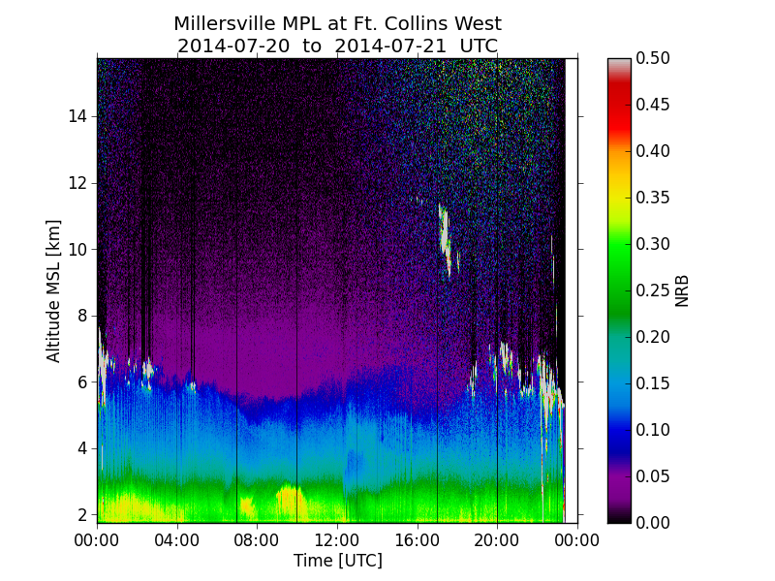
Comparison→ July 20, 2014

Slide 11
Erie, Colorado: Long Term Analysis
Co-located measurements (CO, AOD, Ceilometer) at a multi-year scale allow for a detailed analysis of the surface ozone record (2009-2015)
Complete the analysis outlined in the case study for all high ozone hours observed
O3 above 70 ppb
CO above 150 ppb
Elevated AOD
Analyze each episode with back trajectory and satellite imagery → confirm smoke influence
Model confirmation
FRAPPE Team Meeting: Boulder, Colorado May 3, 2017

Slide 12
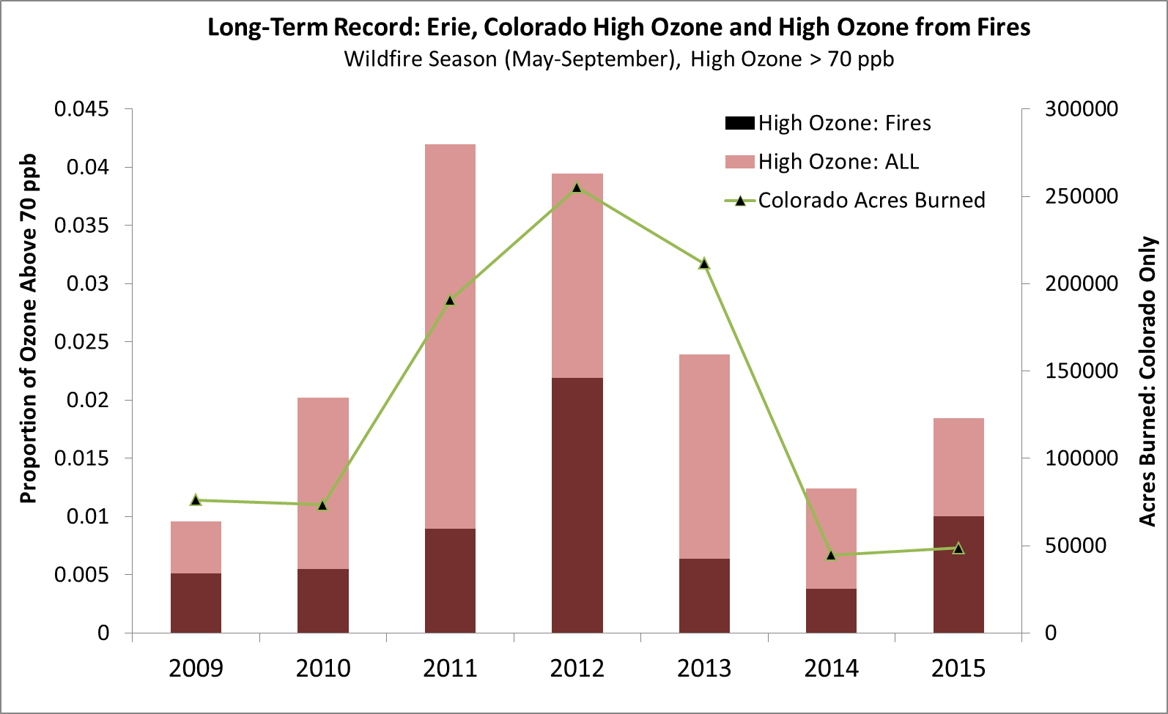
Long-Term Trends: Erie, Colorado BAO Tower
Notes:
Erie, Colorado surface ozone record is analyzed in the methods outlined above. Individual high ozone episodes are scrutinized for each year to determine if fire emissions influenced the air mass sampled. The percentage of hours ozone was above the NAAQS limit are shown for each year, as well as the portion of these episodes that can be attributed to interactions with biomass burning plumes . For reference, the local fire acres burned is shown. Erie, Colorado provides a unique opportunity to complete this type of analysis with co-located measurements of Carbon Monoxide, Carbon Dioxide, Methane, and Aerosol back-scatter.

Slide 13
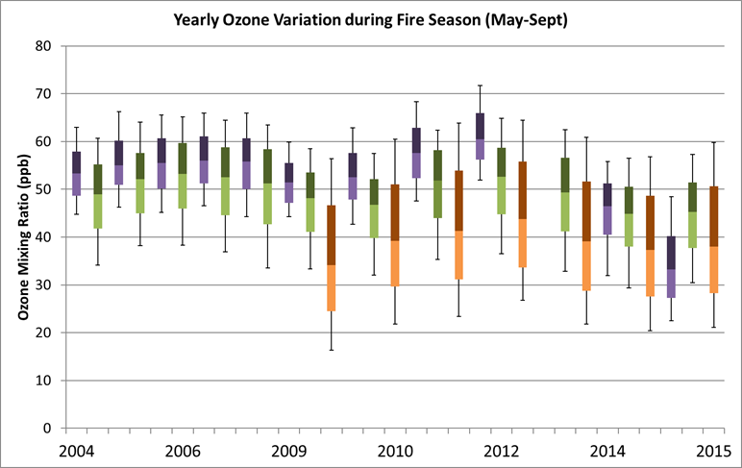
Conclusions
Co-located measurements of VOC’s, Meteorology, Aerosols, and model results are essential for determining the impact of biomass burning on ozone conditions
Biomass burning episodes are variable in space and time, generalized (ex. Monthly) studies are often not sufficient to identify the influence
Future Research
Investigate long term variation in frequency of biomass burning related high ozone events for each NOAA monitoring station
New monitoring location: Table Mountain, Boulder

Slide 14
Questions?
Thank you to NOAA GMD, NOAA PSD, University of Colorado-Boulder, FRAPPE team, DiscoverAQ team, All Data Providers, Site Technicians, and PIs.
Contact: Audra.McClure@noaa.gov
Jaffe, D. and Wigder, N. (2012). Ozone Production from wildfires: A critical review
Lewis, A. C. et. al (2013) The Influence of Biomass Burning on the Global Distribution of Selected Non-Methane Organic Compounds. Atmosphere Chemistry and Physics.
Monks, P. S. et al. (2015) Tropospheric Ozone and its precursors from the urban to global scale from air quality to short-lived climate forcer. Atmospheric Chemistry and Physics.
Val Martin, M. et. al (2006). Significant enhancements of nitrogen oxides, black carbon, and ozone in the North Atlantic lower free troposphere resulting from North American boreal wildfires. Journal of Geophysiccal research.
NASA Earth Observatory
OMPS AOD Imagery
NOAA HYSPLIT: Reanalysis

Slide 15
Additional Slides

Slide 16
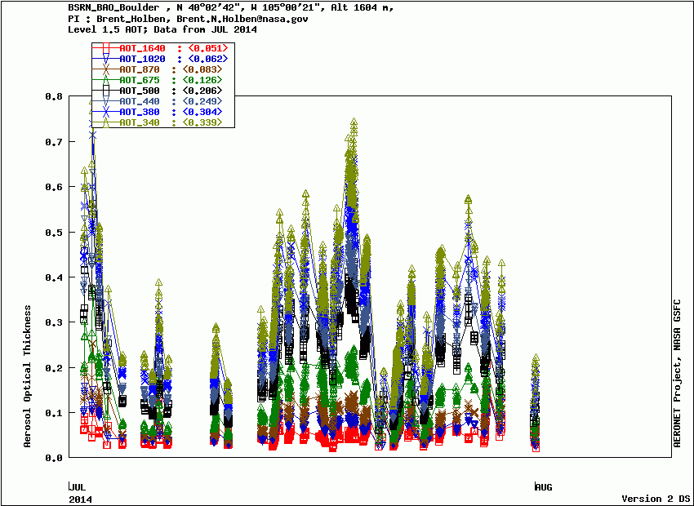
July 19 is the day of the highest AOT in July (except for July 2)

Slide 17
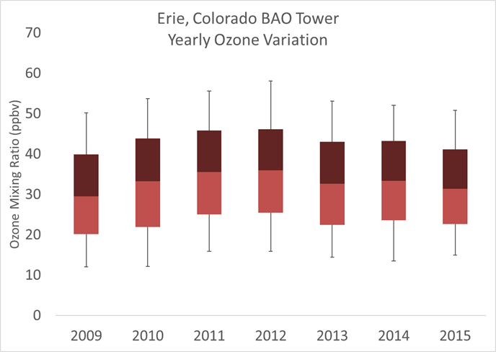

Slide 18
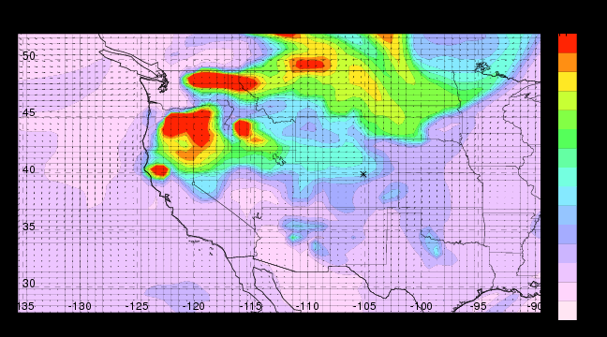

Slide 19
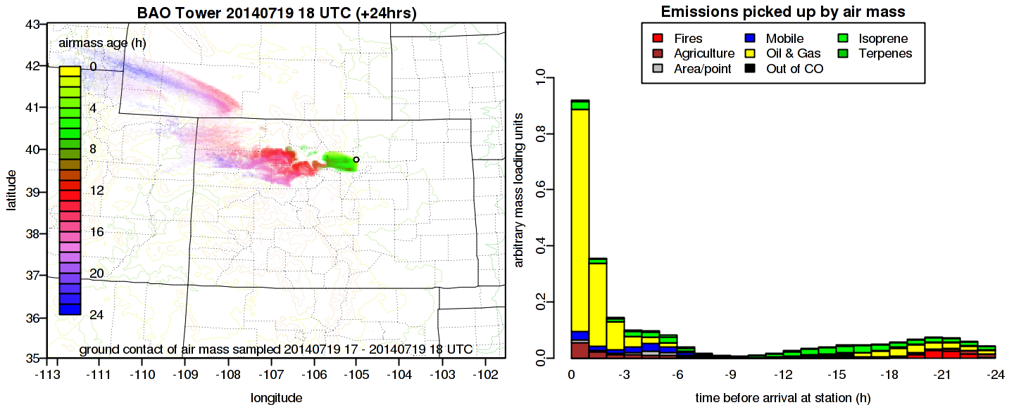

Slide 20
