Slide 1
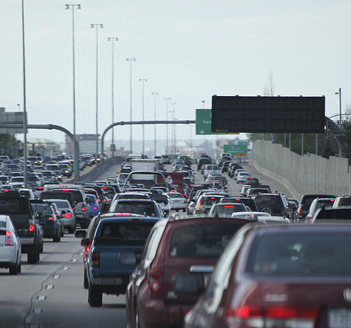
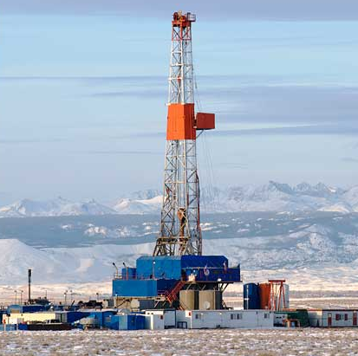

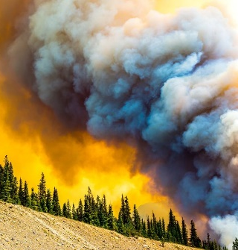



Impact of different VOC sources on organic nitrates, O₃ and the No_{y} budget at the BAO site
Delphine Farmer
*Department of Chemistry, Colorado State University
A. Abeleira*, E. Emerson*, E.V. Fischer†, I. Pollack*†, Y. Zhou†, J. Lindaas†, B. Sive‡, S. Herndon§, R. Roscioli§
†Dept. of Atmospheric Sciences, Colorado State University ‡National Parks Service; §Aerodyne Research, Inc.

Slide 2
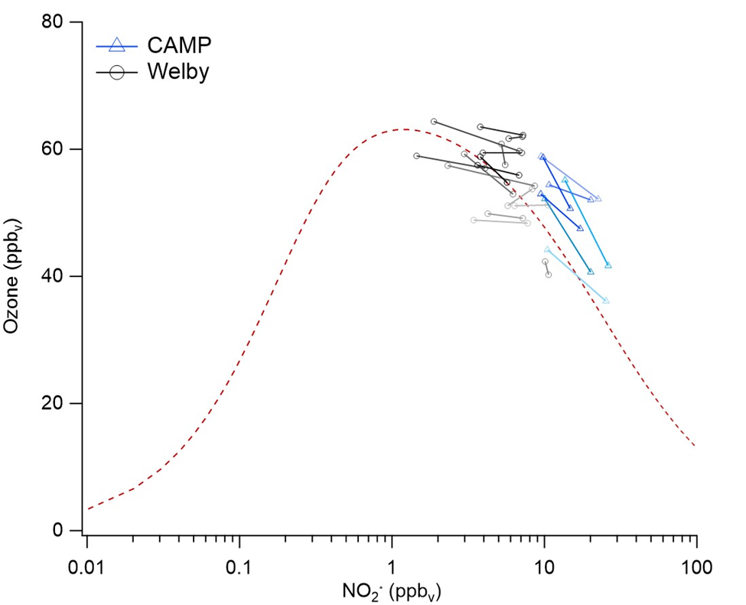
Link between NO_{x} regime and VOC reactivity is important
Currently in NO_{x}-saturated/peak O₃ regime, where VOC reactivity matters
Changing VOC reactivity may affect the transition from NO_{x}-limited to NO_{x}-saturated

Slide 3
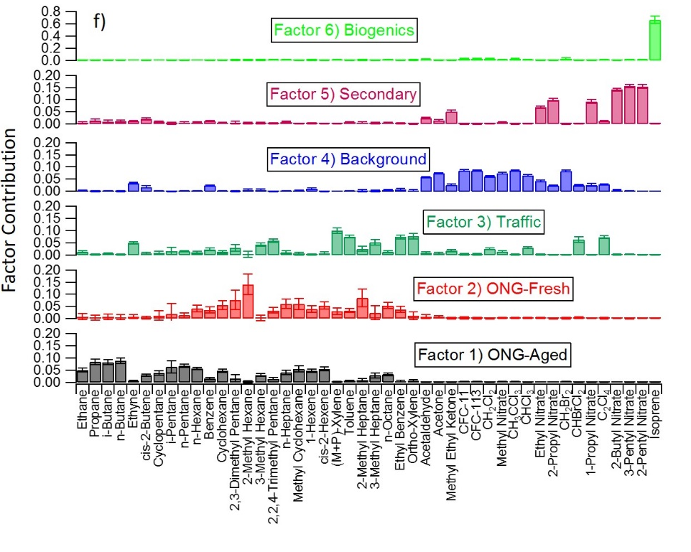
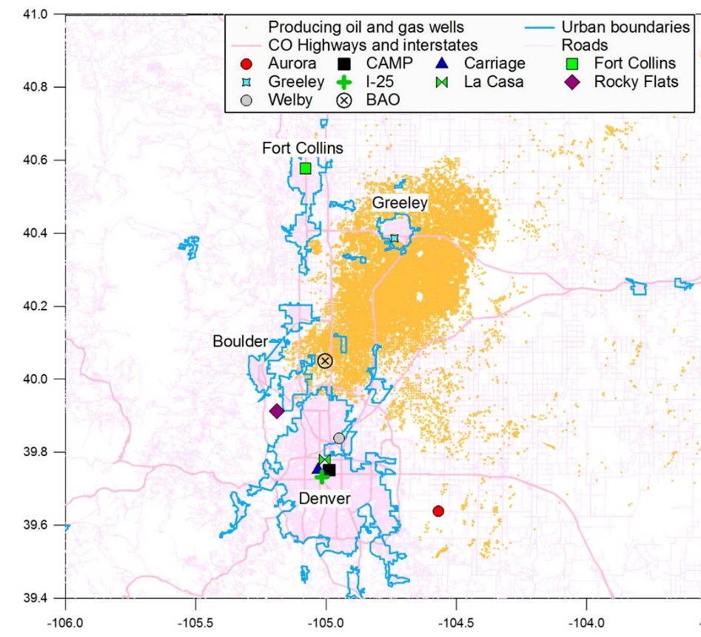
16 weeks of BAO measurements in Spring/Summer 2015
Farmer & Fischer groups, CSU
Boulder Atmospheric Observatory
45+ VOCs
O₃, SO₂, NO_{x} , PAN, NO_{y}, etc.
PMF

Slide 4

VOC reactivity is a useful metric for O₃ chain initiation: ONG dominates, but biogenics matter on summer afternoons
$R_{OH,VOCs}=\sum_{i}{\left(k_{{OH+VOC}_{i}}[{VOC}_{i}\text{]}\right)}$
Spring
Summer
Abeleira et al., [2017]

Slide 5
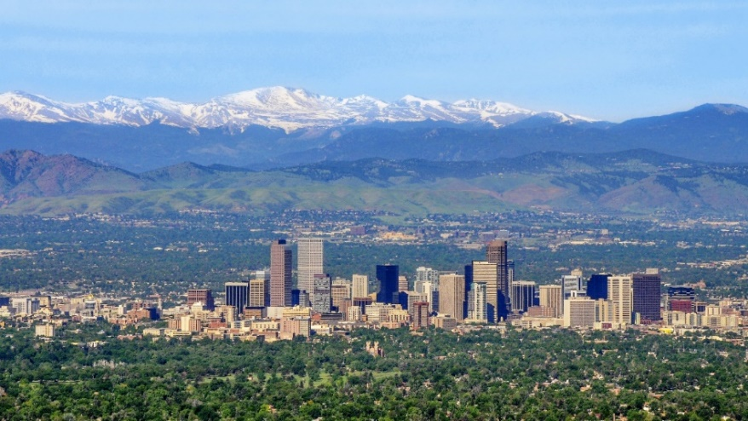
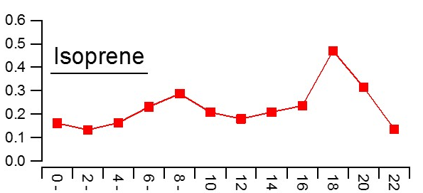
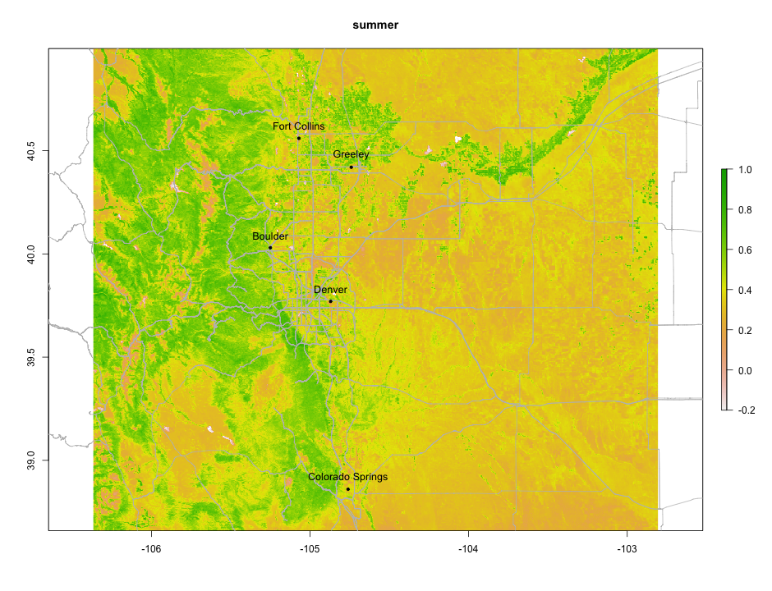
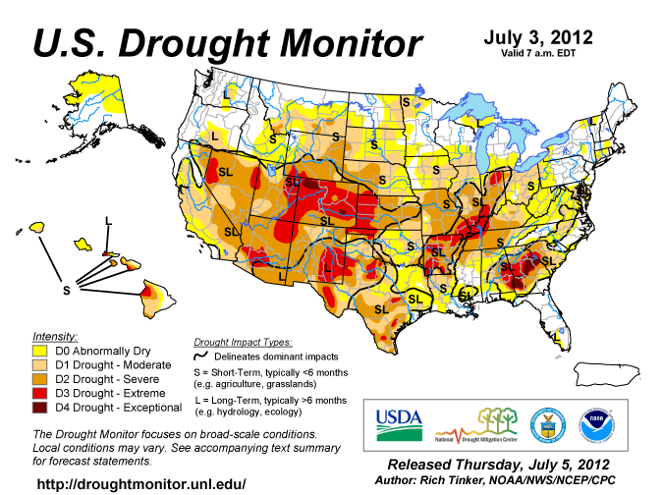
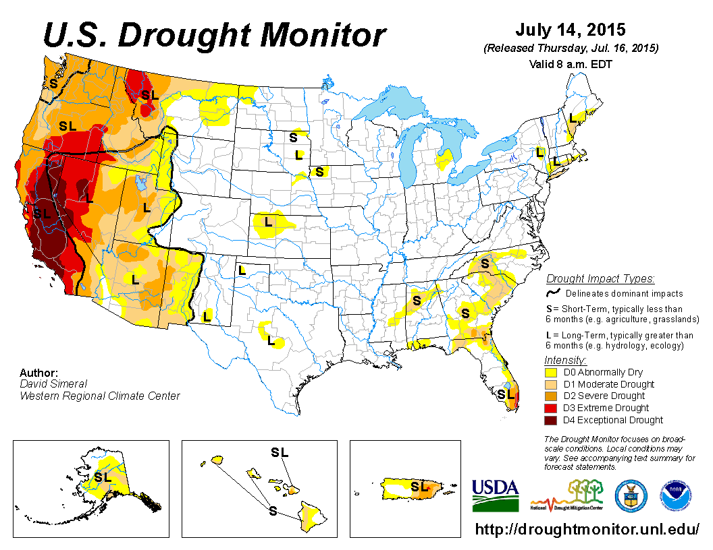
Large biogenic isoprene source in the Front Range in 2015 vs 2012; changing drought conditions impacted biogenic VOCs
2012
2015
[isoprene] (ppb_{v})
Local time
Local time
[McDuffie et al. 2016. JGR]
[Abeleira et al. 2017. JGR]
[NDVI figures from J.Lindaas]

Slide 6
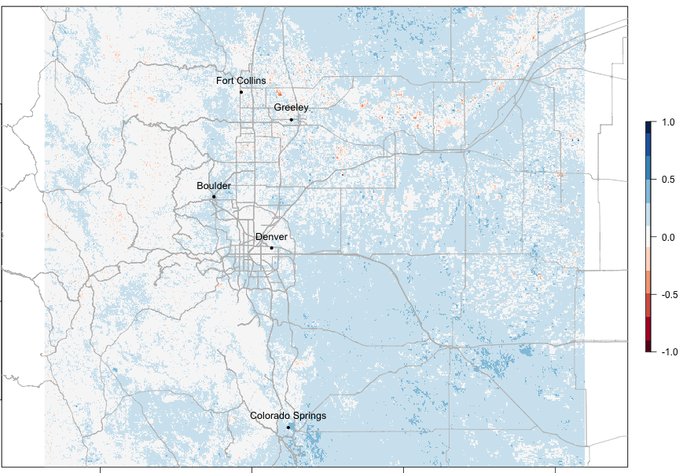
Large biogenic isoprene source in the Front Range in 2015 vs 2012; changing drought conditions impacted biogenic VOCs
NDVI Difference (summer 2015 : summer 2012)
Biogenic VOC emissions typically increase with temperature
Temperature-dependence of isoprene is suppressed in 2012 compared to 2015
If biogenics affect O₃, impact
O₃-temperature penalty?

Slide 7
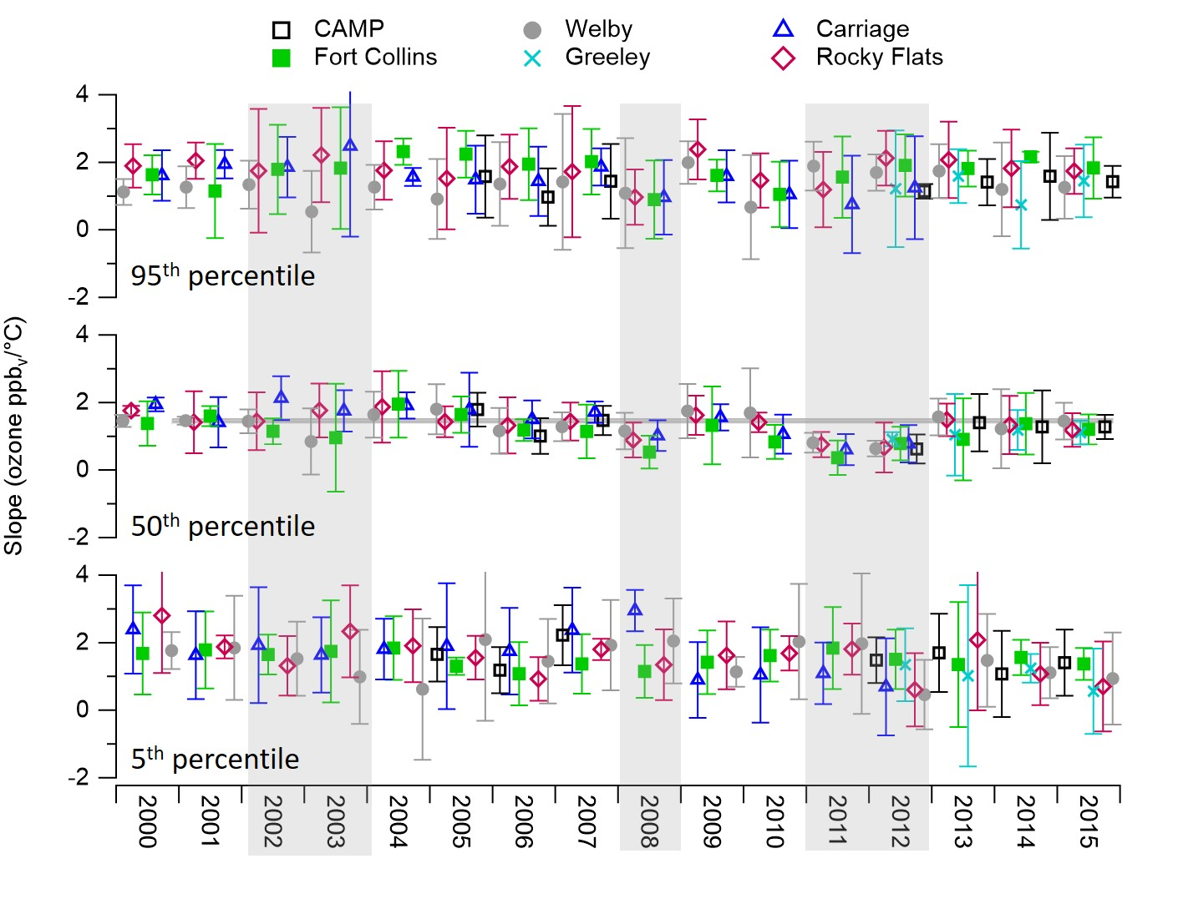
Drought suppresses O₃ –temperature relationship
Abeleira & Farmer [In Press]

Slide 8

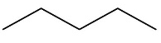
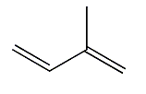

How do VOCs affect chain termination of O₃ production?
VOCs
H₂O
HNO₃
O₂
RONO₂
OH
(C₁-C₅ alkyl nitrates)
RO₂
O₂
NO₂
O₃
NO
hν
hν
O₃
NO
NO₂
O₂
HO₂
RO
RO₂NO₂
(PAN, PPN)

Slide 9
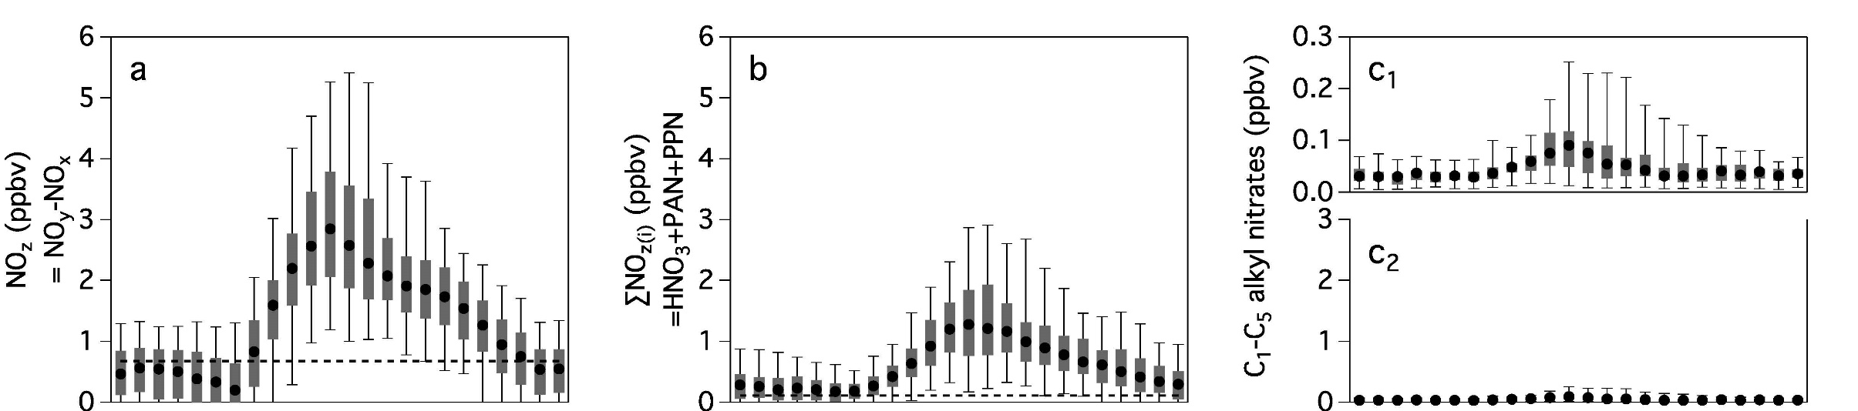

NO_{y} budget suggests large amount of organic nitrates
Difference = “missing NO_{y}”
NO_{y}-NO_{x}
NO_{y}-NO_{x}-PAN-PPN-HNO₃
Missing NO_{y} is often observed in urban environments, and typically thought to be large multifunctional RONO₂ species
The substantial presence of RONO₂ suggests:
Region is at the interface of NO_{x}-limited/saturated (i.e. near peak P_{O3})
At least some VOCs are efficient at forming RONO₂ – and thus less efficient at forming O₃
Emerson et al., [In review, 2017]

Slide 10
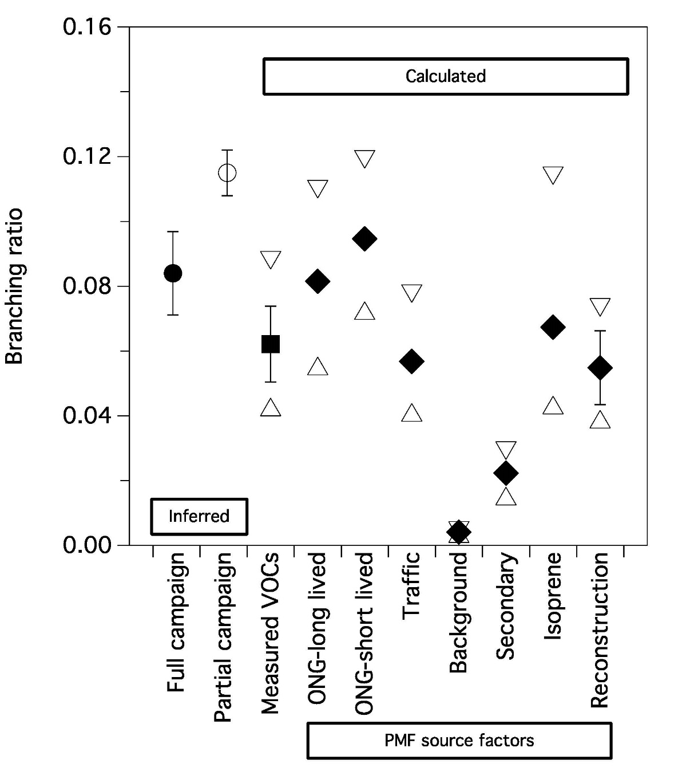
Different factors have different efficiencies at making RONO₂ and terminating O₃
Use VOC measurements & PMF factors to estimate RONO₂
NO + RO₂ → NO₂ + RO
→ RONO₂
ONG VOCs contribute far more VOC reactivity than other sources, but make more RONO₂ than traffic or biogenic VOCs (i.e. less efficient at making O₃ as other VOC factors)
1-α
α
Branching ratio (α)
Emerson et al., [In review, 2017]

Slide 11
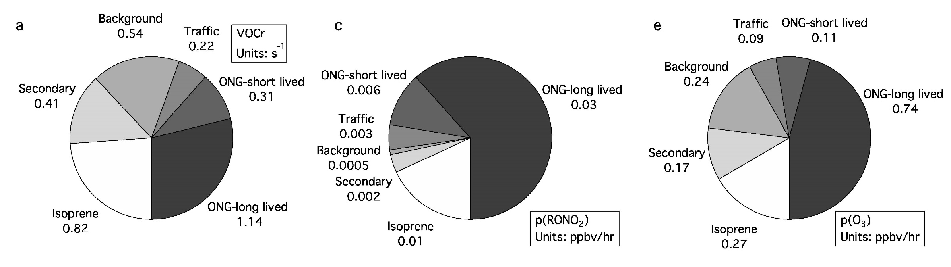
Different factors have different VOCs – and different efficiencies at making RONO₂ and terminating the O₃ chain
measurement-based instantaneous calculation vs. model-based integrated calculation
VOCs associated with oil & natural gas are the single largest sources of VOC reactivity (chain initiation)
…but they are also the largest contributors to organic nitrate formation (chain termination)
Net effect: ONG is the largest contributor to instantaneous BAO O₃ production, but other sources are efficient & warrant consideration
Notes:
ONG ~40% of VOC reactivity (summer 2015)
Traffic ~6%; Isoprene ~24%
RONO2: 70% is ONG; traffic <10%, isoprene 20%
O3: ONG 52%, traffic 5%, biogenics 17%

Slide 12
How do different precursors influence O₃?
Traffic is a small contributor to VOC reactivity & O₃, but makes little RONO₂, so an efficient O₃ producer
ONG dominant contributor to VOC reactivity & O₃ production
Biogenics influence O₃ in the Front Range; O₃ temperature penalty is small & suppressed by drought

Slide 13
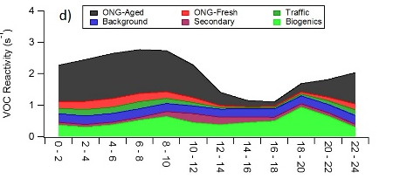

Summary
BAO 2015: continued dominance of oil and natural gas to VOC reactivity
Biogenic emissions influence O₃ & temperature dependence → suppressed by drought
NO_{y} measurements are consistent with region being near peak O₃ production, with VOCs associated with oil and natural gas impacting O₃
While less important in magnitude, traffic can be an efficient O₃ producer
Andy Abeleira. Summer O₃ in the Front Range (Tues a.m. Oral)
Jimmy Mattila. Vertical gradients of gas-phase acids from FRAPPE at BAO tower (poster)
Jakob Lindaas (Fischer group). Case Study: Smoke at BAO in 2015 (Wed a.m. Oral)

