Slide 1
Modeling AQ in the Front Range
(or anywhere for that matter)
In order to adequately simulate Front Range ozone and accurately predict outcomes of possible control strategies, the model must:
Use accurate emissions (magnitude, speciation, location, diurnal and seasonal variability)
Distribute emissions into an accurate boundary layer
Predict wind direction and speed, horizontal dispersion and mixing and vertical mixing/dilution with accurately modeled background air
Accurately compute the chemical reactions and physical transformations
→ Only then can we play with sources and predict outcomes of future trends and controls

Slide 2
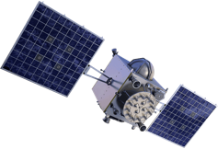


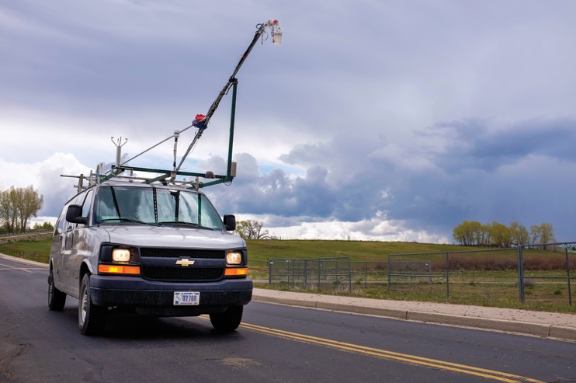
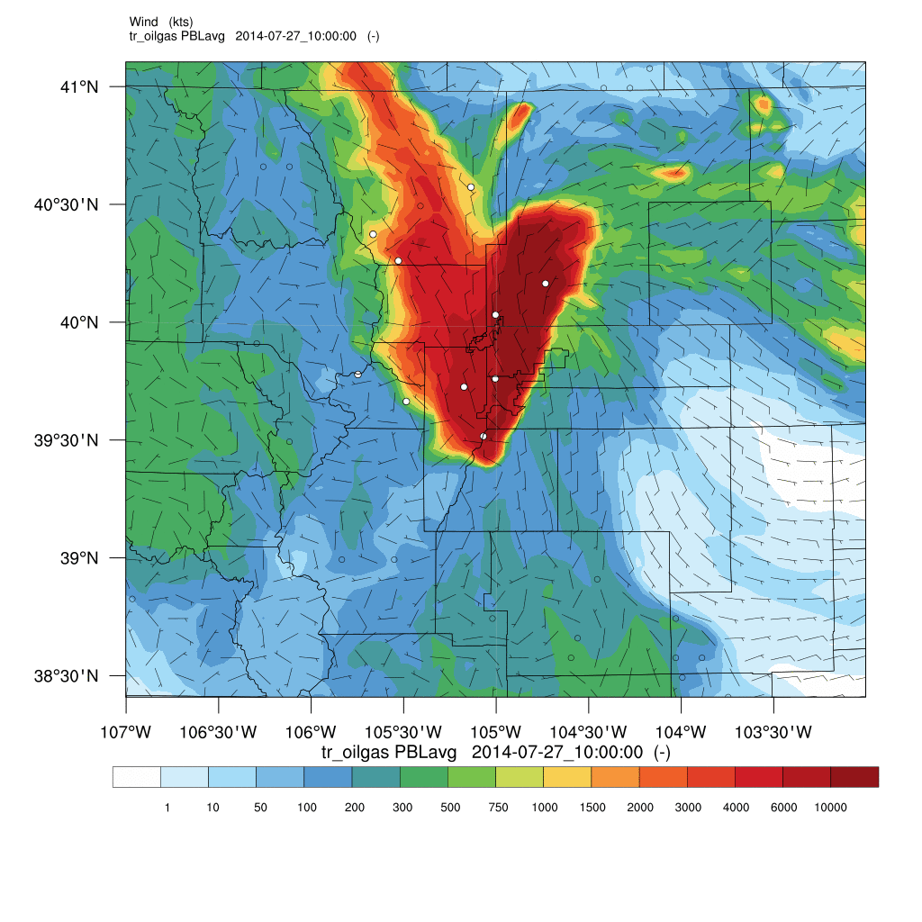







FRAPPÉ (Field Campaign) Study Approach
refine
Observations
Processes
compare
evaluate
refine
evaluate
Model
Emissions

Slide 3
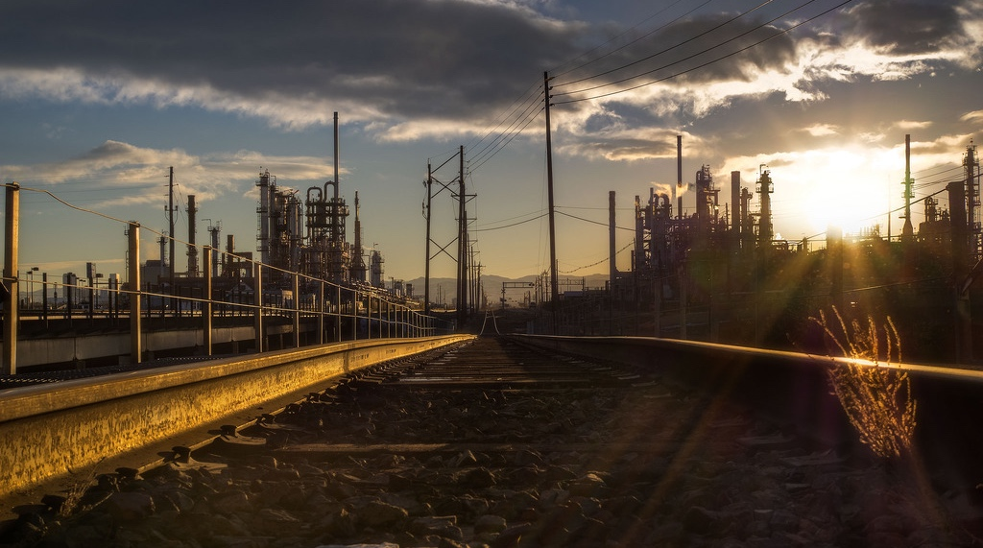
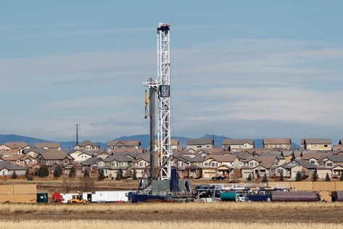
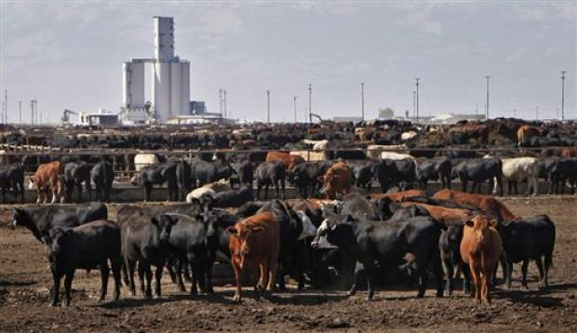
Emission evaluation strategy

Slide 4
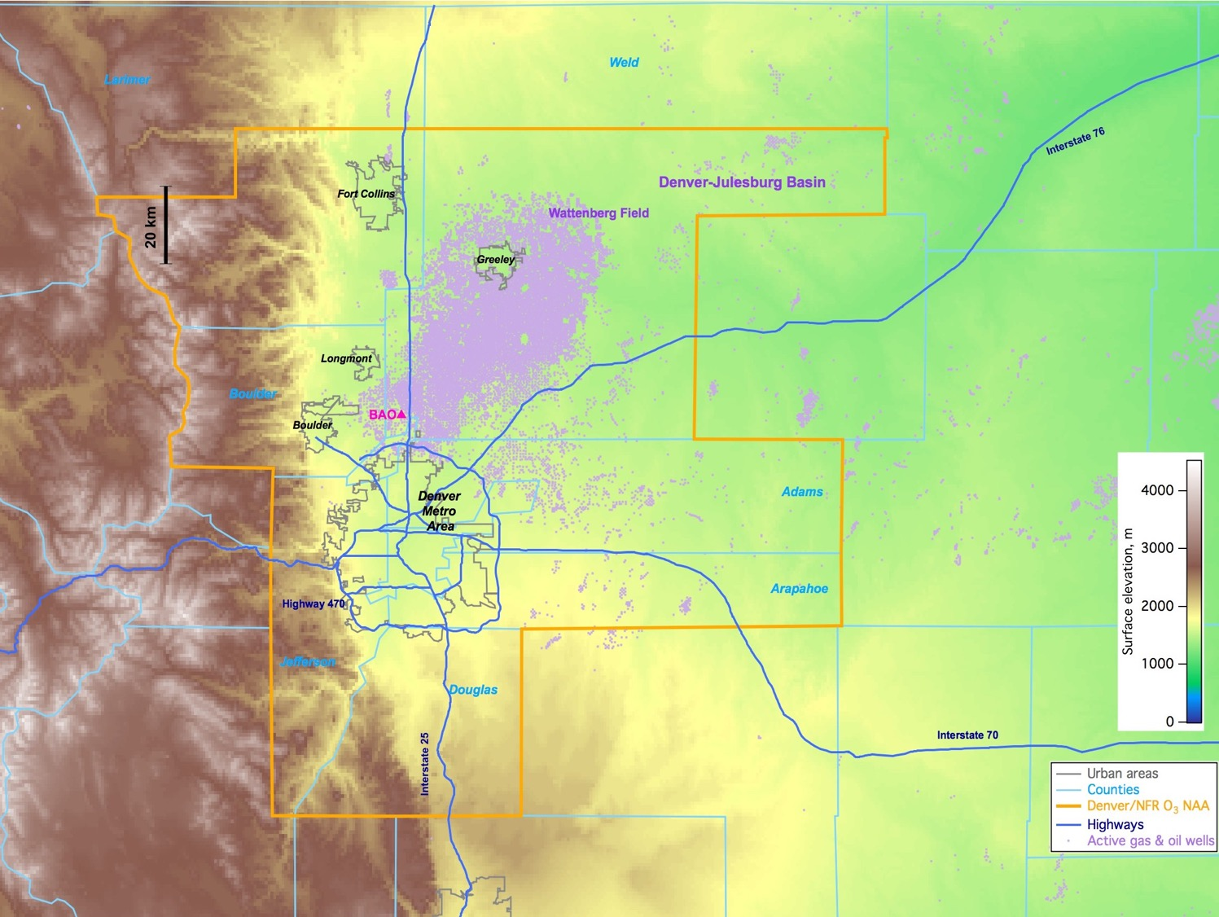


























- Non-Attainment Area
● Oil/Gas Wells

Slide 5
Model evaluation strategy
Adjust individual individual emission sectors to improve inventories and perform iterative model runs
Surface In-situ to refine inventories (point sources, emission ratios, ....). TBD
Support CTM study through box modeling to identify relevant VOCs and characterize chemical regimes (and the model’s ability to represent the chemistry)
Do some old school looking-at-data
(turns out I should have stuck with that)

Slide 6
Ozone Production from Alkanes
Use alkyl nitrates to estimate alkane contribution to ozone production
1- α RO + NO₂ → O₃
RO₂ + NO
α RONO₂
α ranges from <0.01 – 0.2+ish

Slide 7
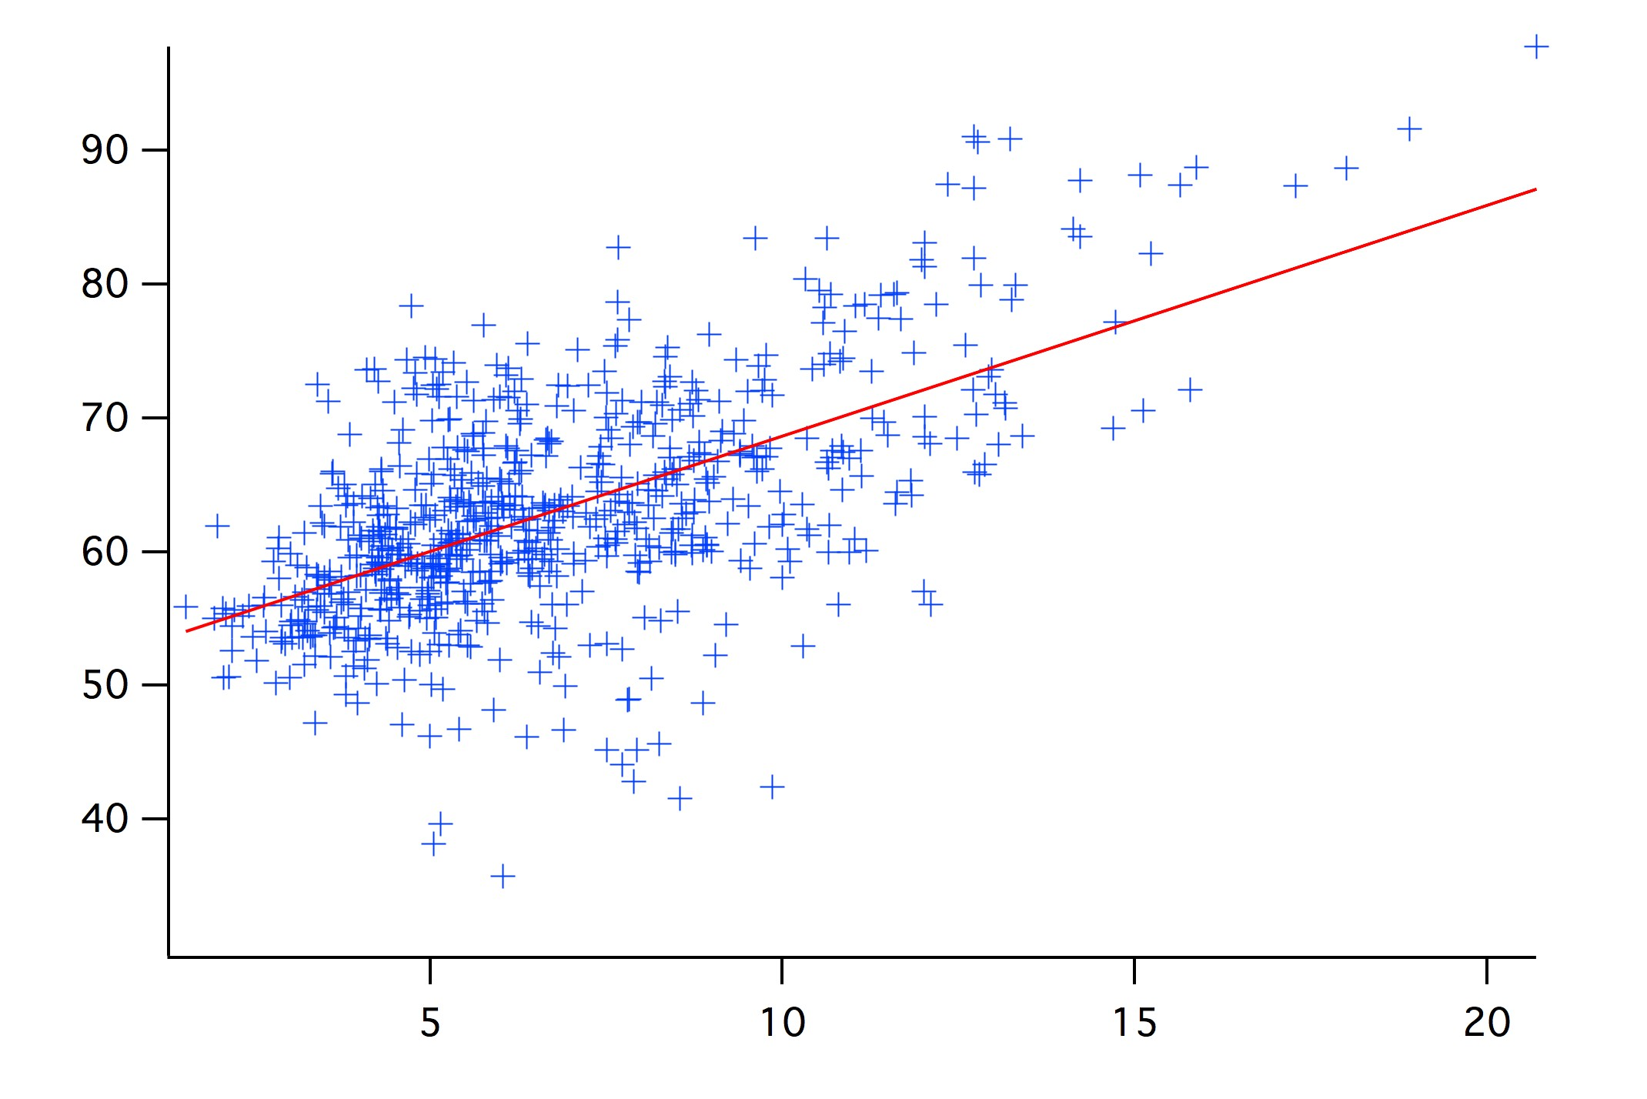
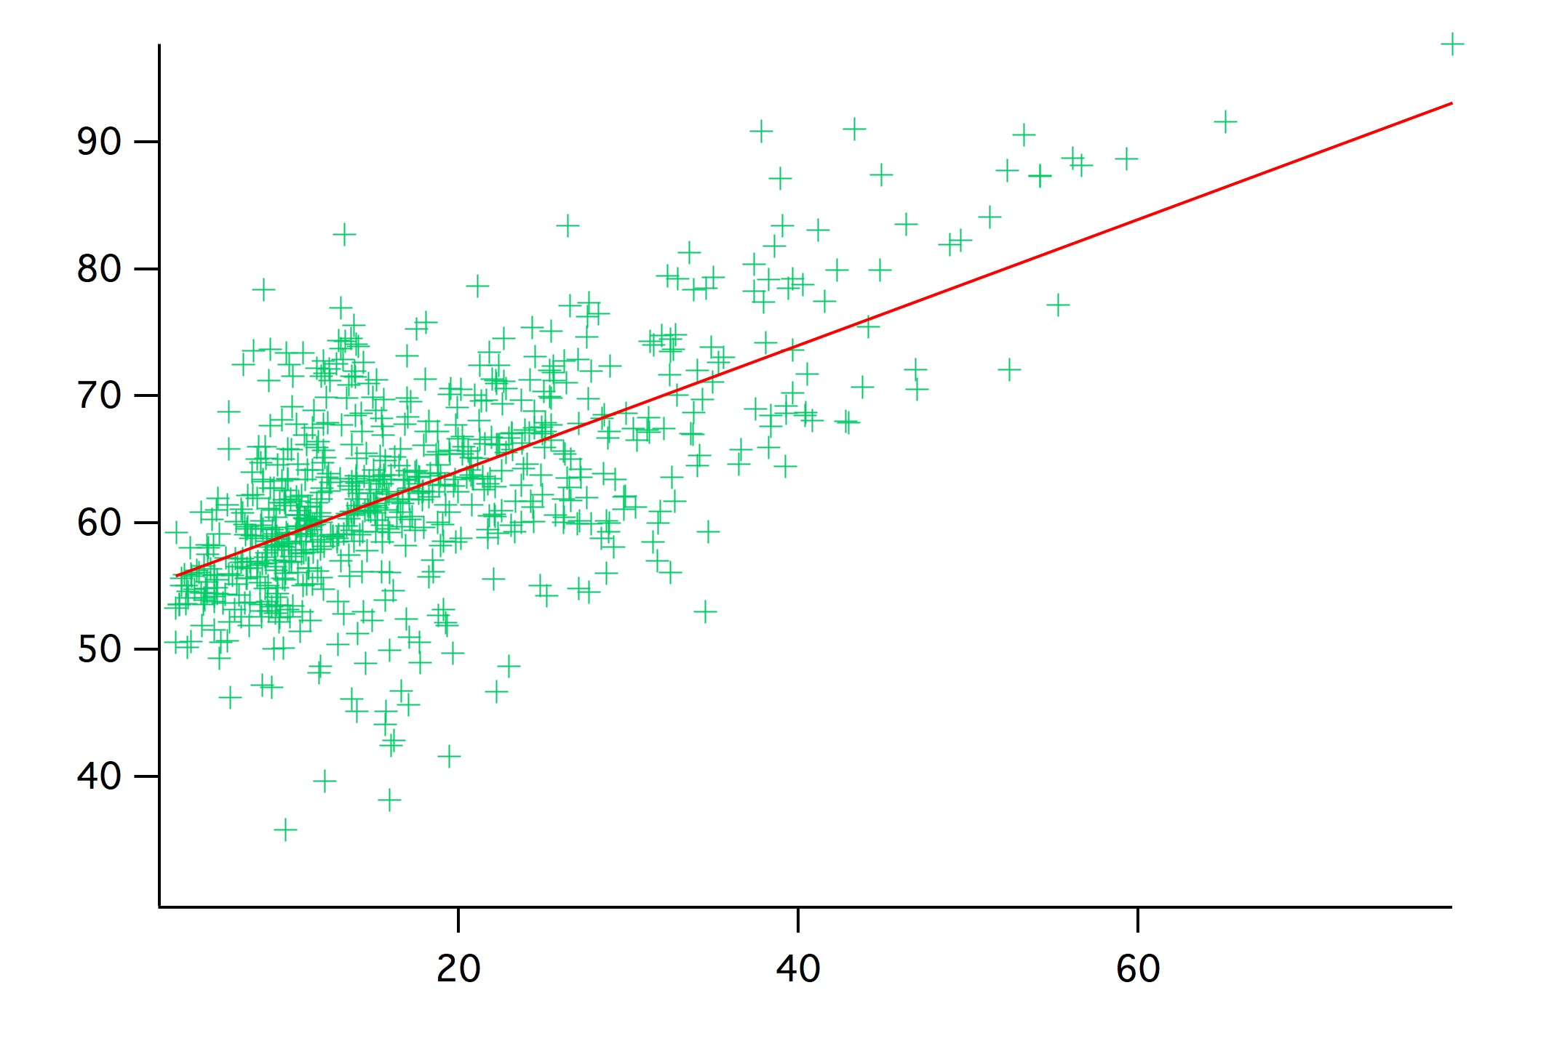
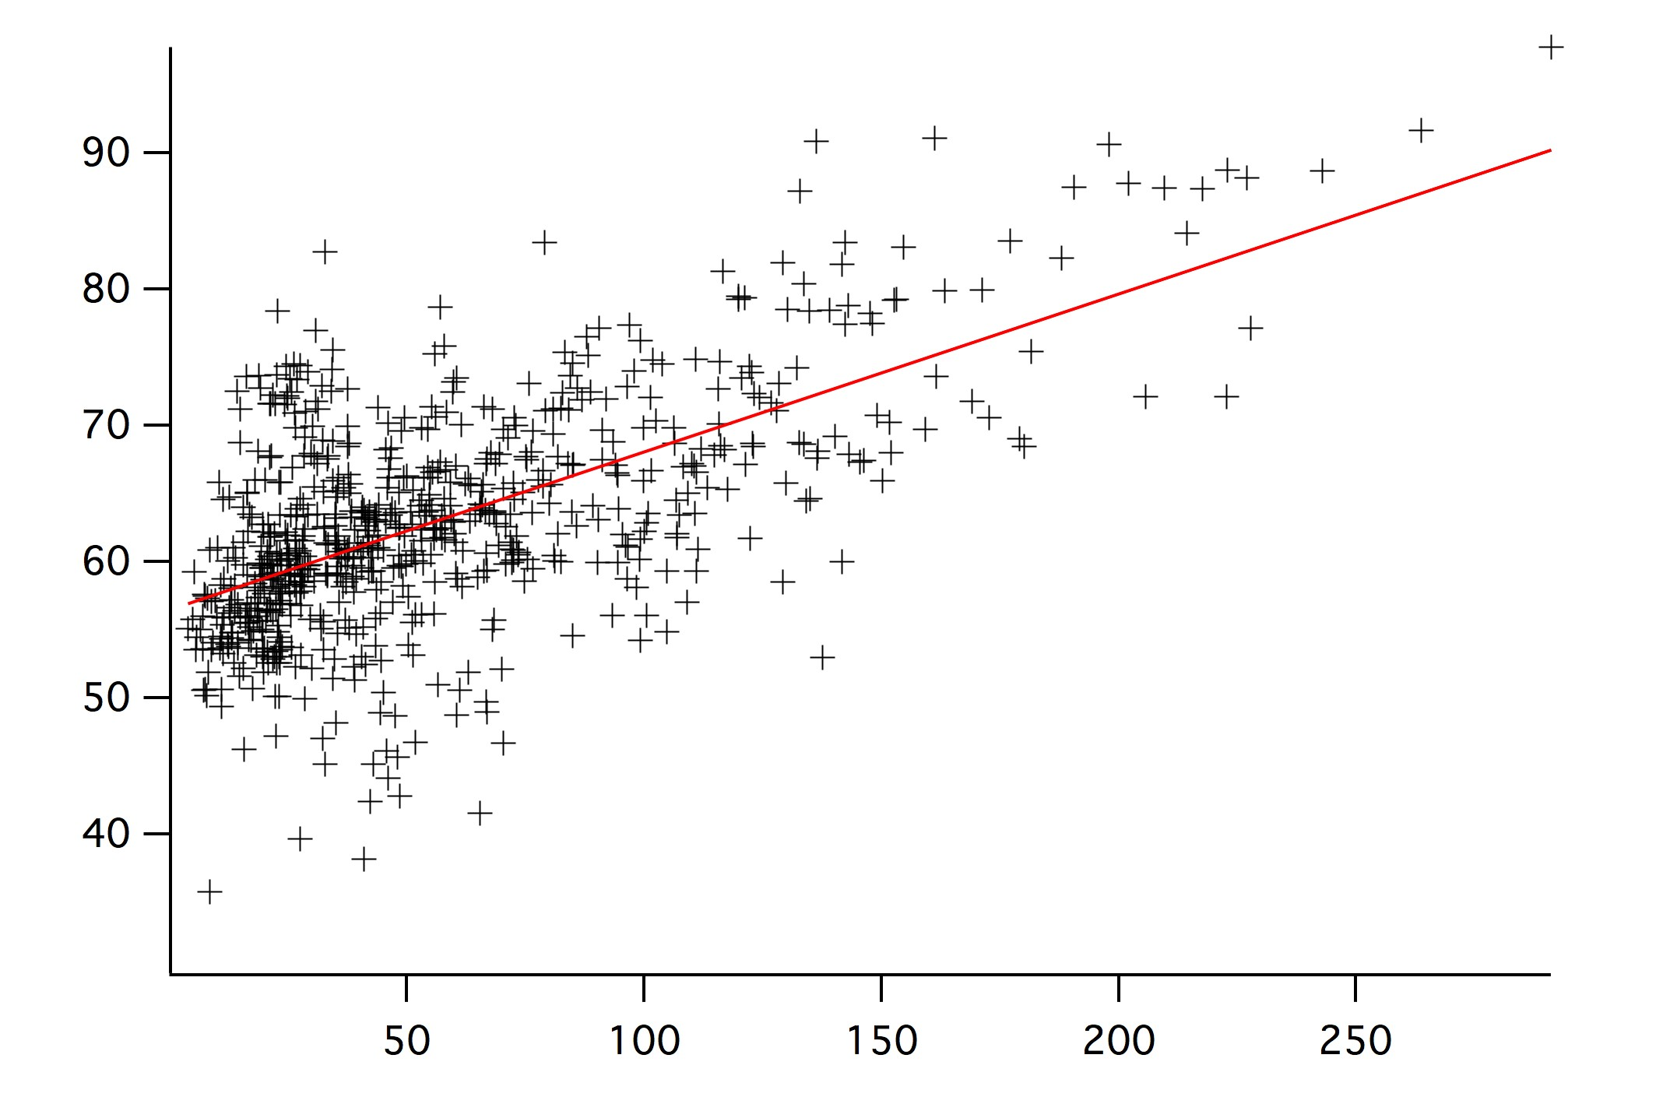
Alkyl nitrate production → Ozone production
(ignoring some common inconveniences)
20 ppt
O3 = EN*1.7e3 + 52
O3 = iPN*0.49e3 + 54
O3 = 2BN*0.12e3 + 56
model 1.4e3
model 0.47e3
model 0.17e3
Ethylnitrate (EN)
with
follows:
75 ppt
1/α (EtN) ≈ 100
1/α (iPrN) ≈ 13
1/α (2BuN) ≈ 8
contr (EtOO) ≈ 6%
contr (iPrOO) ≈ 3%
contr (2BuOO) ≈ 6%
15%
isoPropylnitrate (iPN)
Not all ethyl and propyl peroxy radicals come directly from their parent alkanes, but from decomposition of larger, mostly branched alkanes.
Either way this shows that (mostly oil and gas related) emissions of light alkanes contribute significantly to ozone production in the Front Range
250 ppt
N-2-Butylnitrate (2BN)
Data from TOGA and WAS merges, filtered for Front Range area and flight altitude < 2km

Slide 8
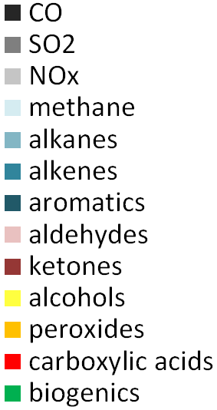
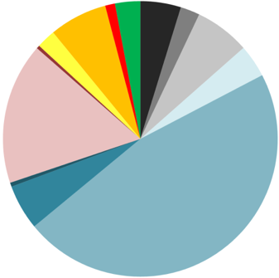
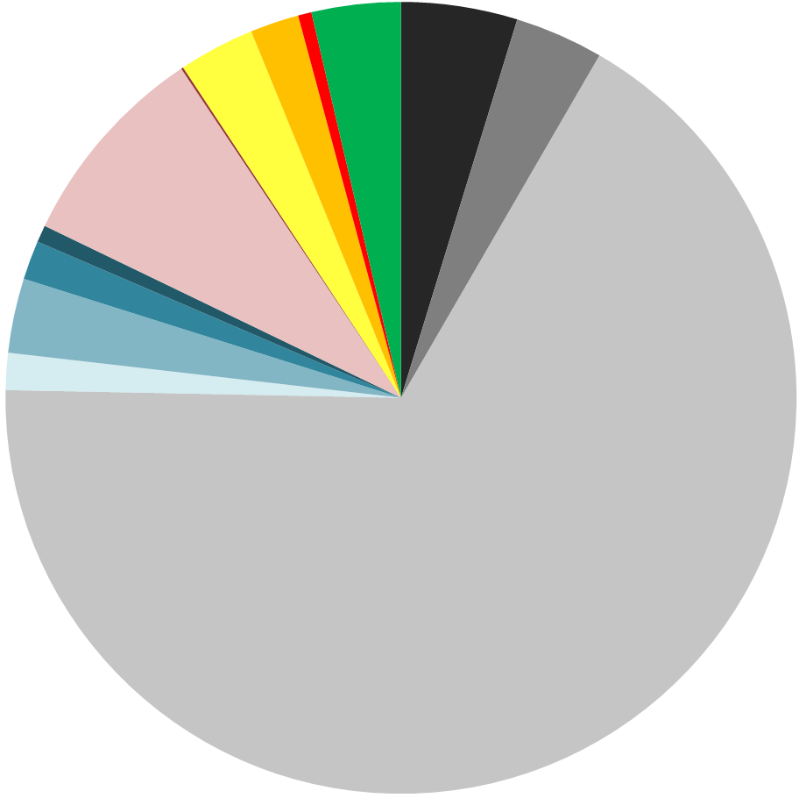
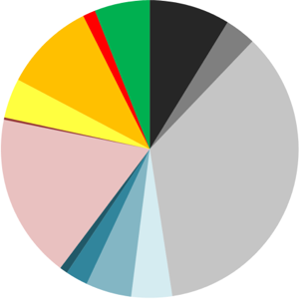
Calculated OH Reactivity by FRAPPÉ Region
Weld County
6.7 s⁻¹
0.1
Commerce City
16.5 s⁻¹
Denver Urban
5.4 s⁻¹
NCAR/ACOM TOGA group; Rebecca Hornbrook
Rebecca Hornbrook
Notes:
How much fuel

Slide 9
- Non-Attainment Area
● Oil/Gas Wells

Slide 10

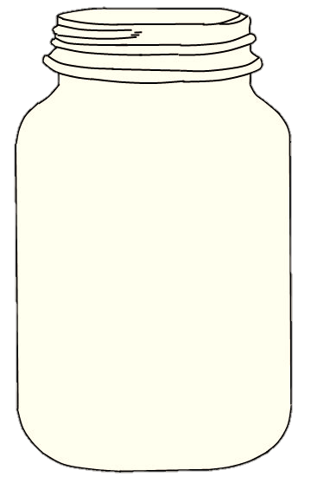

Chemical Box Modeling (BOXMOX)
Puts the air parcel in a jar then follows the chemistry
MCM (Leeds Master Chemical Mechanism) plus comparison with lumped mechanisms.
No dilution, entrainment, mixing, deposition, etc.
Yields the ozone formation potential of a sample/average of samples.
Simulations at 2 pm LT, 40N, clear sky, fixed Temperature (“idealized conditions!”)
Becky’s
famous
C-130
measured
samples
BOXMOX: Knote et al., Atmos. Environ, 2015;
https://www2.acom.ucar.edu/modeling/boxmox-box-model-extensions-kpp

Slide 11
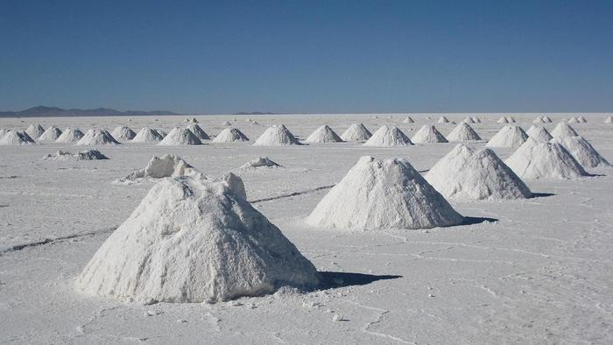
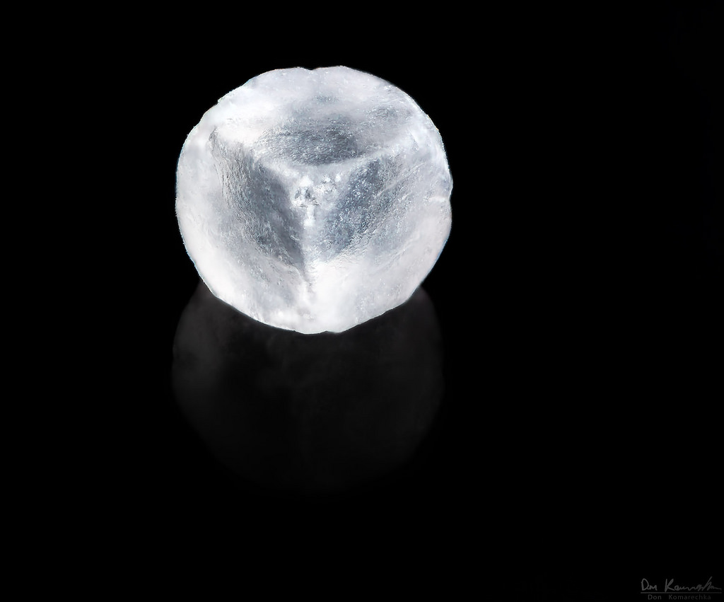
Modeling

Slide 12
Chemical box modeling (BOXMOX) – Commerce City
Both mechanisms indicate NOx saturation…
and are (now) pretty close!! ☺

Slide 13
Chemical box modeling (BOXMOX) – Commerce City
Both mechanisms produce ozone much more efficiently without EGU NOx
(and they are still pretty close)

Slide 14
Chemical box modeling (BOXMOX) – Denver urban
Transportation is important (we’d take it) but does not appear to be the major factor in Denver Metro
(although this is a lower limit for how much lower the ozone could get)

Slide 15
Summary
FRAPPÉ & DISCOVER-AQ analysis is coming along, but there still is work to do. We could use a larger band (better functioning / younger brains would likely help, too).
Emissions are one of the largest source of uncertainty in current understanding and modeling of NFRMA pollution. Being close to extensive (and variable) O&NG activities doesn’t help, but industrial and mobile emissions are also uncertain.
Transport in the NFRMA is extremely complex. WRF does a reasonable job, but could use improvement for full emission assessment. Tests with observation nudging of FRAPPE observations are pending.
Box modeling and OH reactivity studies show promise in assessing ozone chemical regimes and sensitivities, but need more explicit model runs (GECKO-A, modified MCM) to accurately test lumped mechanism performance. Fewer old and less mushy brains would be advantageous here as well.
Long range transport, regional background (increasing in the western US) and (maybe) stratospheric influence can be important for NFRMA ozone (including surface ozone). Current work shows shortcomings in the models in this area.

