Slide 1
Developing Fuel-Based Inventories of Mobile Source and Oil & Gas Emissions for Colorado
Brian C. McDonald, Ph.D.
CU/NOAA: Stuart McKeen, Yuyan Cui, Ravan Ahmadov, Si-Wan Kim, Jeff Peischl,
Tom Ryerson, Gregory Frost, Michael Trainer
Undergraduate Students: Alan Gorchov Negron (Brown Univ.), Justin DuRant (Univ. South Carolina)
Acknowledgments: NCAR SOARS and NOAA Hollings Scholarship programs
FRAPPÉ Science Team Meeting: May 2, 2017

Slide 2
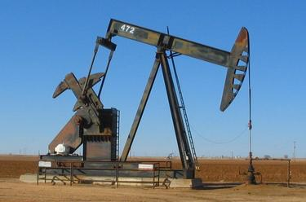
Recent Studies Suggest Overestimate in U.S. NO_{x} Emissions
DISCOVER-AQ (2011): Mobile source NO_{x} high by 51-70% in the National Emissions Inventory (NEI) 2011 (Anderson et al., Atmos. Env. 2014)
UBWOS (2012-13): Oil & gas NO_{x} in the Uintah Basin, UT high by factor of ~4x in the NEI (Ahmadov et al., Atmos. Chem. Phys. 2015)
SEAC⁴RS (2013): Industrial and mobile source NO_{x} high in the NEI, 30-60% reductions needed (Travis et al., Atmos. Chem. Phys. 2016)
Mobile Sources
Industry
Oil & Gas Development

Slide 3
Research Objectives
Are NO_{x} emissions in the NEI overestimated in Colorado, as reported elsewhere from recent field campaigns?
Construct a fuel-based inventory of on-road emissions
Focus on NO_{x}, but CO and VOCs can also be estimated
Evaluate in an atmospheric model
Construct a fuel-based inventory of oil & gas emissions
Evaluate with “top-down” emissions derived by aircraft data

Slide 4
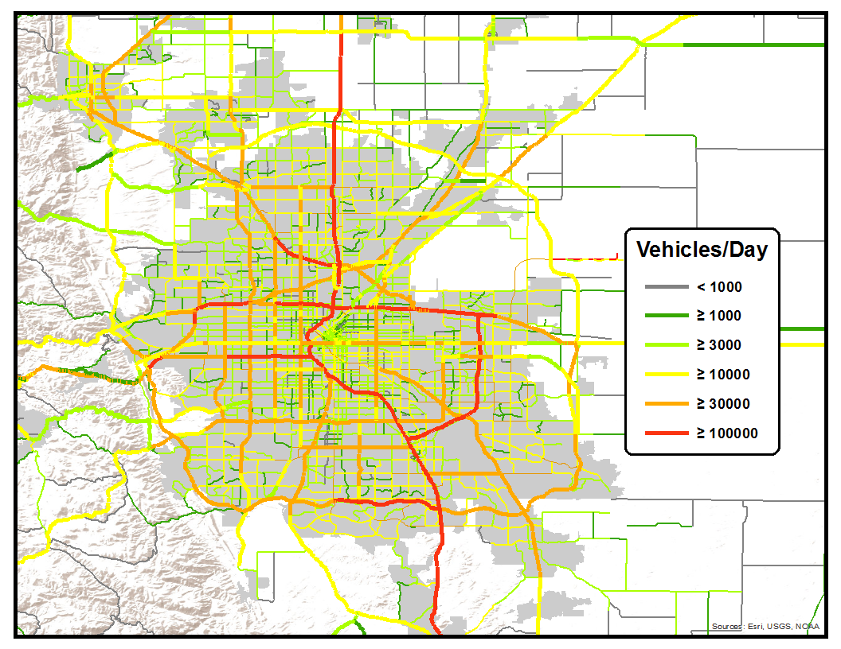
Building an Alternative Bottom-Up Vehicle Emissions Inventory
Emissions = Activity (kg fuel) x Emission Factor (g/kg fuel)
State-level taxable gasoline and diesel fuel sales reports
Public and annual
Map on-road CO₂ emissions
Using traffic count data
Basis for scaling co-emitted combustion byproducts
DENVER
See McDonald et al. (J. Geophys. Res. 2014)
for more details

Slide 5
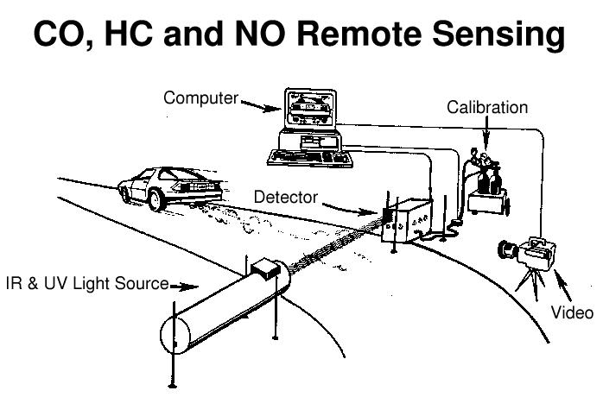
Use of Roadway Studies for Emission Factors
Emissions = Activity (kg fuel) x Emission Factor (g/kg fuel)
Roadside monitoring data
Measures in-use vehicles
Captures high-emitters
Regulatory models typically rely on chassis dynamometer tests
Univ. of Denver FEAT

Slide 6
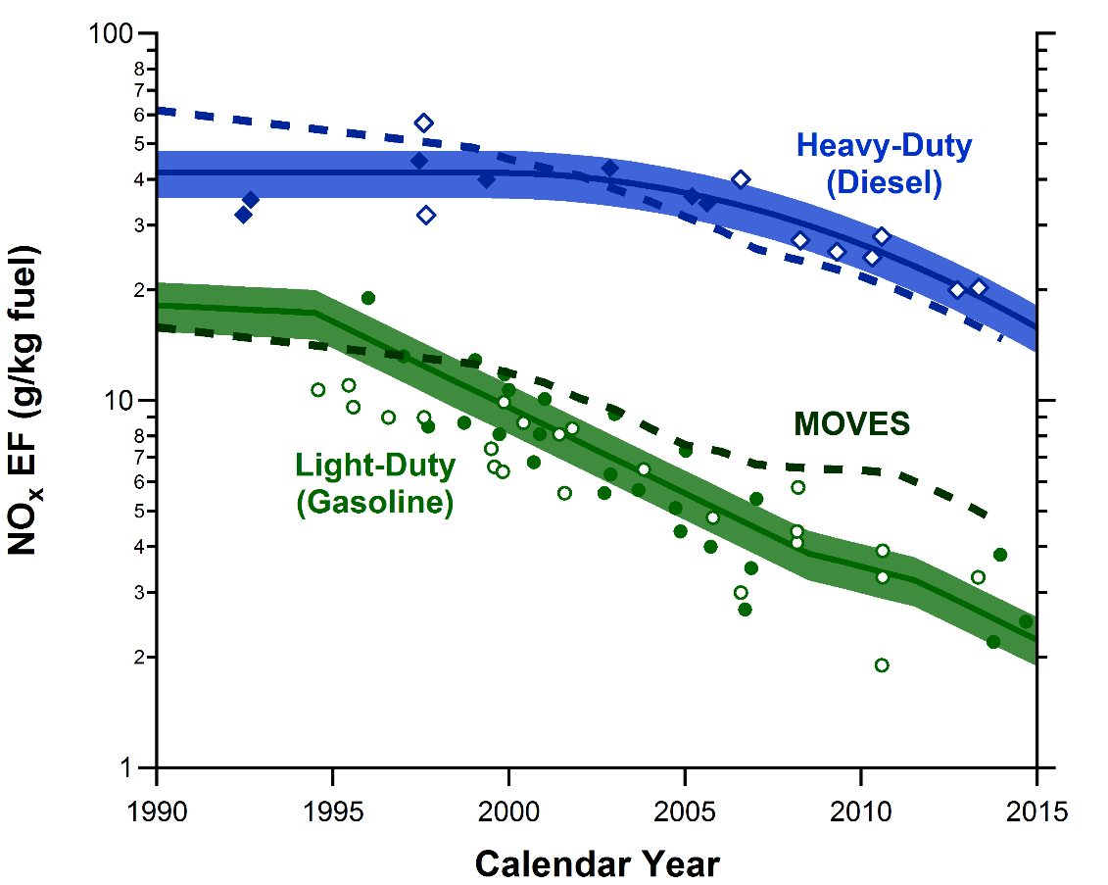
Long-Term Trends in U.S. On-Road NO_{x} Emission Factors
Diesel EF high
within ~20%
Gasoline EF high
by factor of ~2
(MOVES EF are default values)
Figure updated from McDonald et al. (J. Geophys. Res. 2012)

Slide 7
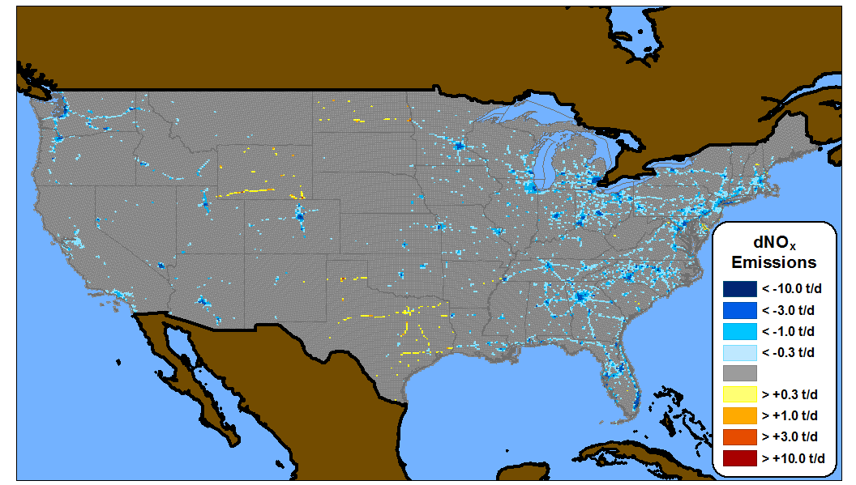
Difference in Total U.S. NO_{x} Emissions (Fuel-Based – MOVES)
Travis et al. (2016): NEI 2011 emissions of NO_{x} too high by ~50%
Southeast Nexus Study 2013
This Study: -20%

Slide 8
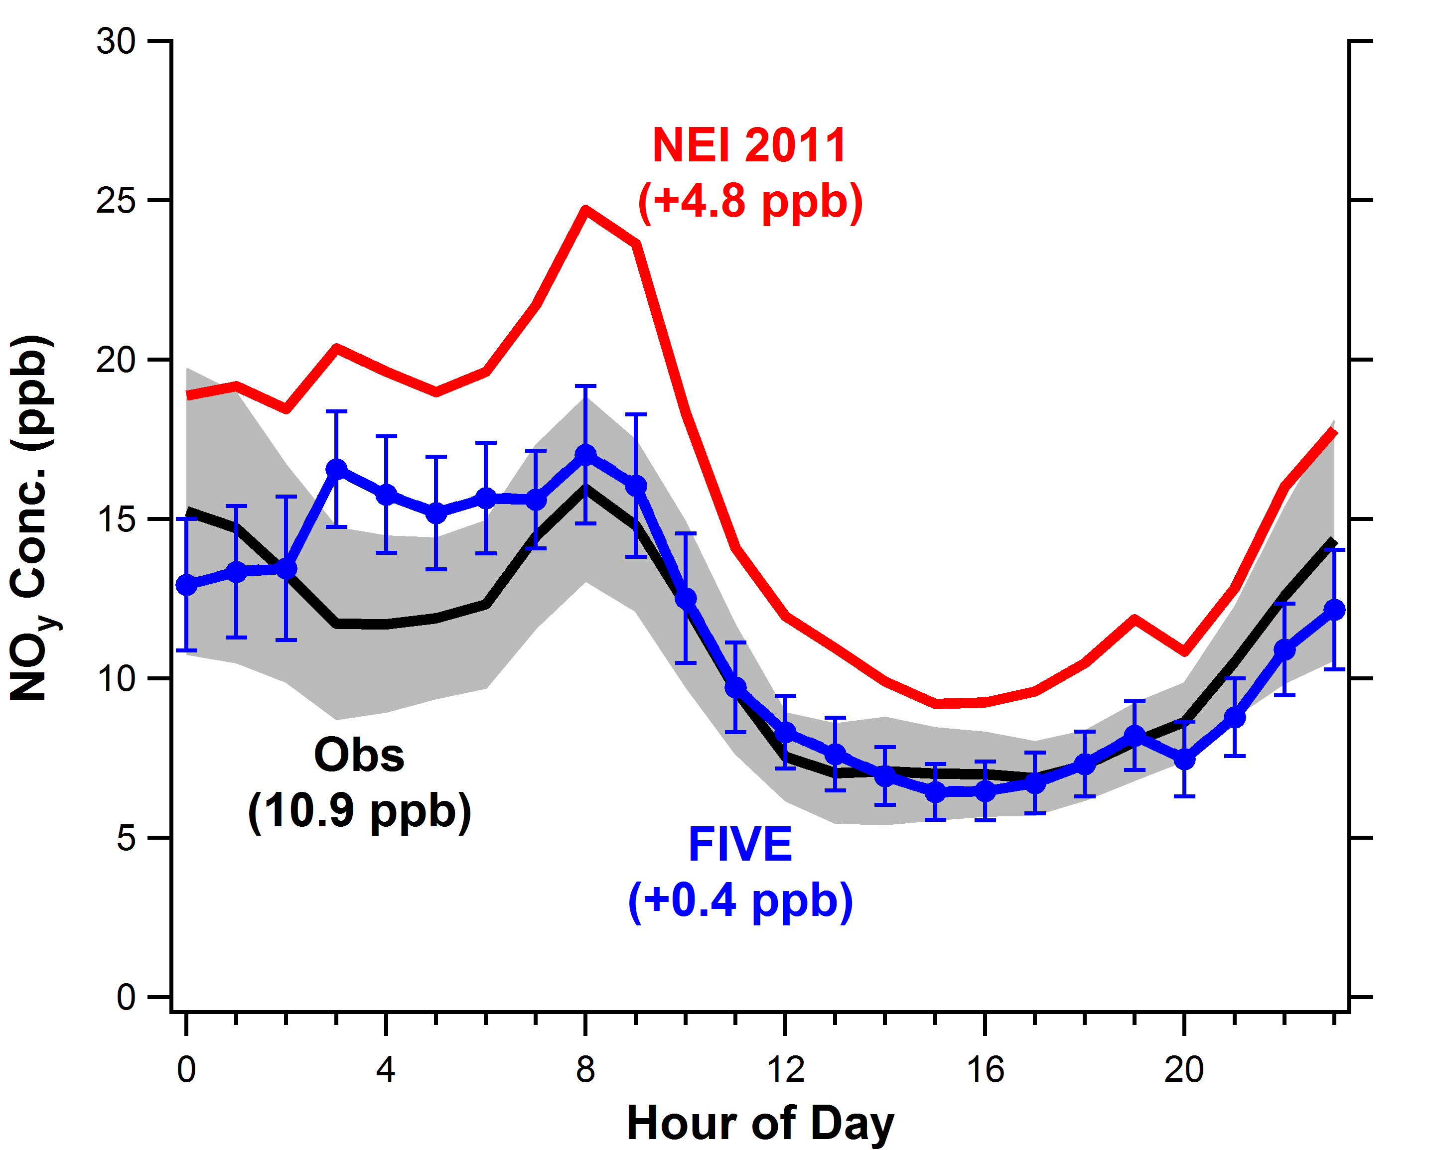
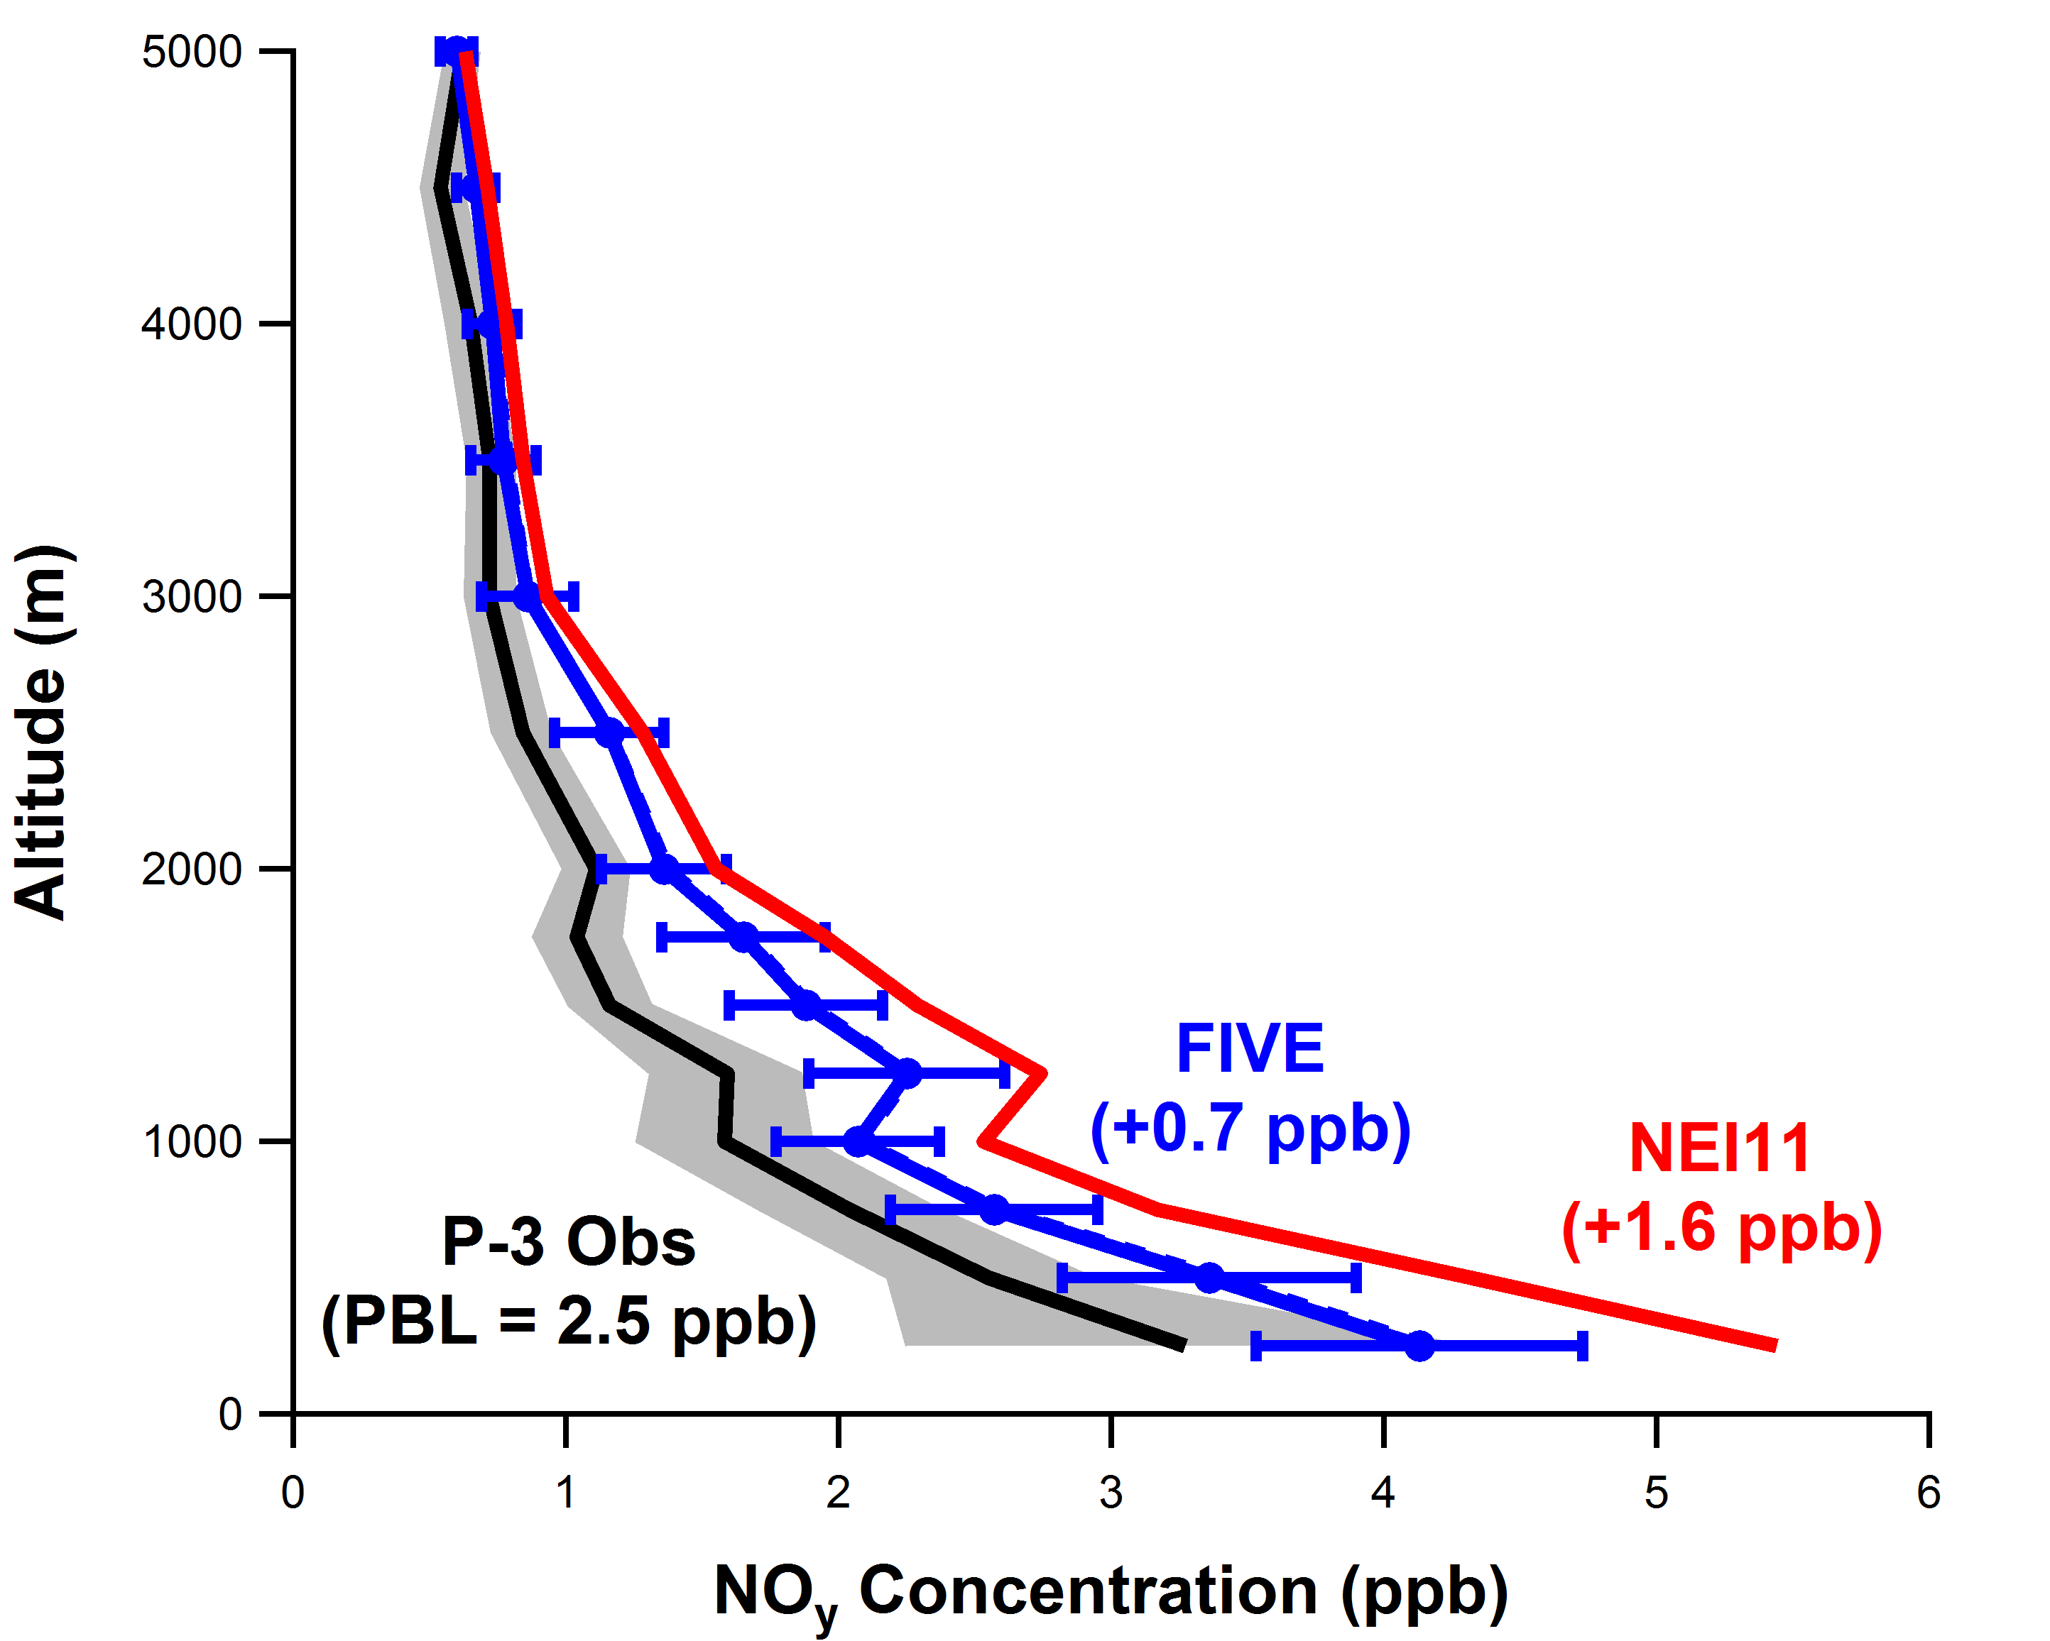
Comparing Fuel-Based Inventory and NEI/MOVES in Regional Model
Downtown Atlanta
Nashville
McDonald et al. (in prep.)

Slide 9
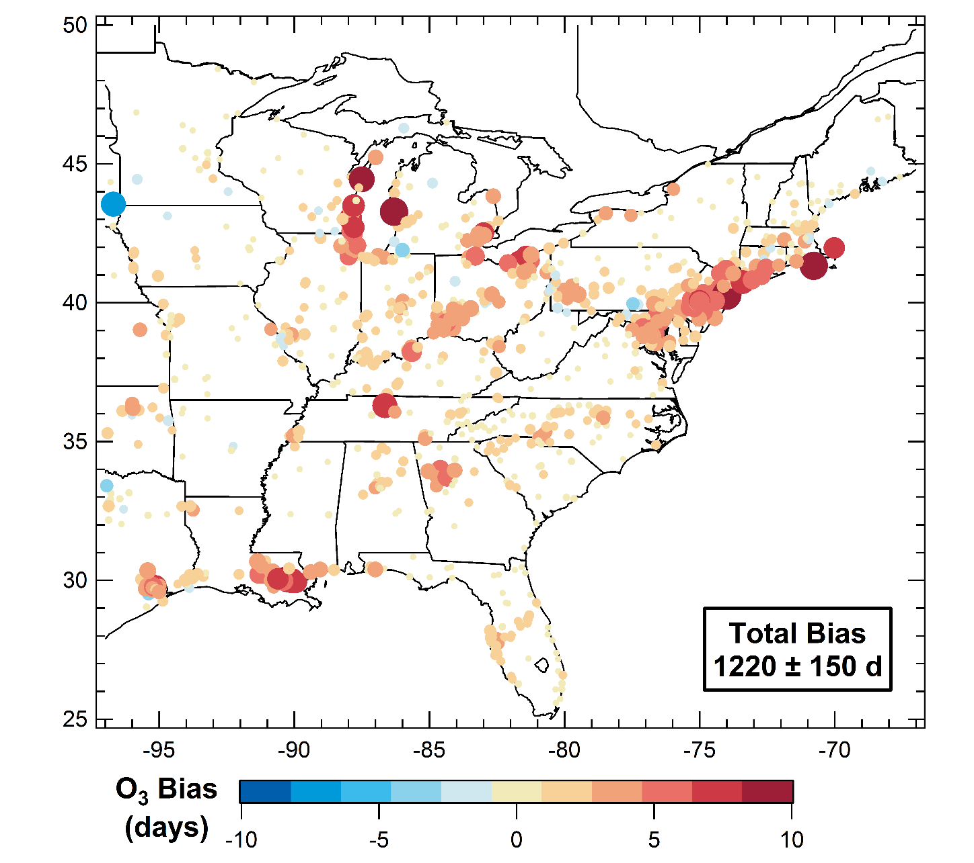
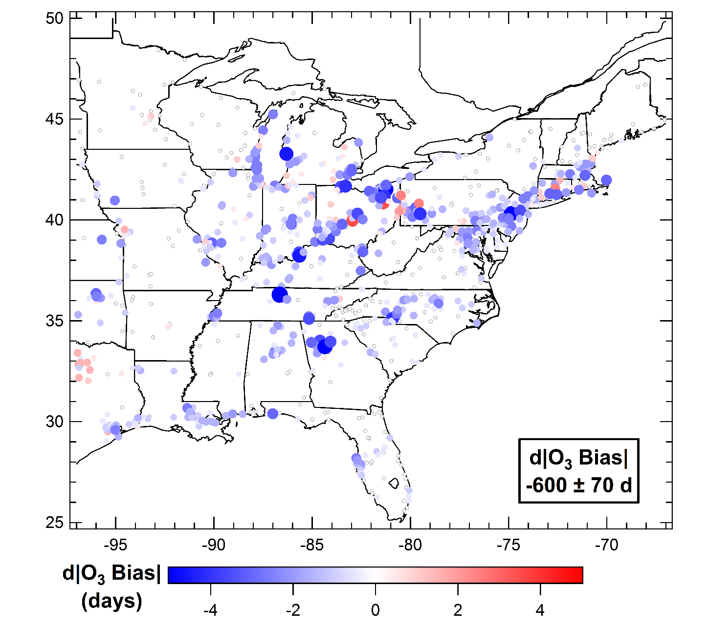
Reducing NO_{x} Emissions Improves O₃ Models
Bias in summer 2013 O₃ exceedance days
(>70 ppb) modeled with NEI 2011 vs. AQS data
← FIVE is worse
FIVE is better →
McDonald et al. (in prep.)

Slide 10
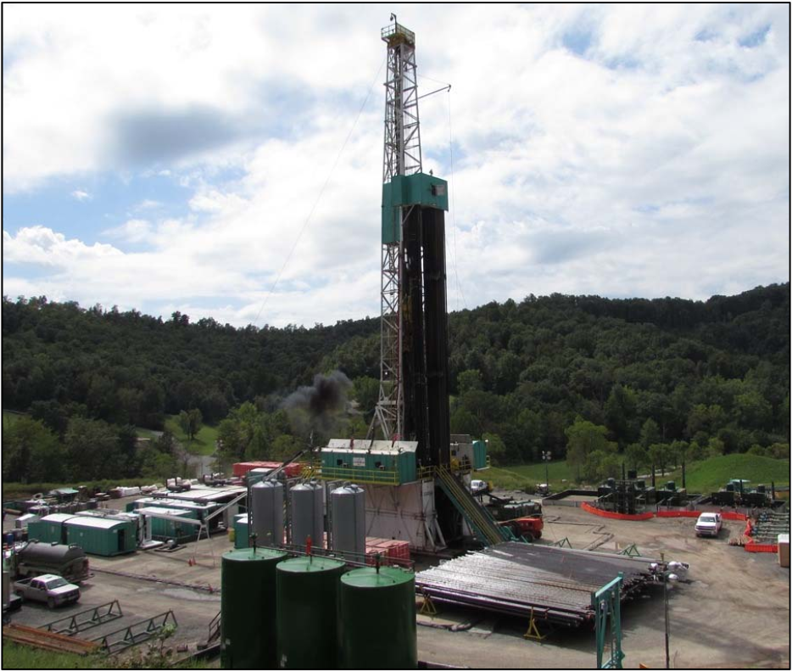
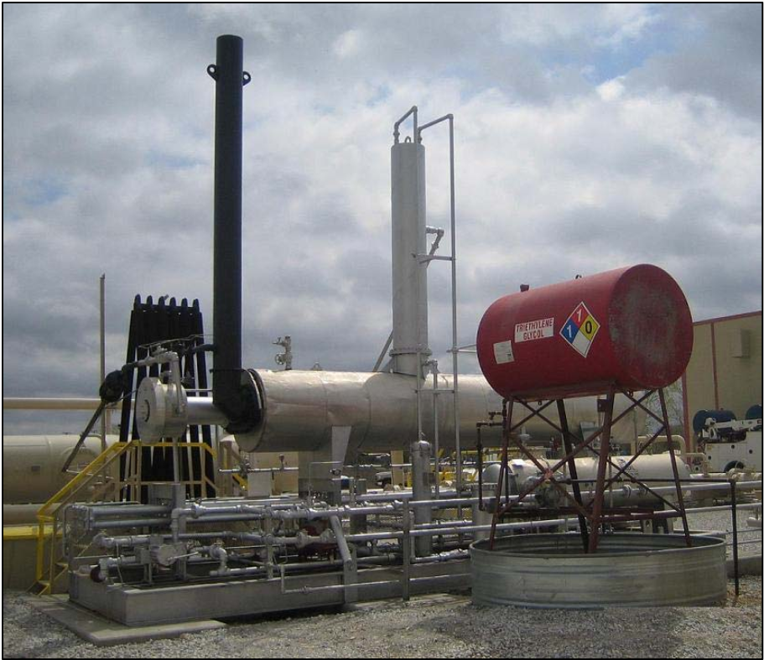
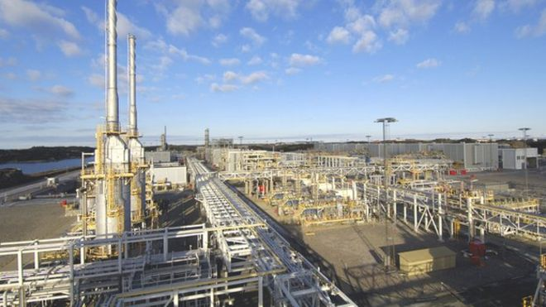
Fuel-Based Estimate of Oil & Gas NO_{x} Emissions
Emissions = Activity (kg CO₂) x Emission Factor (g/kg CO₂)
Exploration
e.g. drilling, fracturing, trucking
Off-road diesel fuel (EIA)
Production
e.g. dehydrators, heaters, compressors
NG on-site fuel (EIA)
NG Processing Plants
CO₂ emissions reported at facility level (EPA)
EPA Oil & Gas Tool
+
Literature Review
Continuous Emissions Monitoring (CEMS)

Slide 11
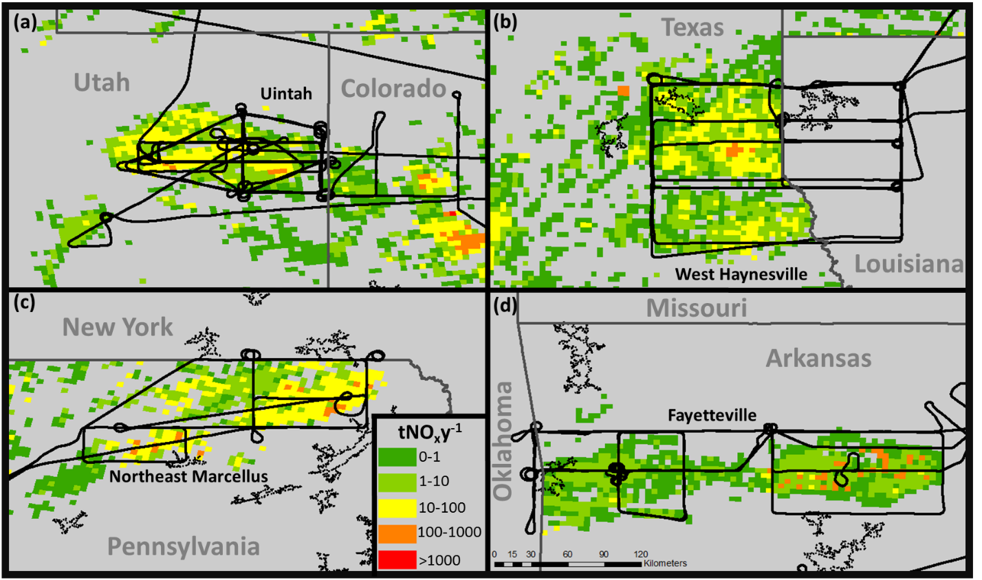
Fuel-Based Inventory of Oil & Gas Emissions Scalable Across U.S.
Well-level production, drilling data used to spatially allocate emissions
Evaluate with
aircraft-derived
“top-down” emissions
Gorchov Negron et al. (in prep.)

Slide 12
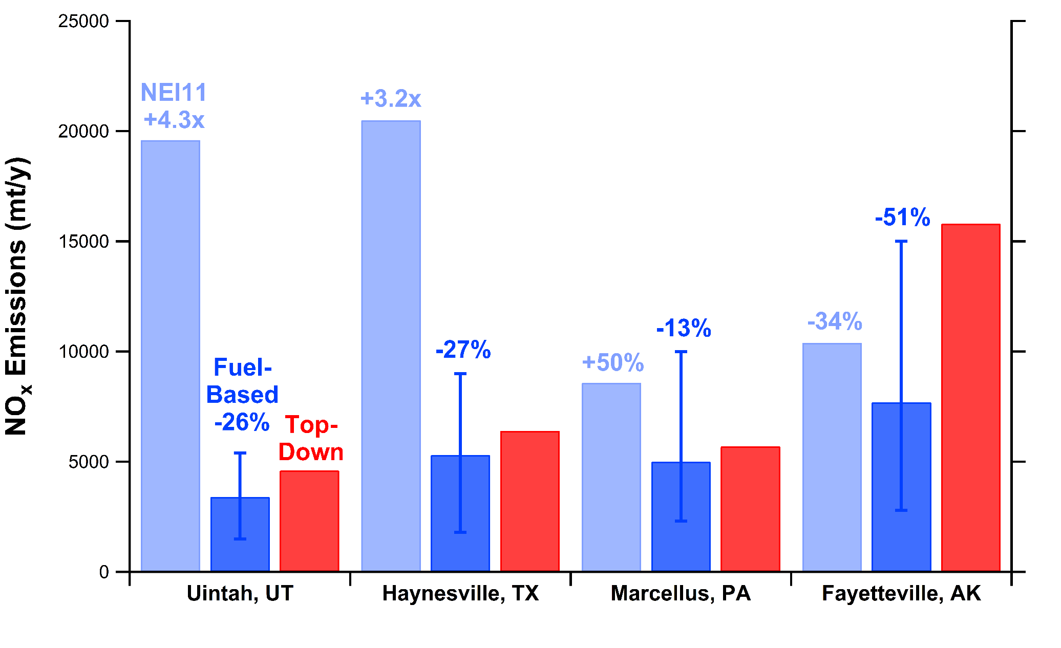
Comparison of Top-Down and Bottom-Up Emissions in O&G Basins
NEI high by ~2.5x on average, fuel-based inventory low by ~30%
Gorchov Negron et al. (in prep.)

Slide 13
Modeling O₃ in Uintah Basin during Wintertime
Observations Bottom-up (NEI11) Top-Down Zero Oil & Gas
O&G NO_{x} emissions in NEI11 high by ~4x, VOC emissions low by ~2x
Ahmadov et al. (Atmos. Chem. Phys. 2015)

Slide 14
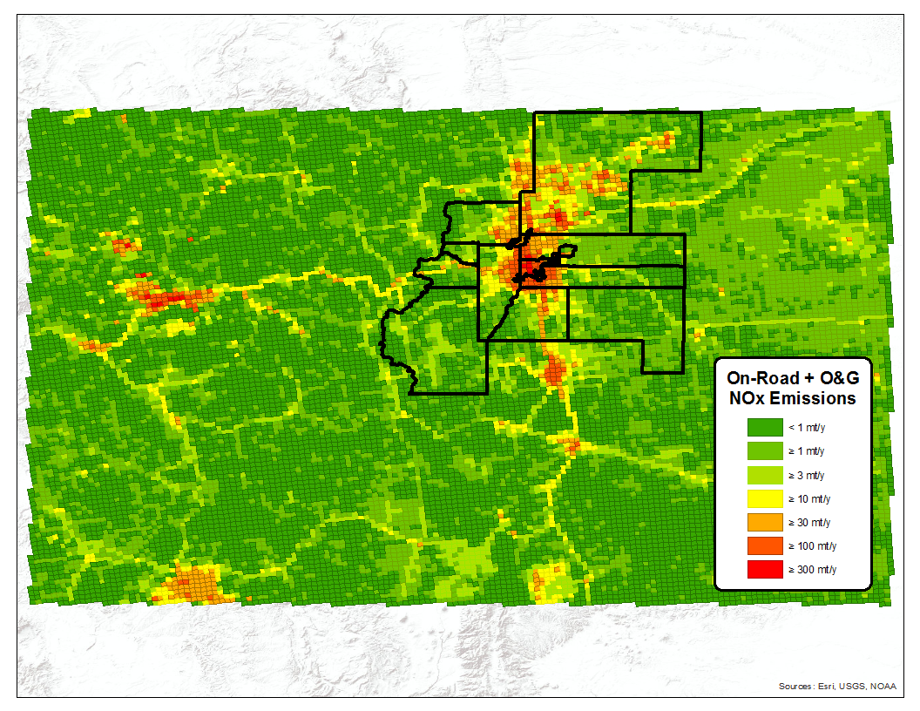
In Denver Front
Range Counties
On-Road
Fuel-Based 27 000 mt/y
NEI14 38 500 mt/y
(+43%)
Oil & Gas
Fuel-Based 9 400 mt/y
NEI14 17 200 mt/y
(+83%)

Slide 15
Summary
Developed fuel-based inventory for on-road and oil & gas sectors
Similar methodology employed based on energy statistics, in-situ measurements (where available), and spatial surrogates
NO_{x} emissions evaluated with field intensive measurements
Evidence for overestimate in on-road gasoline NO_{x} in NEI →
over-prediction of O₃ exceedance events in Eastern U.S.
Evidence for overestimate in oil & gas NO_{x} in NEI, but varies by basin
Compared to the fuel-based inventory, NO_{x} emissions in the NEI are higher for the on-road and oil & gas sectors in Colorado

