Slide 1



Observations of Reactive Nitrogen in RMNP during the Front Range Air Pollution Photochemistry Éxperiment (FRAPPÉ)
Katherine B. Benedict¹, Anthony J. Prenni², Ashley Evanoski-Cole¹, Amy P. Sullivan¹ , Emily V. Fischer¹, Barkley Sive², Yong Zhou¹, Bret Schichtel³, Jeffrey L. Collett, Jr. ¹
¹Department of Atmospheric Science, Colorado State University, Fort Collins, CO 80523, USA
²National Park Service, Air Resources Division, Lakewood, CO 80225, USA
³National Park Service, Air Resources Division, Fort Collins, CO 80523, USA

Slide 2
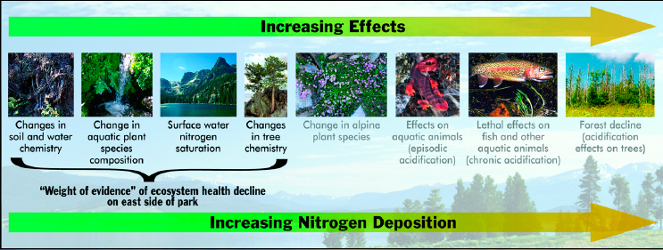
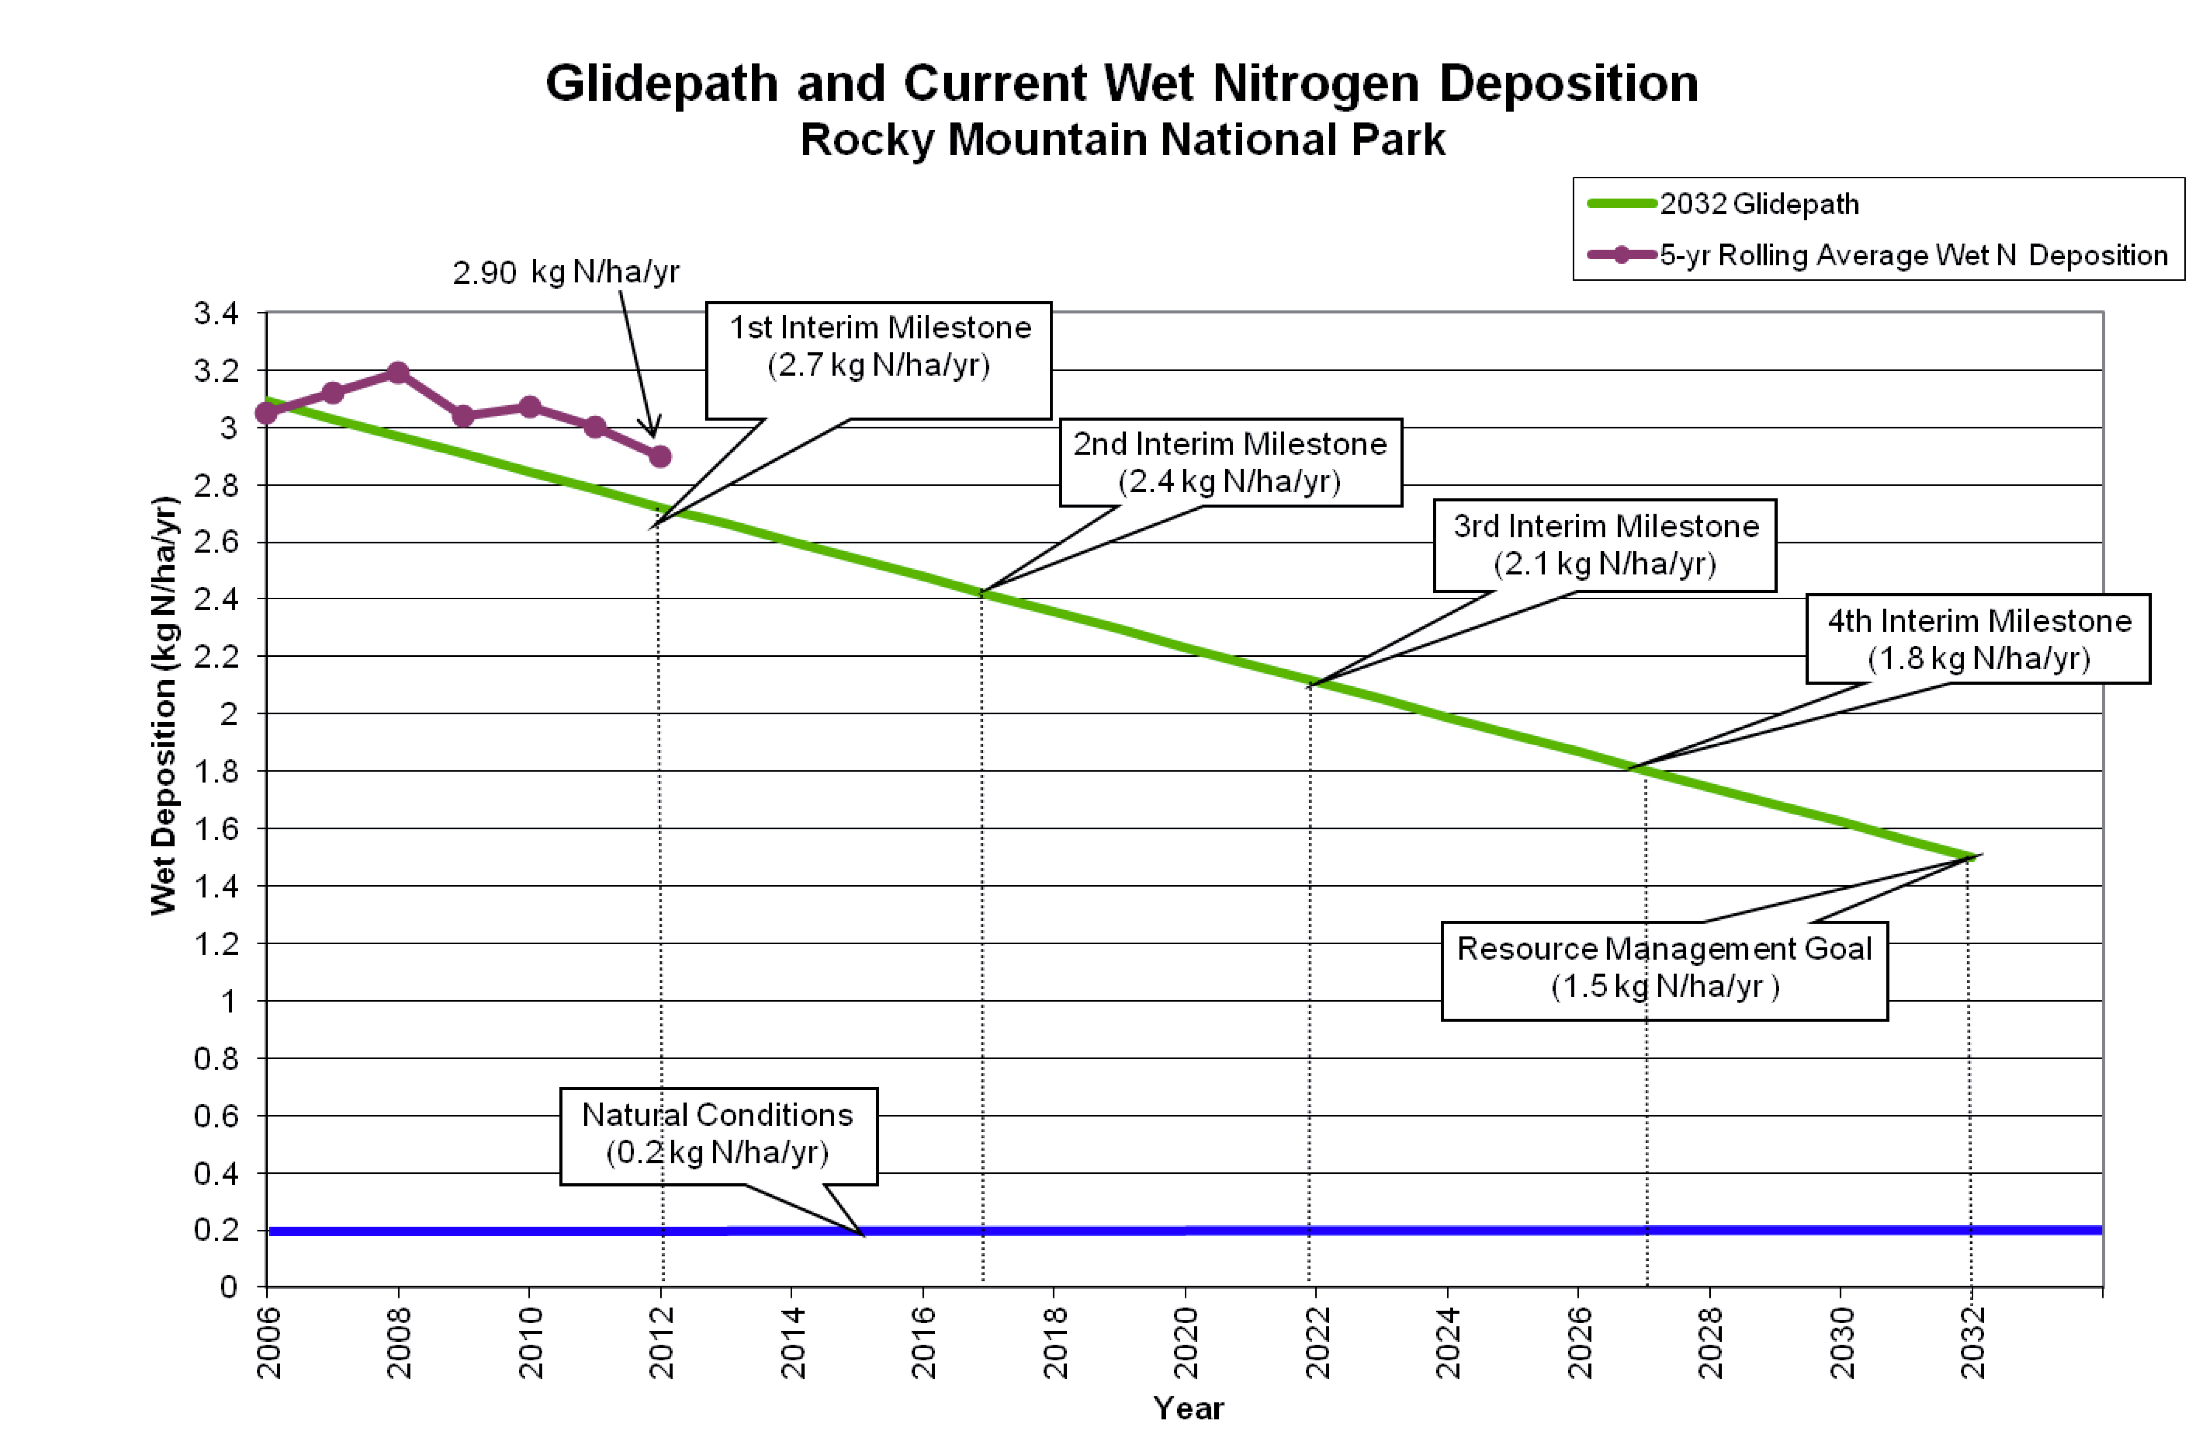
Concerns about Nitrogen in Rocky Mountain National Park
2017 Milestone Assessment Year
Memorandum of Understanding between EPA, NPS, and State of Colorado
Rocky Mountain National Park Initiative/Nitrogen Deposition Reduction Plan

Slide 3
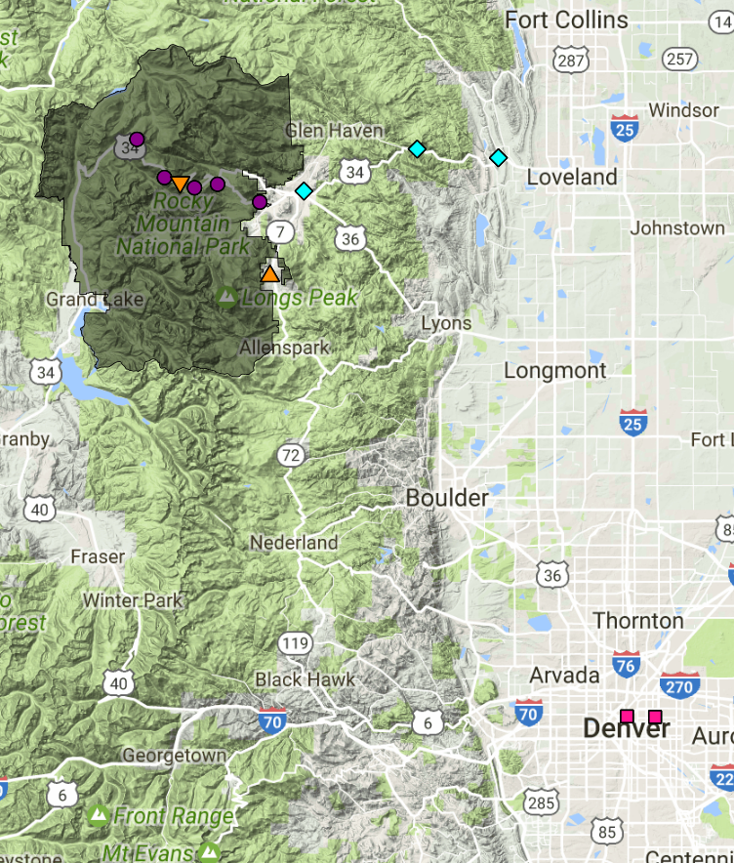
Rocky Mountain
Sampling Site
High-time resolution NH₃ (Picarro)
PAN (GC; Emily Fischer)
NO_{y}/NO (Castnet)
Alkyl nitrates (in situ GC)
24-hour average HNO₃, NO₃⁻, NH₄⁺, NH₃
C-130 Data for Comparison (~0.5° x 0.5 ° box over RMNP):
NCAR C-130 PAN CIMS (PI: Frank Flocke)
NH₃ Aerodyne QC-laser tracer gas (PI: Scott Herndon)
Whole Air Samples Canisters (PI: Don Blake)
ROMO

Slide 4
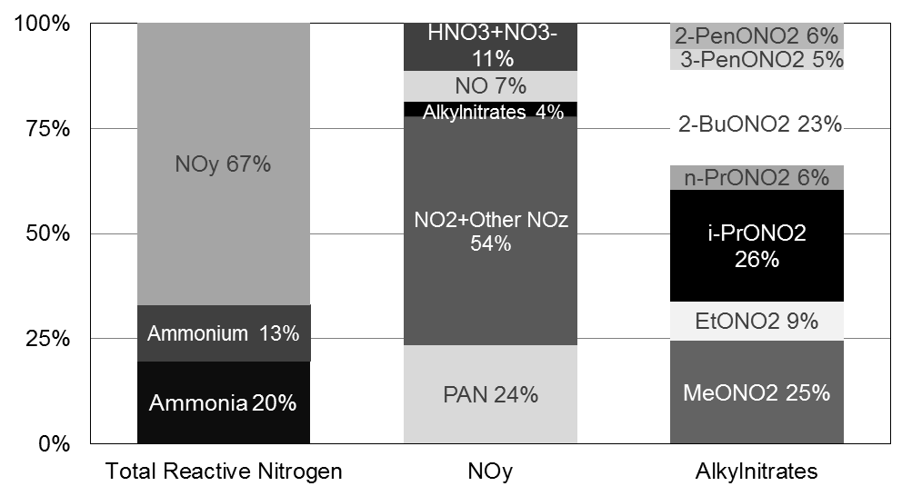
The relative contributions of N-containing compounds in the RMNP atmosphere.
Oxidized and Reduced Nitrogen fractions are similar to what we’ve previously observed.
The compounds not regularly measured vary in their significance to the total nitrogen.
Notes:
In 2009, 2010, and 2015 on average NOy contributed 66% which is similar to 2014 for the July to October period. Total reactive N concentration (sum of NOy, NH3, NH4+) was lowest of the years for which we have data in 2014. In 2009 total atmospheric N was highest at 2.6 ppb, 2015 was second highest at 2.0 ppb followed by 2010 at 1.9 ppb while 2014 was 1.6 ppb.

Slide 5
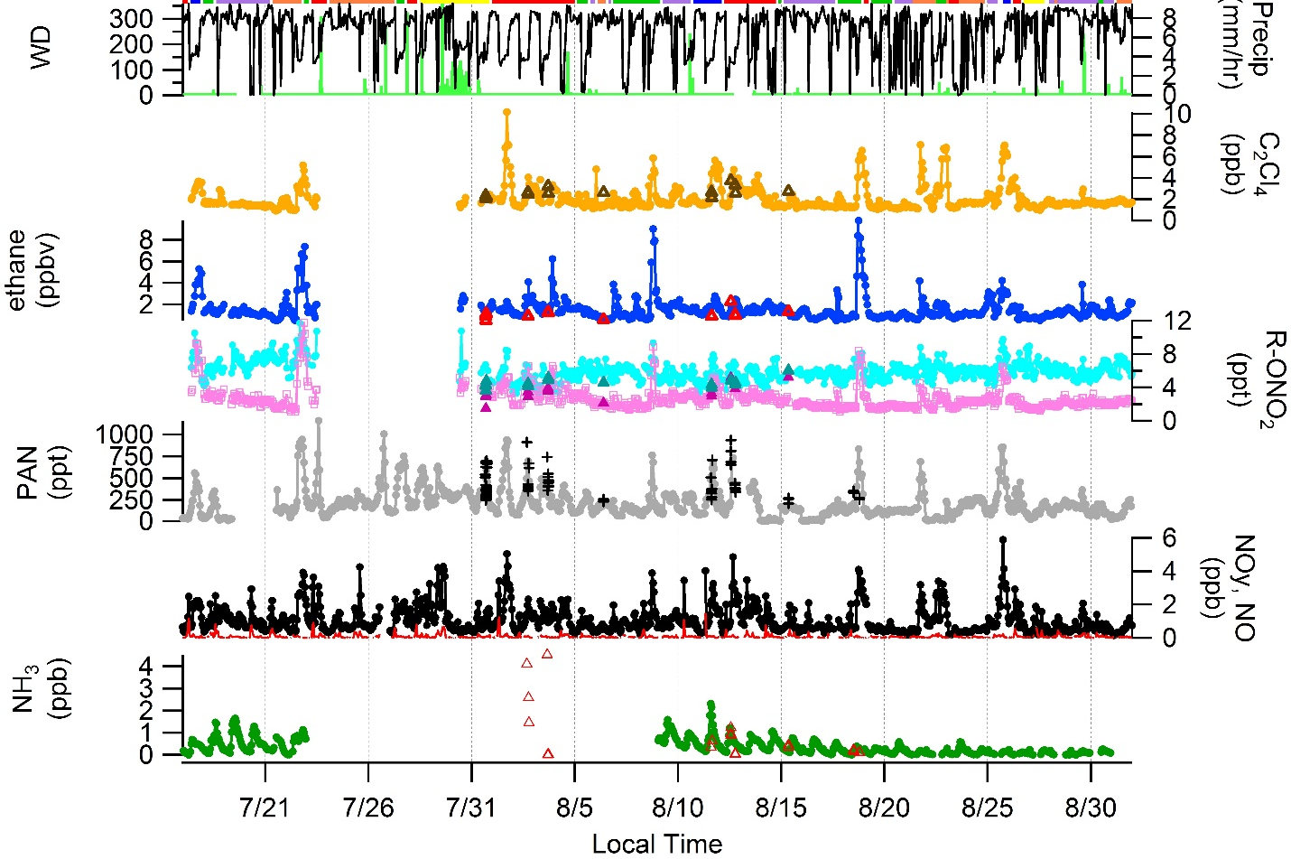
A snapshot of what we observed..
Urban tracer
Oil and Gas
tracer
C-130 Data
Ethyl nitrate
Methyl nitrate
2014

Slide 6
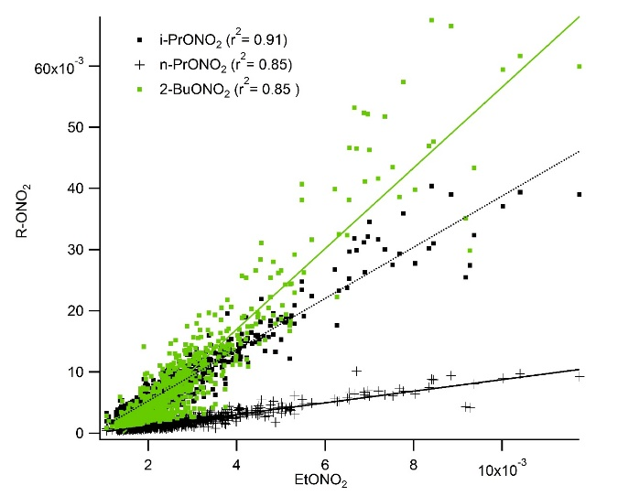
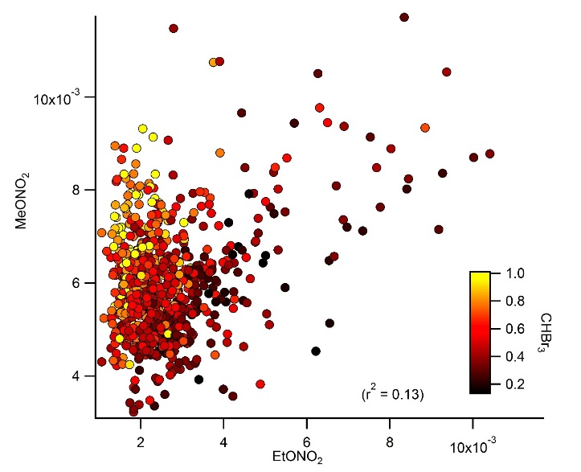
Alkyl nitrates at Rocky
Marine Tracer

Slide 7
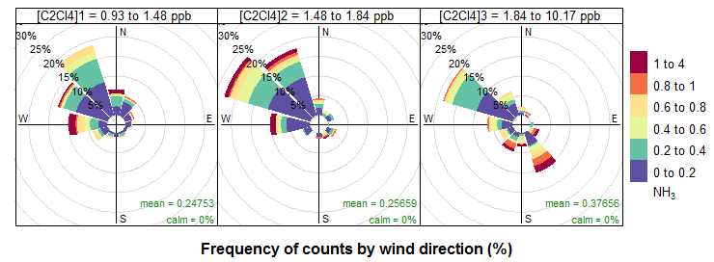
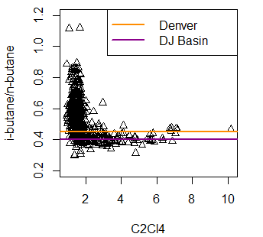
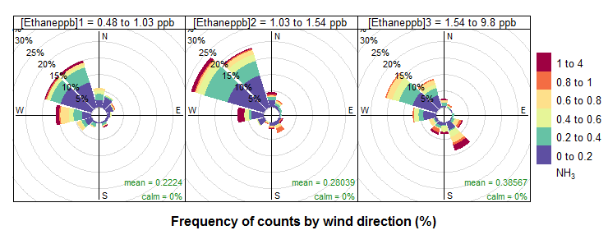
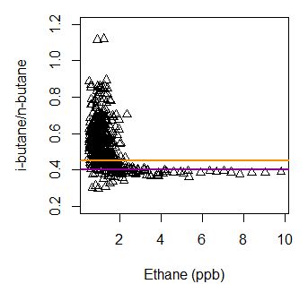
Can VOCs help identify sources of nitrogen compounds to RMNP?
C₂Cl₄
Urban
Ethane
Oil & Gas/Ag

Slide 8
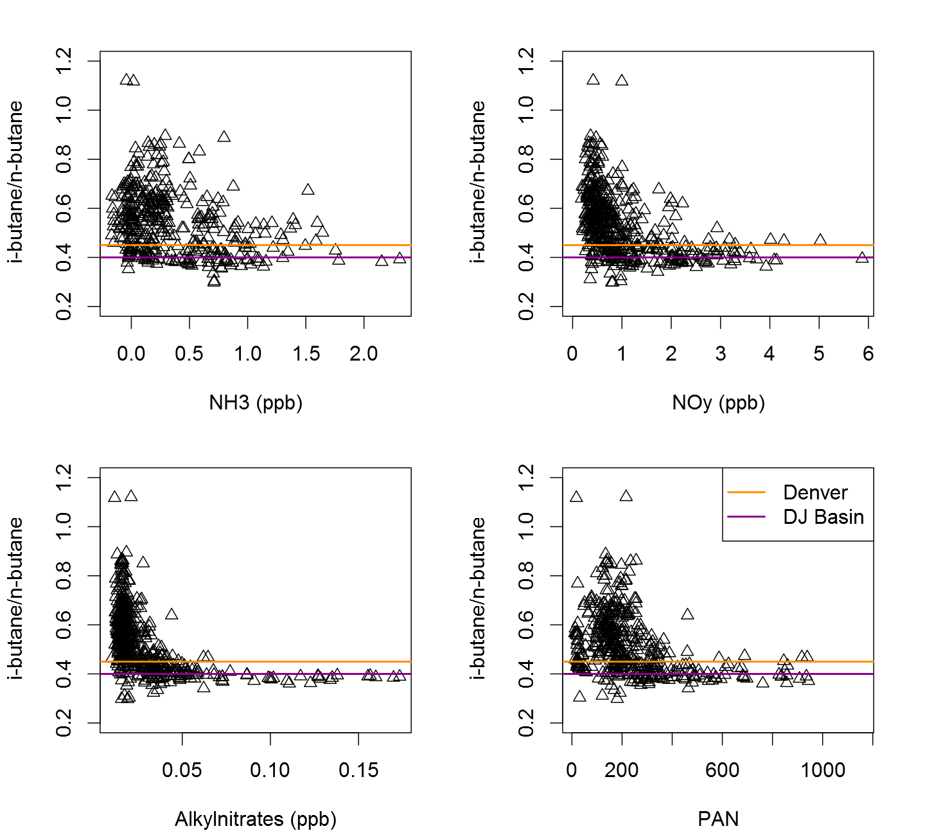
i-butane/n-butane v N-containing species
At highest ethane and alkyl nitrate concentrations clear DJ Basin signal.
Mixed Denver/DJ Basin air masses for high concentrations of other N species.

Slide 9
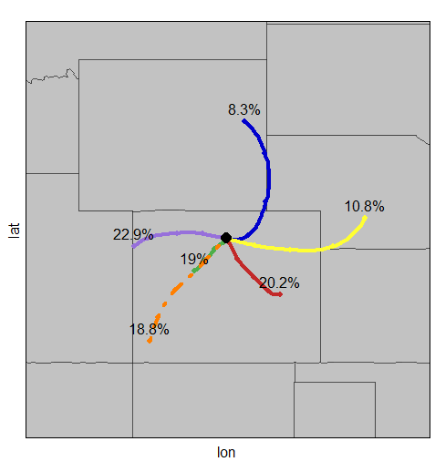
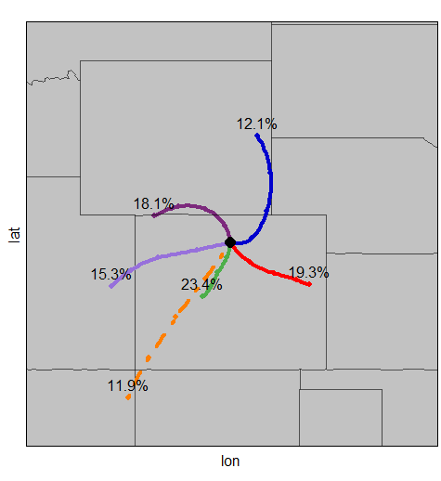
How do nitrogen concentrations change with transport?
2014
2015-2016 July-Sept
Notes:
PAN and alkylnitrates are similar

Slide 10
Summary
Similar concentrations were measured at the surface and on the C-130 during the periods where flights passed over ROMO.
FRAPPÉ provided an opportunity to make comprehensive measurements of compounds that are distinctly related to sources along the Front Range.
We need more data to make strong conclusions about sources of reactive nitrogen.
Findings suggest high concentrations of ammonia are associated with transport from the Front Range and sources to the west (N. Utah).
2014 was a low NH₃ year likely due to more precipitation in RMNP July-Oct.
Katherine.Benedict@colostate.edu

Slide 11
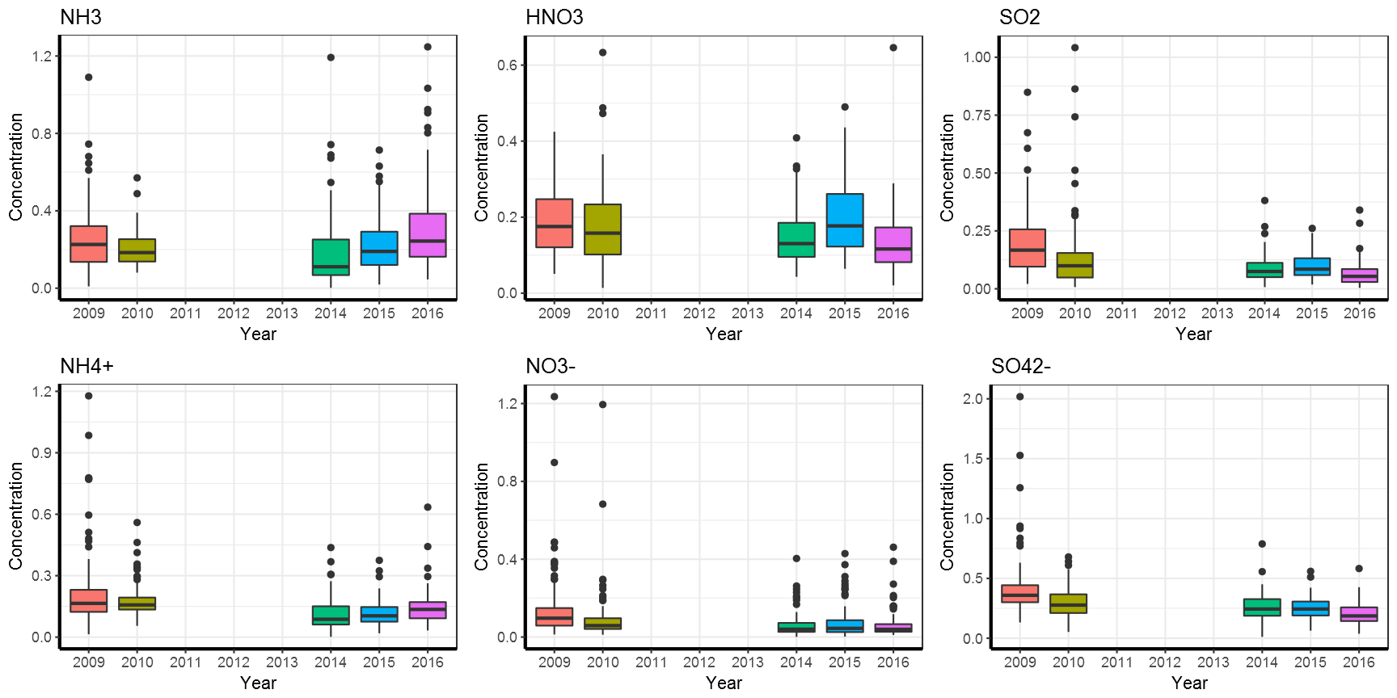
Denuder/filter-pack measurements from ROMO special study years

Slide 12
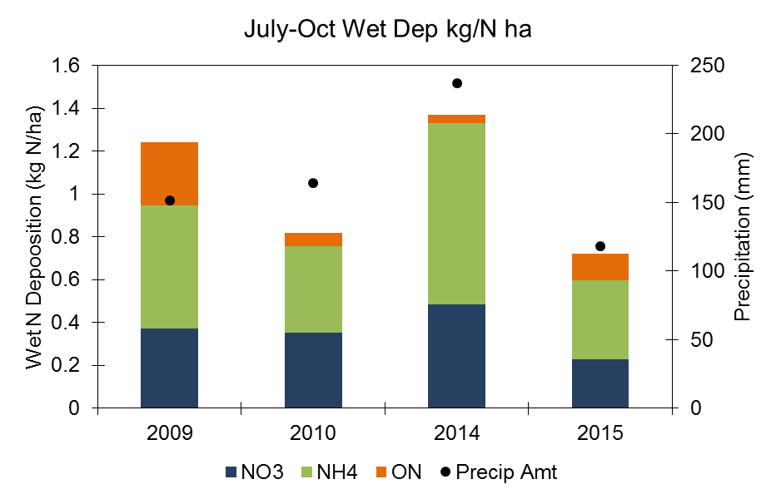
Nitrogen deposition budget for RMNP
Year | Precipitation During Upslope (mm) | Total Precipitation 7/1 -10/30 | Fraction of Precipitation During Upslope | Fraction of time flow upslope (regardless if precipitating)
2009 | 52.9 | 159.1 | 33% | 25%
2010 | 57.1 | 221.7 | 26% | 23%
2014 | 77.9 | 246.5 | 32% | 34%
2015 | 23.6 | 128.4 | 18% | 24%

Slide 13
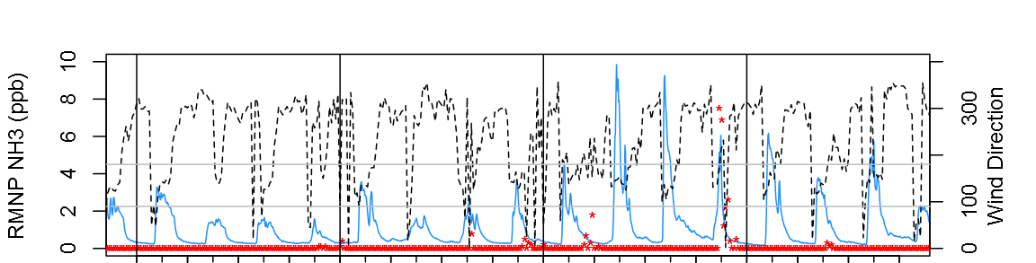

Slide 14
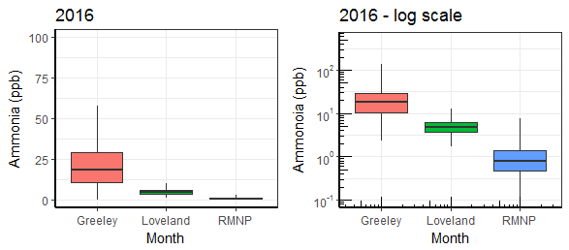
Can we observe transport from NH₃ source regions to RMNP?
Gradient in NH₃ from RMNP to Greeley.
What are the sources of high concentration ammonia events at RMNP?

