Slide 1
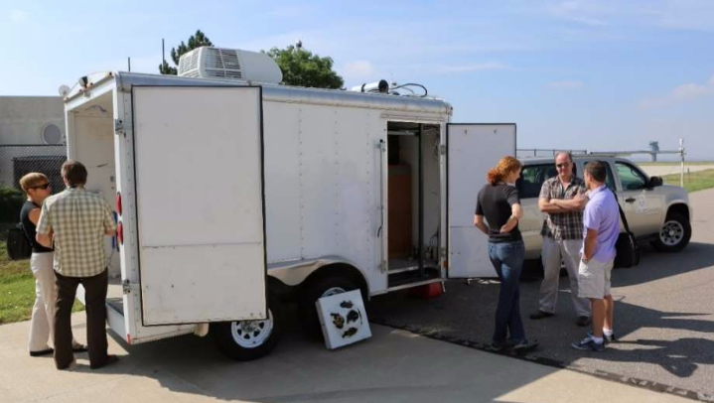




NH₃ and NO_{x} emissions from CAFO soils, and Structure Functions measured by CU mobile SOF during FRAPPE and ARISTO16
Rainer Volkamer & Natalie Kille
Department of Chemistry and Biochemistry & Cooperative Instituted for Environmental Sciences (CIRES), University of Colorado at Boulder
Instrumentation: CU SOF
Quantify emission fluxes of NH₃, NO_{x}, C₂H₆ from Oil & Ag near Greeley, CO
Comparison with NEI2011 & structure functions
Outlook: Airborne SOF

Slide 2

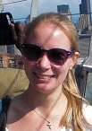


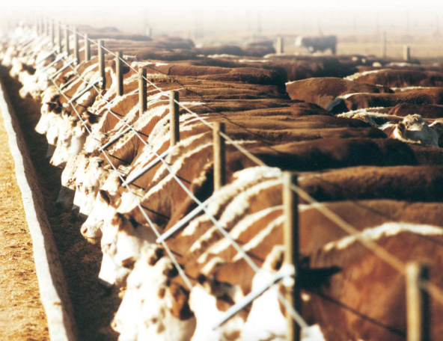
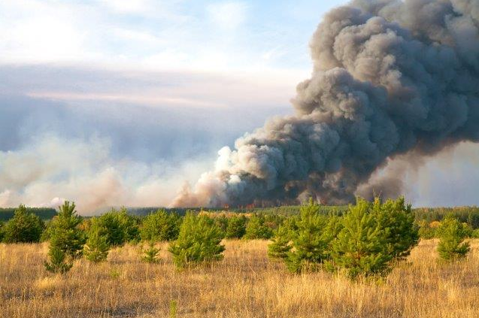
Natalie Kille
Sunil Baidar
Philip Handley
David Thomson
Roman Sinreich
Ivan Ortega
Jim Hannigan, Gabi Pfister (NCAR)
Frank Hase (KIT)
Owen Cooper (NOAA)
Dan Bon (CDPHE)
Pavel Romashkin (NCAR/EOL/RAF)
Poster: Kille et al. Separation of methane emissions from biogenic sources and natural gas …
CAFO emissions
Excess CH₄ source
apportionment
BB emissions

Slide 3
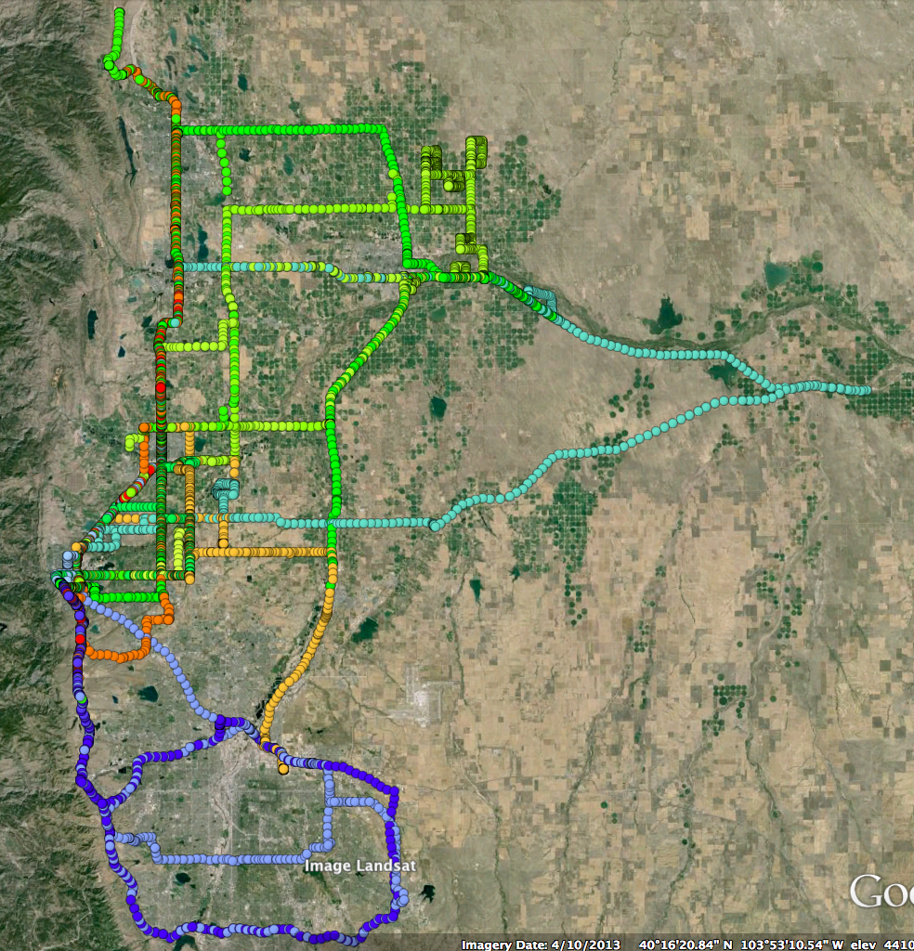
Research drives – FRAPPE 2014
Front Range Air Pollution and Photochemistry Experiment
RD Date Description
1 07/21 Sampling at Magnum CAFO
2 07/28 Urban emission around Denver
3 08/01 Urban emission around Denver
4 08/02 Urban emission around Denver
5 08/04 Regional outflow and CAFO
6 08/06 Regional outflow
7 08/08 Regional within Boulder County
8 08/09 Regional outflow
9 08/11 Regional
10 08/12 Various farms around Greeley
11 08/13 Various farms around Greeley
12 08/15 Regional within Boulder County
13 08/16 Overflight, BAO tower
14 08/18 Morning mountain upslope flow
15 08/18 Evening mountain upslope flow
16 09/03 Urban emission around Denver
Ft. Collins
Greeley
Boulder
Denver

Slide 4
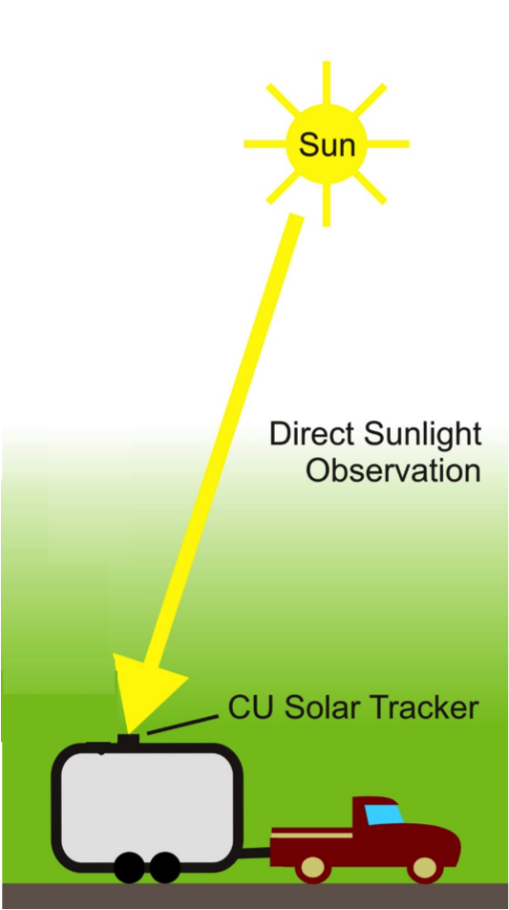
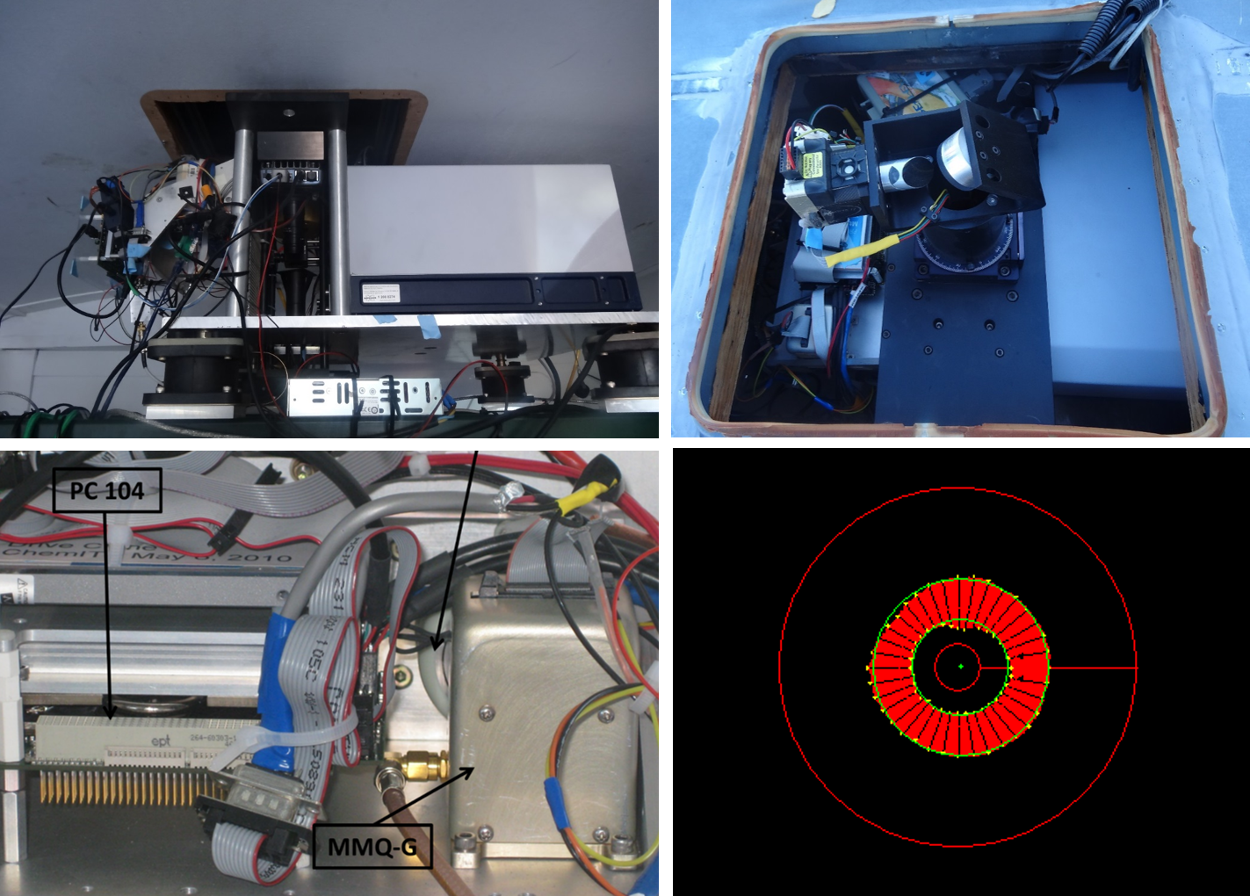
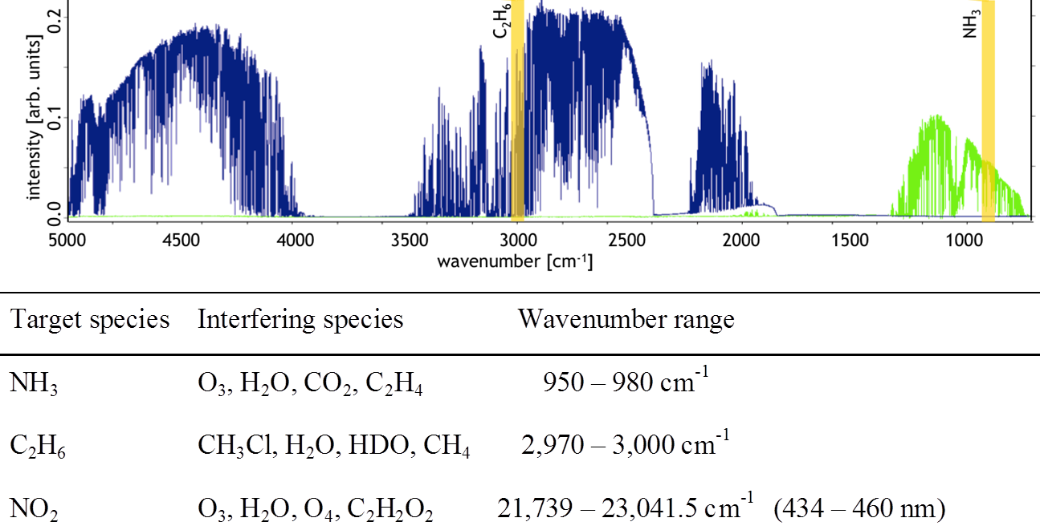
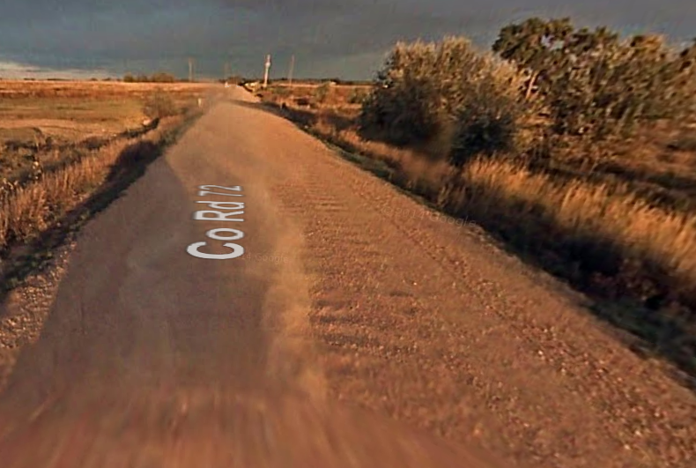
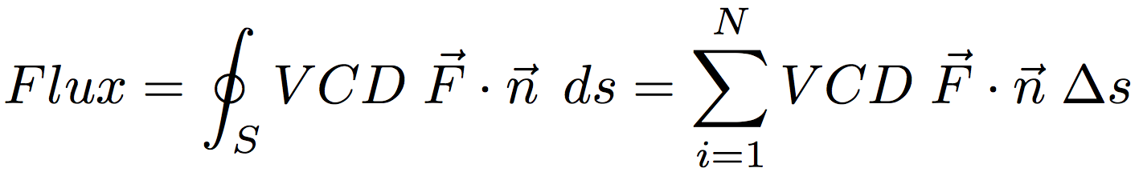
CU mobile SOF: emission flux & chemistry
UV-VIS & mid-IR measurements of columns are independent of PBLH

Slide 5
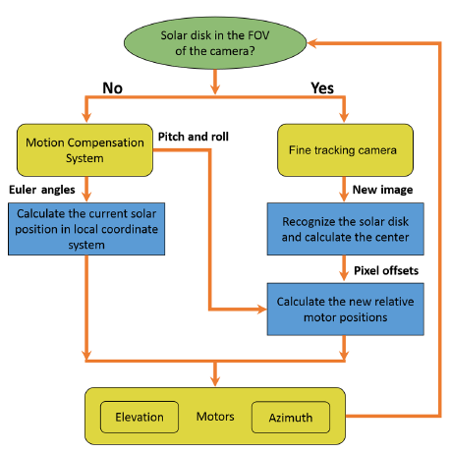
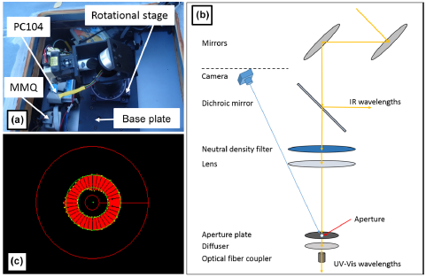
Digital mobile solar tracker
Access to the Euler Angles of the sun.
Active control to correct for vehicle motion
→ Less time adjusting & more time measuring
Baidar et al., 2016 AMT; U.S. Patent Pending

Slide 6
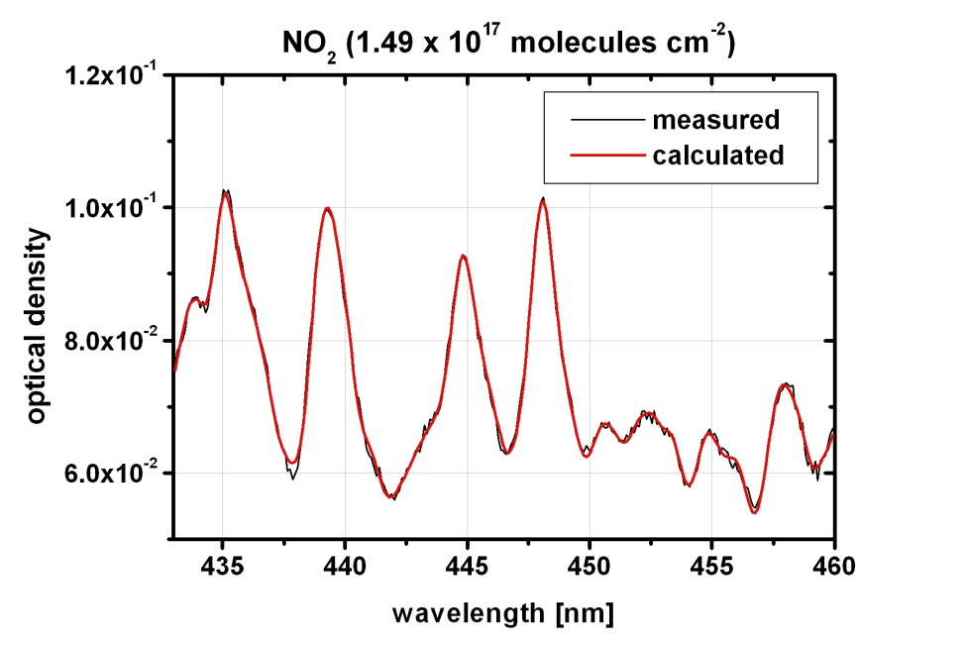
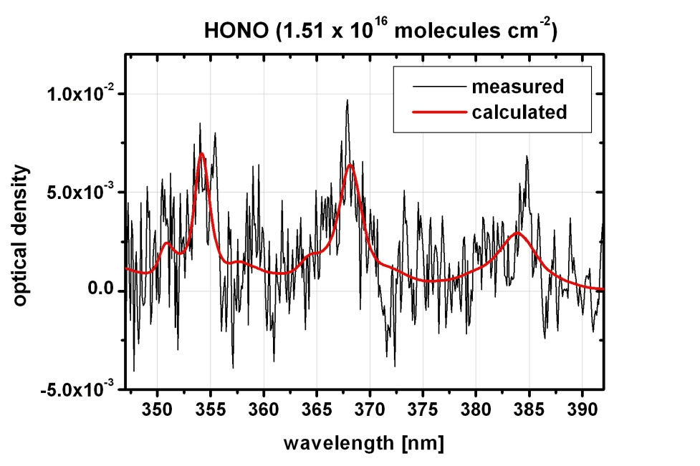
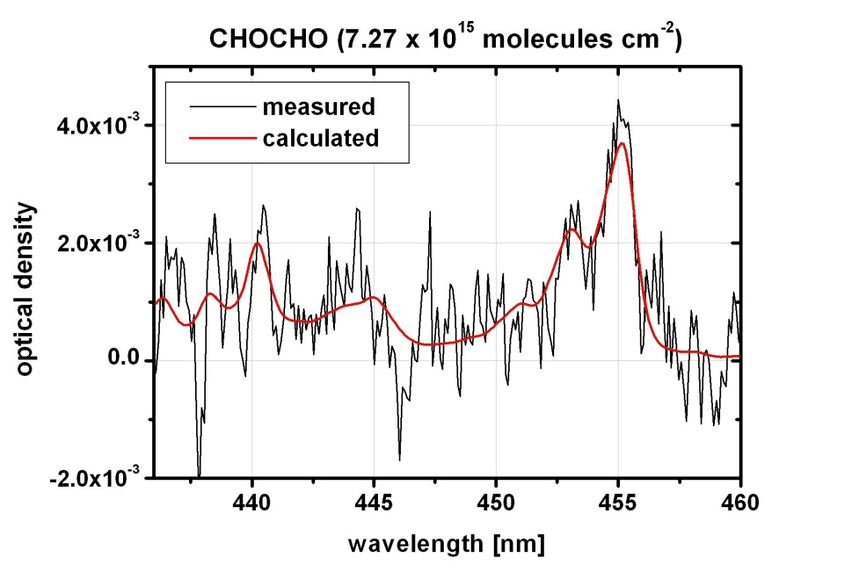
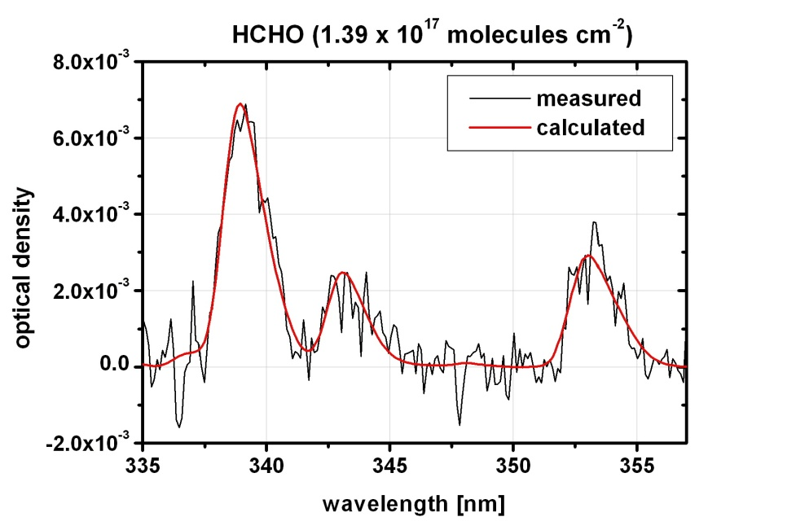
Fit Examples: UV-vis

Slide 7
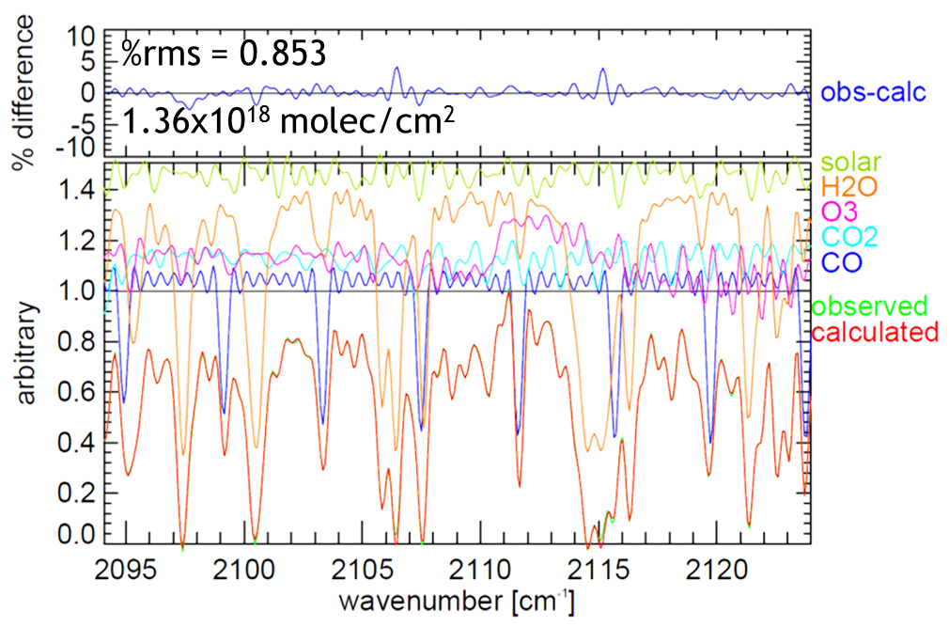
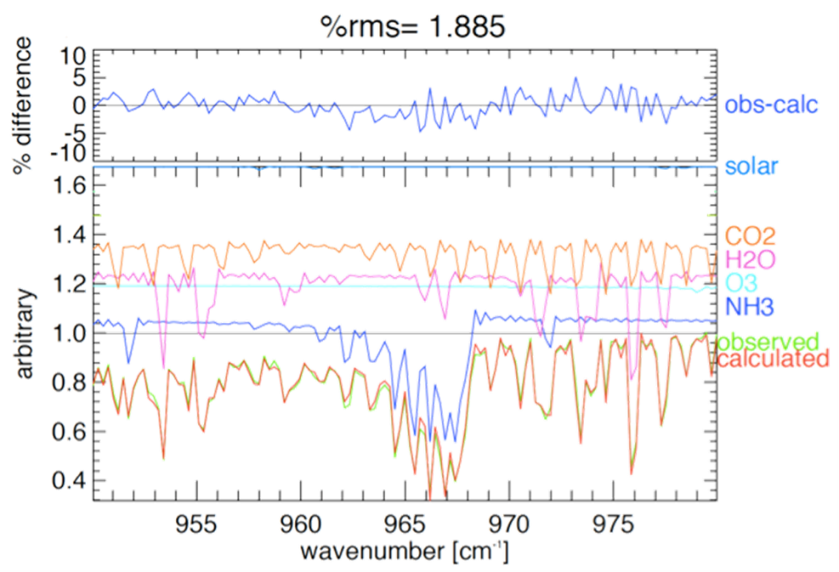
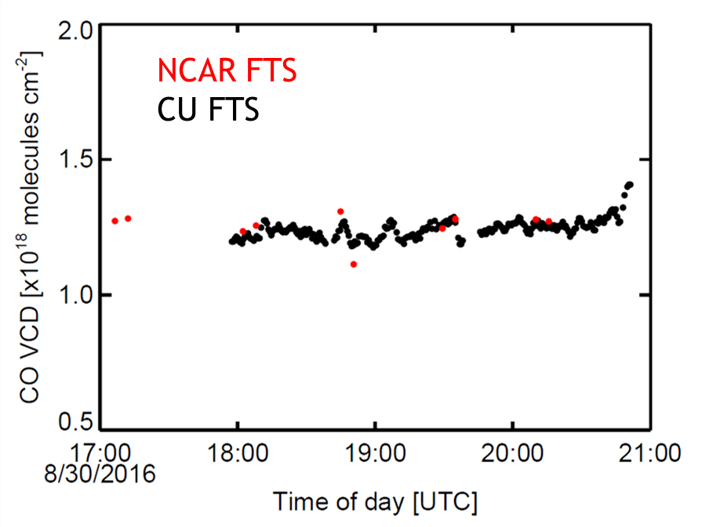
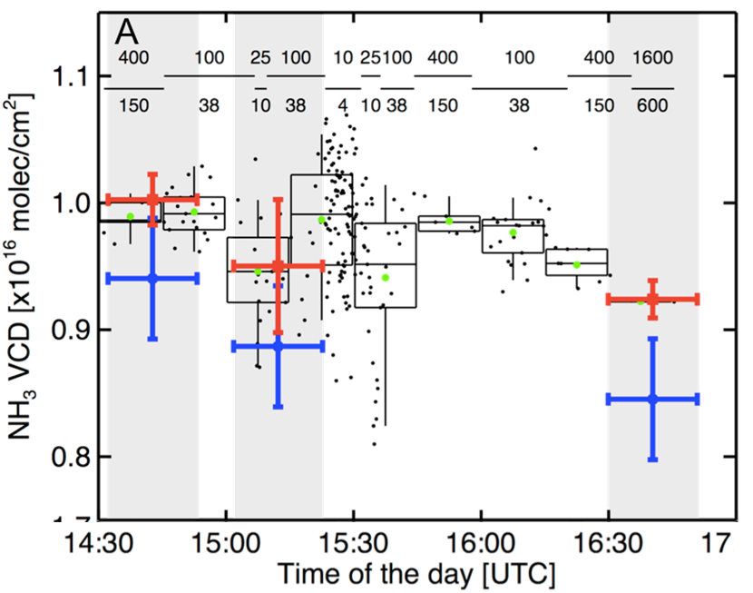
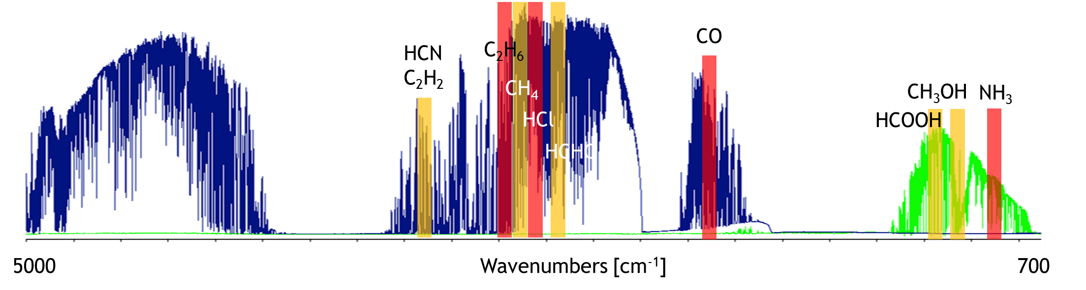
Fit Examples: mid infrared
CO
NH₃
%rms = 1.9
4.02 x 10¹⁷ molec/cm²

Slide 8
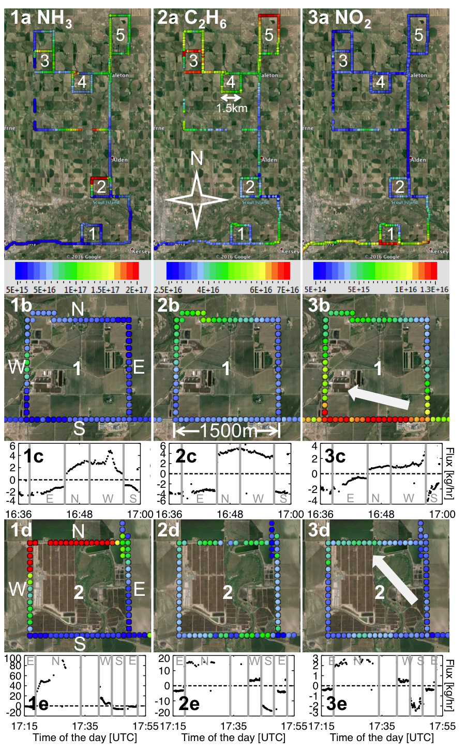
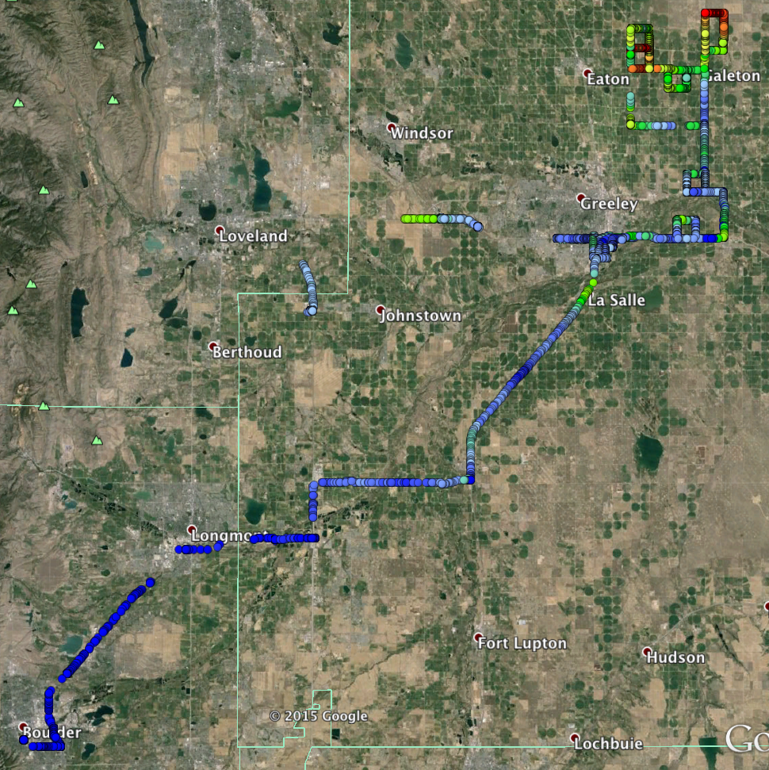
Research drives – spatial variability
IASI
CriS
OMI
TES
IASI
CriS
TEMPO
TES
OMI

Slide 9
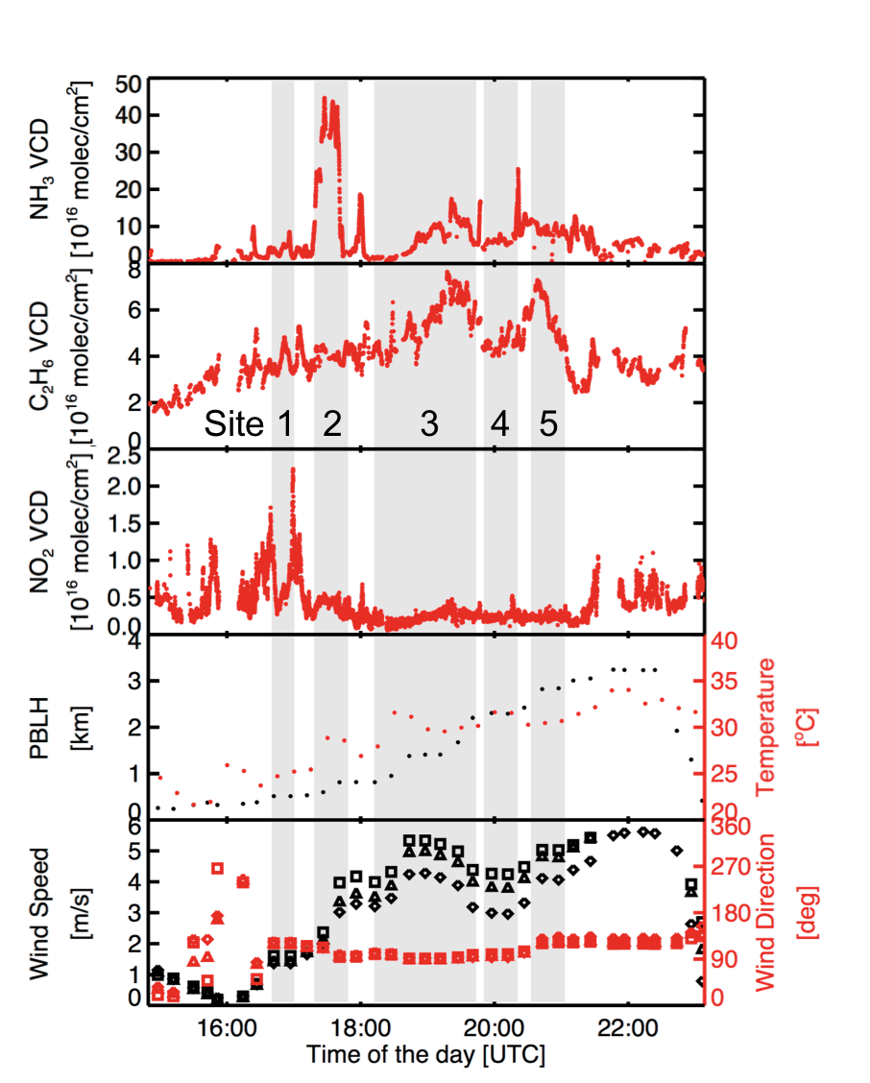

Case Study – RD11
Site 1 – Dairy
Site 2 – Beef
Site 3 – Sheep
Site 4 – Dairy
Site 5 – Dairy
NH₃ NO₂
Wind averaged over
Full PBLH
Half PBLH
Lowest level

Slide 10
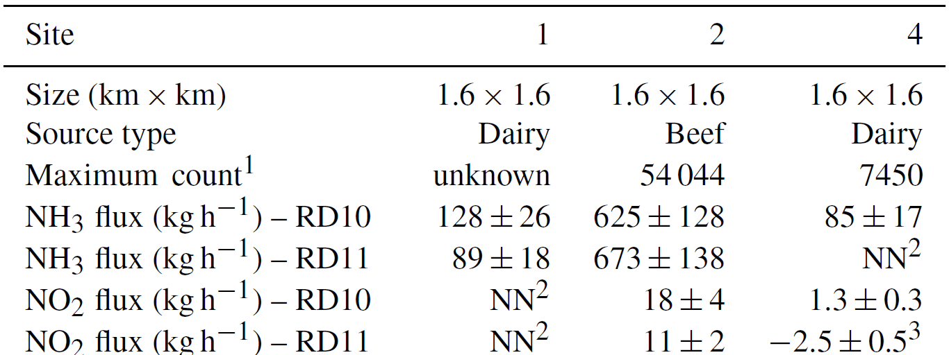
Emission Flux
NH₃ Emission Factors:
Beef: 12.0 ± 2.8 g hr⁻¹ head⁻¹
Dairy: 11.4 ± 3.5 g hr⁻¹ head⁻¹
NO_{x} Emission Rates:
Site 2: 7.3 ± 2.9 kg km⁻² hr⁻¹ or 18.6 kg hr⁻¹
11.8 ± 2.1 g hr⁻¹ head⁻¹

Slide 11
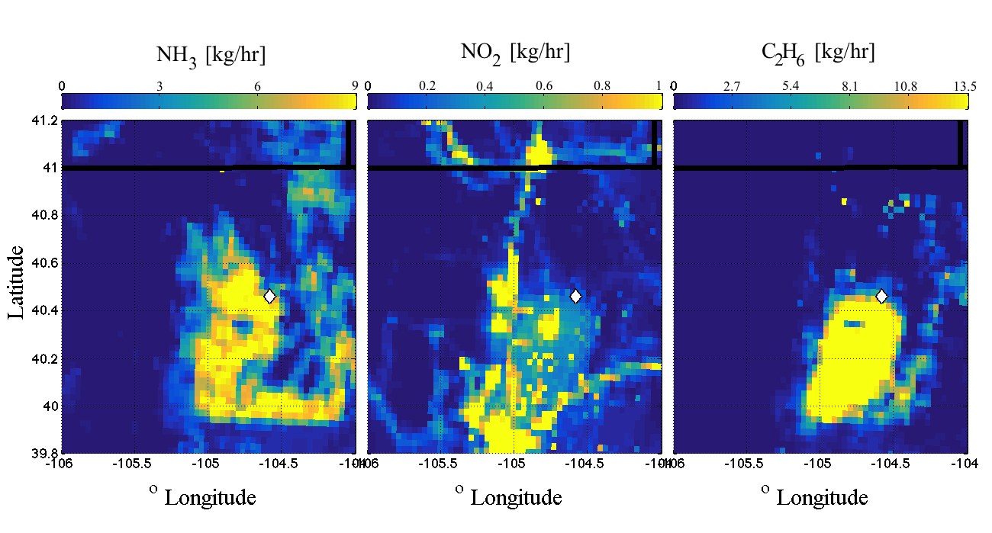
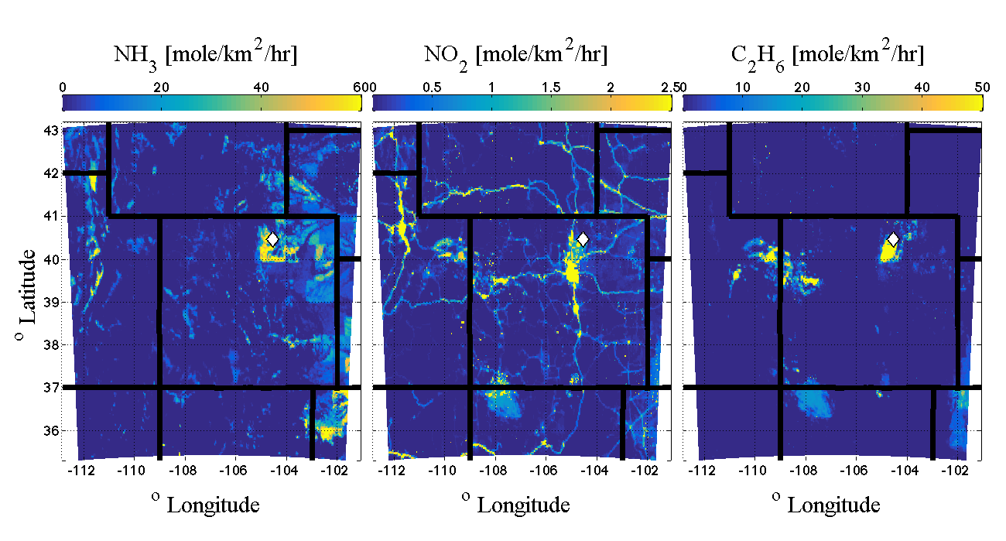
Comparing NH₃ flux to the NEI 2011
NH₃ EF = 11.8 g hr⁻¹ head⁻¹
(12.9% of cattle population in Weld County were probed)
~100-600 kg/hr
Weld County:
535 766 cattle
10440 km²
0.63 kg km⁻² hr⁻¹
NEI – avg NH₃ ERate:
0.36 kg km⁻² hr⁻¹
^{(all sources)}
1.8
Remote Study area:
224 469 cattle
414 km²
6.39 kg km⁻² hr⁻¹
NEI – avg NH₃ ERate:
0.73 kg km⁻² hr⁻¹
^{(all sources)}
8.8
Kille et al., 2017 AMT
Ratio Meas/NEI:

Slide 12
Comparing NO_{x} flux to the NEI 2011
Site 2: 18.6 kg hr⁻¹ or 0.34 g hr⁻¹ head⁻¹
(comprises 10% of cattle population in Weld County)
Weld County:
535 766 cattle
10440 km²
0.018 kg km⁻² hr⁻¹
NEI – avg NO_{x} ERate:
0.17 kg km⁻² hr⁻¹
^{(incl. traffic)}
+11%
Remote Study area:
224 469 cattle
414 km²
0.18 kg km⁻² hr⁻¹
NEI – avg NO_{x} ERate:
0.15 kg km⁻² hr⁻¹
^{(incl. traffic)}
+120%
~18.6 kg/hr
Kille et al., 2017 AMT
Additional NO_{x}
from CAFO Soils:

Slide 13
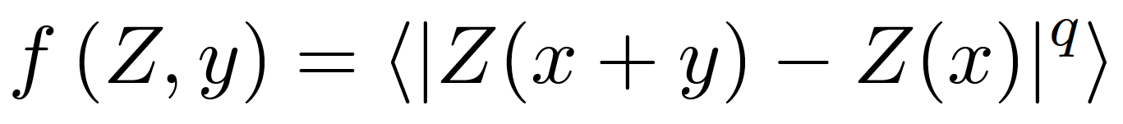
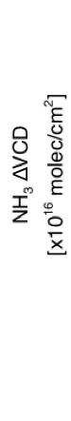
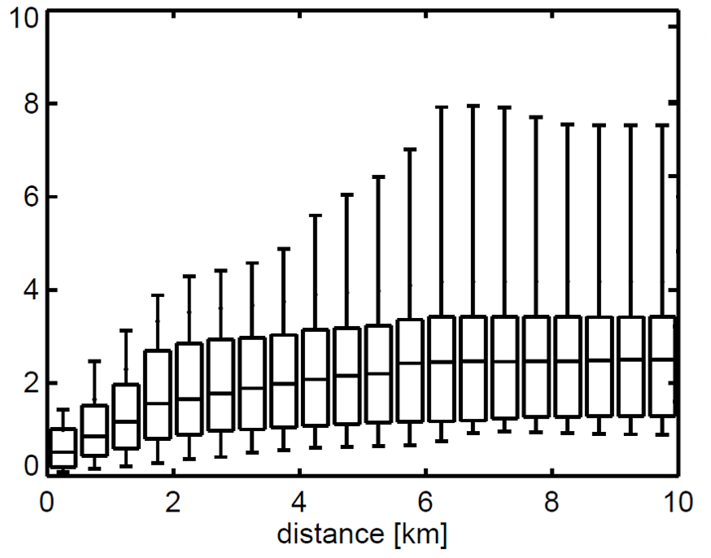
Structure functions & satellites
50% variability at <1.6km
90% variability at <5.6km
>95%
90%
IASI, CrIS
50%
TES
  NH₃ – IASI (12 x 25 km²), TES (5.3 x 8.5 km²), CrIS: currently resolve 5-10% of the NH₃ VCD variability in the Colorado Front Range
NO₂ - TEMPO (future: 2 x 4.5 km²): will be able to resolve ~50% of the NO₂ VCD variability in the Colorado Front Range

Slide 14
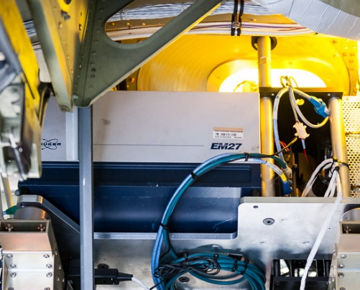
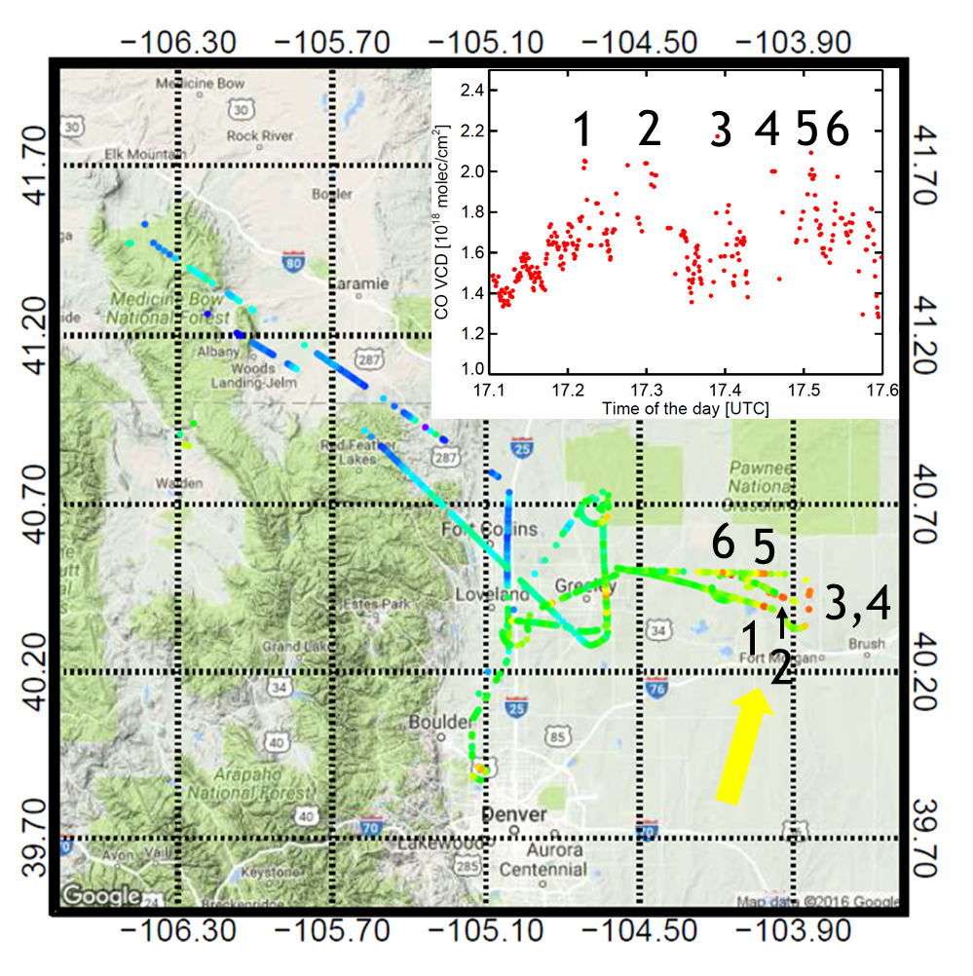
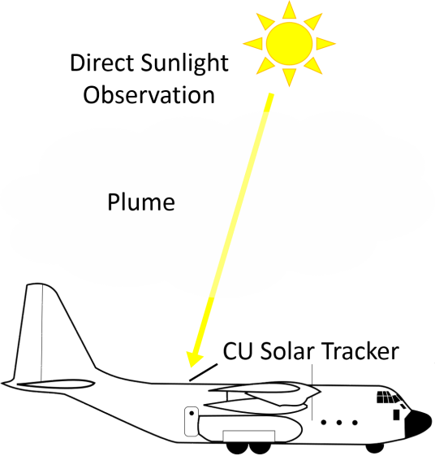
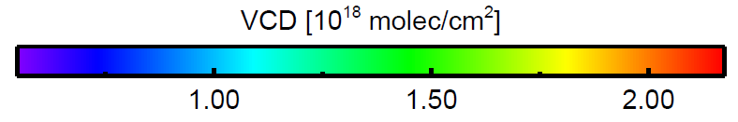
ARISTO2016: CU airborne SOF
Potential future applications include study of biomass burning emissions and plume processing
Postdoctoral openings:
Airborne SOF & biomass burning fluxes
~5 TgN/yr
Baidar et al., 2016 AMT
Kille et al., 2017 AMT
Notes:
Animals 32 (24 – 40)
Sea 13 ( 8 – 18) (largest natural source)
Soils 10 ( 6 – 45)
Fertilizer 9 ( 5 – 10)
Biomass 5 ( 1 – 9)
Other 6

Slide 15
Conclusions
The observed NH₃ EF (11.8 ± 2.1 g hr⁻¹ head⁻¹) is compatible with the upper range of literature values (Kille et al., 2017). Emissions of NH₃ from cattle are underestimated by a factor 1.8-8.8 (NEI 2011).
NO_{x} emissions from CAFO soils account for 1.2% of the N-flux.
This NO_{x} source is currently missing in models, and becomes increasingly important as other NO_{x} sources continue to decrease. It has potential to add between 10% (county) and 120% (remote) to the NO_{x} burden. Missing NO_{x} sources are relevant because O₃ chemistry is NO_{x} limited in remote areas where CAFO are located.
Future - airborne SOF: many molecules (CO, C₂H₆, C₂H₂, CH₃OH, HCOOH, HCHO, CHOCHO, NH₃, HCN, NO, NO₂, HONO, HNCO?, etc.)
Funding: CDPHE, NSF, CIRES, KIT
rainer.volkamer@colorado.edu

Slide 16
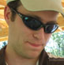

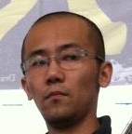


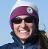

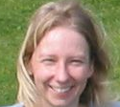



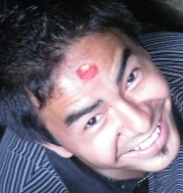





Former Volkamer group members
Ryan Thalman, tenure track faculty
Snow College, Richfield, UT
Faculty
PI position
Christopher Kampf, Junior Group
MPI Chemistry, Germany
Eleanor Waxman
NRC fellowship/NIST
Postdoc
National
Laboratory
Postdoc
Industry
Postdoc
University
Hilke Oetjen
NASA-JPL
Ivan Ortega
Scientist
Sunil Baidar
CIRES-NOAA/Ball Aerospace
Sean Coburn, Siyuan Wang
Postdoc CU/NIST, UMichigan

Slide 17


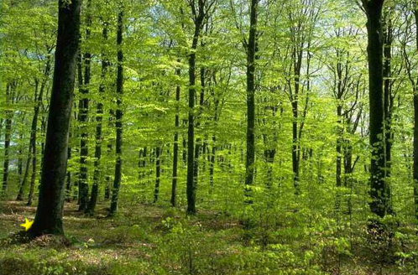
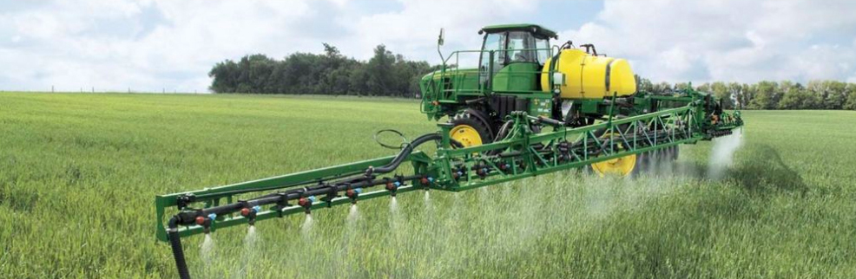
Food, Energy & Environment
Global budget of NH₃
  75 (50 – 128) TgN/yr (Schlesinger & Hartley, 1992, Biogeochemistry)
  65 (45 – 85) TgN/yr (Sutton et al., 2013, RSTP)
~32 TgN/yr
~13 TgN/yr
~10 TgN/yr
~9 TgN/yr
~5 TgN/yr
Source: Google Images
“Despite the fact that NH₃ at its current levels is a major threat to the environment and human health, relatively little is known about its total budget and global distribution.” (Dammers et al., 2016, ACP)
Notes:
Animals 32 (24 – 40)
Sea 13 ( 8 – 18) (largest natural source)
Soils 10 ( 6 – 45)
Fertilizer 9 ( 5 – 10)
Biomass 5 ( 1 – 9)
Other 6

Slide 18
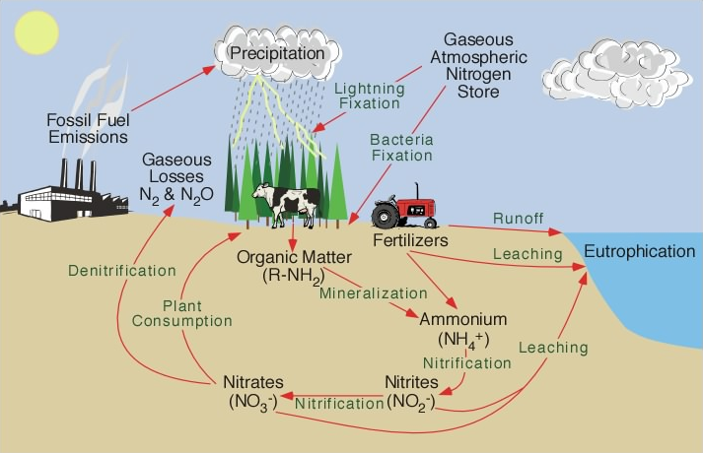
NO_{x}
NH₃
physicalgeography.net

