Slide 1
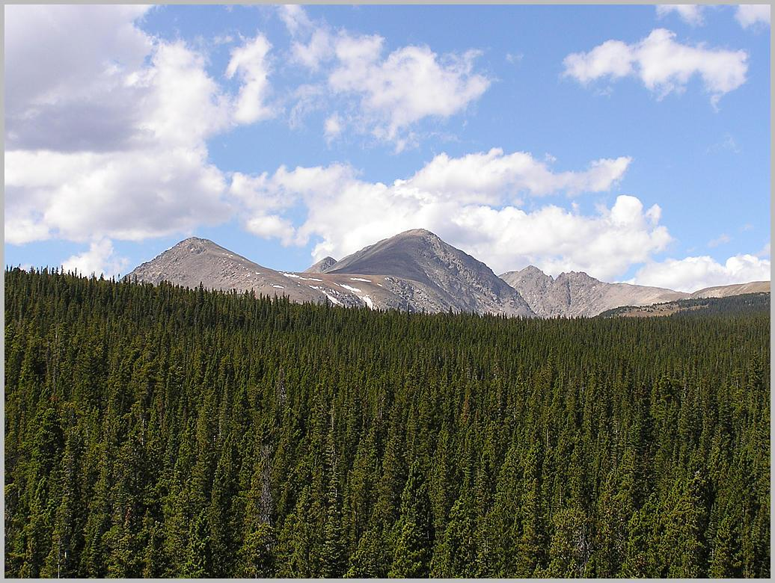



BEACHON:
Bio-hydro-atmosphere-interactions of Energy, Aerosols, Carbon, H2O, Organics and Nitrogen
Andrew Turnipseed
Measuring and Monitoring Forest Carbon in the Americas
Manitou Experimental Forest
September 15, 2011

Slide 2
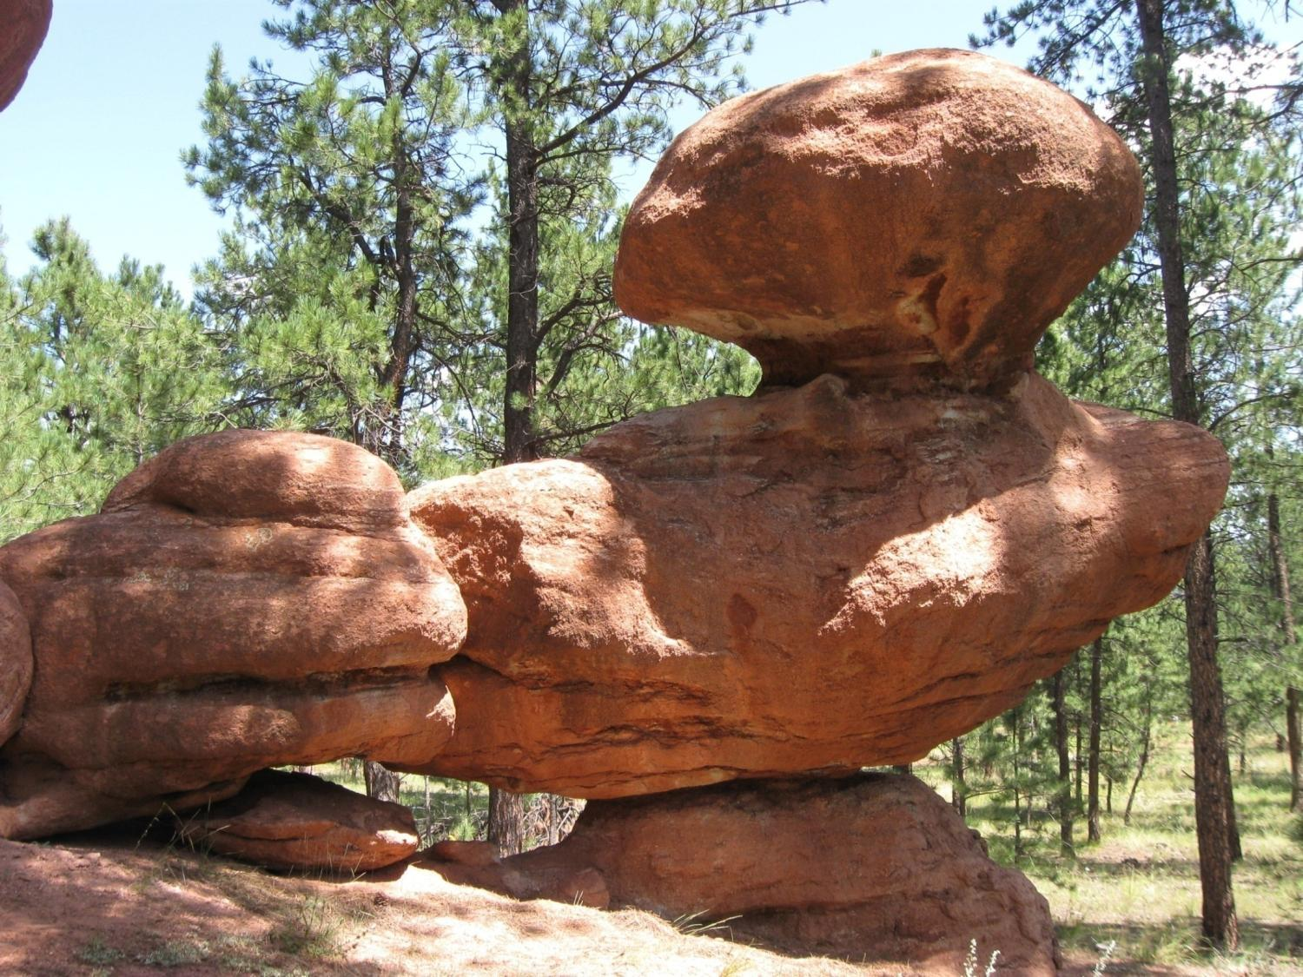


BEACHON Manitou Forest Observatory, Colorado USA
It is NCAR's mission to plan, organize, and conduct atmospheric and related research programs in collaboration with the universities and other institutions, to provide state-of-the-art research tools and facilities to the atmospheric sciences community, to support and enhance university atmospheric science education, and to facilitate the transfer of technology to both the public and private sectors.
NCAR is sponsored by the National Science Foundation

Slide 3
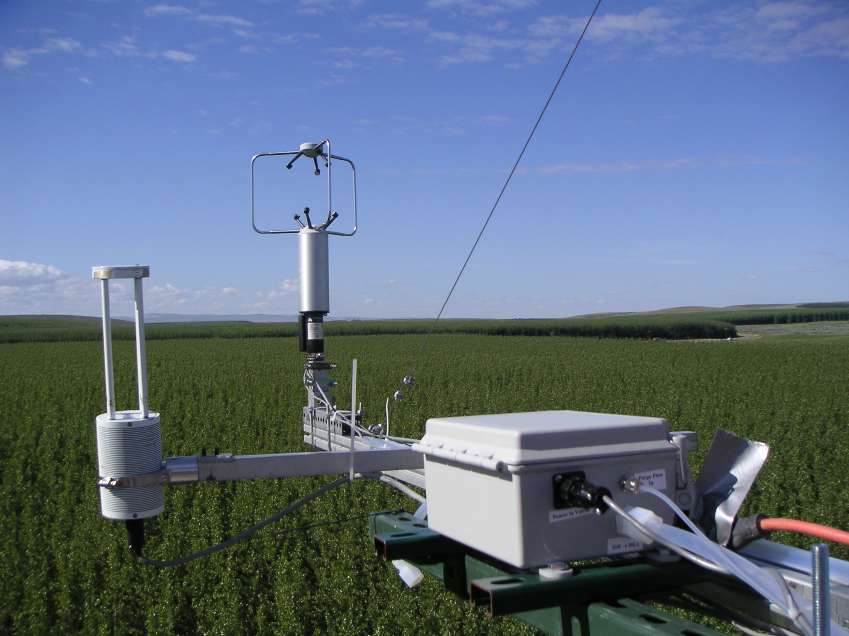
How does the atmosphere respond to changes in the biosphere?
Are there significant interactions and feedbacks?
How does the biosphere respond to the atmosphere?

Slide 4
General Theme: How will ecohydrological disturbances of biogeochemical and water cycles impact air quality, weather, and ecosystem health?
BEACHON
Atmosphere
Cloud processes
Organic aerosol processes
Photo-oxidant processes
Biological particles and VOC emissions
CO₂
H₂O
NO_{y}NH₃
Latent and sensible heat
NO/NH3 emission
Carbon Cycle
Water & Energy Cycles
Nitrogen Cycle
Precipitation and solar radiation
Ozone and N deposition
Water-limited
Biosphere
Warming,Drying
Disturbances:
Urbanization
Insect outbreaks

Slide 5

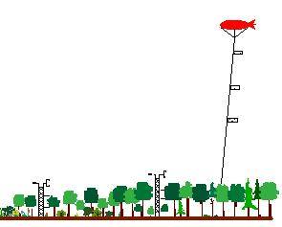

BEACHON: multi-scale modeling and observations
Detailed canopy, cloud and B. L. processes
WRF modeling
Global change impacts
Regional biogeochemical and water cycle interactions
BEACHON Observations
Sub-grid scale: laboratory and chamber observations
Chamber studies
Ecosystem manipulations
WRF model algorithms
Canopy and boundary layer scale: tower, balloon, radar observations
LES modeling
Canopy and boundary layer processes
Airborne studies
Regional scale
Aircraft, satellite, regional network observations
Nested regional WRF modeling
GLOBOENET network
Global scale:
Global measurement network, satellite observations,
Global WRF modeling

Slide 6
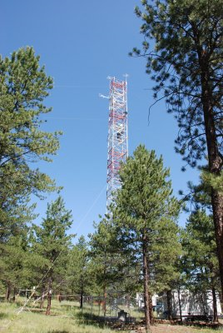
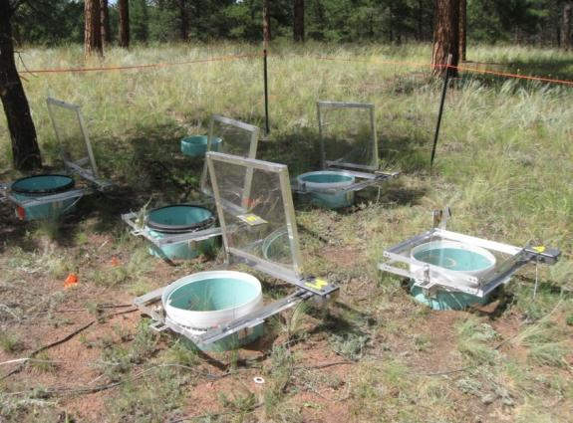
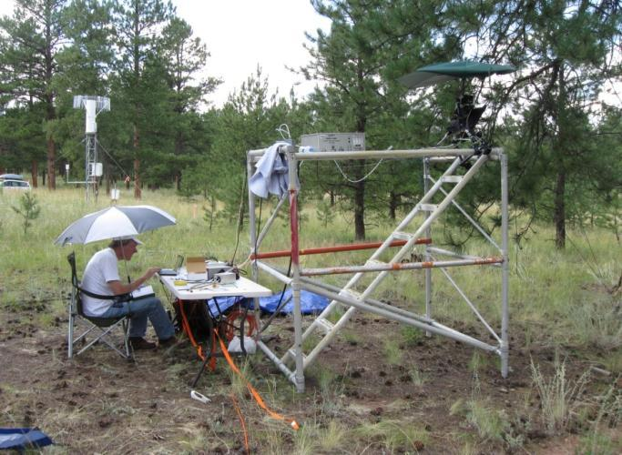
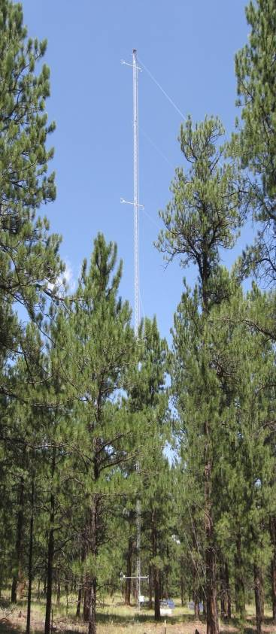
BEACHON: Manitou Forest Observatory
Ponderosa pine woodland in the Colorado Rockies
Chemistry
28-m walk-up tower
Met. (T, RH,Q).
Energy, H2O CO2, VOC Fluxes.
Concentrations: NO/NOx, ozone, SO2, CO, aerosol form.
Specialties: sulfuric acid, OH reactivity, OH, aerosol composition.
enclosure CO2, H2O, VOC, NO flux
soil moisture and characteristics.
Precip. and dew.
k-band radar
Soil
branch/leaf enclosure CO2, H2O, VOC flux
sap flow
45-m triangular tower w/ 5 levels of CO2, H2O, energy fluxes, turbulence
Met. data
Micrometeorology
Vegetation
Notes:
6

Slide 7
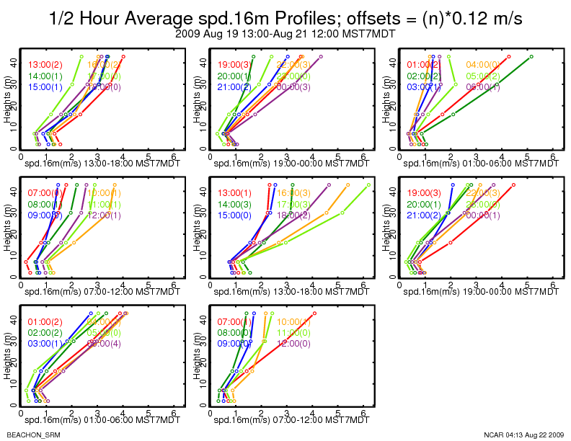
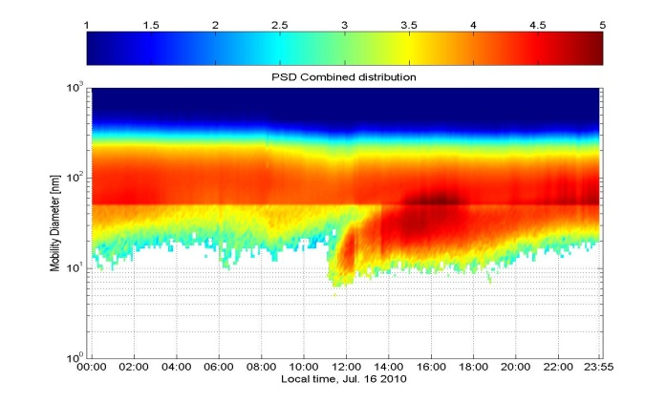
Concentration gradients along with wind speed/turbulence profiles to obtain fluxes
Size resolved aerosol measurements to observe new particle formation events

Slide 8
Micrometeorlogical Flux Measurements:
Many different techniques,
Flux gradients
Relaxed Eddy Accumulation
Budget studies
Eddy Covariance
Of these: Eddy Covariance is the most direct and most often-used technique. (especially for CO2 and water)

Slide 9
Eddy Covariance Method : Starts with the Mass Conservation Equation

Slide 10
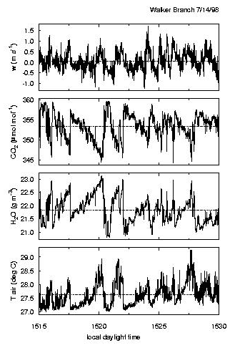
Eddy Covariance Flux
is given by:
where
and
where the overbar
represents an average over
some time period
(typically 15-60 minutes)

Slide 11
Another way to look at the Eddy covariance:
Can use Fourier transform to look at covariance as a function of frequency (Cospectral analysis)
Integrating under the curve yields the covariance (w’c’).
Need to measure c’ very fast. 10 Hz is typical.
But need to average over 15-30 min. to fully sample the low frequencies.
< 1 sec
15 min
15 sec

Slide 12
Other Factors that must be considered for EC fluxes:
Coordinate Frame (rotation)
Density corrections (WPL corrections)
Tubing Attenuations (for closed-path analyzers)
Spectral corrections (setup, instrumental, etc.)
Turbulence Stationarity and integrity
Footprint considerations
Sounds fairly complicated, but……
Since the widespread use of the EC technique in FLUXNET
sites – there are many available resources to instruct how to set up equipment as well as software packages that do much of the computation for you.

Slide 13
Advantages of Eddy Covariance fluxes:
Fairly standardized
Instrumentation for winds, CO2 and H2O.
Quite robust – allows for continuous operation.
Would like as flat and homogeneous a site as possible.

Slide 14
Can see fairly rapid measures in ecosystem dynamics such as carbon uptake, water use, energy partitioning, etc.
See CO₂ uptake once liquid water is able to percolate through the snowpack and reach the soils/roots.
Springtime carbon uptake is more effective with late turn-on, when air temperatures were warmer.
Much of the interannual variability in total NEE is explained in the variability of carbon uptake in springtime.
Spring Turn-on/Niwot Ridge

Slide 15
Can develop algorithms to describe ecosystem behavior based on climate variables
Optimal CO₂ uptake at ~ 8-12ºC

Slide 16
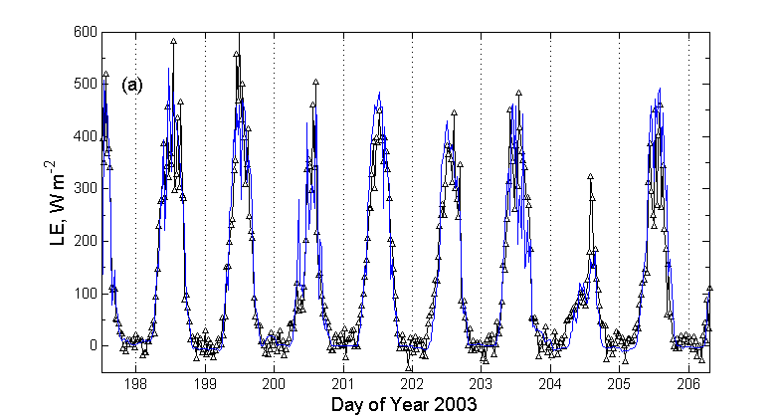
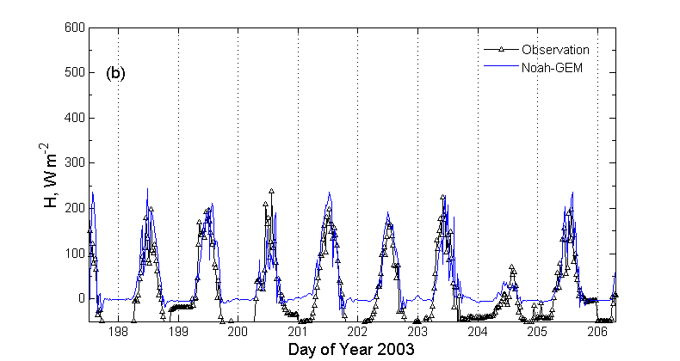
Relatively rapid sample rate allows comparison with process-level models
Comparison with remote sensing (means of “calibrating”) or other regional flux estimates.
Data from Duke Forest, 2003

Slide 17
Problems with Eddy Covariance:
Measure a “net” flux (cannot separate photosynthesis/respiration, etc.)
Sources/Sinks vary spatially (non-homogeneous fetch)
Main Problem: The world is not ideal!!!!
Topography can induce non-uniform airflows/advection
Atm. Stability can change within canopies
Turbulence is not always adequate
Nighttime – Often a co-occurrence of all EC limitations

Slide 18
Back to the Mass Conservation Equation

Slide 19
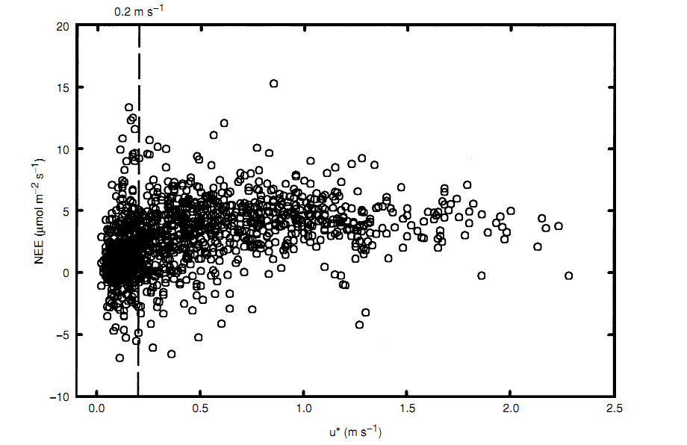
Calm, Stable Nights: Observe EC fluxes approaching zero.
For total Forest carbon – biases towards more uptake!!!
Niwot Ridge, 1999
Must (1) objectively determine when fluxes are affected, and (2) replace suspect data with some type of modeled flux values.

Slide 20
How you handle these advection terms (or biased nighttime fluxes) can have huge impact on annual sums!!!!
Both advection terms are large – for Niwot Ridge the vertical advection term appears to be slightly larger than horizontal (not sure why or if that is just a problem with uncertainties in measurement).
Can’t just include one adv. Term or the the other.
Coincidence or not?!? – best NEE estimate is near the NEE based solely on EC + storage.
Problems – big uncertainties in both advection measurements.

Slide 21
Summary:
Eddy Covariance – most direct way to determine ecosystem level fluxes. For H2O and CO2 – these methods are becoming more standardized.
Good for observing changes in ecosystem dynamics.
Useful in testing of ecosystem level models and comparisons to remote sensing estimations.
The technique does have limitations! Often the basic tenets can be violated which cause fluxes to be underestimated (primarily at nighttime!).
Therefore, must especially be used with caution when looking at total carbon sums over long periods (annual sums).

Slide 22
Thanks!
Mike Ryan, Richard Oakes, USFS
Alex Guenther, Jim Smith, NCAR
Niwot Ridge AmeriFlux site/Russ Monson, Univ. of Colorado

Slide 24
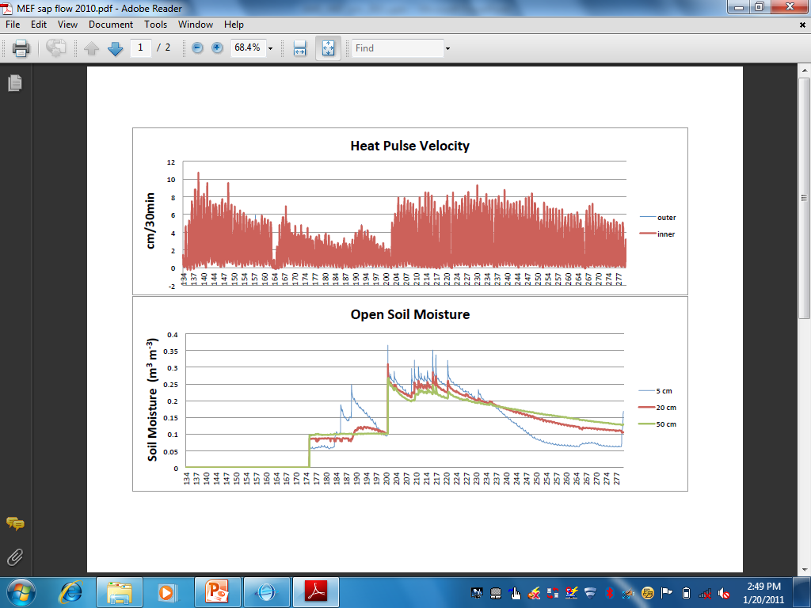
Sapflow & Soil Moisture Response
Strong response in sapflow latent heat flux, and near surface soil moisture in response to mid-summer precipitation events
Whereas deep soil moisture is fairly constant.

