Slide 1
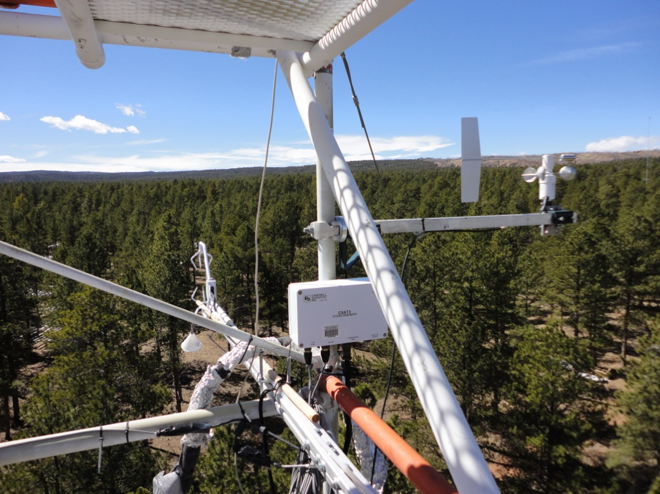
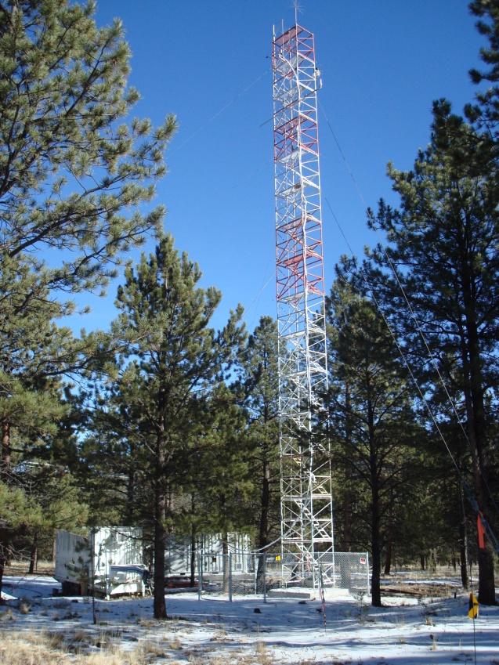
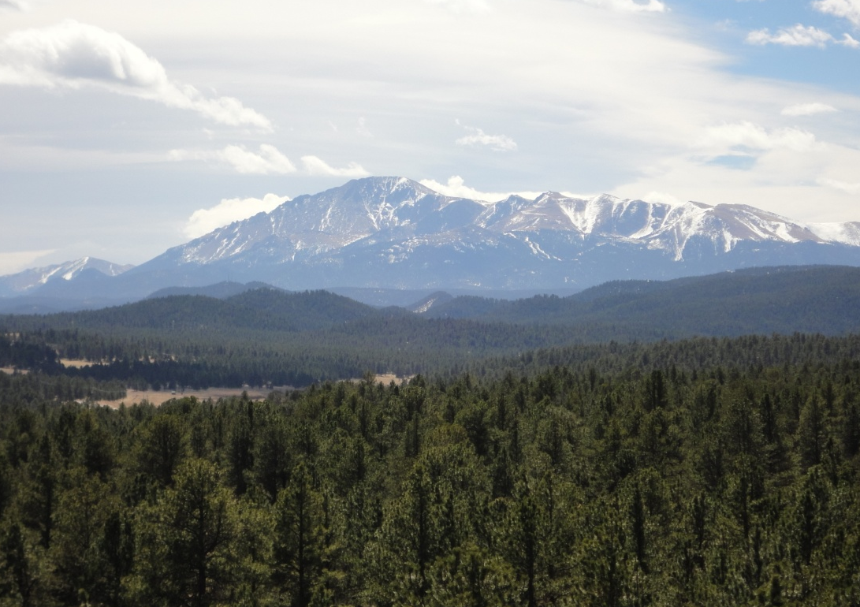
BEACHON-ROCS
Data Meeting
April 26, 2011
Meteorology, Ecosystem Status and some Trace Gases
Andrew Turnipseed
NCAR, ACD/BAI

Slide 2
Meteorological Variables: Temperature/Light/Precipitation
missing
Unstable
Stable

Slide 3
Ecosystem Fluxes: Sensible/Latent heat, CO2 flux
July-August, 2010
Beginning of several precipitation events

Slide 4
Winds during BEACHON-ROCS
Night (6PM-6AM) – Drainage Flows from the South
Midday (10:00-16:00) – South and west are still most likely. But see signifcant flows from NE

Slide 5
Typical Wind Patterns
1. Southerly drainage flows at night – shifts to the SW during the day.
2. Southerly drainage flows at night – shifts to the NE during the day. (Likely a mountain-valley flow pattern!)

Slide 6
Mtn/Valley Flow
SW daytime flow
“Cleaner” conditions. See NOy increase after stable layer sets up (South winds)
Higher O₃, NOy with NE winds (Denver)

Slide 7
Bottom Line:
“Cleaner” conditions the more westerly the wind. See more anthropogenic influences in the eastern hemisphere, particularly NE (Denver) and SSE (Woodland Park/ Colorado Springs).

Slide 9
SO₂ Emissions from Colorado Counties (EPA, 2005)
 | Boulder | Jefferson | Douglas | Denver | Arapahoe | Adams |  | El Paso | Pueblo
Emission/Area | 1921 | 3540 | 493 | 4357 | 1356 | 7129 |  | 14435 | 13906
Area | 740 | 773 | 842 | 156 | 804 | 1182 |  | 2128 | 2397
Emissions (x10⁶) | 1.42 | 2.74 | 0.42 | 0.68 | 1.09 | 9.63 |  | 30.72 | 33.33
Denver Metro Emission (x10⁶) | 15.98 |  |  |  |  | El Paso + Pueblo |  | 64.05

Slide 13
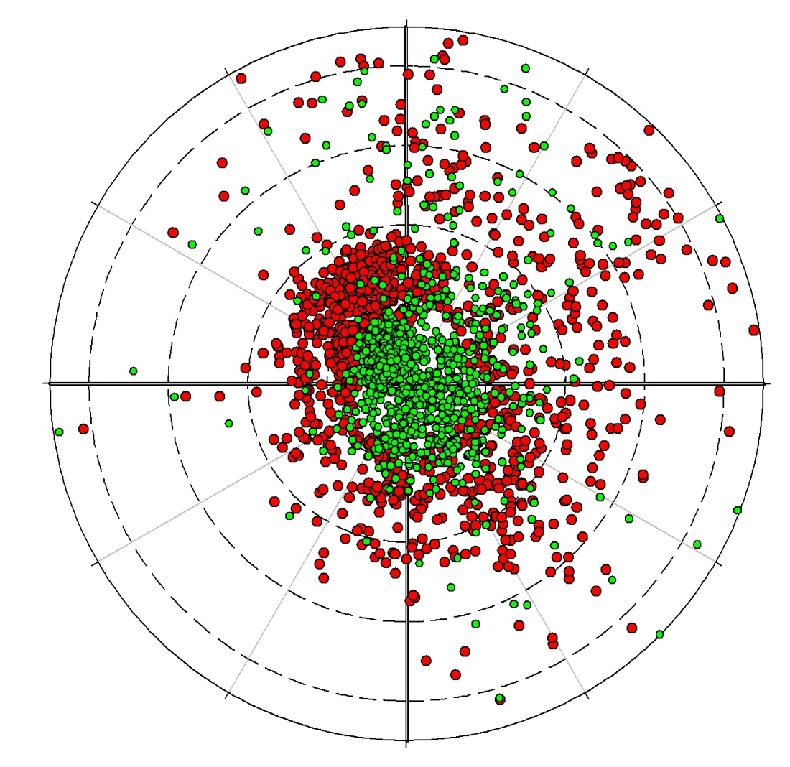
0°
NOx
NOy
270°
90°
2
3
4
180°

