Slide 1
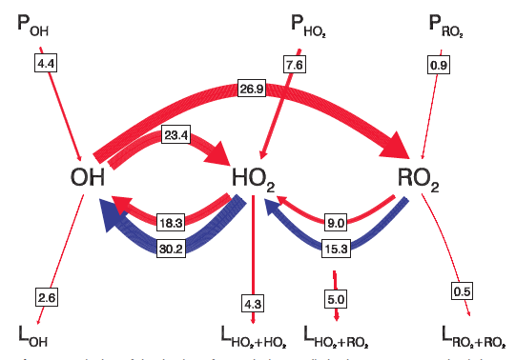
Current View on HO-HO2-RO2 cycle (Hofzumahaus 2009, Science)
The issue is we don’t know the regeneration mechanism from RO2+HO2 towards OH

Slide 2
A little more simpler view
During BEACHON ROCS 2010, we were constrained all terms except the regeneration term
Ozone production
O3 + hv -> O2 + O(1D)
O(1D)+M -> O(3P)+M
O(1D)+H2O -> 2OH
Permanent Loss of OH
(e.g. OH + NO2 -> HNO3)
P(OH)
L(OH)
(OH Reactivity)
OH
HO2+RO2
R(OH)
Simple Steady State Calculation is Possible, like
P(OH) + R(OH)*[HO2+RO2] = L(OH)[OH]
Therefore
[OH] = (P(OH)+R(OH)*[HO2+RO2])/L(OH))

Slide 3
Results
R(OH) = k_{HO2+NO} [HO2][NO]
JO3 was estimated from the Saunder et al. (2003) scheme and scaled it with measured J_{NO2}
The calculations show a reasonable agreement

Slide 4
Daily Variations-Measurement vs highly constrained SS calculations vs highly constrained MCM model
- The SS calculations show excellent agreement with the measurement except early morning (may be due to HONO??)
- The MCM calculations look disaster… (need to double check the calculations)

