Slide 1
SFIT Workshop
Shima Shams

Slide 2
Data
Fourier transform infrared spectroscopy (FTIR)
looks at the atmospheric column from the surface
high temporal resolution , every min
P-AERI (Polar Atmospheric Emitted Radiance Interferometer) at
since 2010 at Summit Station, Greenland (72°N, 39°W)
the Integrated Characterization of Energy, Clouds, Atmospheric State, and Precipitation at Summit (ICECAPS) project
400 cm⁻¹ (25μm) and 3000 cm⁻¹ (3μm) with a moderate spectral resolution of 0.6 cm⁻¹ (Revercomb et al., 1998; Knuteson et al., 2004a; 2004b).
winter time measurements
Notes:
Fourier transform infrared spectroscopy (FTIR) has been used to retrieve ozone (García et al., 2012; Vigouroux et al., 2008; 2015). One of the biggest advantages of ground-based infrared spectroscopy comparing to space/airborne is the absence of surface reflectance and emission in the dataset. This characteristic makes it easier and more accurate to quantify the concentration of atmospheric gases.
In this research P-AERI (Polar Atmospheric Emitted Radiance Interferometer) at Summit Station, Greenland (72°N, 39°W) and Solar FTIR at Thule, Greenland (77°N, 69°W) will be used to retrieve ozone. P-AERI is part of the Integrated Characterization of Energy, Clouds, Atmospheric State, and Precipitation at Summit (ICECAPS) project. P-AERI has measured the down-welling infrared spectral radiance since 2010 at Summit Station. The spectral range of P-AERI is between 400 cm⁻¹ (25μm) and 3000 cm⁻¹ (3μm) with a moderate spectral resolution of 0.6 cm⁻¹ (Revercomb et al., 1998; Knuteson et al., 2004a; 2004b). P-AERI measurements are taken every minute year-round. Having continuous radiance measurements is the main advantages of P-AERI. Retrieving ozone over winter time is extremely important and informative. In addition, P-AERI has been operating continuously at Summit Station since July 2010, yielding almost nine years of continuous data including nine winter seasons.
Solar FTIR is part of the Network for the Detection of Atmospheric Composition Change (NDACC) since 1999. Solar FTIR has measured the infrared spectra in the range of to 769 cm⁻¹ (13μm) to 5000 cm⁻¹ (2μm) with 0.0035 cm⁻¹ spectral resolution. Solar FTIR has captured down-welling radiance measurements every minute for 8 months, excluding polar nights (Hannigan et al., 2009). The main advantage of solar FTIR is the high spectral resolution. Retrieving vertical information about ozone is possible because of the high spectral resolution of solar FTIR.
Near-infrared light generally refers to light within the wavenumber range of 12,500 to 4,000 cm⁻¹(wavelengths from 800 to 2,500 nm)

Slide 3
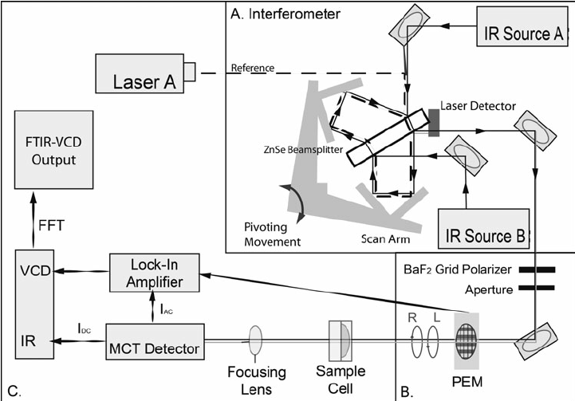
PAERI
Mechanism of double port, Bomem Interferometer
Source A using a mirror switch between HOT black body (BB), cold BB (Ambient), sky.
Source B is a black body at the instrument temperature.
To be able to remove the emission of instrument from the spectra
Schweitzer-Stenner, Reinhard & B Soffer, Jonathan & Verbaro, Daniel. (2012). Structure Analysis of Unfolded Peptides I: Vibrational Circular Dichroism Spectroscopy. Methods in molecular biology (Clifton, N.J.). 895. 271-313. 10.1007/978-1-61779-927-3_18.

Slide 4
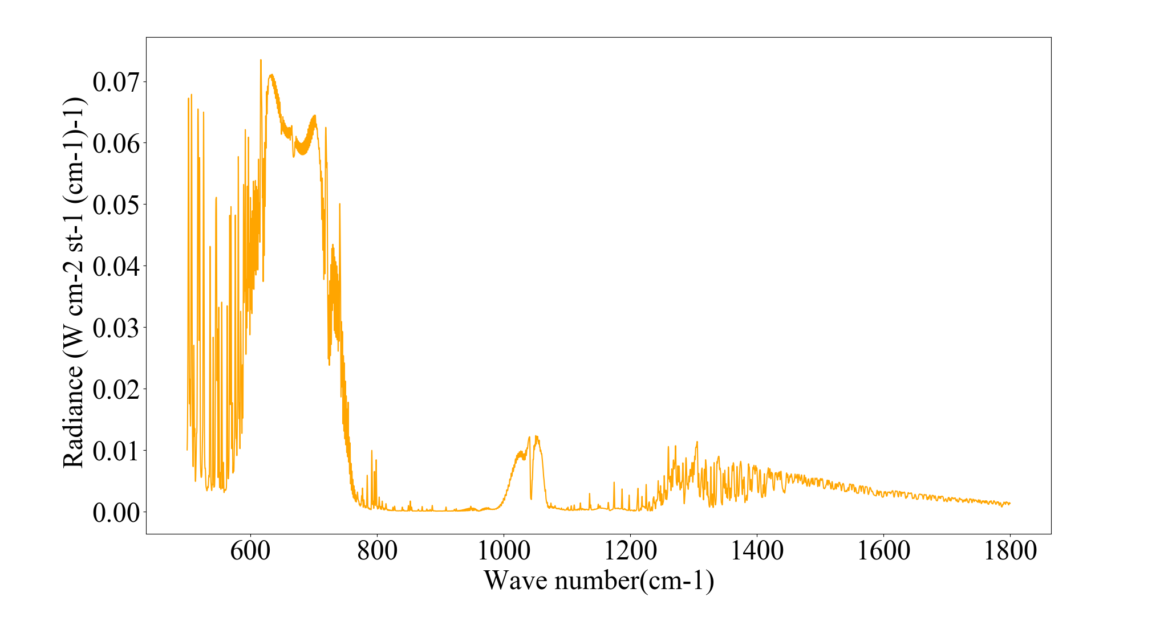
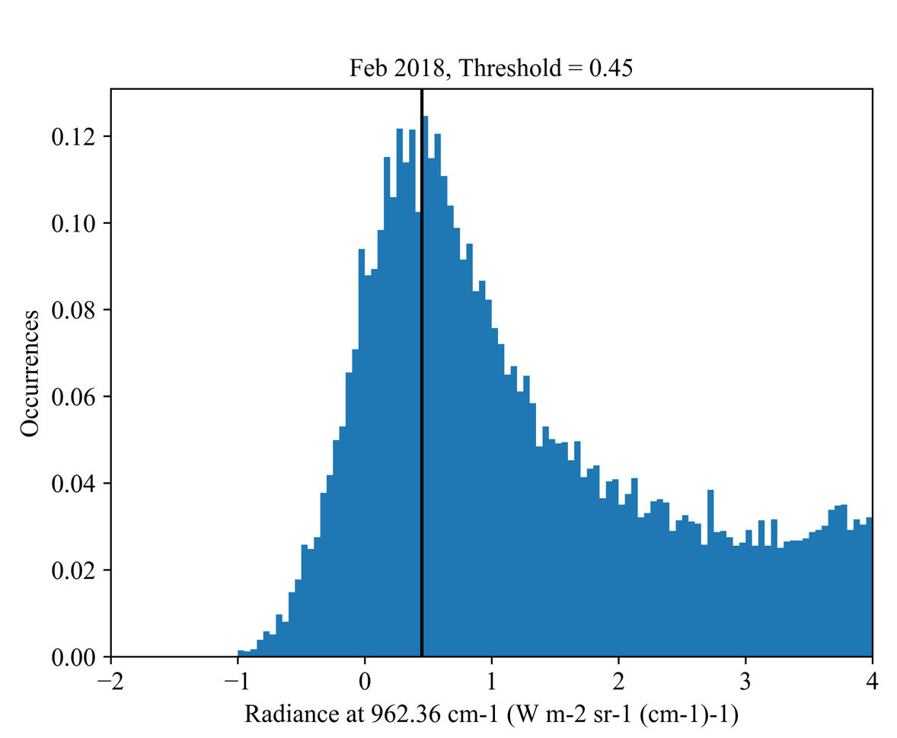
Spectra
Clear sky determination
962.36 cm-1
Monthly variation in near-surface water vapor
Monthly histograms to find the threshold
To increase the signal-to-noise ratio
Hourly average the clear sky radiances
longer than 30 min.
P-AERI radiance noise from 0.1 mW m-2 sr-1 (cm-1)-1 to higher than 0.012 mW m-2 sr-1 (cm-1)-1.
spectral range of retrieval
950 to 1100 cm⁻¹ using P-AERI
Ozone band
Clear sky

Slide 5
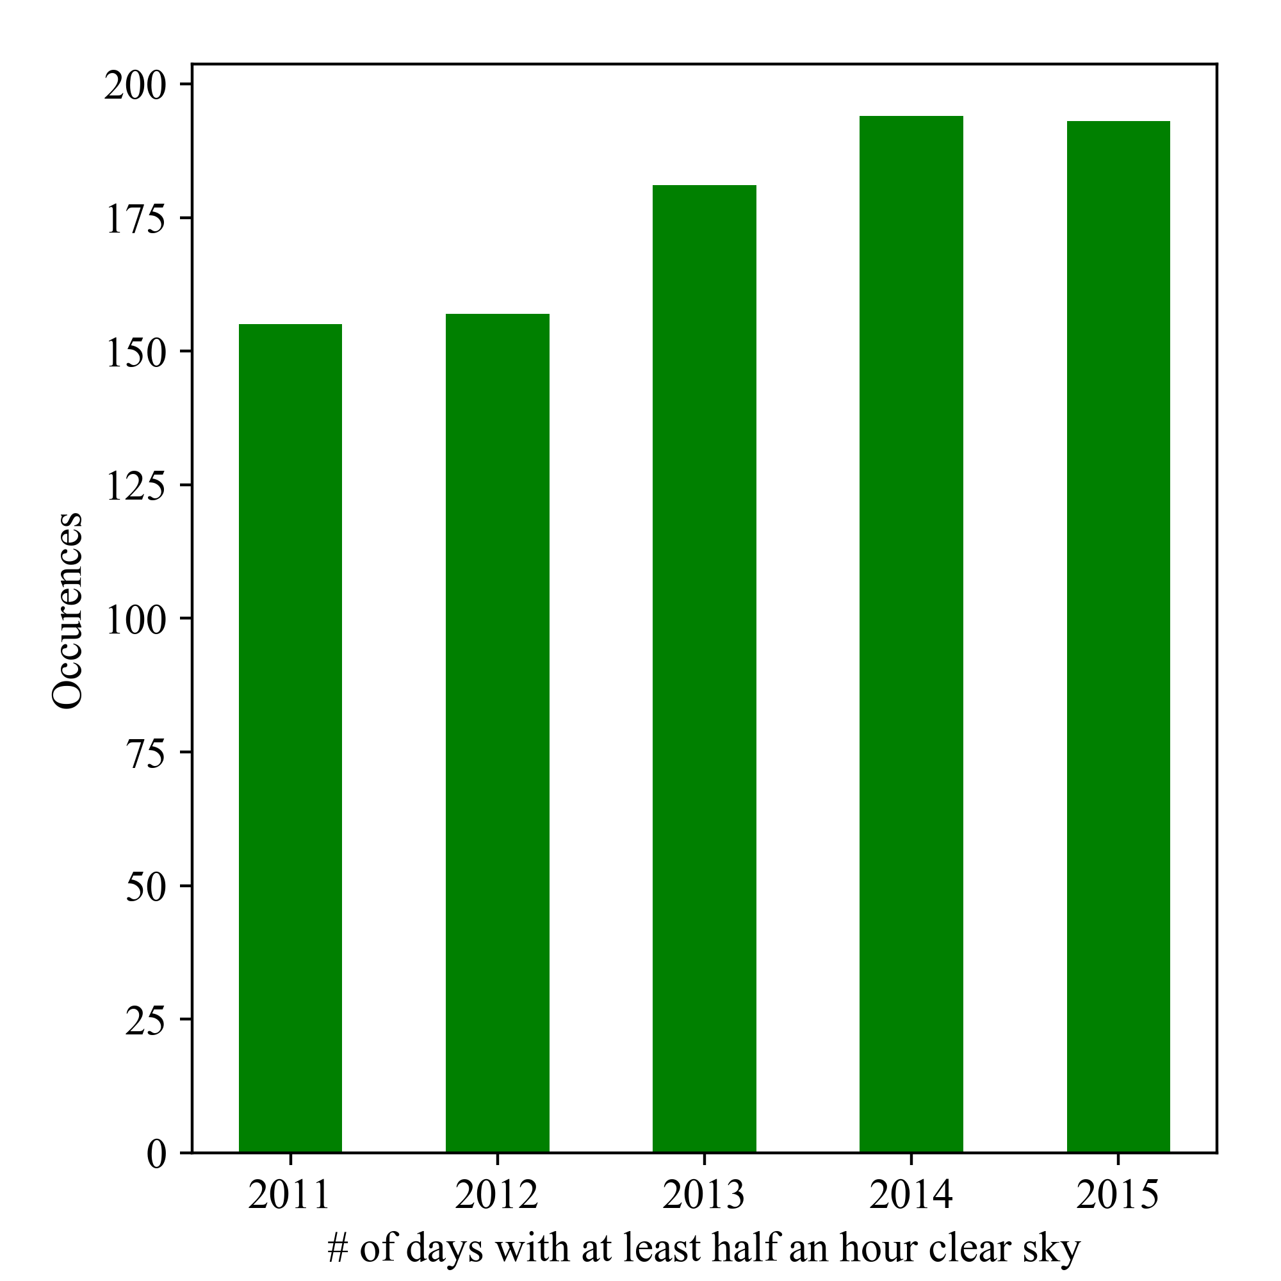
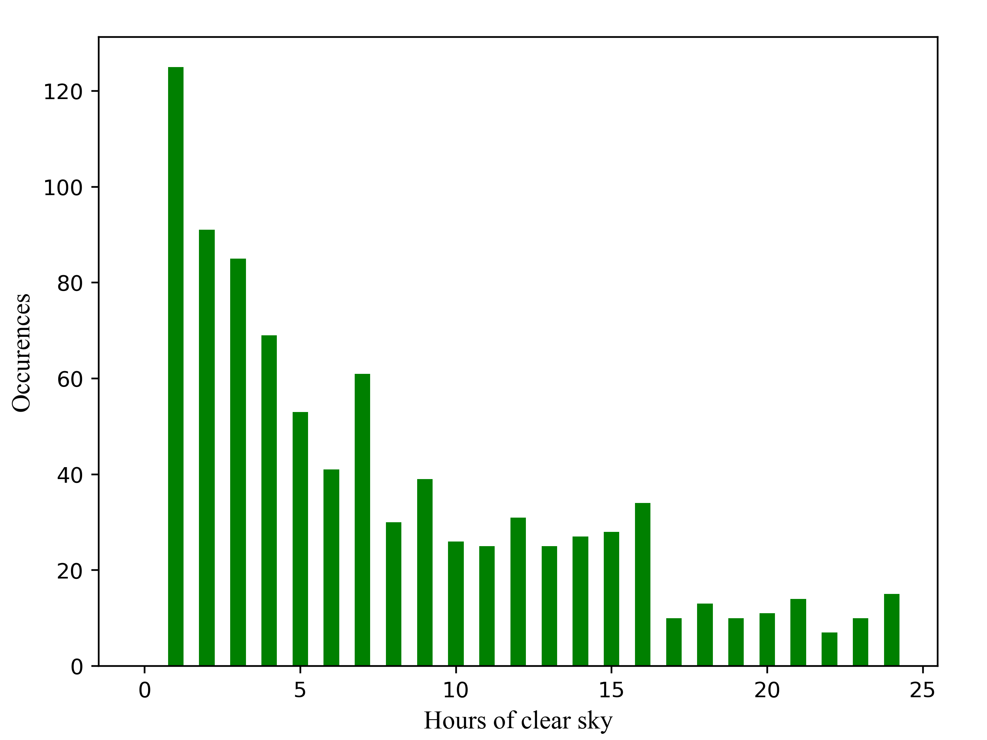
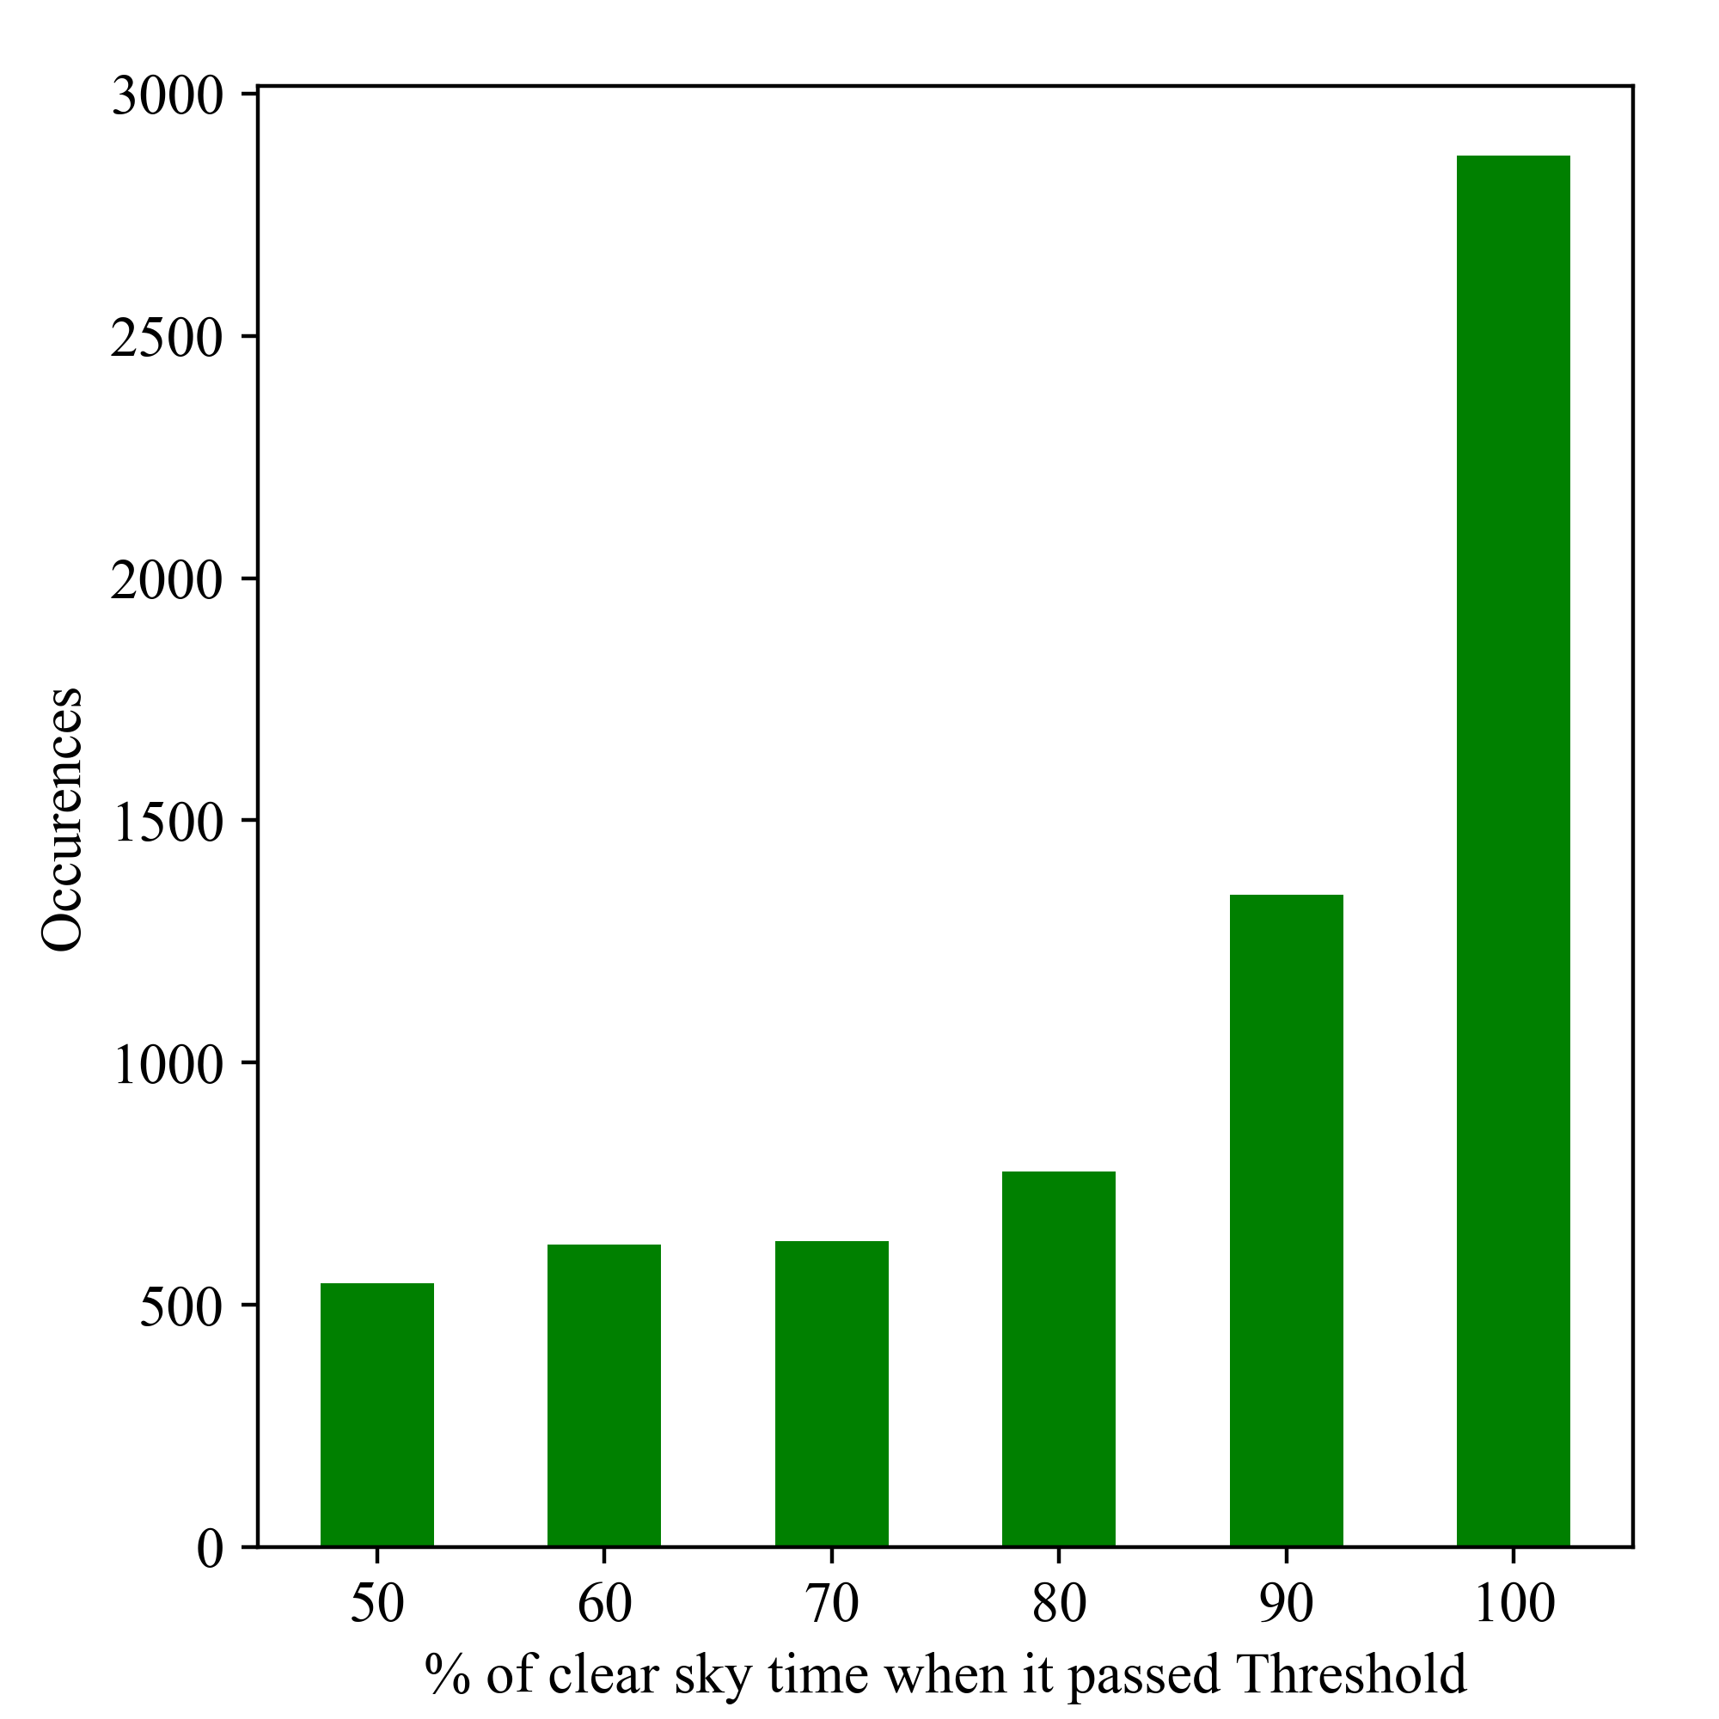
Clear sky data
In days that contains clear sky
In a give hour

Slide 6
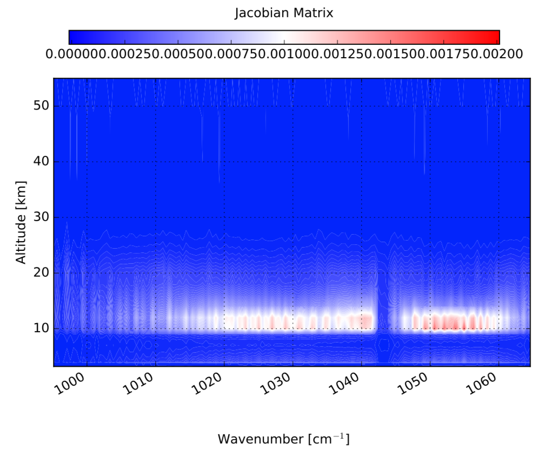
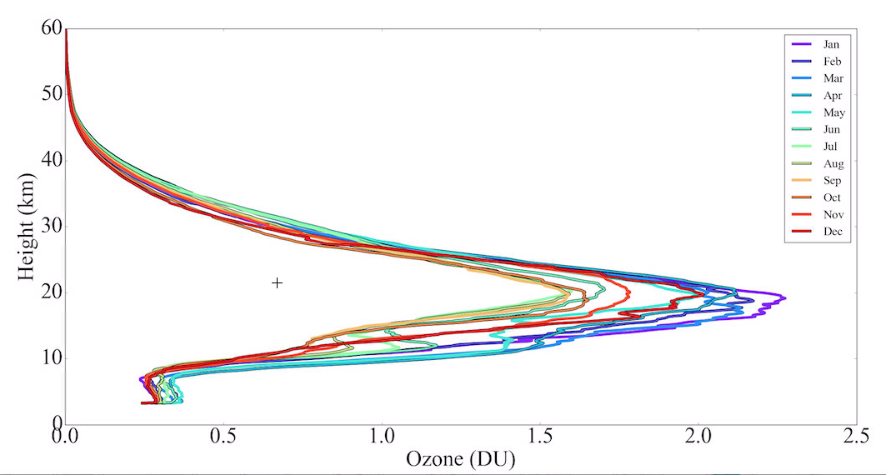
Jacobian Matrix
Looking at the Jacobian Matrix (K)
It explain that PAERI spectra is mostly sensitive to the 10 to 15 km and then there signal up to 20 km.
Below 10 km:there is not that much signal because of very low amount of ozone compared to stratosphere.
We need to have good estimation of upper level ozone prior to the retrieval
In this presentation we use Ozonesonde+MLS
eventually we will use MERRA2

Slide 7
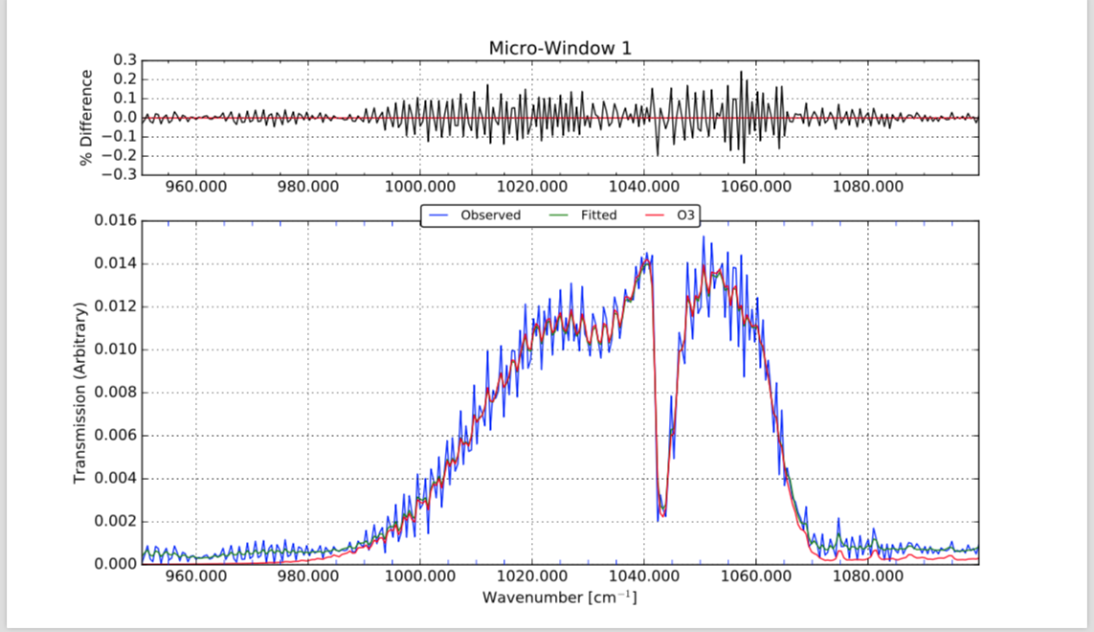
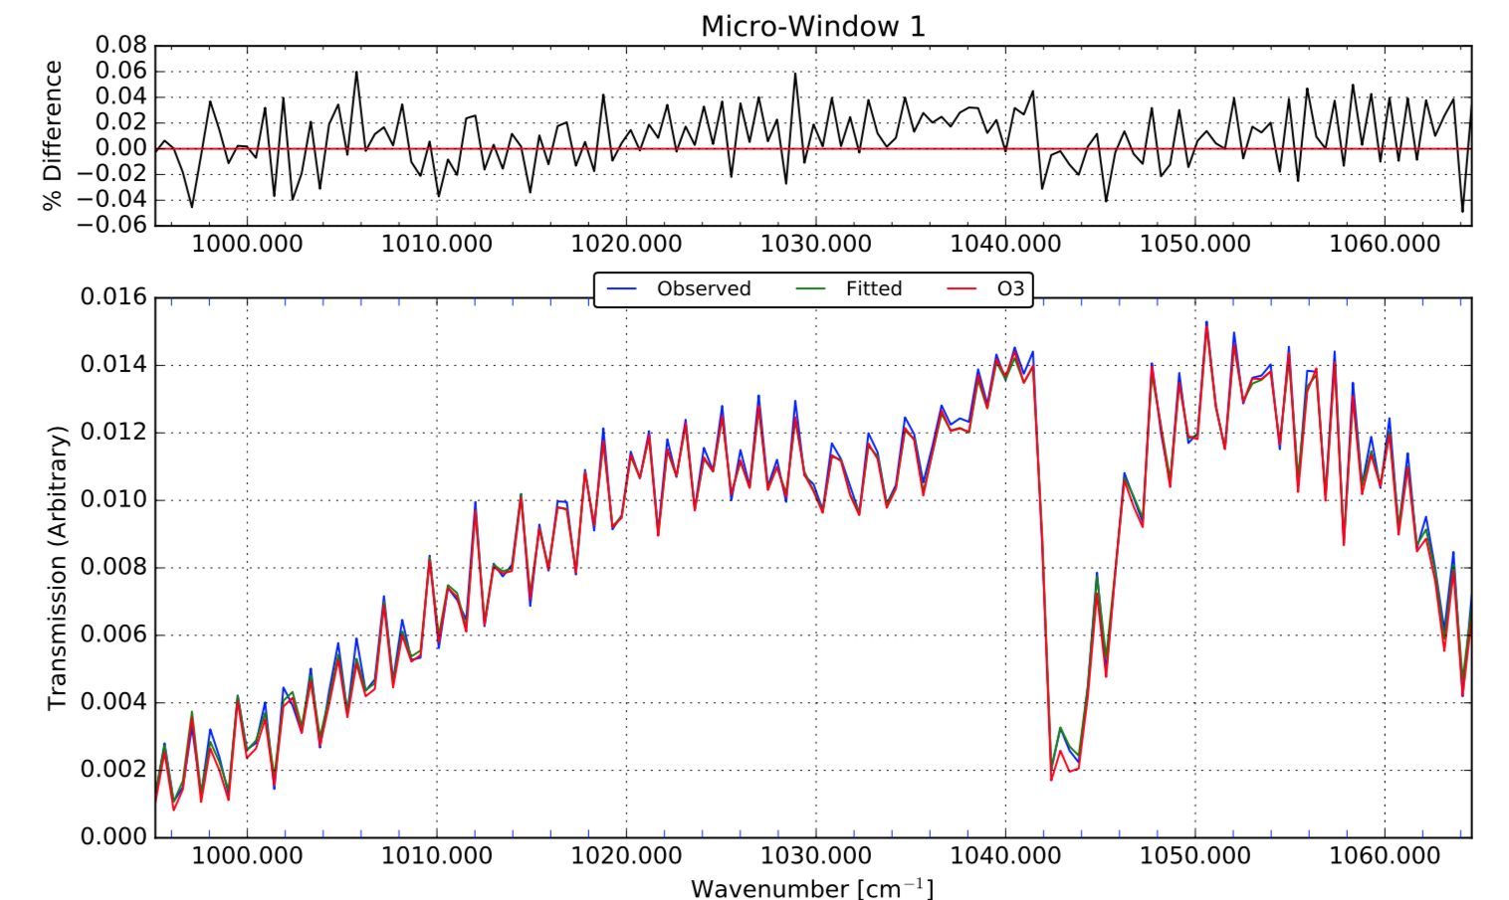
Truncation function
Hamming
Box-car
This is showing the Box-car is our Truncation function

Slide 8
Do we have interfering gases in this spectral region?
We looked at all gases in that were used to create main hbin file
Group #1: Gases had some lines in the spectral region
H20 | HO2 | C2H2
O2 | H2O2 | CHF2CL
NO | N2O5 | CH3BR
SO2 | CLONO2 | HCOOH
NO2 | HCN | H2S
NH3 | CH3CL | SF6
HNO3 | CF4 | CFC113
OH | CCL2F2 | F142B
CLO | CCL3F | HOCL
OCS | C2H4
Group #2: No spectral line of these gases exists in the 950 to1100 cm-1. Thus the code errored.
CO | HONO | COCL2
HF | HO2NO2 | CH3I
HCL | CH3F | CHCL2F
HBR | CH3CCL3 | NF3
HI | CCL4 | OCLO
H2CO | COCLF | F134A
C3H8 | C2H6
C3H6 | N2
We even scale gases group #1 by 20 to see if exaggerated value of these gas has a significant signature in 950 to 1100 cm-1
Retrieving H2o and co2
None of them showed a significant signature of other gases
Removing other gases from Hbin to speed up the retrievals.
Group #3: In the prior file zero array were assigned to these thus we couldn't test them
O2CIA | CH3COOH
CH3OH | C5H8
CH3CNPL | MVK
C2H6PL | MACR
PAN | C4H8
CH3CHO | CH3CN

Slide 9
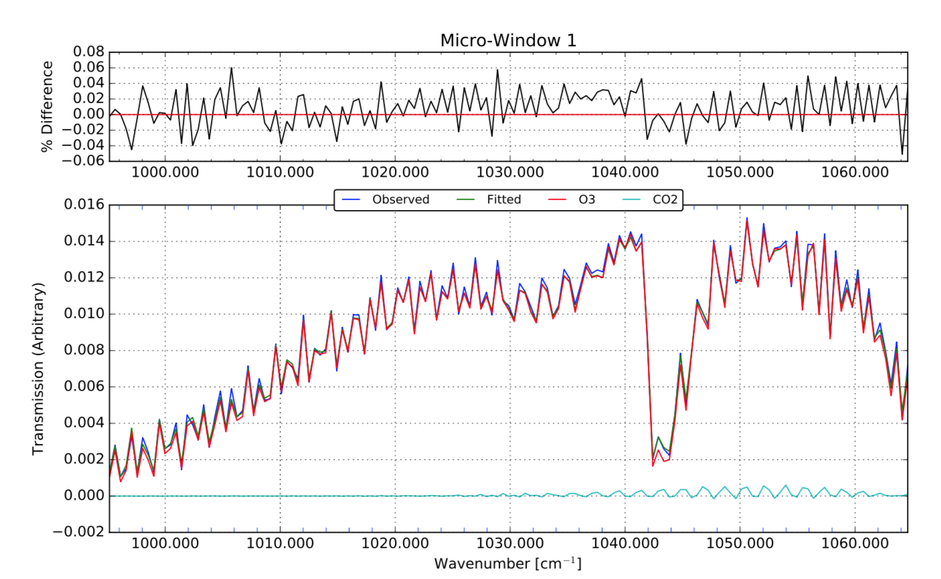
O3 + CO2 retrieval
We know that there is a CO2 signal in this region
We decide to retrieve CO2 to help the RMSE in the retrieval

Slide 10
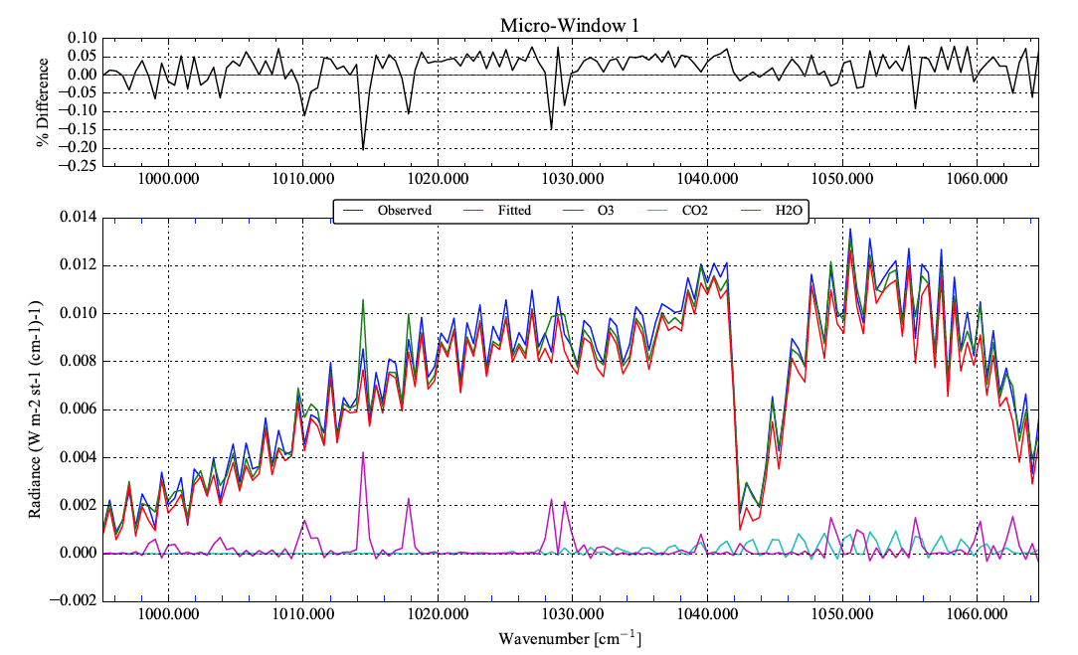
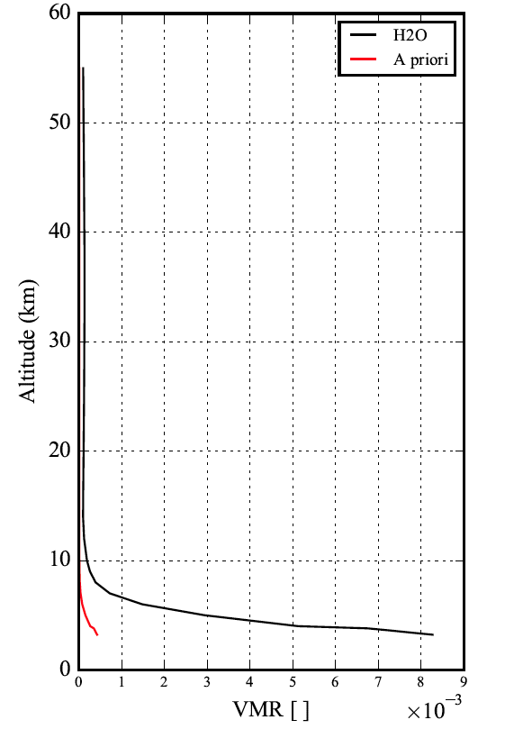
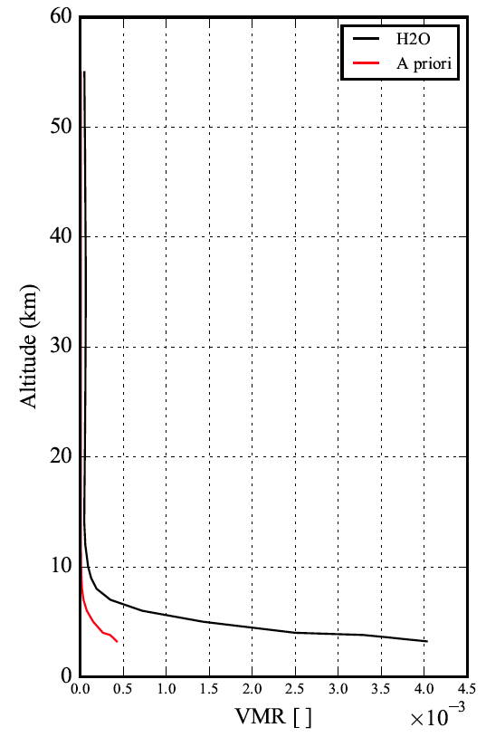
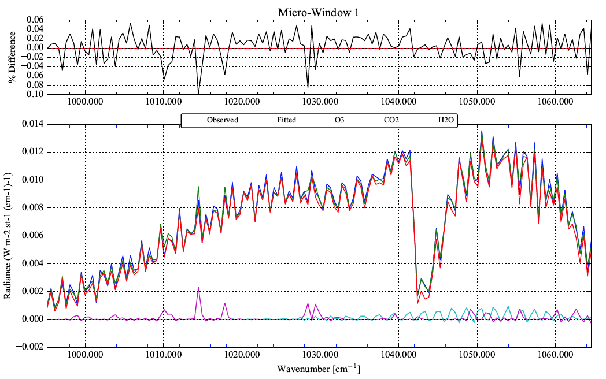
Scaling water vapor profile
H2O,Scale 20
We only see water vapor spectaral signal in 950 -1100 cm-1 if we scale it
We tried the scale value of 20 and 10
It this realistic??
H2O, Scale 10

Slide 11
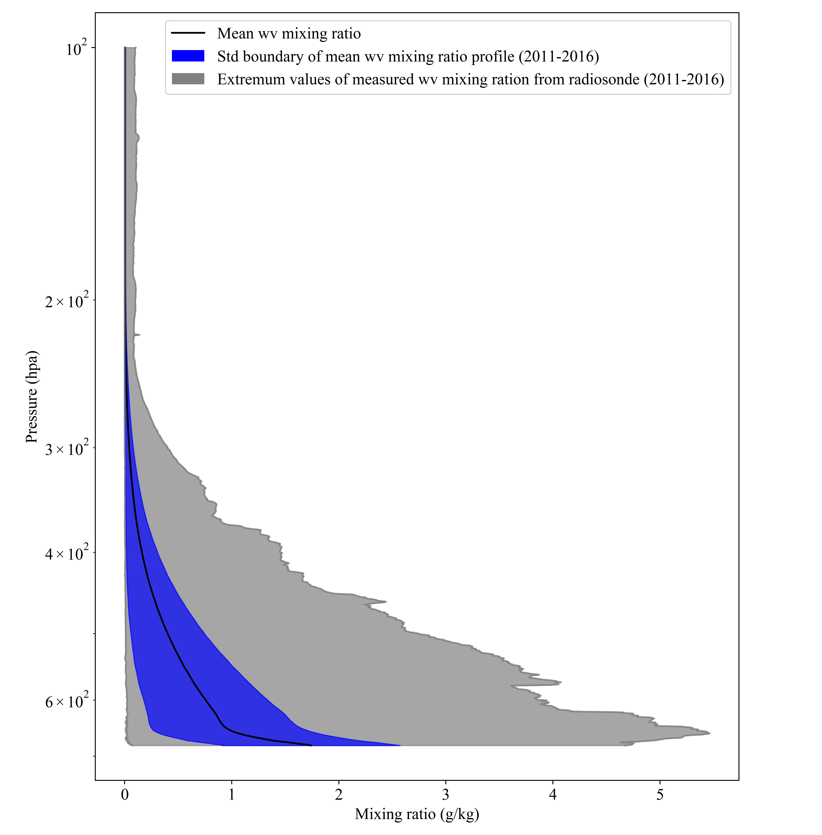
Looking at the variability range of Water vapor may be we are better to include it in the retrieval
Thus we also include the water vapor

Slide 12
Different tests

Slide 13
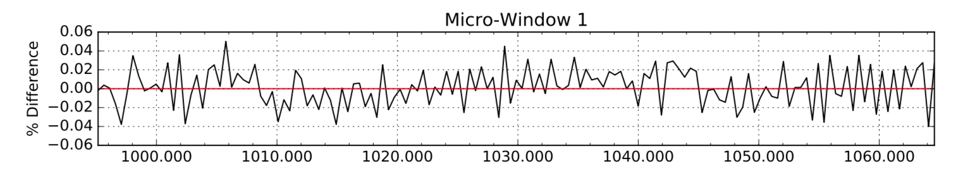
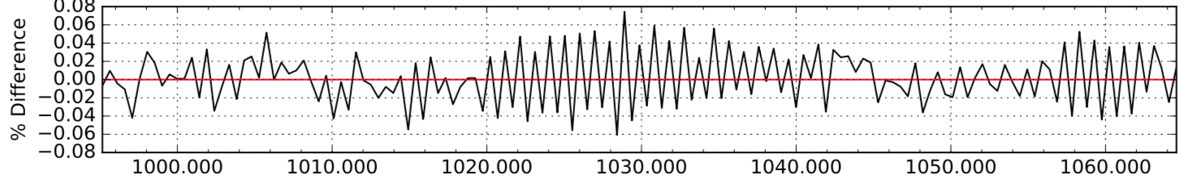
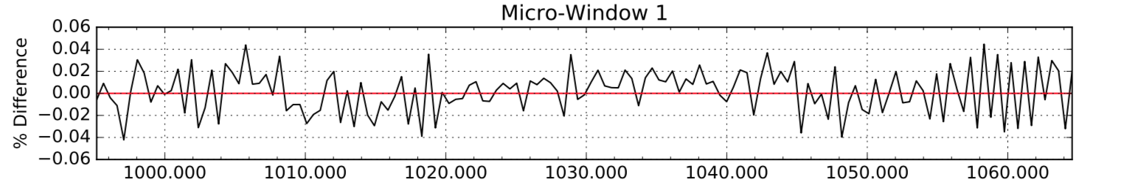
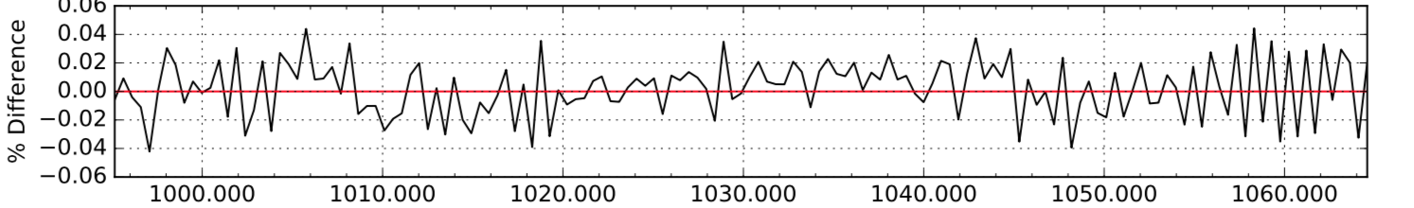
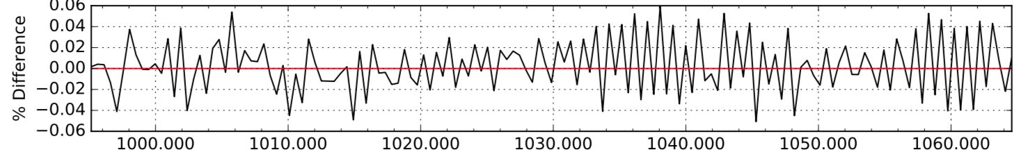
Tune up opd
For the base case
Opd=1.02
Opd list | RMSE | (opd-base - new)/base*100 | Delta SMRE
1.02 | 0.0293 | -1.6 | 47.9
1.037 (base ) | 0.0198
1.042 | 0.0197 | 0.5 | -0.5
1.045 | 0.0197 | 0.8 | -0.5
1.08 | 0.0258 | 4.1 | 29.9
Opd=1.042
Opd= 1.045
Changes in the RMSE are not significant
Thus we stick to 1.037
Further on we look at small tuning of of OPD and see how that affects the retrieval over the coincide Ozonesonde+MLS dates,
1.032 and 1.042 did not significantly change the TCO! (further slides)
Opd=1.08

Slide 14
SNR for the emission FTIR is actually just noise!

Slide 15
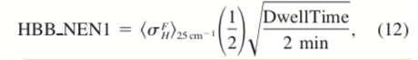
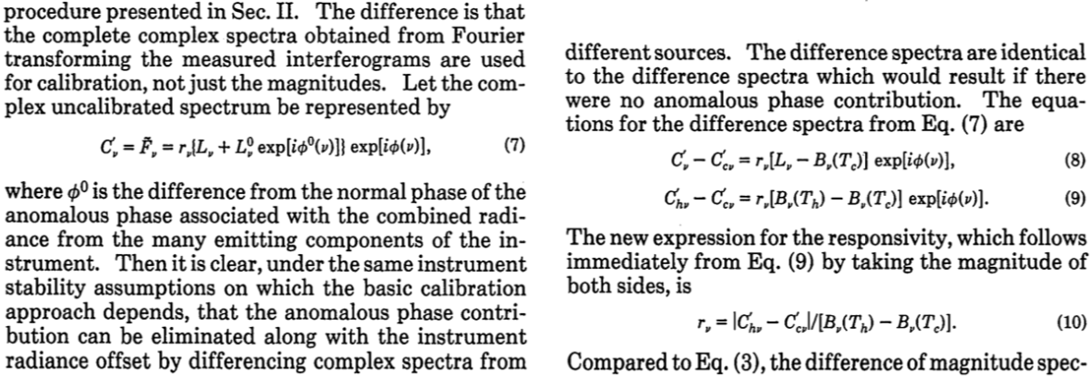
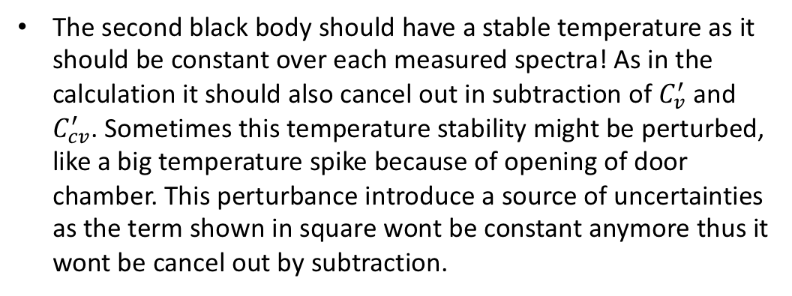
Noises
The first AERI noise estimate uses the variance computed during the dwell period of the internal hot blackbody reference.
Where 𝞭 is the square root of the variance of magnitude spectra collected during the forward Michelson sweep directions of the hot blackbody view. (Knuteson et al, 2004)
The second black body should have a stable temperature as it should be constant over each measured spectra! As in the calculation it should also cancel out in subtraction of $C_{v}^{′}$ and $C_{cv}^{′}$. Sometimes this temperature stability might be perturbed, like a big temperature spike because of opening of door chamber. This perturbance introduce a source of uncertainties as the term shown in square wont be constant anymore thus it wont be cancel out by subtraction.
Revercomb et al,1988
Second BB
Instrument temp
DwellTime= averaging over six spectra that each one took 3 to 6 secs

Slide 16
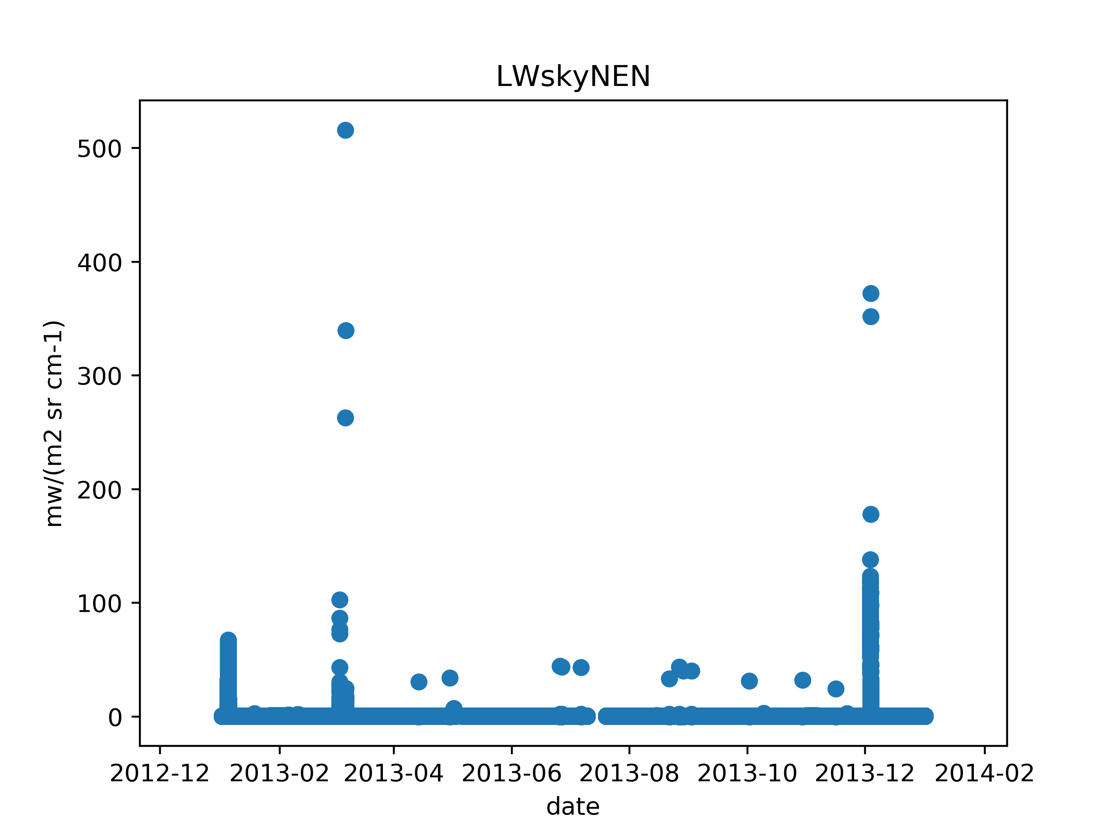
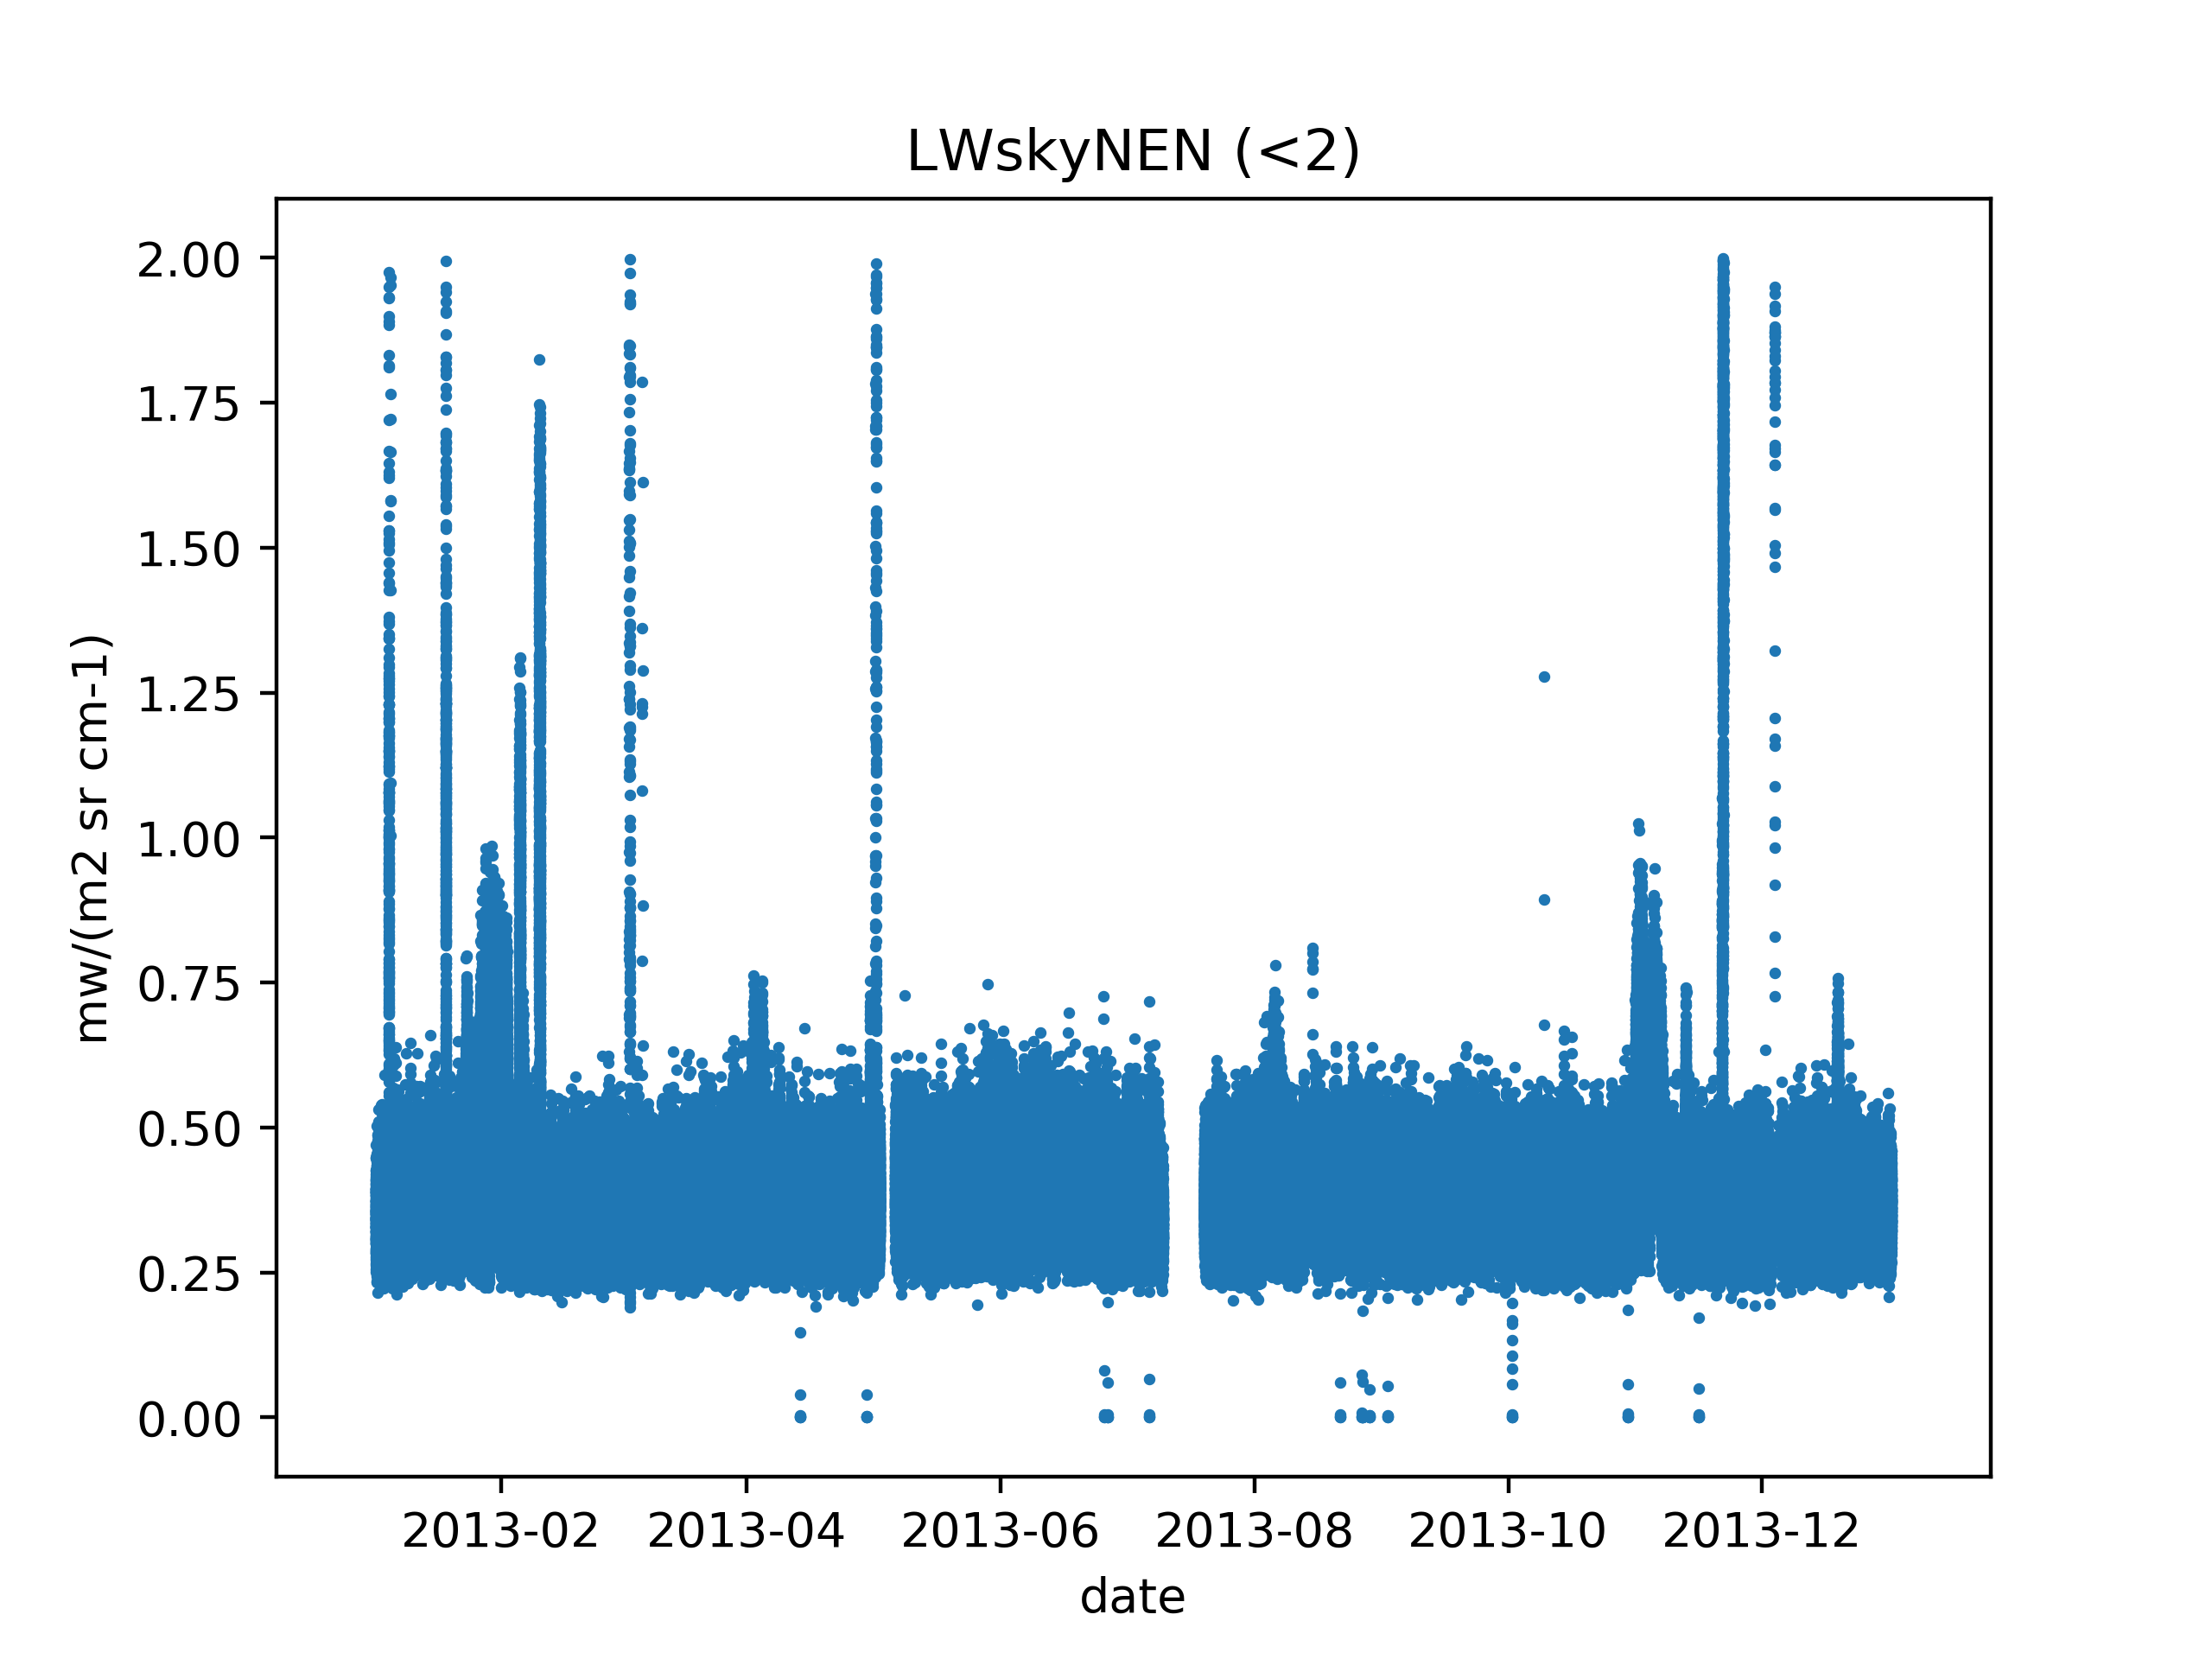
The noise equivalent radiance observed in the longwave channel during a sky view at 1000 cm-1
The main range is 0.25 to 0.5 mw/(m2 sr cm-1) which is way higher that 0.1 of previous slide
Why they are some high values? What physical process could cause these fluctuations?

Slide 17
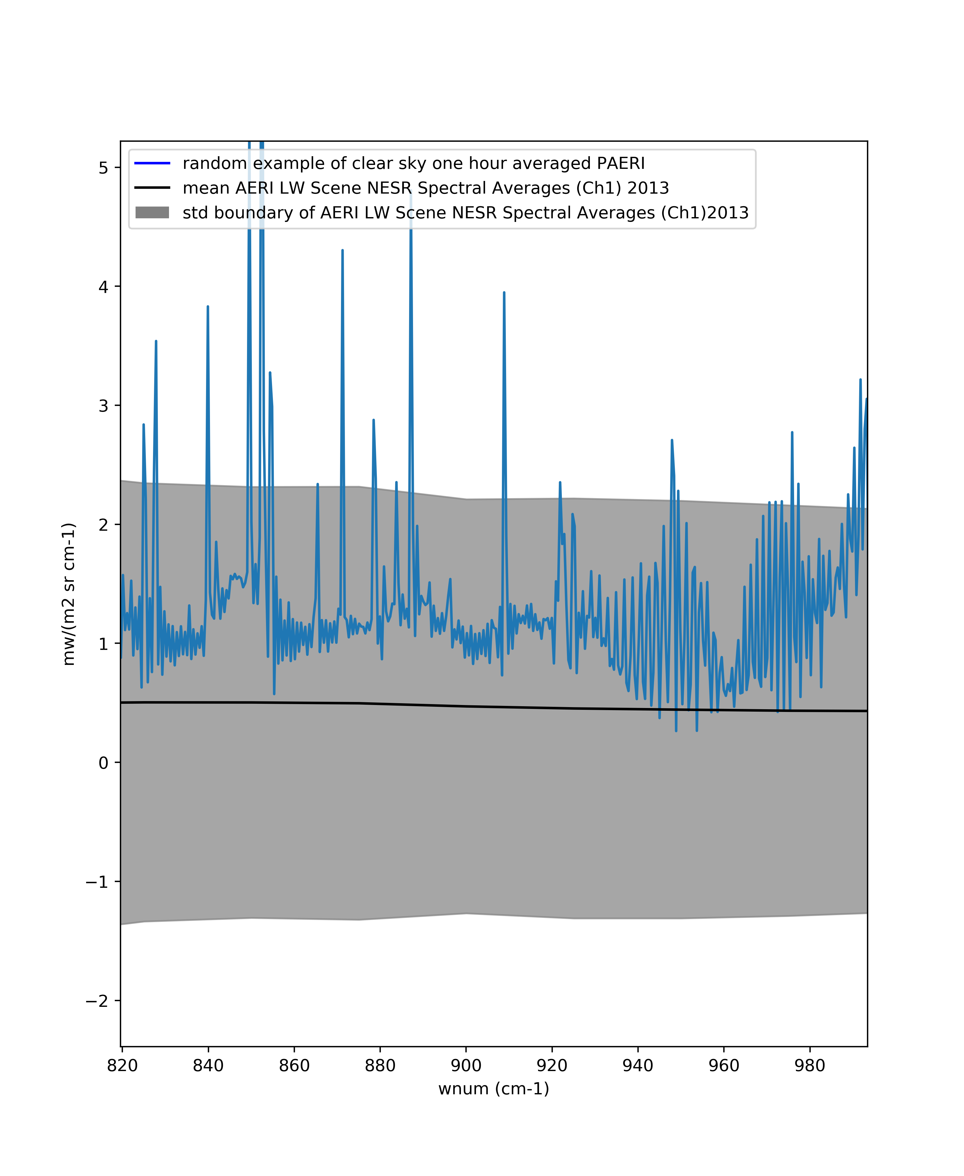
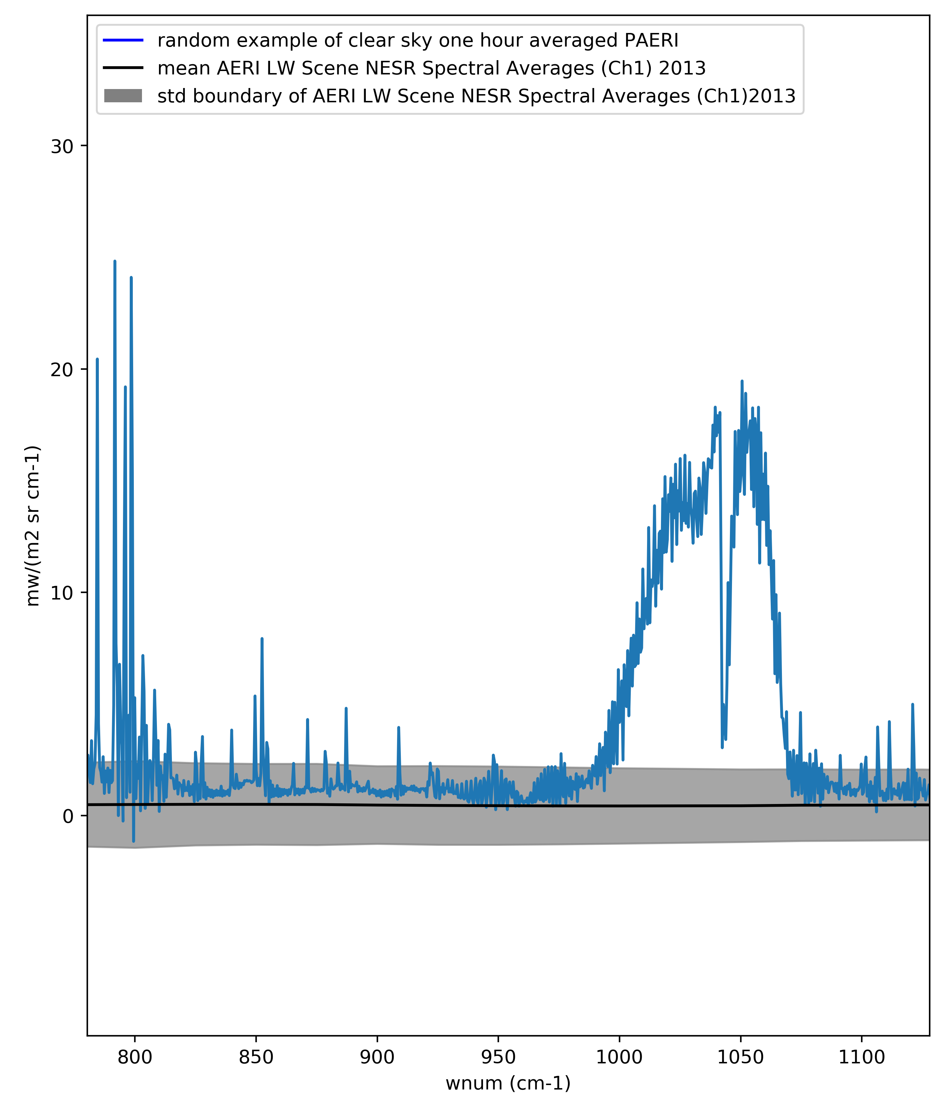
SkyNENch1

Slide 18
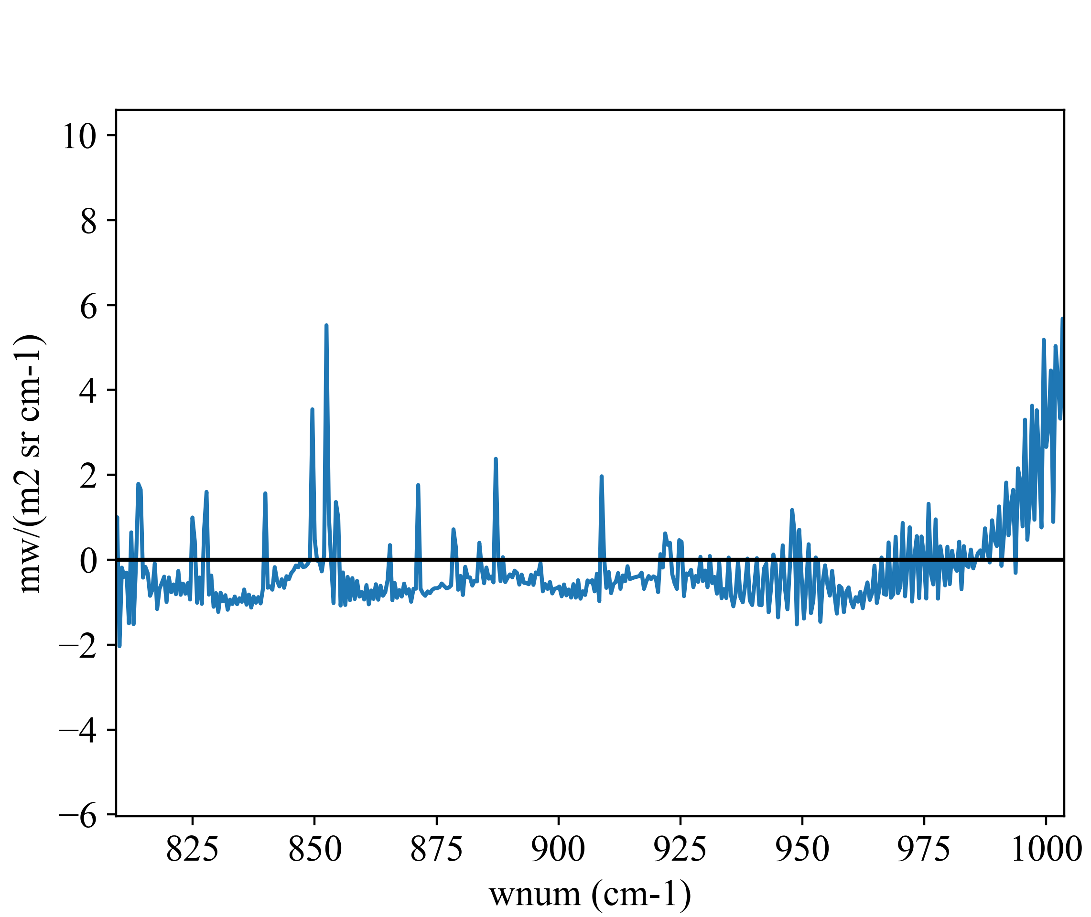
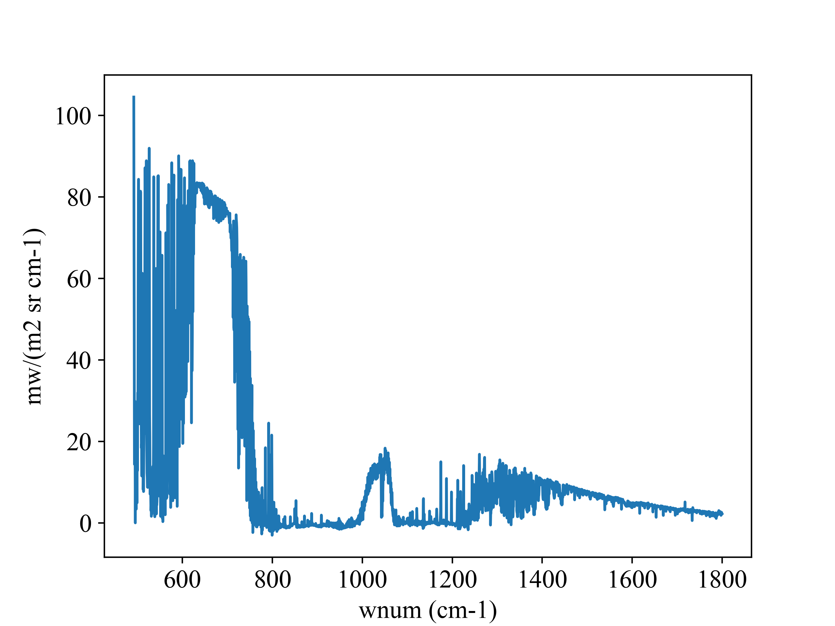
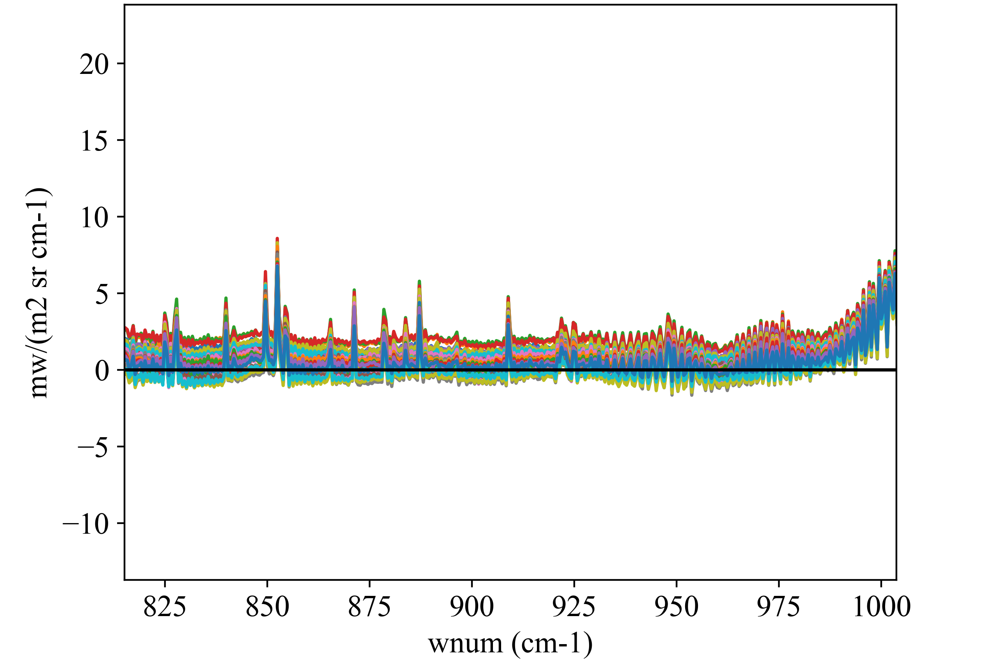
Question about averaging when it is clear
20130815.000302.cdf
zoom
It is fine to include a spectra that has so much negative number in the averaging?

Slide 19
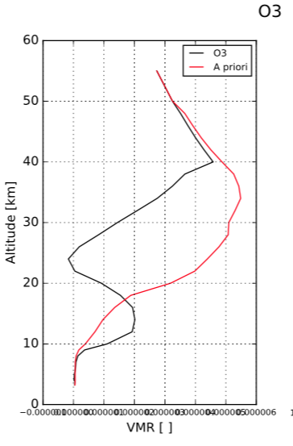
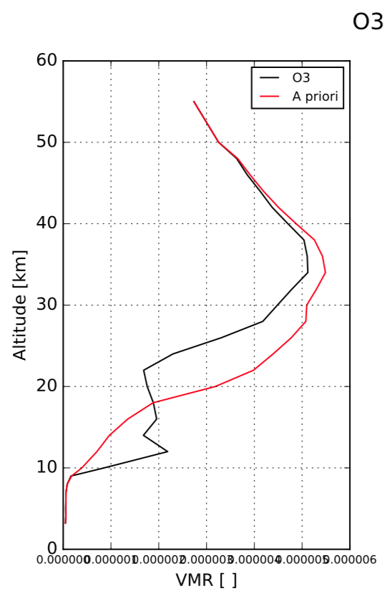
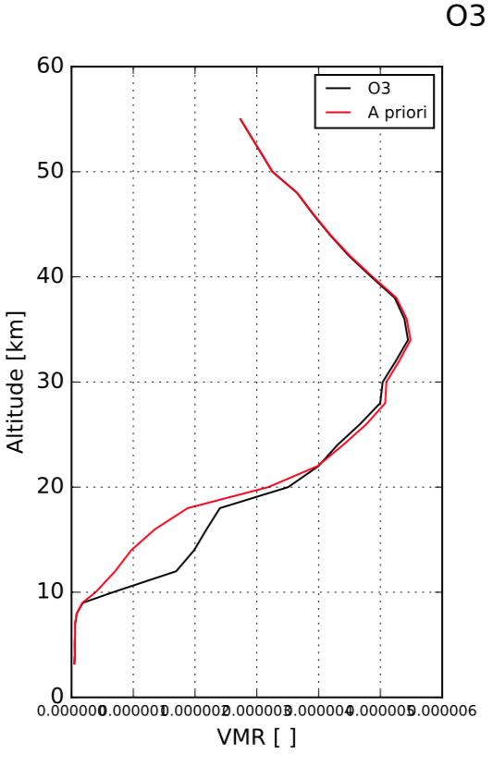
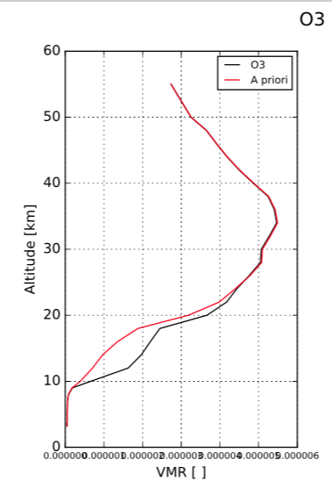
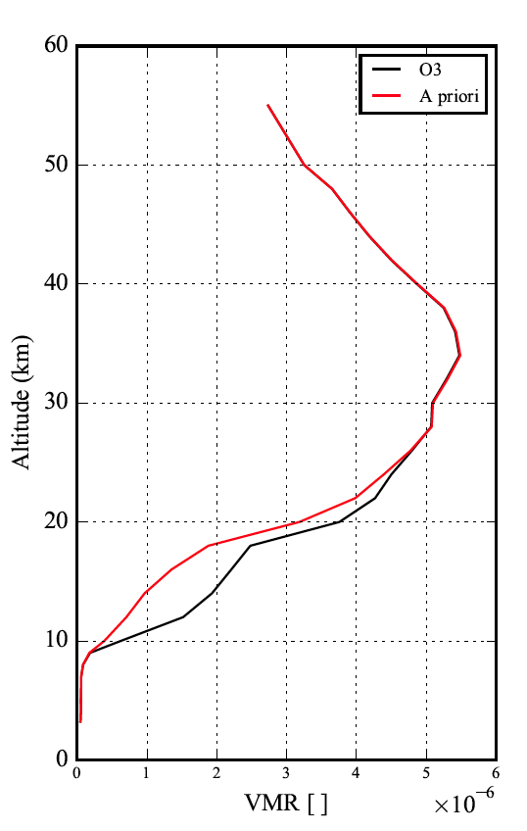
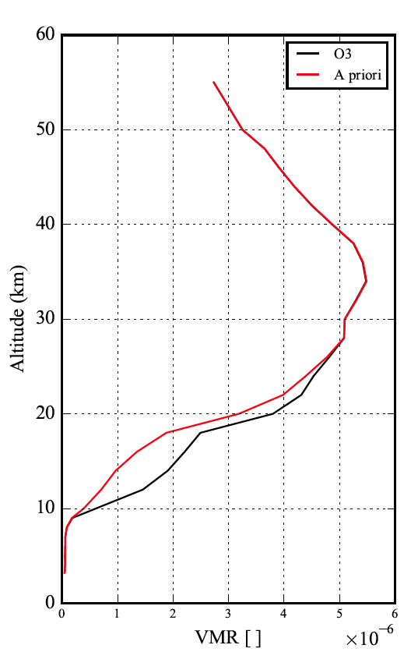
Tests of different noise values
These runs are with correlation of 4km width6 to40km
noise tested list | 0.000012 | 0.00005 | 0.0001 | 0.00015 | 0.00018 | 0.0002 (default) | 0.00025 | 0.0003
RMSE | 0.019918 | 0.019848 | 0.021070 | 0.022441 | 0.022705 | 0.022829 | 0.025024 | 0.025905
DOF | 5 | 3 | 2.3 | 1.9 | 1.8 | 1.7 | 1.5 | 1.3
Snr=0.000012
Snr=0.00005
Snr=0.00015
Snr=0.0002
Snr=0.00025
Snr=0.0003

Slide 20
Using ozonesondes to check test cases
sonde date |  | PAERI date |  | time difference
1/6/15 | 13:13:34 | 1/6/15 | 14:00:00 | 0:46:26
2/5/15 | 12:53:13 | 2/5/15 | 19:00:00 | 6:06:47
6/4/15 | 16:54:31 | 6/4/15 | 17:00:00 | 0:05:29
10/15/15 | 15:30:26 | 10/15/15 | 0:00:00 | 15:30:26
2015 retrievals, coincide time, sa=20%, also co2-sa=0.01
spacing 0.03
spacing 0.01

Slide 21
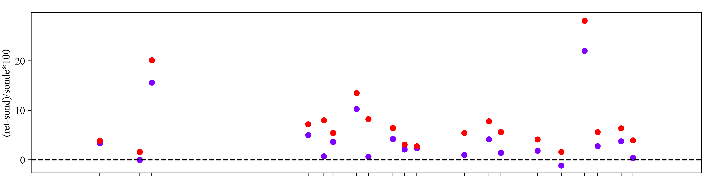
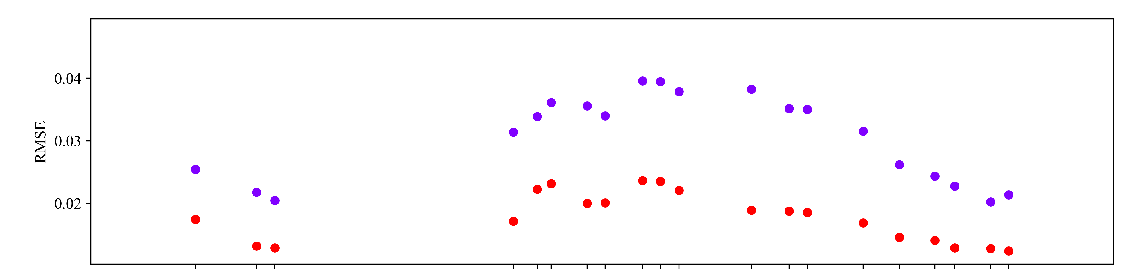
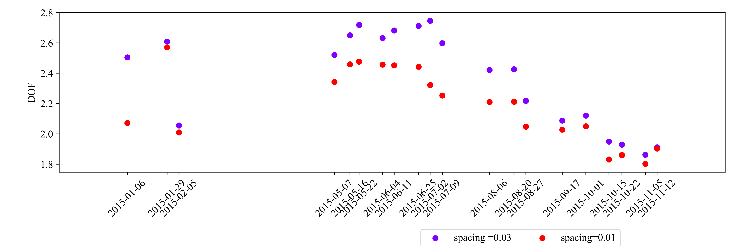
Comparison of spacing for 2015 retrieval spacing

Slide 22
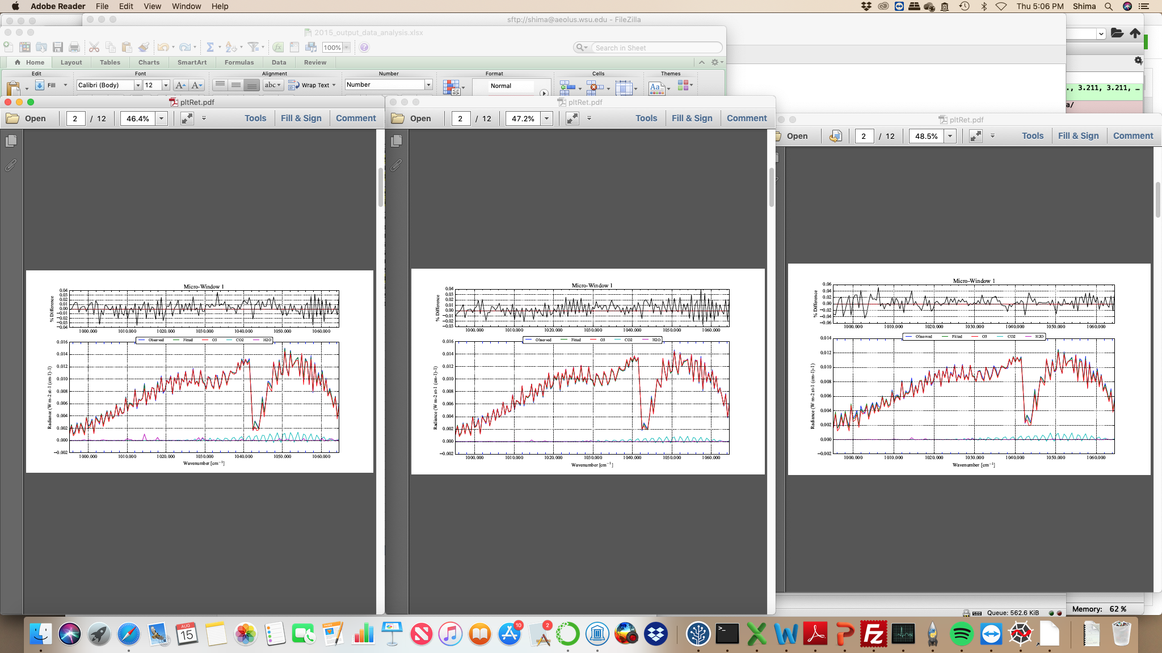
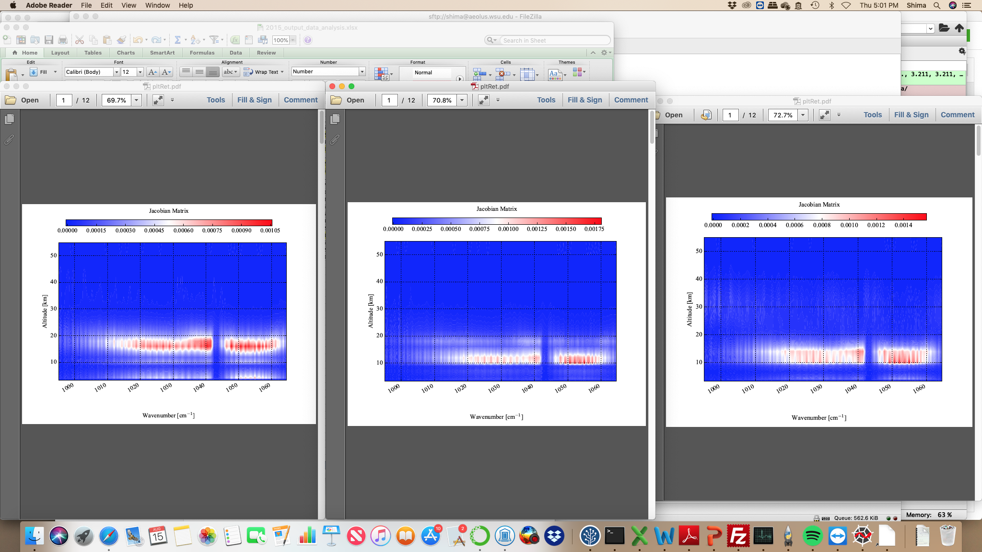
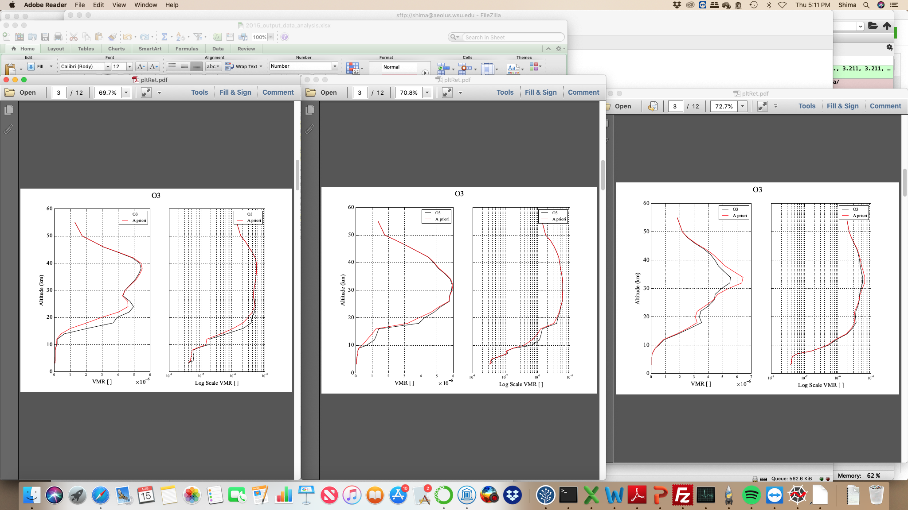
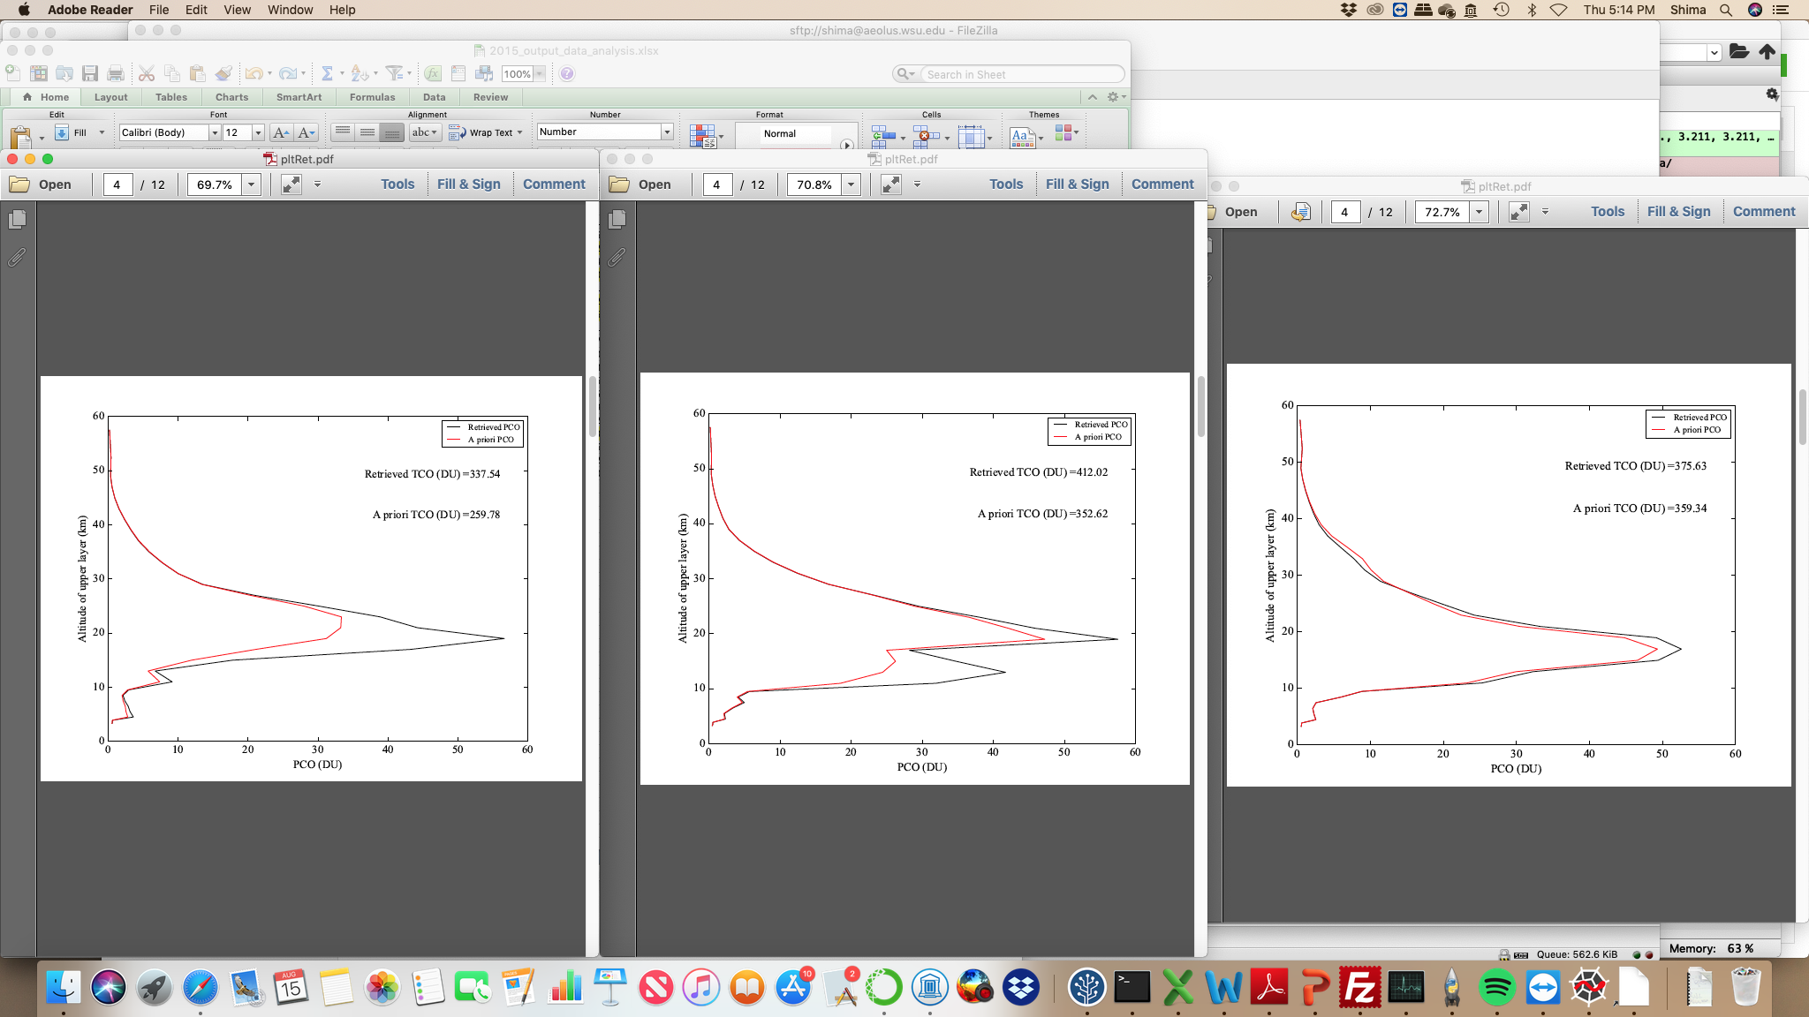
Spacing=0.01
10/15/2015
2/5/2015
1/6/2015
The profile definitely is looking better but it gives higher TCO but realistic

Slide 23
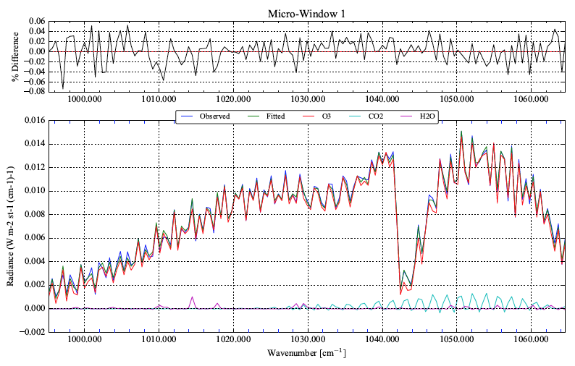
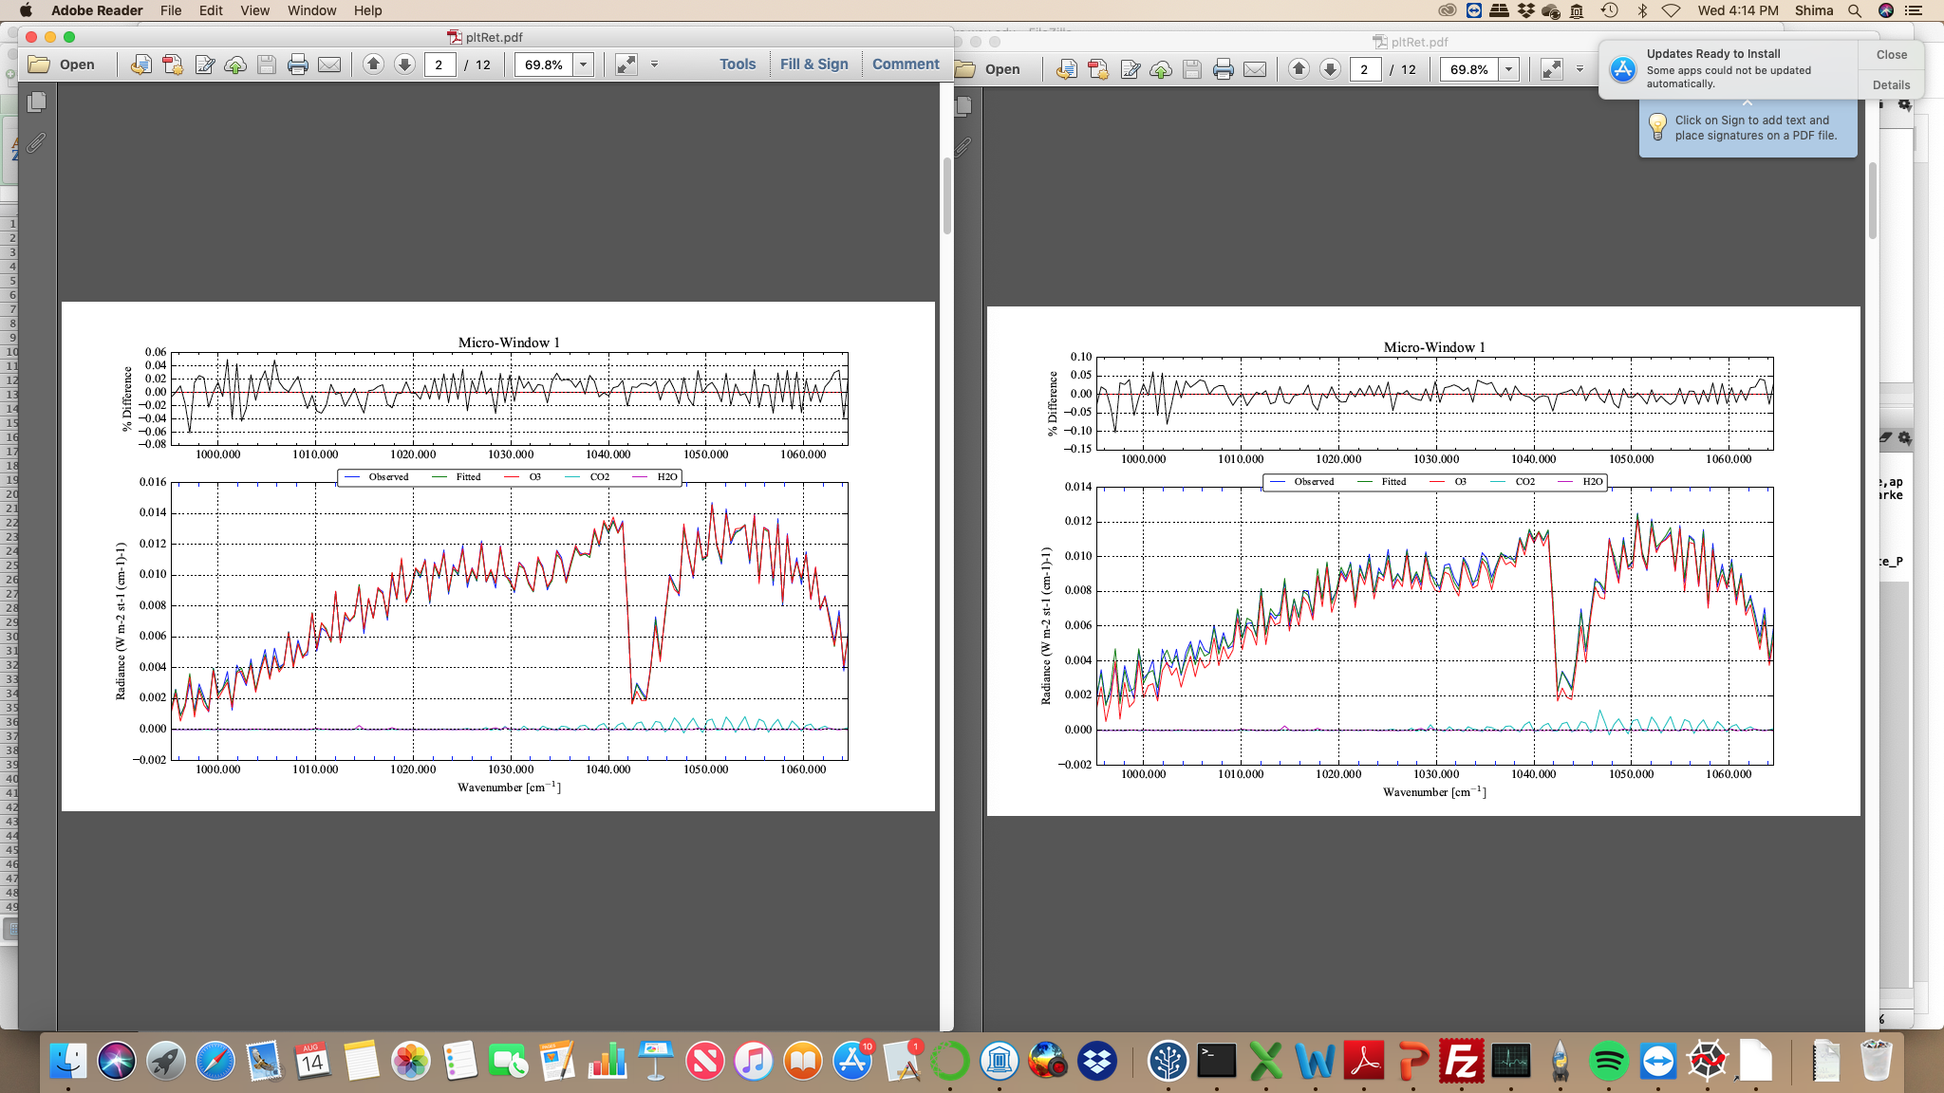
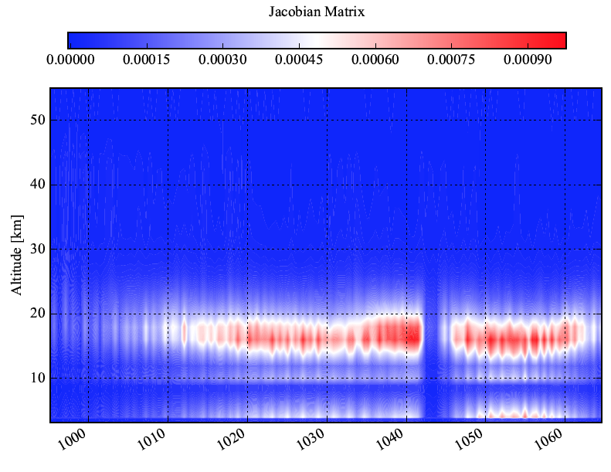
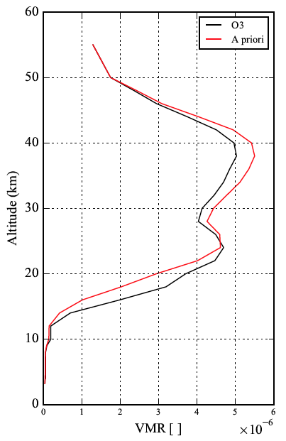
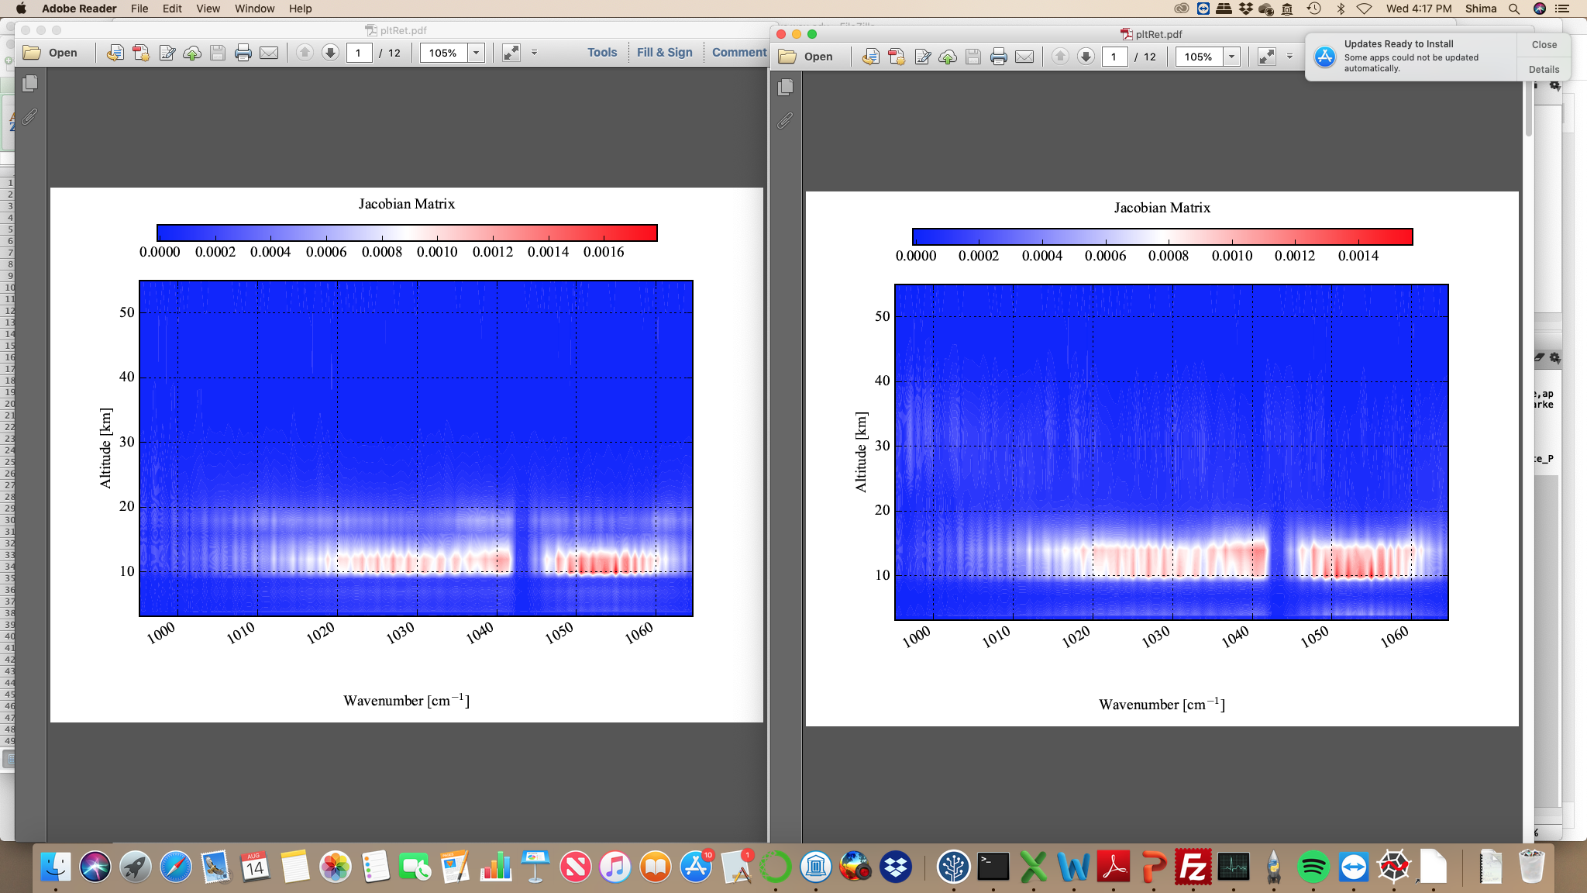
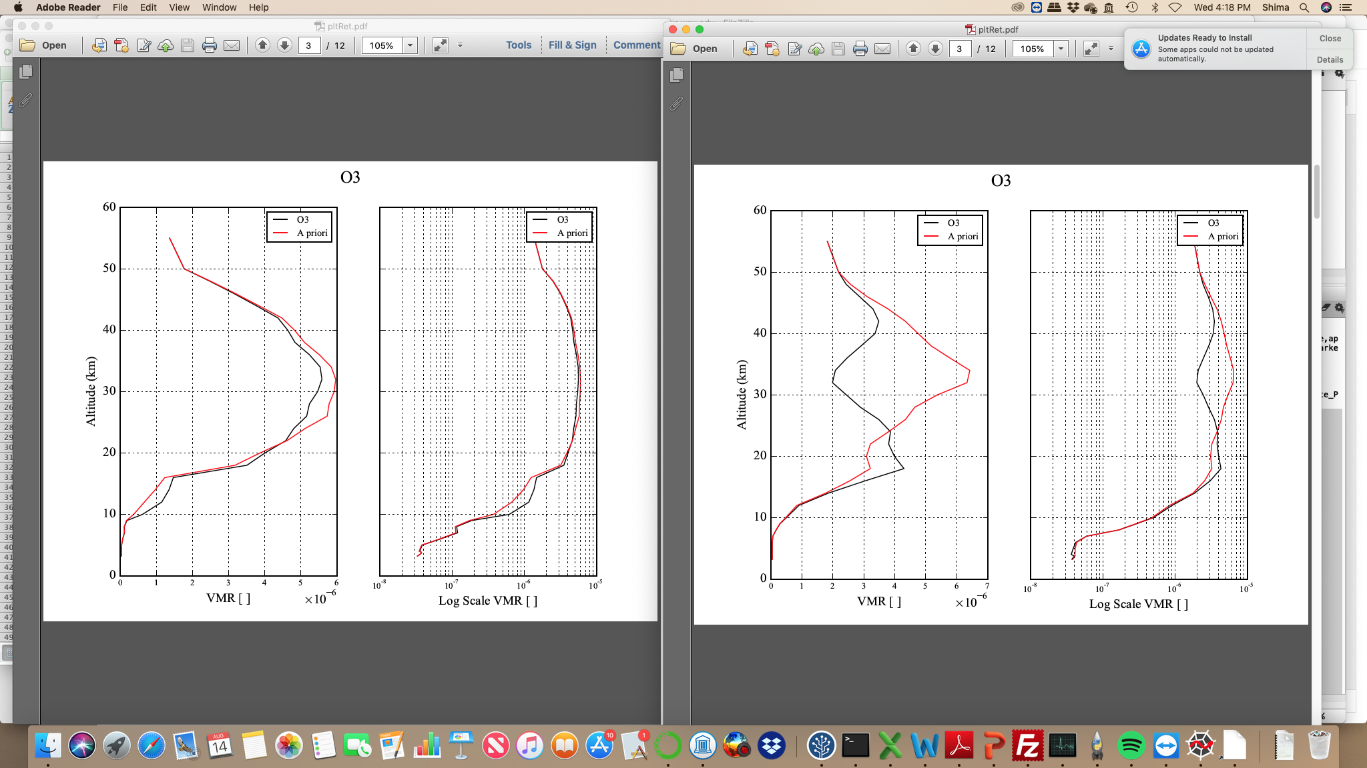


Spacing =0.03
10/15/2015
2/5/2015
1/6/2015

Slide 24
One interesting thing is change in Jacobian when we play with snr, Sa, or spacing which is unexpected as it is the derivative of forward model over state vector
Spacing=0.01
10/15/2015
Spacing =0.03
10/15/2015

Slide 25



As it was shown, spacing of 0.03 has better TCO, but with the expense of some unrealistic profile shape.
Spacing 0.01 helped the residual, fit, and the profile shapes.
Spacing 0.01 plus nterp=2, improves the retrieved tco ozonesonde comparison and keeps the RMSE small.

Slide 26




Spacing=0.01
10/15/2015
Spacing = 0.01, nterp= 2

Slide 27




6/4/2015
Spacing 0.01
Spacing 0.01, nterp=2

