Slide 1
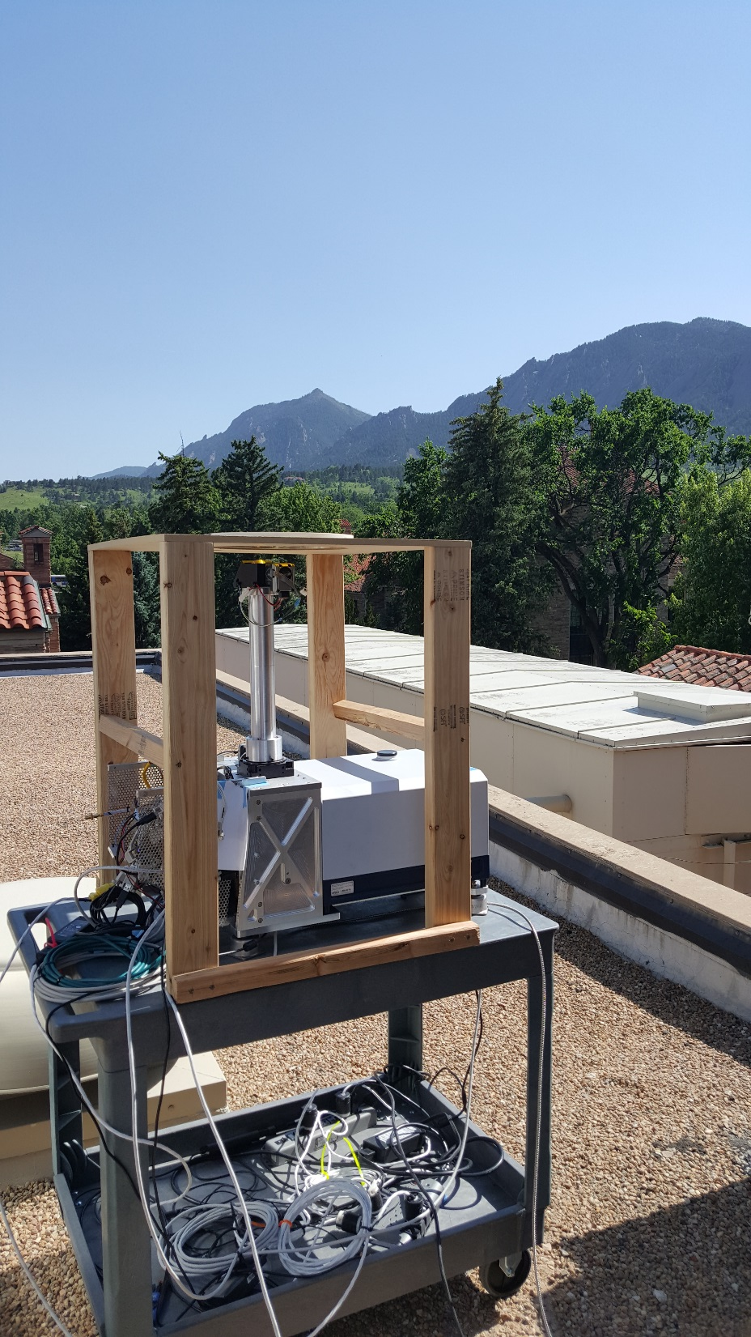
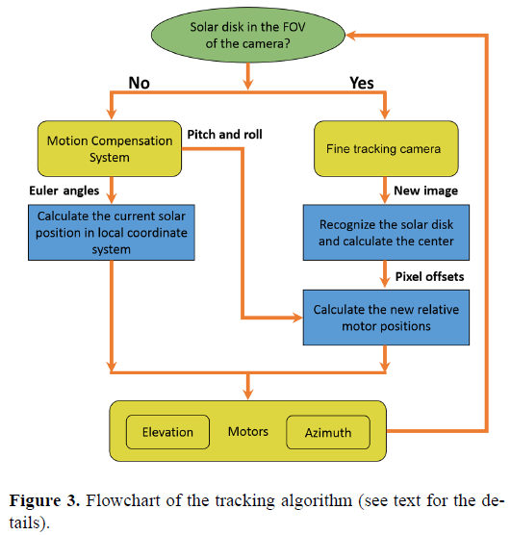
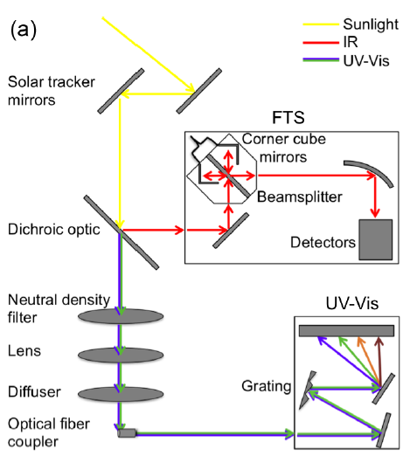
The CU SOF Instrument (University of Colorado Solar Occultation Flux)
Baidar et al., 2016, AMT Kille et al., 2017, AMT Kille et al., 2019, GRL

Slide 2
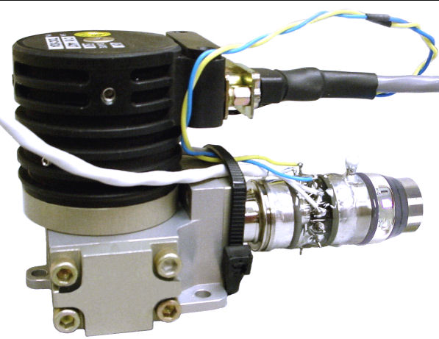
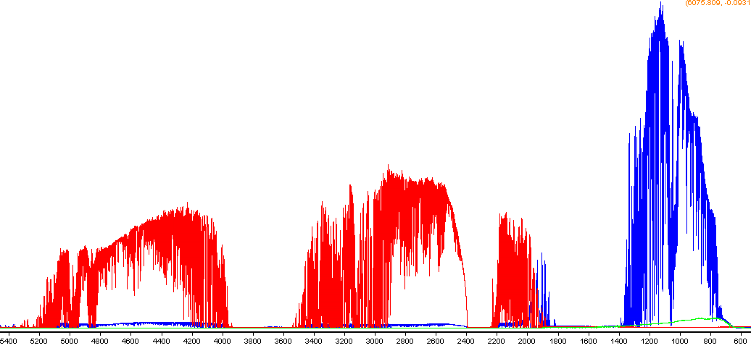
MCT & InSb detector
MCT “background”
Wavenumber [cm⁻¹]

Slide 3
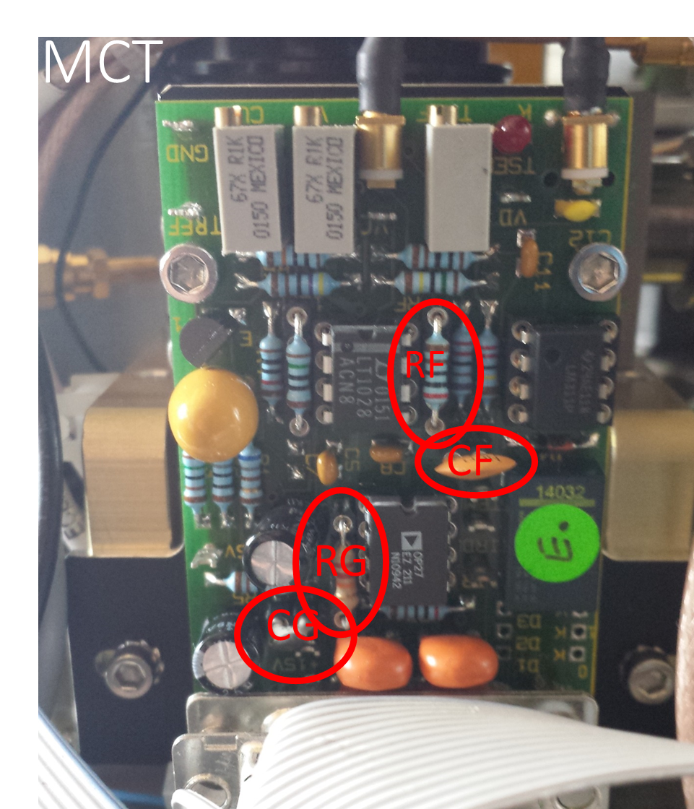
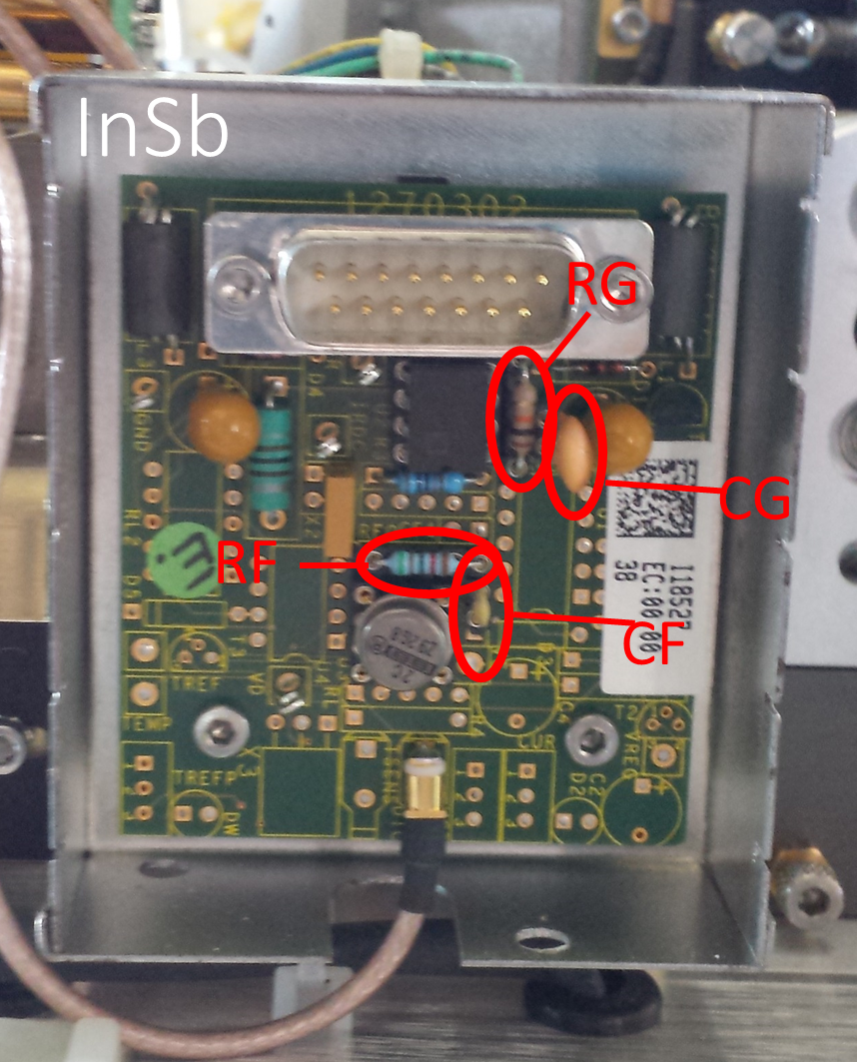
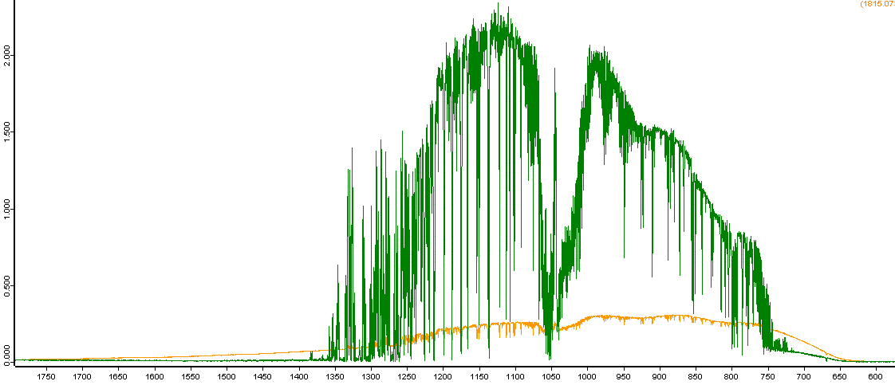
Can control signal and background
aperture reduces background
resistor/ capacitor pair control signal
added aperture
Spectrum after Bruker engineer set it up after delivery
Spectrum after additional modifications
modified resistor/ capacitor for MCT

Slide 4
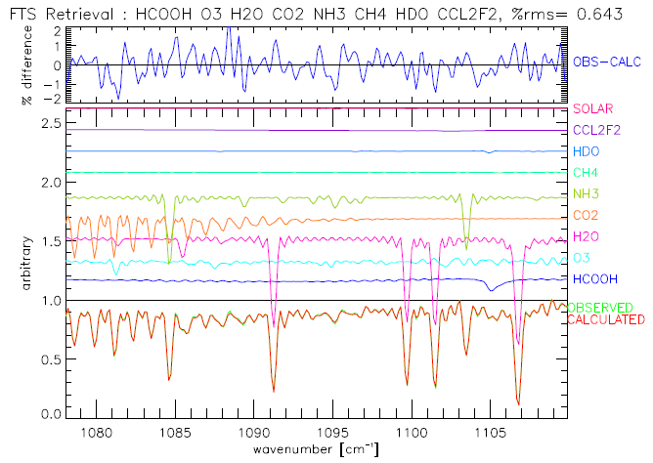
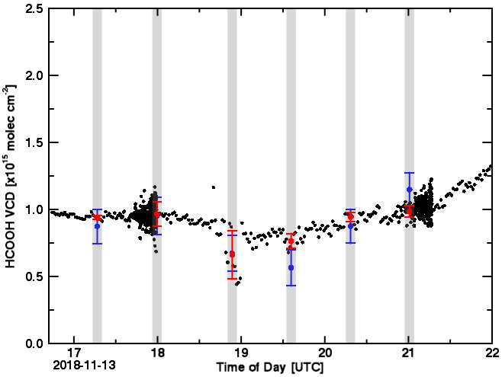
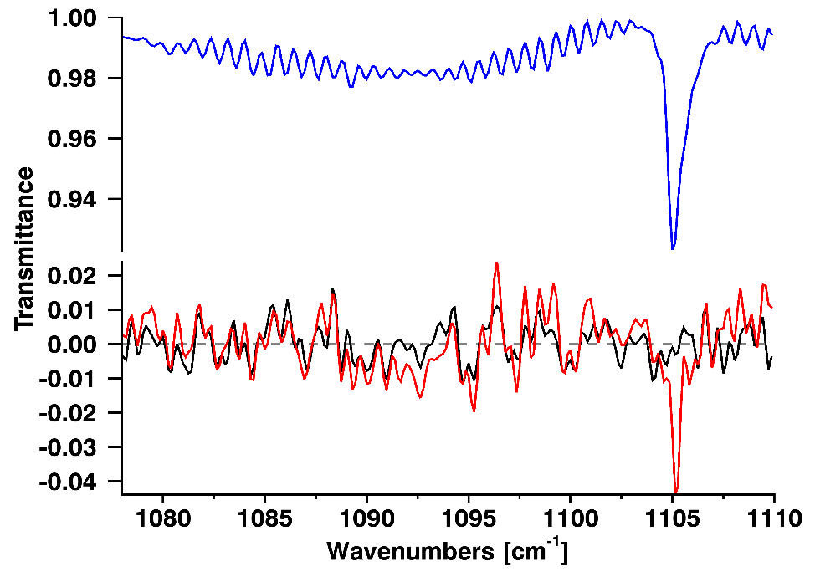
Co-location at NCAR:
NCAR HR-FTS
CU SOF
CU SOF average over HR-FTS acquisition time
Individual absorption contribution of target gas (blue) and residuals from including (black) and excluding (red) it in the retrieval.

Slide 5
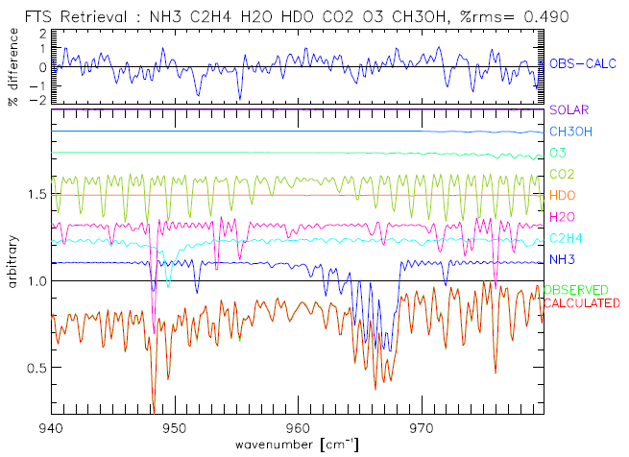
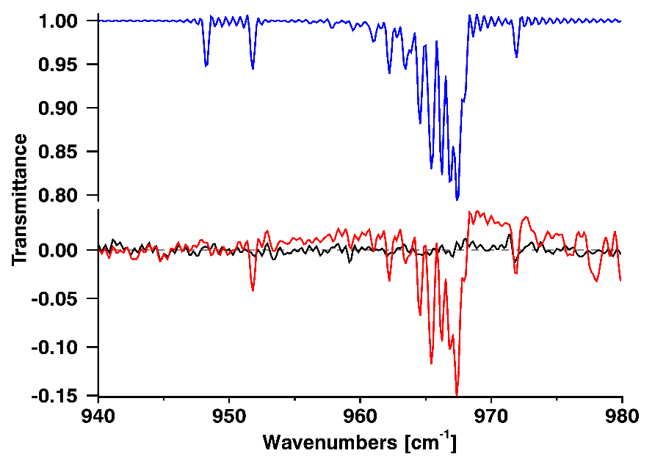
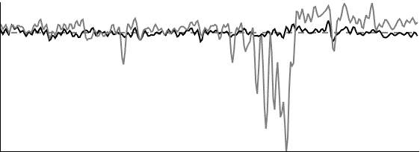
Individual absorption contribution of target gas (blue) and residuals from including (black) and excluding (red&gray) it in the retrieval.
?
interfering gas flexibility in retrieval
interfering gas constrained

Slide 6
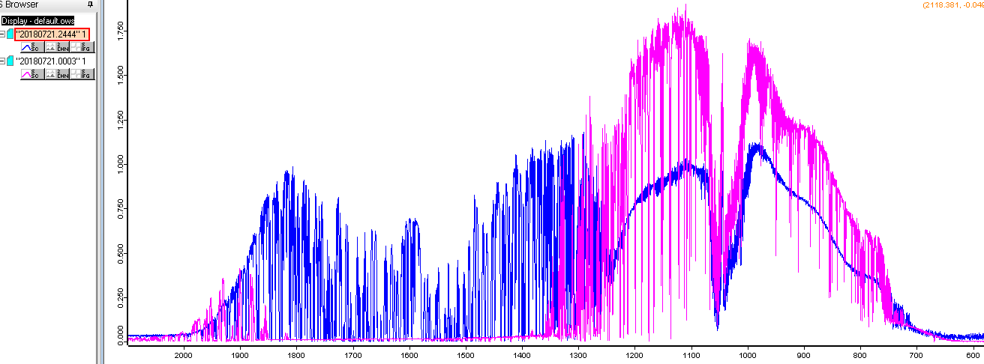

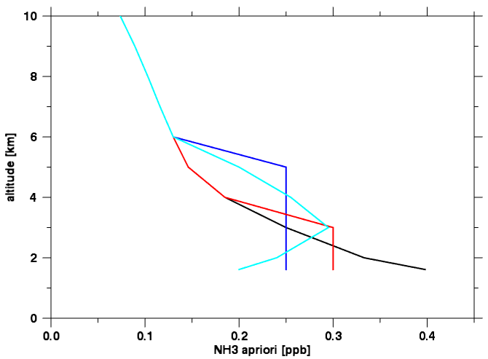
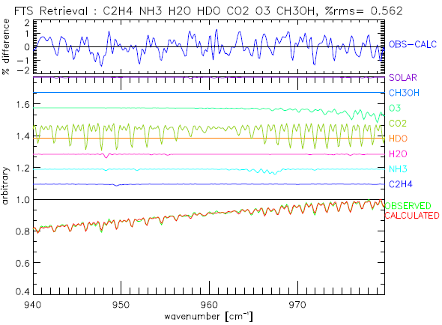
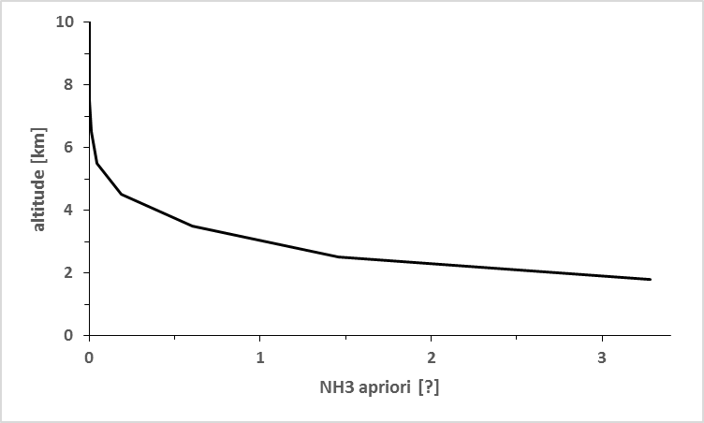
~900m asl (Boise, ID)
8 km asl flight altitude
 | Sigma | NH3 | C2H4 | CO2 | %rms
Apriori VCD | --- | 2.83 e14 | 1.28 e13 | 2.97 e21 | ---
a) | 1000, 1000, 1 | 9.05 e15 | 4.30 e15 | 9.84 e21 | 0.562
b) | 1, 1, 0.1 | 2.48 e15 | 1.31 e13 | 3.61 e21 | 0.576
c) | 0.1, 0.1, 0.1 | 3.38 e14 | 1.28 e13 | 4.18 e21 | 0.592
d) | 0.1, 0.1, 0.01 | 3.22 e14 | 1.28 e13 | 2.99 e21 | 0.596
Columns inside/outside wildfire plumes at low altitudes vary several order of magnitude
Default apriori
(G.C. Toon Ballon-FTIR *10)
a)
E. Dammers apriori for Boulder

Slide 8
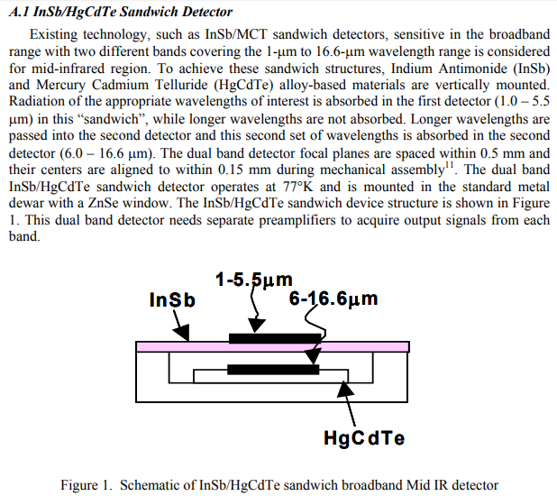
https://ntrs.nasa.gov/archive/nasa/casi.ntrs.nasa.gov/20100030592.pdf

