Slide 1
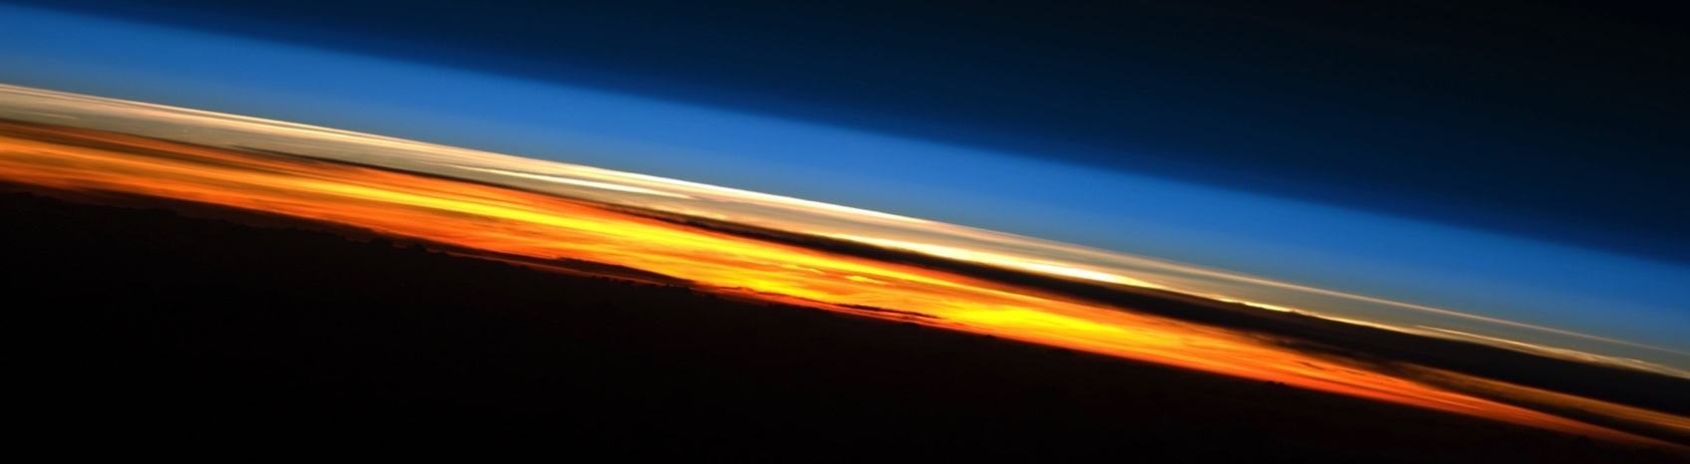

Measurements of Trace Gases in the Remote Atmosphere at Thule Greenland

Slide 2
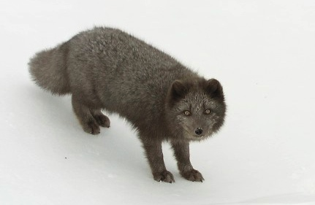
Why Thule?
We are interested in long term trends & annual cycles of trace gases in the atmosphere, then deviations then tell us about specific phenomena,
Thule gets us a direct view of Ozone chemistry in the winter to spring season,
Thule has become more important since the Arctic exhibits the most rapid effects of climate change,
How is human activity changing the Arctic atmosphere.
Effects of air pollution, AMAP program,
Thule Air Base provides excellent logistical support for this work.

Slide 3
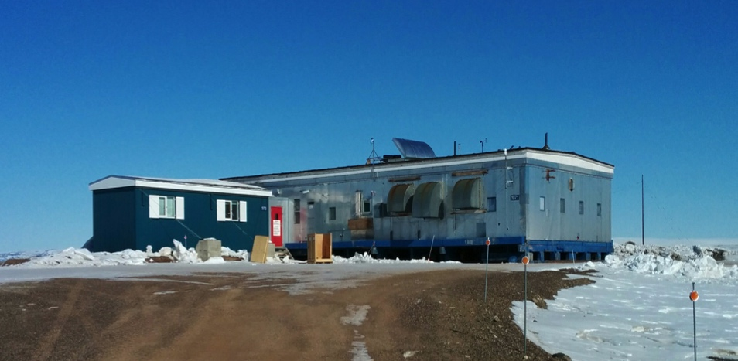
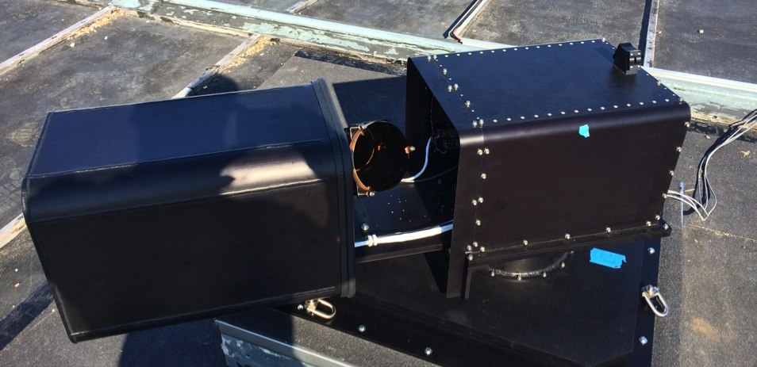
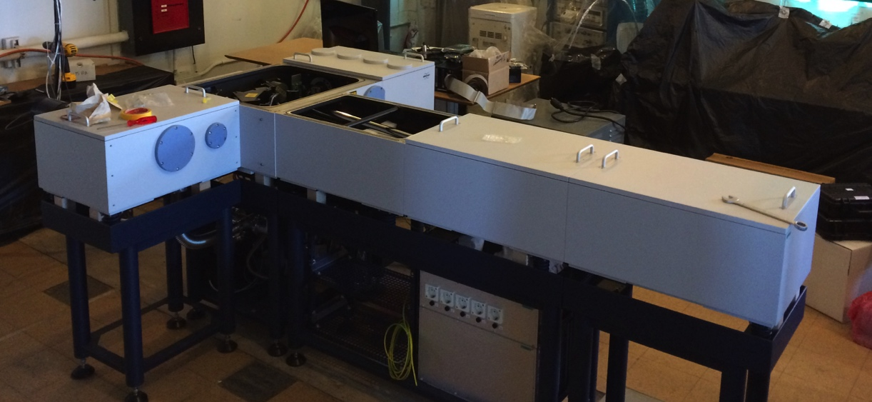
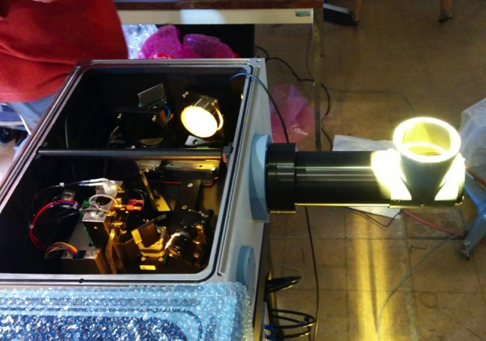
The Thule Observation Instrument
South Mountain building
Tracking the Sun
Imaged solar radiation
Infra-red Spectrometer

Slide 4
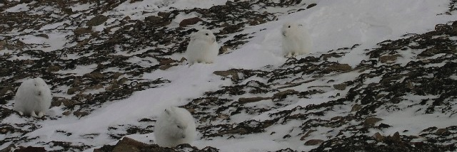
Features of the FTS at Thule
Wide spectral range, high-resolution solar viewing FTS covering Mid to Near-infrared spectrum,
Total column, and vertically resolved profiles of many trace gases:
Greenhouse : CO₂, N₂O, CH₄, CO, CFC, HCFC, H₂O, HDO, H₂¹⁸O
Ozone chemistry: HCl, HNO₃, HF, NO₂, O₃, ClONO2
Anthro & Bio -genic : C₂H₆, C₂H₂, C₂H₄, HCOOH, H₂CO, SF₆, CCl4, HCN, CH₃OH, NH₃
Permanent autonomous operation, since 1999

Slide 5
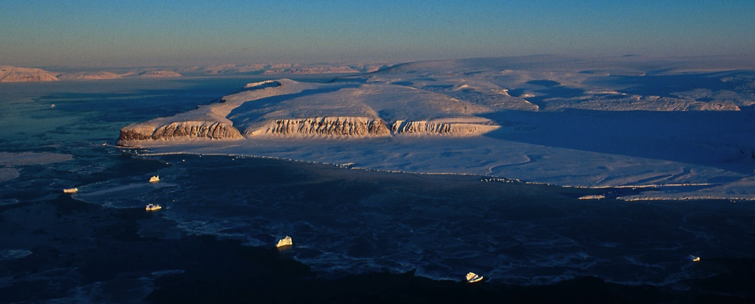
The Instrument Provides :
The Thule FTS infrared spectra distinguish thousands of absorption features that are signatures of many gases in the atmosphere….

Slide 6
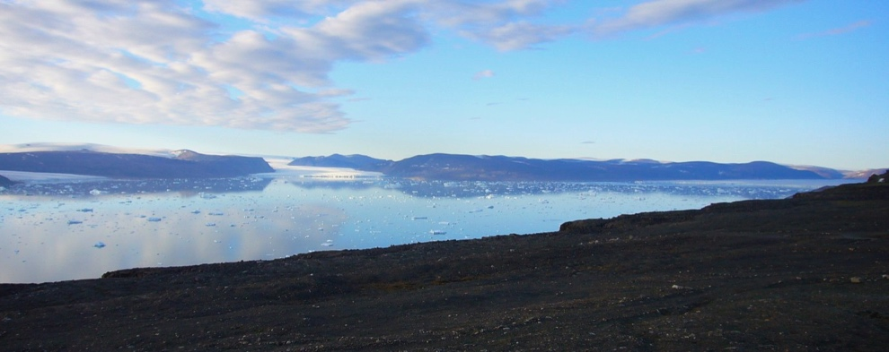
The Analyzed Spectra :
These are converted into time series of total abundance and vertical distributions of all possible trace gases.

Slide 7
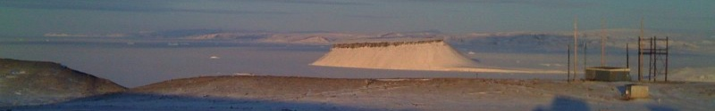
Network for the Detection of Atmospheric Composition Change
Establishing links and feedbacks between climate change and atmospheric composition,
Calibrating and validating space-based measurements of the atmosphere,
Supporting process-focused scientific field campaigns and
Testing and improving theoretical models of the atmosphere.
Globally disperse stations yield a global view

Slide 8
Unexpected Reversal of Northern Hemisphere Stratospheric Chlorine Burden
Observations at 8 NDACC FTS sites including the NCAR site at Thule GR since 1999, detected an anomalous change in the HCl total column trend in 2007.
Latitudinally, sites are widely separated & provide a cohesive global dataset.
Rate increase with latitude in the NH is nearly monotonic but in the SH shows continued decrease.
Satellite measurements show the increase is confined to the lower stratosphere (20-25km).
Modeled HCl reveals slowed circulation.
Slowed NH circulation as opposed to increased emissions, has lead to increased stratospheric age of air (up to .5yr & counter to some climate change predictions) allowing enhanced conversion of Cl containing species to the reservoir HCl.
Anthropogenic Cl emissions from surface observations continue to be in line with the Montreal Protocol.
Enhanced HCl in the lower NH stratosphere increases possibility of NH winter Ozone loss.
Circulation change may be due to variability or a possibly a systemic climate change related source; more observations and analysis will tell.
Science March 2013 E. Mahieu et al.
Notes:
1. Plot Rates of change in %/yr, Error bars are 2σ uncertainty, GOZGARDS are a combined satellite time series.
2. s2000 is SLIMCAT model with constant year 2000 wind fields
3. This was another step in verification of the MP
4. Larger question – the cause of the change in circulation? Climate or anomalous?
5. Question 2 - immediate (within the next few years) o3 loss implications given another cold winter eg 2011
6. Lead author Emmanuel Maheiu Univ. Leige, Belgium
7. B-D circulation increasing due to climate: McLandress, C. and Shepherd, T.G. Simulated anthropogenic changes in the Brewer-Dobson circulation, including its extension to high latitude. J. Climate 22, 1516-1540, (2009).

Slide 9
Arctic Ozone Hole of 2011
Very Cold Temperatures!
Excess HCl converted to Cl⁻ Nearly all lower stratospheric HCl was depleted!
Up to 48% of the total O₃ was removed by late March 2011.
Legend:
A: mean March outside vortex
B: mean March inside vortex
C: mean March 2011(all inside)
Strong descent -> More HCl
(Seen here in HF⁾
ARCTIC, 2012, Hannigan et al.

Slide 10
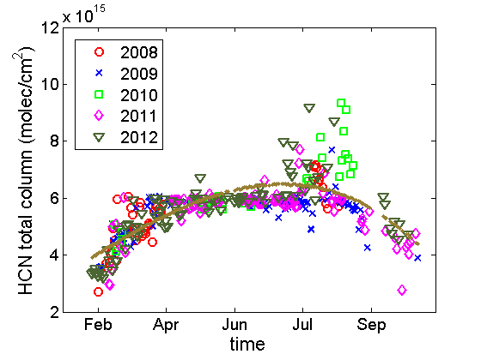
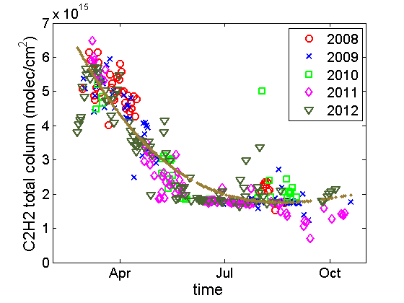
Air Pollution in the Arctic
Air pollutants are transported into the Arctic from lower latitudes via different pathways, some more continuously, some more event driven.
For example shown are 5 year annual overlays for two very different species
HCN (hydrogen cyanide) is produced naturally in the summer and is a large component of biomass burning.
C2H2 (Ethyne, Acetylene) is transported continuously but is destroyed in the summer sun.

Slide 11
Air Pollution in the Arctic
Vegetation maps, aerosol footprints, fire maps along with back trajectories, aid in pinpointing source regions.
ACP, 2015, Viatte et al.

Slide 12
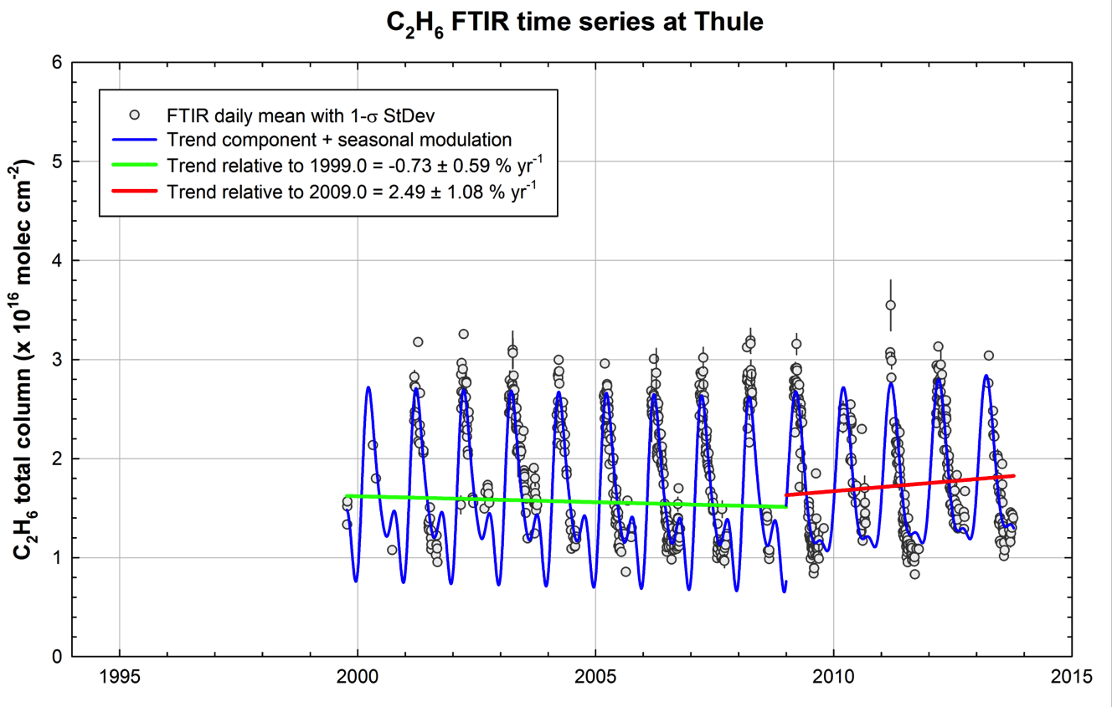
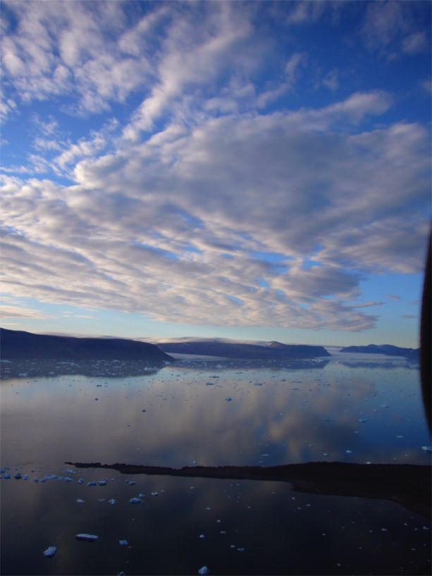
Ethane increase since 2008
Current hypothesis : fugitive effluent from hydraulic fracturing in the continental US. This increase is seen across the Northern Hemisphere.

Slide 13
Summary
Long term measurement programs yield information on the changing Arctic.
Remote sensing techniques gives us information in the:
Long range pollution and transport on annual time scales,
Local air quality chemistry and deposition,
Ozone chemistry and annual loss,
Signatures of changing global circulation,
Adherence to Montreal Protocols evidenced by the change in Chlorine and Fluorine reservoirs.
Feedback from these data & analyses go to improve model simulations and prediction.
We expect to see continued changes as the Arctic continues to warm, and hope to be at Thule to witness them.

Slide 14
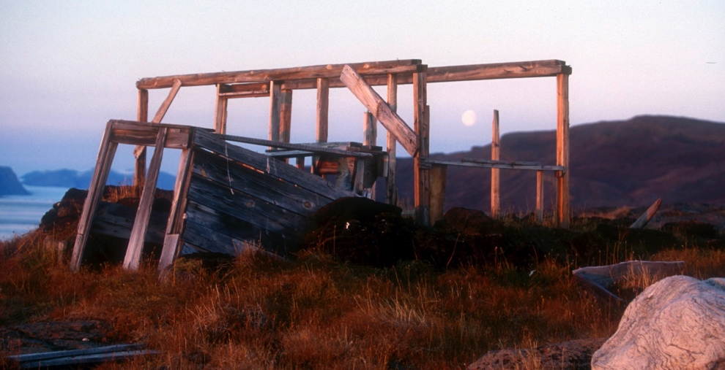



Acknowledgments
NASA is the primary supporter of the NDACC FTS Observation program at Thule.
Danish Meteorological Institute provides logistical support and scientific collaboration.
NSF provides logistical support while in Thule.
NSF supports The National Center for Atmospheric Research.
US Air Force provides logistical support in Thule.

