Slide 1

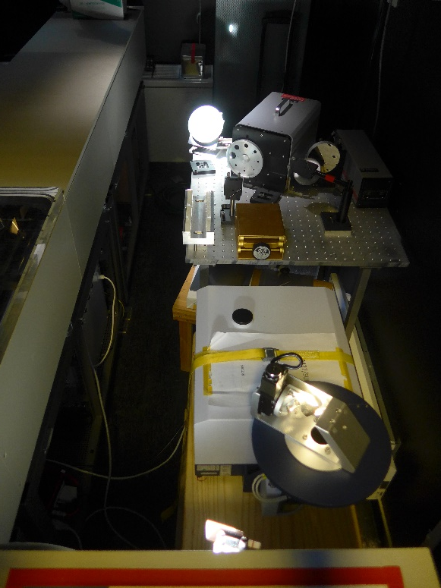
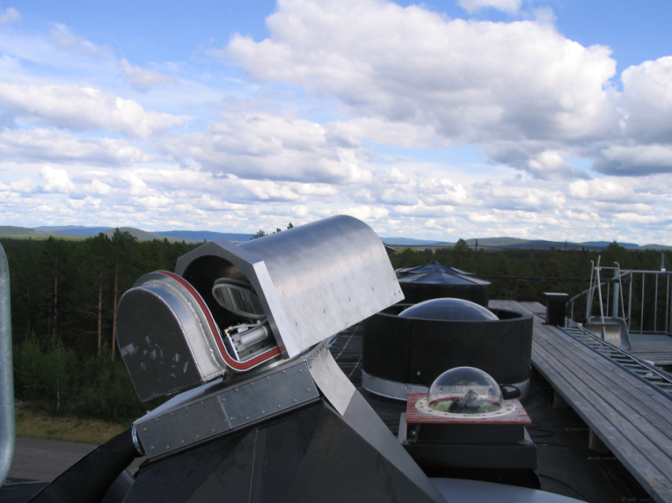
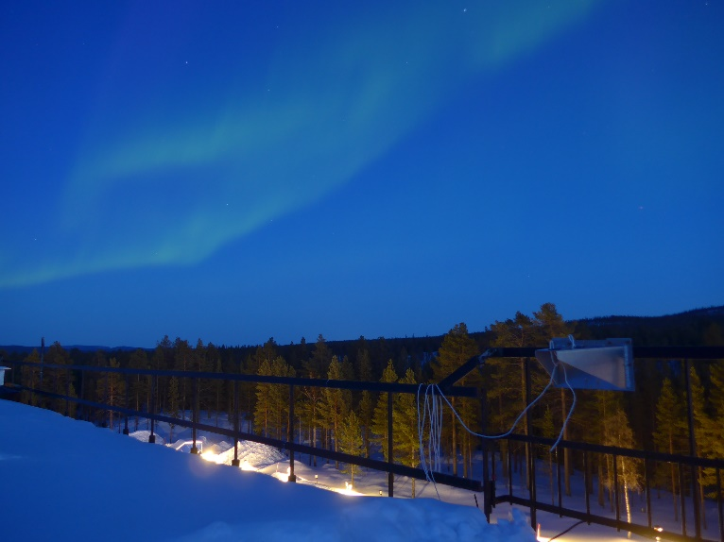
Kiruna site report
Thomas Blumenstock, Jochen Groß, Frank Hase, Amelie Röhling
KIT-IMK, Karlsruhe, Germany
Uwe Raffalski, IRF Kiruna, Sweden

Slide 2
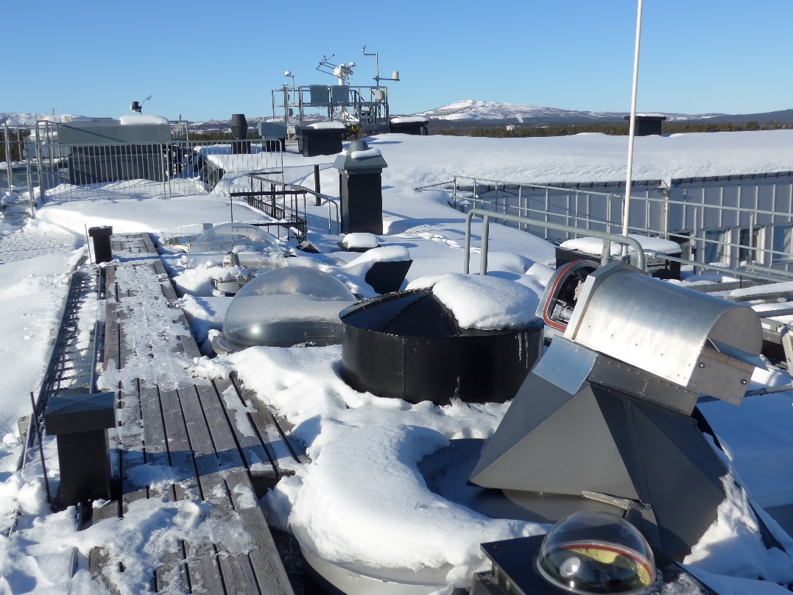
Kiruna site report
Start in March 1996
Regular cell measurements from beg.
Remote control since 2004
Upgrade to 125 HR in July 2007
Camtracker software in Sept. 2010
Bruker EM-27-SUN added in 2017
Laser broken in 2010, 2011, 2014, 2018 and 2022!
Switch to M16 electronics in 2021
Thanks to Gregor just plug & play!
New InSb detector in 2023
Issues during Covid were fixed by Uwe Raffalski on site!
2 NDACC-IRWG, 2023, 2019

Slide 3
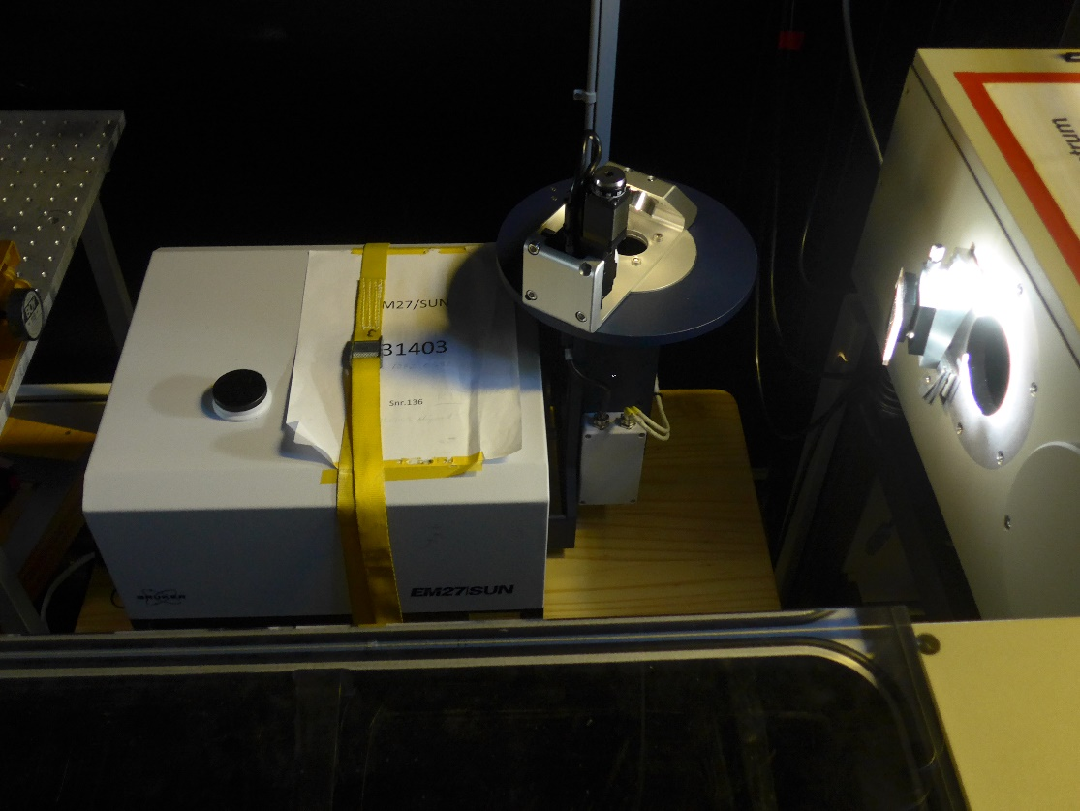

Two Bruker at IRF Kiruna: HR plus EM-27
Set-up of Bruker EM-27-SUN at IRF:
Using the same solar beam as the HR
Not a big effort
Complementary to NDACC instrument
Measuring GHG (XCO₂ & XCH₄) with high precision
3 NDACC-IRWG, 2023, 2019
3 NDACC-IRWG, 2019

Slide 4
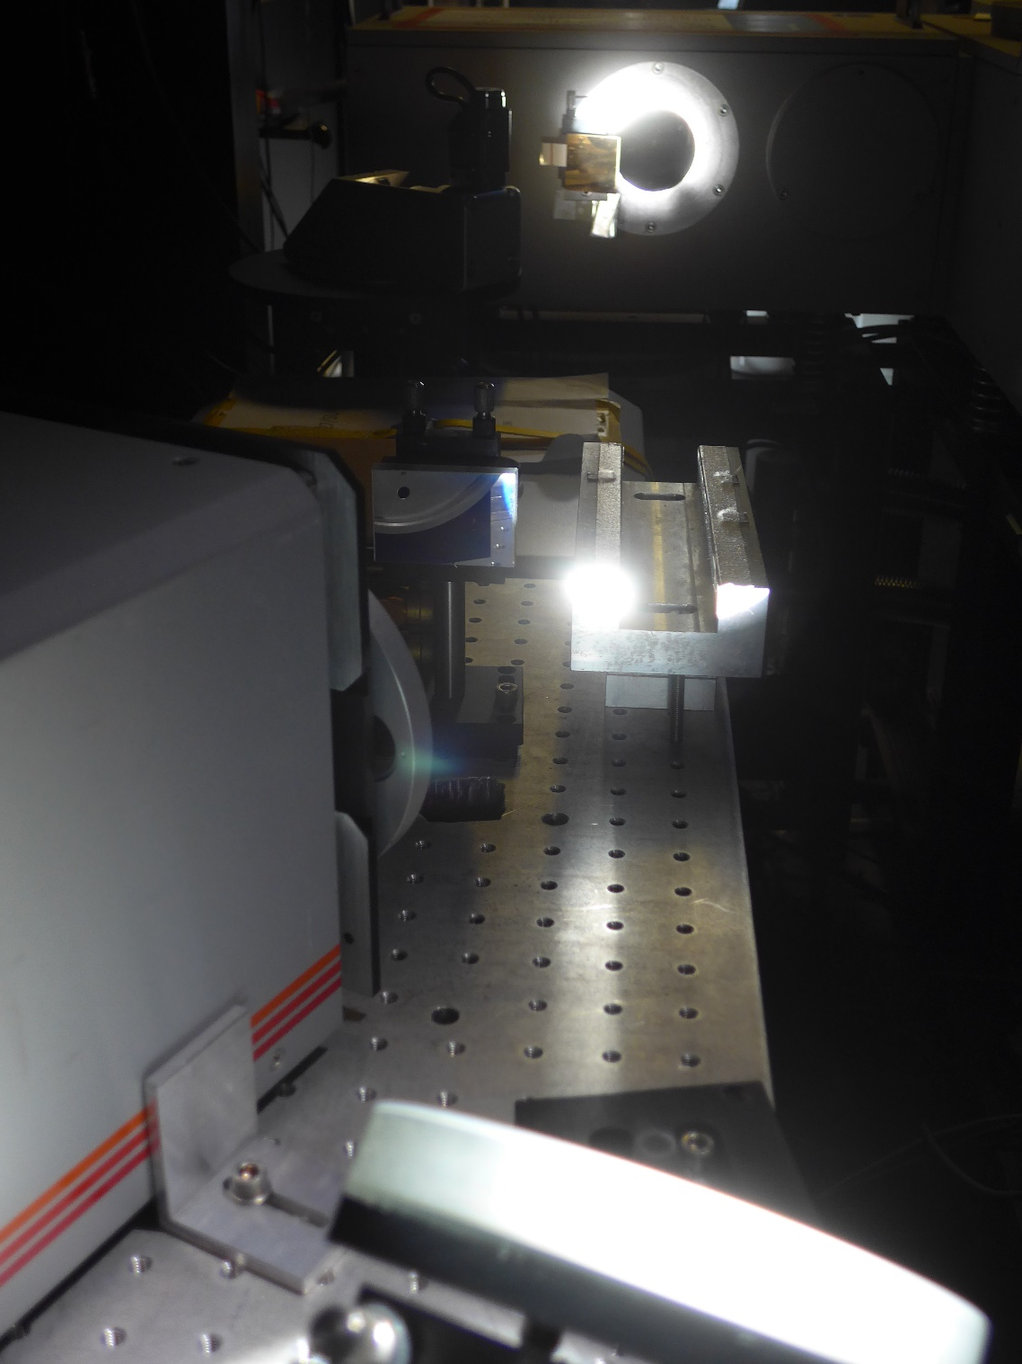
Two Bruker at IRF Kiruna: HR plus EM-27
Advantages of two spectrometers:
NDACC measurements without any compromise:
Full spectral coverage incl. MCT
Full observation time
No beam splitter exchange nor broadband BS needed
COCCON measurements without any compromise or extra effort:
Full observation time
No need for enclosure, just a small mirror needed, RC possible
=> Measuring GHG (CO₂ & CH₄) and O₂ with EM-27 and full suite of NDACC species with HR spectr.!
4 NDACC-IRWG, 2023, 2019
4 NDACC-IRWG, 2019

Slide 5
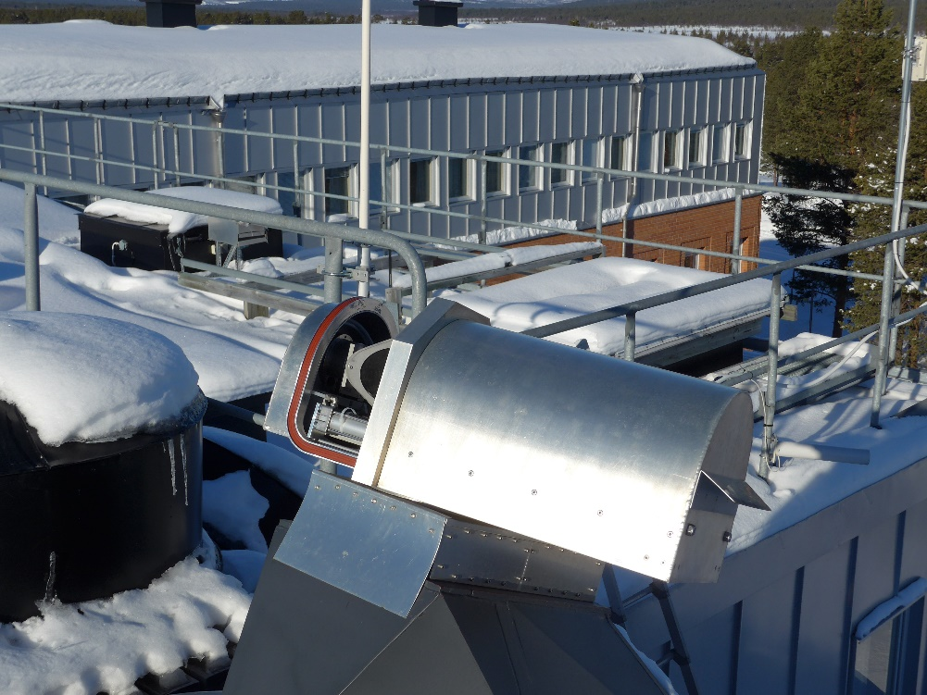
Kiruna site: brief summary 2020 to date
Kiruna FTIR site fully operational
NDACC site operated remote controlled
Site visits postponed to 2021 (JG) & 2023 (TB)
Technical issues during Covid were broken laser, scanner cable and tracker cabling. All issues were fixed by Uwe Raffalski on site (with video support).
Days of operation:
  2020: 105
  2021: 95
  2022: 99
Thanks to Uwe!
5 NDACC-IRWG, 2023, 2019

Slide 6
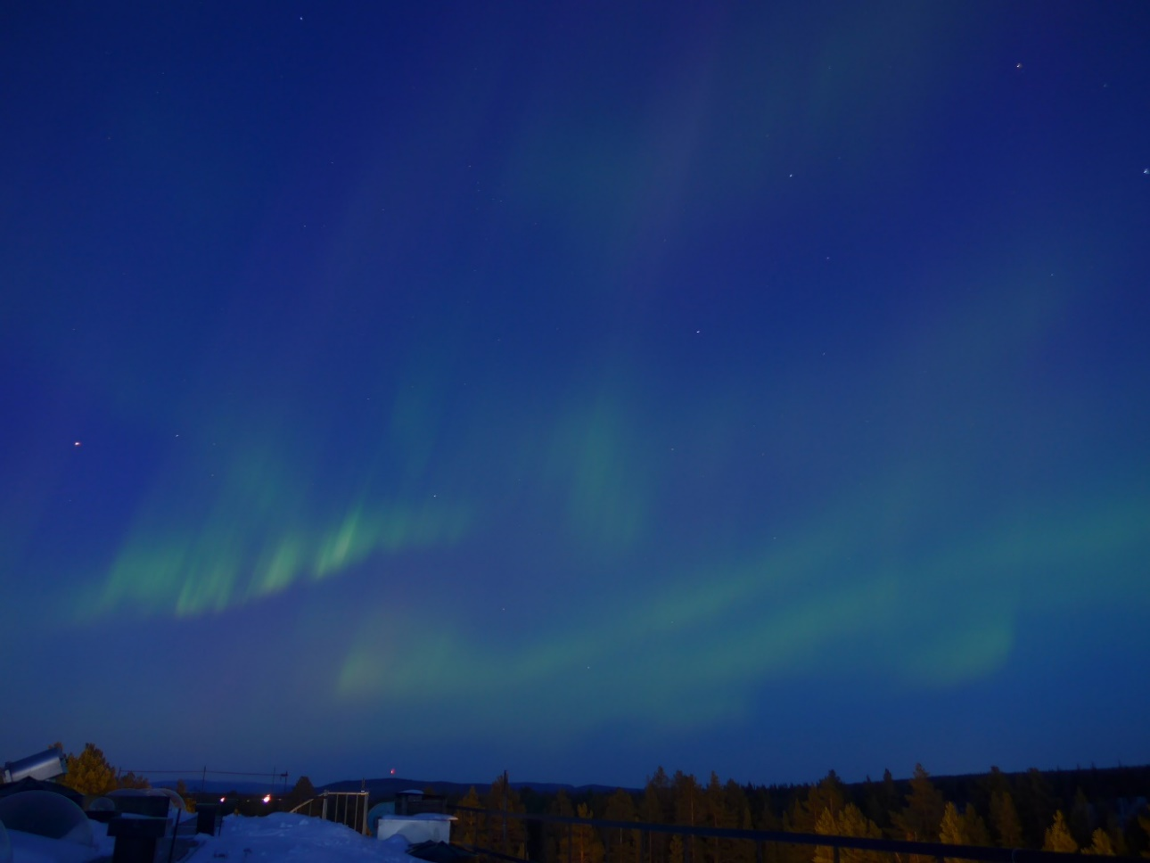
Kiruna: Current status / data analysis
Data analysis:
PROFFIT 9.6
Data base:
NASA: 1996 - 2007
HDF: 1996 – end of 2022
Species:
O₃, HCl, HF, HNO₃, N₂O, CH₄, ClONO₂, C₂H₆, CO, HCN, NO₂, NO
Last archiving date: June 2023
Next archiving date:
Early 2024
Thanks to
BMWi via DLR under
grant 50EE1711A.
6 NDACC-IRWG, 2023, 2019
6 NDACC-IRWG, 2019

Slide 7
Kiruna site: any losses (due to Covid), outlook 2023 and beyond
No loss due to Covid
No NDACC related project funded anymore!
TB retired beginning of this month (June 2023).
Replacement in half a year hopefully.
Observations to be continued by Uwe Raffalski, IRF Kiruna.
Technical support by Jochen Groß & Frank Hase
Standard data analysis to be cont’ed
Please expect delays in re- processing and new species in 2023.
Thanks to Uwe, Amelie, Jochen & Frank!
7 NDACC-IRWG, 2023, 2019

Slide 8

Summary Kiruna site report
NDACC site fully operational and no loss of data due to Covid or technical issues
Data analysis and archiving up to date
Bruker EM-27 added for XCO₂ & XCH₄
For publications please see list (not only NDACC):
http://www.imk-asf.kit.edu/english/709.php
One of the PIs retires, FTIR Kiruna continues
Thank you very much for your attention and collaboration!
Good bye!!
8 NDACC-IRWG, 2023 2019

