Slide 1
Analysis of Satellite-based XCO2 measurements from OCO-2 against Ground-based TCCON and COCCON measurements
Saswati Das¹, Matthäus Kiel¹, Joshua Laughner¹, and Gregory Osterman¹
¹Jet Propulsion Laboratory, California Institute of Technology
Copyright 2023 California Institute of Technology, U.S. Government sponsorship acknowledged

Slide 2
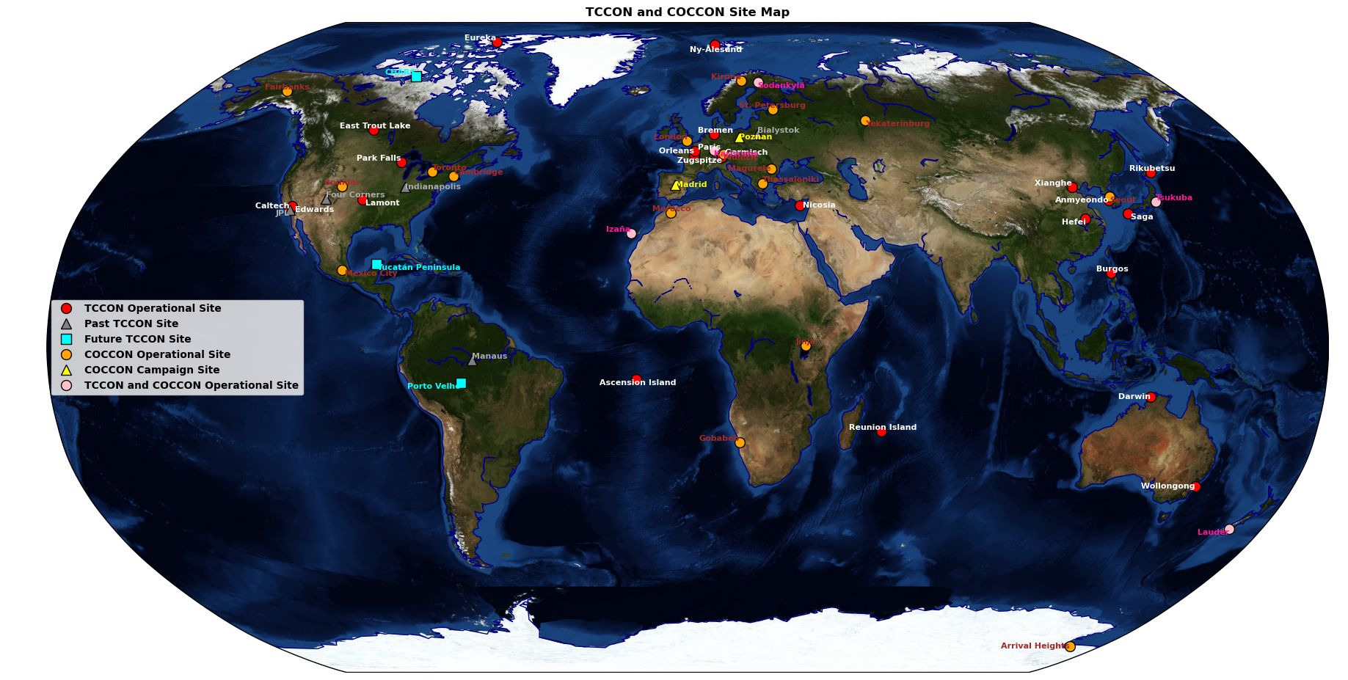
Introduction
Data Used
  OCO-2 V11.1 (Sep 2014 – Dec 2022) uses a digital elevation map (Copernicus) that improves the retrievals, particularly at high latitudes, and has updated quality filters.
  TCCON (GGG2020 x2019)
  COCCON
Collocation Criteria
  ± 2.5° x ± 5° latitude-longitude boxes around TCCON and COCCON sites (except at specific sites)
  Minimum of 100 good quality OCO-2 soundings required
  For Target comparisons, all good target soundings collected during a target overpass are included
  TCCON and COCCON XCO2 (median) ±1h of overpass time
Notes:
Verify Missing TCCON data.
GGG2020 updates: improved CO2 priors, airmass correction, background continuum treatment, new AICFs, XLuft quality filter, …

Slide 3
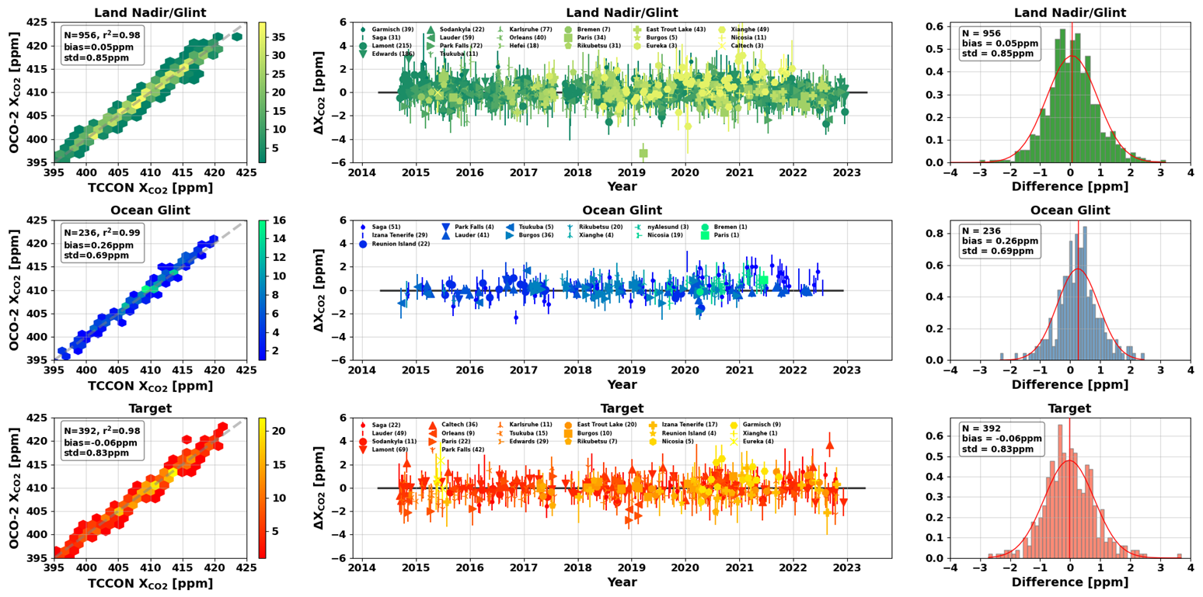
OCO-2 V11.1 vs. TCCON GGG2020
Land Nadir/Glint
The overall bias is slightly positive.
Ocean Glint
The bias is higher than other modes, (though still reasonable given the uncertainty).
Target
Overall, the bias is slightly negative.
Mode | # of Comparisons | Bias | Standard Deviation
Land Nadir/Glint | 956 | 0.05 | 0.85
Ocean Glint | 236 | 0.26 | 0.69
Target | 392 | -0.06 | 0.83

Slide 4
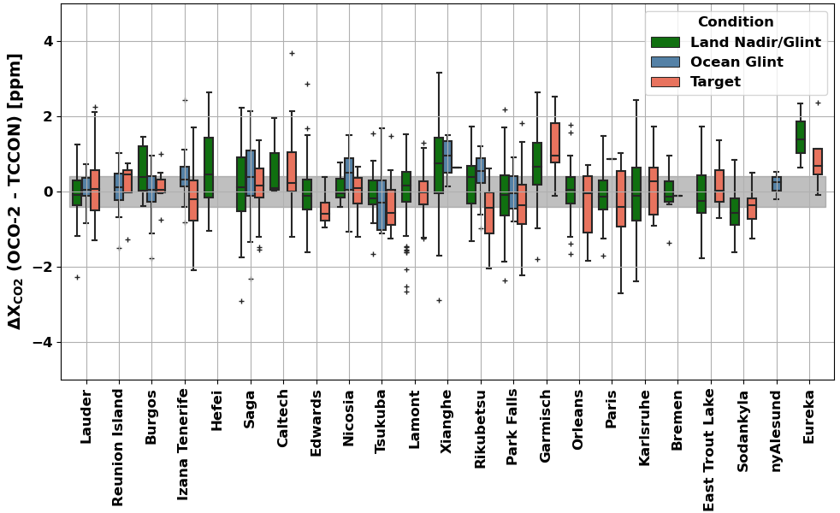
OCO-2 V11.1 vs. TCCON GGG2020 – Site-to-Site Differences
Overall, there is a decrease in the Target mode bias compared to previous OCO-2 data versions due to the updated global scaling factor.
The Ocean Glint bias is also significantly reduced in OCO-2 V11.1.
Overall, for all conditions, OCO-2 V11.1 performs well against TCCON.

Slide 5
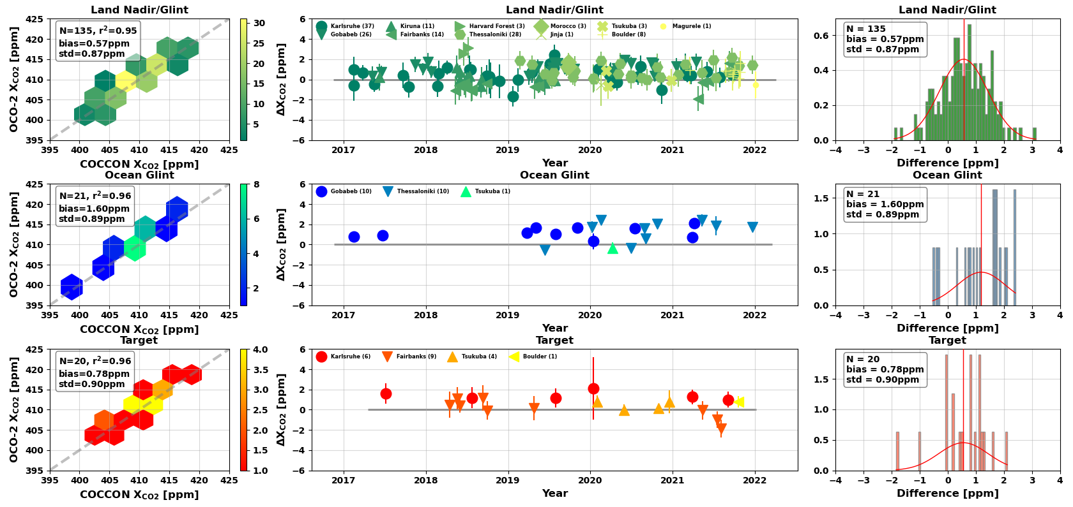
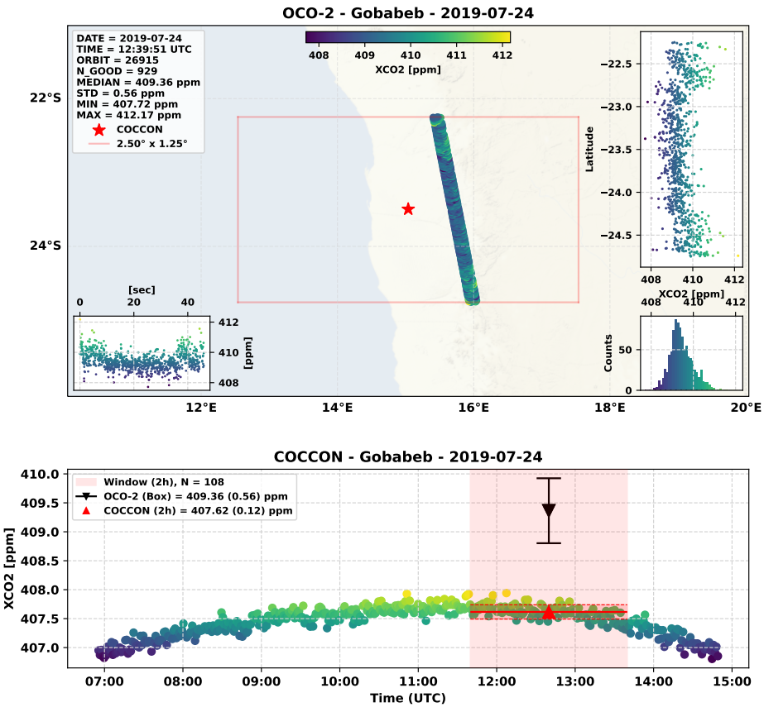
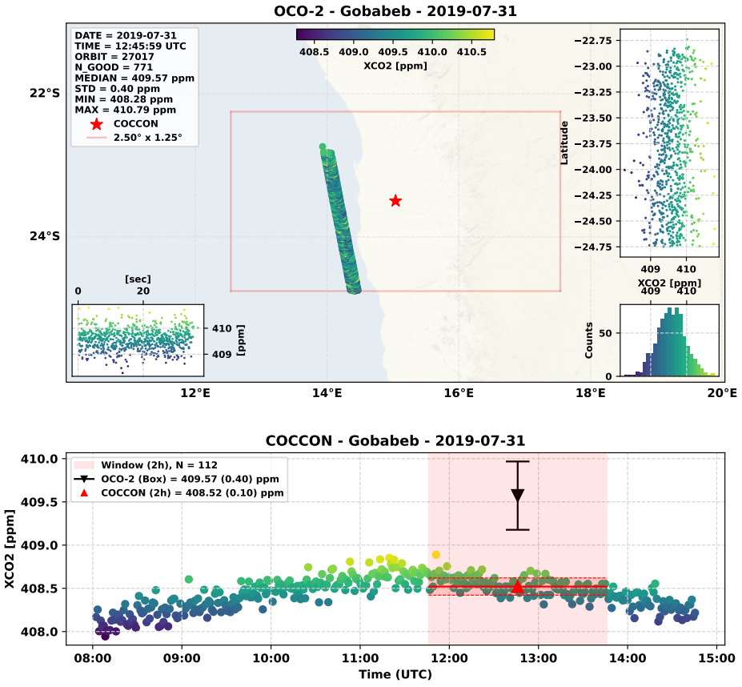
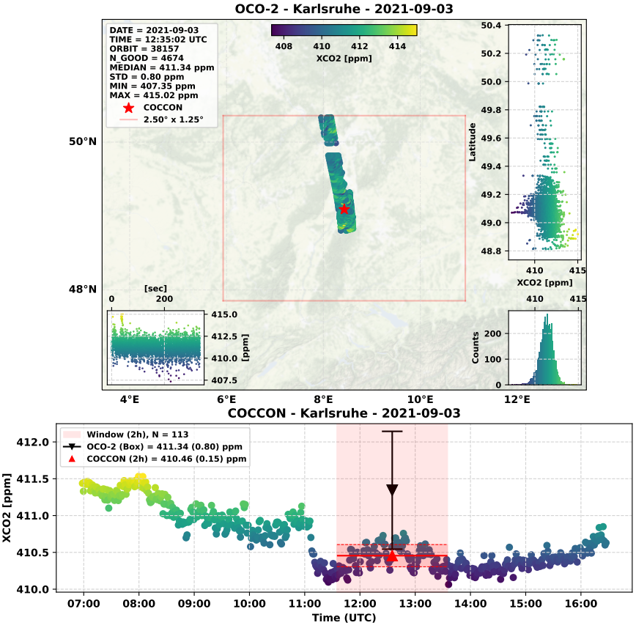
OCO-2 V11.1 vs. COCCON
Land Nadir/Glint
The overall bias is high and positive.
Limited data available.
Diagnostic Plots for Specific Sites
a) Gobabeb – Land Glint
b) Gobabeb – Ocean Glint
c) Karlsruhe – Target
The standard deviation values for Land and Ocean Glint over Gobabeb are under 0.6 ppm, and the slightly high bias is expected.
The standard deviation is 0.8 ppm for Karlsruhe for the Target mode.

Slide 6



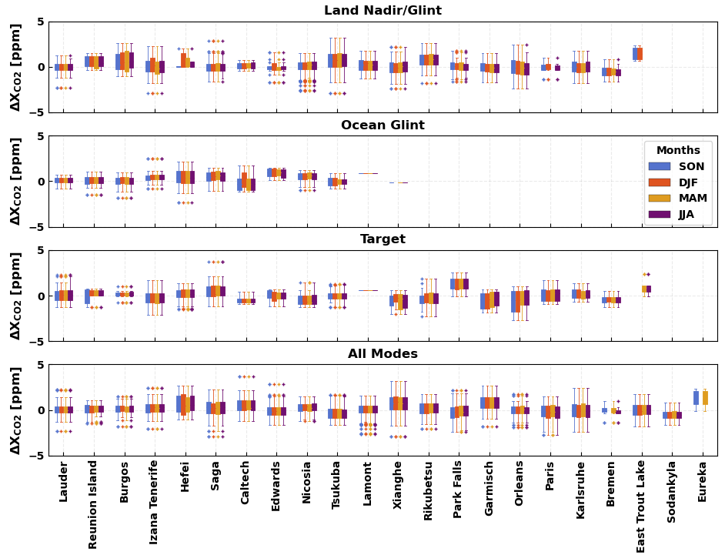
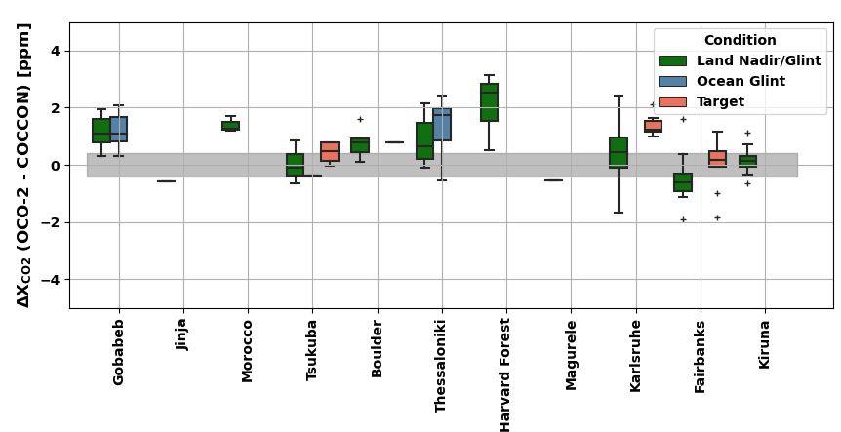
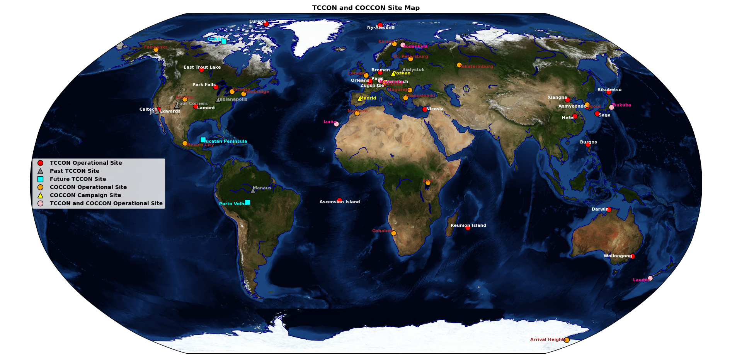
Analysis of Satellite-based X_{CO2} measurements from OCO-2 against Ground-based TCCON and COCCON measurements
National Aeronautics and Space Administration
Saswati Das¹, Matthäus Kiel¹, Joshua Laughner¹, and Gregory Osterman¹
¹Jet Propulsion Laboratory, California Institute of Technology
Poster #12
OBJECTIVE
Satellite measurements of column-averaged dry-air mole fraction of CO₂ (X_{CO2}) from the Orbiting Carbon Observatory-2 (OCO-2) are compared against the ground-based Total Carbon Column Observing Network (TCCON) and COllaborative Carbon Column Observing Network (COCCON) measurements to identify potential biases and errors.
OCO-2 vs. TCCON
RESULTS
OCO-2 vs. COCCON
DATA and METHODOLOGY
The new and improved Version 11.1 (V11.1) of OCO-2 data (Sep 2014 – Dec 2022), the TCCON (GGG2020 x2019), and COCCON (Versions 1 and 2) data products have been used in this work.
V11.1 uses a digital elevation map (Copernicus) that improves the retrievals, particularly at high latitudes, and has updated quality filters. V11.1 Lite files will be made publicly available soon.
Coincidence Criteria:
± 2.5° x ± 5° latitude-longitude boxes around TCCON and COCCON sites
Minimum of 100 good quality OCO-2 soundings required
For Target comparisons, all good target soundings collected during a target overpass are included
TCCON and COCCON X_{CO2} (median) ±1h of overpass time
TCCON GGG2020 data is missing for several sites which affects the ocean glint comparison
Figure 5. Left columns indicate the OCO-2 one-to-one plot against COCCON, middle columns indicate the time series of the differences, and the right columns show the statistical parameters. ‘N’ and ‘r²’ indicate the number of points on the graph and the coefficient of determination, respectively.
The absolute average bias is 0.57 ppm for Land Nadir/Glint. Low N values for Ocean Glint and Target contribute to the large bias values in these observation modes.
Figure 2. Left columns indicate the OCO-2 one-to-one plot against TCCON, middle columns indicate the time series of the differences, and the right columns show the statistical parameters. ‘N’ and ‘r²’ indicate the number of points on the graph and the coefficient of determination, respectively.
The overall absolute average bias is close to 0 ppm for Land Nadir/Glint and Target modes, and ~ 0.25 ppm for Ocean Glint.
Figure 6. Site-to-site differences between OCO-2 and COCCON, separated by observation modes for sites for which 10 or more coincident measurements are available. The COCCON stations are ordered by latitude from Gobabeb (23.5º S) to Kiruna (67.8º N). The bottom and top edges of the box indicate the 25 and 75 percentile limits; whiskers represent the full range of the data, excluding the outliers indicated by ‘+’ markers. The grey shaded area shows the ±0.4 ppm uncertainty in the COCCON values.
Overall, site-to-site comparisons between OCO-2 and COCCON suggest reasonable agreement between the datasets, considering the uncertainty and the limited number of coincident measurements.
a)
b)
c)
The standard deviation values for Land and Ocean Glint over Gobabeb are under 0.6 ppm, and the slightly high bias is expected.
The standard deviation is 0.8 ppm for Karlsruhe for the Target mode.
Figure 3. Site-to-site differences separated by observation modes for sites for which 10 or more coincident measurements are available. The TCCON stations are ordered by latitude from Lauder (45º S) to Eureka (80º N). The bottom and top edges of the box indicate the 25 and 75 percentile limits; whiskers represent the full range of the data, excluding the outliers indicated by ‘+’ markers. The grey shaded area shows the ±0.4 ppm uncertainty in the TCCON values.
Overall, there is a decrease in the Target mode bias compared to previous OCO-2 data versions due to the updated global scaling factor.
The Ocean Glint bias is also significantly reduced in OCO-2 V11.1.
Overall, for all conditions, OCO-2 V11.1 performs well against TCCON.
Figure 4. The dependence of the difference (ΔX_{CO2}) between OCO-2 X_{CO2} and coincident TCCON X_{CO2} on the season and OCO-2 observing mode. The site-to-site differences are shown when 10 or more coincident observations are present. The different colored boxes indicate the different seasons (blue = DJF, orange = MAM, yellow = JJA, and purple = SON). The TCCON stations are ordered by latitude, where Lauder is 45º S and Eureka is 80º N. The equator is between Reunion Island (20º S) and Burgos (18º N).
Xianghe, Hefei, and Garmisch typically show high bias values over all seasons in the Land Nadir/Glint mode.
The seasonal variation is low for all individual sites when observed over ‘All Modes’.
Figure 7. Diagnostic figures in the top panels indicate the latitude and time-based distribution of X_{CO2} for coincident OCO-2 overpasses, and the bottom panels indicate the COCCON X_{CO2} distribution during the OCO-2 overpass for a) land glint and b) ocean glint over Gobabeb, and c) target over Karlsruhe.
Figure 1. Past, present, and future TCCON and COCCON sites.
SUMMARY
Aggregated OCO-2 X_{CO2} estimates filtered with xco2_quality_flag = 0 typically compare well with coincident TCCON and COCCON data at global scales
The absolute average bias values are close to 0 ppm for TCCON and less than 0.8 ppm for COCCON in the Land Nadir/Glint and Target mode observations.
The Land Nadir/Glint comparisons against COCCON provide similar statistics to TCCON, except for the expected bias.
This study bridges the gap between satellite and ground-based X_{CO2} measurements, and aids the improvement of the OCO-2 X_{CO2} data product.
Acknowledgement: We thank the TCCON and COCCON investigators for providing their data and their assistance in the validation analysis for OCO-2.
National Aeronautics and Space Administration
Jet Propulsion Laboratory
California Institute of Technology
Pasadena, California
www.nasa.gov
Copyright 2023. All rights reserved.
References:
Crisp, D., Miller, C. E., and DeCola, P. L.: NASA Orbiting Carbon Observatory: measuring the column averaged carbon dioxide mole fraction from space, J. Appl. Remote Sens., 2, 23508,https://doi.org/10.1117/1.2898457, 2008.
Wunch, D., Wennberg, P.O., Osterman, G., Fisher, B., Naylor, B., Roehl, C.M., O'Dell, C., Mandrake, L., Viatte, C., Kiel, M. and Griffith, D.W., 2017. Comparisons of the orbiting carbon observatory-2 (OCO-2) X CO 2 measurements with TCCON. Atmospheric Measurement Techniques, 10(6), pp.2209-2238.
Frey, M., Sha, M.K., Hase, F., Kiel, M., Blumenstock, T., Harig, R., Surawicz, G., Deutscher, N.M., Shiomi, K., Franklin, J.E. and Bösch, H., 2019. Building the COllaborative Carbon Column Observing Network (COCCON): long-term stability and ensemble performance of the EM27/SUN Fourier transform spectrometer. Atmospheric Measurement Techniques, 12(3), pp.1513-1530.
Author Contact Information:
(+1) 626-437-8756
saswati.das@jpl.nasa.gov

Slide 7
Author Contact Information
(+1) 626-437-8756
saswati.das@jpl.nasa.gov

