Slide 1
GHG observations at the COCCON Tsukuba site
Matthias Max Frey, Isamu Morino, Hirofumi Ohyama, Astrid Müller et al.

Slide 2
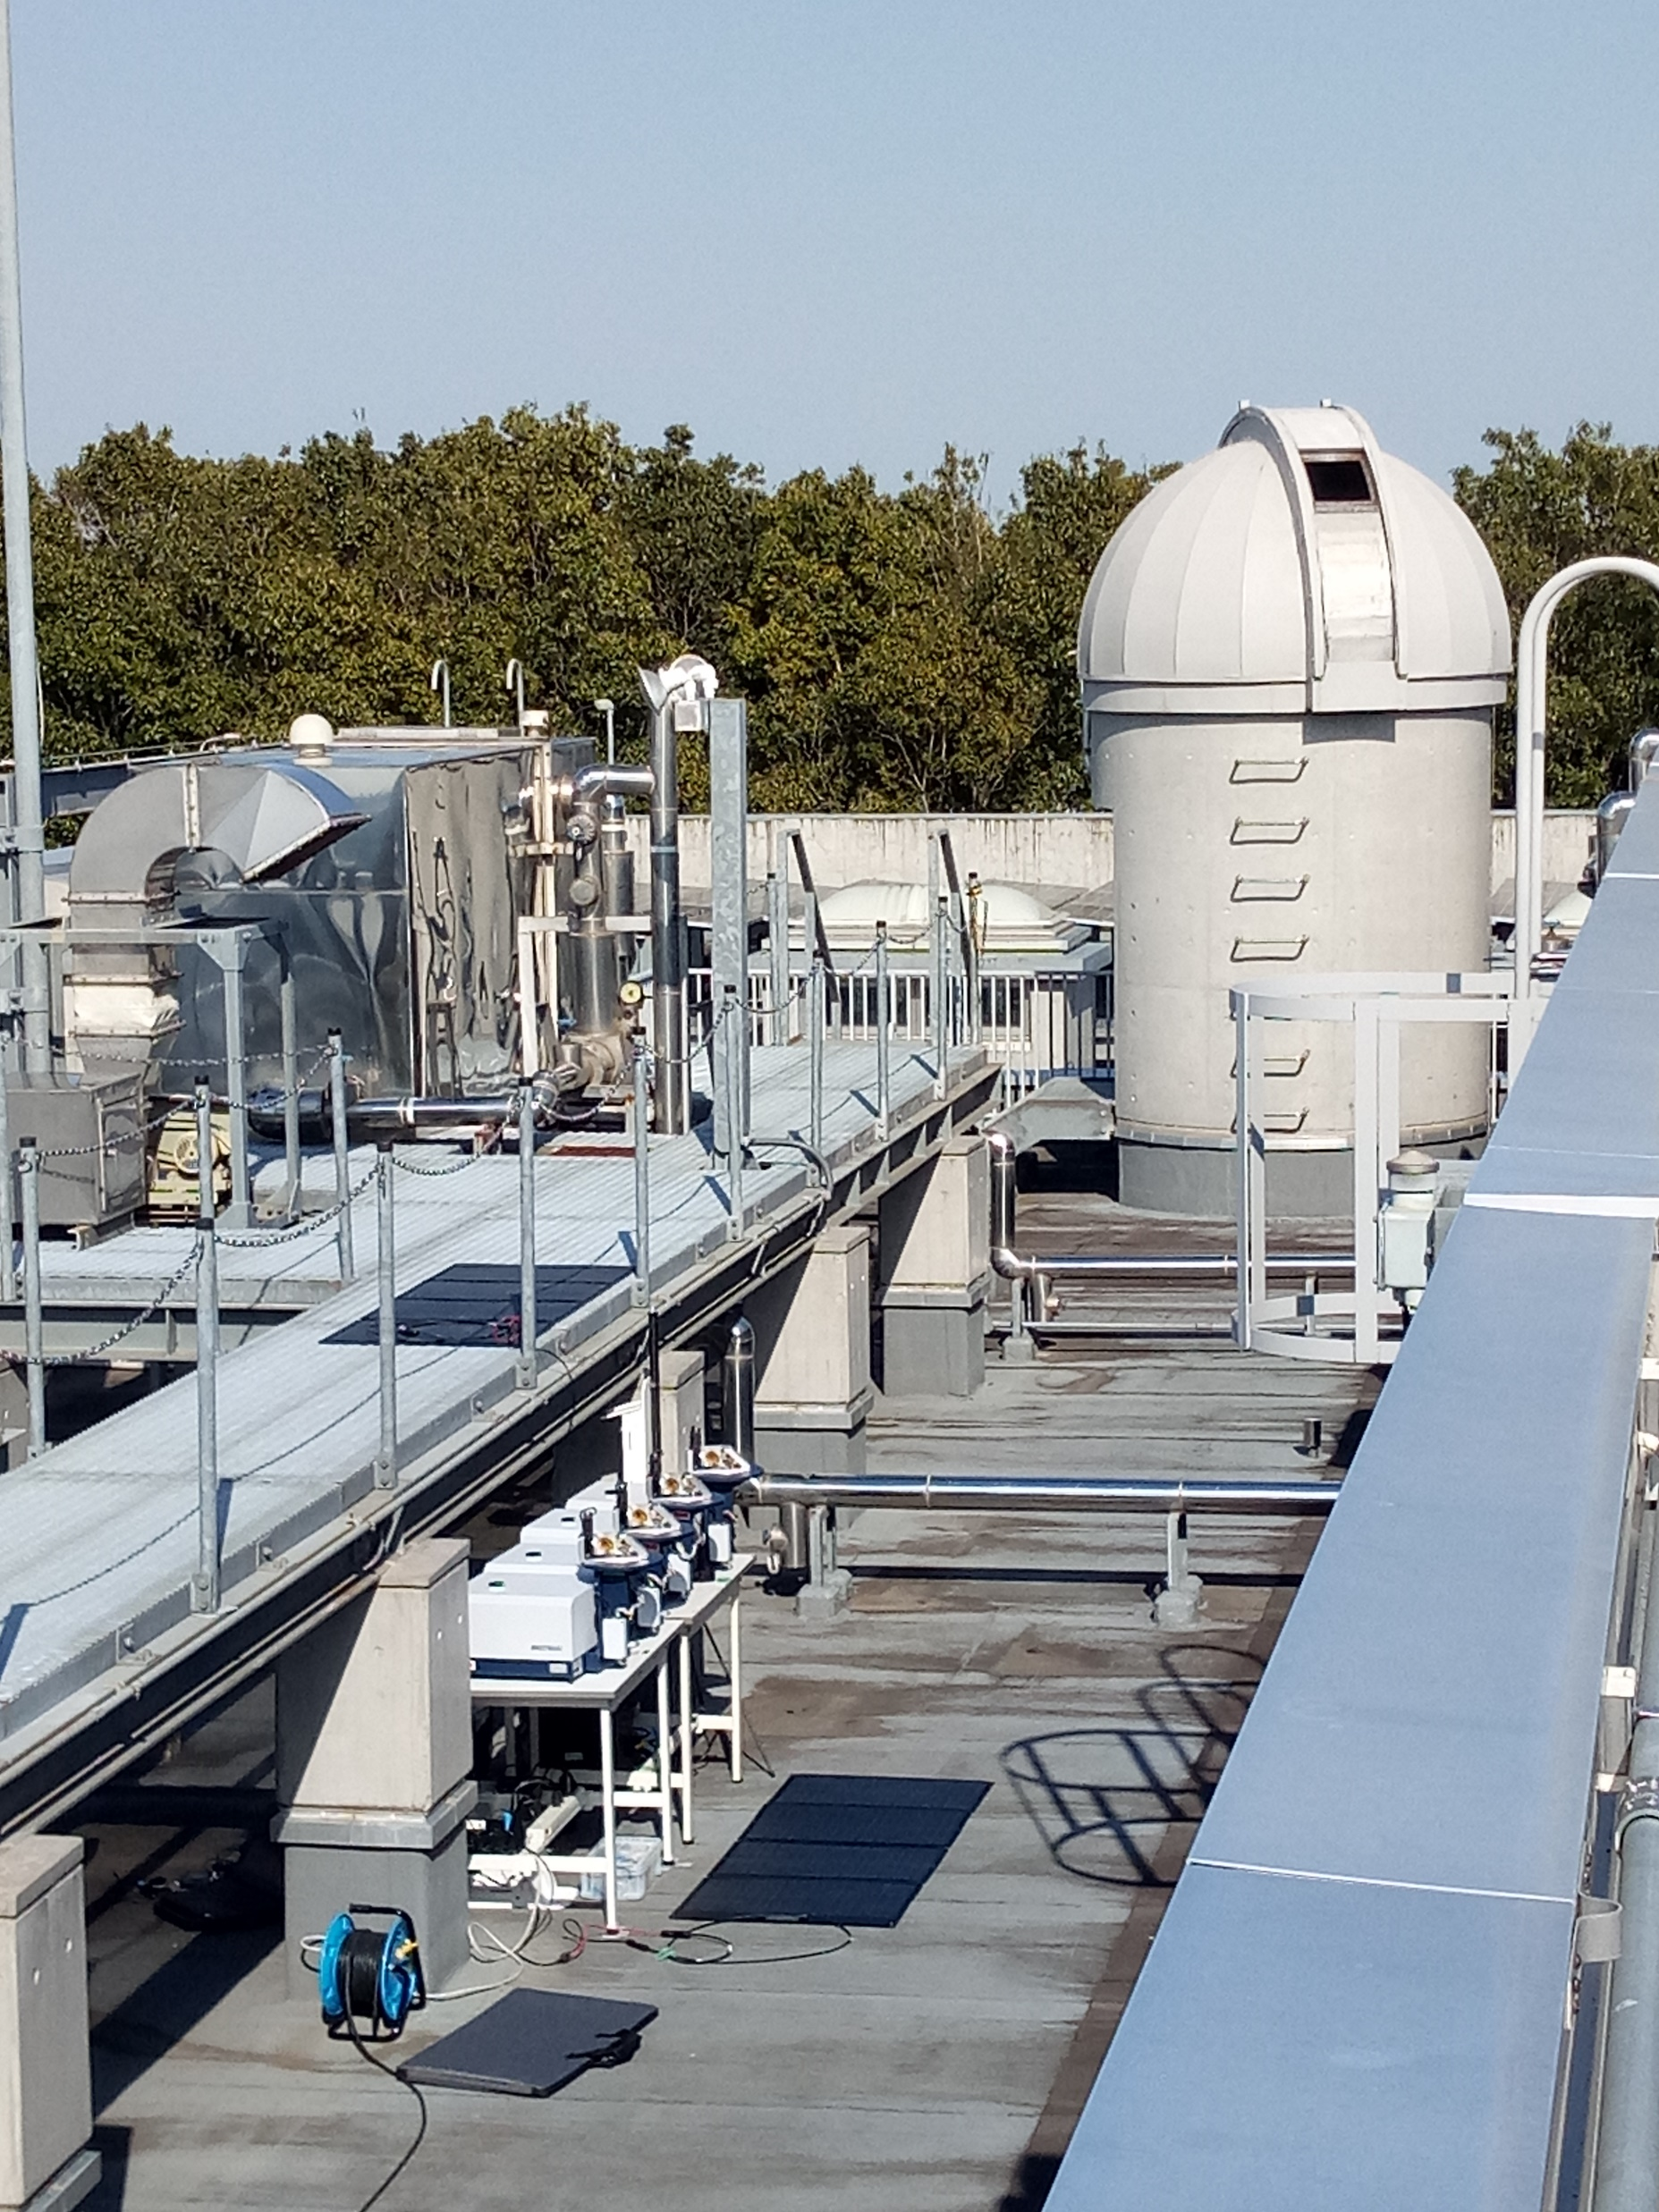


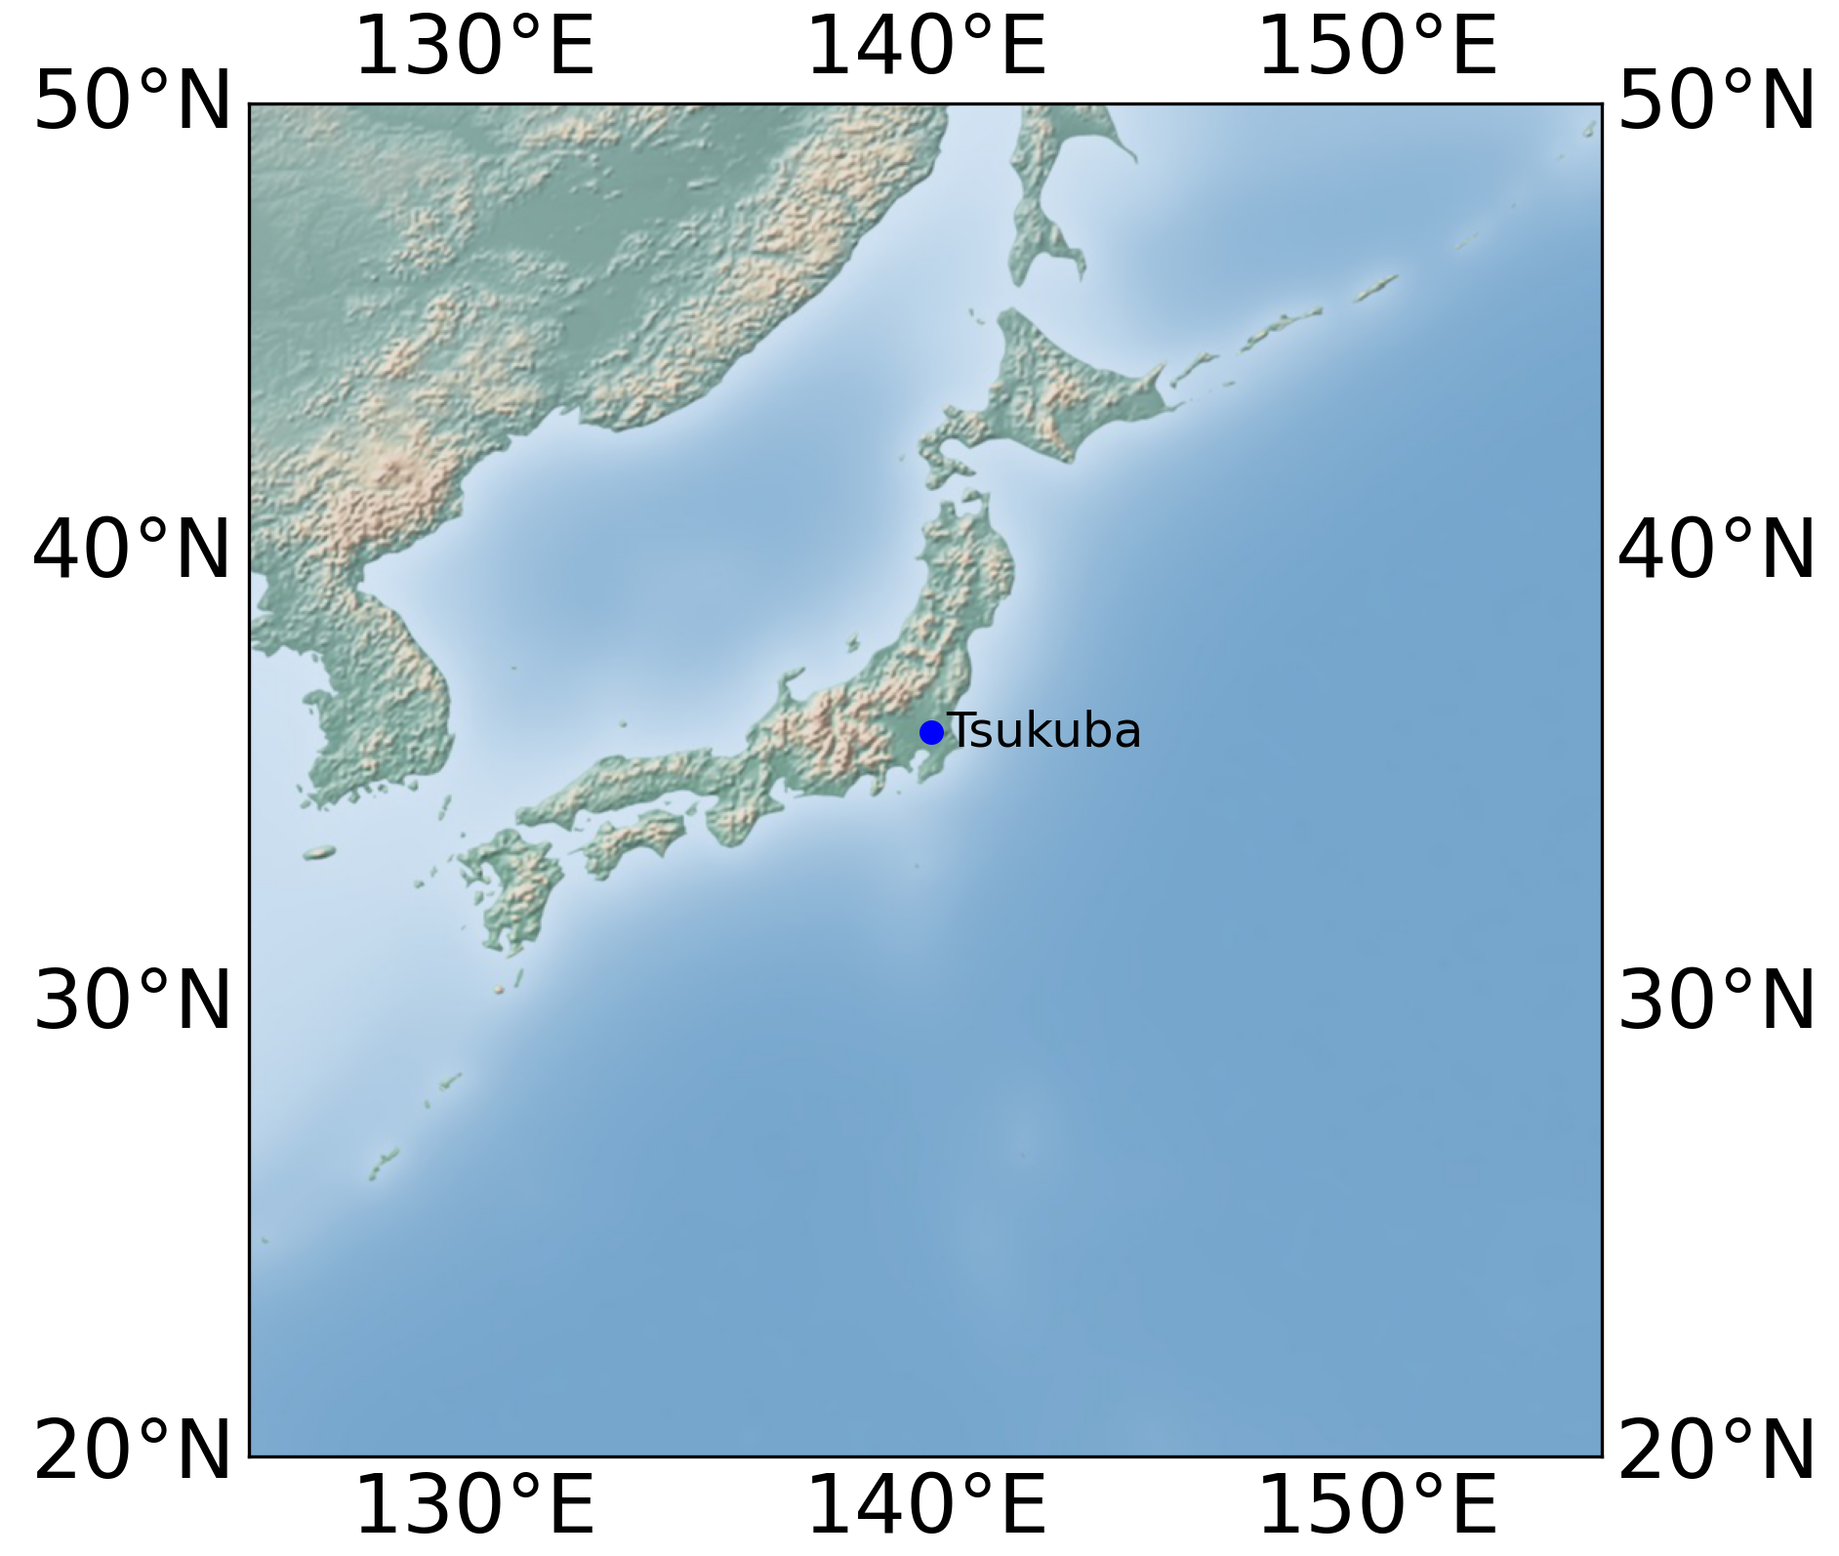

Ground-based remote sensing networks at NIES
TCCON & NDACC
  High-resolution spectrometer
  Gold standard for satellite validation
  Capable of profile retrieval
COCCON
  Small, portable spectrometer (EM27/SUN)
  Low infrastructure demands
    Various applications

Slide 3
COCCON Tsukuba site

Slide 4
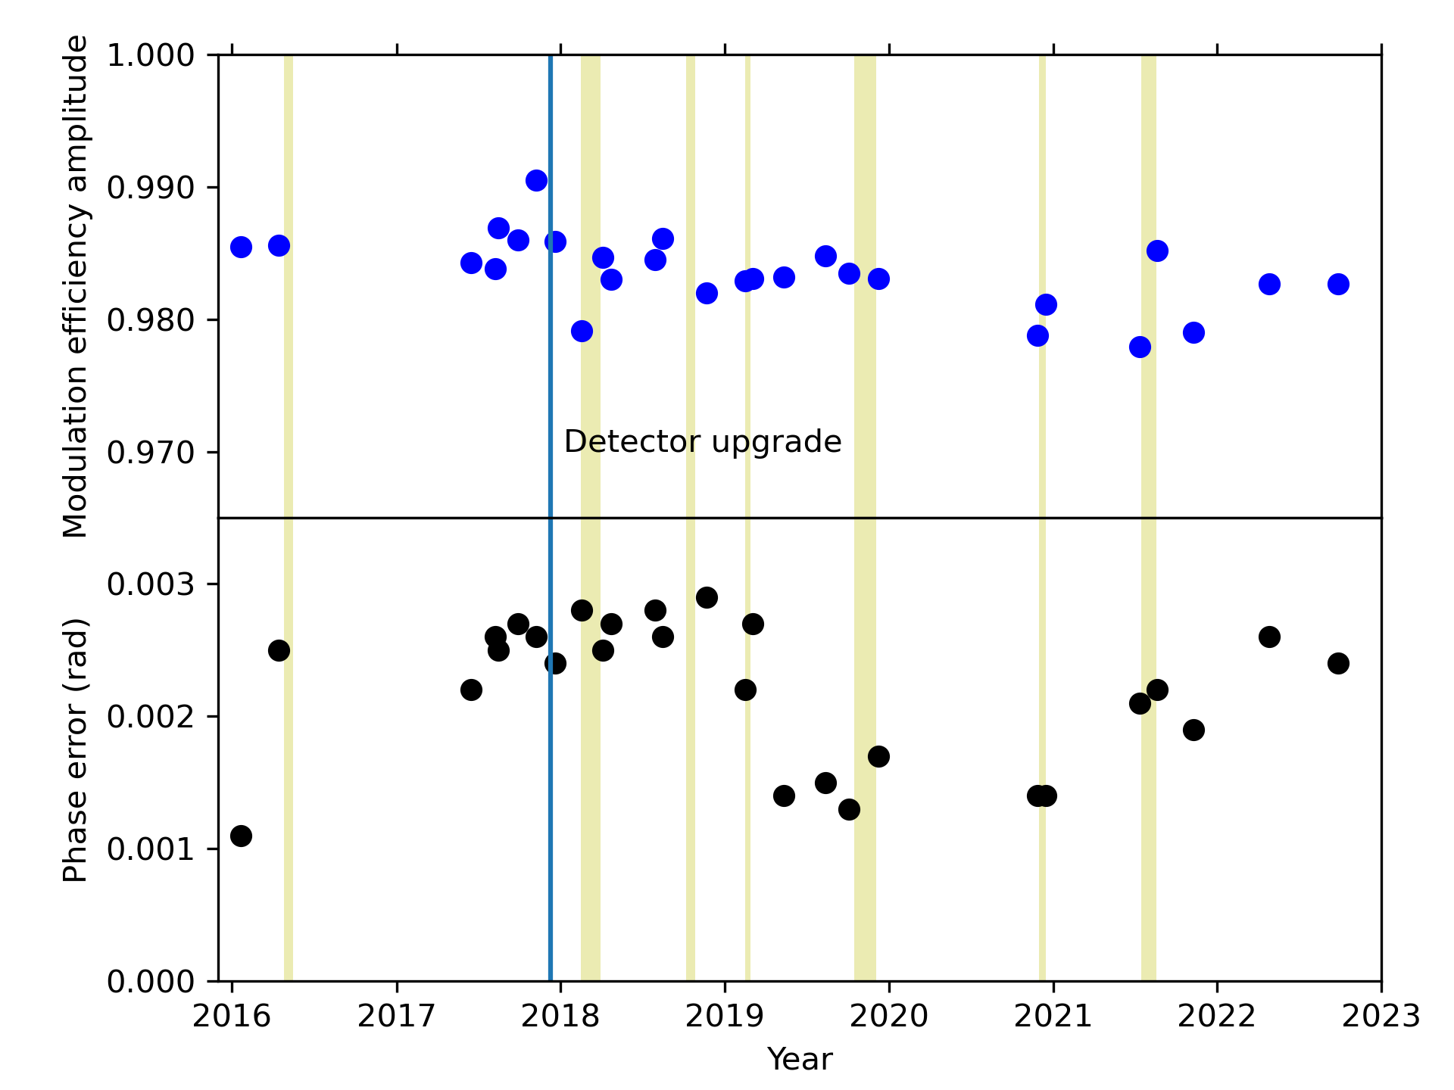
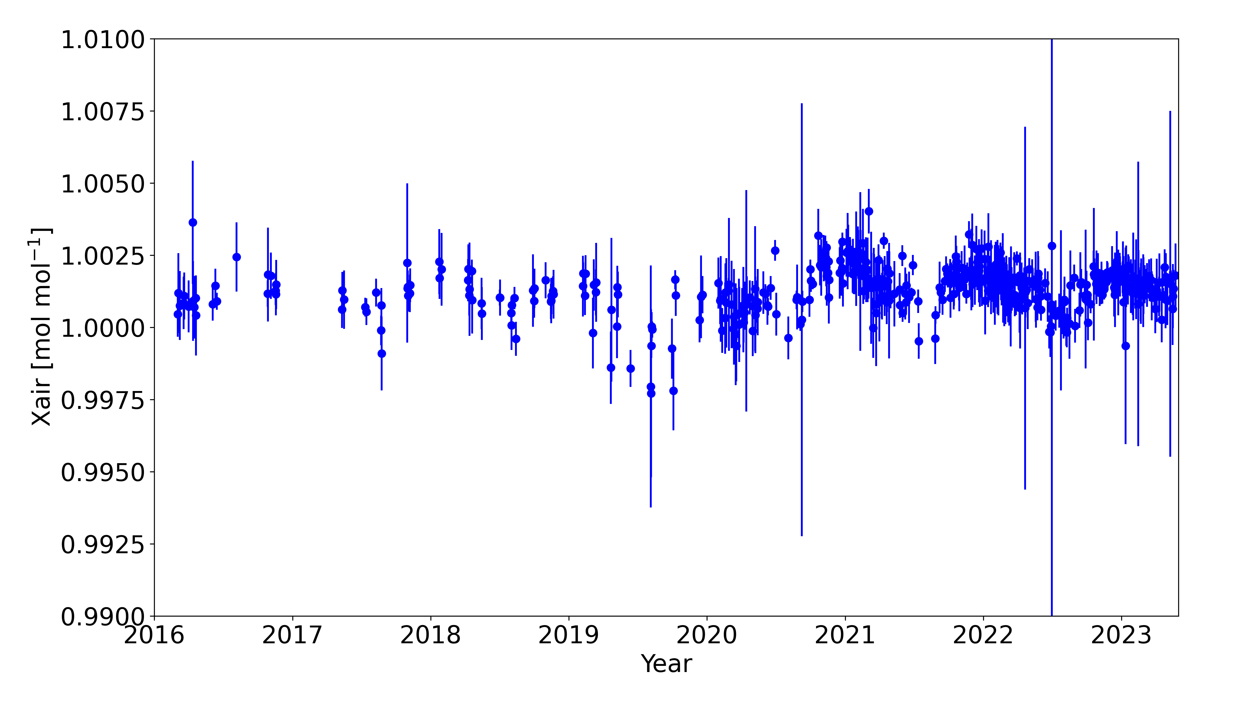
Instrumental stability
Verification of instrumental stability using different metrics
  Instrumental line shape (ILS) measurements
  X_{air} timeseries
  Calibration w.r.t. COCCON reference instrument in Karlsruhe
COCCON Tsukuba instrument (SN063) remarkably stable since 2016
ILS timeseries
X_{air} timeseries

Slide 5
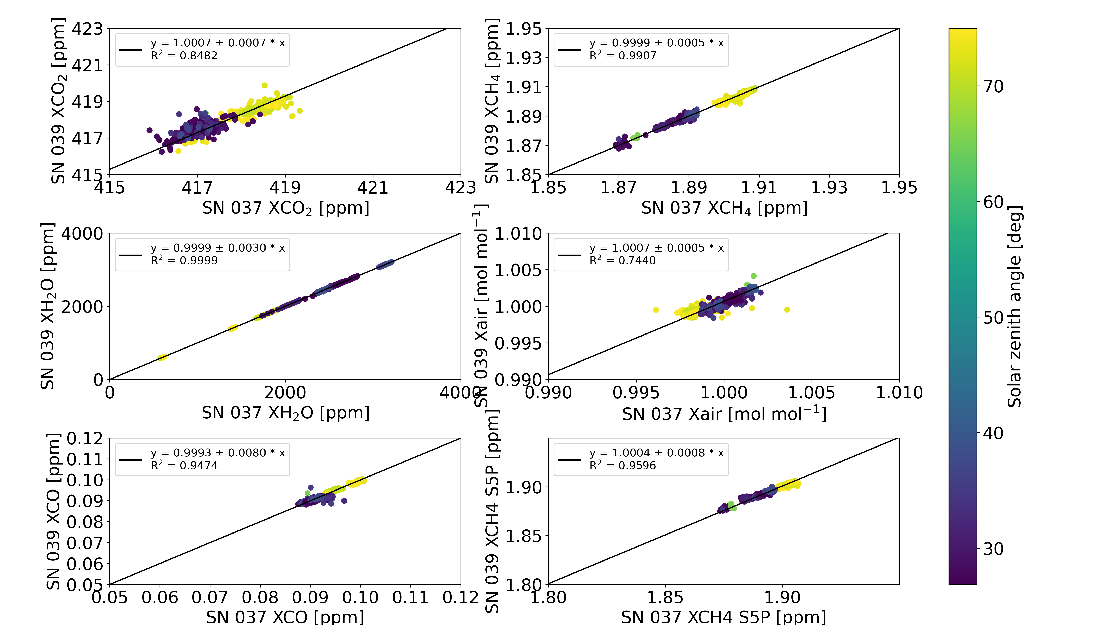
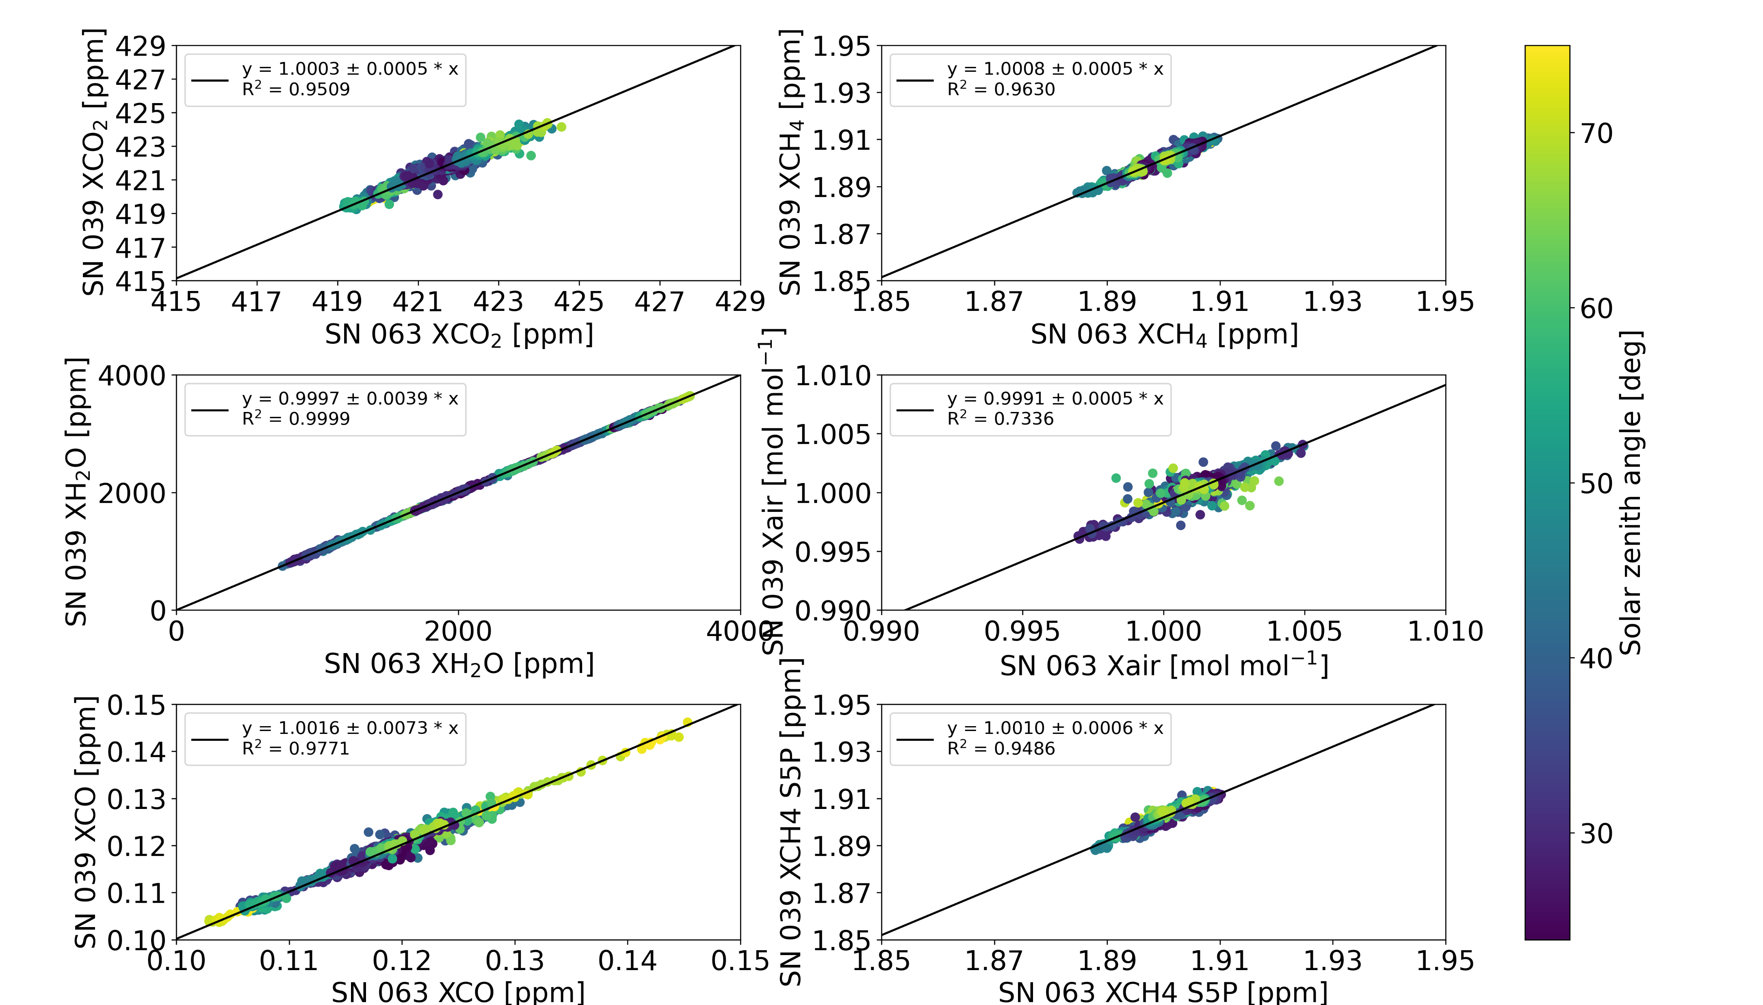
Instrumental stability
Calibration w.r.t. COCCON reference instrument (SN037) in Karlsruhe
  Performed January 2016
    Instrument specific calibration factors: XCO₂ – 1.0003, XCH₄: 1.0001
  EM27 Travel Standard (SN039) visited Tsukuba April 2022
  Check calibration w.r.t. reference instrument using Travel Standard
    Instrument specific calibration factors: XCO₂ – 1.0003, XCH₄: 1.0008
COCCON Tsukuba instrument (SN063) remarkably stable since 2016
Comparison SN037 – SN039 Karlsruhe
Comparison SN063 – SN039 Tsukuba

Slide 6
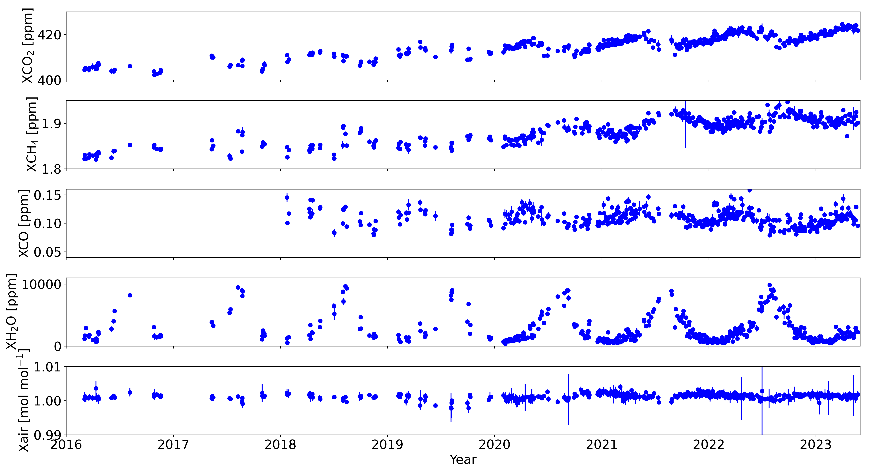
COCCON timeseries

Slide 7
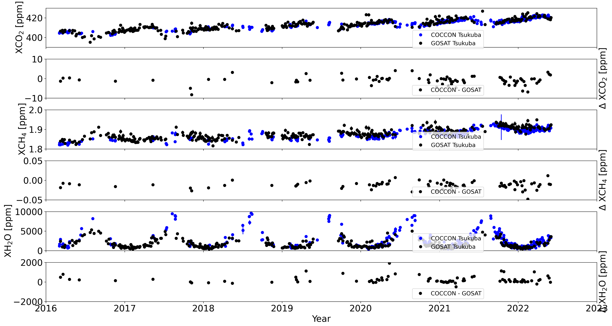
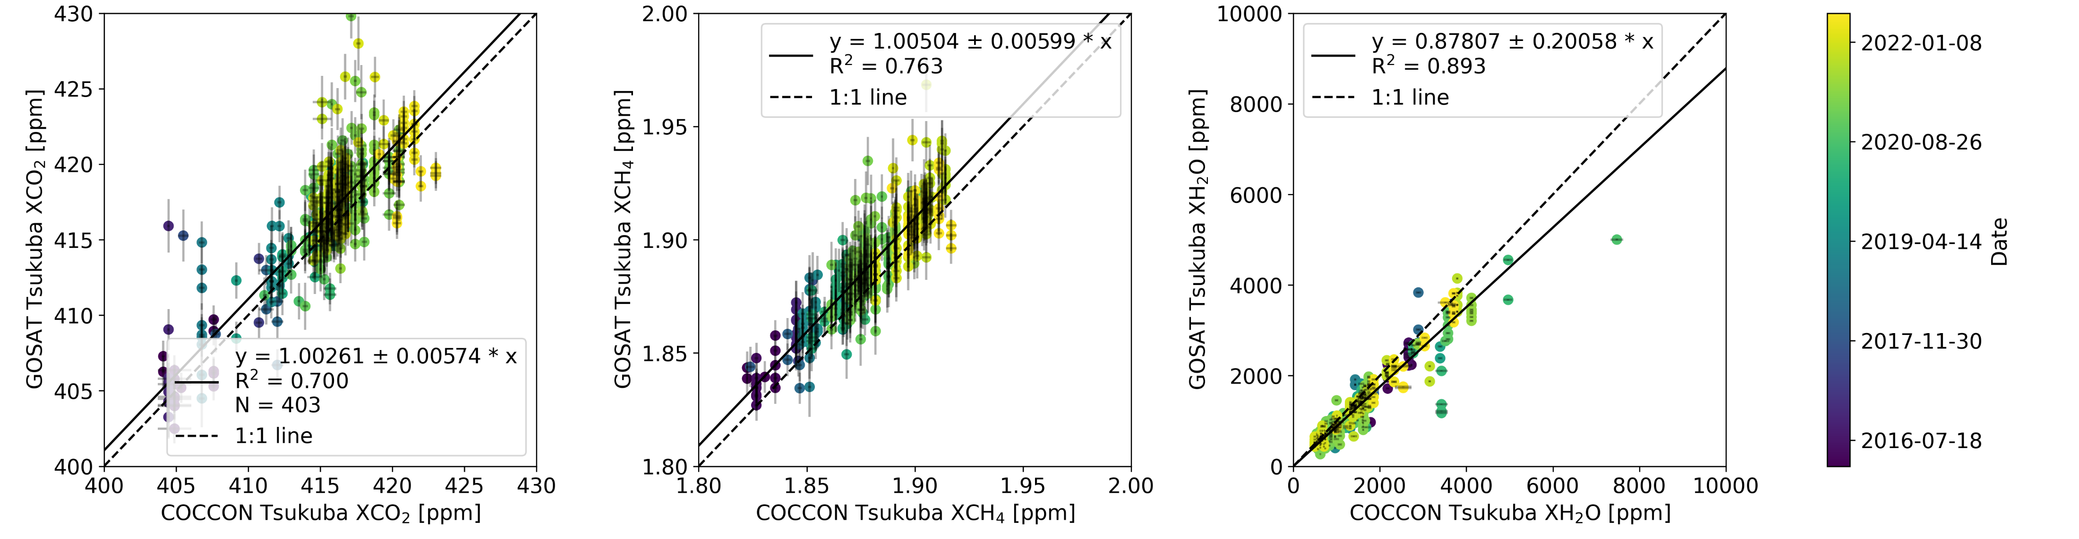

GOSAT series validation: GOSAT NIES v02.91
± 2° coincidence criterion
COCCON Measurements ± 30 min of overpass
XCO₂ bias: 1.1 ppm
XCO₂ STD: 2.4 ppm
Slight GOSAT XCO₂ high bias expected as coincidence criterion includes the densely populated Kanto plain

Slide 8
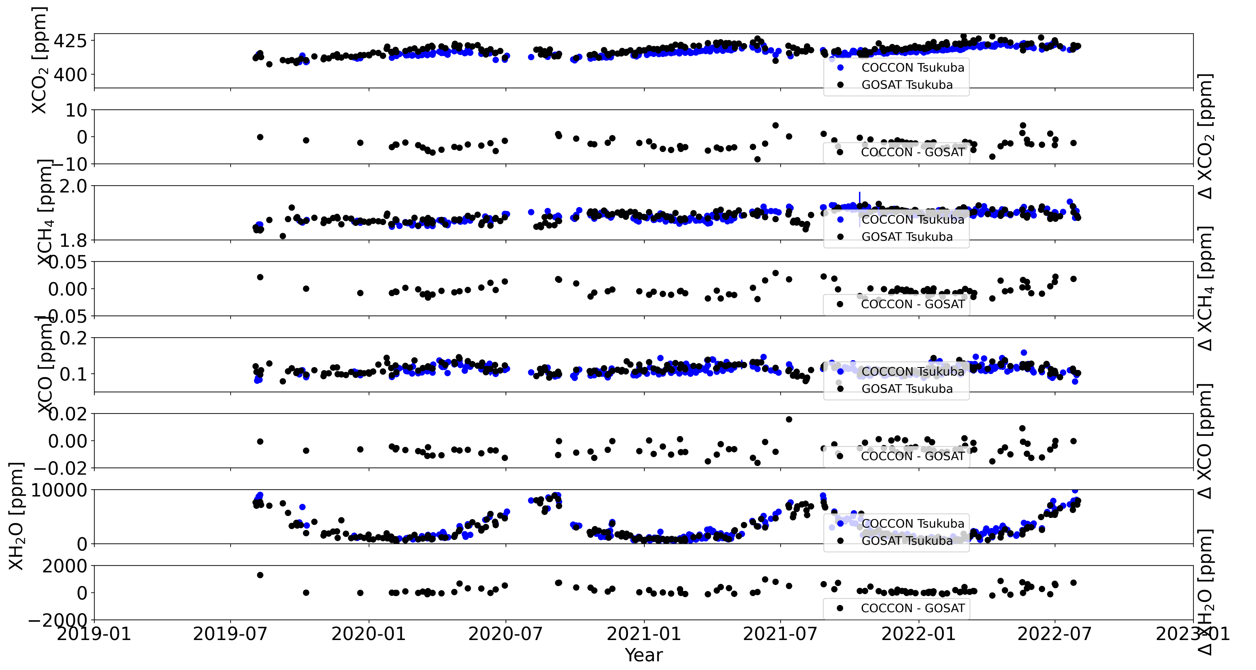
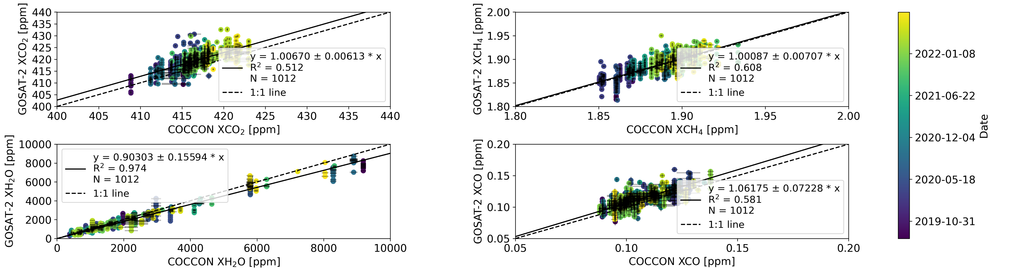
GOSAT series validation: GOSAT-2 FP v02.00
± 2° coincidence criterion
Higher number of coincidence observations compared to GOSAT
For XCO₂, XCO, and XCH₄ observed biases are similar to biases seen by the GOSAT validation team for TCCON comparison

Slide 9
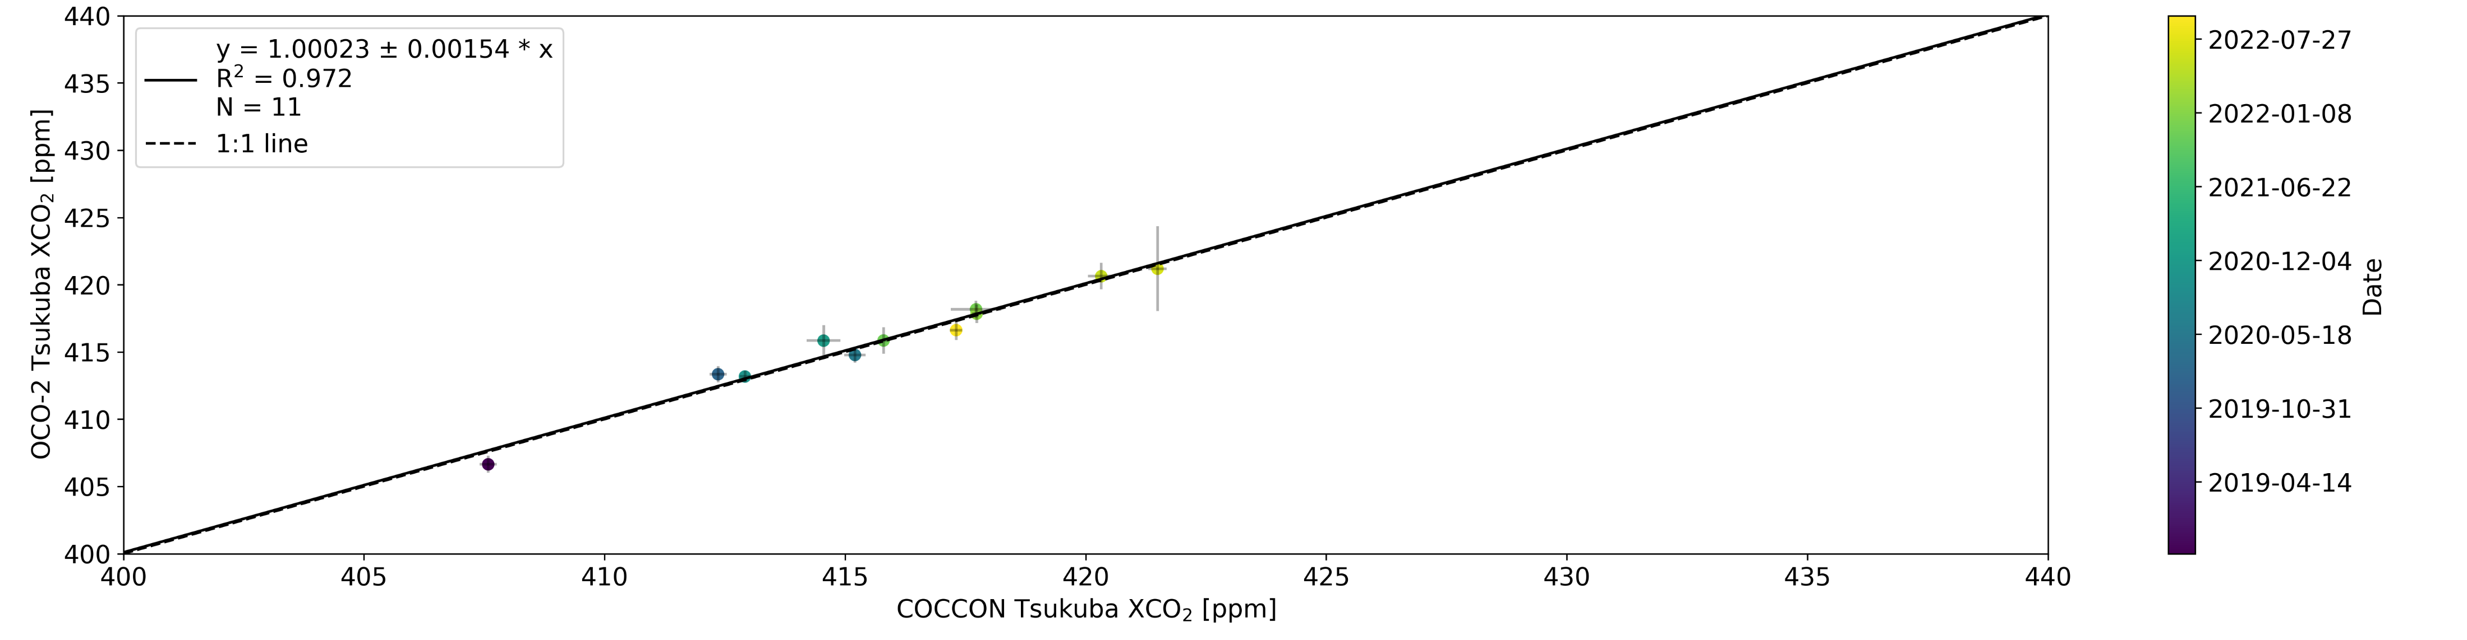
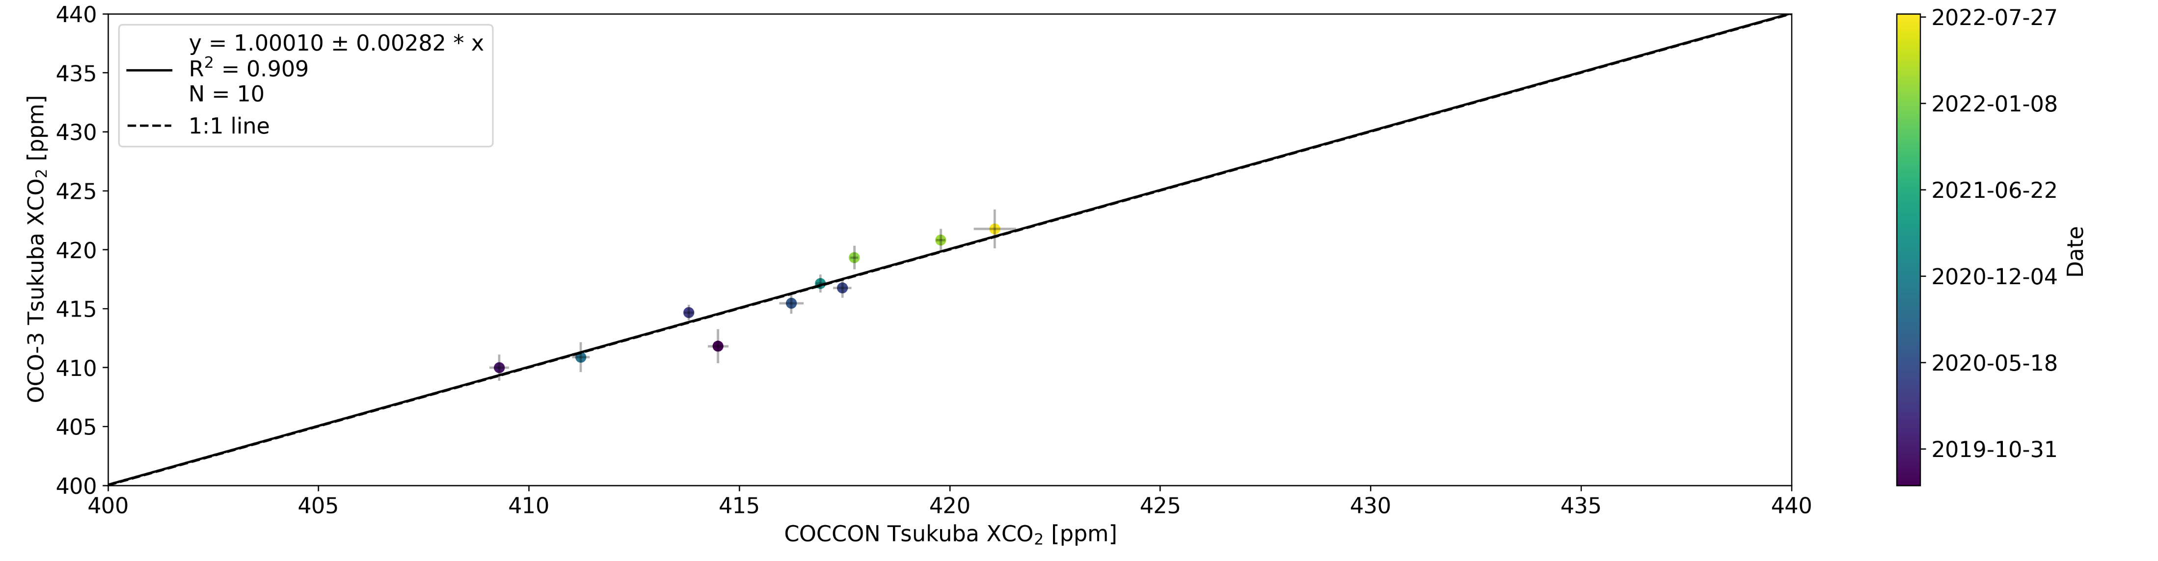
OCO-2 / OCO-3 validation
± 2° coincidence criterion
OCO-3 data screened for Tokyo SAMs
Only overpasses including over 500 footprint pixels with quality flag == 0 used
OCO-2
bias 0.1 ppm,
STD 0.6 ppm
OCO-3
bias 0.0 ppm,
STD 1.1 ppm

Slide 10
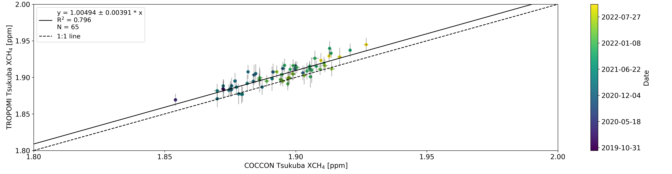
TROPOMI XCH₄ validation
Only TROPOMI overpasses with quality flag > 0.5 for at least 100 footprints used
TROPOMI bias 9 ppb, STD 7ppb
Bias as well as STD are well within the TROPOMI mission requirements

Slide 11
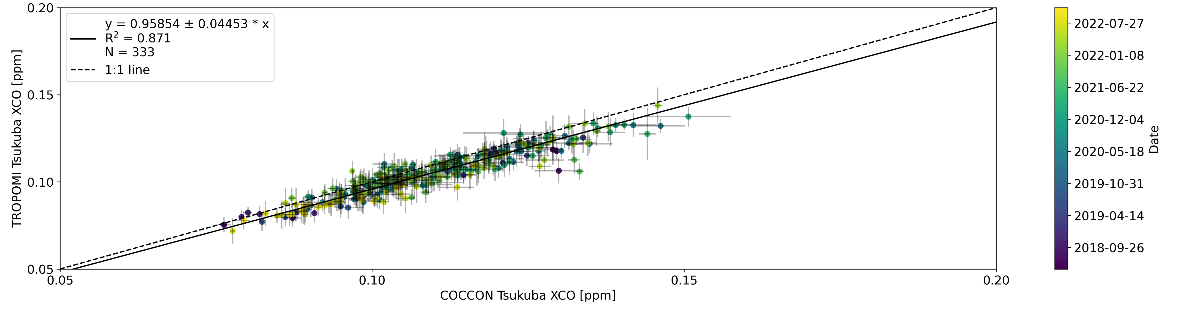
TROPOMI XCO validation
Here 0.5° coincidence criterion used, this still includes most of Tokyo
Compared to 2° criterion, the bias decreases, on the edge of not being significant on the 1-σ level
Also tested 0.2° criterion and min pooled data for COCCON No significant difference
Bias as well as STD are well within the TROPOMI mission requirements

Slide 12
Ship-borne EM27/SUN observations

Slide 13
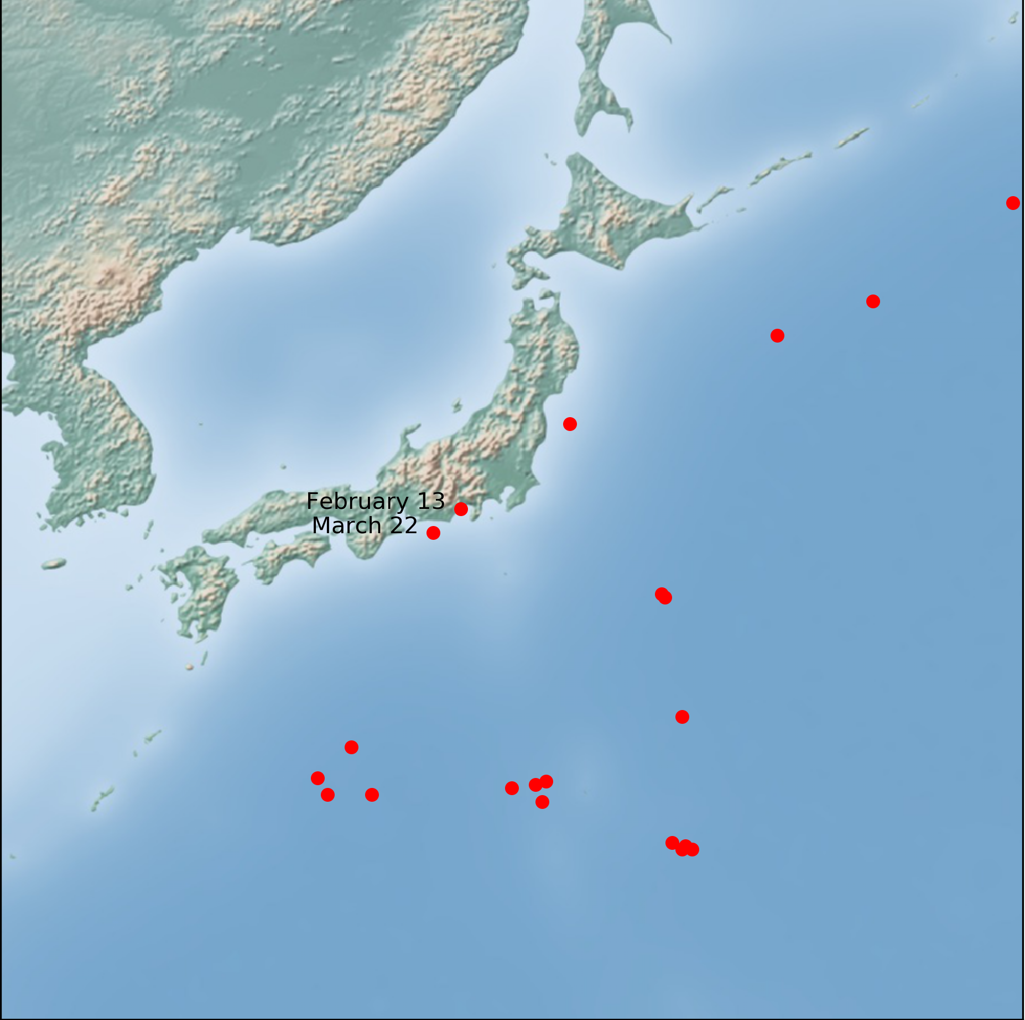
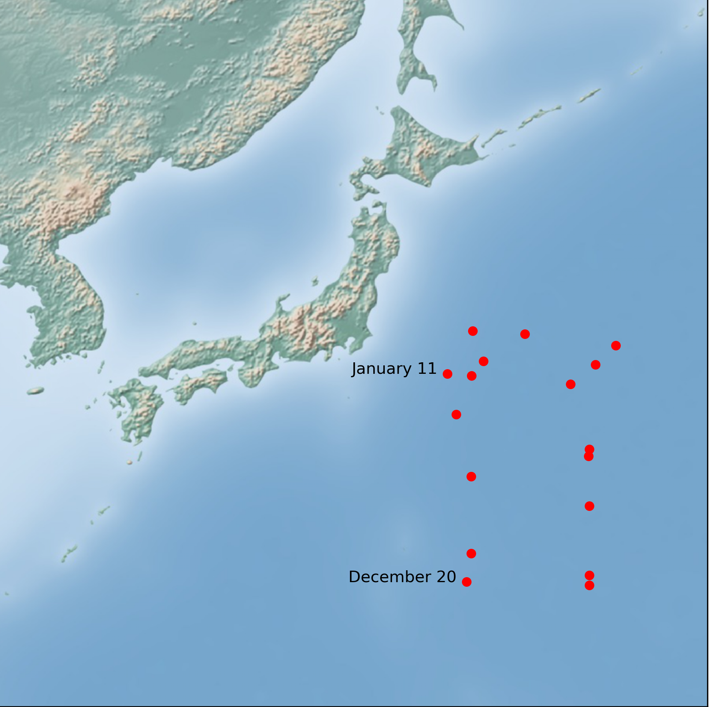
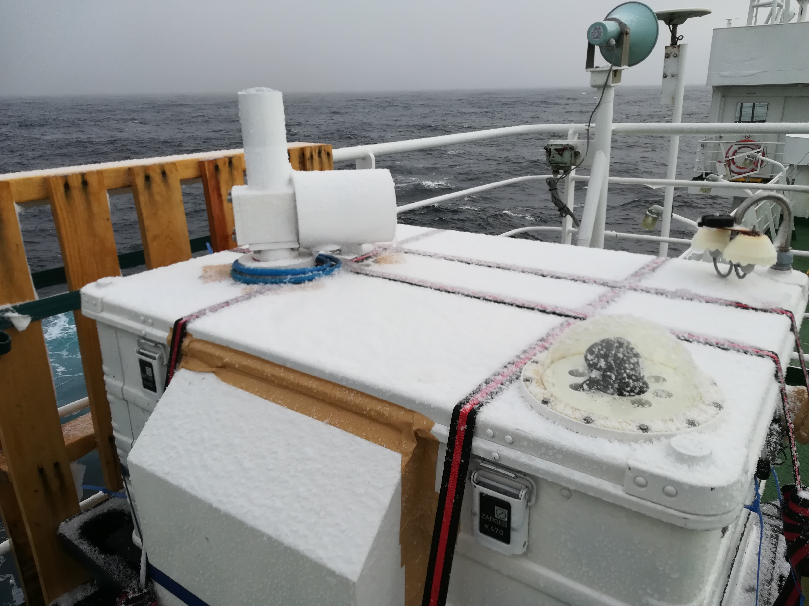
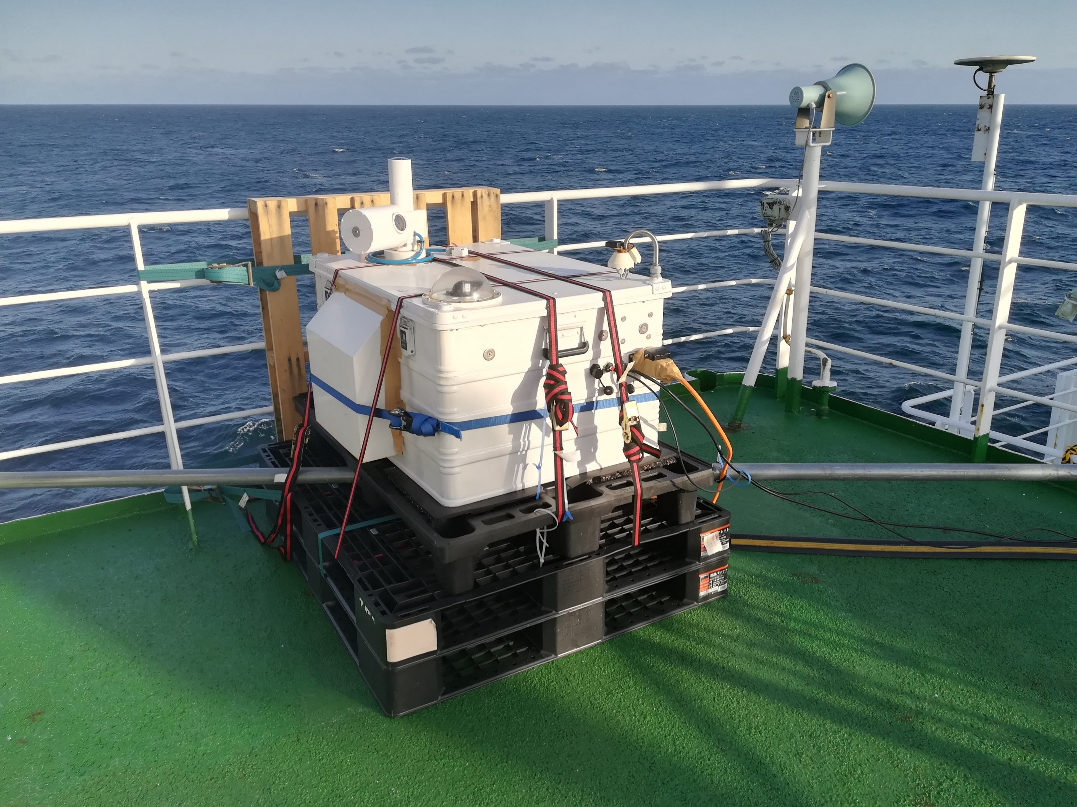
Research vessel Mirai cruises 2021/2022
MR21-1
NIES and Heidelberg University collaboration
Partly harsh environmental conditions
  Wave heights up to 10 m
  Strong winds
MR21-1
  February 13 – March 22 2021
MR21-6
  December 18 2021 – January 13 2022
  Software update to enable remote control
    Observations even when outside access prohibited
MR21-6

Slide 14
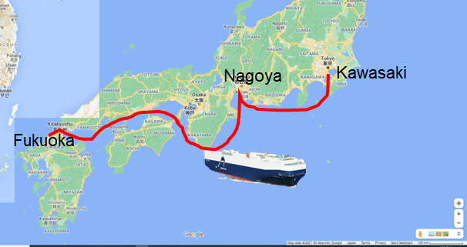
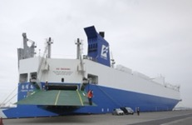
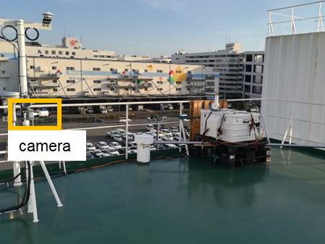
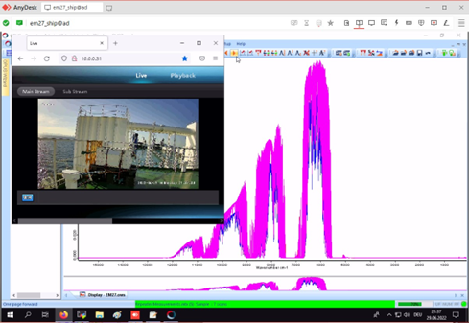
First cargo ship-based XCO₂, XCH₄, and XCO measurements with a semi-automatic EM27/SUN
Vehicle carrier “Nichiyu Maru” (Kagoshima Senpaku Co., Ltd.)
Phase 1: Technical feasibility (successful)
Test under “real” conditions 6/2022 – 9/2022
Remote control via LTE router
Phase 2: Operational measurements along
major emission hotspots of Japan (scheduled for September 2023)
→ dataset for the validation of
obs. XCO₂, XCH₄, XCO, NO₂
GOSAT series, OCO-2/3, TROPOMI retrievals
models
Return trip:
1 week
Google Maps, Map data ©2021
Remote control via LTE router and camera from office/home
Setup location
EM27/SUN
International collaboration: NIES, Japan (Astrid Müller, Matthias Max Frey, Hiroshi Tanimoto, Isamu Morino, Shin-Ichiro Nakaoka), Heidelberg University, Germany (Ralph Kleinschek, Ken von Buenau, André Butz)
Slide courtesy of Astrid Müller

Slide 15
Spare slides

Slide 16
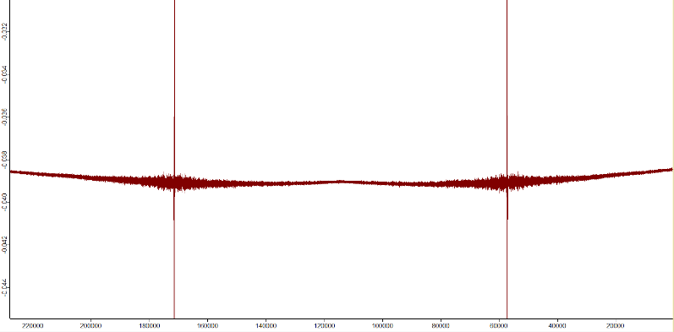
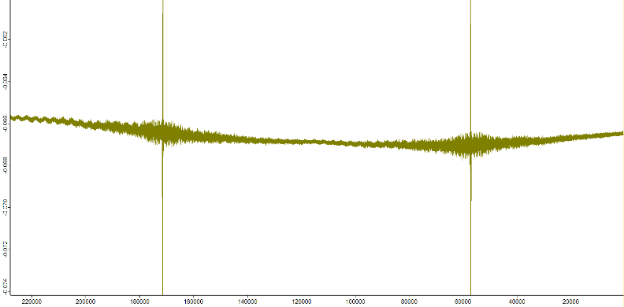
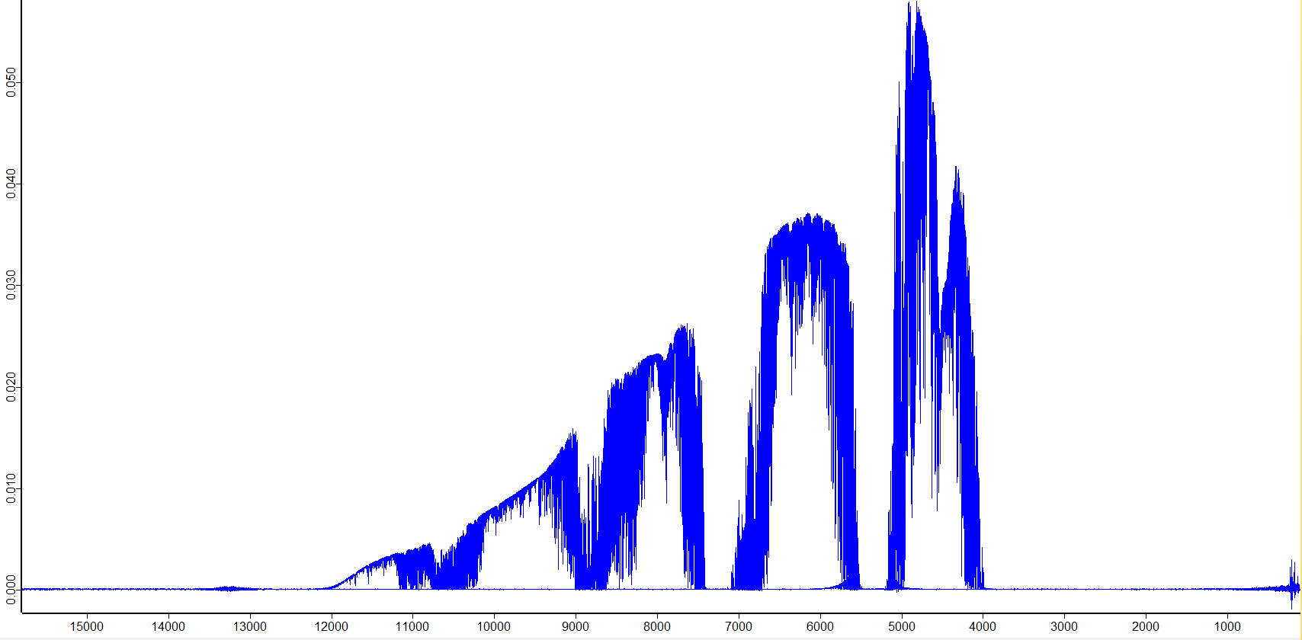
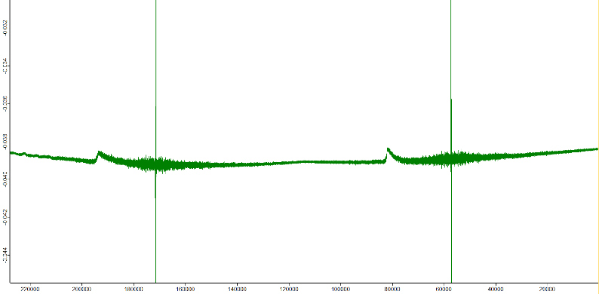
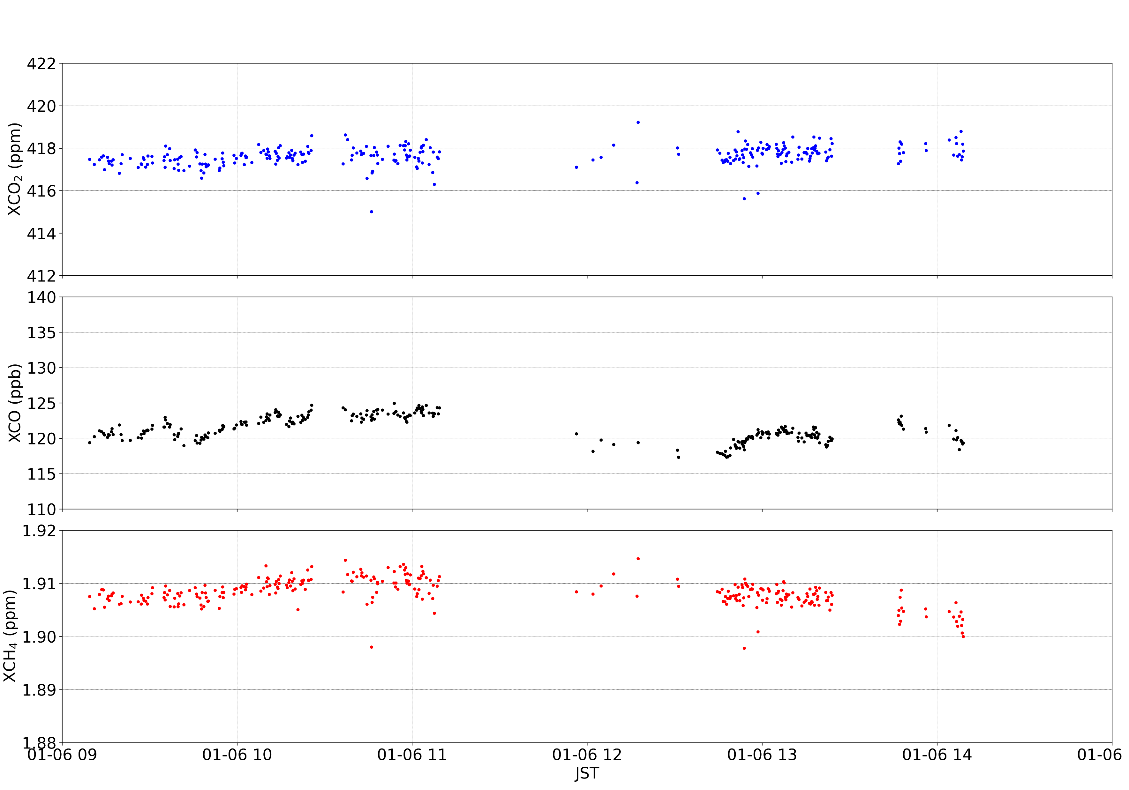
Instrumental challenges
Vibrations
Fourier Transformation
Spikes
Retrieved X_{gas} for sample day
Could normally be mitigated

Slide 17
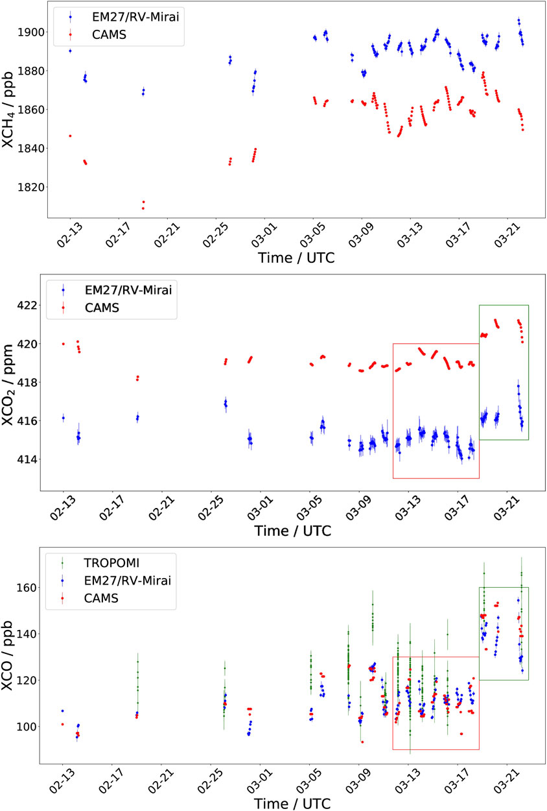
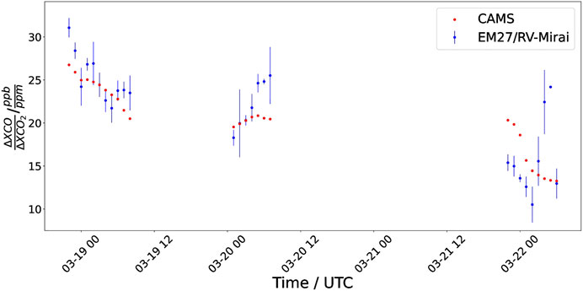
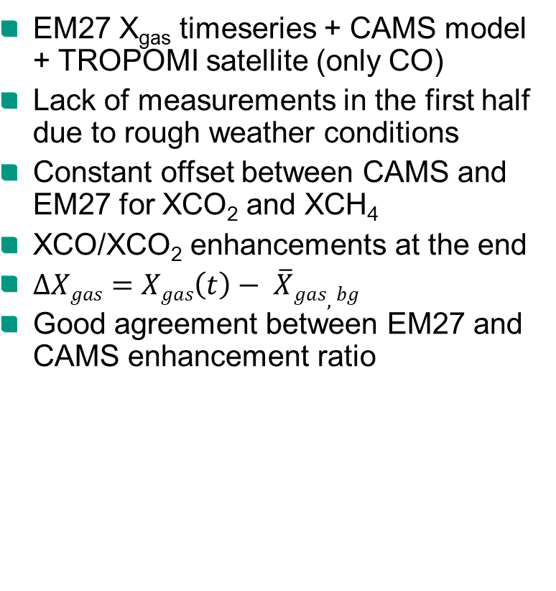
Results MR21-1 [Butz et al., 2022, FRS]
EM27 X_{gas} timeseries + CAMS model + TROPOMI satellite (only CO)
Lack of measurements in the first half due to rough weather conditions
Constant offset between CAMS and EM27 for XCO₂ and XCH₄
XCO/XCO₂ enhancements at the end
$∆Xgas=Xgas\left(t\right)− \overline{X}gas,bg$
Good agreement between EM27 and CAMS enhancement ratio

