Slide 1
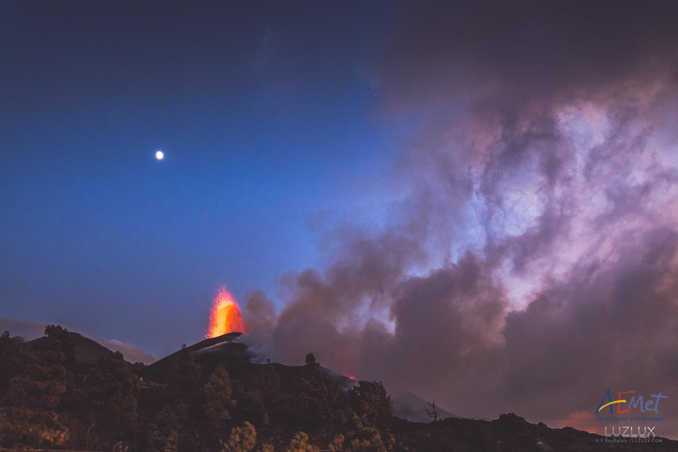
COCCON activities during the 2021
La Palma volcano eruption
N. Taquet, O. García, R. Campion, T. Boulesteix, W. Stremme,
C. Rivera, M. Grutter, A. Barreto, O. Álvarez, S. León-Luis, R. Ramos,
V. Carreño, F. Almansa, F. Hase, T. Blumenstock
noemie@atmosfera.unam.mx, ogarciar@aemet.es
NDACC-IRWG/TCCON/COCCON Annual Meeting, 13 June 2023

Slide 2
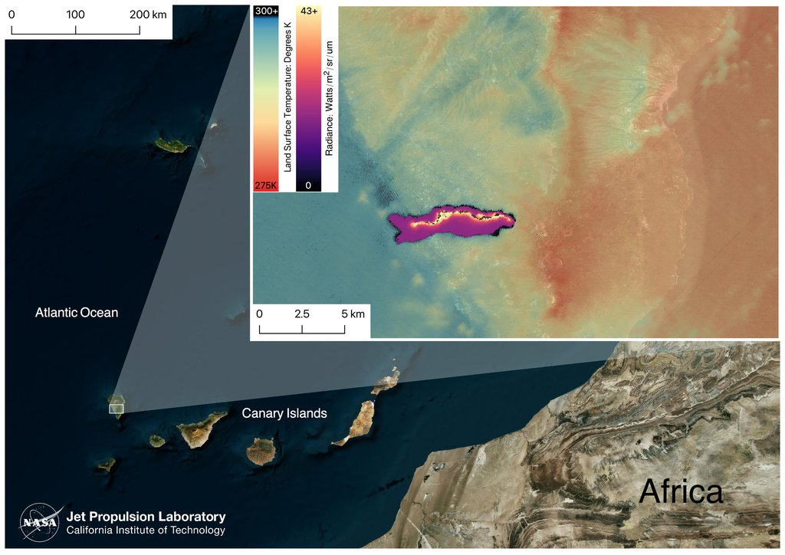
La Palma Volcanic Eruption
- Eruption period: Sept. 19 - Dec. 13, 2021 (85 days)
- Most recent subaerial eruption in 50 yr
- Volcanic explosivity index (VEI) of 3
- Lava flows covered more than 1.200 ha (infrastructures, towns, crops,...)
La Palma
Volcano
IZO
Notes:
The Volcanic Explosivity Index (VEI) is a scale that describes the size of explosive volcanic eruptions based on magnitude and intensity. The numerical scale (from 0 to 8) is a logarithmic scale, and is generally analogous to the Richter and other magnitude scales for the size of earthquakes.

Slide 3
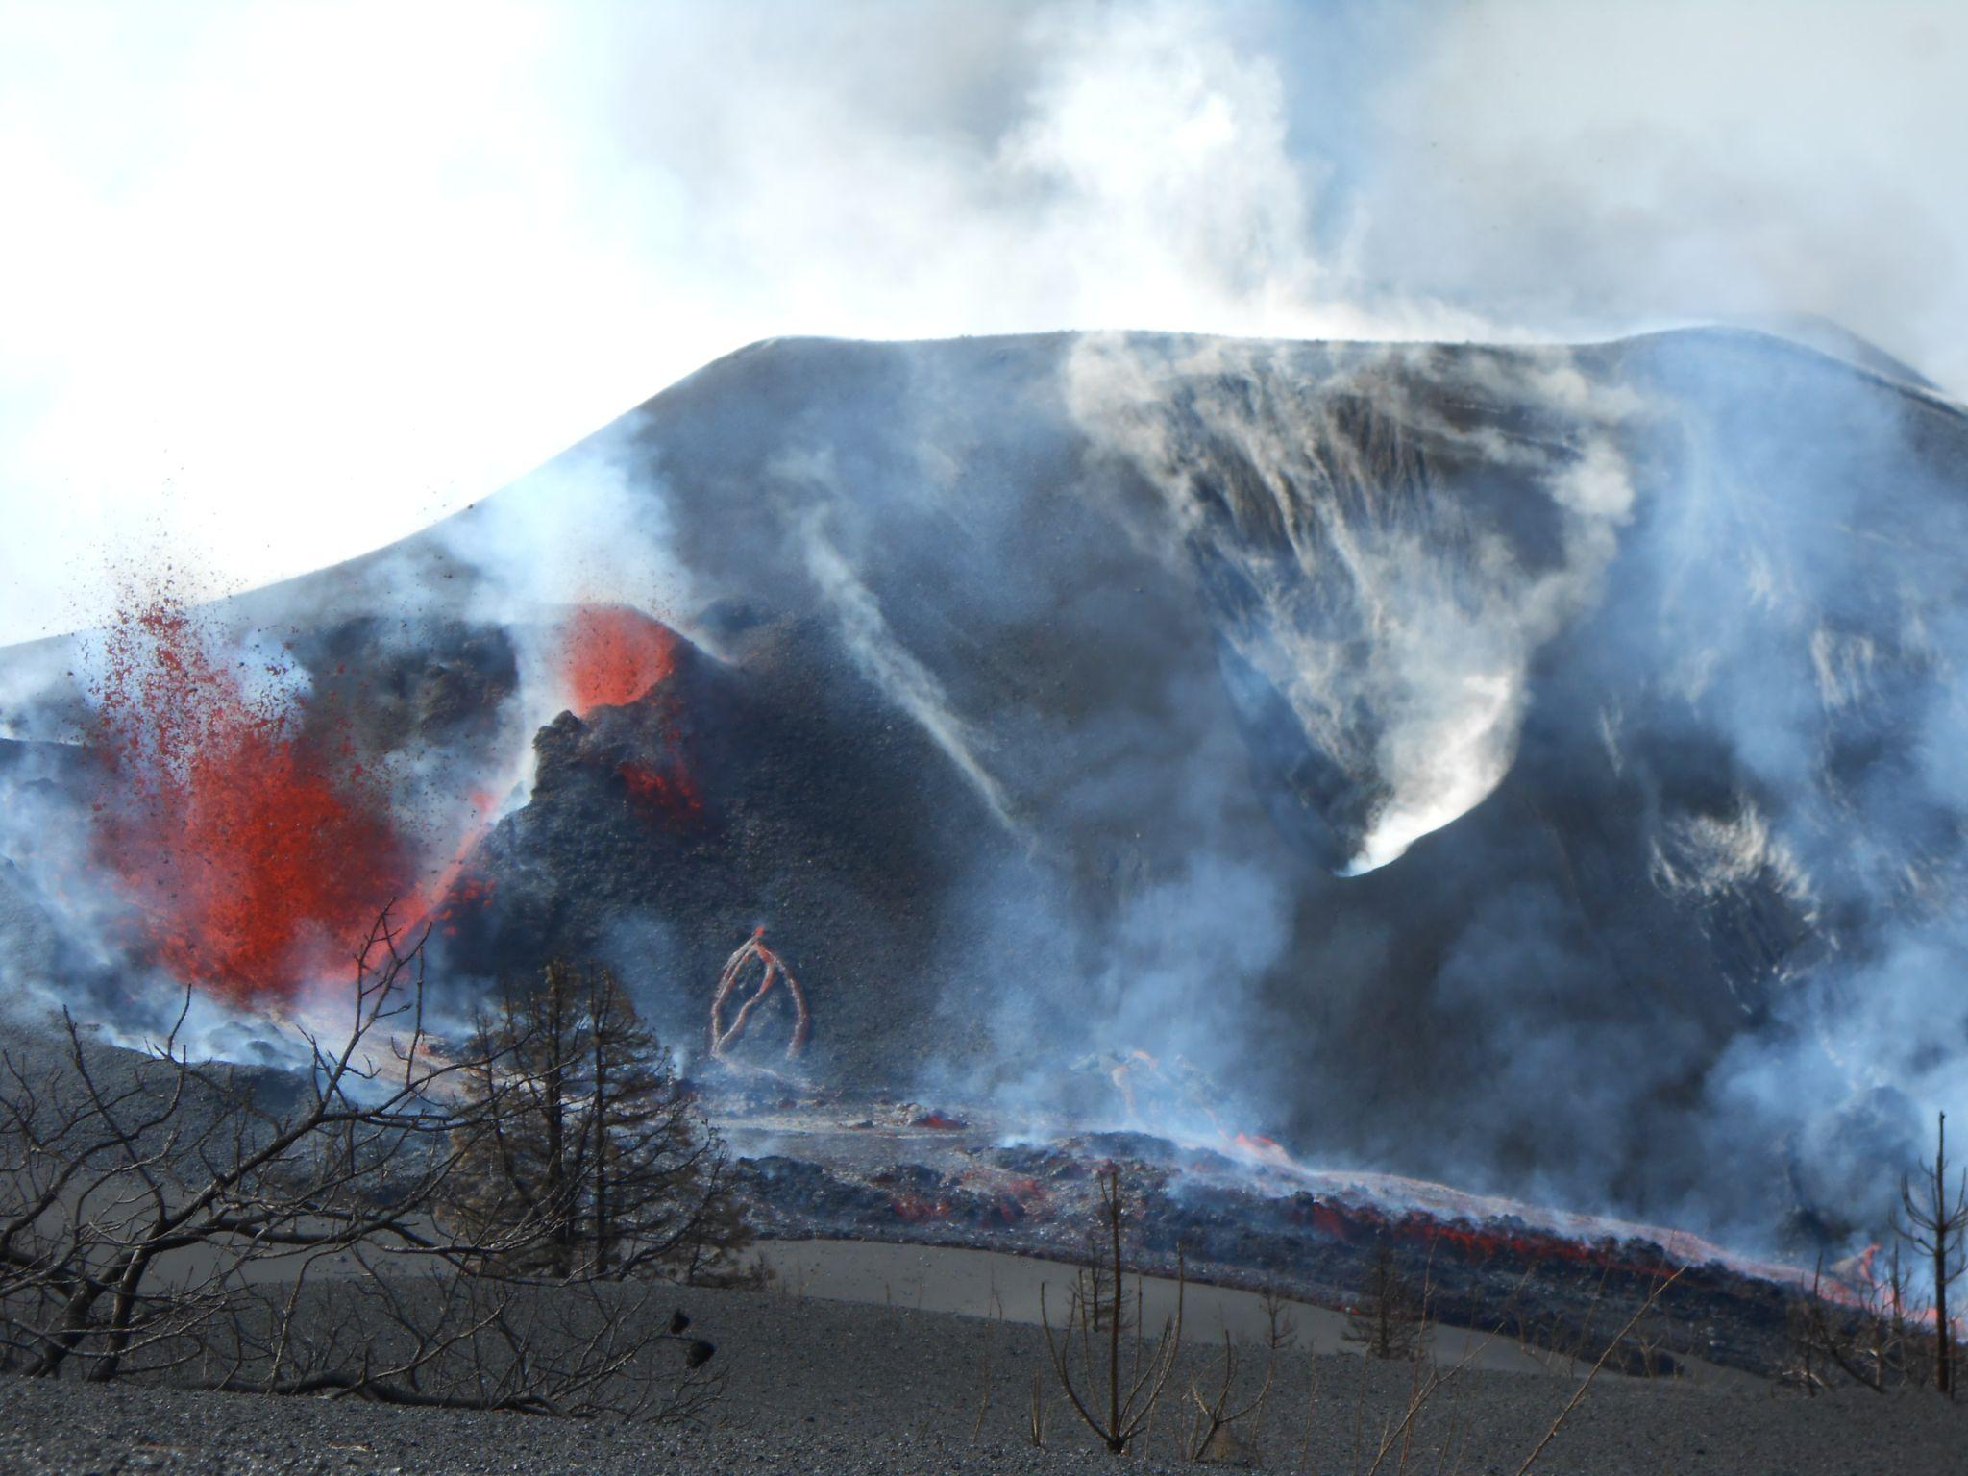
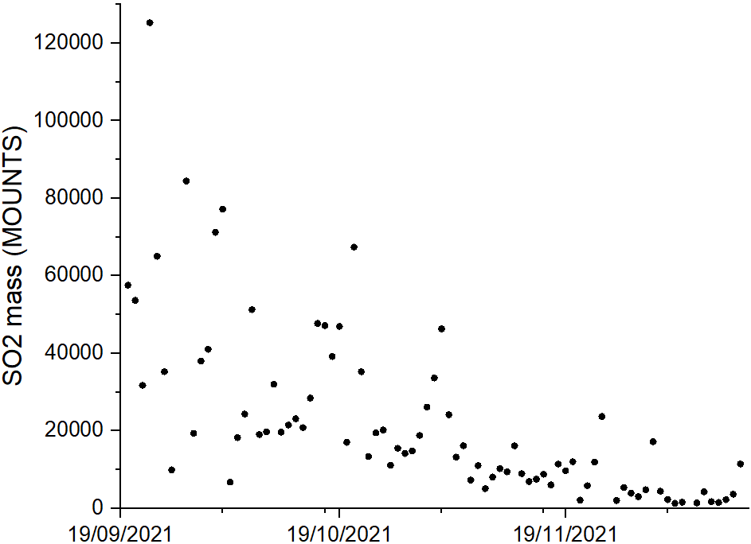

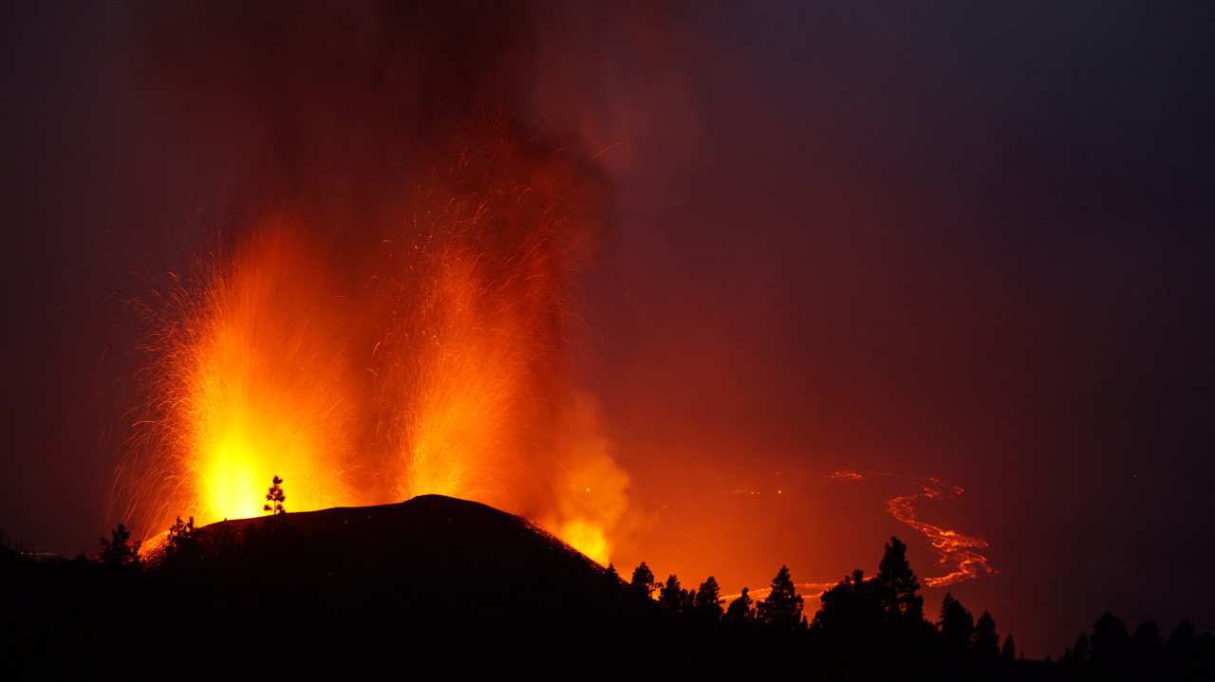
La Palma Volcanic Eruption
Total SO₂ amount released: 1,84 Mt
Phase I
MOUNTS project
TROPOMI processing
Valade et al. (2019)
Phase II
Phase I: alternating explosive and effusive activity, emissions at different vents.
Phase II: less energy in the volcanic system, intense effusive activity (more lava flows, less aerosol and gas emissions)

Slide 4
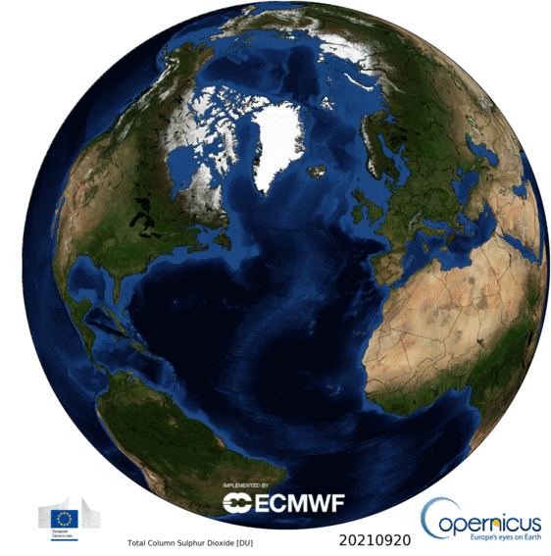
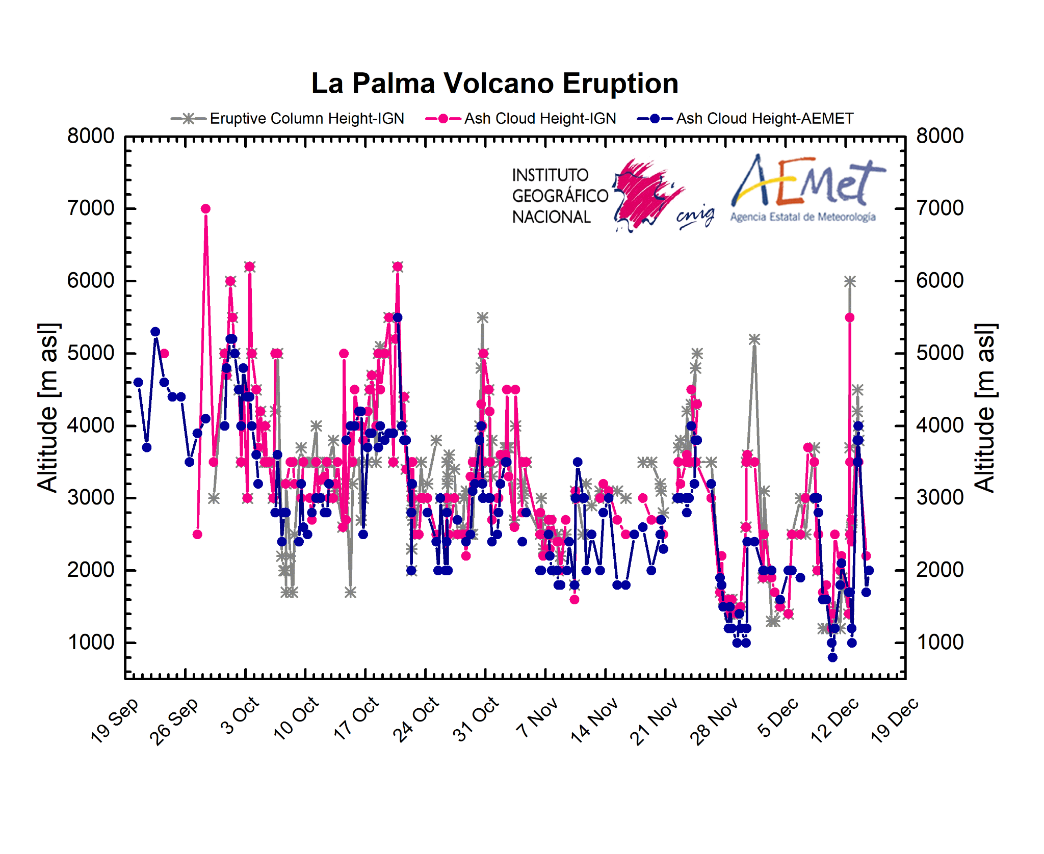
La Palma Volcanic Eruption
Transport to Europe, America and Africa in the middle troposphere
(aerosol and gas injection between 2-6 km)

Slide 5
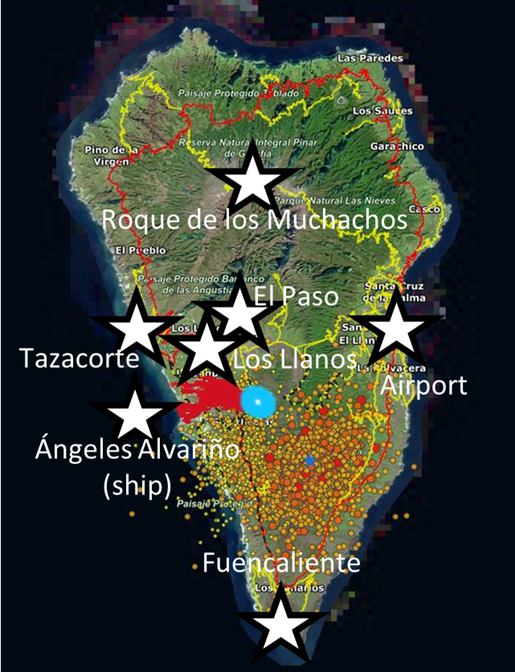
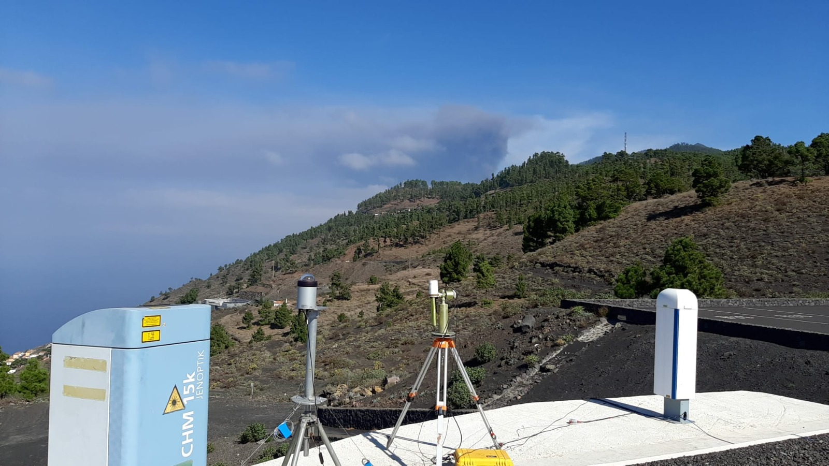
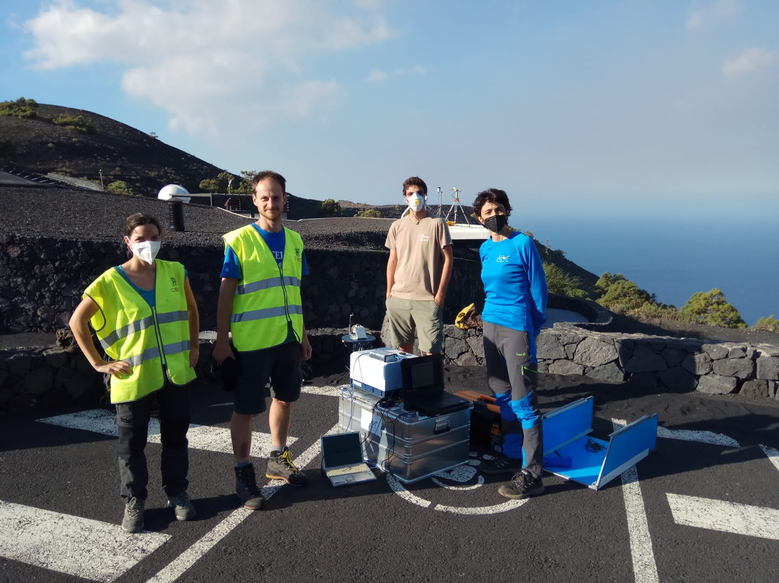
AEMet, CSIC and UNAM Deployment at La Palma
Roque de los Muchachos (2400 m): ARCADE Raman Lidar at Cherenkov Telecospe Array + Sun-photometer (AERONET)
El Paso (700 m): Prototype Vaisala CL61 ceilometer
Tazacorte (140 m): Surface SO2, O3, aerosols, MPL lidar (MPLNet+e-profile), all-sky cameras, ZEN radiometer, ash deposition, meteo
Airport (60 m): Vaisala CL51 ceilometer (e-profile), meteo
Fuencaliente (680 m): sun-lunar photometer (AERONET), CHM15k Luff ceilometer (e-profile), all-sky camera, EM27/SUN, DOAS (direct-sun)
Los Llanos (295 m): meteorological sondes
Angeles Alvariño (ship): low-cost air quality products
Mobile records: ash collection and multigas measurements (in collaboration with UNAM)

Slide 6
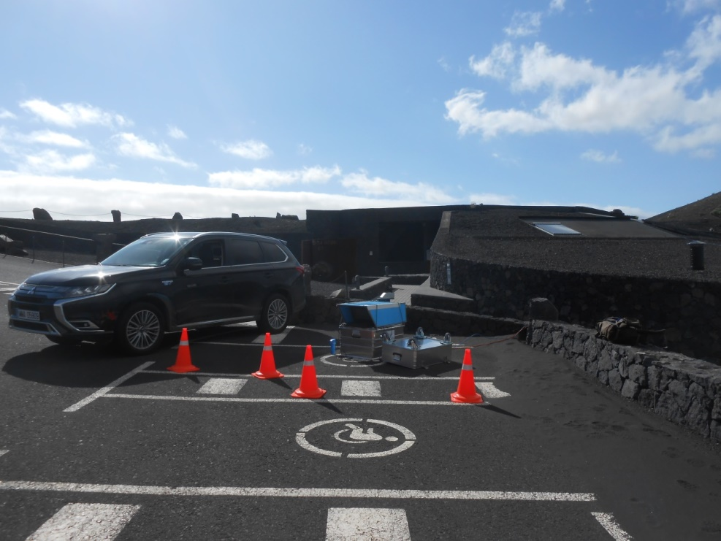

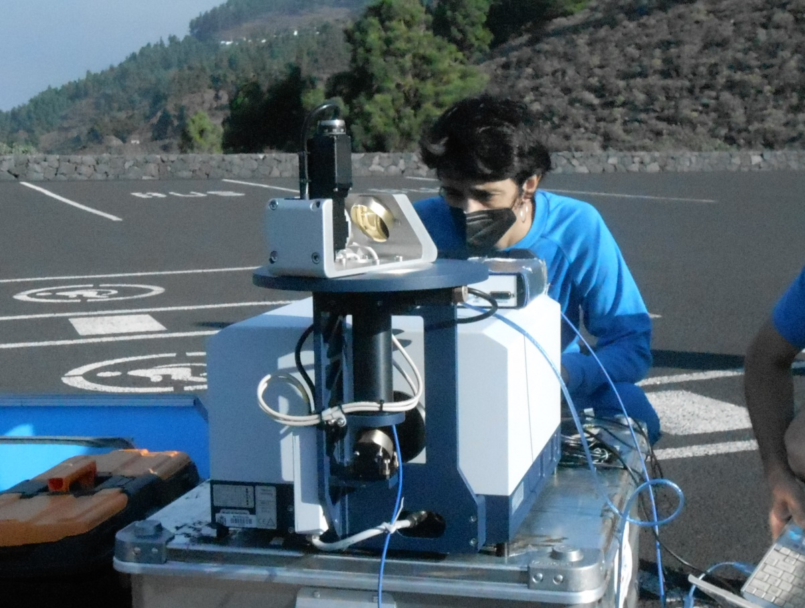
DOAS & EM27/SUN Measurements at FUE station
San Antonio (1677) volcano
visitors center, Fuencaliente
EM27/SUN:
Spectral range: (4000 - 11000 cm⁻¹)
Res: 0.5 cm⁻¹ (OPD max: 1.8 cm)
DOAS: Model Avantes ULS 2048
Spectral range: 270-425 nm
Res: 0.4 nm
Volc. species: HCl, HF, CO₂, CO and SO₂
Measurement days:
DOAS: 33 (from 10/10 to 10/12 )
EM27/SUN: 59 (from 25/09 to 14/12)
+ 14 (post eruptive)
Days capturing volcanic plume: 21
DOAS &
Optical Fiber

Slide 7
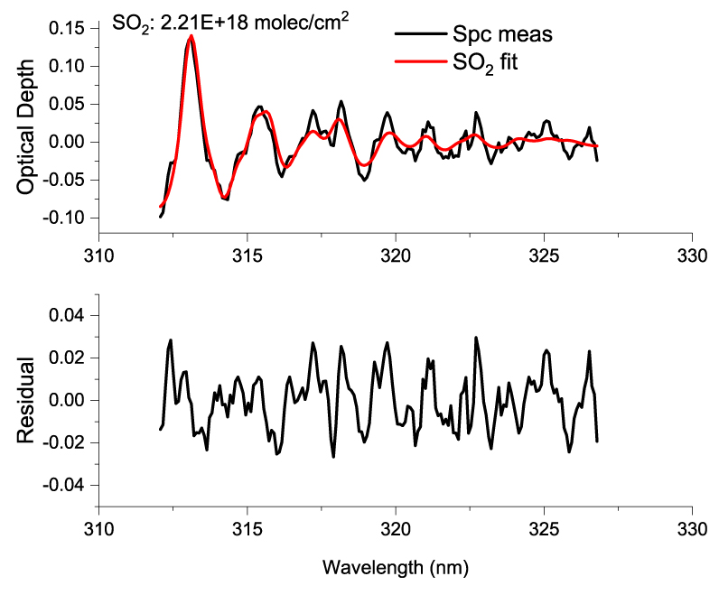
DOAS Measurements and Data Processing
Measurements performed with MobileDOAS software (developed by BIRA-IASB)
Exposition Time: Manually adjusted
Integration time: ~30 sec
QDOAS processing:
Reference: 1 Measured spectrum without volcanic signature & SZA close to 0.0
Settings: Based on Butz et al. (2017)
OClO, BrO (330.6–356.2) nm: too much noise
Conversion of Slant Col. to Vert. Col:
VC_SO₂=SlC_SO₂/ airmass
with airmass= 1/cos (SZA)
Example of SO₂ fit from FUE DOAS solar absorption measurements
Target Gas | Spectral windows (nm) | Interfering gases
SO₂ | 312.0-326.8 | O₃

Slide 8
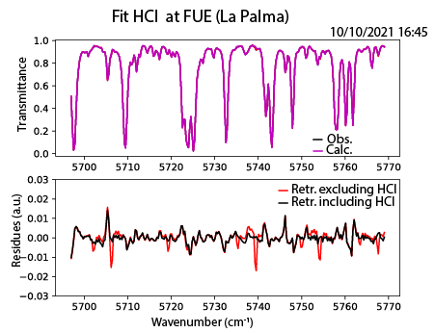
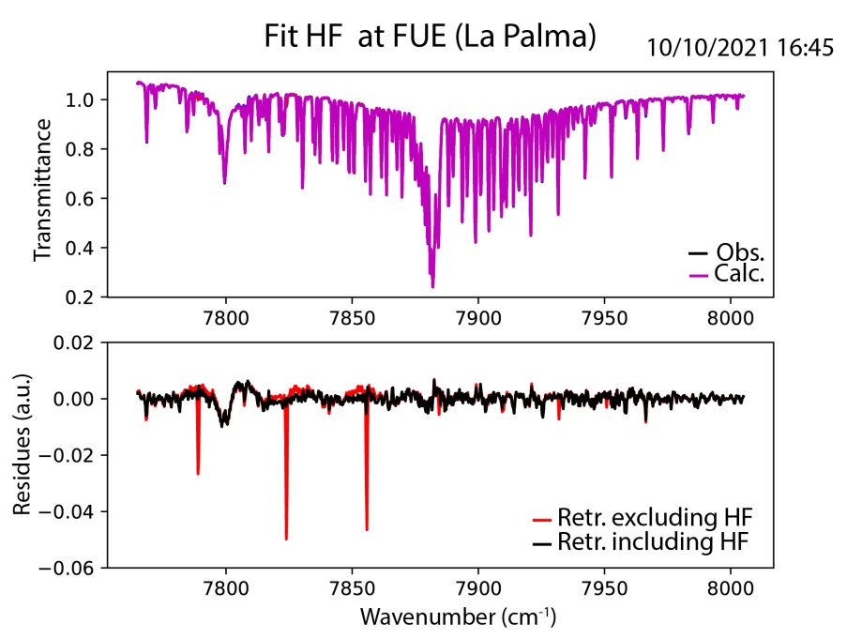
EM27/SUN Data Processing: HCl, HF, CO₂, CO
Using PROFFAST v2.2 (Hit. 2020 Linelist)
Gas | Spectral windows (cm⁻¹) | Interfering gases
HCl | (5697.0 - 5769.0) (5684.0 – 5795.0 ) * | H₂O, CH₄
HF_v1 HF_v2 | (7765.0 - 8005.0) (3995.0 - 4043.0) | H₂O, CO_{2 ,} O₂ H₂O, HDO, CH₄
CO₂ | (6173.0 - 6390.0) | H₂O, CH₄
CO | (4208.7 - 4318.8) | H₂O, HDO, CH₄
HCl & HF:
*Butz et al., (2017) & Taquet et al., (2023)
Scaling of the lower troposphere (0.630 – 4.0 km) & background contribution neglected
pT files and VMR a priori from MAPs files GGG2014
(factor of 1.00065 with GGG2020)
Volcanic CO₂ & CO :
Retrieval with COCCON settings + post-correction to remove the background contribution

Slide 9
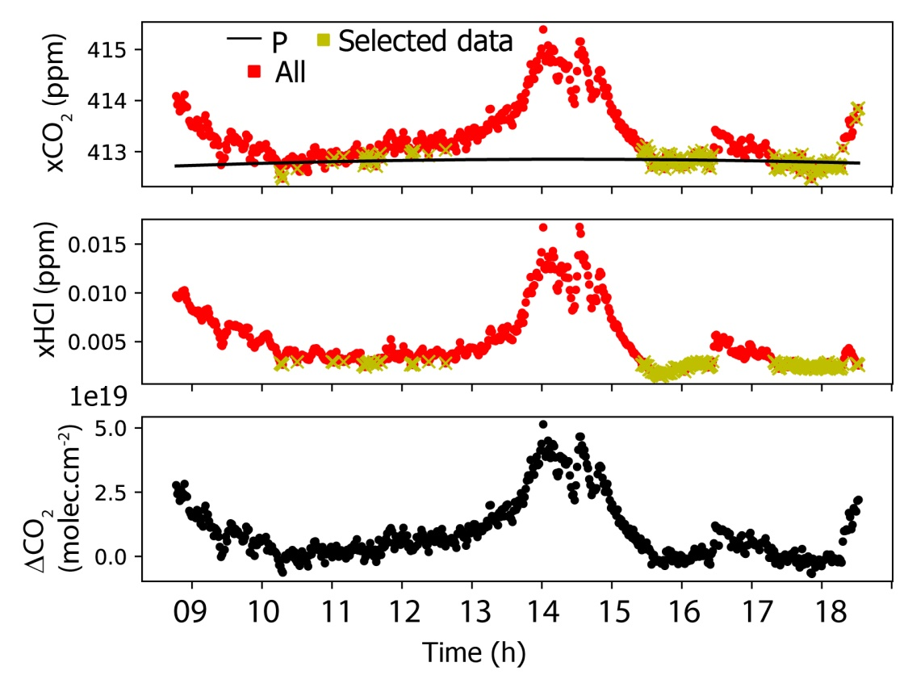
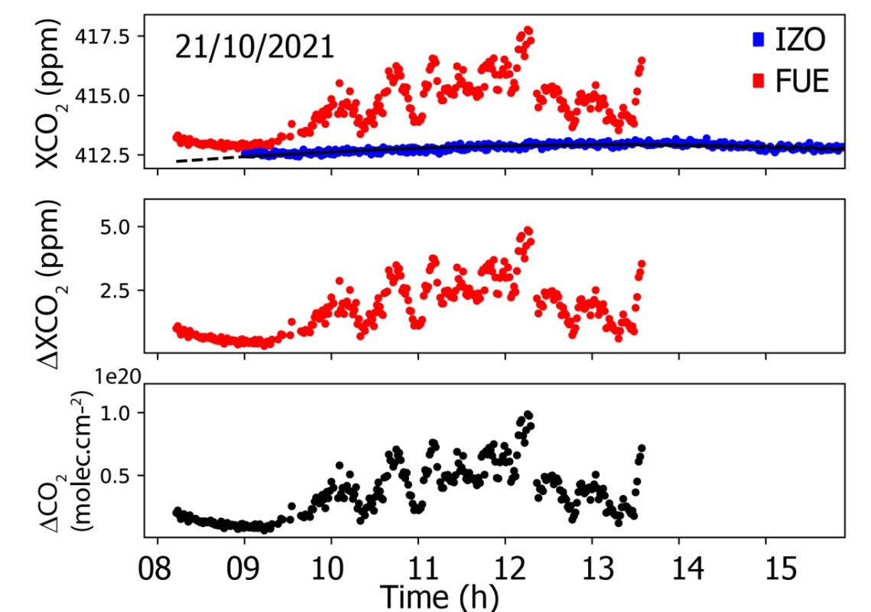
Determination of Volcanic CO₂ Columns
Daily selection of XCO₂ data without volcanic contribution (XHCl < 0.002 ppm)
Determination of a P function fitting the selected spectra
Similar approach for volcanic CO columns
When IZO data exists:
Use of XCO_{2 IZO} to refine the P function
(3) Determination of Volcanic CO₂ VCD:
ΔXCO₂=XCO₂–P
CO_{2VOLC}=ΔXCO₂ . [O₂]/0.20942
Based on Butz et al. (2017)

Slide 10
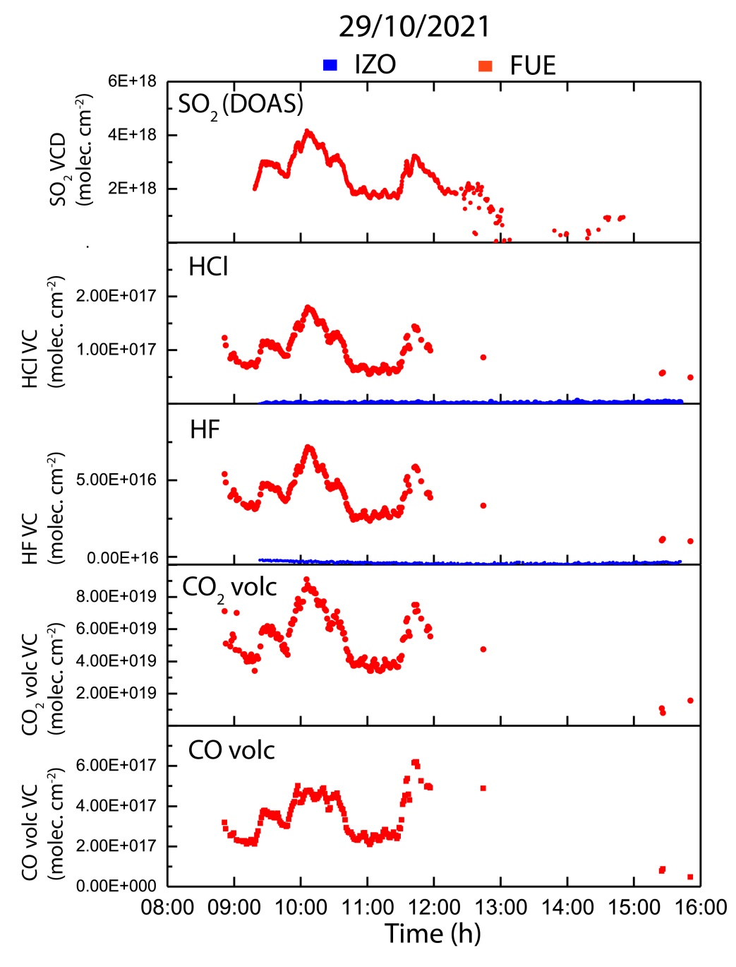
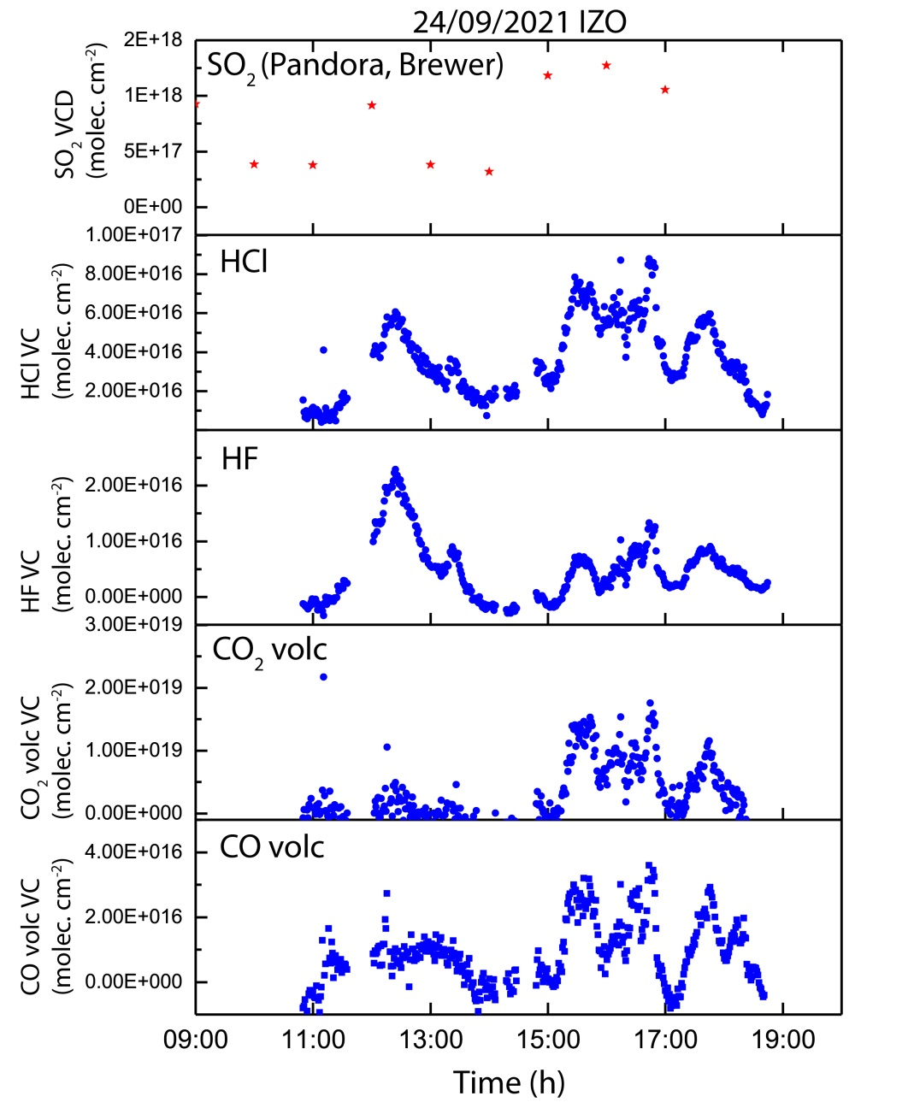
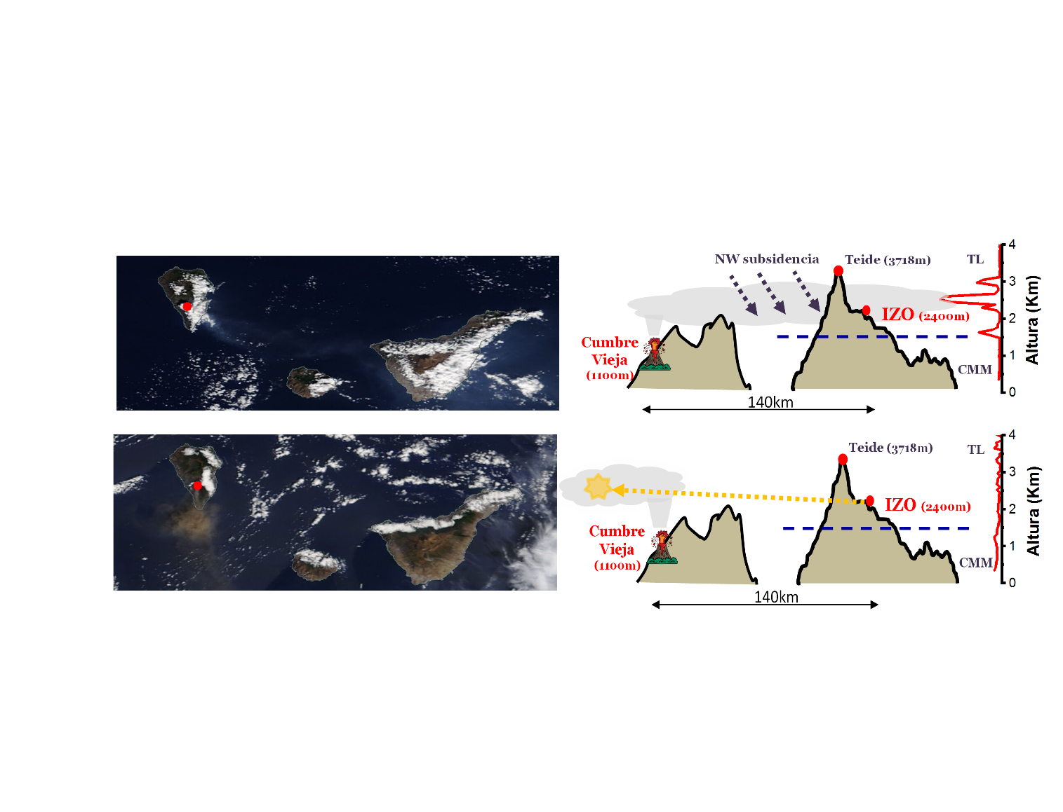
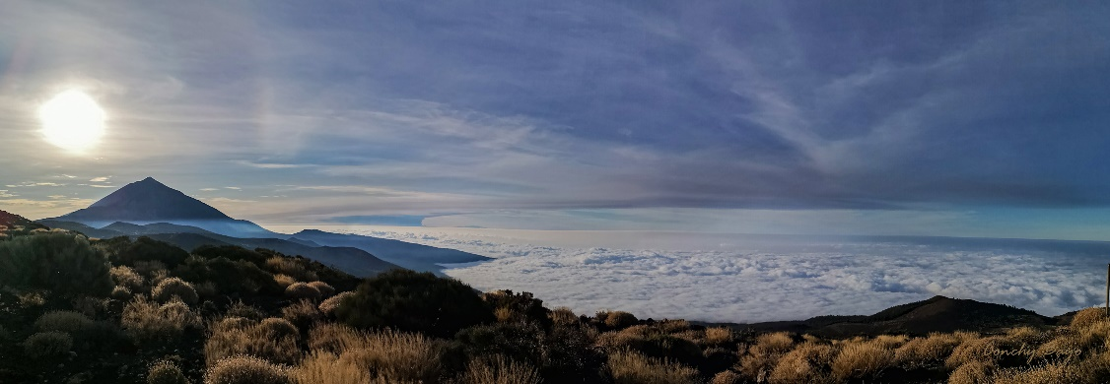
Examples of Volcanic Plume Detection at FUE and IZO
140km
(At IZO: Days capturing volcanic plume: 9
+ EM27 measurements: 4)

Slide 11
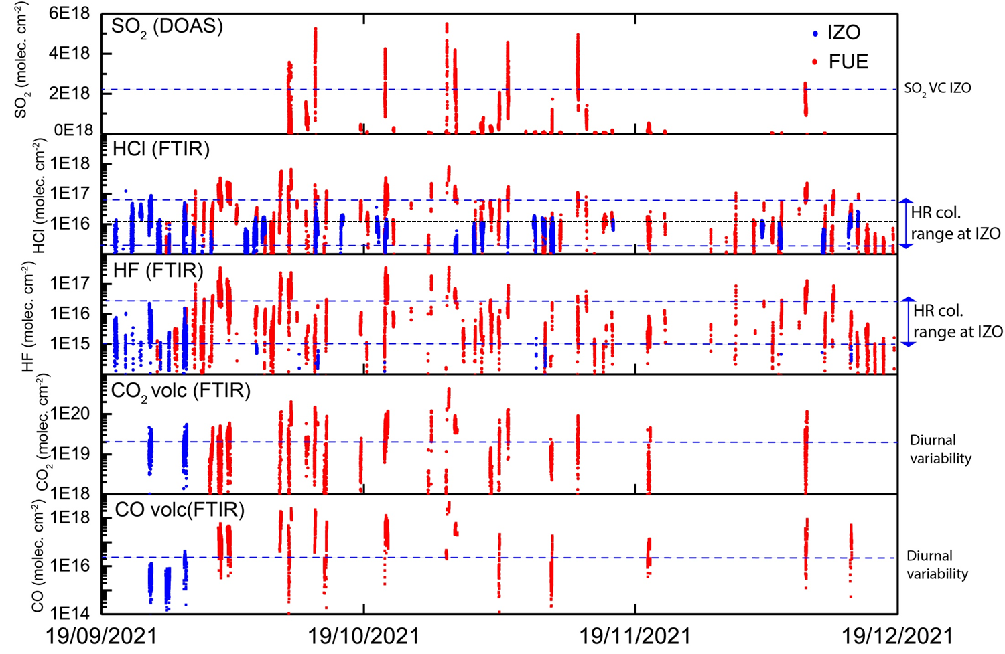
Volcanic Columns at FUE and IZO: SO₂, HCl, HF, CO₂, CO
FTIR=EM27/SUN

Slide 12
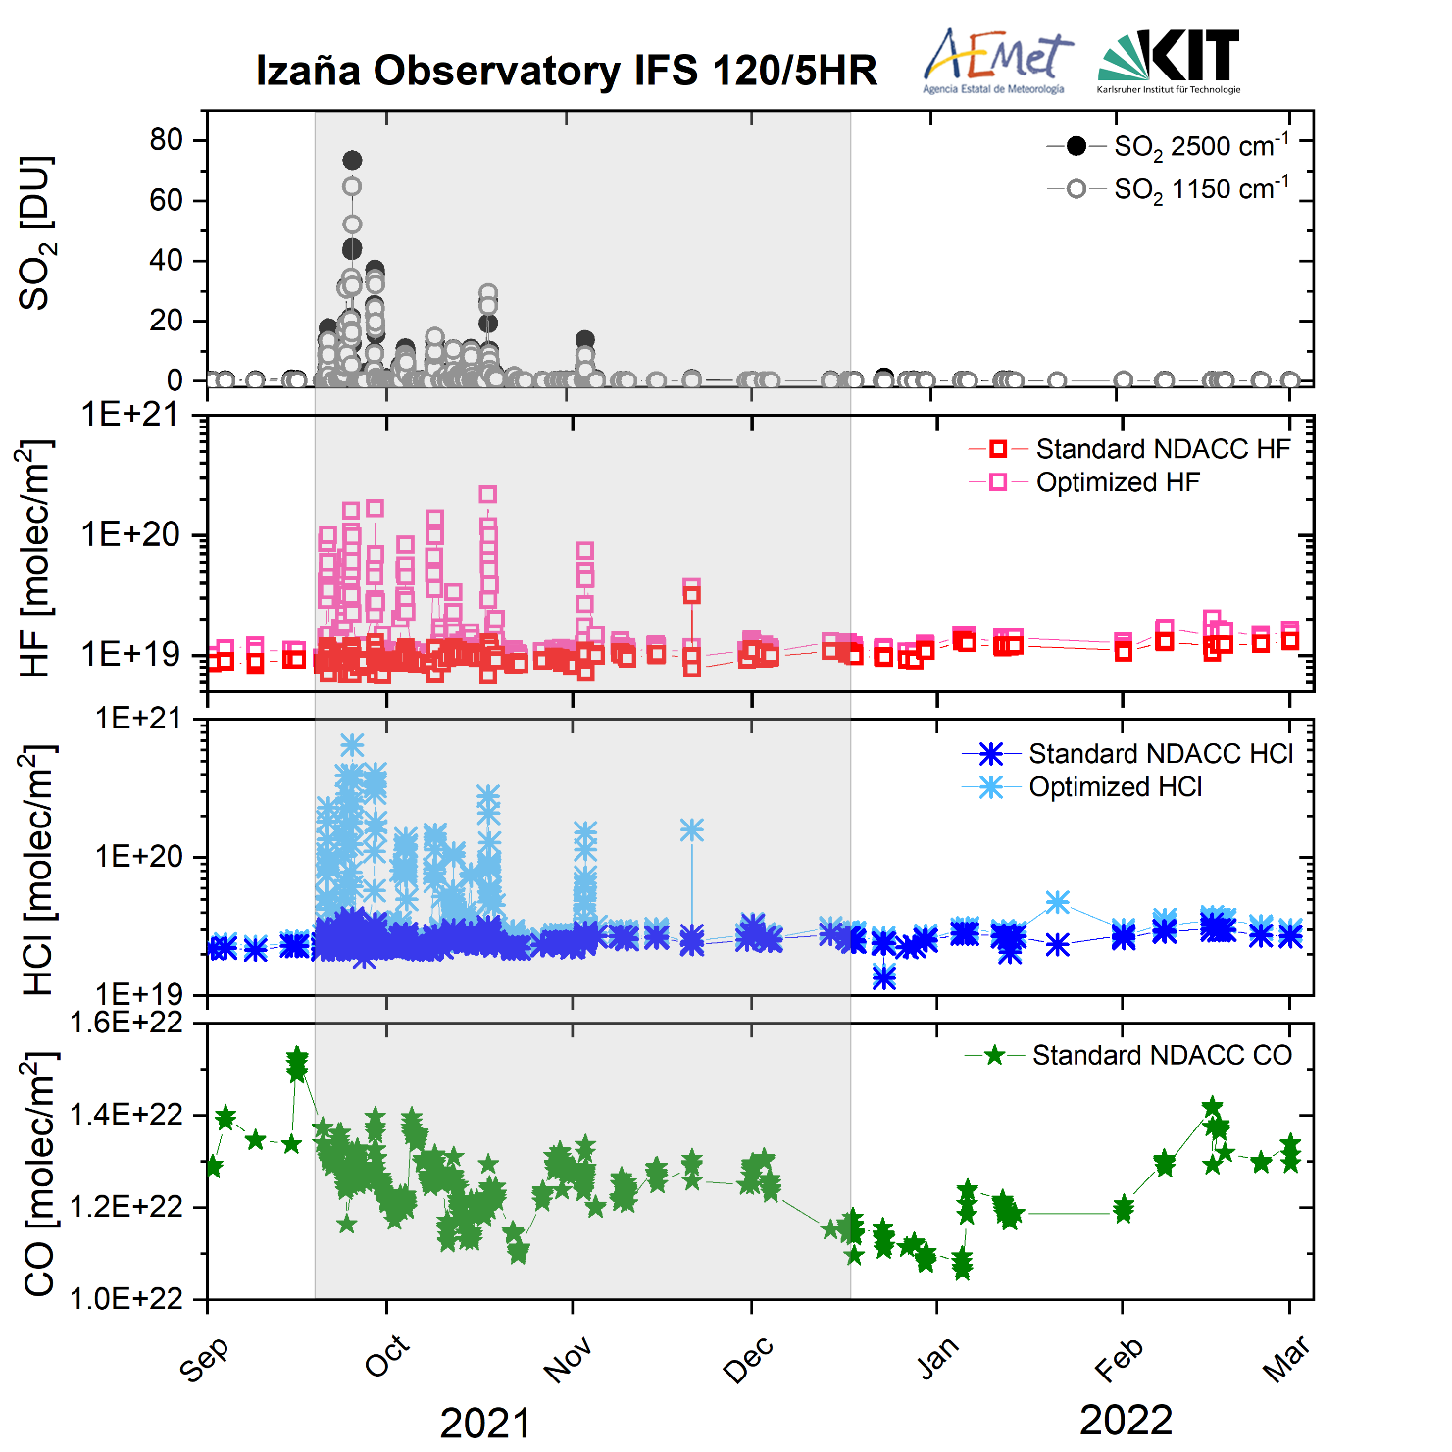
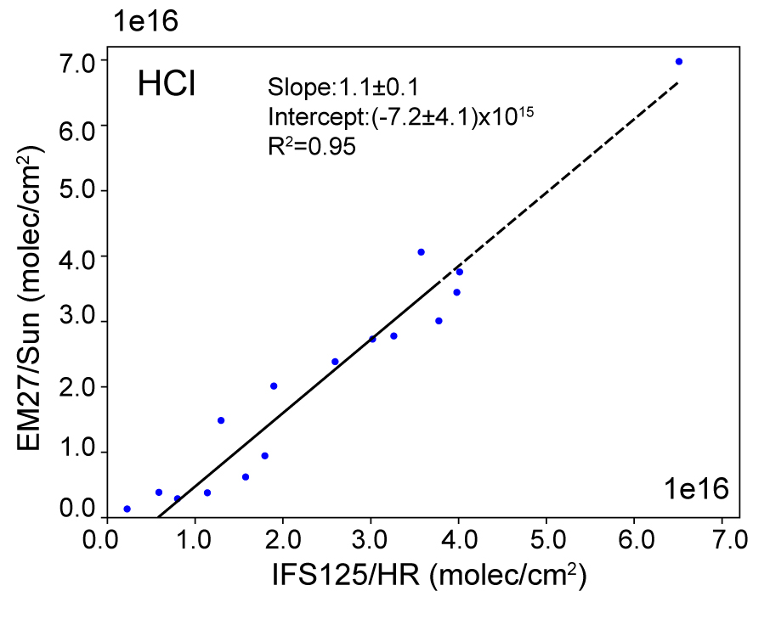
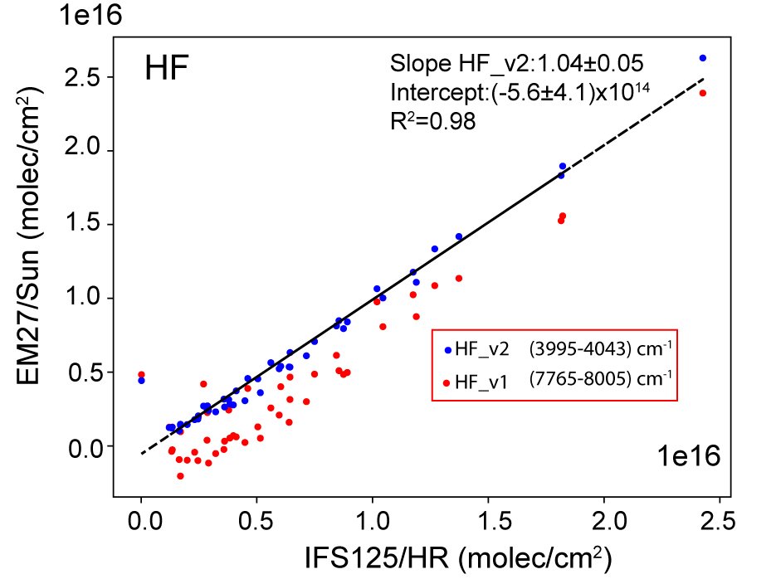
Volcanic IFS 125HR Columns at IZO: SO₂, HF, HCl, CO
Similar results as Popocatépetl volcano (Taquet et al., 2019)
PROFFIT – 2022
(Standard NDACC and optimized products)
Days capturing volcanic plume: 9

Slide 13
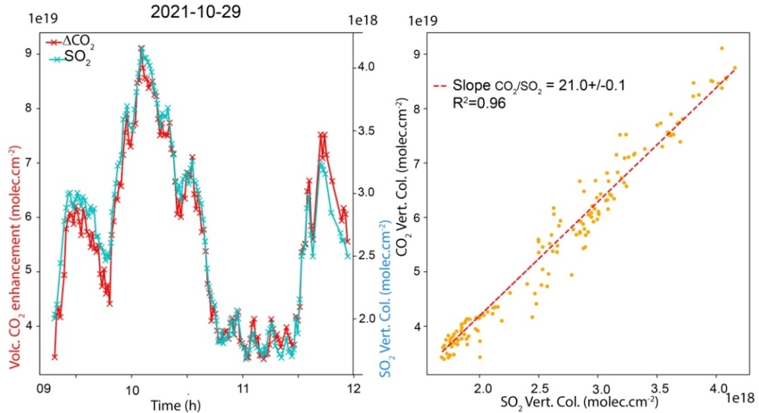
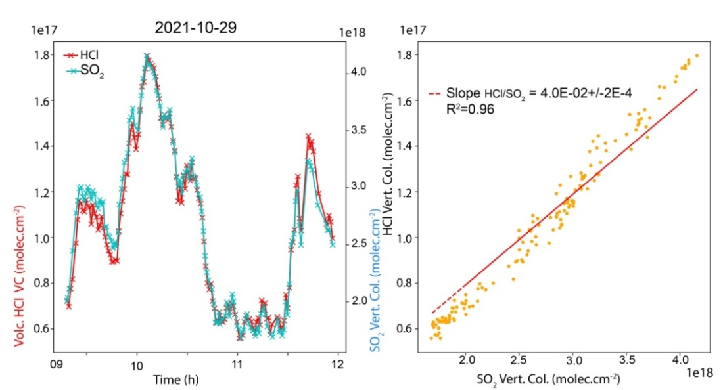
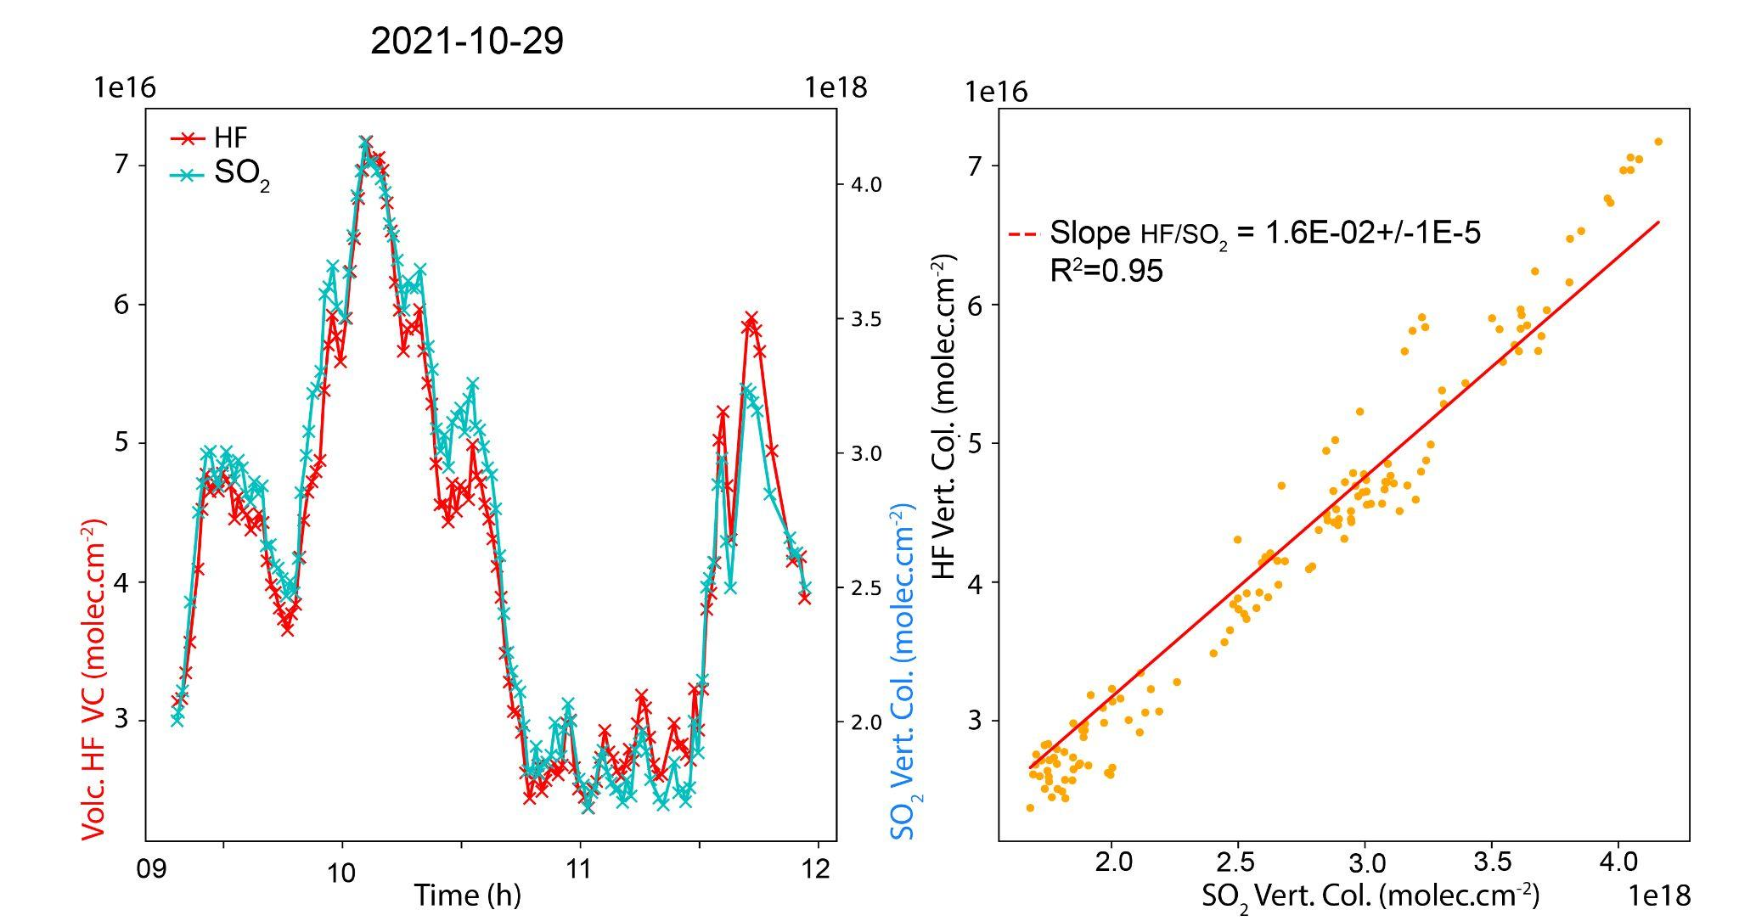
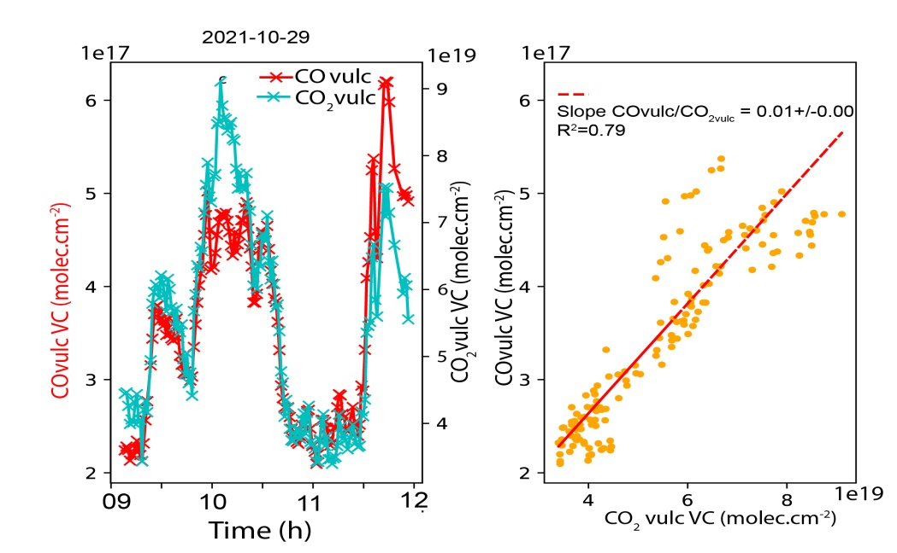
Calculation of Ratios from Daily Correlation Plots
CO₂volc/SO₂
HCl/SO₂
HF/SO₂
COvolc/CO₂volc

Slide 14
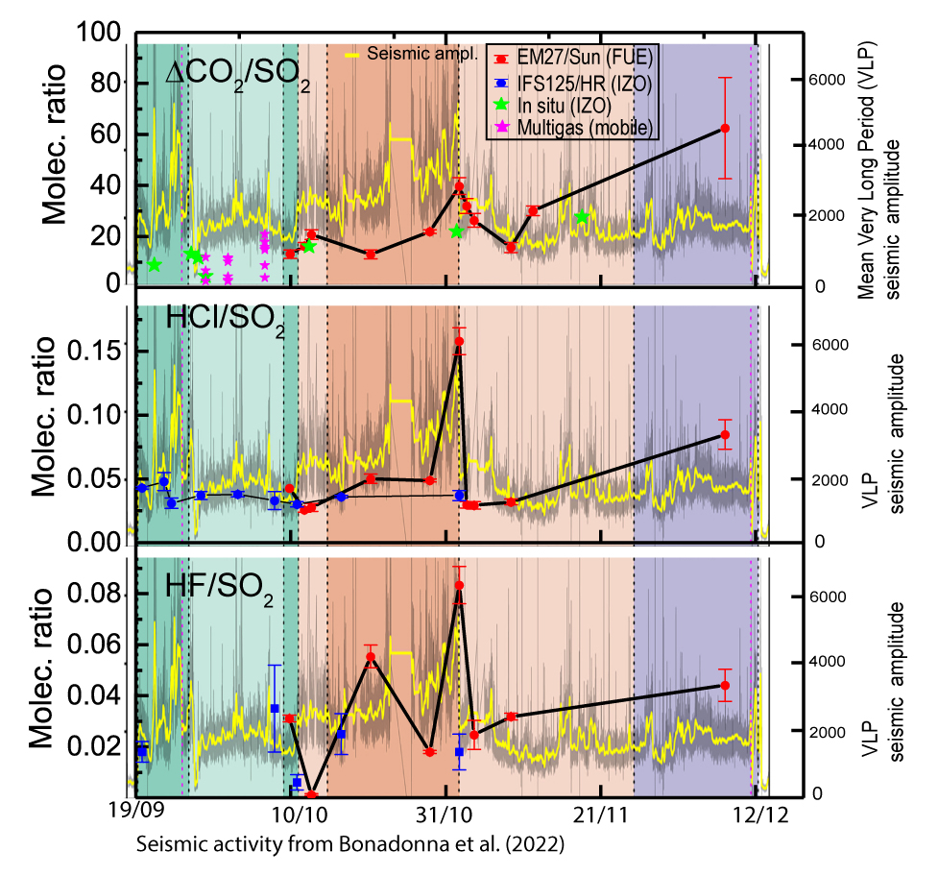
Variability of the Volcanic Gas Ratios
Consistency between ratios from EM27/SUN at FUE and IFS125/HR at IZO during the eruption.
Volcanic gas ratios (ΔCO₂/SO₂, HCl/SO₂, HF/SO₂) showed a relationship with a seismic proxy for volcanic activity.
Estimation of Halogen & CO₂ emissions during the eruption:
  Total SO₂ amount released: 1.84 Mt
  HCl/SO₂ mean mass ratio = 0.03+/-0.02
  HF/SO₂ mean mass ratio = 0.011+/-0.007
  CO₂/SO₂ mean mass ratio= 16 +/-6
  Total HCl emissions: 0.055+/-0.040 Mt
  Total HF emissions: 0.021+/0.014 Mt
  Total CO₂ emissions: 29+/-11 Mt
  (Mexico city CO₂ emissions ~60Mt /year)

Slide 15
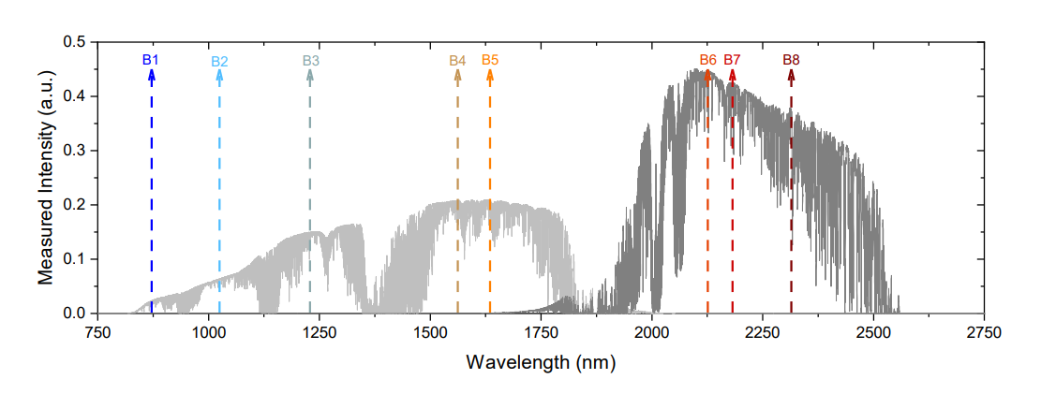
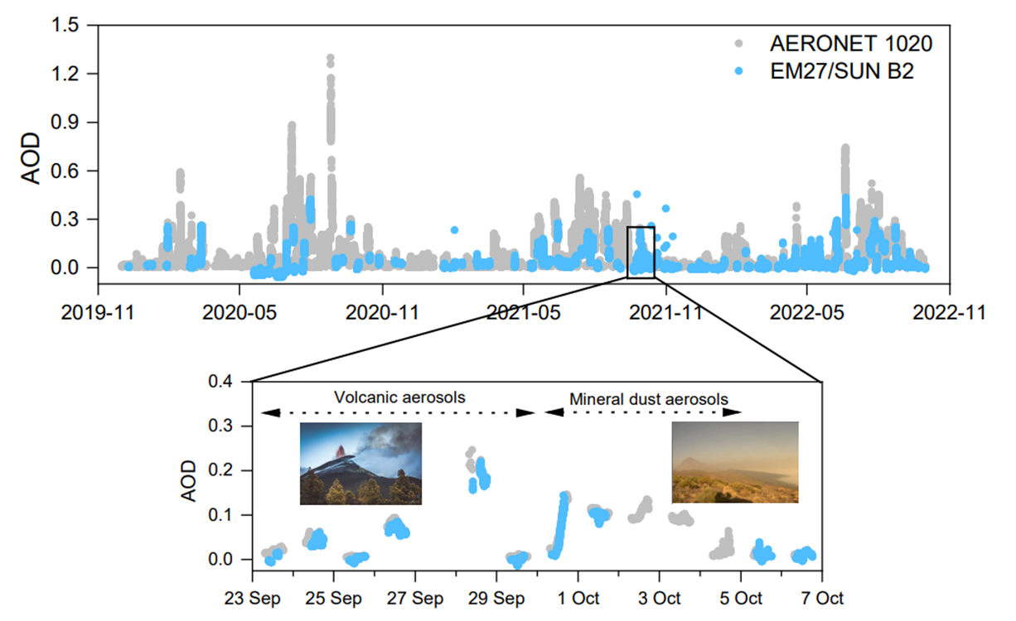
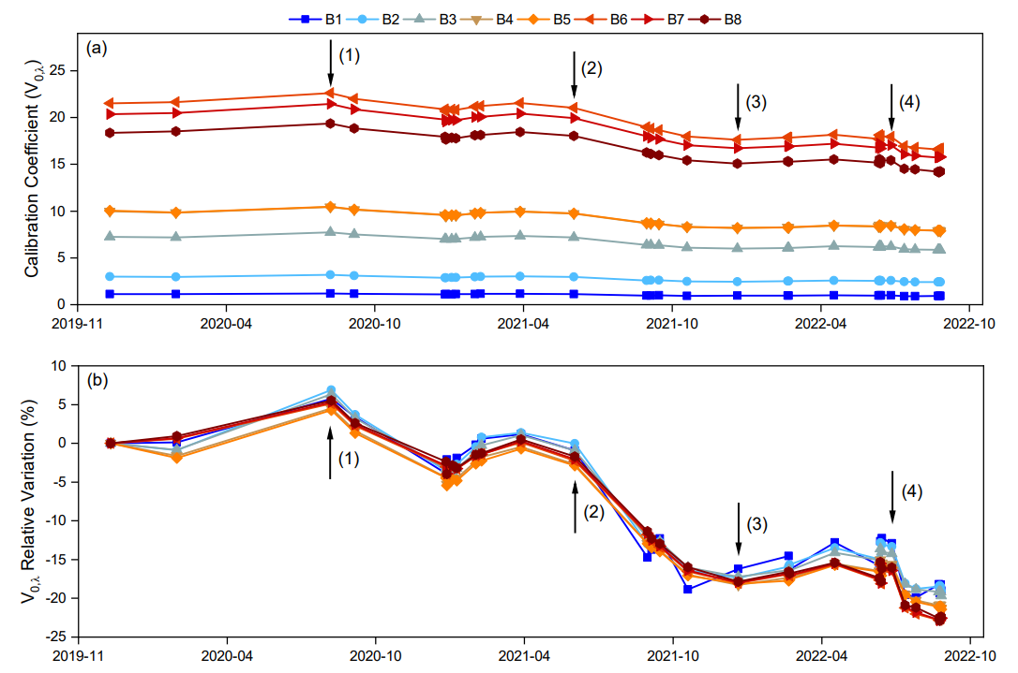
Aerosol Retrievals from EM27/SUN
See poster COCCON-Spain: Towards an Integrated Greenhouse Gas
Observation System in Spain
Álvarez et al., submitted to AMTD, 2023
Aerosol products can be used as proxy for atmospheric chemistry
Spectral Aerosol Optical Depth (AOD)
Long (3 years) Spectral AOD retrievals at IZO
Validation with co-located AERONET AOD
for 870, 1020, 1640 nm (R>0.95, positive bias 1.0-2.5%)
8 Micro-Windows (very high solar transmission) and
continous Langley-plot Calibration at IZO
1636.00 nm
2133.40 nm
2192.00 nm
2314.20 nm
872.55 nm
1020.90 nm
1238.25 nm
1558.25 nm
Linear degradation rate of ~0.6%month⁻¹!
Notes:
Slide 15:
The aerosol information is a very useful proxy for atmospheric chemistry and can help us to identify more clearly emission sources in complex conditions.
At IZO, we have developed an approach to retrieve spectral aerosol optical depth from the EM27 sola spectra. To do so, we select eight micro-Windows with high transmission to avoid gas absorptions between 0.8 to 2.3 microns.
Unlike gases, the aerosol retrievals required an absolute calibration of the EM27 spectra, for which we use continuous Langley-plot measurements. Here, the time series of teh calibration coefficient variation with respect to the first valid calibration days, showing a linear degration rate of about 0.6 % per month in the whole study period from 2019 to 2022.
As an example, this is our EM27 AOD for the band of 1020 nm. As you can see, from the comparison with coincident AERONET data used as reference, the agreeement is really robust [robast] with correlation higher tan 95%. In the zoom, for example, we observe as both techniques perfectly capture a volcanic event followed by a mineral dust event.

Slide 16
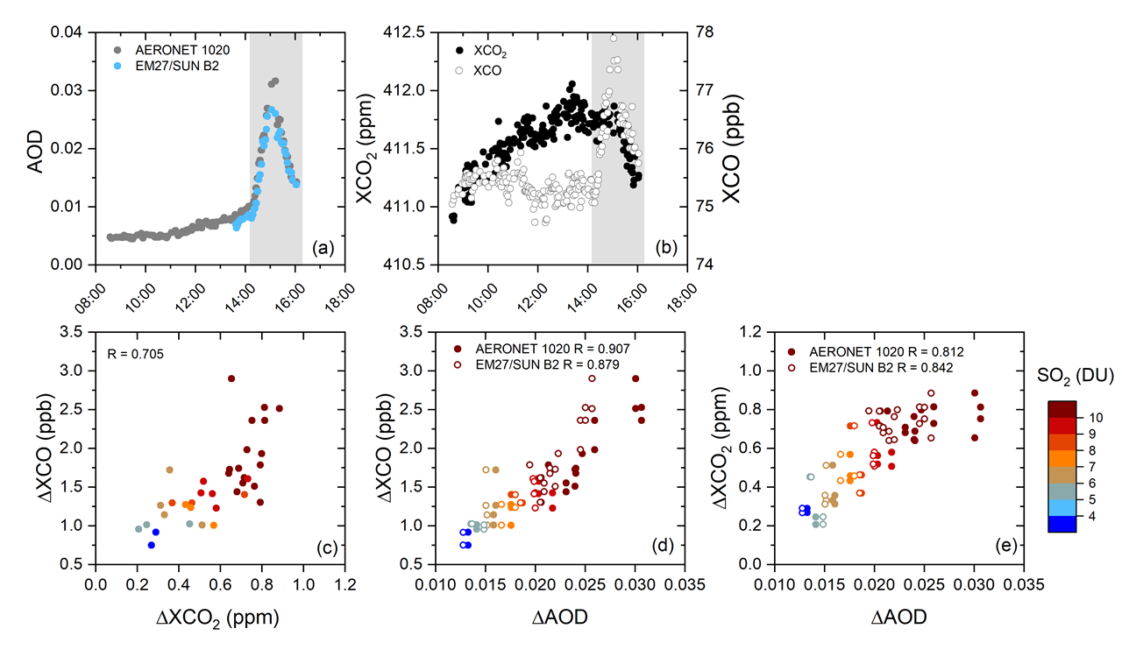
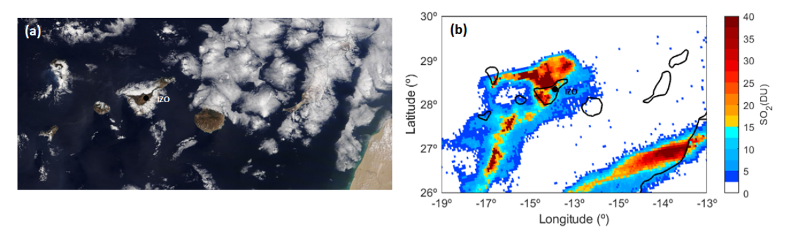
EM27/SUN Gas and Aerosol Enhacements
Volcanic gas /aerosols ratios
A volcanic plume from La Palma volcano at IZO
(11th October 2021)
∆XCO₂ (up to 1 ppm) are comparable to the Kilauea eruption (Hawaii) in 2018, Mt. Etna’s plume (Italy) and the Popocatepetl’s plume.
(Johnson et al., 2020; Butz e al., 2017; Stremme et al., 2023)
∆XCO₂/∆AOD = 43.0±4.7 410 ppm/∆AOD
∆XCO/∆AOD = 118.2±11.0 ppb/∆AOD
∆XCO/∆XCO₂ = 1.86±0.32 ppb/ppm

Slide 17
Summary and Outlook
(1) Different tests are still pending, however the excellent agreement between DOAS, EM27/SUN, IFS 125HR points to reliable volcanic SO₂, HCl, HF, CO, CO₂ measurements!!
(2) Volcanic gas ratios (ΔCO₂/SO₂, HCl/SO₂, HF/SO₂) showed a relationship with a seismic proxy for volcanic activity and allow for determining the order of magnitude of the total gas emissions:
  Total HCl emissions: 0.055+/-0.040 Mt
  Total HF emissions: 0.021+/0.014 Mt
  Total CO₂ emissions: 29+/-11 Mt
(3) Low-resolution COCCON instruments are suitable for detecting the aerosol NIR broadband signal and for retrieving precise gas concentrations (multi-parameter capability)

Slide 18

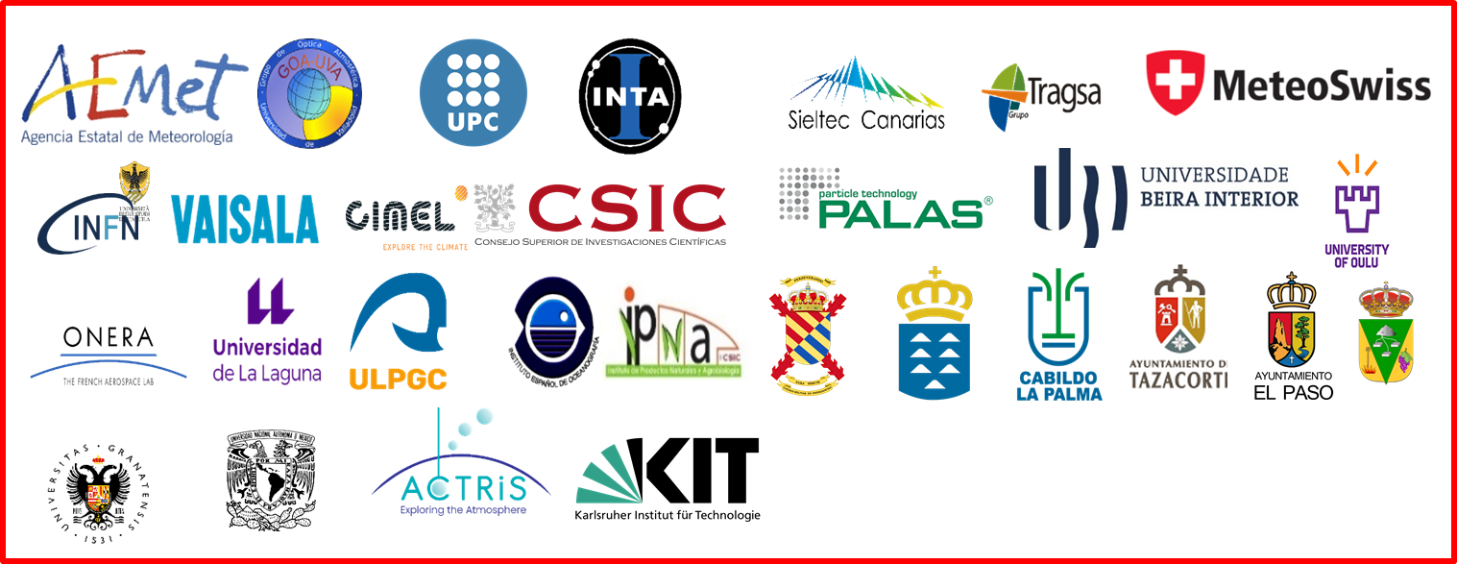
Many thanks!!!!

Slide 19
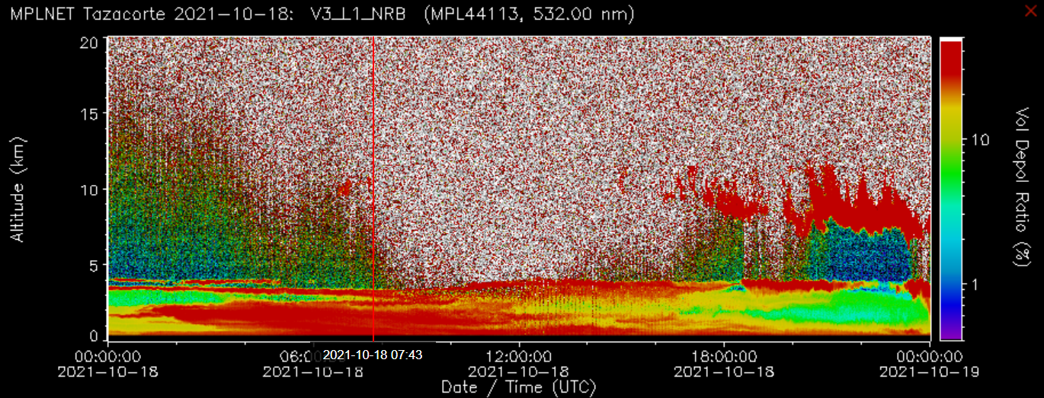
La Palma Volcanic Eruption
Transport to Europe, America and Africa in the middle troposphere
(aerosol and gas injection between 2-6 km)

Slide 20

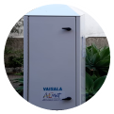
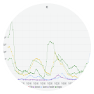


AEMet Deployment at La Palma
Weather monitoring and forecasting
Aerosol profiling (Transport)
Air Quality
Research
(aerosols & gases)
IZO
WMO-GAW

Slide 21

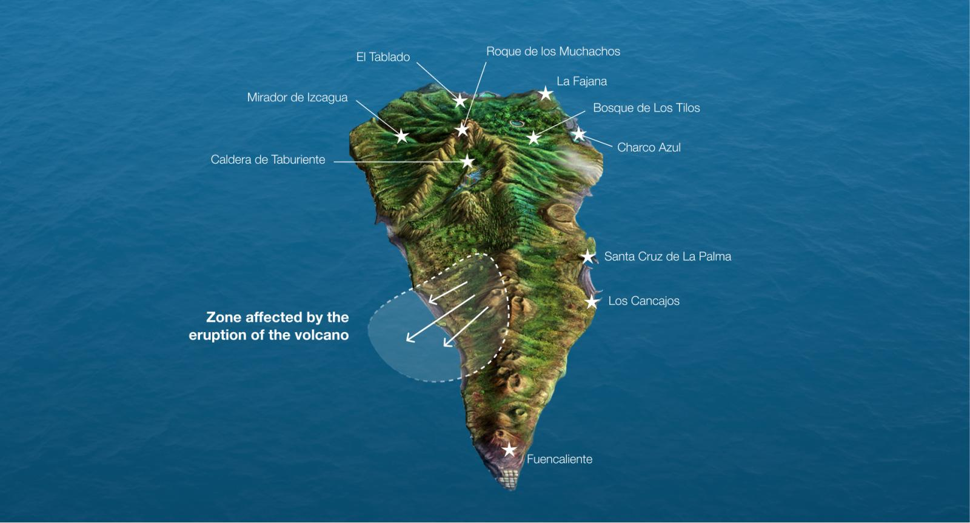
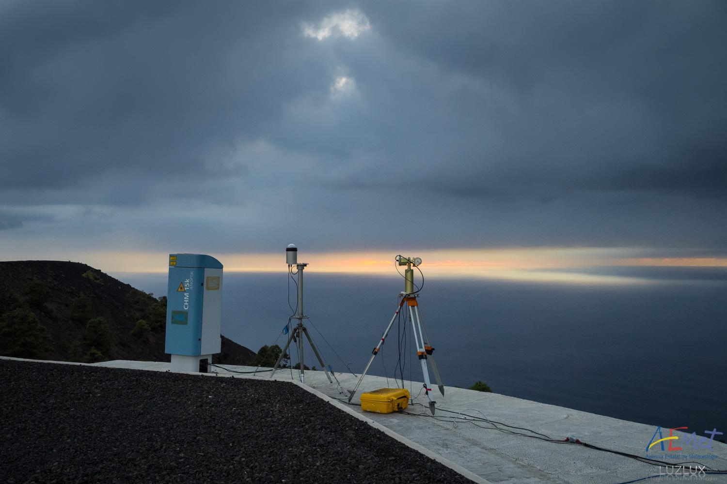
Installation of FUE station (La Palma, Canary Islands)
San Antonio (1677) volcano
visitors center, Fuencaliente
Tajogaite
Volcano
~14 km
Cumbre Vieja
FUE
  DOAS instrument (Avantes ULS 2048)
  EM27-SUN (Bruker)
  Ceilometer (CHM), Photometer (CIMEL)
  All-sky camera
DOAS &
Optical
Fibber

Slide 22
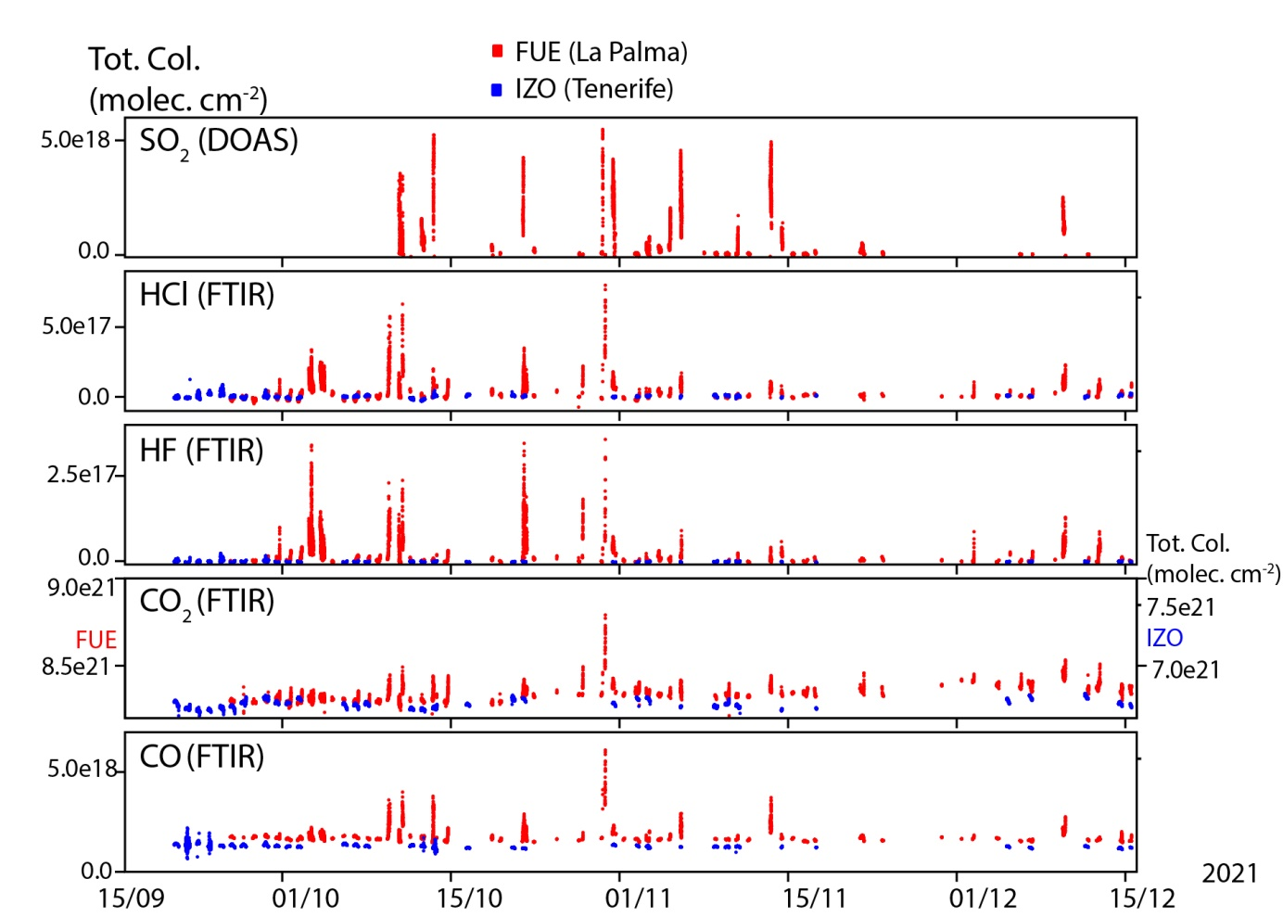
Measurements during La Palma eruption: SO₂, HCl, HF, CO₂, CO

Slide 23
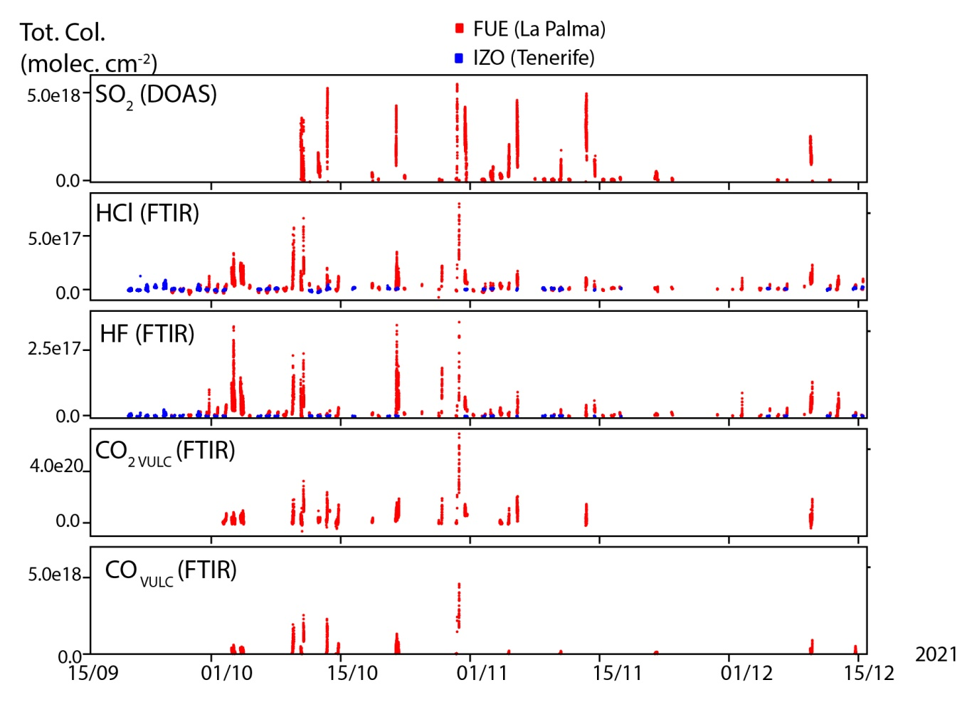
CO₂ VULC and CO VULC Time series

Slide 24
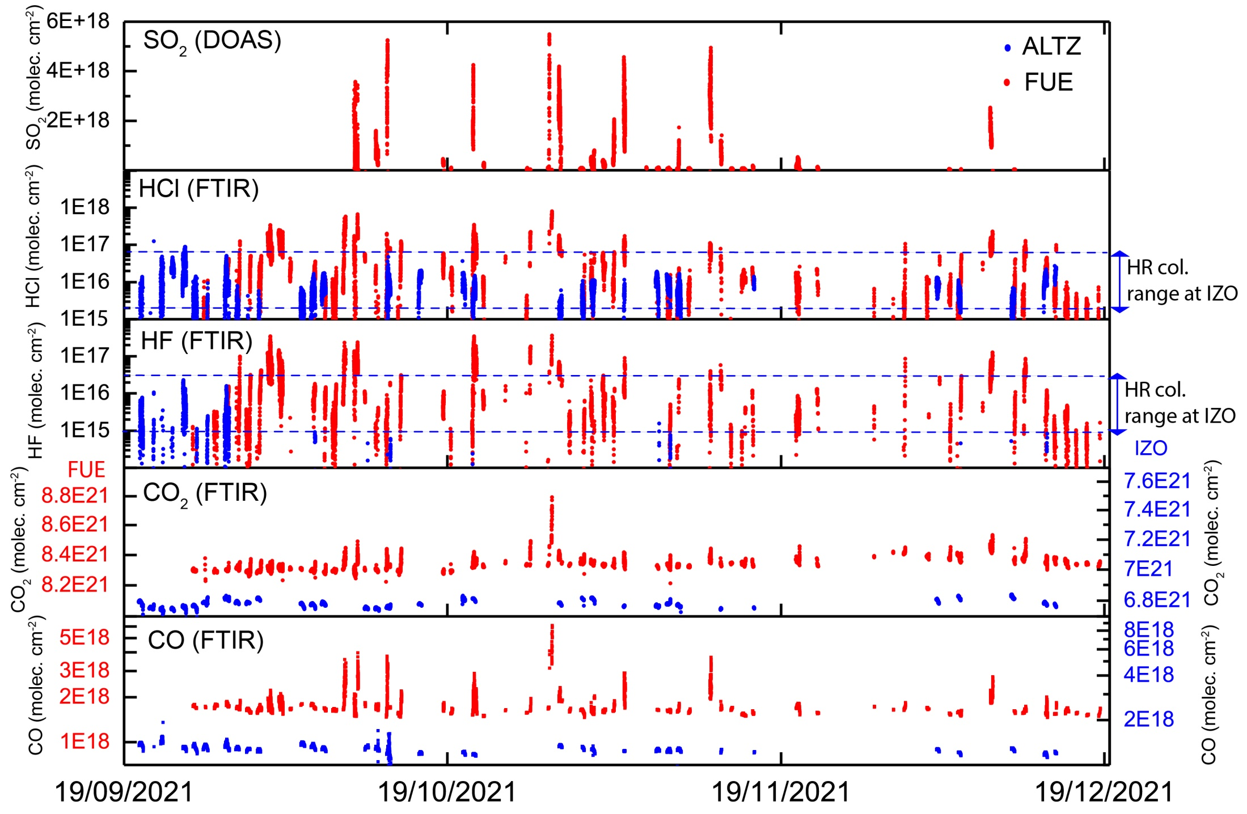
Measurements during the La Palma eruption : SO₂, HCl, HF, CO₂, CO

Slide 25
Volcanic columns at FUE and IZO: SO₂, HCl, HF, CO₂, CO

Slide 26
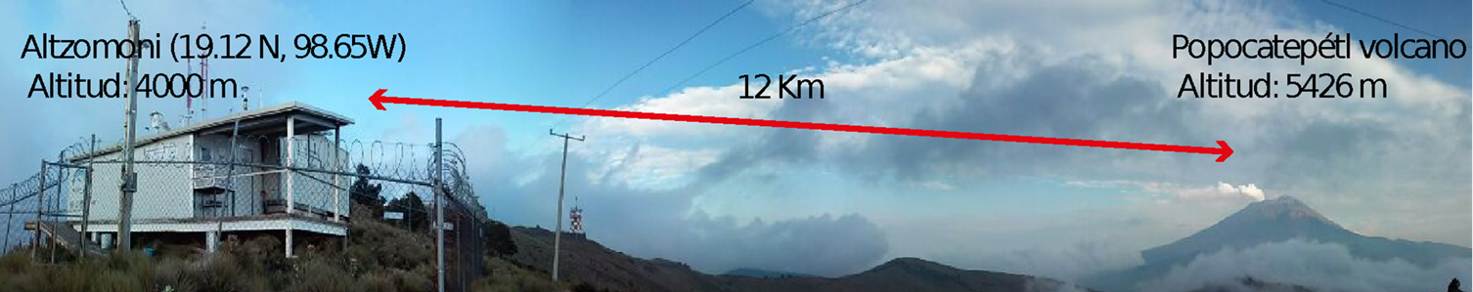
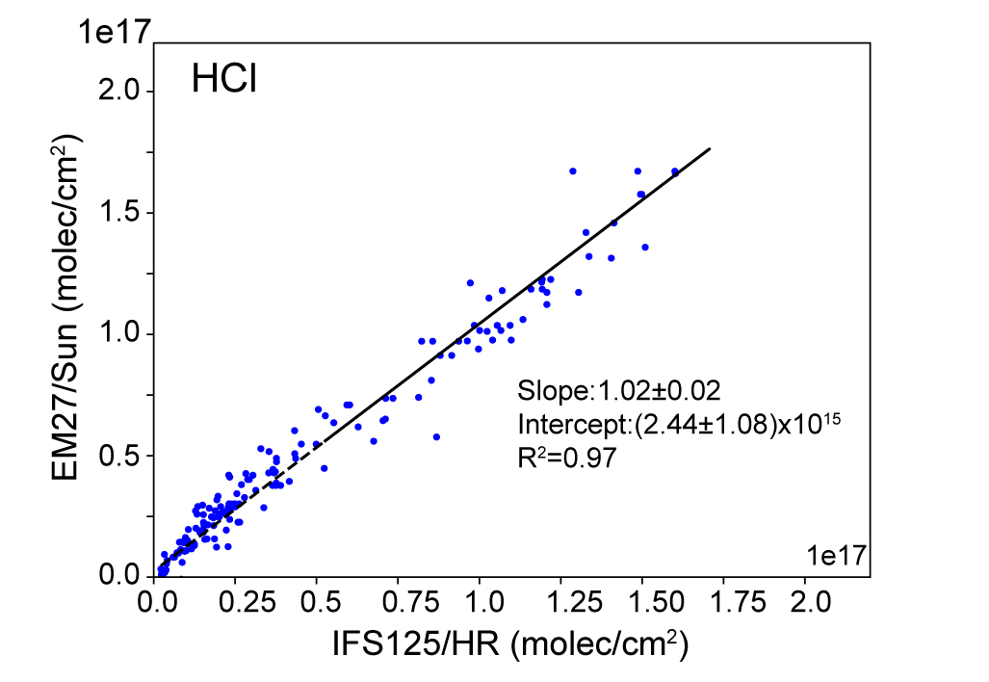
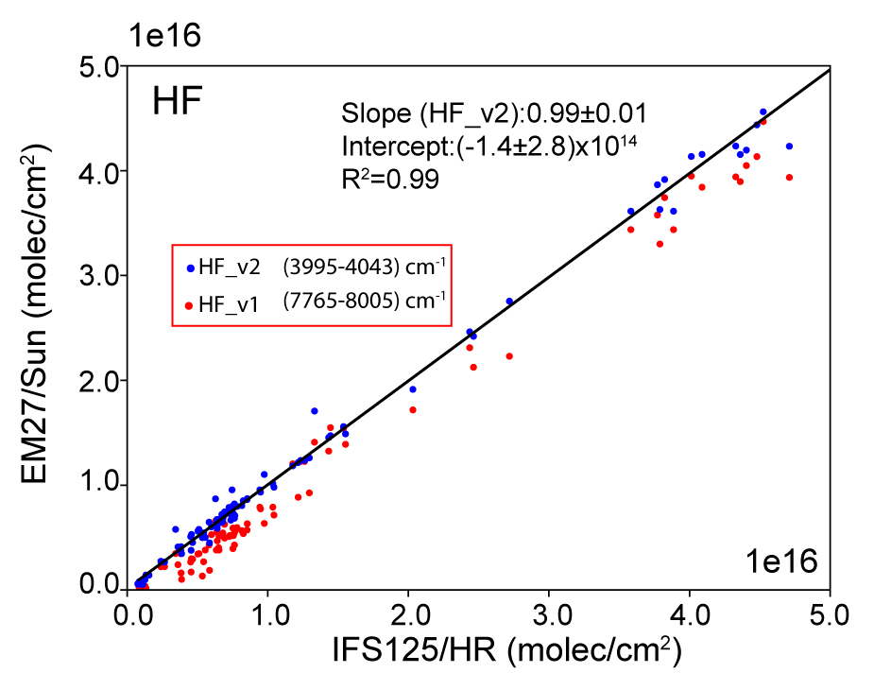
Validation HF & HCl at Popocatépetl: EM27/SUN vs IFS 125HR
HCl EM27/SUN (5697.0 - 5769.0) cm⁻¹
HCl IFS 125HR : 12 independent windows in (2727.0 – 2796.5 ) cm⁻¹
(Taquet et al., 2019)
HF EM27/SUN (7765.0 - 8005.0) cm⁻¹ and (3995-4043) cm⁻¹
HF IFS 125HR : (3999.0 – 4003.5) & (4036.5-4041.0) cm⁻¹
(Taquet et al., 2019)

Slide 27
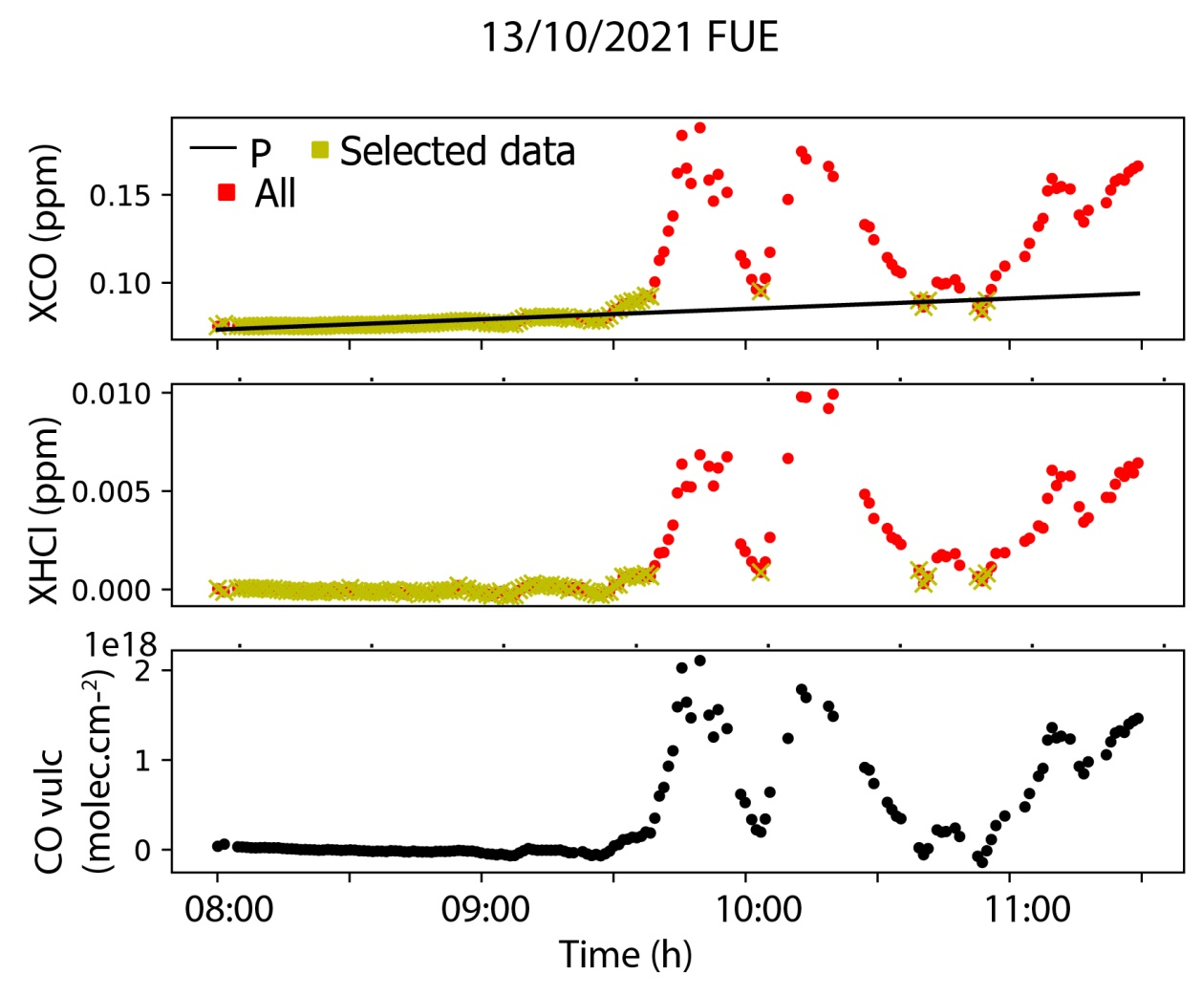
Determination of Volcanic CO columns
ΔXCO=XCO_{FUE}–P
Volcanic CO VCD:
CO_{VOLC}=ΔXCO. O₂/0.20942

Slide 28
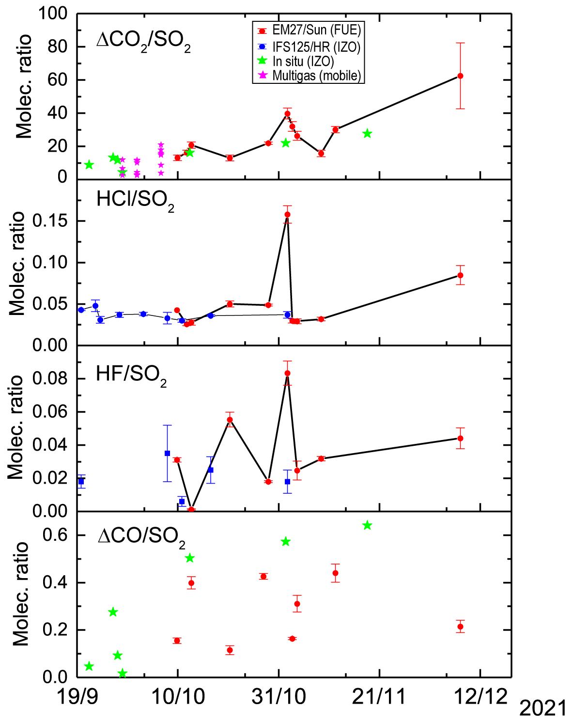
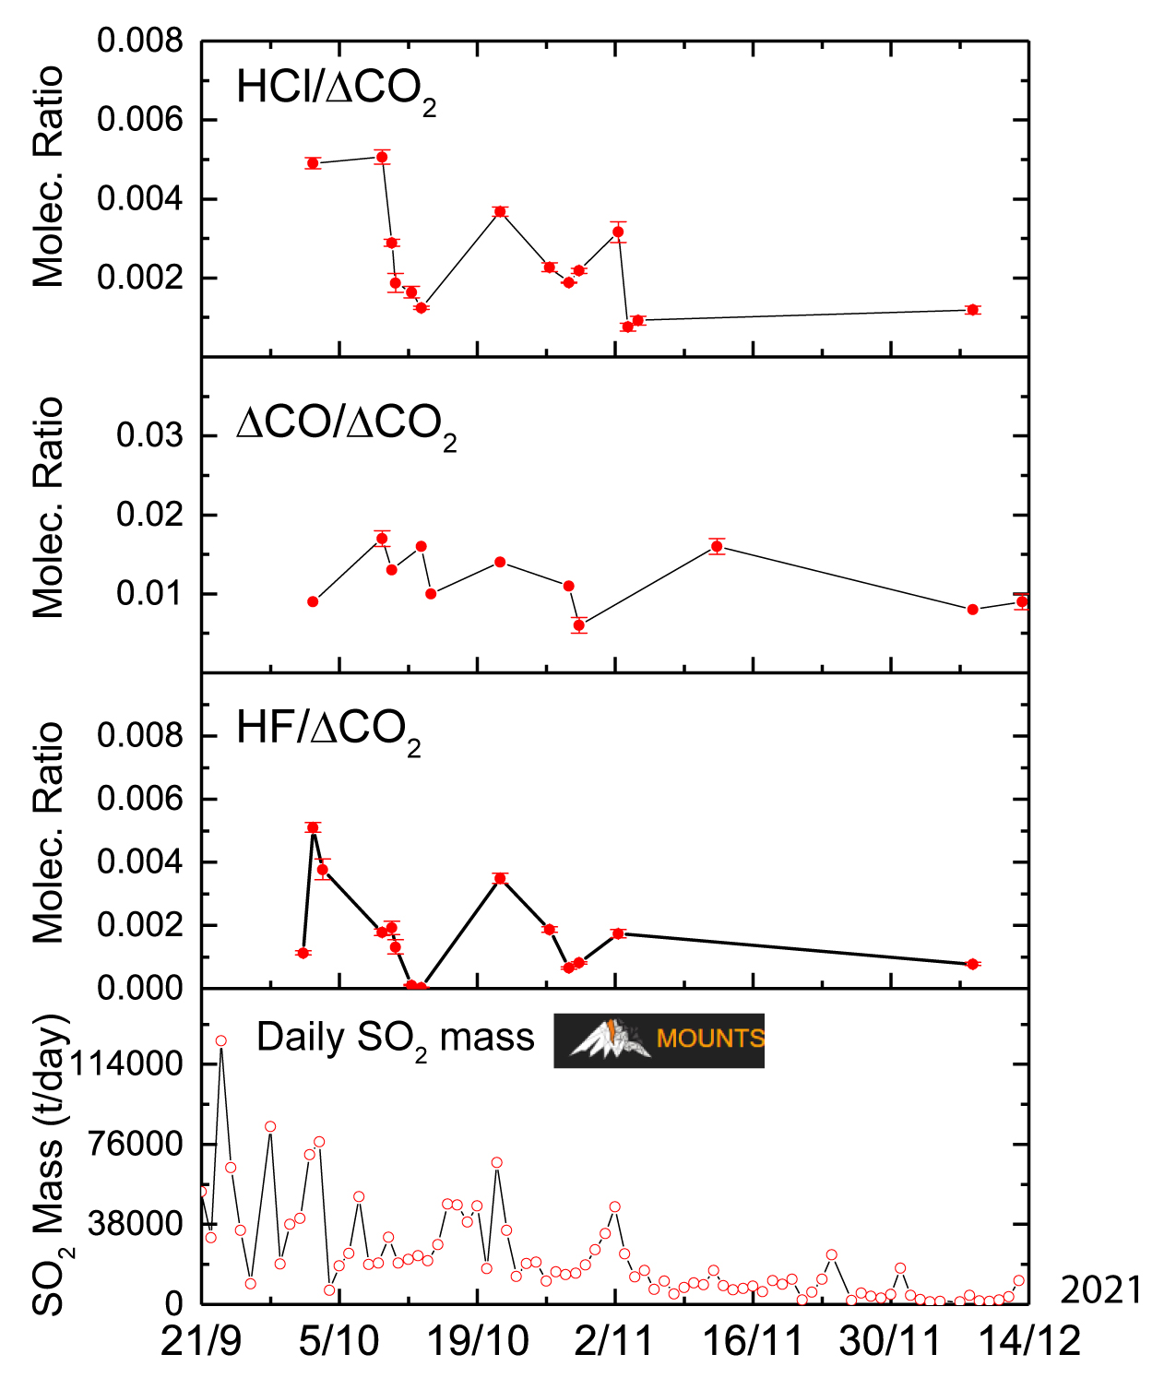
Variability of the Volcanic Gas Ratios

Slide 29

References of CO2, SO2, HCl and HF emissions

Slide 30

WMO-GAW in-situ measurements at IZO: SO₂, CO₂, CO

Slide 31


IFS 125HR SO₂ Retrieval Strategies
- Based on Taquet et al. (2019), but they have been optimized and applied consistently to all FTIR sites
MW (cm⁻¹) | Filter/Detector | Interfering Gases | Fit
2480-2520 | S3&S4, InSb | H₂O, CO₂, O₃, CH₄, N₂O, SO₂ | Scale retrieval for all gases
1120-1180 | S6, MCT | H₂O, HDO, CO₂, O₃, CH₄, N₂O, SO₂, CFC12 | Profile retrieval for SO₂, H₂O, O₃ Scale retrieval for the remaining gases
  For 1100 cm⁻¹ region the positive constrain using a profile retrieval on a logarithmic scale is CRITICAL, because it avoids SO₂ negative concentrations and provides more stable retrievals.
  Total DOFS ≈ 1
  (SO₂ vertical information is not retrievable!).
- WACCM v6 for all a priori profiles, except for SO₂ (on-site information!).
- HITRAN2020 for all gases

Slide 32

Intercomparison IFS 125HR & Brewer/Pandora at IZO: SO₂
Pandora/Brewer (Sep2021 - Feb2022)
Temporal Window: ± 10 min
Difference = FTIR - Pandora/Brewer
Pandora (All SO2>0) | MD (DU) | STD (DU) | R
2500 cm⁻¹ HIT2008 | 0.535 | 1.368 | 0.981
2500 cm⁻¹ HIT2020 | 0.463 | 1.368 | 0.981
1150 cm⁻¹ HIT2008 | 0.085 | 0.697 | 0.995
1150 cm⁻¹ HIT2020 | -0.007 | 0.623 | 0.995
Excellent correlation for all SO₂ range
HITRAN 2020 provides the best agreement between techniques (1150 cm⁻¹)
Brewer shows a positive bias of 3 DU
(SO₂ cross section?)
Brewer | MD (DU) | STD (DU) | R
2500 cm⁻¹ HIT2008 | -2.836 | 0.975 | 0.984
2500 cm⁻¹ HIT2020 | -2.897 | 0.978 | 0.984
1150 cm⁻¹ HIT2008 | -3.160 | 0.698 | 0.995
1150 cm⁻¹ HIT2020 | -3.248 | 0.670 | 0.995

Slide 33

IFS 125HR HF & HCl Retrieval Strategies
Based on PROFFIT recipes, but they have been optimized.
HF: 2 windows in SA filter (4000.90-4001.05; 4038.85-4039.08) cm-1; interfering gases H2O, O3, CH4 and HF; HITRAN2020 for all gases.
HF_optimized
HCl: 4 windows in SC filter (2727.73-2727.83; 2775.60-2775.90; 2821.40-2821.75; 2925.75-2926.10) cm-1; interfering gases H2O, HDO, O3, N2O, CH4, HCl, and OCS; HITRAN2020 for all gases.
Gas_Setup | Fit | A priori | Vertical Constraint
HF_NDACC | Scale H2O, HF: TP, log, 1e4/300 | WACCM v6 | First and last altitude level clamped
HF_optimized | Scale H2O, HF: TP, log, 1000, 30 | 1E-4 up to 6 km, beyond WACCM v6 | First altitude level free
HCl_NDACC | Scale all, HCl: TP, log, 1000/1000 | WACCM v6 | First and last altitude level clamped
HCl_optimized | Scale all, HCl: TP, log, 100/100 | 1E-4 up to 6 km, beyond WACCM v6 | First altitude level free

Slide 34

IFS 125HR HF & HCl Retrieval Strategies
Averaging Kernels, a priori and retrieved VMR profiles
HF_optimized
HCl_optimized
Performance
Gas_Setup | Median Residues (STD) [au] | Median Iterations (STD) | Median DOFS (STD)
HF_NDACC | 128588 (674735) | 5 (3.46) | 1.80 (0.32)
HF_optimized | 49725 (166614) | 6 (2.71) | 2.73 (0.27)
HCl_NDACC | 13684 (52165) | 3 (1.11) | 2.03 (0.33)
HCl_optimized | 11450 (13367) | 4 (1.78) | 3.33 (0.33)

Slide 35
Summary of IFS 125HR Retrieval Strategies
Gas Setup | Filter/Detector | Mw (cm⁻¹) | Interfering Gases | Fit
SO₂ | S3&S4, InSb | 2480-2520 | H₂O, CO₂, O₃, CH₄, N₂O, SO₂ | Scale retrieval for all gases
SO₂ | S6, MCT | 1120-1180 | H₂O, HDO, CO₂, O₃, CH₄, N₂O, SO₂, CFC12 | Profile retrieval for SO₂, H₂O, O₃ Scale retrieval for the remaining gases
HF | SA, Ingas | 4000.90-4001.05; 4038.85-4039.08 | H₂O, O₃, CH₄ and HF | Scale H2O, HF: TP, log, 1000, 30 Vert. Constraint: First altitude level free
HCl | SC, InSb | (2727.73-2727.83; 2775.60-2775.90; 2821.40-2821.75; 2925.75-2926.10) | H₂O, HDO, O₃, N₂O, CH₄, HCl, and OCS | Scale all, HCl: TP, log, 1000/1000 Vert. Constraint: First and last altitude level clamped

Slide 36



Aerosol Retrievals from EM27/SUN
See poster COCCON-Spain: Towards an Integrated Greenhouse Gas
Observation System in Spain
Aerosol products can be used as proxy for atmospheric chemistry
(CO/SO₂: 2 ranges = 2 different sources Volcanic CO or GHG/biomass burning (due to lava flows))
Spectral Aerosol Optical Depth (AOD)
Validation with co-located AERONET AOD
for 870, 1020, 1640 nm
8 Micro-Windows (very high solar transmission) and
continous Langley-plot Calibration at IZO
1636.00 nm
2133.40 nm
2192.00 nm
2314.20 nm
872.55 nm
1020.90 nm
1238.25 nm
1558.25 nm
Linear degradation rate of ~0.6%month⁻¹!
Excellent correlation for all the AOD range
EM27/SUN AOD shows a positive bias
between 1-2.5%

