Slide 1


Updates in the forward model of PROFFAST Ver 2
Presenter: Frank Hase*
*frank.hase@kit.edu https://frm4ghg.aeronomie.be/

Slide 2
PROFFAST Ver 2 updates
Fiducial Reference Measurements for Ground-Based Infrared Greenhouse Gas Observations (FRM4GHG 2.0)
Introduction: One task of FRM4GHGII is to enhance the COCCON code suite. The COCCON processing chain has three steps:
The pre-processing or L1-processing (performed by PREPROCESS): from raw OPUS interferograms to spectra. The resulting spectra are used for the quantitative trace gas analysis.
The daily calculation of lookup tables with x-sections of gases for given atmospheric conditions (performed by PCXS)
The trace gas retrievals (performed by INVERS)
This talk describes updates in PCXS as incorporated in Ver 2 of PROFFAST.

Slide 3
PROFFAST Ver 2 updates
Contents:
Update + refined parameterization of TIPS
Refined tabulation of x-sections as fct of airmass
Spectroscopic improvements (line lists, line shape model)

Slide 4
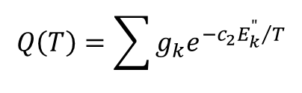
TIPS update
HITRAN tabulated TIPS: CO₂, main isotopologue
TIPS: Total Internal Partition Sum
The TIPS is used to determine the population of molecules as function of quantum state. These population factors are needed to determine the intensity of
ro-vibrational transitions.
$$Q\left(T\right)=\sum{g_{k}e^{−{c_{2}E_{k}^{"}}/T}}$$

Slide 5
TIPS update
Handling of TIPS in PROFFAST ver 2
This table contains the masses and temperature parameterisations for Qvib(T)/Qvib(296), used by the forward model in the form
Qrel(x) = Qvib(296) / Qvib(T)
= exp(-(a1 * x + a2 * x**2 + a3 * x**3 + a4 * x**4 + a5 * x**5 + a6 * x**6 + a7 * x**7)).
x = (T[K] - 296.0) / 120.0, the fit to the tabellated values in parsum.dat is restricted to x=-1.0 to +1.0 (176K ... 416K)
HITRAN# mass[amu] a0 a1 a2 a3 a4 a5 a6 a7 species description
$
11 18.010565 9.8819E-07 6.0605E-01 -1.1930E-01 3.3006E-02 -9.5289E-03 2.9598E-03 -1.3178E-03 4.8037E-04 H2O_161
....
21 43.989830 7.0029E-07 5.1587E-01 -4.8593E-02 1.6248E-02 -6.8149E-03 2.7411E-03 -1.2363E-03 4.0896E-04 CO2_626
22 44.993185 7.2299E-07 5.2327E-01 -4.8421E-02 1.5669E-02 -6.5587E-03 2.6907E-03 -1.2581E-03 4.2542E-04 CO2_636
23 45.994076 6.9872E-07 5.1849E-01 -4.8090E-02 1.6110E-02 -6.8039E-03 2.7401E-03 -1.2376E-03 4.1061E-04 CO2_628

Slide 6
TIPS update
Resulting improvement

Slide 7
TIPS update
TIPS summary:
Improved parameterisation
Fits performed for all isotopologue TIPS provided in HITRAN 2020
New species-ver2.inf file incorporated PROFFAST ver 2 distribution
Handling in PROFFIT and LINEFIT updated accordingly

Slide 8
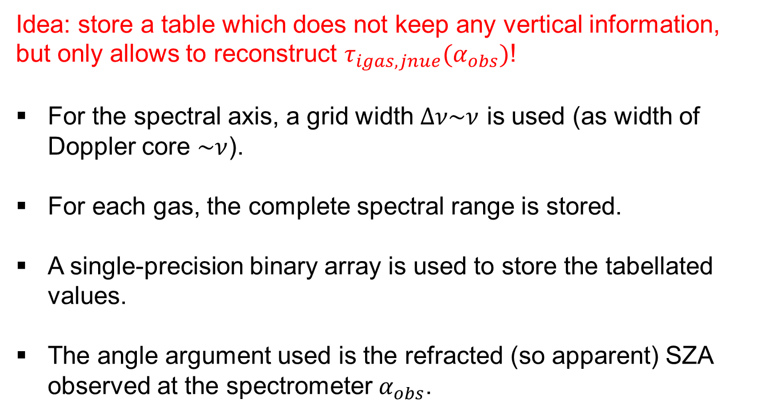
X-sections lookup table
Use of pre-calculated x-sections
Idea: store a table which does not keep any vertical information, but only allows to reconstruct $τ_{igas,jnue}(α_{obs})$!
For the spectral axis, a grid width $∆ν\sim ν$ is used (as width of Doppler core $\sim ν$).
For each gas, the complete spectral range is stored.
A single-precision binary array is used to store the tabellated values.
The angle argument used is the refracted (so apparent) SZA observed at the spectrometer $α_{obs}$.

Slide 9
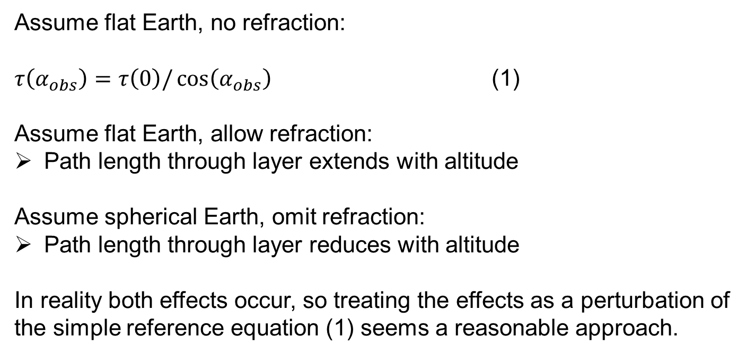
X-sections lookup table
Designing the table …
Assume flat Earth, no refraction:
$τ\left(α_{obs}\right)=τ\left(0\right)/\cos\left(α_{obs}\right)$ (1)
Assume flat Earth, allow refraction:
Path length through layer extends with altitude
Assume spherical Earth, omit refraction:
Path length through layer reduces with altitude
In reality both effects occur, so treating the effects as a perturbation of the simple reference equation (1) seems a reasonable approach.

Slide 10
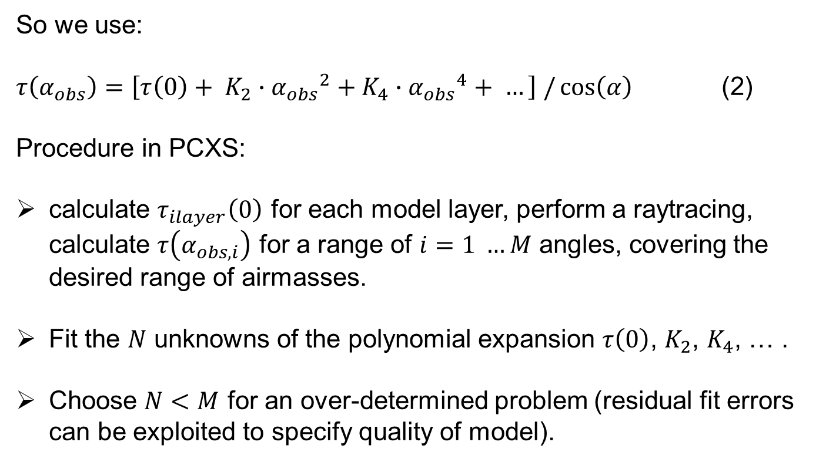
X-sections lookup table
Designing the table …
So we use:
$τ\left(α_{obs}\right)=\left[τ\left(0\right)+ K_{2}∙{α_{obs}}^{2}+K_{4}∙{α_{obs}}^{4}+ …\right] /\cos\left(α\right)$ (2)
Procedure in PCXS:
calculate $τ_{ilayer}\left(0\right)$ for each model layer, perform a raytracing, calculate $τ\left(α_{obs,i}\right)$ for a range of $i=1 …M$ angles, covering the desired range of airmasses.
Fit the $N$ unknowns of the polynomial expansion $τ\left(0\right)$, $K_{2}$, $K_{4}$, … .
Choose $N<M$ for an over-determined problem (residual fit errors can be exploited to specify quality of model).

Slide 11
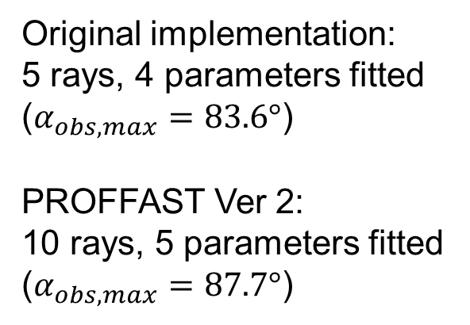
X-sections lookup table
Adjusting the model quality …
Original implementation:
5 rays, 4 parameters fitted
($α_{obs,max}=83.6°$)
PROFFAST Ver 2:
10 rays, 5 parameters fitted
($α_{obs,max}=87.7°$)

Slide 12
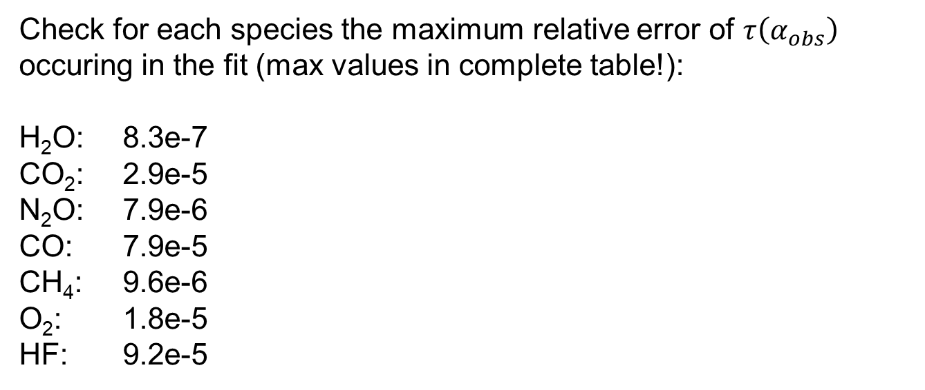
X-sections lookup table
Quality of the model
Check for each species the maximum relative error of $τ\left(α_{obs}\right)$ occuring in the fit (max values in complete table!):
H₂O: 8.3e-7
CO₂: 2.9e-5
N₂O: 7.9e-6
CO: 7.9e-5
CH₄: 9.6e-6
O₂: 1.8e-5
HF: 9.2e-5

Slide 13
Spectroscopic improvements
Spectroscopic improvements:
Solar transmission (thanks to G. C. Toon!): GGG14 -> GGG20
Atmospheric gases:
Ver 1: wild mixture (HIT08 + empirical ad-hoc corrections, HIT12), O₂: GGG14
Ver 2: HIT20 (H₂O, CO₂ [+ LM + SDV], N₂O, CO, O₂ [+ SDV??])
Implementation of 1st order LM + SDV in PROFFAST Ver 2
Special item: CH₄
HITRAN: LM under construction ~ 1 a
Recent DLR line list covers only TROPOMI window (uses HTP + 2nd order LM)

Slide 14
Spectroscopic improvements
Collect room-temperature cell measurements: pure CH₄ and CH₄ in air
(~ 1000, 500, 250, 125 mbar), use a “poor-man‘s“ measurement strategy
coding of a multispectrum fitting tool
Retrieval of optimized spectral parameters from available line lists and own measurements (TROPOMI range: DLR line positions + intensities consistent, only fit of p-dependent parameters, TCCON range: HIT20 line positions + intensities not satisfactory, ATM20 line list: significantly better than HIT20, not on DLR quality level, re-fit positions and intensities)
pressure | Fitted CH₄ column | ratio
949.0 | 5.293e+23 | --
460.0 | 2.566e+23 | 0.4848
223.0 | 1.244e+23 | 0.4848
108.0 | 6.031e+22 | 0.4848

Slide 15
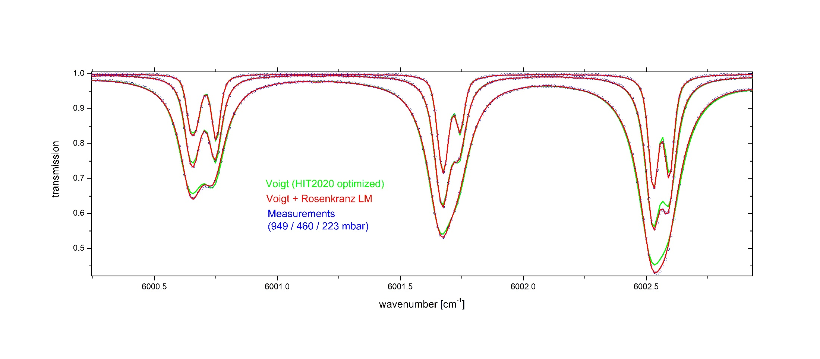
Spectroscopic improvements

Slide 16
Spectroscopic improvements
Fit quality on 1000 mbar spectrum (note: multispectrum fit was performed).

Slide 17
Spectroscopic improvements
Fit quality on 1000 mbar spectrum (note: multispectrum fit was performed).

Slide 18
Spectroscopic improvements
Do the new CH₄ line parameters really work? - Tests on high-res solar spectra.
(Shown here: fits to average noon spectrum TCCON Ka 01-Aug-2019)

Slide 19
Spectroscopic improvements
Summary spectroscopic improvements:
PROFFAST Ver 2 supports 1st order LM + SDV
Solar transmission model updated
HIT2020 O₂ line list
HIT2020 CO₂ line list (+ LM + SDV)
Homebrewn CH₄ line list (+ LM)

Slide 20
X-sections lookup table
Use of pre-calculated x-sections
Model limitations accepted for PROFFAST implementation:
Assume horizontal atmospheric homogeneity, local sphericity of Earth
Neglect atmospheric dispersion
Technical limitations accepted in PROFFAST implementation:
Supports only fit of scaling factors on a-priori trace gas profiles (no profile retrievals)
Vertical sensitivities cannot be calculated in INVERS

Slide 21
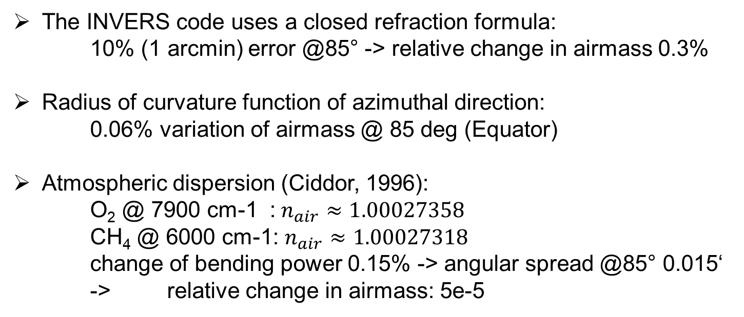
X-sections lookup table
Limitations, residual errors
The INVERS code uses a closed refraction formula:
10% (1 arcmin) error @85° -> relative change in airmass 0.3%
Radius of curvature function of azimuthal direction:
  0.06% variation of airmass @ 85 deg (Equator)
Atmospheric dispersion (Ciddor, 1996):
  O₂ @ 7900 cm-1 :$n_{air}≈1.00027358$
  CH₄ @ 6000 cm-1: $n_{air}≈1.00027318$
  change of bending power 0.15% -> angular spread @85° 0.015‘
  -> relative change in airmass: 5e-5

Slide 22
X-sections lookup table
Improved x-sections lookup table summary
New implementation supports the SZA range up to ~ 85°
Remaining possible refinements:
replace closed formula for atmospheric refraction

