Slide 1

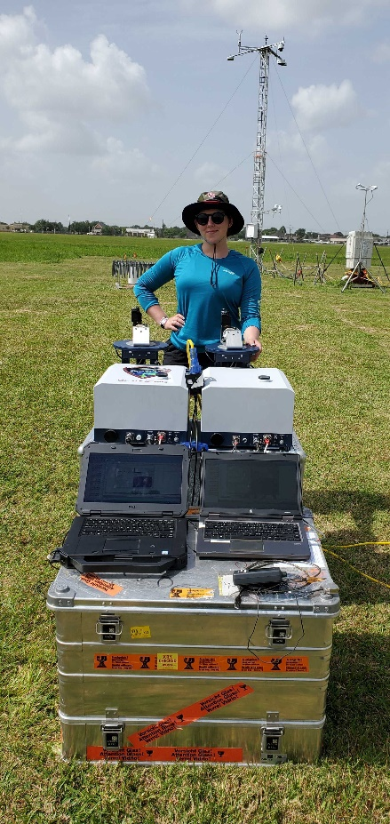
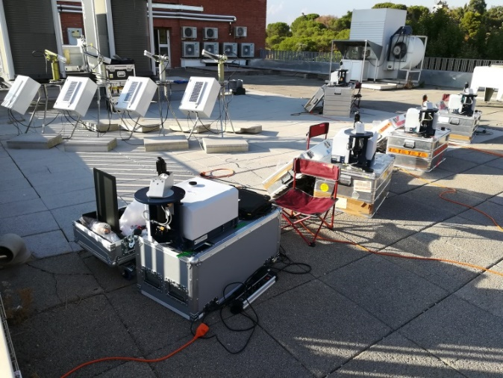
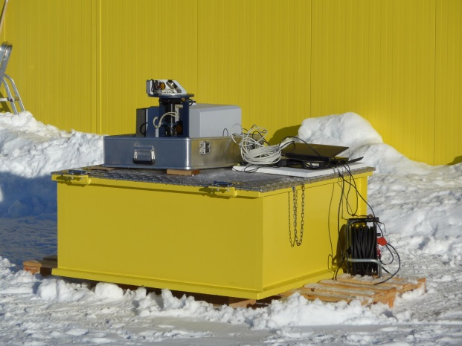
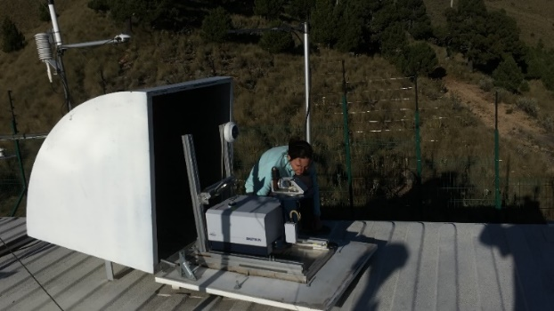
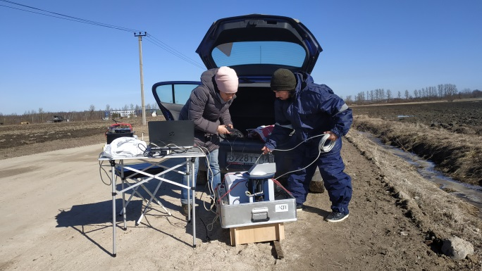
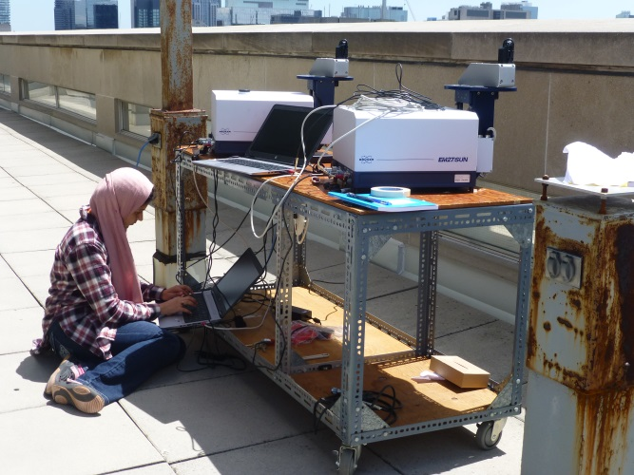
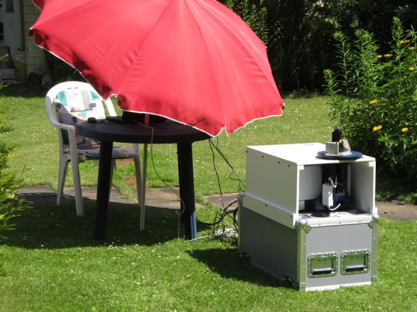
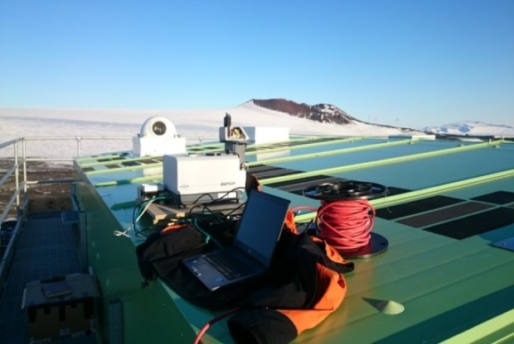
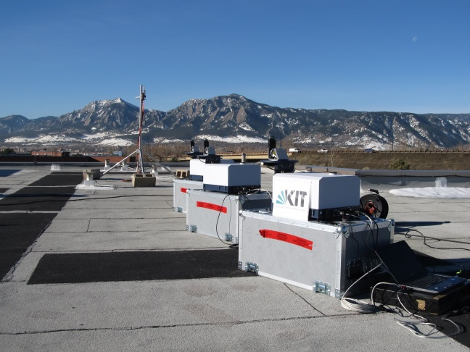
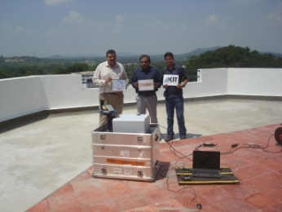
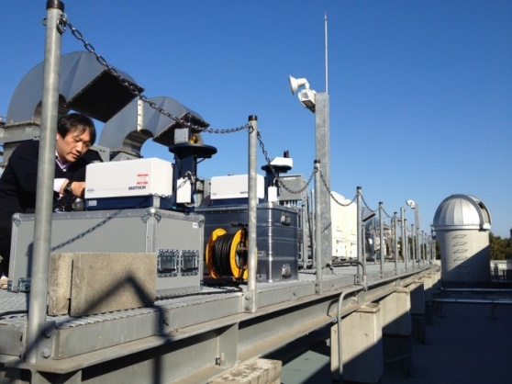
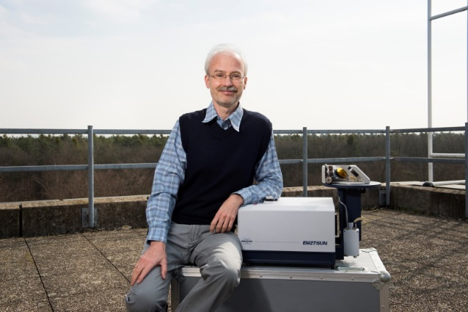
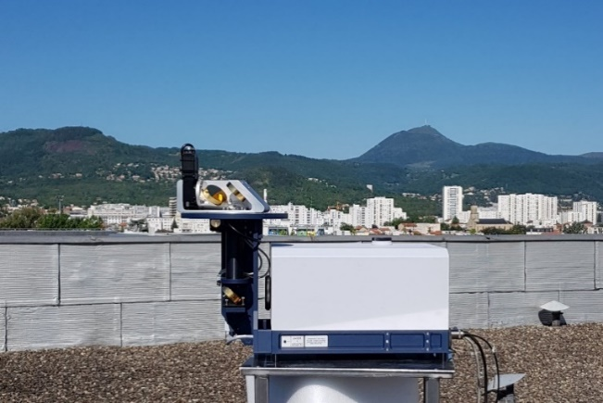
COCCON & EM27/SUN welcome
Notes:
This is all I wanted to present, thanks so much for your attention!

Slide 2
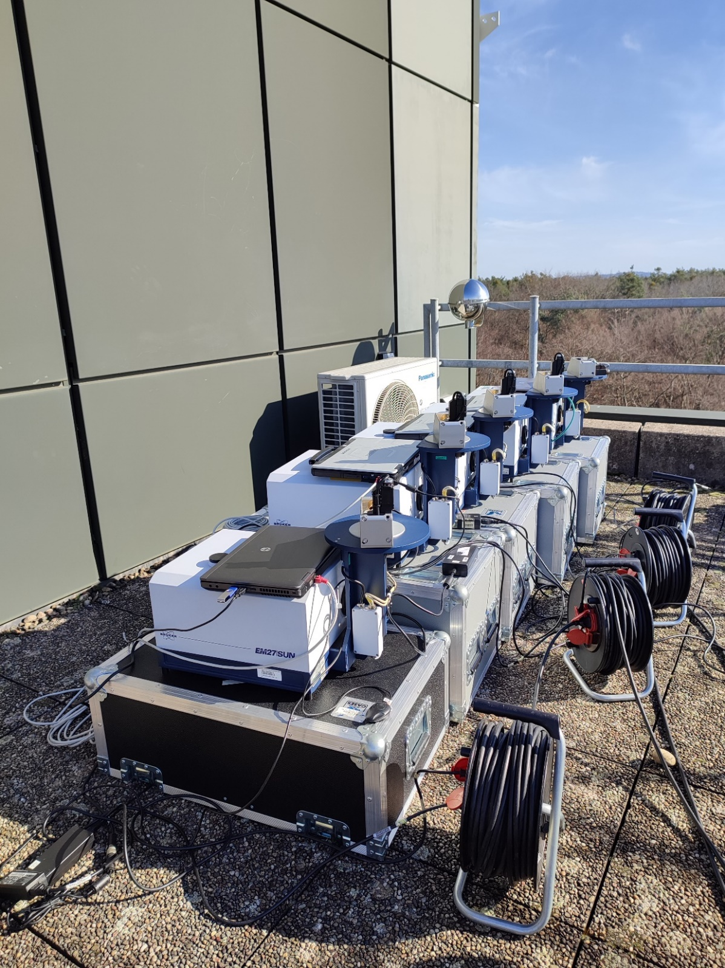
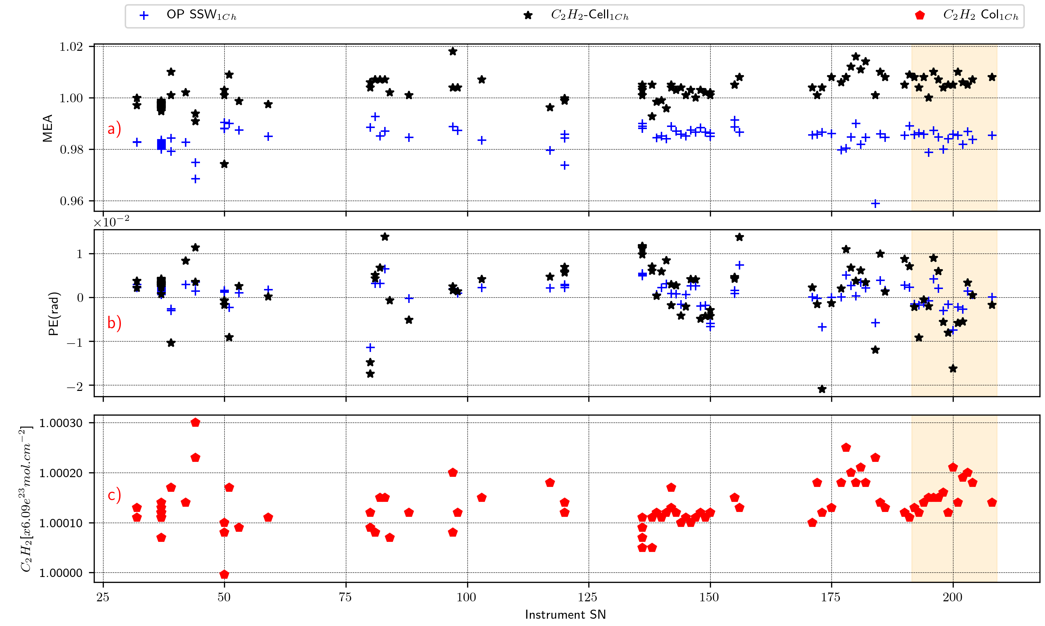
COCCON & EM27/SUN welcome
Greetings from Carlos Alberti, who unfortunately for VISA reasons cannot attend!

Slide 3




COCCON & EM27/SUN welcome
Number of spectrometers growing quickly
Numerous campaign activities (cities, coal mining areas, high altitude, …)
New activities (shipborne measurements, AOD retrievals, open path, …)
Permanent installations of arrays (e.g., TUM, UoT + EC, UK, France, Spain, …)
COCCON functionalities enabled by ESA
(data processing, instrumental QA/QC, TS, …) :
COCCON PROCEEDS I – III
FRM4GHG + FRM4GHG2
COCCON OPERA (2023 - 2027)
Cooperation with Bruker highly appreciated! (G. Surawicz & K. Loran)

Slide 4
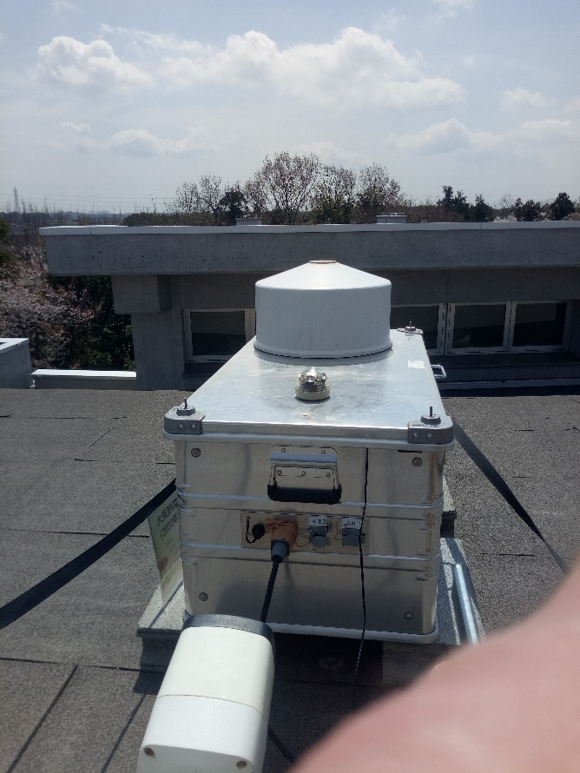
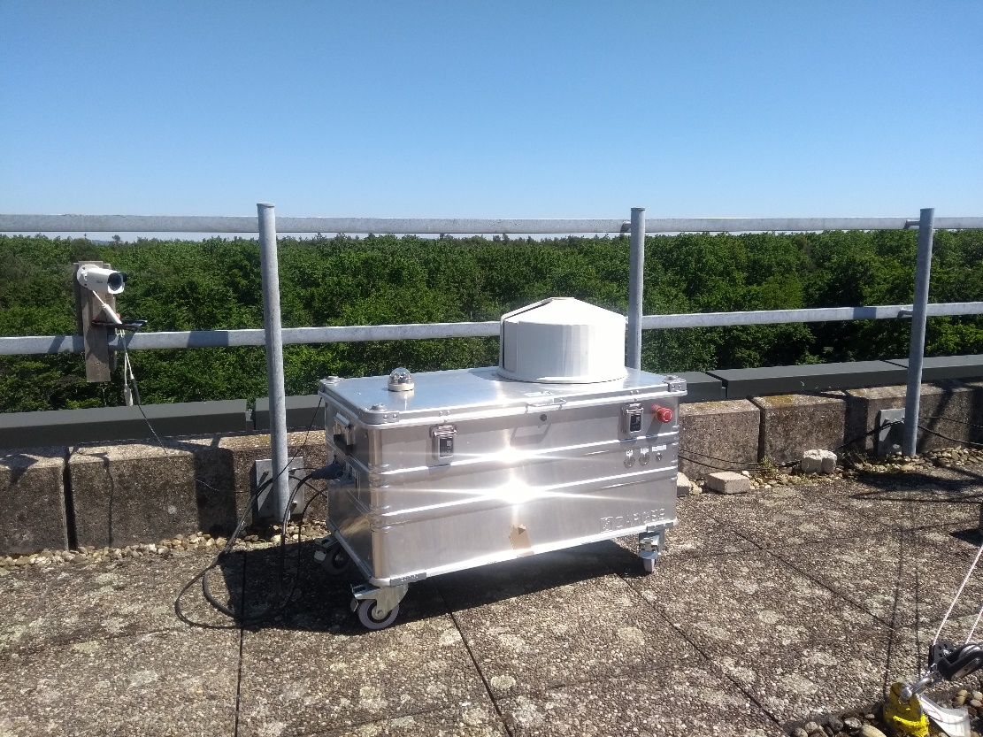
COCCON & EM27/SUN welcome
Wrapper for new PROFFAST ver 2: Lena Feld & Benedikt Herkommer (feedback & contributions highly valuable: TUM, Y. Té, UoW, D. Pollard, D. Noone, …)
Implementation of regular telecons (thanks to you all, JPL, B. Herkommer)
Travel Standard: Even closer connection of TCCON & COCCON (B. Herkommer + TUM, TCCON partners):
  Tsukuba
  East Trout Lake
  Wollongong
  Tenerife
  Paris
  …

Slide 5
COCCON & EM27/SUN welcome
In my feeling, TCCON + COCCON persistently demonstrate their impressive skills (see all those publications …). We keep up with the increasing validation demands of current and future GHG space missions and we recommend ourselves as backbone of a validation infrastructure for these missions!
The upcoming dense TCCON & COCCON networks will provide essential datasets for constructing bottom-up GHG inventories on national scales.

