Slide 1











NDACC-IRWG-TCCON-COCCON Annual Meeting 2023
Anmyeondo station report and Long-term variability characteristics of FTS spectra.
Young-Suk Oh*, Su Ryon Shin, Nicole Bassous, Hyun Young Jung, Chang Kee Lee, Sangwon Joo, Myoung-Hwan Ahn, Mina Kang , Sang-Woo Kim, Jeongsoon Lee, ,Sumin Kim, Soo Jeong Lee, Shanlan Li, Samuel Takele Kenea, Nicholas Deutscher, David Griffith.
I would like to shear the information of AMY station with you through the presentation, The key is site reports and ongoing research
National Institute of Meteorological Sciences, Young-Suk Oh, ysoh306@korea.kr, ysoh306@korea.kr, 2023.06.13.

Slide 2
NDACC-IRWG-TCCON-COCCON Annual Meeting 2023
Contents
1. Anmyeondo Station Report
2. Observational data from AMY.
3. AMY data processing. (GGG2020)
4. Long-term variability characteristics of FTS
5. Non-contact, Low-cost GHG Sensor (Graphene-Based)
6. EM27/SUN equipment validation and operation.
7. Conclusion
National Institute of Meteorological Sciences, Young-Suk Oh, ysoh306@korea.kr, ysoh306@korea.kr, 2023.06.13.

Slide 3
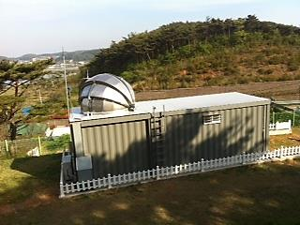
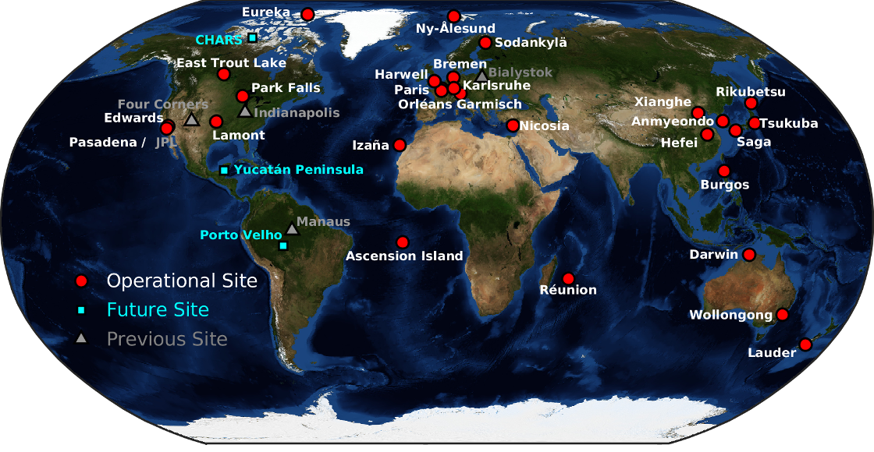
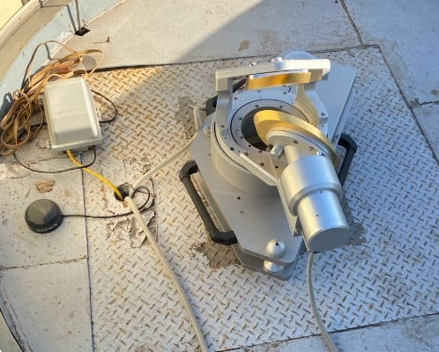
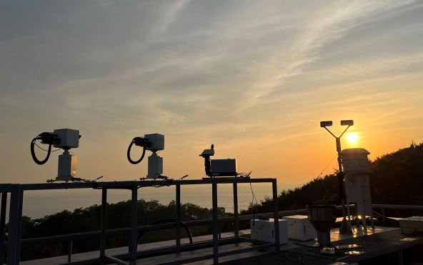
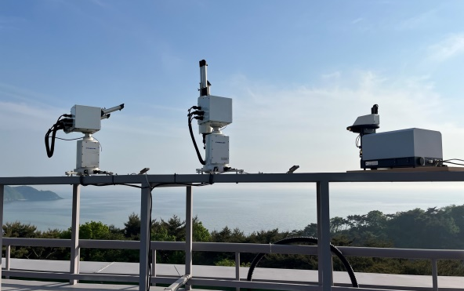
NDACC-IRWG-TCCON-COCCON Annual Meeting 2023
1. Anmyeondo Station Report
※ AMY’s History
* 2018 GPS replacement and alignment calibration performed.
* Installed IFS 125HR equipment in 2013.
* Designated AMY-TCCON station for 2014.
* Solar tracker and laser replacement in 2019.
AMY : Co-located with GAW site in-situ measurements, Capture east Asia outflow, Model and Satellite validation and for carbon cycle science.
* GGG2020 installation operation in 2021.
* Laser and Cam replacement in 2022.
* 2023 EM27/SUN operation and IFS125HR alignment calibration performed.
The flow of this figure is the AMY history. We have been running station for 10 years. After designation, there was an issue
National Institute of Meteorological Sciences, Young-Suk Oh, ysoh306@korea.kr, ysoh306@korea.kr, 2023.06.13.

Slide 4
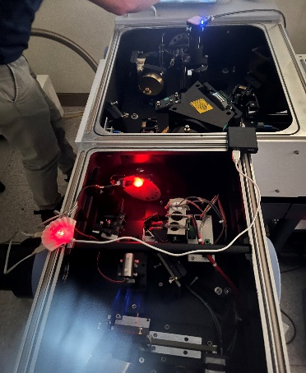
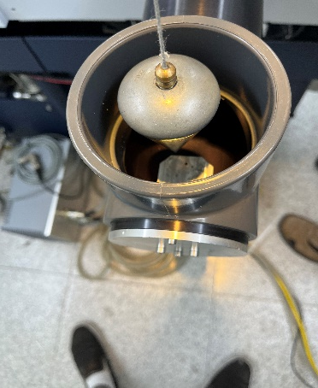
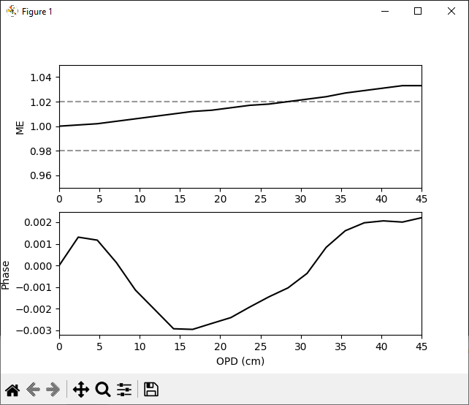
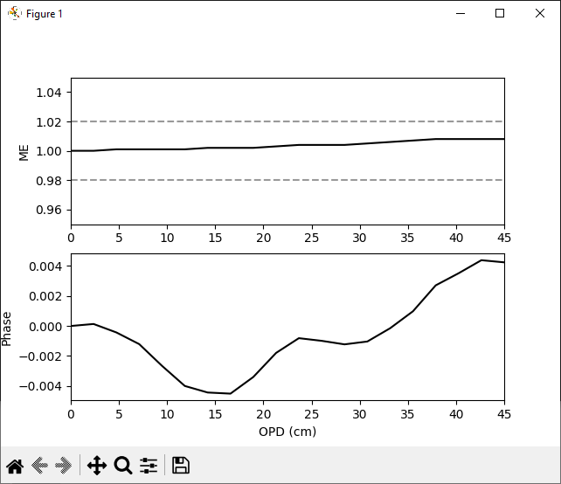
NDACC-IRWG-TCCON-COCCON Annual Meeting 2023
1. Anmyeondo Station Report
※ AMY’s Equipment
Before Alignment.
* The ME as a function of OPD is picture, but reaches 1.033 at 45cm OPD. While the alignment is still within the broad TCCON criterion of ME being within 5% of ideal, is had clearly degraded in the 3.5years since the previous analysis.
OPD (cm)
* The resulting ME as a function of OPD is shown. The ME and 45cm OPD is now 1.008, well within the ideal TCCON range.
After Alignment.
AMY station equipment meets TCCON standards,. The data will go through QA/QC and be provided soon.
OPD (cm)
National Institute of Meteorological Sciences, Young-Suk Oh, ysoh306@korea.kr, ysoh306@korea.kr, 2023.06.13.

Slide 5
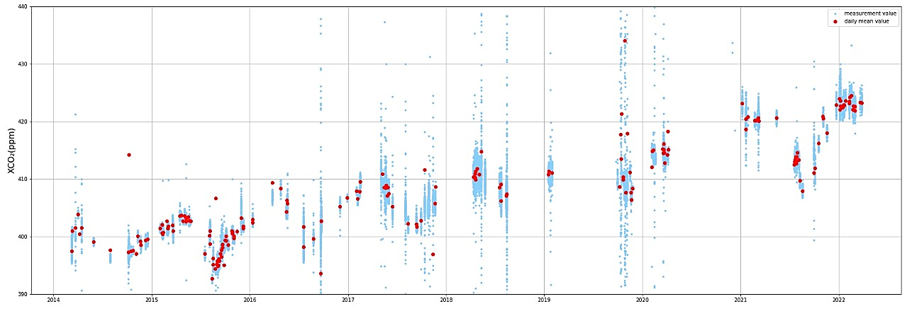
NDACC-IRWG-TCCON-COCCON Annual Meeting 2023
Period of unavailability of data.
(Solar tracker and laser replacement)
Period of without data.
(OPUS and Mirror replacement)
2. Observational data from AMY.
[GGG 2014(2014.4~2022.5)]
(2019.4)
(2019.12)
(2020.6)
(2020.11)
√. AMY data has been produced from March 2014 to the present of 2023. (However, GGG analysis was completed by May 2022.)
√. The average increase in GHG concentration for 8 years of AMY is 3.1ppm/year (XCO2), 9ppb/year (XCH4), and 1.9ppb/year (XCO).
( AMY data is of sufficient quality to detect the amount of variation.)
National Institute of Meteorological Sciences, Young-Suk Oh, ysoh306@korea.kr, ysoh306@korea.kr, 2023.06.13.

Slide 6
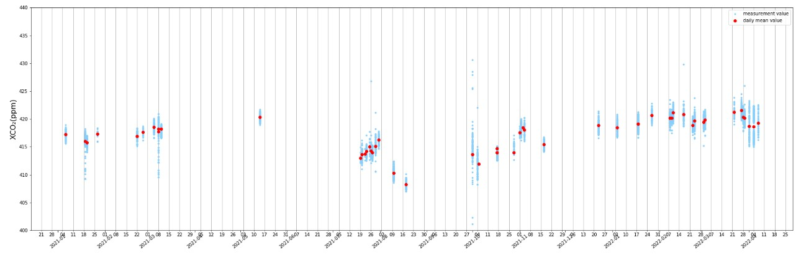
NDACC-IRWG-TCCON-COCCON Annual Meeting 2023
3. AMY data processing. (GGG2020)
It shows data processing using AMY Station’s GGG2020. We produced data using GGG2020 from January 2021.
Config
Path
Spectra
Tccon
Windows
Observation
Observation
GGG2020
Run shell
Iterative process gfit
╊
Forward model
Levels
Models
Vmrs
Mod_vmr_maker
Ncdf
Cell_status_info
First-Guess
Output
(VFS for gases and others)
First-Guess
Other info
* VFS: Volume-mixing-ration Scaling Factor
AMY’s data information.
( http: // 175 . 213. 240. 12 : 7855 )
Linelist
Isotopologes
Apriori
[GGG 2020(2021.1~2022.05)]
Other info
Src bin
Sunruns
Runlogs
Install
Run shell
Spt
Ak
Outputs
Tsen_cofts
History …
National Institute of Meteorological Sciences, Young-Suk Oh, ysoh306@korea.kr, ysoh306@korea.kr, 2023.06.13.

Slide 7
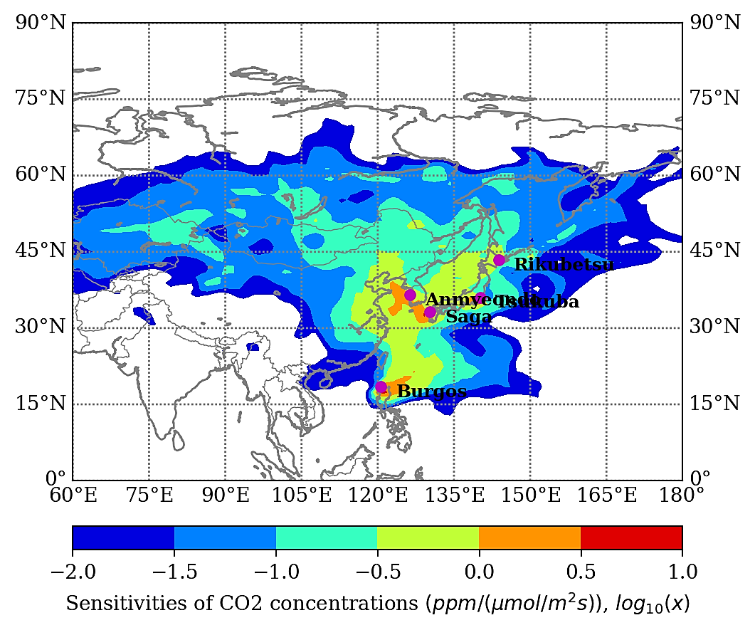
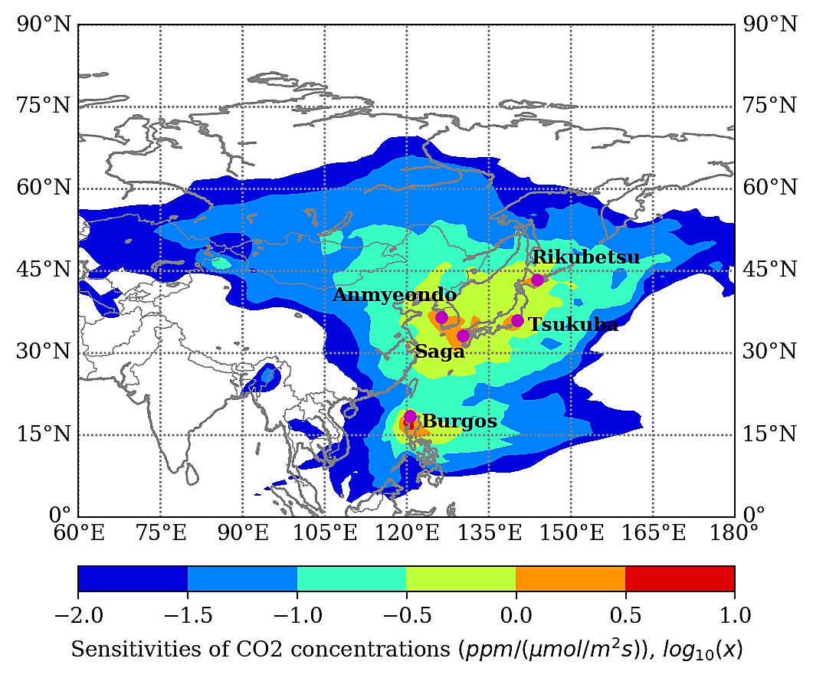
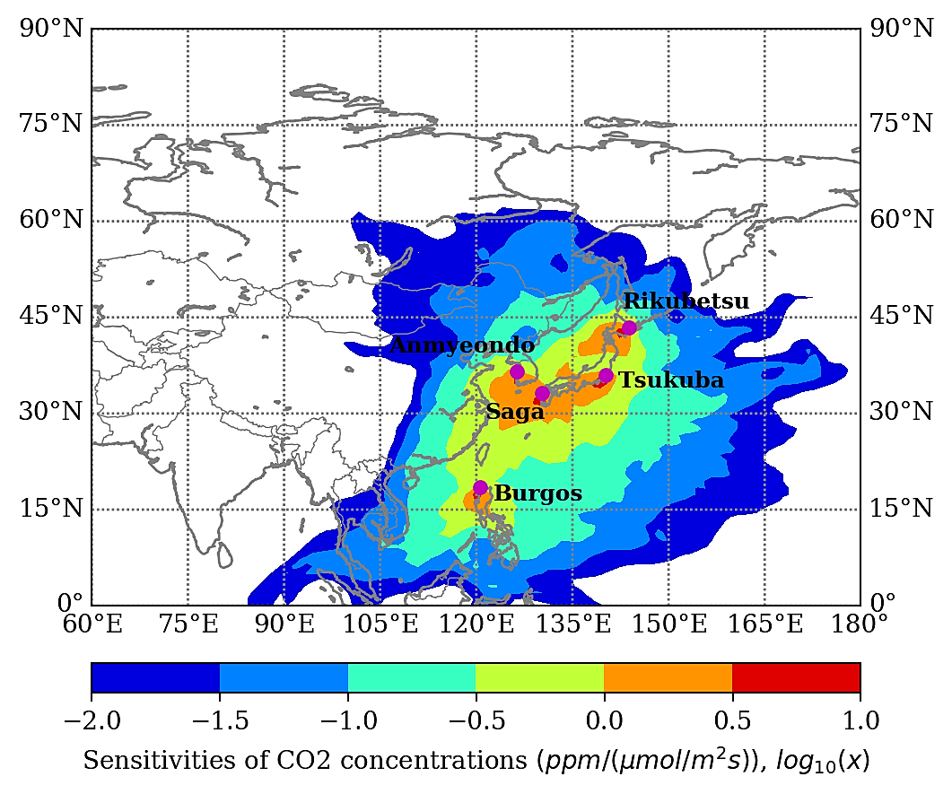
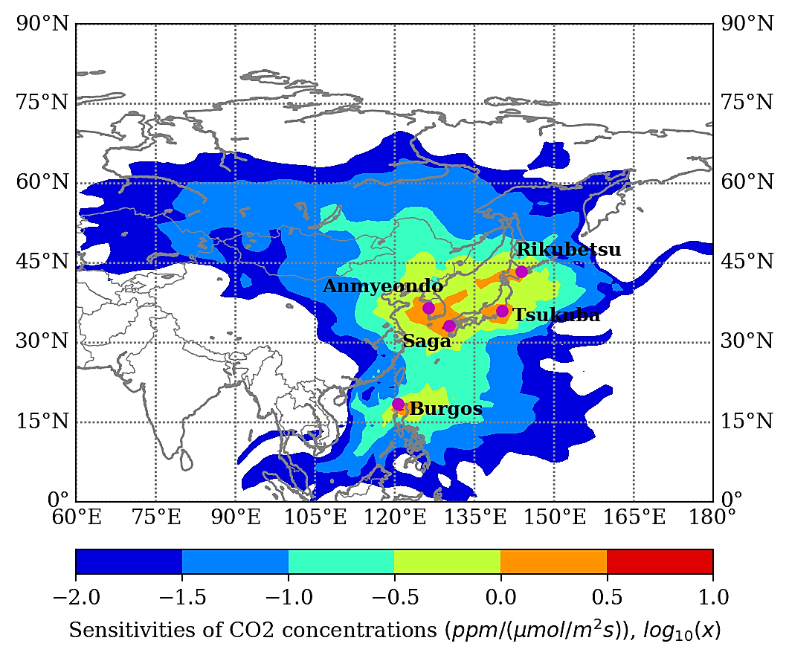
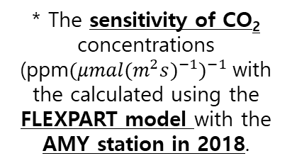
NDACC-IRWG-TCCON-COCCON Annual Meeting 2023
4. Long-term variability characteristics of FTS
※ Seasonal characteristics of AMY.
* The sensitivity of CO₂ concentrations (ppm${({{μmal(m}^{2}s)}^{−1})}^{−1}$with the calculated using the FLEXPART model with the AMY station in 2018.
* The footprints of Asian station mainly span countries bordering the East Sea, i.e. Korea, Japan, the Russian Far East and eastern China. Although the coverage of these station is relatively small, the main industrial centers in the region are included.
DJF (Winter(December – February))
MAM (Spring(March – May))
JJA (Summer(June – August))
SON (Autumn(September – November))
National Institute of Meteorological Sciences, Young-Suk Oh, ysoh306@korea.kr, ysoh306@korea.kr, 2023.06.13.

Slide 8
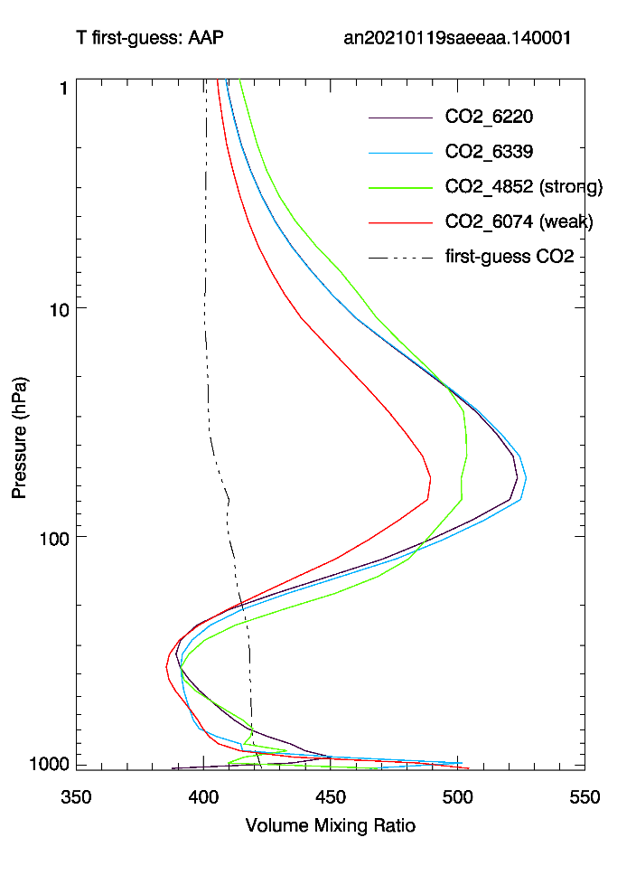
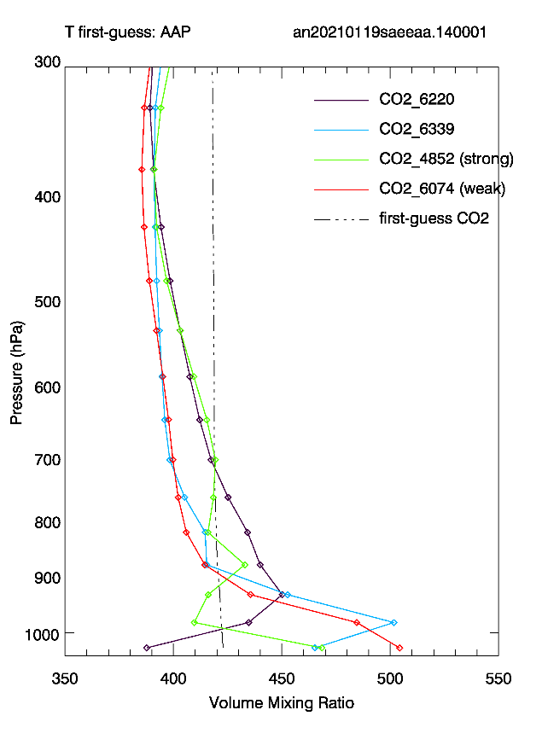
NDACC-IRWG-TCCON-COCCON Annual Meeting 2023
4. Case Research: Altitude characteristics of AMY
CO₂ vertical profile calculation according to wavelength/ channel of AMY.
Two windows with high vertical sensitivity and TCCON1, TCCON2 windows are used.
(TCCON 1: 6220cm⁻¹, TCCON 2: 6339cm⁻¹, Strong: 4852 cm⁻¹, Weak: 6074cm⁻¹)
Differences in the temperature profile of the low layer affect the CO₂ altitude profile .
Therefore, window information that is sensitive to the low layer is required .
* NIMS plans to conduct a campaign to generate additional information. (July- September 2023.)
Participating equipment: FTS, M-FTS, Aircraft, Satellite, Radio zone, Tower, AERI, Lidar, Photometer, Low cost sensor, etc.
National Institute of Meteorological Sciences, Young-Suk Oh, ysoh306@korea.kr, ysoh306@korea.kr, 2023.06.13.

Slide 9
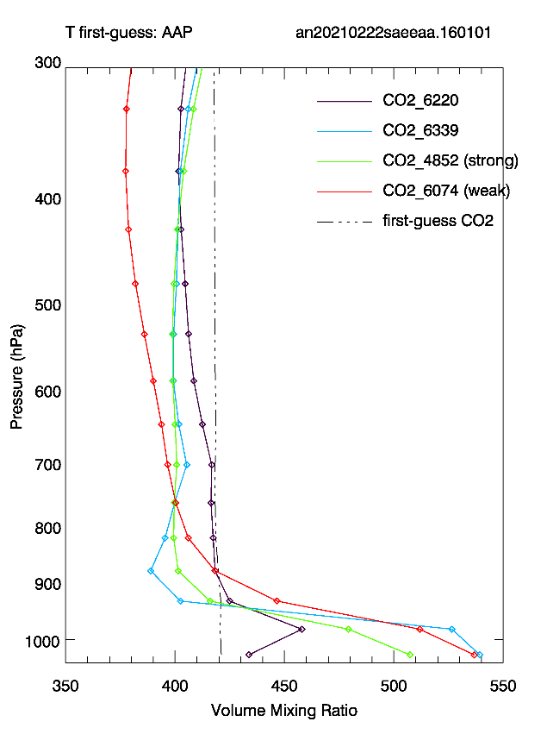
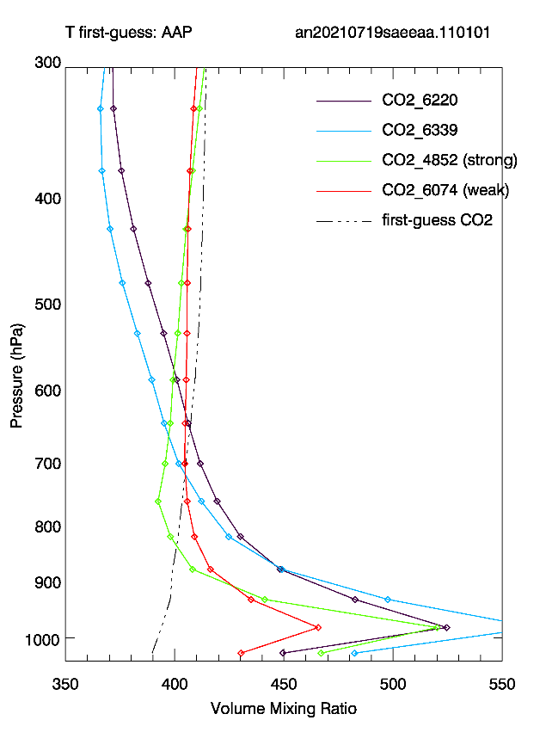
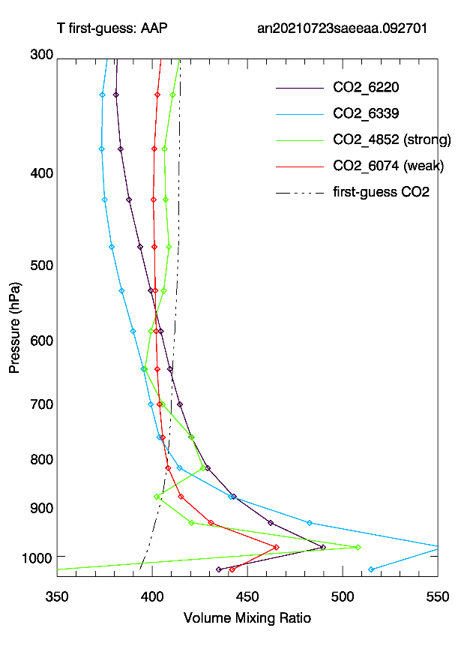
NDACC-IRWG-TCCON-COCCON Annual Meeting 2023
4. Case Research: Altitude characteristics of AMY
(2021.1.10.)
(2021.2.22.)
(2021.7.10.)
(2021.7.23.)
√. Analysis of window characteristics sensitive to height by period and season in AMY. In the future, analysis will be conducted on the entire data from 2022 to 2023, and CH₄ will also be added.
As the analysis data, the channel/ wavelength sensitive to the low layer was identified as a strong window(4852 cm⁻¹).
National Institute of Meteorological Sciences, Young-Suk Oh, ysoh306@korea.kr, ysoh306@korea.kr, 2023.06.13.

Slide 10
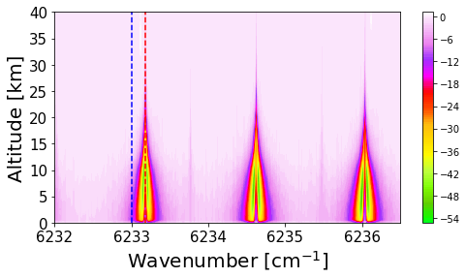
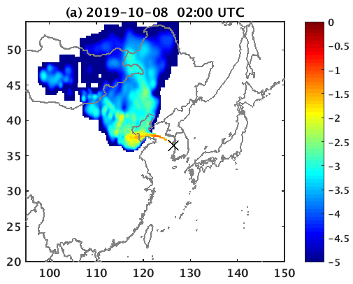
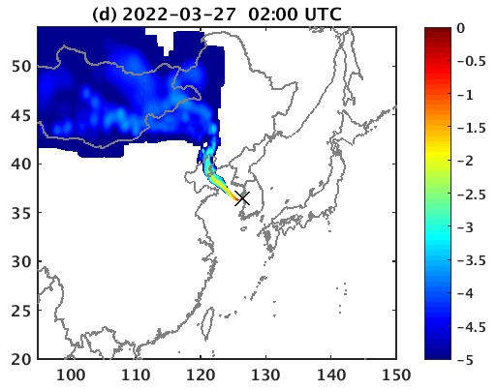
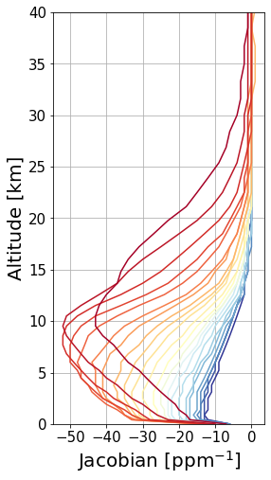
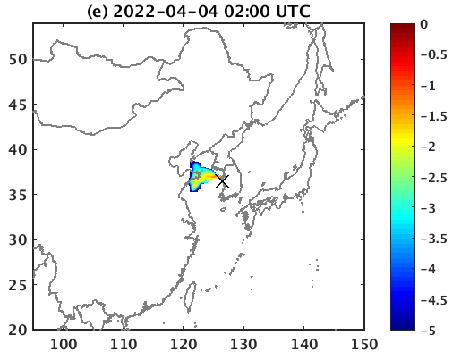
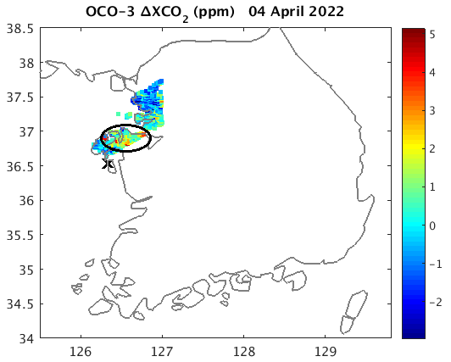
NDACC-IRWG-TCCON-COCCON Annual Meeting 2023
4. Case Research: Source tracking characteristics of AMY
Source tracking analysis using Footprint (STILT model): Altitude: 5km, Time: 11 am, KST)
* The peak is distributed at an altitude of 3 to 10km in the form of complex Jacobion. (11 a.m., KST.)
Comparative analysis of footprint results and satellite information on April 4.
( affects the area near AMY)
=ΔTransmittance/ΔX_{CO2}
National Institute of Meteorological Sciences, Young-Suk Oh, ysoh306@korea.kr, ysoh306@korea.kr, 2023.06.13.

Slide 11


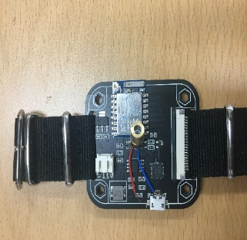
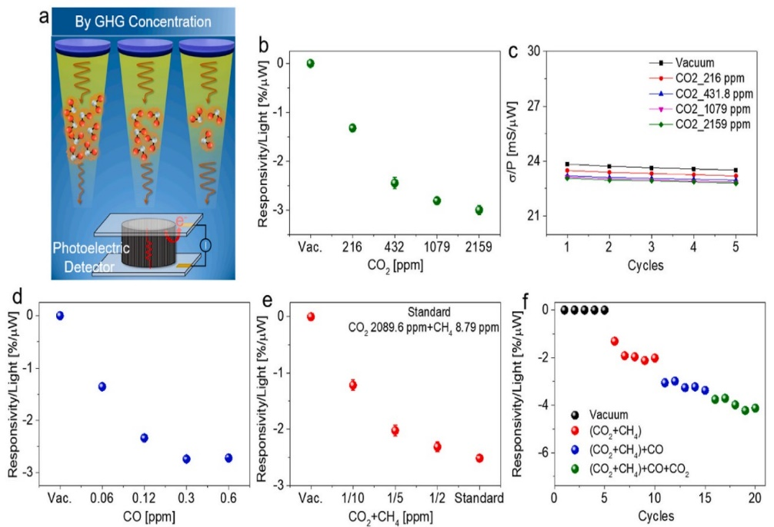
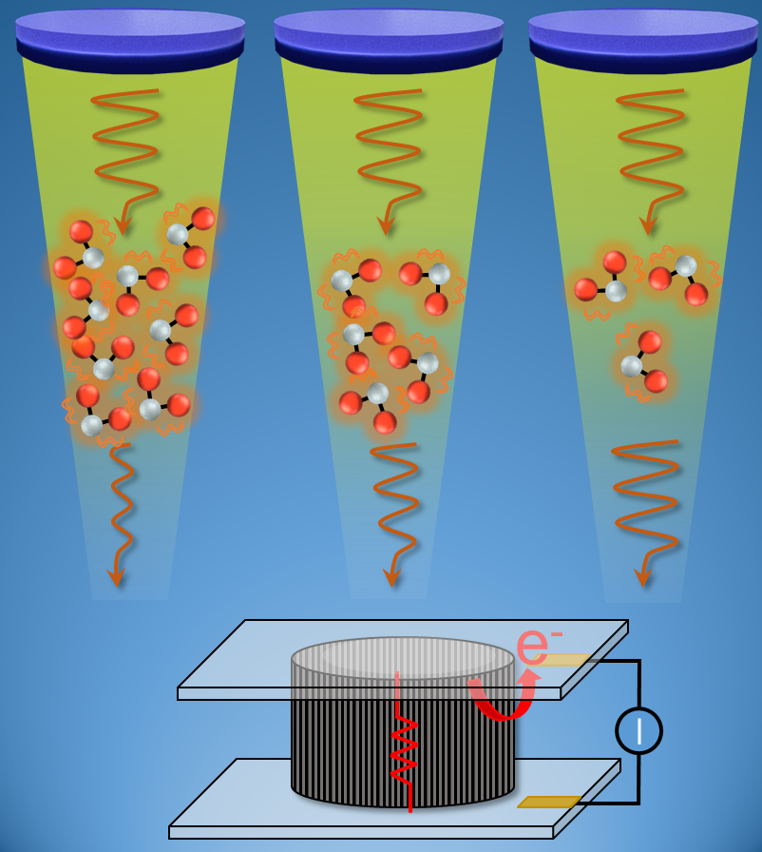
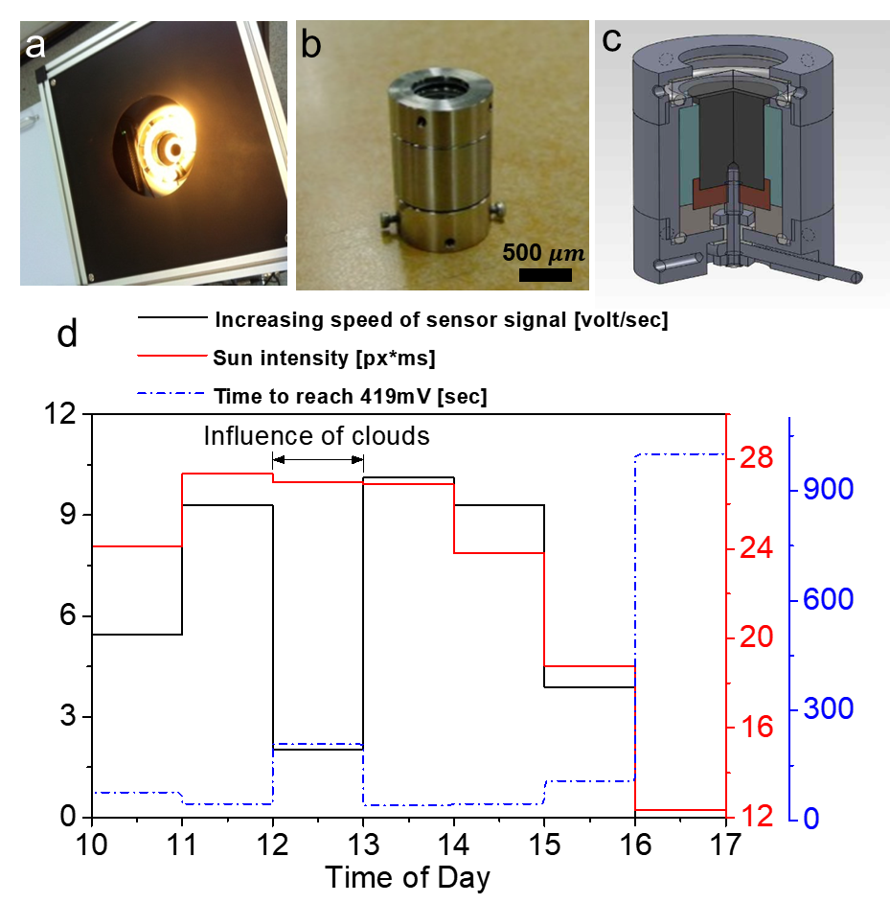


NDACC-IRWG-TCCON-COCCON Annual Meeting 2023
5. Non-contact, Low-cost GHG Sensor (Graphene-Based)
Sun Source
* GHG measurements of Graphene Photoelectric – Based Detector
* Detection Methods: The graphene photocurrent generated by the light passing through the GHG layer is reduced compared to the photocurrent generated by the light passing through the vacuum layer without the GHG.
N₂O
CH₄
(ref: Nano Letters, Young-Suk Oh at al. 2022.6.20.)
CO
HDO
CO₂
Distance
* By measuring the amount of change in the reduced photocurrent, it becomes possible to detect GHGs.
H₂O
GHG
HF
$$E_{ad}≈{∆E}_{electric}$$
$E_{ad}:$ The light energy absorbed by the GHGs
${∆E}_{electric}:$ The photocurrent of the graphene detector
Photoelectric
Detector
Responsivity according to the concentration of GHG
National Institute of Meteorological Sciences, Young-Suk Oh, ysoh306@korea.kr, ysoh306@korea.kr, 2023.06.13.

Slide 12
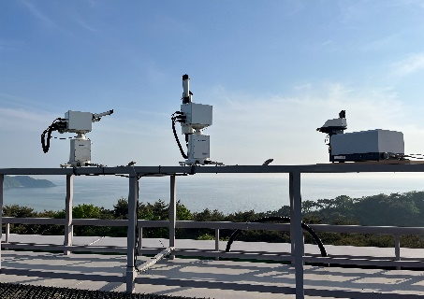
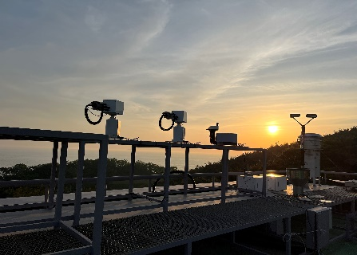
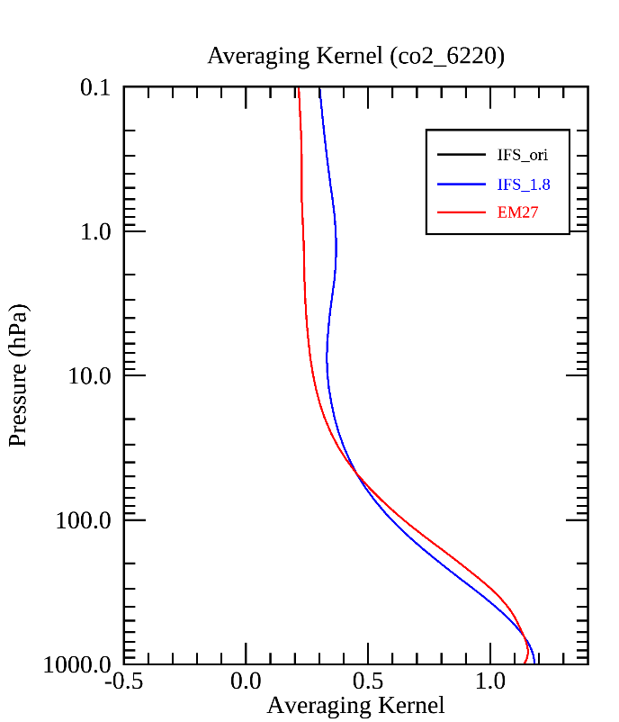
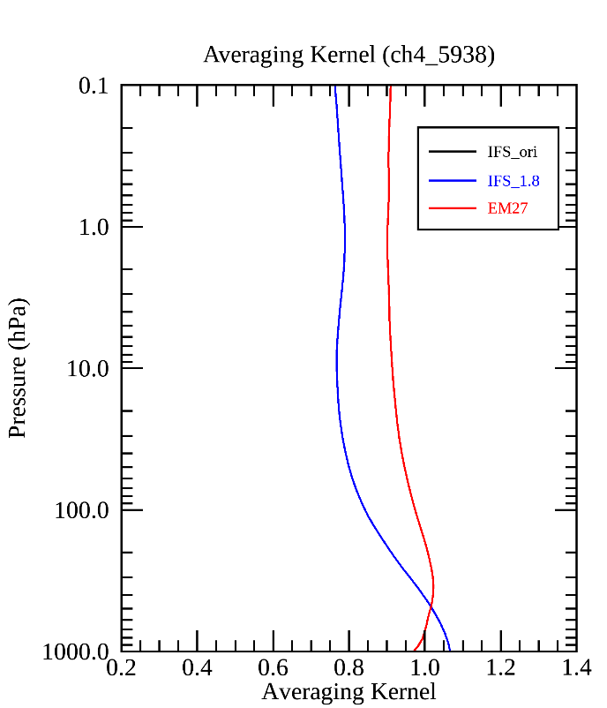
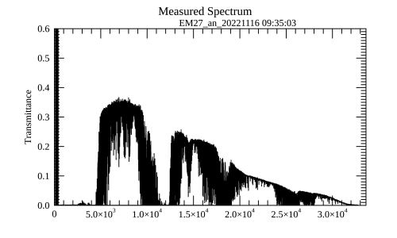
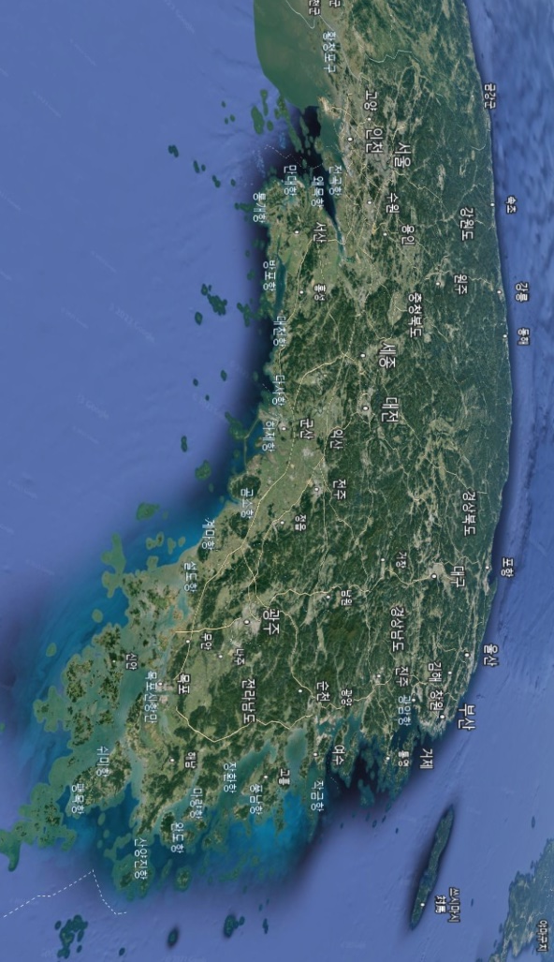
NDACC-IRWG-TCCON-COCCON Annual Meeting 2023
6. EM27/SUN equipment validation and operation.
* Preparing for EM27 operation and designation of COCCON stations.
Ewha University station in Seoul
AMY station in GAW
We will prepare for EM27 operation and COCCON station designation.
Therefor, research is underway to verify the operated data.
* Designation of COCCON station in Korea
National Institute of Meteorological Sciences, Young-Suk Oh, ysoh306@korea.kr, ysoh306@korea.kr, 2023.06.13.

Slide 13
NDACC-IRWG-TCCON-COCCON Annual Meeting 2023
7. Conclusion
1. The conclusion is as follows. Our AMY station is operating from 2014 to the present in 2023, and the observation data analyzes the characteristics of GHG fluctuations.
2. Our AMY station is producing data using both GGG2014 and GGG2020, and is researching climate change characteristics with the production data.
3. We are analyzing three characteristics of climate change. GHG sensitivity, concentration distribution by altitude, source tracking.
4. We are also conducting research in new fields. The studies are “Low-cost sensor” and “EM27/SUN”. A daemon version of that sensor was built. And EM27 has started operating and is pushing to join COCCON.
We always welcome your participation in research.
National Institute of Meteorological Sciences, Young-Suk Oh, ysoh306@korea.kr, ysoh306@korea.kr, 2023.06.13.

Slide 14
NDACC-IRWG-TCCON-COCCON Annual Meeting 2023
We always welcome your participation in research.
Thank You.
National Institute of Meteorological Sciences, Young-Suk Oh, ysoh306@korea.kr, ysoh306@korea.kr, 2023.06.13.
Acknowledgment: This work was funded by the Korea Meteorological Administration Research and Development Program under grant KMA2018-00522 and KMI2022-01610
National Institute of Meteorological Sciences, Young-Suk Oh, ysoh306@korea.kr, ysoh306@korea.kr, 2023.06.13.

Slide 15
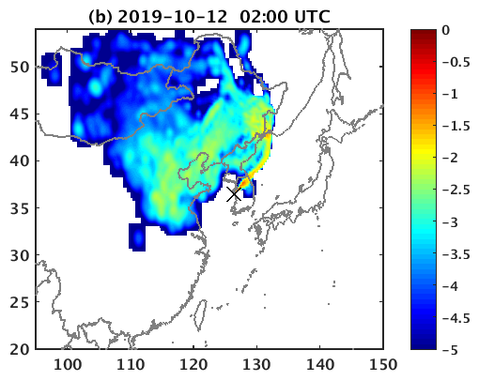
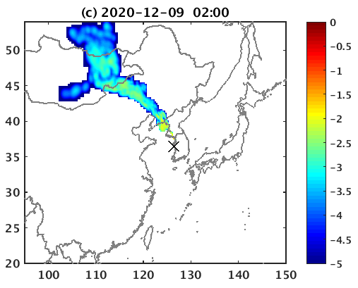
Here are the footprint distributions for AMY site (Figure 1), which were considered a 5-day backward time to look at the source influence regions. Unit for footprint is given in log₁₀ (ppm/µmol m⁻² s⁻¹).
National Institute of Meteorological Sciences, Young-Suk Oh, ysoh306@korea.kr, ysoh306@korea.kr, 2023.06.13.

Slide 16
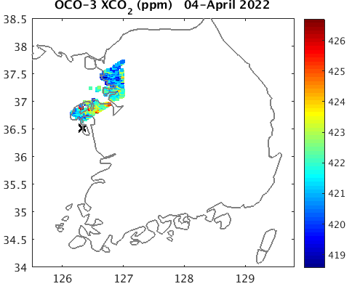
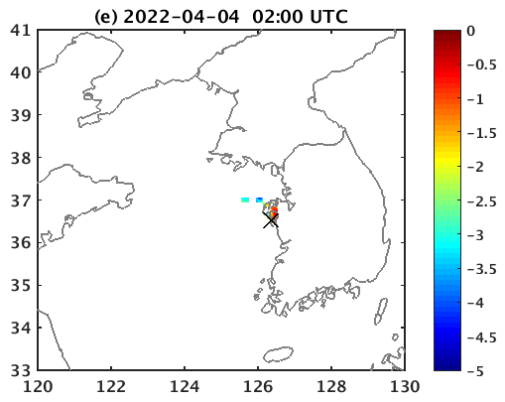
Figure 2. OCO-2 XCO₂ (ppm) (left panel) and ∆XCO2 = XCO2-mean(XCO2) (right panel). The marked one by circle is a Taean power plant?
Figure 3. Footprint distribution at AMY. It is considered 12-hour backward time. Unit for footprint is given in log₁₀ (ppm/µmol m⁻² s⁻¹).
National Institute of Meteorological Sciences, Young-Suk Oh, ysoh306@korea.kr, ysoh306@korea.kr, 2023.06.13.

Slide 17
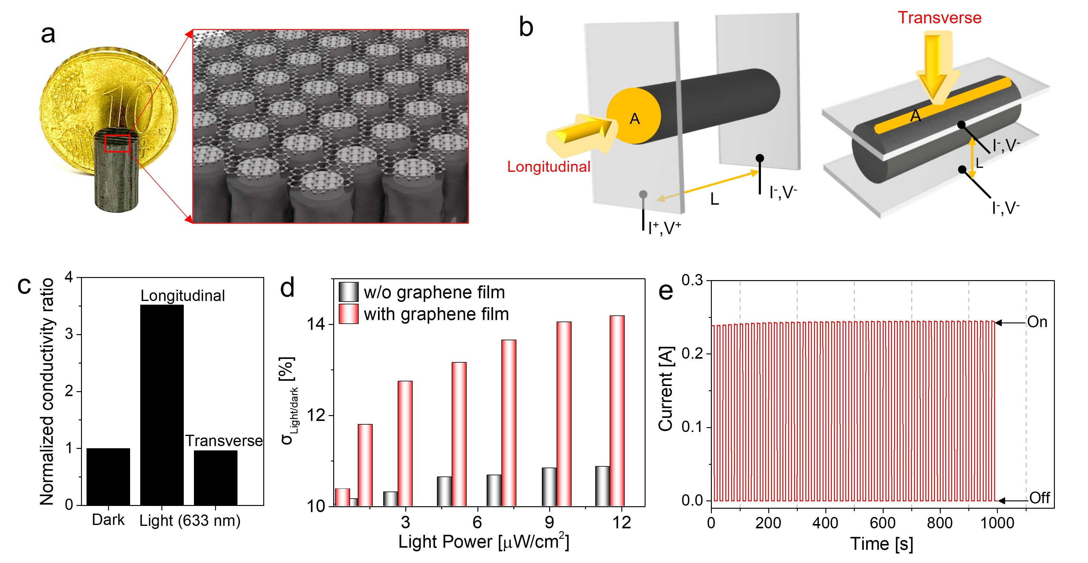
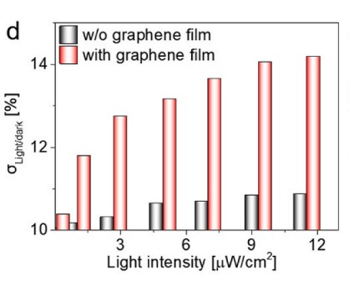
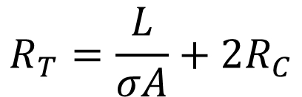
$$R_{T}=\frac{L}{σA}+2R_{C}$$
$R_{T}$: total resistance, $σ$: electrical conductivity, L: graphene rod length
A: contact area, $R_{C}$: contact resistance
Of some interest, this structure showed an interesting potential for infrared optical light absorption.
Electrical conductivity in the graphene sheet-stacked device increased as light intensity increased.
The photo-induced detection stability of our GHG photoelectric device was confirmed by generating a constant photocurrent at a constant applied voltage (5 V of for on) over several tens of cycles.
National Institute of Meteorological Sciences, Young-Suk Oh, ysoh306@korea.kr, ysoh306@korea.kr, 2023.06.13.

Slide 18
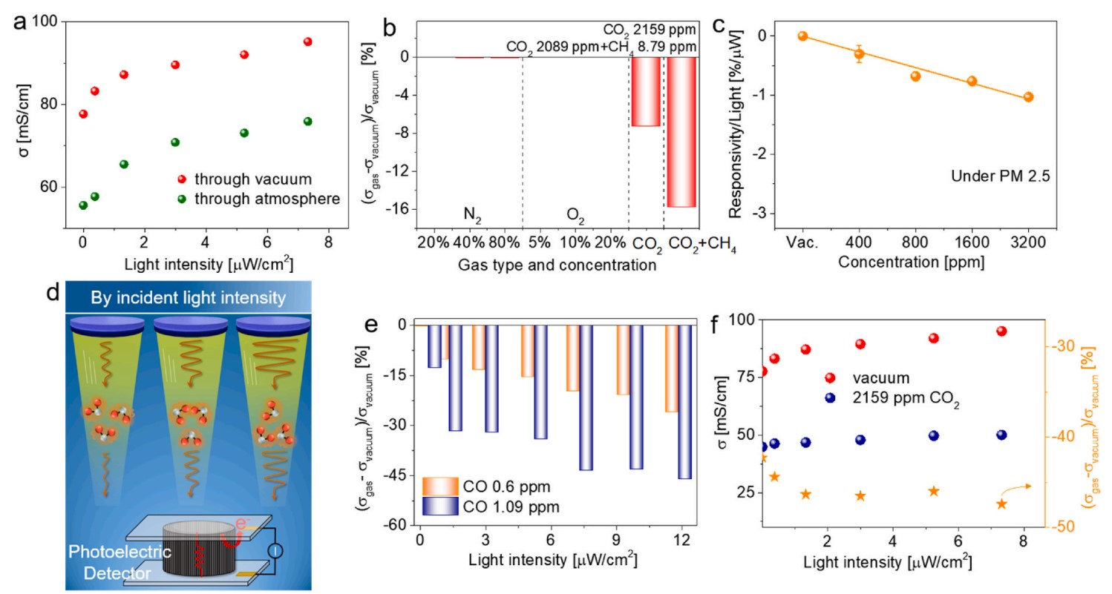
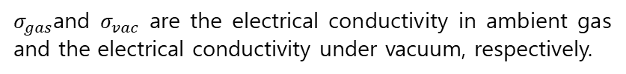
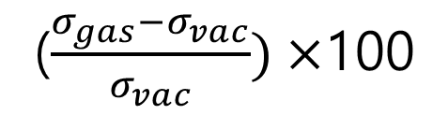
The correlation between generating a photocurrent proportional to the number of photons when the light intensity incident on graphene surfaces, after passing through CO and CO₂ media, at a given time, increases.
This characteristic of the GHGs provides clear evidence that a fraction of the incident light energy is absorbed in the from of heat energy by the GHG media.
($\frac{σ_{gas}−σ_{vac}}{σ_{vac}})×$100
$σ_{gas}$and $σ_{vac}$ are the electrical conductivity in ambient gas and the electrical conductivity under vacuum, respectively.
National Institute of Meteorological Sciences, Young-Suk Oh, ysoh306@korea.kr, ysoh306@korea.kr, 2023.06.13.

Slide 19
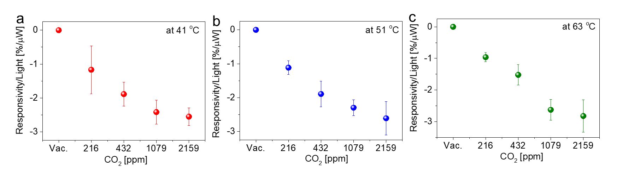
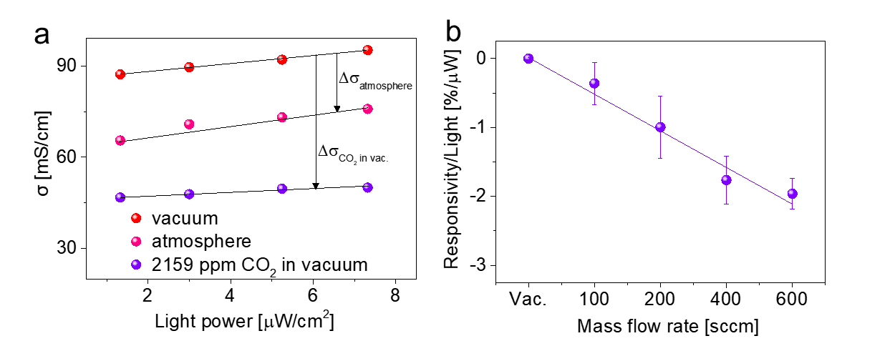
Since the change in the resistance of the element according to temperature is reflected in the electrical conductivity of a vacuum, the change in conductivity according to temperature is not considered in the responsivity calculation when detecting GHGs.
It should be emphasized that this GHG detection device is not affected by temperature.
Photoelectric conductivity of the graphene detector via light passing through a carbon dioxide medium in a vacuum and the atmosphere.
The change in electrical conductivity with respect to mass flow is not considered because it is insignificant.
National Institute of Meteorological Sciences, Young-Suk Oh, ysoh306@korea.kr, ysoh306@korea.kr, 2023.06.13.

Slide 20
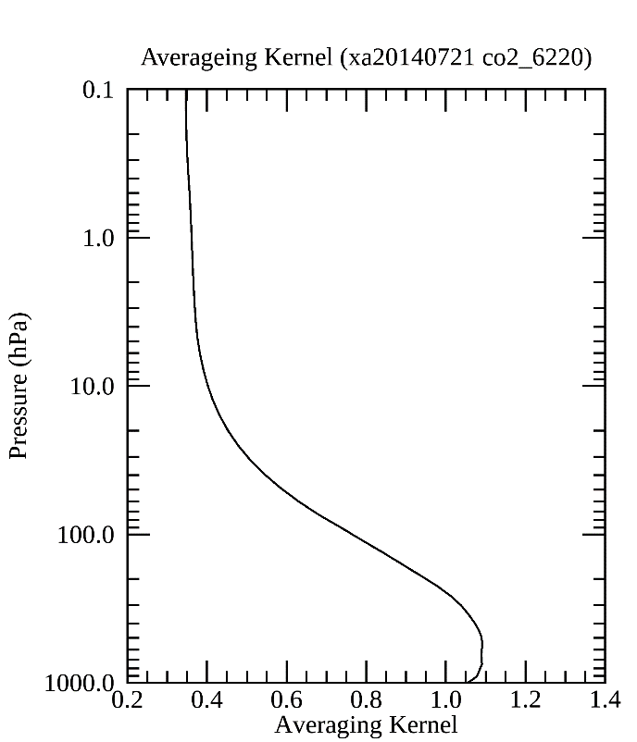



CO2
CH4
National Institute of Meteorological Sciences, Young-Suk Oh, ysoh306@korea.kr, ysoh306@korea.kr, 2023.06.13.

Slide 21




CO2
Residuals (Measured – Simulated)
CH4
National Institute of Meteorological Sciences, Young-Suk Oh, ysoh306@korea.kr, ysoh306@korea.kr, 2023.06.13.

