Slide 1
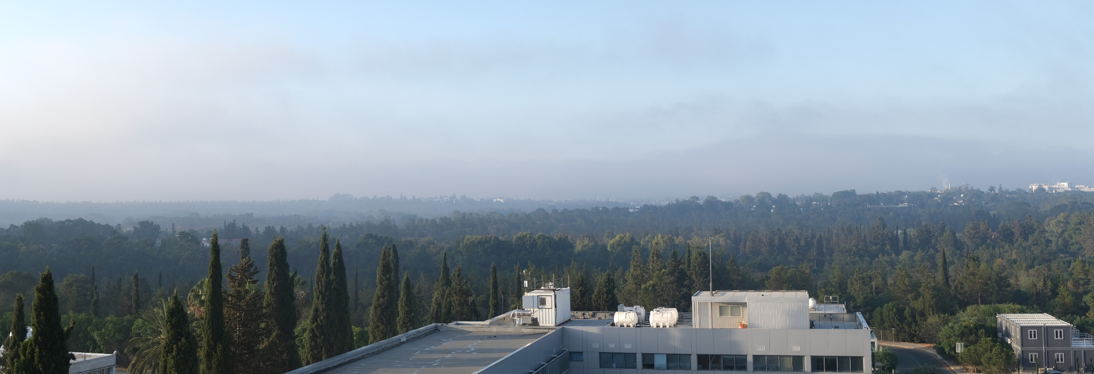



TCCON Nicosia Update
Rousogenous C.¹, Petri C.², Quéhé P.Y.¹, Desservettaz M.¹, Warneke T.²,
Laemmel Th.^{3,4}, Ramonet M.³, Notholt J.², Paris J-D.^{1,3}, Vrekoussis M.^{1,2}, Sciare J.¹
¹: Climate and Atmosphere Research Centre (CARE-C), The Cyprus Institute (CyI), Cyprus
^{2:} Institute of Environmental Physics, IUP, University of Bremen, Germany
³: LSCE/IPSL, CEA-CNRS-UVSQ, Université Paris Saclay, Gif-sur-Yvette, France
⁴:Now at Department of Chemistry, Biochemistry and Pharmaceutical Sciences, University of Bern, Switzerland

Slide 2
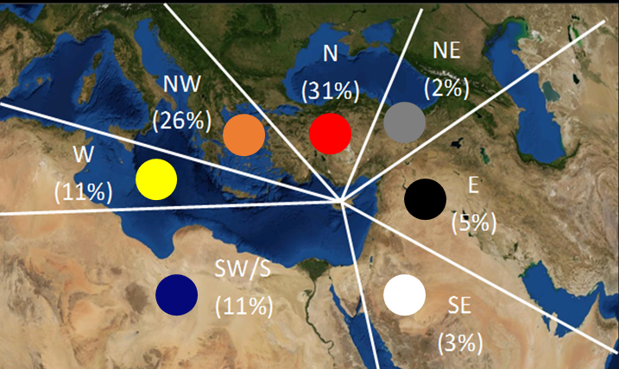
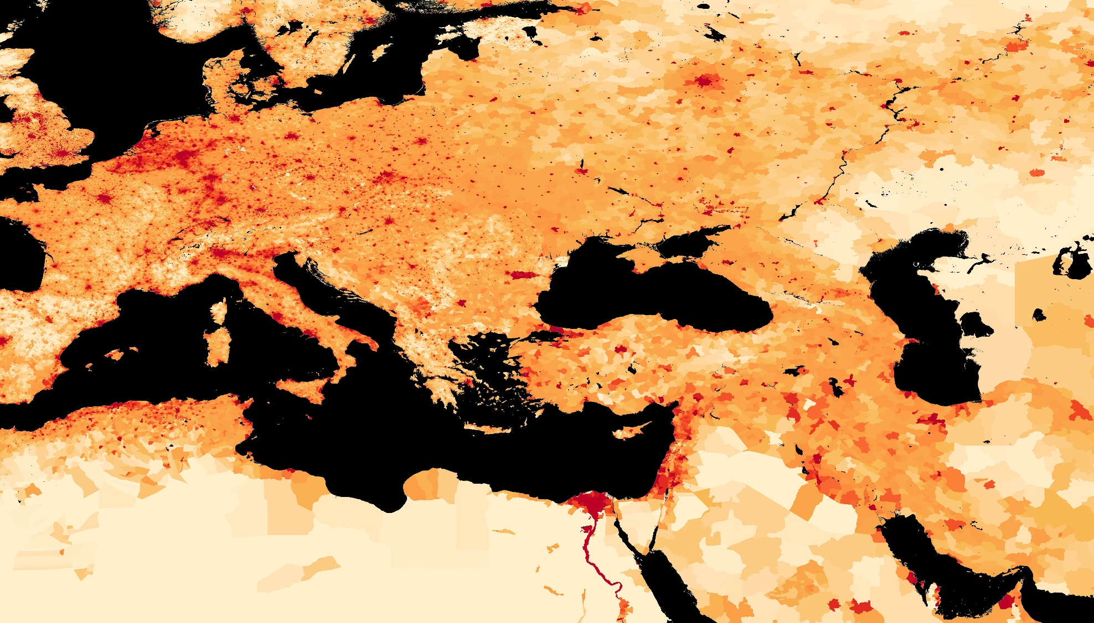
Regional Boundary Layer
Air Masses in Cyprus & Seasonal Variability
Outflow
Western Europe
Outflow
Eastern Europe
+ Turkey
Credit: M. Vrekoussis
Source: Kleanthous et al., 2014
Clean
maritime air
Outflow
Middle East
Source: Center for International Earth Science Information Network - CIESIN - Columbia University. 2016. Gridded Population of the World, Version 4 (GPWv4): Population Count Adjusted to Match 2015 Revision of UN WPP Country Totals. Palisades, NY: NASA Socioeconomic Data and Applications Center (SEDAC). https://doi.org/10.7927/H4SF2T42. Access date: May 2021

Slide 3
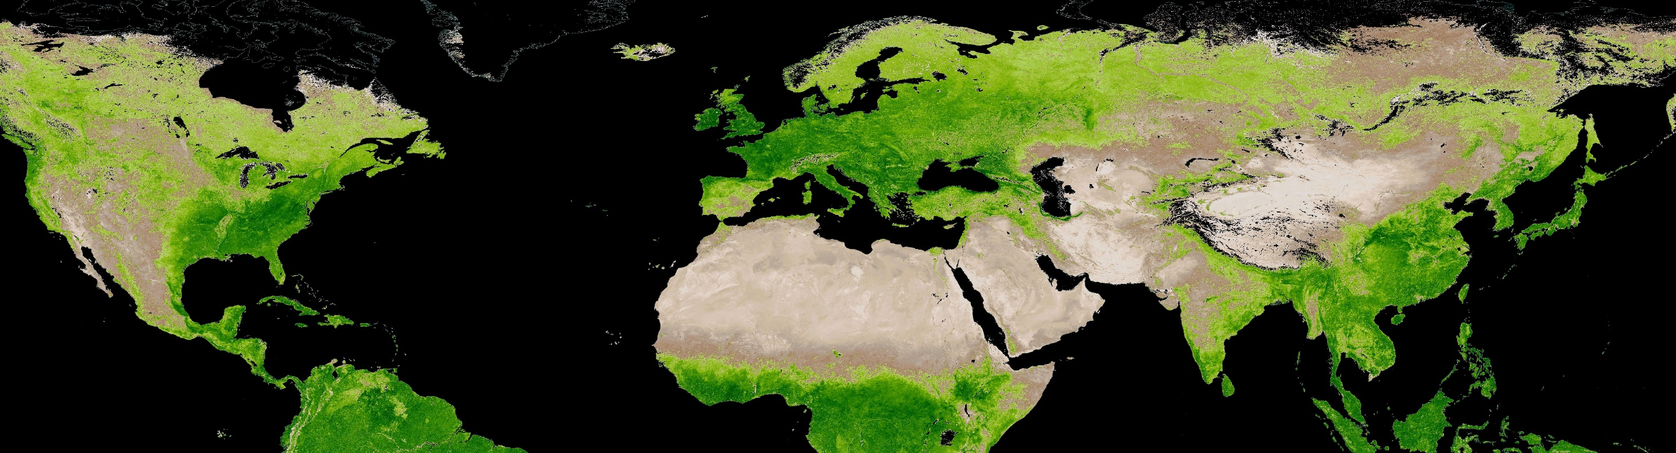
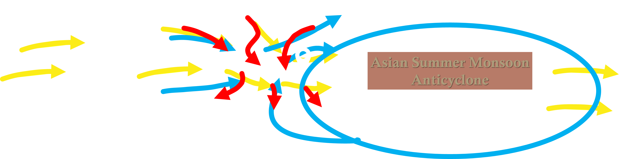

Air Masses Over Cyprus
Boundary Layer
Mid Troposphere
Upper Troposphere
Enhanced Vegetation Index (L3, Monthly), May 2023
References: MYD13A3 doi:10.5067/MODIS/MYD13A3.061
Inspiration: Lelieveld et al., 2002

Slide 4
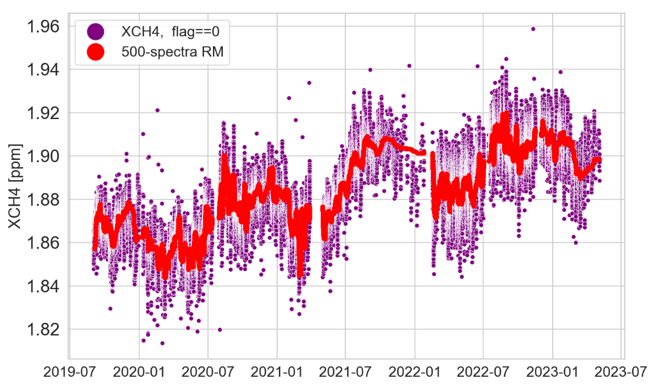
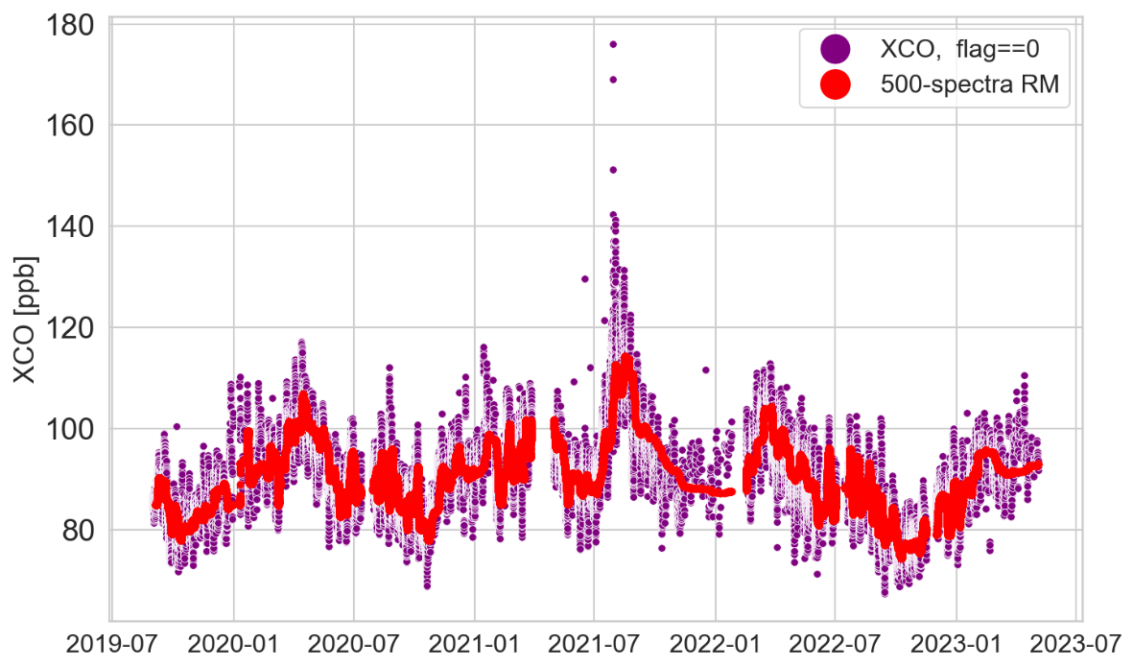
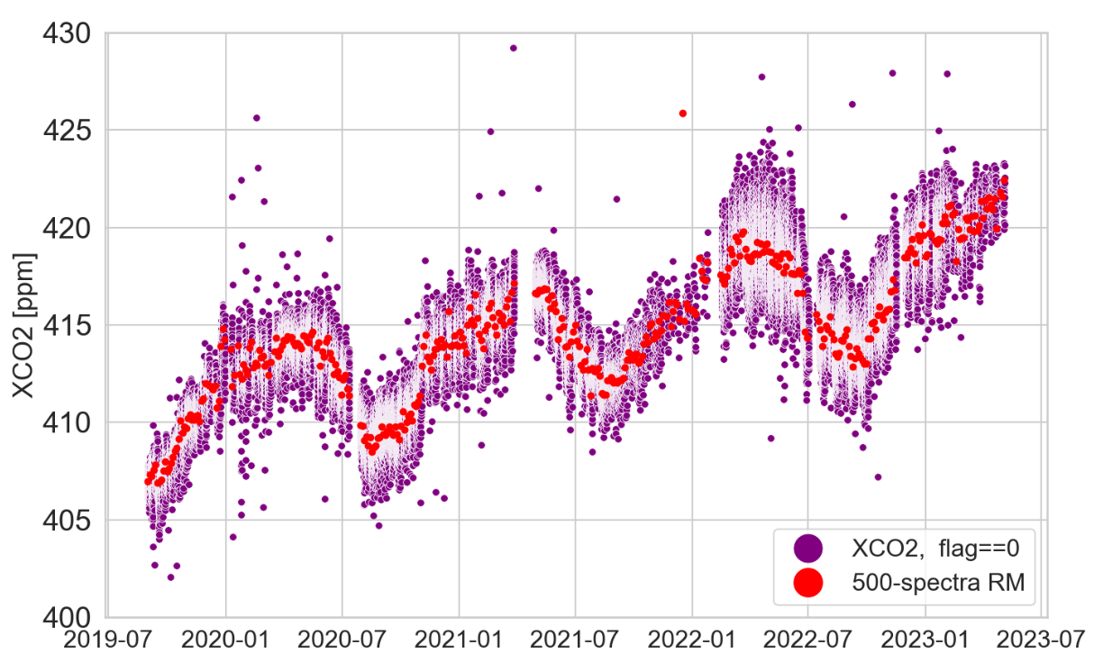
Xgases Time Series of Nicosia
Rousogenous et al. (in preparation)

Slide 5
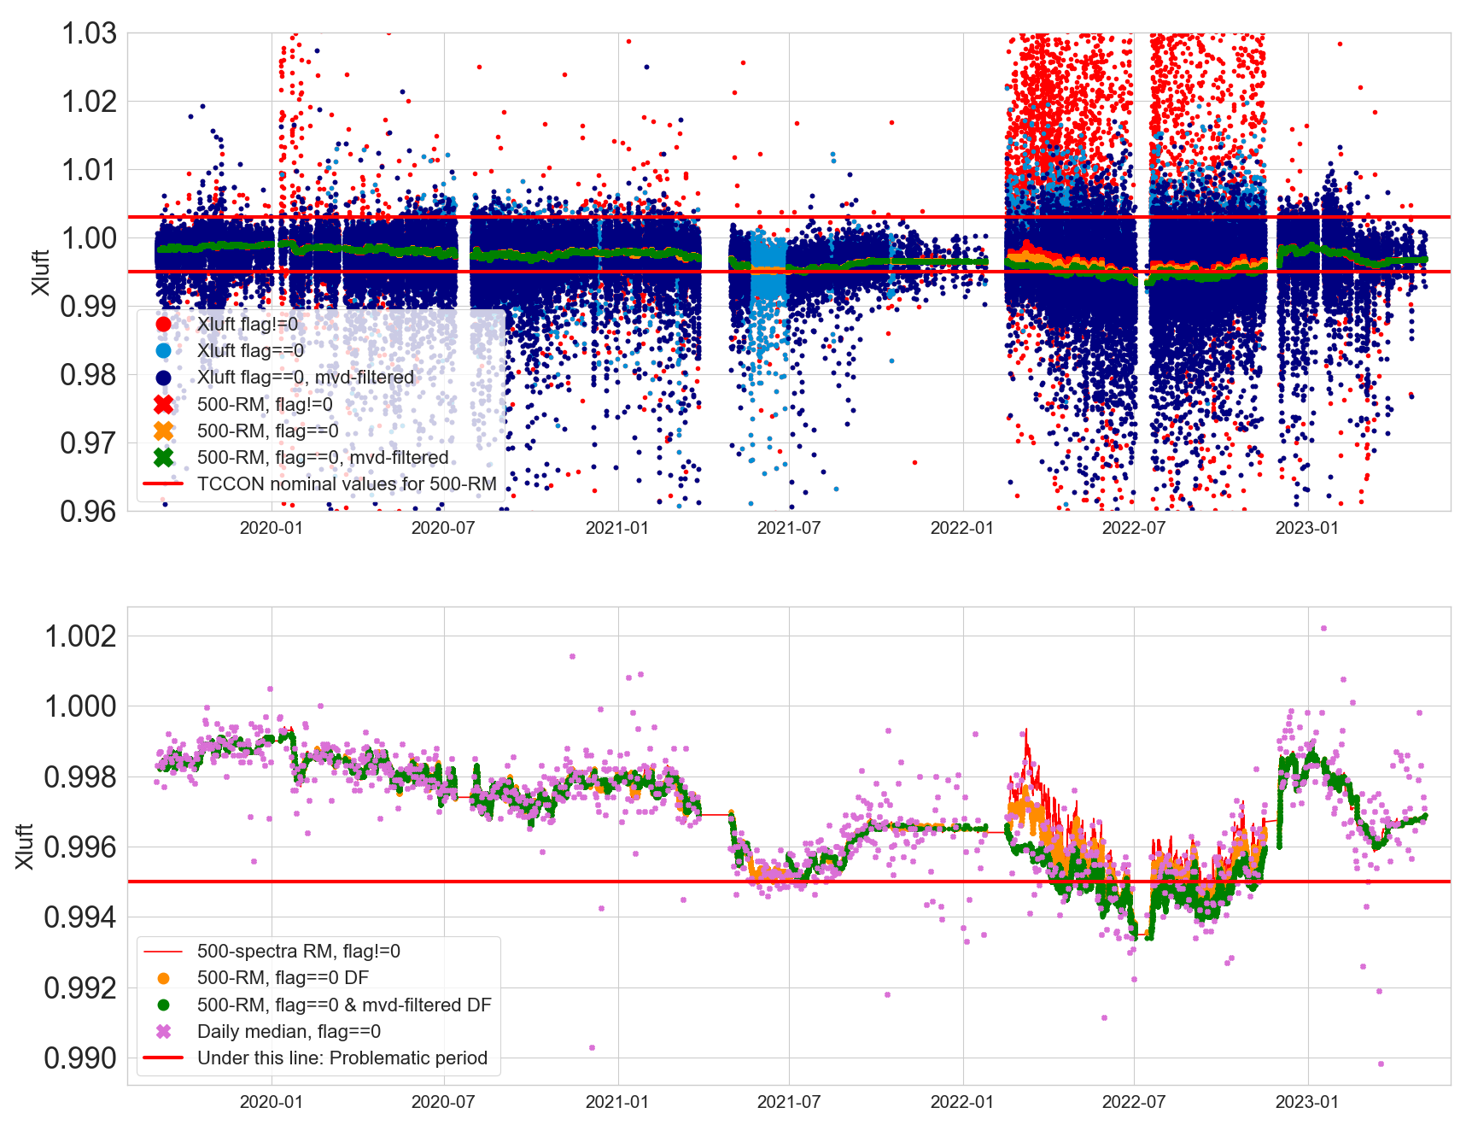
Xluft Time Series of Nicosia
AirCore
Laser Broke ☹

Slide 6
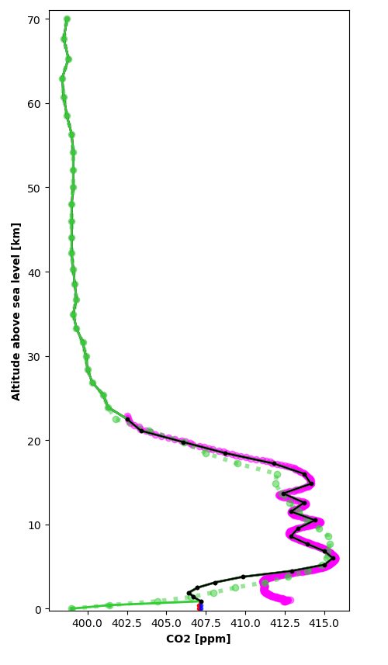
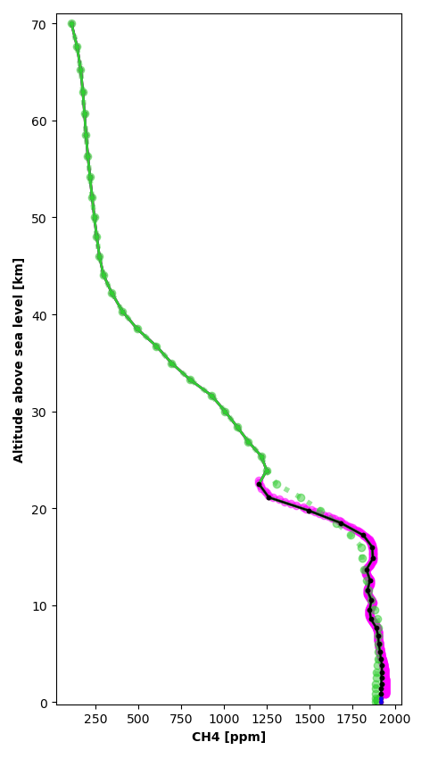
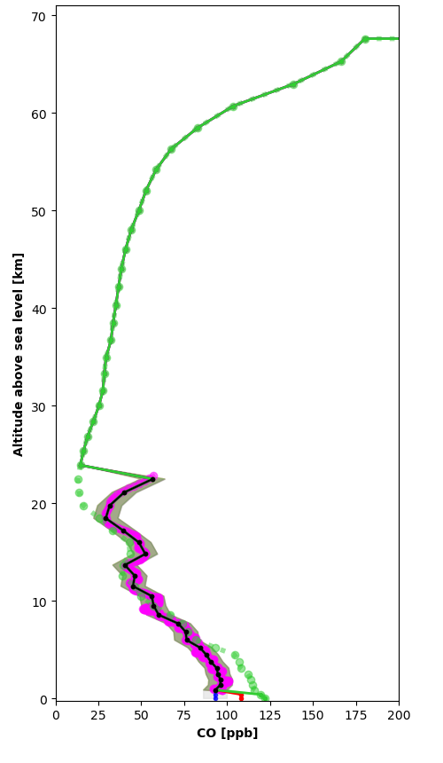
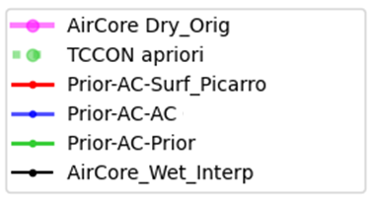
AirCores Nicosia June 19, 2020

Slide 7
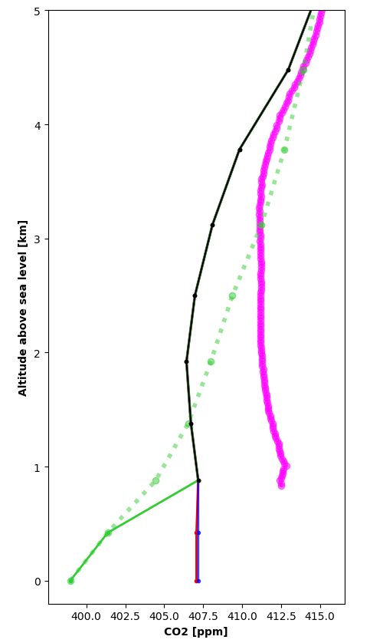
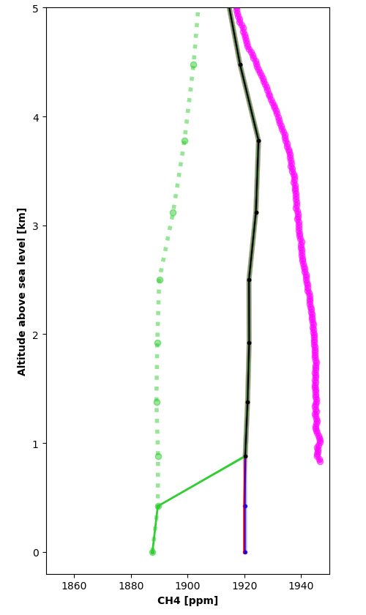
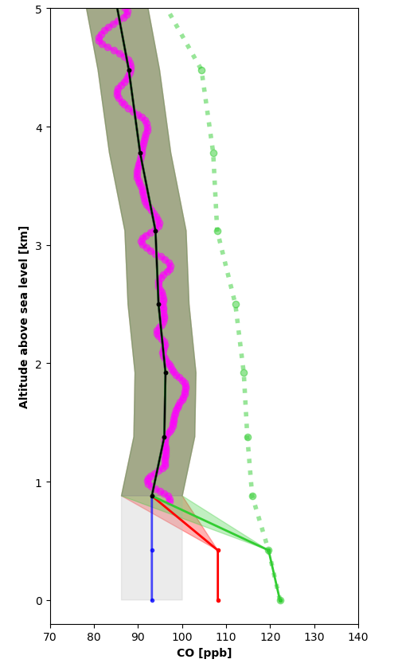
AirCores Nicosia June 19, 2020

Slide 8
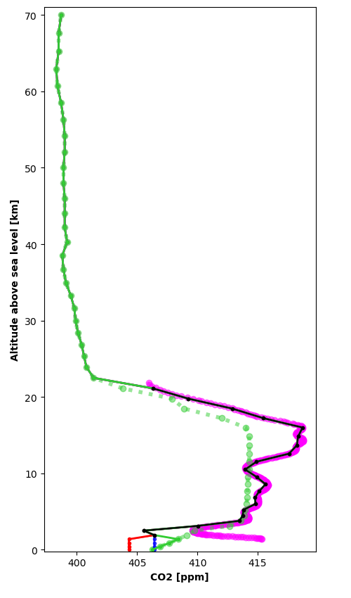
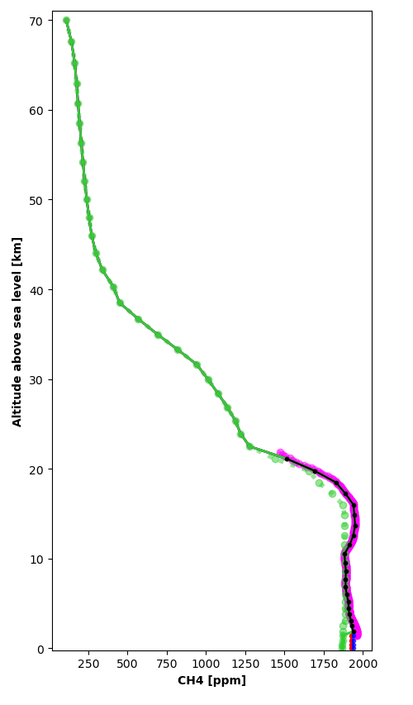
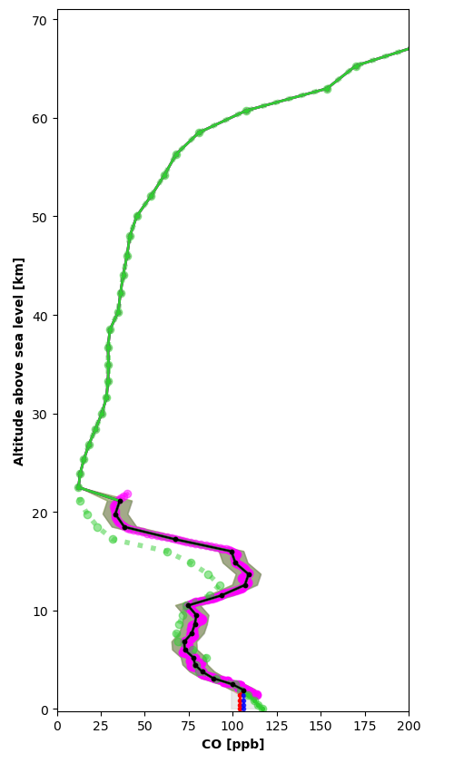
AirCores Nicosia June 29, 2020

Slide 9
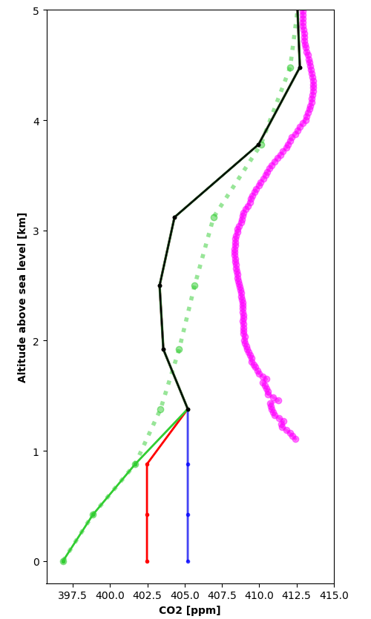
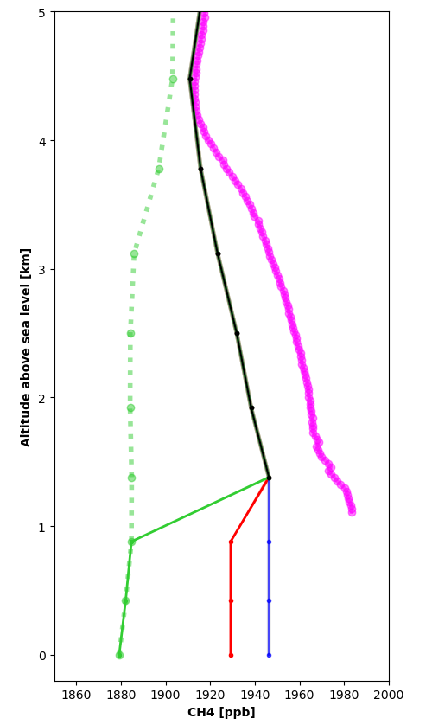
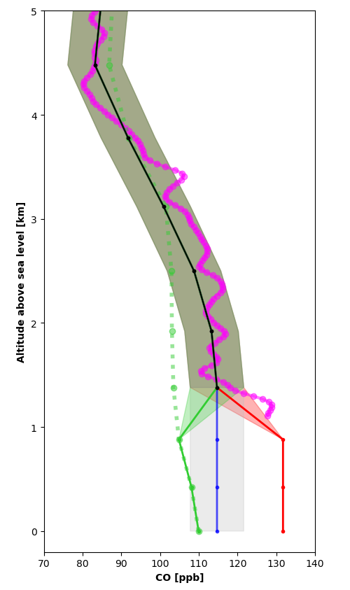
AirCores Nicosia June 30, 2020

Slide 10
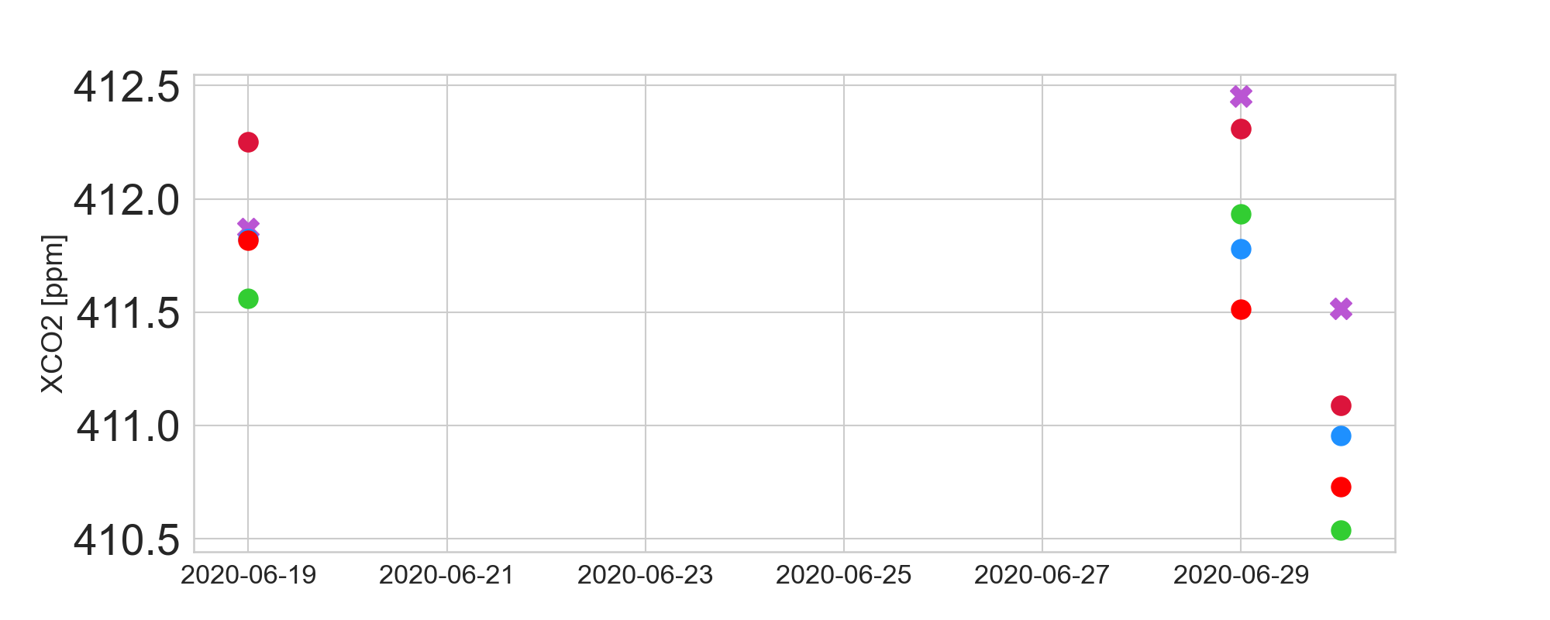
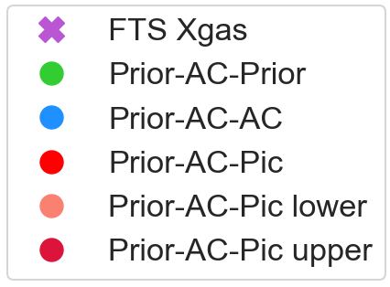
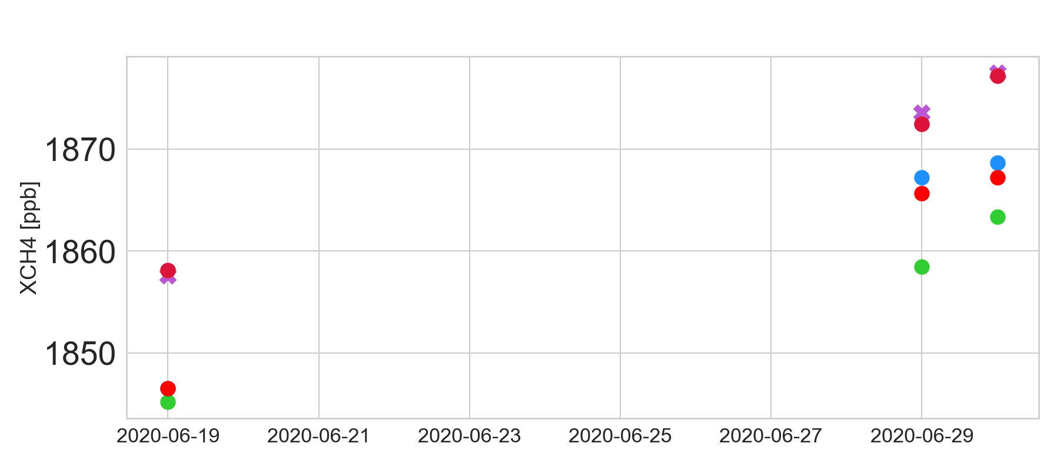
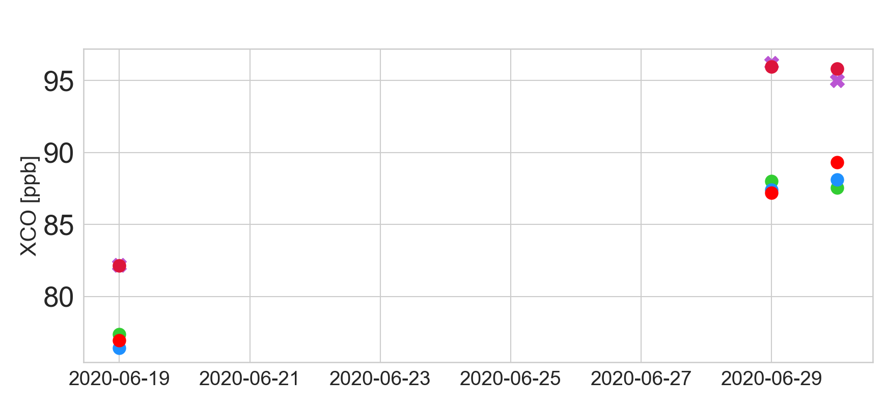
AirCores Comparison & Sensitivity to bottom: Preliminary (!)

Slide 11
Conclusions
Nicosia is the first TCCON In the Region (EMME)
Bridge Between Europe & Middle East
Very high data coverage
AirCores in June 2020
AirCores’ Comparison quantities tested for sensitivity w.r.t. the lower profile patch.

Slide 12
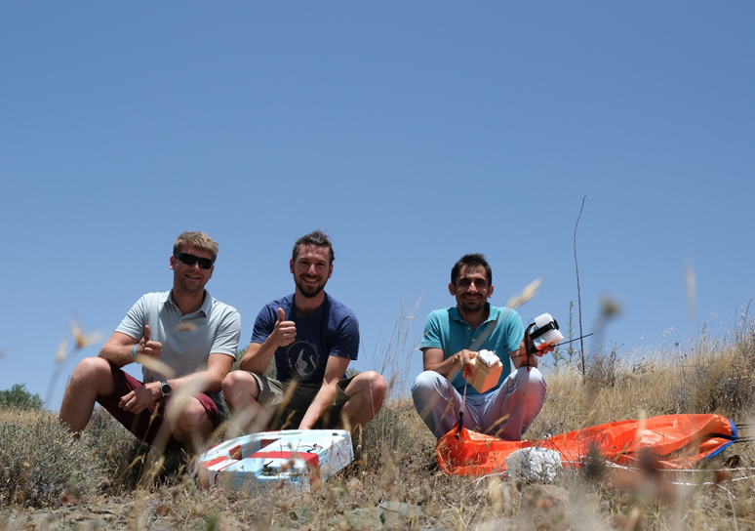
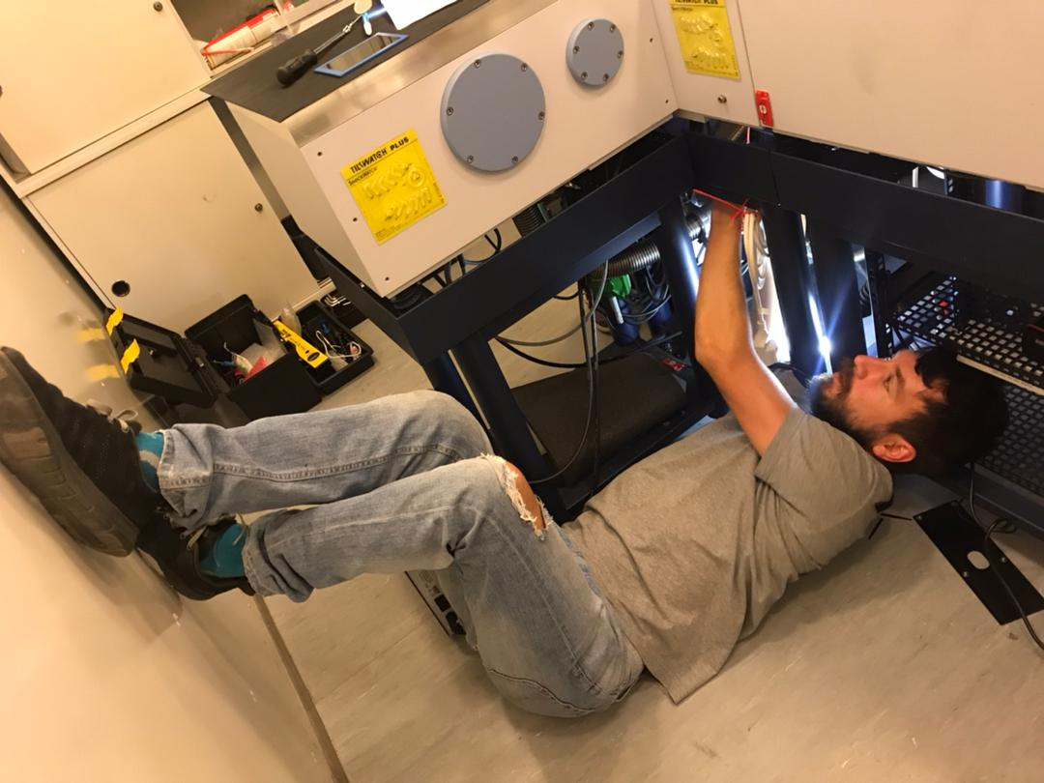
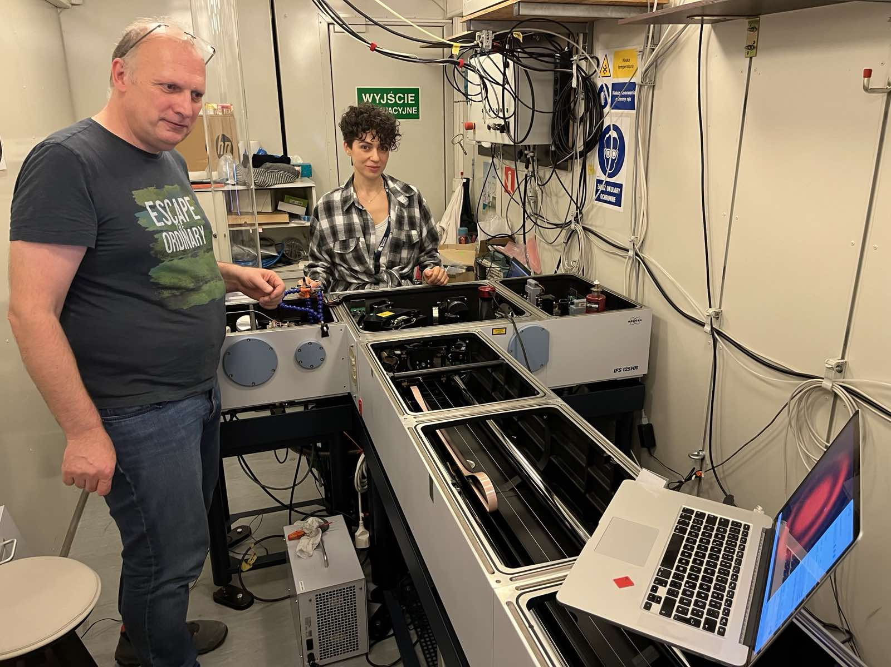
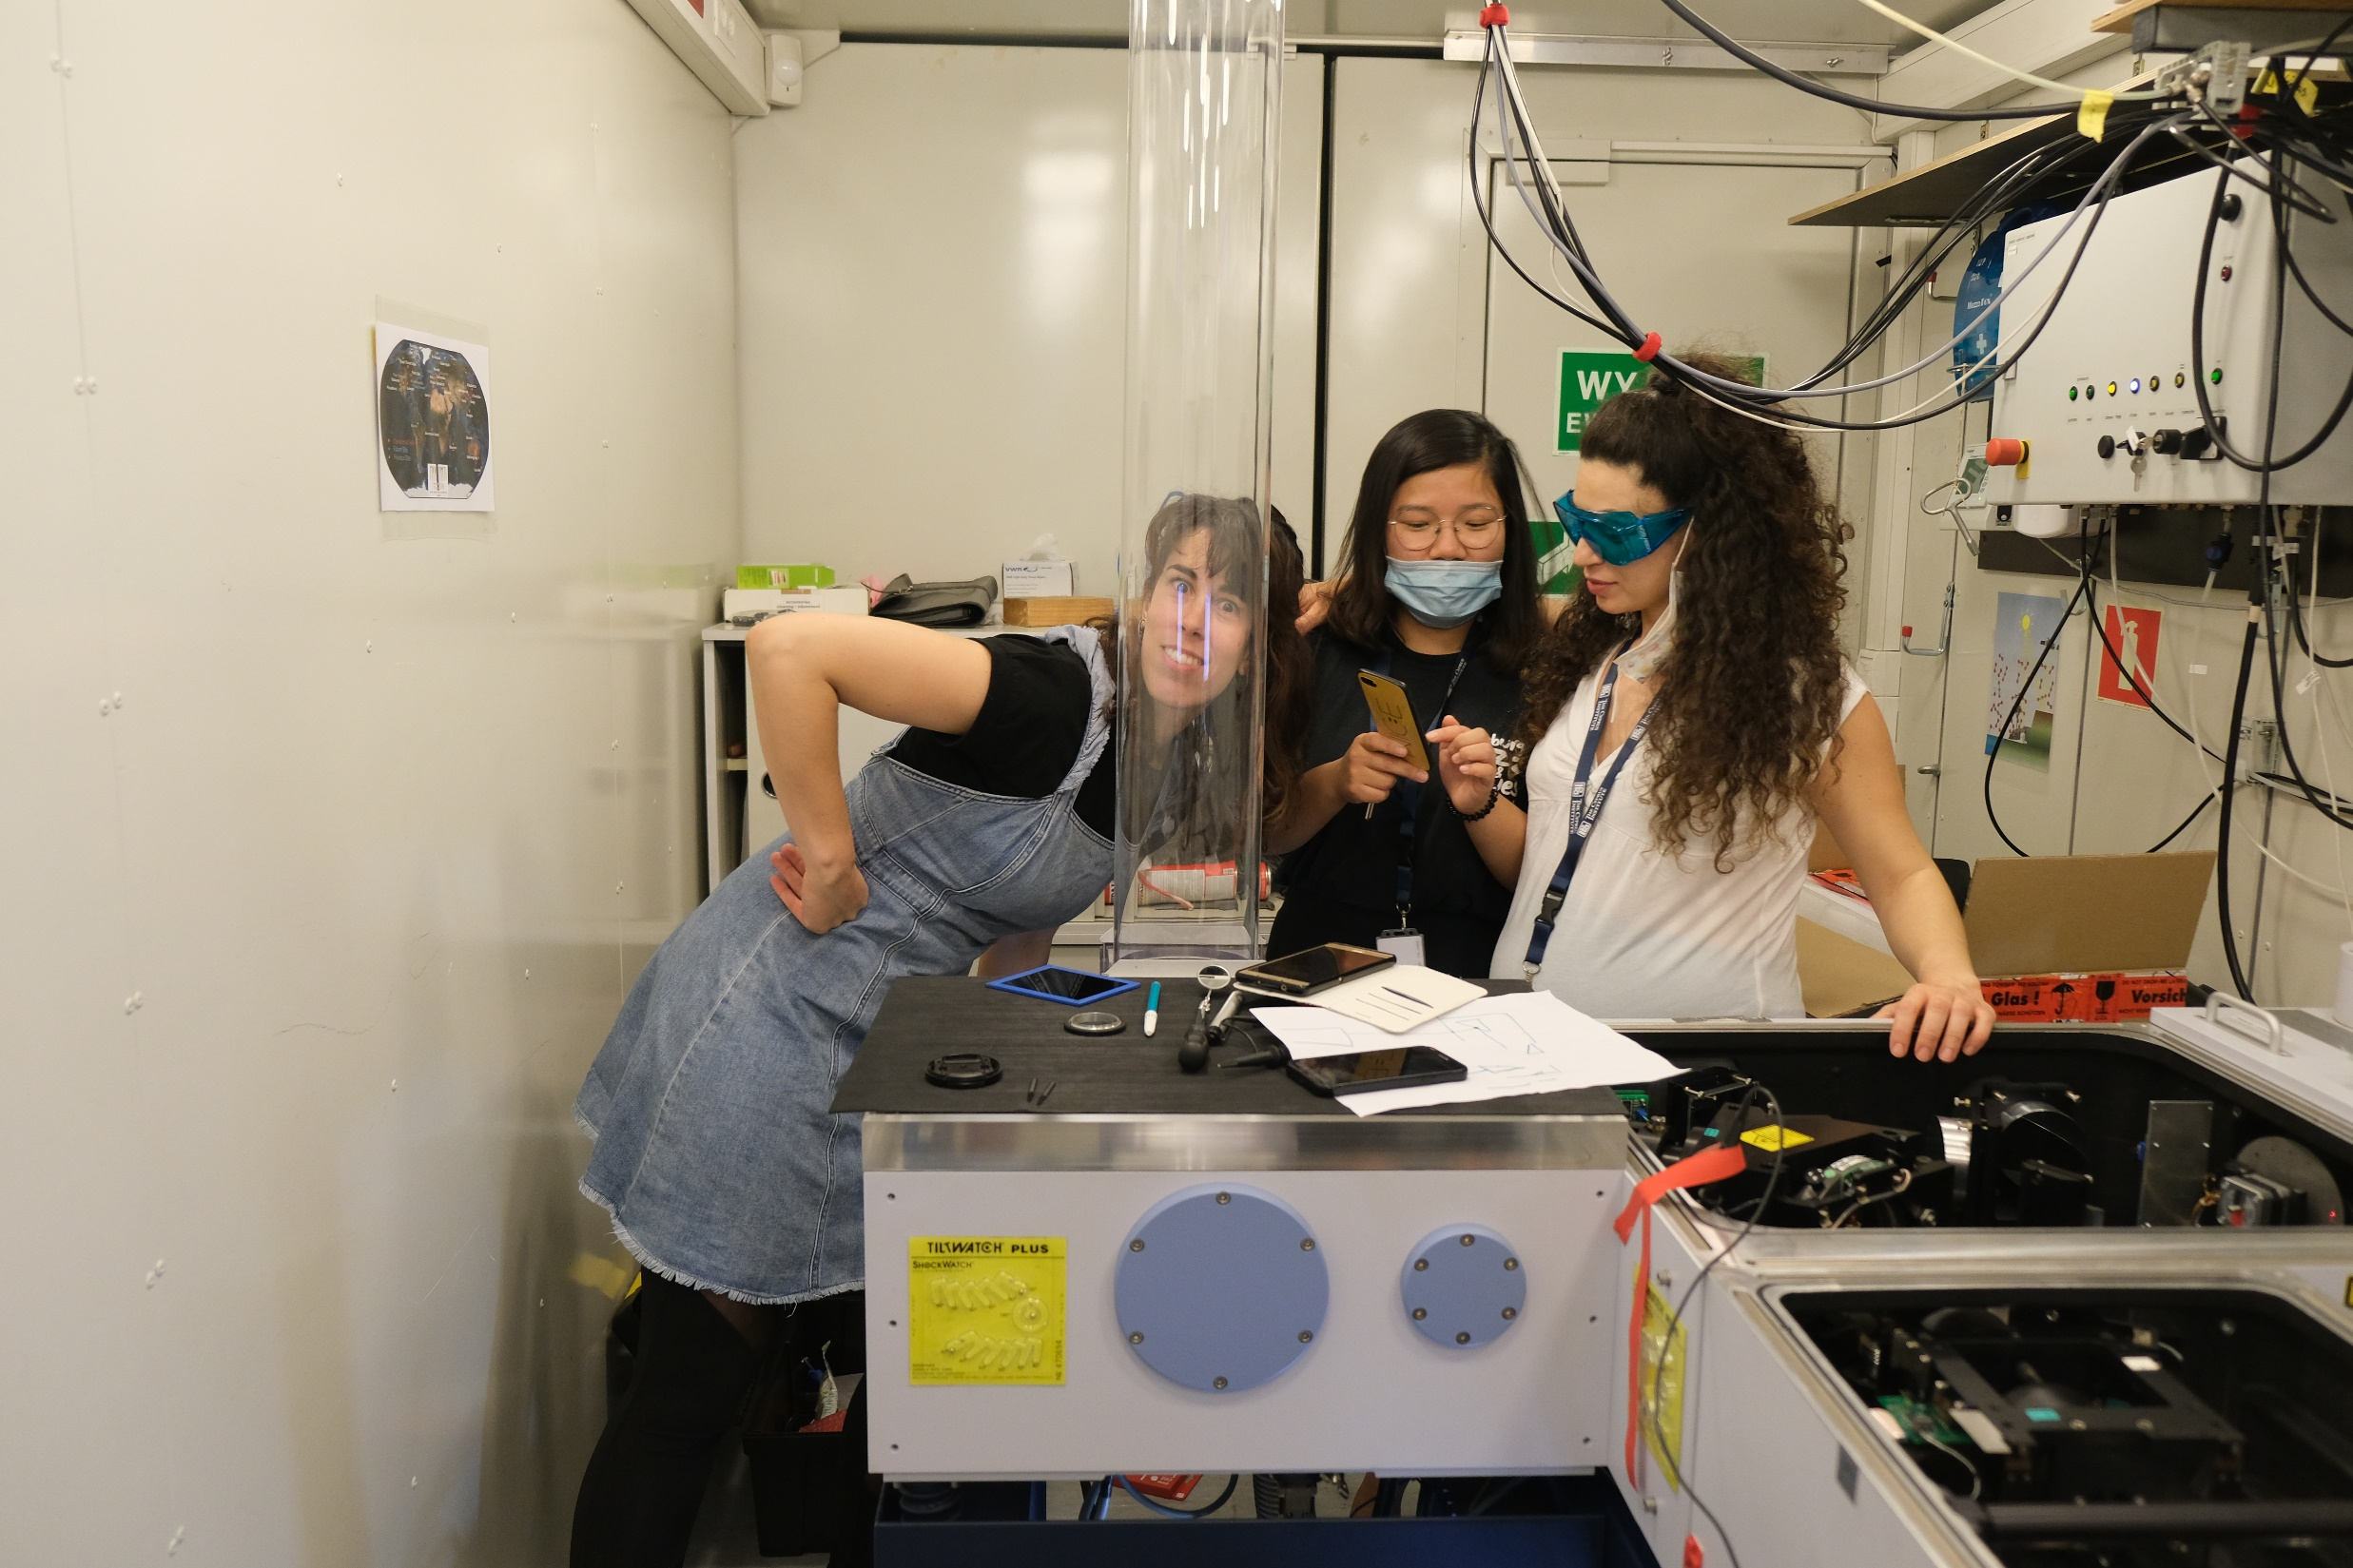
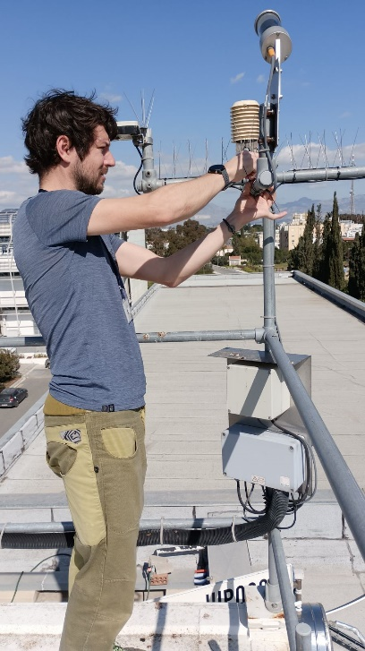
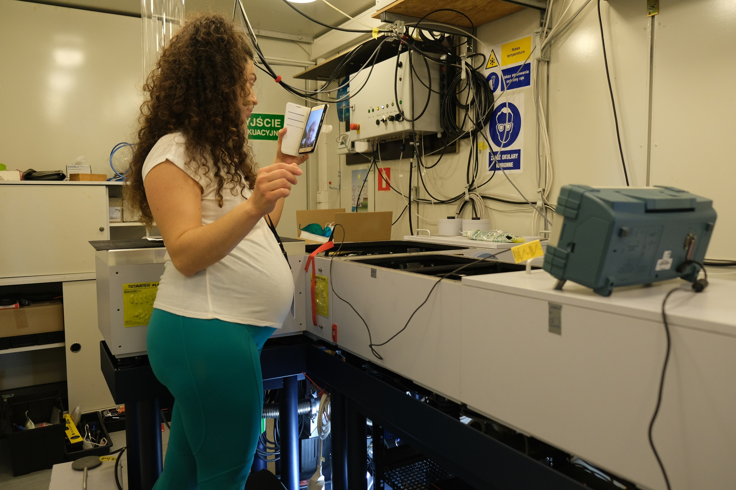
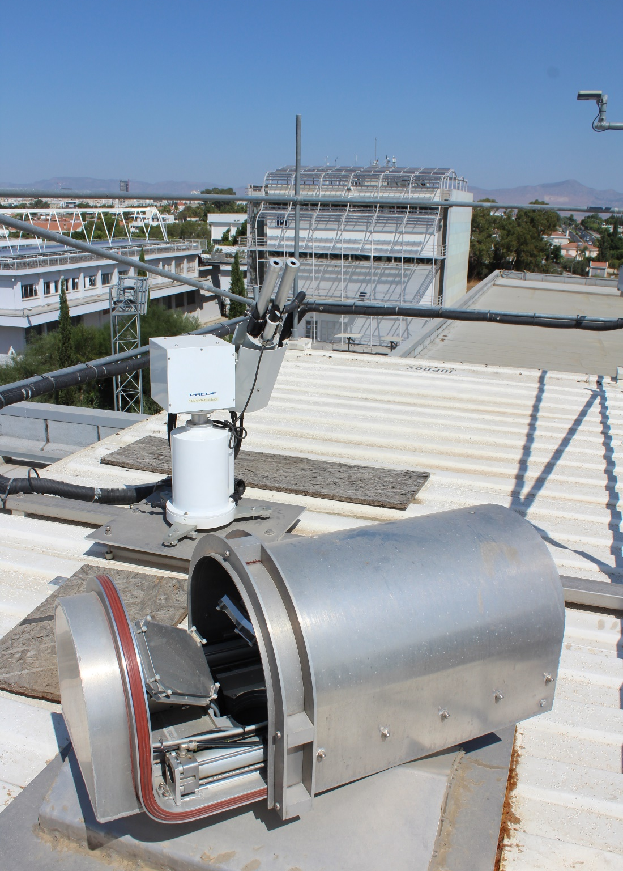
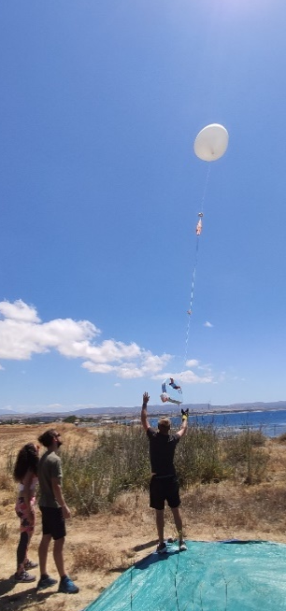



Thank you!!!!
This project has received funding from the European Union’s Horizon 2020 research and innovation programme under grant agreement No. 856612 and the Cyprus Government.

Slide 13
Supplementary Slides

Slide 14
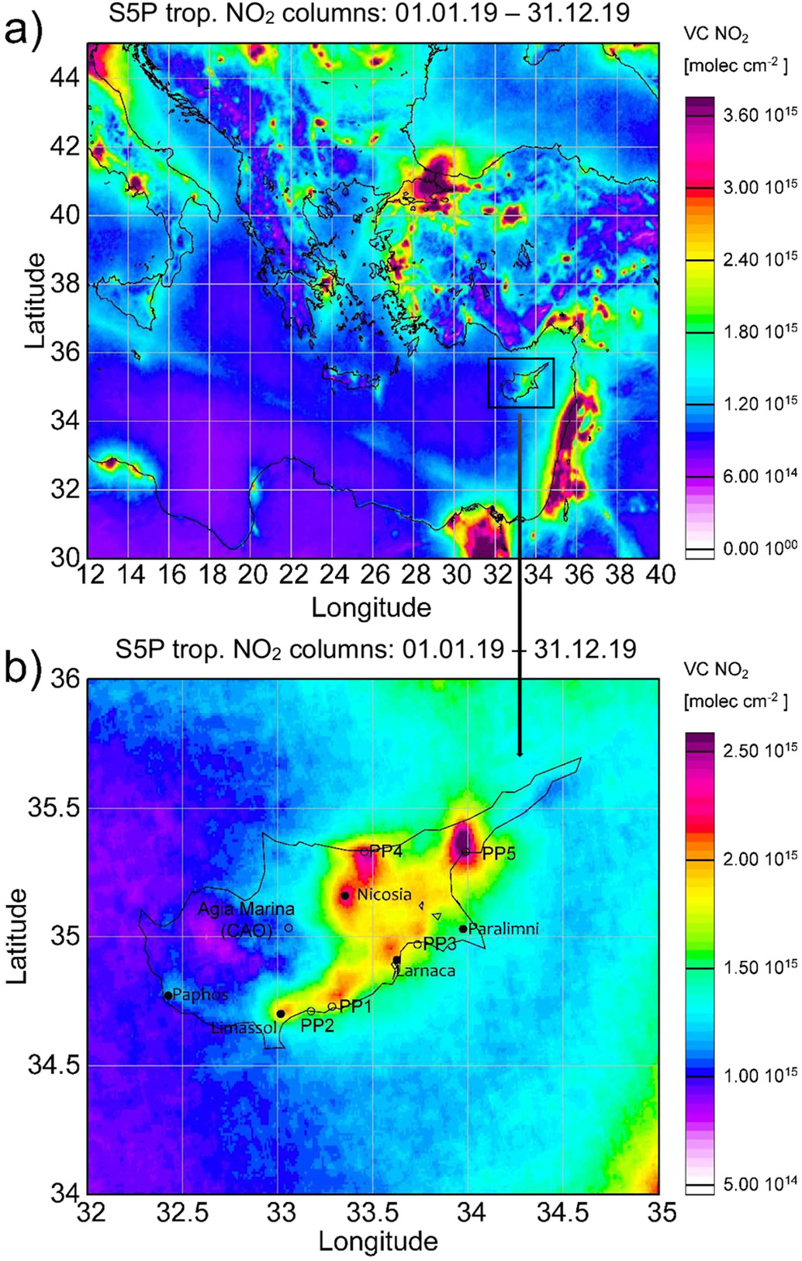
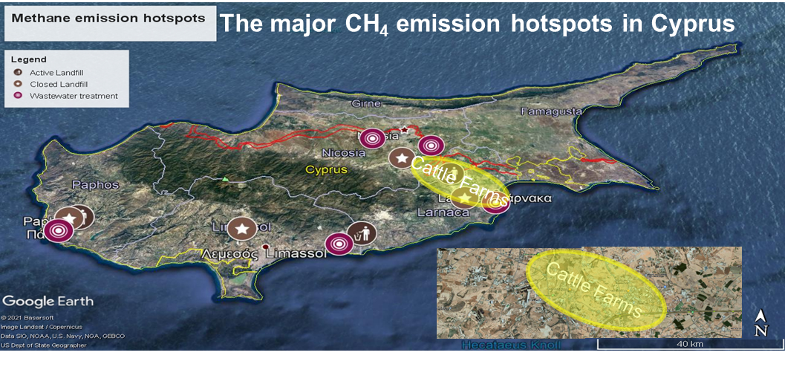
Regional Sources
Local Sources

Slide 15
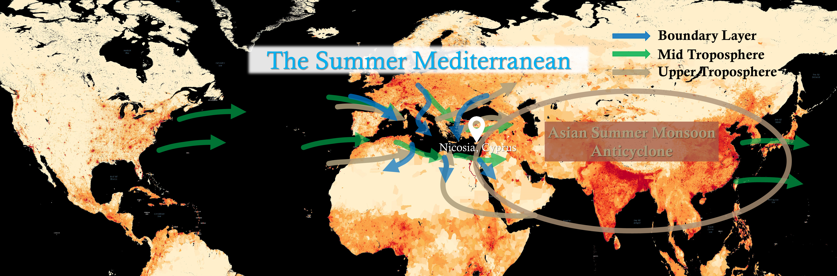
Air Masses Over Cyprus
Inspiration: Lelieveld et al., 2002
Gridded Population of the World, Version 4 (GPWv4): Population Count Adjusted to Match 2015 Revision of UN WPP Country Totals. Palisades, NY: NASA Socioeconomic Data and Applications Center (SEDAC). https://doi.org/10.7927/H4SF2T42. Access date: May 2021

