Slide 1

New sites at Port Velho and Kolkata
Mahesh Kumar Sha, Filip Desmet, Nicolas Kumps, Corinne Vigouroux, Bavo Langerock, Martine De Mazière (BIRA-IASB), Brussels, Belgium
Justus Notholt, Thorsten Warneke, Christof Petri – University of Bremen
Carlos Augusto Bauer Aquino, Kaio Alexandre da silva – Instituto Federal de Educação, Ciência e Tecnologia de Rondônia - Porto Velho (IFRO), Brazil
Gopala Krishna Darbha – Indian Institute of Science Education and Research Kolkata (IISER Kolkata), India

Slide 2
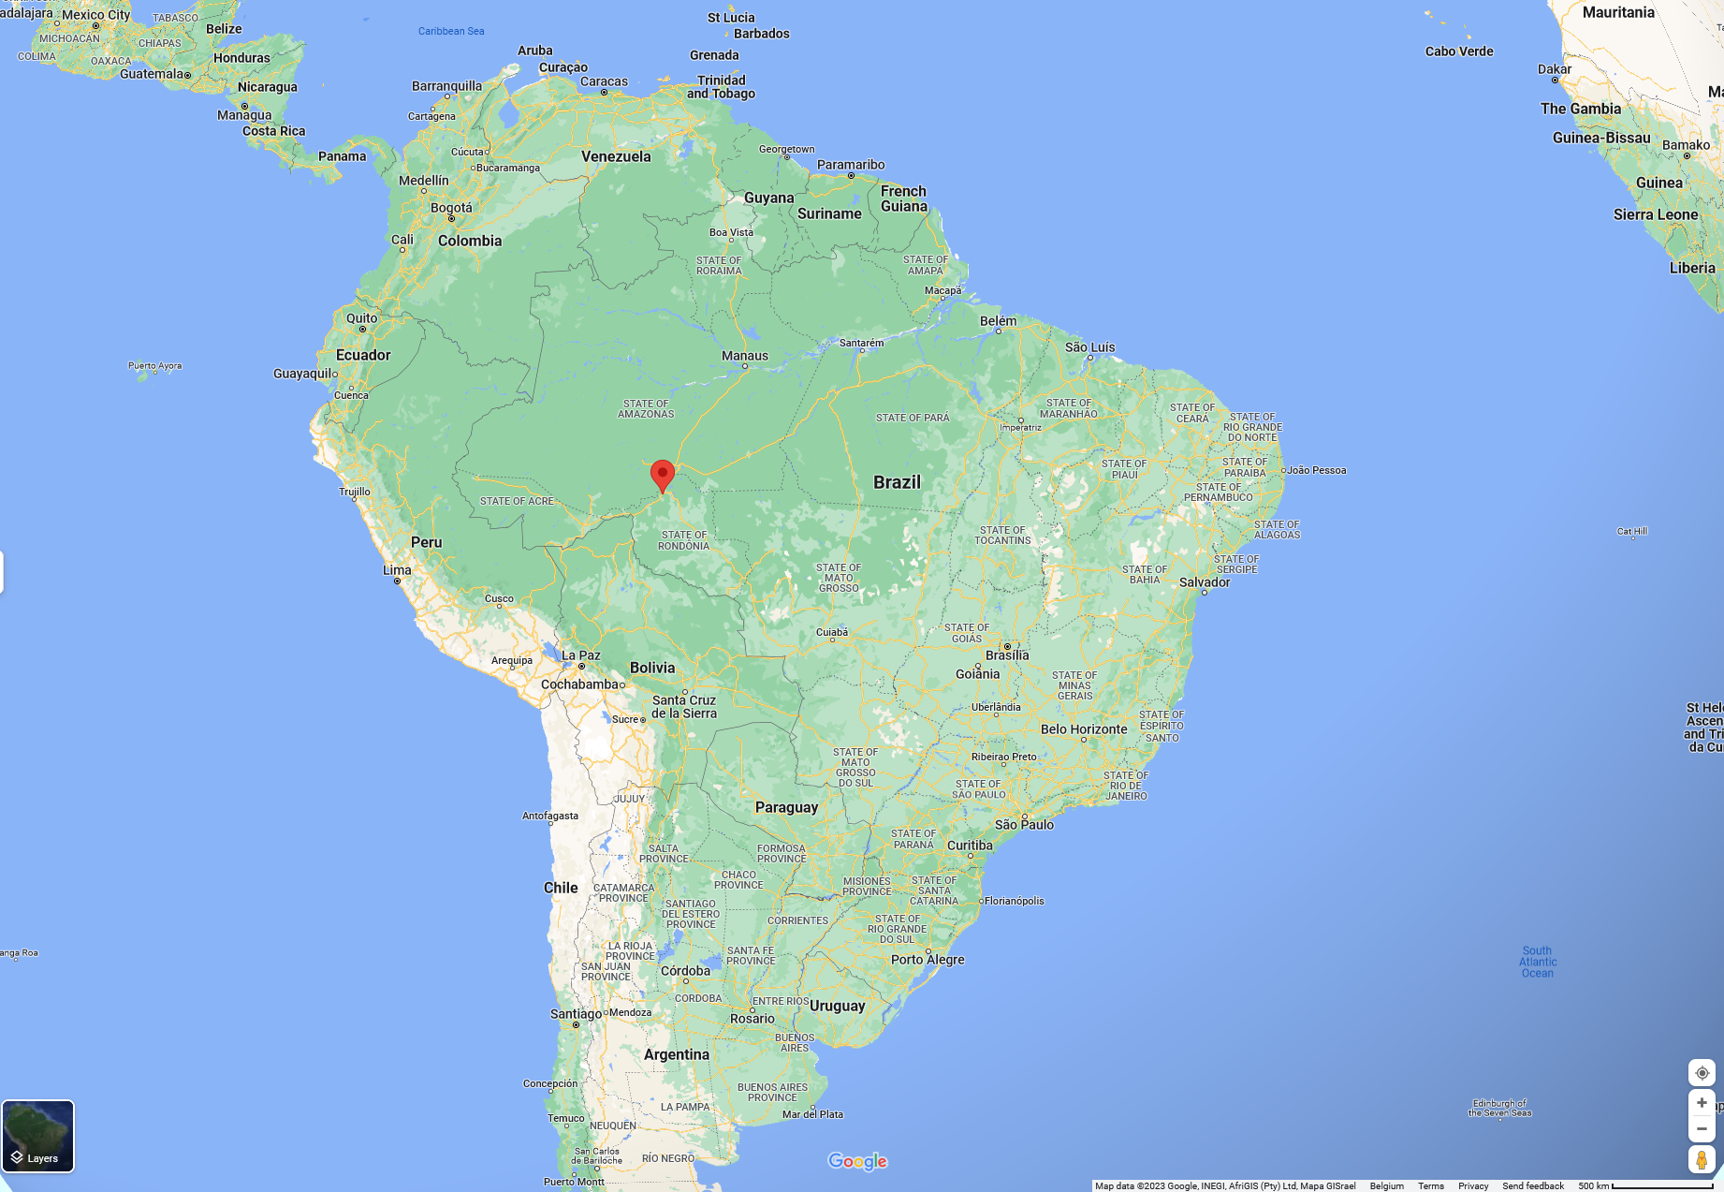
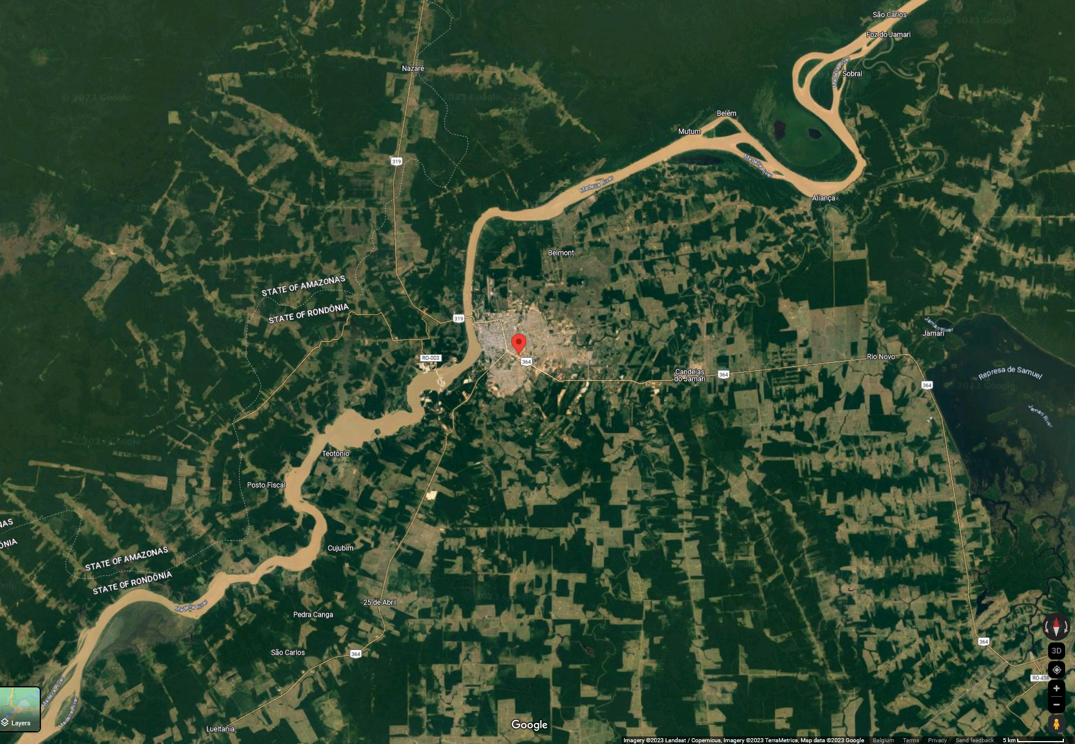
Porto Velho, Brazil
Site location:
Campus of Instituto Federal de Educação, Ciência e Tecnologia de Rondônia - Porto Velho (-8.774° N, 296.128° E, 87.0 m.a.s.l) in Brazil
Location of Porto Velho on google maps

Slide 3
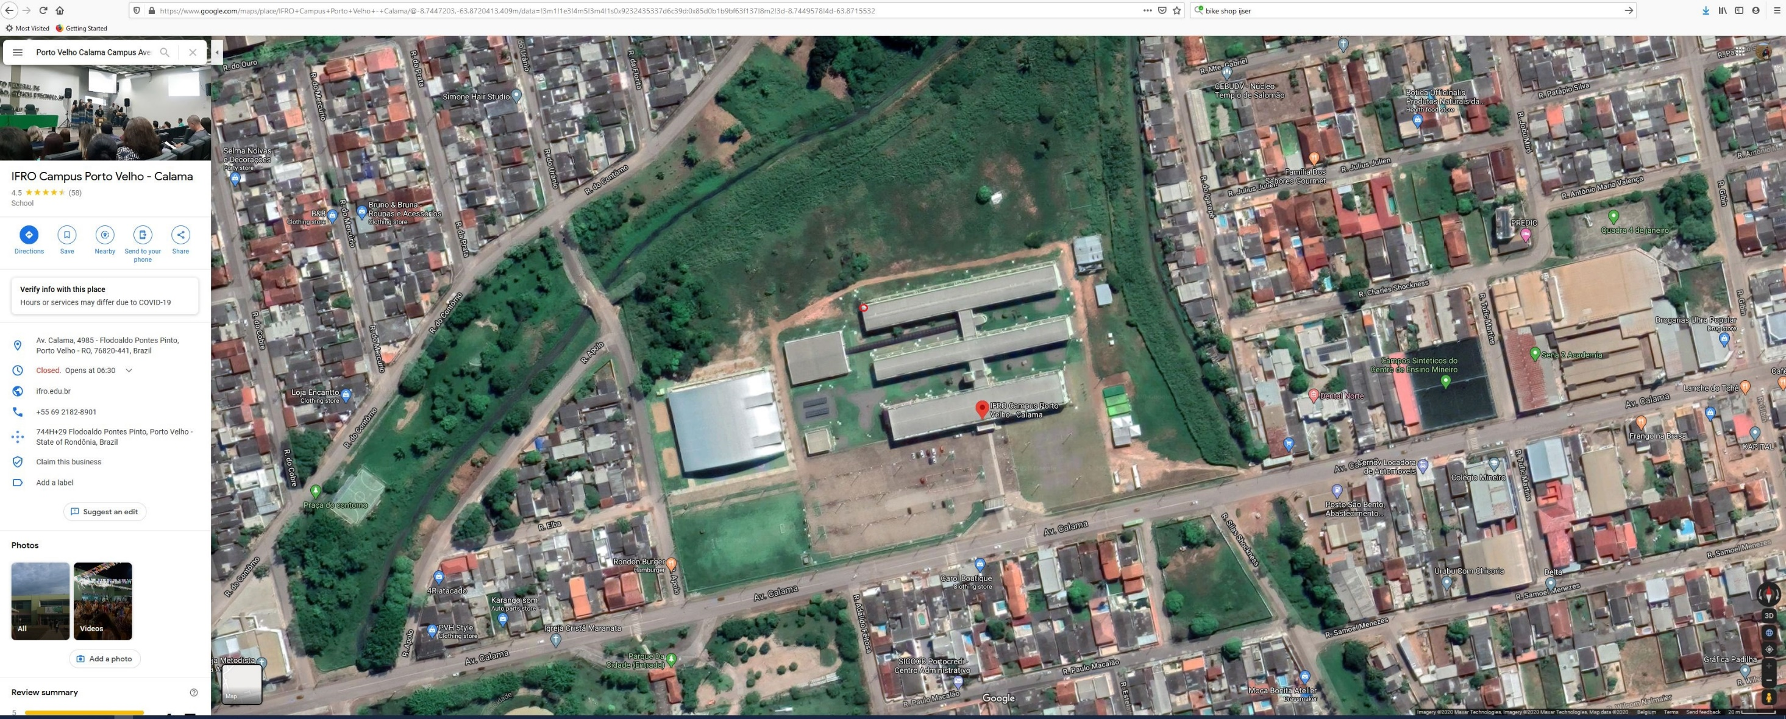
Porto Velho, Brazil
IFRO campus and location of the solar tracker on the roof and FTIR underneath setup in the laboratory

Slide 4
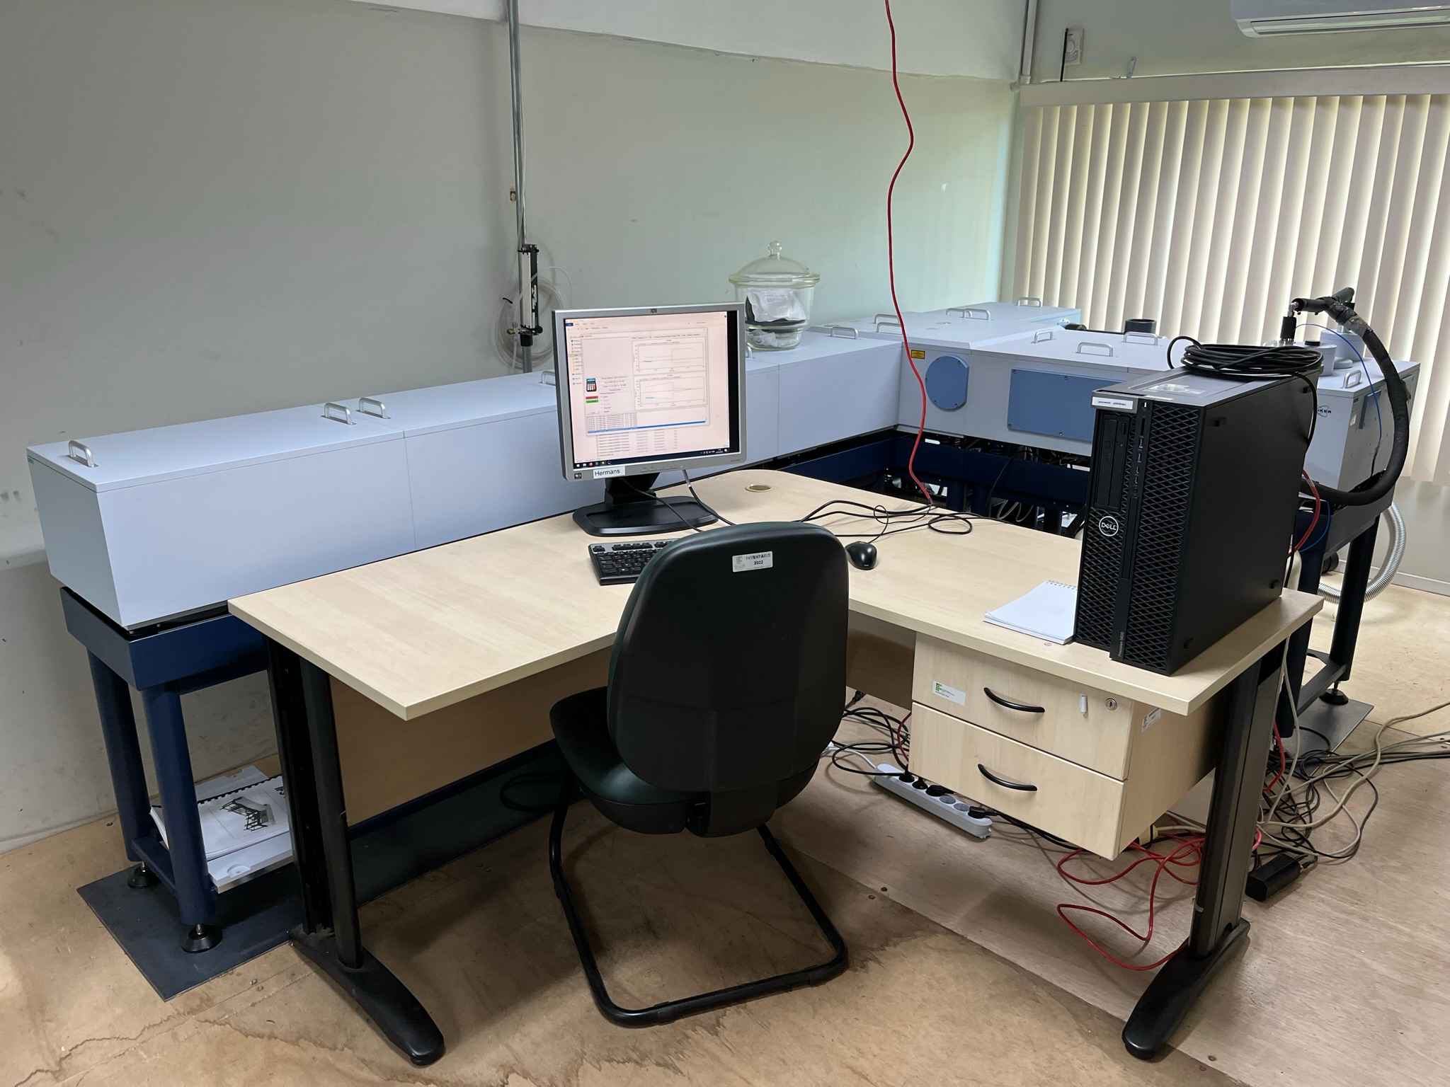
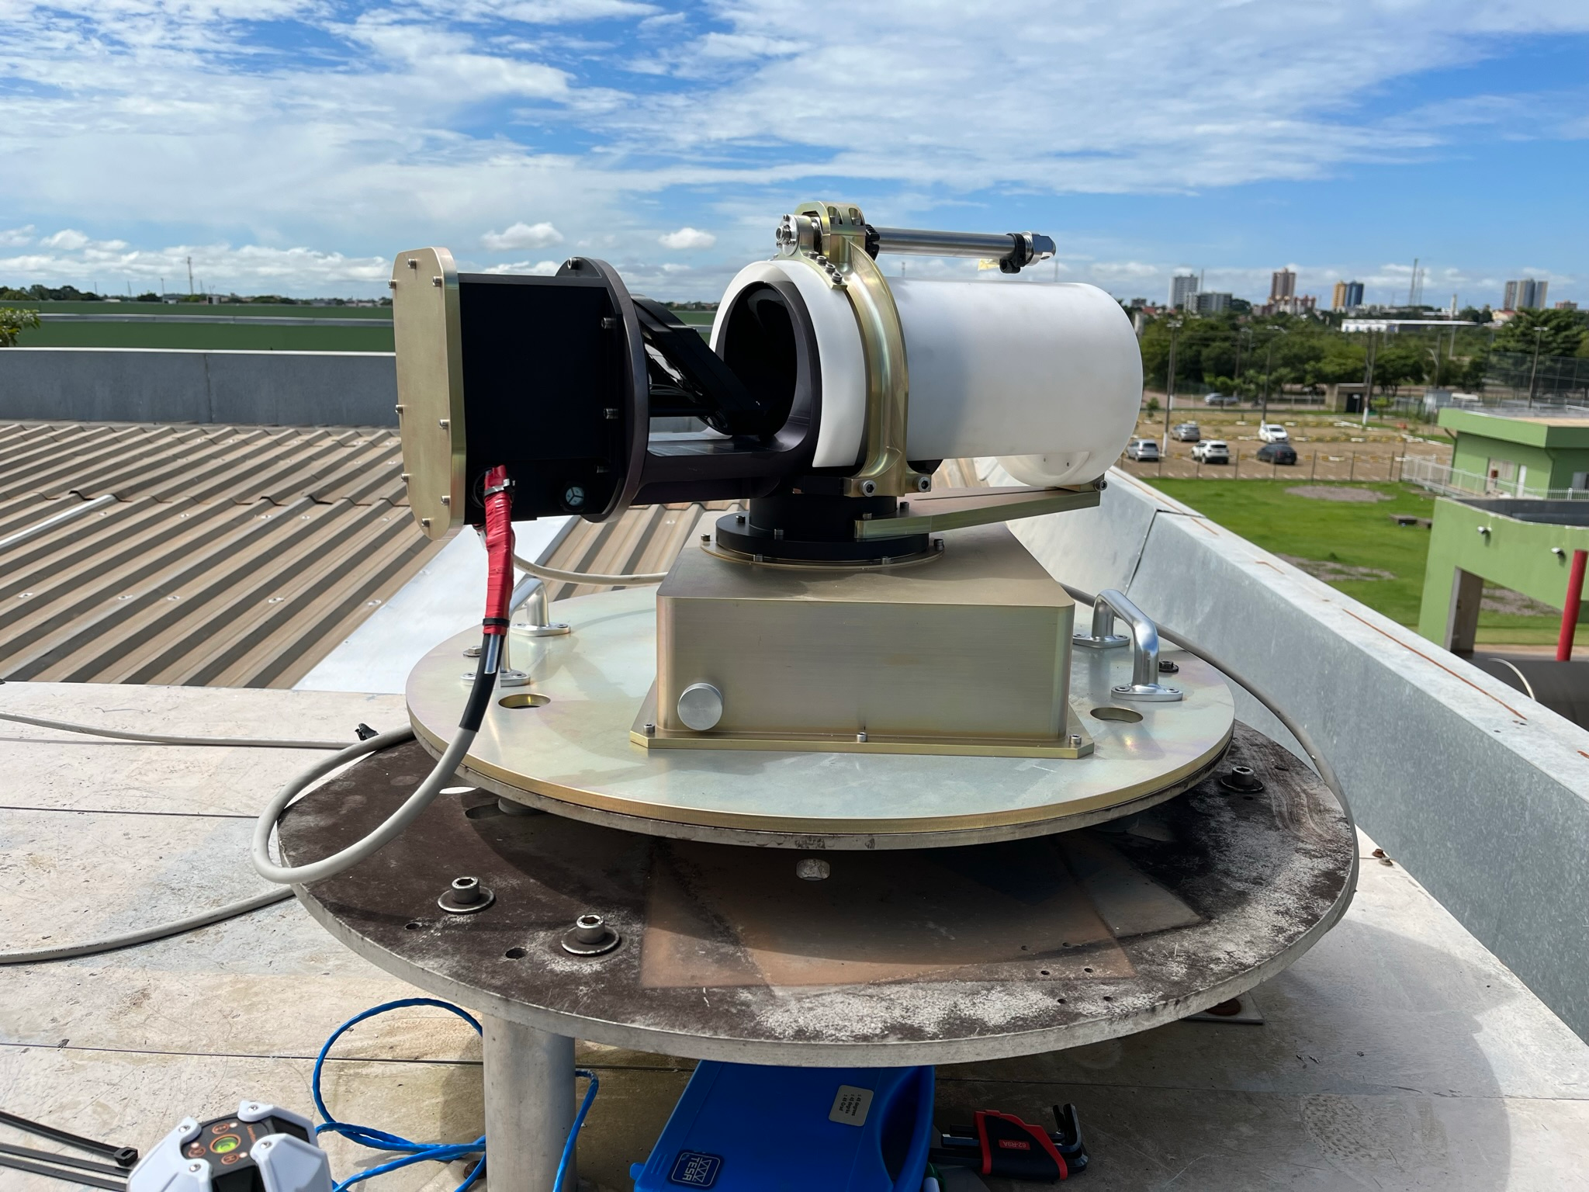
Porto Velho, Brazil
Site location:
Campus of Instituto Federal de Educação, Ciência e Tecnologia de Rondônia - Porto Velho (-8.774° N, 296.128° E, 87.0 m.a.s.l) in Brazil
Instrument setup:
A new Bruker IFS 125HR spectrometer and a home-built solar tracker were installed in March 2023 with the focus on retrieval of multiple species under realistic conditions of cloud cover.
Automatic weather station:
Vaisala WXT510 6-in-1 (p, T, RH, wind speed and direction, rain), Vaisala PTB 210, Delta-T SPN1 pyranometer

Slide 5
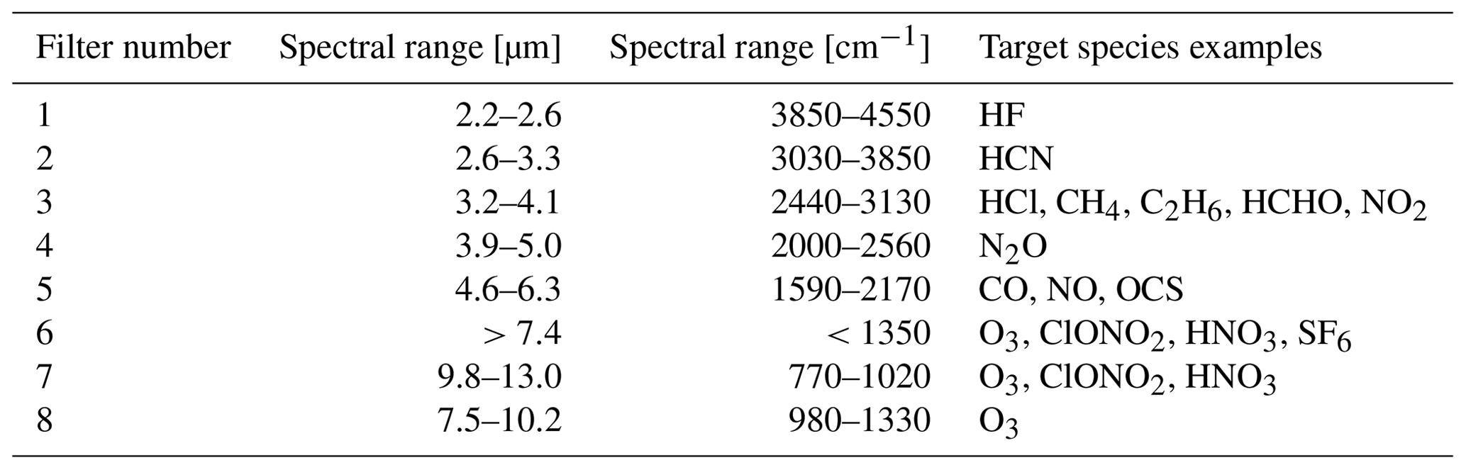
Porto Velho – measurement configuration
Combined NDACC-IRWG and TCCON measurements
Extended KBr Beamsplitter (600 – 10 000 cm⁻¹)
In the TCCON configuration: Simultaneous InGaAs and InSb measurements – providing the standard TCCON species – column averaged abundances of CO2, CH4, N2O, H2O, HDO, CO and HF.
In the NDACC configuration: measurements with InSb and MCT detector (with filters 1 – 6) – providing the standard NDACC molecules listed below plus some other additional species
HCN, C₂H₂
CH₃OH, HCOOH, NH₃, PAN, isoprene
Table: https://doi.org/10.5194/amt-14-1239-2021

Slide 6
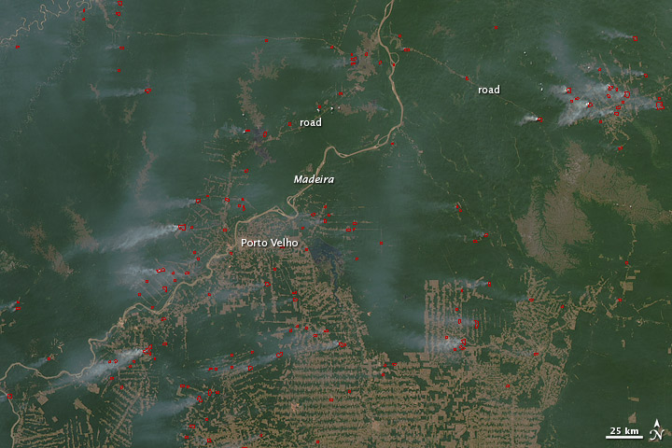
Porto Velho – biomass burning tracers (Courtesy C. Vigouroux, BIRA)
Image from MODIS: August 7, 2010.
Many species with a maximum observed during the biomass burning season.

Slide 7
Porto Velho – a high species-concentration location (C. Vigouroux, BIRA)
FTIR location with the highest levels of HCHO ! (more than Mexico City).
Important for the satellite validation (here S5P TROPOMI): the satellite bias depends on the HCHO concentrations. (positive for clean sites; negative for polluted sites)

Slide 8
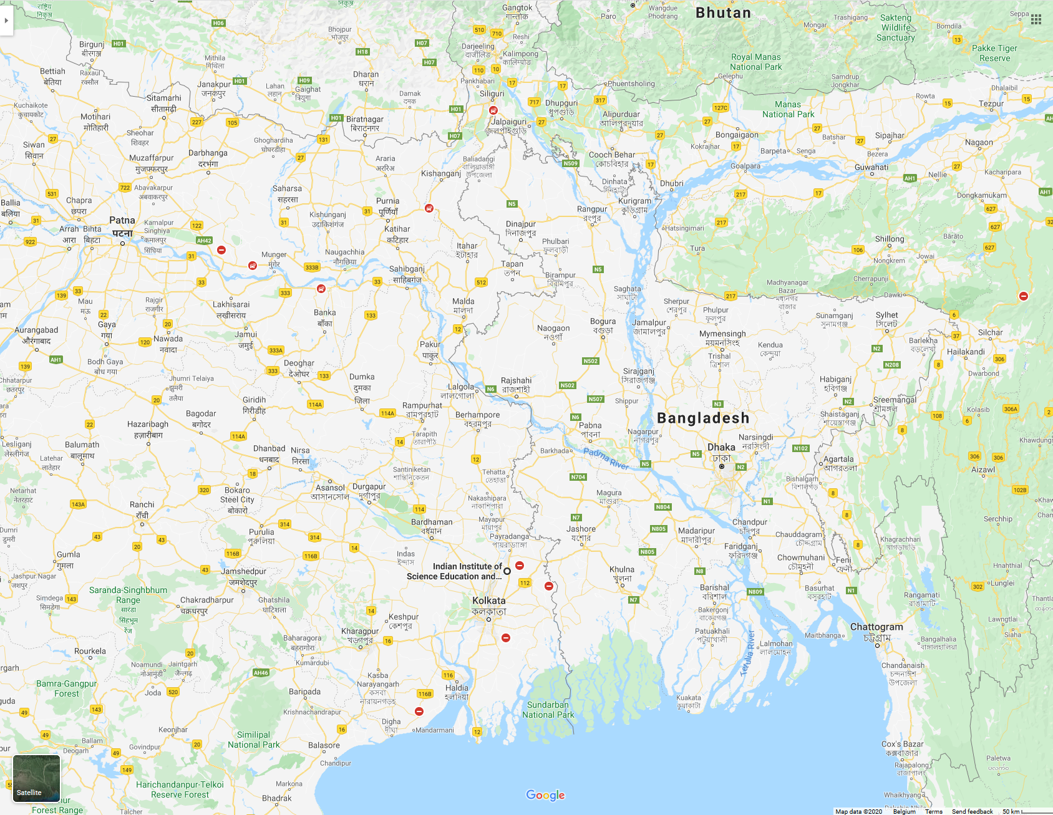
Kolkata, India
Site location:
Campus of India Institute of Science Education and Research Kolkata (IISER Kolkata; 22°57'50" N, 88°31'28" E) in India
Location of Kolkata site on google maps

Slide 9
Kolkata, India
Site location:
Campus of India Institute of Science Education and Research Kolkata (IISER Kolkata; 22°57'50" N, 88°31'28" E) in India
Instrument setup:
A Vertex70 infrared spectrometer (tested during FRM4GHG campaign) and a home-built solar tracker were installed in January 2023 with the focus on retrieval of multiple species under realistic conditions of cloud cover. RT-InGaAs and LN2-InSb detectors to cover both NIR and MIR spectral regions. Target species are CO2, CH4, CO, H2O (NIR); N2O, CH4, HCHO, …. (MIR)
Automatic weather station:
Vaisala WXT536 meteorological station 6-in-1 (p, T, RH, wind speed and direction, rain), Delta-T SPN1 pyranometer, Lambrecht U-shaped rain sensor

Slide 10
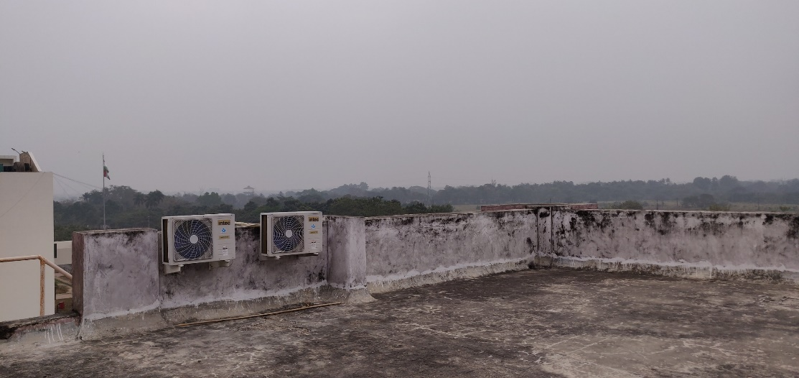
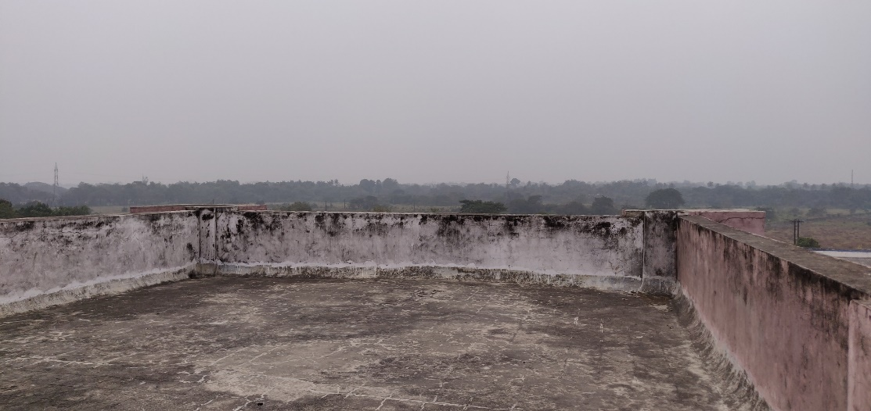
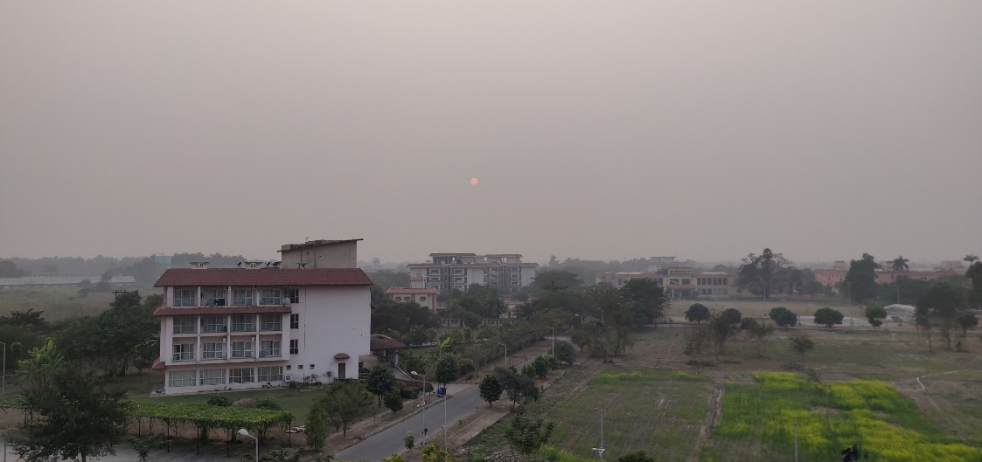
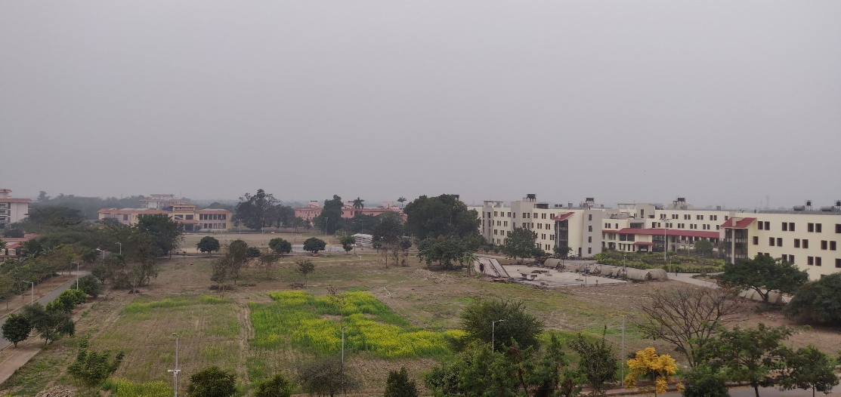
Kolkata, India
View from East to West

Slide 11
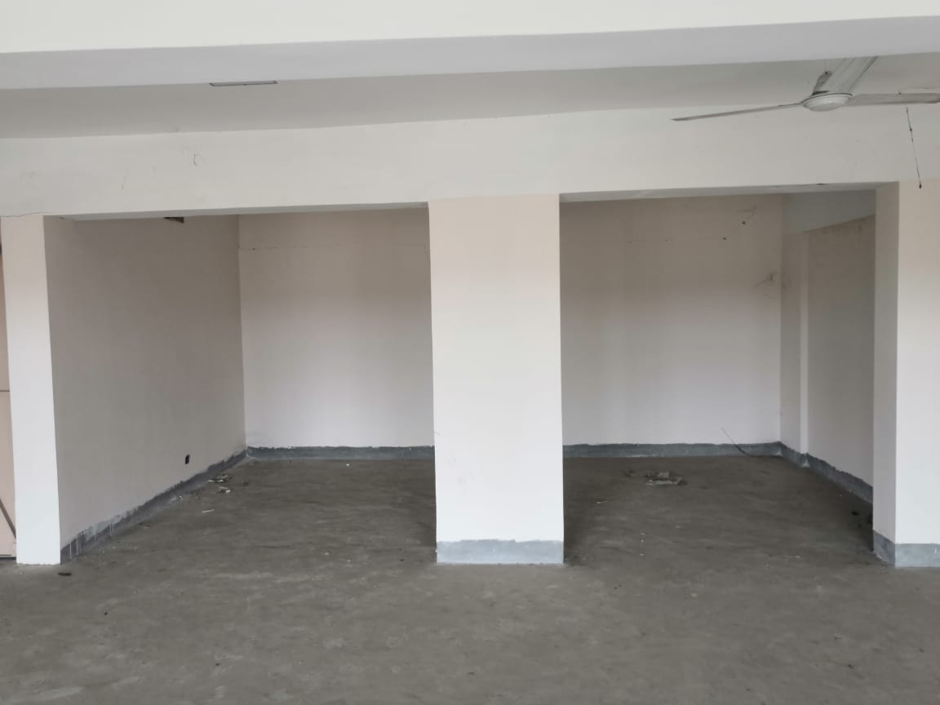
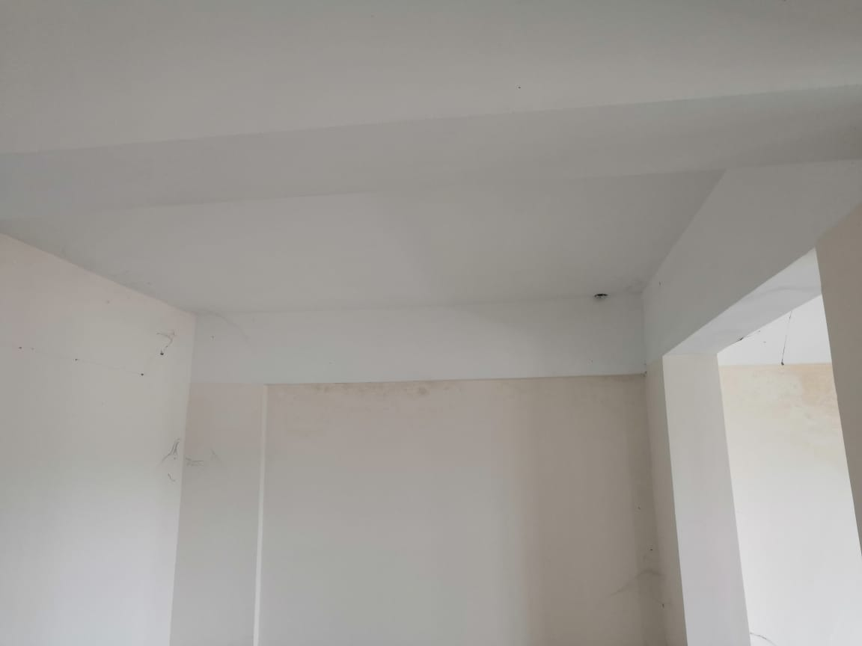
Kolkata, India
Laboratory space for installing Bruker Vertex70
Roof top – need to create a hole for light passage

Slide 12
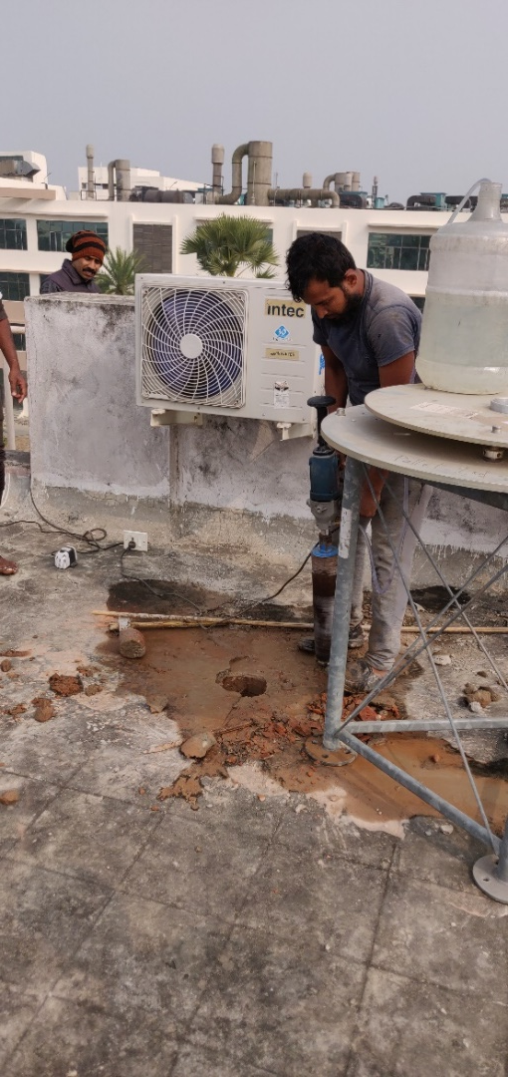
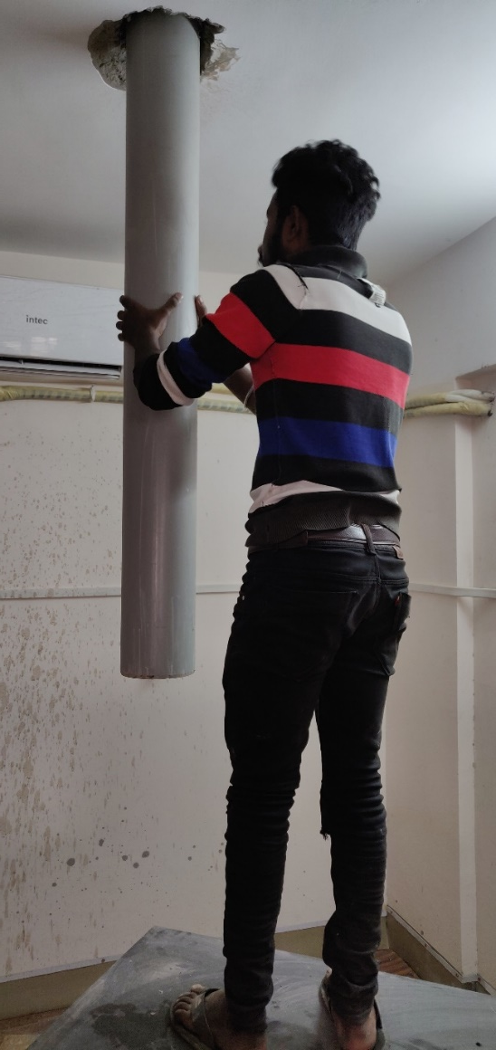
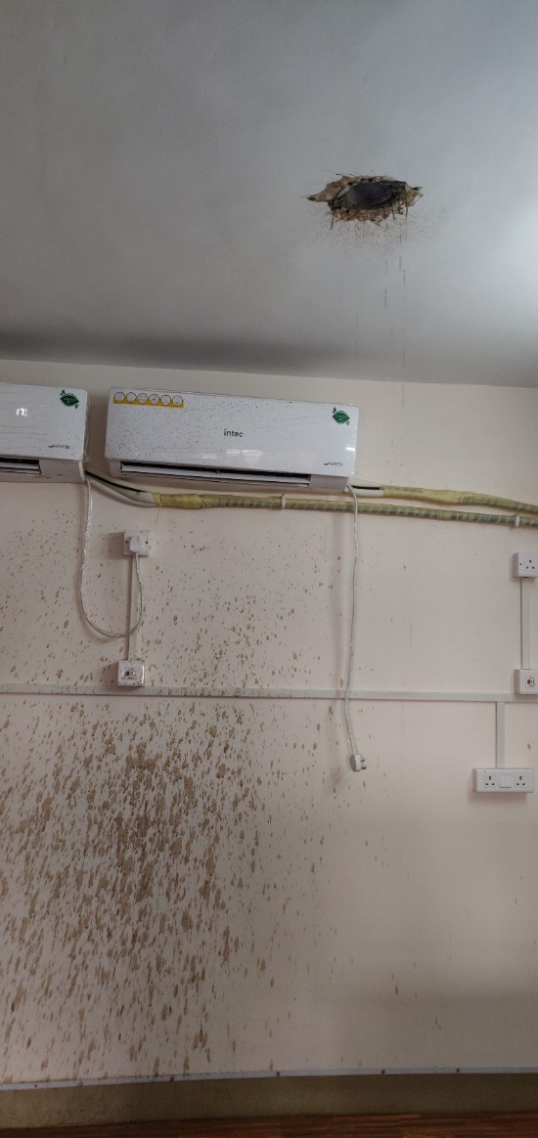
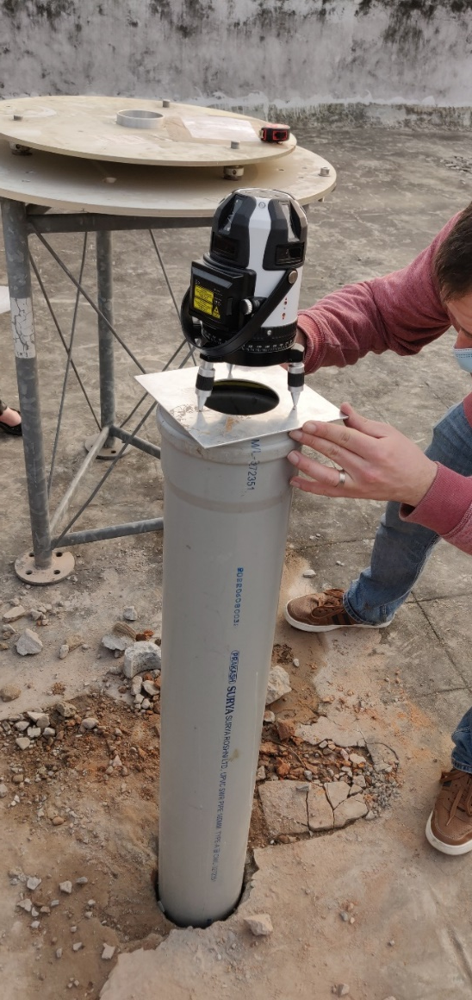
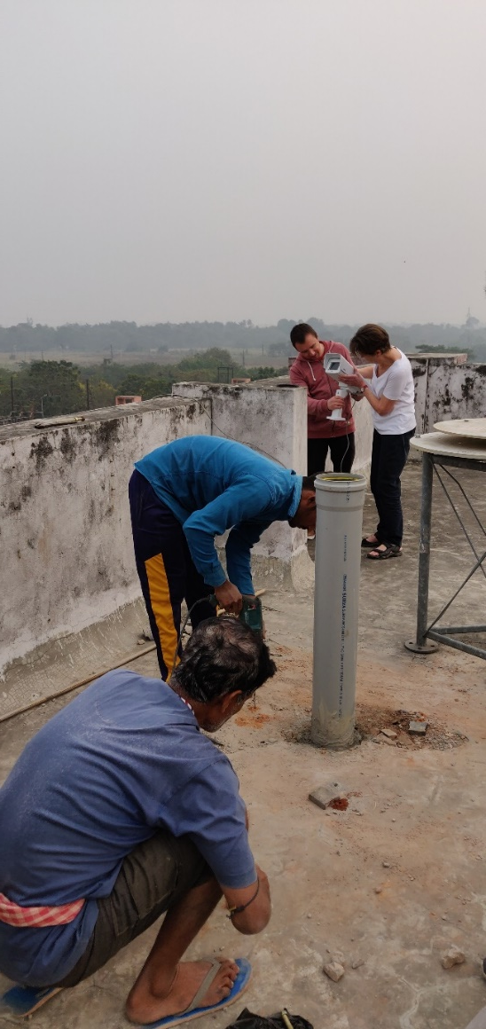
Kolkata, India
Solar tracker installation at the site 17/01/2023

Slide 13
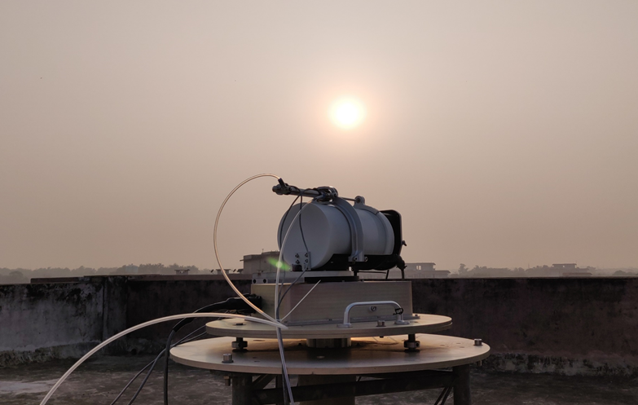
Kolkata, India
End of measurement day

Slide 14
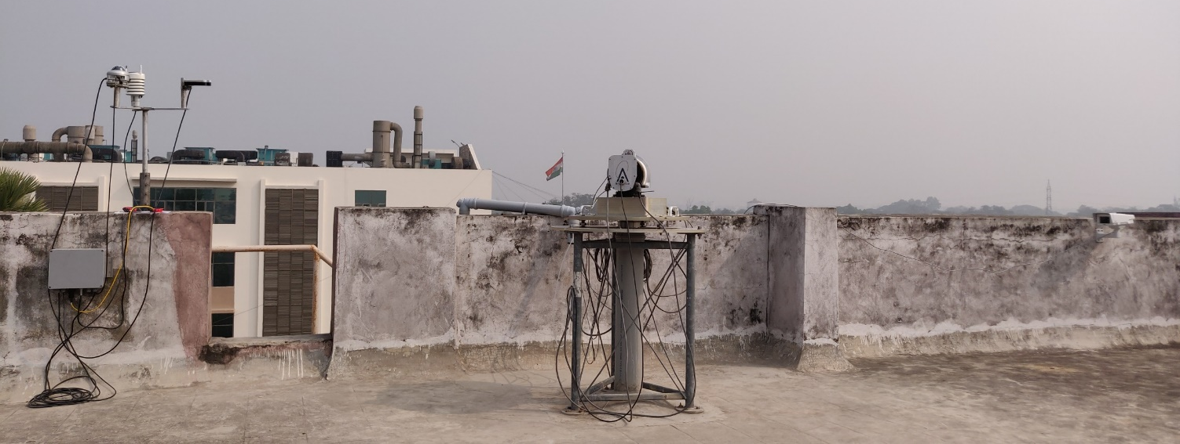
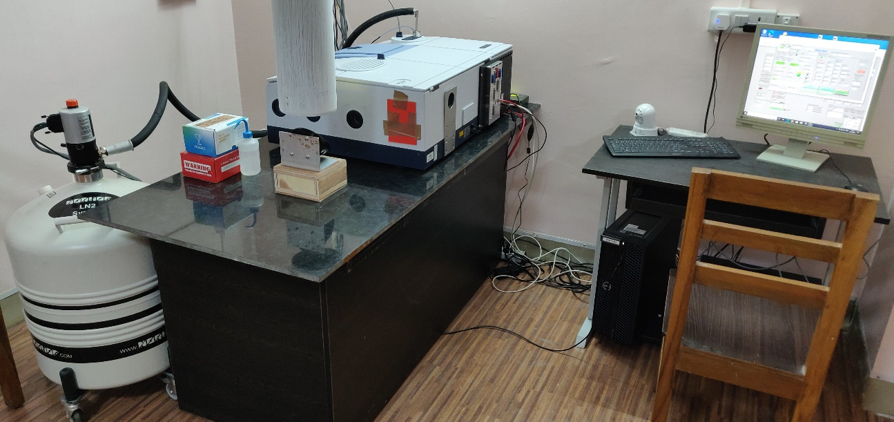
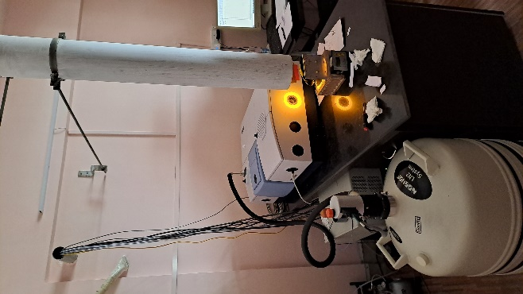
Kolkata, India
Solar beam path from the roof to the FTIR lab

Slide 15
Kolkata, India – HCHO retrievals (C. Vigouroux, BIRA)
The main HCHO retrieval settings (mws, spectroscopy) can be kept the same as for the 125HR (see Vigouroux et al., 2018), which gives a very good consistency with the FTIR network, as demonstrated by looking at the TROPOMI validation.
TROPOMI bias at Kolkata (-32%) is perfectly in line with the results from the FTIR network (mostly 125HR instruments).
PORTO VELHO
KOLKATA
Figure updated from Vigouroux et al., 2020
Included in the last quarterly ESA S5P validation report https://mpc-vdaf.tropomi.eu/
UNAM

Slide 16
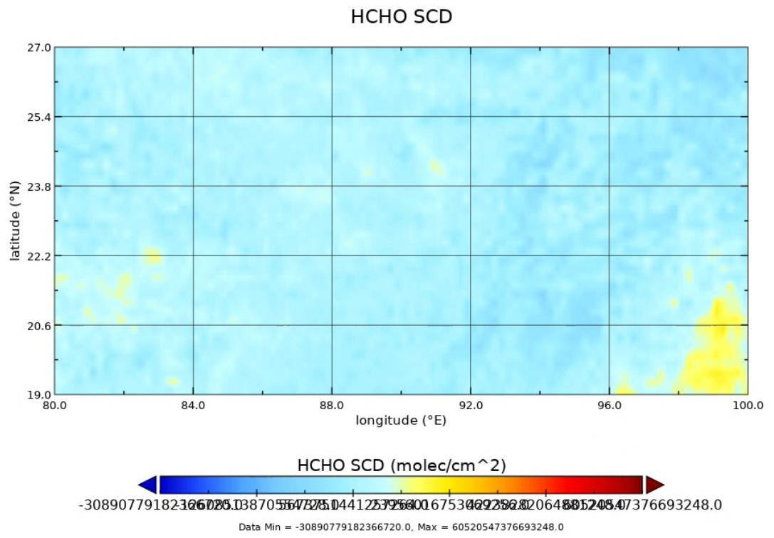
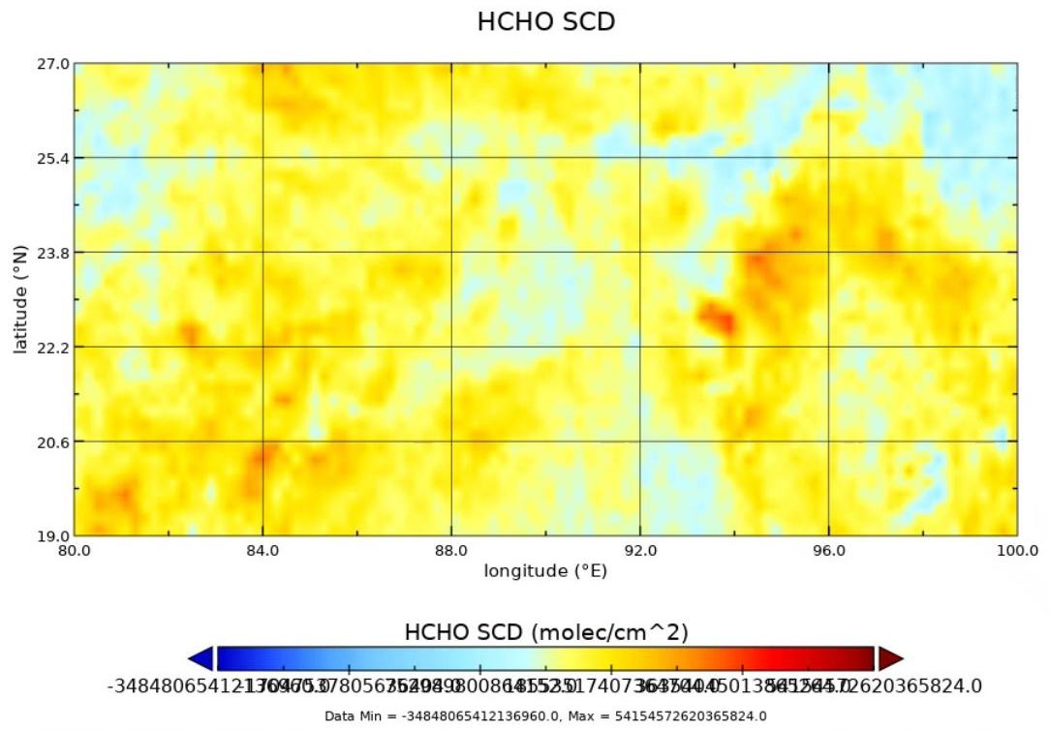
Kolkata, India – HCHO retrievals (C. Vigouroux, BIRA)
S-5P HCHO 19 April 2023
S-5P HCHO 19 April 2023

Slide 17
Summary
Thanks to the ESA campaigns (https://s5pcampaigns.aeronomie.be/) project SVANTE and QA4EO for supporting the campaign based activities in Kolkata and Porto Velho. Data to support validation of S5P products.
Interest from OCO-team and GOSAT-team as a target location.
We are looking for funding for long-term operation of the instruments at the site.
Kolkata site is prepared such that an IFS 125HR can be easily installed, rest of the system for automated operation is already in place. The site has the potential to become a TCCON/NDACC-IRWG site.

Slide 18
Thank you for your attention

