Slide 1

Impact of indigenous fire management on the annual cycle of carbon monoxide over Northern Australia
Shyno Susan John, Nicholas M. Deutscher, Clare Paton-Walsh, David W.T. Griffith
Centre for Atmospheric Chemistry (CAC), University of Wollongong
Notes:
1

Slide 2
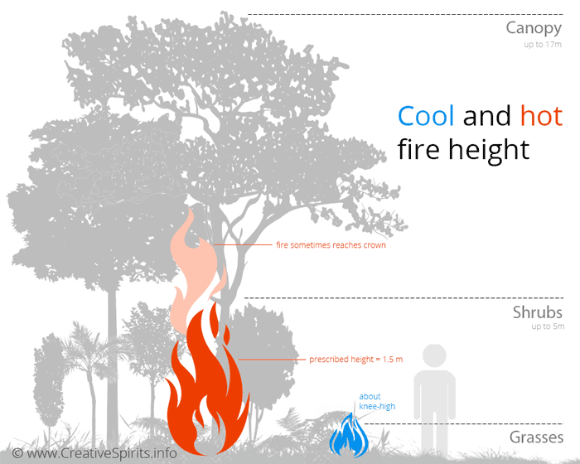
Indigenous fire management
Fire is an important part of the indigenous culture.
Indigenous burning reinstated in Northern Australia since 1990.
Cultural burning (“cool burns”) are typically different from other fuel reduction burning.
Currently, they have been used to obtain carbon credits in Australia by reducing the emissions of CO₂, CH₄ and N₂O.
Notes:
Indigenous population effectively used fires to manage and protect their land by by burning early to avoid the intensity and extent of late dry season fires.

Slide 3
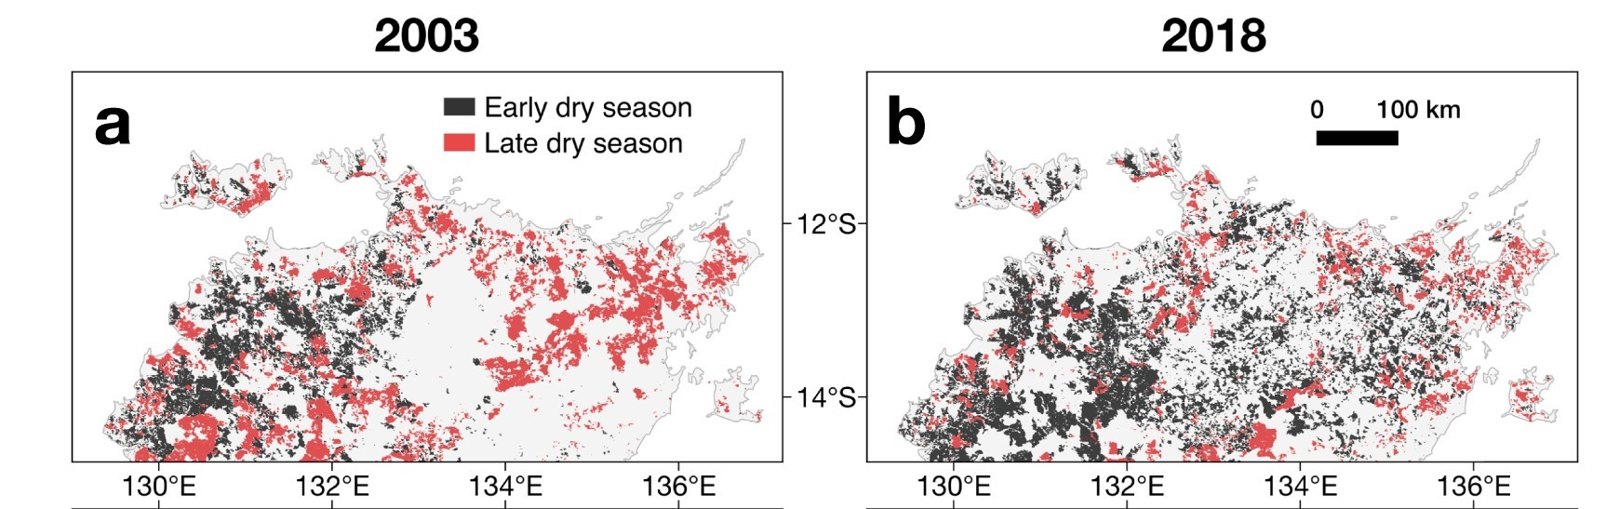
Temporal shifts in fire activity in Northern Australia
Primary biomass burning season of Northern Australia is shifting early, [2.41 days/yr (39 days earlier) over 2003-2018]
- Liu, T. et al., 2021
How does it impact the seasonal variability of atmospheric CO measured at Darwin?.

Slide 4
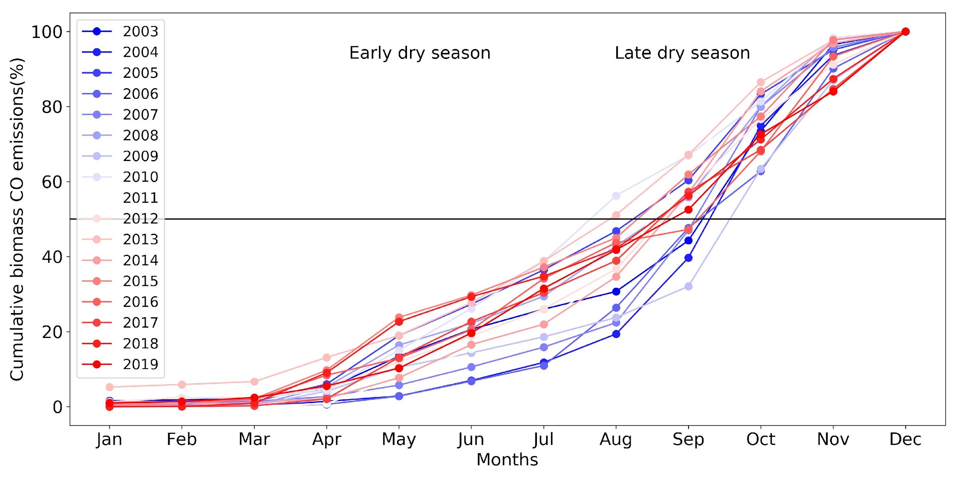
QFED: CO emissions shifting to early dry season
(over 10S-15S,126E-145E)

Slide 5
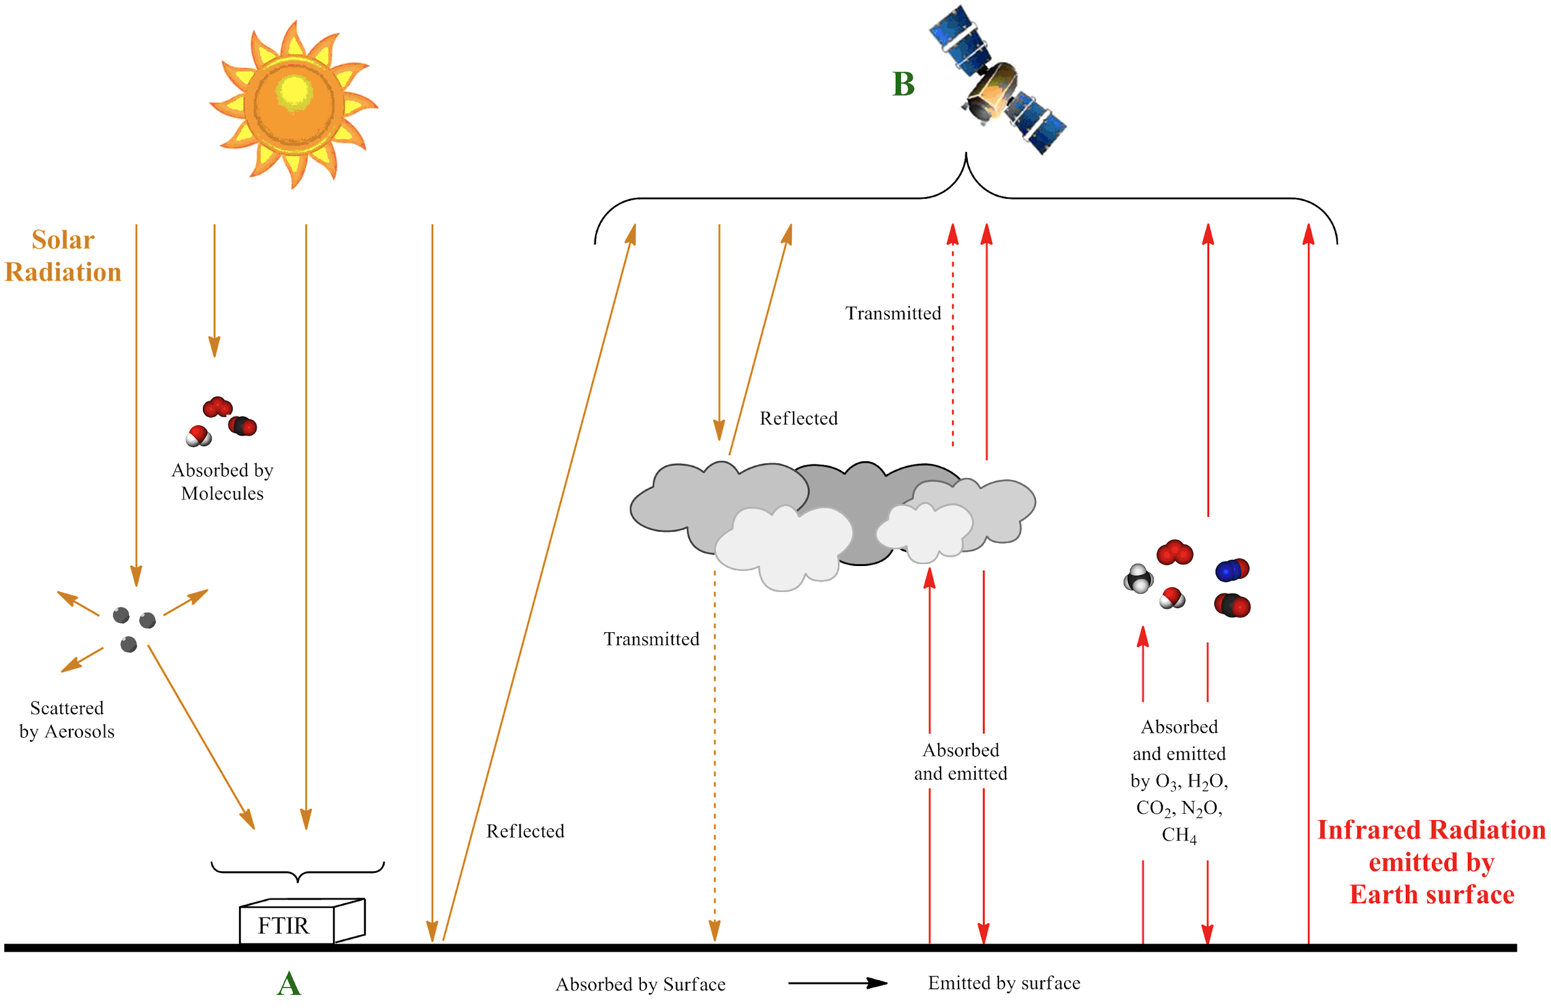

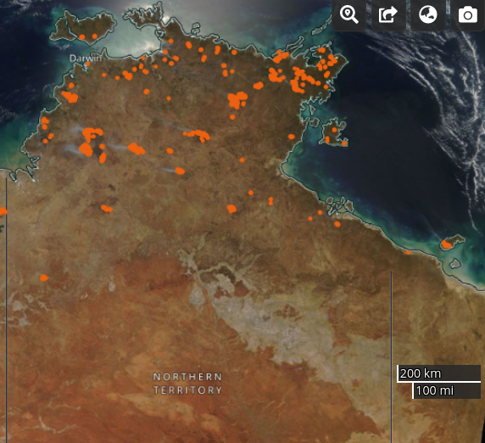



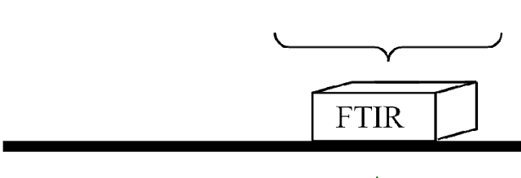
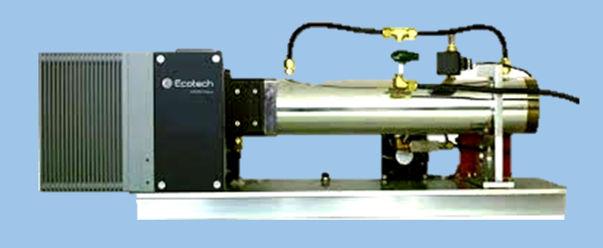
Trace gas measurements in Darwin
In situ FTIR
inlet
Notes:
Ground based solar viewing FTIR which provides the column abundance of the trace gases based on the direct solar radiation.
Satellite measurements.
5

Slide 6
Trends in Darwin column CO measurements
Months | Slope (ppb/year) | Uncertainty*
January | 0.50 | [-0.22,0.94]
February | -0.05 | [-1.21,0.65]
March | 0.07 | [-0.33,0.58]
April | 0.49 | [-0.097,1.10]
May | 0.33 | [-0.80,0.99]
June | 0.11 | [-0.65,0.96]
July | 0.05 | [-0.40,0.49]
August | -0.23 | [-0.97,0.51]
September | -0.55 | [-1.69,0.93]
October | -0.92 | [-2.87,1.24]
November | 0.0083 | [-1.76,1.38]
December | 0.80 | [-1.24,2.43]
Monthly column CO trends in Darwin tends to be increasing in the early dry season and decreasing in the late dry season.
Effect of cultural burning during the early dry season.
Other sources of variabilities can influence the column CO measurements.
Although, the monthly trend is consistent, it is not statistically significant.
*Lower and upper bound of the 95% confidence interval on slope

Slide 7
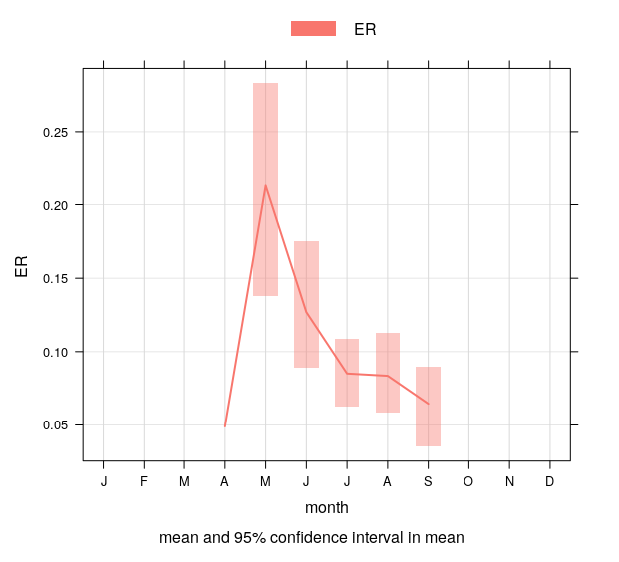
CO - CH₄ variation at Darwin based on the surface in situ measurements
Smokey events were filtered from the surface in situ data record using high CO values and high CH₄ to CO correlation.
The shift to earlier burning results in fires that burn at cooler temperatures, reducing the amount of biomass burned (or CO₂ emitted), but increasing the proportion of fire emissions from incomplete combustion.
Seasonal pattern in CH₄:CO emissions from the fires, indicates that reductions in CO₂ might be offset by increased emissions of CH₄.
Enhancement ratio of CH₄ /CO from Darwin in situ FTIR
Enhancement ratio CH₄ /CO
Notes:
As I have mentioned earlier, cultural burning are different and are usually associated with a different enhancement ratio.
Linear regression performed for each of these events to obtain the enhancement ratio of CH4 vs CO; only events with r2>0.5 is considered here.

Slide 8
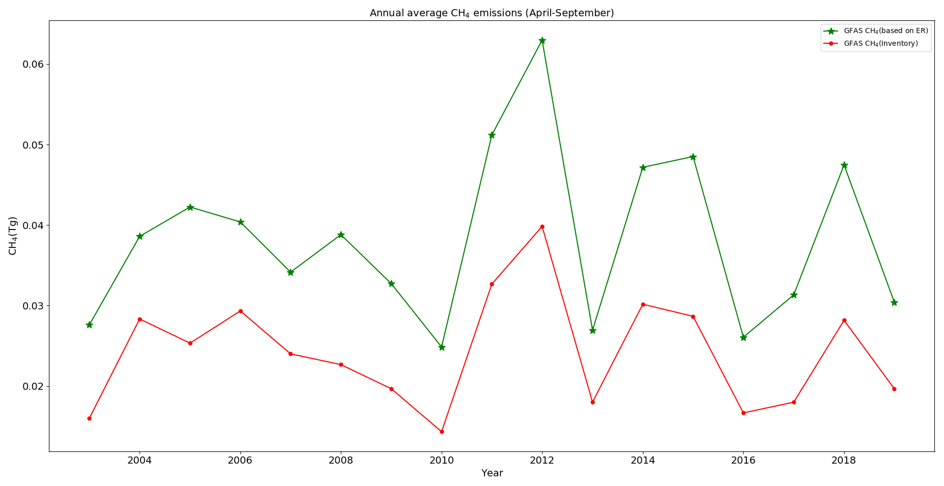
Annual CH₄ emissions reported in Northern Australia
One of the major objectives associated with the savanna burning projects involve avoiding the emission of carbon dioxide and methane.
Comparing CH₄ emissions from inventories and the estimated emissions based on the CH₄/CO enhancement ratio from Darwin in situ FTIR.
How reliable are the CH₄ credits claimed through the Emission Reduction Fund?

Slide 9
Conclusions
The shift to earlier burning results in fires that burn at cooler temperatures, reducing the amount of biomass burned (or CO₂ emitted), but increasing the proportion of fire emissions from incomplete combustion.
We see a seasonal pattern in CH₄:CO emissions from the fires, indicating that reductions in CO₂ might be offset by increased emissions of CH₄.
We find significant difference between the annual CH₄ emissions from the global biomass burning inventories and the estimated emissions based on the CH₄/CO enhancement ratio we measre at Darwin.
Thus the CH₄ credits claimed through the Emission Reduction Fund are most likely over-estimated

Slide 10
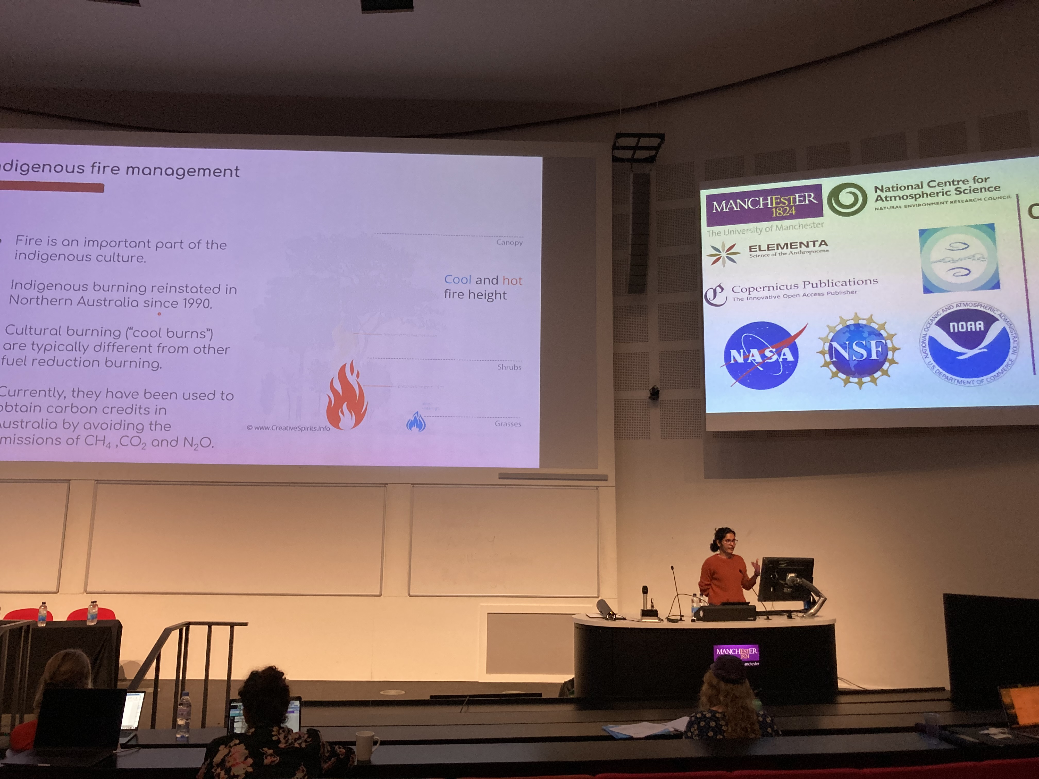
Thank you

