Slide 1


Atmospheric Ozone and CO measurements by FTIR and at Koror, Palau (7.34°N, 134.47°E)
Universität Bremen
Institut für Umweltphysik (IUP)
Fachbereich 01
Xiaoyu Sun¹, Mathias Palm¹, Katrin Mueller² and Justus Notholt¹
¹Institute of Environmental Physics, University of Bremen, Otto-Hahn-Allee 1, 28359 Bremen, Germany
²Alfred Wegener Institute, Helmholtz Centre for Polar and Marine Research, Telegrafenberg A43, 14473 Potsdam, Germany

Slide 2
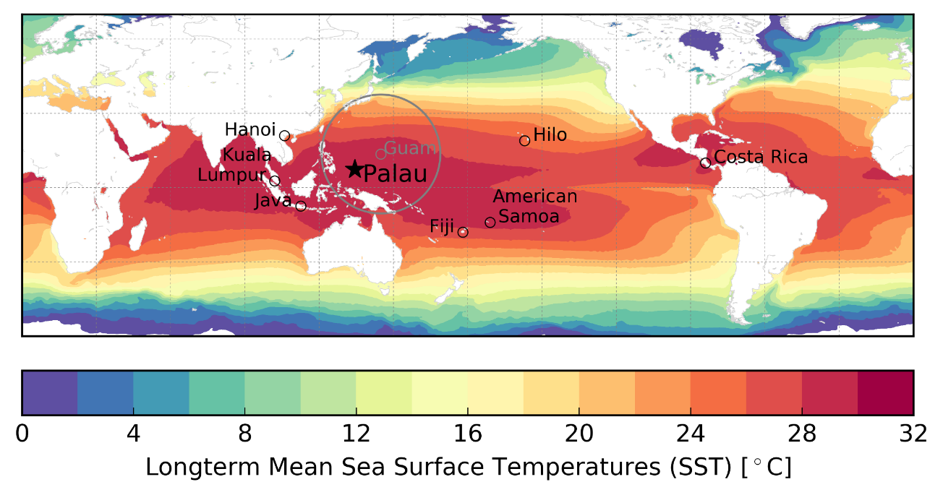

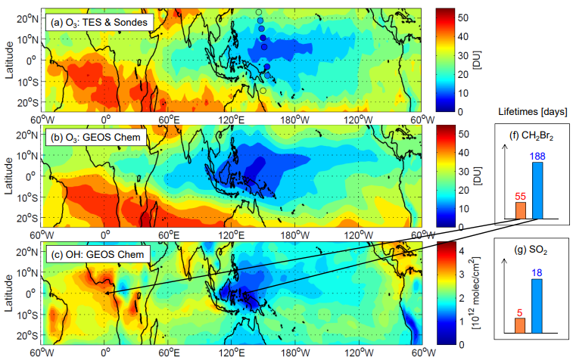
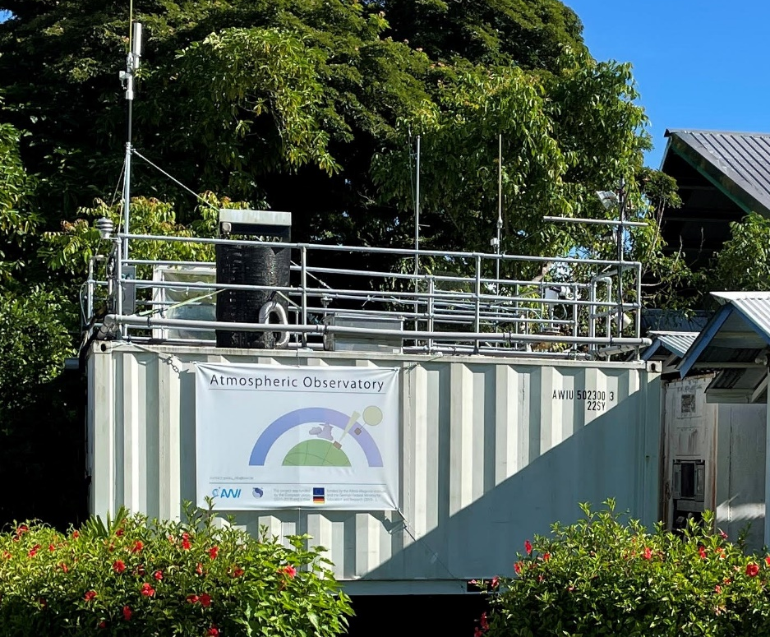
Motivation
Why do we want to measure in Koror, Palau?
Located in the Western Pacific, Warm Pool, SST~28°C all year.
Low Oxidizing capacity → ‘long lifetime’ of short-lived pollutants
O₃ + hv → O(¹D) + O₂
O(¹D) + H₂O → OH + OH
Tropospheric - Stratospheric Exchange
X
X
X
Rex et al., 2014

Slide 3
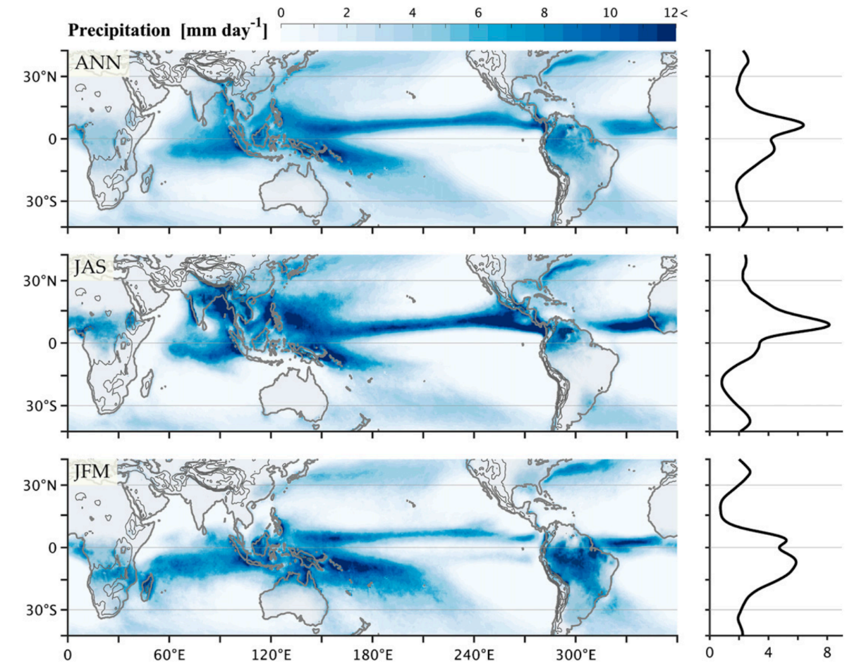
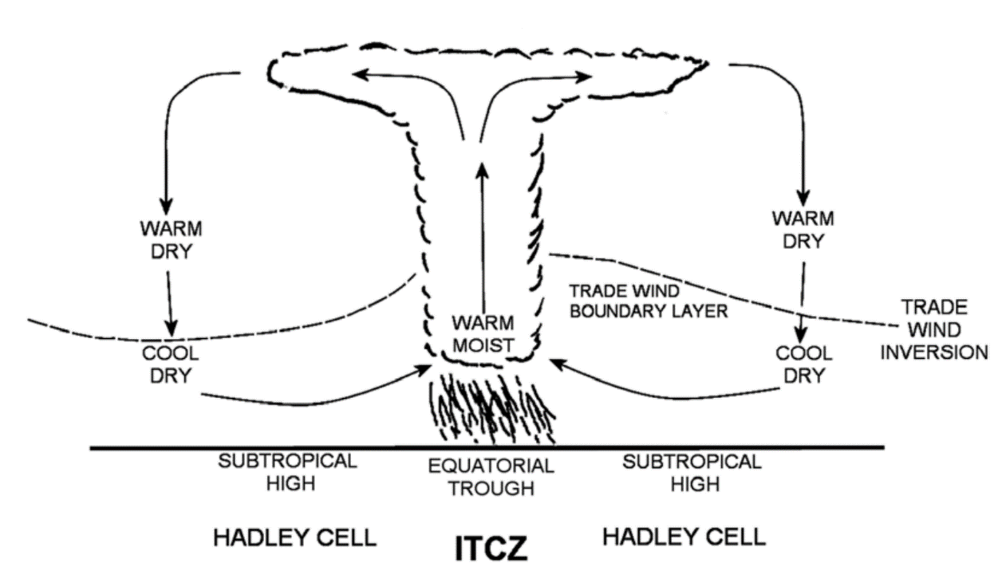
Motivation
Difficulties in Studying the Origin of Air Masses Using ITCZ
ITCZ (The Inter-Tropical Convergence Zone): the tropical trade winds from the Northern and Southern hemispheres meet
Tropical precipitation from TRMM for 1998–2014
Annual, boreal summer (JAS), and boreal winter (JFM)
+
+
+
Nicholson et al., 2018
Adam et al., 2016

Slide 4
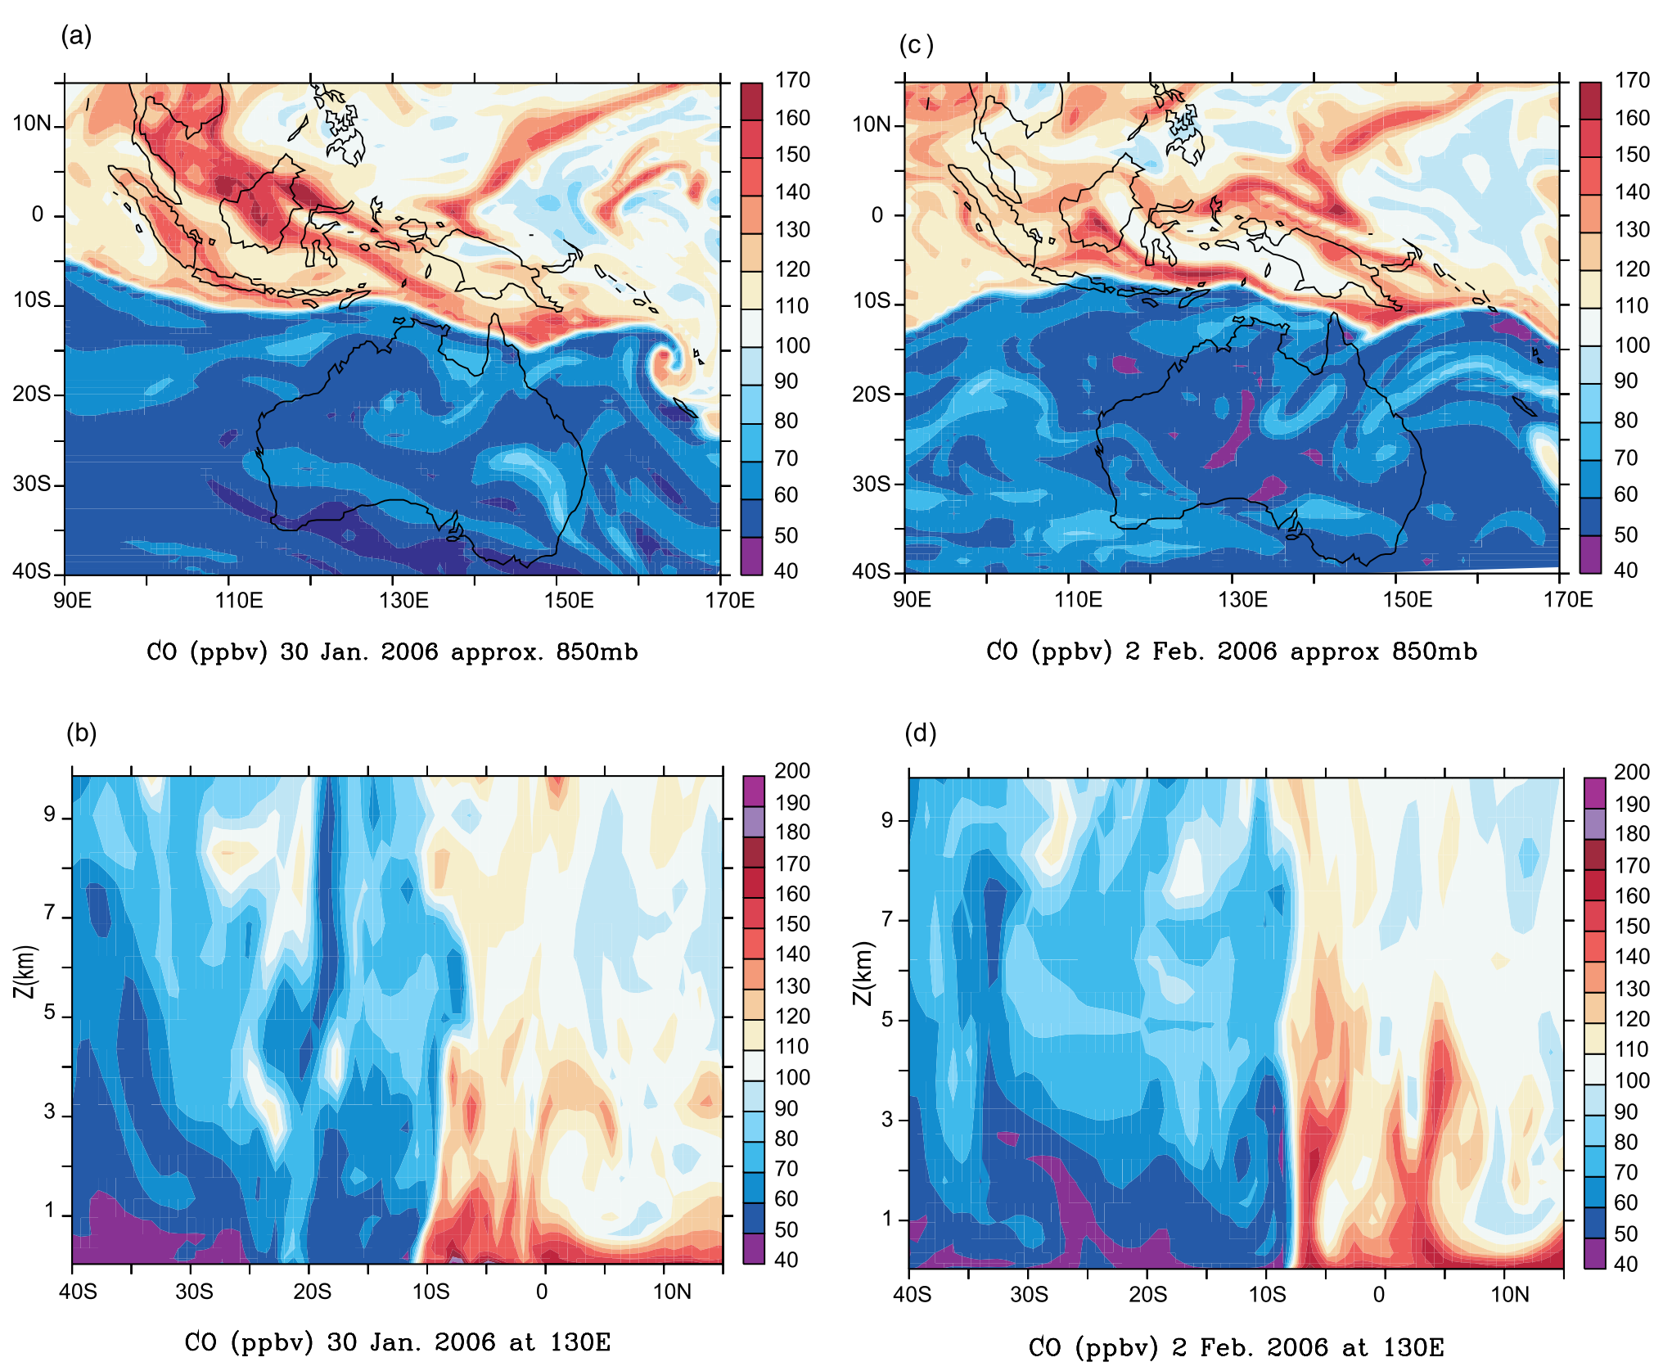
The Chemical Equator (CE) in the WP by CO tracer
CO modeled using the p-TOMCAT chemical transport model. Hamilton et al., 2008
The CO as a tracer in the model settings: turn off the chemical process
The model captures the high gradient in CO concentration both sides of the Chemical Equator (CE)
The vertical section of the chemical equator from surface to 10 km.
Use a passive tracer without chemical process can capture the airmass transport, and establish an atmospheric pattern of a ‘polluted’ and a ‘clean’ hemisphere

Slide 5
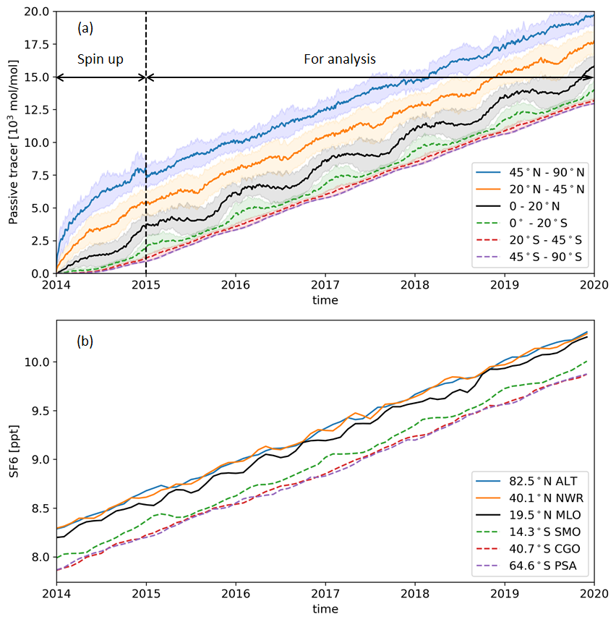
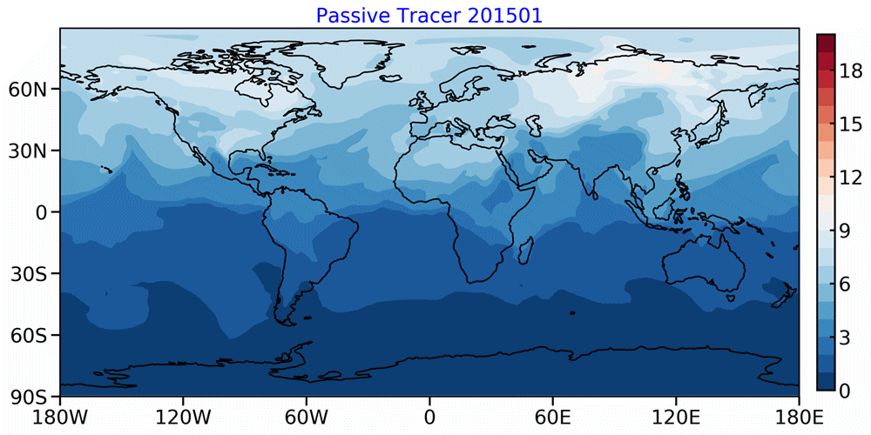
Model simulation of passive tracers for Inter-Hemispheric Transport (IHT)
The passive tracer is uniformly and constantly released from 30° - 90°N (2014-2020)
Always higher amount of tracer in the NH and lower in the SH
The distribution of the passive tracer capture the boundary between NH and SH
Virtual tracer transport simulation by GEOS-Chem
Sun et al., 2023, ACP, accepted

Slide 6
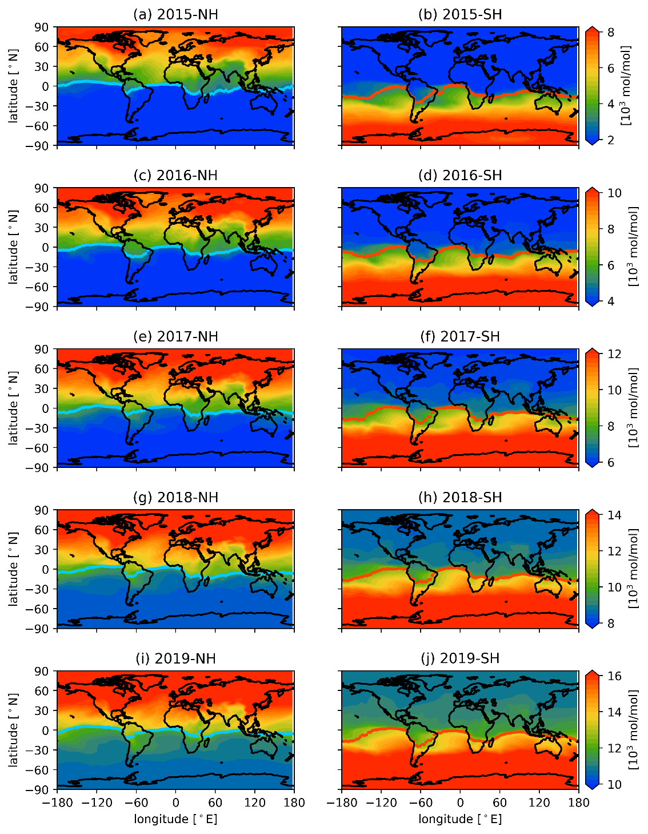
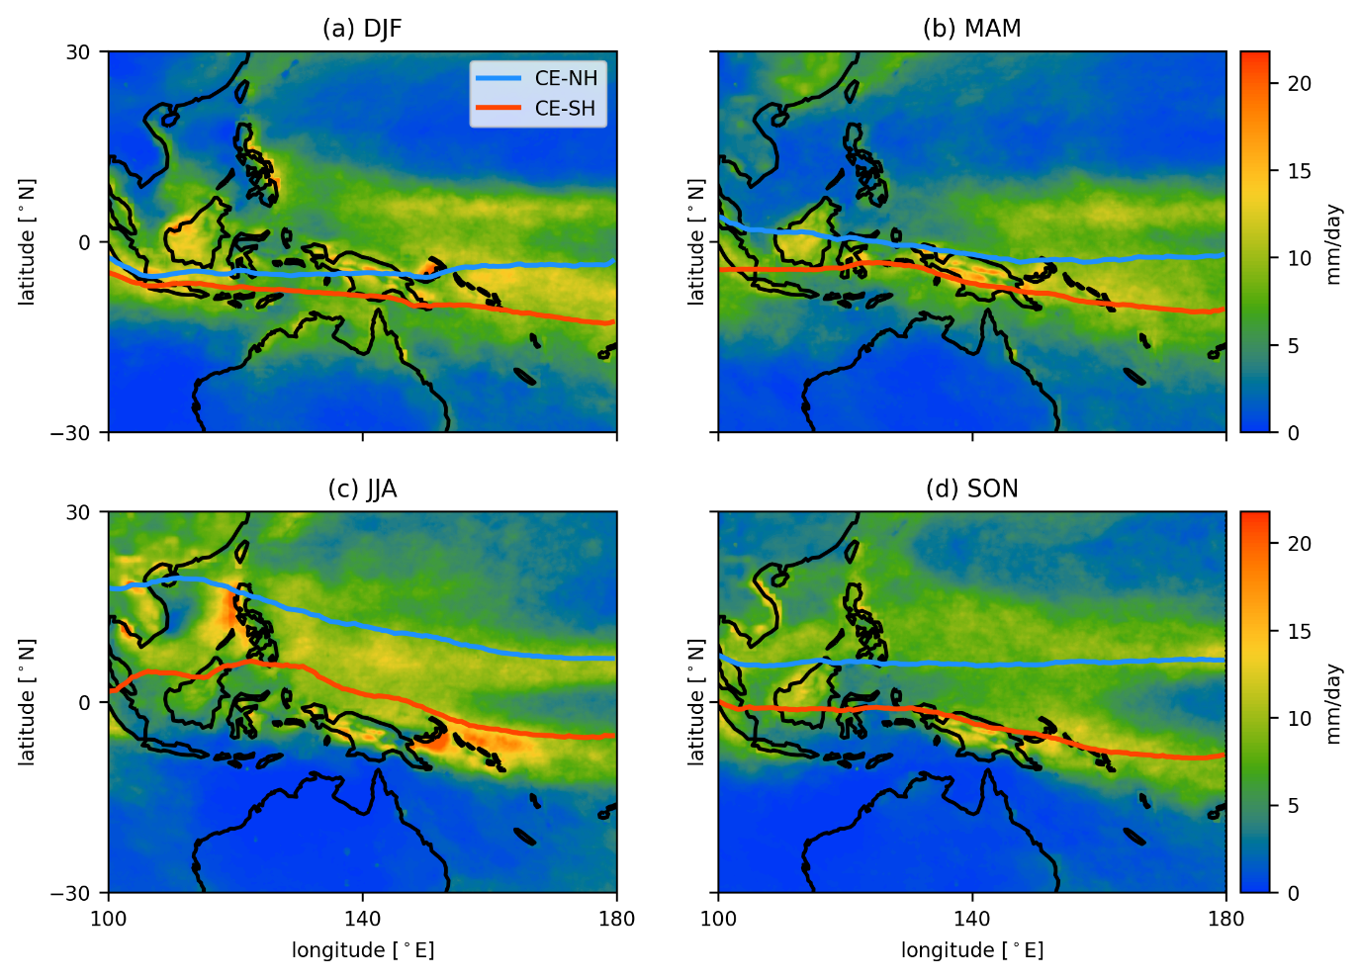
Model simulation of passive tracers for IHT
The same setups of passive tracer but released from 30° - 90°S to get the south boundary of the CE
The extent of the CE indicates a narrow transition zone where IHT happens throughout the year
The CE and passive tracer
CE and rain rate in the Tropical Western Pacific
Sun et al., 2023, ACP, accepted

Slide 7
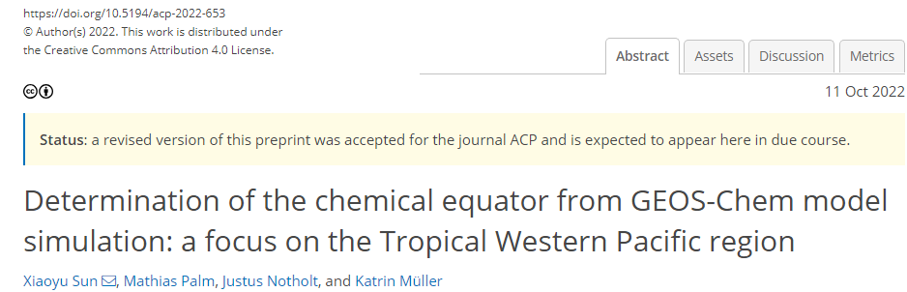
Model simulation of passive tracers for IHT
The same setups of passive tracer but released from 30° - 90°S to get the south boundary of the CE
The CE and passive tracer
CE and rain rate in the Tropical Western Pacific
Sun et al., 2023, ACP, accepted

Slide 8
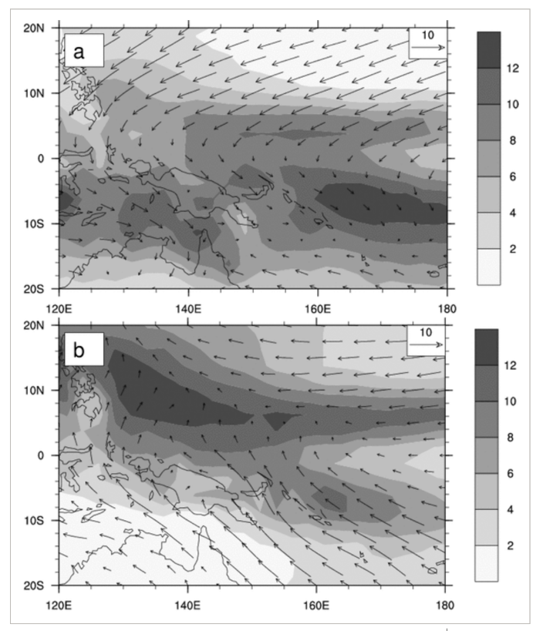
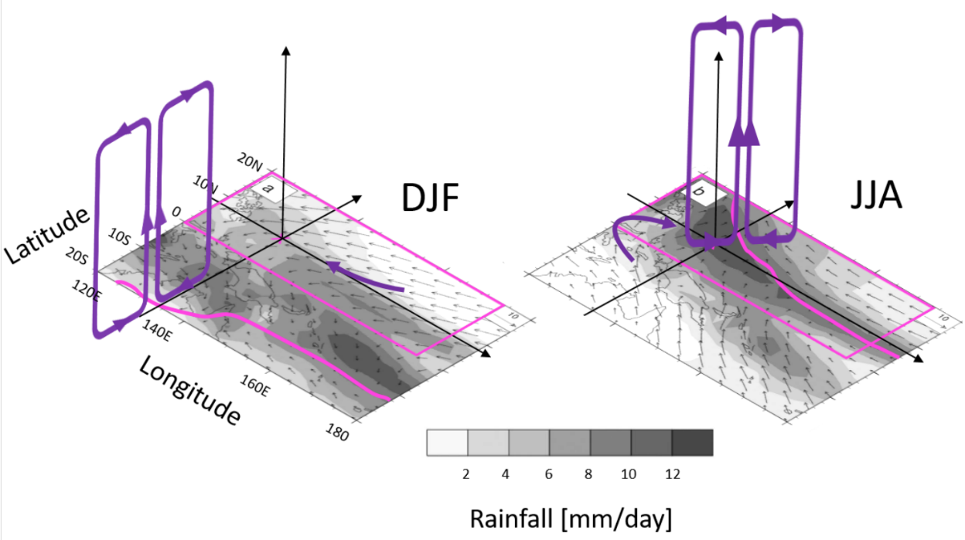
The Monsoon in the Western Pacific (WP)
X
DJF
X
JJA
Mueller, PhD-thesis, 2020
Adapted from Smith et al., 2012
The circulation system Monsoon shift with seasons.
From November to June next year, Palau is on the north to CE, and the West Pacific monsoon brings airmasses from NH to Palau with NE trade winds.
From July to October, Palau is on the south to CE latitude, airmass from SH to Palau with SE trade winds deflected to the east after crossing the equator.
Notes:
From previous study, the migration of ITCZ is an commonly used identification of the airmass origin

Slide 9
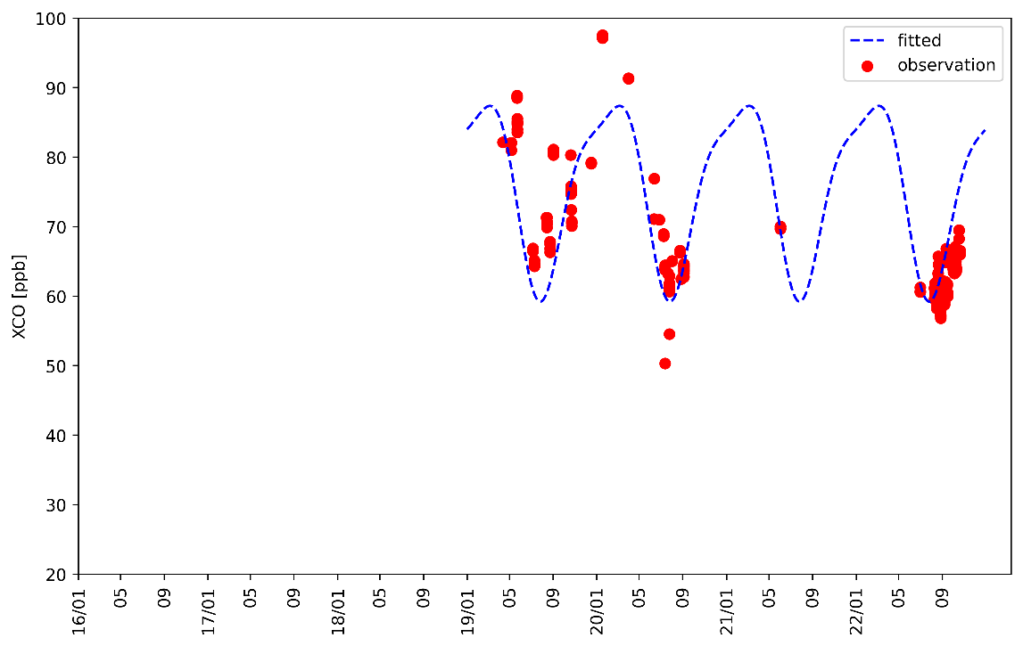
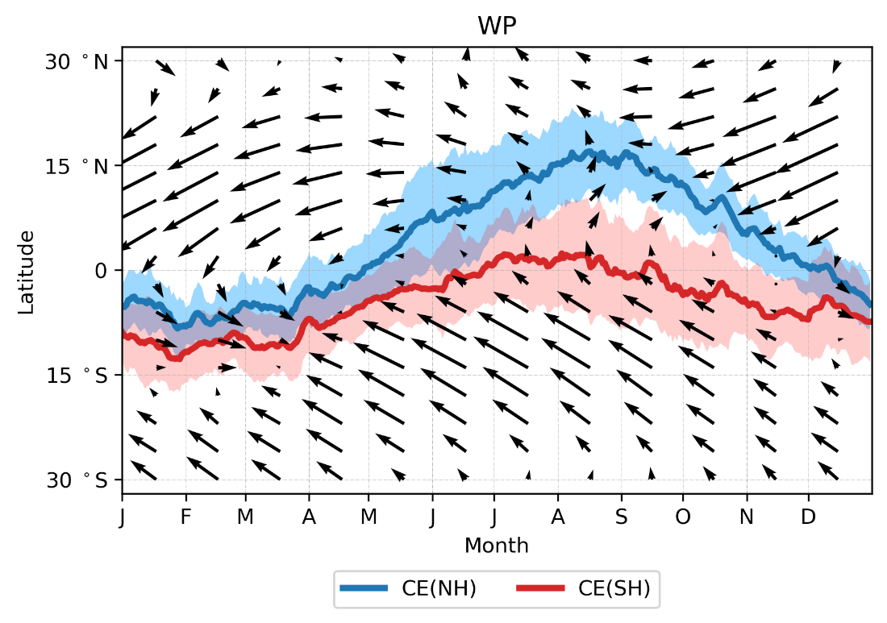
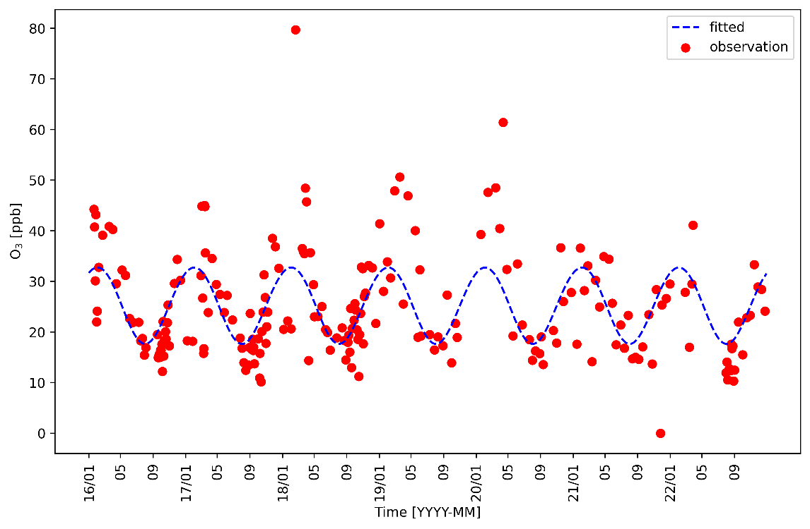
The seasnal variation of CO and Ozone
(b) X_{CO} derived by FTIR 2019 – 2022 [surface – 7 km]
Circulation system shift captured by CE
High CO and O₃ content in NH winter and early spring
From Nov – May next year, Palau located in the NH
(a) Monthly mean chemical equator and the trade wind vector from 2016-2021
(c) dry-air column averaged mole fraction of Ozone derived by Ozonesonde, 2016 - 2022 [surface – 7 km]
Latitude of
Palau 7.5°N

Slide 10
The seasnal variation of CO and Ozone
(b) X_{CO} derived by FTIR 2019 – 2022 [surface – 7 km]
Circulation system shift presented by CE
Low CO and O₃ content in NH summer and early autumn
From June – Nov., Palau located in the SH
(a) Monthly mean chemical equator and the trade wind vector from 2016-2021
(c) dry-air column averaged mole fraction of Ozone derived by Ozonesonde, 2016 - 2022 [surface – 7 km]
Latitude of
Palau 7.5°N

Slide 11
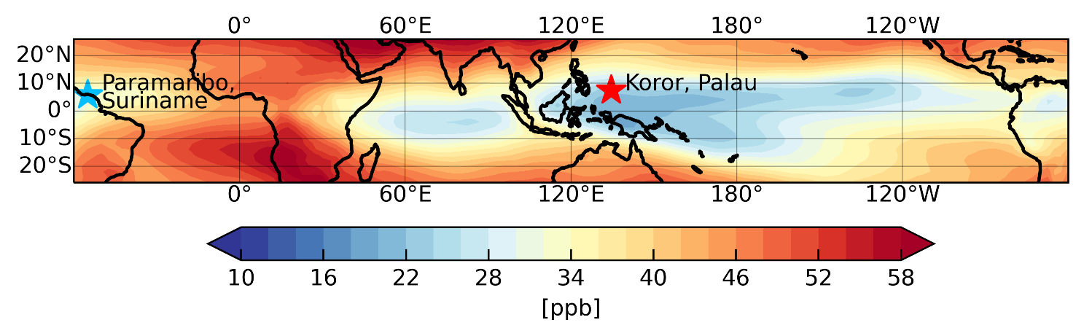
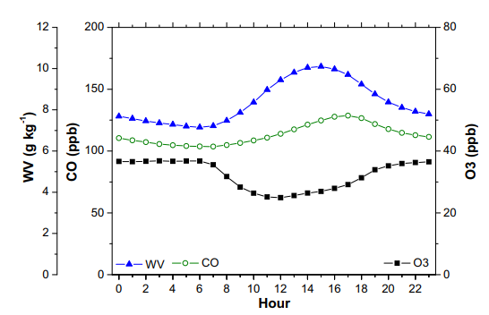
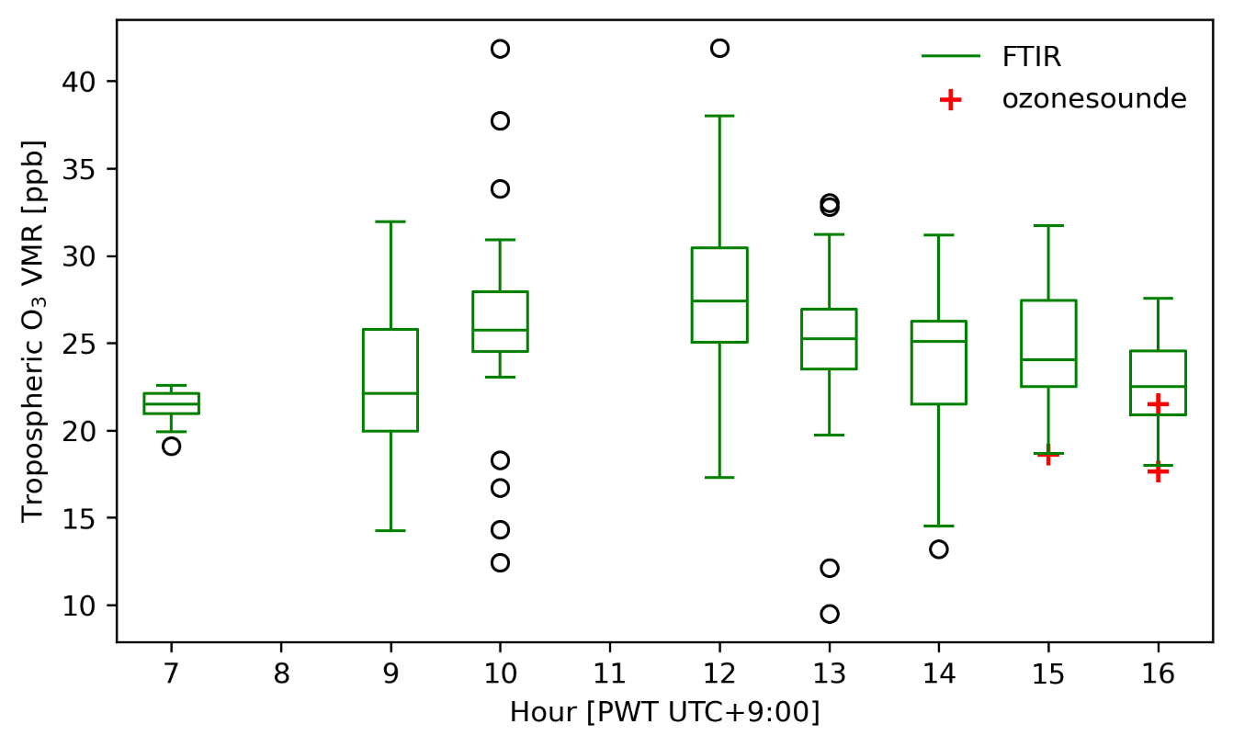
The O₃ measured in Palau during ACCLIP Campaign
(b) Tropospheric O₃ simulated by GEOS-Chem (averaged in 2022)
The O3 measurement by FTIR spectra during ACCLIP campaign from Aug. - Oct. 2022
Slight diurnal variation in Palau
Low content of tropospheric O₃ captured by FTIR and ozonesounde
X
C.-F. Ou Yang et al. 2012
(a) Hourly averaged Tropospheric O₃ in Palau
(c) Diurnal cycle of O3 observed in Mt. Lulin, Taiwan (120.92°E, 23.51°N)
~20 – 30 ppb

Slide 12
Thanks!
Summary
A tool called Chemical Equator by simulation of the passive tracer from GEOS-Chem model are developed to characterize the IHT in the tropical regions.
Seasonal changes in CO and O3 are associated with large-scale circulation and exchanges between the two hemispheres. The low CO and Ozone are in summer and early autumn and high CO and Ozone in winter and early spring can be explained by seasonal shifts in CE.
The hourly averaged of O3 measured by FTIR shows a slight diurnal variation in Palau. Low content of O₃ is captured by the measurement both by FTIR and ozonesounde.

