Slide 1



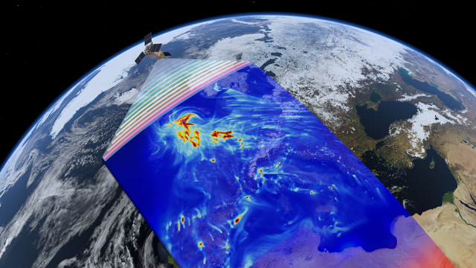

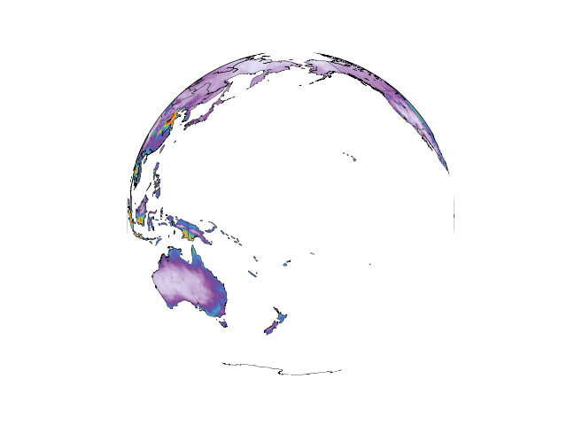
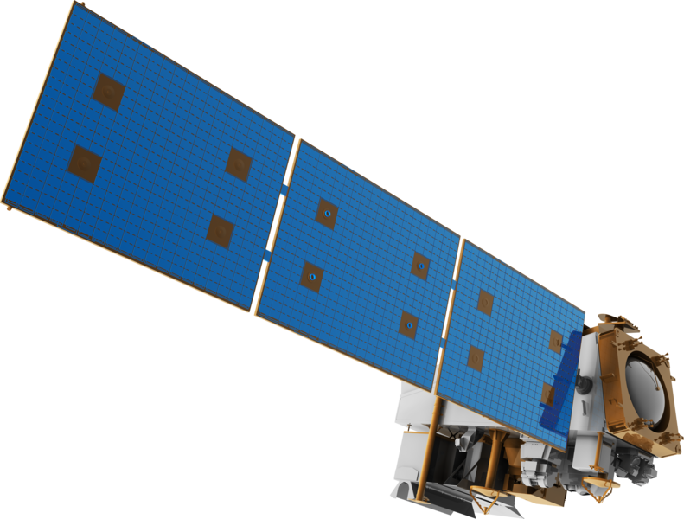
An update of the FTIR-NH3 record and validation of CrIS, IASI and GOSAT-NH3 products
An update of the FTIR-NH3 record and validation of CrIS, IASI and GOSAT-NH3 products
The Nitrogen crisis
and the need for VALidated products

Slide 2
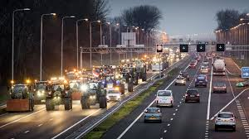
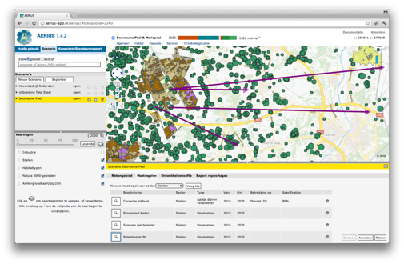
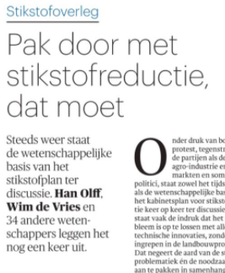
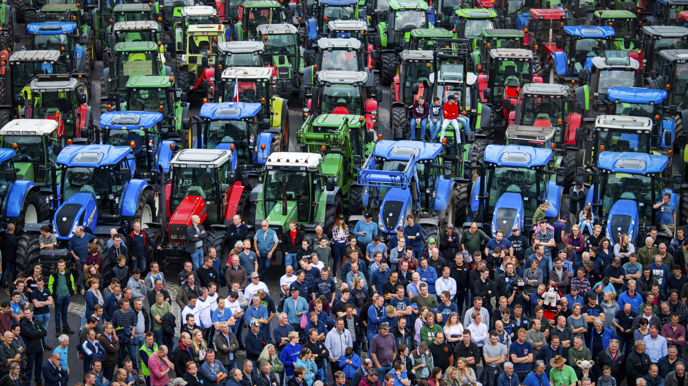
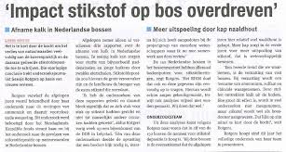
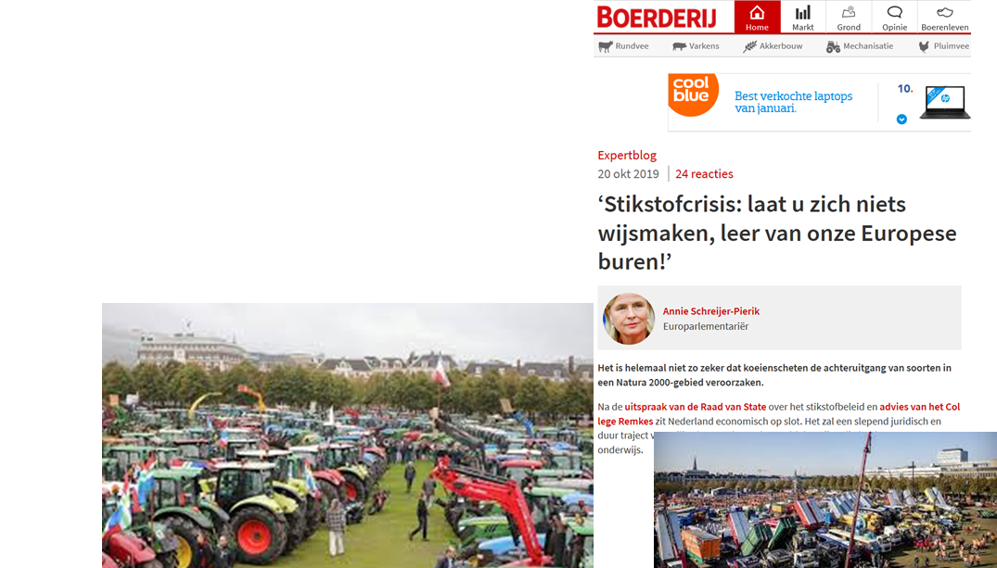
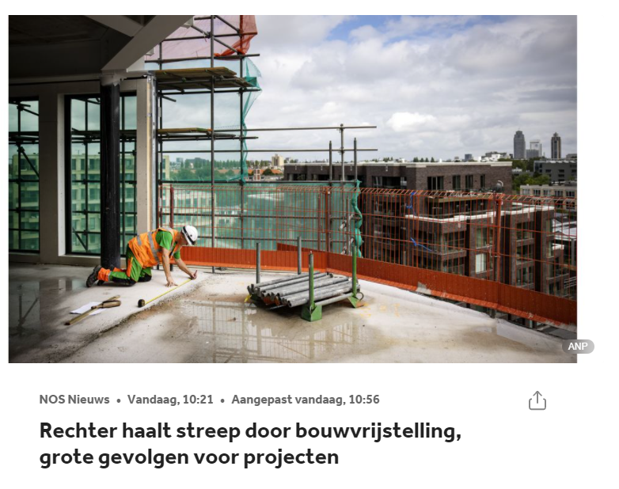
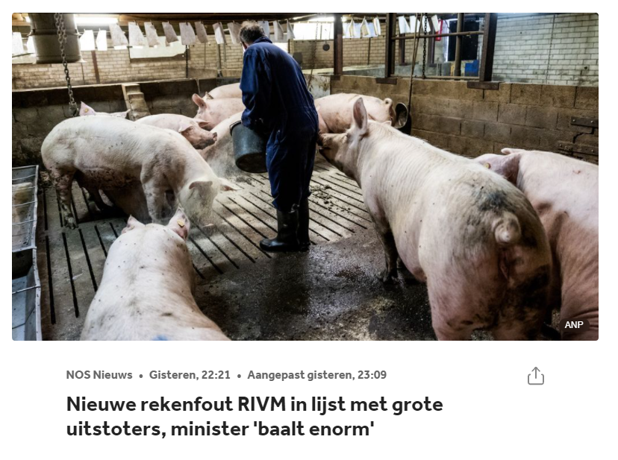

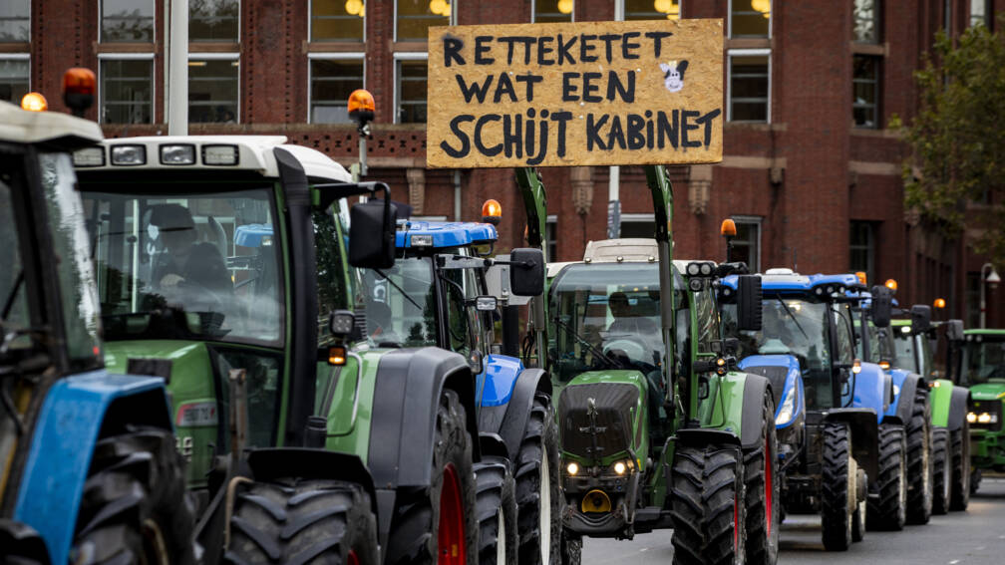
Nitrogen
CrISIs!
Notes:
Actueel onderwerp, hoeven we niet toe te lichten

Slide 3
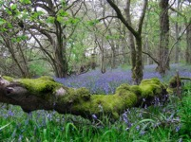
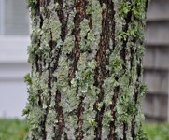


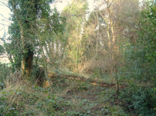
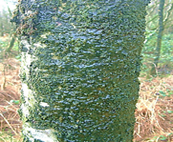
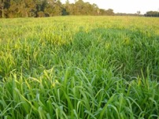
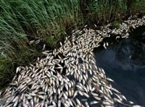
Nitrogen effects: everything grows more
N-poor semi-natural ecosystems
Biodivers understory lichens herb-rich grasslands pristine rivers
N-rich ecosystems
Loss of: forest biodiversity lichen species monoculture grasslands fish dieback

Slide 4
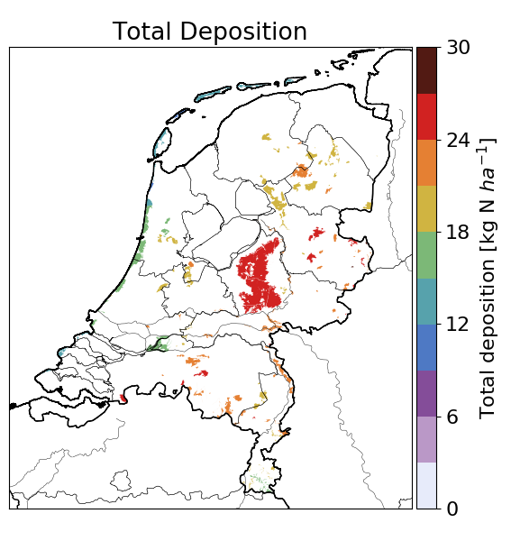
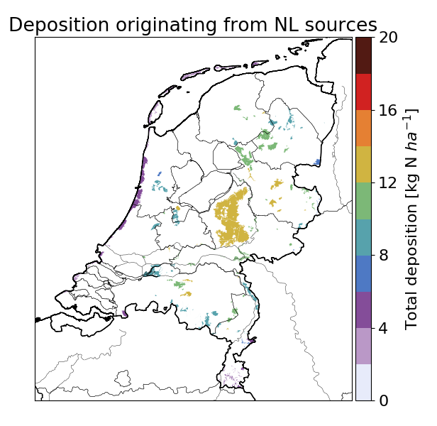
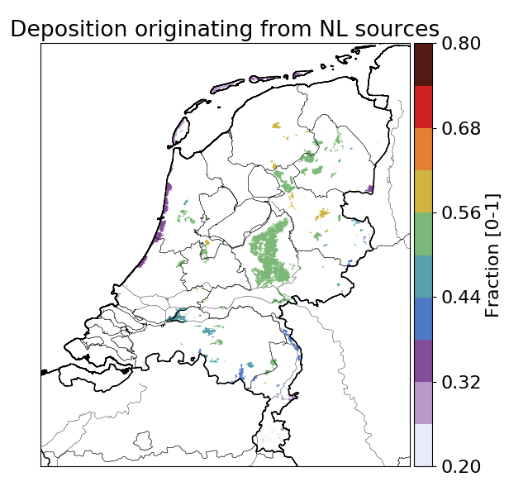
Nitrogen
CrISIs!
Notes:
Actueel onderwerp, hoeven we niet toe te lichten

Slide 5
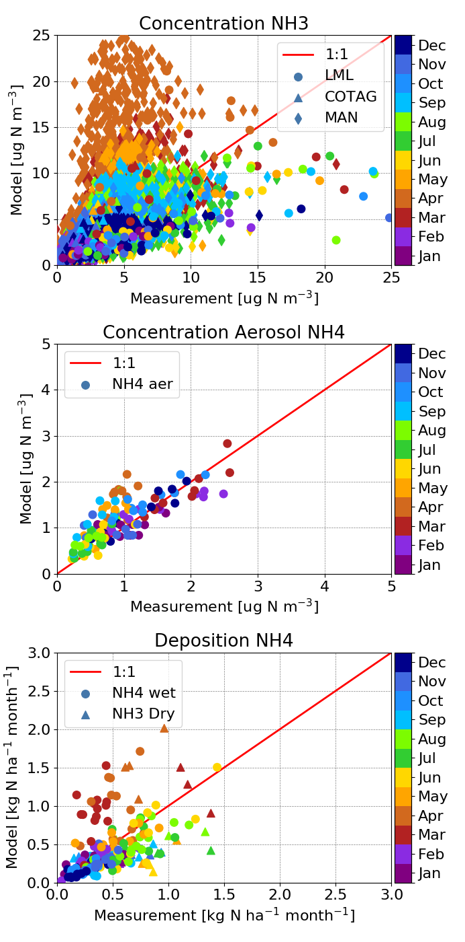
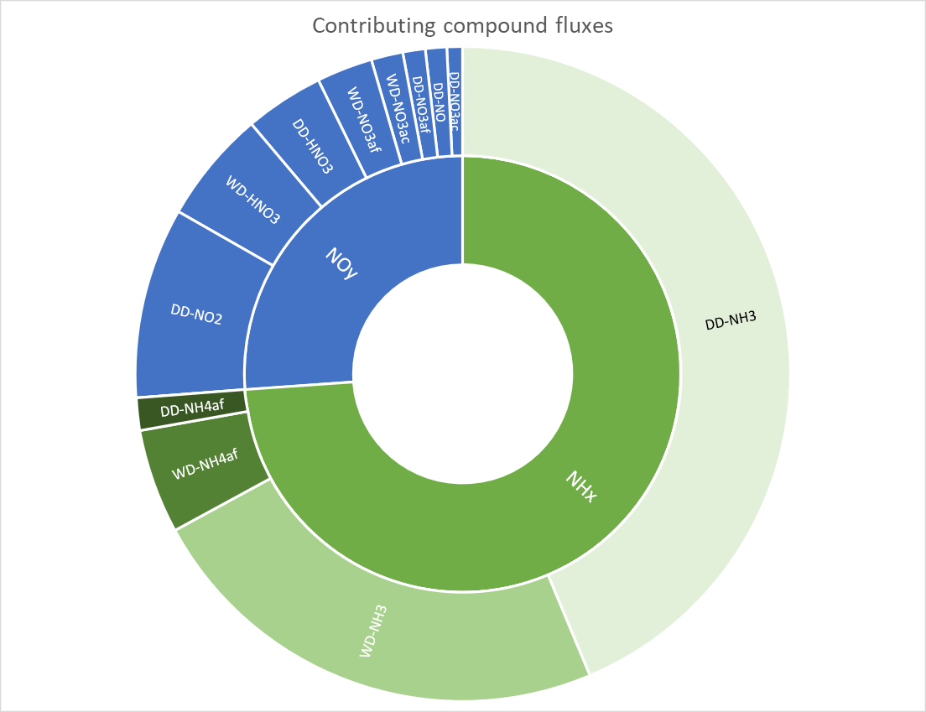
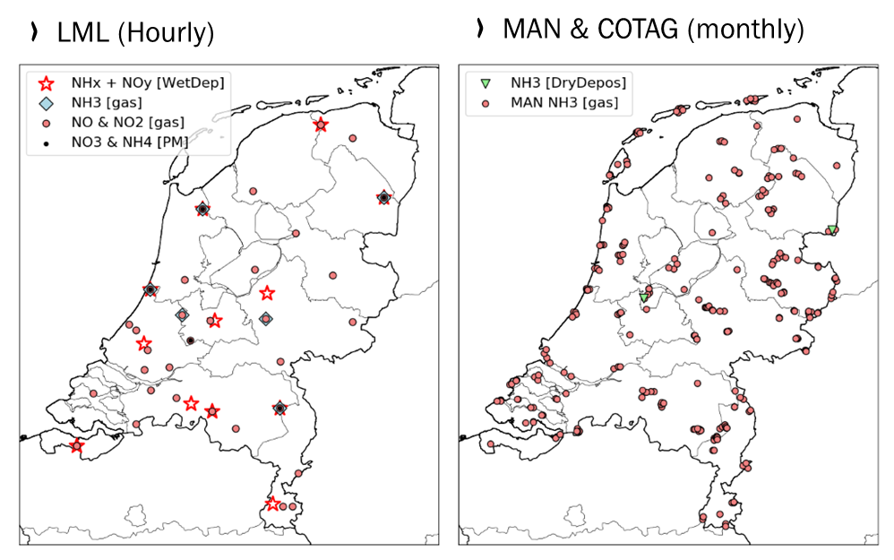
Ammonia & modelling

Slide 6
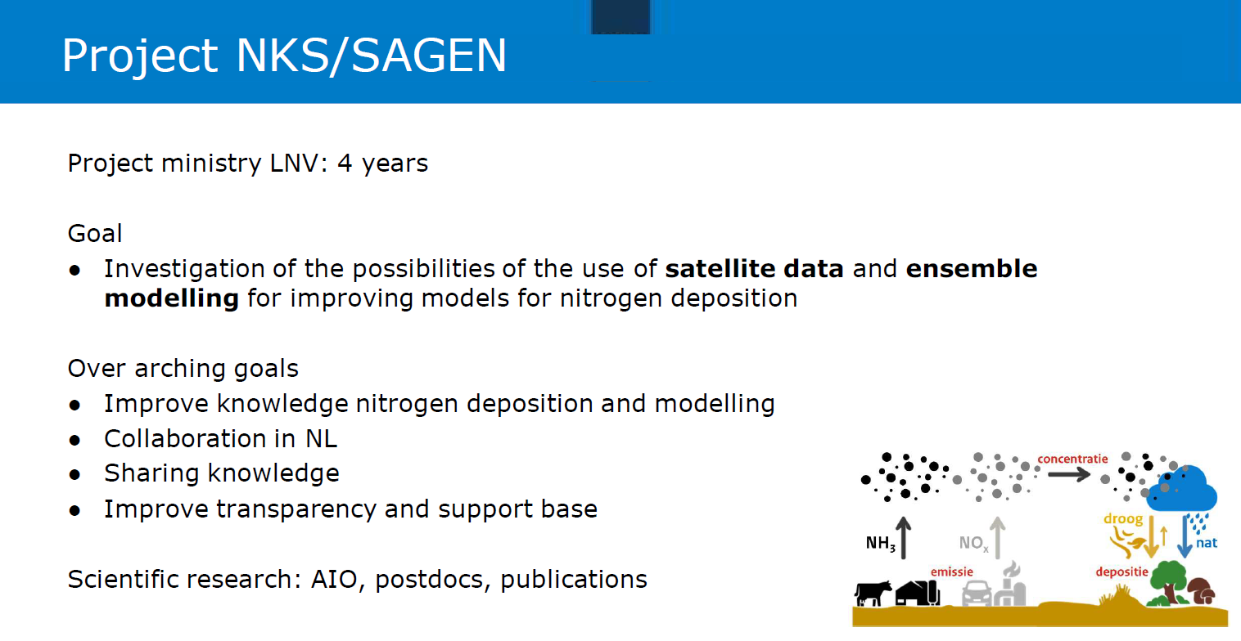
Nitrogen
CrISIs!
Notes:
Actueel onderwerp, hoeven we niet toe te lichten

Slide 7
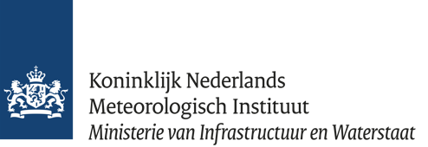


NKS-SAGEN WP3 & satellite NH3
Apply current systems and methodologies to the Netherlands:
Validation using ground-based FTIR
Study distributions of NH3
Study trends, IASI (A,B,C) (2008-) and CrIS (1,2,3) (2013-) AIRS(2002-)
Evaluate model simulations (LOTOS-EUROS, EMEP, OPS..)
Further develop and improve inversion methods

Slide 8
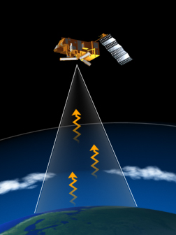
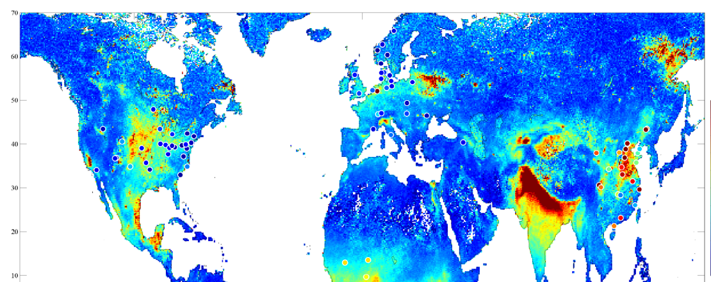
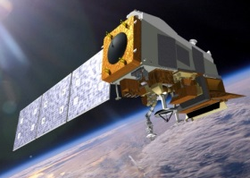
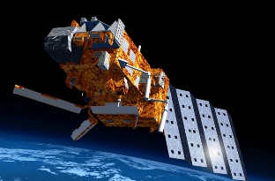
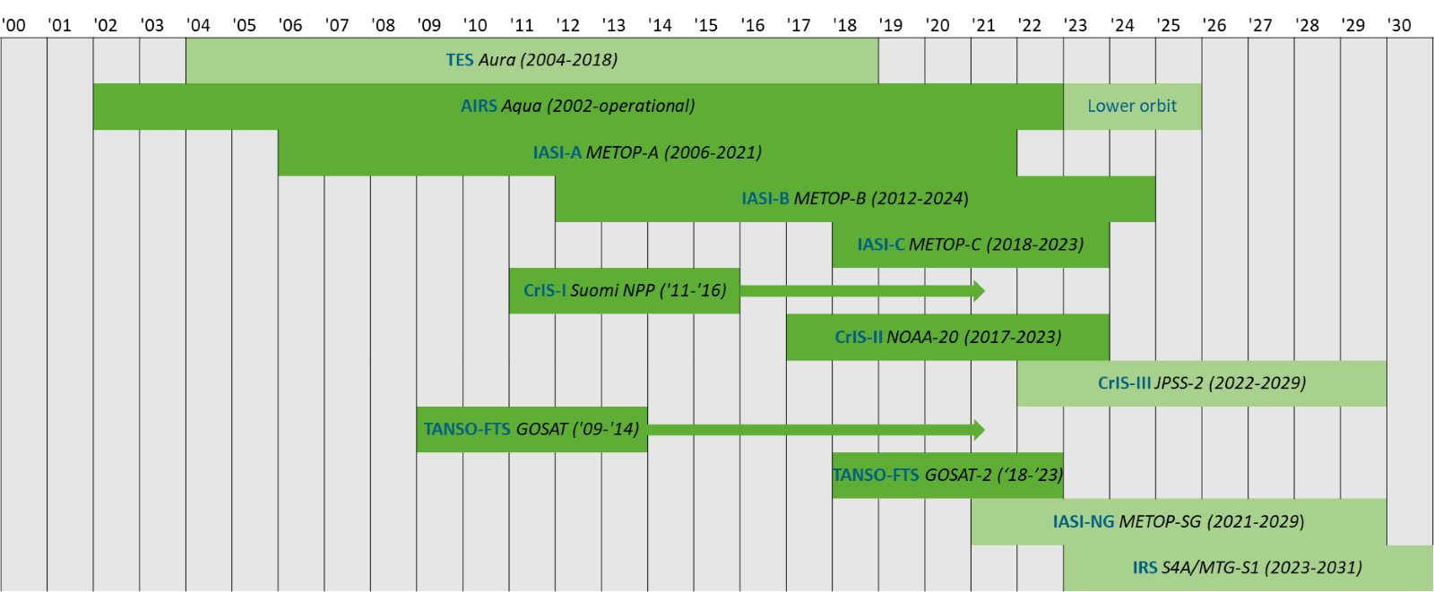


Why use satellites for observing Ammonia?
  Full vertical column
  Global coverage & Daily overpasses (consistent methodology around the world)
  Two most commonly used instruments:
CrIS on the Suomi-NPP satellite
Cross-track Infrared Sounder (CrIS)-1 & -2
  Footprint: 14-km diameter
  13:30 (day) & 1:30 (night) overpass
  Detection limit ~0.5ppbv
IASI on the MetOp-A satellite
Van Damme et al., 2015 ; doi:10.5194/amt-8-1575-2015
Infrared Atmospheric Sounding Interferometer (IASI-A (B & C))
  Long measurement records
  Footprint: 12-km diameter (andir)
  9:30 (morning) & 21:30 (evening) overpass
  Detection limit ~2ppbv
Disadvantages
Coverage is not continuous:
  2 measurements per day and not under clouds
Limited resolution spatially (~10 km) and vertically (surface & boundary layer values are correlated)

Slide 9
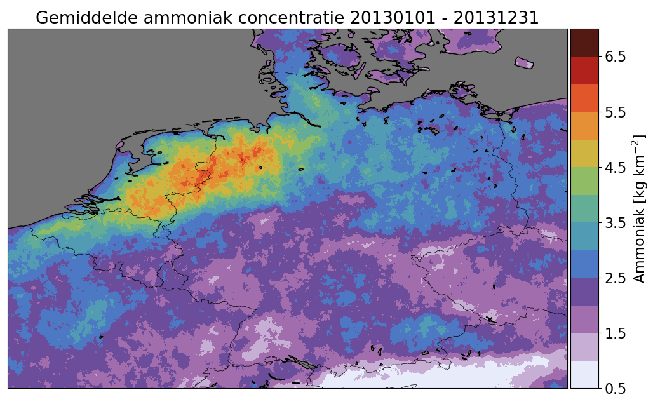
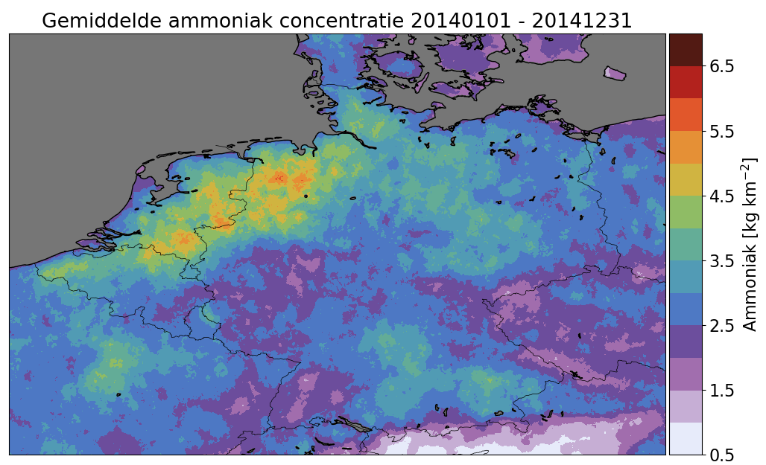
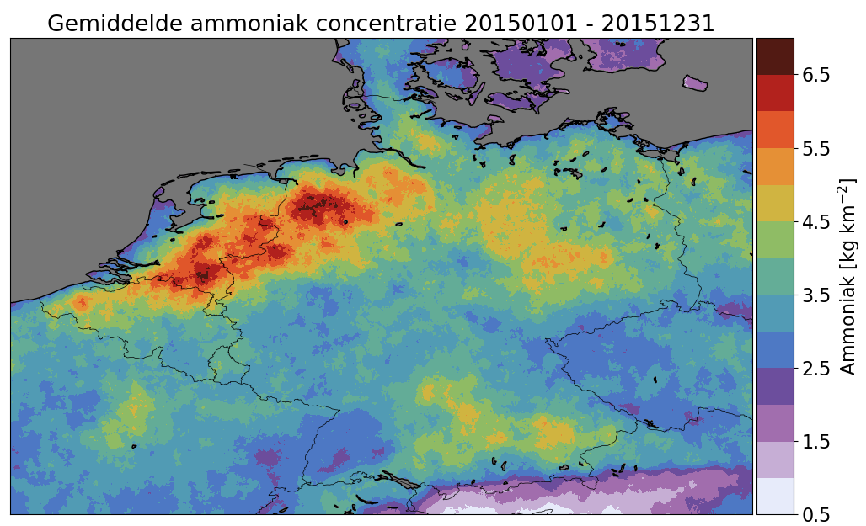
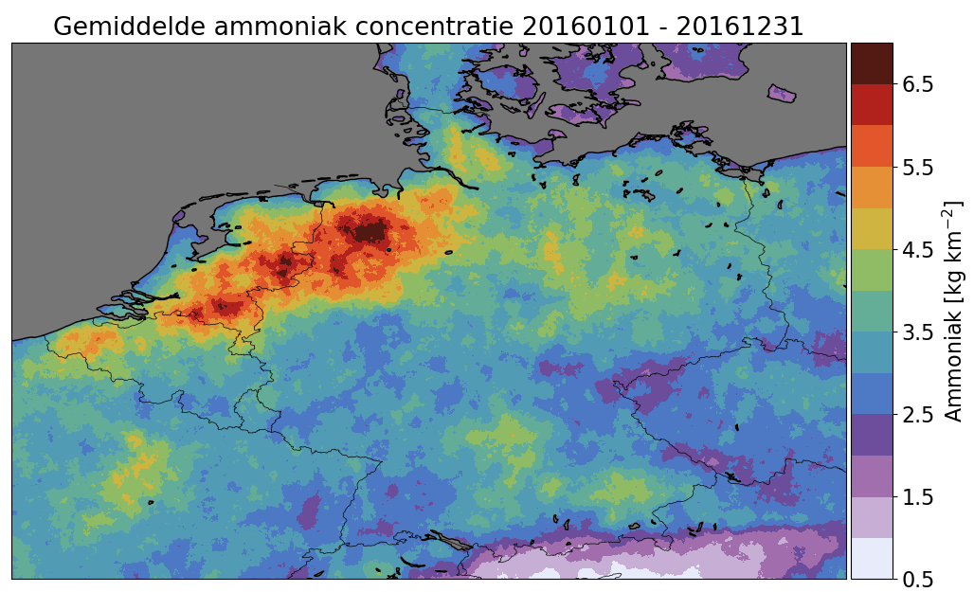
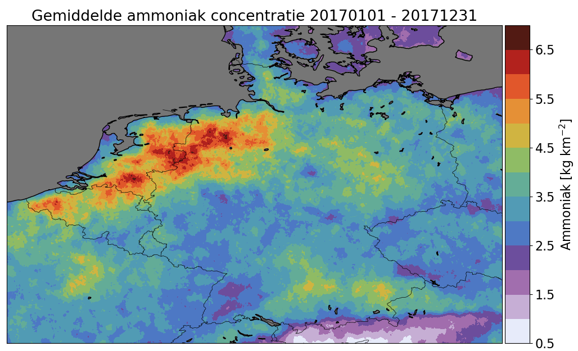
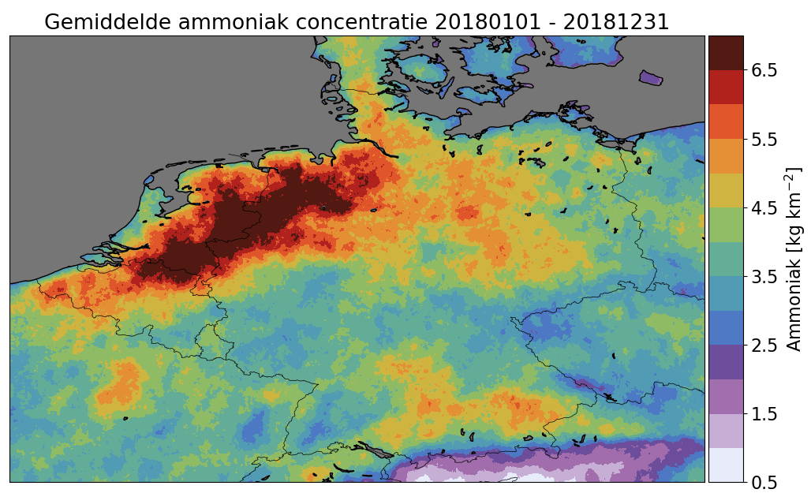
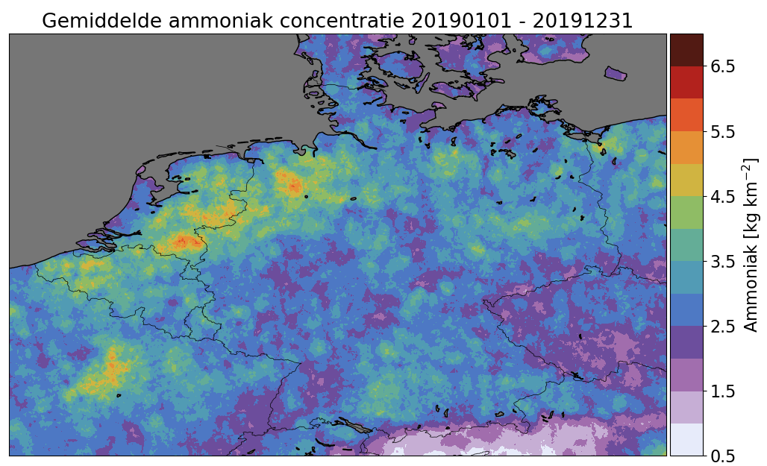
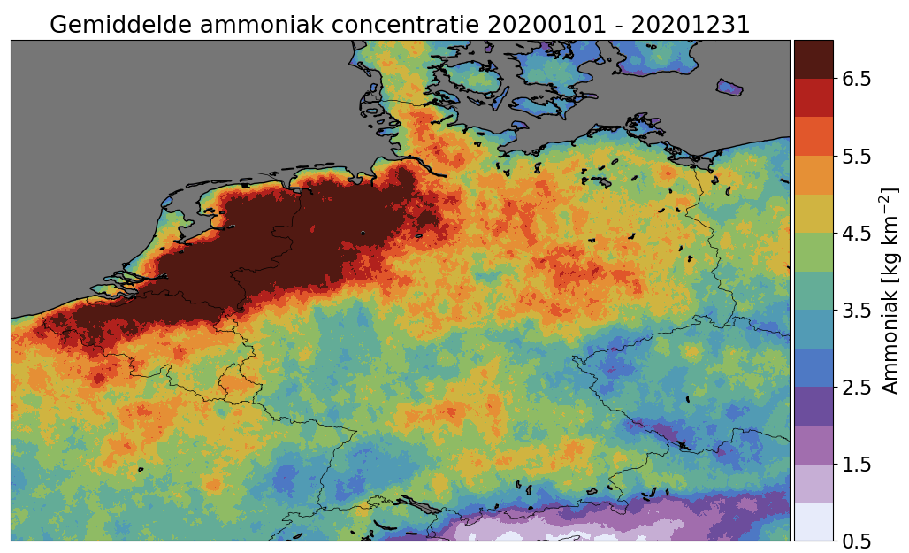
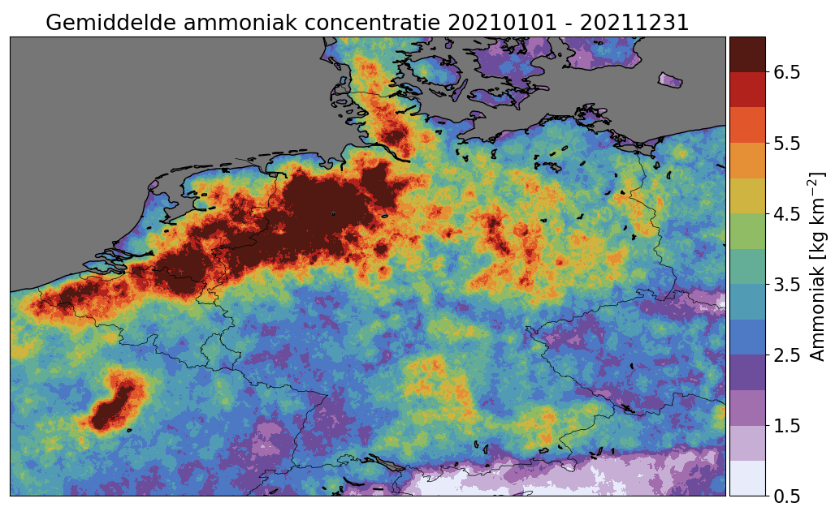
April-August missing due to outtage/circuit board problems
No obs after May 21st 2021 - End of CrIS-1 for NH3

Slide 10
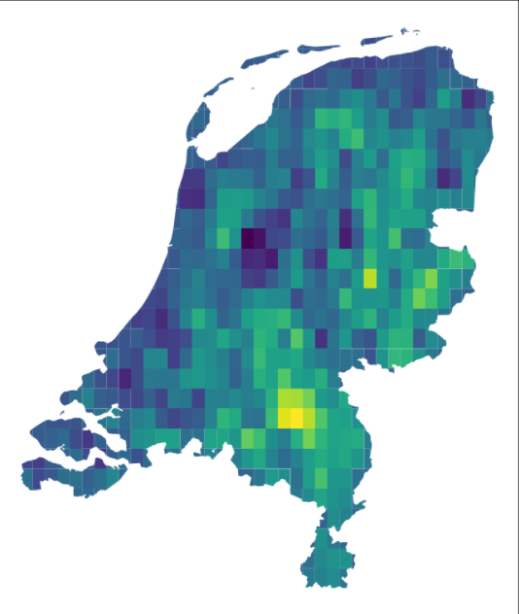
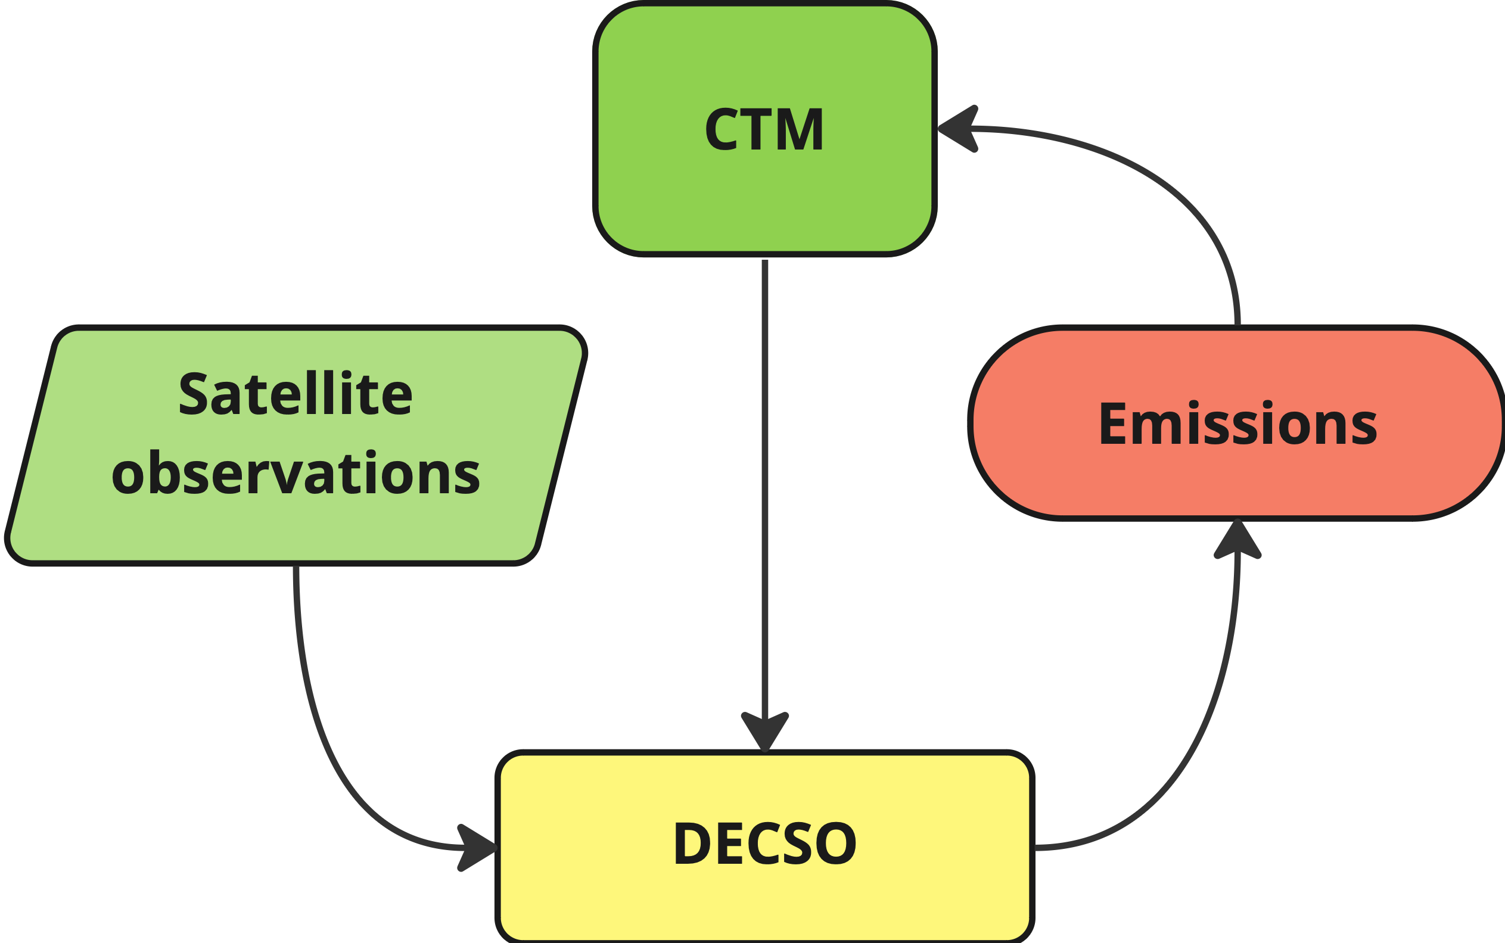
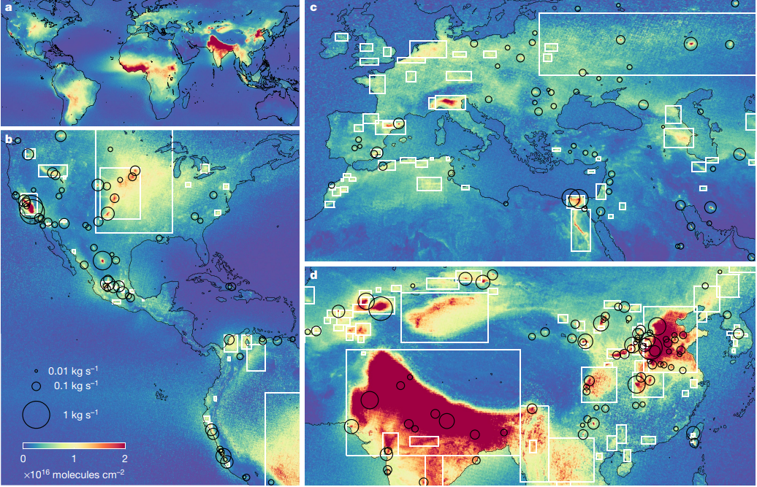
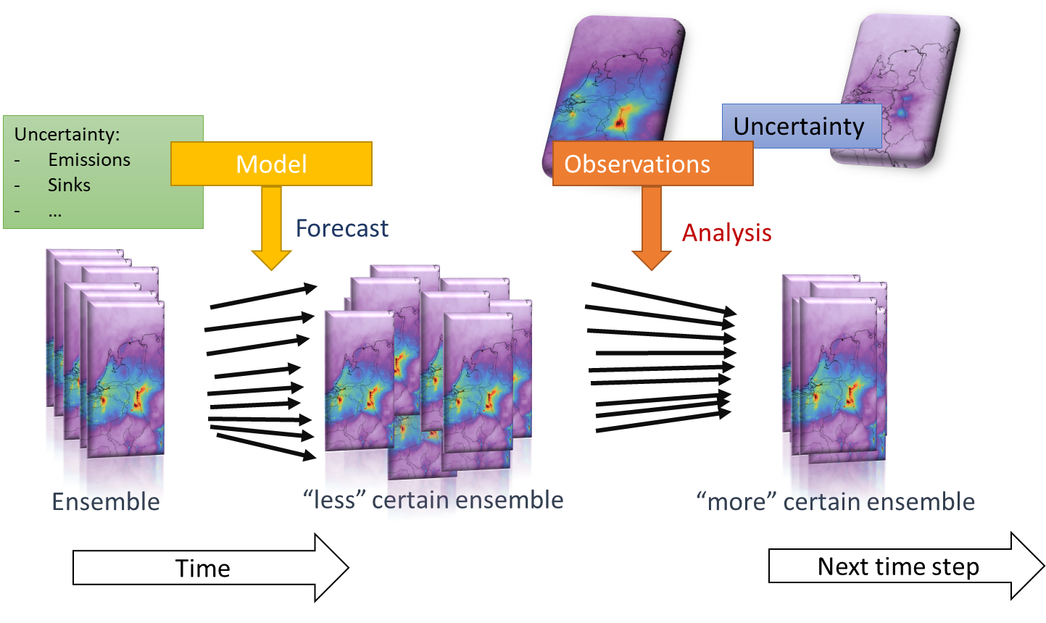
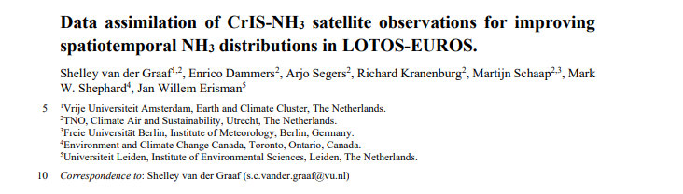
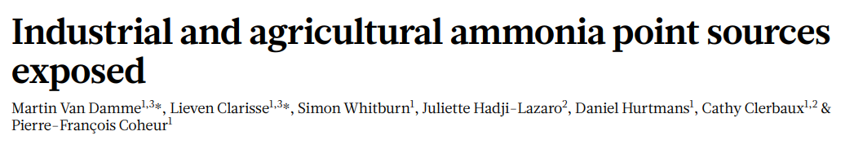
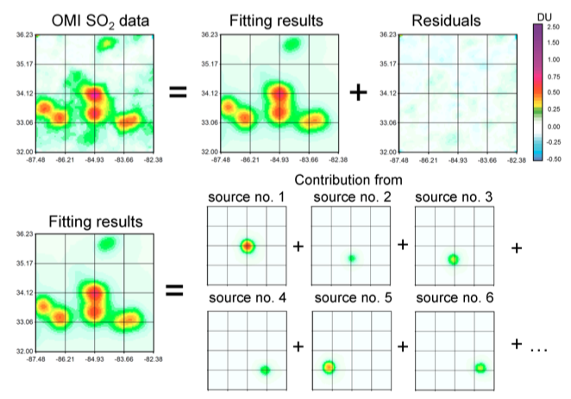
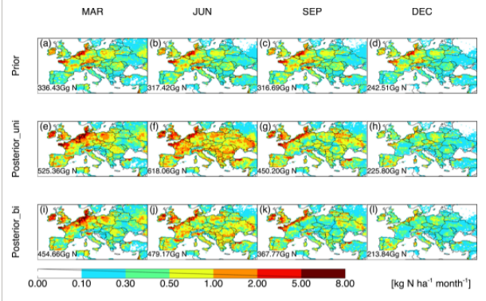
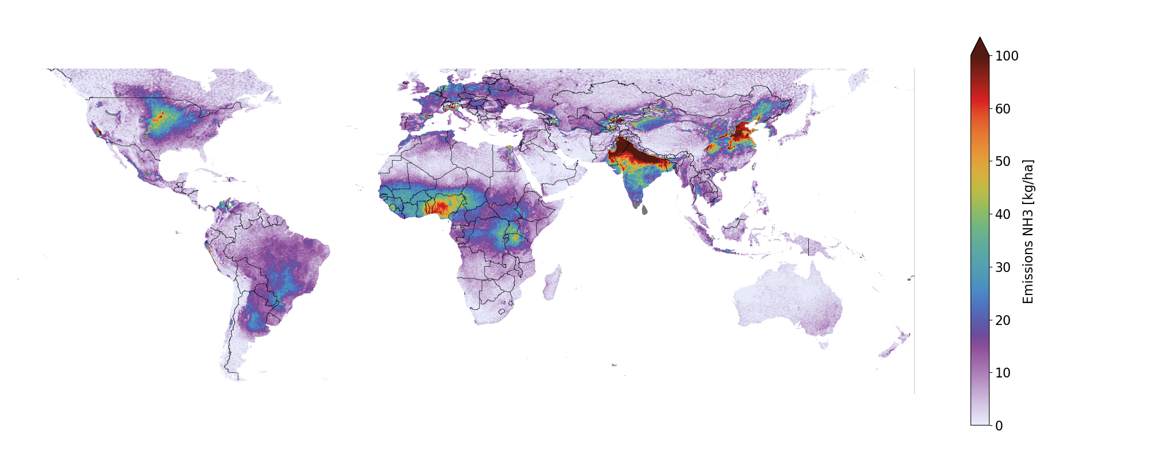
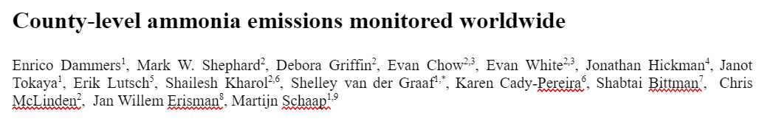

How to get to an improved Budget?
  Methods requiring a Chemistry Transport model
  Mass-balance
  Plume models
  Variational - Ensemble Kalman Filters
  Adjoint /4d variational
Notes:
Advantages
Fast and typically computationally cheap
Ideal for detecting new sources
Independent of Chemistry Transport models
Disadvantages
Often steady state or average over longer periods
No additional information (typically only emission)
Advantages
Typically more Accurate
Day to day variations
Additional information (Deposition fields for example)
Disadvantages
Computationally expensive
Expertise and experience required

Slide 11


Multi-gaussian-Plume - GLOBAL NH3 emissions 2013-2020
Notes:
Emission clusters mostly seen around the expected locations (India, China, mid US, NL, Germany)
Typical uncertainties in the range of 30%, increasing towards regions at the sensitivity limit and or near mountainous terrain (Based on monte carlo analysis)
Potential anomalous measurements over some deserts (Dust / H2O Vapour / other?) under investigation

Slide 12


Multi-gaussian-Plume - GLOBAL NH3 emissions 2013-2020
?
Most of the EU27 countries match well with the satellite estimates
  Each of these countries are required to report NH₃ emissions
Inventory country totals typically factor 1.5-2 higher for regions with previously reported emissions
Whats missing for most of the globe:
  Inventory/measurements of “Natural” emissions
  Representative emission factors
Notes:
Emission clusters mostly seen around the expected locations (India, China, mid US, NL, Germany)
Typical uncertainties in the range of 30%, increasing towards regions at the sensitivity limit and or near mountainous terrain (Based on monte carlo analysis)
Potential anomalous measurements over some deserts (Dust / H2O Vapour / other?) under investigation

Slide 13


Validation: ground-based FTIR – NDACC-IRWG network
Strategy based on Dammers et al., 2015
Choice between narrow and wider micro windows
  Focus on two main absorption features of ammonia around 930 & 967 cm⁻¹
Apriori’s based on GEOS-CHEM run v12 (no seabird emissions)
Scaled apriori’s based on experience with satellite observations /ground-based data / results from inversions studies
HITRAN 2008 (atm20 for H2O, varies from site to site)
Few exceptions for apriori’s, more details on request

Slide 14







Validation: ground-based FTIR – NDACC-IRWG network
?
CrIS
WIP
IASI-A
GOSAT

Slide 15












Cabauw 2023 JUN-AUG - FTIR-NH3 campaign

Slide 16



Cabauw 2023 JUN-AUG - FTIR-NH3 campaign

Slide 17







Cabauw 2023 JUN-AUG - FTIR-NH3 campaign

Slide 18



Thank you for
Your time
Questions?
Enrico Dammers
Enrico.dammers@tno.nl

Slide 19
Thank you for
Your time
For further questions contact:
Enrico Dammers
Enrico.dammers@tno.nl

Slide 20


Results - GLOBAL NH3 emissions 2013-2017
CAMS-GLOB-ANT inventory
CrIS
Broadly speaking, similar emission patterns found for CrIS & the inventory
Large parts of Europe / India / China show a very similar distributions
India & China: mostly redistribution of emissions in inventory needed
US / South America / Africa showing large differences in emissions totals
Whats missing: a “natural” soil emissions inventory
Enrico.dammers@tno.nl
Dammers et al., 2021, to be submitted

Slide 21

Results - Aggregated Province/state totals
At provincial/state/county level similar patterns emerge.
Most EU27 countries closely aligned around the 1:1 line, more spread for eastern/southern european countries…
Globally, most of the other regions show large spread
Satellite based estimates for the EU27 provinces compare well with the inventory, especially NL/DE/DK/UK/CH…
  Inventories typically use high levels of information to create their inventories (e.g. animal numbers, location of animals/livestock housing, application location).
  Showcase of the value of the effort put into such inventories
Enrico.dammers@tno.nl

Slide 22

Results - Aggregated spatio-temporal totals
Aggregated yearly and monthly regional totals
  Satellite: CrIS
  Inventory: CAMS-GLOB-ANT (Granier, 2019, doi:10.24380/d0bn-kx16)
  Red outline indicates added counties/municipalities
Inter-annual patterns almost missing in the current inventories
  Recent increase in NLD-BEL-GER concentrations also observed in in-situ concentrations
  Besides increasing agricultural/industrial activities variations between years to be expected due to meteorology (temperature, rainfall) influencing emissions
Seasonal variations somewhat reproduced
  Spring peaks less pronounced (US/NLD-BEL-GER)
  Timing can be off due to shifting fertilizer season
  Larger emissions livestock?
  India surprisingly close, potentially overestimated in burning season (end of year)
  Lack of observations in monsoon season resulting in underestimation of July-September
Enrico.dammers@tno.nl

Slide 23

Conclusions
Created a multi-source plume model, enabling fast global emission estimates
Satellite based estimates of EU27 country and provincial totals closely match the CAMS-GLOB-ANT inventory
Inter-annual variations currently not reproduced in inventory
Seasonal variations, less pronounced fertilizer peaks
Results for the CrIS and IASI satellites show comparable patterns, difference likely due to differences in sensor/retrieval/overpass
Global satellite based estimate show emissions up to a factor 3 higher than currently in the inventories.
IASI-A
Enrico.dammers@tno.nl

