Slide 1


Year-round trace gases at Eureka, Nunavut from 2008-2022 using Infrared Emission Spectroscopy
NDACC-IRWG-TCCON-COCCON Meeting
Joseph Hung$^{1}$, Lei Liu$^{2}$, Zen Mariani$^{2}$, Mathias Palm$^{3}$ Kimberly Strong$^{1}$
University of Toronto, Department of Physics$^{1}$
Environment and Climate Change Canada$^{2}$
University of Bremen, Institute of Environmental Physics$^{3}$

Slide 2
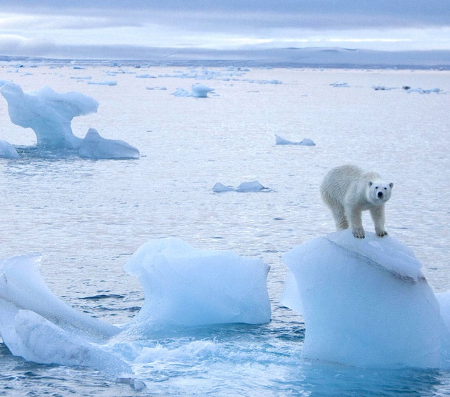
Introduction
The Arctic has experienced unprecedented (on human timescales) climatological change
High quality datasets are key in understanding the rapid changes occurring in the region
Solar-viewing instruments have a data gap for a third of the year at Eureka!
Source: The Independent

Slide 3
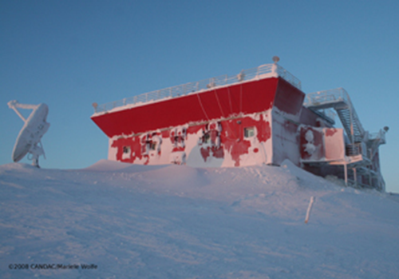
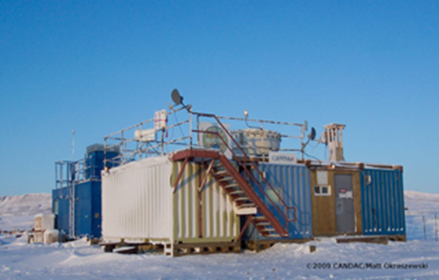
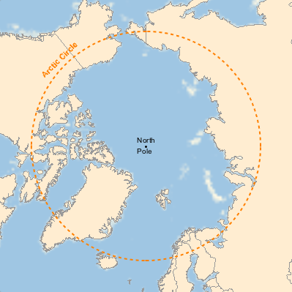

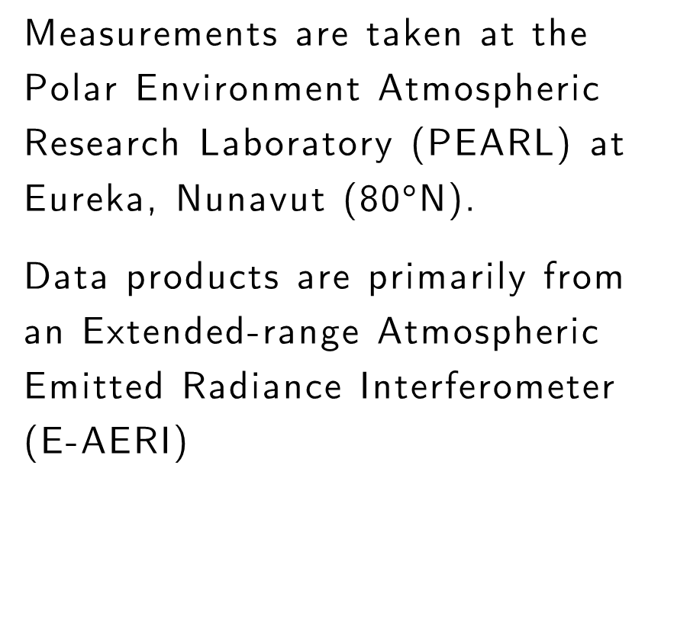
Site and Instrumentation
PEARL Ridge Lab
PEARL 0PAL
Measurements are taken at the Polar Environment Atmospheric Research Laboratory (PEARL) at Eureka, Nunavut (80$°$N).
Data products are primarily from an Extended-range Atmospheric Emitted Radiance Interferometer (E-AERI)

Slide 4
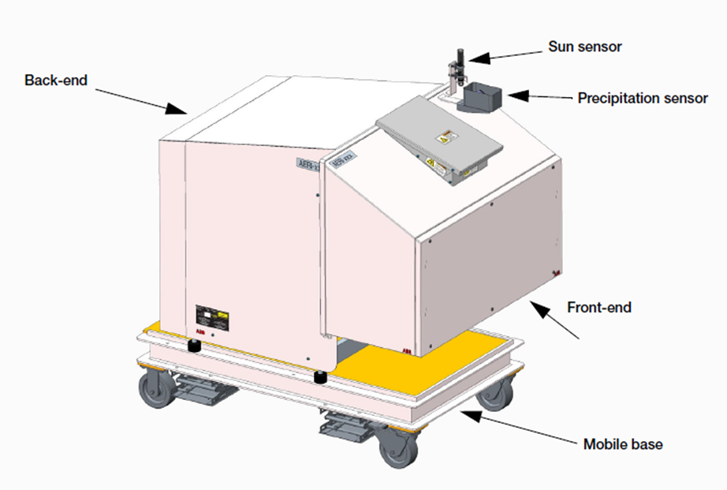
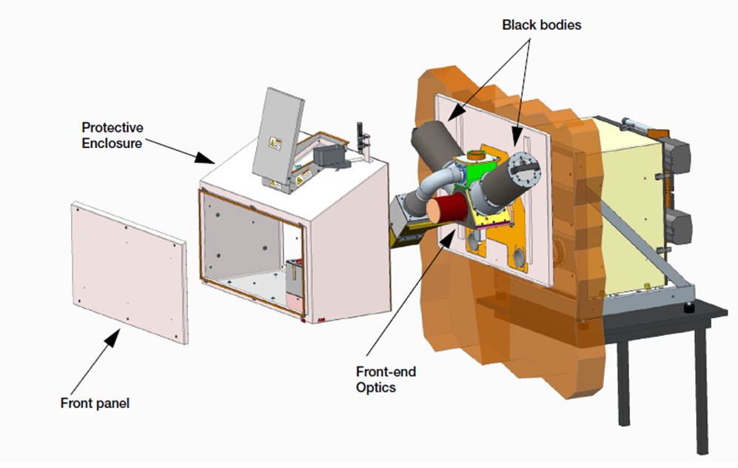
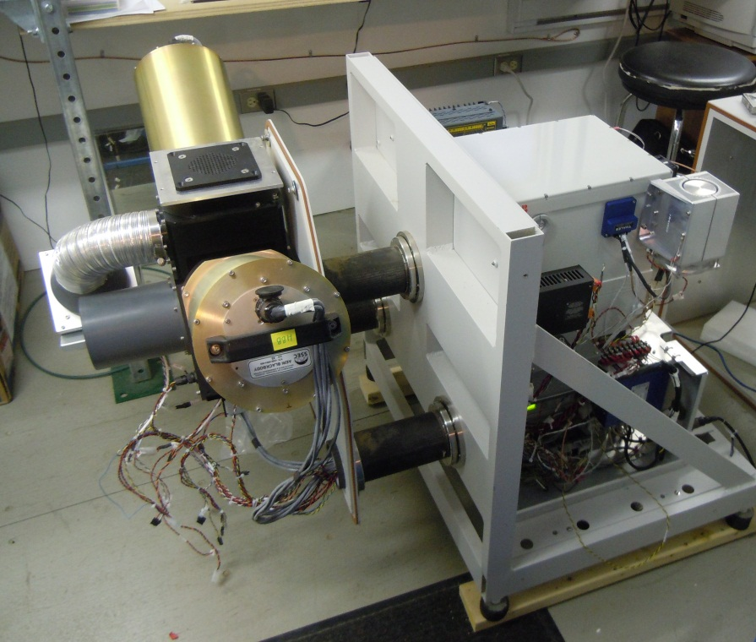
The Extended-Range Atmospheric Emitted Radiance Interferometer (E-AERI)
(Mariani et al., 2014)
(ABB Bomem)
Instrument measuring calibrated downwelling infrared thermal emission from the atmosphere with a 1 cm⁻¹ spectral resolution, from 2008 to present.
Spectral range covers 400-3000 cm⁻¹ (3-25 µm). This range includes the “dirty window” (400 cm⁻¹/25 μm), where much of the infrared cooling occurs in the dry air of the Arctic.
Spectra are recorded every 7 min, 24 hours a day, 365 days a year (precipitation permitting), independent of sunlight.

Slide 5
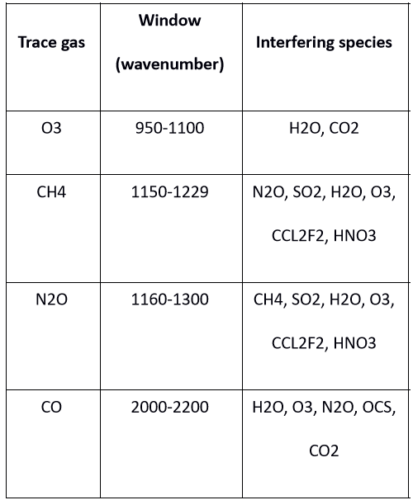

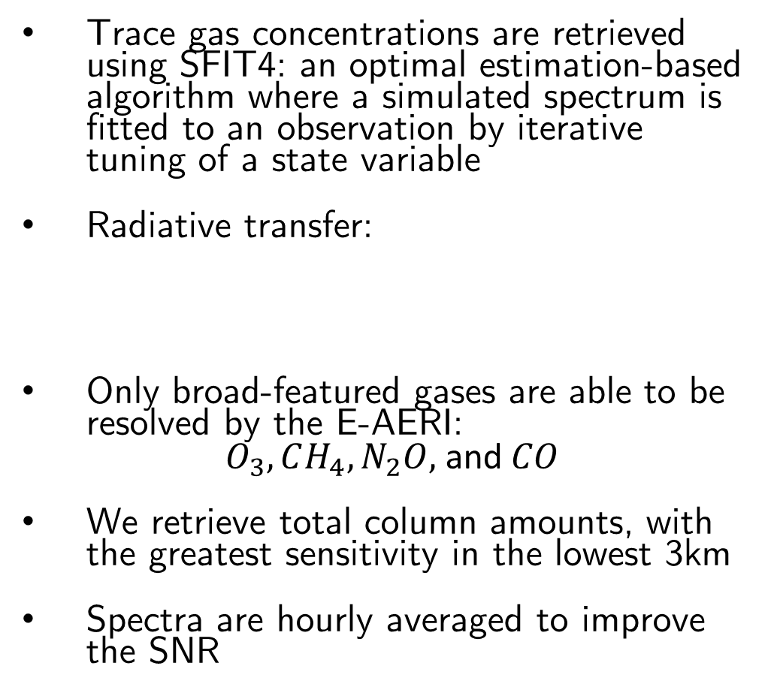
Retrievals
Trace gas concentrations are retrieved using SFIT4: an optimal estimation-based algorithm where a simulated spectrum is fitted to an observation by iterative tuning of a state variable
Radiative transfer:
Only broad-featured gases are able to be resolved by the E-AERI:
$O_{3}, CH_{4}, N_{2}O,$and $CO$
We retrieve total column amounts, with the greatest sensitivity in the lowest 3km
Spectra are hourly averaged to improve the SNR
Emission
Table: List of windows used for retrieval of selected trace gases. Key interfering species in each window are listed.

Slide 6
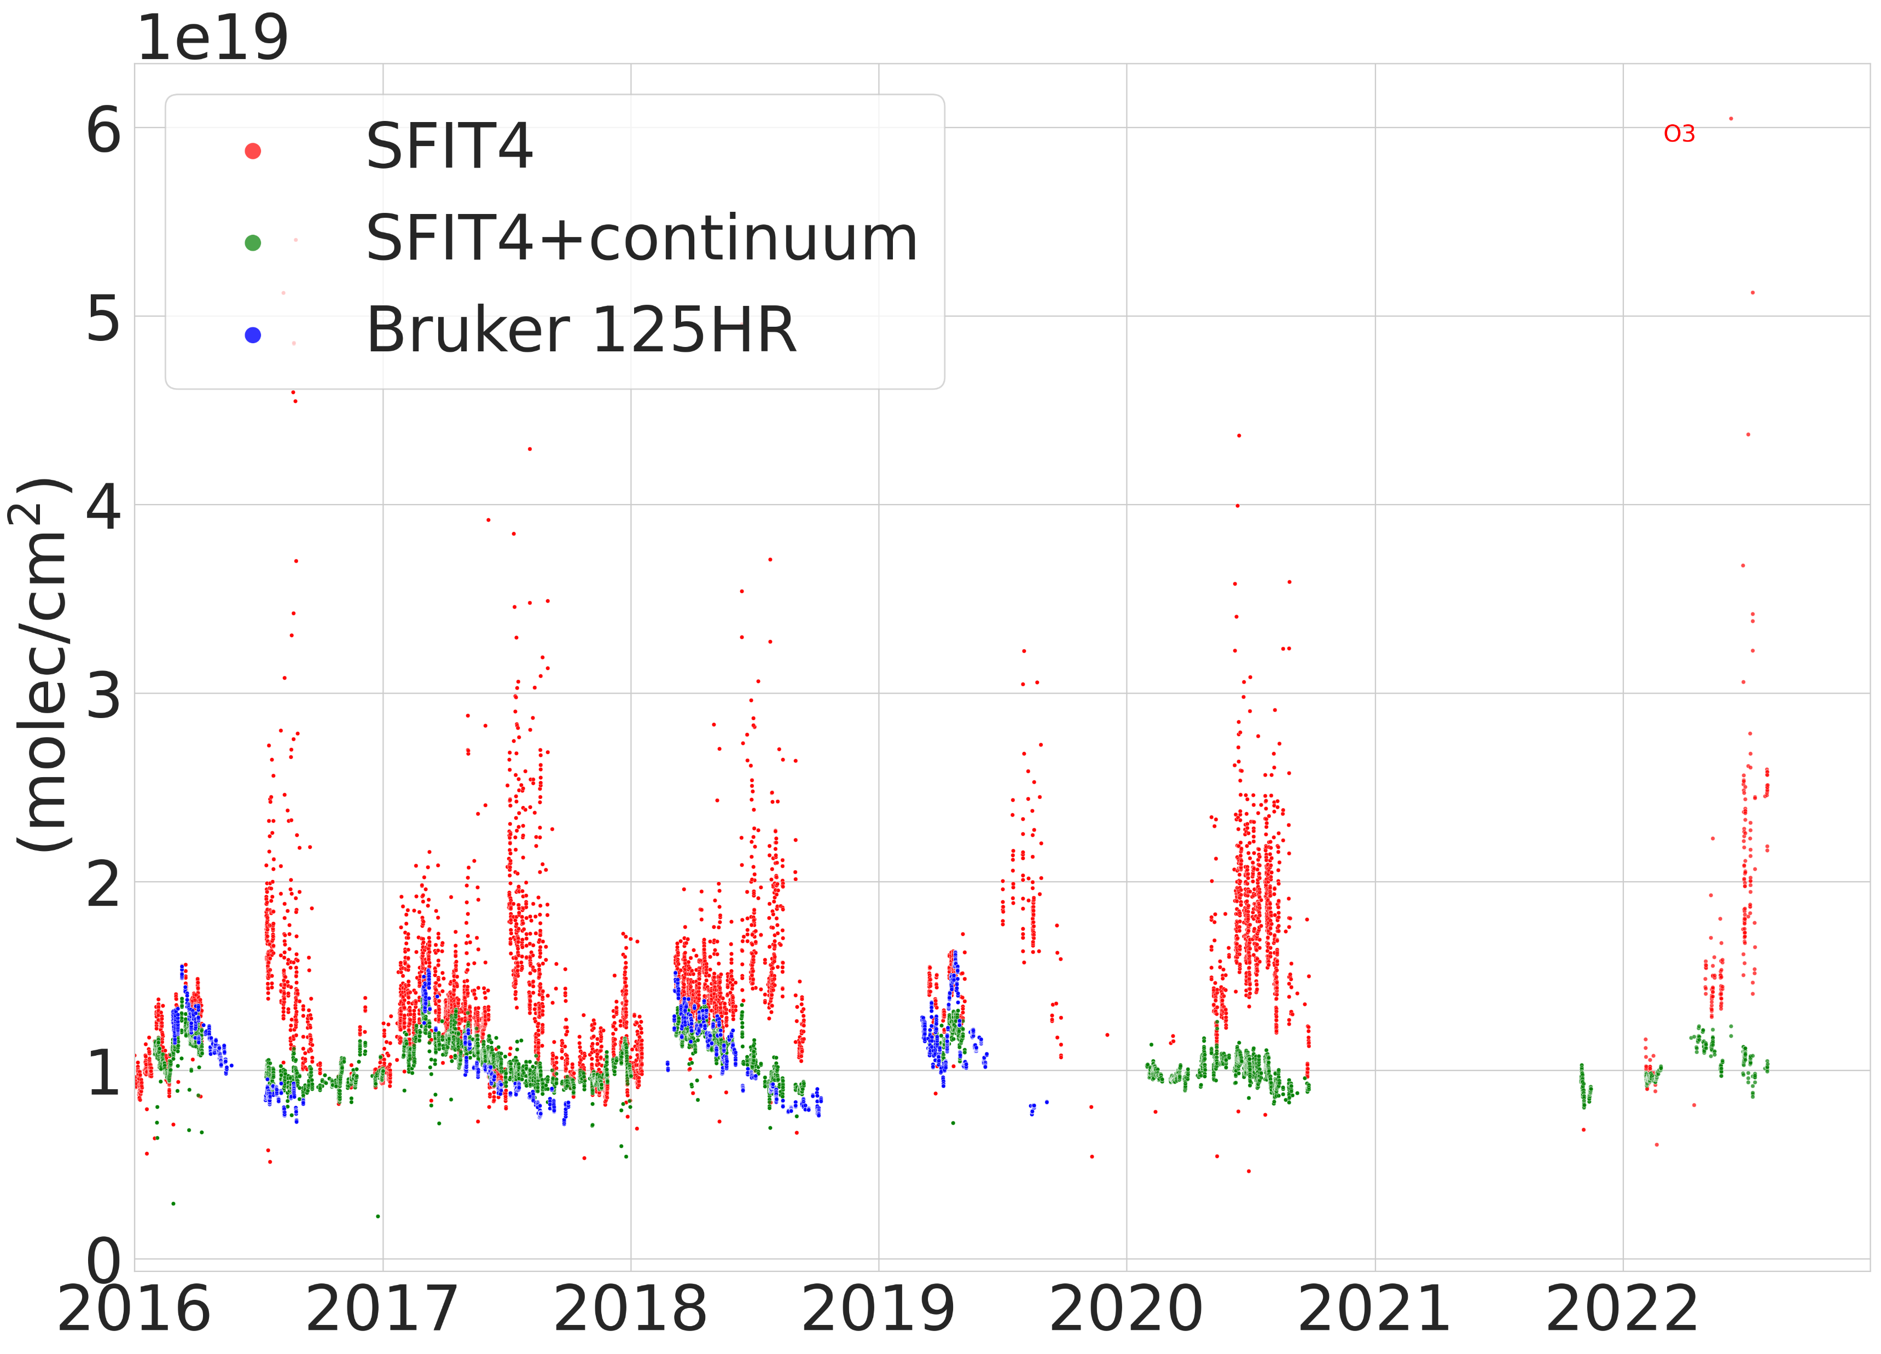
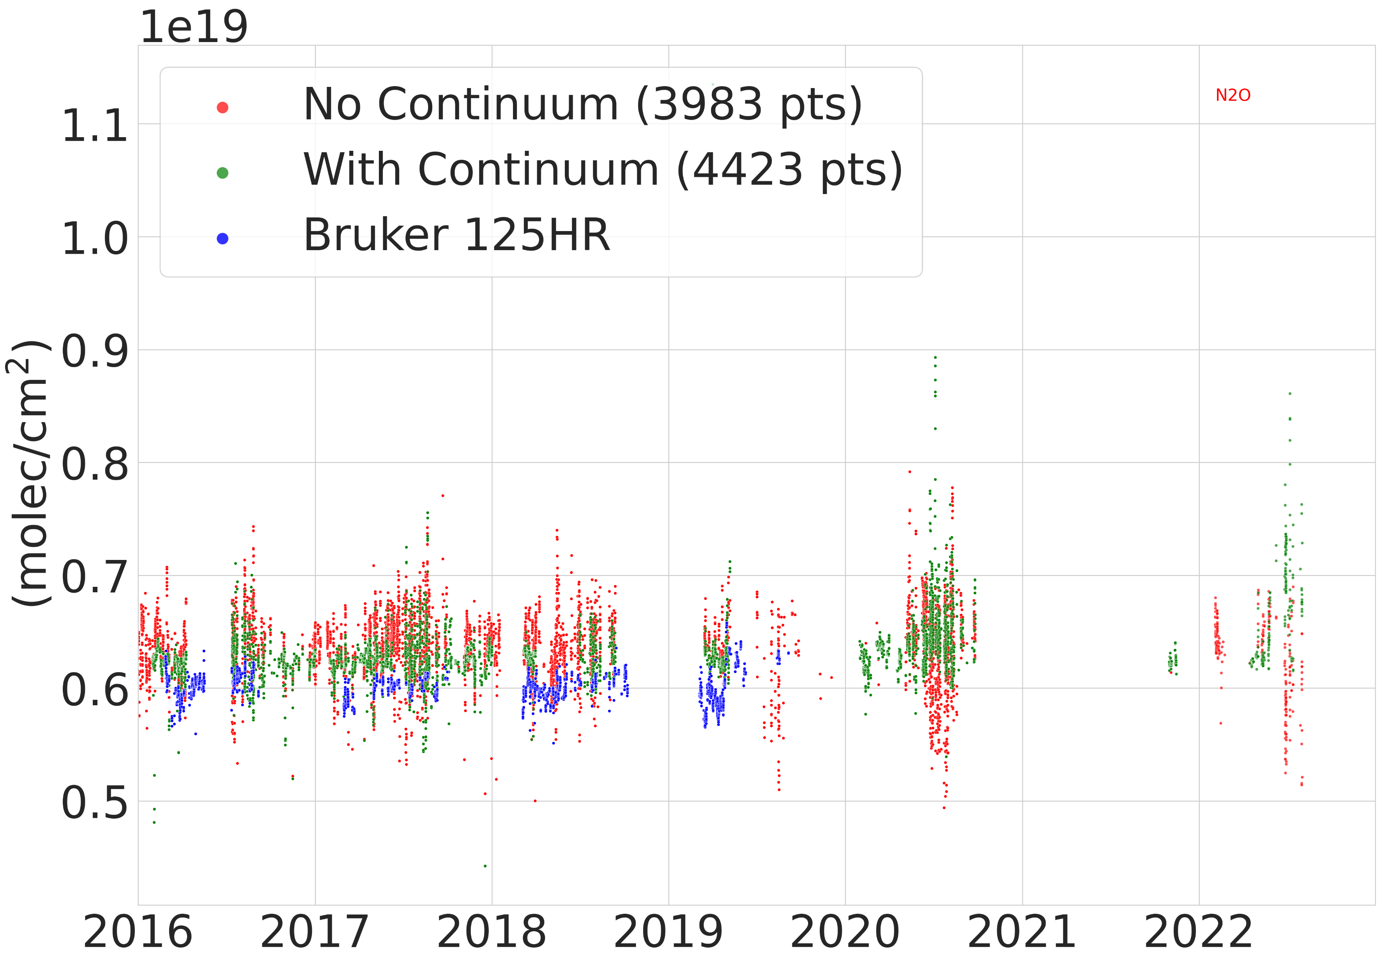
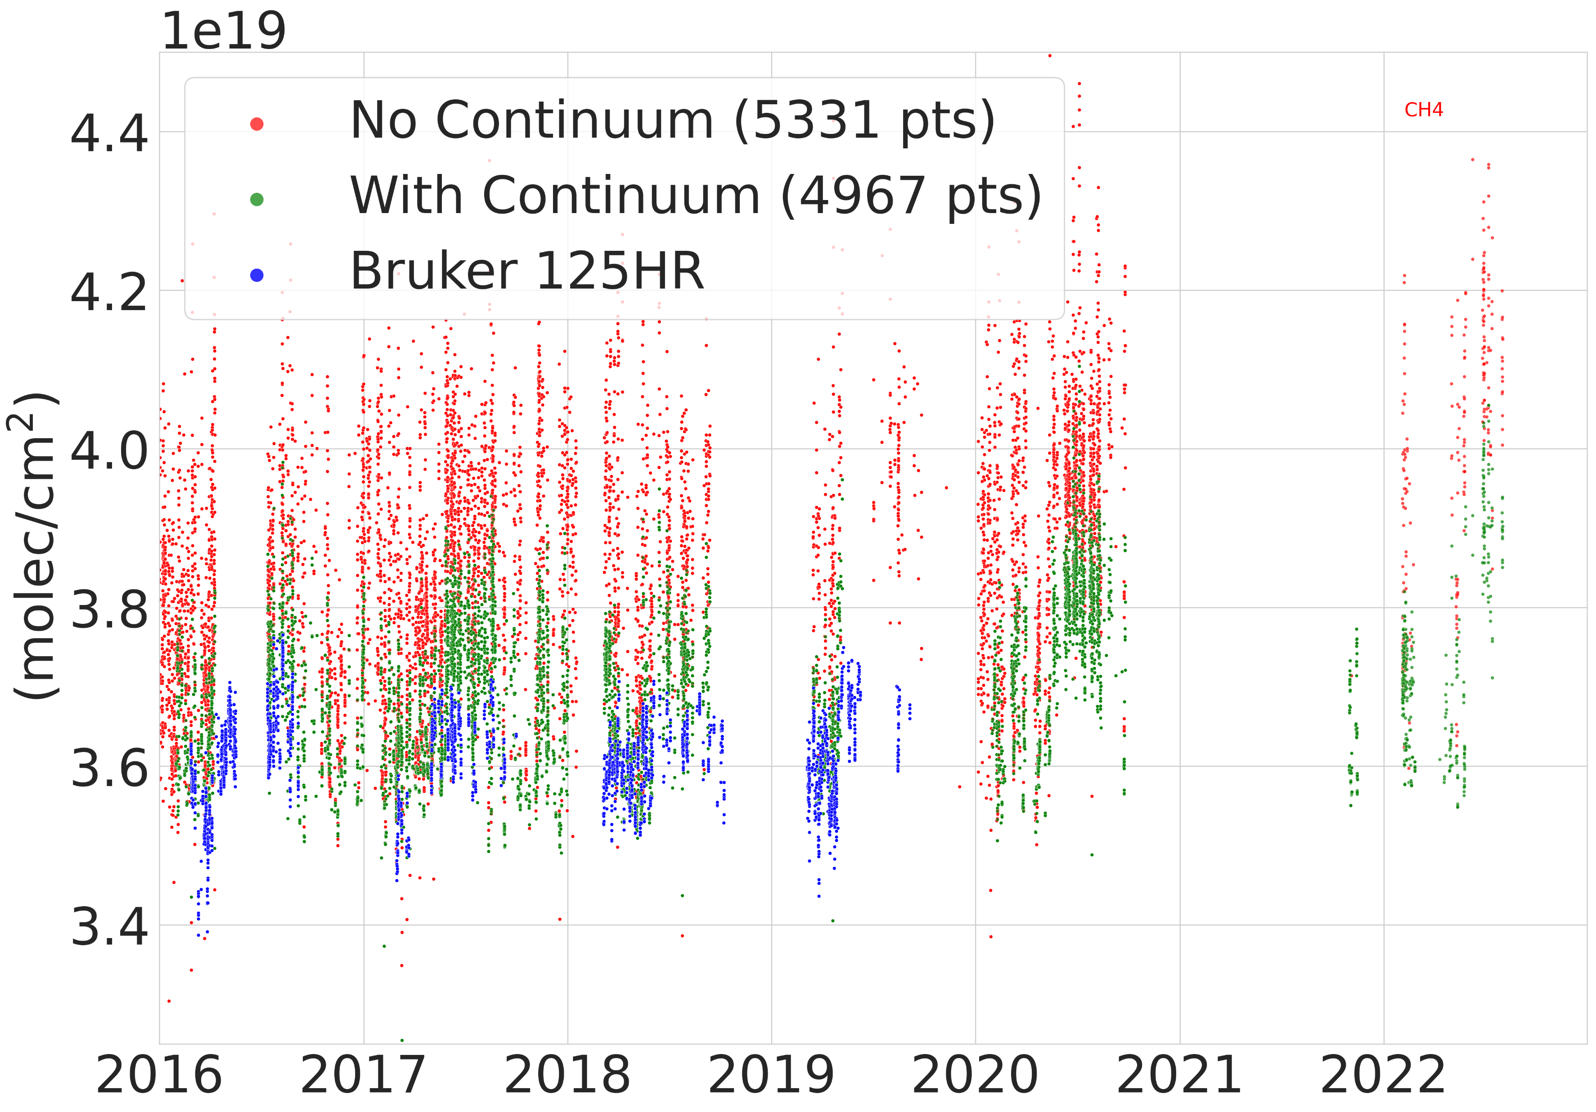
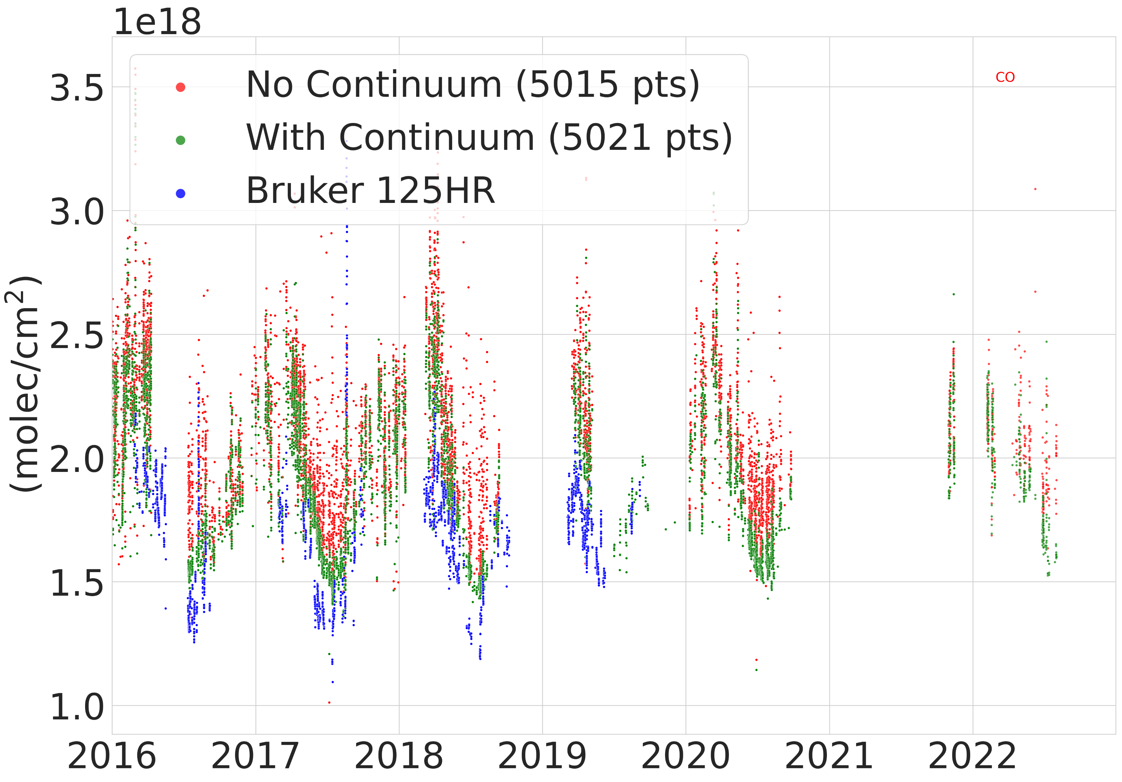

The SFIT4+continuum code
O3
N2O
Built on SFIT4v0.960
Radiative transfer includes a contribution from the water vapour continuum emission (via the MT_CKD model)
Largest differences appear in the summer months
All subsequent slides (after the next one) refer to retrievals performed with the SFIT4+continuum!
Total Column (molec/${cm}^{−1}$)
CH4
CO
2016 2022 2016 2022
Figure: Retrieval timeseries from 2016 – 2022 retrieved with SFIT4, SFIT4+continuum, and the Bruker 125HR.

Slide 7
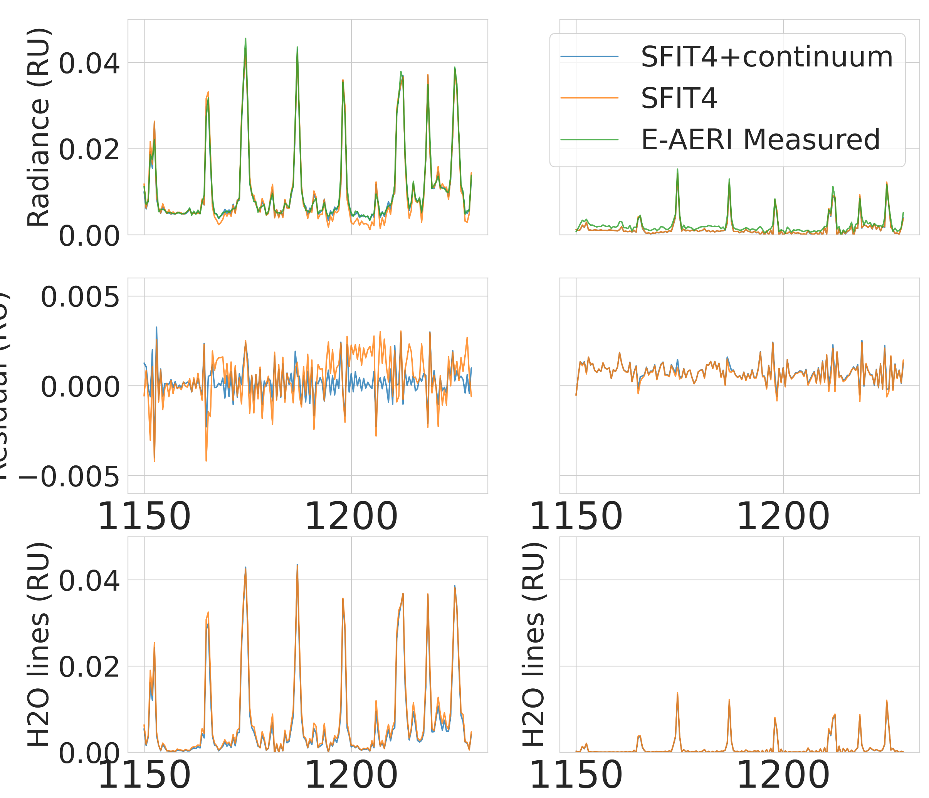
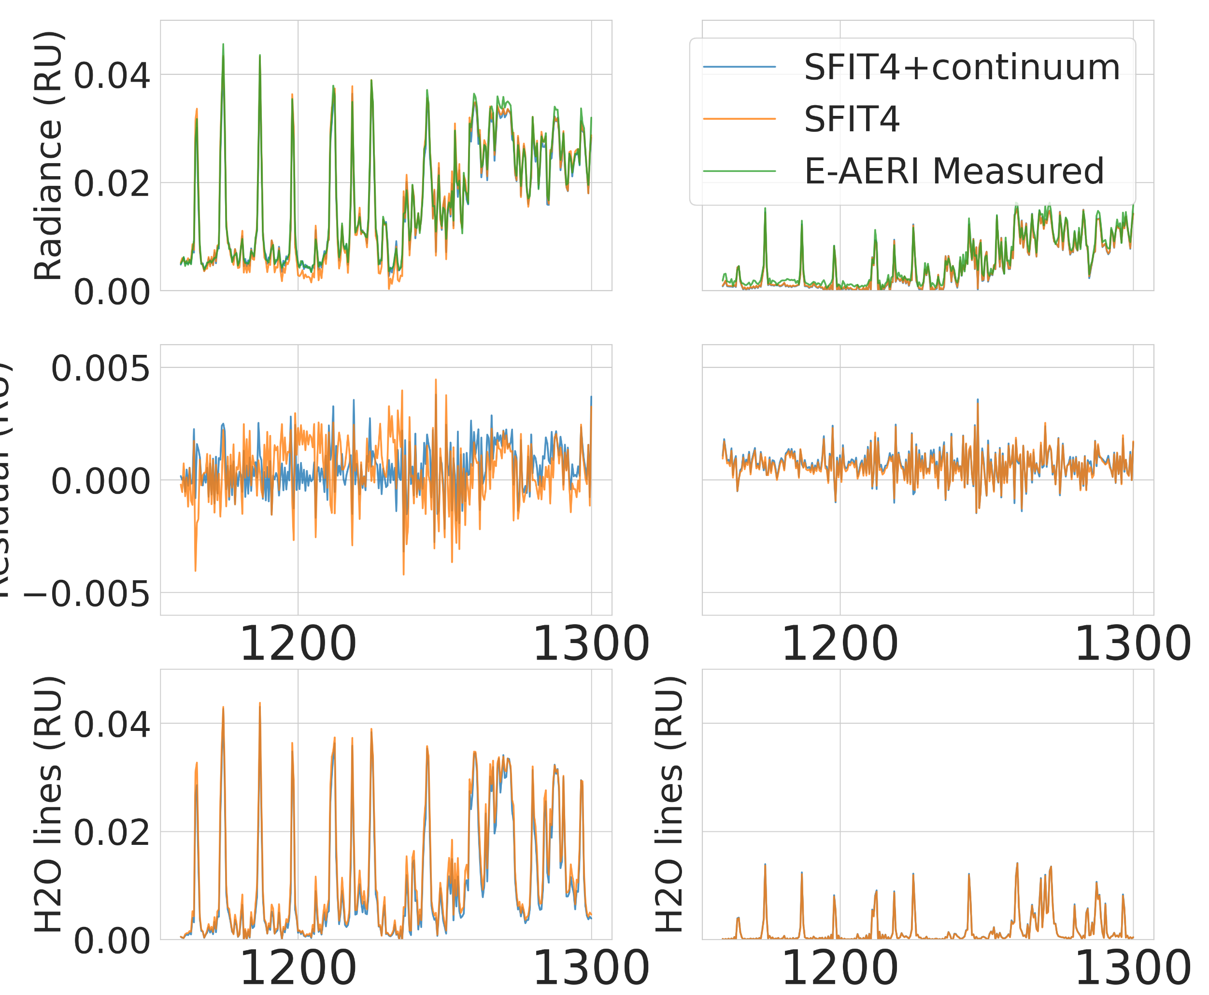
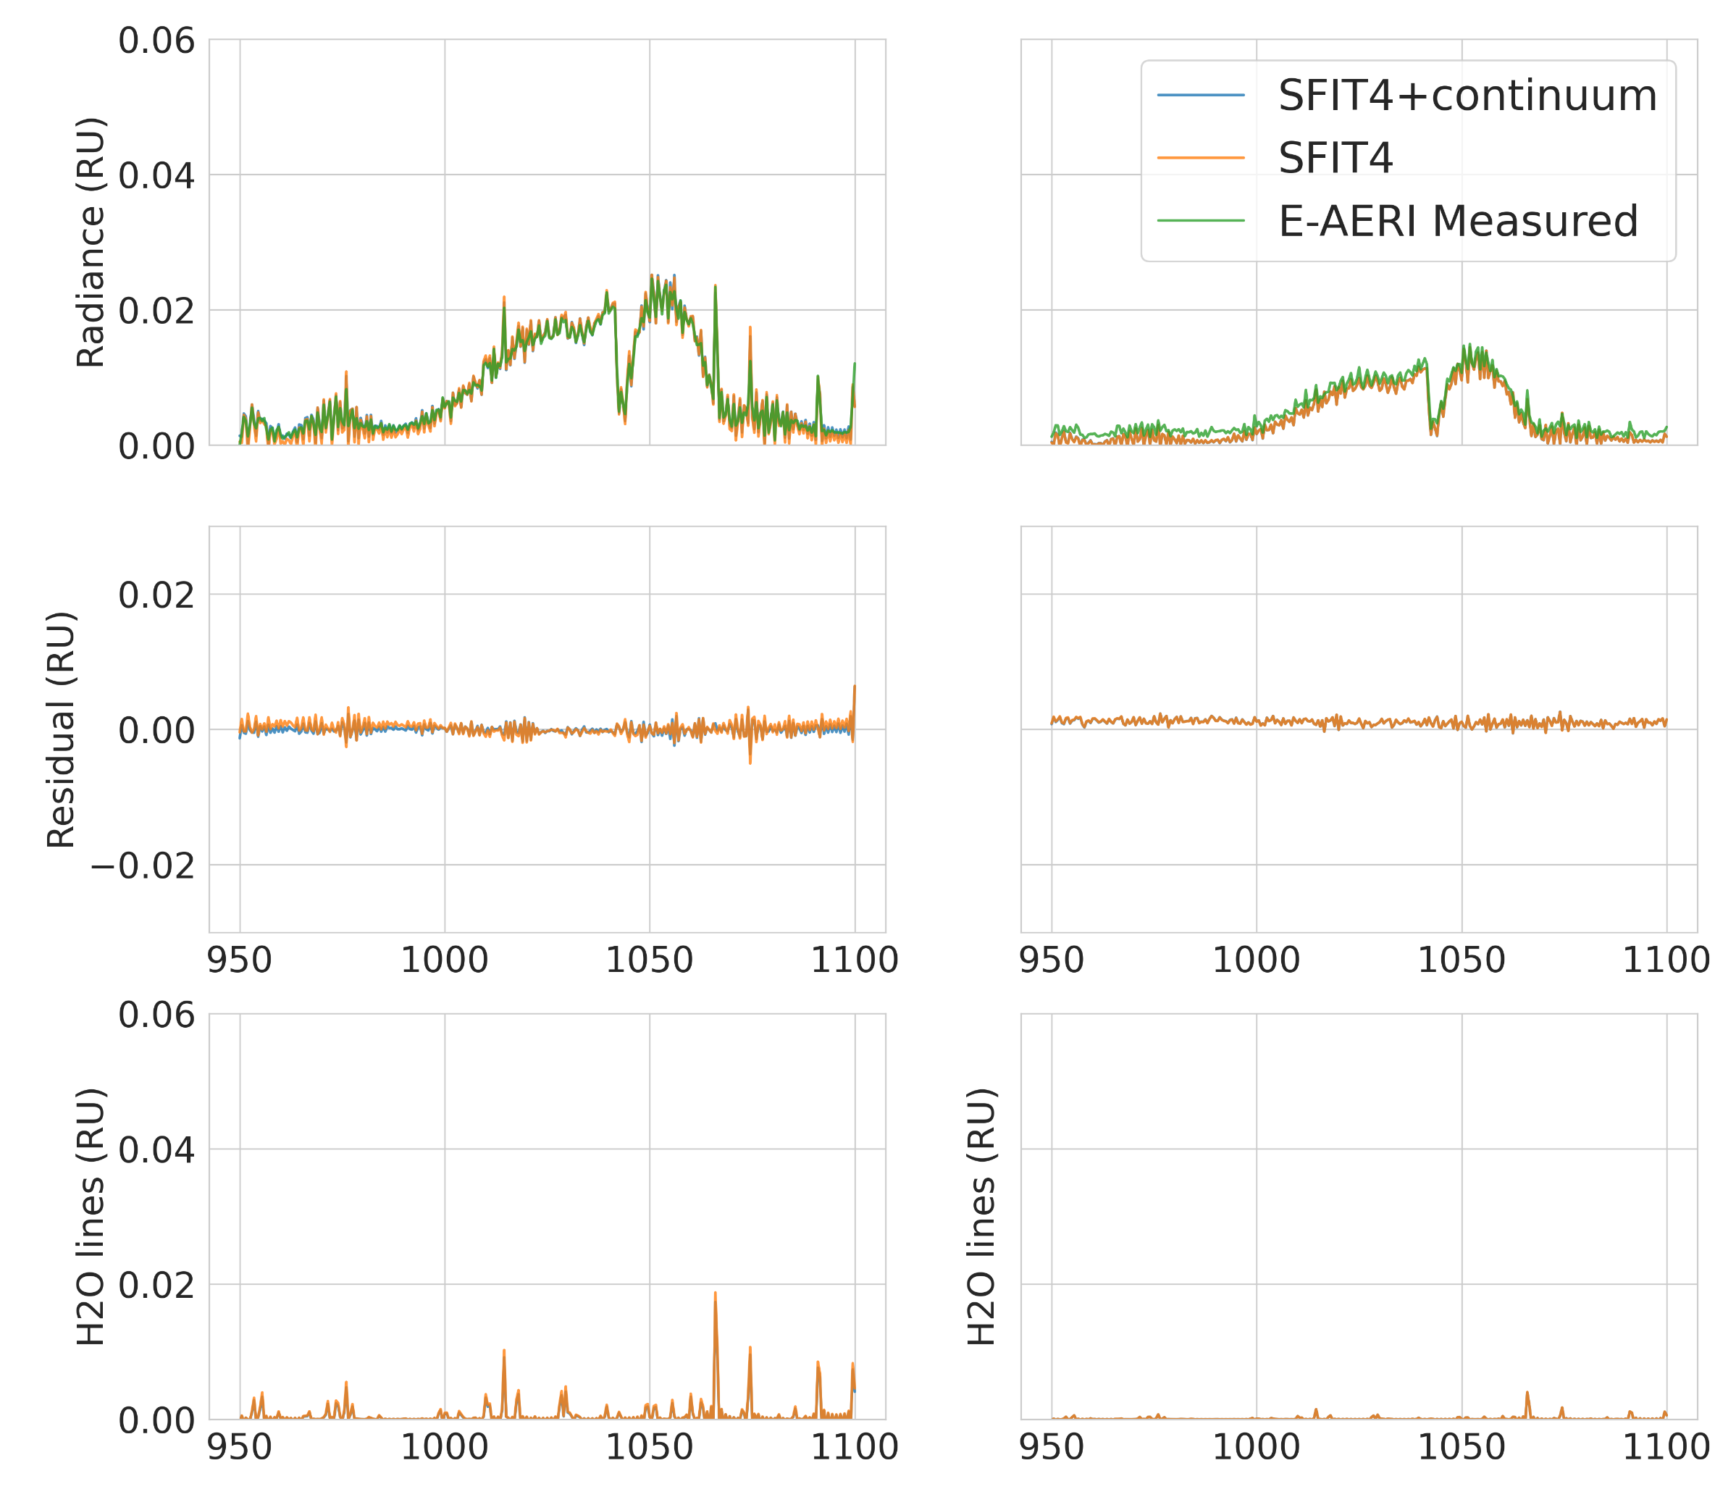
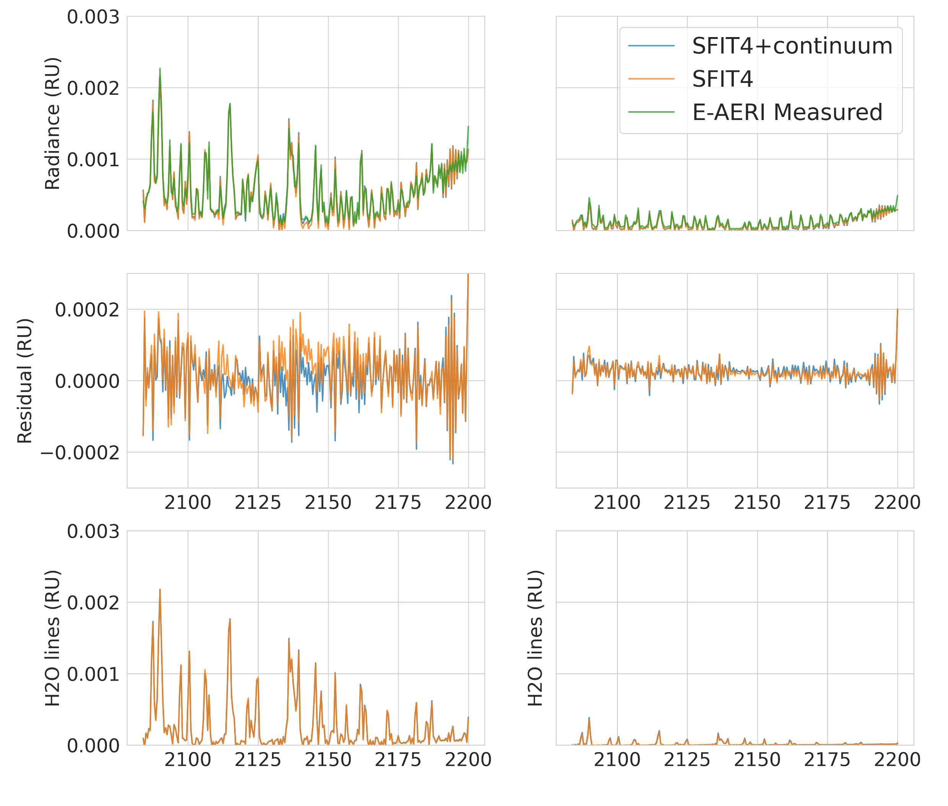
Spectral Fits
Summer Winter
Summer Winter
CH4
N2O
The mean, max, and variance of residuals are improved in the summer
  Depending on the gas, between 10-30%
Residuals are comparable, or slightly worse in the winter
O3
CO

Slide 8
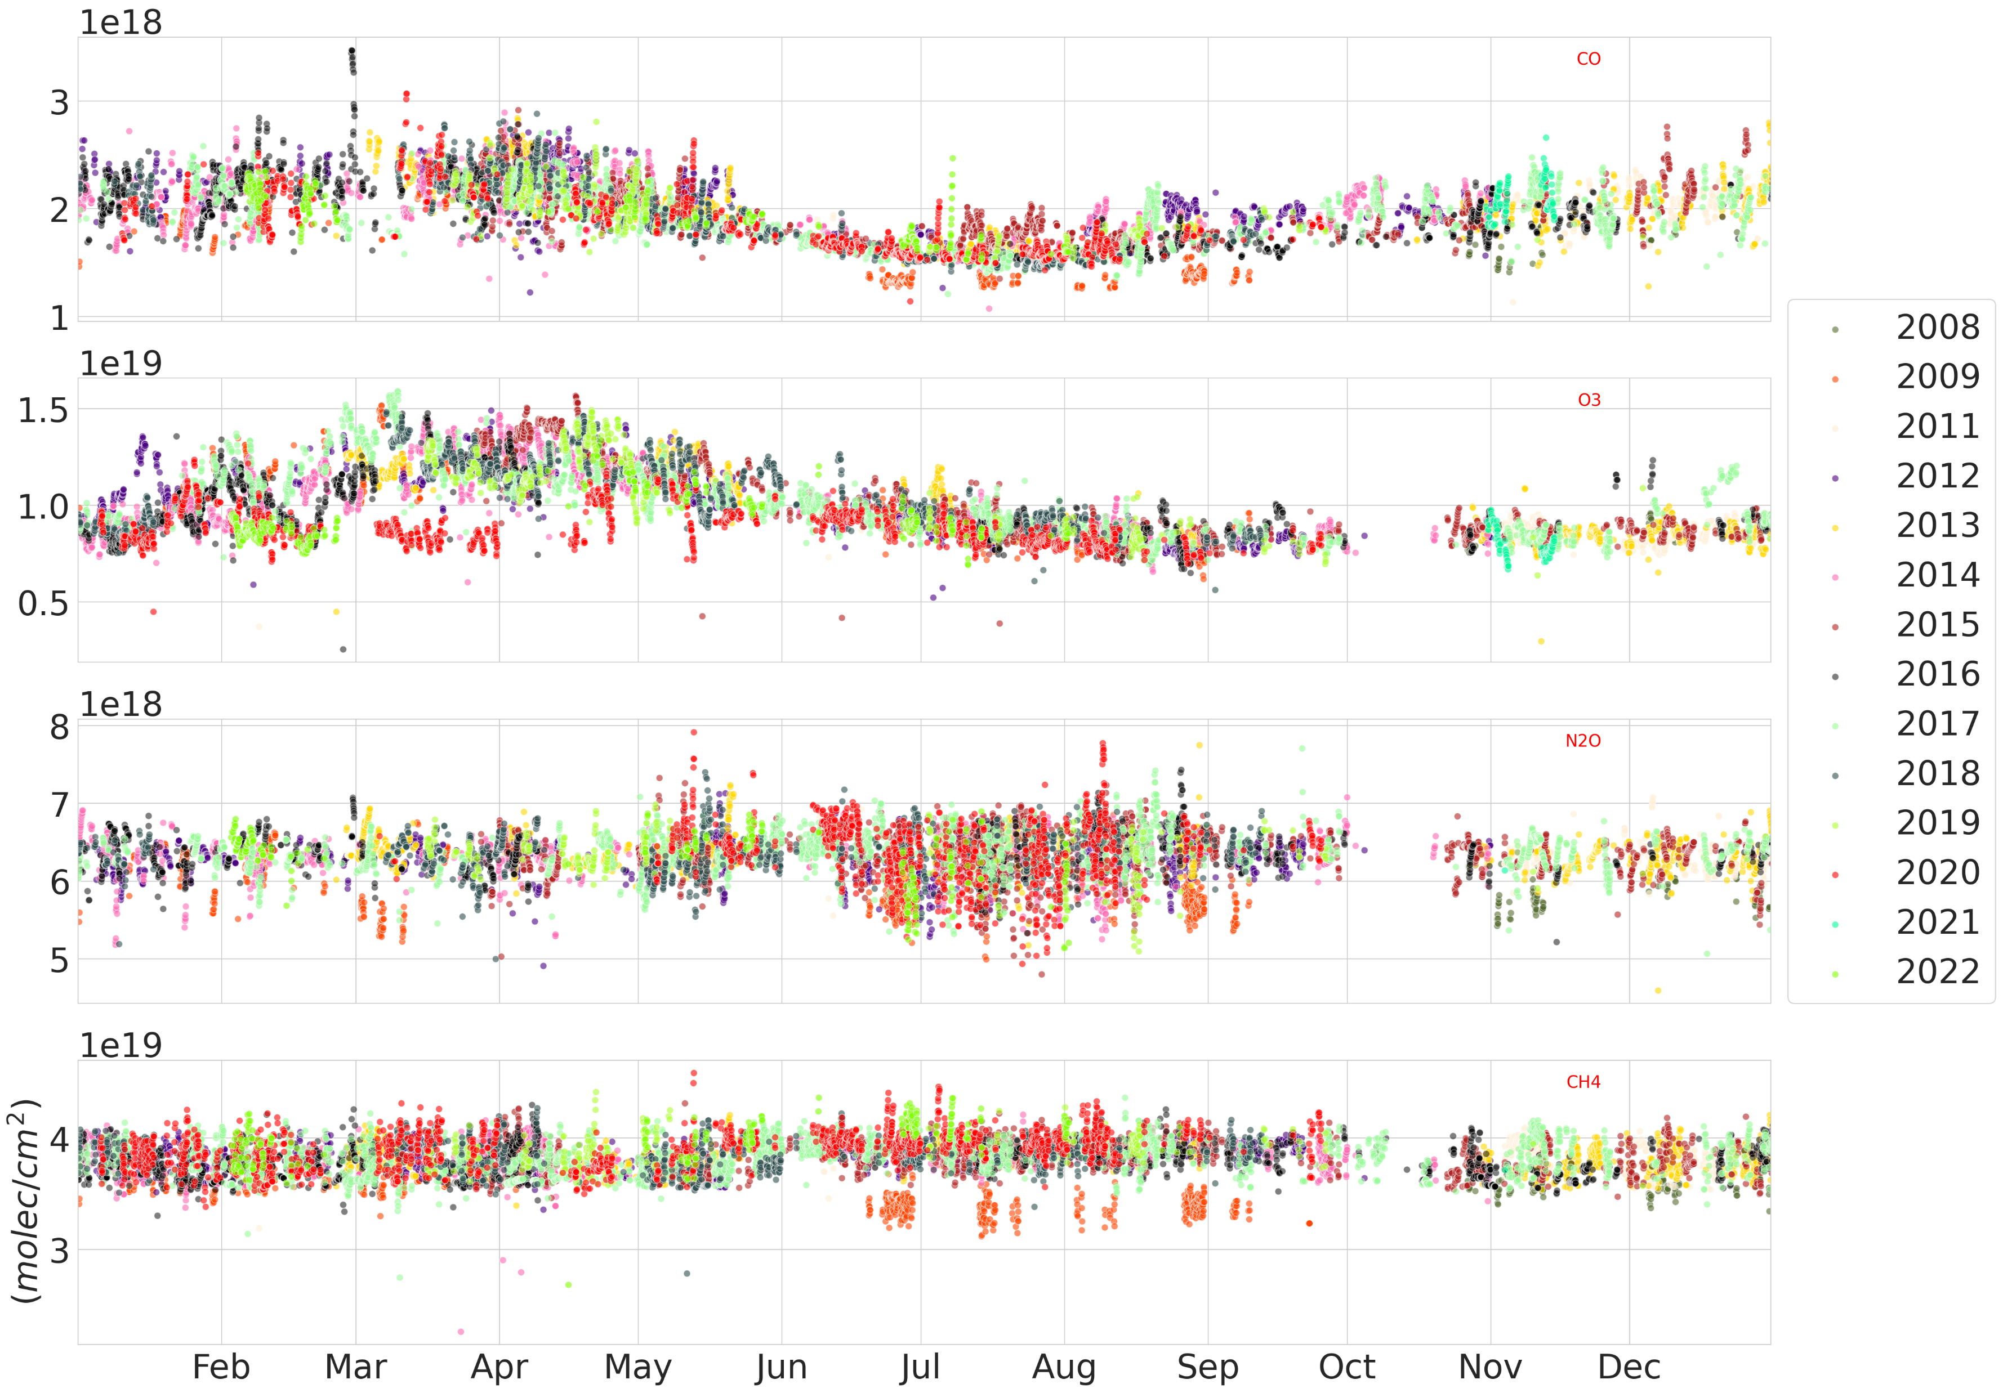

The EAERI-Retrieved Timeseries
Figure: Retrievals of CO, O3, N2O, and CH4 from 2008 – 2022.
Measurements from 2008 and 2009 were taken at the PEARL Ridge Lab (610 m a.s.l), 2011 onwards at 0PAL (10 m a.s.l.)
Total Column (molec/${cm}^{−1}$)

Slide 9
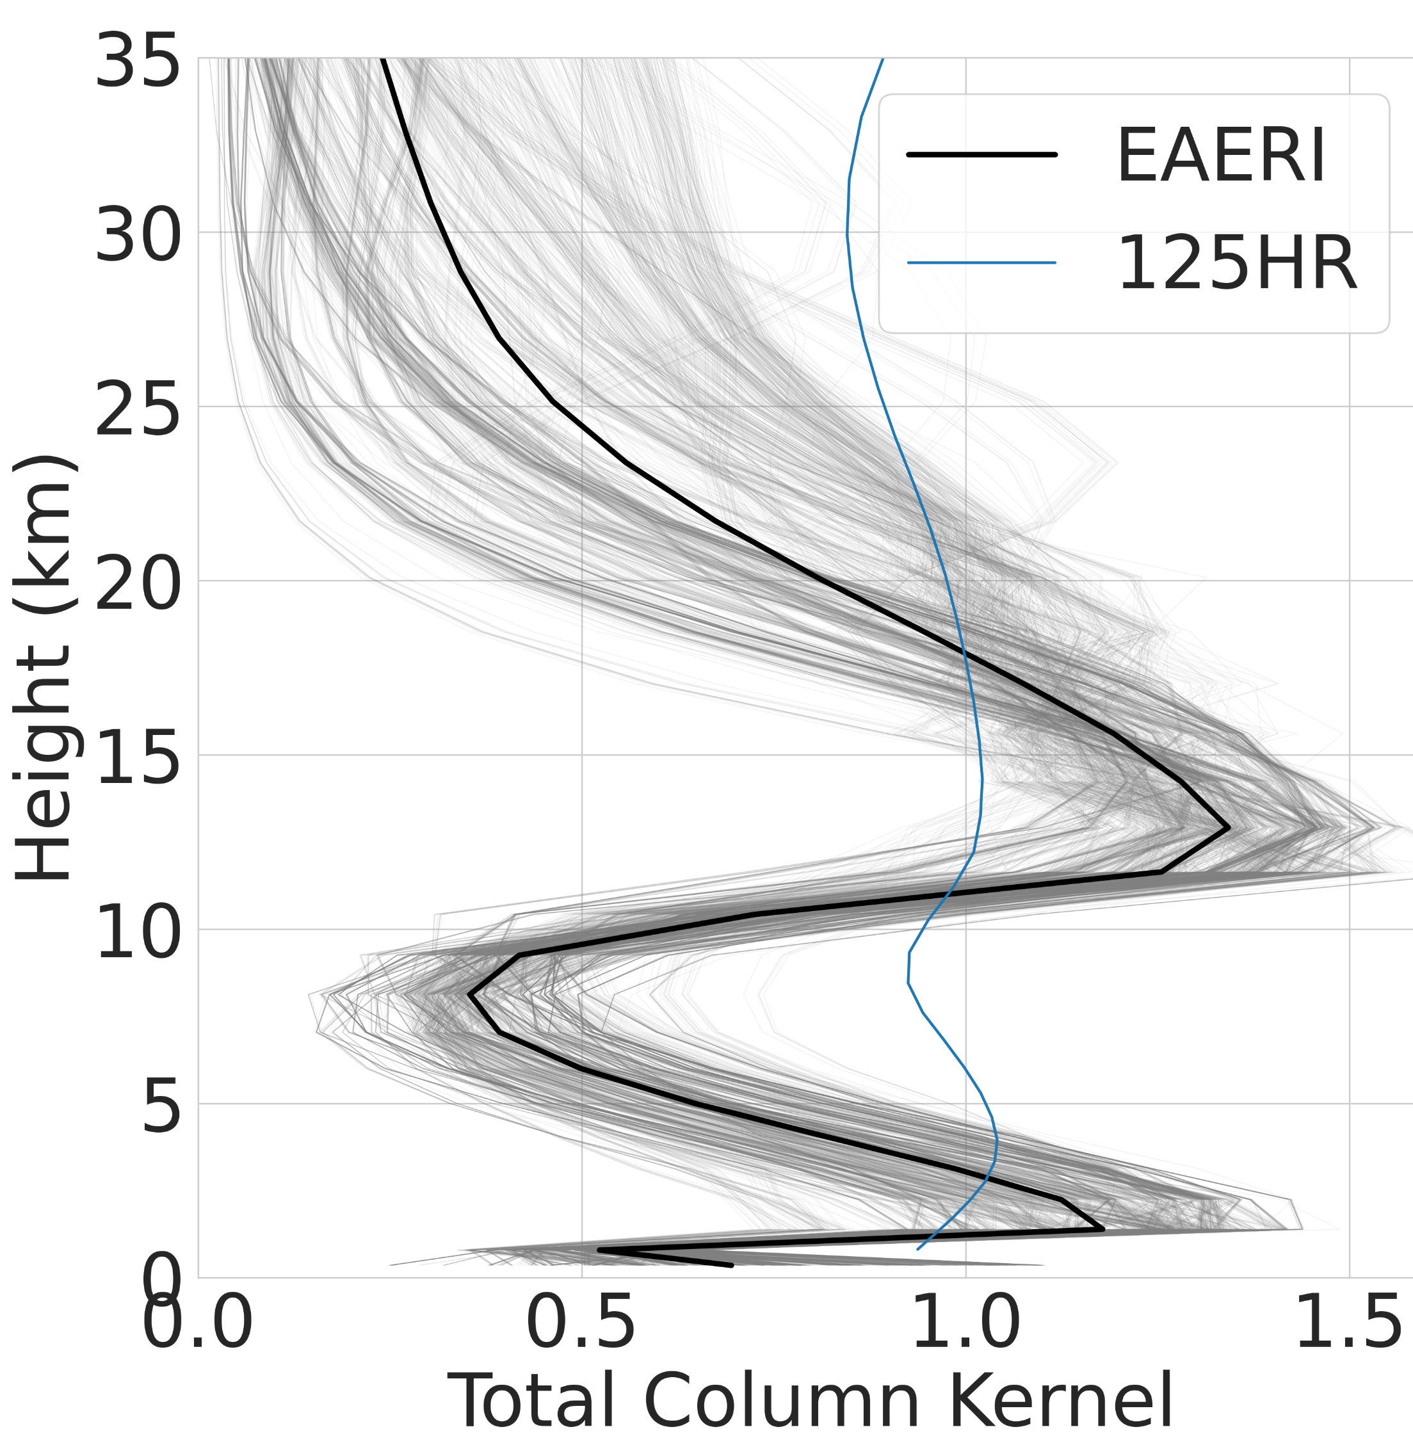
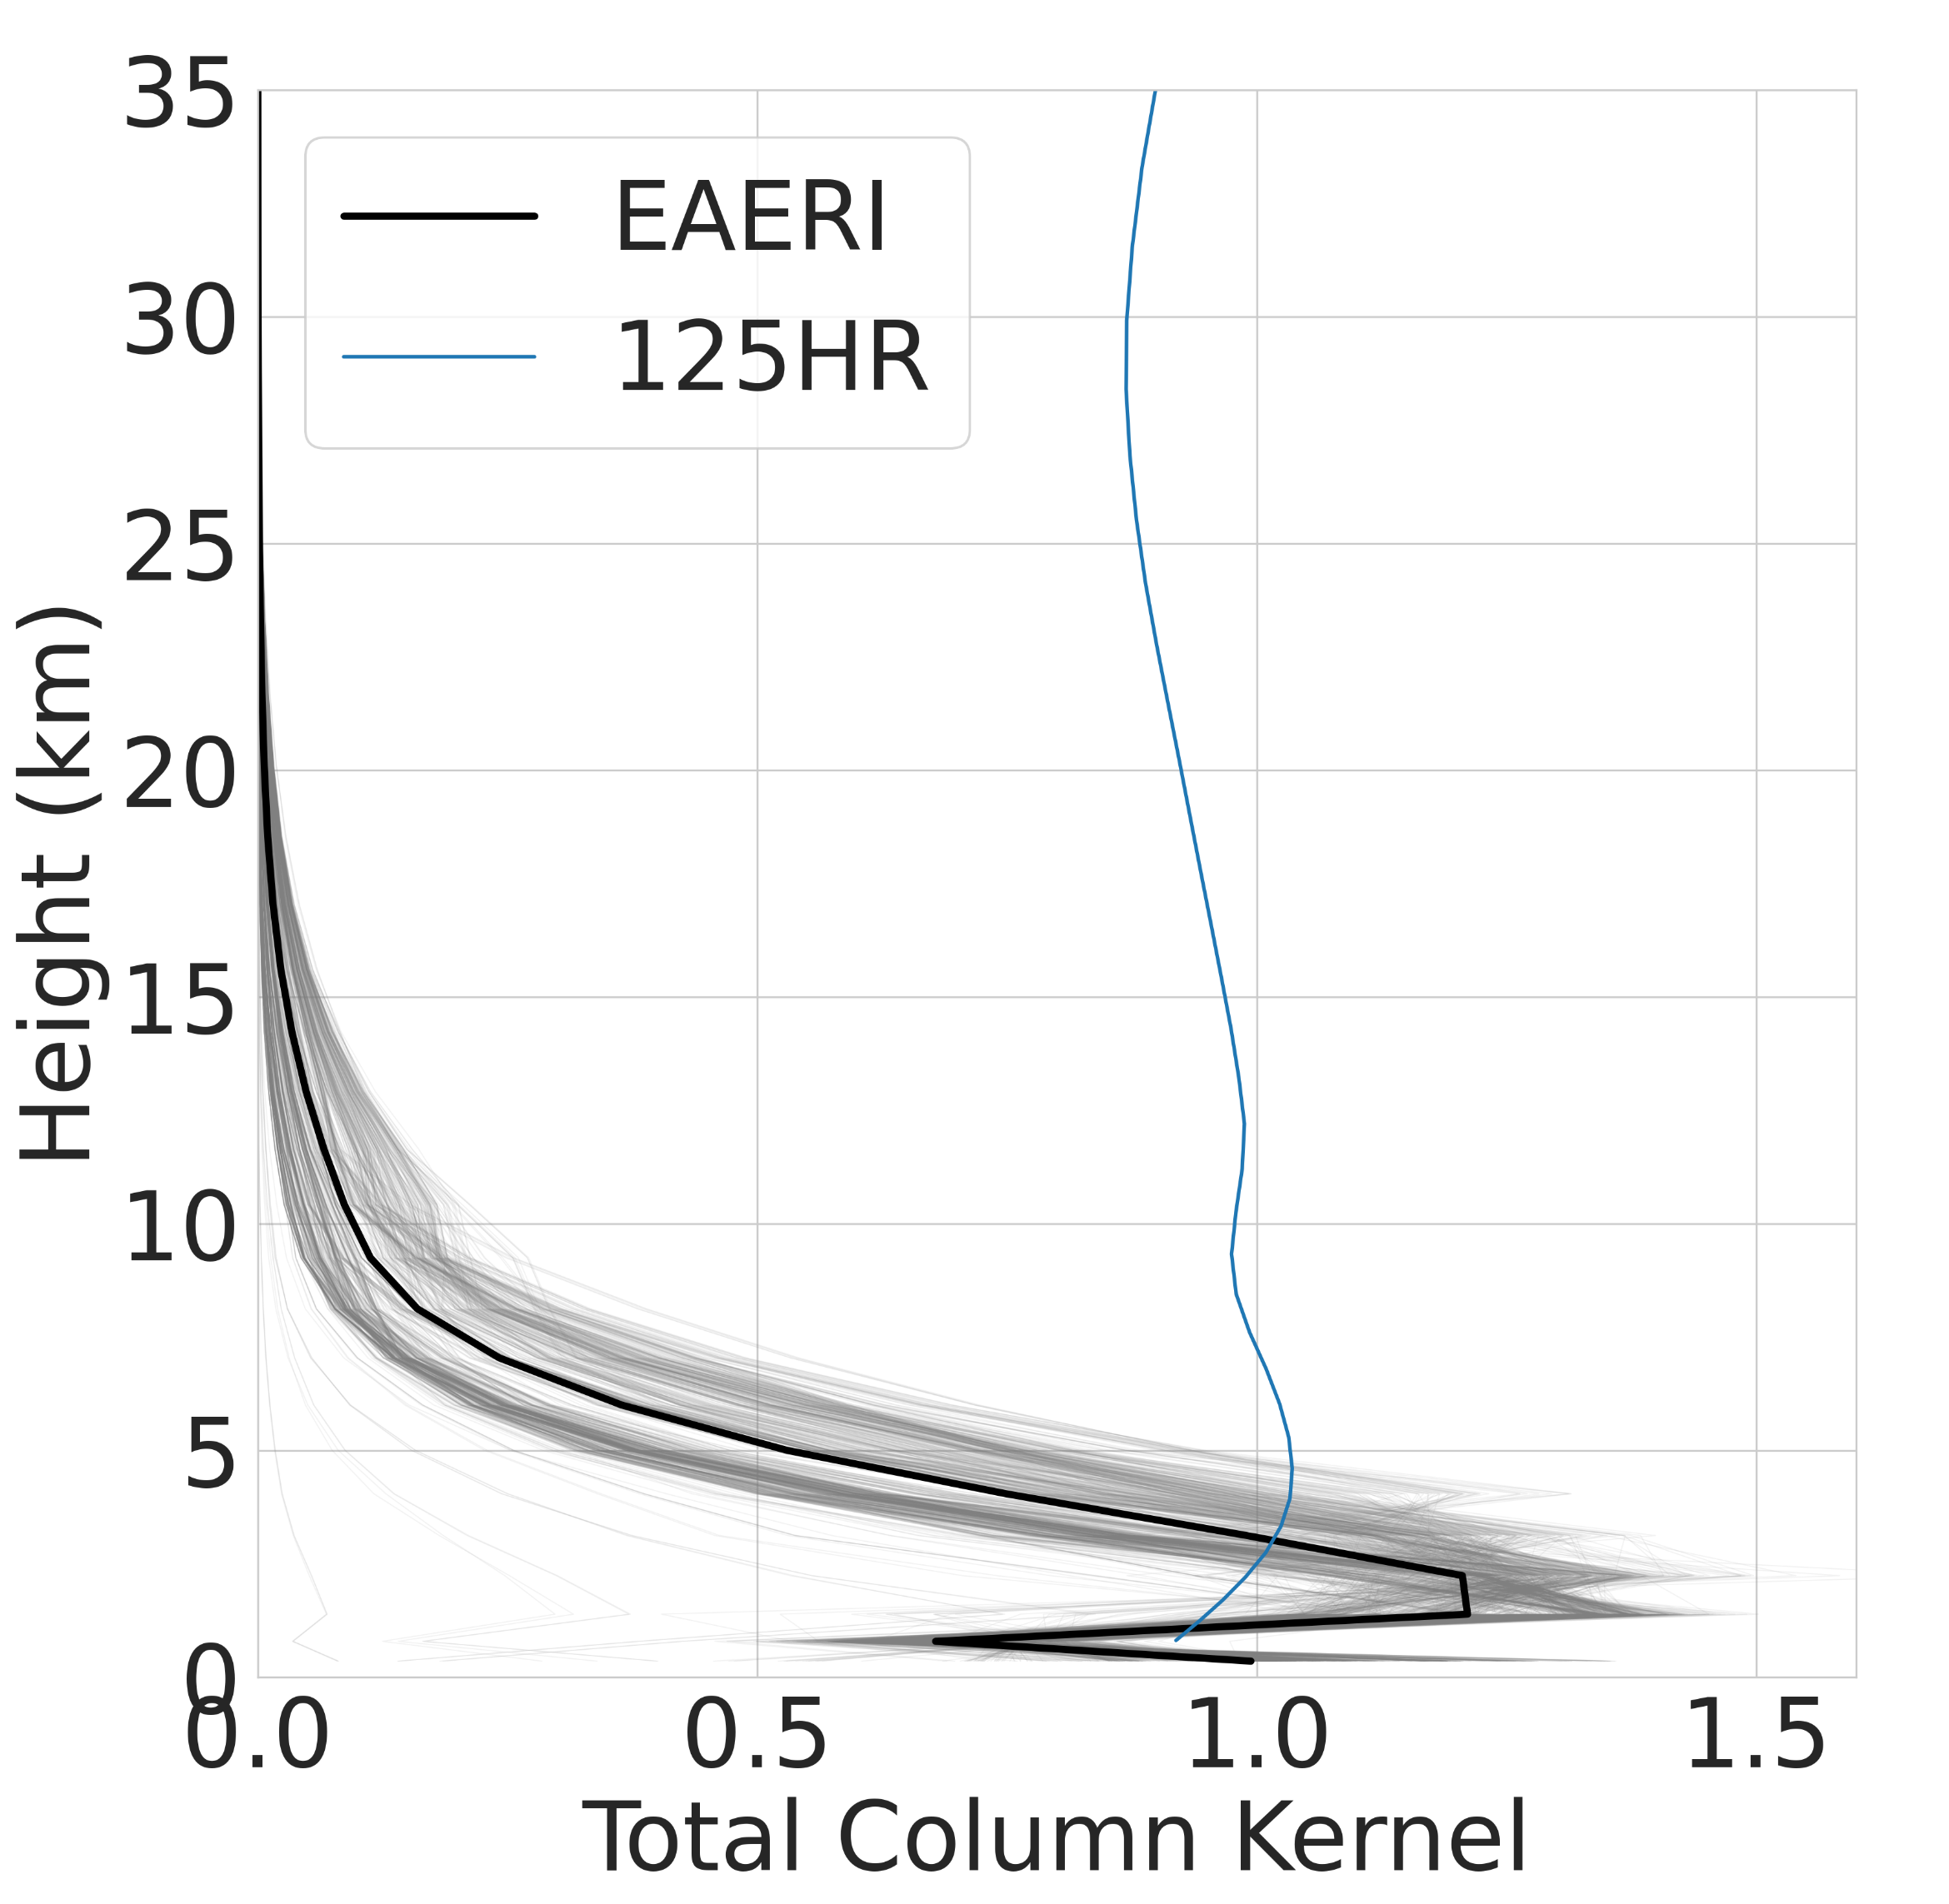
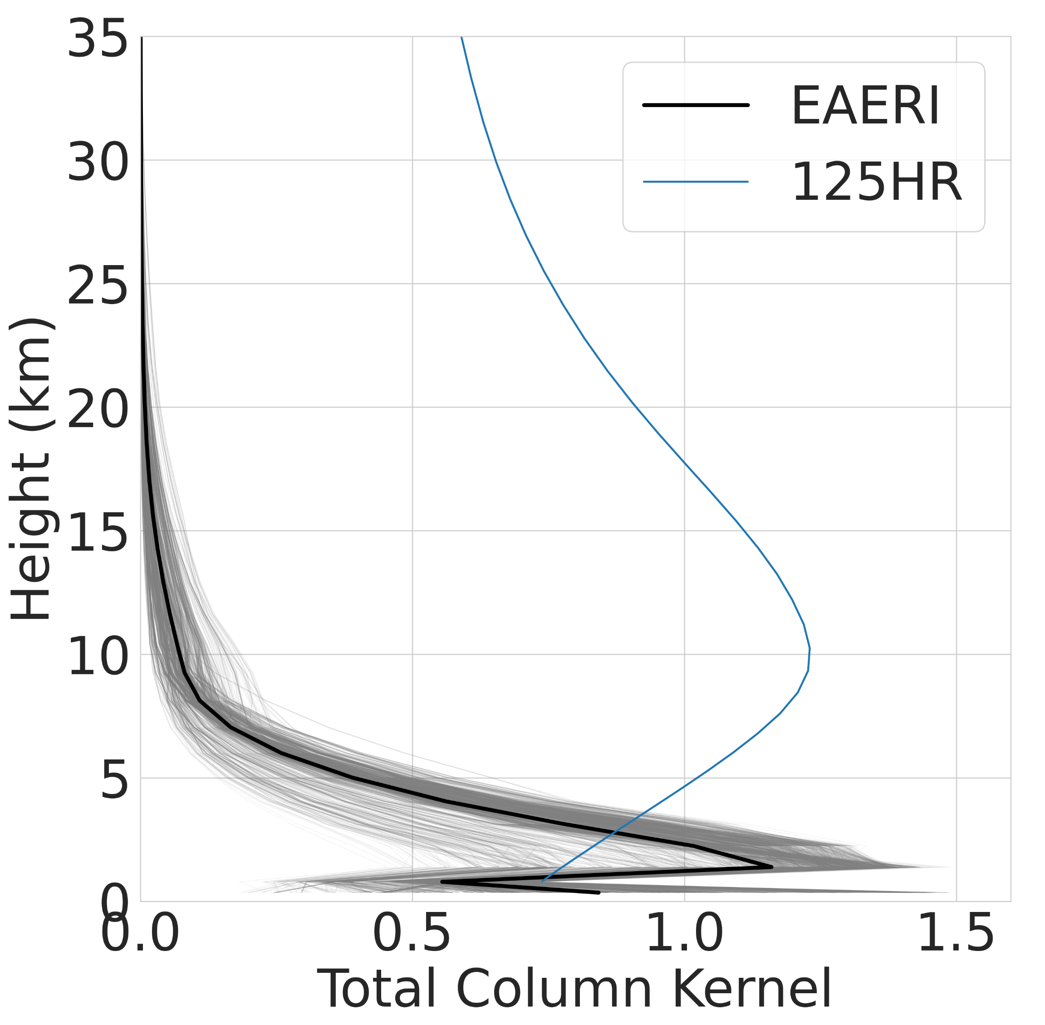
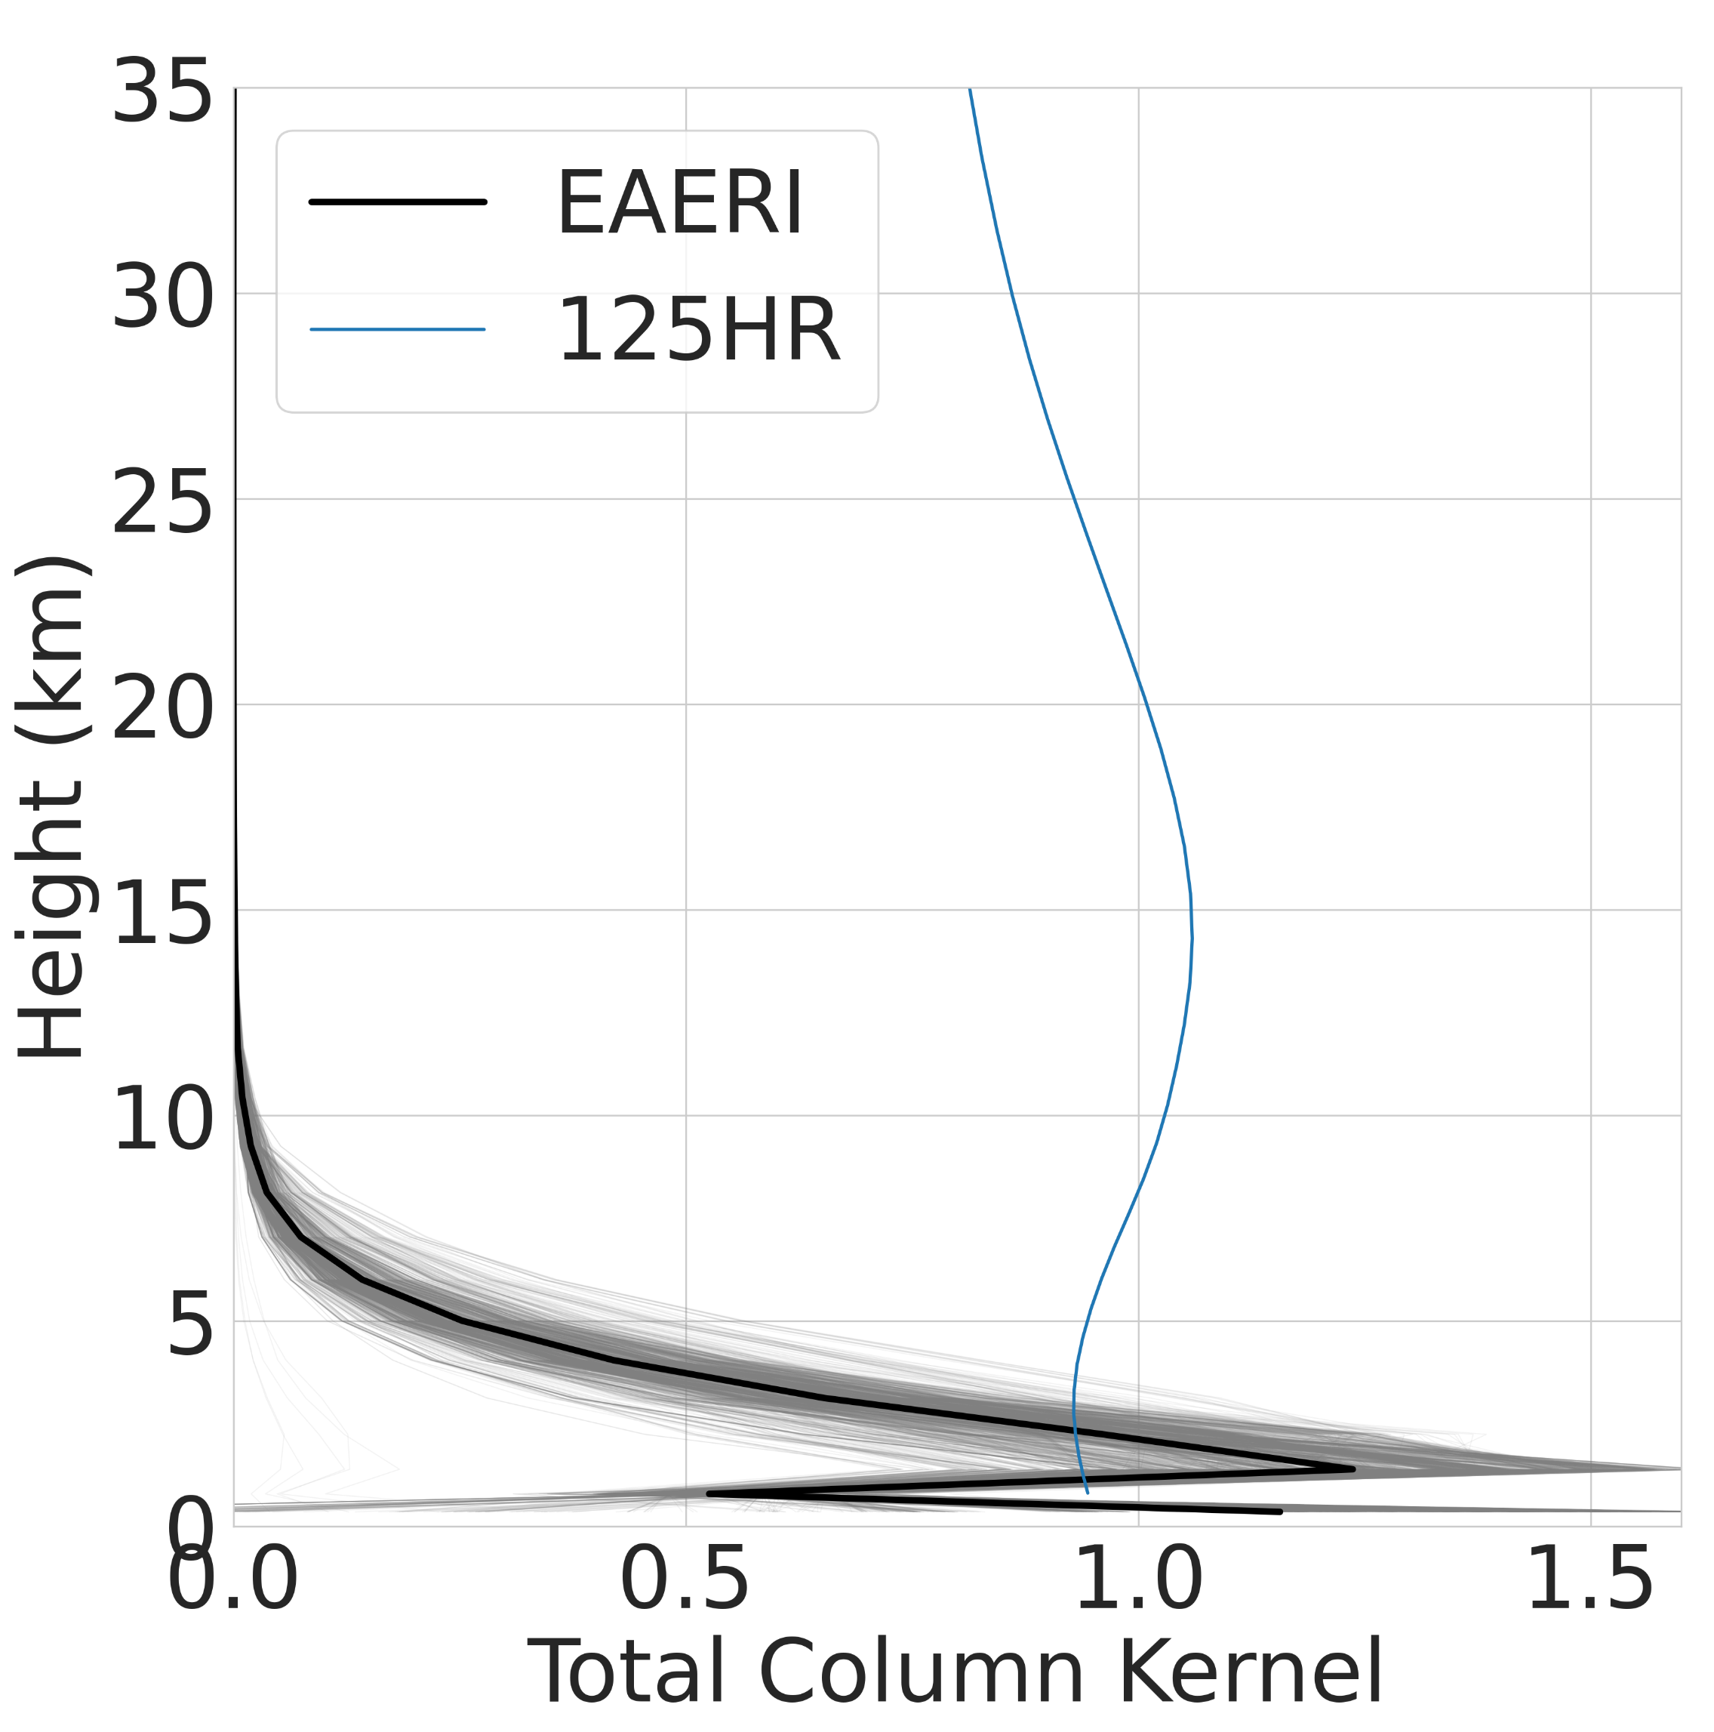
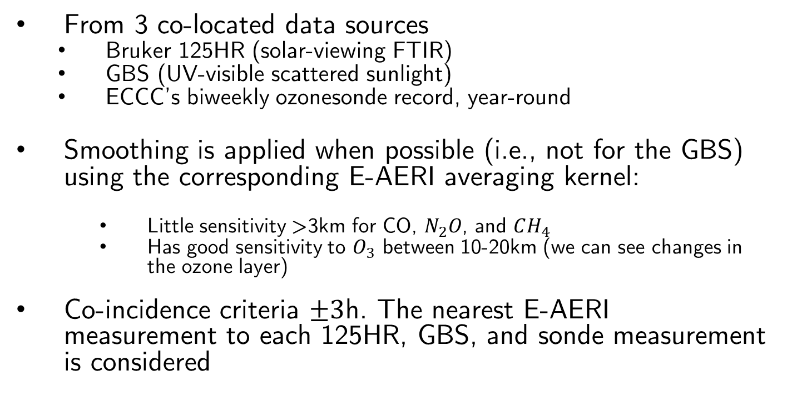
Validative Datasets
N2O
O3
From 3 co-located data sources
  Bruker 125HR (solar-viewing FTIR)
  GBS (UV-visible scattered sunlight)
  ECCC’s biweekly ozonesonde record, year-round
Smoothing is applied when possible (i.e., not for the GBS) using the corresponding E-AERI averaging kernel:
    Little sensitivity >3km for CO, $N_{2}O$, and $CH_{4}$
    Has good sensitivity to $O_{3}$ between 10-20km (we can see changes in the ozone layer)
Co-incidence criteria $±3$h. The nearest E-AERI measurement to each 125HR, GBS, and sonde measurement is considered
CH4
CO
Figure(s): Total column averaging kernels for 2016: E-AERI in grey, E-AERI average in bold, 125HR kernel for comparison in blue

Slide 10
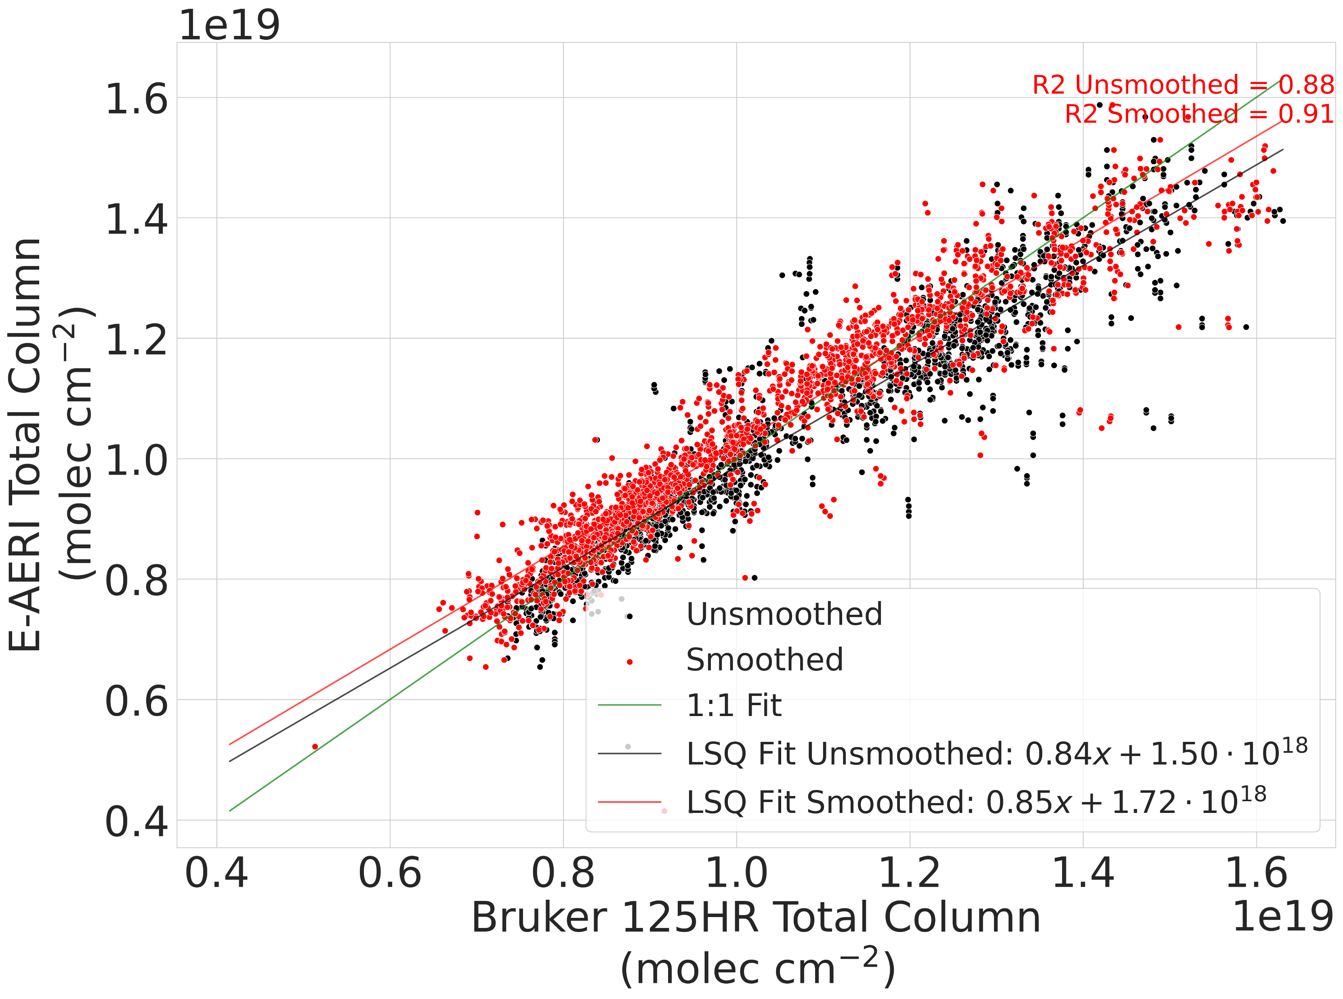
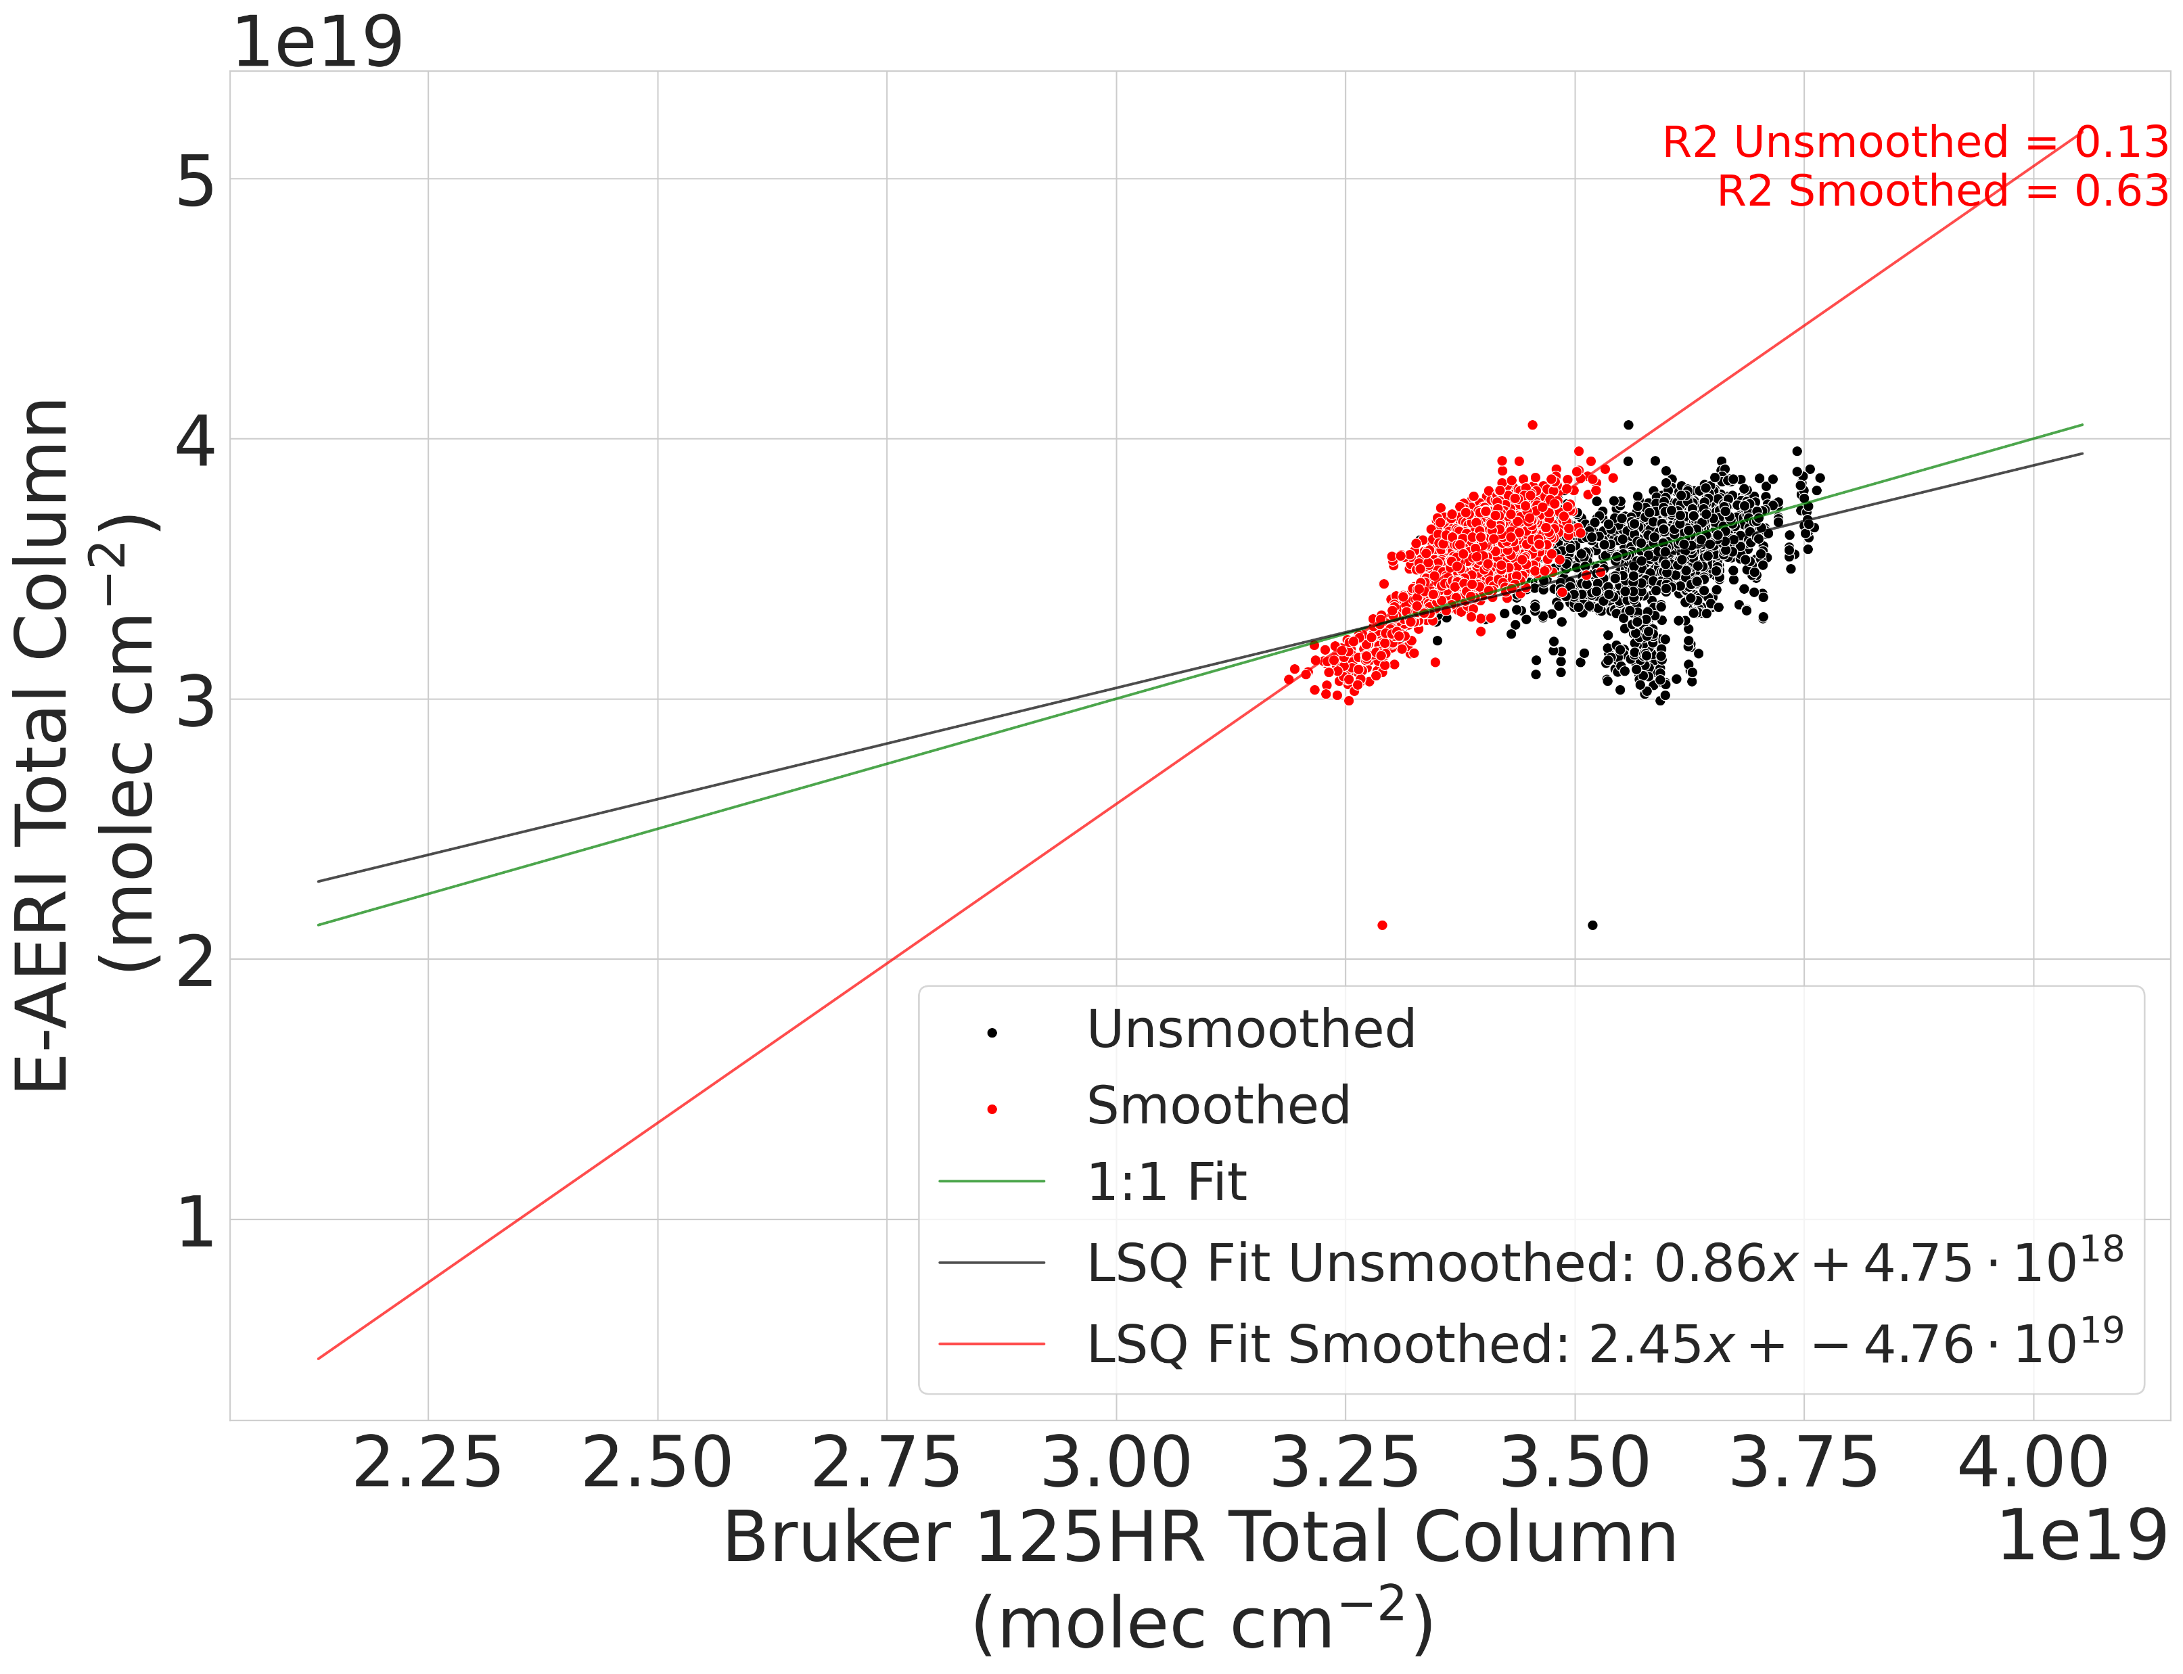
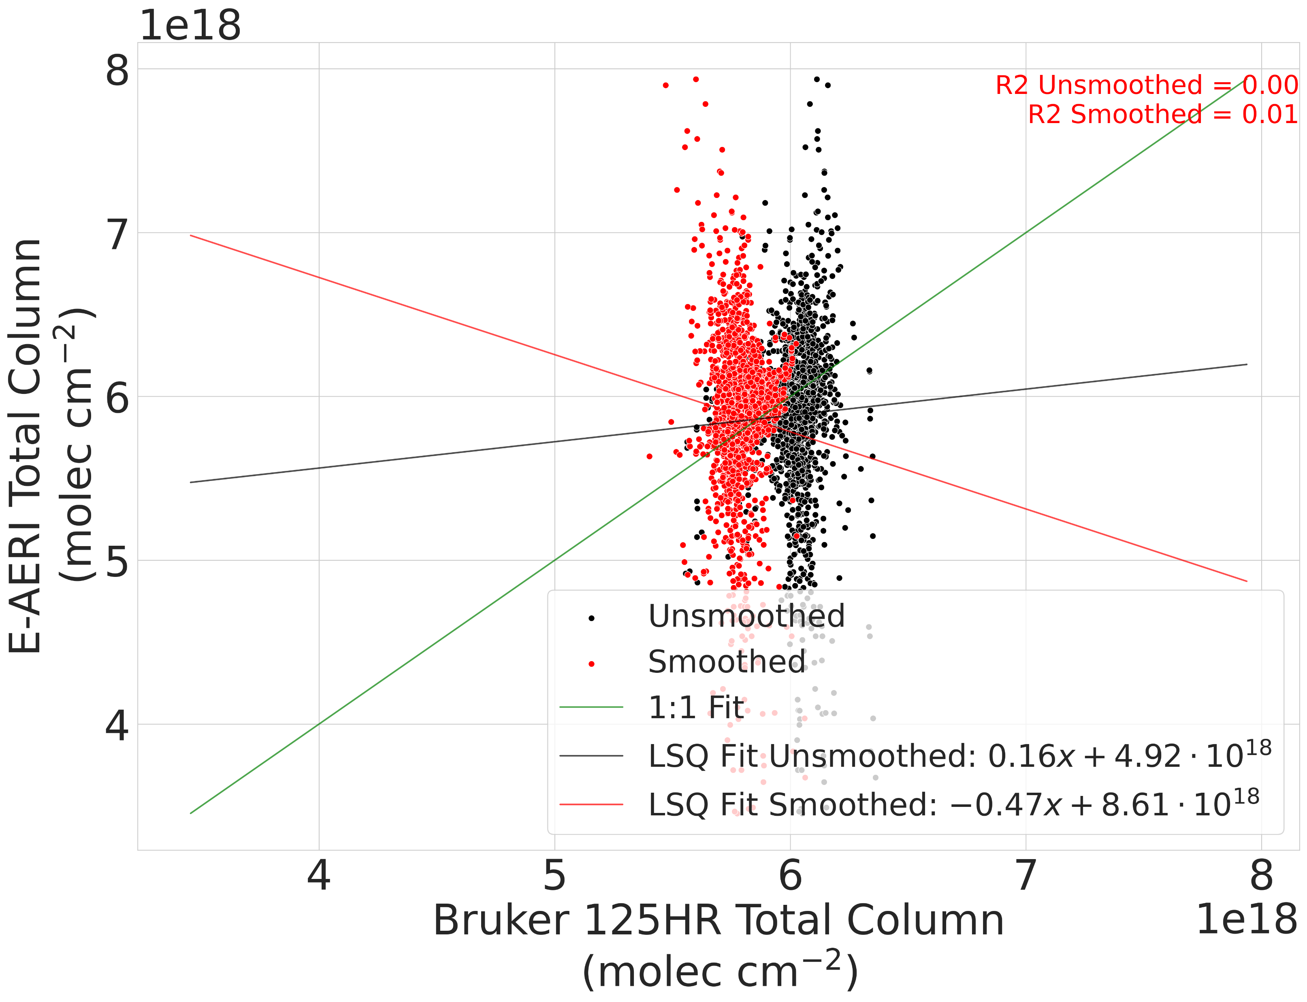
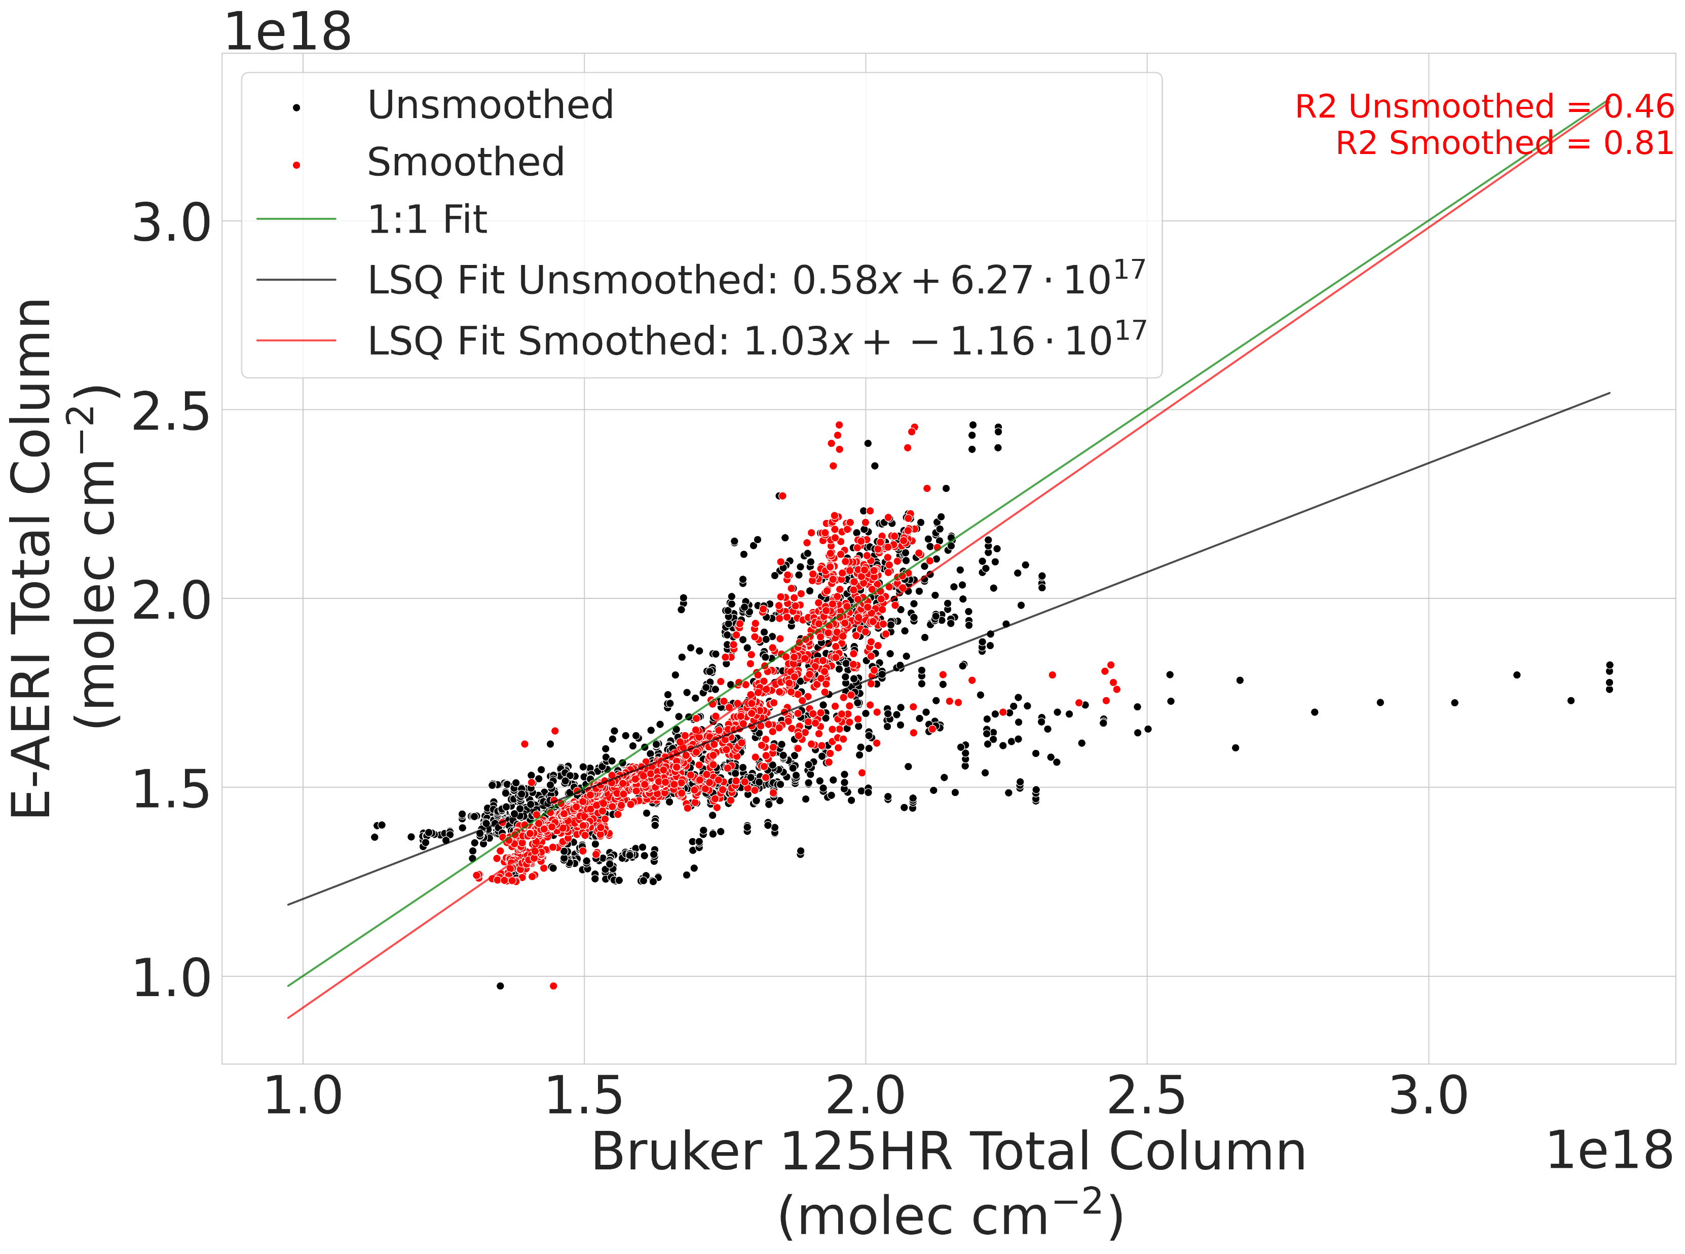
Comparison against the Bruker 125HR
Good agreement for gases which have strong seasonal variability and dynamic range (CO/O3)
Relative differences
((EAERI-125HR)/mean):
-3.9% [CO]
+2.3% [O3]
N2O and CH4 do not have strong seasonal cycles and poor correlation as a result.
Relative differences:
+1.3% [N2O]
+4.4% [CH4]
O3
CH4
N2O
Figure: Comparison for co-incident 125HR – EAERI retrievals. Black points are direct comparisons, Red points indicate 125HR measurements smoothed with the EAERI averaging kernel.
CO

Slide 11
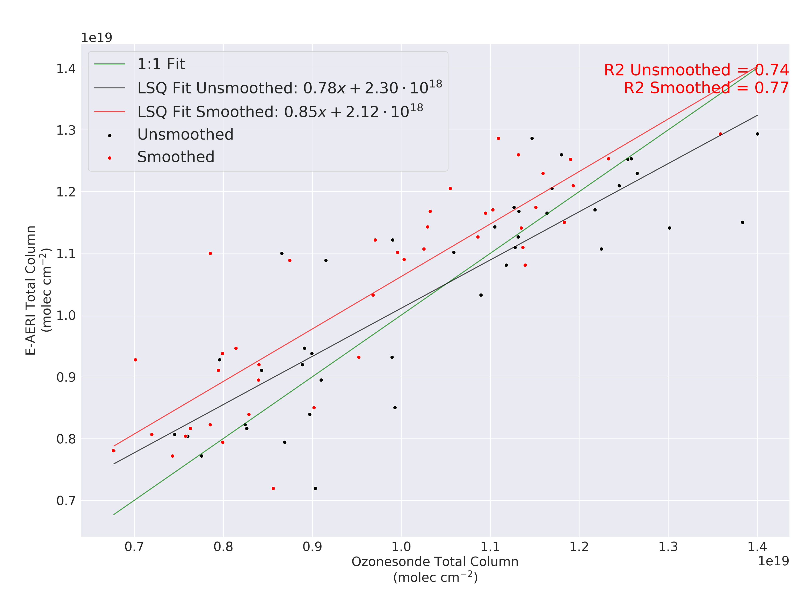
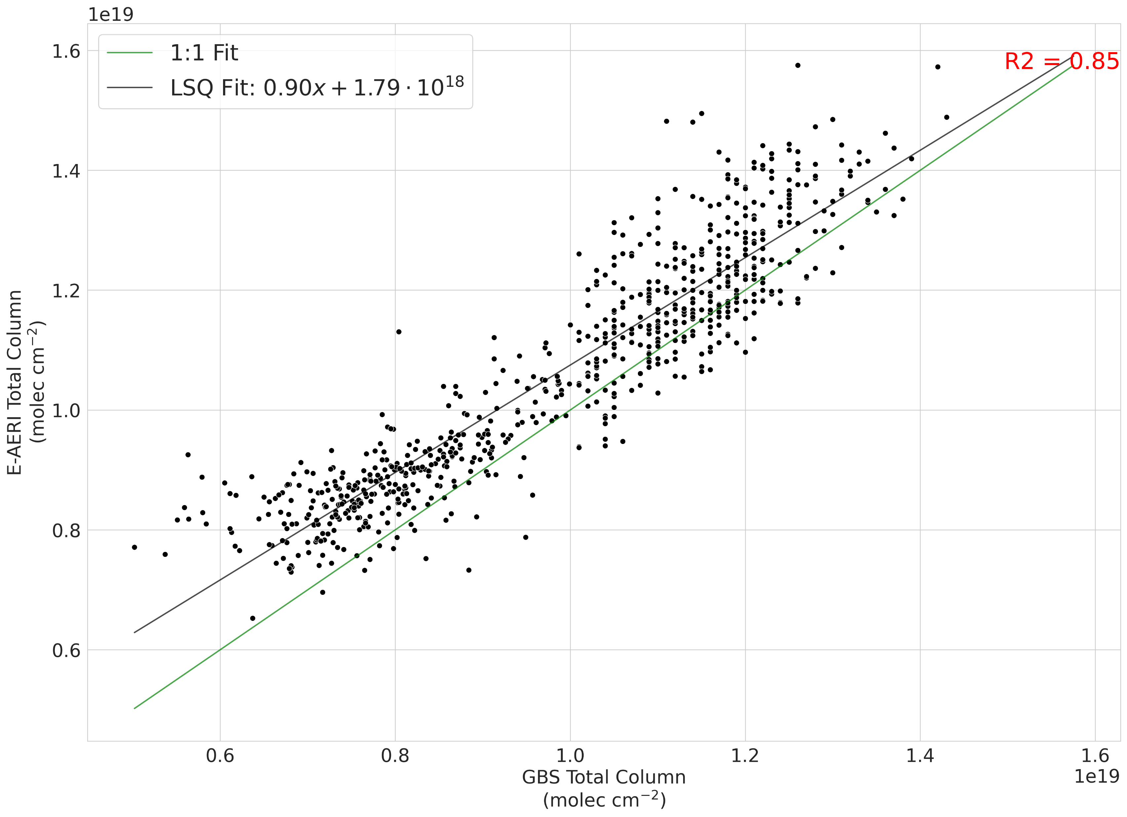
Comparison against Ozonesondes and GBS
Ozonesondes GBS
Figure: Comparison for co-incident ozonesonde/GBS - EAERI retrievals. Black points are direct comparisons, Red points indicate sonde measurements smoothed with the EAERI averaging kernel.
1:1 line and fitted correlations are plotted in their respective colours.

Slide 12
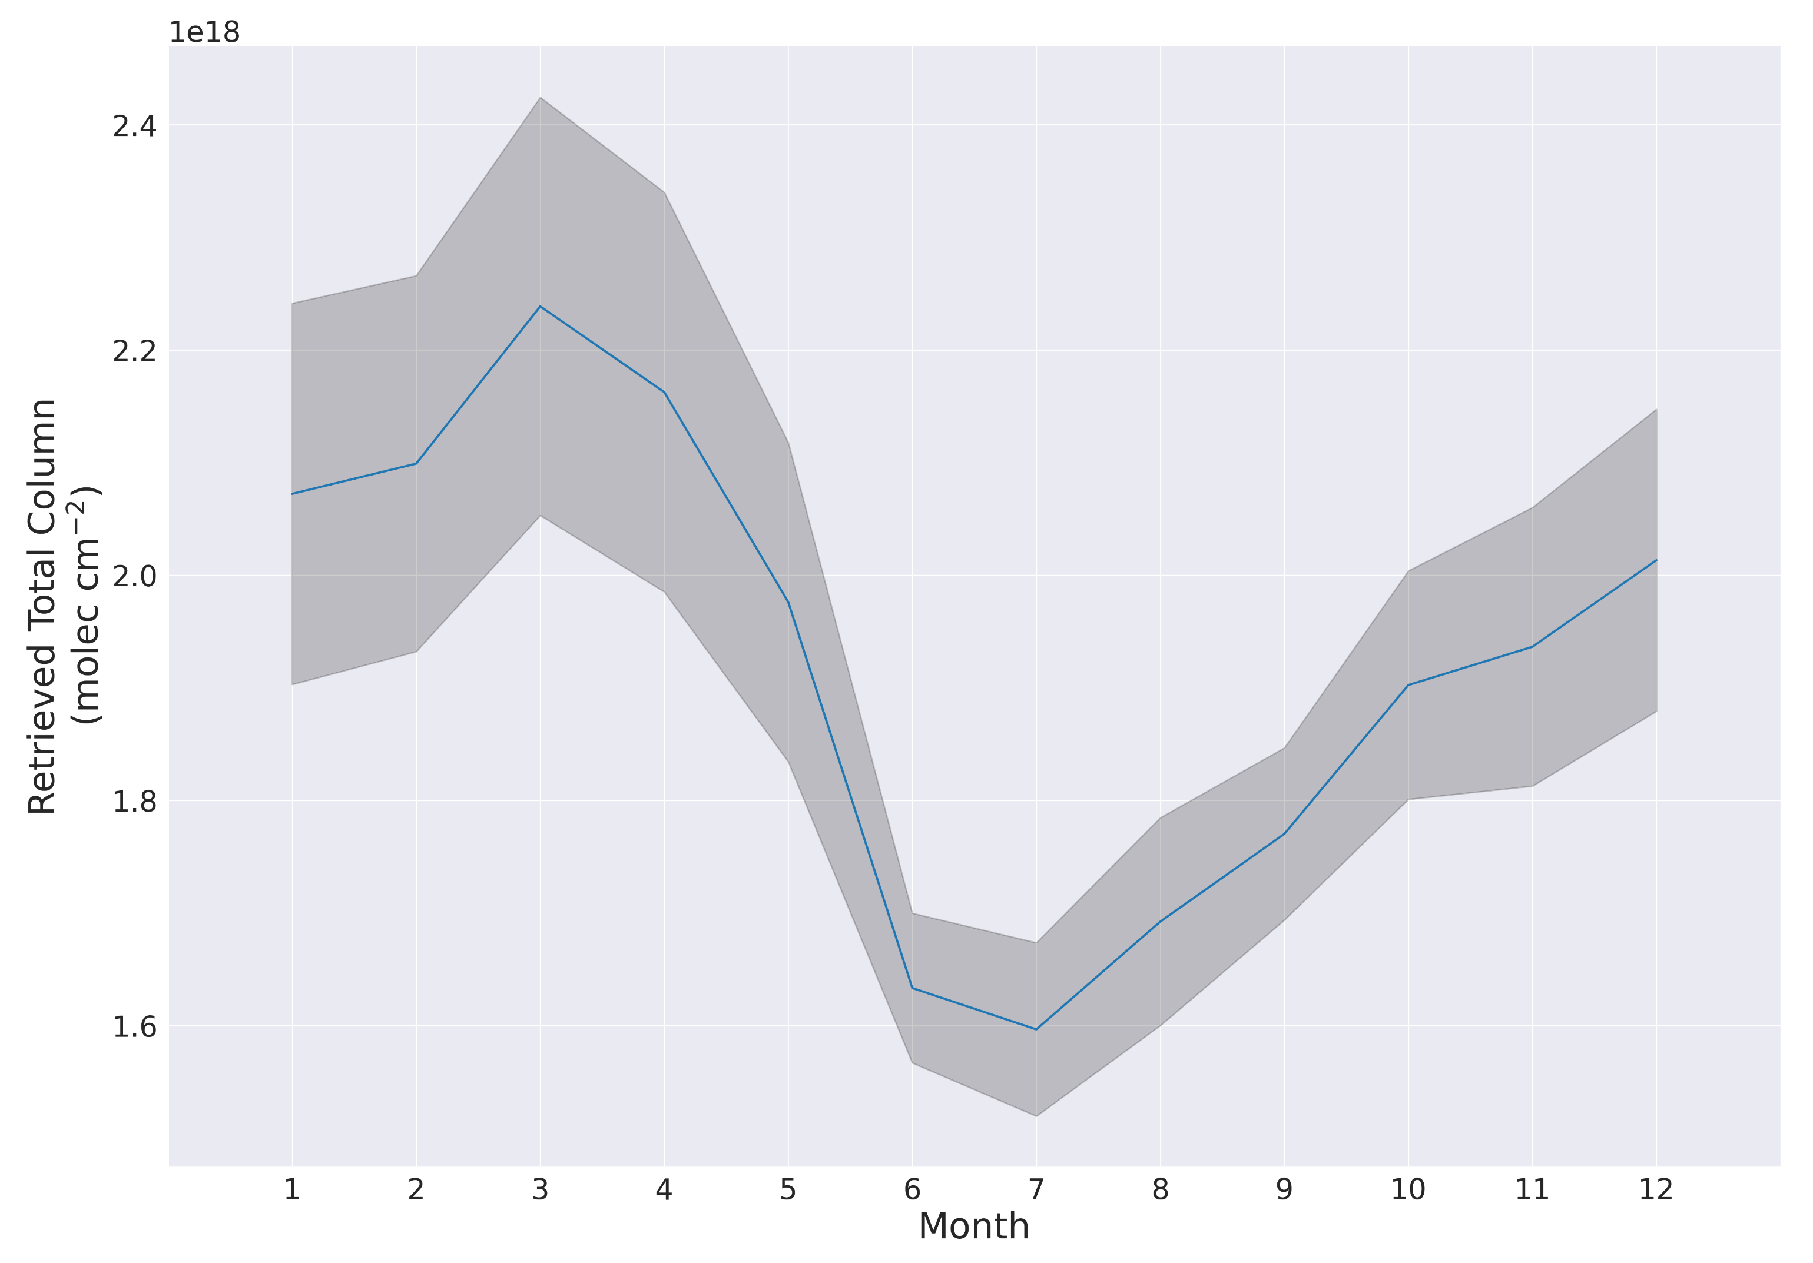
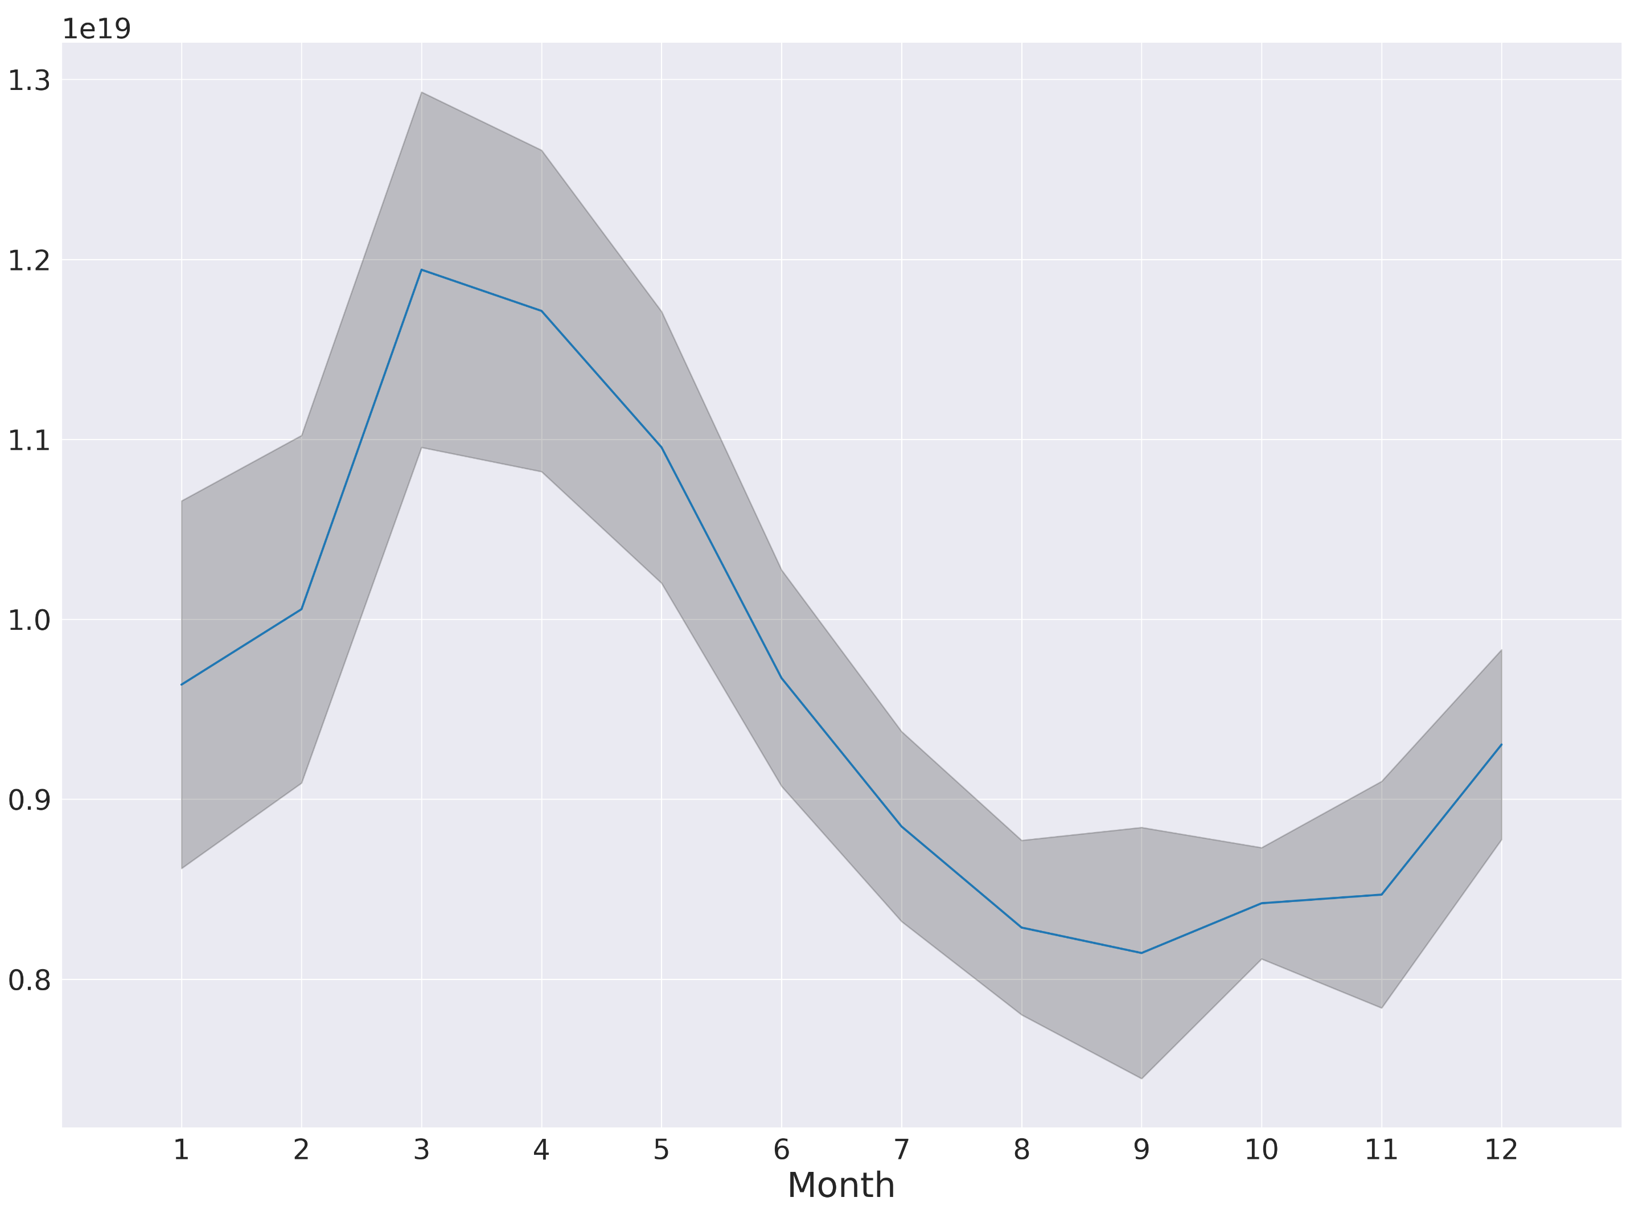
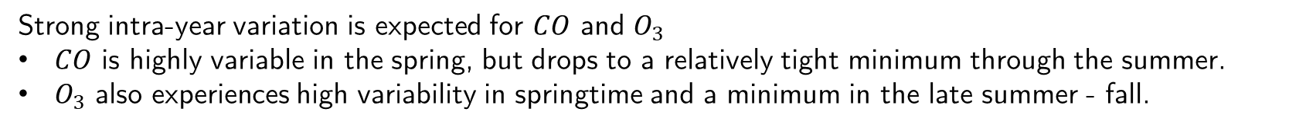
Seasonal Variability
CO $O_{3}$
37%
45%
Figure: Average monthly means for CO and $O_{3}$. 1$σ$ in grey shading.
Strong intra-year variation is expected for $CO$ and $O_{3}$
$CO$ is highly variable in the spring, but drops to a relatively tight minimum through the summer.
$O_{3}$ also experiences high variability in springtime and a minimum in the late summer - fall.

Slide 13
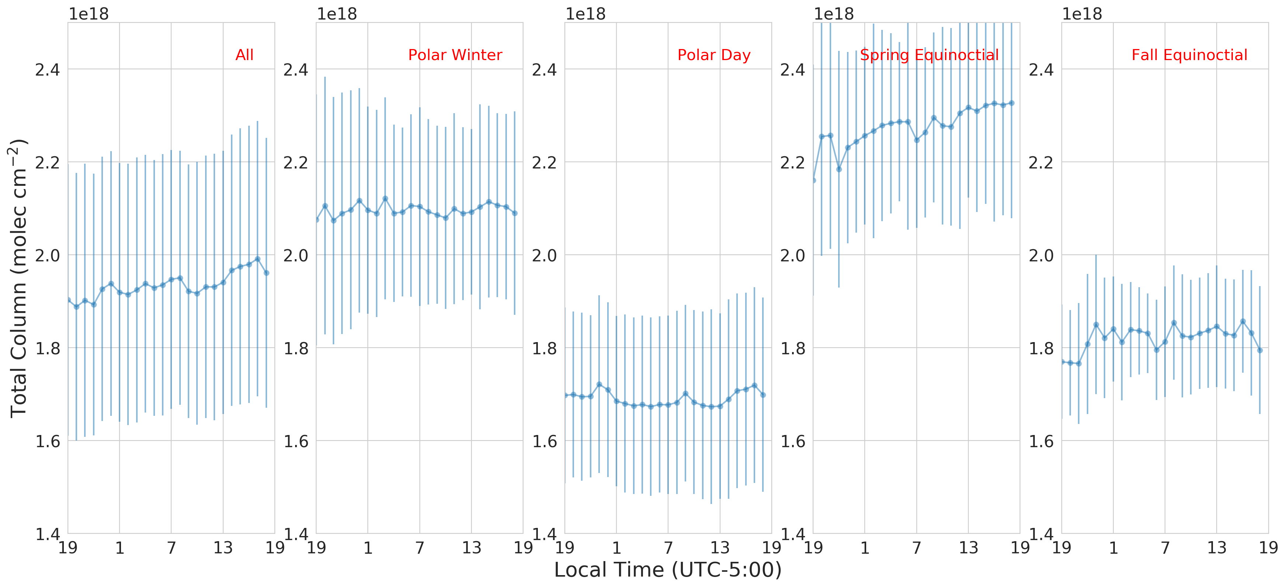
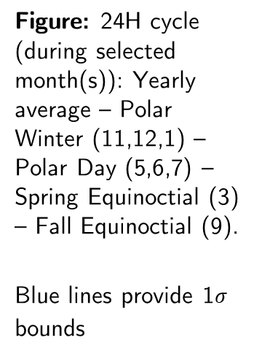
The 24H Diurnal Cycle of CO
Figure: 24H cycle (during selected month(s)): Yearly average – Polar Winter (11,12,1) – Polar Day (5,6,7) – Spring Equinoctial (3) – Fall Equinoctial (9).
Blue lines provide 1$σ$ bounds
Equinoctial periods show up to 10% variability within a single day, with a minimum in the late afternoon
Settles into relatively constant equilibrium during polar day and night
Other gases do not experience strong intra-day variation

Slide 14
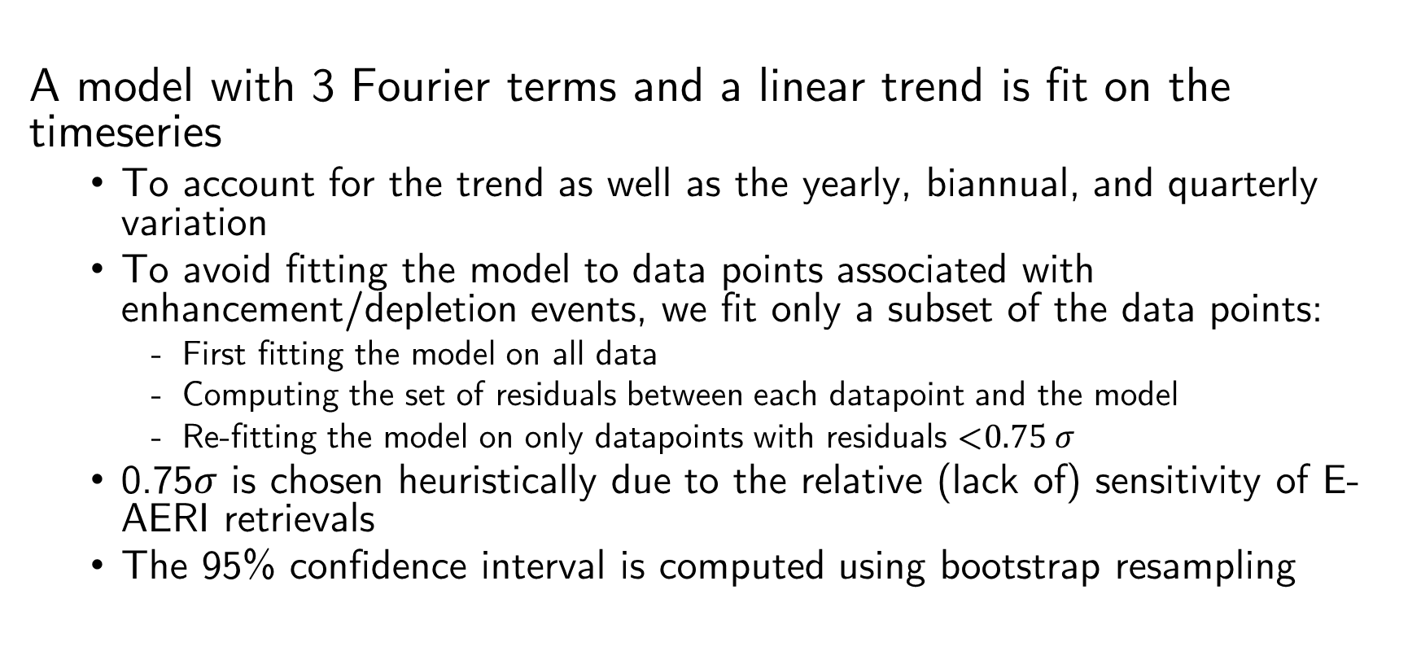
Trends
A model with 3 Fourier terms and a linear trend is fit on the timeseries
  To account for the trend as well as the yearly, biannual, and quarterly variation
  To avoid fitting the model to data points associated with enhancement/depletion events, we fit only a subset of the data points:
    First fitting the model on all data
    Computing the set of residuals between each datapoint and the model
    Re-fitting the model on only datapoints with residuals <$0.75 σ$
  0.75$σ$ is chosen heuristically due to the relative (lack of) sensitivity of E-AERI retrievals
  The 95% confidence interval is computed using bootstrap resampling

Slide 15
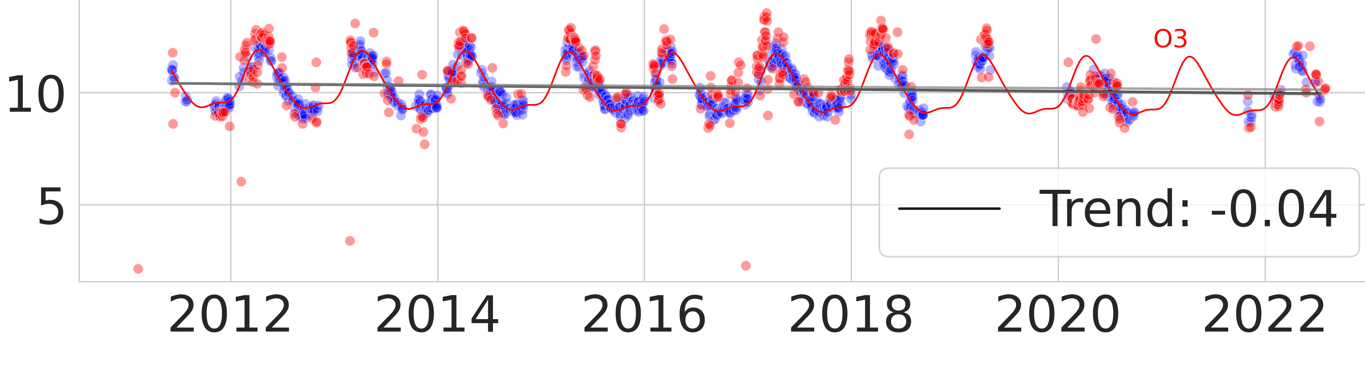
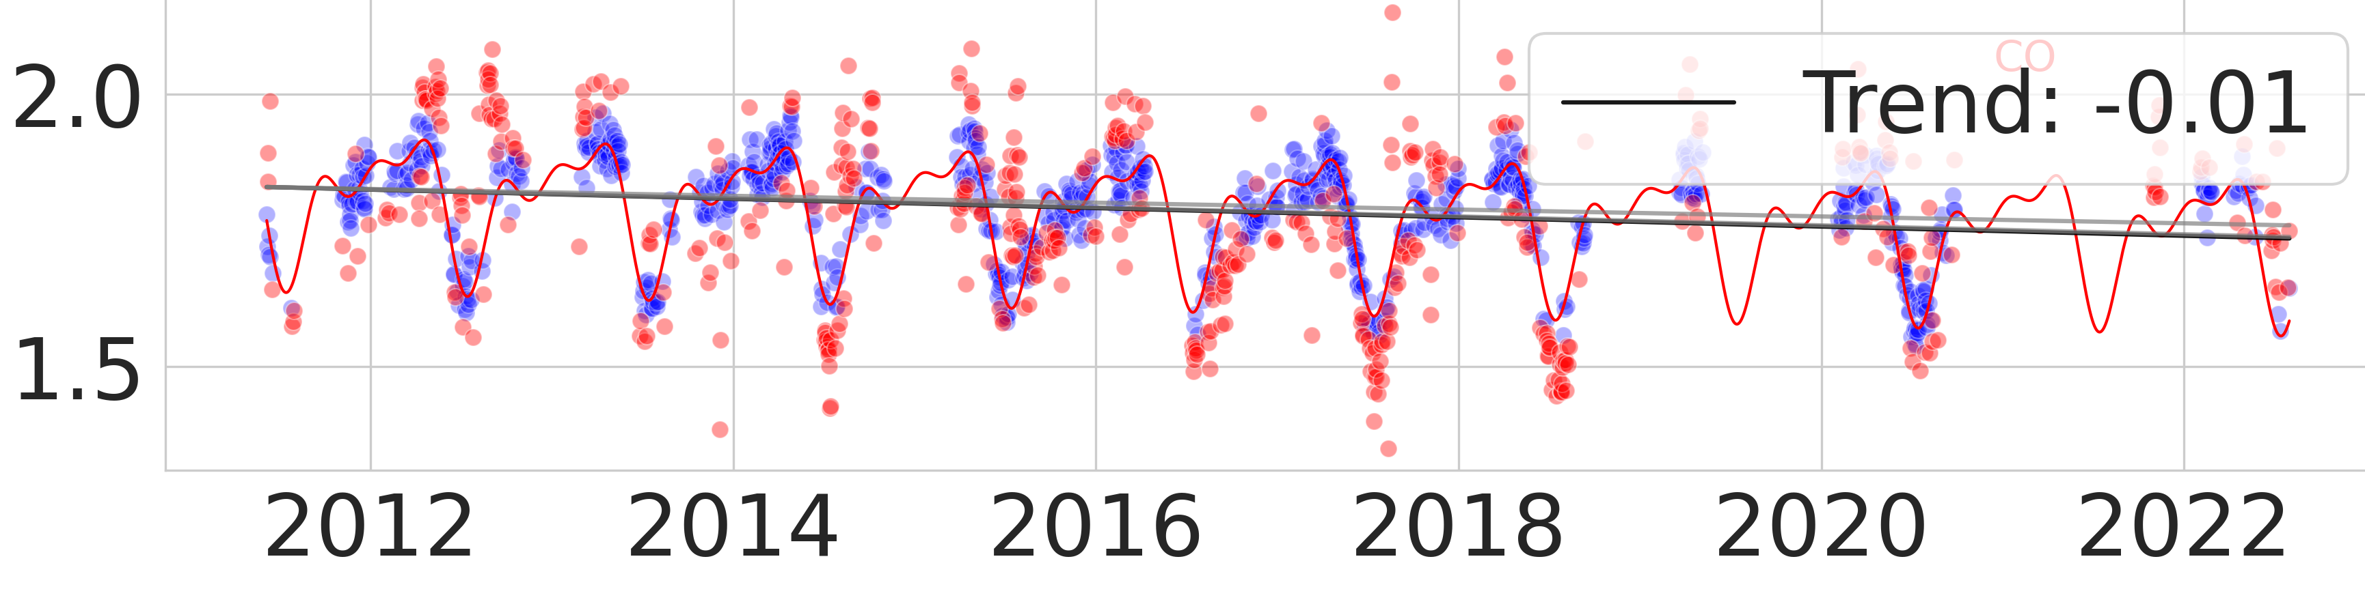
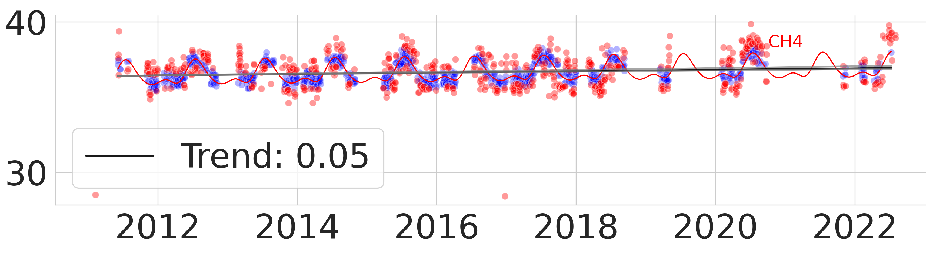
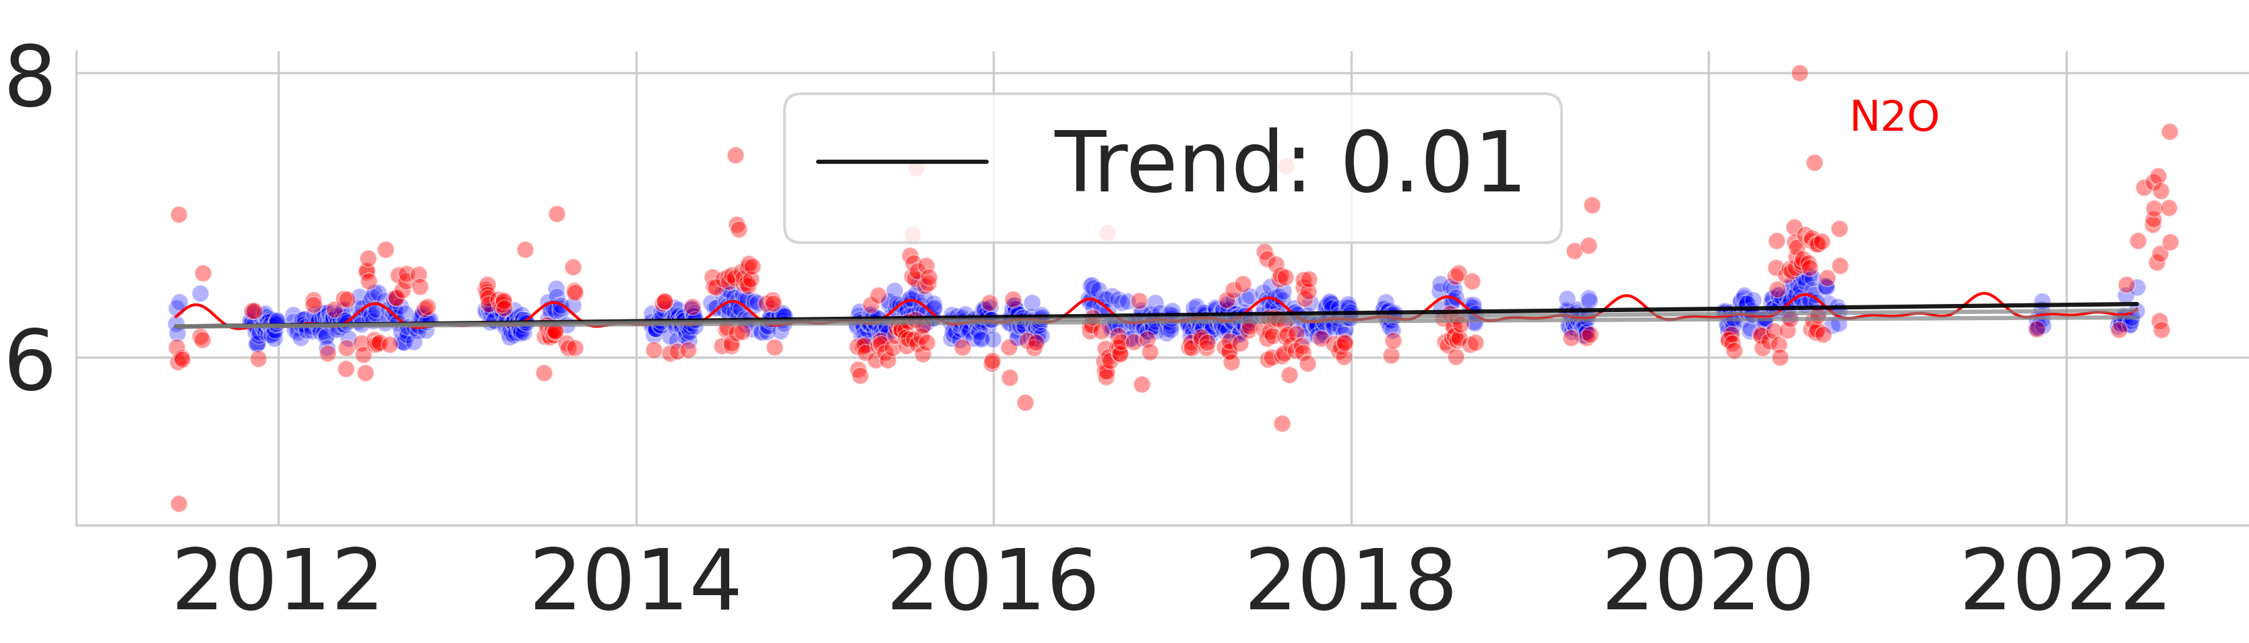

Trends
O3: -0.9% / year CO: -0.6% / year
Total Column (${10}^{19}$molec ${cm}^{−2}$)
CH4: +0.3% / year N2O: +0.03% / year
Figure: Retrieved timeseries and fitted model. Red points indicate discarded values. Grey band indicates the 95% confidence interval computed with bootstrap resampling.
Note we do not consider the measurements from 2008-2010 due to the change of measurement site.

Slide 16
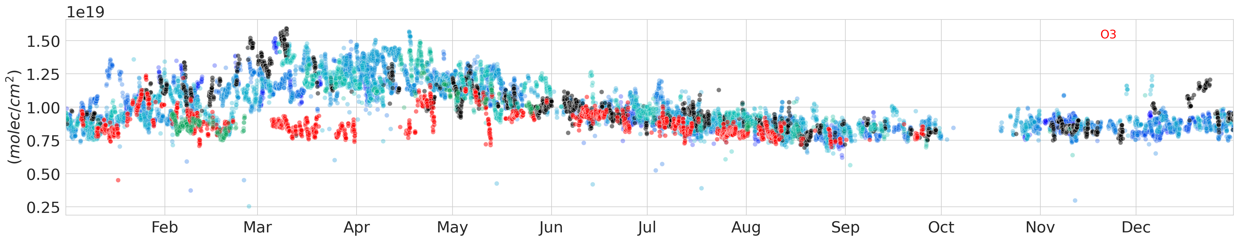
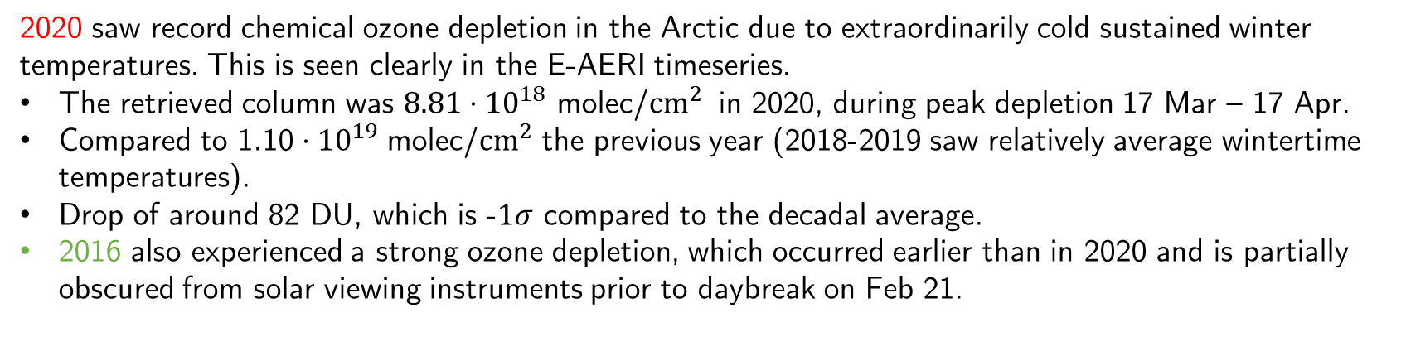
Case Study: 2020 Ozone Depletion
Figure: Ozone timeseries 2011 – 2022. Shaded region indicates polar night.
2020 saw record chemical ozone depletion in the Arctic due to extraordinarily cold sustained winter temperatures. This is seen clearly in the E-AERI timeseries.
The retrieved column was $8.81⋅{10}^{18}$ molec/${cm}^{2}$ in 2020, during peak depletion 17 Mar – 17 Apr.
Compared to 1.10$⋅{10}^{19}$ molec/${cm}^{2}$ the previous year (2018-2019 saw relatively average wintertime temperatures).
Drop of around 82 DU, which is -$1σ$ compared to the decadal average.
2016 also experienced a strong ozone depletion, which occurred earlier than in 2020 and is partially obscured from solar viewing instruments prior to daybreak on Feb 21.

Slide 17
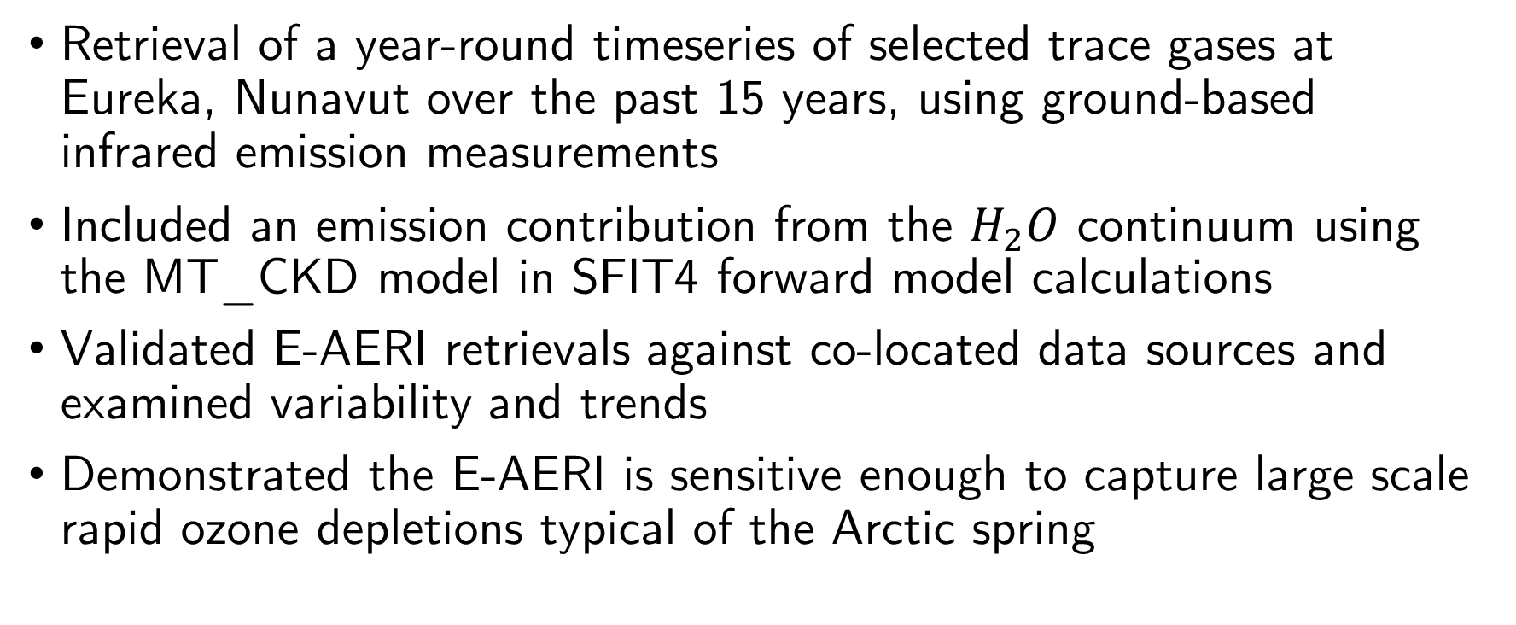
Summary
Retrieval of a year-round timeseries of selected trace gases at Eureka, Nunavut over the past 15 years, using ground-based infrared emission measurements
Included an emission contribution from the $H_{2}O$ continuum using the MT_CKD model in SFIT4 forward model calculations
Validated E-AERI retrievals against co-located data sources and examined variability and trends
Demonstrated the E-AERI is sensitive enough to capture large scale rapid ozone depletions typical of the Arctic spring

