Slide 1
Designing additional GHGs observations network over Korea using Lagrangian inversion model
Samuel Takele Kenea¹, Sangwon Joo¹, Shanlan Li^{1,}, Sumin Kim¹, Young-SuK Oh¹, Daegeun Shin¹, Soojeong Lee¹, Lev, D. Labzovskii², Sanghun Park³
Climate Research Department, National Institute of Meteorological Sciences (NIMS), 33, Seohobuk-ro, Seogwipo-si 63568, Jeju-do, Korea
R&D Satellite and Observations Group, Royal Netherlands Meteorological Institute (KNMI), 3731GA De Bilt, The Netherlands
Laboratory for Atmospheric Modeling Research, Yonsei University, Seoul, Korea
Contact: samueltakele81@gmail.com
NDACC-IRWG-TCCON-COCCON meeting 2023

Slide 2
Introduction
Uncertainty in anthropogenic emissions is a fundamental science question
The aim of this work is to propose new additional GHGs (CO2) candidate sites, which will enable us to improve GHGs emissions at fine spatiotemporal scales over Korea.
We need to have
simulated footprints (e.g., KIM-STILT model), together with Bayesian inverse modelling framework
Meteorological deriving fields are obtained from KIM (Korean Integrated Model)
prior and true GHGs emissions data at high spatiotemporal resolution,
defined model-data mismatch errors, priori flux uncertainties, and error correlations

Slide 3
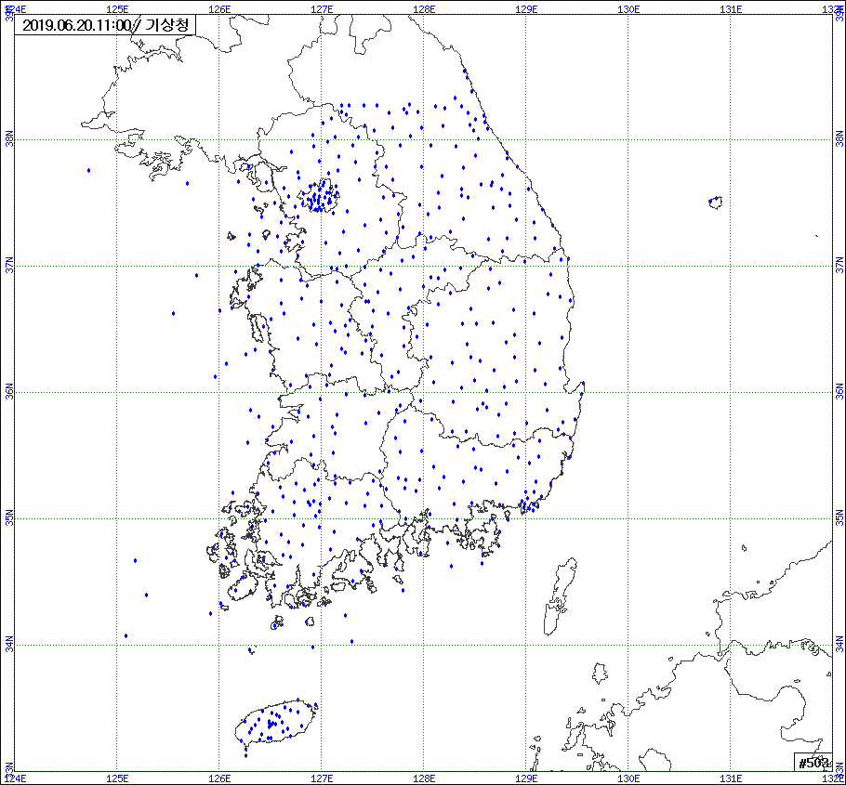
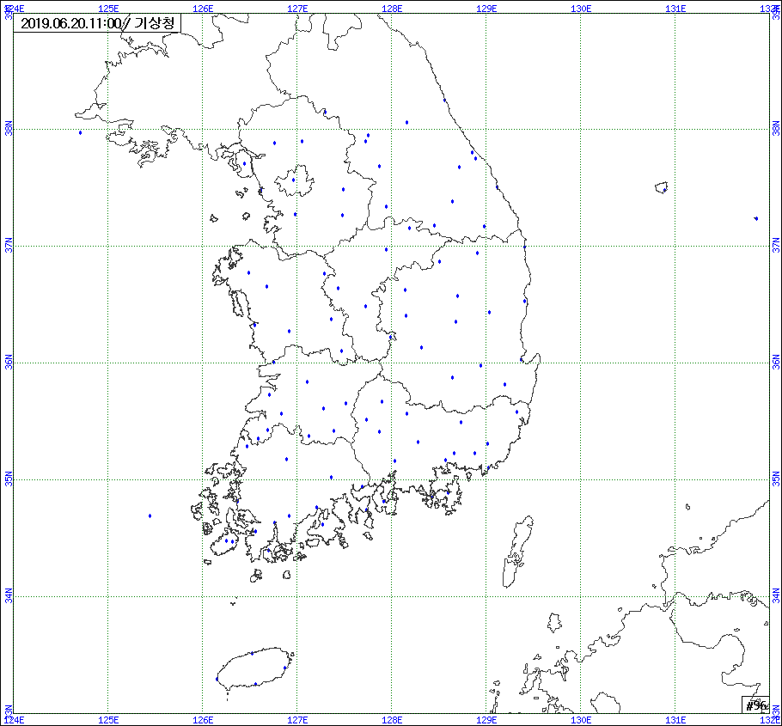
Measurement activities operated by NIMS
Platform description
In situ surface (AMY, JGS, ULD)
Tall tower (LWT, BST)
Mobile (Vessel, Aircraft)
Remote observation (FTS, mobile FTS)
Low cost sensors are under developing stage
Measurement details
CO₂/CH₄/N₂O/SF₆
Data Visualization
Observation data
Model data
GHG monitoring network in Korea
Lotte
(LTT)
Ulleung-do
(ULD)
Aircraft
(Nara)
Anmyeon-do
(AMY)
Vessel
(Gisang)
Boseong
(BST)
Jeju Gosan
(JGS)
In-situ surface
Ground FTS

Slide 4
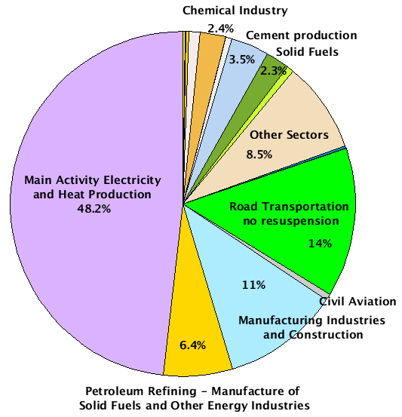
Korea CO₂ emission sectors based on EDGAR data
Major contributions
Main Activity Electricity and Heat Production 48.2%
Road Transportation no resuspension 14%
Manufacturing Industries and Construction 11%
Other sectors 8.5%

Slide 5
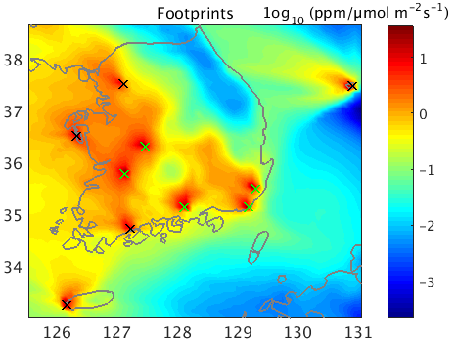
Footprints
STILT (Stochastic Time Inverted Lagrangian Transport, Lin et al. 2003)
horizontal resolution - 0.1˚ x 0.1˚ lat-lon
Temporal resolution - 1-hour
Number of particle - 500
Backward time – 3 days
The footprint – quantifies the influence of upwind surface fluxes on the concentrations measured at the receptor and is computed by counting the number of particles in surface-influenced volume and the time spent in that volume.
KIM (Korean Integrated Model, Hong et al., 2018 ) for meteorological data
horizontal resolution- 0.125˚ x 0.125˚ lat-lon
Temporal resolution - 3-hour
Vertical levels - 31
Figure 1. KIM-STILT aggregated footprints of 10 sites located in Korea, December 2020 (2-7 UTC).
Table 1. List of GHG observation sites including existing and new candidate sites over Korea.
No | Site | Lat. (˚N), lon. (˚E), | STILT height (m.a.g.l)
1 | Anmyeondo (AMY) | 36.538576, 126.330071 | 40
2 | Gosan (JGS) | 33.29382, 126.16283 | 12
3 | Ulleungdo (ULD) | 37.48, 130.90 | 10
4 | Lotte World Tower (LWT) | 37.5126, 127.1025 | 550
5 | Boseong Tower (BST) | 34.76, 127.21 | 140
6 | Ulsan (ULS) | 35.52636, 129.293686 | 20
7 | Busan (BSN) | 35.1573, 129.1797 | 40
8 | Jeonju (JOJ) | 35.8026, 127.1182 | 40
9 | Daejeon (DJN) | 36.3359, 127.4576 | 40
10 | Jinju (JNJ) | 35.16425, 128.10732 | 40

Slide 6
Bayesian Inverse Method
Posterior emission estimates are optimized through the minimization of the cost function
$L_{s}= \frac{1}{2}{\left(z−Hs\right)}^{T}R^{−1}\left(z−Hs\right)+ \frac{1}{2} {\left(s− s_{p}\right)}^{T}Q^{−1}\left(s− s_{p}\right)$ (1)
$z=Hs_{truth}+ ∈$ (2)
$z−observed enhancments{, s}_{p}−prior emissions,s−true emissions$,
R- covariance of model-mismatch error, Q-covariance of prior emissions,$∈$-error
The posterior best estimate of emissions, $ŝ$, is expressed as:
$\hat{s}= s_{p}+ {\left(HQ\right)}^{T}{( HQH^{T}+ R)}^{−1}(z−Hs_{p})$ (3)
Posterior uncertainty covari­ance matrix $V_{\hat{s}}$, is given as:
$V_{\hat{s}}=Q− {\left(HQ\right)}^{T}{\left( HQH^{T}+ R\right)}^{−1}(HQ)$ (4)

Slide 7
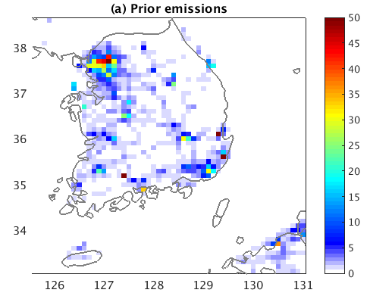
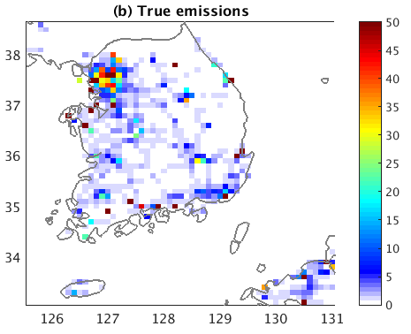
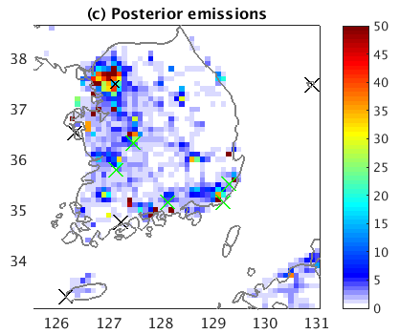
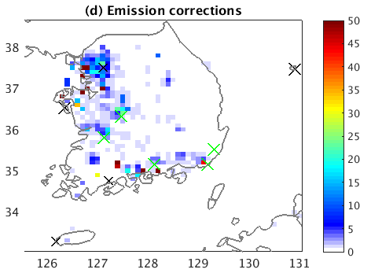
CO₂ emissions
EDGAR v6
horizontal resolution - 0.1˚ x 0.1˚ lat-lon
Temporal resolution - monthly
the latest available data is December 2018
Constructed as a prior emission
Diurnal scaling factor (from Nassar Emissions Scale Factors) is applied
GRACE2021 (Dou et al. 2023)
horizontal resolution - 0.1˚ x 0.1˚ lat-lon
Temporal resolution - daily
near-real-time daily national CO₂ emissions estimates (Carbon monitor), multi-source spatial activity data emissions
Satellite NO₂ data for time variations
Diurnal scaling factor (from Nassar Emissions Scale Factors) is applied
Constructed as a true emission
Figure 2. CO₂ emissions for December 2020.
Unit for emission is µmol m⁻² s⁻¹.

Slide 8
Error covariance parameters
Prior error covariance (Q) describes both variance in prior emissions uncertainty and spatial and temporal correlation of these uncertainties.
$$Q= I_{σ}(D⊗E)I_{σ}$$
Exponential decay equations
$E=exp{(}−\frac{x_{s}}{l_{s}}$)
$D=exp{(}−\frac{x_{τ}}{l_{τ}}$)
horizontal length scale = 45 km, temporal length scale = 5 days
Model-data mismatch (R)
R typically reflect inaccuracies in the transport, prior fluxes, and measurements
Vertical mixing layer height error is approximated of 7% mean enhancement adopted from Gerbig et al. (2008),
representing error for afternoon time period only.
Horizontal wind error is assumed to be 35% of mean enhancement (Kunik et al., 2019), with a correlation time
scale of 2.8 hours (Mallia et al., 2017)
uncertainty in STILT based on the finite number of particles released is considered 0.1 ppm (Mallia et al., 2017;
Kunik et al.,2019)
Error introduced by aggregating spatially and temporally heterogeneous fluxes into one homogeneous grid cell
and timesteps (followed Kunik et al. (2019) approach)

Slide 9
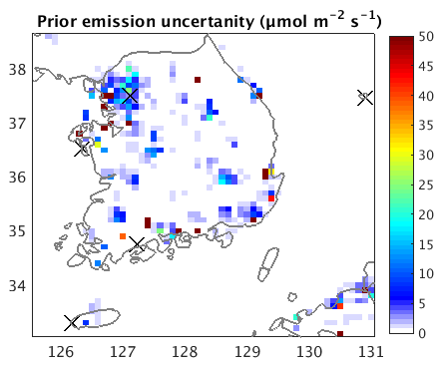
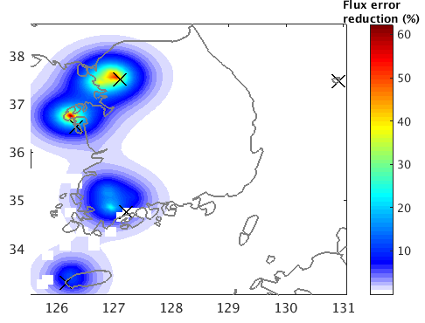
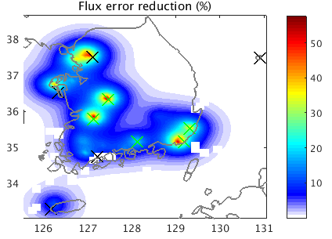
Uncertainty reduction
Prior uncertainty from absolute difference of prior minus true emission
The assigned model-mismatch values are ranging between 2.44 ppm and 3.28 ppm
ULD site only does not have influence on the uncertainty reduction
Uncertainty reduction$\left(\%\right)= \left(1−\frac{σ_{predicted}}{σ_{prior}}\right)x 100$
Daytime (2-7 UTC) uncertainty reduction =
19.1 % (5 sites) 29.7 % (10 sites)
Reduced χ² = 0.926
Figure 3. Prior uncertainty and uncertainty reduction maps. Unit for emission is µmol m⁻² s⁻¹.

Slide 10
Undergoing work: sensitivity analysis and method validation
Influence of spatial and temporal correlation length
Ranking the site influence in terms of uncertainty reduction
Investigate the impact of inlet heights, backward time of the trajectory

Slide 11
Thank you!

