Slide 1
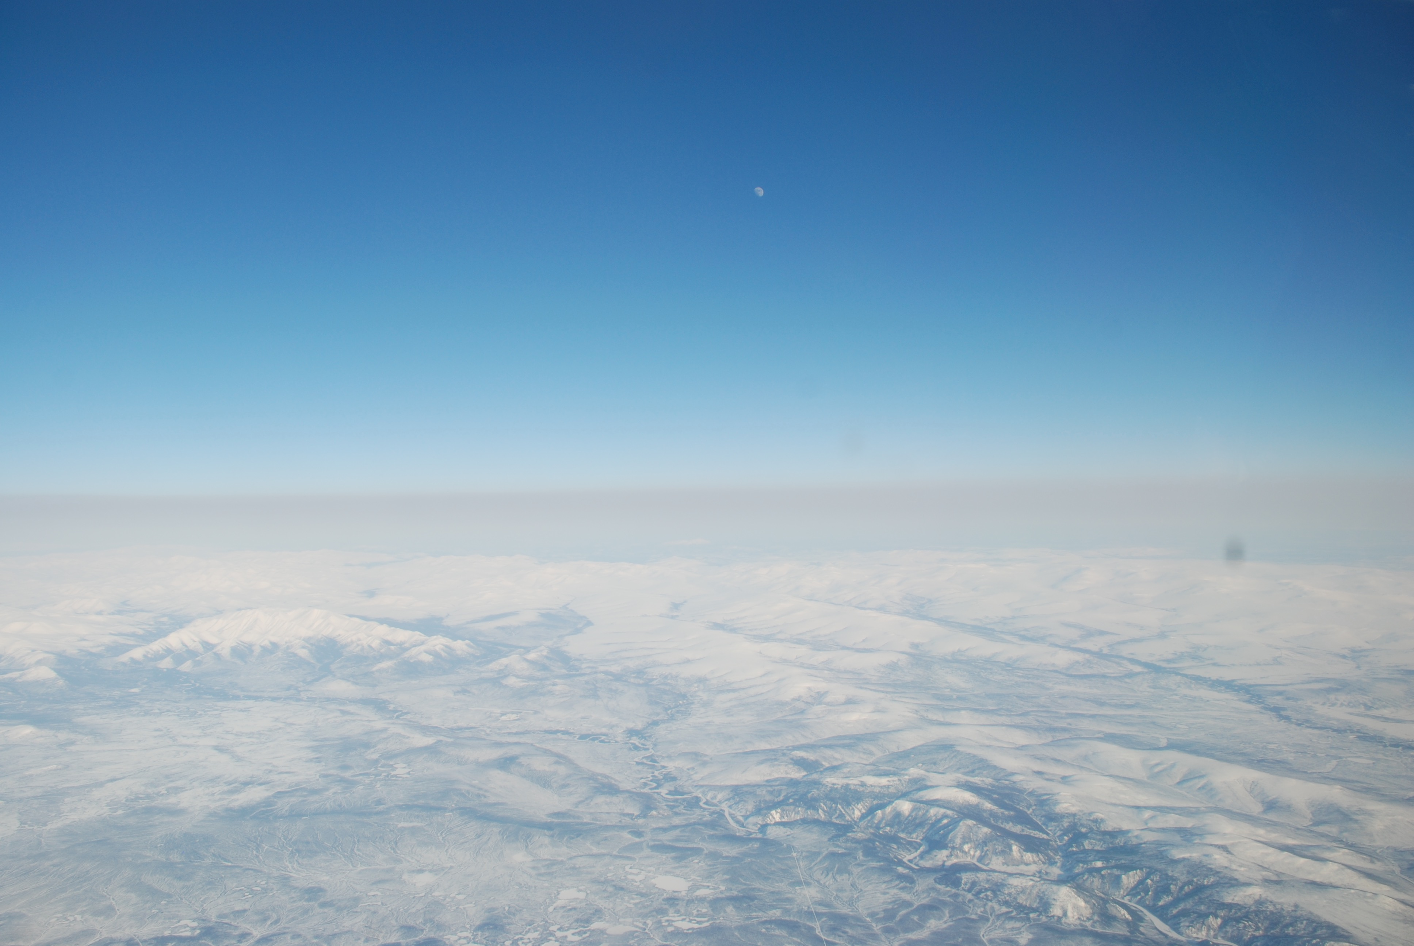
Investigating Tropospheric Pollutant Trends in the High-Arctic Region
NDACC-IRWG Meeting 2023
15 June, 2023
Tyler Wizenberg, K. Strong, D. B. A Jones,
E. Mahieu, I. Ortega, and J. W. Hannigan
Arctic haze observed over the Brooks Range, Alaska during the IPY campaign of 2007-2008.
Image credit J. Cozic NOAA/CIRES.

Slide 2
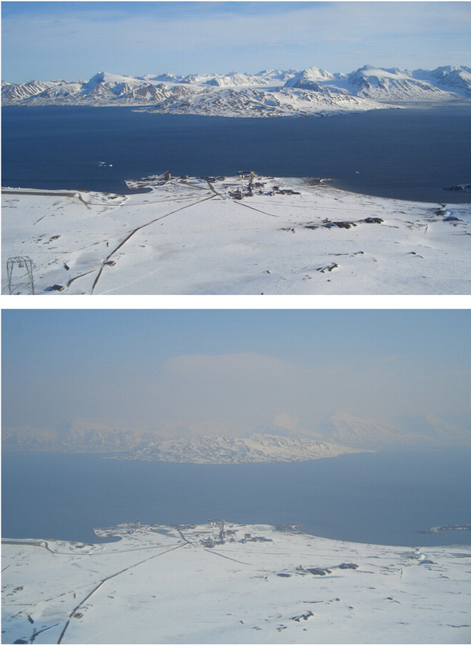
Introduction - Arctic Air Pollution
The Arctic region is a major receptor of mid-latitude anthropogenic pollution [Law et al., 2014; Schmale et al., 2018]
Wildfires are also a significant natural source of pollution to the Arctic [Roiger et al., 2011; Viatte et al., 2015; Lutsch et al., 2020]
Climate change and human development are likely to influence these pollution sources.
Transport pathways and effects on the Arctic environment are not well understood [Arnold et al., 2016].
View from the zeppelin station near Ny-Ålesund, Svalbard (top) during clear conditions, and
(bottom) when agricultural fire plumes from Eastern Europe were transported to the station.
Photo credit: A.-C. Engvall, Stockholm University.

Slide 3
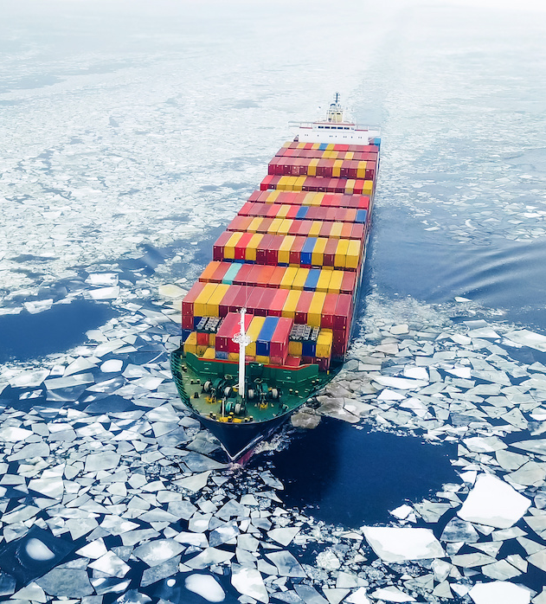
Motivation
Reliable measurements of many tropospheric pollutants are sparse in the high Arctic region.
Satellite measurements of some tropospheric pollutants are available from certain sensors (e.g., CrIS, TES, and IASI)
Poor observational conditions for nadir-viewing TIR instruments.
Without a long time-series of reliable measurements, its difficult to assess inter- and intra-annual variability.
A container ship passing through the European Arctic. Photo credit: A. Medvedkov.

Slide 4
Motivation
Ground-based Fourier Transform Infrared (FTIR) measurements provide a consistent dataset at a single site, and can help address this issue.
Chemical transport models (e.g., GEOS-Chem) can provide an additional point of comparison with the ground-based data when assessing trends.
Classic CTM’s can be slow due to the detailed chemistry, making long-term simulations less feasible… That's where GCHP comes in!
Here we investigate seasonality and trends in eight tropospheric species; CO, C2H2, C2H4, C2H6, CH3OH, HCHO, HCOOH, and PAN.
Image credit J. Cozic NOAA/CIRES.
Notes:
Some satellites do measure these species, but the observational conditions over the Arctic are extremely poor, making measurements unreliable and inconsistent

Slide 5
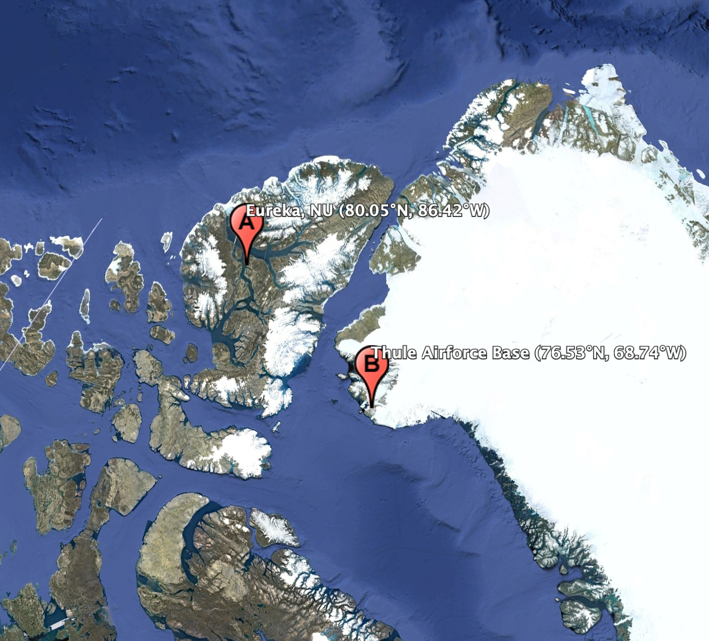
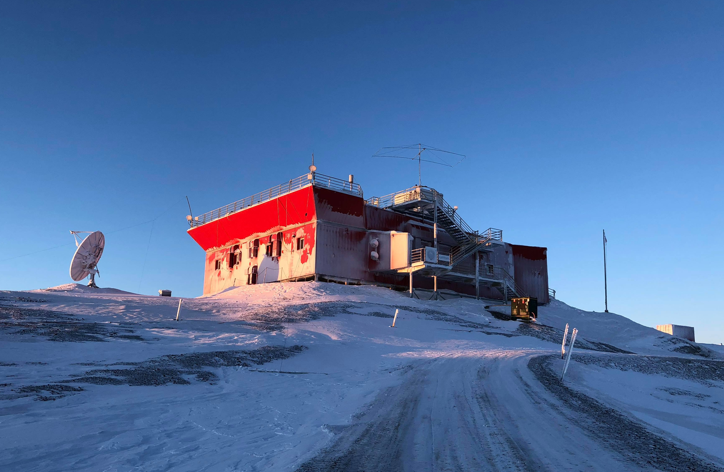
Methods & Datasets - Arctic FTIR Sites
First instrument is located at the Polar Environment Atmospheric Research Laboratory (PEARL) in Eureka, NU (80.05°N, 86.42°W, 610m ASL) [Batchelor et al., 2009].
Bruker 125HR, in operation July 2006 - present.
Second is located at the Thule Airforce Base (TAB) in Thule, Greenland (76.53°N, 68.74°W, 225m ASL) [Hannigan et al., 2009].
In operation Oct 1999 - present, 120M until 2015, 125HR after.
The PEARL Ridge Lab at Eureka, NU
Photo credit: Google Earth (top), Me (bottom)

Slide 6
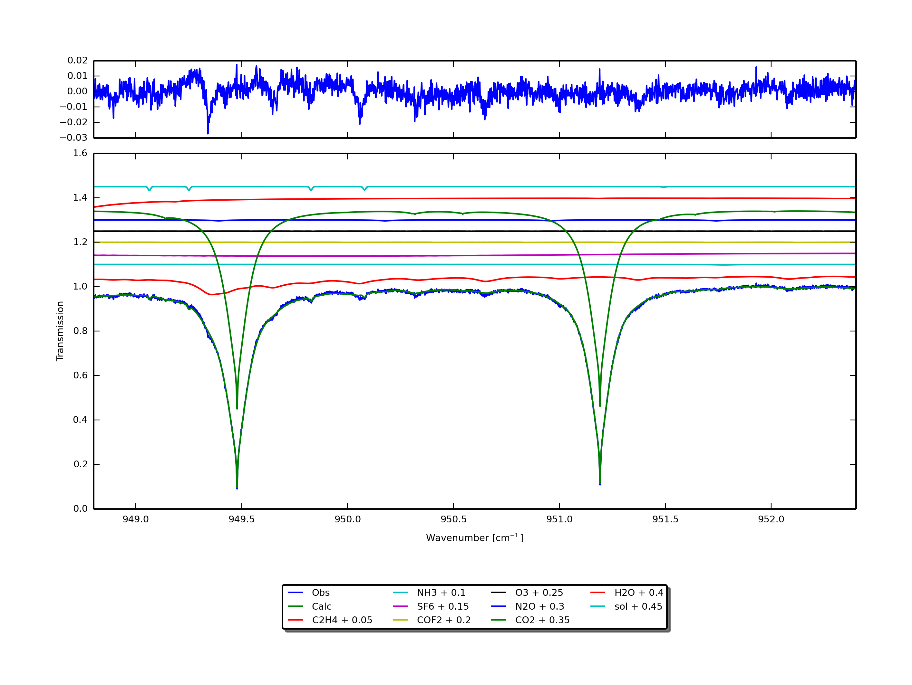
Methods & Datasets - SFIT4 Retrievals
All retrievals performed using SFIT4 v0.9.4.4.
P-T profiles are daily averages of the US National Centers for Environmental Prediction (NCEP).
HIT16 H2O lines used for PAN retrieval, ATM16 used for HCHO, ATM20 used for C2H4. HIT08 line-list database used for all others [Rothman et al., 2009]
A priori profiles are from a 40-year average of the WACCM v4.0 [Marsh et al., 2013].
SFIT4 C2H4 retrieval microwindow showing the spectral features of C2H4 and the interfering species in the specified wavenumber range.

Slide 7
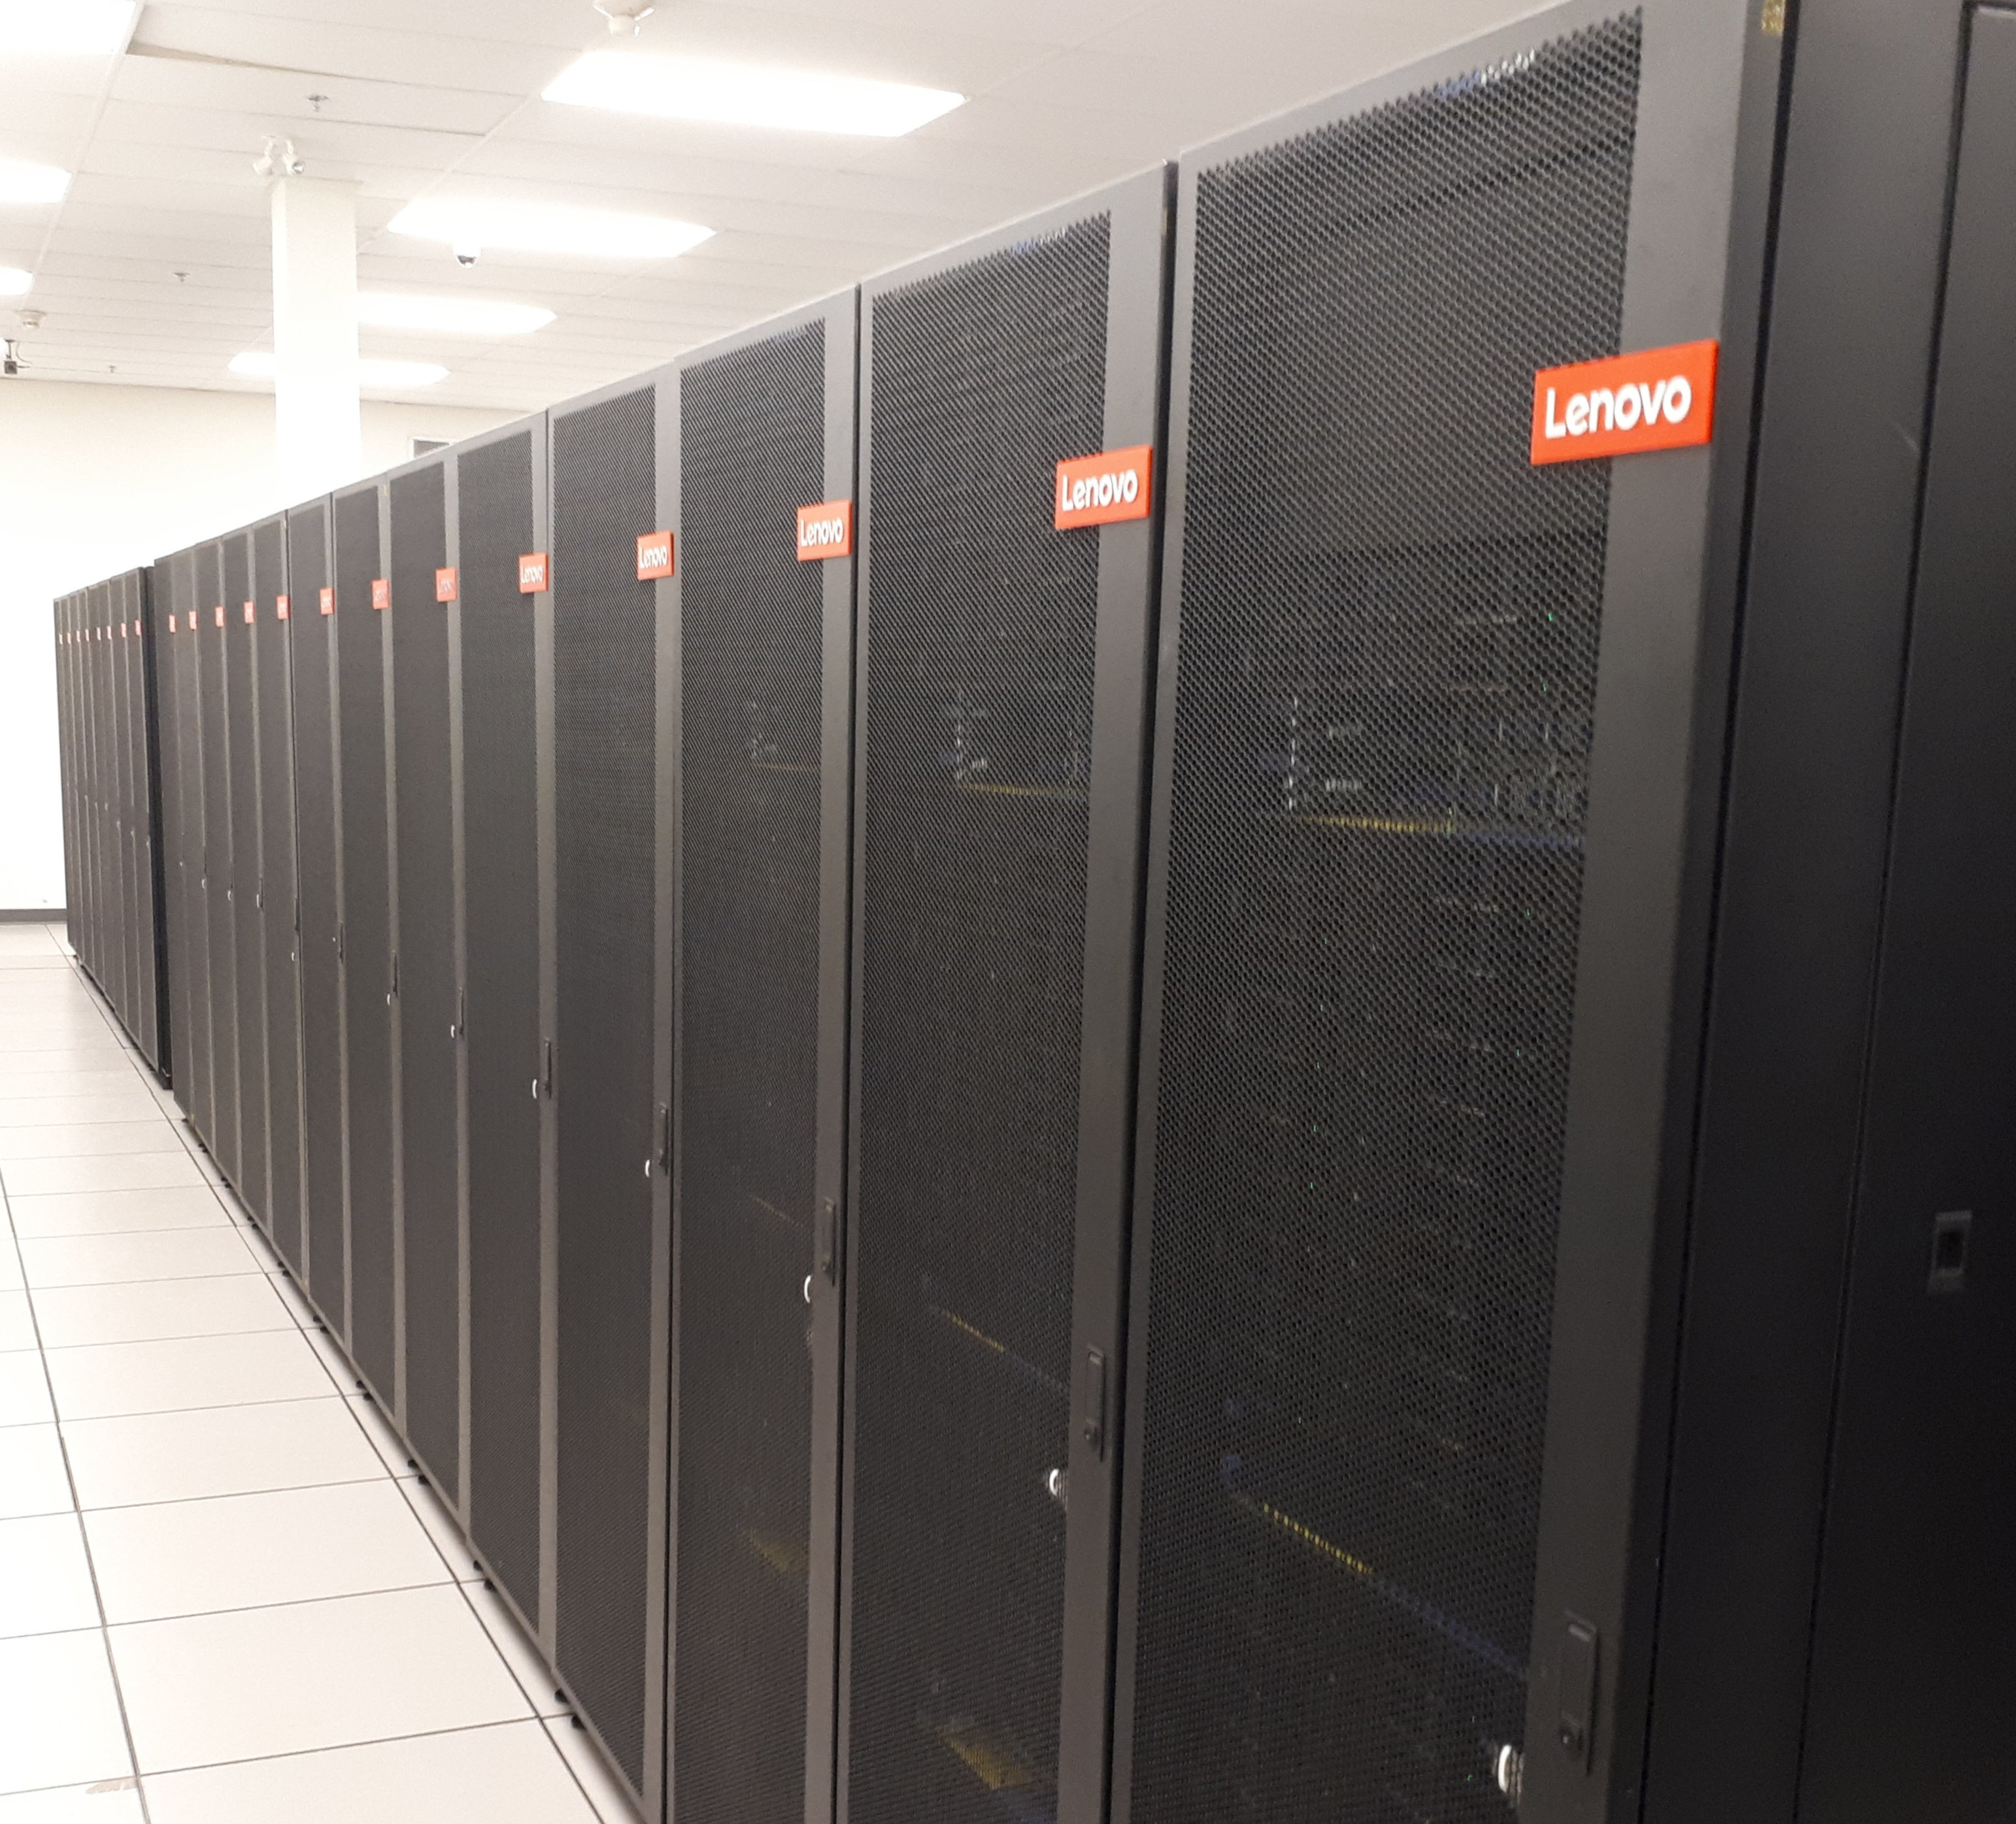
Methods & Datasets - GCHP
GEOS-Chem High Performance (GCHP) is the next generation of the model.
It is highly parallelizable, and comes with new features.
Uses a novel equidistant ‘cubed-sphere’ grid.
Simulation was run on the SciNet Niagara HPC cluster with 600 cores.
SciNet Niagara HPC cluster

Slide 8
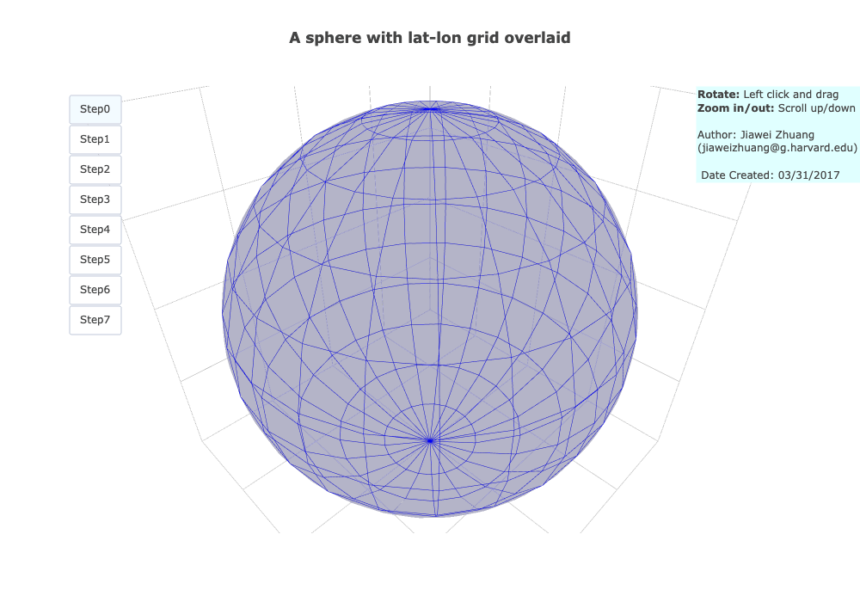
Methods & Datasets - GCHP

Slide 9
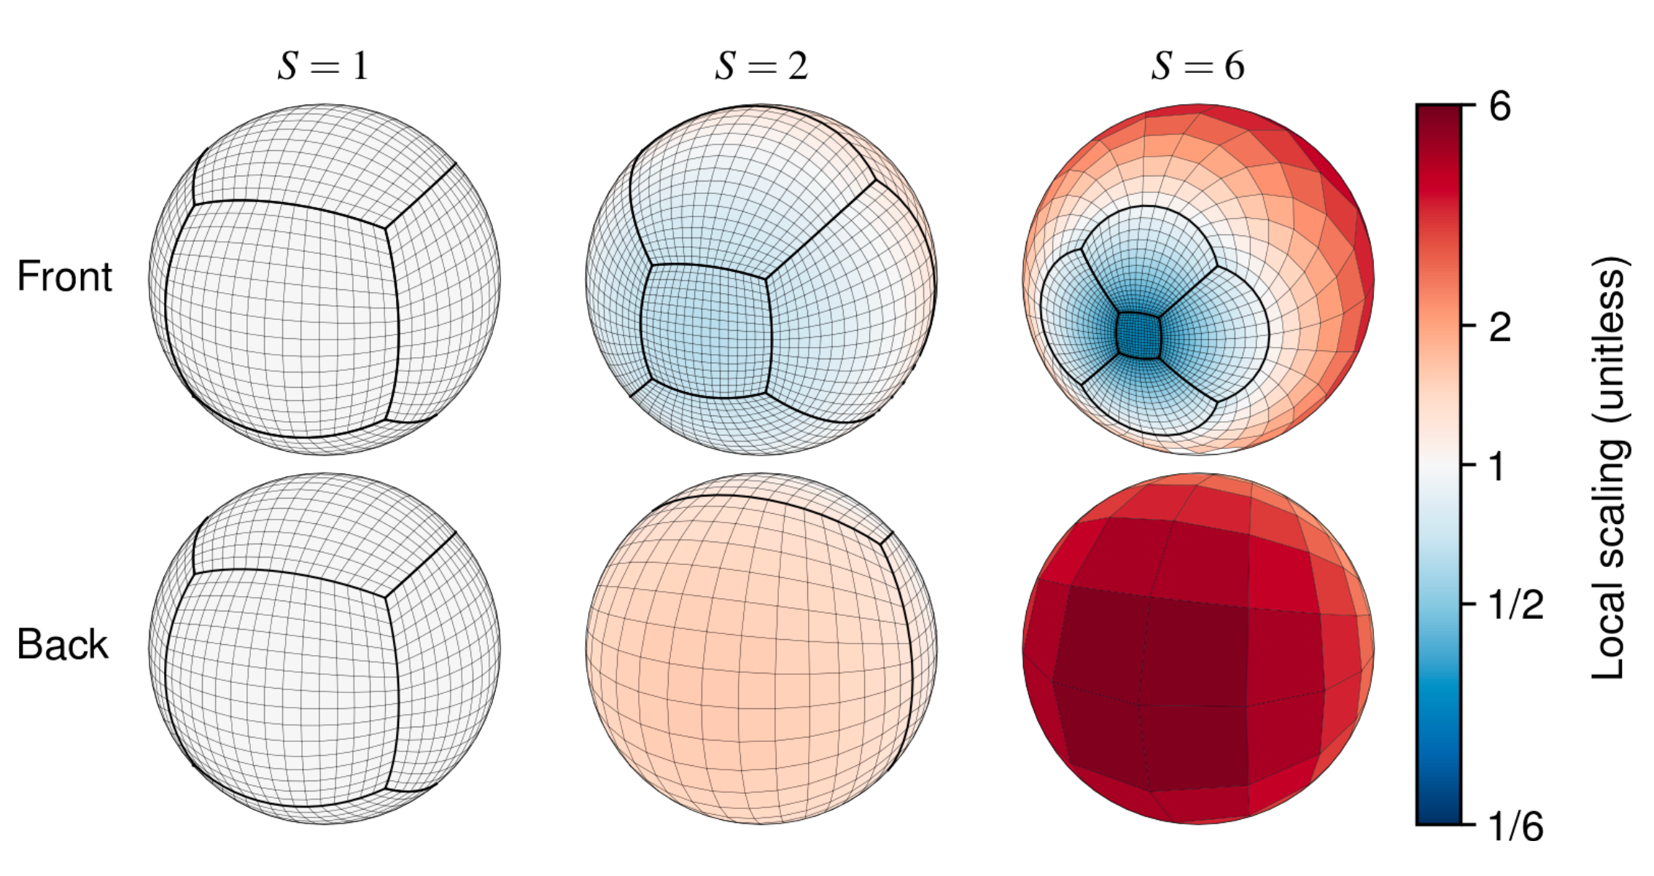
Methods & Datasets - GCHP
Bindle et al. (2021)
Illustration showing the ‘stretched-grid’ capability of GCHP. Three stretched grids that show the effect of the stretch factor (S) on stretching a C16 cubed sphere. Local scaling is the relative change to a grid box’s edge length induced by stretching. Reproduced from Bindle et al. (2021).

Slide 10
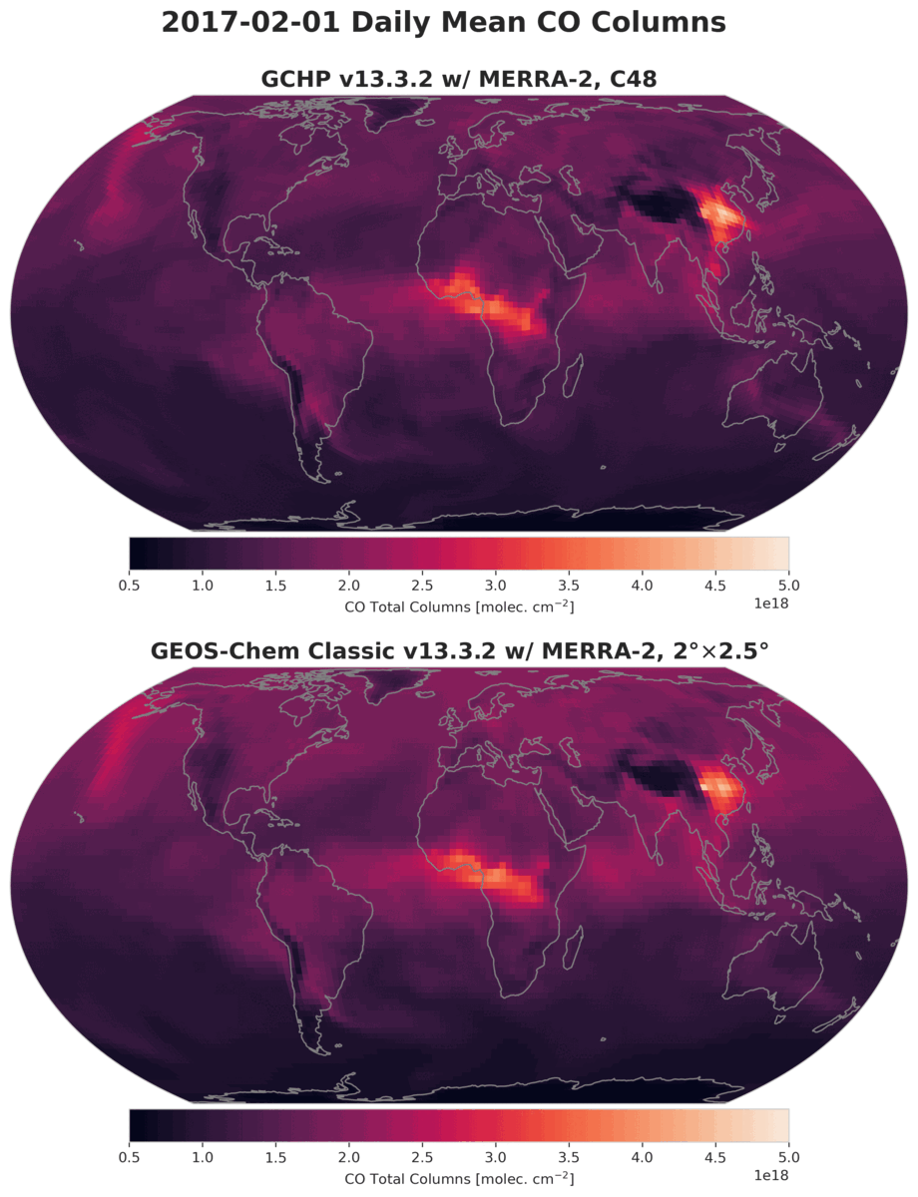
Methods & Datasets - GCHP
Global simulation at C48 resolution (~2°$×$2.5°) and covers the period of 2003-2021.
1-year spin-up during 2002.
MERRA-2 meteorology, CEDS anthropogenic emissions, GFAS BB emissions, and biogenic emissions from MEGAN.
C2H2 and HCOOH BB emissions estimated by scaling CO fields by molar emission ratios for different forest types.
SciNet Niagara HPC cluster

Slide 11
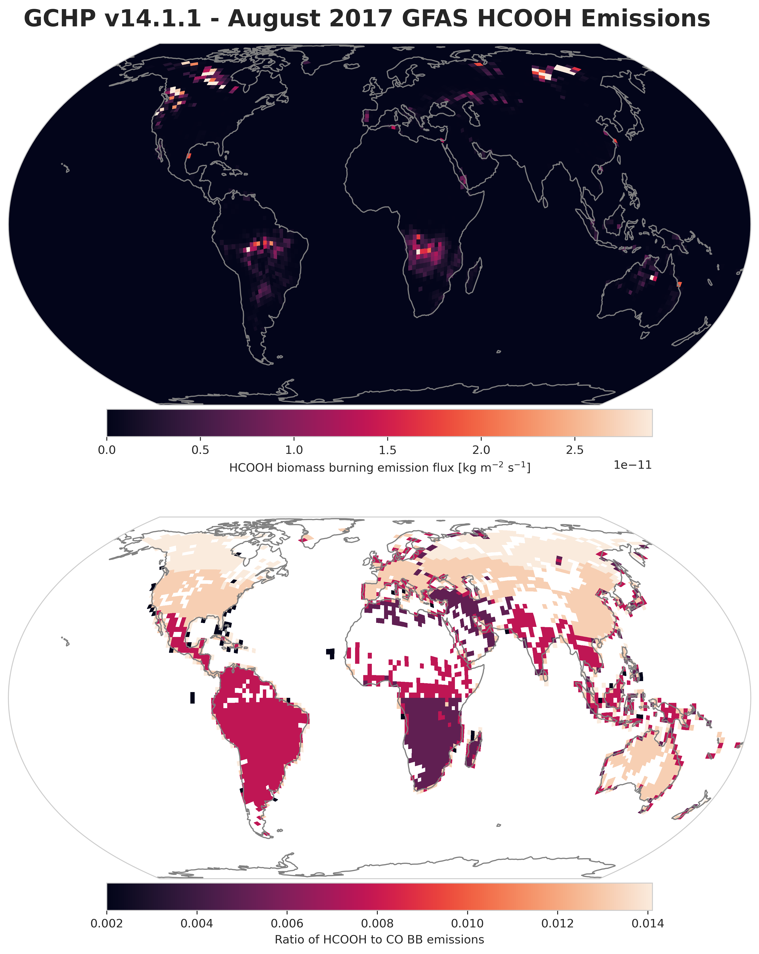
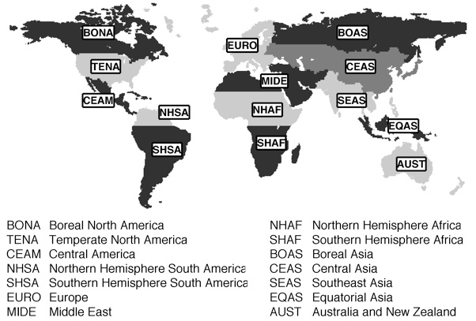
GFAS Emissions Scaling
GFED4.1 Basis Regions
Method from Wizenberg et al. (2023) expanded to global GFAS emissions.

Slide 12
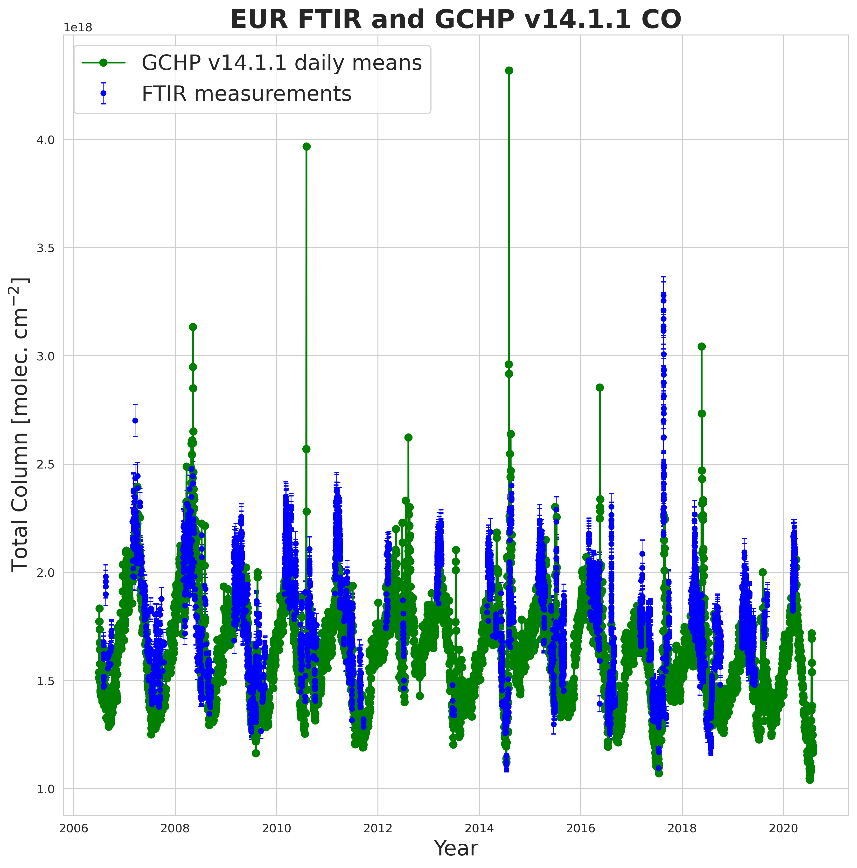
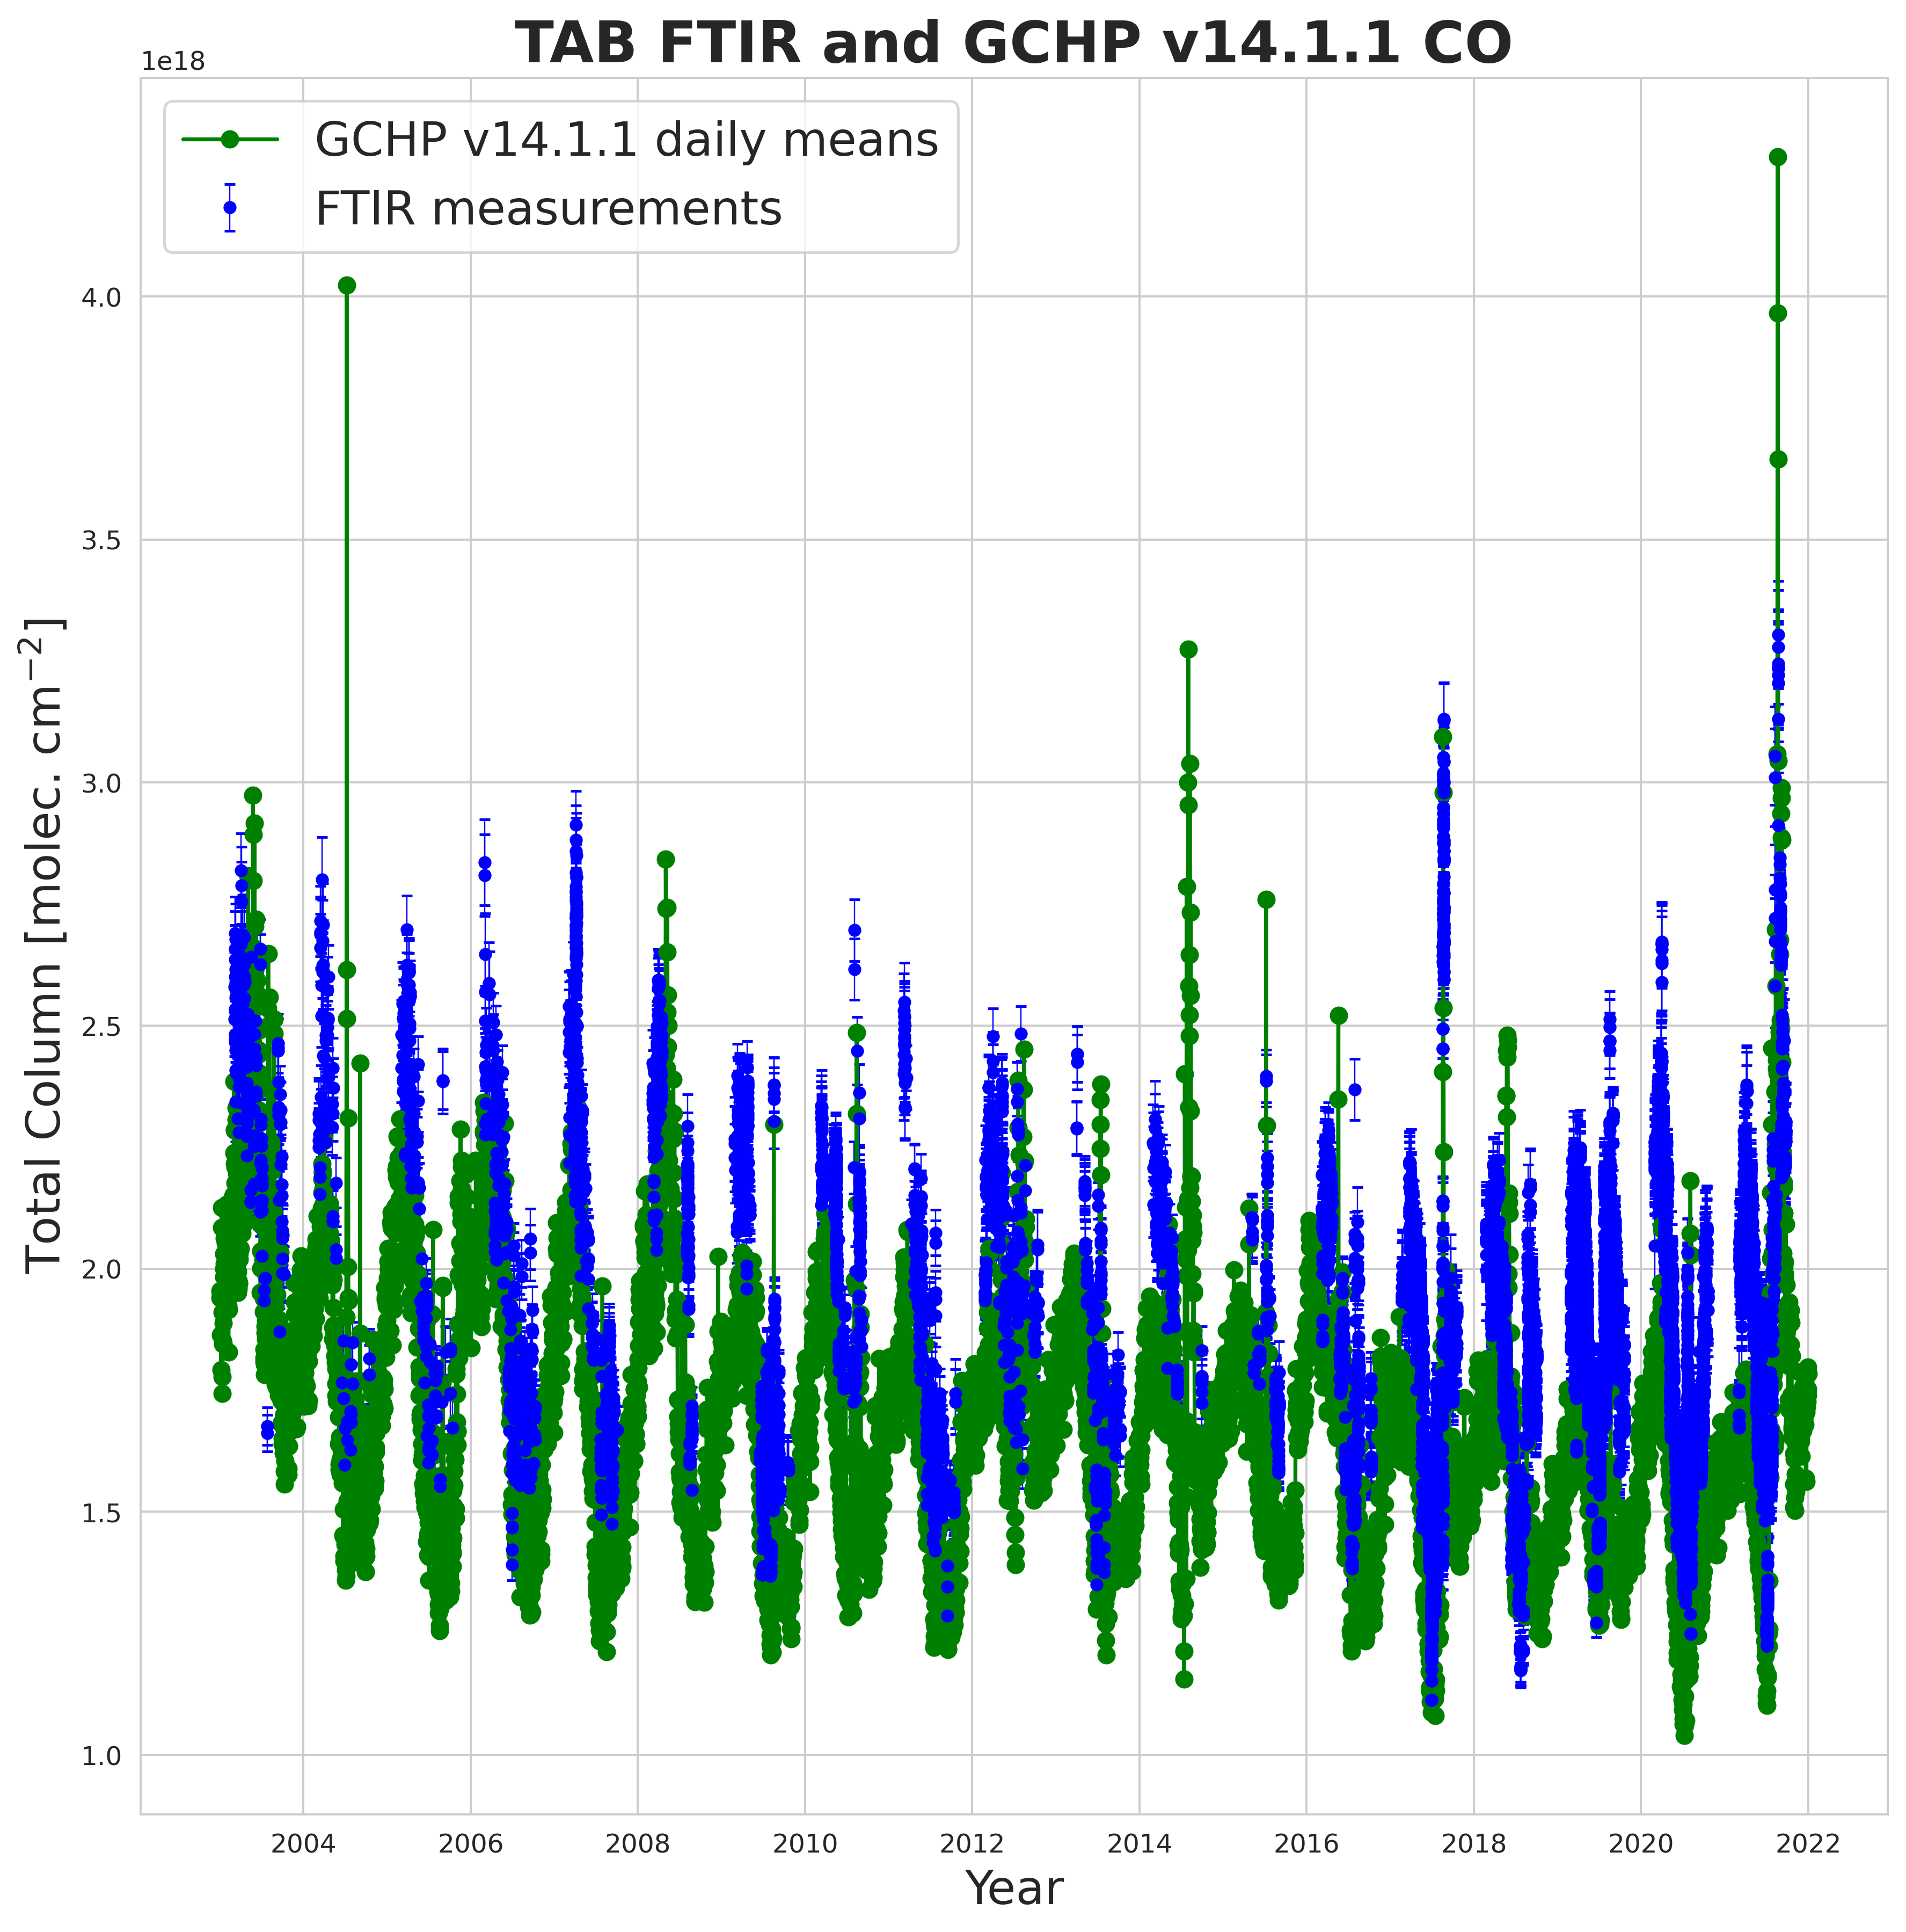
Results - GCHP vs. FTIR Obs.
Carbon Monoxide (CO)
Eureka
Thule
Notes:
CO appears to be simulated quite well by GCHP at both sites. Simulated columns follow the FTIR measurements relatively closely, and seem to track the downward trend in CO.
Main discrepancies are seen during fire enhancements, some are over-estimated by the model, while others are underestimated. Likely related to the emissions injection heights.
Included the one time-series plot here just to show how the model data looks, the rest are included as additional slides at the end in case anyone is interested.

Slide 13
Results - FTIR & GCHP Seasonal Cycles
Carbon Monoxide (CO)
Notes:
Main source is fossil fuel combustion at mid-latitudes, which is transported to the Arctic and accumulates in the winter. Biomass burning is a notable source in the late summer months.
Strong seasonal cycle, largely driven by the absence of OH, the primary sink, in the wintertime (polar night)
CO appears to be simulated quite well by GCHP at both sites. Simulated columns agree very closely with the FTIR during May to July. Some differences in August, likely driven by wildfires, but still within 1-sigma.
Slightly higher columns in the spring and fall from the FTIR vs. GCHP.

Slide 14
Results - FTIR & GCHP Seasonal Cycles
Acetylene (C2H2)
Notes:
Main sources are mid-latitude combustion of fossil fuels and biofuels, as well as BB.
Similar seasonal cycle to CO, C2H2 is primarily removed by OH, so it accumulates in the wintertime, and then gradually decreases as the sun returns and OH is produced.
Very similar seasonal cycles seen between the FTIR’s and GCHP at both sites. Particularly close agreement in the late spring. Agreement may become closer when AVK smoothing is applied to GCHP.

Slide 15
Results - FTIR & GCHP Seasonal Cycles
Ethane (C2H6)
Notes:
Similar seasonal cycle to CO and C2H2, C2H6, is primarily removed by OH, so it accumulates in the wintertime, and then gradually decreases as the sun returns and OH is produced.
Main sources are mid-latitude combustion of natural gas and fossil fuels, as well as BB. Natural gas production is a major source of ethane.
Generally, quite similar seasonal cycles between the FTIRs and GCHP for ethane, but…
Similar low-bias in GCHP seen at both sites in ethane during February - April, may be related to wintertime mid-latitude emissions and/or transport up to the Arctic, or possibly over-estimated loss processes.

Slide 16
Results - FTIR & GCHP Seasonal Cycles
Ethylene (C2H4)
Notes:
Very little seasonal cycle due to the lack of local sources and very short lifetime of ~24-36 hours. However, fire plumes appear to extend the lifetime long enough for C2H4 to reach the Arctic
Close agreement between the Eureka FTIR and GCHP for Ethylene during the spring and fall, low bias in GCHP during June - August, possibly due to the underestimated influence of wildfires in the model.

Slide 17
Results - FTIR & GCHP Seasonal Cycles
Methanol (CH3OH)
Notes:
Most abundant non-methane VOC in the global atmosphere.
Seasonal cycle differs quite significantly from the previous gases. Minimum in the Spring/Fall months, and a maximum in the summer at both sites
Primary source is vegetation growth and decomposition, as well as the ocean. Biomass burning is also a source of methanol in the summer, but not as significant as some of the other species.
GCHP shows some seasonal cycle in methanol, but a significant low bias compared to the FTIR observations at both sites. Might indicate missing chemistry, or underestimated local sources (e.g., oceanic or atmospheric sources) in the model.

Slide 18
Results - FTIR & GCHP Seasonal Cycles
Formic acid (HCOOH)
Notes:
HCOOH is the 2nd most abundant carboxylic acid in the atmosphere, has important implications for soil and atmospheric acidity in remote regions
Seasonal cycle takes a similar shape to CH3OH, but is not as pronounced. Main sources are human activities, biogenic emissions from plant leaves, biomass burning, and photo-oxidation of non-methane hydrocarbons. Sinks include oxidation by OH, and dry + wet deposition
GCHP shows weak seasonal cycle in Formic acid at both sites, lower columns in the early spring and fall, higher columns in May-August. Low bias to some extent seen in GCHP.

Slide 19
Results - FTIR & GCHP Seasonal Cycles
Formaldehyde (HCHO)
Notes:
HCHO is produced by the oxidation of CH4 and NMHC’s, which are emitted by plants, animals, industrial processes, as well as the incomplete combustion of fossil fuel and biomass burning. Removed by reaction with OH. OH plays a major role in both its formation and removal, so its cycle is largely correlated with the presence of OH.
Distinct seasonal cycle appears to be captured relatively well by GCHP compared to what is observed by the FTIRs.
A bit larger of a bias is seen at Thule vs. Eureka, but generally the agreement looks quite reasonable and may improve with AVK smoothing.

Slide 20
Results - FTIR & GCHP Seasonal Cycles
Peroxyacetyl nitrate (PAN)
Notes:
PAN displays a similar seasonal cycle to CO, C2H2 and C2H6, but for different reasons.
The lifetime of PAN in the atmosphere is temperature sensitive, and its primarily formed in polluted mid-latitude regions by the oxidation of NMVOC’s. PAN is transported to the Arctic from mid-latitudes during the winter, and due to the cold stable atmosphere and lack of loss-processes, it can accumulate in high concentrations.
Pretty close agreement between the Eureka FTIR and GCHP during June - August, poorer agreement during the spring months (GCHP is biased low). Weaker seasonal cycle in the model.

Slide 21
Results - Fourier Series Fitting
The total column time-series of the gases contain both intra-annual variability (seasonal cycles), and inter-annual variability (long-term trends), so we can apply Fourier series fitting to account for both.
We fit the data with a function of the form [Gardiner et al., 2008]:
$$F(t,a,b)=at+V(t,b)$$
with:
$$V(t,b)=b_{0}+b_{1}\text{cos}2πt+b_{2}\text{sin}2πt+b_{3}\text{cos}4πt+b_{4}\text{sin}4πt+...$$
where $a$ is the annual trend in the data, $b_{0}$ to $b_{n}$ are the parameters of the Fourier series, and $t$ is measured in years. 95% CI’s are calculated from bootstrap resampling with $N_{boots}=5000$.
Notes:
The seasonal cycles are periodic in nature, while the long-term trends should be linear.
Since FTIR data is non-normally distributed, we use bootstrap resampling to derive the 95% confidence intervals of our trends.

Slide 22
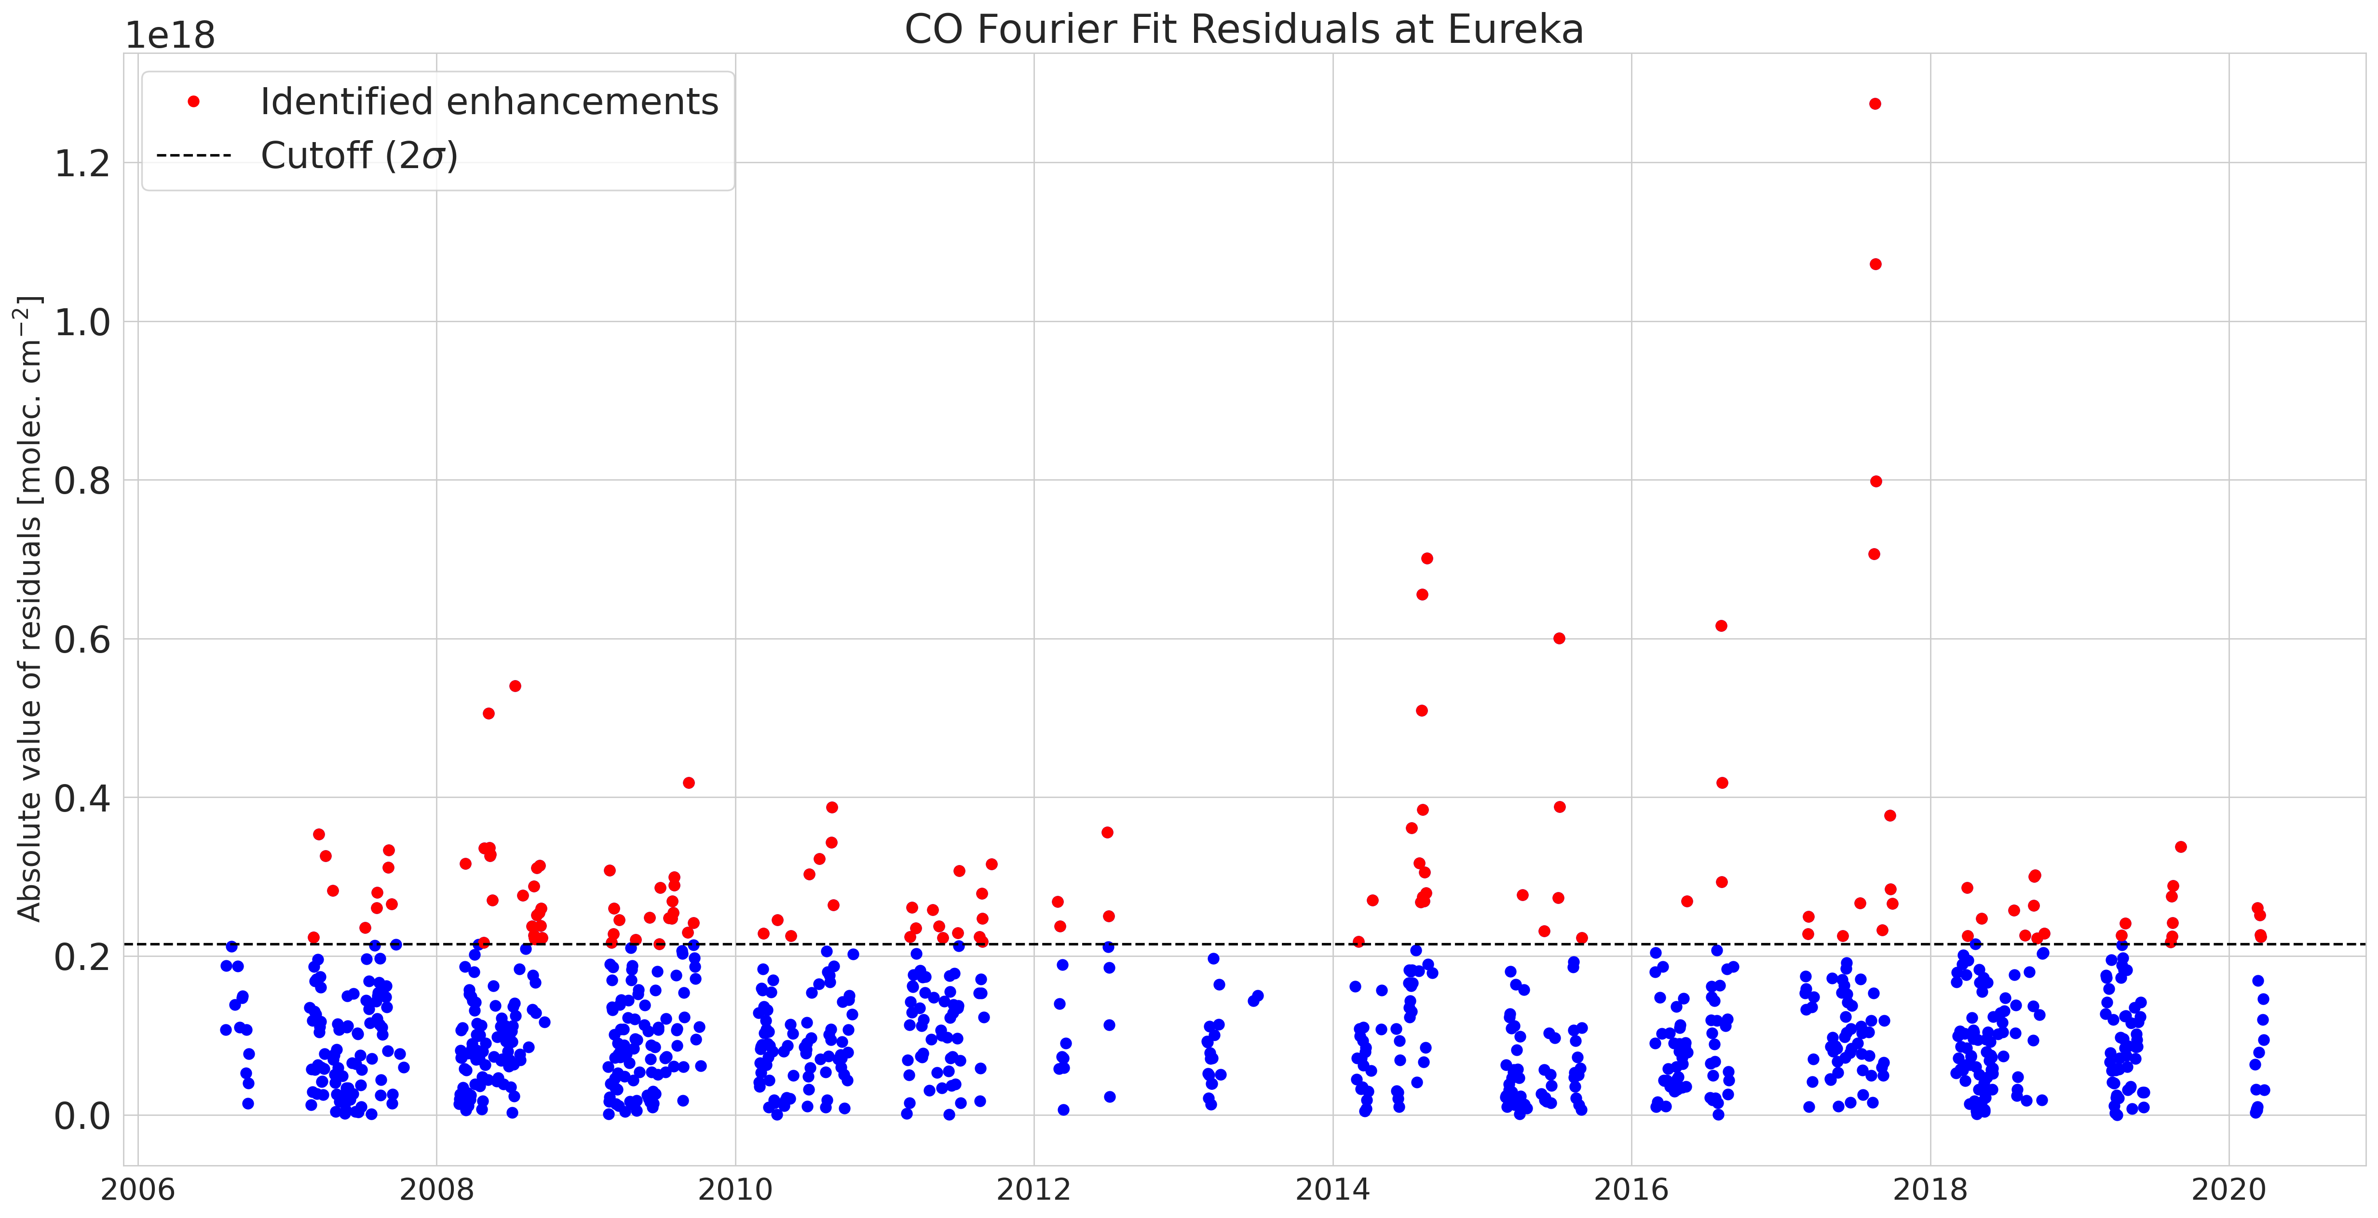
Results - Fourier Series Fitting
The time-series also include transient events such as biomass burning enhancements.
To account for these, we calculate the absolute value of the residuals, and remove those which deviate $>2σ$ from the mean, and re-fit.
Carbon Monoxide (CO)

Slide 23
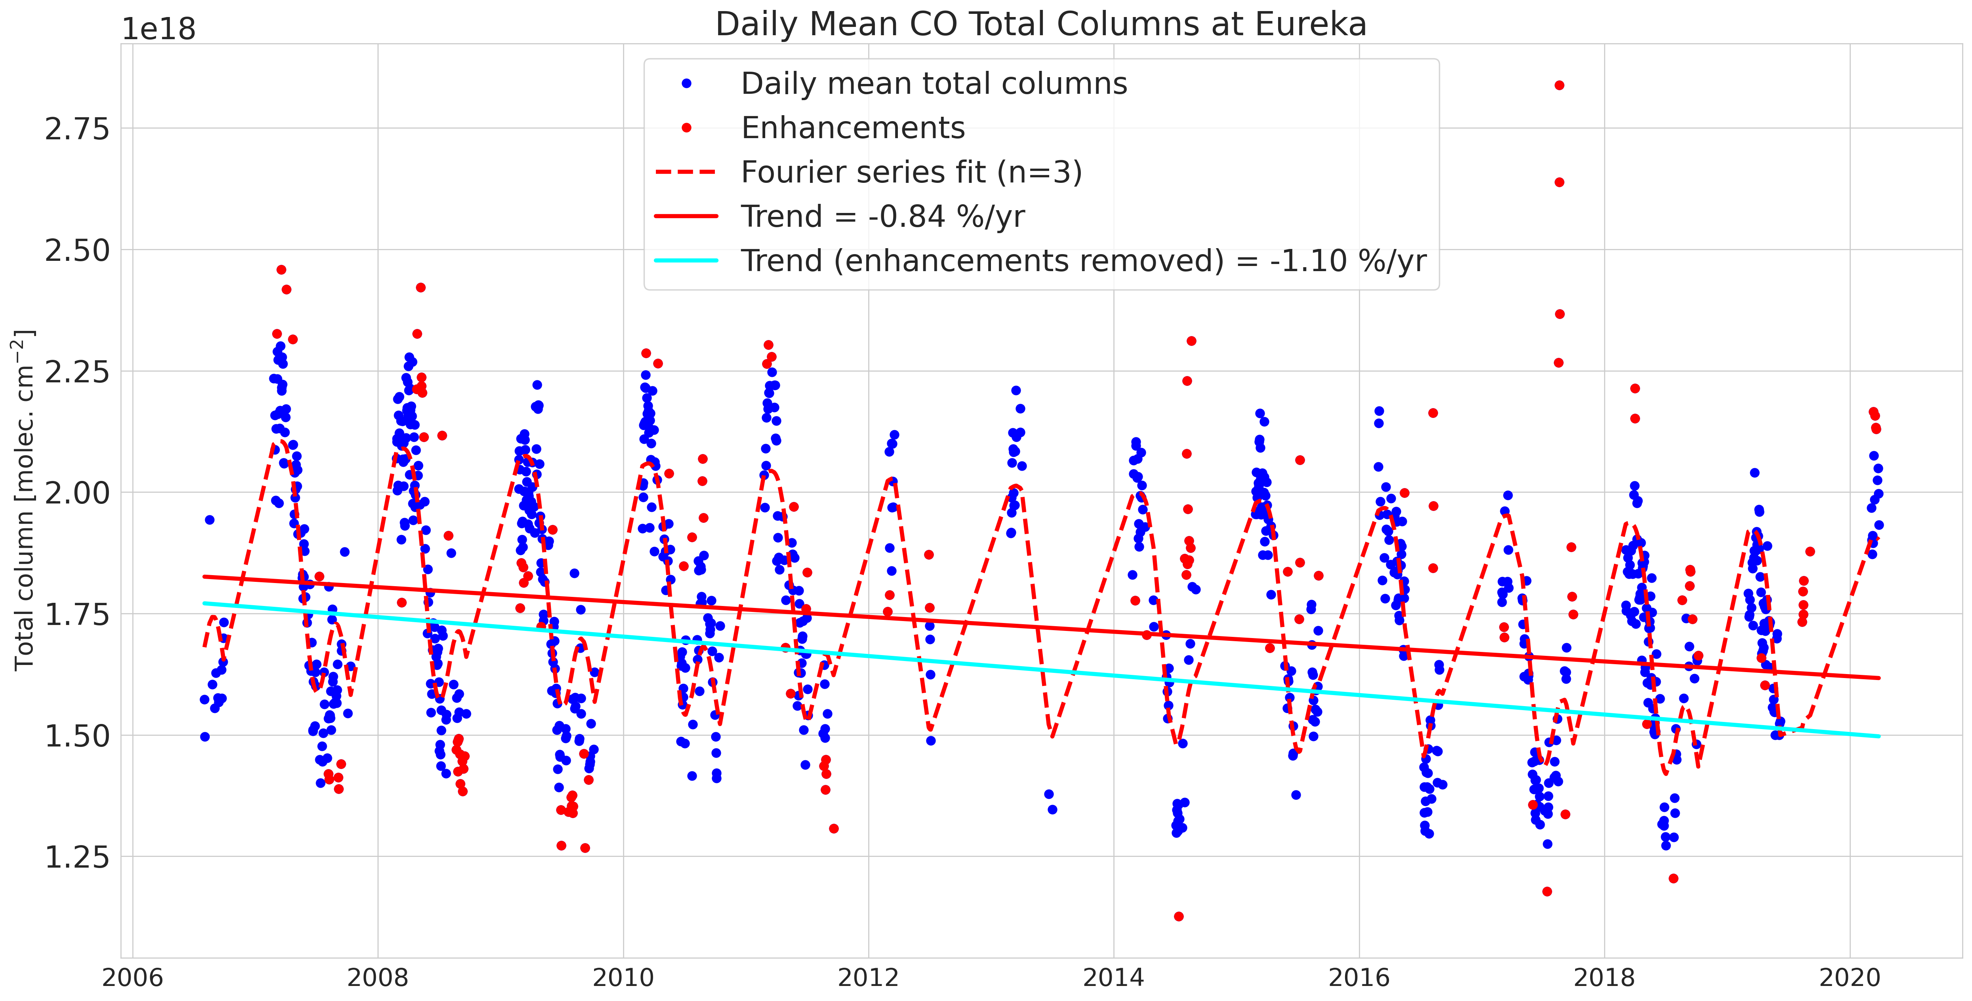
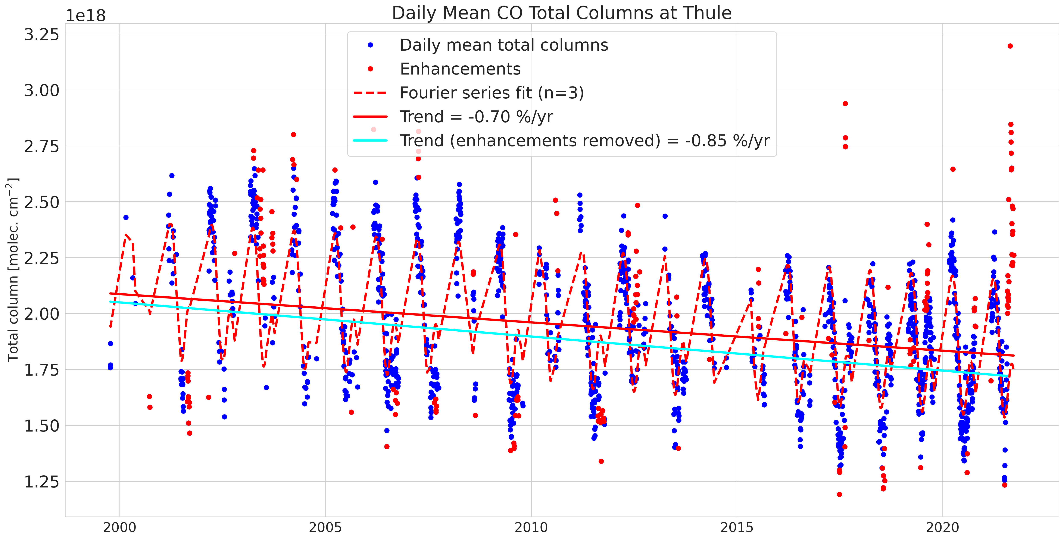
Results - Long-term Trends
Carbon Monoxide (CO)
Eureka
Trend = -1.10% yr⁻¹
CIs = [-1.23%, -0.97%]
Thule
Trend = -0.85% yr⁻¹
CIs = [-0.96%, -0.74%]
All trends summarized later on!
Notes:
Same fitting approach applied to both FTIR data and the GCHP model data
Both sites show a strongly decreasing trend in CO columns over their full time-series, which is largely consistent with the decreases in dirtier/less efficient forms of fossil fuel burning over the last decades.
-1.10% yr⁻¹ at Eureka, and -0.85% yr⁻¹ at Thule. It should be noted that the Thule time-series for CO extends ~6 years before Eureka.

Slide 24
Results - Summary of Trends (Eureka)
Summary of FTIR- and GCHP-derived Trends at Eureka (2006 - 2020)
Species | FTIR Trend (% yr⁻¹) | GCHP Trend (% yr⁻¹)
CO | -1.10% [-1.23, -0.97] | -0.83% [-0.96, -0.71]
C2H2 | -2.57% [-3.13, -2.00] | -1.93% [-2.19, -1.67]
C2H4 | -0.02% [-0.65, +0.60] | -0.13% [-0.56, +0.30]
C2H6 | +0.98% [+0.78, +1.18] | -0.15% [-0.25, -0.04]
CH3OH | -0.21% [-0.65, +0.23] | -0.44% [-0.63, -0.24]
HCHO | +1.80% [+1.33, +2.26] | -0.09% [-0.26, +0.07]
HCOOH | -3.29% [-4.44, -2.10] | -1.09% [-1.41, -0.79]
PAN | +2.13% [+1.64, +2.60] | -0.81% [-0.92, -0.69]
*Note: BOLDED trends are statistically significant. Trends presented here are the ‘enhancement removed’ trends for both the FTIR and GCHP.
Notes:
FTIR shows an increasing trend for C2H6, while GCHP shows a slightly negative trend.
FTIR also shows a strongly positive trend of +1.8%/yr in HCHO, while GCHP shows no statistically significant trend.
There is also a strong positive trend in PAN of 2.13%/yr which is not seen by GCHP

Slide 25
Results - Summary of Trends (Thule)
Summary of FTIR- and GCHP-derived Trends at Thule (2003 - 2021)
Species | FTIR Trend (% yr⁻¹) | GCHP Trend (% yr⁻¹)
CO | -0.85% [-0.96, -0.74] | -0.86% [-0.94, -0.78]
C2H2 | -1.39% [-1.61, -1.17] | -1.71% [-1.85, -1.58]
C2H4 | -5.13 [-6.60, -3.60] | +0.42% [+0.06, +0.77]
C2H6 | +0.76% [+0.61, +0.90] | -0.26% [-0.32, -0.19]
CH3OH | -1.87% [-2.40, -1.34] | -0.21% [-0.34, -0.08]
HCHO | +0.44% [+0.10, +0.78] | +0.02% [-0.11, +0.16]
HCOOH | -0.11% [-0.67, +0.46] | -0.63% [-0.81, -0.44]
PAN | 1.29% [-0.60, 3.15] | -0.58% [-0.66, -0.51]
*Note: BOLDED trends are statistically significant. Thule FTIR trends cover 1999-2021, but 1999-2002 data was sparse. Thule CH3OH only covers 2011-2020, PAN and C2H4 data only covers 2015-2022.
Notes:
Similar to Eureka, Thule FTIR data shows an increasing trend in C2H6 of +0.76%/yr, while GCHP shows a slightly negative trend.
Weaker positive trend in HCHO FTIR data at Thule vs. Eureka, but no statistically significant trend in GCHP.

Slide 26
Conclusions
Inter- and intra-annual variability of CO, C2H2, C2H4, C2H6, CH3OH, HCOOH, HCHO, and PAN investigated in the time-series from two high-Arctic FTIR sites, Eureka, Nunavut (2006-2020) and Thule, Greenland (1999-2021).
Consistent seasonal cycles observed from both FTIRs, and biomass burning influence is seen to some extent for all species.
Similarly, trends derived from Fourier series fitting are broadly consistent between the two sites, particularly for the direction of the trends.
Decreasing trend was observed at Eureka and Thule in CO and C₂H₂, but C₂H₆ was found to be increasing.
PAN and HCHO also show increasing trends.

Slide 27
Conclusions
GCHP simulation was performed for 2003-2021, and comparisons done against Eureka and Thule FTIR data.
CO and C₂H₂ appear to be simulated quite well at both sites. Some of the VOC species show some seasonally dependent biases (e.g., C₂H₆).
GEOS-Chem CH3OH columns biased low at both sites.
FTIR- and GCHP-derived trends broadly agree except for C₂H₆, HCHO, and PAN, which show opposite trends.
Currently investigating the source of these discrepancies.
Paper currently in-prep for JGR:Atmospheres!

Slide 28
References
Arnold, S., Law, K., Brock, C., Thomas, J., Starkweather, S., Salzen, K. V., . . . Bozem, H. (2016). Arctic air pollution: Challenges and opportunities for the next decade. Elementa: Science of the Anthropocene, 4, 000104. doi:10.12952/journal.elementa.000104
Batchelor, R. L., Strong, K., Lindenmaier, R., Mittermeier, R. L., Fast, H., Drummond, J. R., & Fogal, P. F. (2009). A new bruker IFS 125hr Ftir Spectrometer for the Polar Environment Atmospheric Research Laboratory at Eureka, Nunavut, Canada: Measurements and comparison with the existing Bomem DA8 spectrometer. Journal of Atmospheric and Oceanic Technology, 26(7), 1328–1340. https://doi.org/10.1175/2009jtecha1215.1
Bindle, L., Martin, R. V., Cooper, M. J., Lundgren, E. W., Eastham, S. D., Auer, B. M., Clune, T. L., Weng, H., Lin, J., Murray, L. T., Meng, J., Keller, C. A., Putman, W. M., Pawson, S., & Jacob, D. J. (2021). Grid-stretching capability for the GEOS-chem 13.0.0 atmospheric chemistry model. Geoscientific Model Development, 14(10), 5977–5997. https://doi.org/10.5194/gmd-14-5977-2021
Buchholz, R. R., Worden, H. M., Park, M., Francis, G., Deeter, M. N., Edwards, D. P., Emmons, L. K., Gaubert, B., Gille, J., Martínez-Alonso, S., Tang, W., Kumar, R., Drummond, J. R., Clerbaux, C., George, M., Coheur, P.-F., Hurtmans, D., Bowman, K. W., Luo, M., … Kulawik, S. S. (2021). Air Pollution Trends measured from Terra: Co and AOD over industrial, fire-prone, and background regions. Remote Sensing of Environment, 256, 112275. https://doi.org/10.1016/j.rse.2020.112275
Gardiner, T., Forbes, A., de Mazière, M., Vigouroux, C., Mahieu, E., Demoulin, P., Velazco, V., Notholt, J., Blumenstock, T., Hase, F., Kramer, I., Sussmann, R., Stremme, W., Mellqvist, J., Strandberg, A., Ellingsen, K., & Gauss, M. (2008). Trend analysis of greenhouse gases over Europe measured by a network of ground-based remote FTIR instruments. Atmospheric Chemistry and Physics, 8(22), 6719–6727. https://doi.org/10.5194/acp-8-6719-2008
Hannigan, J. W., Coffey, M. T., & Goldman, A. (2009). Semiautonomous FTS observation system for remote sensing of stratospheric and tropospheric gases. Journal of Atmospheric and Oceanic Technology, 26(9), 1814–1828. https://doi.org/10.1175/2009jtecha1230.1
Law, K. S., Stohl, A., Quinn, P. K., Brock, C. A., Burkhart, J. F., Paris, J., . . . Thomas, J. L. (2014). Arctic Air Pollution: New Insights from POLARCAT-IPY. Bulletin of the American Meteorological Society, 95(12), 1873-1895. doi:10.1175/bams-d-13-00017.1
Lutsch, E., Strong, K., Jones, D. B., Blumenstock, T., Conway, S., Fisher, J. A., Hannigan, J. W., Hase, F., Kasai, Y., Mahieu, E., Makarova, M., Morino, I., Nagahama, T., Notholt, J., Ortega, I., Palm, M., Poberovskii, A. V., Sussmann, R., & Warneke, T. (2020). Detection and attribution of wildfire pollution in the Arctic and northern midlatitudes using a network of Fourier-transform infrared spectrometers and GEOS-Chem. Atmospheric Chemistry and Physics, 20(21), 12813–12851. https://doi.org/10.5194/acp-20-12813-2020

Slide 29
References
Roiger, A., Schlager, H., Schäfler, A., Huntrieser, H., Scheibe, M., Aufmhoff, H., . . . Arnold, F. (2011). In-situ observation of Asian pollution transported into the Arctic lowermost stratosphere. Atmospheric Chemistry and Physics, 11(21), 10975-10994. doi:10.5194/acp-11-10975-2011
Schmale, J., Arnold, S. R., Law, K. S., Thorp, T., Anenberg, S., Simpson, W. R., . . . Pratt, K. A. (2018). Local Arctic Air Pollution: A Neglected but Serious Problem. Earth's Future, 6(10), 1385-1412. doi:10.1029/2018ef000952
U.S. EPA. 2018. Data from the 2014 National Emissions Inventory, Version 2. Accessed 20 April 2023. https://www.epa.gov/air-emissions-inventories/2014-national-emissions-inventory-nei-data.
Viatte, C., Strong, K., Walker, K. A., & Drummond, J. R. (2014). Five years of CO, HCN, C2H6, C2H2, CH3OH, HCOOH and H2CO total columns measured in the Canadian high Arctic. Atmospheric Measurement Techniques, 7(6), 1547-1570. doi:10.5194/amt-7-1547-2014

Slide 30
https://www.cmos.ca/uploaded/web/admin/theme/img/logo.png
Thank you for your attention!
Questions/comments/suggestions?
Feel free to contact me at: tyler.wizenberg@mail.utoronto.ca

Slide 31
Results - FTIR Seasonal Cycles
Carbon Monoxide (CO)
Eureka
Thule
Notes:
Strong seasonal cycle, largely driven by the absence of OH, the primary sink, in the wintertime (polar night)
Main source is fossil fuel combustion at mid-latitudes, which is transported to the Arctic and accumulates in the winter. Biomass burning is a notable source in the late summer months.
Higher CO columns are seen at the beginning of the Thule time-series.

Slide 32
Results - FTIR Seasonal Cycles
Acetylene (C2H2)
Eureka
Thule
Notes:
Similar seasonal cycle to CO, C2H2 is primarily removed by OH, so it accumulates in the wintertime, and then gradually decreases as the sun returns and OH is produced.
Main sources are mid-latitude combustion of fossil fuels and biofuels, as well as BB.
The influence of BB can again be seen in the late summer months. A particularly large enhancement is seen at EUR from the 2017 fires.

Slide 33
Results - FTIR Seasonal Cycles
Ethane (C2H6)
Eureka
Thule
Notes:
Similar seasonal cycle to CO and C2H2, C2H6, is primarily removed by OH, so it accumulates in the wintertime, and then gradually decreases as the sun returns and OH is produced.
Main sources are mid-latitude combustion of natural gas and fossil fuels, as well as BB. Natural gas production is also a pretty major source of ethane.

Slide 34
Results - FTIR Seasonal Cycles
Ethylene (C2H4)
Eureka
Thule
Notes:
Very little seasonal cycle due to the lack of local sources and very short lifetime of ~24-36 hours
However, fire plumes appear to extend the lifetime long enough for C2H4 to reach the Arctic
Can possibly aid in the detection/identification of fires at Arctic sites.

Slide 35
Results - FTIR Seasonal Cycles
Methanol (CH3OH)
Eureka
Thule
Notes:
Most abundant non-methane VOC in the global atmosphere.
Seasonal cycle differs quite significantly from the previous gases. Minimum in the Spring/Fall months, and a maximum in the summer at both sites. Mean CH3OH lifetime is ~6 days.
Primary source is vegetation growth and decomposition, as well as the ocean. Biomass burning is also a source of methanol in the summer, but not as significant as some of the other species.
Recent model study by Bates et al. (2021) suggests that the reaction of methylperoxy radical with itself is a significant additional driver of its seasonal cycle.

Slide 36
Results - FTIR Seasonal Cycles
Formic Acid (HCOOH)
Eureka
Thule
Notes:
HCOOH is the 2nd most abundant carboxylic acid in the atmosphere, has important implications for soil and atmospheric acidity in remote regions
Seasonal cycle takes a similar shape to CH3OH, but is not as pronounced. Main sources are human activities, biogenic emissions from plant leaves, biomass burning, and photo-oxidation of non-methane hydrocarbons.
Sinks include oxidation by OH, and dry + wet deposition

Slide 37
Results - FTIR Seasonal Cycles
Formaldehyde (HCHO)
Eureka
Thule
Notes:
HCHO is produced by the oxidation of CH4 and NMHC’s, which are emitted by plants, animals, industrial processes, as well as the incomplete combustion of fossil fuel and biomass burning
Removed by reaction with OH. OH plays a major role in both its formation and removal, so its cycle is largely correlated with the presence of OH.

Slide 38
Results - FTIR Seasonal Cycles
Peroxyacetyl Nitrate (PAN)
Eureka
Thule
Notes:
PAN displays a similar seasonal cycle to CO, C2H2 and C2H6, but for different reasons.
The lifetime of PAN in the atmosphere is temperature sensitive, and its primarily formed in polluted mid-latitude regions by the oxidation of NMVOC’s. PAN is transported to the Arctic from mid-latitudes during the winter, and due to the cold stable atmosphere and lack of loss-processes, it can accumulate in high concentrations.
When the atmosphere begins to warm in the spring, PAN decreases to a minimum in summer. PAN is also formed within biomass burning plumes, so the influence of BB is seen in the late summer.

Slide 39
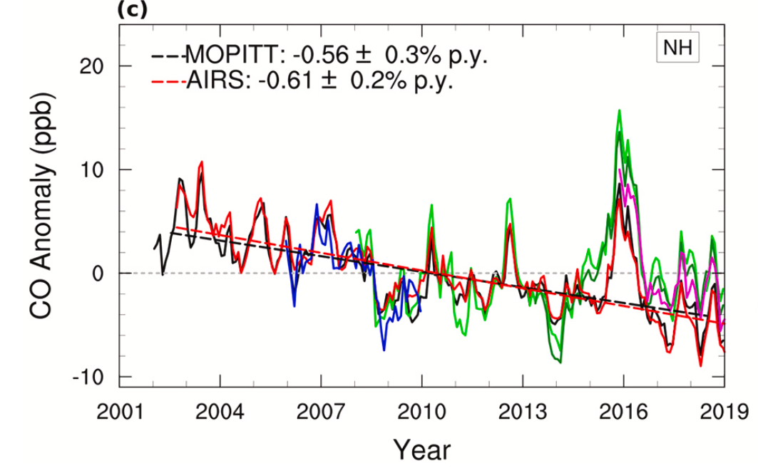
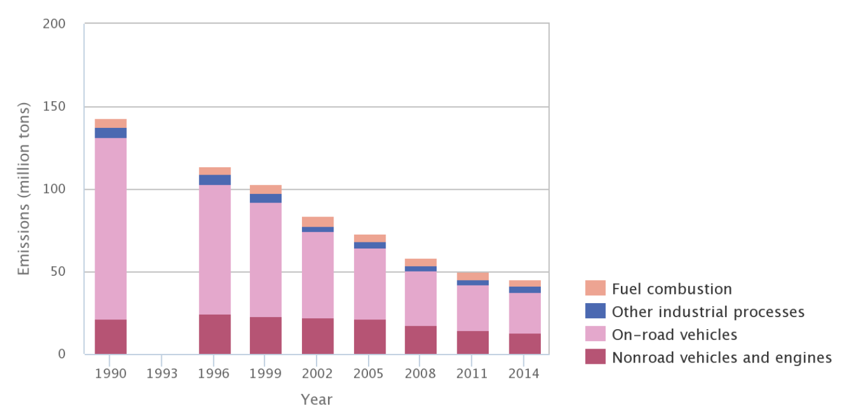
Results - Long-term Trends
Buchholz et al. (2019)
Northern hemisphere CO trends derived from MOPITT and AIRS satellite observations.
U.S. EPA 2014 National Emissions Inventory (NEI), V2
Bottom-up CO emissions estimates showing the various sources and their contributions in the U.S.
U.S. EPA (2018)
Notes:
Our findings for CO are generally consistent with satellite observations over the northern hemisphere, which have also shown broadly decreasing trends. Some studies have found that the rate of decrease has slowed after 2010.
The U.S. EPA National Emissions Inventory shows a large decrease in CO emissions from on-road vehicles between 1990-2014, largely due to more efficient combustion engines

Slide 40
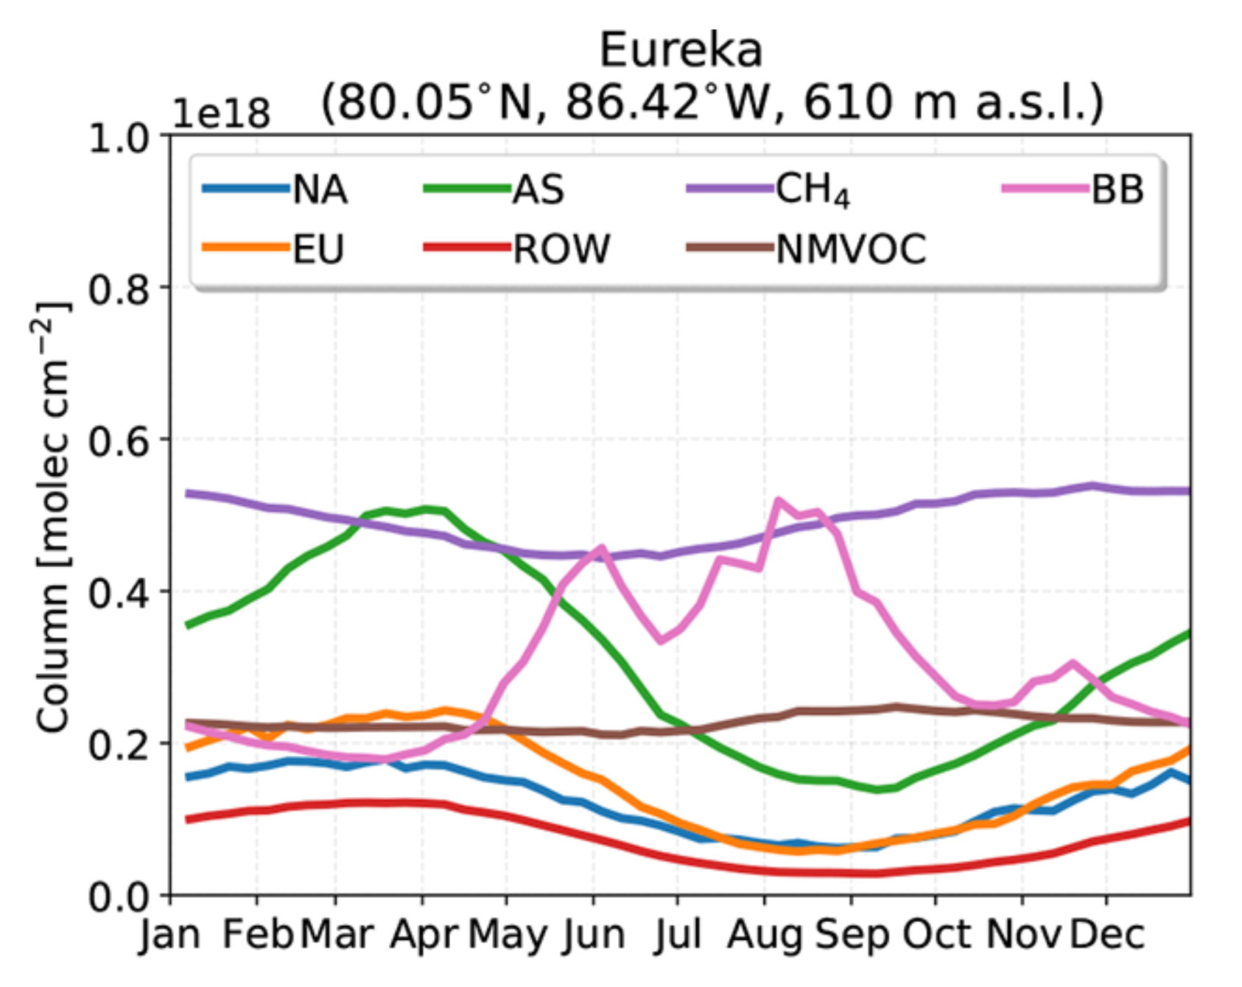
Results - Long-term Trends
Lutsch et al. (2020)
GEOS-Chem v12.1.1 tagged CO simulation weekly means for 2003-2018. Transported Asian emissions are the largest component of CO at Eureka, particularly during the springtime.

Slide 41
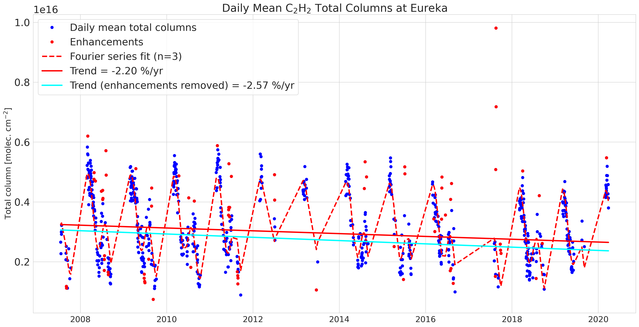
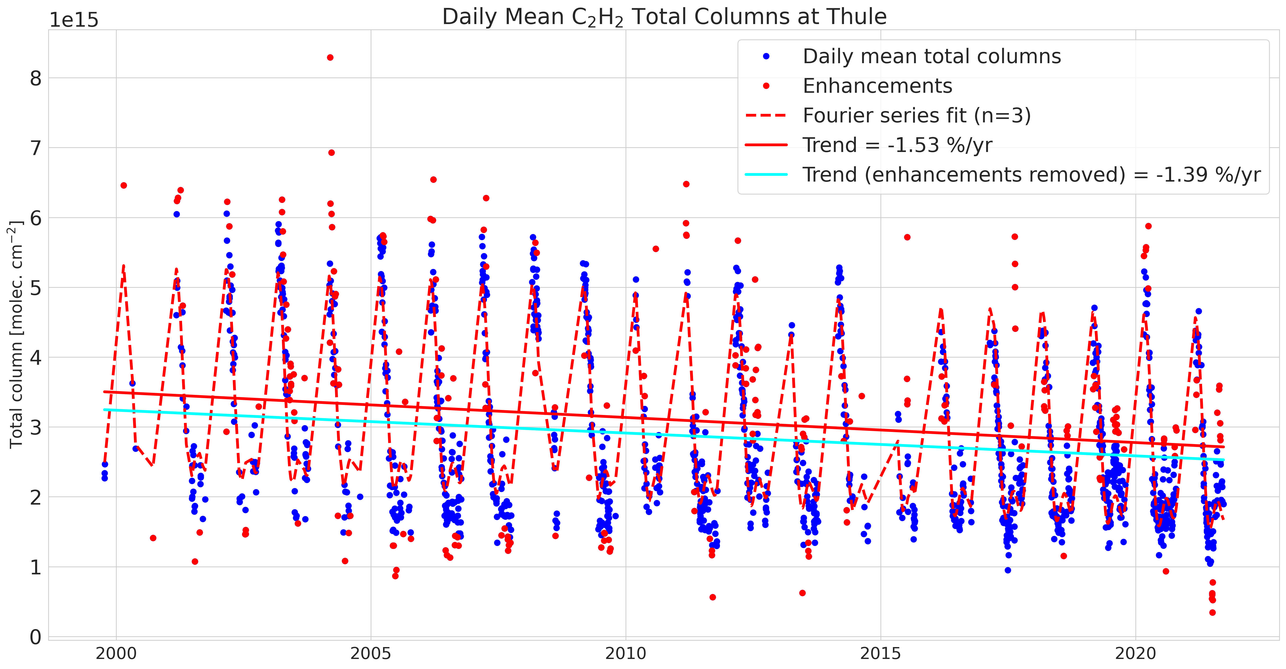
Results - Long-term Trends
Acetylene (C2H2)
Eureka
Trend = -2.57% yr⁻¹
CIs = [-3.13%, -2.00%]
Thule
Trend = -1.39% yr⁻¹
CIs = [-1.61%, -1.17%]
Notes:
Again, both sites show a clear decreasing trend in Acetylene which is largely consistent with the decreases in “dirty” fossil fuel burning over the last decades.
-2.57% yr⁻¹ at Eureka, and -1.39% yr⁻¹ at Thule.

Slide 42
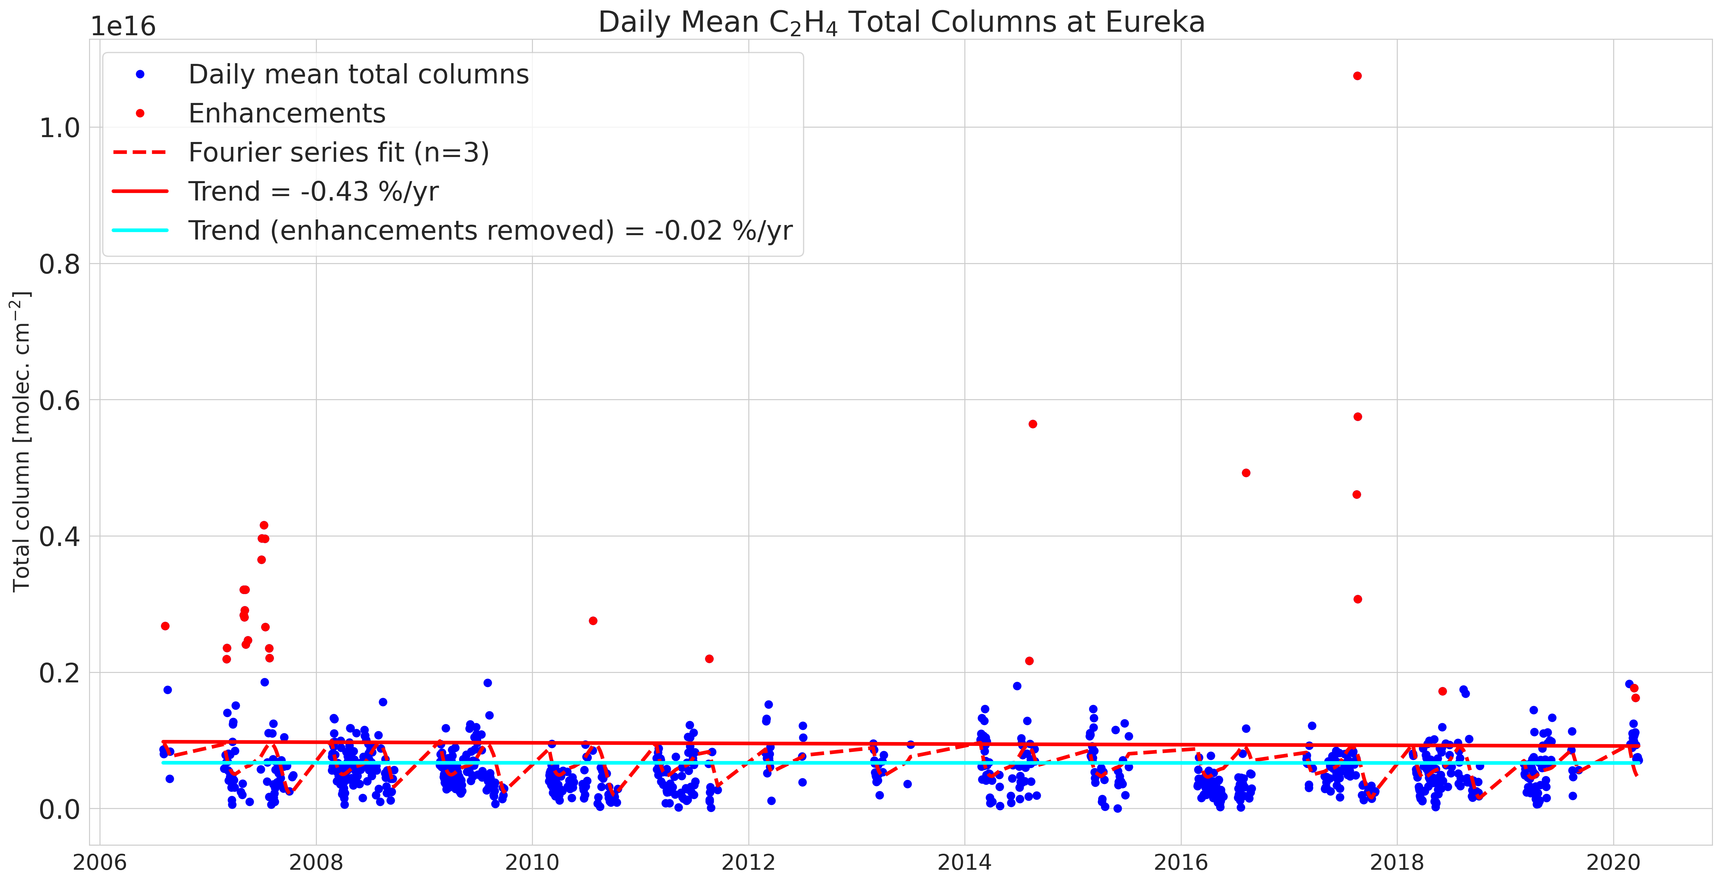
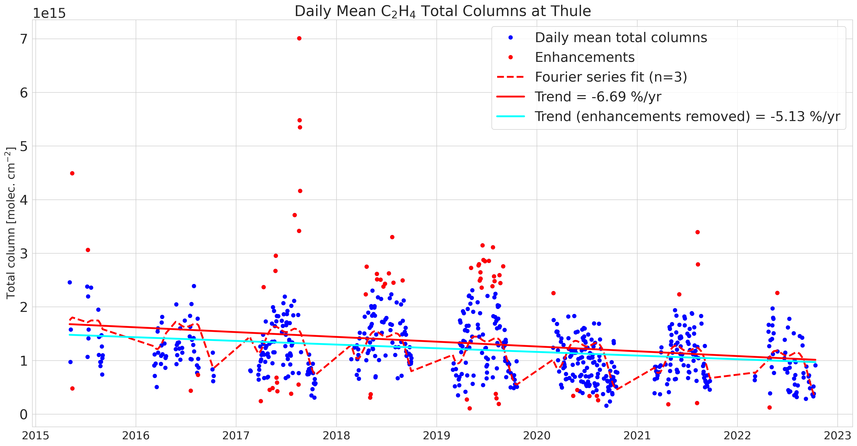
Results - Long-term Trends
Ethylene (C2H4)
Eureka
Trend = -0.02% yr⁻¹
CIs = [-0.65%, 0.60%]
Thule
Trend = -5.13% yr⁻¹
CIs = [-6.6%, -3.6%]
Notes:
Due to its extremely short atmospheric lifetime and lack of local sources, there is no detectable trend in ethylene at Eureka once enhancements are removed, which is expected.
Thule appears to show a downward trend, but there is only measurements from 2015-2022, and there is significant year-to-year variability making the trend unreliable compared to Eureka.

Slide 43
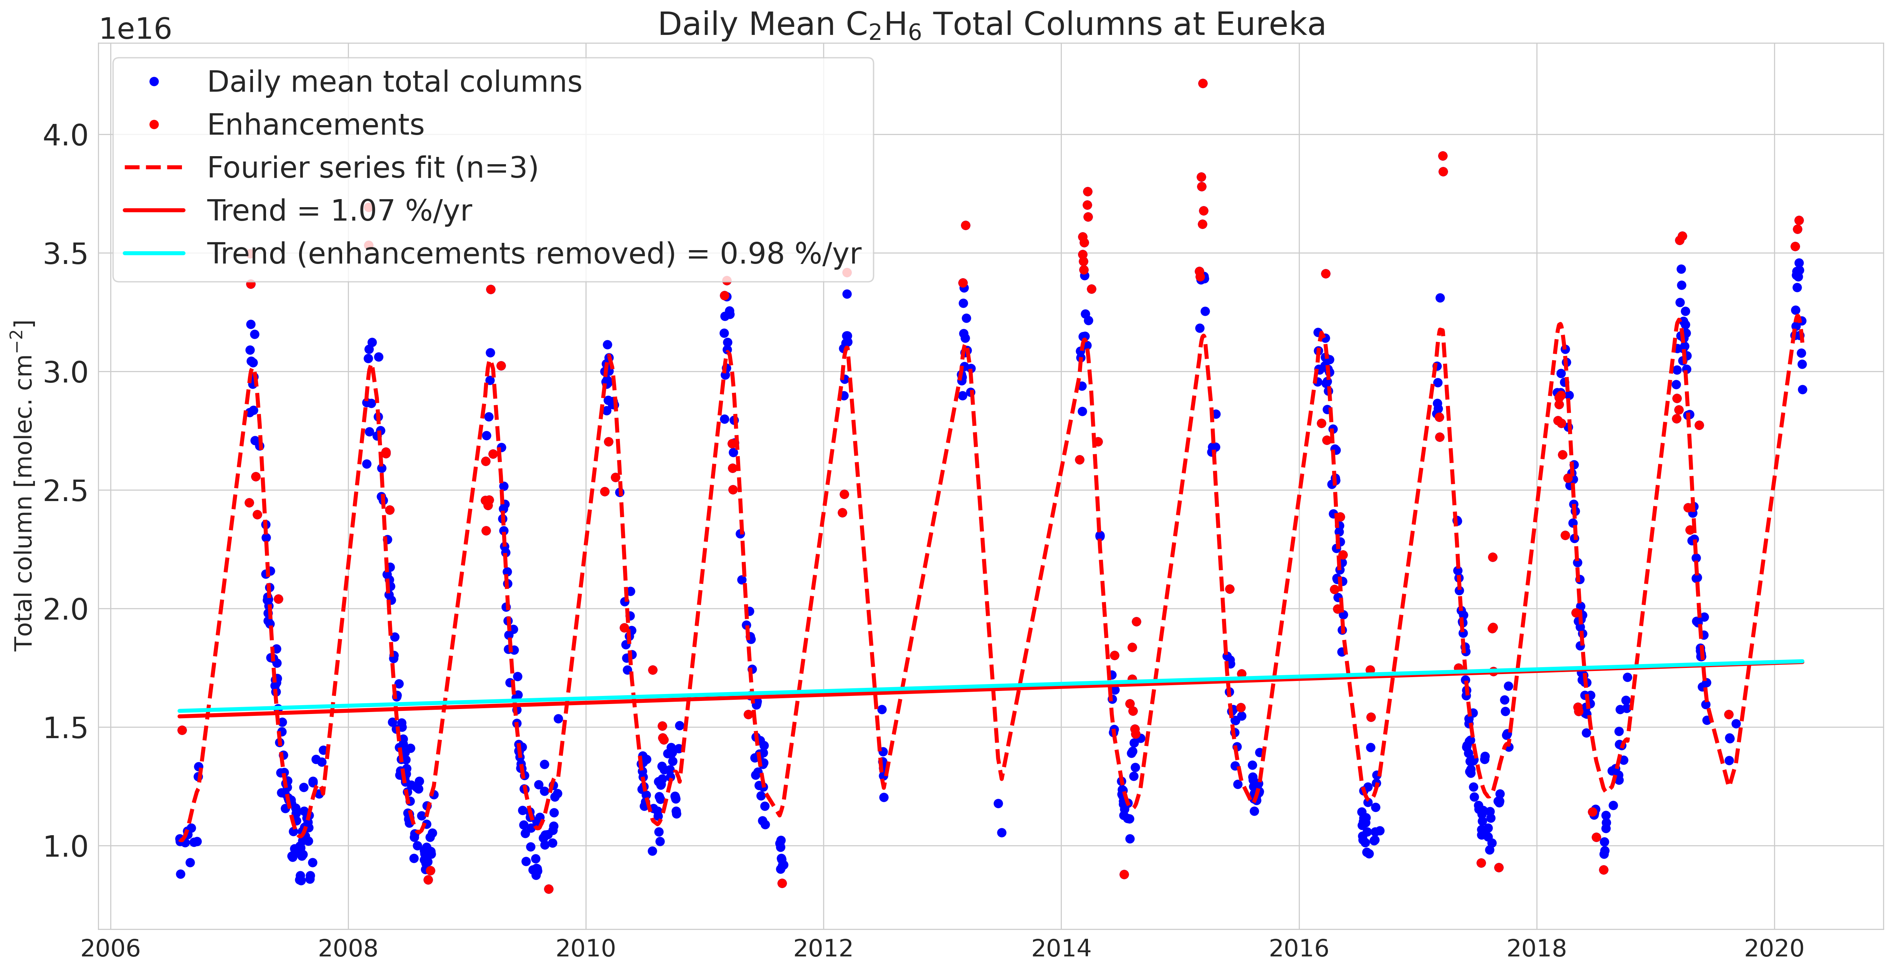
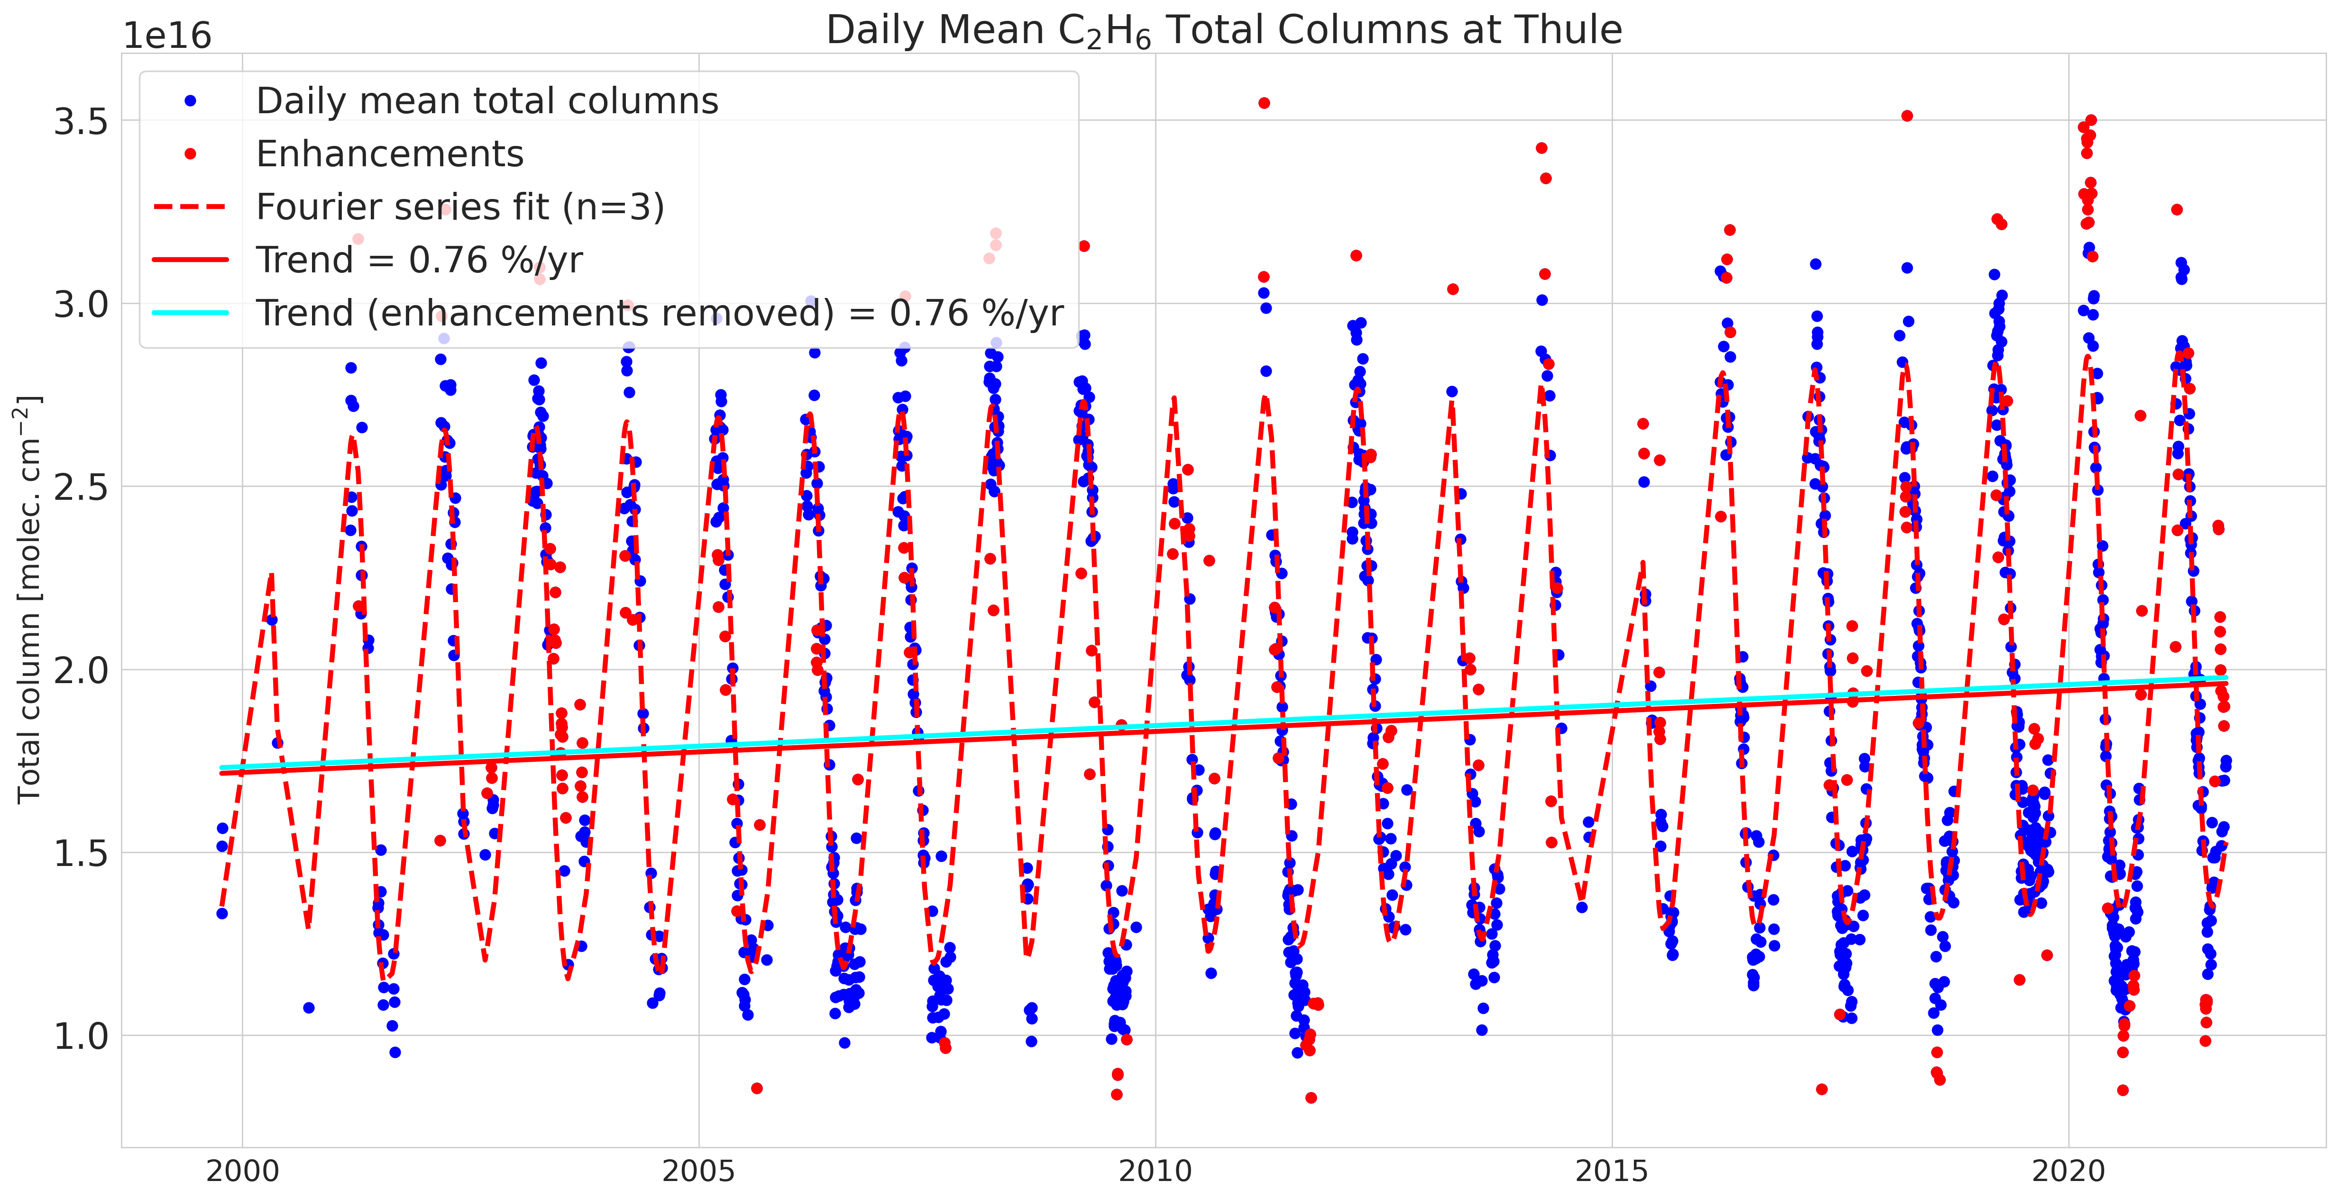
Results - Long-term Trends
Ethane (C2H6)
Eureka
Trend = +0.98% yr⁻¹
CIs = [0.78%, 1.18%]
Thule
Trend = +0.76% yr⁻¹
CIs = [0.61%, 0.90%]
Notes:
Both sites show an increasing trend in C2H6 columns, which is interesting because it does not correspond to the decrease in fossil fuel burning like CO, but it may be related to increases in natural gas production, which has increased significantly after 2009.
+0.98% yr⁻¹ at Eureka, and +0.76% yr⁻¹ at Thule.
NDACC is working on a network-wide Ethane trend study at the moment. These findings are consistent with Franco et al. 2016

Slide 44
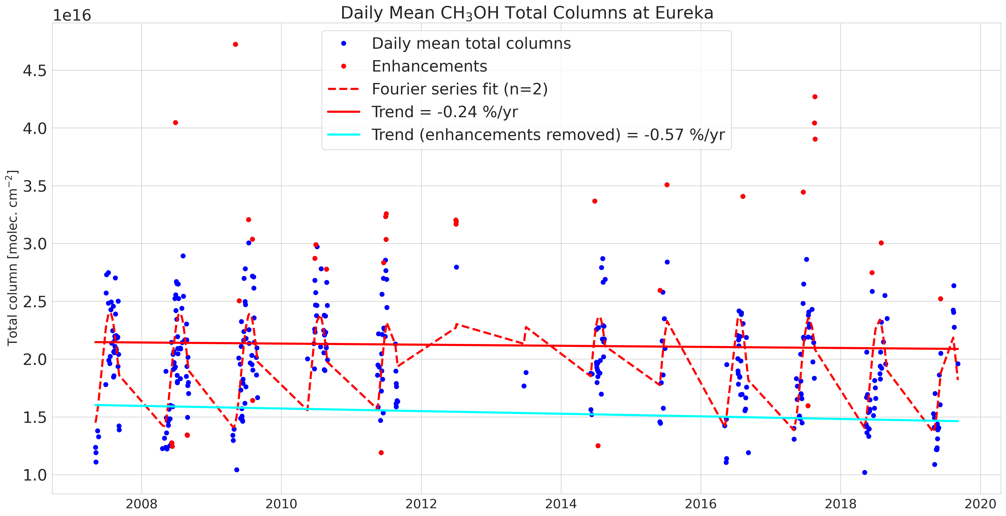
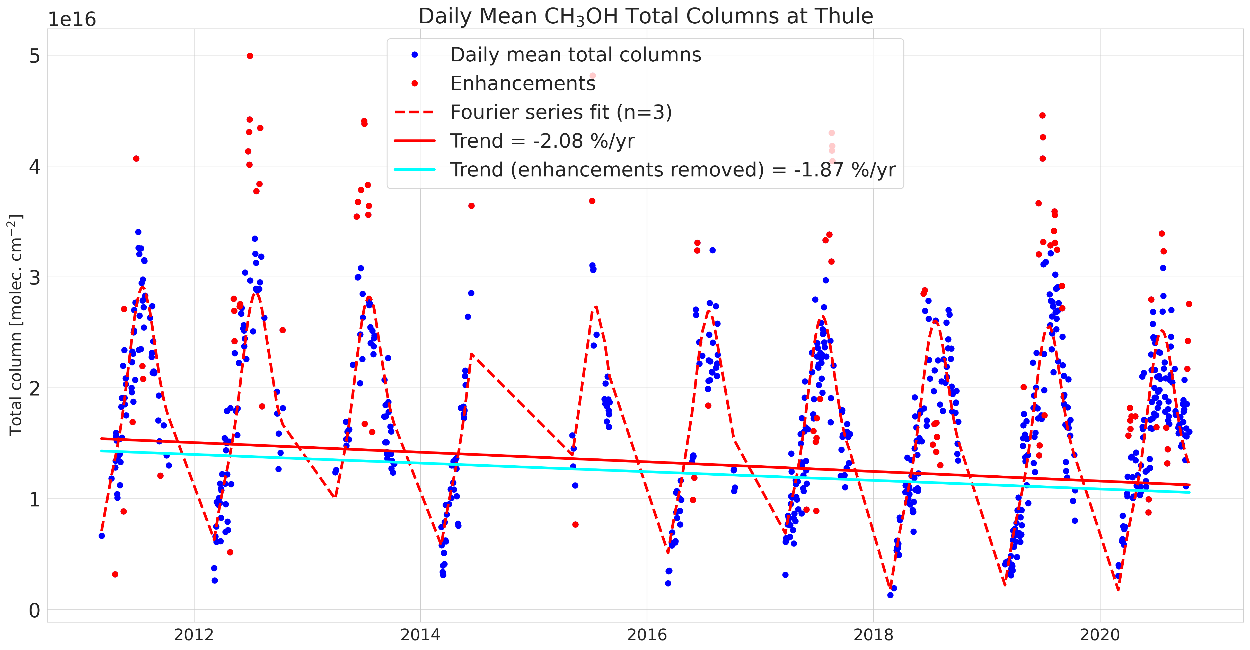
Results - Long-term Trends
Methanol (CH3OH)
Eureka
Trend = -0.57% yr⁻¹
CIs = [-1.08%, -0.09%]
Thule
Trend = -1.87% yr⁻¹
CIs = [-2.40%, -1.34%]
Notes:
Both sites show a decreasing trend in Methanol concentrations. At Eureka, it almost appears as though methanol was increasing from 2006-2012, and then begins decreasing from 2012-2020, however the data is sparse so its hard to make conclusions.
The nature of local sources and sinks of Methanol are not well understood in the Arctic, and the observed trends. Possibly driven by changes in the atmospheric or oceanic sources with time?
-0.57% yr⁻¹ at Eureka, and -1.87% yr⁻¹ at Thule, it should be noted that the time-series at Thule is shorter than at Eureka.

Slide 45
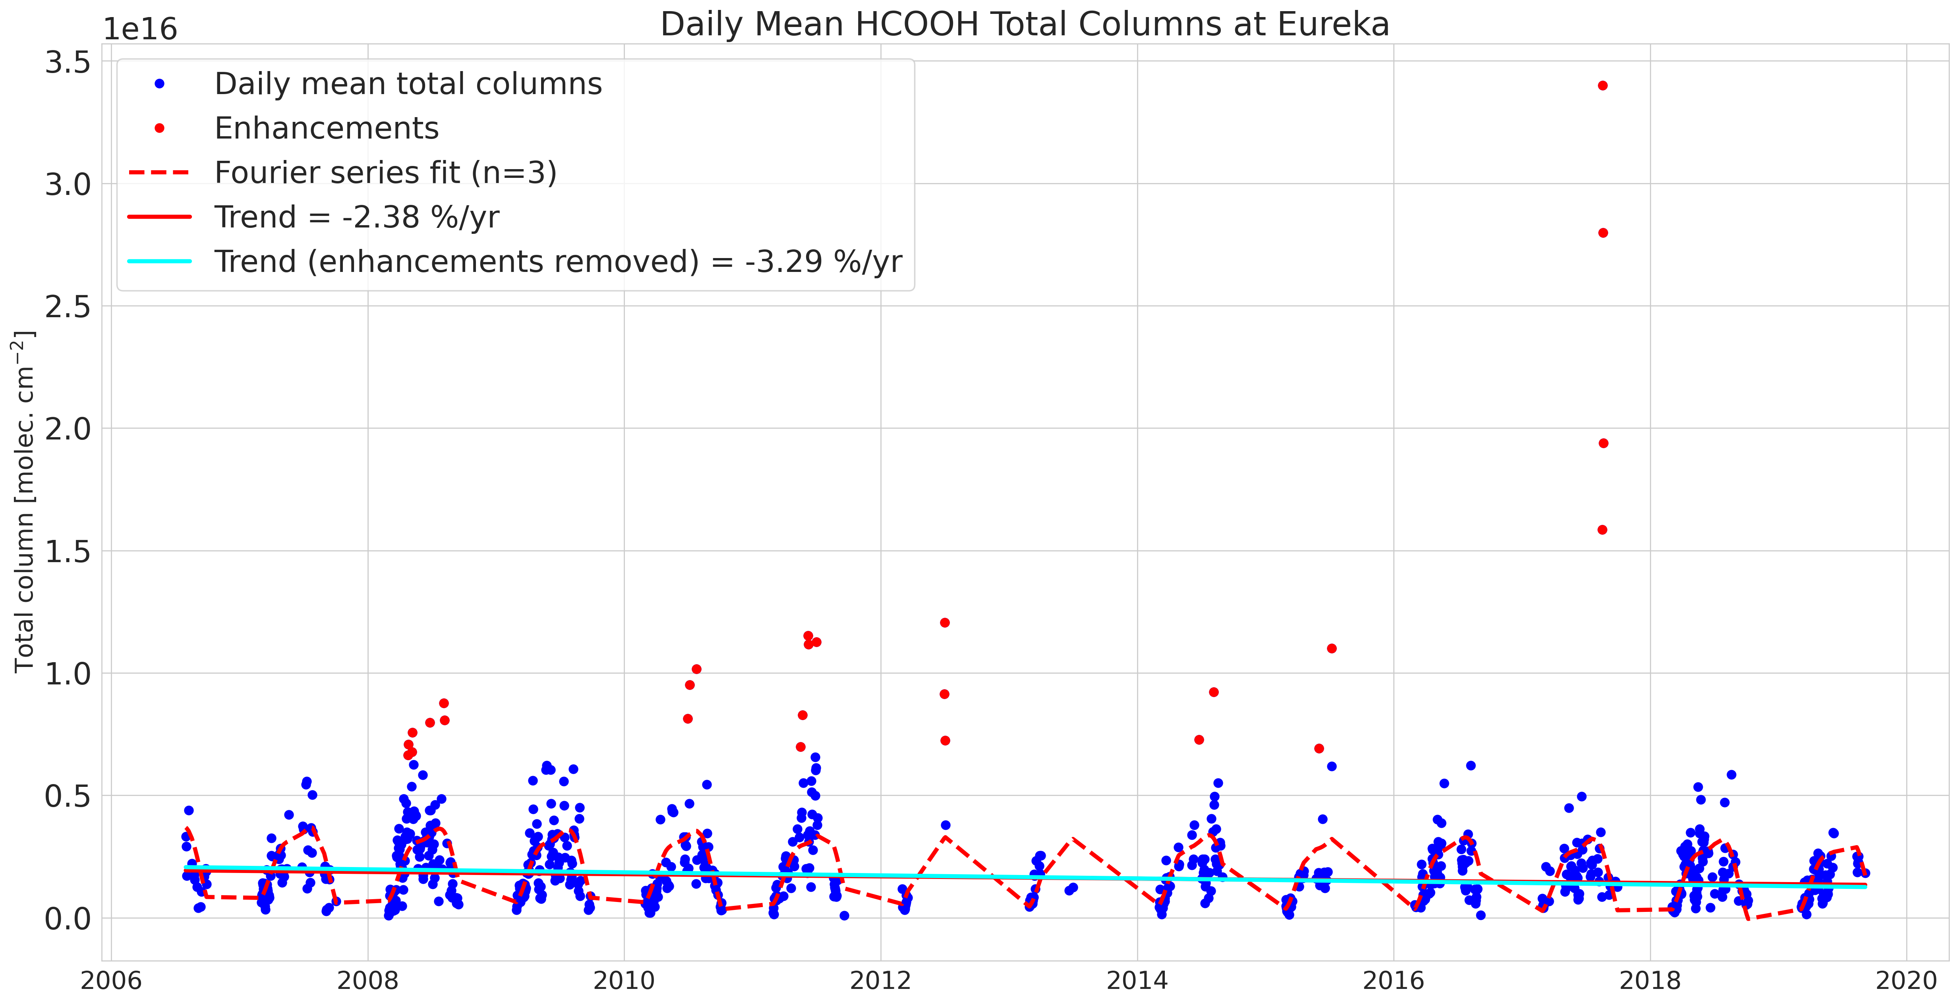
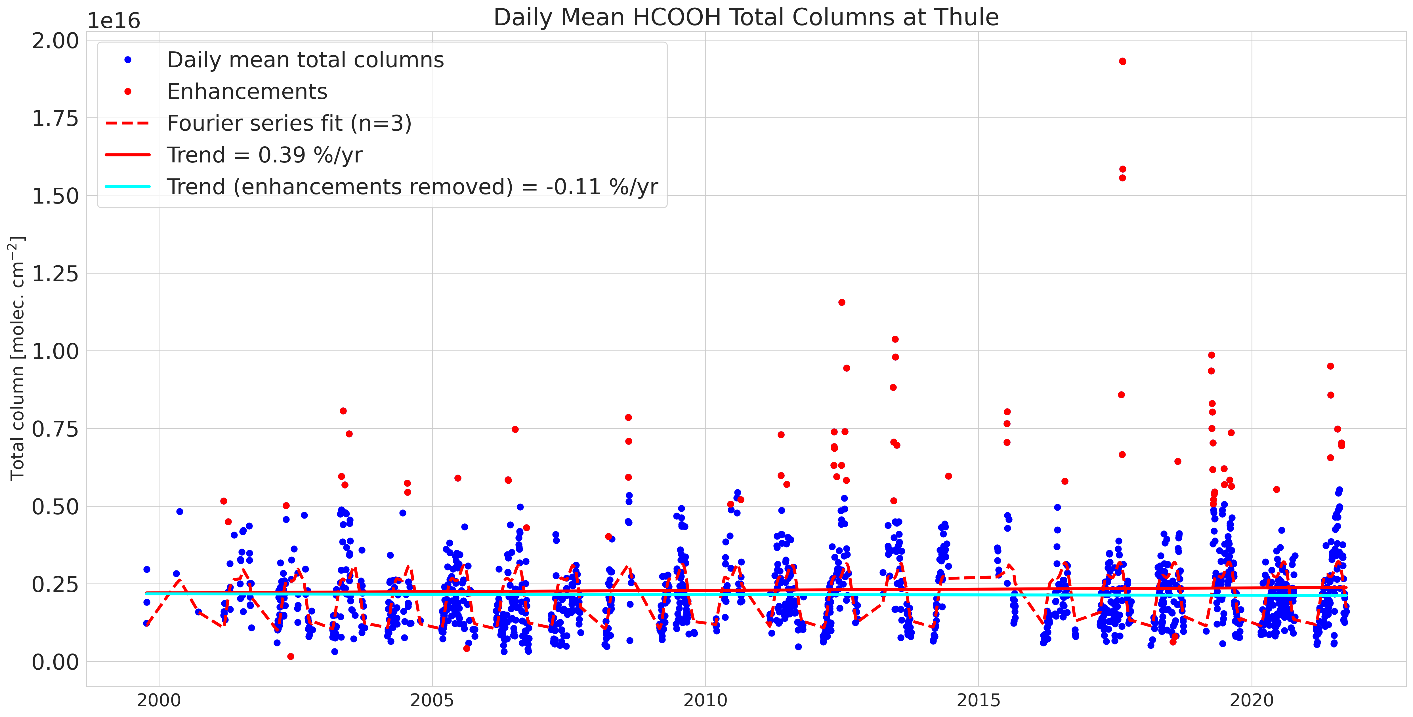
Results - Long-term Trends
Formic Acid (HCOOH)
Eureka
Trend = -3.29% yr⁻¹
CIs = [-4.44%, -2.10%]
Thule
Trend = -0.11% yr⁻¹
CIs = [-0.67%, 0.46%]
Notes:
Eureka data shows a strongly decreasing trend in HCOOH columns between 2006-2020, while Thule shows a much weaker decreasing trend.
-3.29% yr⁻¹ at Eureka, and -0.11% yr⁻¹ at Thule. With enhancements included, Thule actually shows an increasing trend which is likely driven by larger and more severe biomass burning events in the 2nd half of the time-series, the slope of the Eureka trend also appears to be influenced by this.

Slide 46
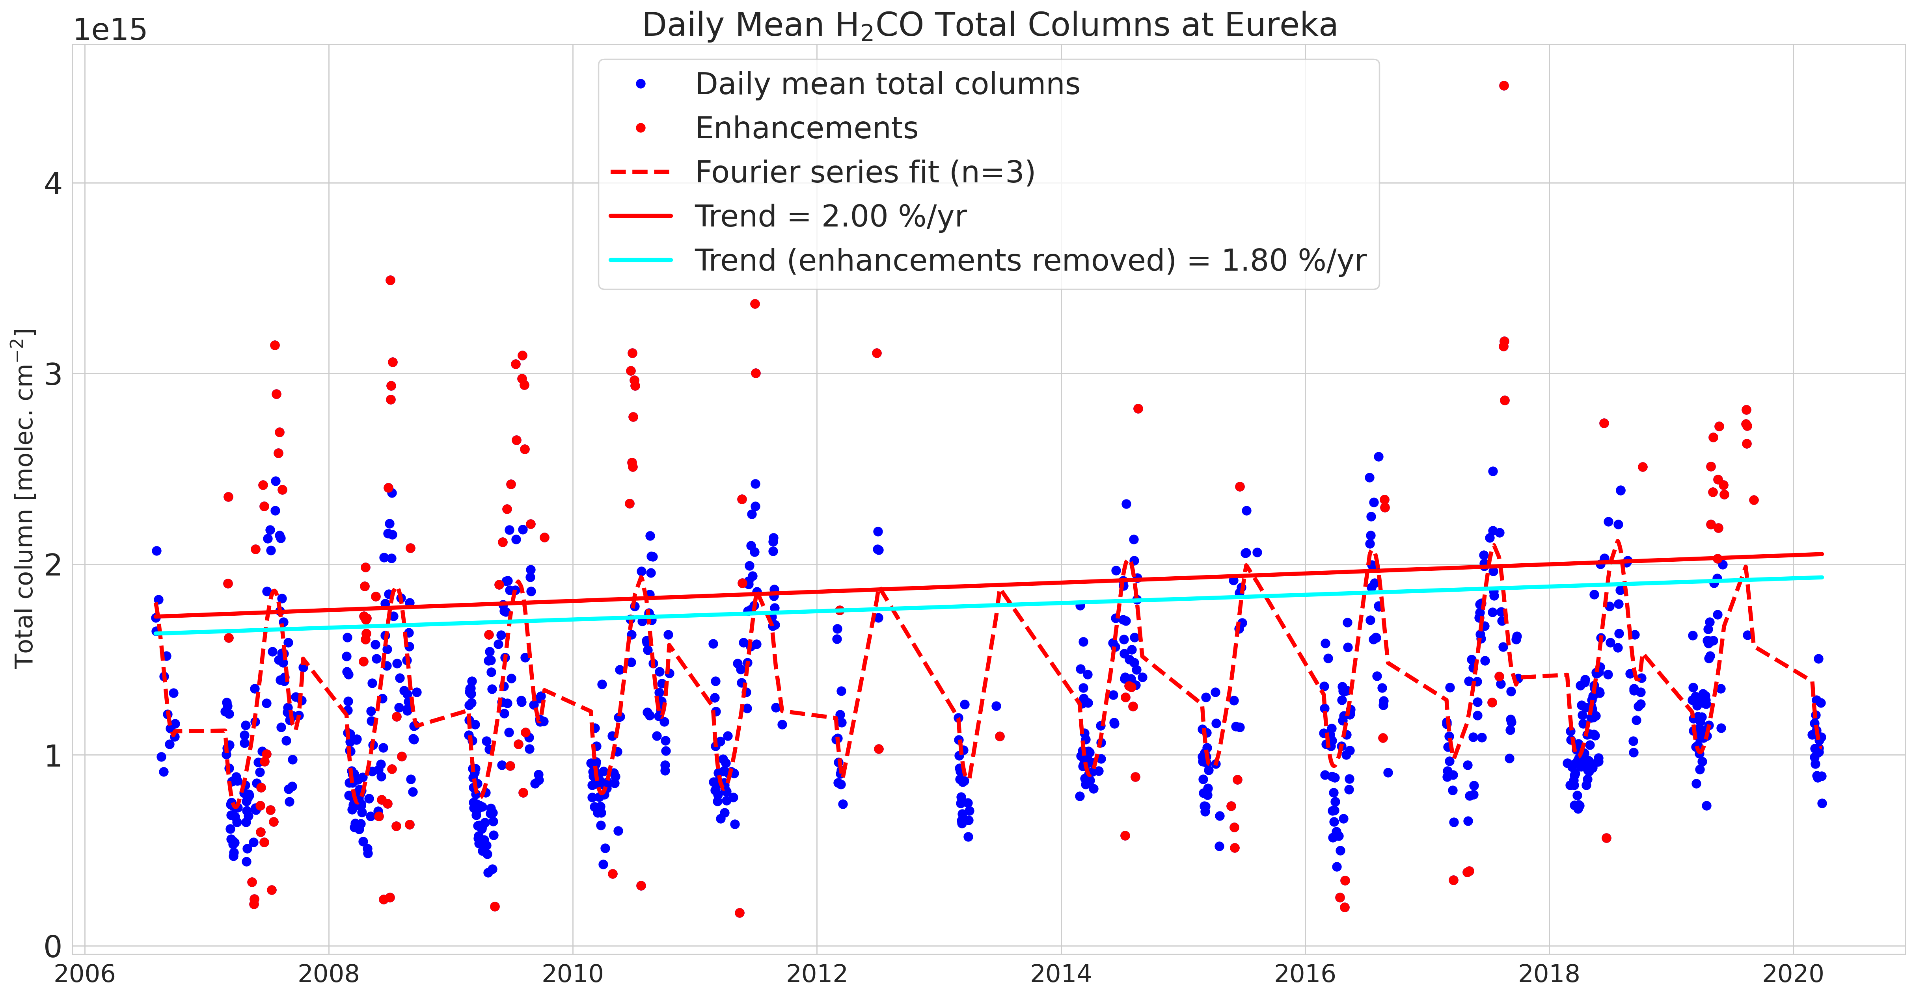
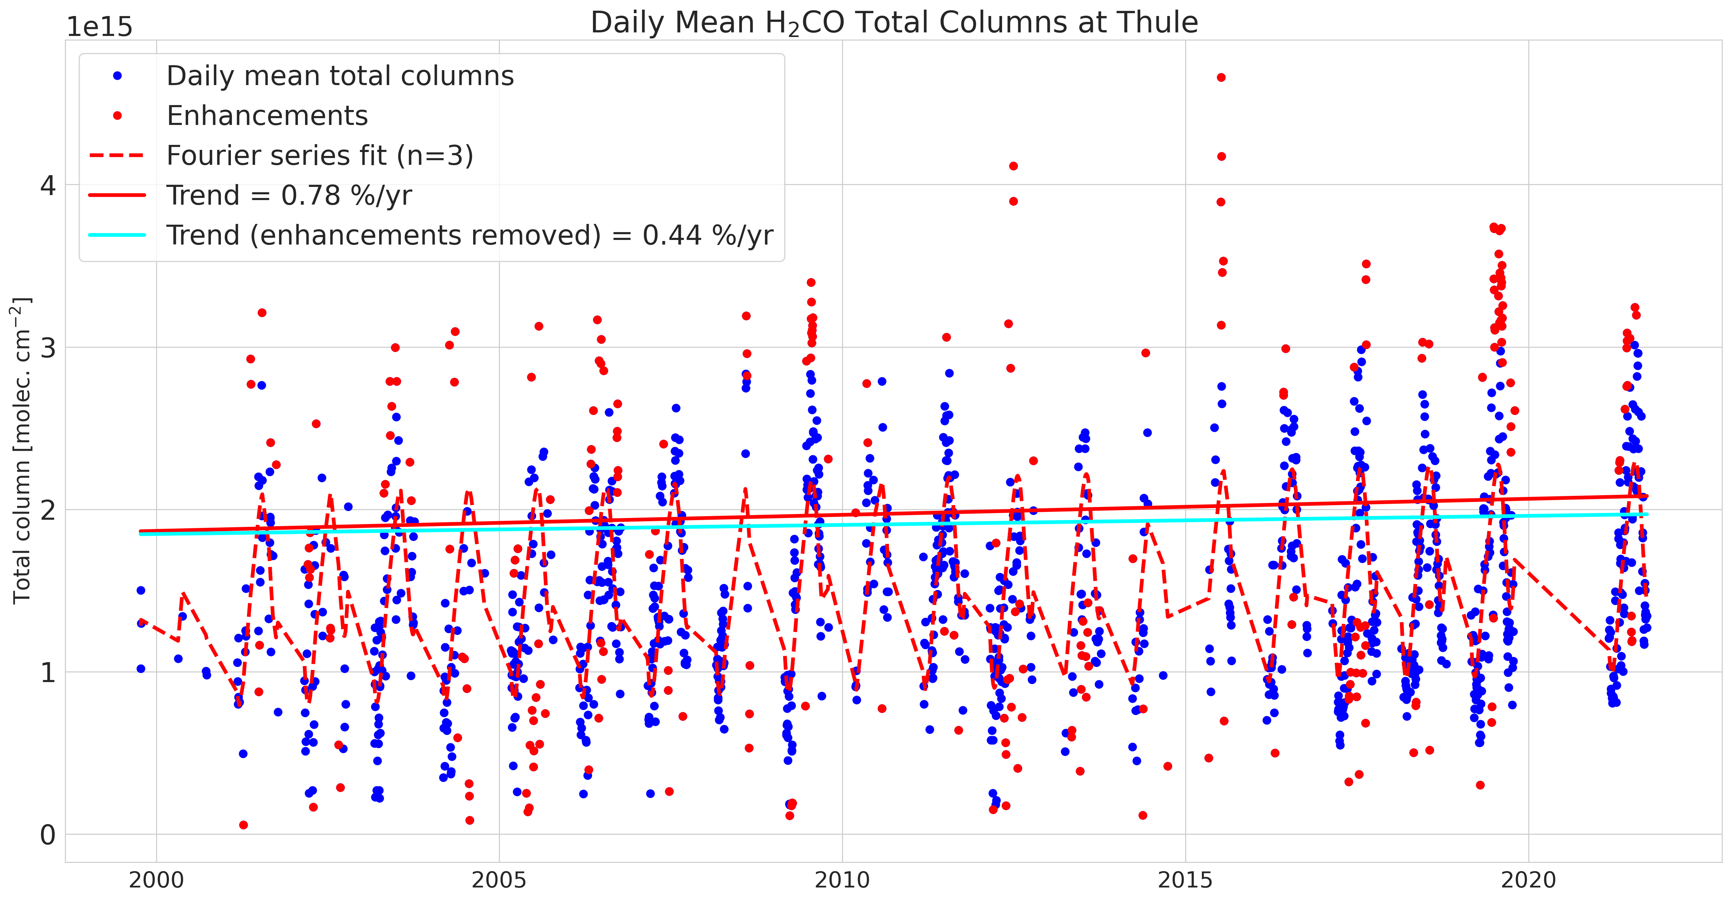
Results - Long-term Trends
Formaldehyde (HCHO)
Eureka
Trend = +1.80% yr⁻¹
CIs = [1.33%, 2.26%]
Thule
Trend = +0.44% yr⁻¹
CIs = [0.10%, 0.78%]
Notes:
Both sites show increasing HCHO, but Eureka displays a slightly stronger trend.
This is likely driven in-part by increasing CH4 in the atmosphere, as it is one of the largest sources of HCHO.
+1.80% yr⁻¹ at Eureka, and +0.44% yr⁻¹ at Thule.

Slide 47
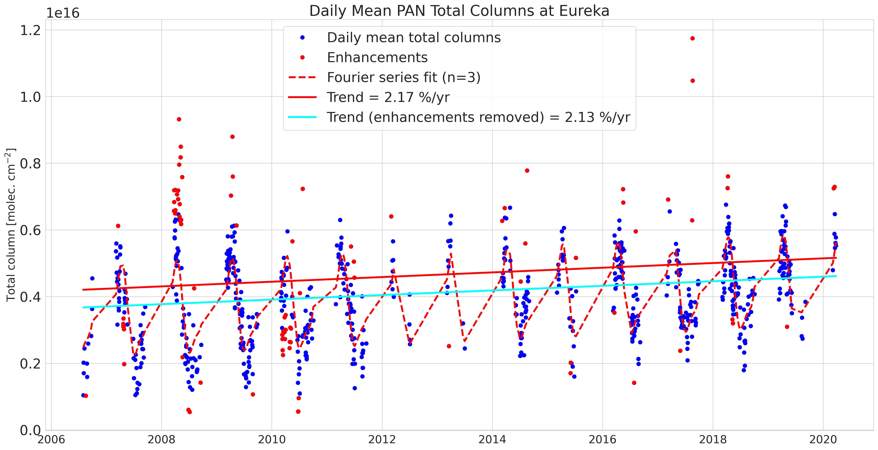
Results - Long-term Trends
Peroxyacetyl Nitrate (PAN)
Trend = +2.13% yr⁻¹
CIs = [1.64%, 2.60%]
Eureka
Notes:
PAN shows a clear increasing trend at Eureka of +2.13% yr⁻¹, possibly driven by increased formation at lower-latitudes and subsequent transport to the Arctic.
PAN is a main component of the Arctic haze pollution phenomenon, and may hint at worsening haze episodes going forwards.

Slide 48
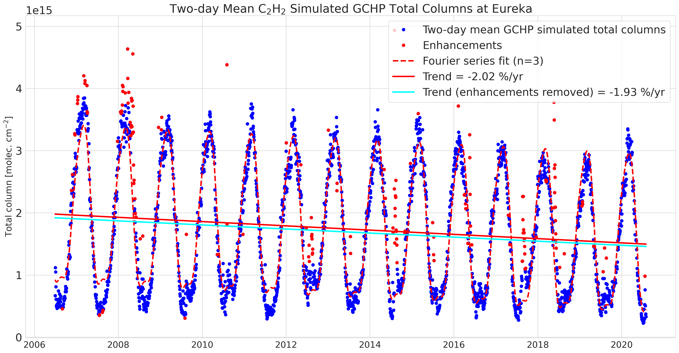
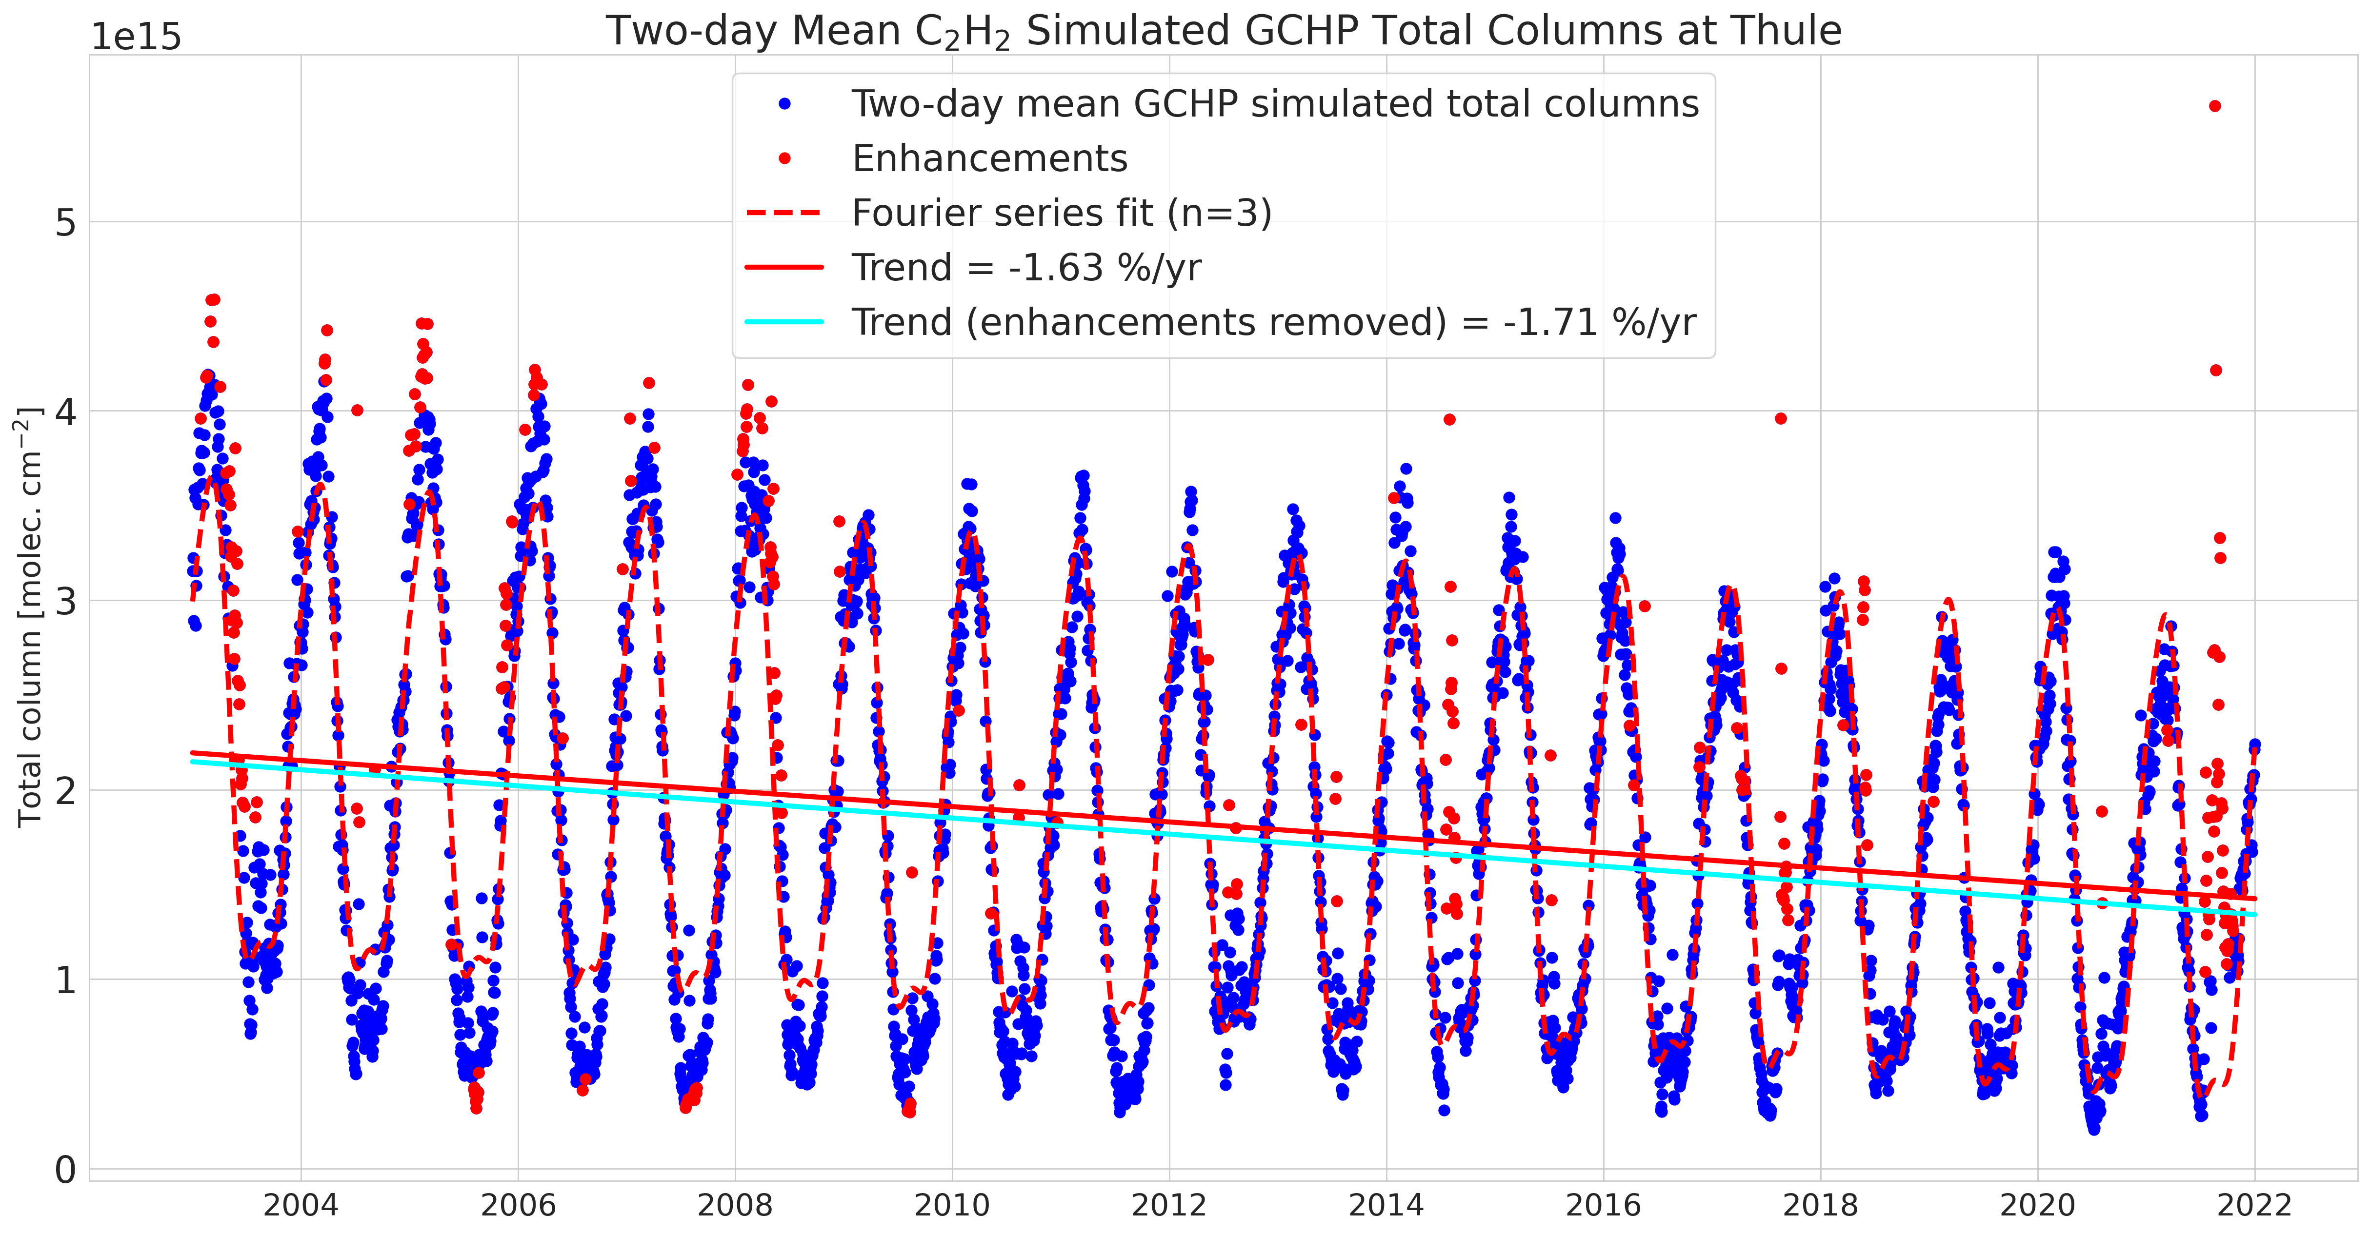
Additional Slides - GCHP-derived Trends
Acetylene (C2H2)
Eureka
Trend = -1.93% yr⁻¹
CIs = [-2.19%, -1.67%]
Thule
Trend = -1.71% yr⁻¹
CIs = [-1.85%, -1.58%]
Notes:
Both sites show a strongly decreasing trend in CO columns over their full time-series, which is largely consistent with the decreases in fossil fuel burning over the last decades.
-1.10% yr⁻¹ at Eureka, and -0.85% yr⁻¹ at Thule. It should be noted that the Thule time-series for CO extends ~6 years before Eureka.

Slide 49
Additional Slides - GCHP-derived Trends
Ethylene (C2H4)
Eureka
Trend = -1.93% yr⁻¹
CIs = [-2.19%, -1.67%]
Thule
Trend = -1.71% yr⁻¹
CIs = [-1.85%, -1.58%]
Notes:
Both sites show a strongly decreasing trend in CO columns over their full time-series, which is largely consistent with the decreases in fossil fuel burning over the last decades.
-1.10% yr⁻¹ at Eureka, and -0.85% yr⁻¹ at Thule. It should be noted that the Thule time-series for CO extends ~6 years before Eureka.

Slide 50
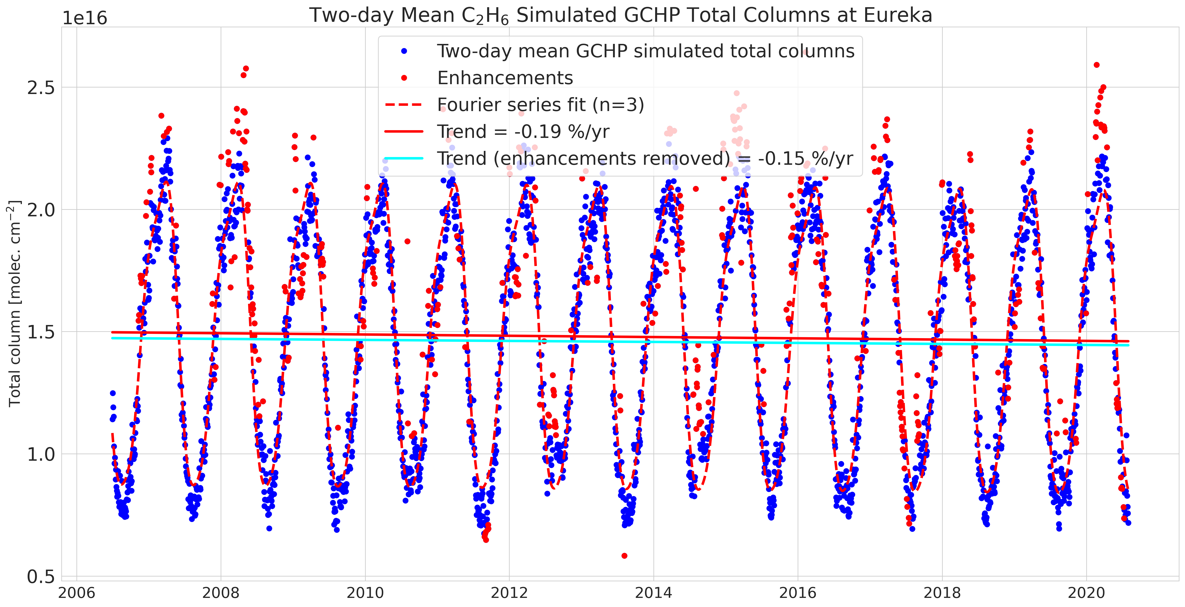
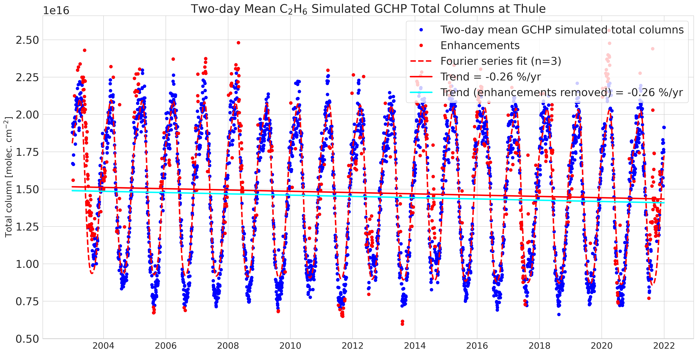
Additional Slides - GCHP-derived Trends
Ethane (C2H6)
Eureka
Trend = -0.15% yr⁻¹
CIs = [-0.56%, +0.30%]
Thule
Trend = -0.26% yr⁻¹
CIs = [-0.32%, -0.19%]
Notes:
Both sites show a strongly decreasing trend in CO columns over their full time-series, which is largely consistent with the decreases in fossil fuel burning over the last decades.
-1.10% yr⁻¹ at Eureka, and -0.85% yr⁻¹ at Thule. It should be noted that the Thule time-series for CO extends ~6 years before Eureka.

Slide 51
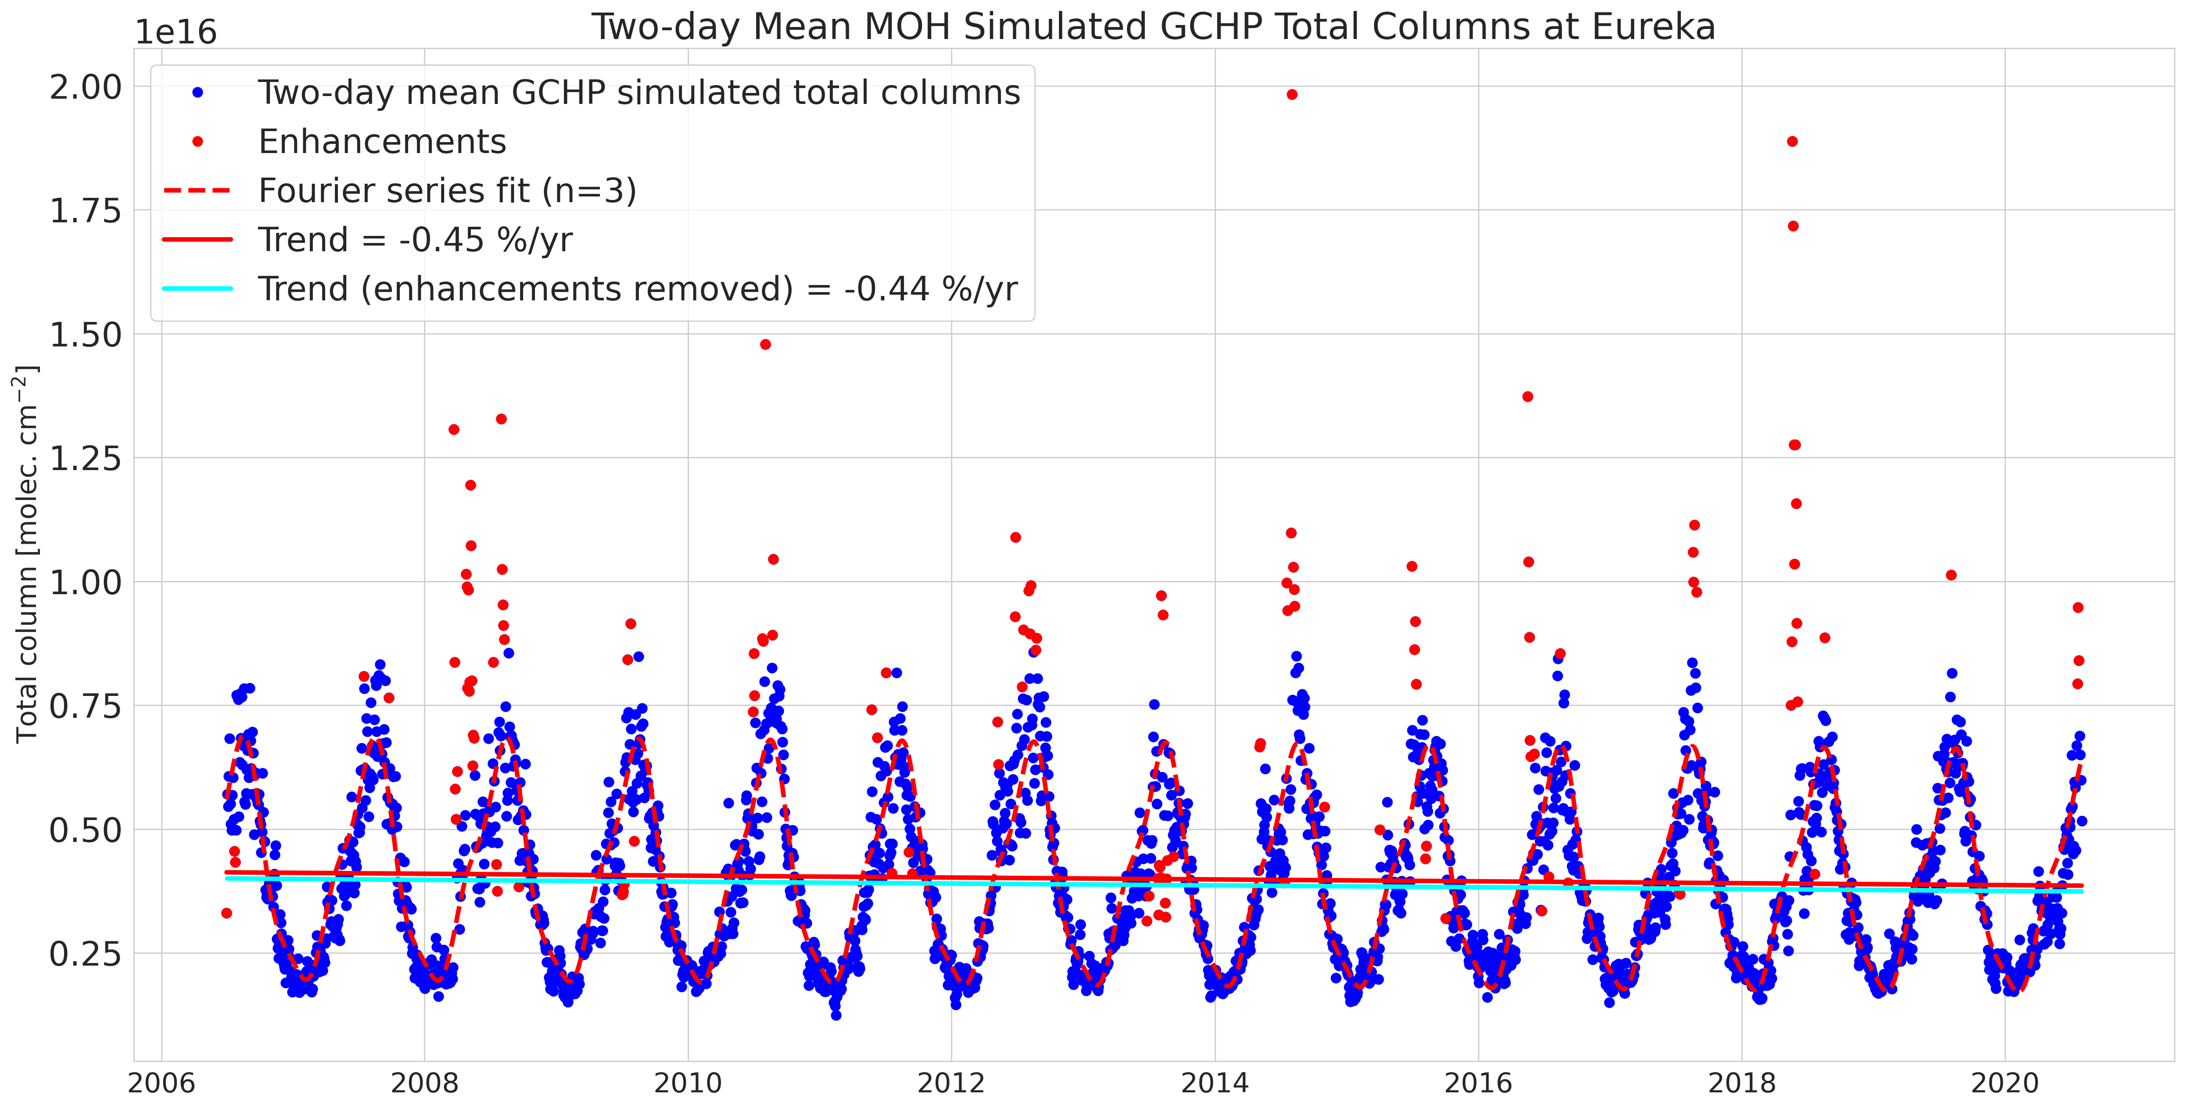
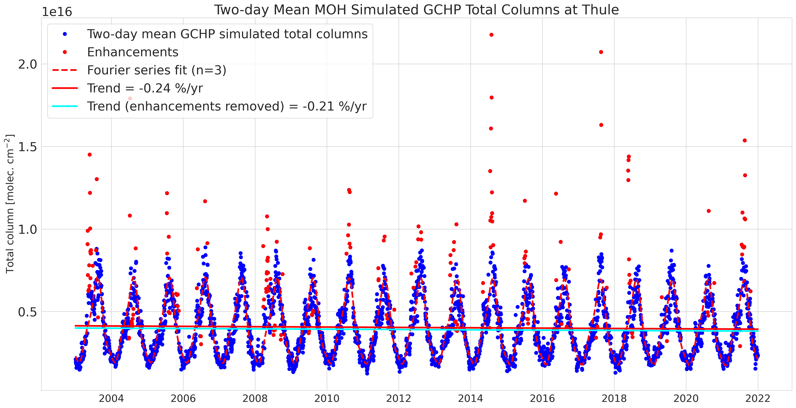
Additional Slides - GCHP-derived Trends
Methanol (CH3OH)
Eureka
Trend = -0.44% yr⁻¹
CIs = [-0.63%, -0.24%]
Thule
Trend = -0.21% yr⁻¹
CIs = [-0.34%, -0.08%]
Notes:
Both sites show a strongly decreasing trend in CO columns over their full time-series, which is largely consistent with the decreases in fossil fuel burning over the last decades.
-1.10% yr⁻¹ at Eureka, and -0.85% yr⁻¹ at Thule. It should be noted that the Thule time-series for CO extends ~6 years before Eureka.

Slide 52
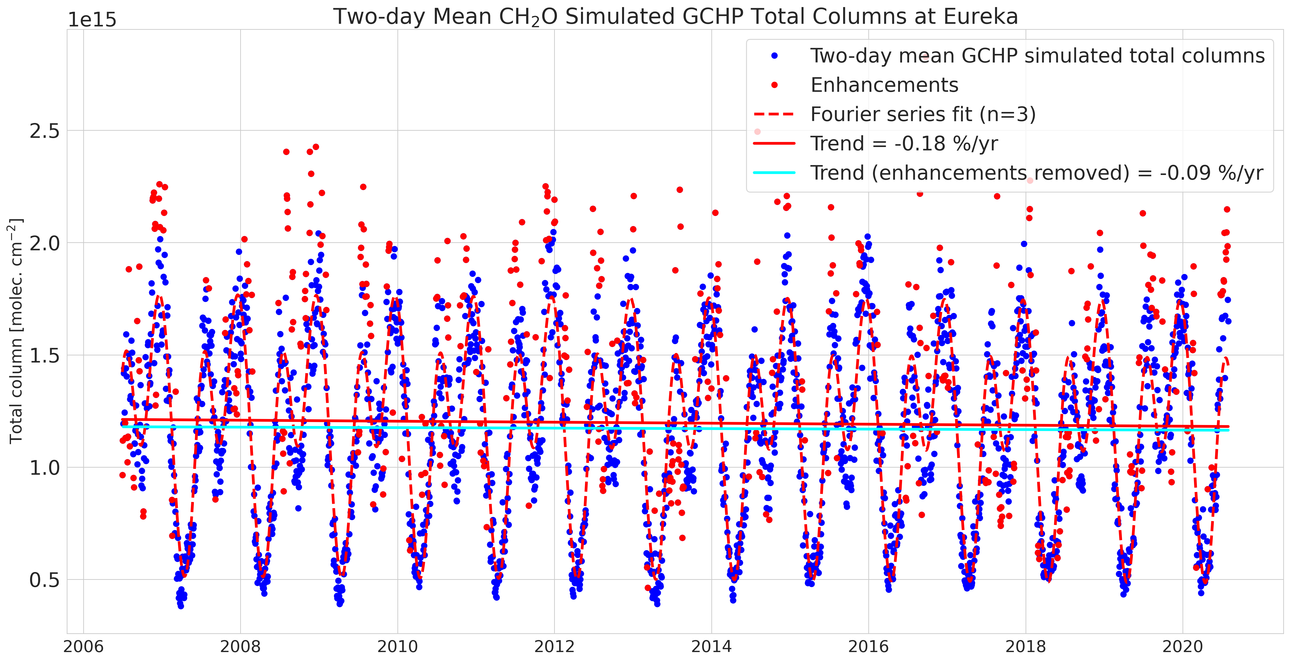
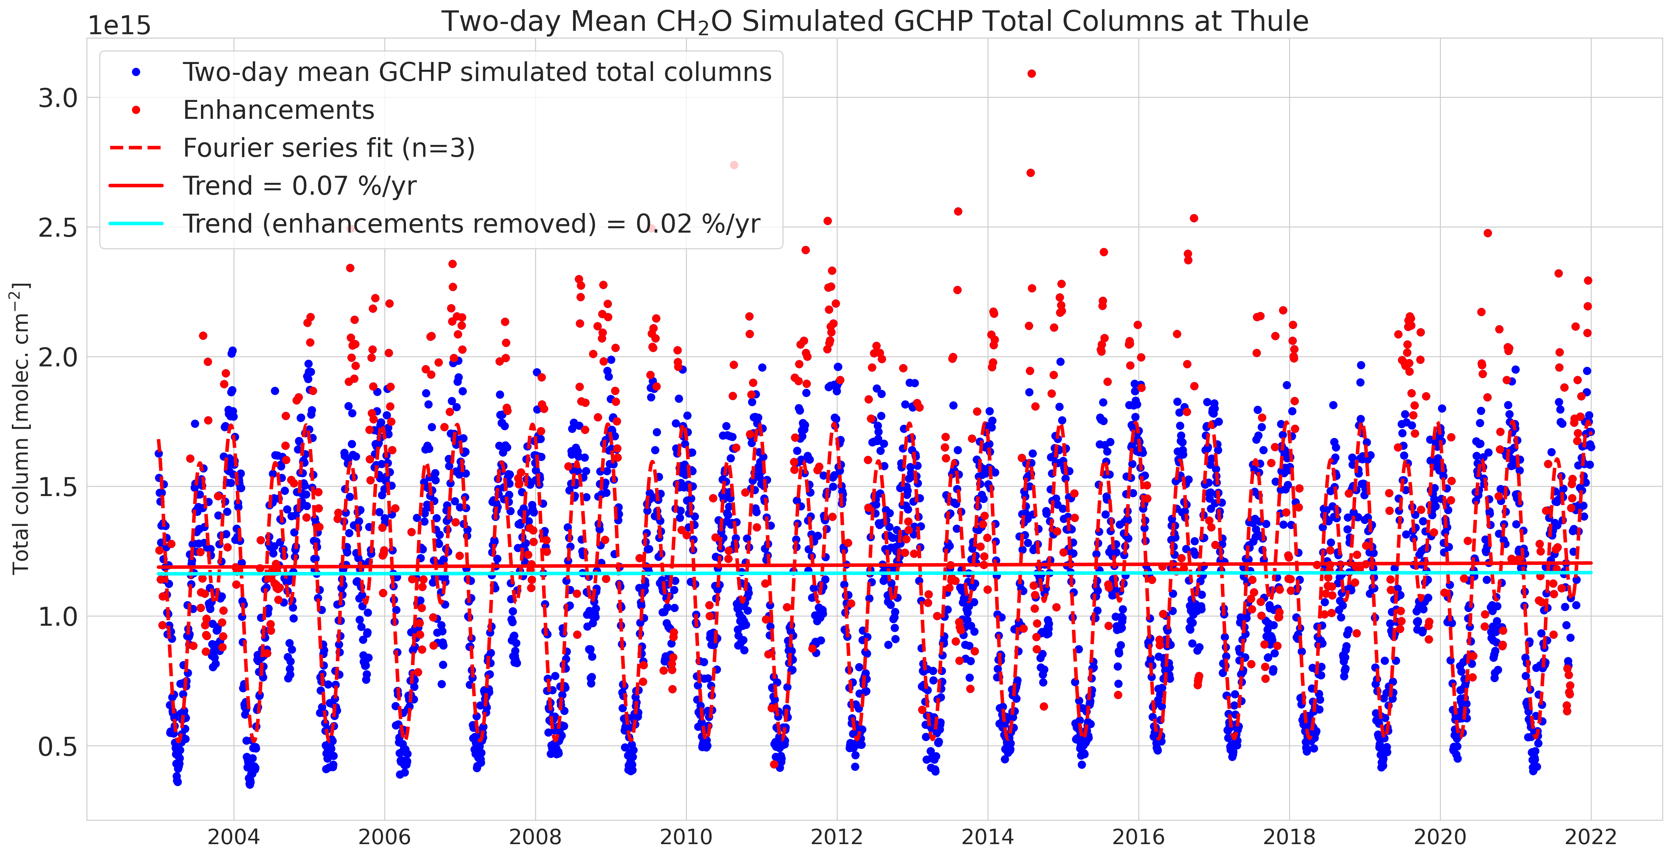
Additional Slides - GCHP-derived Trends
Formaldehyde (HCHO)
Eureka
Trend = -0.09% yr⁻¹
CIs = [-0.26%, +0.07%]
Thule
Trend = +0.02% yr⁻¹
CIs = [-0.11%, +0.16%]
Notes:
Both sites show a strongly decreasing trend in CO columns over their full time-series, which is largely consistent with the decreases in fossil fuel burning over the last decades.
-1.10% yr⁻¹ at Eureka, and -0.85% yr⁻¹ at Thule. It should be noted that the Thule time-series for CO extends ~6 years before Eureka.

Slide 53
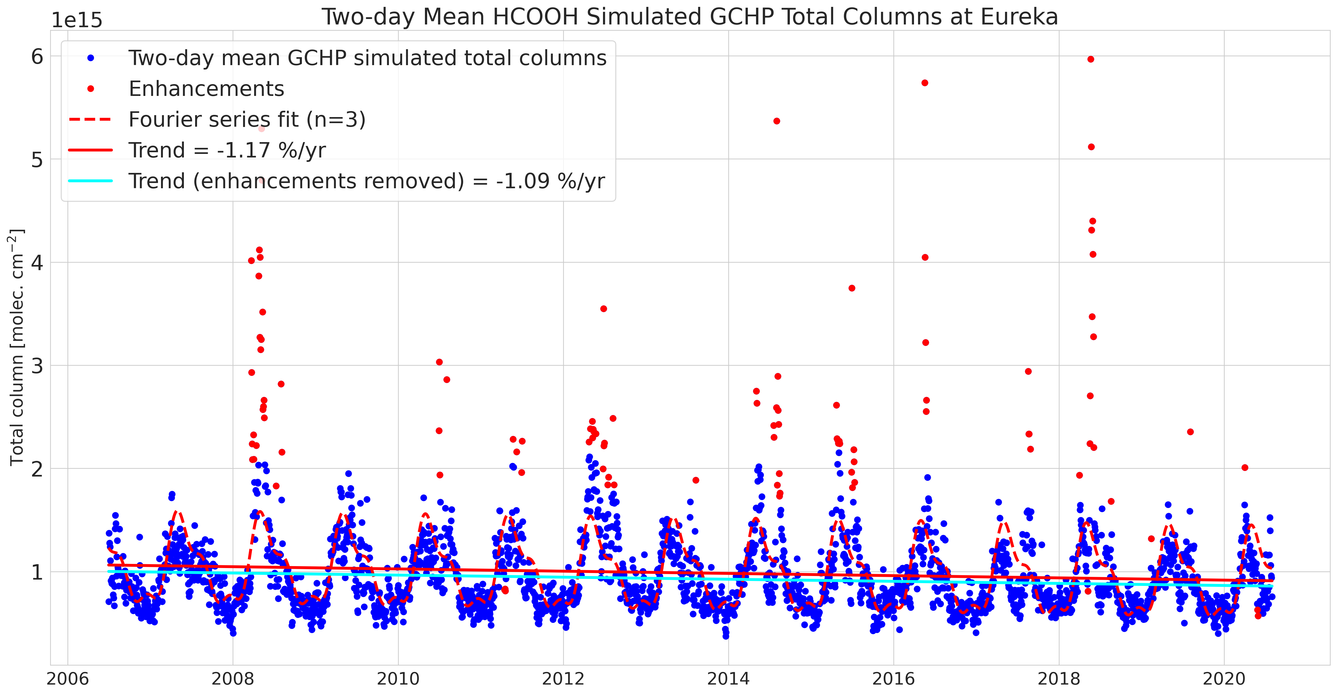
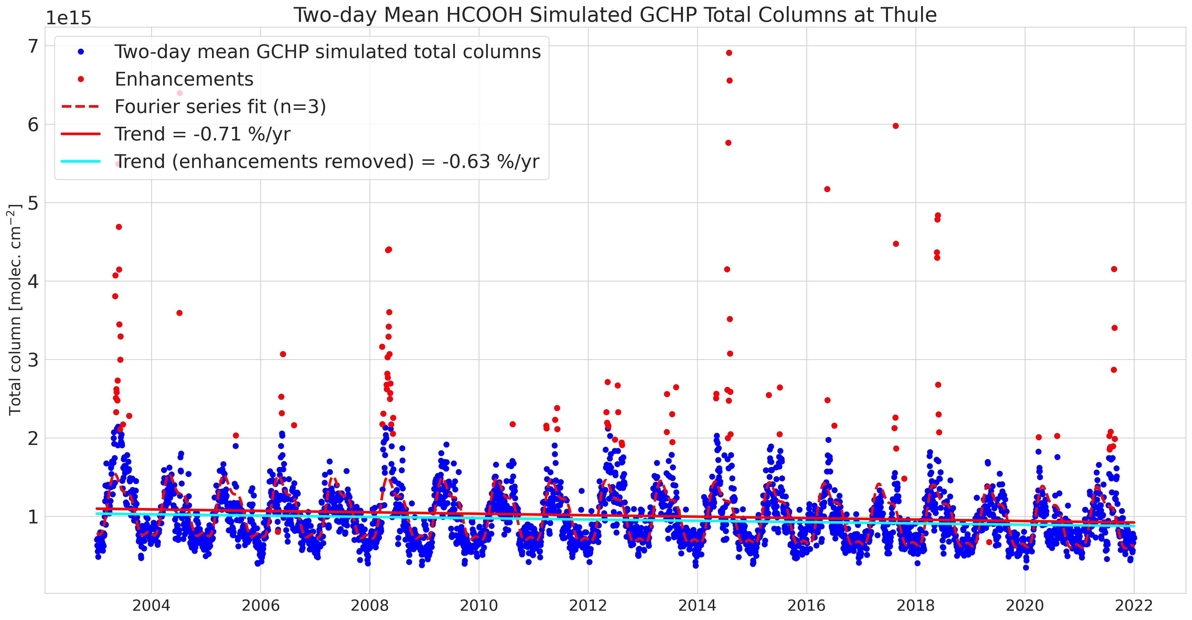
Additional Slides - GCHP-derived Trends
Formic acid (HCOOH)
Eureka
Trend = -1.09% yr⁻¹
CIs = [-1.41%, -0.79%]
Thule
Trend = -0.63% yr⁻¹
CIs = [-0.81%, -0.44%]
Notes:
Both sites show a strongly decreasing trend in CO columns over their full time-series, which is largely consistent with the decreases in fossil fuel burning over the last decades.
-1.10% yr⁻¹ at Eureka, and -0.85% yr⁻¹ at Thule. It should be noted that the Thule time-series for CO extends ~6 years before Eureka.

Slide 54
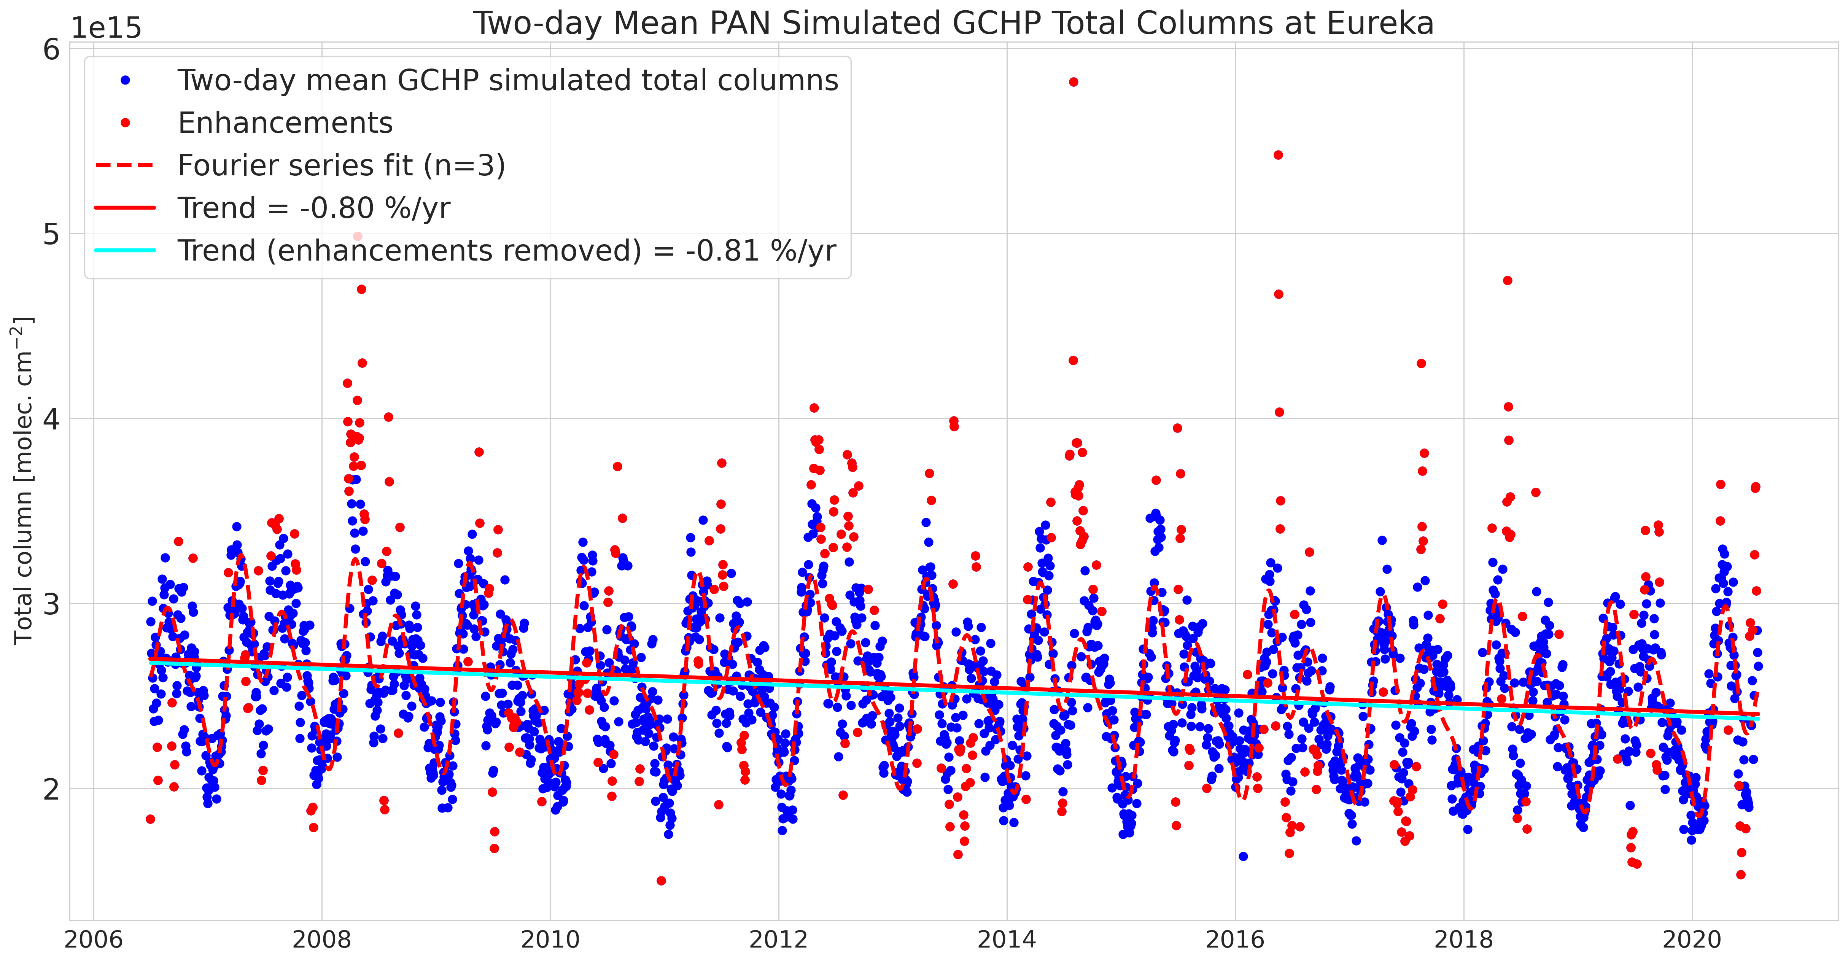
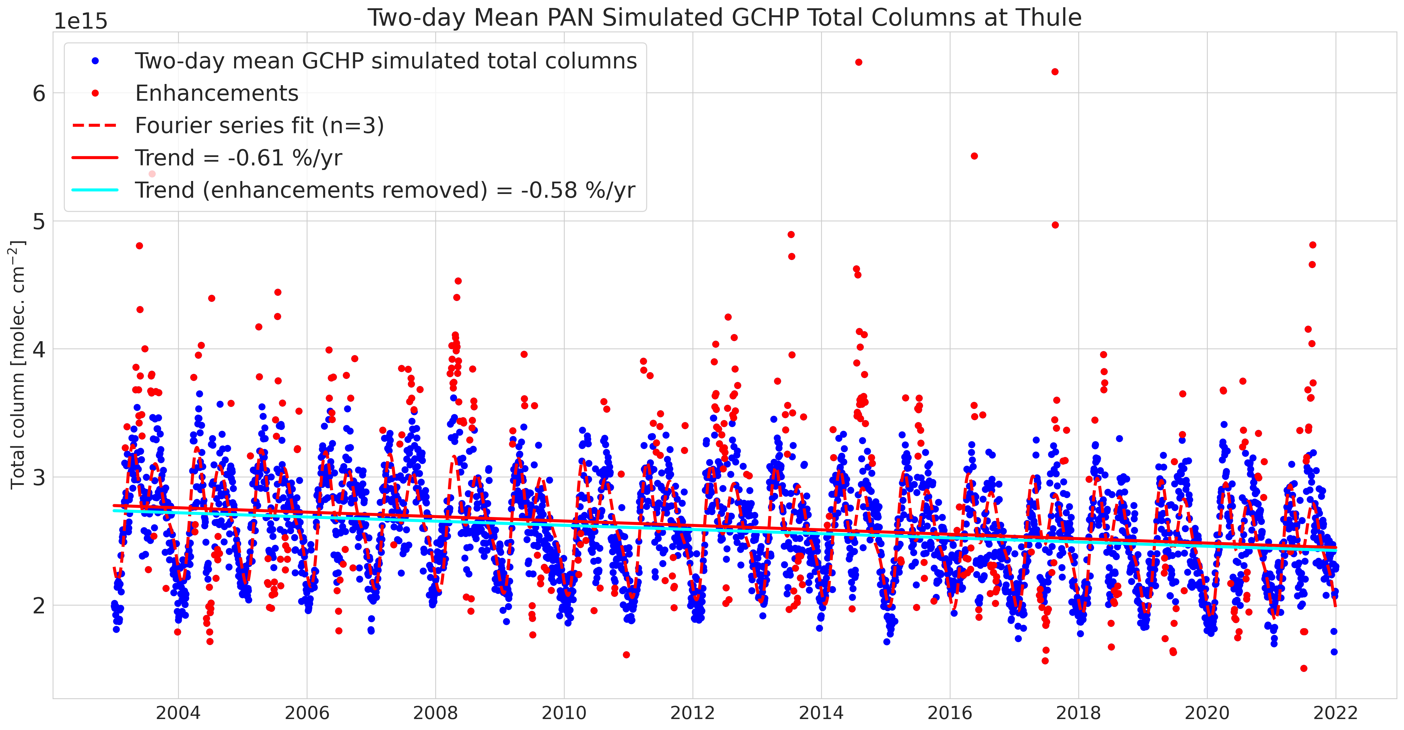
Additional Slides - GCHP-derived Trends
Peroxyacetyl nitrate (PAN)
Eureka
Trend = -0.81% yr⁻¹
CIs = [-0.92%, -0.69%]
Thule
Trend = -0.58% yr⁻¹
CIs = [-0.66%, -0.51%]
Notes:
Both sites show a strongly decreasing trend in CO columns over their full time-series, which is largely consistent with the decreases in fossil fuel burning over the last decades.
-1.10% yr⁻¹ at Eureka, and -0.85% yr⁻¹ at Thule. It should be noted that the Thule time-series for CO extends ~6 years before Eureka.

