Slide 1


Variability and trends of ammonia from urban and remote ground-based FTIR measurements globally distributed
Beatriz Herrera, Enrico Dammers, Michel Grutter, James W. Hannigan, Dylan Jones, Nicholas Jones, Maria Makarova, Kazuyuki Miyazaki, Isamu Morino, Isao Murata, Mathias Palm, Anatoly Poberovskii, Dan Smale, Kimberly Strong, Tyler Wizenberg, and Corinne Vigouroux.
NDACC – IRWG Annual Meeting 2023
Spa, Belgium
15 June 2023

Slide 2
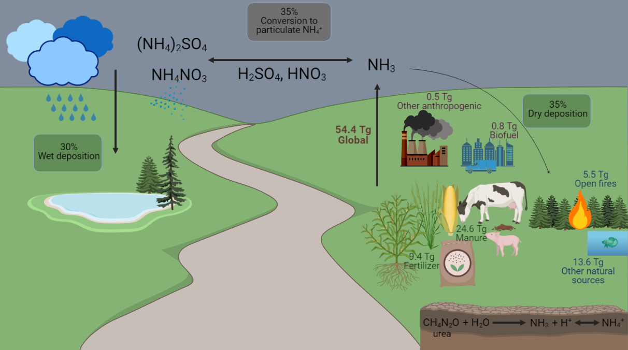
Background - Atmospheric Ammonia (NH₃)
Atmospheric NH₃: main chemical reactions, global emissions and sources, and global budget. The emission values are mostly for 2005 -2008 (Paulot et al., 2014). The global depositions and conversion to particulate NH₄⁺ percentages are from model simulations (Khan et al., 2020).

Slide 3
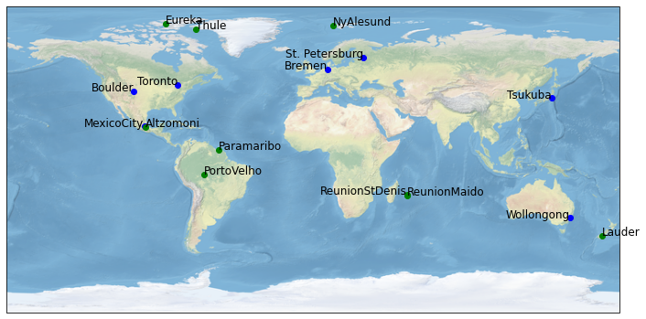
Motivation
To investigate the global variability and trends of NH₃ at urban and remote regions using data from ground-based instruments and model outputs
Study site locations, green for remote sites and blue for urban sites. Most of the sites are part of the Network for the Detection of Atmospheric Composition Change (NDACC)

Slide 4
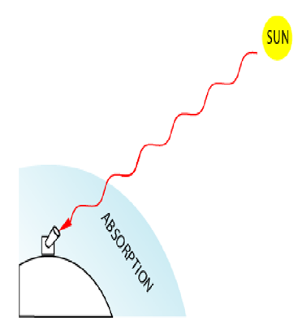

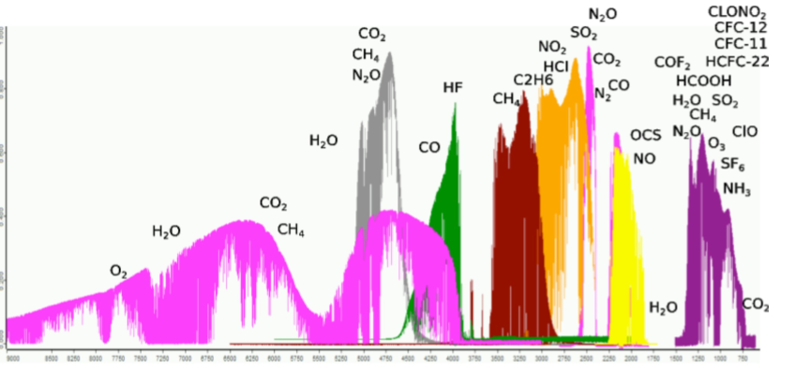
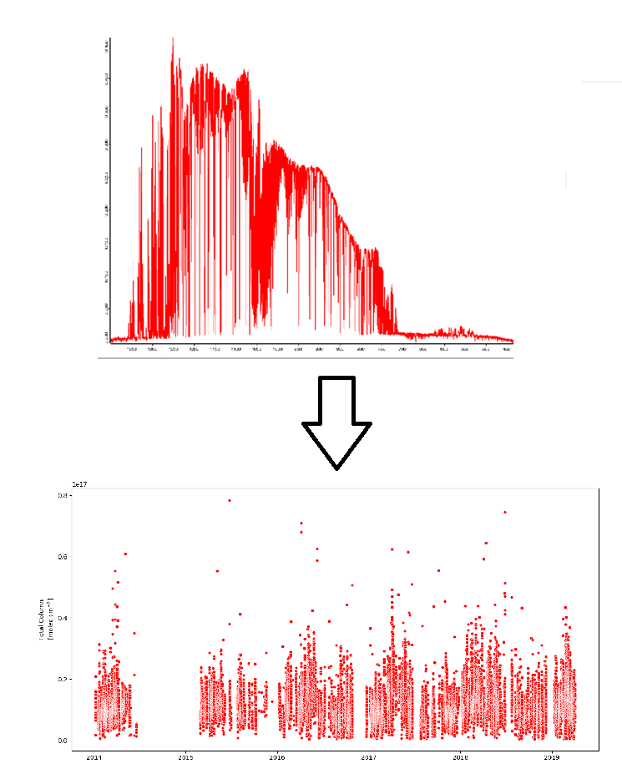
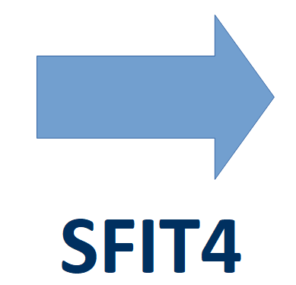
Methodology - FTIR
FTIR (Fourier Transform Infrared) Spectroscopy
Retrieval Code
Total column
Solar spectra
Retrieval Code Parameters
*Parameters | NH₃ retrieval
Microwindow 1 | 930.32 – 931.32 cm⁻¹
Microwindow 2 | 966.97 – 967.675cm⁻¹
Interfering species | H₂O, O_{3,} CO_{2,} N₂O, HNO₃
SFIT4 version | V0.9.4.4
Trend model
Linear trend model
Fourier series of third degree.
Bootstrap resampling methods to construct the 95% confidence intervals (Friedrich et al. 2020)
*Most common for polluted sites. The parameters can vary among the sites (Dammers et al., 2015)
Notes:
4

Slide 5
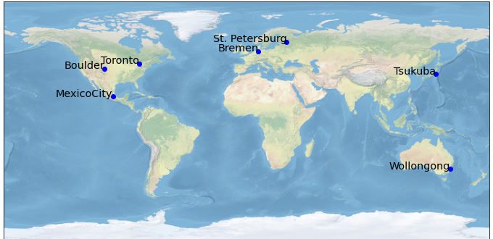
Results - Urban Sites
Station | Time Period | NH₃ mean column (molecules cm⁻²) x10¹⁵ | NH₃ sources
St. Petersburg, Russia | 2010-2022 | 2.96 ± 2.77 | Biomass burning, local sources
Bremen, Germany | 2004-2018 | 16.8 ± 14.7 | Fertilizers, livestock
Toronto, Canada | 2002-2022 | 8.40 ± 8.25 | Fertilizers, biomass burning
Boulder, USA | 2010-2021 | 6.88 ± 5.68 | Fertilizers, biomass burning
Tsukuba, Japan | 2014-2020 | 4.60 ± 3.42 | Fertilizers
Mexico City, Mexico | 2014-2019 | 11.7 ± 6.63 | Large local sources
Wollongong, Australia | 2007-2022 | 2.66 ± 2.15 | Fertilizers, biomass burning

Slide 6
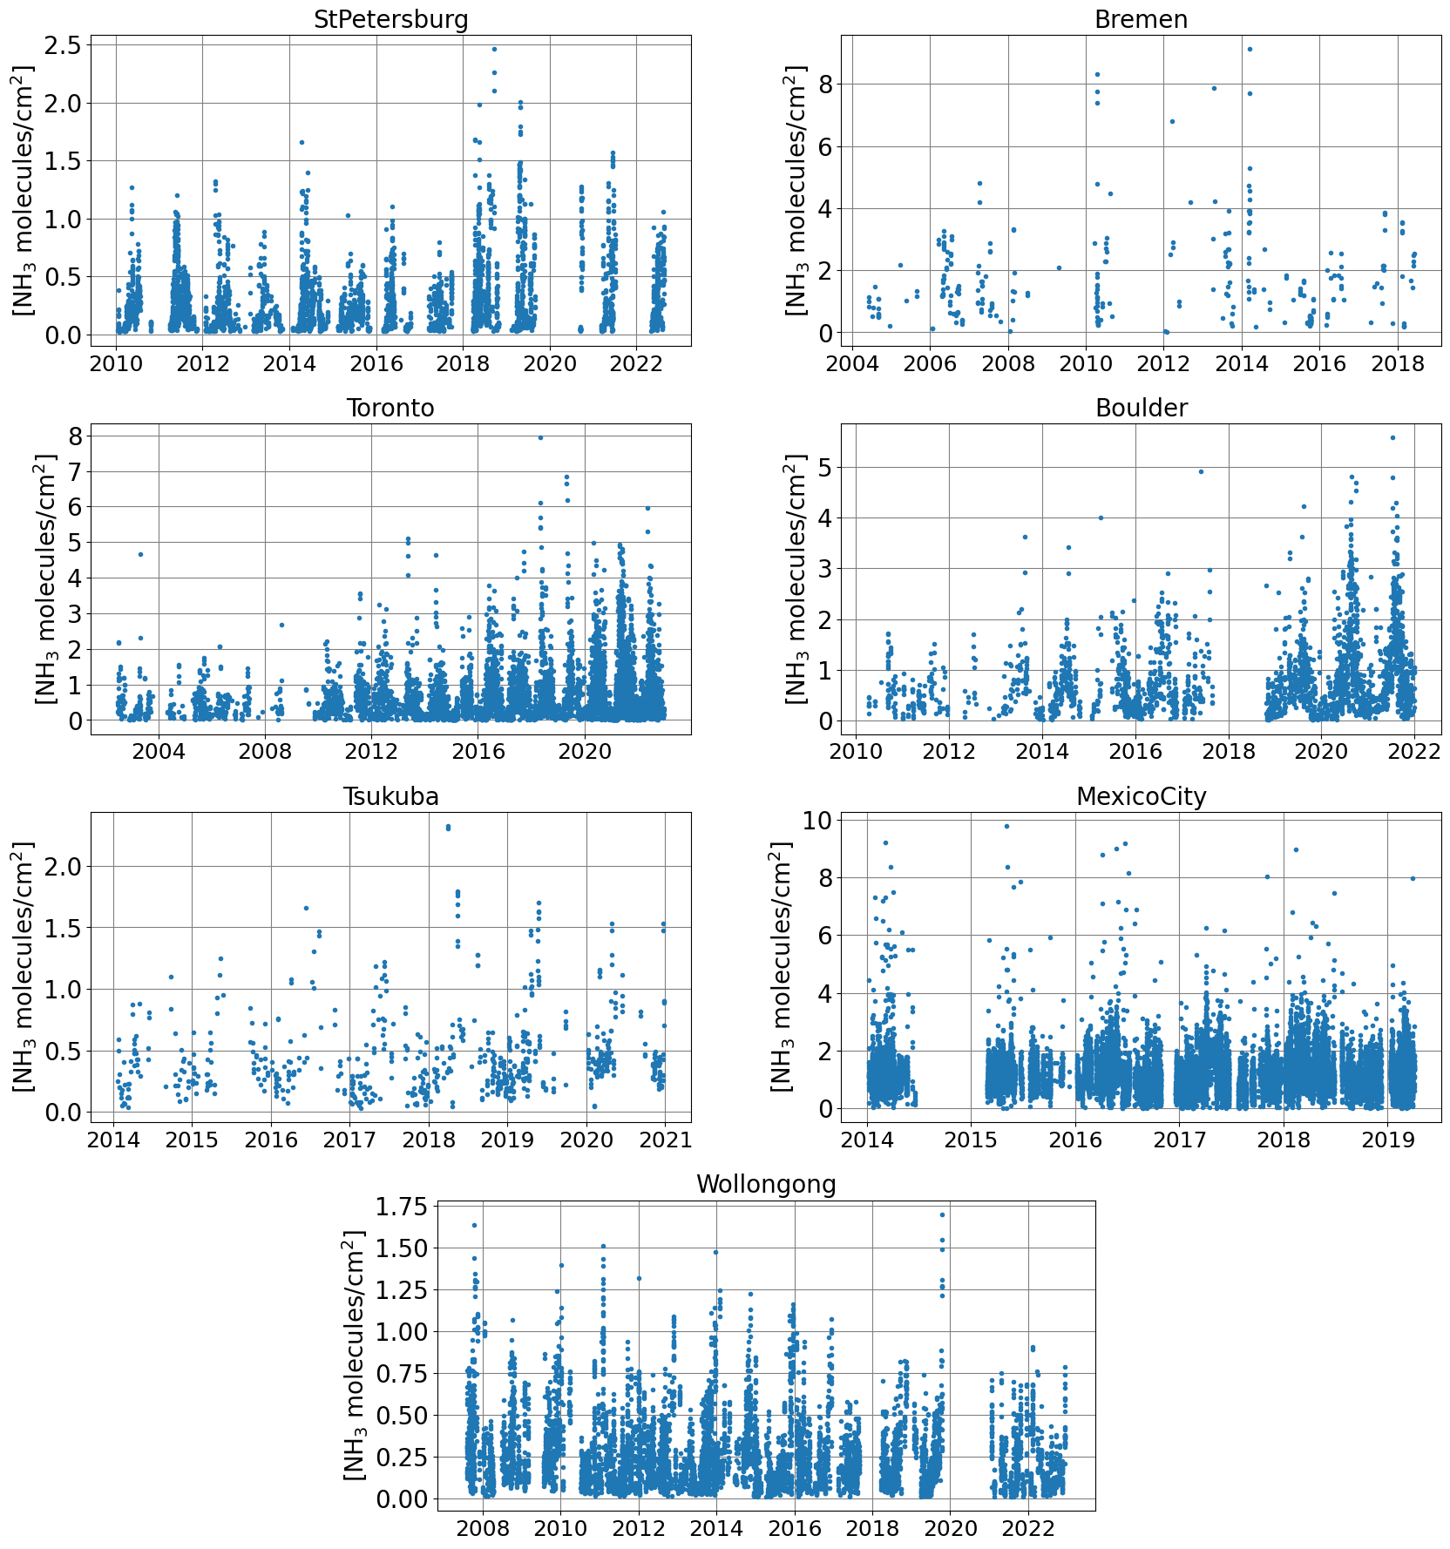
Urban NH₃ Total Column Time Series
1e16
1e16
The largest columns are seen at Bremen, an area influenced by the nearby intense agriculture activity, and at Mexico City, an area influenced by numerous local urban sources. The smallest columns are in Wollongong, a coastal city without large local sources and smaller population
1e16
1e16
1e16
1e16
1e16

Slide 7
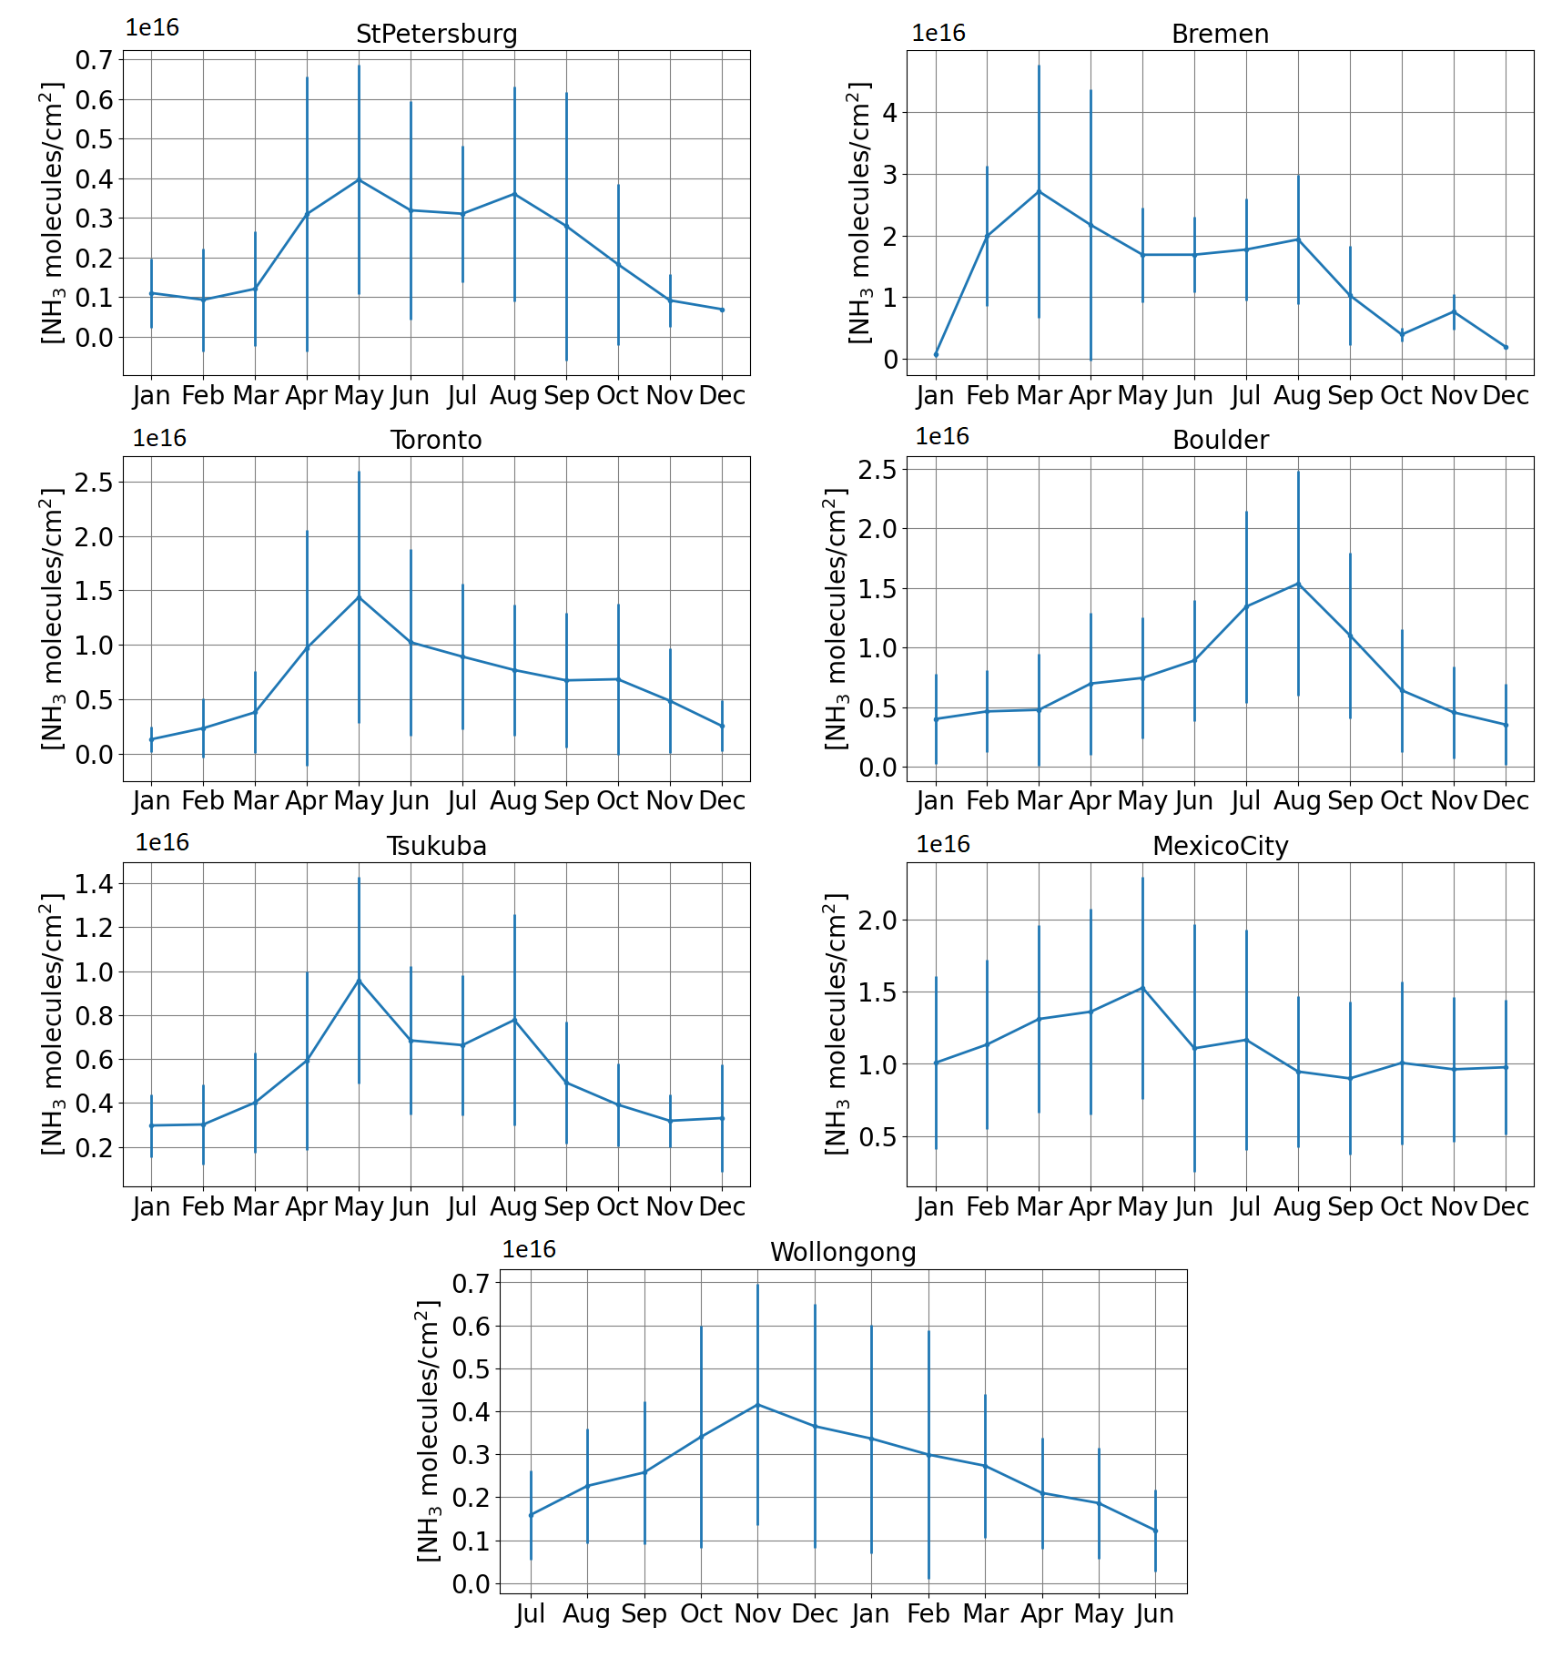
Urban NH₃ Total Column Monthly Means
The seasonal patterns are very similar for all stations, peaking during the spring/summer season, including Wollongong in the Southern Hemisphere, showing the temperature dependence of NH₃, with the highest values in the warm months due to the increased volatilization of NH₃

Slide 8
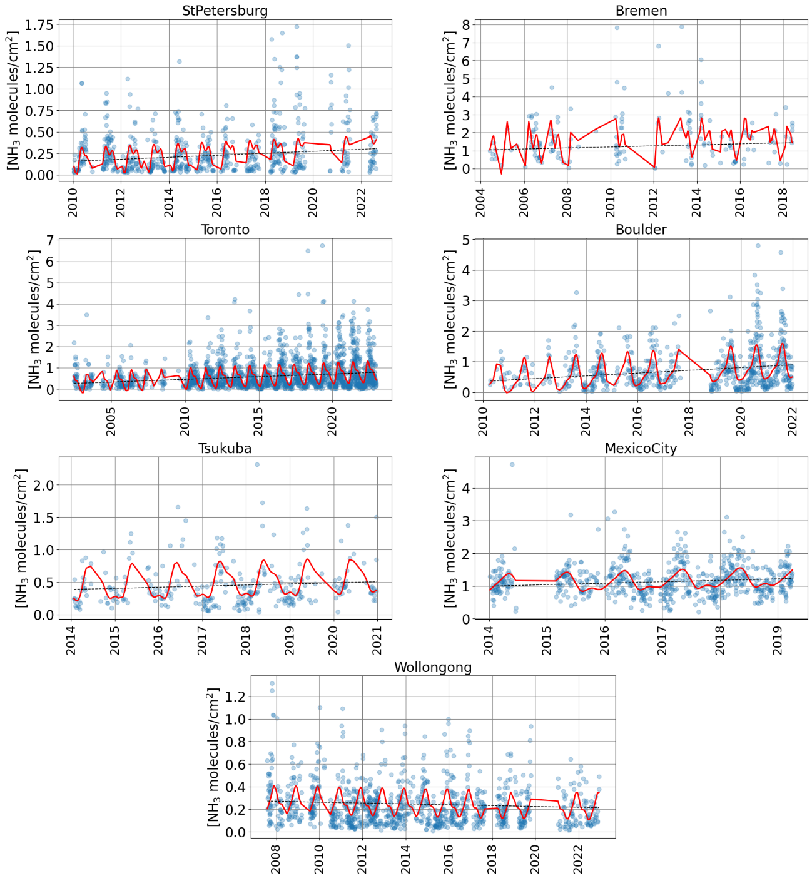
Urban Trends
1e16
1e16
NH₃-FTIR trends for the daily means (blue), fitted Fourier series (red) and linear trend (black) for urban sites. Most of the sites show increasing trends
1e16
1e16
1e16
1e16
1e16

Slide 9
Urban Trends
Urban sites
Station | Time Period | FTIR NH₃ trend and 95% CI (molecules cm⁻² yr⁻¹) x10¹⁴
St. Petersburg | 2010-2022 | 1.17 (0.31 – 1.90)
Bremen | 2004-2018 | 2.82 (-0.71 - 6.47)
Toronto | 2002-2022 | 2.54 (1.92 – 3.11)
Boulder | 2010-2021 | 4.53 (3.09 – 5.88)
Tsukuba | 2014-2020 | 1.61 (-0.06 - 3.31)
Mexico City | 2014-2019 | 4.41 (1.64 - 6.97)
Wollongong | 2007-2022 | -0.38 (-0.73 - -0.002)
NH₃ trends for the diurnal means for the urban sites and 95 % confidence intervals (CI). Trends indicated in bold are significant. The confidence intervals were derived using bootstrap resampling (Friedrich et al. 2020)

Slide 10
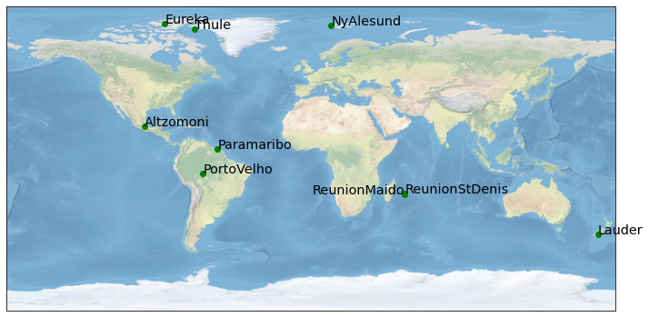
Results - Remote Sites
Station | Time Period | NH₃ mean column (molecules cm⁻²) x10¹⁵ | NH₃ sources
Eureka, Canada | 2006-2020 | 0.16 ± 0.24 | Seabirds, biomass burning
Ny-Alesund, Norway | 2017-2019 | 0.11 ± 0.12 | Seabirds, biomass burning
Thule, Greenland | 1999-2021 | 0.59 ± 0.50 | Seabirds, biomass burning
Altzomoni, Mexico | 2016 | 0.62 ± 0.72 | Biomass burning, transport
Paramaribo, Suriname | 2018-2019 | 2.90 ± 4.80 | Biomass burning, local sources
Porto Velho, Brazil | 2019 | 12.89 ± 10.81 | Fertilizers, biomass burning
St. Denis, Reunion | 2004-2011 | 1.23 ± 1.11 | Fertilizers, biomass burning
Maido, Reunion | 2013-2019 | 0.38 ± 0.28 | Fertilizers, biomass burning
Lauder, New Zealand | 1996-2022 | 3.15 ± 2.95 | Fertilizers, livestock

Slide 11
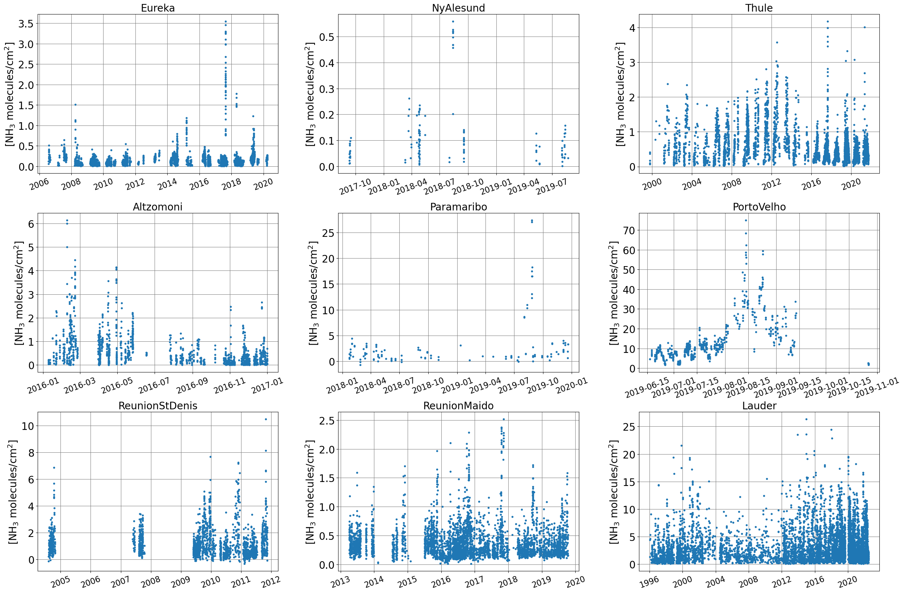
Remote - NH₃ Total Column Time Series
1e15
1e15
1e15
1e15
1e15
1e15
1e15
1e15
1e15
The largest columns are at PortoVelho station, and the smallest columns are at the Arctic stations

Slide 12
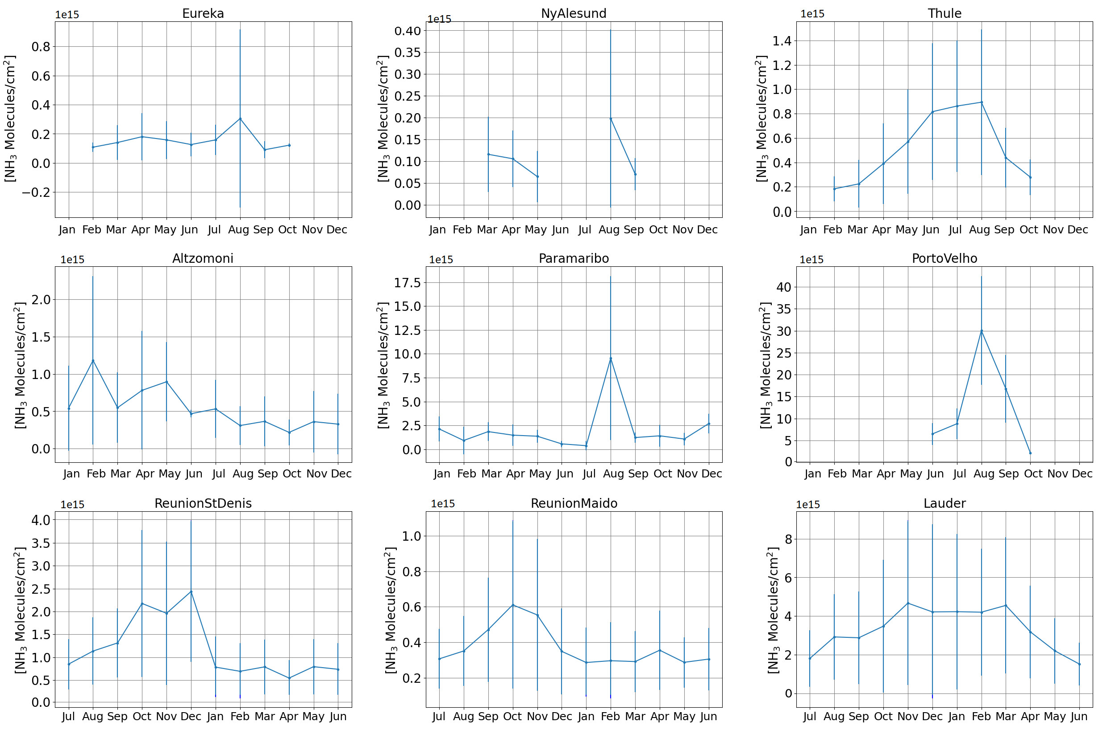
Remote - NH₃ Total Column Monthly Means
The seasonal patterns are different across both hemispheres, however, several stations showed higher values during the spring/summer season, showing the temperature dependence of NH₃

Slide 13
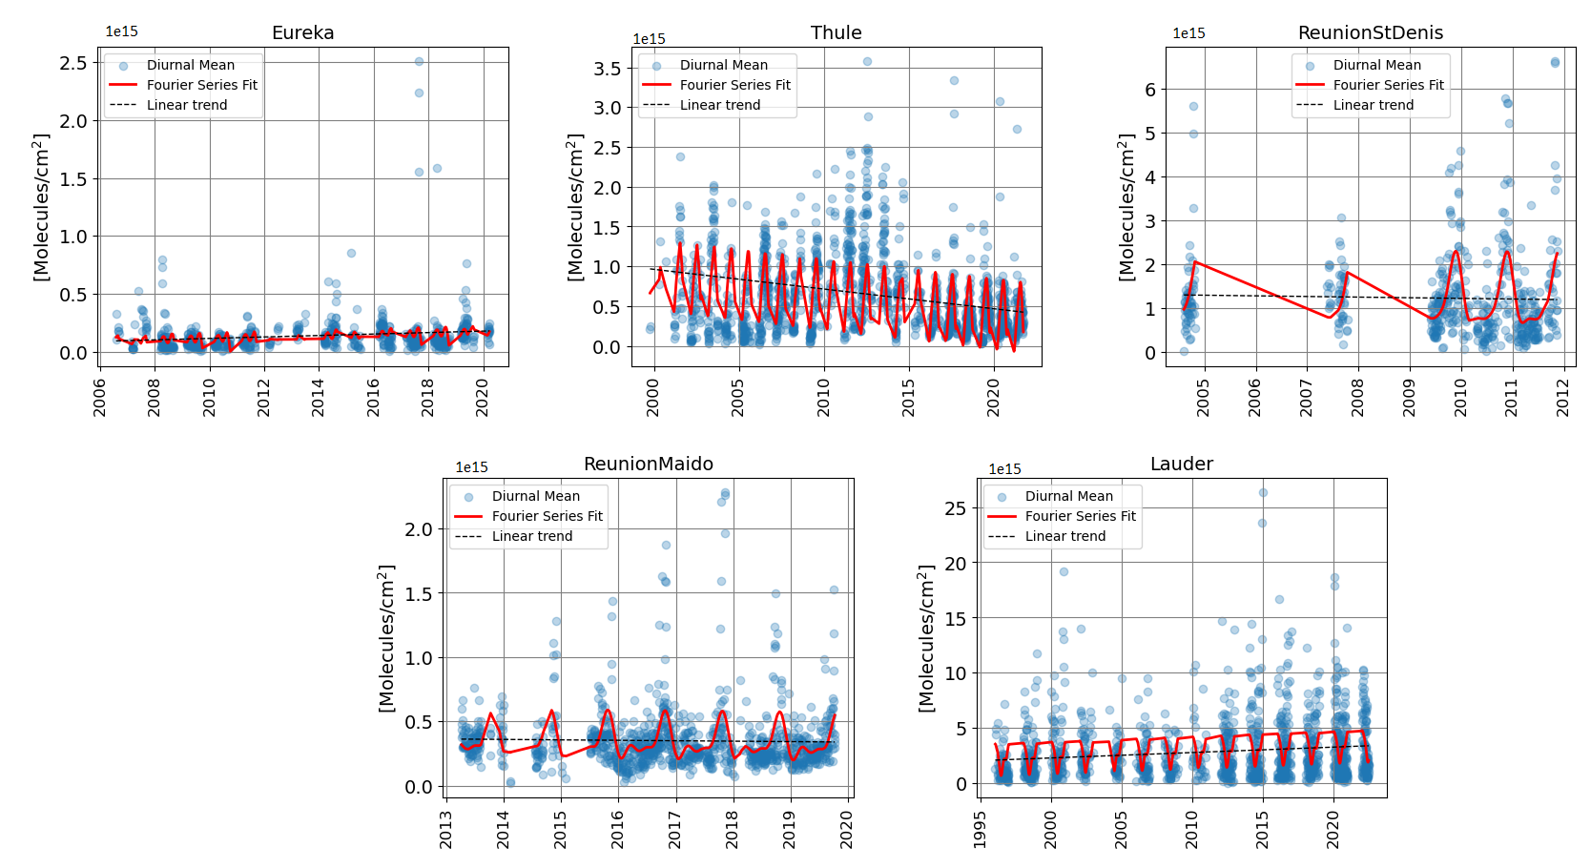
Remote Trends
1e15
1e15
1e15
1e15
1e15
NH₃-FTIR trends for the daily means (blue), fitted Fourier series (red) and linear trend (black) for remote sites. Some sites show decreasing trends

Slide 14
Remote Trends
Urban sites
Station | Time Period | FTIR NH₃ trend and 95% CI (molecules cm⁻² yr⁻¹) x10¹³
Eureka | 2006-2020 | 0.58 (0.07 - 1.01)
Thule | 1999-2021 | -2.48 (-2.92 - -2.00)
St. Denis | 2004-2011 | -1.10 (-7.36 - 5.31)
Maido | 2013-2019 | -0.45 (-1.34 - 0.35)
Lauder | 1996-2022 | 2.37 (0.86 - 3.85)
NH₃ trends for the diurnal means for the remote sites and 95 % confidence intervals. Trends indicated in bold are significant. The trends were calculated using a linear trend model and the confidence intervals were derived using bootstrap resampling (Friedrich et al. 2020)

Slide 15
Methodology – Models
GEOS-Chem High Performance (GCHP)
Global full chemistry simulation, v14.1.1
2003 to 2021
C48 resolution (‘cubed-sphere’ grid, ~2° x 2.5°)
Tropospheric Chemistry Reanalysis (TCR-2) Miroc
Global NH₃ 3D product based on the MIROC-CHASER model
2005 to 2017
1.1° x 1.1° horizontal resolution

Slide 16
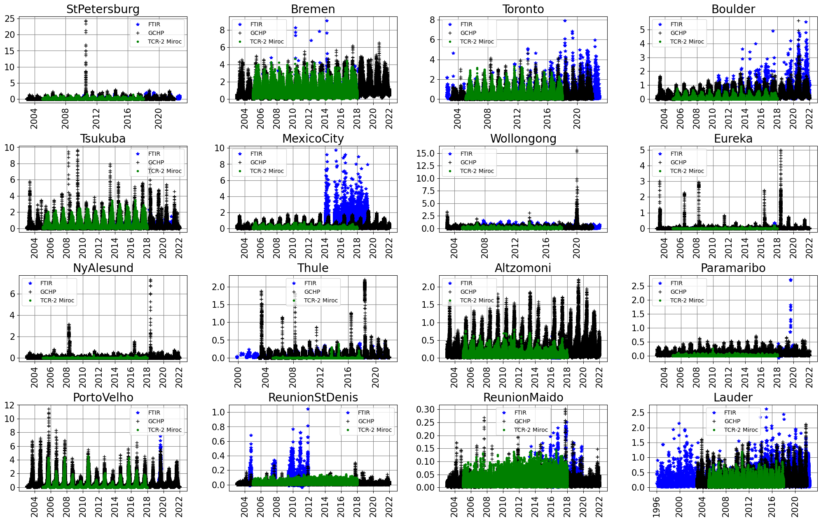

TCR-2 vs FTIR vs GCHP NH₃ Total Column Time Series
1e16
1e16
1e16
1e16
1e16
1e16
1e16
1e16
1e16
1e16
1e16
1e16
1e16
1e16
1e16
1e16
GCHP and TRC-2 Miroc time series compared with FTIR.

Slide 17
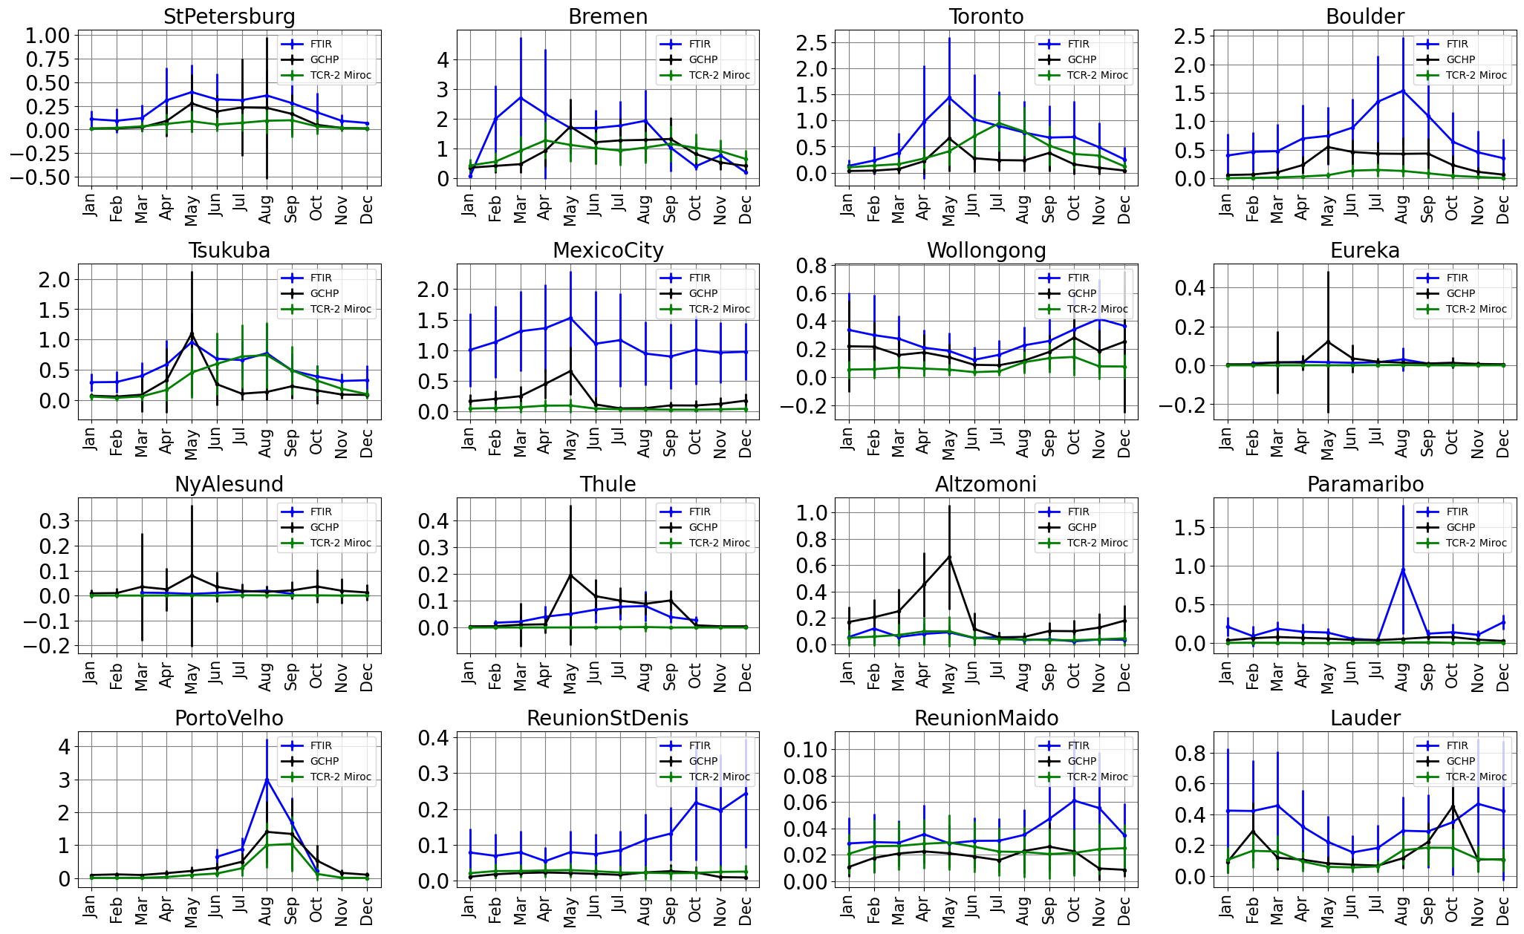
TCR-2 vs FTIR NH₃ vs GCHP Total Column Monthly Means
1e16
1e16
1e16
1e16
1e16
1e16
1e16
1e16
1e16
1e16
1e16
1e16
1e16
1e16
1e16
1e16
GCHP and TCR-2 Miroc seasonal patterns compared with FTIR.

Slide 18
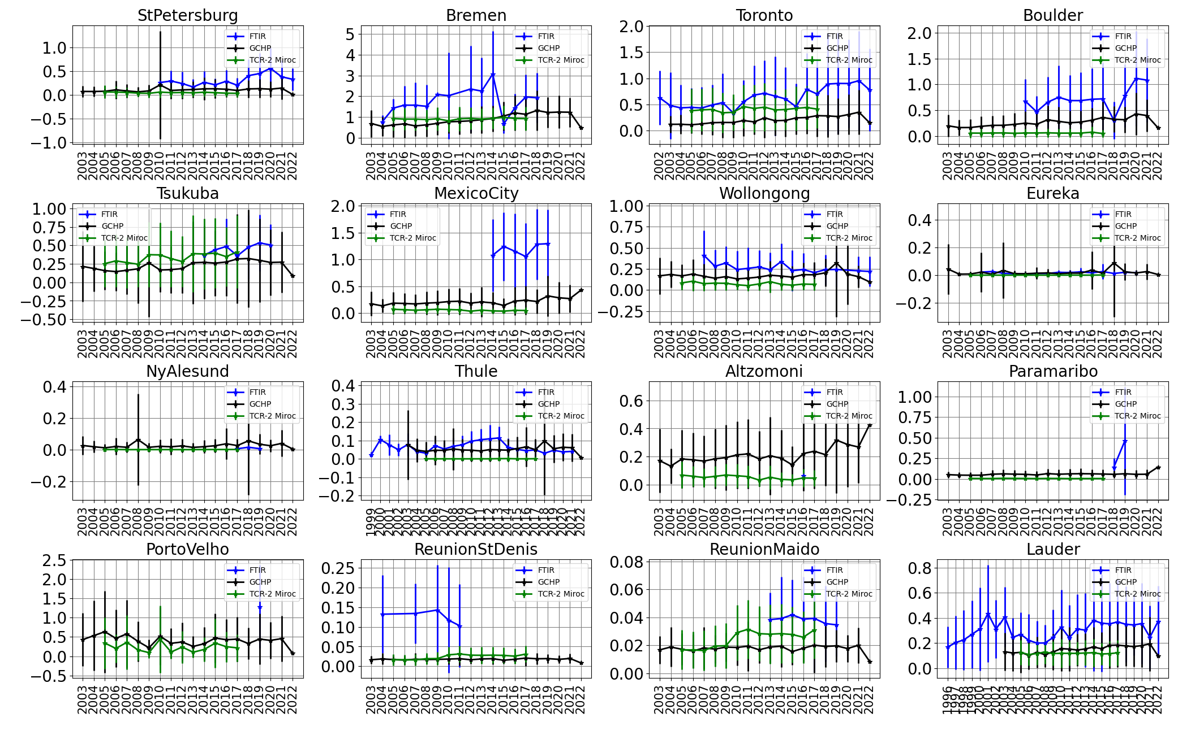
TCR-2 vs FTIR NH₃ vs GCHP Total Column Annual Means
1e16
1e16
1e16
1e16
1e16
1e16
1e16
1e16
1e16
1e16
1e16
1e16
1e16
1e16
1e16
1e16
GCHP and TCR-2 Miroc annual means compared with FTIR.

Slide 19
Urban Trends Comparison
Urban sites
Station | Time Period | FTIR NH₃ trend and 95% CI (molecules cm⁻² yr⁻¹) x10¹⁴ | GCHP NH₃ trend and 95% CI (molecules cm⁻² yr⁻¹)x10¹⁴ | TCR-2 NH₃ trend and 95% CI (molecules cm⁻² yr⁻¹)x10¹⁴
St. Petersburg | 2010-2022 | 1.17 (0.31 – 1.90) | 0.94 (0.07 – 1.82) | -0.71 (-1.19 – -0.22 )
Bremen | 2004-2018 | 2.82 (-0.71 – 6.47) | 4.36 (1.38 – 7.11) | -1.51 (-3.53 – 0.52)
Toronto | 2002-2022 | 2.54 (1.92 – 3.11) | 1.22 (1.05 – 1.41) | 0.70 (0.09 – 1.33)
Boulder | 2010-2021 | 4.53 (3.09 – 5.88) | 1.83 (1.19 – 2.47) | 0.15 (-0.28 – 0.57)
Tsukuba | 2014-2020 | 1.61 (-0.06 – 3.31) | 3.16 (0.64 – 5.86) | 1.76 (-1.01 – 4.64)
Mexico City | 2014-2019 | 4.41 (1.64 – 6.97) | 1.97 (0.58 – 3.46) | 0.72 (0.12 – 1.38)
Wollongong | 2007-2022 | -0.38 (-0.73 – -0.002) | 0.35 (0.13 – 0.59) | -0.03 (-0.26 – 0.19)
NH₃ trends for the diurnal means for the urban sites and 95 % confidence intervals (CI). Trends indicated in bold are significant. The confidence intervals were derived using bootstrap resampling (Friedrich et al. 2020)

Slide 20
Remote Trends Comparison
Urban sites
Station | Time Period | FTIR NH₃ trend and 95% CI (molecules cm⁻² yr⁻¹) x10¹³ | GCHP NH₃ trend and 95% CI (molecules cm⁻² yr⁻¹)x10¹³ | TCR-2 NH₃ trend and 95% CI (molecules cm⁻² yr⁻¹)x10¹³
Eureka | 2006-2020 | 0.58 (0.07 – 1.01) | 5.17 (-1.59 – 12.4) | 0.18 (-0.10 – 0.44)
Thule | 1999-2021 | -2.48 (-2.92 – -2.00) | 1.25 (-1.01 – 3.43) | 0.13 (-0.02 – 0.28)
St. Denis | 2004-2011 | -1.10 (-7.36 – 5.31) | 0.97 (-0.46 – 2.27) | 4.77 (2.82 – 6.56)
Maido | 2013-2019 | -0.45 (-1.34 – 0.35) | 0.53 (0.09 – 0.98) | 1.96 (0.51 – 3.51)
Lauder | 1996-2022 | 2.37 (0.86 – 3.85) | 3.76 (2.34 – 5.19) | 0.72 (-0.77 – 0.21)
NH₃ trends for the diurnal means for the remote sites and 95 % confidence intervals. Trends indicated in bold are significant. The trends were calculated using a linear trend model and the confidence intervals were derived using bootstrap resampling (Friedrich et al. 2020)

Slide 21
Conclusions
Temporal variability of NH₃ over sixteen sites using ground-based solar absorption FTIR measurements
Mainly positive trends at urban sites (average of 2.38x10¹⁴ molecules cm⁻²) and positive and negative trends at remote sites (average of -2.38x10¹³ molecules cm⁻²) Most of them in agreement with IASI satellite trends
The drivers behind this trends depend on each site. NH₃ lifetime is affected by changes in sources and sinks (changes in NOx and SO₂ concentrations, meteorological conditions)
GCHP exhibited generally a good agreement with a MRD of -38% for urban sites and 77% for remote sites. The GCHP matching trends are in average -32% smaller than FTIR for urban sites and 58% bigger for remote sites. The overall GCHP trends are 1.23x10¹⁴ molecules cm⁻² at urban sites and 1.02x10¹³ molecules cm⁻² at remote sites
TCR-2 Miroc product underestimated NH₃ with a MRD of -61% for urban sites and -38% for remote sites. The TCR-2 matching trends are in average -92% smaller than FTIR for urban sites and -260% for remote sites. The overall TCR-2 trends are 0.20x10¹⁴ molecules cm⁻² at urban sites and -0.40x10¹³ molecules cm⁻² at remote sites
Looking for more FTIR sites!

Slide 22



Acknowledgements
Marina Friedrich (Trendfit)
References
Bey, I., Jacob, D. J., Yantosca, R. M., Logan, J. A., Field, B. D., Fiore, A. M., Li, Q., Liu, H. Y., Mickley, L. J., and Schultz, M. G.: Global modeling of tropospheric chemistry with assimilated meteorology: Model description and evaluation, J. Geophys. Res. Atmos., 106, 23073–23095, https://doi.org/10.1029/2001JD000807, 2001.
Friedrich, M., Beutner, E., Reuvers, H., Smeekes, S., Urbain, J. P., Bader, W., Franco, B., Lejeune, B., and Mahieu, E.: A statistical analysis of time trends in atmospheric ethane, Clim. Change, 162, 105–125, https://doi.org/10.1007/s10584-020-02806-2, 2020.
Hase, F., Hannigan, J. W., Coffey, M. T., Goldman, A., Höpfner, M., Jones, N. B., Rinsland, C. P., and Wood, S. W.: Intercomparison of retrieval codes used for the analysis of high-resolution, ground-based FTIR measurements, J. Quant. Spectrosc. Radiat. Transf., 87, 25–52, https://doi.org/10.1016/j.jqsrt.2003.12.008, 2004.
Khan, M. A. H., Lowe, D., Derwent, R. G., Foulds, A., Chhantyal-Pun, R., McFiggans, G., Orr-Ewing, A. J., Percival, C. J., and Shallcross, D. E.: Global and regional model simulations of atmospheric ammonia, Atmos. Res., 234, 104702, https://doi.org/10.1016/j.atmosres.2019.104702, 2020.
De Mazière, M., Thompson, A. M., Kurylo, M. J., Wild, J. D., Bernhard, G., Blumenstock, T., Braathen, G. O., Hannigan, J. W., Lambert, J. C., Leblanc, T., McGee, T. J., Nedoluha, G., Petropavlovskikh, I., Seckmeyer, G., Simon, P. C., Steinbrecht, W., and Strahan, S. E.: The Network for the Detection of Atmospheric Composition Change (NDACC): History, status and perspectives, Atmos. Chem. Phys., 18, 4935–4964, https://doi.org/10.5194/acp-18-4935-2018, 2018.
Miyazaki, K., Bowman, K., Sekiya, T., Eskes, H., Boersma, F., Worden, H., Livesey, N., H. Payne, V., Sudo, K., Kanaya, Y., Takigawa, M., and Ogochi, K.: Updated tropospheric chemistry reanalysis and emission estimates, TCR-2, for 2005-2018, Earth Syst. Sci. Data, 12, 2223–2259, https://doi.org/10.5194/essd-12-2223-2020, 2020.
Van Damme, M., Clarisse, L., Franco, B., Sutton, M. A., Erisman, J. W., Wichink Kruit, R., Van Zanten, M., Whitburn, S., Hadji-Lazaro, J., Hurtmans, D., Clerbaux, C., & Coheur, P. F. Global, regional and national trends of atmospheric ammonia derived from a decadal (2008-2018) satellite record. Environmental Research Letters, 16(5), 055017. https://doi.org/10.1088/1748-9326/abd5e0, 2021.

Slide 23
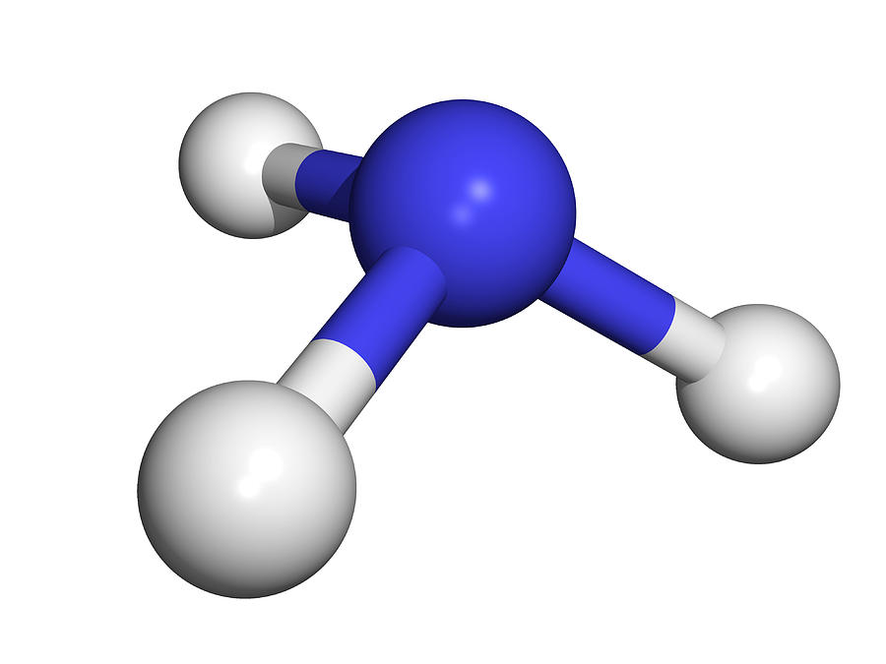
Questions?
Thank you for your attention!
beatriz.herrera@mail.utoronto.ca

