Slide 1
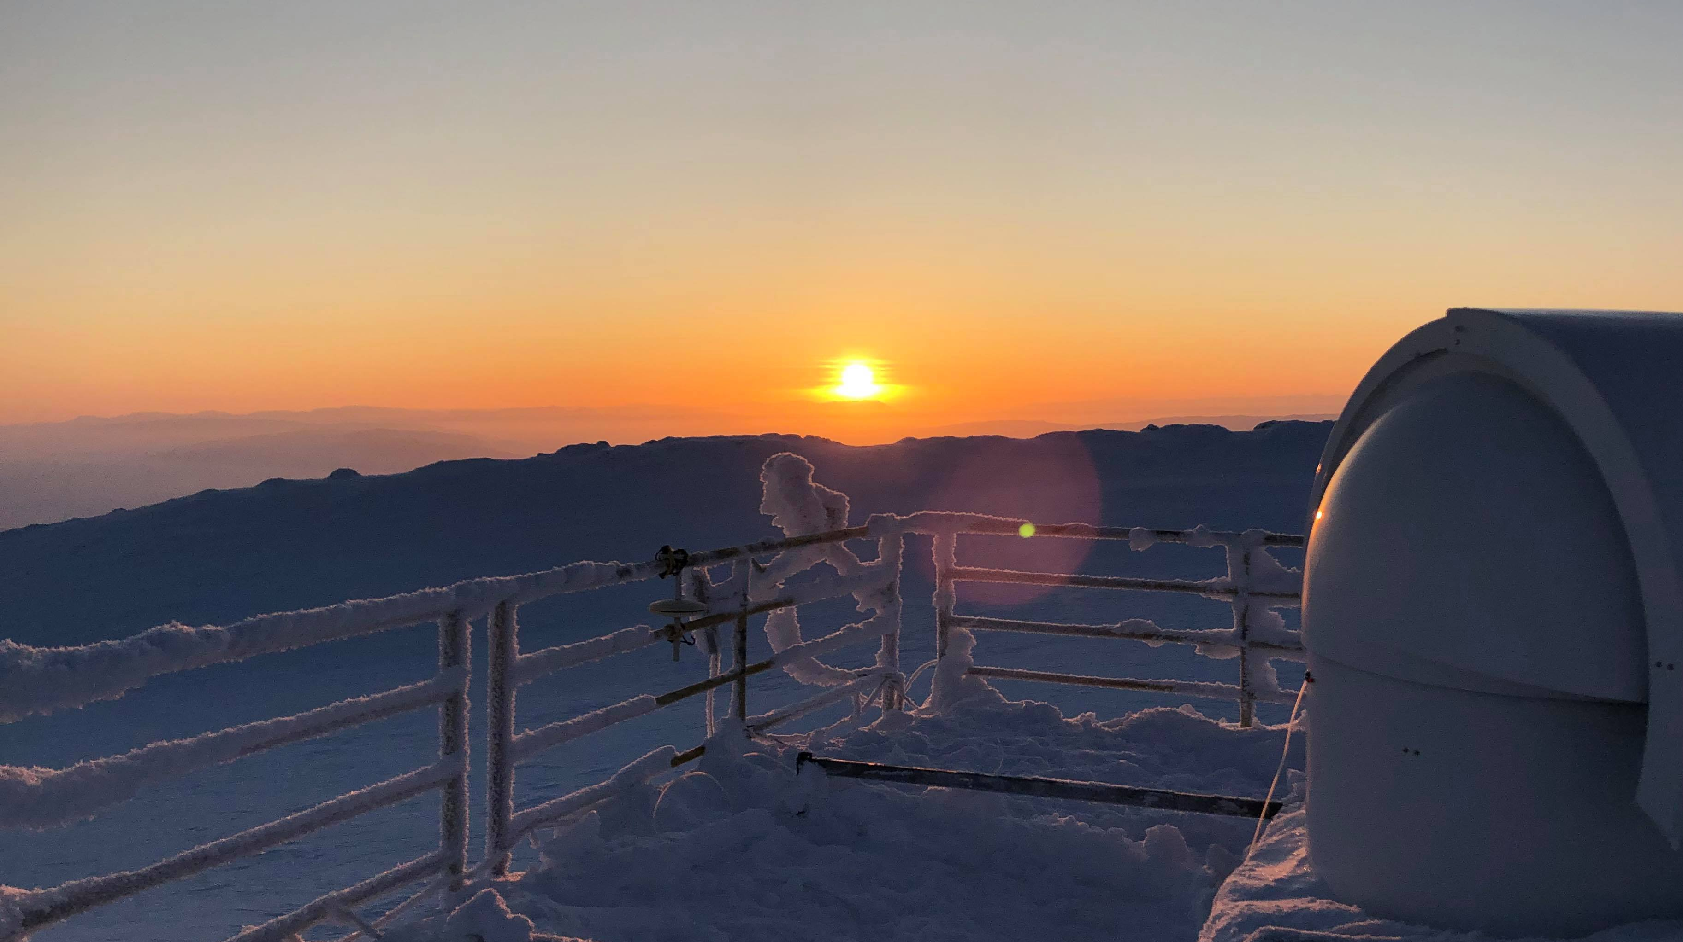
Evaluating modelled tropospheric columns of CH₄, CO and O₃ in the Arctic using ground-based FTIR measurements
Presented By : Victoria Flood
Department of Physics, University of Toronto
v.flood@utoronto.ca
(she/her)
Kimberly Strong, Cynthia H. Whaley, Kaley A. Walker,
T. Blumenstock, J.W. Hannigan, J. Mellqvist, J. Notholt, M. Palm, A.N. Röhling
& the AMAP SLCF Modelling Team
Notes:
the solar tracker dome at the PEARL lab in eureka Nunavut

Slide 2
Motivation & Objectives
Short-Lived Climate Forcers
  Also known as short-lived climate pollutants or near-term climate forcers
  Have lifetimes less than 2 decades
  Have accelerated climate impacts
    Additionally, negative impacts on air quality, ecosystems and human health
Model – Measurement Comparisons
Assess how well the chosen models reflect historical ground-truth measurements
Utilize long-term trace gas datasets for comparisons
  Historical measurements from five high-latitude NDACC FTIR stations
  11 models as selected by the 2021 AMAP SLCF Assessment Report
  CH₄, CO, and O₃
High-Latitude Measurements
The Arctic is warming at 3-4x the global average
Measurement stations are sparse due to remote locations, harsh environments and increased costs
Long-term datasets are key in monitoring atmospheric changes and trends

Slide 3
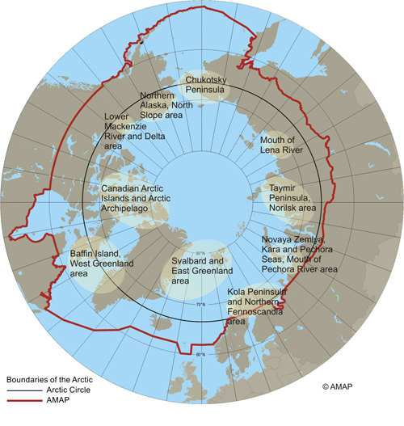
AMAP
Arctic Monitoring & Assessment Program
Aims to :
  Monitor pollution and climate change impacting the Arctic regions
  Assess the impact of these on the local ecosystems and human health
  Provide science-based reports for policy and sustainable development
2021 SLCF Assessment Report :
  Assesses impacts of SLCFs on Arctic Region
    Comparing 18 models with historical measurements (e.g. satellite, aircraft, ship and in situ)
  Examines effects of possible emission scenarios
  Emphasis on air quality and human health
[source: AMAP]
Notes:
Where relevant to its assessment activities, AMAP's work extends beyond the Arctic to address global connections associated with long-range transport of contaminants, and global climate linkages.

Slide 4



SLCF 2021 Report :
Key Findings for Policy Makers
Reductions of SLCFs can have short term benefits (20-30 years)
SLCF mitigation can help prevent premature deaths from air pollution
A warming Arctic climate will result in an increase of wildfires, leading to further black carbon and organic carbon
Notes:
A few of the key findings presented in the report for policy makers , short 20 pages highlighting findings of the unreleased full report, used as a call to action for policy makers to implement legislations “timely and effectively”

Slide 5
Benefits of using NDACC Ground-Based FTIR Spectroscopy
Wide range of species measured
High spectral resolution
Multiple sites
Data available publicly
Notes:
And can measure multiple species at once
Consistency across the network , and multiple arctic sites
Project may be extended to other FTIR locations

Slide 6
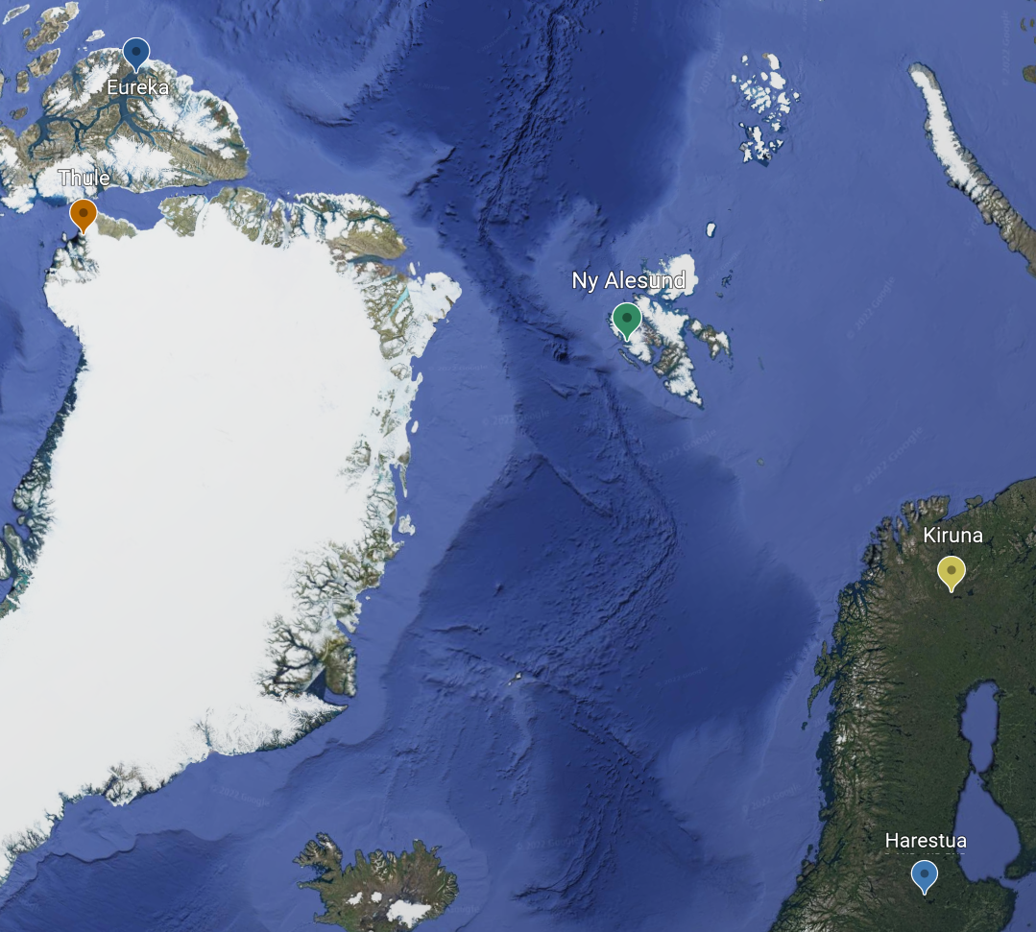
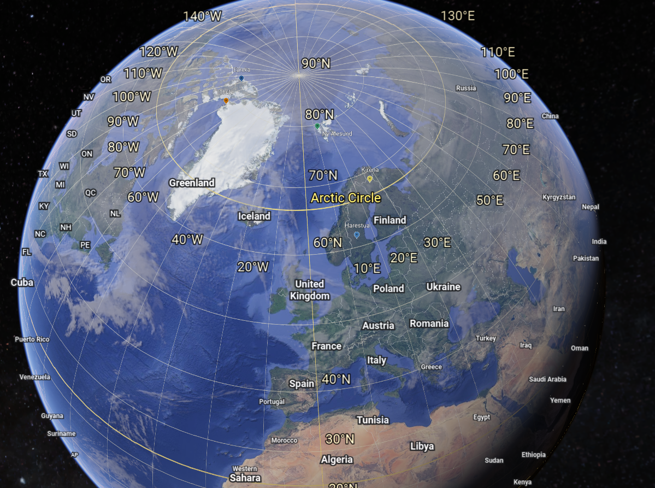
High- Latitude NDACC FTIR Locations
[source: Google Earth]
Notes:
Dark green upper left Eureka in Nunavut Canada
Below that thule in Greenland in bright green
To the right of that in turquoise is ny alesund in Norway
Below that in blue is kiruna in Sweden
And just outside the arctic circle below that in purple is harestua in norway

Slide 7
Model-Measurement Comparisons
Model
- All use the same anthropogenic emissions
- Differing grids, gas-phase chemistry,
biogenic/volcanic emissions …
- Pressure profiles of Volume Mixing Ratios (VMR)
FTIR
- 3-hour intervals
- Single location
- layered pressure grid
- Columns in molecules / cm²
- Various times during sunlit portion of day and year

Slide 8
The
Setup
11 Models
  2008, 2009, 2014, 2015
  CH₄, CO, O₃
  CESM, CMAM, DEHM, EMEP-MSC-W, GEM-MACH, GEOS-Chem, MATCH, MATCH-SALSA, MRI-ESM2, UKESM1 and WRF-Chem
Observatory Location
  Extract model outputs at FTIR locations
Match times
  Match each FTIR measurement to the nearest model time
Align model with FTIR
  Interpolate model profile to FTIR pressure grid
  Make partial columns in molec/cm²
  Smooth model by FTIR AVK
Plot & Compare

Slide 9
Analysis
For SLCFs CH₄ and O₃, and SLCF precursor CO
For a 0-7km partial column
  Chosen as the study is focused on the troposphere
Showing primary examples for Eureka, Canada
1:1
Regression analysis
Seasonal cycle overlay
See when model may be misrepresenting data
Relative difference
See extent they differ
Multi-Model Mean
See where models are differing in general

Slide 10

Methane

Slide 11
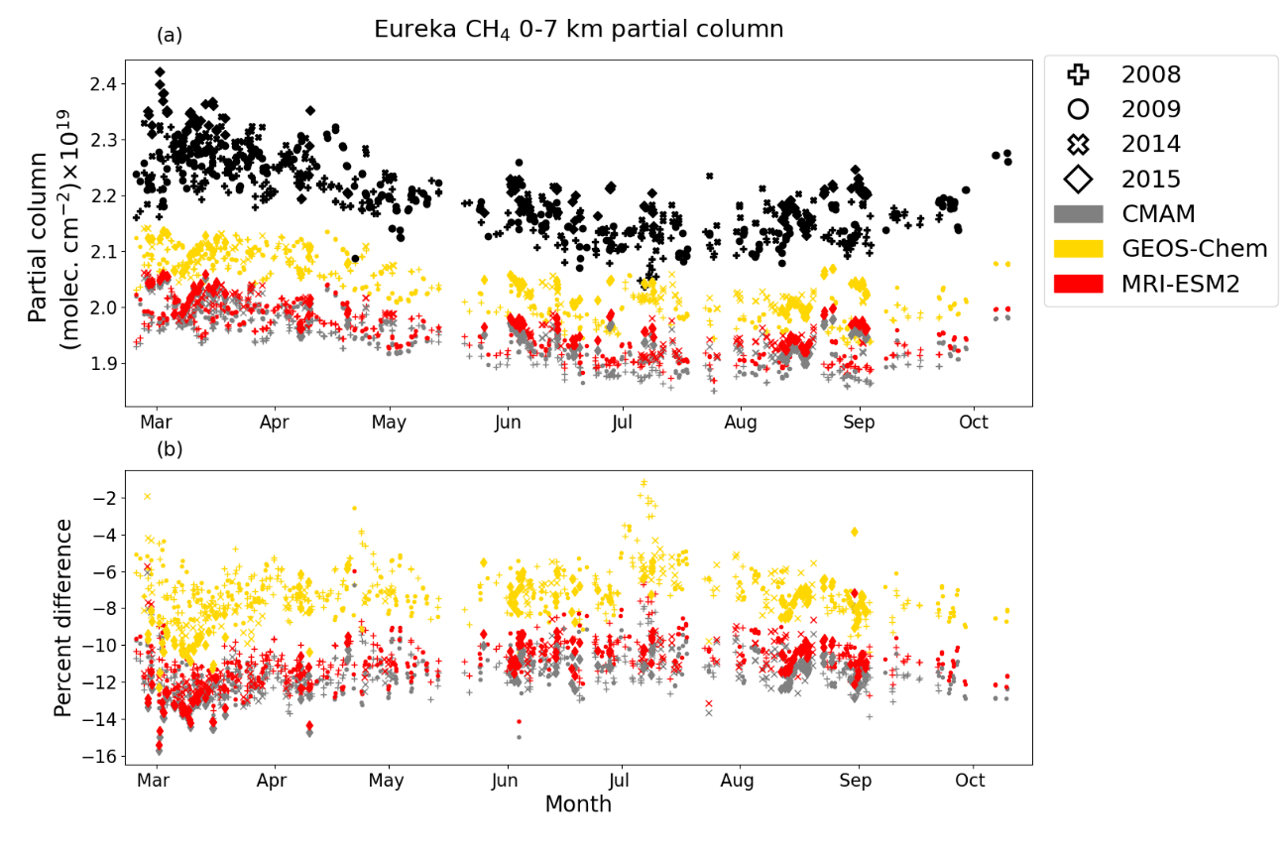
CH₄
Seasonal cycle – all points
Important GHG
  Expected to increase with melting permafrost
Only simulated by 3 of the 11 models
Surface concentrations were prescribed in the models
Captures seasonal cycle, amplitude is underestimated

Slide 12
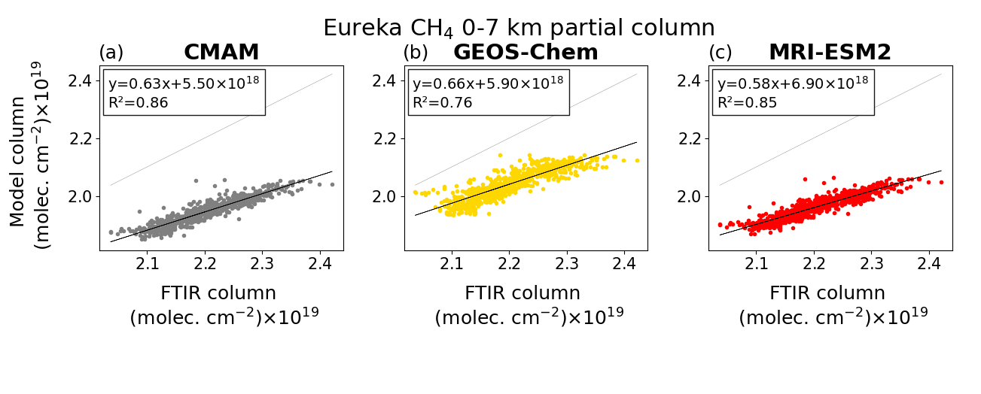
CH₄
1:1 Ratio – all points
Demonstrates consistently underpredicted

Slide 13
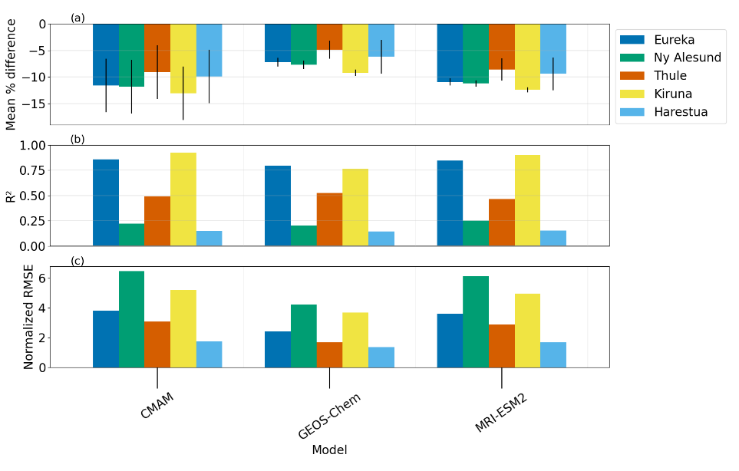
CH₄
Summary Stats – all locations
Relatively consistent mean percent difference for each model across locations
Decrease for some R² likely due to less measurements

Slide 14
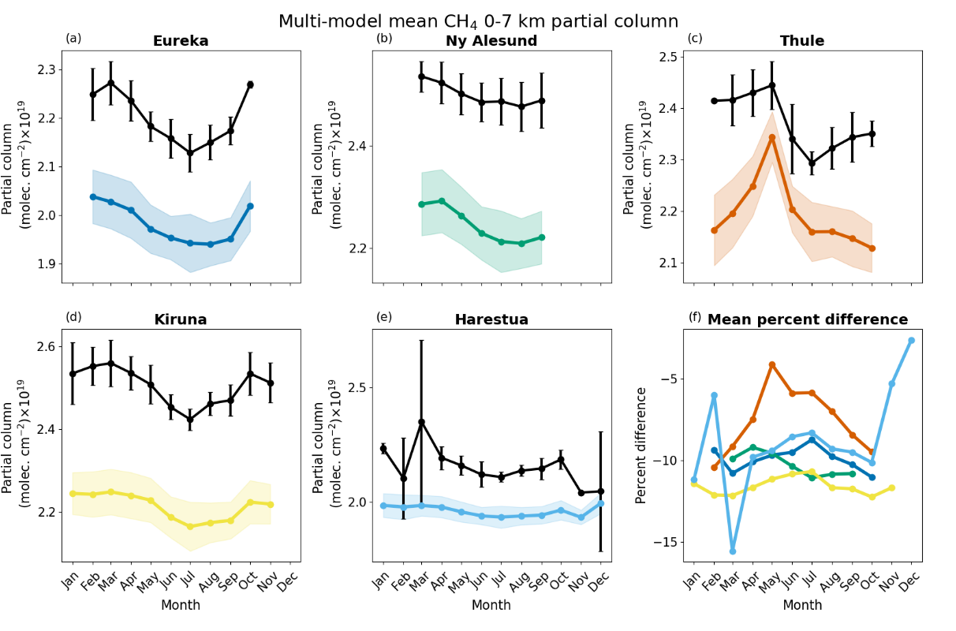
CH₄
Multi-Model Monthly Mean
– all locations
Demonstrates consistently underpredicted
  Between -5 and -15 % difference
Low bias also found around the tropopause when models are compared with ACE-FTS [Whaley et al., 2022]
Notes:
upper-troposphere/lower-stratosphere

Slide 15
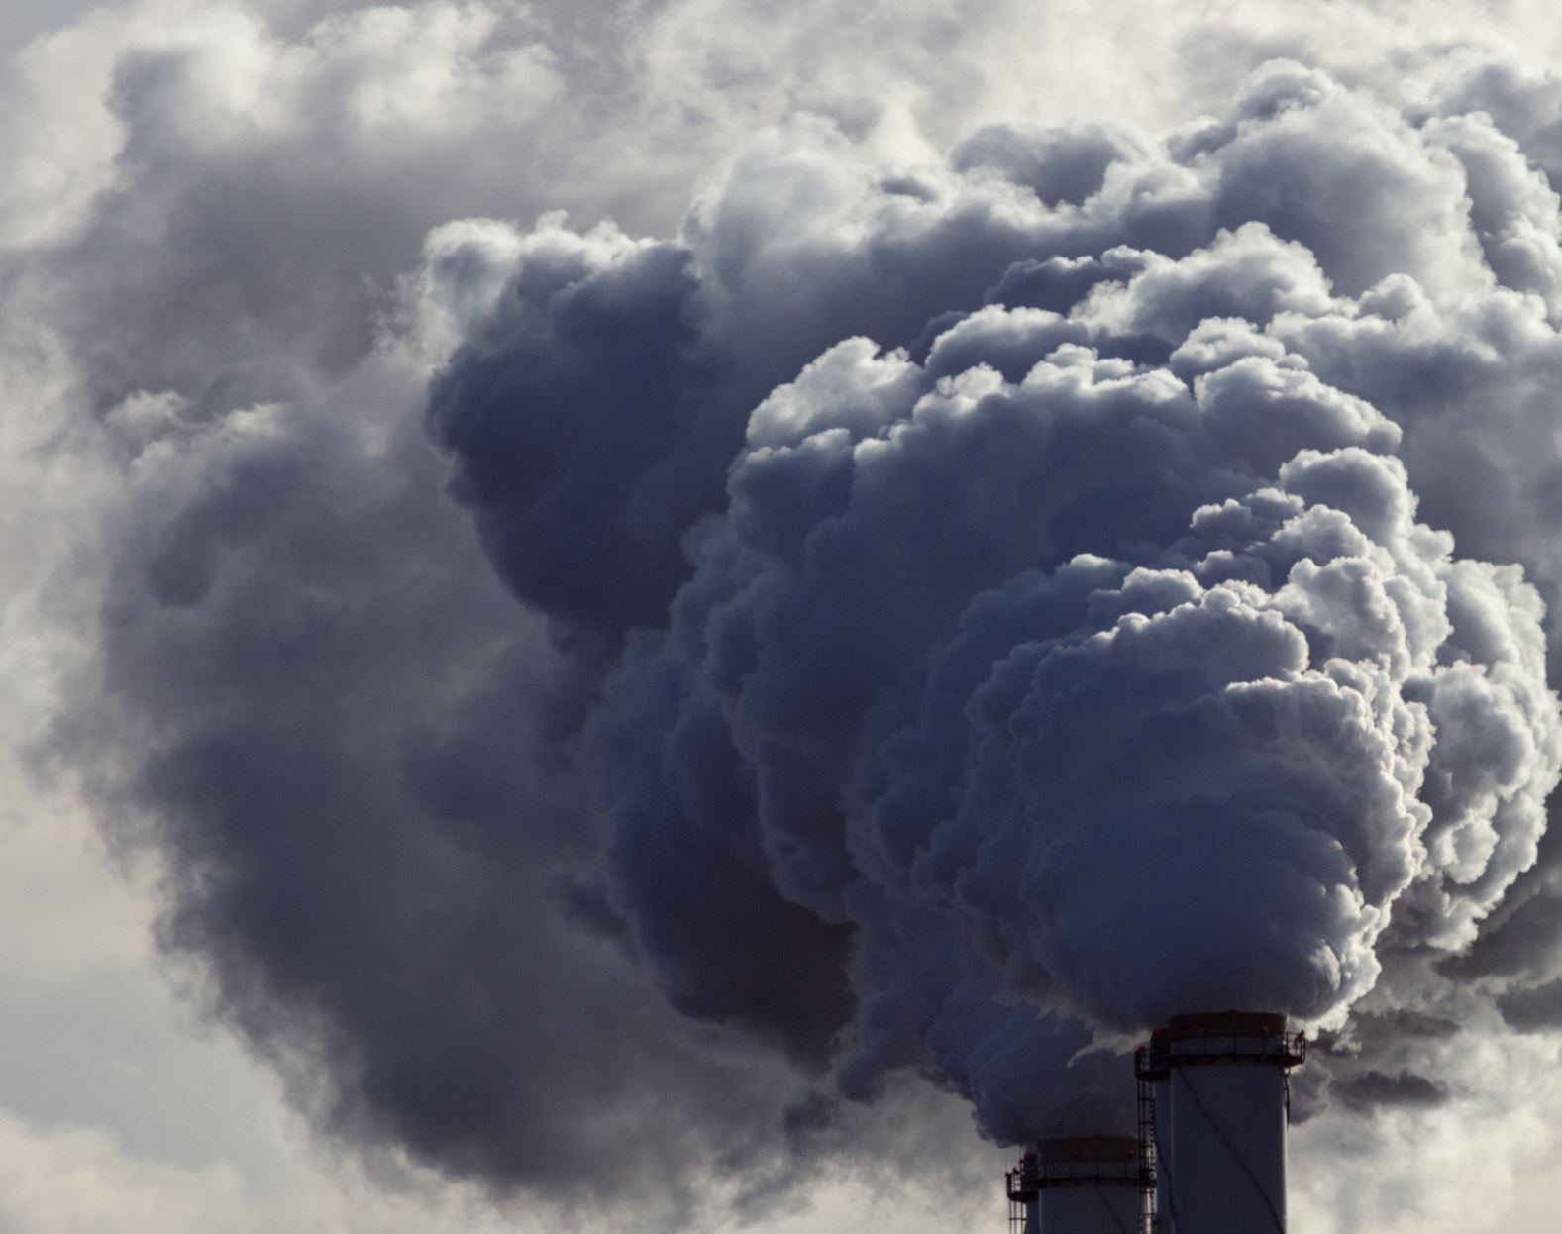
Carbon Monoxide

Slide 16
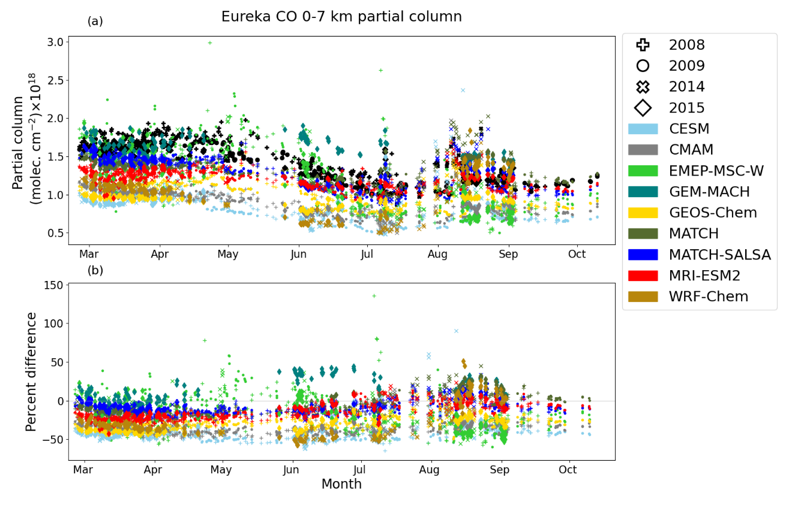
CO
Seasonal cycle – all points
Important for simulation of O₃
Tracer for biomass burning and lower latitude anthropogenic emissions
9 of 11 models simulate
Evidence of biomass burning events seen in the summer months
  7 of 9 models use the same fire emissions inventory

Slide 17
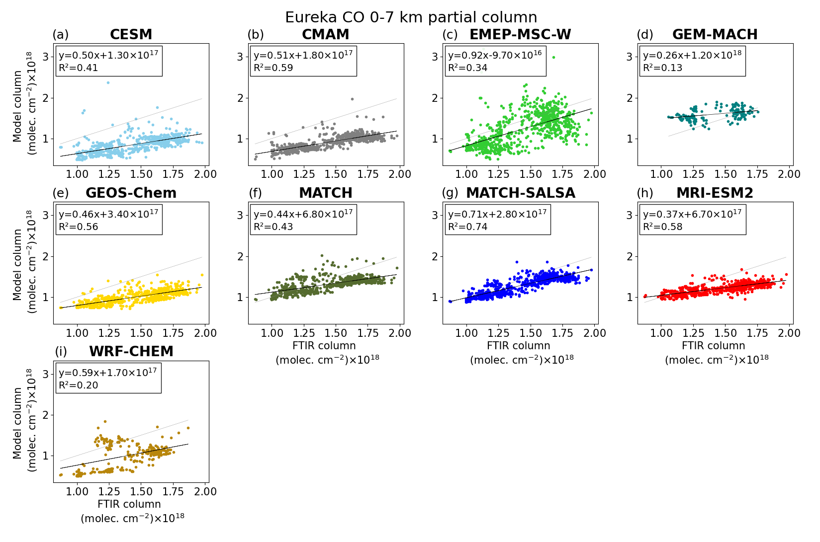
CO
1:1 Ratio – all points
Models have better agreement with low CO values, increasing in difference as CO increases
  Corresponding to an underprediction in the spring peak

Slide 18
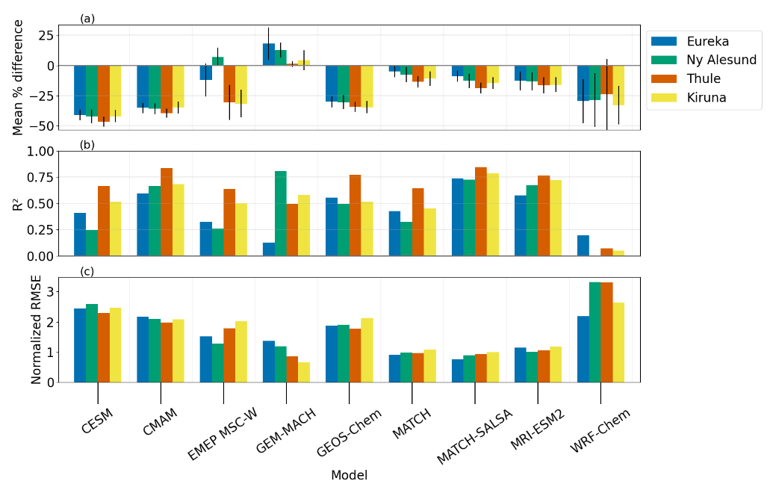
CO
Summary Stats – all locations
All negative bias except GEM-MACH and EMEP-MSC W (Ny Ålesund)
Biases range from +18 to -45%
MATCH-SALSA & MRI-ESM2 have high R2 and low percent difference, but the results are not within the FTIR’s partial column uncertainties

Slide 19
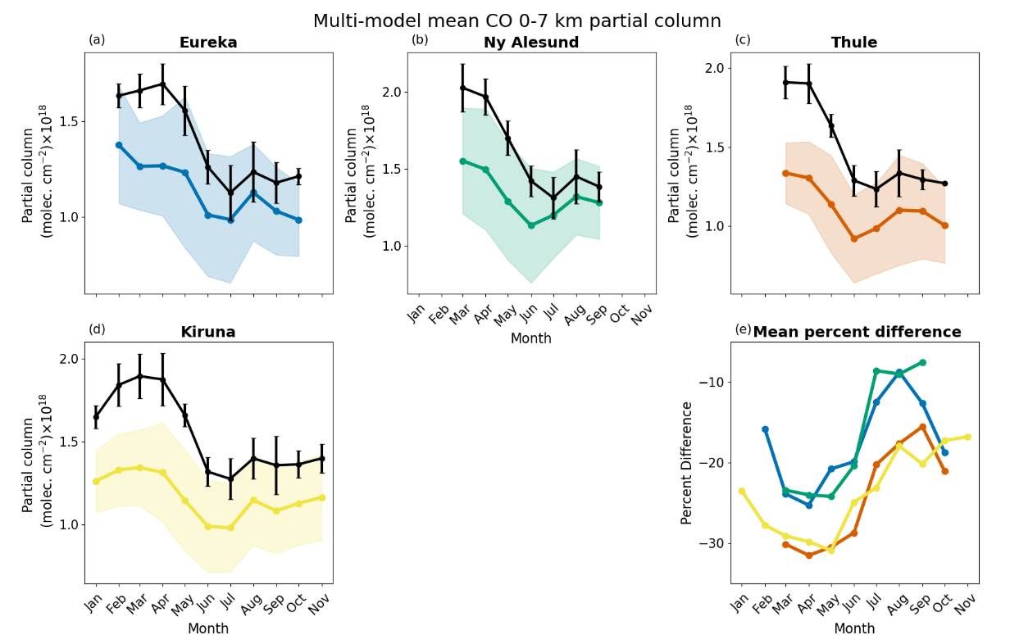
CO
Multi-Model Monthly Mean
– all locations
Mean percent difference (bottom right) shows all models, in all locations tend to underpredict more in spring than summer
  Similar result observed by other Arctic model comparison studies [e.g. Emmons et al., 2015; Whaley et al., 2022/2023]
  May be due to underestimation in emission fluxes

Slide 20
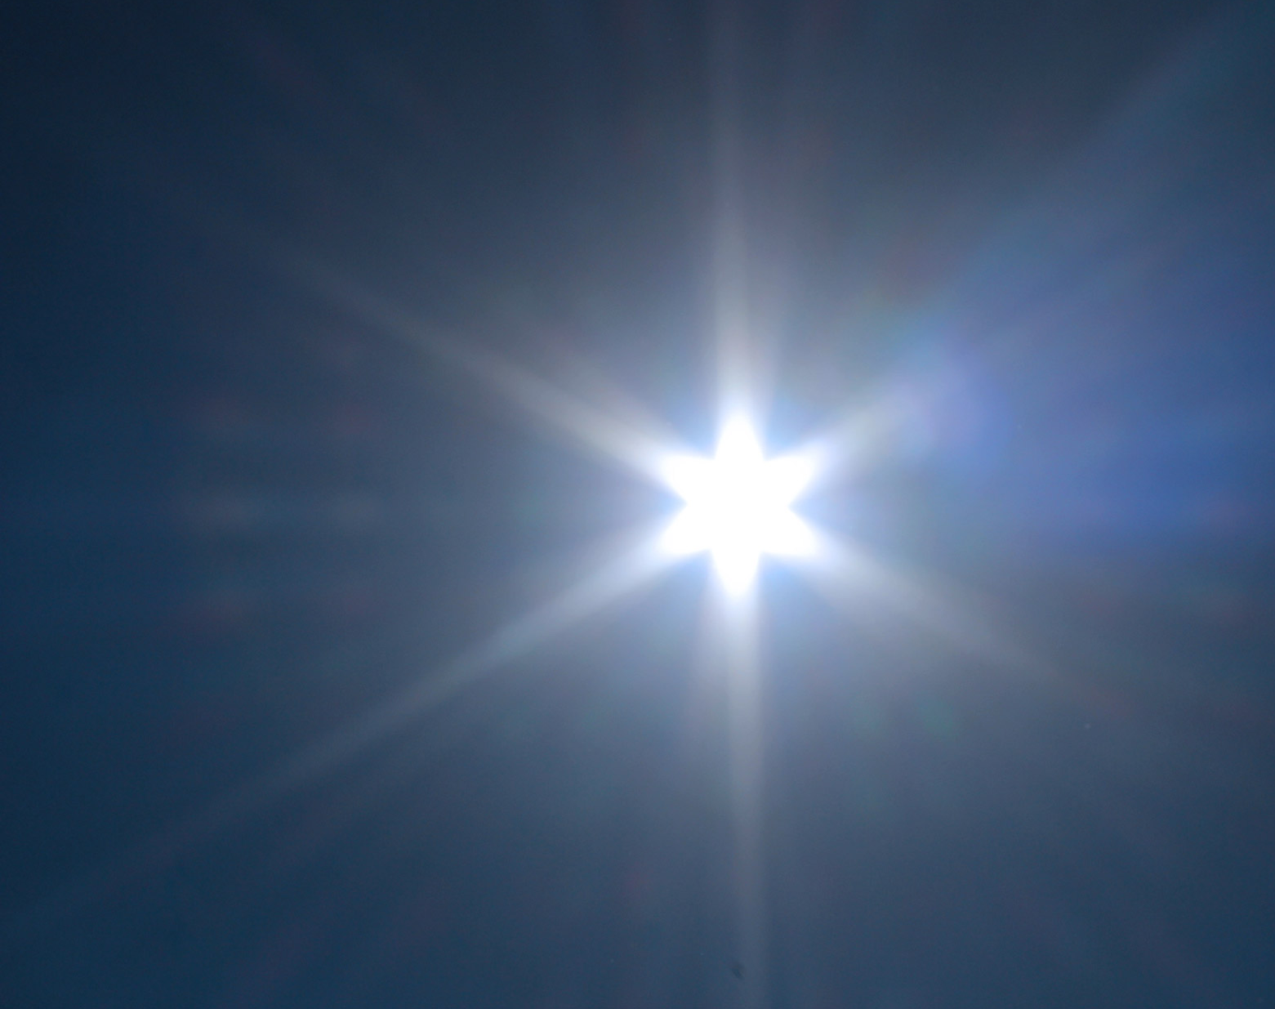
Ozone

Slide 21
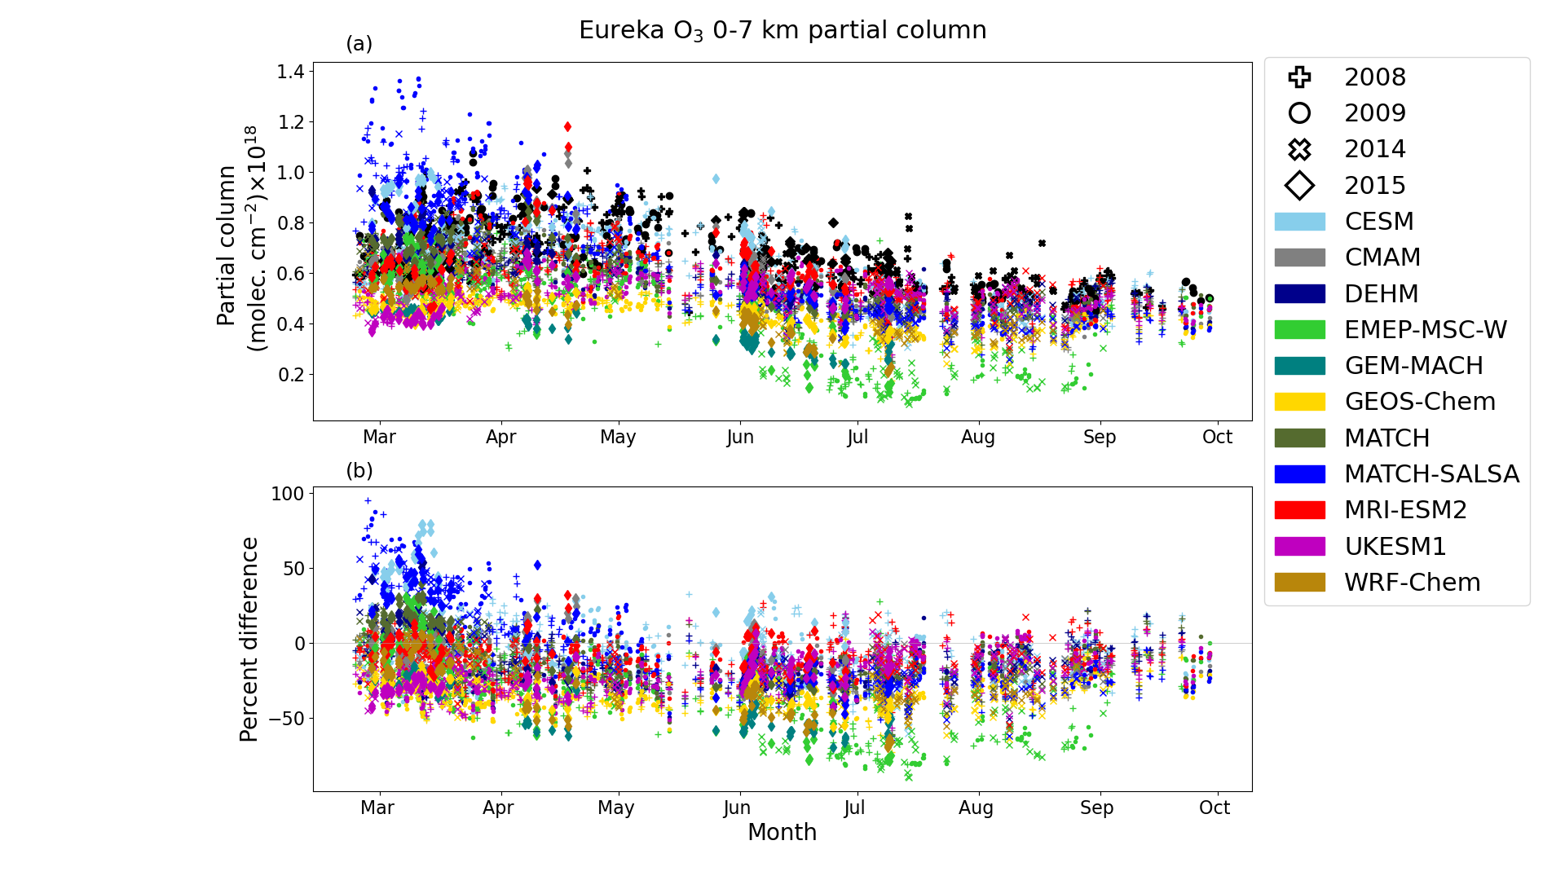
O₃
Seasonal cycle – monthly mean
Significant GHG and air pollutant
Secondary pollutant
  adds to difficulty in modelling
All 11 models used simulate O₃
Large variations between models and within model across the year

Slide 22
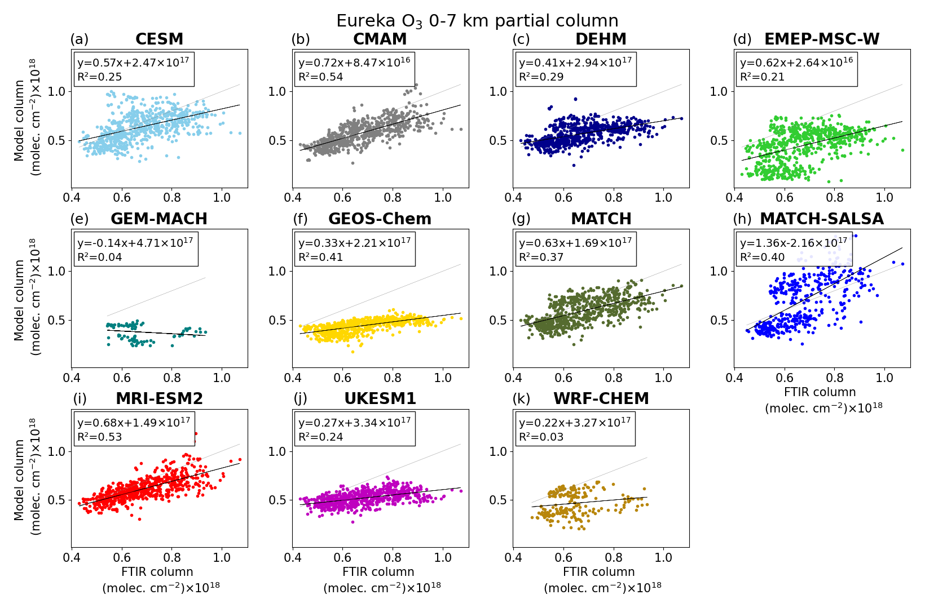
O₃
1:1 Ratio – all points
Models have better agreement with lower O₃ values than higher
  Similar to CO
Could be related to :
  underestimation in precursor species
  Lack of long-range transport
  Underestimation of ozone production in air masses

Slide 23
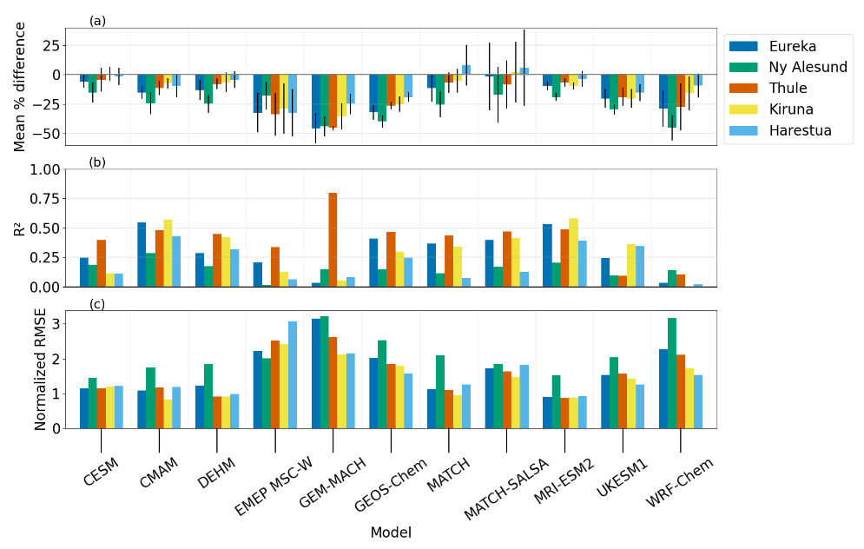
O₃
Summary Stats – all locations
Generally, negative bias and R²< 0.5
  Mean percent difference ranging from +8% to -45%
Models with a larger percent difference also have weaker correlations and higher NRMSEs
Level of chemistry and resolution did not advantage models
Notes:
For example, WRF-Chem, EMEP MSC-W and GEM-MACH show a low R² and higher NRMSEs (varying between sites and models). These models have detailed chemistry and were run at higher spatial resolutions, whereas for example CMAM has a coarser resolution with simplified chemistry and demonstrates larger R² and smaller mean percent differences

Slide 24
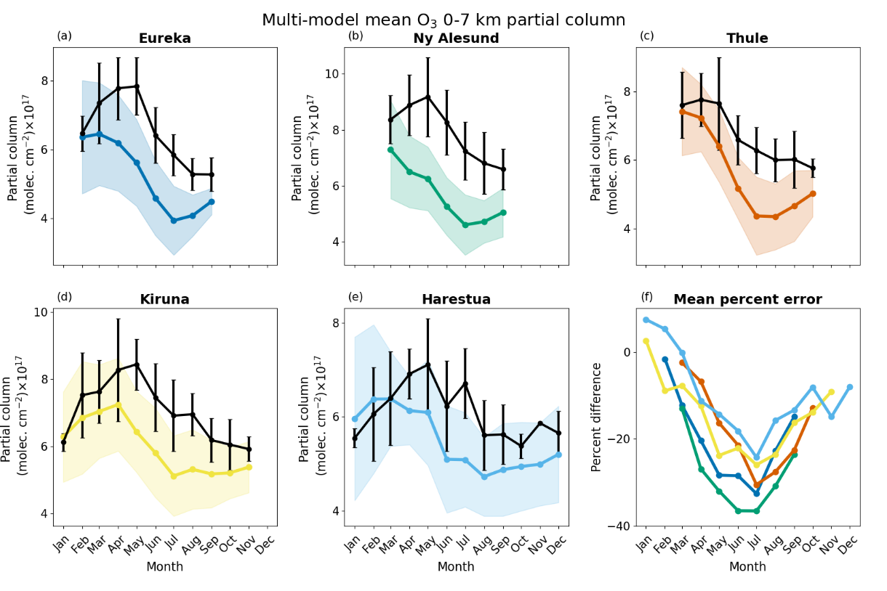
O₃
Multi-Model Monthly Mean
– all locations
Maximum mean percent difference centered around the summer for all locations
Other Arctic model comparison studies report negative biases when comparing with aircraft, satellites, FTIR and ozonesondes [Wespes et al., 2012; Whaley et al., 2022/2023]

Slide 25
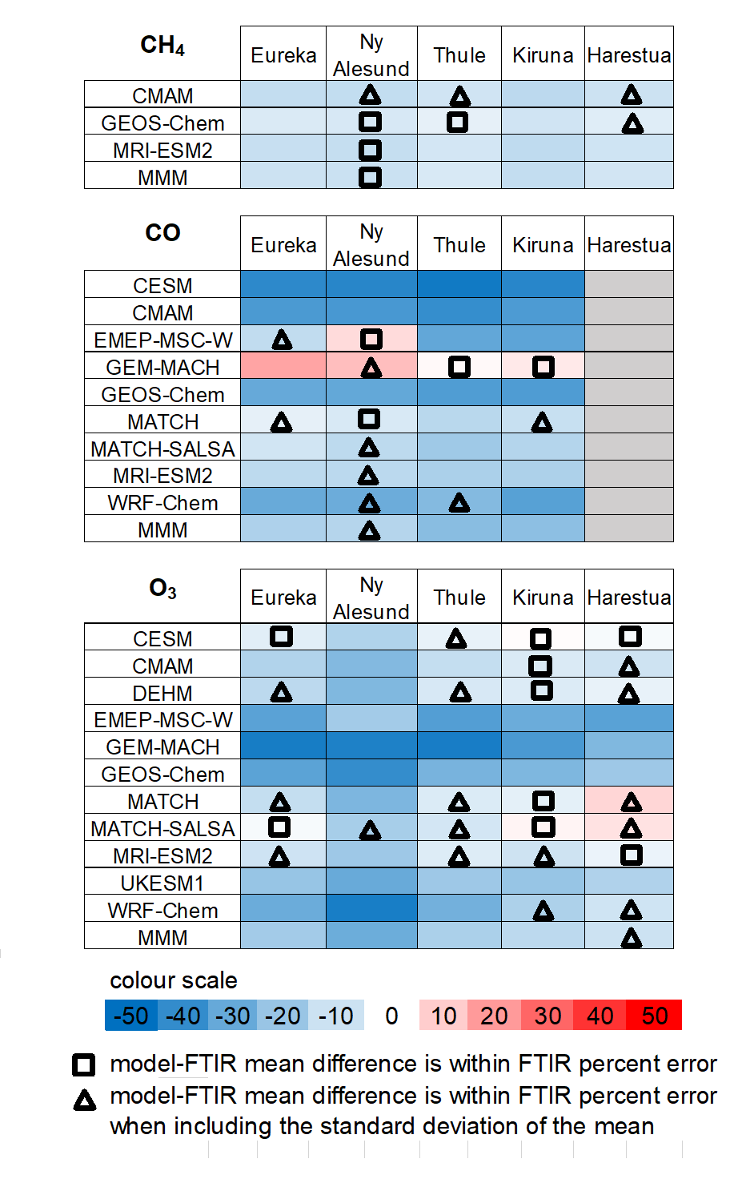
Mean Difference

Slide 26





Summary
SLCFs are harmful to ecosystems, human health and the climate
FTIR data from five NDACC Arctic stations are used for evaluation of models from the AMAP SLCF report
The modeled CH₄, CO and O₃ 0-7 km partial columns are generally underestimated relative to Arctic FTIR measurements
No model consistently outperforms other models and no regional biases were identified
A manuscript on this work is under review

Slide 27




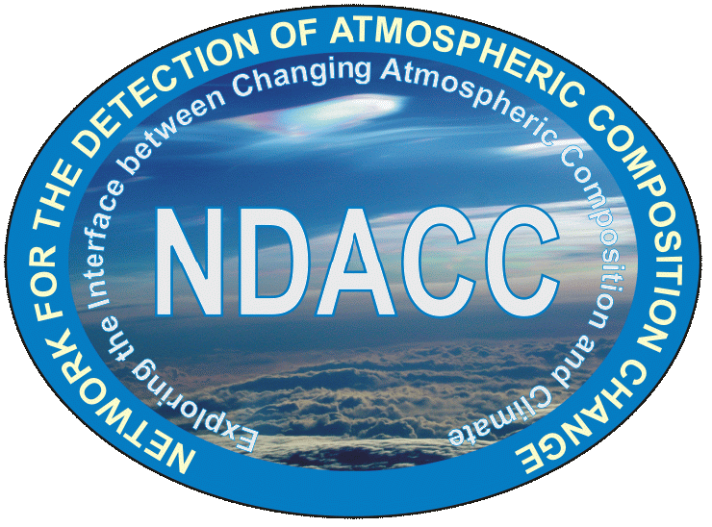
Acknowledgments
email : v.flood@utoronto.ca

Slide 28
Sources
AMAP, 2021. AMAP Assessment 2021: Impacts of Short-lived Climate Forcers on Arctic Climate, Air Quality, and Human Health. Arctic Monitoring and Assessment Programme (AMAP), Tromsø, Norway, viii + 324pp, https://www.amap.no/documents/doc/amap-assessment-2021-impacts-of-short-lived-climate-forcers-on-arctic-climate-air-quality-and-human-health/3614, 2021.
Emmons, L. K., Arnold, S. R., Monks, S. A., Huijnen, V., Tilmes, S., Law, K. S., Thomas, J. L., Raut, J.-C., Bouarar, I., Turquety, S., Long, Y., Duncan, B., Steenrod, S., Strode, S., Flemming, J., Mao, J., Langner, J., Thompson, A. M., Tarasick, D., Apel, E. C., Blake, D. R., Cohen, R. C., Dibb, J., Diskin, G. S., Fried, A., Hall, S. R., Huey, L. G., Weinheimer, A. J., Wisthaler, A., Mikoviny, T., Nowak, J., Peischl, J., Roberts, J. M., Ryerson, T., Warneke, C., and Helmig, D.: The POLARCAT Model Intercomparison Project (POLMIP): overview and evaluation with observations, Atmos. Chem. Phys., 15, 6721–6744, https://doi.org/10.5194/acp-15-6721-2015, 2015.
IPCC, 2021: Climate Change 2021: The Physical Science Basis. Contribution of Working Group I to the Sixth Assessment Report of the Intergovernmental Panel on Climate Change [Masson-Delmotte, V., P. Zhai, A. Pirani, S.L. Connors, C. Péan, S. Berger, N. Caud, Y. Chen, L. Goldfarb, M.I. Gomis, M. Huang, K. Leitzell, E. Lonnoy, J.B.R. Matthews, T.K. Maycock, T. Waterfield, O. Yelekçi, R. Yu, and B. Zhou (eds.)]. Cambridge University Press, Cambridge, United Kingdom and New York, NY, USA, 2391 pp. doi:10.1017/9781009157896, 2021.
Monks, S. A., Arnold, S. R., Emmons, L. K., Law, K. S., Turquety, S., Duncan, B. N., Flemming, J., Huijnen, V., Tilmes, S., Langner, J., Mao, J., Long, Y., Thomas, J. L., Steenrod, S. D., Raut, J. C., Wilson, C., Chipperfield, M. P., Diskin, G. S., Weinheimer, A., Schlager, H., and Ancellet, G.: Multi-model study of chemical and physical controls on transport of anthropogenic and biomass burning pollution to the Arctic, Atmos. Chem. Phys., 15, 3575–3603, https://doi.org/10.5194/acp-15-3575-2015, 2015.
Wespes, C., Emmons, L., Edwards, D. P., Hannigan, J., Hurtmans, D., Saunois, M., Coheur, P.-F., Clerbaux, C., Coffey, M. T., Batchelor, R. L., Lindenmaier, R., Strong, K., Weinheimer, A. J., Nowak, J. B., Ryerson, T. B., Crounse, J. D., and Wennberg, P. O.: Analysis of ozone and nitric acid in spring and summer Arctic pollution using aircraft, ground-based, satellite observations and MOZART-4 model: source attribution and partitioning, Atmos. Chem. Phys., 12, 237–259, https://doi.org/10.5194/acp-12-237-2012, 2012.
Whaley, C. H., Mahmood, R., von Salzen, K., Winter, B., Eckhardt, S., Arnold, S., Beagley, S., Becagli, S., Chien, R.-Y., Christensen, J., Damani, S. M., Dong, X., Eleftheriadis, K., Evangeliou, N., Faluvegi, G., Flanner, M., Fu, J. S., Gauss, M., Giardi, F., Gong, W., Hjorth, J. L., Huang, L., Im, U., Kanaya, Y., Krishnan, S., Klimont, Z., Kühn, T., Langner, J., Law, K. S., Marelle, L., Massling, A., Olivié, D., Onishi, T., Oshima, N., Peng, Y., Plummer, D. A., Popovicheva, O., Pozzoli, L., Raut, J.-C., Sand, M., Saunders, L. N., Schmale, J., Sharma, S., Skeie, R. B., Skov, H., Taketani, F., Thomas, M. A., Traversi, R., Tsigaridis, K., Tsyro, S., Turnock, S., Vitale, V., Walker, K. A., Wang, M., Watson-Parris, D., and Weiss-Gibbons, T.: Model evaluation of short-lived climate forcers for the Arctic Monitoring and Assessment Programme: a multi-species, multi-model study, Atmos. Chem. Phys., 22, 5775–5828, https://doi.org/10.5194/acp-22-5775-2022, 2022.
Whaley, C., Law, K., Hjorth, J. L., Skov, H., Arnold, S., Langner, J., Pernov, J. B., Chien, R.-Y., Christensen, J., Dong, X., Faluvegi, G., Flanner, M., Fu, J., Gauss, M., Im, U., Marelle, L., Onishi, T., Oshima, N., Plummer, D., Pozzoli, L., Raut, J.-C., Skeie, R., Thomas, M., Tsigaridis, K., Tsyro, S., Turnock, S., von Salzen, K., Tarasick, D., and Worthy, D.: Arctic tropospheric ozone: assessment of current knowledge and model performance., Atmos. Chem. Phys 23, 637–661, https://doi.org/10.5194/acp-23-637-2023, 2023.

Slide 29
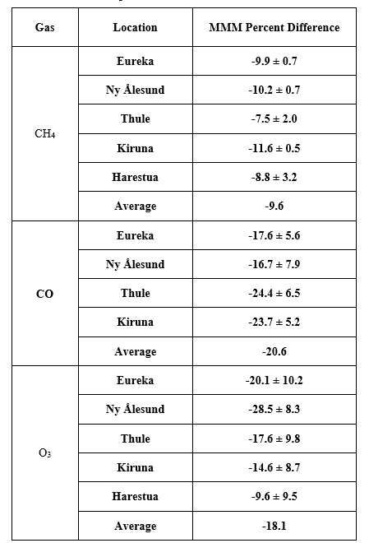
Summary

Slide 30
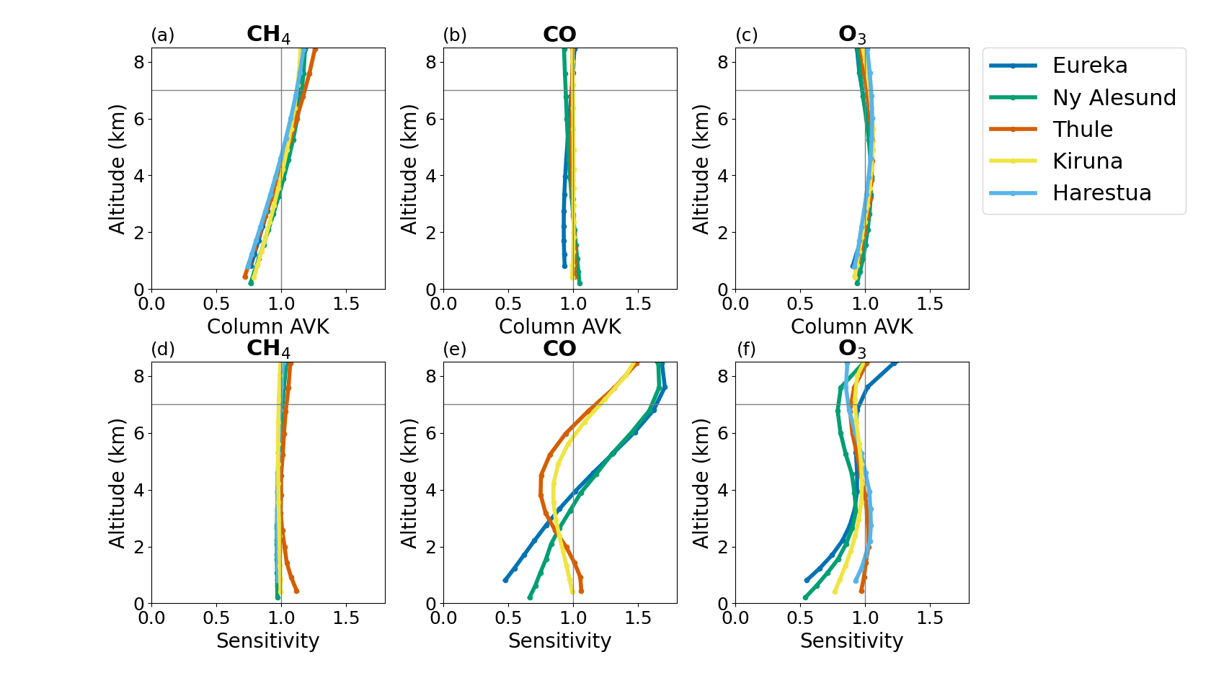
Averaging Kernel and Sensitivity

