Slide 1
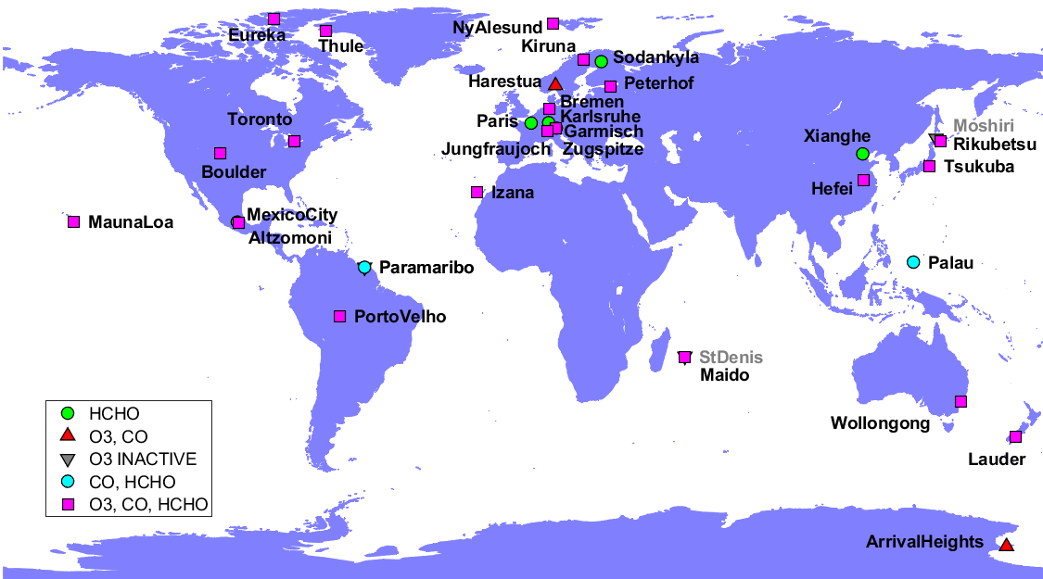
The NDACC FTIR contribution to the Tropospheric Ozone Assessment Report (TOAR-II): ozone and precursors
Corinne Vigouroux
and the FTIR partners:
T. Blumenstock, M. De Mazière, O. García, M. Grutter, J. Hannigan, N. Jones, R. Kivi, B. Langerock, E. Lutsch, E. Mahieu, M. Makarova, J. Mellqvist, I. Morino, I. Murata, T. Nagahama, J. Notholt, I. Ortega, M. Palm, M. Rettinger, A. Röhling, D. Smale, W. Stremme, K. Strong, Y. Sun, R. Sussmann, Y. Té, Y. Virolainen, P. Wang, T. Wizenberg, M. Zhou & probably more !
Data are from NDACC or private communication: Please check if your site is well represented (and well selected for trends) and come-back to me if not !

Slide 2
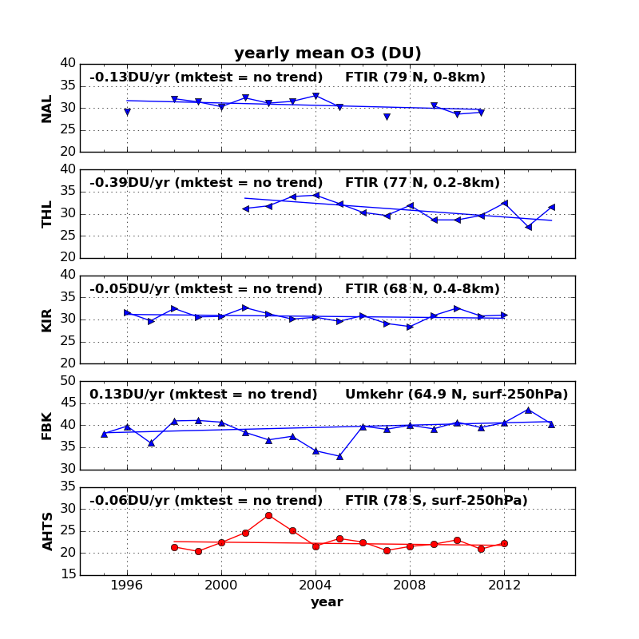
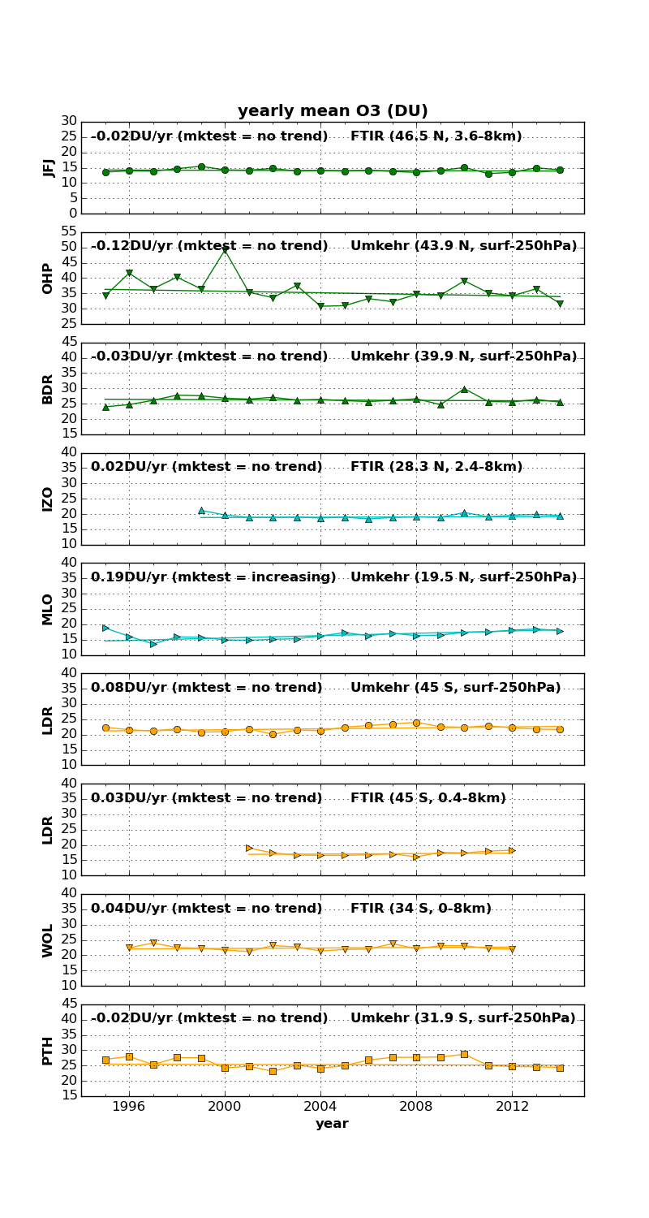
What is TOAR-I (2014-2019) ?
TOAR-I (Tropospheric Ozone Assessment Report, Phase-I; https://igacproject.org/activities/TOAR/TOAR-I):
First-ever international report on tropospheric ozone
Consists in 10 highly-cited publications in Elementa
Database with ozone metrics at 1000s of surface stations worldwide.
Other data sets contributed to the report (satellites, sondes, aircrafts, FTIR,…)
FTIR ozone data contributed to the TOAR-I:
Tarasick et al., 2019: general FTIR description + error budget and comparisons with sondes.
Gaudel et al., 2018: trends of tropospheric O₃ at 8 FTIR sites with long-term measurements (12-17 years; end max. in 2014).
Fig. 4.3.1.2 of Gaudel et al., (2018), TOAR-I

Slide 3
What is TOAR-II (2020-2024) ?
TOAR-II (Tropospheric Ozone Assessment Report, Phase-II; https://igacproject.org/activities/TOAR/TOAR-II):
Up-to-date assessment of tropospheric ozone present distribution and trends on regional and global scales.
Work divided in focus WGs; some of them will also look at ozone precursors.
Focus Working Groups
Chemical Reanalysis
East Asia
HEGIFTOM (Harmonization and Evaluation of Ground-Based Instruments for Free Tropospheric Ozone Measurements)
Ozone over the oceans
Ozone and Precursors in the Tropics (OPT)
Radiative Forcing
Satellite Ozone
Statistics
Tropospheric Ozone Precursors (TOP)
Urban Ozone
FTIR data for TOAR-II:
Ozone updated time-series up to 2022-2023.
Much more sites with time-series longer than 12 years.
Precursors: HCHO and CO data, in addition to ozone.

Slide 4
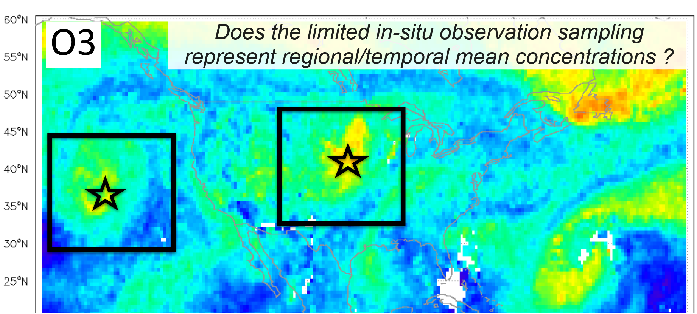
FTIR is contributing to four WGs in TOAR-II
Chemical Reanalysis WG: 3 publications planned (5 reanalysis models involved) on tropospheric ozone (not precursors).
One publication will involve FTIR and will provide results very important for us: representativeness of the ground-based ozone data.
Lead: Kazuyuki Miyazaki (JPL)
Focus Working Groups
Chemical Reanalysis
East Asia
HEGIFTOM (Harmonization and Evaluation of Ground-Based Instruments for Free Tropospheric Ozone Measurements)
Ozone over the oceans
Ozone and Precursors in the Tropics (OPT)
Radiative Forcing
Satellite Ozone
Statistics
Tropospheric Ozone Precursors (TOP)
Urban Ozone
Methodology will follow Miyazaki and Bowman (2017): evaluate the sampling bias in ozonesonde network by comparing reanalysis model outputs based on both complete and ozonesonde samplings.

Slide 5
FTIR is contributing to four WGs in TOAR-II
Focus Working Groups
OPT (lead A. Gaudel & B. Sauvage) and TOP (Y. Elshorbany & R. Seguel).
Both use data from satellites, GB, models
Both O3 and precursors
Both look at present day distribution and trends (OPT only tropics / TOP global)
OPT main goal: Assess the impact of tropical tropospheric ozone & precursors changes on global tropospheric ozone burden & radiative forcing
TOP main goal: Investigate factors that control the trends of ozone as a function of its precursors.
We provide FTIR O3, HCHO and CO time-series for:
Present-day distribution and seasonal cycles (all sites)
Trends (long time-series sites)
Chemical Reanalysis
East Asia
HEGIFTOM (Harmonization and Evaluation of Ground-Based Instruments for Free Tropospheric Ozone Measurements)
Ozone over the oceans
Ozone and Precursors in the Tropics (OPT)
Radiative Forcing
Satellite Ozone
Statistics
Tropospheric Ozone Precursors (TOP)
Urban Ozone

Slide 6
FTIR is contributing to four WGs in TOAR-II
Focus Working Groups
HEGIFTOM (https://hegiftom.meteo.be/):
Harmonization of ground-based ozone data from sondes, Lidar, Umkehr, aircraft, FTIR.
Intercomparisons of the different techniques
Trends from the different techniques
(recently added to give more visibility to GB trends)
Chemical Reanalysis
East Asia
HEGIFTOM (Harmonization and Evaluation of Ground-Based Instruments for Free Tropospheric Ozone Measurements)
Ozone over the oceans
Ozone and Precursors in the Tropics (OPT)
Radiative Forcing
Satellite Ozone
Statistics
Tropospheric Ozone Precursors (TOP)
Urban Ozone

Slide 7
HEGIFTOM https://hegiftom.meteo.be/
Harmonization of ground-based ozone data from sondes, Lidar, Umkehr, aircraft, FTIR:
Done for FTIR within NDACC (Vigouroux et al., 2015; https://www2.acom.ucar.edu/irwg). These are the data sets currently used within TOAR-II.
However: it would be great to have the updated O3 strategy time-series (HITRAN 2020, new mws,…) ready for TOAR-II:
See the e-mail sent to the IRWG 7th March 2023 with all details / strategy files /…;
See Talk by Robin Björklund on Friday.
It must be done for the whole group for consistency: can we fix a realistic deadline together by Friday ? ☺
All techniques must use the same “tropospheric column” definition: a lot of debate within all WGs of TOAR-II about this choice. HEGIFTOM advised two:
Top layer = tropopause height defined as first thermal tropopause by WMO
Top layer = fixed pressure layers that avoid the UTLS:
150 hPa for the tropics (15°S – 15°N)
200 hPa for the subtropcis (15°-30°)
300 hPa for mid-latitudes (30-60°)
400 hPa for high latitudes (60-90°)

Slide 8
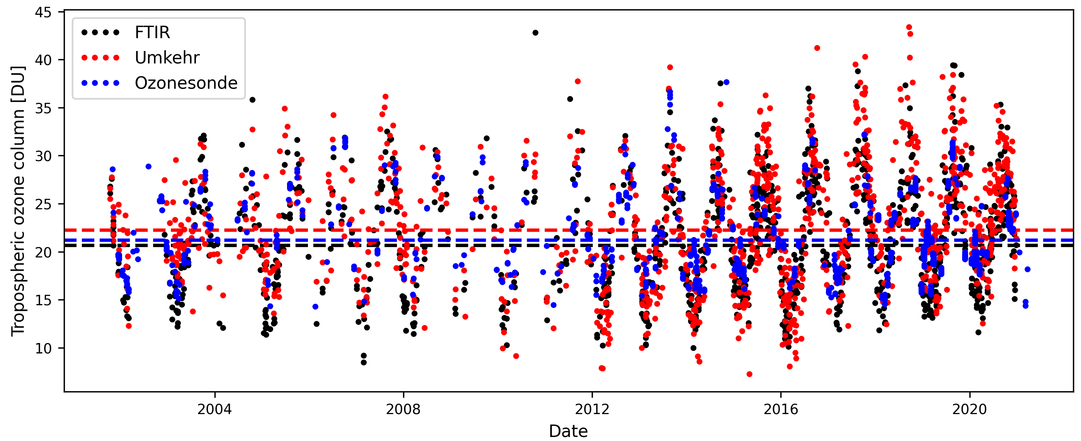
HEGIFTOM https://hegiftom.meteo.be/
Intercomparisons of the different techniques:
FTIR vs Sondes: some work done by Ivan and by Isao: is there plans for publications ?
FTIR vs Satellites: Yana works on IASI-LISA validation; Robin & I plan to validate SUNLIT (Sofieva et al., 2022)
FTIR vs Sondes, Lidar, Umkehr and MWR at Lauder: Robin’s paper in preparation
The troposphere is studied within TOAR-II: are the measurements in agreement ? Are the trends consistent, i.e., is there any drift in the GB measurements ?
The stratosphere is studied within LOTUS (Ozone trends in the Stratosphere):
Godin-Beekman et al. (2022) show inconsistent trends for GB data at Lauder: is it due to different sampling, vertical resolution, time-period,… ?
Main finding for FTIR: the new strategy gives better agreement with the other techniques: in terms of bias (HIT2020 is better than HIT2008) but also in terms of drifts !!

Slide 9
HEGIFTOM https://hegiftom.meteo.be/
Trends from the different techniques (paper lead: A. Thomson and R. Van Malderen)
The trend model will be the same for all techniques: taken from the Statistics WG of TOAR-II, which advises a Quantile Regression model. The choice of proxies (if any) to explain the ozone variability is not done yet.
HEGIFTOM wants to compare with other Multiple Linear Regression models:
I made an update of our past ozone trend study (Vigouroux et al., 2015) & also applied it to the precursors CO and HCHO.
I show here (preliminary results!) trends; only for sites:
Having at least 10 years of regular data
Time-series ending in 2019 at the latest.

Slide 10
FTIR long-term trends: model
We use Multi Linear Regression MLR model to derive our trends.
$$Y\left(t\right)=A_{0}+A_{1}∙cos⁡(\frac{2π}{12}t) {+A_{2}∙\sin\left(\frac{2π}{12}t\right)+A_{3}∙\cos\left(\frac{4π}{12}t\right)+A_{4}∙\sin\left(\frac{4π}{12}t\right)+ A}_{5}×t+ \sum_{k=3}^{n}{A_{k}×X_{k}(t)}+ε$$
- Y(t) is the monthly means time-series of observations, in fractional year.
- A₁ to A₄: seasonal cycle; A₅ is the linear trend
- X_{k} are the explanatory variables (proxies time-series) and A_{k} their respective coefficients;
- ε represents the residuals
Several MLR models are tested:
“Seas”: trend + seasonal cycle
“Classic”: Seas + QBO + ENSO + solar 11-year cycle
“All”: Classic + Tropopause Height + MJO + AO/AAO + EP flux + Volume of Polar Stratospheric Clouds
Note that a stepwise regression is made such as only the significant proxies are kept in the model (to avoid overfitting).
The uncertainty on the trend parameter is corrected according to the auto-correlation of the residuals (Santer et al., 2008)

Slide 11
Ozone long-term trends
Choice of the MLR model:
Only a small impact on the trends and their significance.
the “All” model improves the regression (R² closer to 1; smaller trends uncertainties) mainly for high-latitude and mountain sites: Tropopause Height proxy’s influence.

Slide 12
Ozone long-term & recent trends
Impact of the length/period of the time-series: test to start in 2009:
More coherence at NH high-latitudes: the negative trends in Thule and Kiruna becomes non-significant, as Eureka and Harestua. However, Ny-Alesund becomes an outlier: to be checked with sondes soon.
No big change elsewhere: recent trends are non-significant (although now, almost all negative in NH mid-lat!). Except at Boulder and Antarctic site (significantly negative).

Slide 13
HCHO long-term / recent trends
Impact of the length/period of the time-series: test to start in 2009:
Positive trends in Arctic sites Ny-Alesund and Thule in the most recent years.
Elsewhere: mostly no change in trends (considering significance); Larger uncertainties.

Slide 14
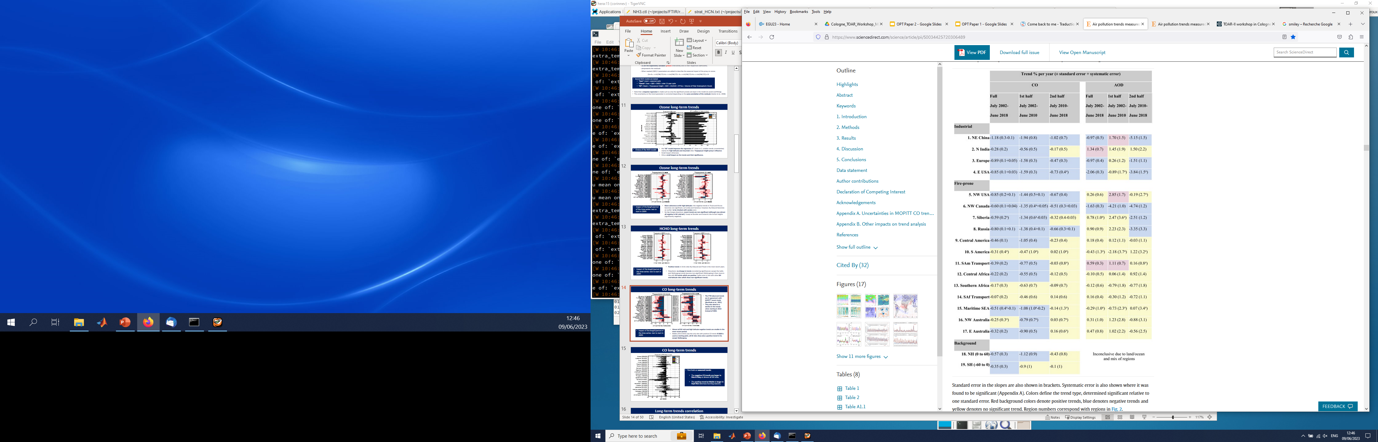
CO long-term / recent trends
The FTIR observed trends are in agreement with MOPITT recent study (Buchholz et al., 2021).
They also observe a decline in the trends when starting in 2010 vs 2002; and trend becoming positive in SH regions.
Impact of the length/period of the time-series: test to start in 2009:
Almost all NH mid and high latitude negative trends are smaller in the more recent period.
Maïdo (2013-) was the only site with positive CO trend: if 2009 is used as starting point, all SH sites show also a positive trend in CO, except Wollongong where the strong negative trend became non-significant.

Slide 15
Trend correlation O3 & precursors
No correlation between O3 and HCHO trends.
Small one between O3 and CO trends (Robust:0.51)
Larger correlation between CO and HCHO trends (R=0.69 for Robust correlation)

Slide 16
Long-term trends vs concentration levels
O3 trends: no clear dependance on the concentration levels
HCHO trends: the significant negative trends are seen for more “polluted” sites.
CO trends: negative trends larger for more “polluted” sites. (also in %/decade)

Slide 17
Conclusions
Long-term trends
No real improvement of the regression with the use of additional proxies for HCHO and CO (not shown).
Ozone trends are small (below 2ppbv/dec.) and usually non-significant.
HCHO trends are usually non-significant; except positive at some clean sites, negative at some “polluted” sites.
CO trends are all negative (except at Maïdo SH; but 2013-2023 period); and usually significant. They are smaller if the more recent period 2009-2023 is considered. At SH stations: if 2009-2023 is considered, the trends become positive (still non-significant, large uncertainties). The CO trends are larger for polluted sites.
The long-term O3 trends show no correlation with the HCHO trends; but small correlation with the CO trends (R=0.51). The HCHO and CO trends show some correlation (R=0.69).
O3 and CO trends are more negative in March-May season for NH & more positive in Sep-Nov for Maïdo (not shown).
Plans within TOAR-II
Provide tropospheric ozone and precursors columns (fixed pressure levels definition) for use in 4 WGs : new strategy O3 data sets if they come soon !
The FTIR ozone trend results will be published with HEGIFTOM WG for all ground-based data involved (FTIR; sondes, Umkehr, Lidar, aircraft).
Make use of models involved in TOAR-II to interpret the results (correlation O3 and precursors; long-term trends; influence of fires,…)

Slide 18
Other plans using our network
TROPOMI HCHO and NO2 validation still on-going (see my poster #36); Quarterly reports https://mpc-vdaf.tropomi.eu/
L3 satellite (long-term time-series) validation (HCHO, CO, NH3): ESA funding CCI+ ozone precursors (Bavo and I)
FTIR O3 trends in the Arctic: national funding DORA (Robin and I; see Robin’s poster)

Slide 19

Thank you for listening !

Slide 20
Ozone time-series: 25 stations
Data from NDACC or private communication: Please check if your site is well represented (length of time-series,…) and come-back to me if not !
Among the 25 sites, we will show trends only for 19 sites:
Having at least 10 years of regular data
Time-series ending in 2019 at the latest.
→ Moshiri, Paramaribo, Porto Velho, StDenis, Tsukuba, Hefei are removed for trend analysis; note that the 2 latest can be added in a near future. Porto Velho just started again.

Slide 21
HCHO time-series: 29 stations
Availability (geoms format) at NDACC: https://www2.acom.ucar.edu/irwg or on request depending on site.
We will show trends only for 21 sites (at least 10 years of regular data, ending in 2019 at the latest). TCCON sites are more recent than NDACC ones. Longer time-series in a few years !

Slide 22
CO time-series: 26 stations
26 NDACC sites. TCCON provides CO total columns; not used here.
Availability (geoms format) at NDACC: https://www2.acom.ucar.edu/irwg.
We will show trends only for 20 sites (at least 10 years of regular data, ending in 2019 at the latest).

Slide 23
Ozone long-term trends
The main contributor to the improvement in R² at high latitude and mountain sites using the “All” model is the Tropopause height proxy.

Slide 24
HCHO long-term trends
The main contributors to the small improvement in R² using the “All” model is the Tropopause height, ENSO and Solar cycle for Izaña and Lauder.

Slide 25
CO long-term trends
Usually very small contribution of other proxies to R² using the “All” model.
We use the simple “Seas” model for CO.

Slide 26
HCHO long-term trends
The “All” proxies model only slightly improves the regression (R² closer to 1).
Very small impact on the trends and their significance (mainly due to tropopause height, and Solar cycle for Izaña and Lauder only).
Choice of the MLR model:

Slide 27
CO long-term trends
The “All” model only very slightly improves the regression (R² closer to 1).
Very small impact on the trends and their significance: we use the simple “Seas” model for CO.
Choice of the MLR model:

Slide 28
Ozone long-term trends
First look on seasonal trends:
Usually no clear difference (also due to larger uncertainties as expected).
Except, significant negative trends in the March-May period at some NH stations.

Slide 29
HCHO long-term trends
First look on seasonal trends:
In NH, positive trends in June-August (except Japan and Toronto).
Large uncertainties.

Slide 30
CO long-term trends
First look on seasonal trends:
The negative CO trends are larger in March-May at almost all NH sites.
The positive trend at Maïdo is larger in Sept-Nov (biomass burning season).

Slide 31
Conclusions
Seasonal cycles / short-term correlation
At high and mid latitude NH stations Typically, no seasonal/short-term correlation is observed between O3 and the 2 precursors (except with CO at Asian cities).
At low latitude NH, correlation between O3 and CO (seasonal and/or short-term) at some sites; between O3 and HCHO for short-term only, and during biomass burning (BB) periods.
At SH stations: O3 and CO seasonal cycle are in phase (R all 0.6-07); O3 and CO short-term correlation small and present only for BB period (R=0.5-06). Even smaller correlation with HCHO (during the BB season R= 0.4-0.5).

