Slide 1
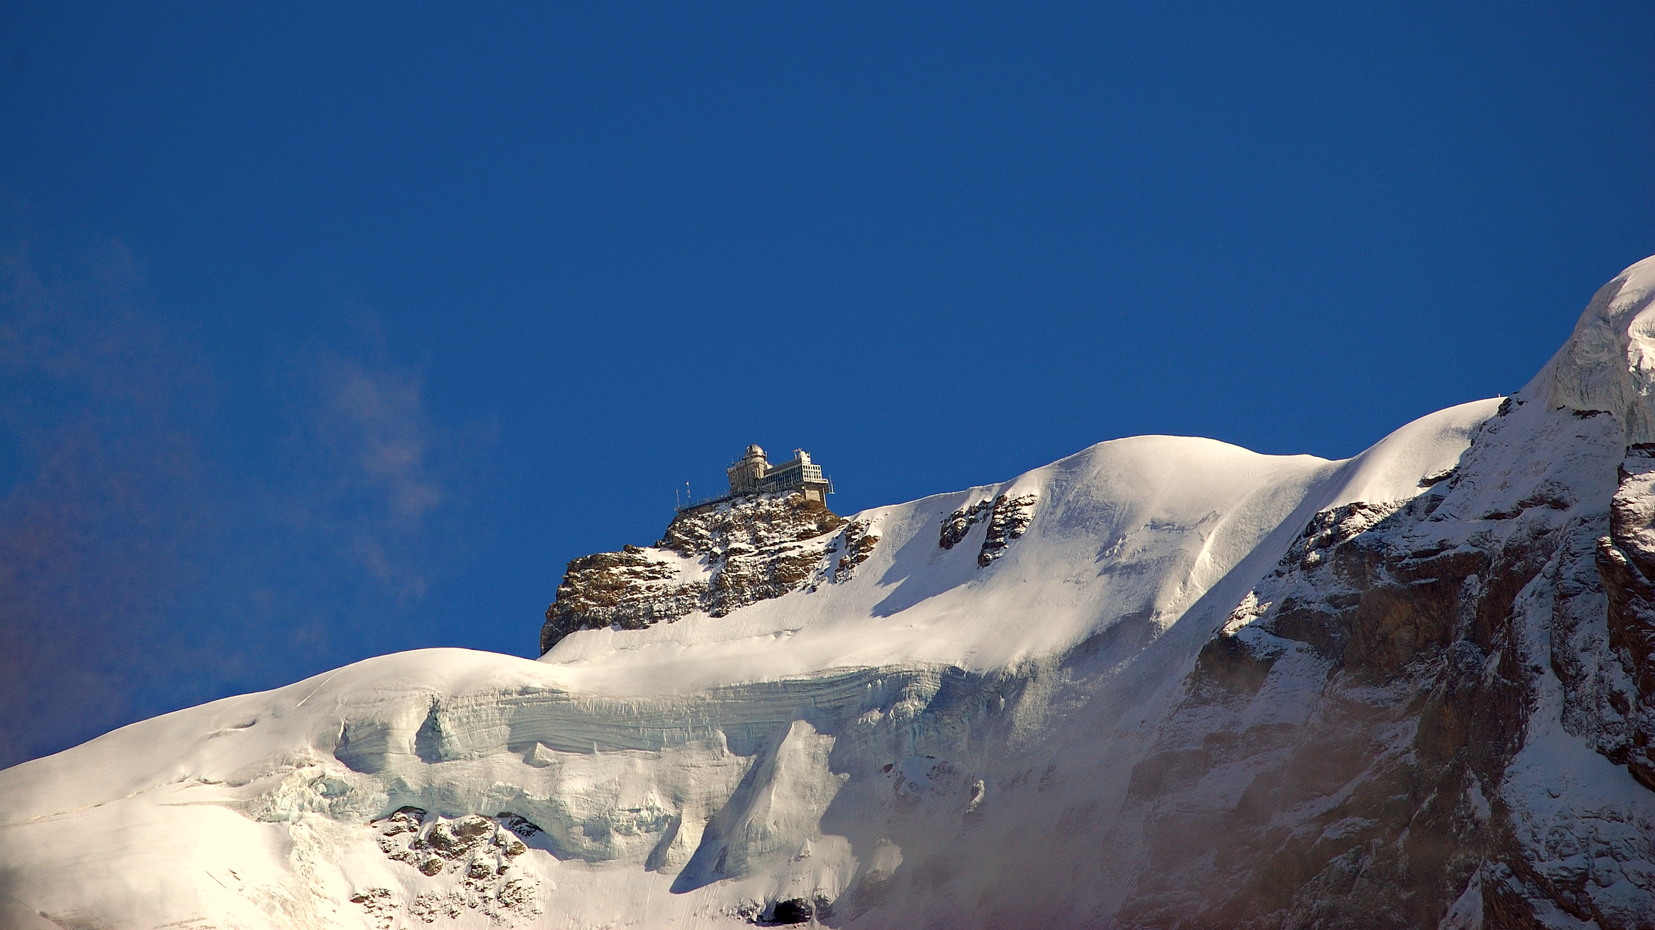
Trend analysis for atmospheric ethane
Marina Friedrich, Siem Jan Koopman, Yicong Lin (VU Amsterdam),
Stephan Smeekes (Maastricht University)

Slide 2
Objectives of the Trend Analysis
Use advanced statistical methods to extract trends from ethane data
Separate ‘significant’ evolution from cyclical changes and local ‘noise’
Find and interpret (dis)similarities between stations
Link (changes in) trends to particular causes (e.g. gas/oil production)

Slide 3
How We Model Trends
Ethane
Station i
Time t
Trend
Long-run movement
Seasonal
Cyclical variation
Noise
Not explained by the model

Slide 4

How to Capture the Trend?
Per Station
Across similar stations
Across Hemisphere

Slide 5
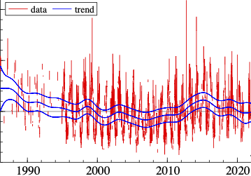
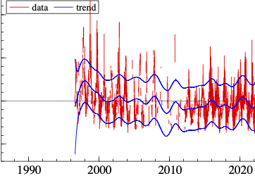
How to Capture the Trend?
Per Station
Very flexible
Does not utilise commonality between stations
May be too sensitive to local noise

Slide 6
Individual Trends

Slide 7
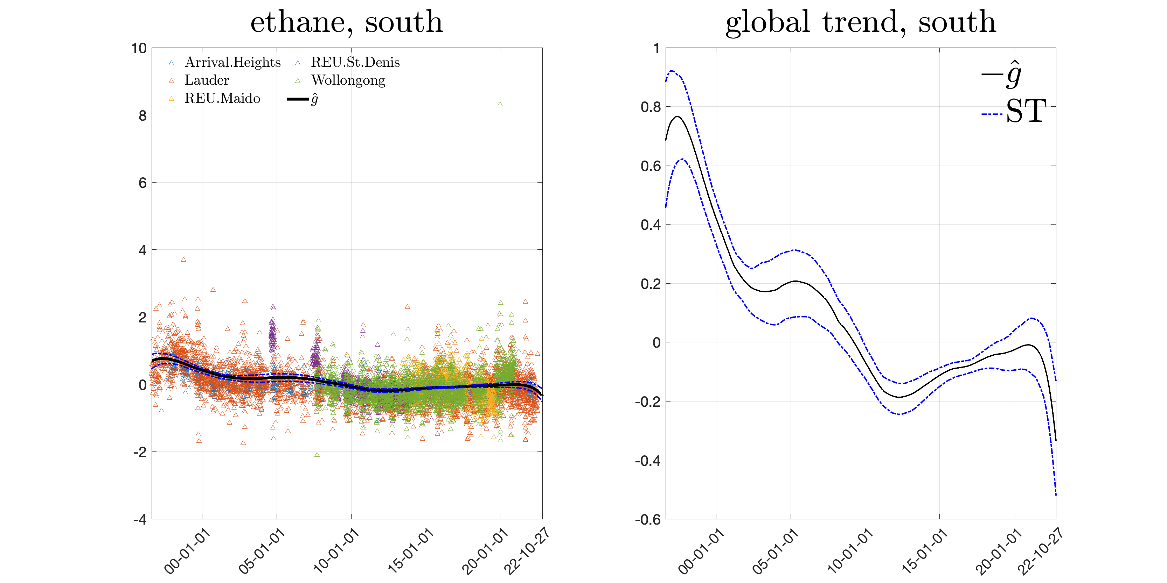
How to Capture the Trend?
Utilises all available information
Assumes hemispheric trend affects all locations similarly
Does not allowed to uncover events only affecting some stations
Across
Hemisphere

Slide 8
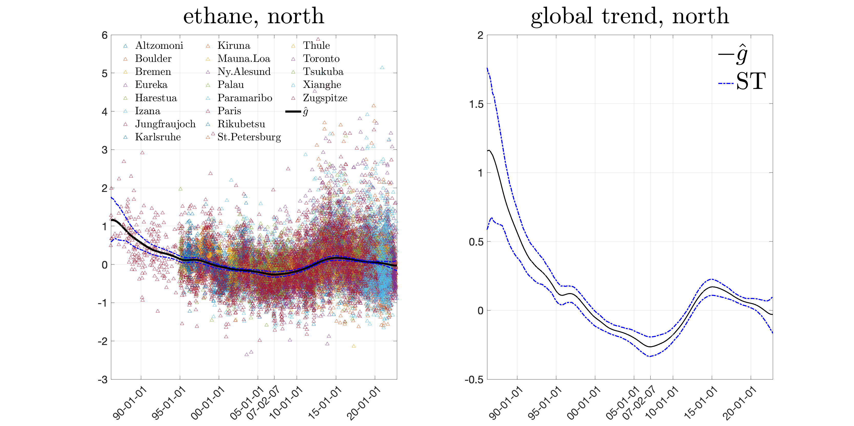
How to Capture the Trend?
Utilises all available information
Assumes hemispheric trend affects all locations similarly
Does not allowed to uncover events only affecting some stations
Across
Hemisphere

Slide 9
Hemispheric Trends

Slide 10
How to Capture the Trend?
Across similar stations
Optimal: only aggregate information across similar stations
Allows to uncover events only affecting some stations
Can learn from similarities and differences between groups
Difficult how to optimally determine groups:
  Let data decide?
  Use station characteristics (altitude, latitude, environment)?
Can also consider a mix of global and local trends
Work in progress!

Slide 11
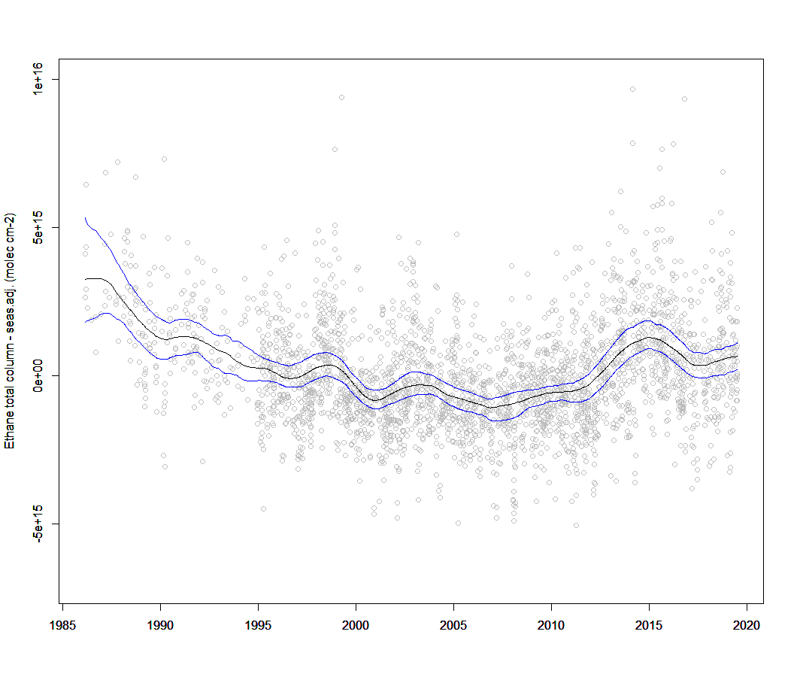
Determining Causes of Changes in Ethane
Trend analysis allow for ex-post identifying important events
Fracking?
Boreal forest fires in Russia

Slide 12
Determining Causes of Changes in Ethane
Effect of Increase US Oil Production (1000 barrels/day)
We can formally include potential causes in our econometric models
Allows to quantify their dynamic effects
E.g., quantify the effect of oil or gas production on ethane (very preliminary results)
Work in progress!
Months ahead
Months ahead

Slide 13
How to Proceed: Next Steps
Determine the right level of detail for the trend analysis
Which characteristics help to group the stations?
Introduce explanatory variables into our trend models
Build models to quantify the effects of particular events, such as fracking
Use trends in observed data to compare with (and thereby validate) model data
Happy to hear your suggestions!

Slide 14

Dry air mole fraction (xC₂H₆) time series at 26 FTIR sites
Notes:
The time series end up mostly in spring 2022 => An update welcome.

