Slide 1
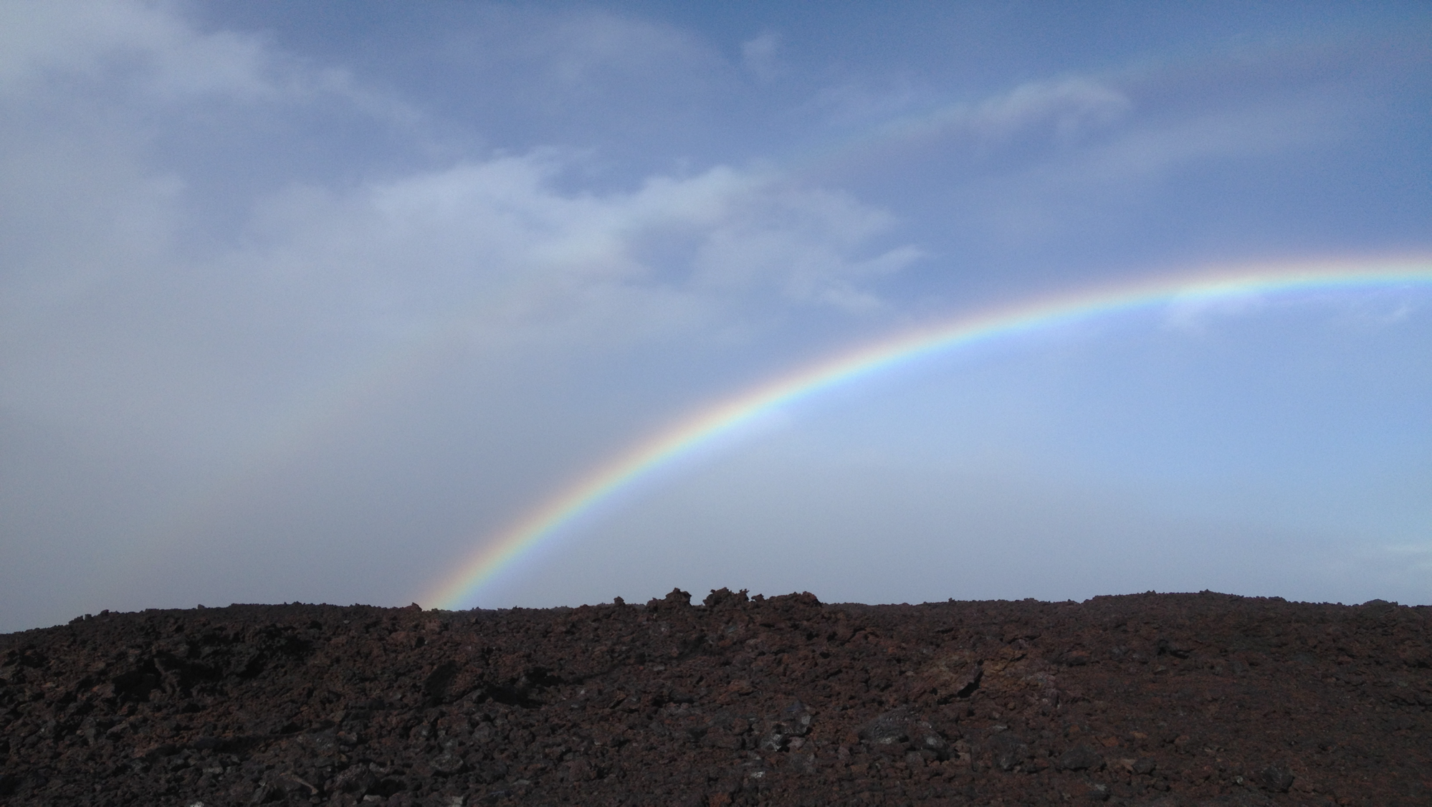


Anomalies of O₃, CO, C₂H₂, H₂CO, and C₂H₆ detected with multiple ground-based FTIR and assessed with model simulation in 2020: COVID-19 lockdowns versus natural variability
Ivan Ortega¹, Benjamin Gaubert¹, James W. Hannigan¹, Guy Brasseur^{1,2}, Helen M. Worden¹, Thomas Blumenstock³, Hao Fu⁴, Frank Hase³, Pascal Jeseck⁴, Nicholas Jones⁵, Cheng Liu⁶, Emmanuel Mahieu⁷, Isamu Morino⁸, Isao Murata⁹, Justus Notholt¹⁰, Mathias Palm¹⁰, Amelie Rohling³, Yao Té⁴, Kimberly Strong¹¹,Youwen Sun¹², and Shoma Yamanouchi¹¹
¹Atmospheric Chemistry Observations & Modeling, National Center for Atmospheric Research, Boulder, CO, USA
²Environmental Modeling Group, Max Planck Institute for Meteorology, Hamburg, Germany
³Karlsruhe Institute of Technology, Institute of Meteorology and Climate Research (IMK-ASF), Karlsruhe, Germany
⁴Laboratoire d’Etudes du Rayonnement et de la Matière en Astrophysique et Atmosphères, Sorbonne Université, CNRS, Observatoire de Paris, PSL Université, Paris, France
⁵School of Physics, University of Wollongong, Wollongong, Australia
⁶Department of Precision Machinery and Precision Instrumentation, University of Science and Technology of China, Hefei, China
⁷Institute of Astrophysics and Geophysics, UR SPHERES, University of Liège, Liège, Belgium
⁸National Institute for Environmental Studies, Tsukuba, Japan
⁹Graduate School of Environmental Studies, Tohoku University, Sendai, Japan
¹⁰Institute of Environmental Physics, University of Bremen, Germany
¹¹Department of Physics, University of Toronto, Toronto, Ontario, Canada
¹²Key Laboratory of Environmental Optics and Technology, Anhui Institute of Optics and Fine Mechanics, HFIPS, Chinese Academy of Sciences, Hefei, China
Ortega et al. (2023) – (Elementa: Science of the Anthropocene)
NDACC-IRWG/TCCON/COCCON Meeting
June 15 2023

Slide 2
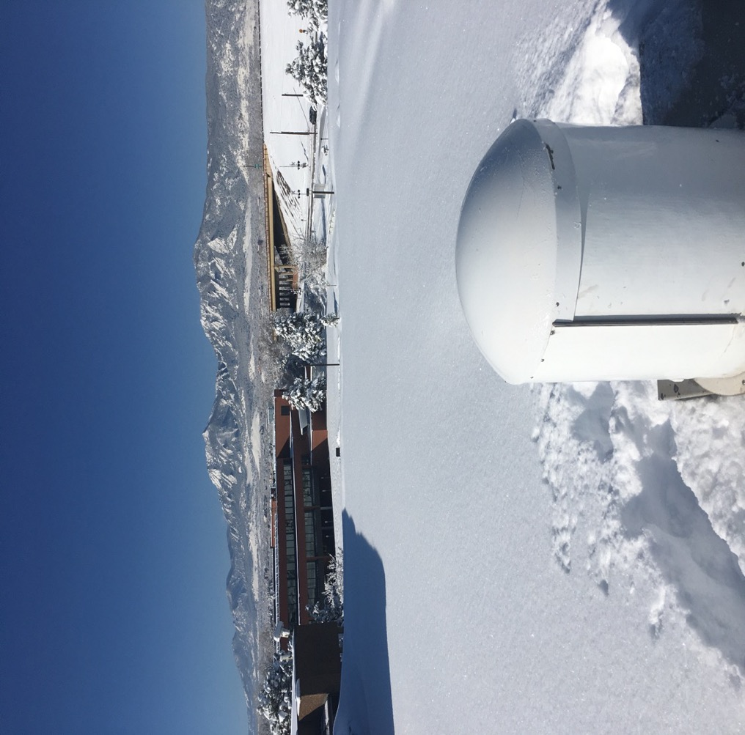

Igniting the Journey by investigating the Boulder Data
April 17 2020
Sep 7 2020
Can we capture significant changes in atmospheric composition due to lockdown restrictions (using FTIR)?
Unprecedent fire tracer enhancements in the region

Slide 3
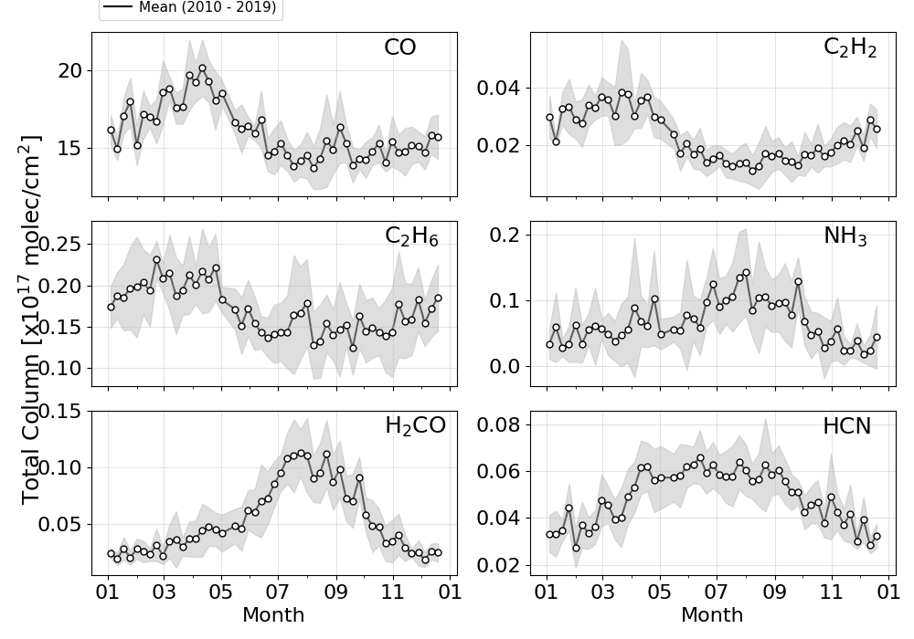
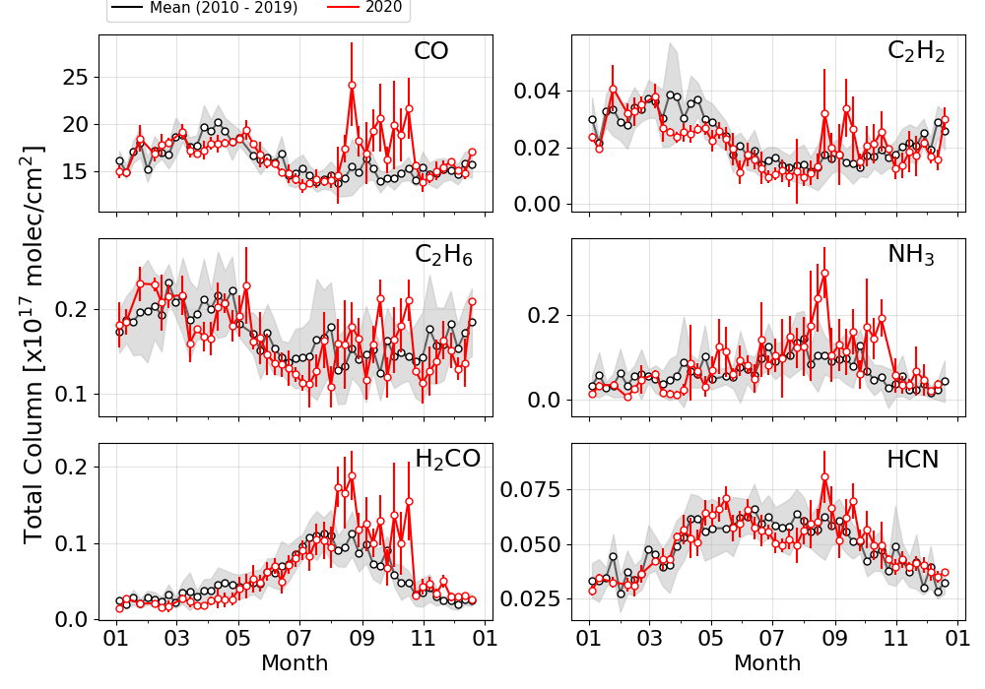
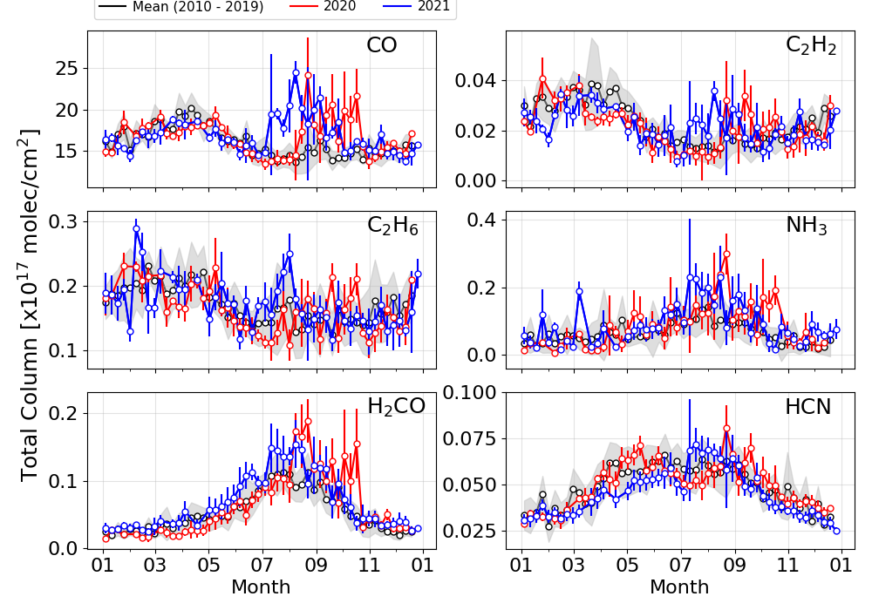
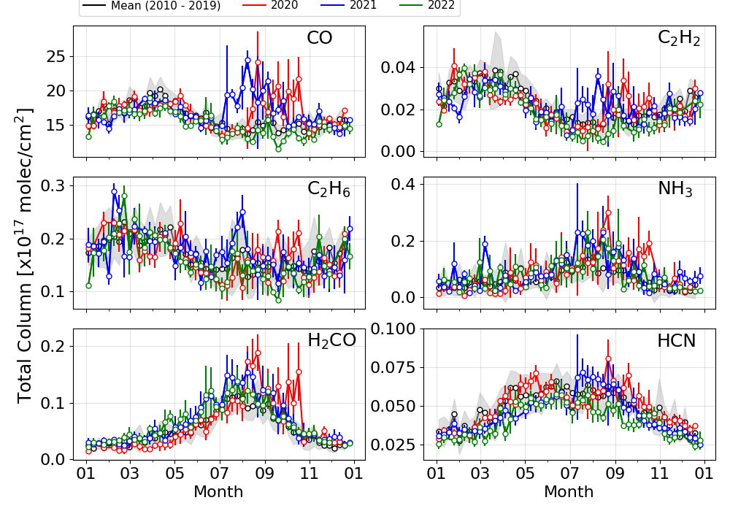
Exploring Atmospheric Conditions in Boulder and Beyond during 2020
Plot shows weekly mean total columns obtained between 2010-2019 and for the following years.
2020 was a unique year with stringent COVID-19 restrictions (March-May) and wildfires in the fall.
The 2020 (and 2021) Colorado wildfire season was a series of significant wildfires that burned throughout CO as part of the 2020 Western US wildfire season (wiki).
2022 is back to normal and no enhancements were observed.

Slide 4
Motivation
    There are several studies/papers reporting changes in the spatial and temporal distributions of atmospheric species during intensive 2020 lockdowns. These studies have focused primarily in either surface (pollutants, e.g., O₃, NO₂, PM) or satellite (NO₂) observations (Gkatzelis et al., (2021) - link). Publications also available under the Analysis of eMIssions usinG Observations (AMIGO) working group of IGAC.
    Multiple species are missing.
    Surface in-situ measurements may be different than tropospheric and/or free tropospheric columns (e.g., Steinbrecht et al. (2021) & Grange et al. (2021)).
    In this study we try to contribute to these studies by using ground-based FTIR observations & model simulations.

Slide 5
Tropospheric Gases
Species | Sources | Sinks | Lifetime
CO | BB, industry, CH₄/VOC oxidation | Reaction with OH | 30 days
CH₂O | CH₄/VOC oxidation, direct from fossil fuel burning | Reaction with OH And photolysis | 3 hours
O₃ | Interaction of sunlight with CH₄/VOC + nitrogen oxides | Deposition, uptake by plants | Hours to weeks
C₂H₆ | BB, O&NG extraction, biofuel use | Reaction with OH | 45 days
C₂H₂ | Fossil fuel burning, industry | Reaction with OH | 60 days
Tropospheric weighted volume mixing ratios (wVMR) are used in the study.
2020 was challenging for many sites and only few sites were able to measure through the lockdowns.
Notes:
CAMS = Copernicus Atmosphere Monitoring Service

Slide 6
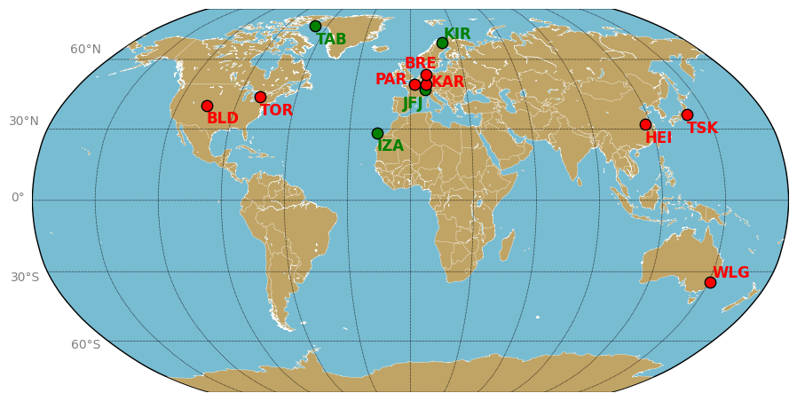
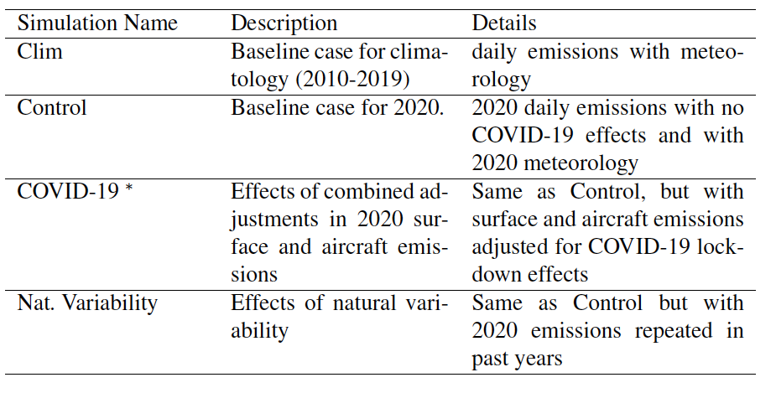
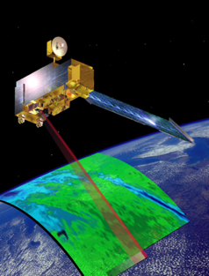
Observations and model simulations
FTIR sites (2010 -2020)
CAM-Chem simulations*
Red and green sites are considered urban and remote sites, respectively.
*Gaubert et al. (2021); Bouarar et al. (2021)
To further understand global CO changes we use the long-term record of the MOPITT (Measurements of Pollution in the Troposphere) instrument, aboard the NASA Terra satellite (version 9 joint thermal infrared and near-infrared).

Slide 7

Methodology applied to FTIR & MOPITT
A baseline (or reference) period is needed in order to calculate anomalies.
We produce 2020 business-as-usual monthly values.
We applied a methodology to forecast monthly for 2019 and 2020, leveraging the long-term (2010 – 2018) monthly time series.
We use the python library for manipulation and forecasting of time series (Darts) → Exponential smoothing approach (probabilistic forecast weighted averages of the past observations, with the weights decaying exponentially as the observations get older).
Train Data (2005-2018)
Test Data (2019)
Prediction (2020)
time
e.g., Boulder
https://github.com/unit8co/darts
Notes:
In order to know 2020 business as usual the python library for manipulation and forecasting of time series (Darts) is used.
Darts uses different models from naïve to deep neural networks - machine learning.
Exponential smoothing was proposed in the late 1950s (Brown, 1959; Holt, 1957; Winters, 1960), and has motivated some of the most successful forecasting methods.

Slide 8
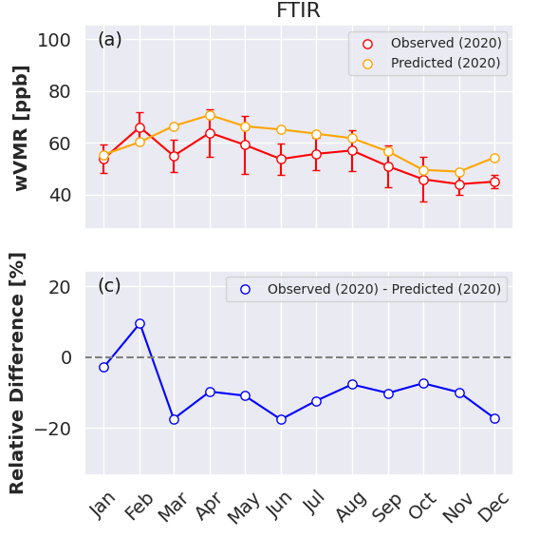
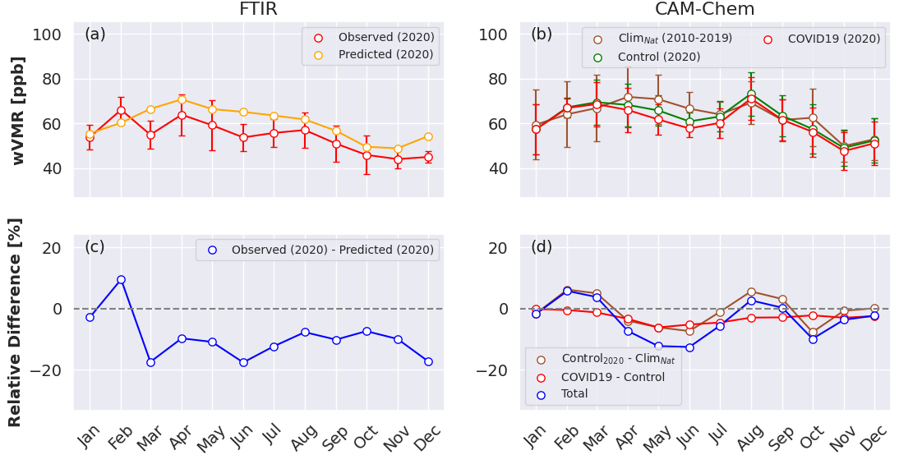
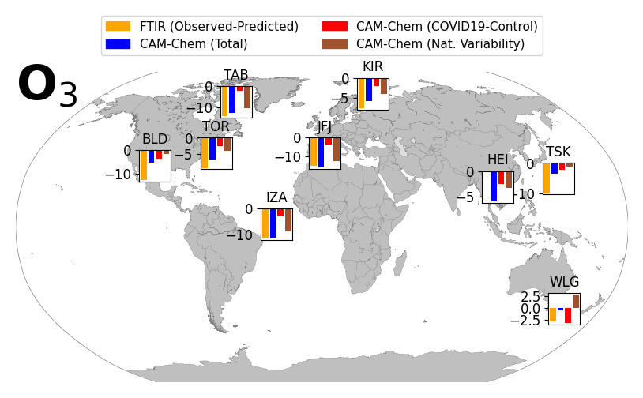
O₃ results
Boulder
Tropospheric anomalies of O₃ in percent
All sites show a decline of O₃ in the troposphere with a global mean of 9.2 ± 4.7 % during March - May 2020 (in agreement with Steinbrecht et al. (2021, GRL) .
The total decrease is well captured in the CAM-chem simulations, especially for the remote sites, e.g., Thule, Kiruna, Jungfraujoch, where natural variability plays a more important role (up to 80 %)
Others studies have shown that reductions in NO₂ concentrations at European and Chinese urban sites were accompanied by considerable increases in O₃, resulting in a shift from a VOC-limited regime to a NOx-limited regime
Notes:
Figure 3. (a) Monthly mean wVMR of O3 observed (red) and predicted
business-as-usual in 2020 (orange) at Boulder, Colorado. (b) Same as the
FTIR but for CAM-chem simulations for the control in 2020 (green), COVID-
19 adjusted emission (red), and natural variability climatology simulations
(brown). (c) Relative differences between the observations and predicted in
2020 for each month. (d) Relative differences between the COVID-19 and
control (red) and control and natural variability (brown). The effect of both
COVID-19 lockdowns and natural variability is shown in blue. Table 4 provides
a comprehensive overview of the various simulations and the methods
used to obtain them.

Slide 9
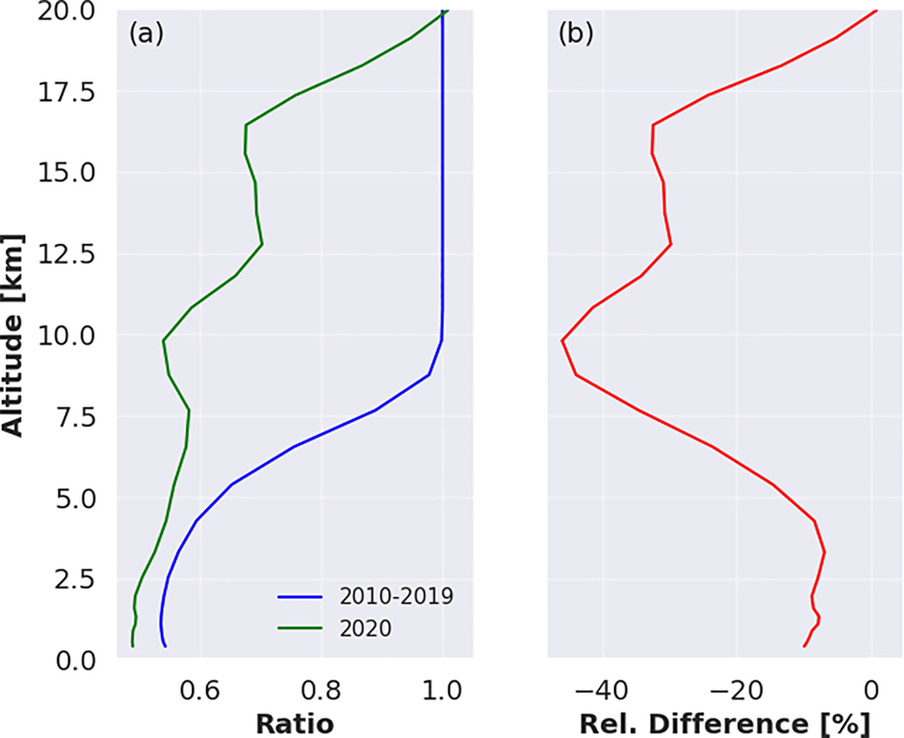
Ozone stratospheric-tropospheric transport changes in 2020
The tagged stratospheric O₃ in the simulations is used to evaluate the difference of the stratospheric contribution into the troposphere in 2020 with respect to the long-term simulations (2010–2019).
The ”typical” contribution is represented in blue and the 2020 in green.
Under normal conditions, the downward contribution of ozone-rich air from the stratosphere starts to decrease at 9 km reaching around 50% at the surface.
Overall, the mean decrease contribution in the troposphere is around 12-14%.
e.g., Thule

Slide 10
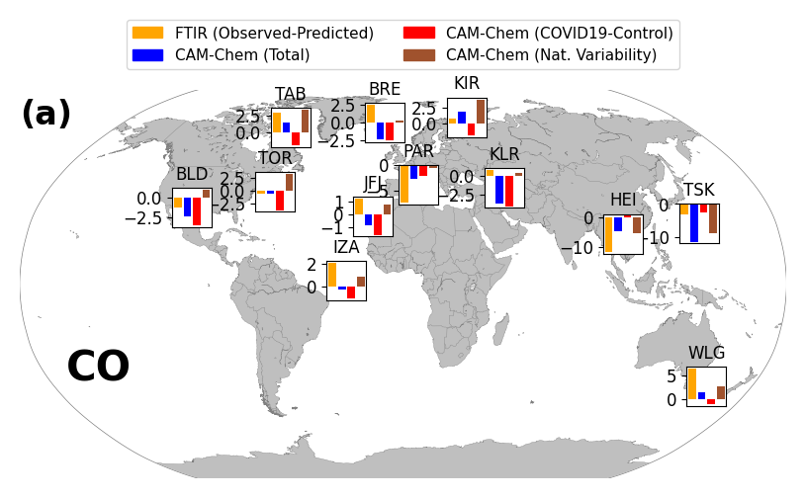
CO results
Tropospheric anomalies of CO in percent
A decrease in CO is detected in most of the Northern Hemisphere urban sites (Paris, Toronto, Boulder, Tsukuba, and Hefei) with negative values between 1-12 %. The remote sites (Thule, Izaña, Jungfraujoch, and Kiruna) show a slight increase between 1-3 %.
Overall, the CO reductions are captured in the simulations for most of the urban sites. At some sites, the effects of natural variability and COVID-19 impacts are in opposition.
At Hefei, significant decrease was observed in late February 2020, which aligns with the strict lockdowns that were implemented. Wollongong shows an increase of 6.5 % in the observations that can be linked to the Australian fires around Dec 2019 - Jan 2020.
CO

Slide 11
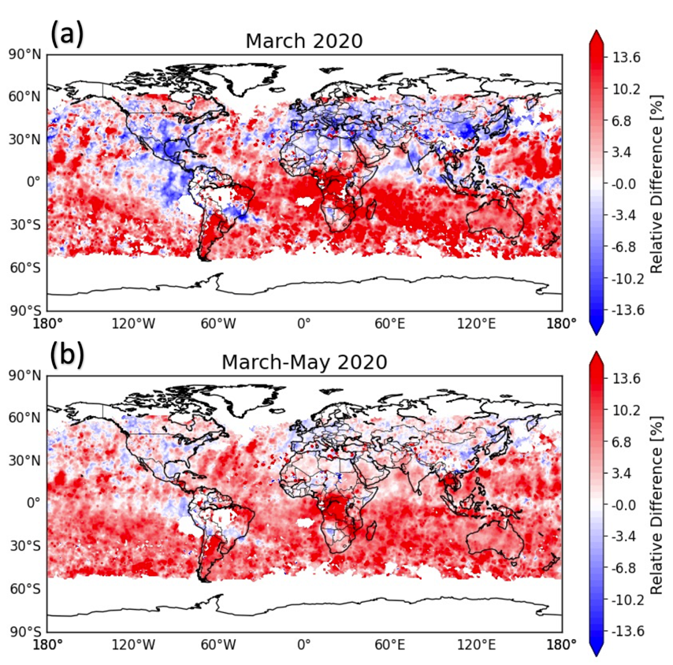
CO MOPITT results
CO anomalies obtained with MOPITT global observations in March (a) and between March - May (b) 2020.
CO anomalies vary across regions and they are sensitive to regional and continental scales but overall the Northern Hemisphere shows a decrease while the Southern Hemisphere shows an increase.
Why is there a slow down in the decrease of CO towards May?
Disentangling the possible COVID-19 lockdown signal from other causes such as large day-to-day variability, long-range transport, emissions, and chemistry is challenging for CO.
Further simulations show that there was a decrease in global tropospheric OH by more than 2%, starting in April and for the rest of the year -> lifetime of CO and CH₄ was impacted.

Slide 12
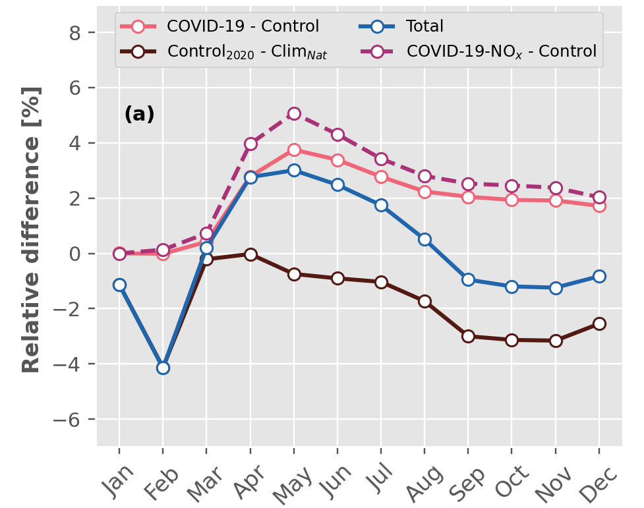
Implications for CH₄ lifetime
CAM-chem monthly mean global CH₄ lifetime anomalies
Lockdown induced emission change increases methane lifetime by up to 4 % in may.
Natural variability, i.e., meteorology, reduces the methane lifetime by a similar amount.
The net effect is 0.1 %, 2020 was an average year for OH.
Only reduction in anthropogenic NOx emissions, for both aircraft and surface, leads to a larger peak in CH₄ lifetime.
Laughner et al. (2021) also pointed out a reduction in OH driven by NOx emissions reduction. Peng et al. (2022) also shows that OH decreased significantly compared to 2019, in addition to an increase in wetland CH₄ emissions.
NASA Earth Observatory

Slide 13
In Summary
Interpreting anomalies solely from observations is a challenging task because natural variability, chemistry, and photochemical regimes may play an important role.
Out of all the gases analyzed, O₃ displayed the most consistent tropospheric column negative anomalies with a drop of about 9% between March and May 2020 among all sites.
CAM-chem reproduces observed ozone decrease, especially remote sites, where natural variability played an important role during intensive 2020 lockdowns.
We investigated and quantified the role of stratospheric ozone change, which played a significant role within the natural variability.
The atmospheric CO signals was a bit more challenging to address because of a delicate balance between emissions, chemical sink, and large natural variability. A decrease in CO is detected in most of the NH urban sites (1-12%) and with MOPITT. However, the lack of reduction signals, in April, May, and June, suggests an increase in CO lifetime due to a reduced OH caused by reduced NOx emissions (As suggested by CAM-Chem simulations).
C₂H₆, C₂H₂, and H₂CO – check the paper… challenging given the sparse data and low number of observations/site.

Slide 14
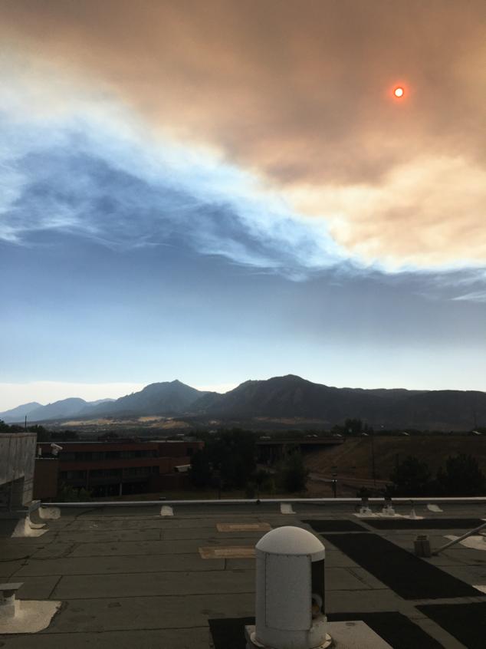
Thanks
Sep 30 2020
iortega@ucar.edu

Slide 15
Extra slides

Slide 16

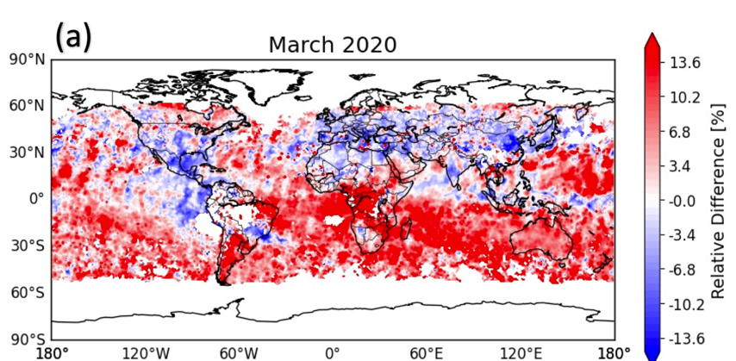
MOPITT global results (March 2020)
CO is sensitive to regional and/or continental scales.
Overall, NH shows a decrease, while SH (and remote areas) capture an increase?
The comparison between MOPITT and FTIR is shown in the supplement. Even though the instruments may sample different spatial scales and sample at different times there is a high level of consistency in the anomalies.

Slide 17
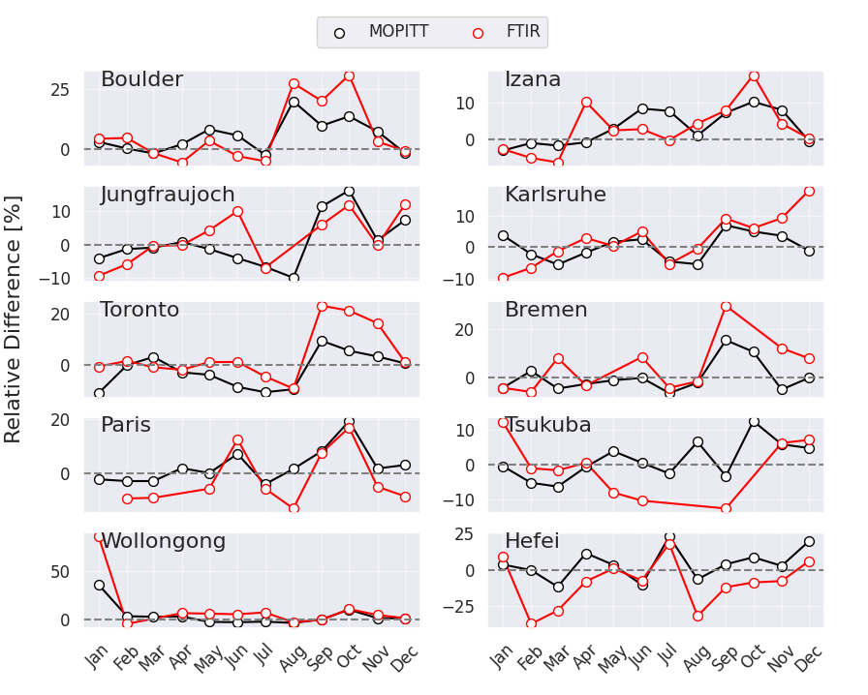
FTIR & MOPITT results

