Slide 1
N2O & HBr Calibration Cells – 2023
2023 NDACC IRWG Meeting, Spa, Belgium
Jim Hannigan, Ivan Ortega
Notes:
NOTE: Background image can be used as is or changed for a particular presentation in the “Slide Master” button found under the “View” tab.

Slide 2
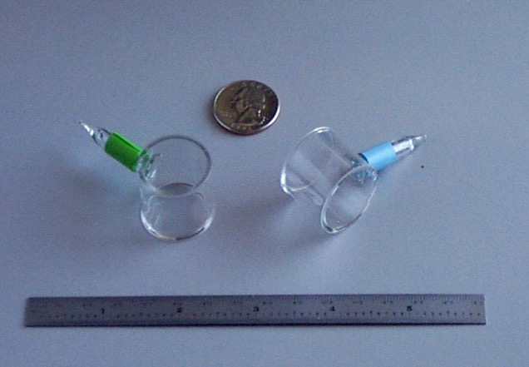
Calibration Cell History 1
Calibration Cell Usage
Determine ILS of a particular instrument
Compare ILS & performance across instruments
Provide actual instrument ILS at retrieval
ILS to be presented at IRWG to document instrument performance over the long term
ILS performance to be maintained by IRWG.
HBr low (no) atmospheric absorption, so can be used inline with solar measurement
An HCl cell was made in the mid 1990’s and sent between some groups
JPL, JFJ, DU, NCAR, HAR & likely other groups
Then it was ‘lost’
The column in the cell was measured, retrieved and compared by all groups.
~1997 two HBr cells were made & used at Thule – Blue & Green
2023 NDACC IRWG Meeting, Spa, Belgium

Slide 3
Calibration Cell History 2
In 1998 M Coffey revised line parameters for HBr
In 1999 F Hase developed LineFit to ingest cell data and estimate modulation efficiency and phase error in a FTIR instrument
In 2000 NCAR made 20 HBr cells identical to the blue & green original cells
2cm long, 1” dia, 2mb, tip-off sealed
Sapphire wedged windows, (low WN limit ~2000cm-1)
Measured by T Stevens at U Denver
Numbers: HBr 03 – 22 distributed to all IRWG groups
In 2003 A Goldman revised line parameters for HBr & HI
Coffey, M., et. al., (1998). Improved Vibration-Rotation (0-1) HBr Line Parameters For Validating High Resolution Infrared Atmospheric Spectra Measurements. Journal of Quantitative Spectroscopy and Radiative Transfer, 60(5):863 – 867.
Goldman, et. al., (2003). HBr and HI line parameters update for atmospheric spectroscopy databases. Journal of Quanti- tative Spectroscopy and Radiative Transfer, 82(1–4):313 – 317. The {HITRAN} Molecular Spectroscopic Database: Edition of 2000 Including Updates of 2001.
Hase, F., et. al., (1999). Analysis of the instrumental line shape of high-resolution Fourier transform IR spectrometers with gas cell measurements and new retrieval software. Appl. Opt., 38(15).
2023 NDACC IRWG Meeting, Spa, Belgium

Slide 4
Calibration Cell History 3
Several (~6) cells were transported to the annual meeting where those cells were measured by the host group’s instrument (IZN, KFJ, TAO, LDR maybe others?)
Until this became problematic.
In 2011 cells HBr 41 – 63
In 2013 Frank updated LineFit and retrieval process for HCl used in TCCON
In 2014 cells HBr 70 – 87 & N2O 1 – 35
In 2016 Frank lead a network wide calibration for all the N2O cell LineFit results
~ 2020 N₂O cell calibration part of ACTRIS protocols, (M Palm)
In 2023 cells HBr 91 – 95 & N2O 101 – 124, 131 - 153 (2 manifold batches)
Hase, F., et. al., (2013). Calibration of sealed hcl cells used for tccon instrumental line shape monitoring. Atmospheric Measurement Techniques, 6(12):3527–3537.
2023 NDACC IRWG Meeting, Spa, Belgium

Slide 5
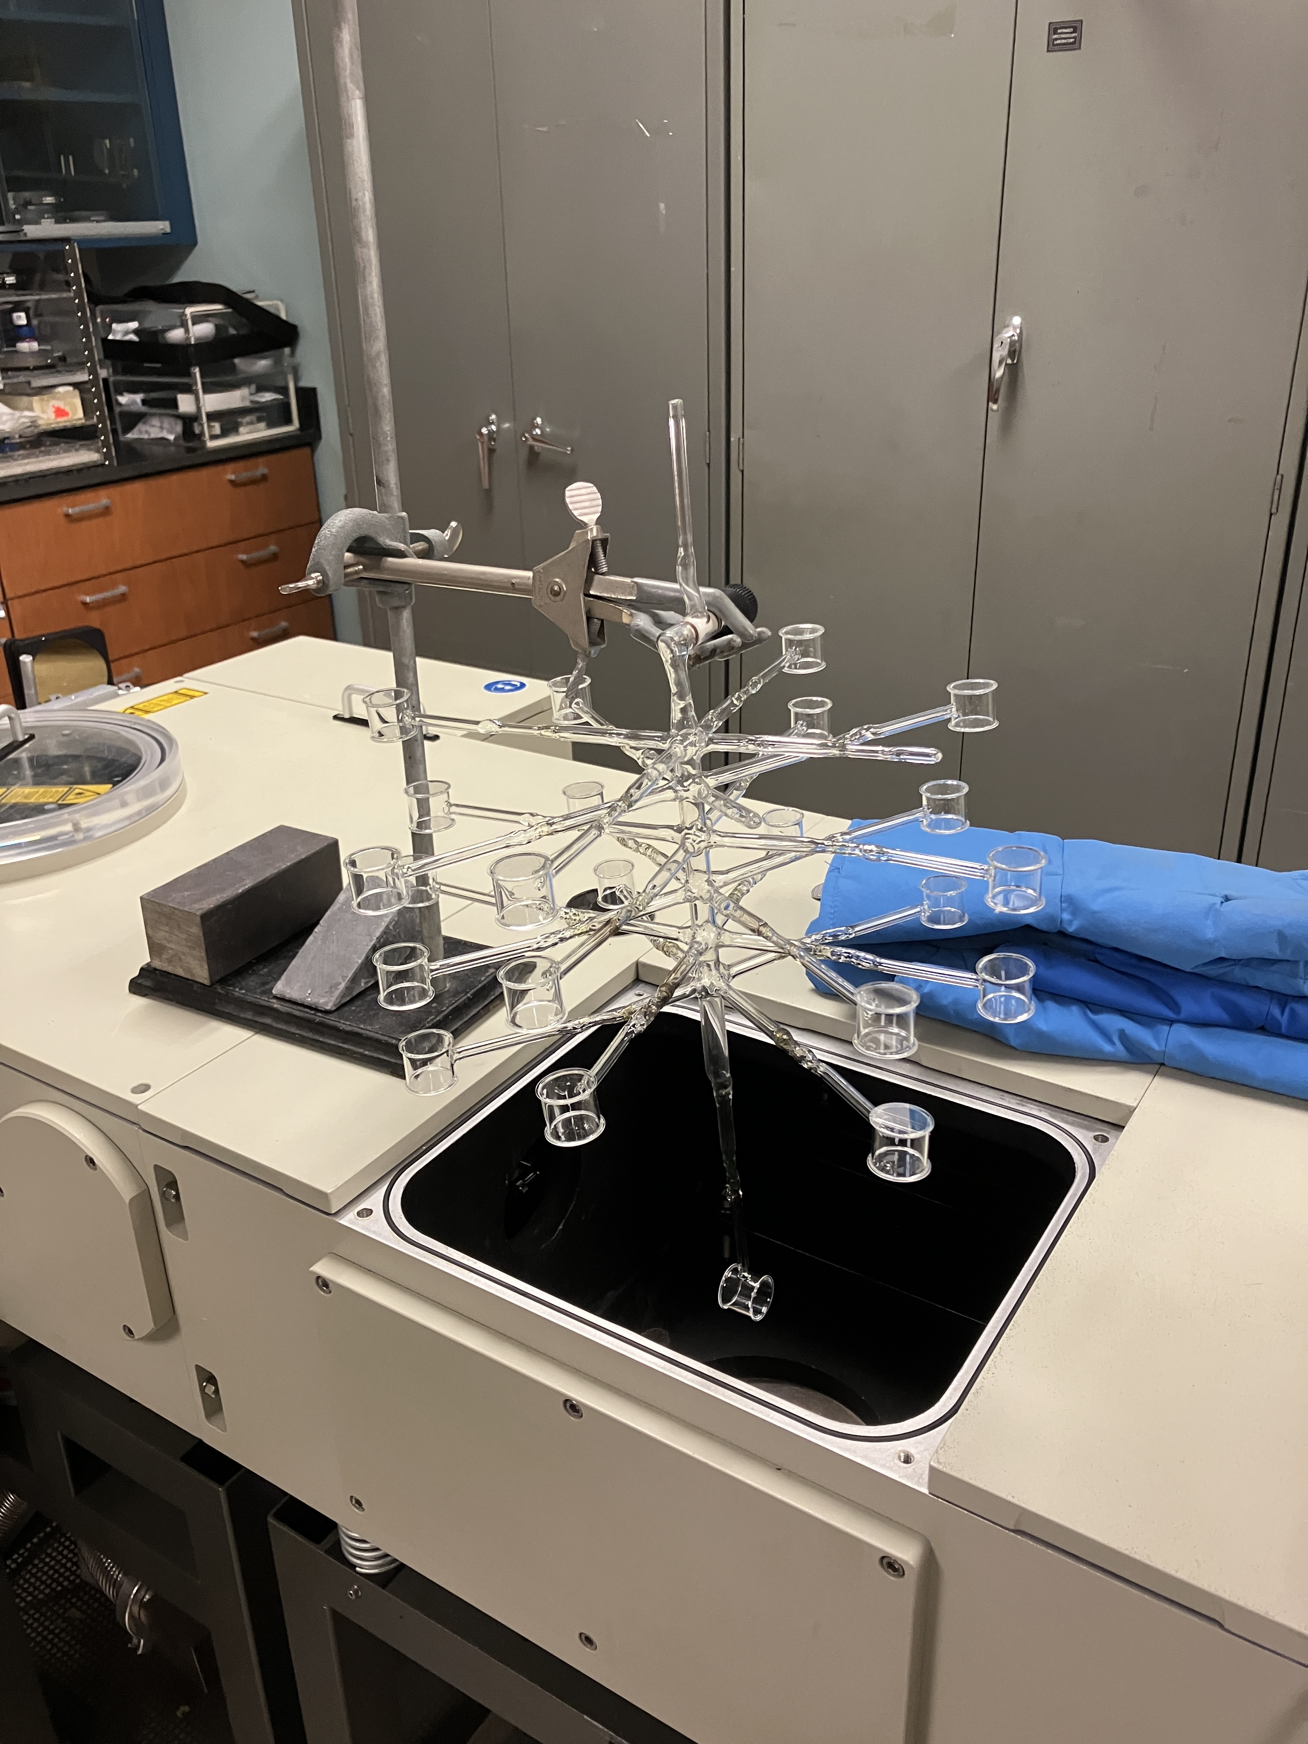
Calibration Cell Process
Cells are manufactured by NDS Glass in NJ, US – same company since blue & green cells
Cells are attached to a manifold that can hold 24 cells with one that can reach into Bruker sample compartment by Allen Scientific Glass in Boulder.
Filled cells are tested at full resolution (at Boulder 125HR) to be consistent with previous cells and simulated spectra.
They are then tipped off and each cell is tested with moderate SNR it be sure of consistent gas amount after tip-off process.
2023 NDACC IRWG Meeting, Spa, Belgium

Slide 6
Current Cell Production
47 N2O and 5 HBr cells (3 manifold fills)
Spectra one new N₂O cell #153, 257cm, 64 scans, Bruker standard glowbar, InSb, no optical filter, Boulder 125HR
2cm, sapphire wedged windows, 1” dia, 1mb N₂O
2023 NDACC IRWG Meeting, Spa, Belgium

Slide 7
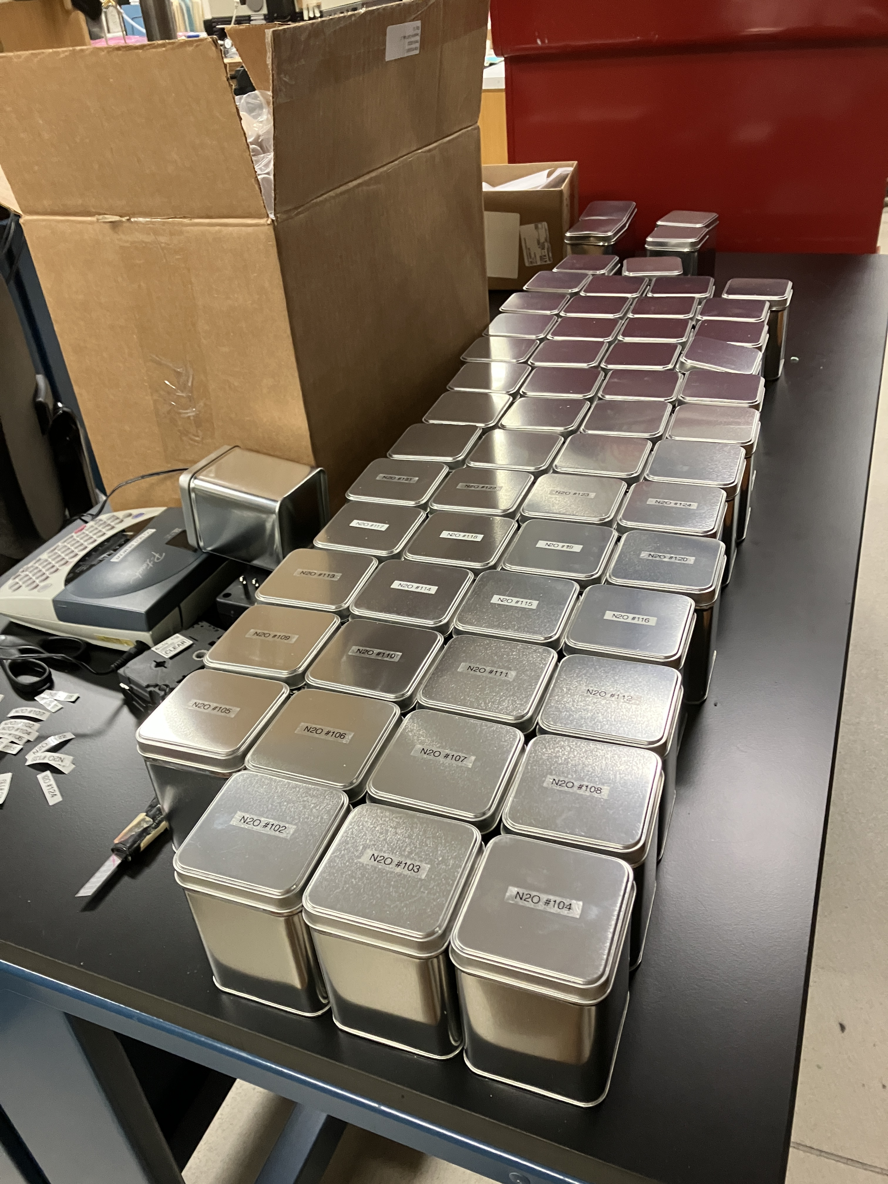
Current Cell Production
Next Steps
As of June 2023 cells are largely ready to order & ship.
We have 1 N₂O spare and 1 HBr spare beyond the pre-order cell count.
We will send a order link when its available – should be last week June.
2023 NDACC IRWG Meeting, Spa, Belgium

Slide 8
Status of IRWG Cell Calibration
Overview of IRWG Cell Calibration
We were in a process of moving more towards N2O from HBr
But earliest records are with HBr
I believe all groups have at least 1 of both cells
We believe records are kept within the groups (standardized spectra, column retrieval, LineFit results…)
Prior to M Coffey retirement, he kept a network wide record & reported at each meeting.
We should require:
Records collected and reported here, for the entire network to a person or committee
Records be stored at the NDACC archive for long term
2023 NDACC IRWG Meeting, Spa, Belgium

Slide 9
FIN
2023 NDACC IRWG Meeting, Spa, Belgium

